Slide 1
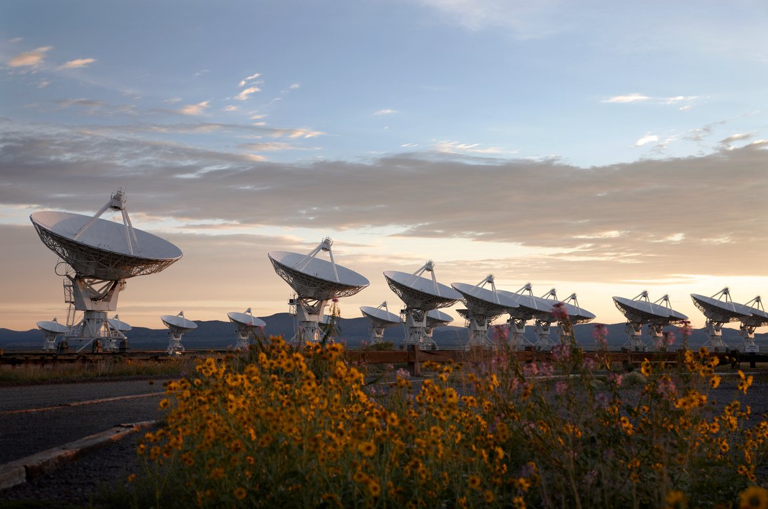
The Very Large Array: Global Powerhouse for Radio astronomy for 40+ years
1972 – Approved by Congress
1975 – 1st antenna
1980 – Full science operations
2001 – Major upgrade approved by NSF (all new electronics)
2011 – Jansky VLA full science ops

Slide 2
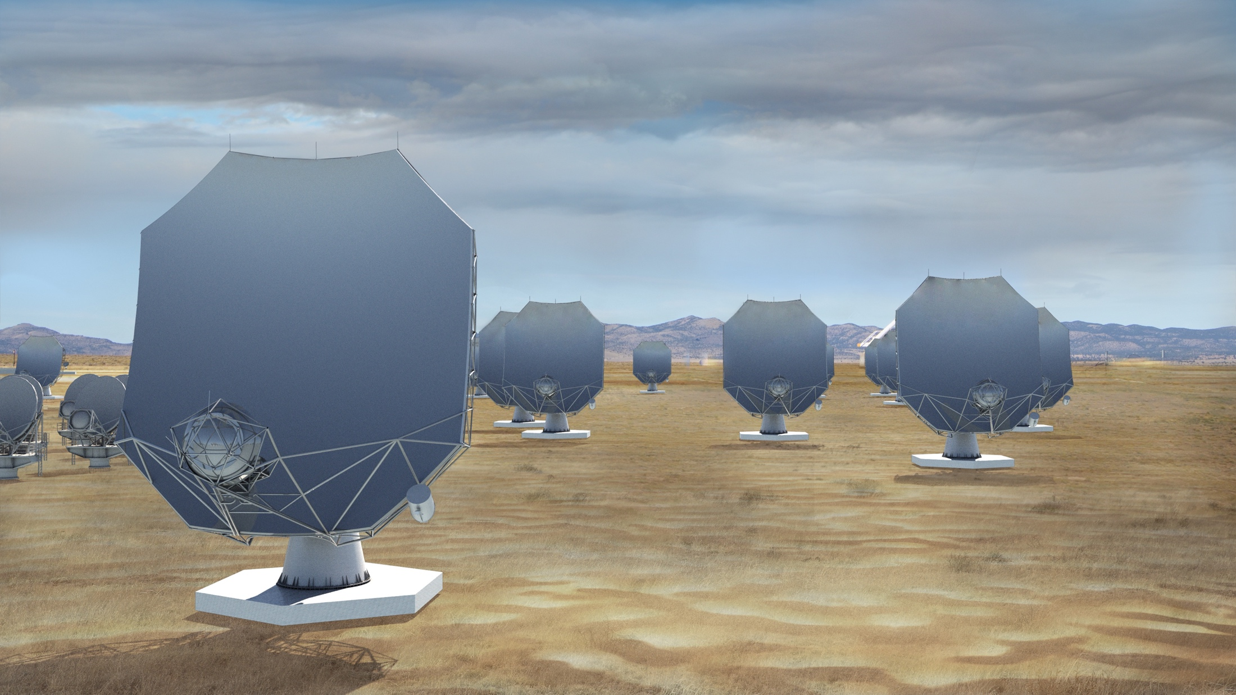
The next-generation Very Large Array (ngVLA)
A new facility for a new millennium: replace the VLA and VLBA to tackle new Scientific Frontiers into the mid-Century
Thermal imaging at milli-arcsec scales (<10K @ 7mas, 3mm)
10x the area of the JVLA/ALMA/VLBA
1.2 - 116 GHz Frequency Coverage
244 x 18m + 19 x 6m offset Gregorian Antennas
    Centered at VLA site, extending over USA, MX, CA
    Fixed antenna locations
Notes:
Will be the next U.S. Flagship Radio Observatory.

Slide 3
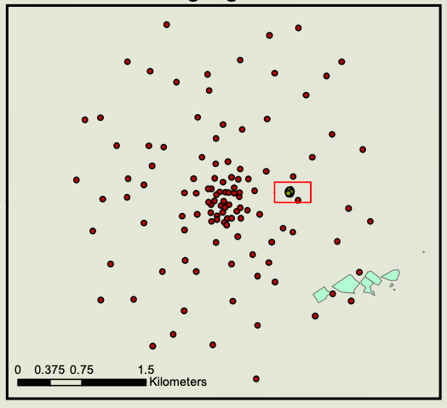
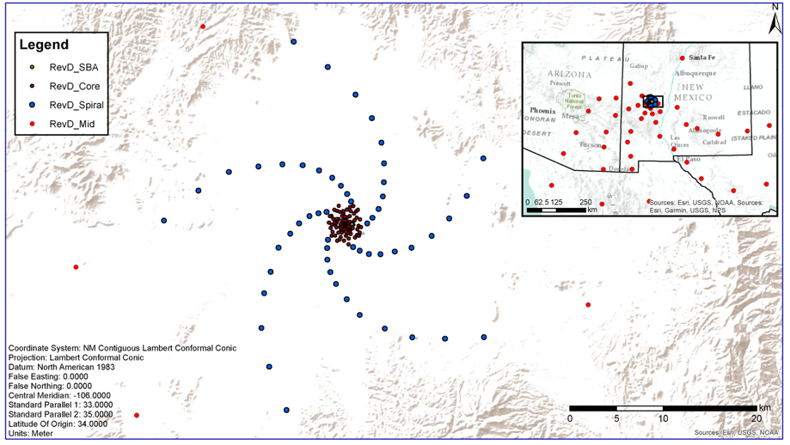
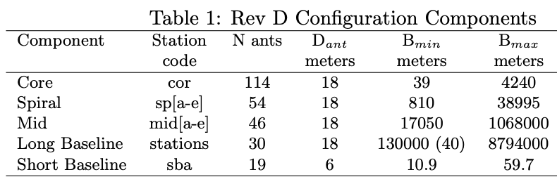
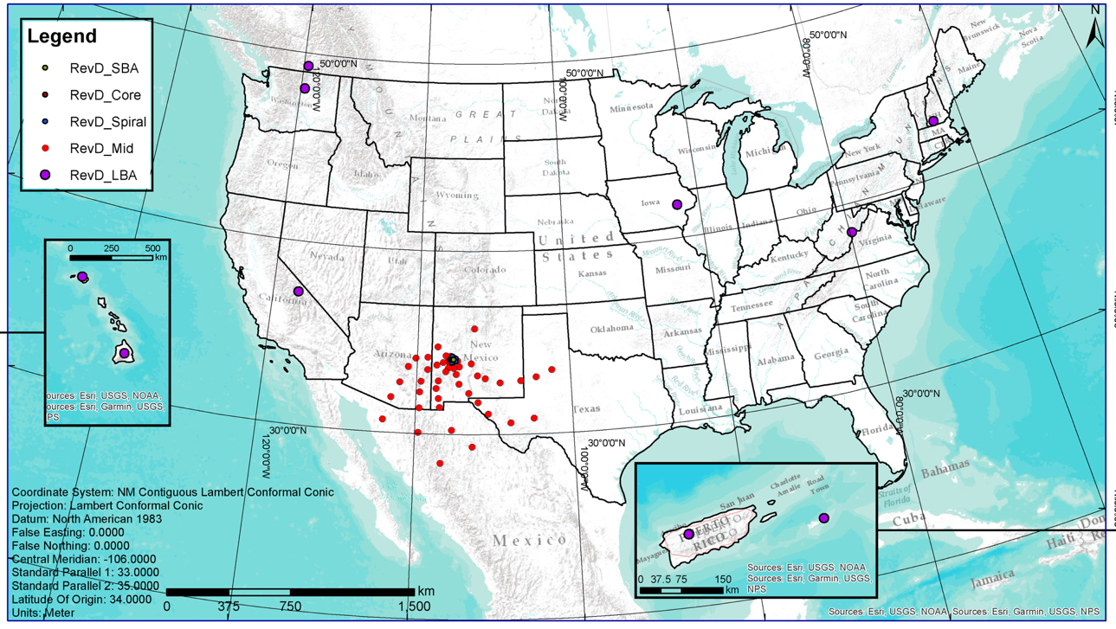
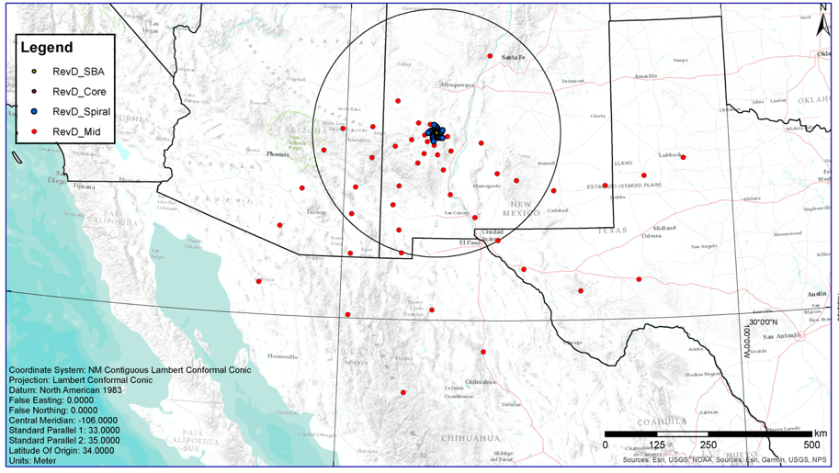
10m to 9000km => 200” to 0.2 mas @ 32GHz
350 miles

Slide 4
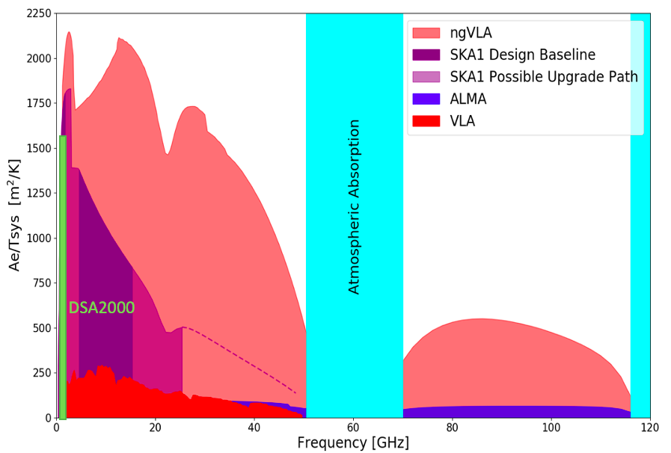
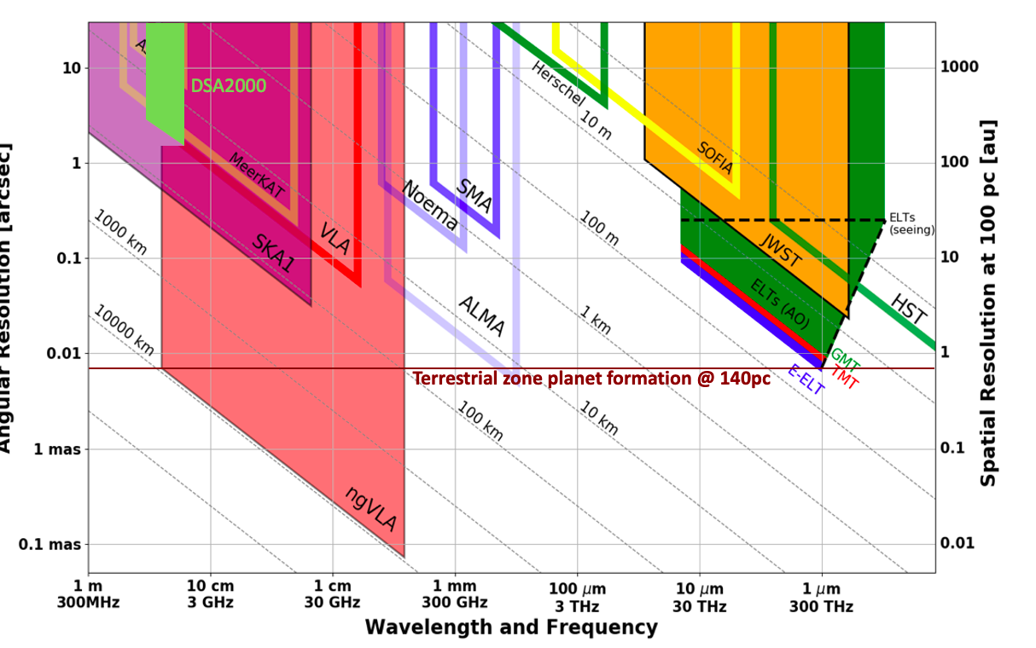
New Parameter Space for the mid-Century
Complementary suite of arrays from meter to submm wavelengths
> 120GHz: ALMA 2030 superb for chemistry, dust, fine structure lines
  1.0 - 116GHz: ngVLA superb for terrestrial planet formation, dense gas history, black holes
  < 15 GHz: SKA superb for pulsars, reionization, HI + continuum imaging
Notes:
Snapshot comparison of effective collecting area for dish-arrays expected in the 2030’s.

Slide 5
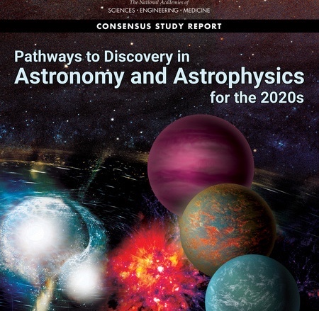
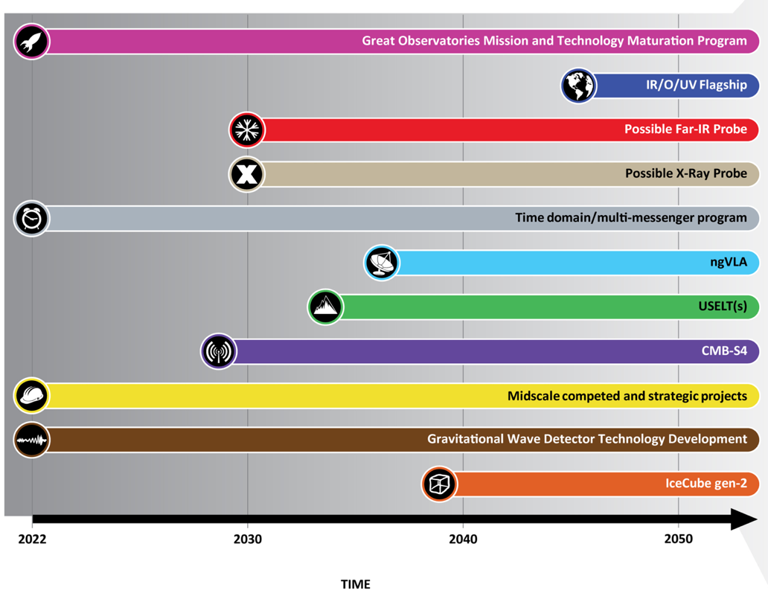
Astro2020 identified the ngVLA as a high-priority large, ground-based facility whose construction should start this decade.
Notes:
ngVLA essentially checked off every box of Astro2020 scientific priorities.

Slide 6
January 2019 Science Book published by the ASP: 90 chapters, 850 pages, 300 authors
ngVLA Science
Strength in Versatility: Planets to Cosmology
ngvla.nrao.edu
Science Advisor Committee and Working Groups
Chairs: D. Wilner and B. Matthews
  SWG1: Stars, Planetary Systems, and their Origins [Co-Chairs: B. Matthews (NRC-Victoria) & D. Wilner (CfA)]
  SWG2: Astrochemistry and the Molecular Emergence of Life [B. McGuire (MIT) & J. Bergner (Chicago)]
  SWG3: Galaxies and Galaxy Evolution [F. Walter (MPIA) & R. Somerville (Flatiron/CCA)]
  SWG4: Pulsars, Cosmology, and Fundamental Physics [M. DeCesar (George Mason) & A. van der Horst (GWU)]
  SWG5: Exploring the Dynamic Universe [R. Osten (STScI) & A. Corsi (TTU)]

Slide 7
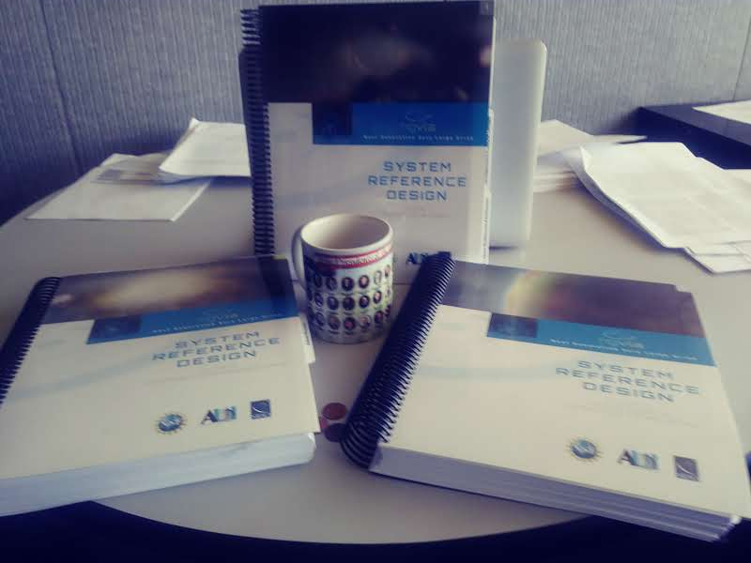
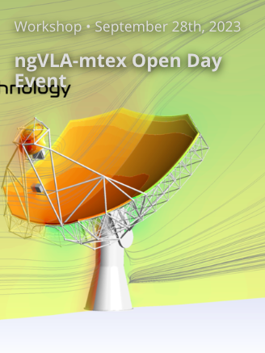
Technical Design: Well advanced and costed
2019 release Reference Design: Build on ALMA, JVLA, SKA development => low-technical-risk and costed concept
U.S. Multiagency Interest (DOD, NASA): ICRF, Space Situational Awareness (radar), Spacecraft tracking/imaging, `burst-telemetry’
Antenna proto-type contract let in 2022 to MTEX in Saxony, Germany
Feed Low: Maintenance requirements favor a receiver feed arm on the low side of the reflector.
Mount concept: Pedestal concepts for life-cycle cost.
Drives: All motor-gearbox; gearbox and linear drives; all direct drive
Materials: Traditional Al panels & steel BUS; composite reflector and mix of steel and carbon BUS
Saxony, Germay

Slide 8
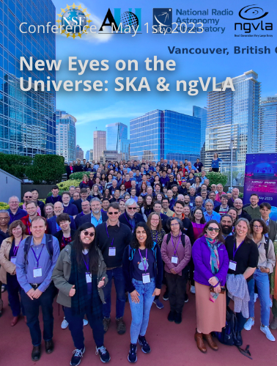
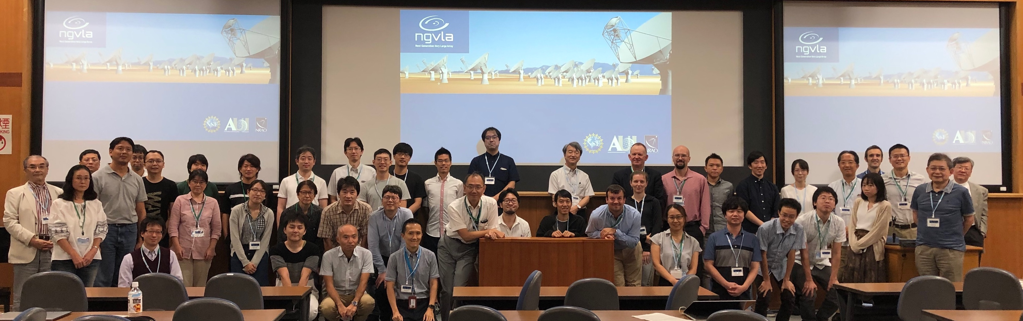

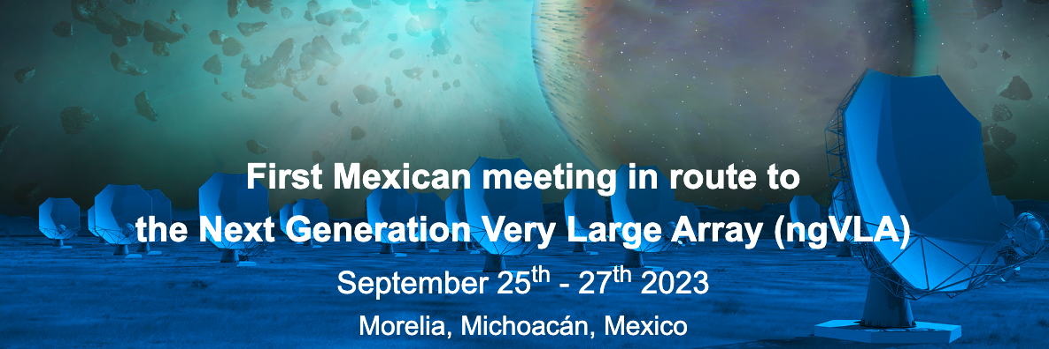
International Participation and Collaboration
Mitaka Japan
NRAO – UNAM MOU Nov 2022

Slide 9
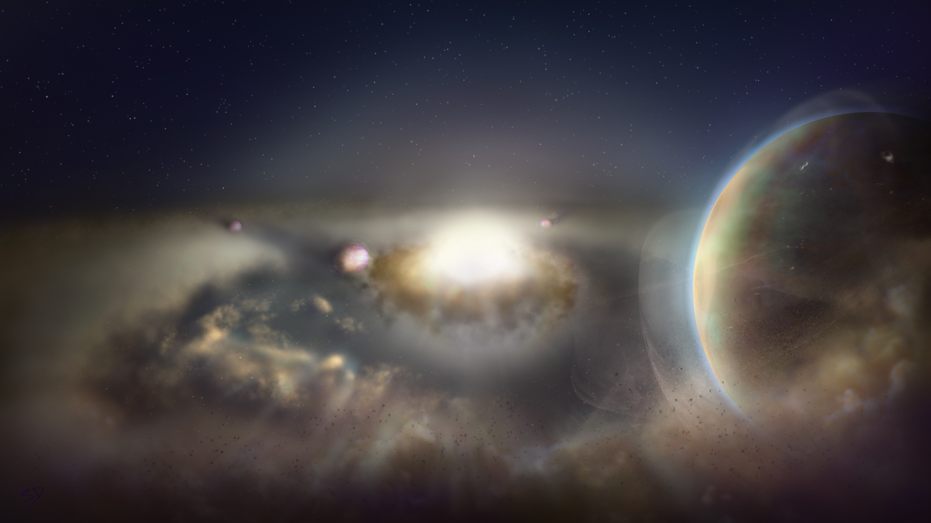
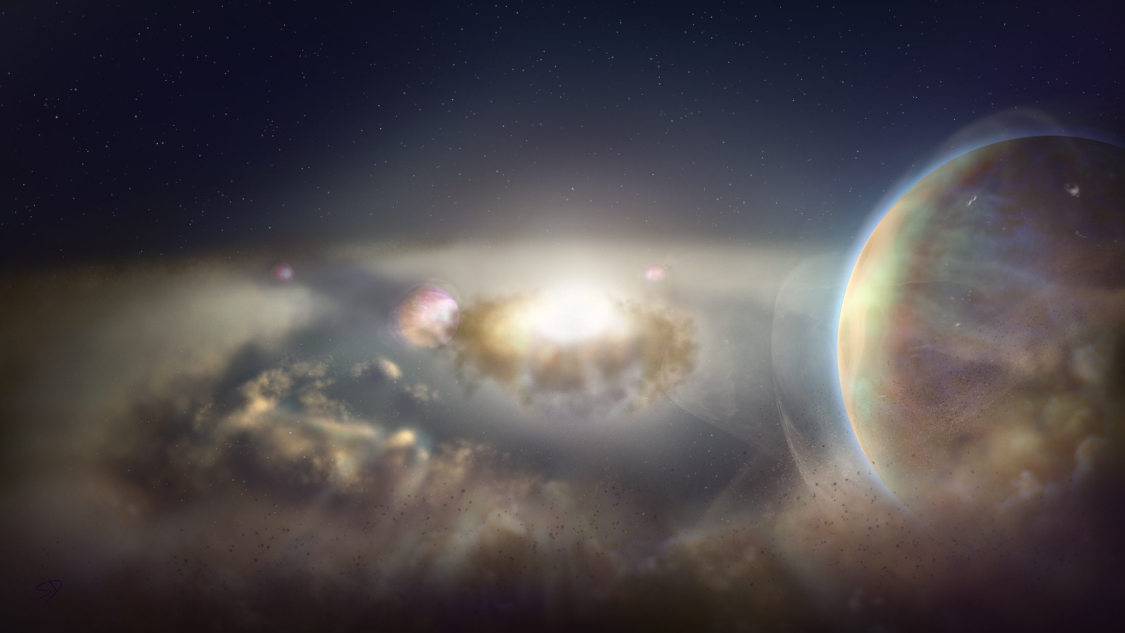
Key Science Goals
https://ngvla.nrao.edu/page/scibook
Unveiling the Formation of Solar System Analogues on Terrestrial Scales
Probing the Initial Conditions for Planetary Systems and Life with Astrochemistry
Charting the Assembly, Structure, and Evolution of Galaxies Over Cosmic Time
Using Pulsars in the Galactic Center as Fundamental Tests of Gravity
Understanding the Formation and Evolution of Stellar and Supermassive
BH’s in the Era of Multi-Messenger Astronomy

Slide 10
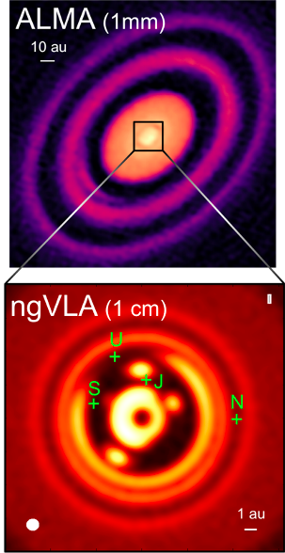
KSG1: Unveiling the Formation of Solar System Analogues
The ngVLA will image planet formation in systems similar to our own Solar System, down to planet masses of a few earth masses
Required resolution: 7mas = 1 AU at 140 pc
ALMA has this resolution at > 350 GHz but PP disks are optically thick in inner 10 AU!
ngVLA can achieve this sensitivity and resolution at 30 to 100 GHz, where inner disk is optically thin
Ricci, Isella…
Notes:
HD 163296
ALMA observation of HD163296 at 1mm along with a simulated 1 cm ngVLA observations (Ricci et al. 2019) of the innermost 24 au region at 1 au resolution for Jupiter-, Saturn-, and Neptune-like planets.
The distribution of exoplanets and young planets embedded in circumstellar disks: Then ngVLA will discover many hundreds of planets with orbital periods <10 yr.
The ngVLA will measure the orbital motion of planets and related features on monthly timescales:
Simulated 100 GHz ngVLA observations of a newborn planetary system comprising a Jupiter analogue orbiting at 5 AU from a Solar type star.

Slide 11
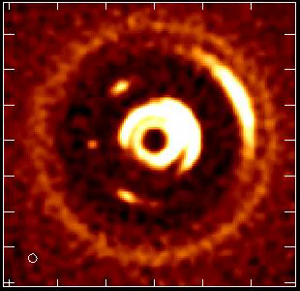
Movies of Planet Formation
Forming Jupiter in 1Myr solar mass protostar and disk at 140 pc
Monthly obs. over few years at 100 GHz, 7mas resolution (1 AU at 140pc; L. Ricci)
Image dust gaps and traps, and potentially the circumplanetary disk = accretion onto planet itself!
Notes:
HD 163296
ALMA observation of HD163296 at 1mm along with a simulated 1 cm ngVLA observations (Ricci et al. 2019) of the innermost 24 au region at 1 au resolution for Jupiter-, Saturn-, and Neptune-like planets.
The distribution of exoplanets and young planets embedded in circumstellar disks: Then ngVLA will discover many hundreds of planets with orbital periods <10 yr.
The ngVLA will measure the orbital motion of planets and related features on monthly timescales:
Simulated 100 GHz ngVLA observations of a newborn planetary system comprising a Jupiter analogue orbiting at 5 AU from a Solar type star.

Slide 12
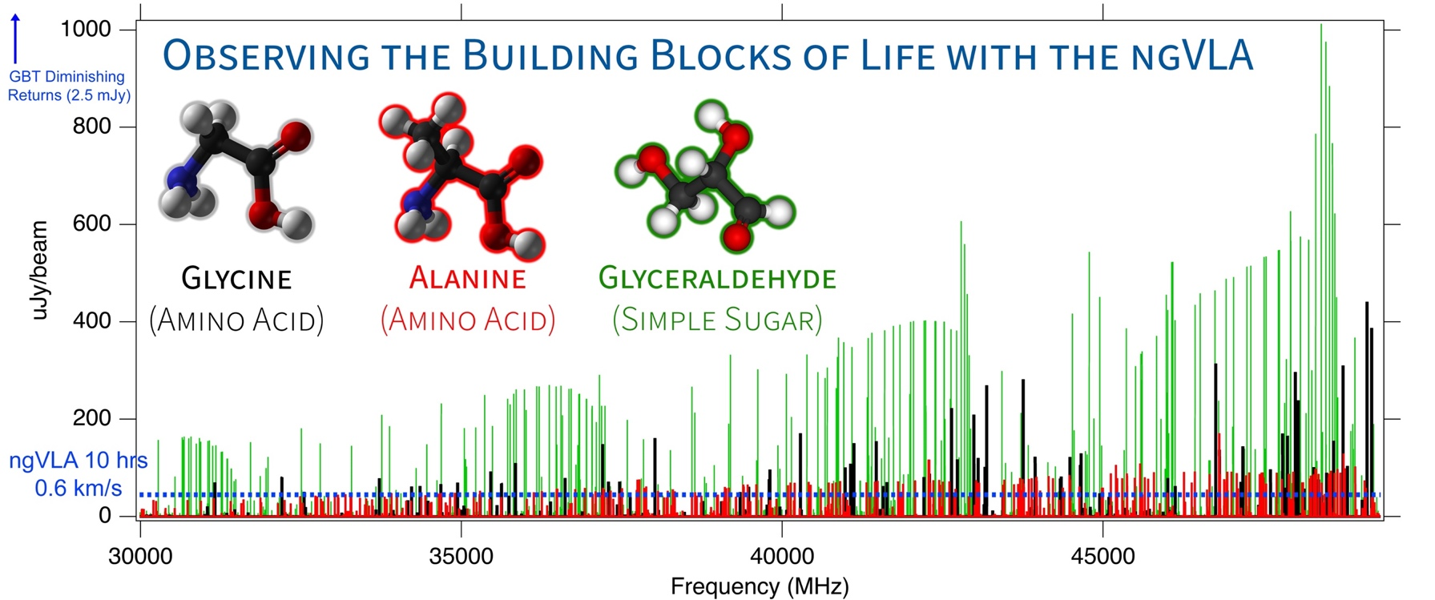
KSG2: Probing the Initial Conditions for Planetary Systems and Life with Astrochemistry
  The ngVLA can detect complex pre-biotic molecules and provide the chemical initial conditions in forming solar systems and individual planets
Credit: Brett McGuire (NRAO)
Notes:
This is a simulation of ~3 complex organic molecules, not currently detected in the ISM, but which are good candidates for detection.
The simulation assumes that the emission is coming from a compact, 1" hot core in Sgr B2(N), from molecules with column densities of 10^12 - 10^14 cm-2, at T = 200 K, and with a linewidth of 3 km/s.
The simulation does *not* contain any currently-detected species, meaning that a real spectrum in this frequency range would have many, many bright lines off the scale of this graph.
The red horizontal line is the ~rms of the current GBT PRIMOS observations. These suffer greatly from beam dilution, as the 1" source is diluted in a 30" GBT beam. This rms is about what we can reasonably get with reasonable integration times at the GBT. Drilling deeper will take far longer than is feasible for a survey.
The green line is taken from the ngVLA tech specs page for line sensitivity at 10 km/s in 1 hr, degraded for 0.3 km/s channels.
The blue shaded region is the area in which I project, from a statistical analysis of the PRIMOS observations, we will hit line-confusion in this frequency range. There is little point in integrating more than 3 sigma deeper than this.
So what are the take-away messages here?
1) the ngVLA will almost certainly provide access to a wealth of new molecular detections of molecules similar to the representative species shown here
2) the ngVLA in reasonable integration times (say 4-20 hours) should hit line confusion in this most molecularly-rich galactic source at the 3 sigma level, something that the GBT and (J/E)VLA cannot hope to accomplish.

Slide 13
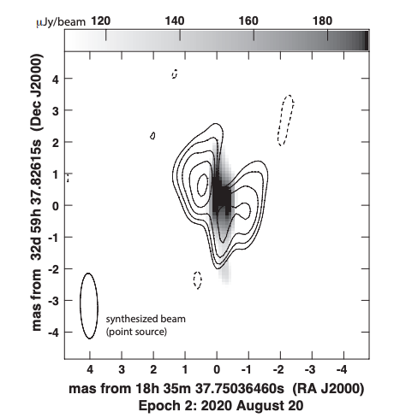
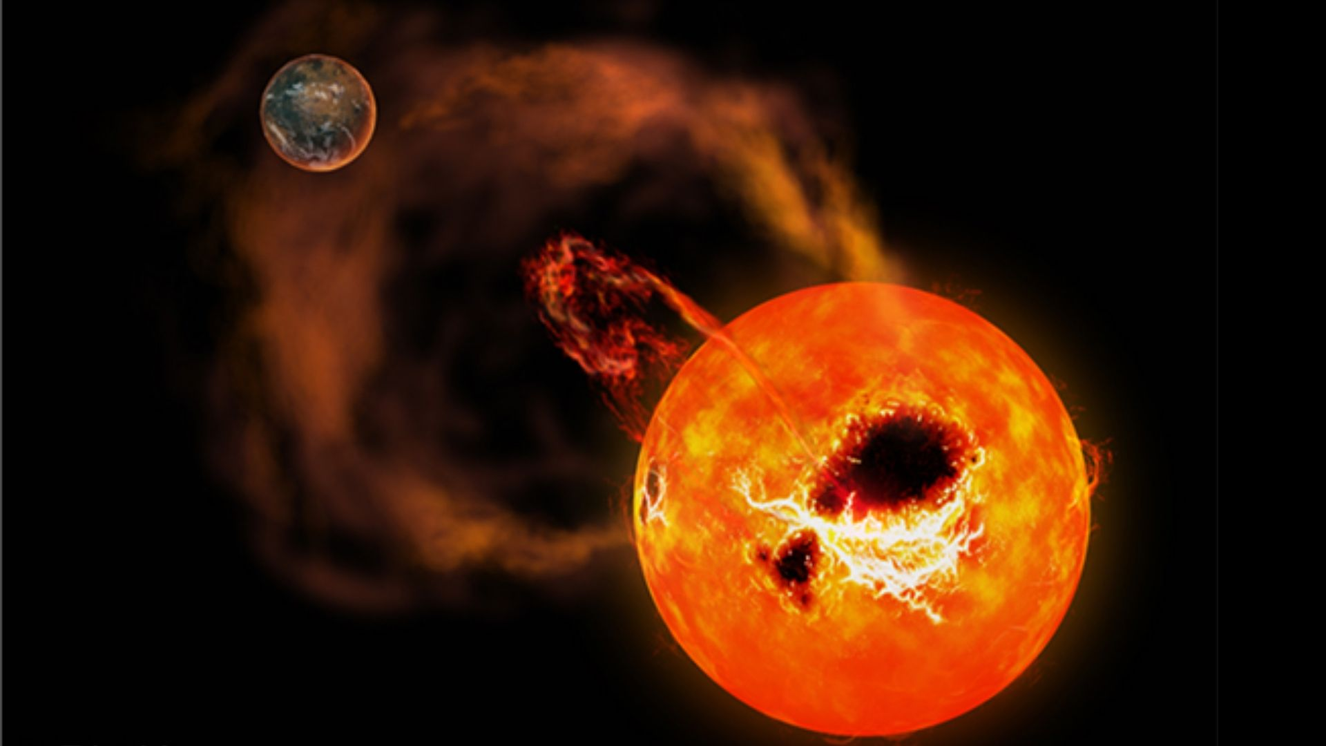
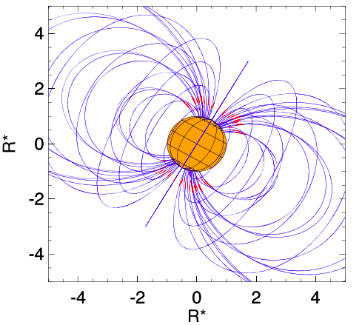
Extreme Exospace Weather and (obstacles to) Life
M-dwarfs: most likely stars to host habitable planets. But M-dwarfs are known to be very active (flares, aurora), w. strong mag. fields ~ 3kG, indicating possible strong star-planet interactions
Star-planet magnetospheric interactions => deleterious effect on life: key term in Drake equation
ngVLA: sub-uJy at sub-mas => increase searchable volume by factor ~30 => hundreds of dwarf targets
Radiation belts
VLBA image of an 77M_{J} ultra-cool dwarf star at 6pc distance. Contours: unpolarized emission from the radiation belts out to 18 R* ; Grayscale: polarized auroral emission (Kao et al. 2023): similar to Jupiter - Io
Aurora
VLBA 8 GHz
rms ~ 12 uJy/beam

Slide 14
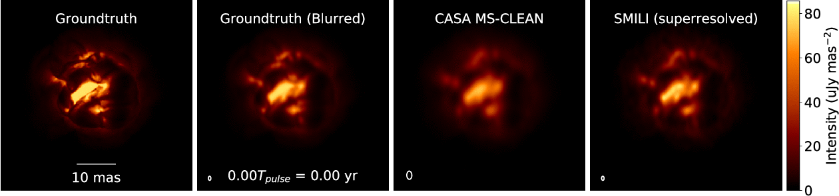
Stellar Radio Photospheres
Movies of extreme mass-loss in evolved stars
Primary enrichment mechanism of ISM
ngVLA imaging of ‘boiling’ AGB star atmosphere (Akiyama & Mathews 2021)
  ngVLA @ 46 GHz; 1.5 mas ~ 0.04 stellar radii at d=150pc
  1.3 year pulse period observed every 2-3 weeks
ngVLA can resolve and determine R*, T_{B} for > 10000 stars, incl. 500 MS stars of all spectral types: Radio ‘HR diagram’ at 85 GHz
Notes:
Simulated movies of the gas motions in the radio photosphere of an asymptotic
giant branch (AGB) star as observed with the ngVLA Main Array at 46 GHz. The
angular resolution is ~1.5 mas, corresponding to roughly 0.04 stellar radii.
Each movie covers a single 1.3-year pulsation period for a model AGB star,
assuming observations every 2-3 weeks. The adopted distance was 150 pc.
AGB star atmospheres are highly dynamic owing to a combination of radial
pulsations, shocks, and large-scale convective processes. These stars also shed
large amounts of matter through cool, dense winds. Radio waves are emitted from
a portion of their atmospheres that lie at a radius of roughly twice the
visible photosphere, and just interior to the wind launch region.
The adopted brightness distribution for the radio photosphere model (the
"ground truth model" shown in the left hand frame) was based on a 3D
hydrodynamic model of an AGB star atmosphere from Freytag et al. (2017). The
Freytag et al. model is not specific to millimeter wavelengths, but was adapted
here for illustrative purposes. The second frame shows the ground truth model
blurred with a Gaussian kernel.
The two frames on the right show image reconstructions of the model based
on simulated ngVLA Main Array observations. The integration time was 2
hours per frame and the assumed bandwidth was 10 GHz in dual
polarizations. The second frame from the right shows a multi-scale CLEAN
reconstruction, while the frame on the right shows the result of a
regularized maximum likelihood reconstruction using the SMILI package of
Akiyama et al. (2019). While both methods do well at reproducing many of
the key features of the model, the SMILI version achieves superior angular
resolution.
These results underscore that the exquisite sensitivity and resolution of the
ngVLA will enable studies of the physical properties and kinematics of the
atmospheres of evolved stars in unprecedented detail.
Credit: K. Akiyama and L. D. Matthews, based on models adapted from B.
Freytag.

Slide 15
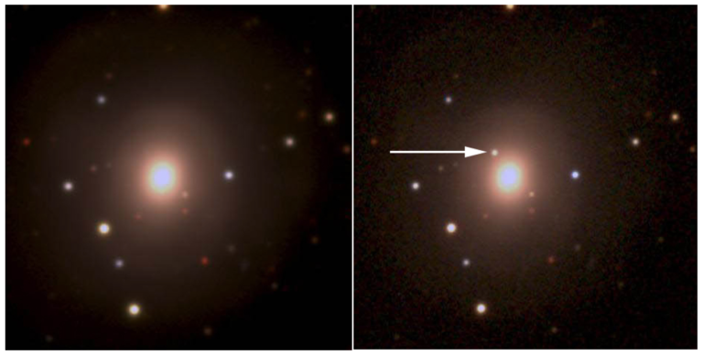
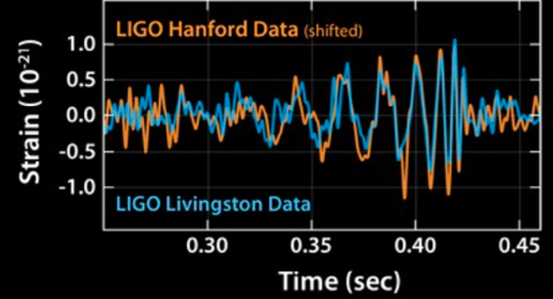
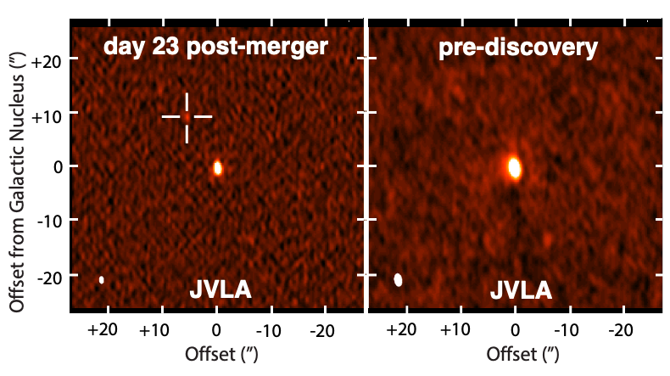
KSG 5: New Windows on the Dynamic Universe
Optical Pan ea. 2017
Gravitational Waves Source: The multi-wavelength campaign that discovered the EM counter-part to the merging binary ~ 30 M_{o} black-holes, identified with a galaxy at z = 0.093.
Hallinan ea. 2017

Slide 16
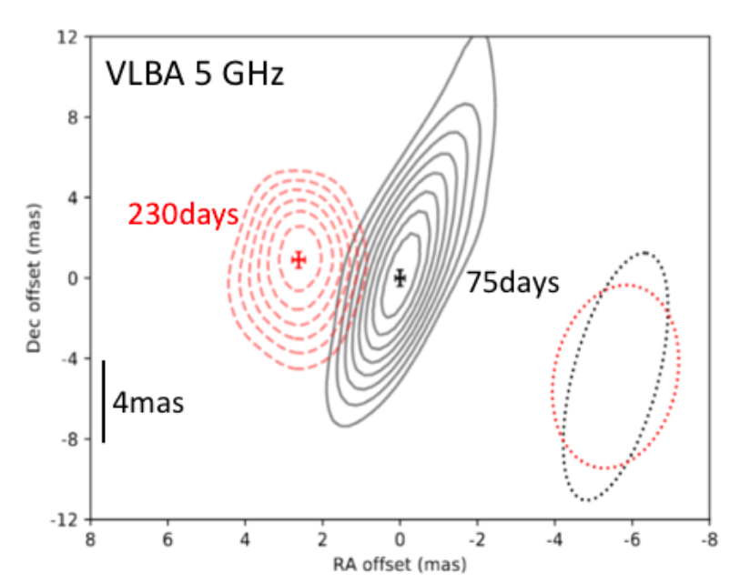
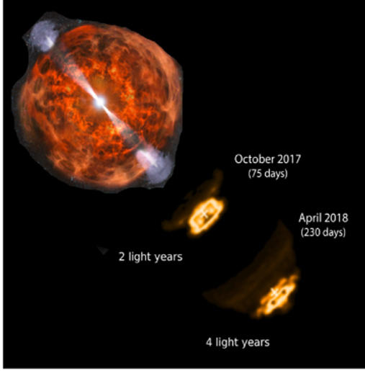
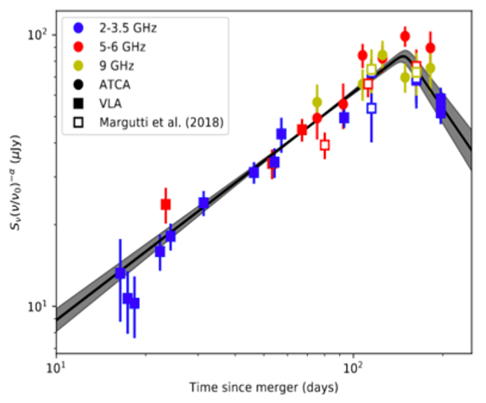
High resolution (mas), broad band radio was key to determining the physics: A smothered, emerging relativistic jet
v = 4c
Radio light curve and VLBA imaging => emerging relativistic jet from merging binary black holes: a wide angle jet which is trapped by the explosion debris (Dobie ea. 2018; Mooley ea. 2018).

Slide 17
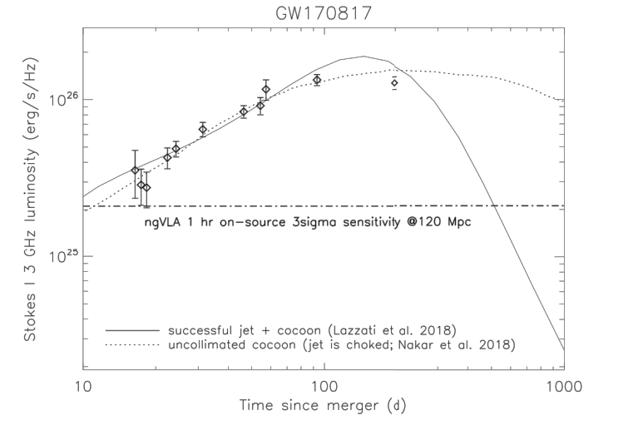
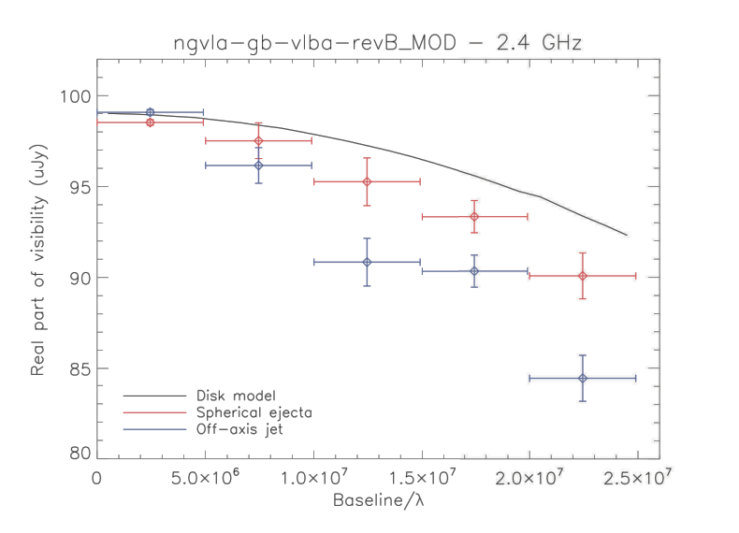
GW170817 at 30 Mpc
ngVLA and Gravitational Wave Sources
VLA sensitivity limit => detect radio counter parts to typical GW sources (merging neutron stars) to 40 Mpc.
ngVLA: 10x sensitivity => 3x further => 27x volume => increase expected event rate by factor 27 (expect 10 to 20 searchable LIGO events per year)
sub-mas resolution => determine source sizes and shapes on scales < 0.6 pc
Multi-messenger, time-domain astronomy (Blazar neutrino sources, LSST and Euclid synoptic surveys, GRBs, TDEs…): radio observations are key to unlocking source physics
Corsi ea. 2019

Slide 18
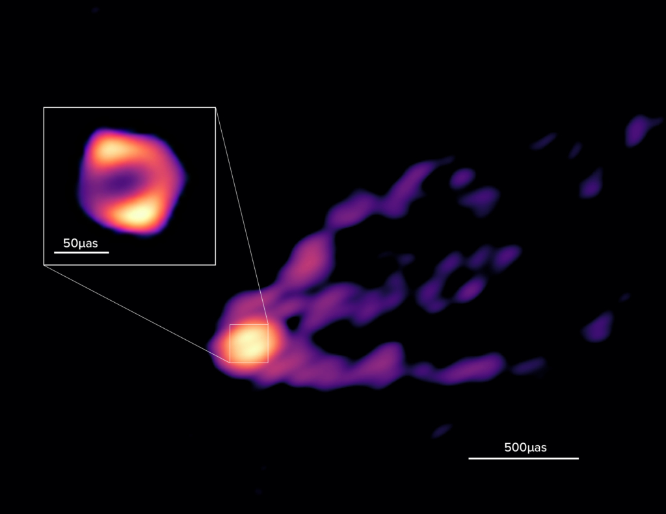
Imaging Supermassive Black Holes
EHT 250 GHz imaging of GR shadow of the SMBH in M87 (R ~ 20uas ~ 6 R_{g}) has opened a era in AGN studies.
GMVA observations of M87 at 90 GHz show a larger ring, by a factor 1.5, and continuity between the ring and jet, possibly indicating a wind driven by the accretion flow.
The ngVLA, operating with the GMVA or ngEHT increases the sensitivity by an order of magnitude at 90 GHz, with dramatically improved UV-coverage: LONG sites are being selected for good 90 GHz performance.
Resolve binary AGN down to 0.5 pc separation at all redshifts
Latest 3.5mm GMVA image down to 37uas resolution, rms ~ 0.1 mJy/beam, including the VLBA and ALMA, of the SMBH and jet in M87 down to scales of a few gravitational radii (Lu et al. 2023).

Slide 19
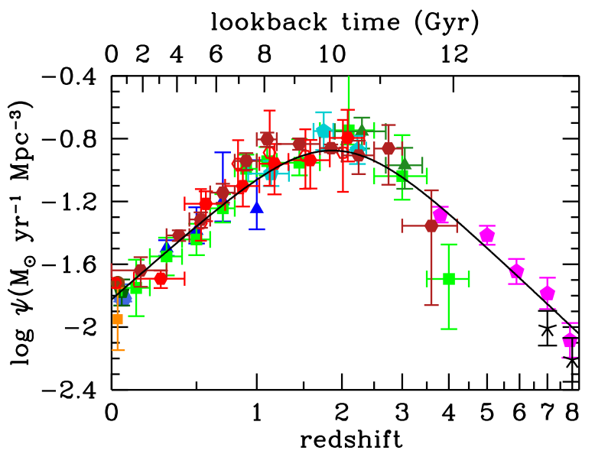
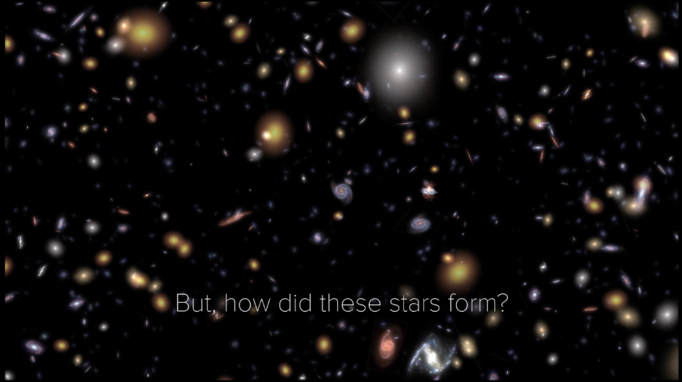
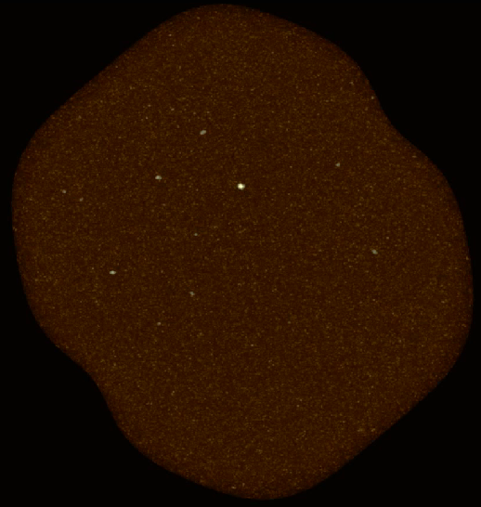
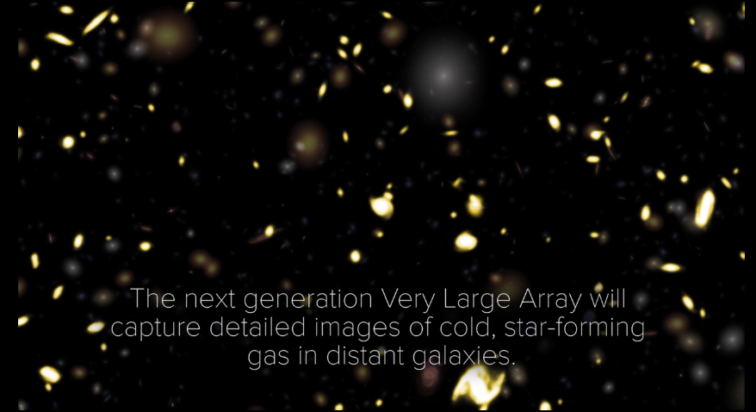
KSG3: Molecular Deep Fields in three dimensions
Revealing the ‘missing half’ of galaxy formation: the molecular gas = fuel for star formation
ASPECS ALMA 200 hrs: 36 CO galaxies z ~ 1 to 3
ngVLA ~ 3000 CO galaxies
HST UDF ~ 5000 galaxies over ~ 5’ field
10x sensitivity + 2.5x bandwidth => 100-fold increase in CO detection rate over VLA, ALMA => Galaxy counts in CO ~ deepest optical fields, with redshifts!

Slide 20
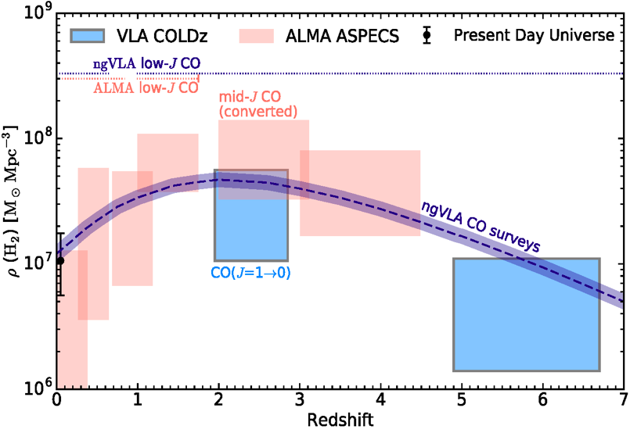
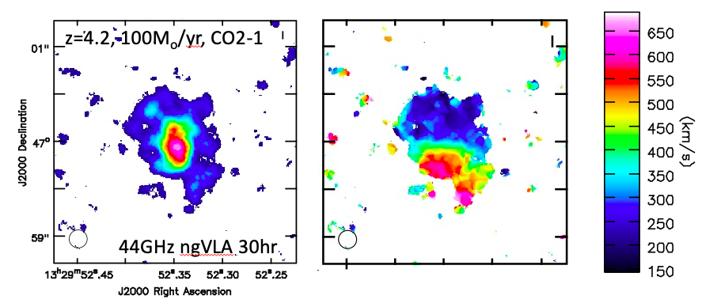
KSG3: Measuring the Dense Gas History of the Universe
Precise measurement of Dense Gas History of Universe
kpc-scale imaging of gas dynamics

Slide 21
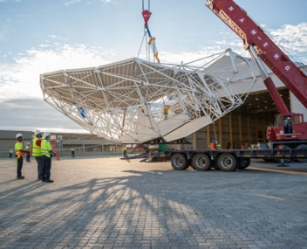
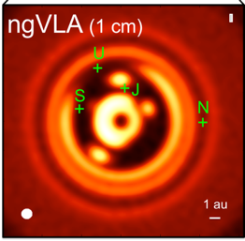
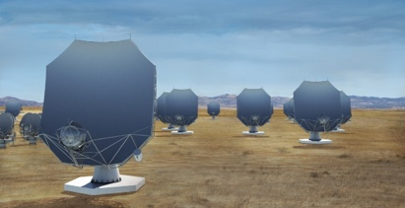
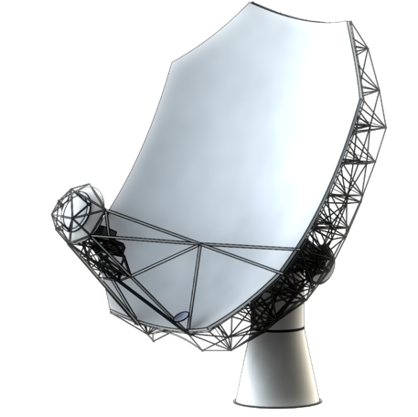
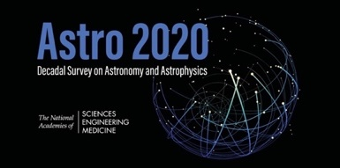
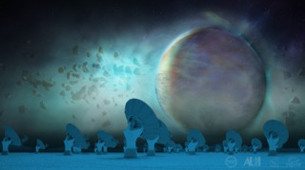
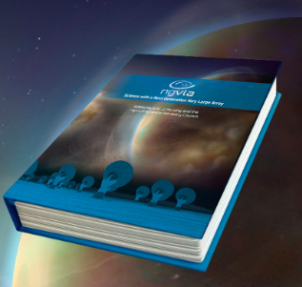
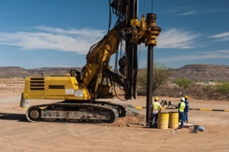
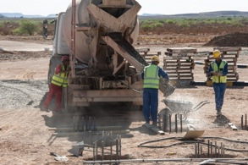
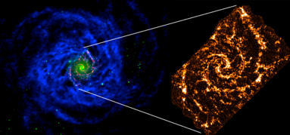
Project Timeline
2018
2019
2021
2023
2026
2029
2035
Astro2020 submission
Prototype antenna at VLA Site
Construction
Early Science Operations
(> VLA capabilities)
Full Science Operations
Science Book
NSF/MREFC FDR
NSF development funds
Construction full cost accounting: $2.3B [FY2018]
Astro2020 Report
July 2023: ‘NSF has formally entered the ngVLA project into the MREFC design process at the Conceptual Design Phase. The NSF-led Conceptual Design Review (CDR) is expected next Spring.’

Slide 23


Front End Concept
6 Bands in 2 Cryogenic Dewars.
1.2-3.5 GHz and 3.5-12.3 GHz Quad-Ridge Horns, 3.25:1 bandwidth, coaxial LNAs.
12.3-50.5 GHz using three 1.67:1 BW corrugated horns and waveguide LNAs.
70-116 GHz 1.67:1 BW corrugated horn and waveguide LNAs with block down conversion.
Single stage down-conversion to baseband for 5 bands. Direct SSB or IQ sampling using modular devices @ FE.
Two-stage Gifford-McMahon cryogenic system with variable-speed cryocoolers and compressors for reference design.

