Slide 1
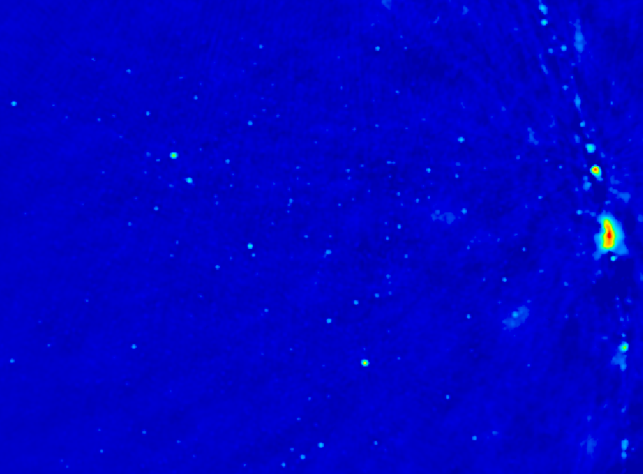
Precision Array to Probe the Epoch of Reionization
Chris Carilli
ESO Garching, March 2012
I. Introduction: Cosmic Reionization
Concept
Constraints on evolution of neutral IGM
II. HI 21cm line
Potential for direct detection of the neutral IGM
PAPER design and status
Fan, Carilli, Keating 2006, ‘Observational constrains on cosmic reionization,’ ARAA, 44, 415
Furlanetto et al. 2006, ‘Cosmology at low frequencies: The 21 cm transition and the high-redshift Universe,’ Phys. Reports, 433, 181
Wyithe & Morales 2010, ARAA, 48, 127

Slide 2
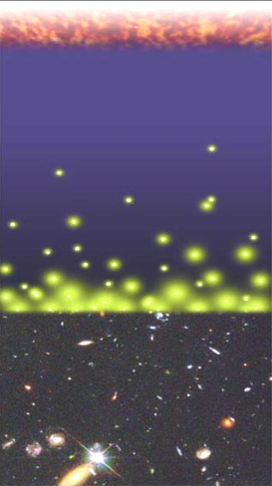
Big Bang f(HI) ~ 0
History of the IGM (Hydrogen)
Recombination
0.4 Myr
z = 1000
f(HI) ~ 1
Reionization
0.3 - 0.8 Gyr
z ~ 7 to 15
f(HI) ~ 10⁻⁵
13.6Gyr
z = 0

Slide 3
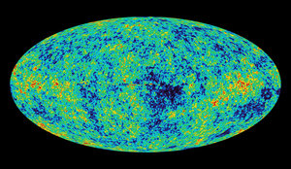
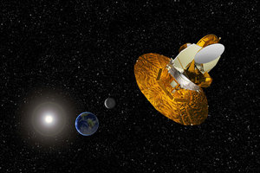
Cosmic microwave background radiation
Chris Carilli (NRAO)
Berlin June 29, 2005
Recombination
Early structure formation
WMAP – imprint of primordial structure from the Big Bang

Slide 4
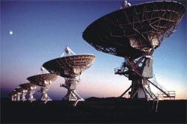
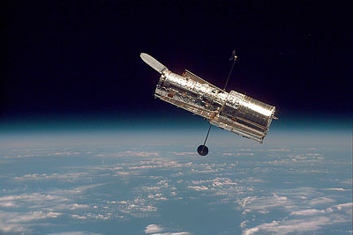
Big glass: HST, VLT, VLA
Late structure formation Realm of the Galaxies

Slide 5
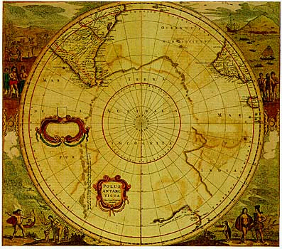
Universum incognitus
Dark ages
Last phase of cosmic evolution to be tested and explored
Cosmological benchmark: formation of first galaxies and quasars
Today’s focus: Evolution of the neutral IGM and reionization
When?
How fast?
HI 21cm signal
Cosmic Reionization

Slide 6
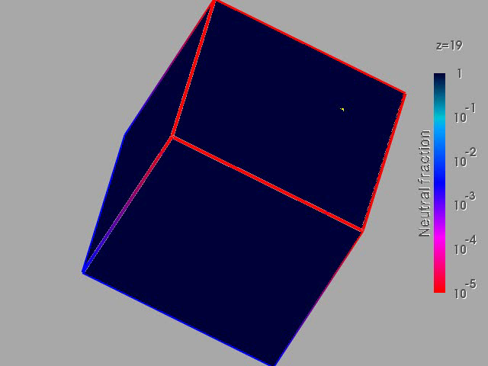
Numerical Simulations of the evolution of the IGM (Gnedin & Fan 2006, 648, 1)
F(HI) from z=20 to 5
Three phases
Dark Ages
Isolated bubbles (slow)
Percolation (bubble overlap, fast)
10cMpc
Matches UV lum. func. at z=5 to 8
Consistent with GP constraints on the IGM opacity at z ~ 6

Slide 7
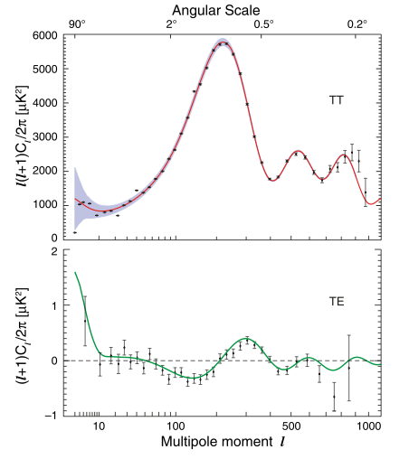
Constraint I: Large scale polarization of the CMB (WMAP)
Thomson scattering CMB (local quadrupole) during reionization => polarized
Large scale ~ horizon at z_{reion} l < 10 or angles > 10º
Integral measure of _{e} back to recombination
Weak: uK rms ~ 1% total inten.
Sachs-Wolfe
Baryon Acoustic Oscillations: Sound horizon at recombination
_{e} = 0.087 +/- 0.015
Jarosik et al 2011, ApJS 192, 14

Slide 8
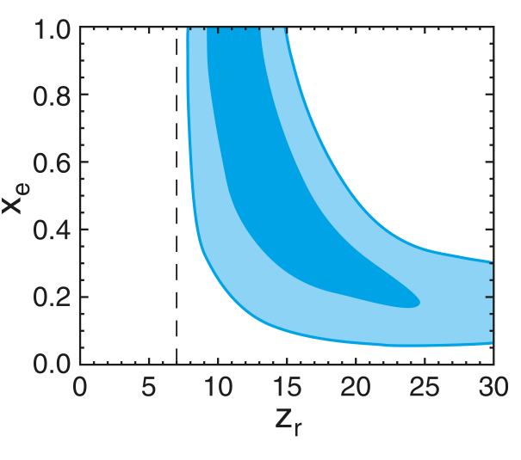
CMB large scale polarization: constraints on F(HI)
Rules-out high ionization fraction at z > 15
Allows for small (≤ 0.2) ionization to high z
Most ‘action’ at z ~ 8 – 13
Challenges:
Systematics in extracting large scale signal
Integral measure of _{e}
1-F(HI)
Two-step reionization: 7 + z_{r}
Dunkley ea 2009, ApJ 180, 306

Slide 9
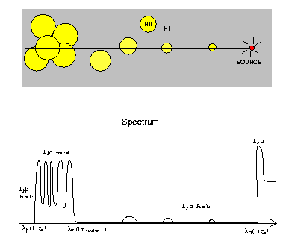
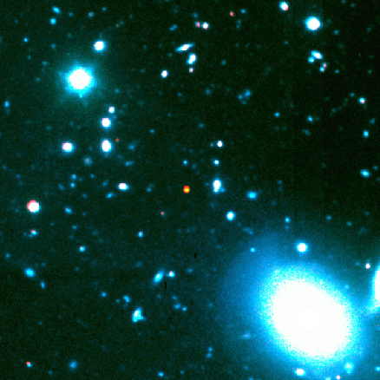
Constraint II: Gunn-Peterson Effect (Gunn + Peterson 1963)
ionized
neutral
quasar
z
SDSS high z quasars
Lya resonant scattering by neutral IGM
J1148+5251 z=6.4
t_{univ} = 0.9Gyr
Barkana and Loeb 2001

Slide 10
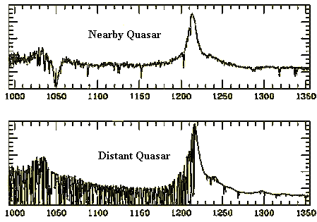
Neutral IGM after reionization = Lya forest
Lya resonant scattering by neutral gas in IGM clouds
Linear density inhomogeneities, δ~ 10
N(HI) = 10¹³ – 10¹⁵ cm⁻²
F(HI) ~ 10⁻⁵
z=0
z=3

Slide 11
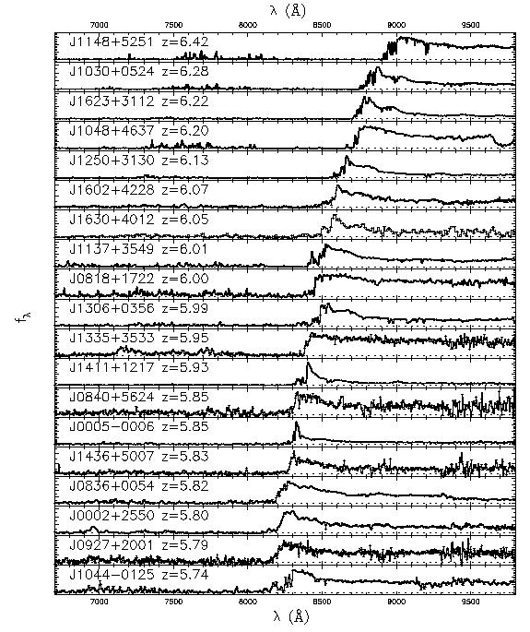
Gunn-Peterson effect
6.4
SDSS z~6 quasars
Opaque (τ > 5) at z>6
=> pushing into reionization?
5.7
SDSS quasars
Fan et al 2006

Slide 12
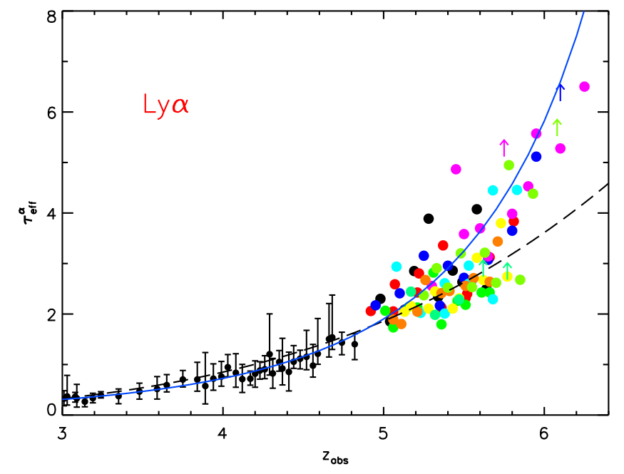
Gunn-Peterson constraints
on F(HI)
F(HI)_{v} ~ 10⁻⁵ at z < 4
F(HI)_{v} ≥ 10⁻⁴ at z ~ 6
Diffuse IGM:
τ_{GP} = 2.6e4 F(HI) (1+z)^{3/2}
Clumping: τ_{GP} dominated by higher density regions => need models of ρ, T, UV_{BG} to derive F(HI)
Challenges:
Continuum extrapolation
Saturates at low F(HI)
τ_{eff}
Becker ea 2007, ApJ, 662, 72
Fan ea 2006, AJ, 132, 117

Slide 13
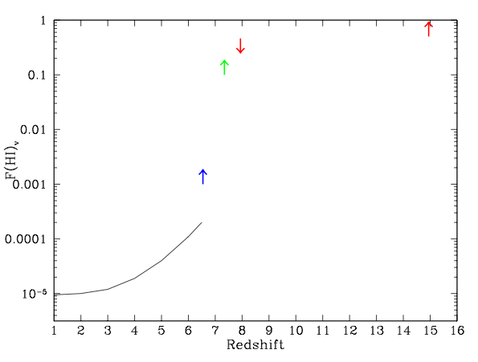
CMB_{pol}
F(HI)_{v}
GP
GP => systematic rise of F(HI) to z ~ 6.5
CMB_{pol} => mostly neutral at z>15, mostly ionized at z < 8

Slide 14
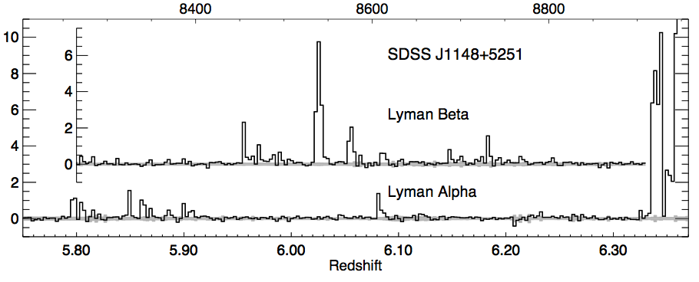
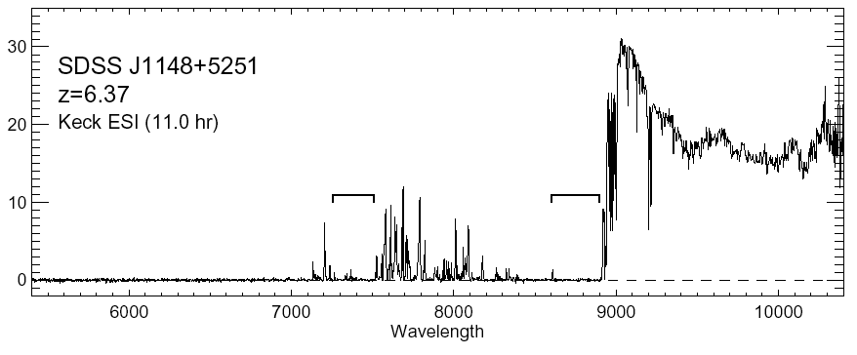
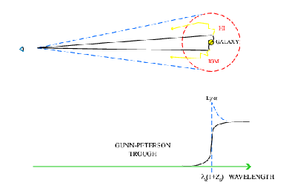
Quasar Near Zones: J1148+5251
Accurate host galaxy redshift from CO: z=6.419
Quasar spectrum => photons leaking down to z=6.32
White et al. 2003
Time bounded Stromgren sphere ionized by quasar
Difference in z_{host} and z_{GP} =>
R_{NZ} =4.7Mpc ~ [L_{γ} t_{Q}/F_{HI}]^{1/3} (1+z)⁻¹
HII
HI

Slide 15
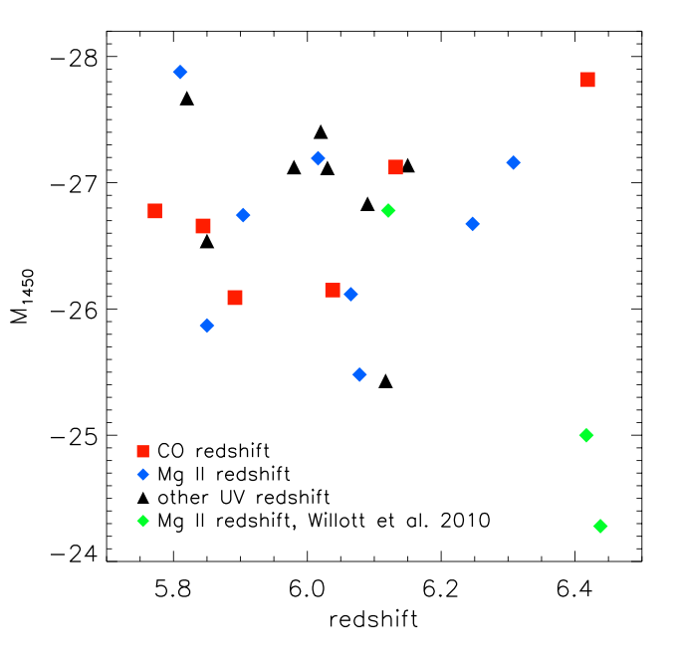
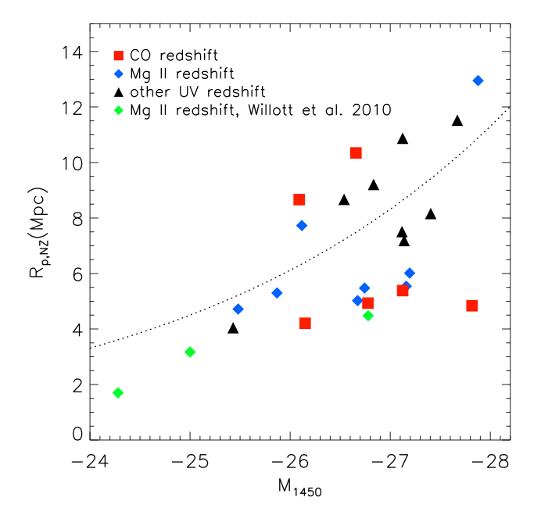
Quasar Near-Zones: 28 GP quasars at z=5.7 to 6.5
L_{UV}
R L_{γ}^{1/3}
L_{UV}
No correlation of UV luminosity with redshift
Correlation of R_{NZ} with UV luminosity
Note: significant intrinsic scatter due to local environ., t_{q}

Slide 16
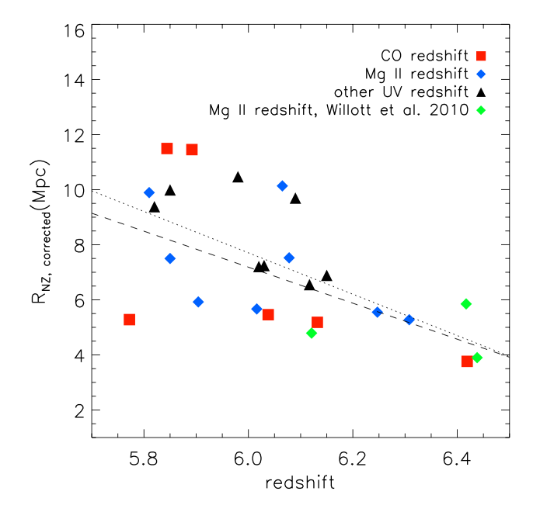
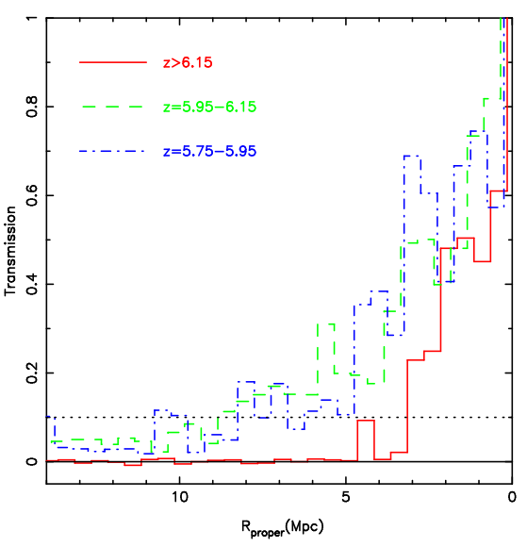
Quasar Near-Zones: R_{NZ} vs redshift
[normalized to M₁₄₅₀ = -27]
R_{NZ} = 7.3 – 6.5(z-6)
z>6.15
<R_{NZ}> decreases by factor 2.3 from z=5.7 to 6.5
If CSS => F(HI) increases by factor ~ 10

Slide 17
CMB_{pol}
QNZ
GP
QNZ => fairly rapid rise in F(HI) at z ~ 6?
Challenges: relative measure of size, pre-ionization, internal clumping

Slide 18
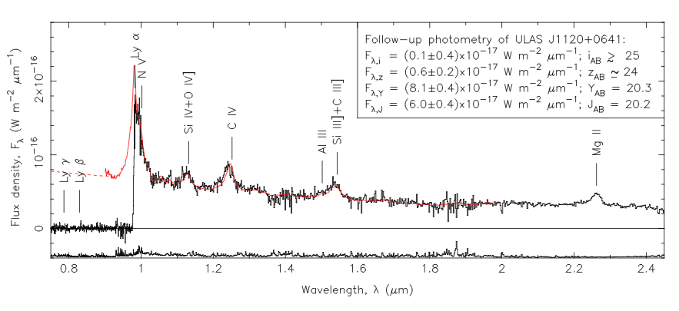
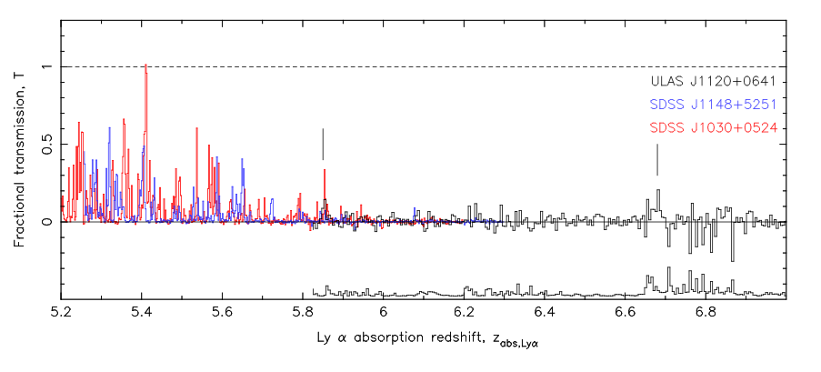
Highest redshift quasar, z=7.1: revolutionary result?
Clear GP absorption trough: τ > 5 => IGM opaque to Lya at z ≥ 6
6.2, 6.4, 7.1
Mortlock ea. Nat 474,616
Bolton ea. MNRAS, 466, L270
5.2
6.0
7.0

Slide 19
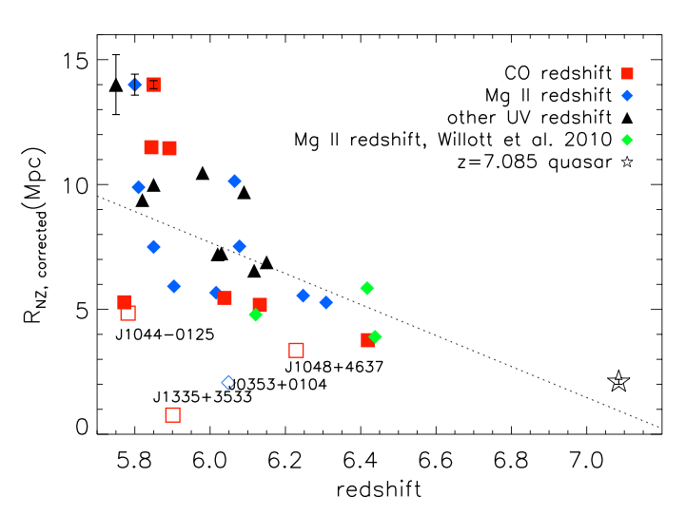
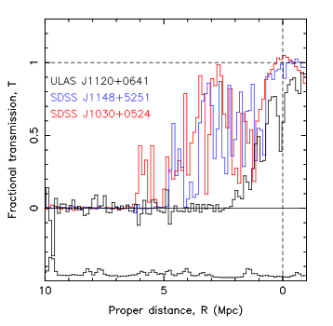
z=7.1 quasar near zone small ~ 2Mpc
z ≤ 6.4
z=7.1
Continues trend for decreasing NZ size with z

Slide 20
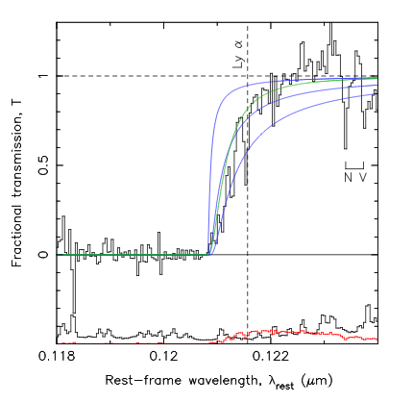
z=7.1 quasar: Damped Lya profile
N(HI) > 10^{20.5} cm⁻²
Substantially neutral IGM: f(HI) > 0.1 at 2Mpc distance, or
Damped Lya galaxy at 2.6Mpc (probability ~ 5%)
0.5
f(HI)=0.1
1.0
N(HI)=4e20 cm⁻² at 2.6Mpc
Bolton ea., Mortlock ea

Slide 21
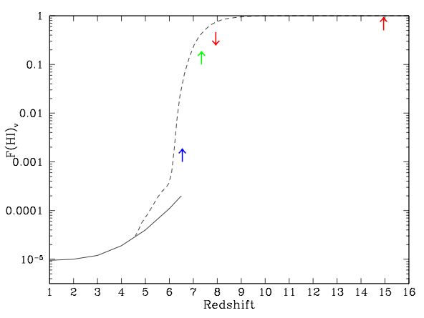
3.34
0.95
0.65
0.48
0.38Gyr
CMB_{pol}
Q-DLA
Gnedin & Fan model
QNZ
GP
z=7.1 quasar => rapid change in IGM (cosmic phase transition)?
Challenge: only one example

Slide 22
3.34
0.95
0.65
0.48
0.38Gyr
CMB_{pol}
Q-DLA
integral measure τ
one source
Gnedin & Fan model
QNZ
relative measure
GP
saturates
Amazing progress, suggesting rapid change in IGM at z~7
All values have systematic/modeling uncertainties
=> Need new means to probe reionization

Slide 23
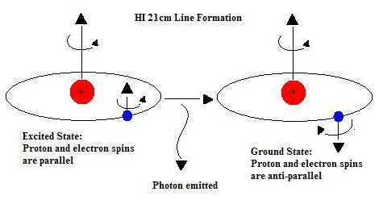
HI 21cm line: Most direct probe of the neutral IGM
Low frequencies:
ν_{obs} = 1420MHz/(1+z) ≤ 200 MHz
Advantages of the 21cm line
Direct probe of neutral IGM
Spectral line signal => full three dimensional image of structure formation (freq = z = depth)
Low freq => very (very) large volume surveys (1sr, z=7 to 11)
Hyperfine transition = weak => avoid saturation (translucent)

Slide 24
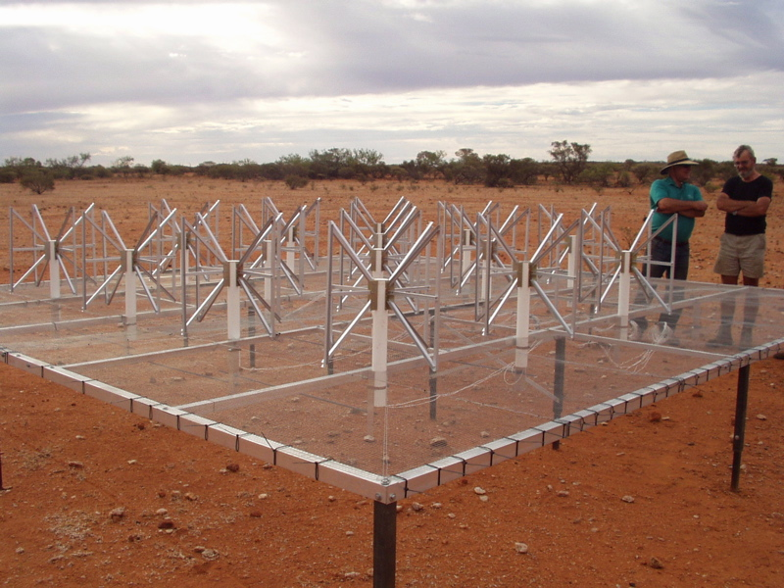
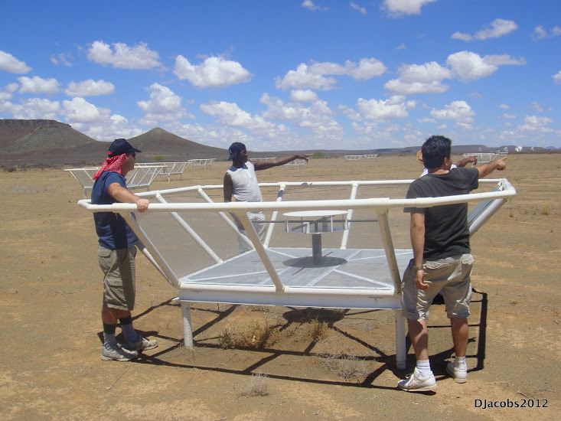
MWA - Oz
PAPER - SA
Pathfinders: 1% to 10% of a square kilometer array
 | FoV deg² | Area m² | Type | Bmax km | 1st light
SKA | 30 | 1e6 | Tile | 5 | ??
LOFAR | 25 | 1e5 | Tile | 2 | 2010
MWA | 600 | 1e4 | Tile | 1.5 | 2011
PAPER | 1600 | 3e3 | Dipole | 0.3 | 2011
GMRT | 9 | 1e4 | Dish | 2 | 2010

Slide 25
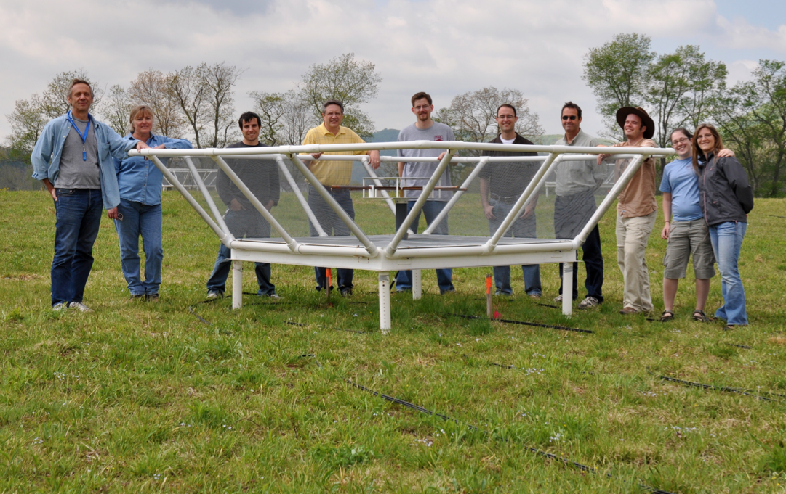
Precision Array to Probe Epoch of Reionization
Don C. Backer Array
Berkeley, NRAO, Penn, SKA/South Africa
Focus: low-ν array to study HI 21cm signal from reionization
Precision: emphasize engineering solutions first
Staged: work through problems before increasing investment

Slide 26
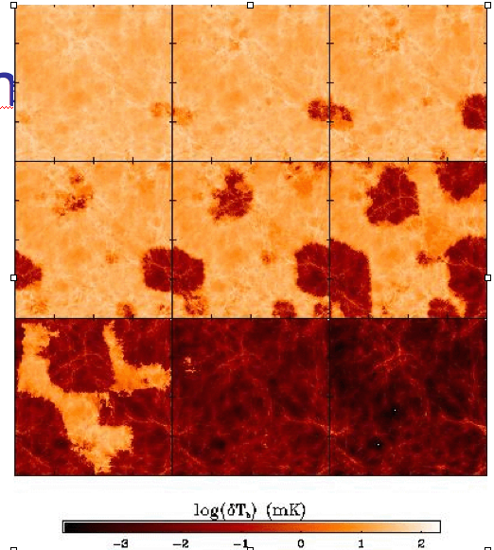
Signal end-game: HI 21cm ‘tomography’ of IGM
z= 12
ν₂₁= 109 MHz
9
‘Richest of all cosmological data sets’ (Loeb & Barkana)
cosmic density, ρ
neutral fraction, f(HI)
Temp: T_{CMB}, T_{spin} [T_{K}, T_{lya}]
z=7.6
ν₂₁= 165 MHz
10cMpc = 4’
Furlanetto ea 2004

Slide 27
Challenge: Sensitivity
z= 12
ν₂₁= 109 MHz
9
Imaging of typical structures requires full Square Kilometer Array
ΔTB(2’) ~ 20 mK ~ 8uJy
SKA rms ~ 4mK
z=7.6
ν₂₁= 165 MHz
10cMpc = 4’
Furlanetto ea 2004

Slide 28
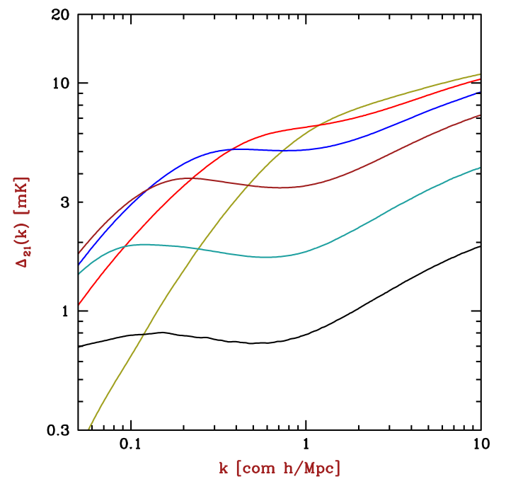
Near-term Reionization: Pathfinder science goals
3D power spectrum in 21cm line
characteristic bubble scale
z==12, f(HI) = 0.9
PAPER
z=7, f(HI) = 0.02
Barkana 2009

Slide 29
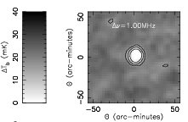
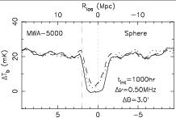
Pathfinder science goals: largest CSS
Quasar or clustered galaxy formation: largest ionized structures ~ 15’
Signal: 20mK => 0.5 mJy
rms(PAPER512, 1yr) ~ 0.1 mJy
Rare but we observe huge volume: 1600deg²; z=6 to 11
50cMpc
0.5 mJy
Wyithe et al. 2006

Slide 30
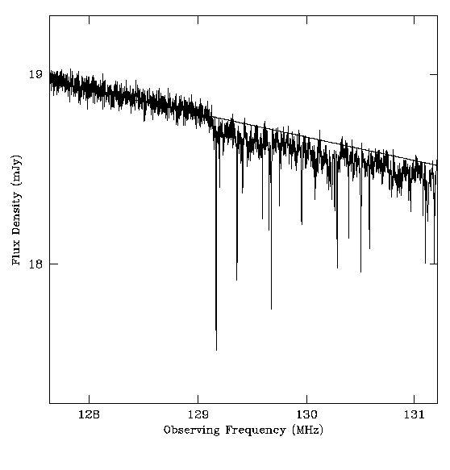
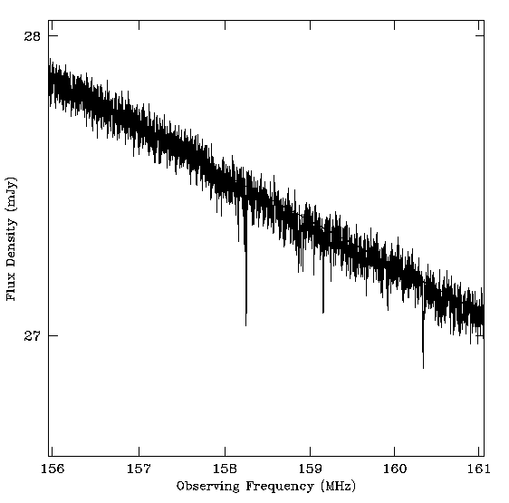
Pathfinder science goals: HI 21cm Forest
0.3 Jy
z=12
z=8
130MHz
159MHz
radio G-P (τ=1%)
21 Forest (10%)
mini-halos, primordial disks (10% to 100%)
rms(PAPER512) ~ 2mJy
Perhaps easiest to detect, if there are sources!
Only way to study small scale structure during reionization

Slide 31
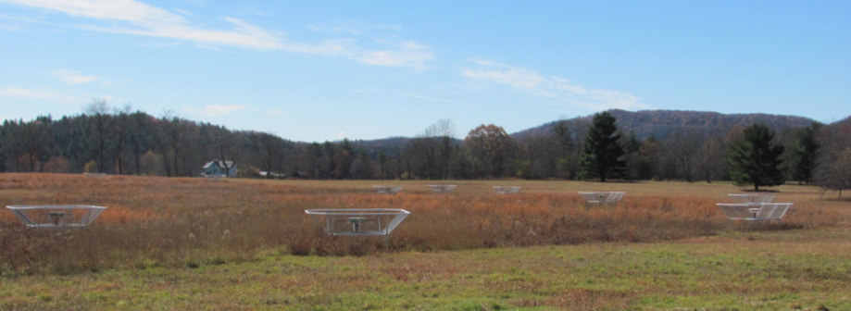
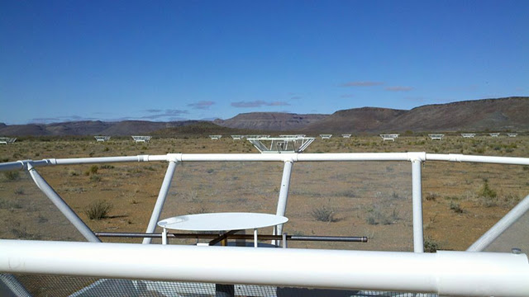
32 station engineering array in Greenbank, WV
PAPER basics
Freq = 115 to 190 MHz (z= 6.5 to 11)
Single dipole elements + ‘flaps’ => FoV_{FWHM} ~ 40º
Max baseline = 300m => res ~ 15’
Build-out to 128 (256?) science array in Karoo, South Africa in 2012 [currently 64 stations]

Slide 32
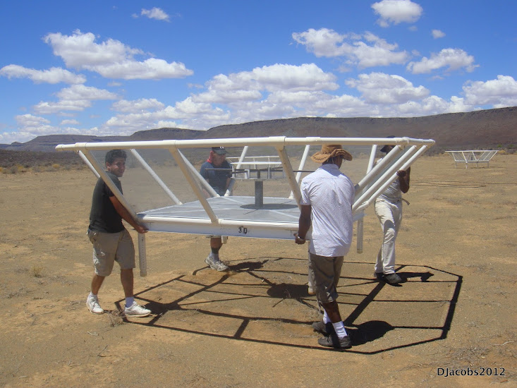
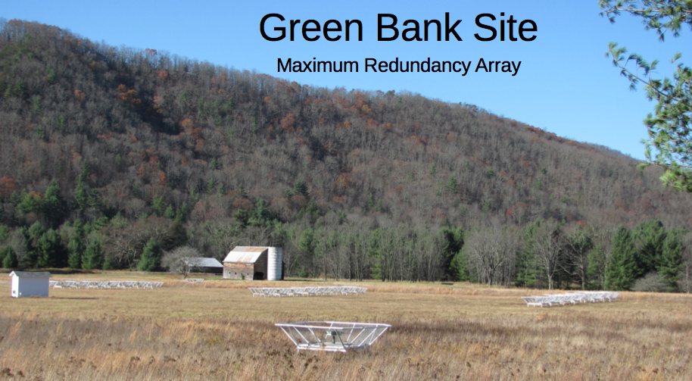
Reconfigurable => optimize for science goal
Minimum redundancy array
maximize u,v coverage => imaging
Delay spectrum analysis (Parsons): pile-up measurements in few u,v cells => coherently add spectra for PS analysis in freq = z

Slide 33
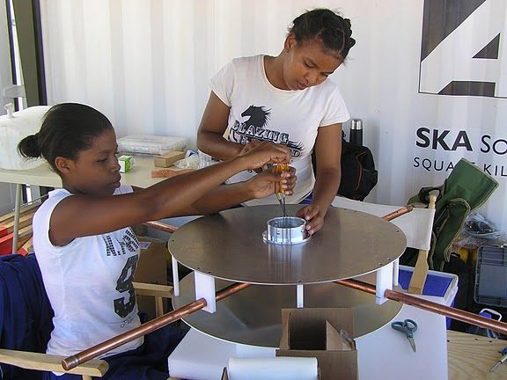
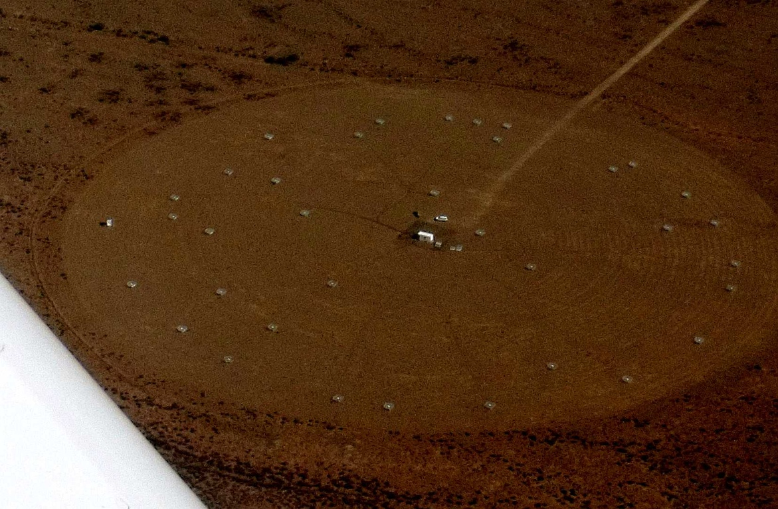
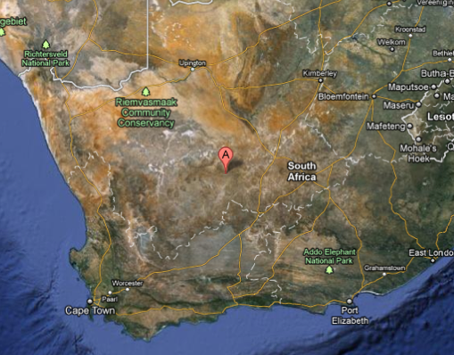
Established working array (now 64 elements) from scratch in ~ 6months, with help from SA (SKA, Durban)
Durban University of Technology
PAPER
575 km
Cape Town

Slide 34
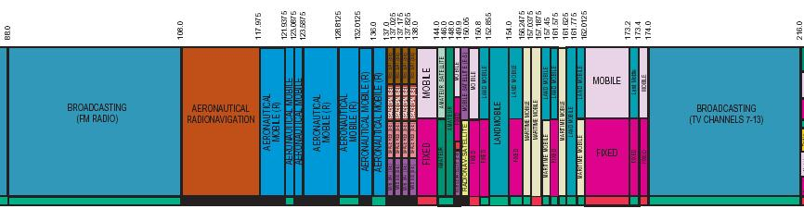
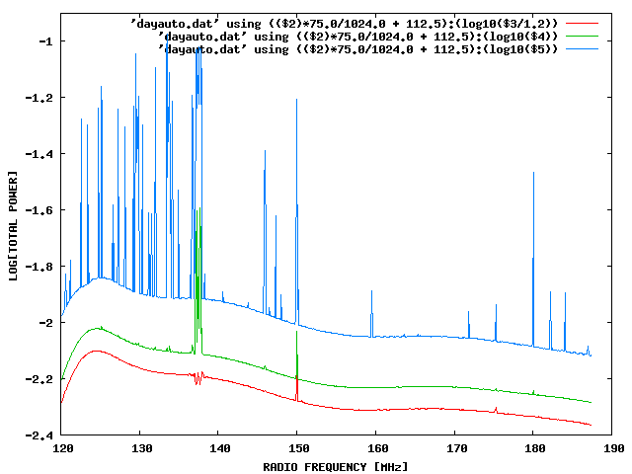
Challenge: Interference
100 MHz z=13
200 MHz z=6
Aircraft
Orbcomm
TV

Slide 35
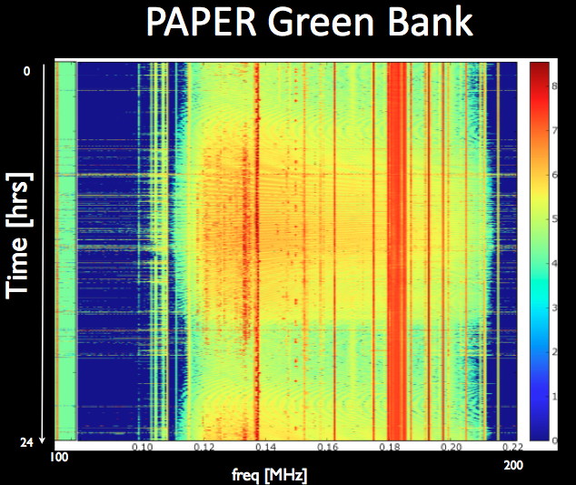
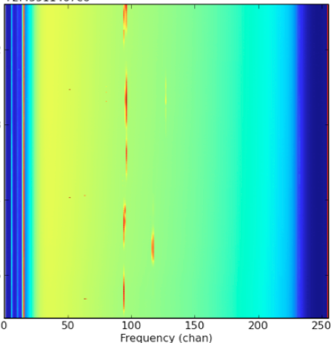
Solution: location!
PAPER South Africa
OrbComm
FM
ISS
OrbComm
100MHz
200MHz
100MHz
200MHz
US ‘radio quiet zone’
ZA ‘radio quiet zone’

Slide 36


Challenge: hot, confused sky at low freq
Haslam, Eberg 408MHz
Coldest regions: T ~ 100 (ν/200 ΜΗz)^{-2.6} K = 10⁴ x 21cm signal
Highly ‘confused’: 1 source/deg² with S140 > 1 Jy

Slide 37


Solution: spectral decomposition
Foreground = non-thermal = featureless over ~ 100’s MHz
Signal = fine scale structure on scales ~ MHz
Cygnus A
Signal/Sky ~ 10⁻⁵
z=13
z=7
500MHz
5000MHz
Critical to mitigate freq dependent telescope response!

Slide 38



PAPER Antenna: ‘clean machine’
Sleeve dipole + flaps
Smooth, broad response in frequency and angle
Gain
10dB
120MHz
200MHz
LNA: T_{rx} = 110K, 30dB gain 120-180MHz

Slide 39



PAPER Primary beam
FW10% ~ 90º
Measure power pattern using Orbcom at 136MHz

Slide 40


Challenge: array spectral sidelobes
Synthesized beam (PSF) is frequency dependent => smooth spectral fitting over MHz bands does not remove far-out sidelobes of (residual) bright sources
1MHz separation
R_{phys} ~ 1.7Mpc
10º
5MHz separation

Slide 41



Example: frequency differencing
Cyg A, DNR ~ 1000
1. Find and subtract continuum through selfcal/deconvol/UVSUB => residual sidelobes due to imperfect calibration
2. Subtract channels to remove residual continuum
50kHz separation => noise limited
5MHz => sidelobe limited

Slide 42

Stringent calibration requirements (Datta ea 2010)
Sidelobe noise
Thermal noise (6hr)
0.1%
1%
Bright source removal requires better than 0.2% antenna calibration to reach thermal noise each day

Slide 43
Results from standard calibration and imaging
32 stations in GB, 64 in Karoo: first test imaging results
Violates all assumptions in synthesis imaging (eg. SIRA)
Transit array => image in snapshots in time (10min)
Very wide field (‘full sky’) => require 3D FT (facets)
Very wide band (octave) => require multifreq synthesis (currently image snapshots in freq ~ 10MHz)
Very high dynamic range > 10⁵: requires extensive iteration in selfcal/deconvolution
Structure on all scales => require ‘multiscale clean’
Strong and weak RFI: multiple layers of flagging
Image processing is SLOW: 10min observations requires hours to selfcal/image/deconvolve on local cluster

Slide 44



PGB32
CygX region
G82.2+5.3
Cygnus A
G78.2+2.1
W51 region
Galactic plane
1 hour, BW=30MHz
18’ resolution
DNR ~ 9500
Weakest src ~ 4 Jy
G49.2-0.7

Slide 45


Stable system: selfcal gain solutions
Few deg over 1hr
Few % over 1hr

Slide 46


PSA64, July 2011
10min snapshots
BW = 60MHz
DNR ~ 1000
Weakest src ~ 1Jy
120MHz
180
10º

Slide 47


Slide 48


Slide 49


Slide 50


Slide 51


Slide 52

Ancillary science on way to reionization
Continuous ‘all-sky’ monitor (GRBs, XRBs...)
Sensitivity(10min) ~ 10mJy
10º

Slide 53


Radio galaxies: imaging and spectra 120 to 180 MHz
600kpc
Parkes: 1.4 GHz, 50hrs
PAPER: 120 to 180MHz, 30min

Slide 54


Spectra from 120 to 180 MHz: SI analysis

Slide 55


SNR searches, spectra, imaging: find the missing large SNR?
Galactic HII regions: free-free absorption (EM > 10⁴ pc cm⁻⁶) => 3D study of thermal/nonthermal ISM
W28-SNR + M8-HII
SgrA*
RCW131-HII
Kes40,41-SNR
RCW132-HII
CTB37-SNR
RimNeb-HII
10º
15’=40pc at GalCent
IRAS 100um

Slide 56

Cosmic Reionization
Cosmic reionization: last frontier in studies of large scale structure formation
Quasar spectra + CMB_{pol} provide first insights: increasing neutral fraction at z ~7, but finite ionization to z ≥ 10
HI 21cm signal: direct observation of neutral IGM
SKA required for full tomography
PAPER: making first all-sky images; targeting first statistical detection by 2013

Slide 57


PAPER: (Xilinx) FPGA-base correlator from Berkeley wireless lab (CASPER)
IBOB F engine: sample, digitize, transform (τ → ν), using polyphase filter (‘preconvolution’)
ROACH X engine: cross multiply V (baseline, ν)
Cross-connections: ‘packetized correlator’ using 10Gb Ethernet protocol + commercial data routers
ROACH II: Easily scalable and reconfigurable. Estimate current architecture is scalable to 256 antennas w. 100MHz bandwidth
Computing and data storage (Penn)
Cluster computing: 32 octal core servers
Store raw visibilities: RAIDS 120 TB

Slide 58



Sources responsible for reionization
Galaxies at z>7
<1um
>1um
HST/WFC3 Bouwens et al. 2010
Note: SDSS quasars (SMBH) are insufficient to cause reionization

Slide 59

Reionization by normal galaxies
Roberston + Ellis 2010
z ~ 7 requires f_{esc} > 0.2 and C < 30
z ~ 8 requires f_{esc} > 0.2 and C < 10

Slide 60

Alternative hypothesis to Stromgren sphere: Quasar Proximity Zones (Bolton & Wyithe; Bolton & Haehnelt)
R_{NZ} = density of ionizing photon from
quasar > background
=> R_{NZ} ~ [L_{γ}]^{1/2}
Increase in R_{NZ} from z=6.5 to 5.7 =>
rapid increase in photon mfp during final
(overlap) stage of reionization
Either case (CSS or PZ) => rapid
evolution of IGM from z ~ 5.7 to 6.5

Slide 61



PS analysis: Delay Transform (Parsons)
HI Bubble dominanted epoch?
signal
Baseline-based, PS analysis in freq = z
Synch. Foregrounds have sharp cut-off
Max redundant array ➔ PS detection with PSA128 in 120d w. 3 flds, 2hrs/fld/day
Wide band analysis is critical
Short baselines => minimize ‘mode mixing’ of spatial and spectral freq

Slide 62
3.34
0.95
0.65
0.48
0.38Gyr
CMB_{pol}
Q-DLA
QNZ
GP
z=7.1 quasar => rapid change in IGM?
Challenge: only one example

Slide 63
CMB_{pol}
CMB_{pol}
Q-DLA
integral measure τ
one source
QNZ
relative measure
QNZ
GP
saturates
GP
0.8Gyr
0.3Gyr
Amazing progress, suggesting rapid change in IGM at z~7
All values have systematic/modeling uncertainties
=> Need new means to probe reionization

Slide 64

QNZ: analyze size evolution of 28 quasars at z=5.7 to 6.5 with measured z_{host} and z_{GP}
z = 6.1
Wyithe et al. 2010
I. Deriving z_{GP}
Variable τ => adopt fixed resolution of 20A
Find 1st point when transmission drops below 10% (well above GP level)
=> uniform, but relative, measure of size of QNZ, δz~ 0.01

Slide 65



II. Deriving z_{host}: UV (8), MgII (14), CO (8), [CII] (3)
δz = 0.03 for UV
δz = 0.01 for MgII
δz = 0.003 for CO, [CII]
Broad ~ few 1000 km/s
Systematic offsets ~ 1000 km/s
CO/CII
Widths ≤ 500 km/s
Centered on galaxy
+ CO
z=6.4

