Slide 1
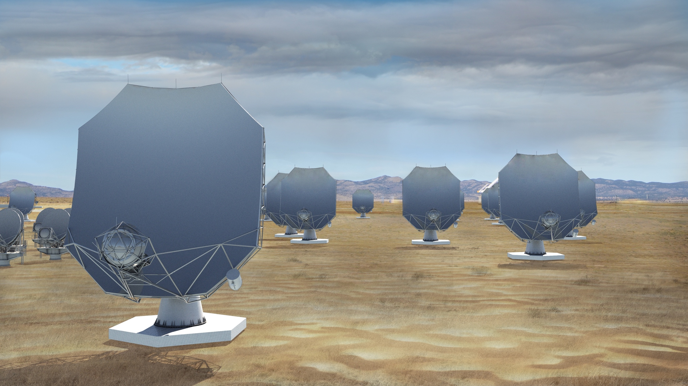
The next-generation Very Large Array (ngVLA)
A transformative new facility to replace the VLA and VLBA to tackle new Scientific Frontiers into the mid-Century:
Thermal imaging at milli-arcsec scales.
10x the sensitivity of the JVLA/ALMA
10x higher resolution than the JVLA/ALMA
1.2 - 116 GHz Frequency Coverage
244 x 18m + 19 x 6m offset Gregorian Antennas
    Centered at VLA site and concentrated in SW US.
    Fixed antenna locations across North America.
Notes:
Will be the next U.S. Flagship Radio Observatory.

Slide 2
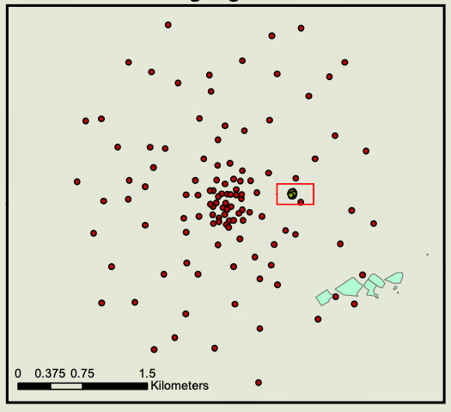
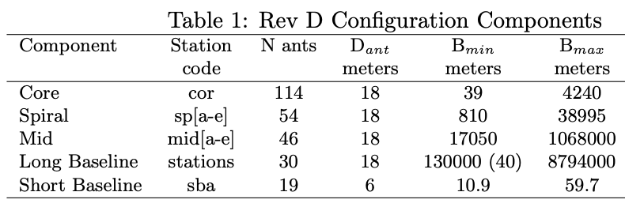
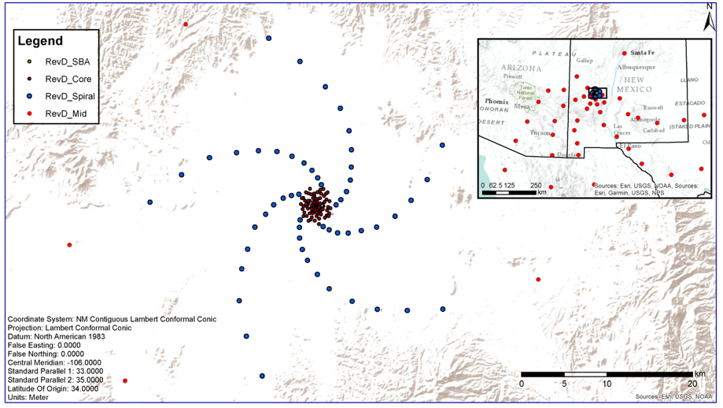
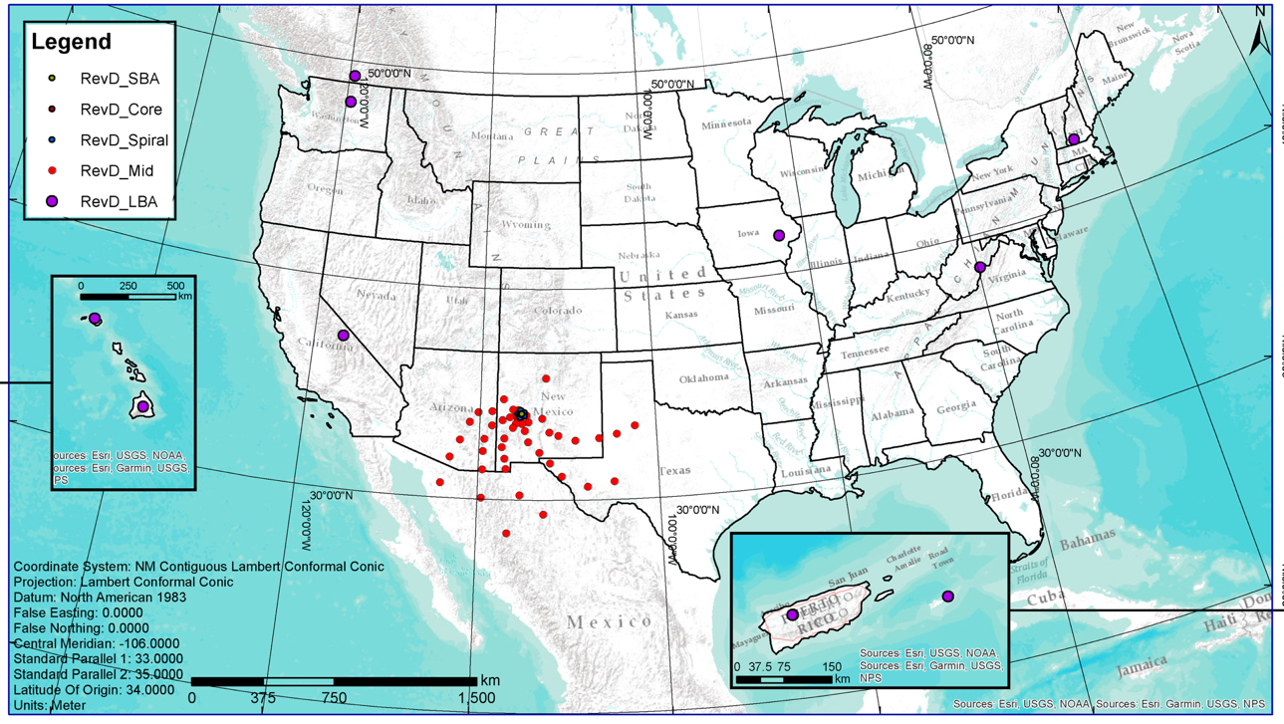
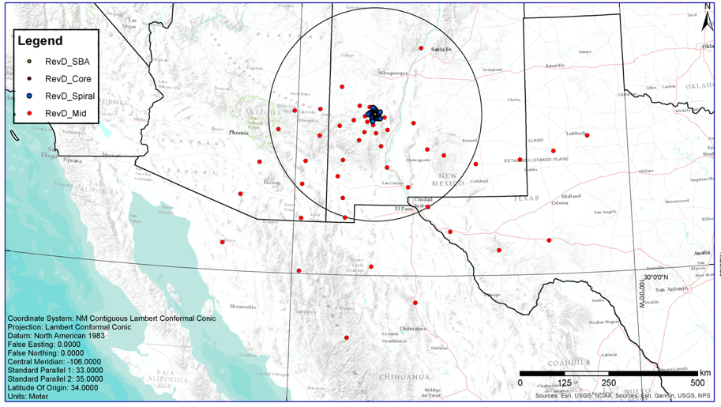
350 miles

Slide 3
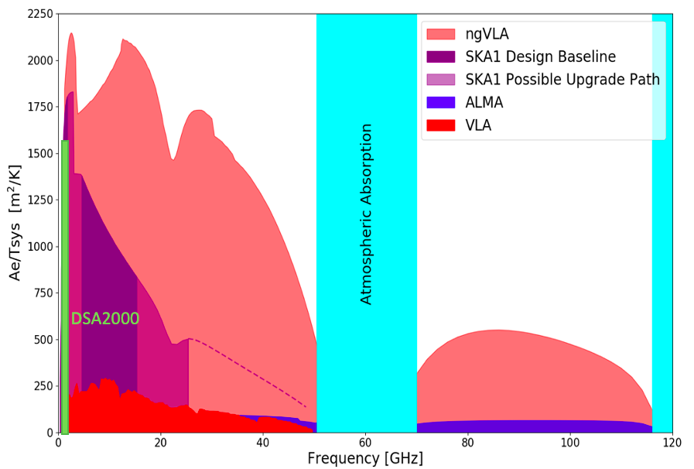
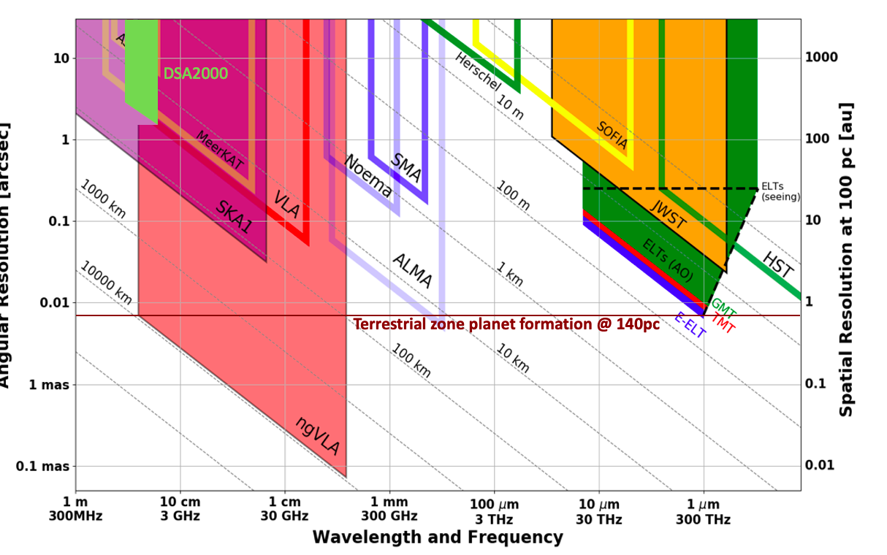
New Parameter Space for the mid-Century
Complementary suite from meter to submm arrays for the mid-21st century
> 120GHz: ALMA 2030 superb for chemistry, dust, fine structure lines
  1.0 - 116GHz: ngVLA superb for terrestrial planet formation, dense gas history, black holes
  < 15 GHz: SKA superb for pulsars, reionization, HI + continuum imaging
Notes:
Snapshot comparison of effective collecting area for dish-arrays expected in the 2030’s.

Slide 4
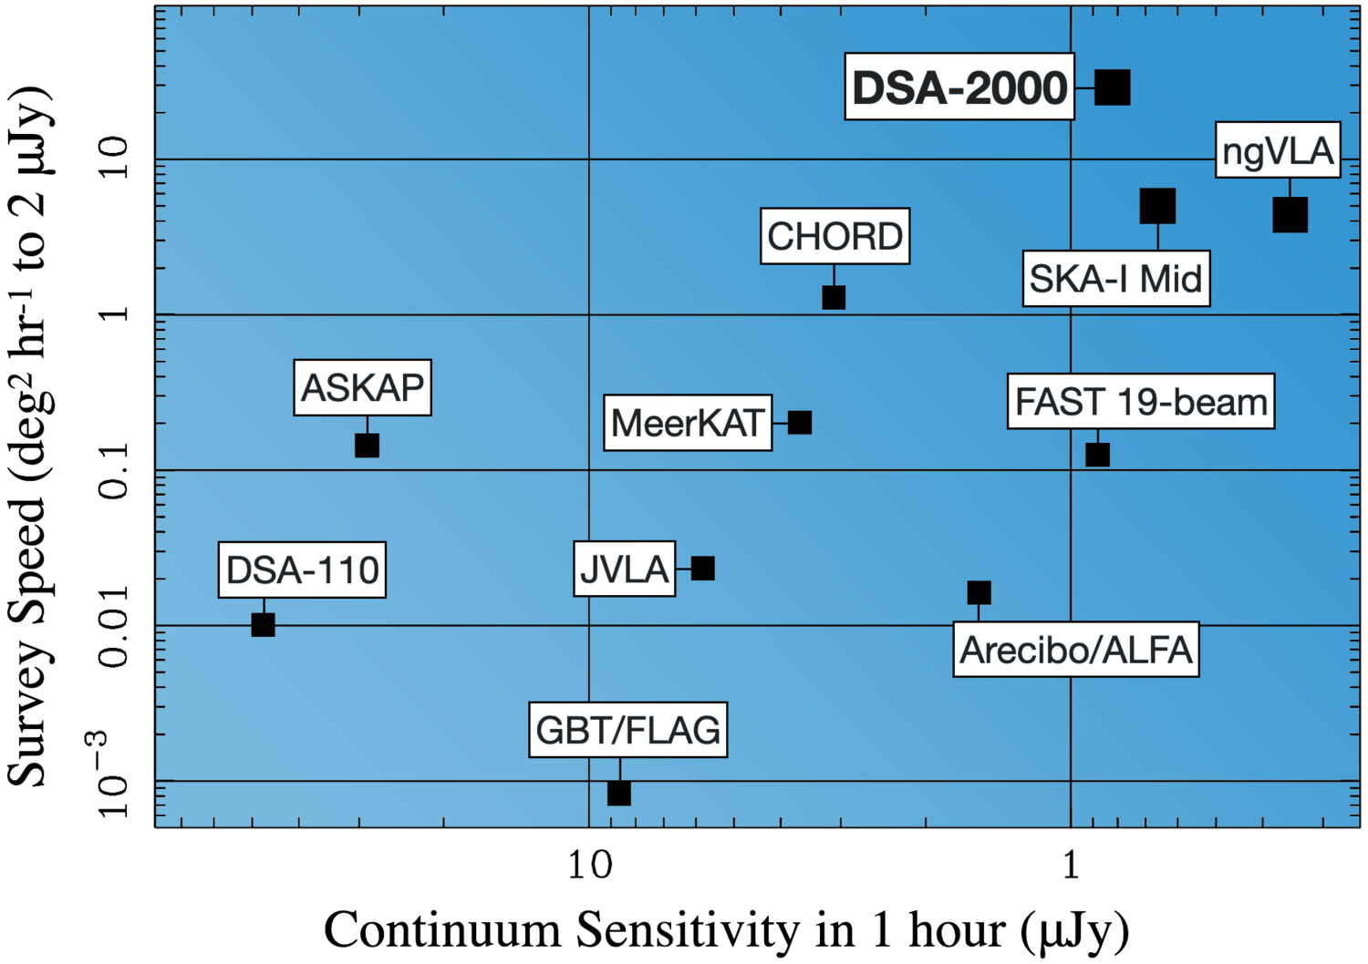
DSA2000 built for synoptic surveys
Excellent ‘finder scope’ for new cosmic phenomena
FoV at 1.4 GHz (half-power)
ngVLA: 1350 arcmin²
SKA: 2200 arcmin²
DSA2000: 17000 arcmin²
Limitation: source characterization
Polarization: good
Temporal: good
Spectral range: limited
Spatial resolution: limited
Requires ngVLA, SKA, ALMA… for broad band, high resolution follow-up

Slide 5
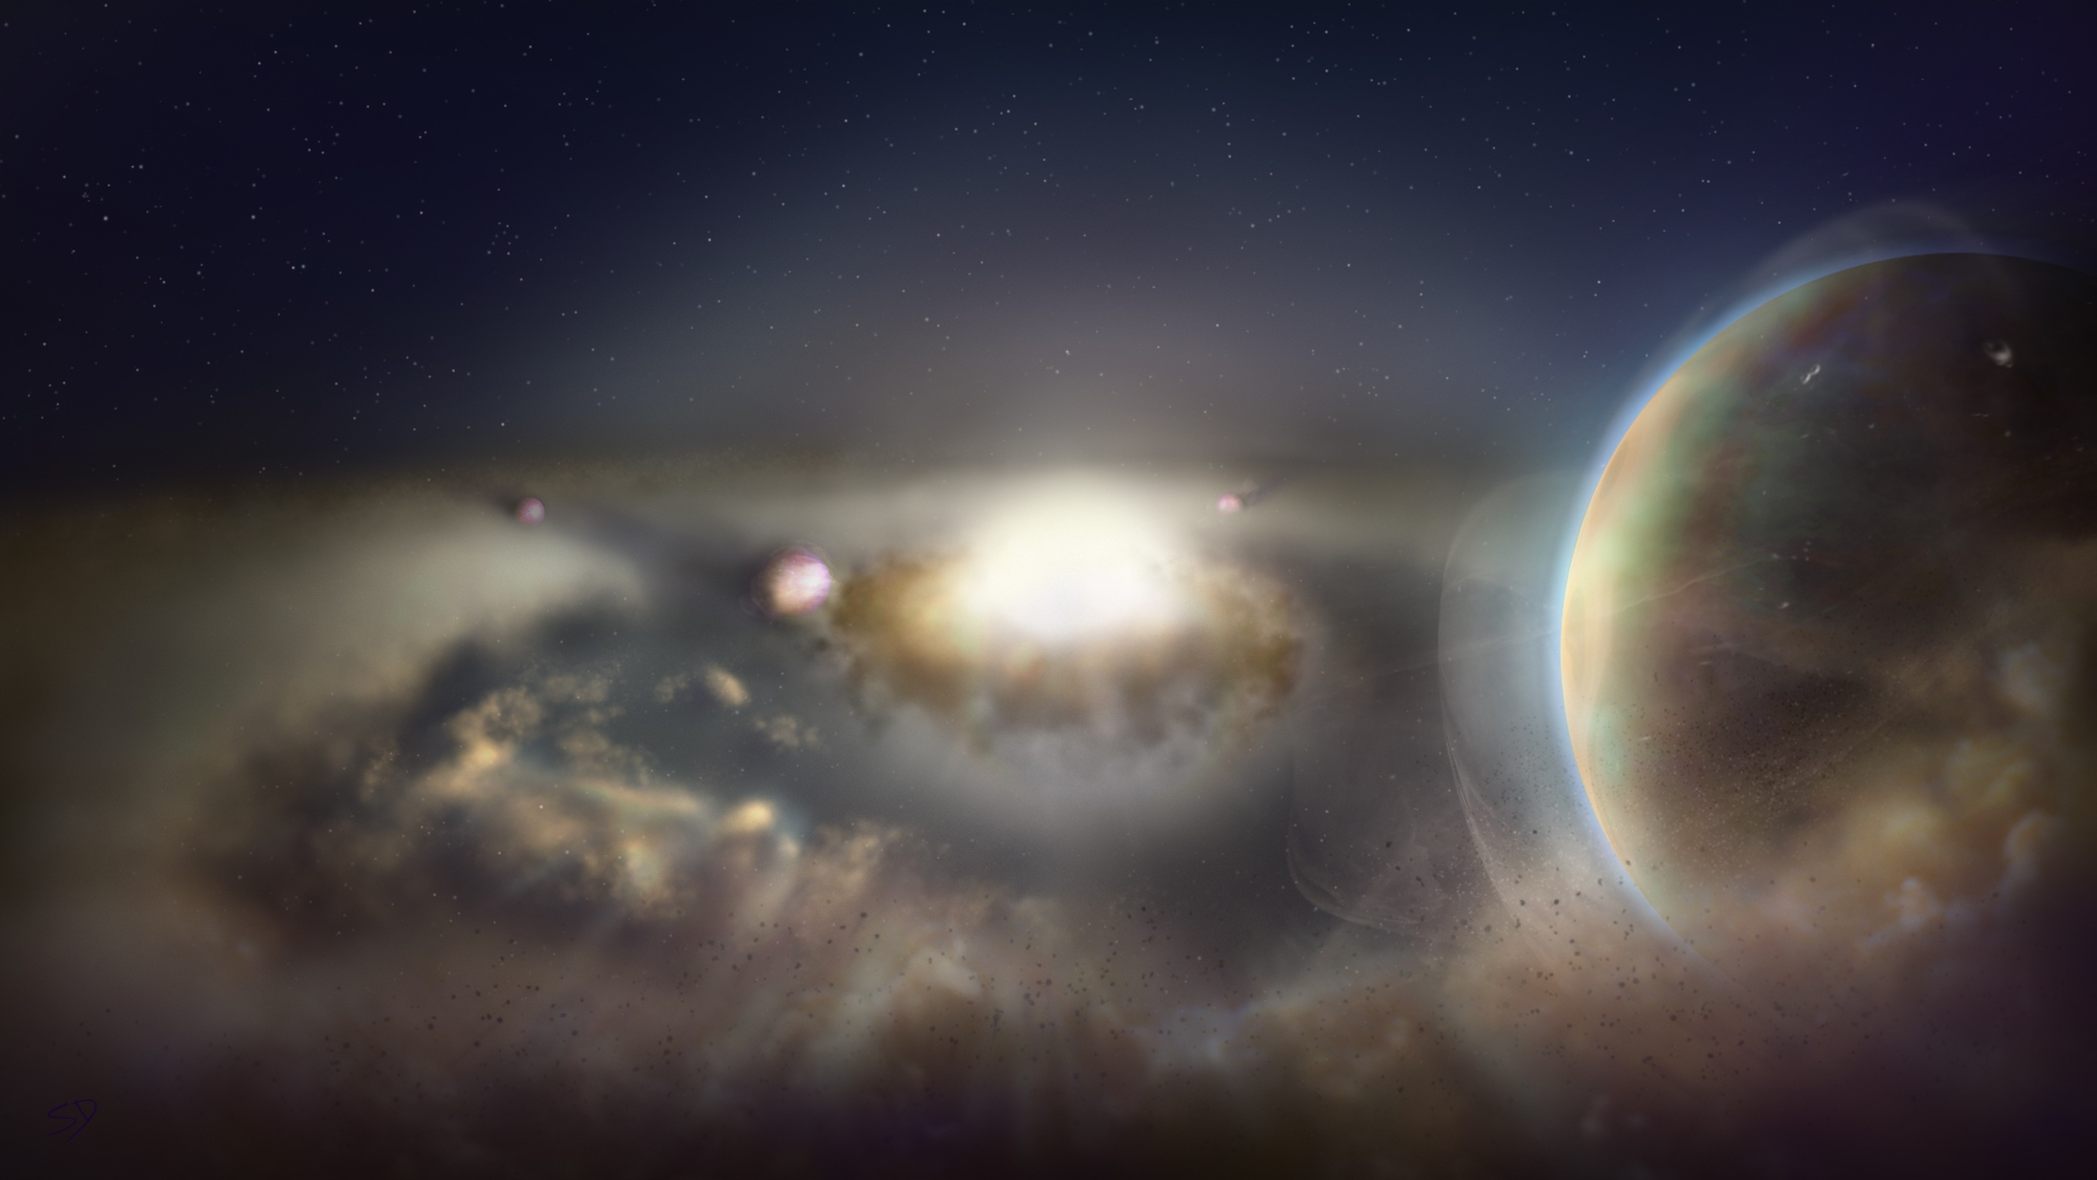
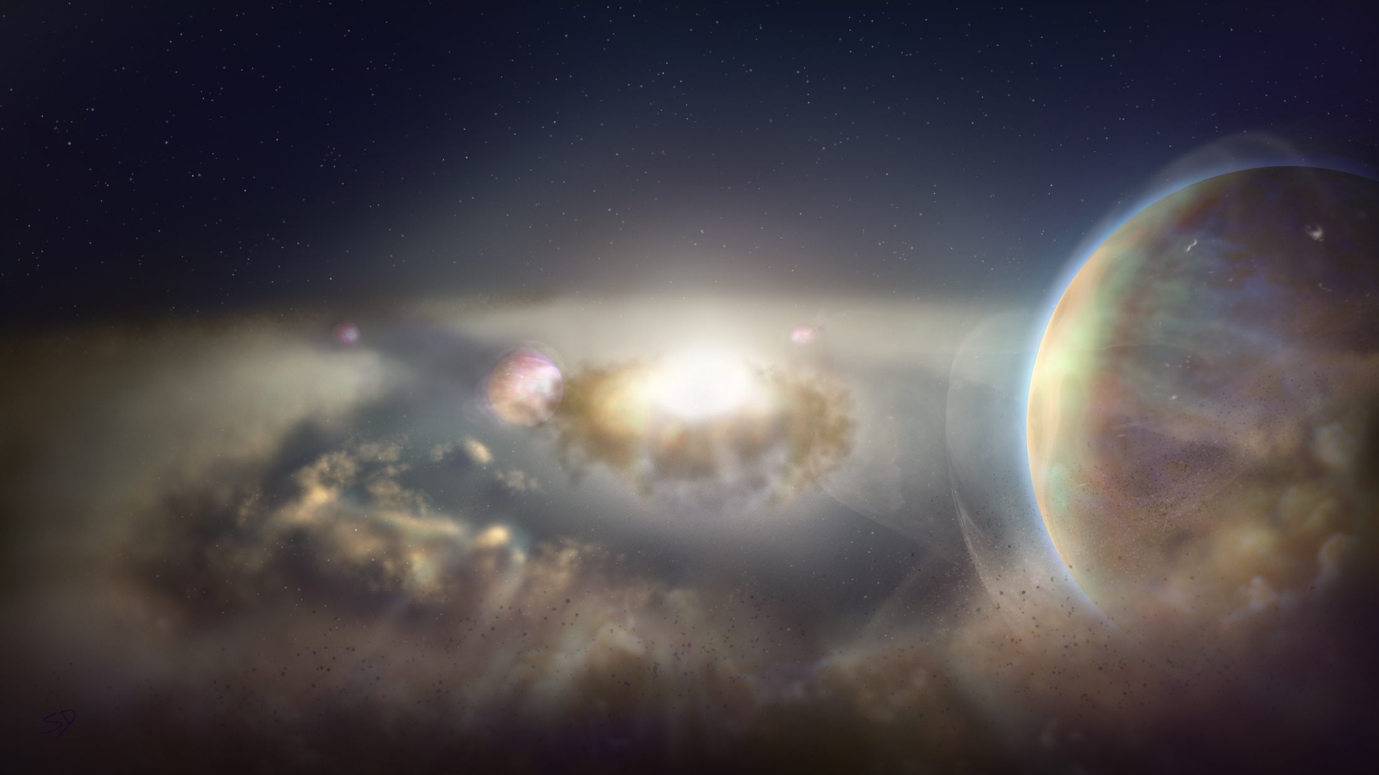
ngVLA Key Science Goals
(SAC ngVLA memo #19)
Unveiling the Formation of Solar System Analogues on Terrestrial Scales
Probing the Initial Conditions for Planetary Systems and Life with Astrochemistry
Charting the Assembly, Structure, and Evolution of Galaxies Over Cosmic Time
Using Pulsars in the Galactic Center as Fundamental Tests of Gravity
Understanding the Formation and Evolution of Stellar and Supermassive
BH’s in the Era of Multi-Messenger Astronomy
ngvla.nrao.edu

Slide 6
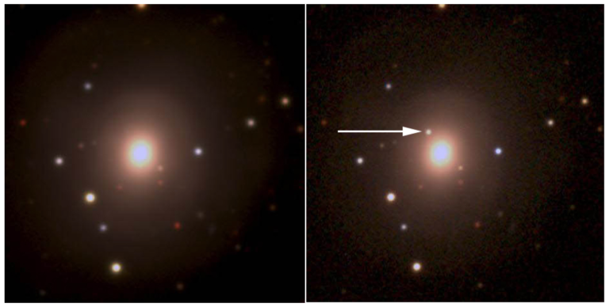
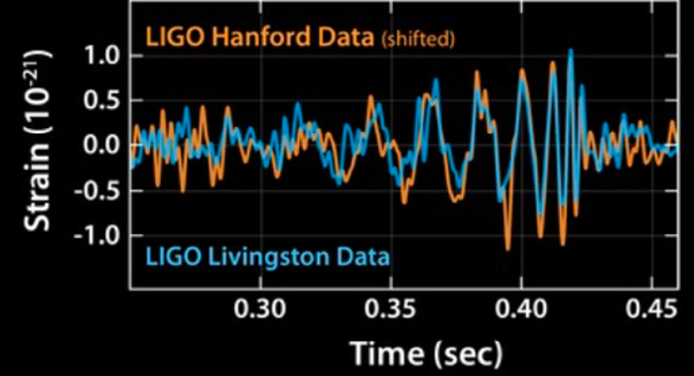
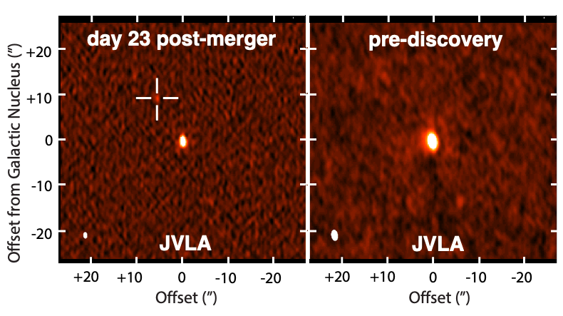
KSG 5: New Windows on the Dynamic Universe
Optical Pan ea. 2017
Gravitational Waves Sources: The multi-wavelength campaign that discovered the EM counter-part to the merging binary ~ 30 M_{o} black-holes, identified with a galaxy at z = 0.093.
Hallinan ea. 2017
DSA2000: expects to be targeting 10 to 20 LIGO events per year

Slide 7
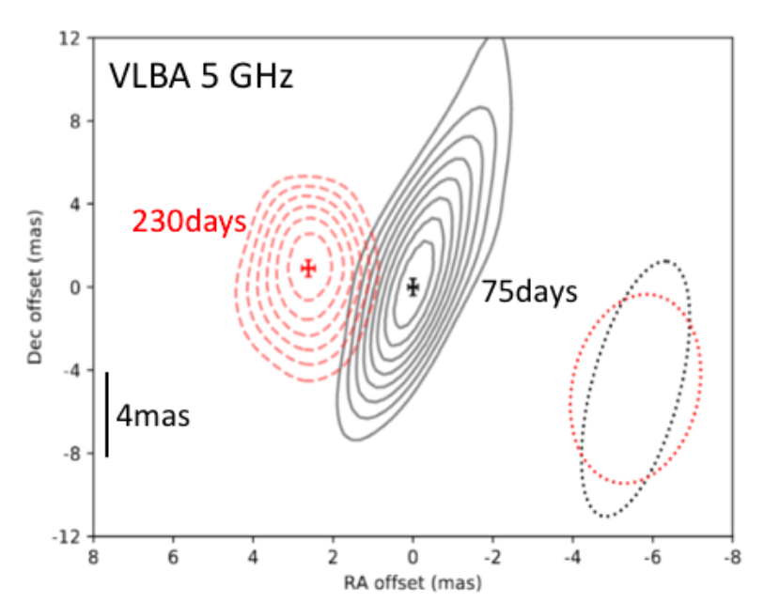
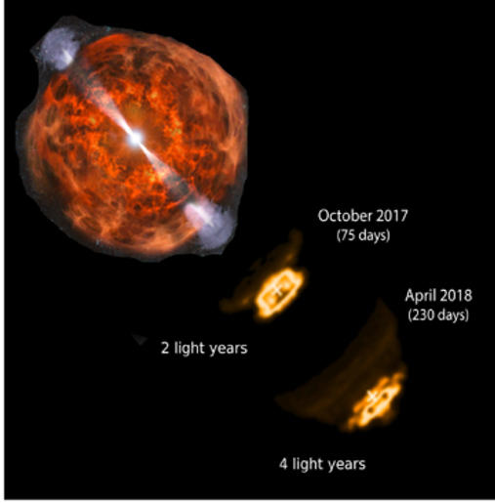
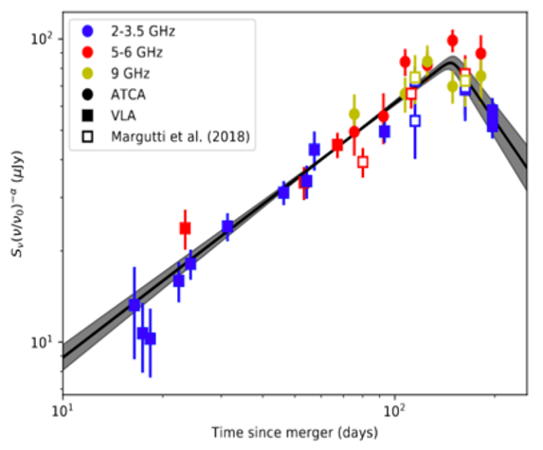
High resolution (mas), broad band radio follow-up was critical to determining the physical model for the source: a smothered, emerging relativistic jet
v = 4c
The radio light curve of GW170817 and VLBA imaging of the emerging relativistic jet from the merging binary black hole system. Right: schematic model for the EM counterpart to GW source: a wide angle jet which is trapped by the explosion debris (Dobie ea. 2018; Mooley ea. 2018).
ngVLA: 10x sensitivity over 1 GHz to 115 GHz, down to 80 uas resolution

Slide 8
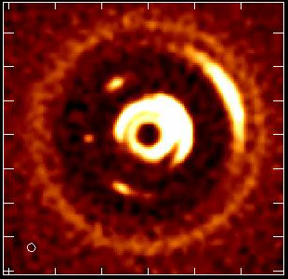
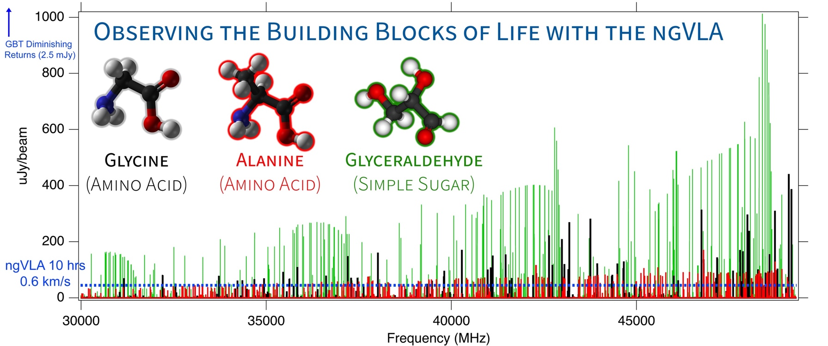
KSG1,2 Development of Life in Cosmic: imaging formation of Solar-system Analogs and the Chemistry for Life
Movies of planet formation to sub-AU scales, 5-10 Earth masses
Detect complex pre-biotic molecules and determine the chemical initial conditions in forming solar systems and individual planets
5AU
B. McGuire
1M_{o} proto-star w. 0.1M_{o} PP disk w. forming Jupiter: Monthly obs. over few years at 100 GHz, 7mas resolution (1 AU at 140pc; L. Ricci)
Notes:
HD 163296
ALMA observation of HD163296 at 1mm along with a simulated 1 cm ngVLA observations (Ricci et al. 2019) of the innermost 24 au region at 1 au resolution for Jupiter-, Saturn-, and Neptune-like planets.
The distribution of exoplanets and young planets embedded in circumstellar disks: Then ngVLA will discover many hundreds of planets with orbital periods <10 yr.
The ngVLA will measure the orbital motion of planets and related features on monthly timescales:
Simulated 100 GHz ngVLA observations of a newborn planetary system comprising a Jupiter analogue orbiting at 5 AU from a Solar type star.

Slide 9
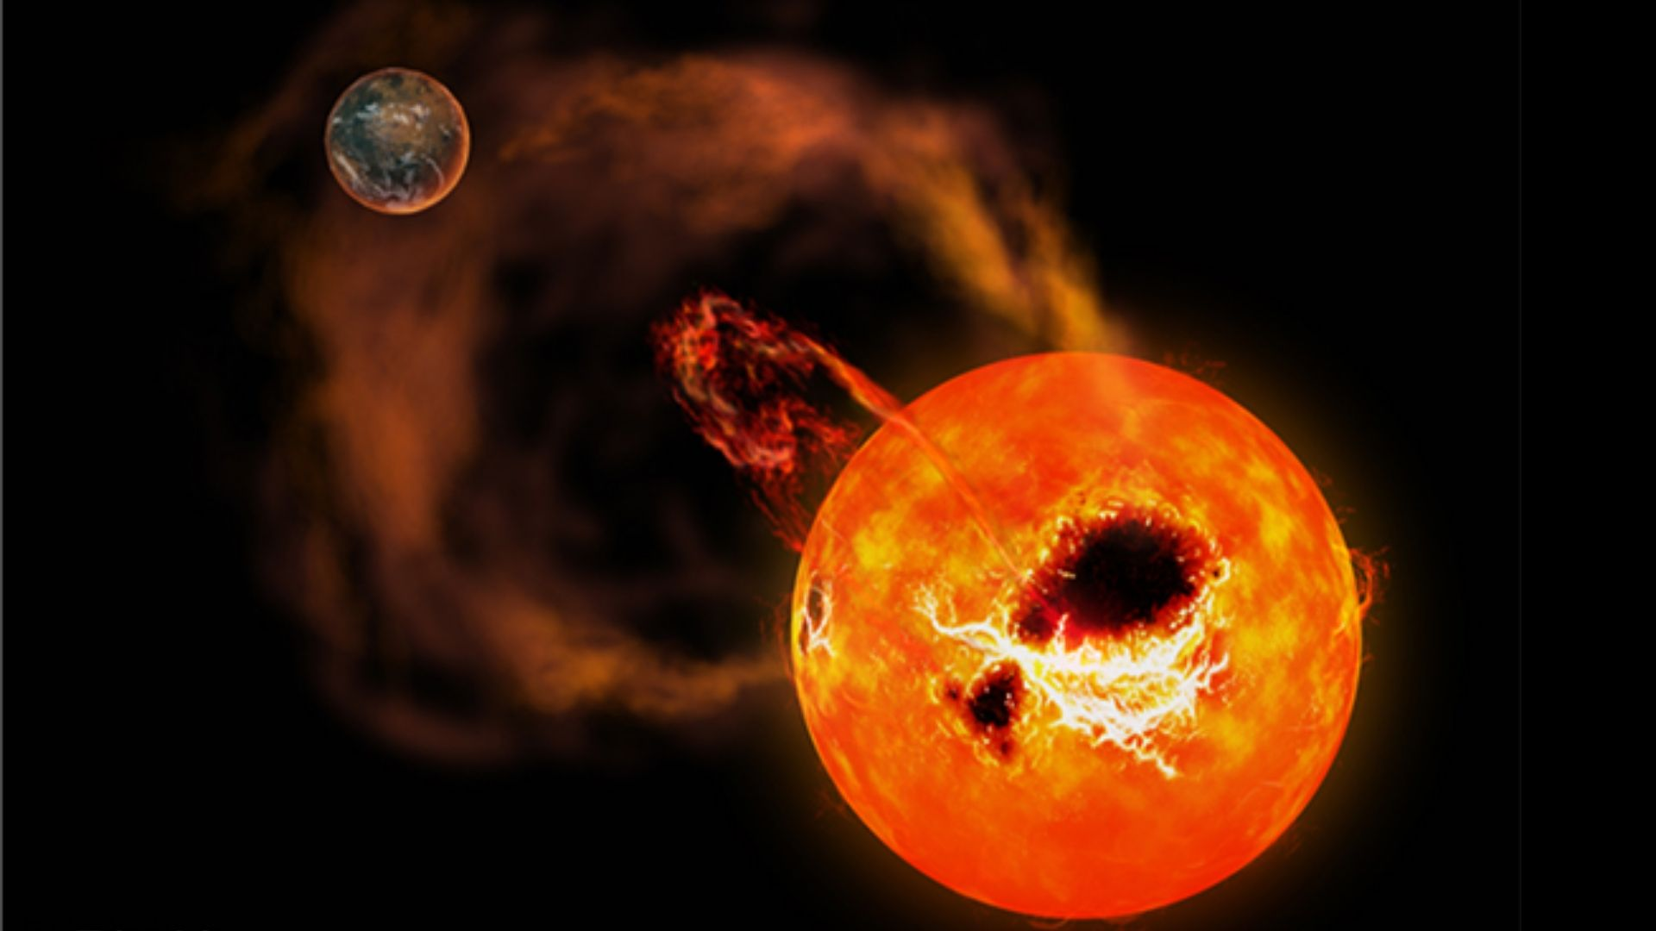
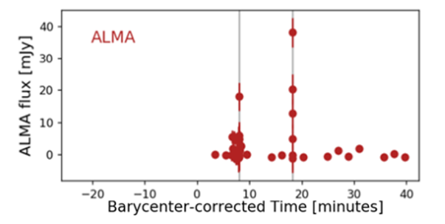
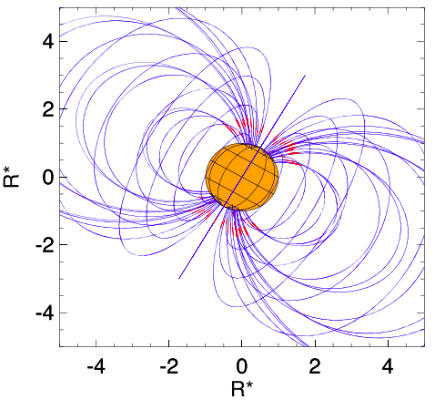
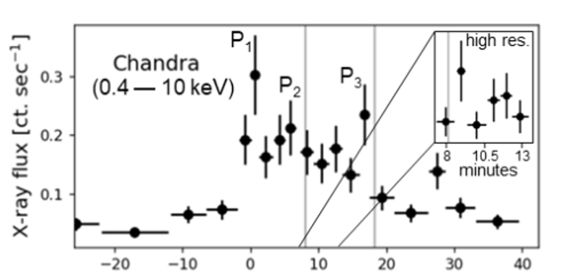
DSA2000: Extreme Exospace Weather and Life
M-dwarfs most likely stars to host habitable planets. But, M-dwarfs known to be very active, w. strong mag. fields:
  Strong flares: radio gyro-synchrotron emission => highly enhanced relativistic electron pressure wrt thermal coronal gas
  Exo-aurora (10⁶ x Earth’s): cyclotron maser emission w. B ~ 2000 G
Star-planet magnetospheric interactions => deleterious effect on life: key term in Drake equation
DSA2000 expects to detect
10⁶ flare stars events
10⁵ stars in non-thermal coronal emission
10³ stars in thermal coronal emission
Howard et al. 2022
Left: Radio, X-ray flare on Prox. Centauri (Howard ea. 2022). X-ray flare power comparable to Sun, but radio 100x Solar, timescales secs.
Right: B field geometry giving rise to auroral radio emission from UV Ceti (Bastian ea. 2022)

Slide 10
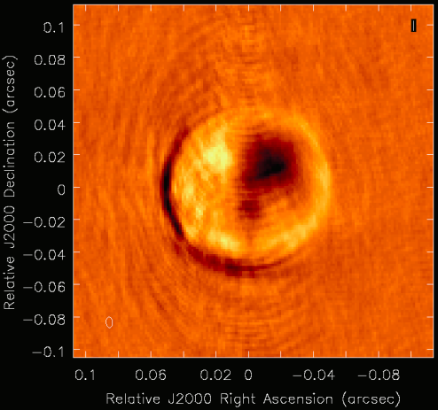
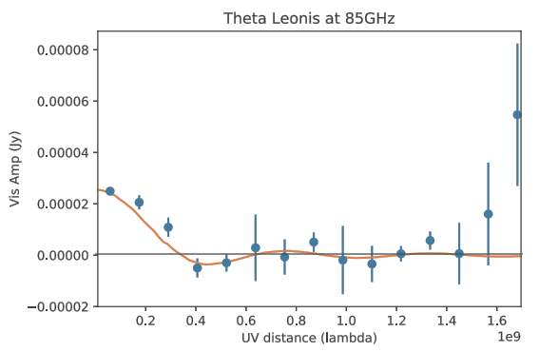
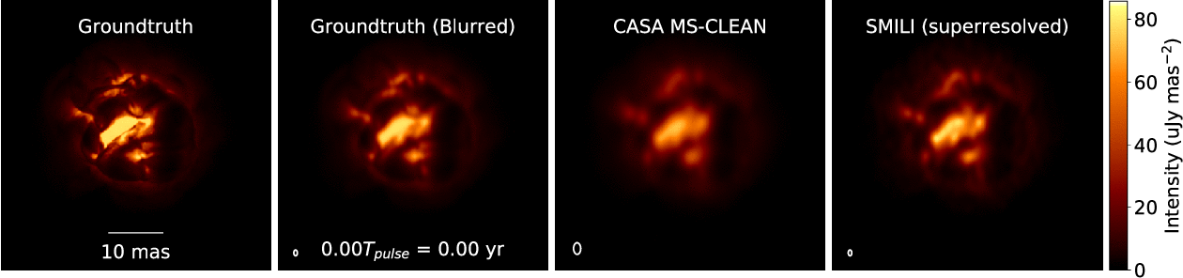
Stellar Radio Photospheres
𝛼 Orionis M1 1A, 38 GHz
A2 V @ 50pc, 85 GHz Carilli
ngVLA: can resolve and determine R, T_{B} for > 10000 stars, incl. 500 MS stars of all spectral types: Radio ‘HR diagram’ at 85 GHz
Movies of extreme mass-loss in evolved stars
40mas
0.5mas
ngVLA imaging of ‘boiling’ AGB stars atmosphere (Akiyama & Mathews 2021)
  ngVLA @ 46 GHz; 1.5 mas ~ 0.04 stellar radii at d=150pc
  1.3 year pulse period observed every 2-3 weeks
Dominates late time mass loss in evolved stars
Notes:
Simulated movies of the gas motions in the radio photosphere of an asymptotic
giant branch (AGB) star as observed with the ngVLA Main Array at 46 GHz. The
angular resolution is ~1.5 mas, corresponding to roughly 0.04 stellar radii.
Each movie covers a single 1.3-year pulsation period for a model AGB star,
assuming observations every 2-3 weeks. The adopted distance was 150 pc.
AGB star atmospheres are highly dynamic owing to a combination of radial
pulsations, shocks, and large-scale convective processes. These stars also shed
large amounts of matter through cool, dense winds. Radio waves are emitted from
a portion of their atmospheres that lie at a radius of roughly twice the
visible photosphere, and just interior to the wind launch region.
The adopted brightness distribution for the radio photosphere model (the
"ground truth model" shown in the left hand frame) was based on a 3D
hydrodynamic model of an AGB star atmosphere from Freytag et al. (2017). The
Freytag et al. model is not specific to millimeter wavelengths, but was adapted
here for illustrative purposes. The second frame shows the ground truth model
blurred with a Gaussian kernel.
The two frames on the right show image reconstructions of the model based
on simulated ngVLA Main Array observations. The integration time was 2
hours per frame and the assumed bandwidth was 10 GHz in dual
polarizations. The second frame from the right shows a multi-scale CLEAN
reconstruction, while the frame on the right shows the result of a
regularized maximum likelihood reconstruction using the SMILI package of
Akiyama et al. (2019). While both methods do well at reproducing many of
the key features of the model, the SMILI version achieves superior angular
resolution.
These results underscore that the exquisite sensitivity and resolution of the
ngVLA will enable studies of the physical properties and kinematics of the
atmospheres of evolved stars in unprecedented detail.
Credit: K. Akiyama and L. D. Matthews, based on models adapted from B.
Freytag.

Slide 11
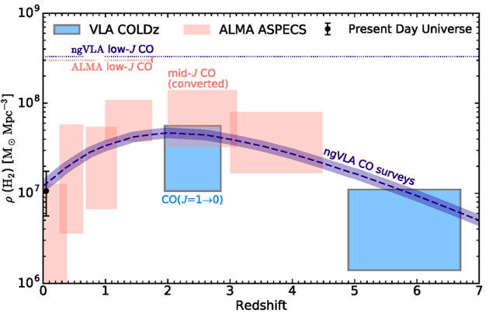
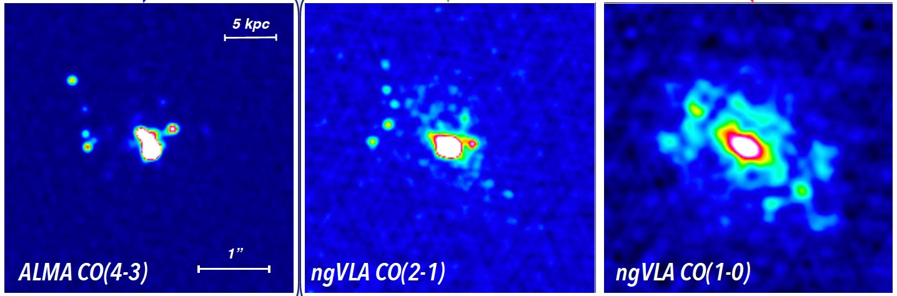
KSG3: Molecular gas – Fuel for Star Formation over 13 Gyr
The ngVLA will routinely detect molecular gas in “normal” galaxies at z=6 via low-J CO transitions
The ngVLA will provide >10x improvement in our knowledge of the cold molecular gas = fuel for star formation, back to cosmic reionization
𝜃 ≈ 0.3”
𝜃 ≈ 0.3”
𝜃 ≈ 0.5”
Casey
ngVLA observations of SMG at z = 4.4; SFR ≈ 400 M⨀ /yr
Total molecular gas content largely missed by high-J lines
Notes:
50 Mpc box cosmological hydrodynamic simulation of galaxy evolution

Slide 12
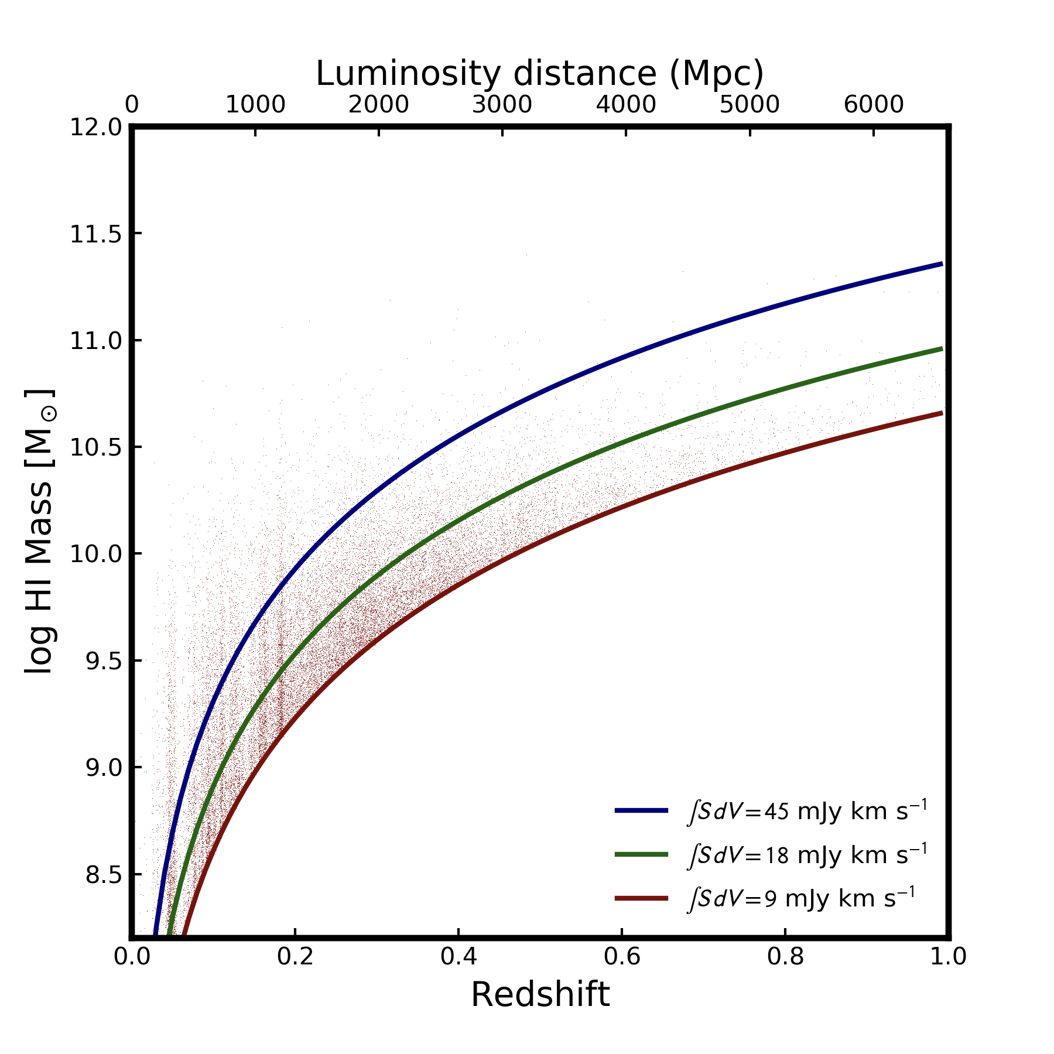
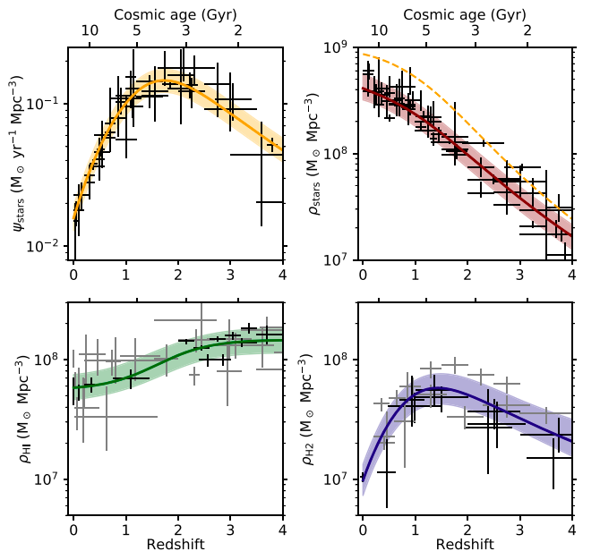
DSA2000: 𝛒_{HI} over the epoch of ‘Cosmic Demise’
4.5e6 HI detections to z ~ 1
Unresolved HI at high redshift (z ~ 0.2-1) N ~ 6.0e5
Resolved HI at low redshift (z < 0.2) N ~ 3.9e6
Shutting down of late-time accretion and cessation of star formation in the Universe?

Slide 13
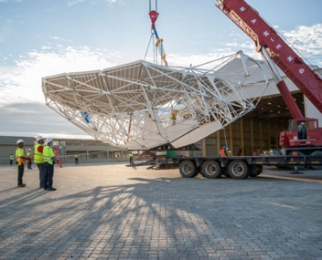
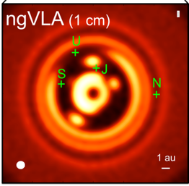
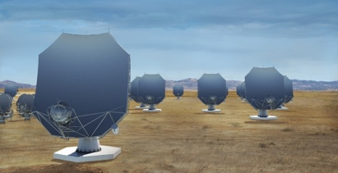
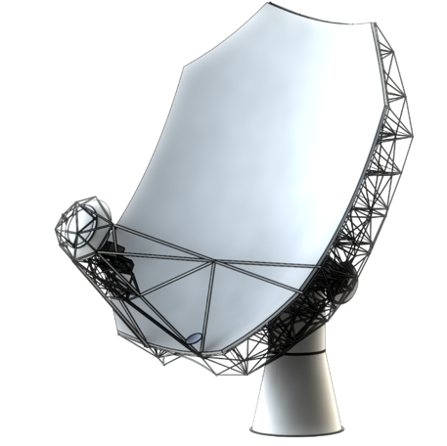
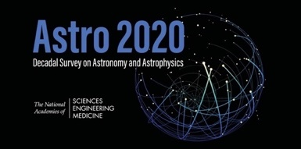
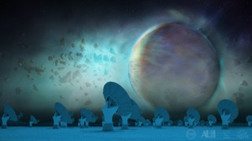
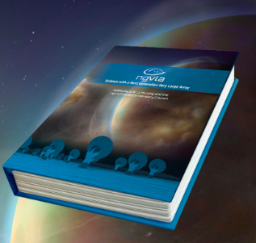
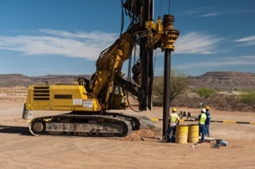
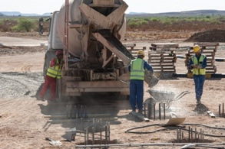
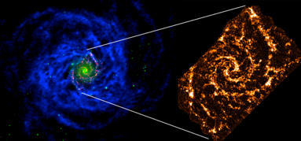
Project Timeline
2018
2019
2021
2023
2026
2029
2035
Astro2020 submission
Prototype antenna at VLA Site
Construction
Early Science Operations
(> VLA capabilities)
Full Science Operations
Science Book
NSF/MREFC FDR
NSF development funds
Astro2020 Report
Construction full cost accounting: $2.3B [FY2018]

Slide 14
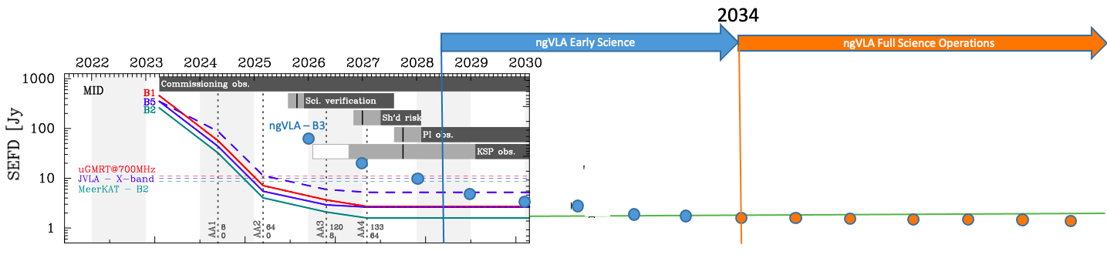
Full Operations
SKAMid
DSA2000
ngVLA
Scaled Sensitivity
?
First few years of DSA2000 operation: follow-up will still rely on VLA, VLBA, SKA, ALMA…
After 2028: ngVLA early science capabilities (>= VLA)
After 2034: ngVLA full science capabilities (10x VLA…)

Slide 15
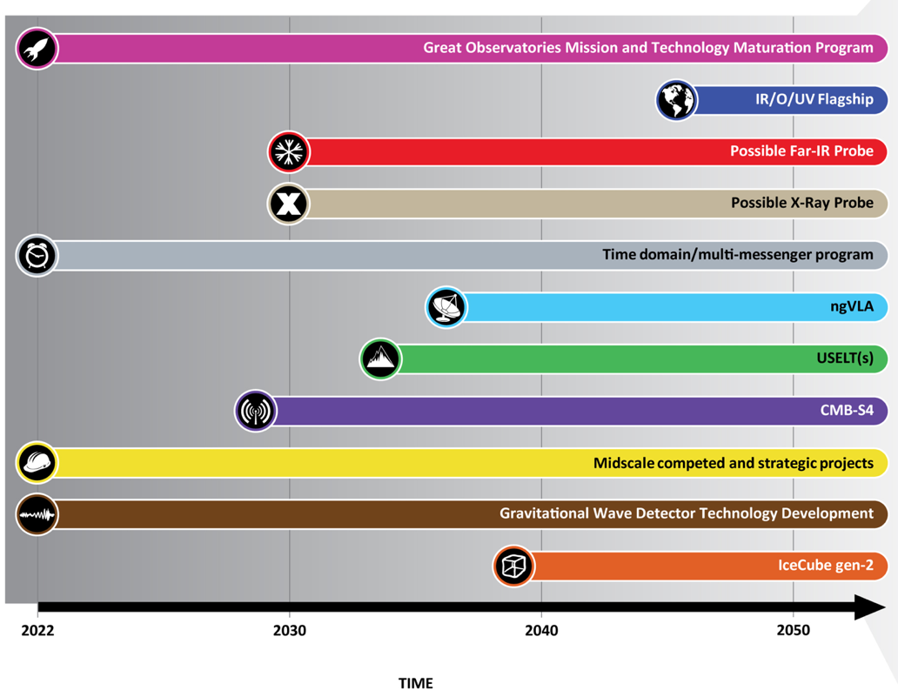
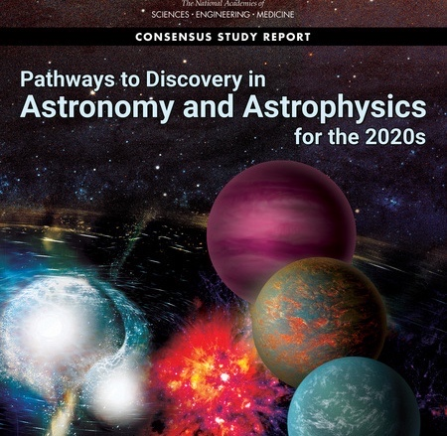
Astro2020
ngVLA: high-priority large, ground-based facility; construction start this decade
DSA2000: high priority ‘midscale++’ for time domain/multi-messenger
DSA2000
Notes:
ngVLA essentially checked off every box of Astro2020 scientific priorities.

Slide 17
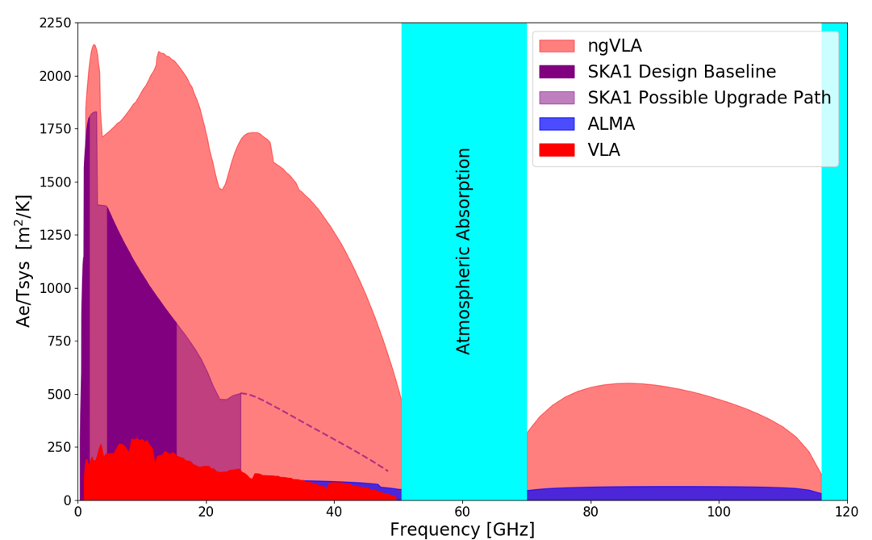
DSA2000
Notes:
Snapshot comparison of effective collecting area for dish-arrays expected in the 2030’s.

Slide 18
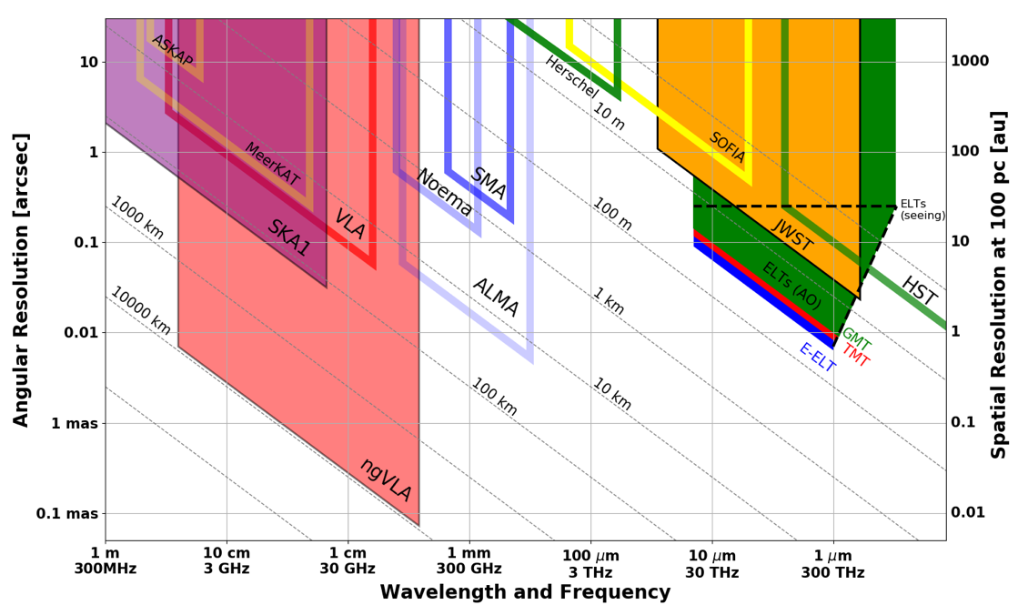
DSA2000
Terrestrial zone planet formation @ 140pc
Notes:
Snapshot comparison of effective collecting area for dish-arrays expected in the 2030’s.

