Slide 1
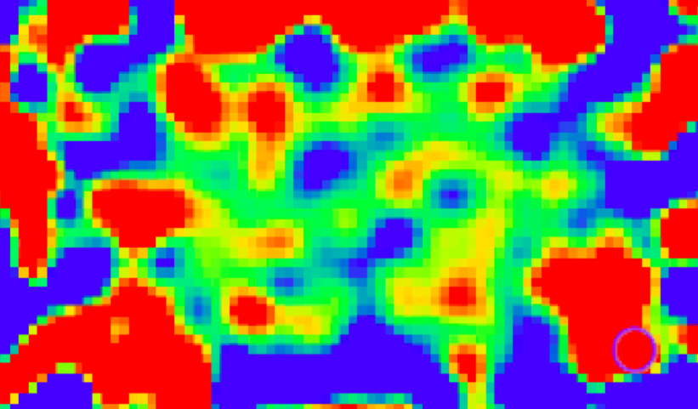
HI 21cm cosmology at z < 6: intensity mapping
Chris Carilli (NRAO), September 2016
General landscape and issues
HI 21cm cosmology via IM: SKA-1 examples
(Continuum surveys: weak lensing)
CO and [CII] IM: push to higher z and ngVLA
KIPAC March 2016: https://imworkshop.github.io/#schedule
Science w. SKA: http://pos.sissa.it/cgi-bin/reader/conf.cgi?confid=215
Thanks: Mario Santos (UWC) for material

Slide 2
Major radio cm arrays: existing and conceived
Telescope | Frequency GHz | Z_{max} | Collecting Area x 10³ m² | Field of view Deg @1.4GHz | Resolution arcsec @ 1.4 GHz | IM
JVLA | (0.07) 1.0 to 50 | 0.4 | 17 | 0.5 | 1 | No
MeerKAT | 0.6 to 8 | 1.4 | 12.5 | 1.0 | 7 | Yes?
ASKAP | 0.7 to 1.8 | 1.0 | 5.2 | 1.0 x 36 | 9 | No
GMRT | 0.05 to 1.4 | 10 | 61 | 0.3 | 2 | No
WSRT/Apertif | 1.0 to 1.7 | 0.4 | 9 | 0.5 x 25 | 5 | No
SKA1-Mid | 0.35 to 14 | 3.0 | 40 | 1.0 | 0.5 | Yes
[SKA2] | 0.35 to 24? | 3.0 | 400 | 1.0 | 0.5? | Maybe
[NextGen. VLA] | 1.0 to 115 | 0.4 | 100 | 0.7 | 0.2 | Maybe
Ops or Construction
Design
Concept

Slide 3


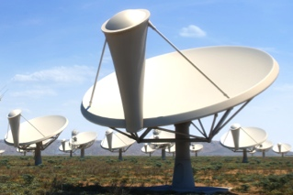
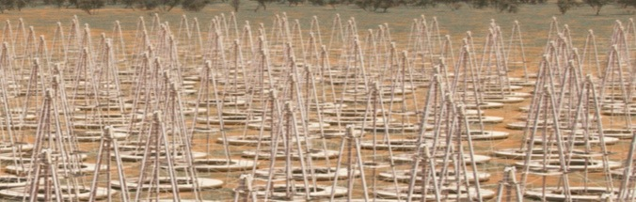



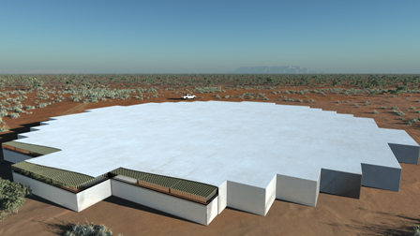
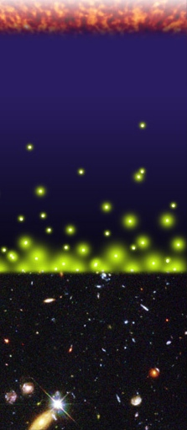
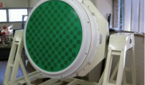
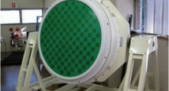
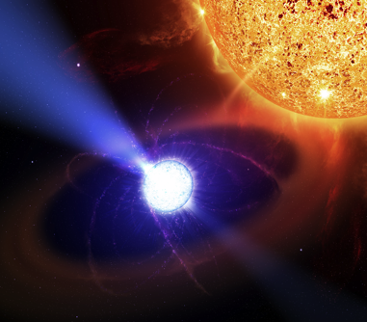
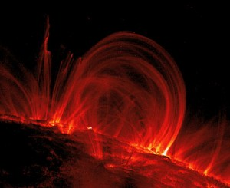
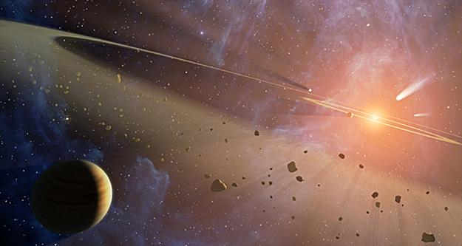
Overview of the ‘rebaselined’ SKA (2015)
Mid ~ 0.04 SKA
Full ops 2023+
Phase I
~130,000 element
Low Frequency Aperture Array
~200 dishes
South Africa
Mid Frequency Aperture Array / Phased Array Feeds
Phase II
Mid ~ 0.5 SKA
Construction 2024+?
~1,000,000 element
Low Frequency Aperture Array
Australia
~2500 dishes
Cosmic Dawn & Reionization
Cosmology &
Galaxy Evolution
Pulsars
Cosmic Magnetism
Cradle of Life
Science
< < < < < < < < < < < < < < < < < < Exploration of the Unknown > > > > > > > > > > > > > > > > > >
50 MHz 100 MHz 1 GHz 10 GHz
Notes:
Broad brush overview of the SKA1 telescopes, main points:
Post RBS the SKA consists of two telescopes, whereby the mid to high-nu component is composed of an array of 133x15m SKA1 dishes plus the 64x13.5m MEERKAT dishes
SKA1-LOW, comprised of ~130 000 log periodic antennas operating between 50 and 350 MHz is the array that will be used to study the EoR/CD and the instrument that I will focus on today

Slide 4
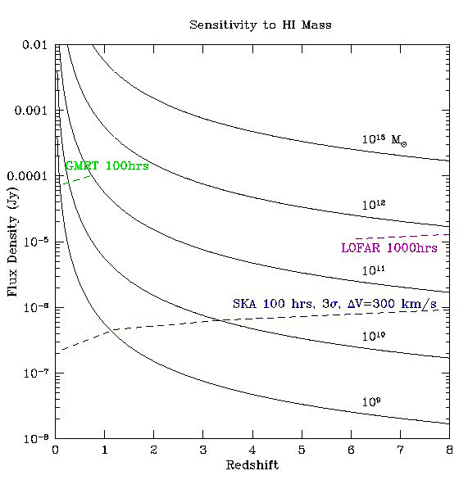
Detection of individual galaxies in HI
Current large arrays: z < 0.5
SKA1: push to z ~ 1
SKA2: push to z ~ 2
1sigma, 100hs, 300 km/s
JVLA
SKA1-Mid
+
SKA2?
MW at z=1

Slide 5
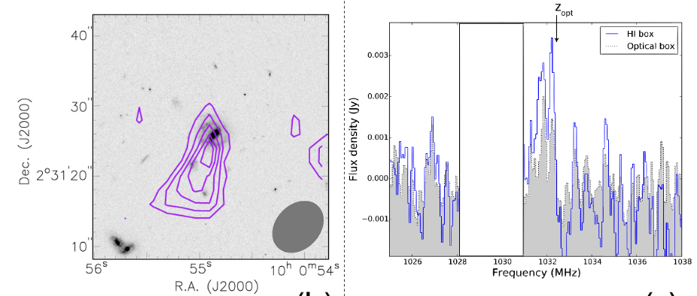
Most Distant HI galaxy image to date
CHILES JVLA Survey: 200hrs, z=0 to 0.4, 0.25 deg² in Cosmos
Galaxy at z=0.38; M(HI) = 3e10 M_{o} = 10x MW
Fernandez ea. 2016

Slide 6
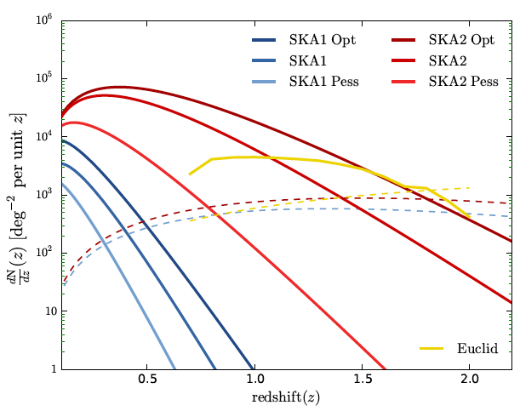
Long term goal: Billion galaxy survey in HI 21cm (Rawlings ea 2005)
DETF ‘stage IV’ experiment
Requires full SKA2+
Galaxy surveys w. SKA ~ 2 year integration
SKA1 ~ 10⁷ galaxies over 5,000 deg²
5e6 for band 2 (z < 0.5)
8e4 for band 1 (0.4 < z < 1; ‘handful’ z > 1)
SKA2+ ~ 10⁹ galaxies over 30,000 deg²
‘Full Sky’ = very large scale structure
Substantial population to z ~ 2
Cosmic variance limited
SKA 2+
SKA 1
Santos et al., http://arxiv.org/abs/1501.03990

Slide 7
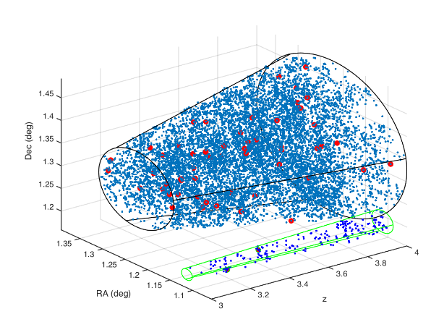
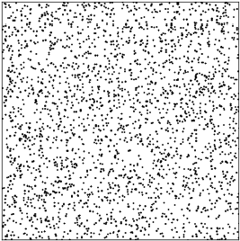
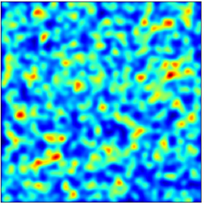
Intensity mapping: very large scale structure in 3D
Look at the total intensity for a given emission line in a large 3d voxel (angle and frequency) super-Mpc scales
Signal = sum over many galaxies: “voxel” = (1 deg)²x(5 MHz) ~ 10⁵ Mpc³, contains ~ 10⁴ galaxies at z~1!
galaxies
Intensity map
𝞶 = z

Slide 8
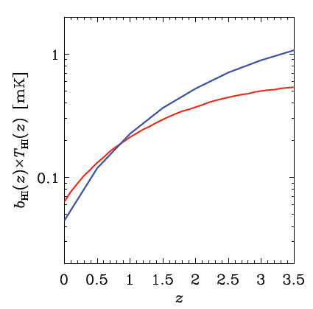
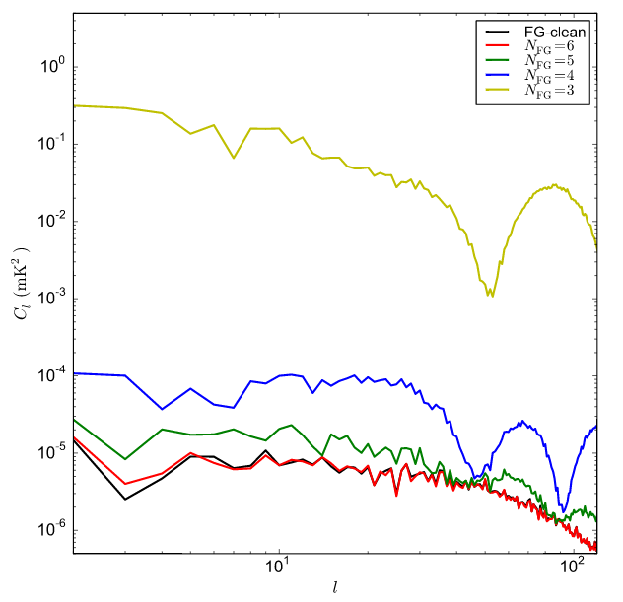
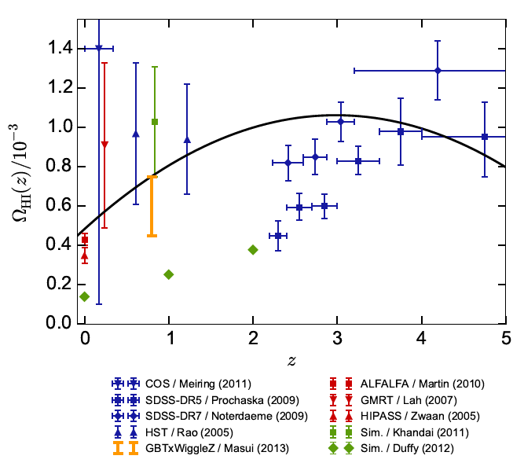
The HI signal
Use Halo mass function plus bias function for M_{HI}(M_{halo},z) to calculate the HI density: <T_{B}> ~ 0.2mK
Sky brightness at 800MHz ~ 6K (synch + CMB) => Cont/Line ~ 3e4 (10x easier than EoR)
Switzer et al. 2013
Santos et al. 1501.03989
Bull et al. 1405.1452

Slide 9
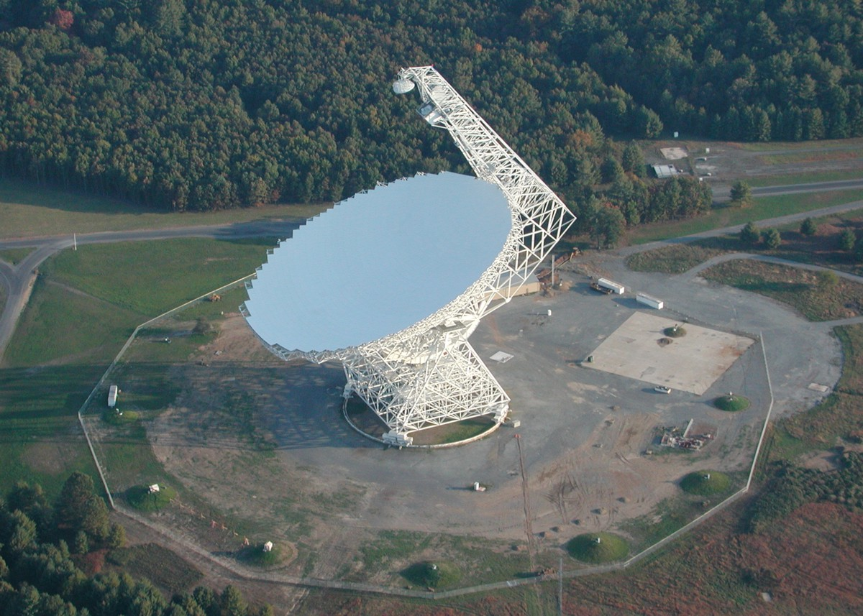
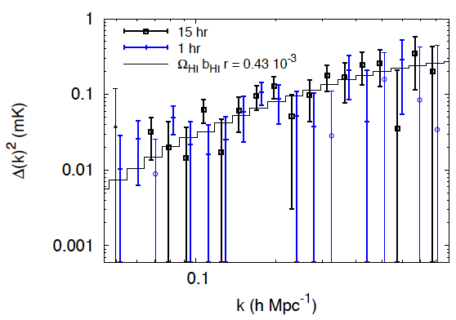
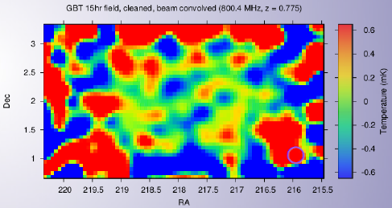
GBT HI IM detection
HI map at z~0.8 (800MHz) over few degrees, 15’ res
PS detection at k ~ 0.2 h/Mpc via cross-correlation with Wigglez
Masui, et al., ApJ 2012, Chang et al., Nature 2010

Slide 10
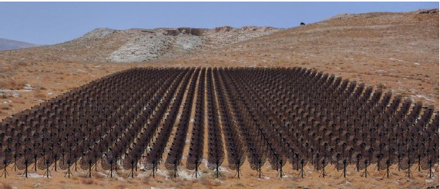
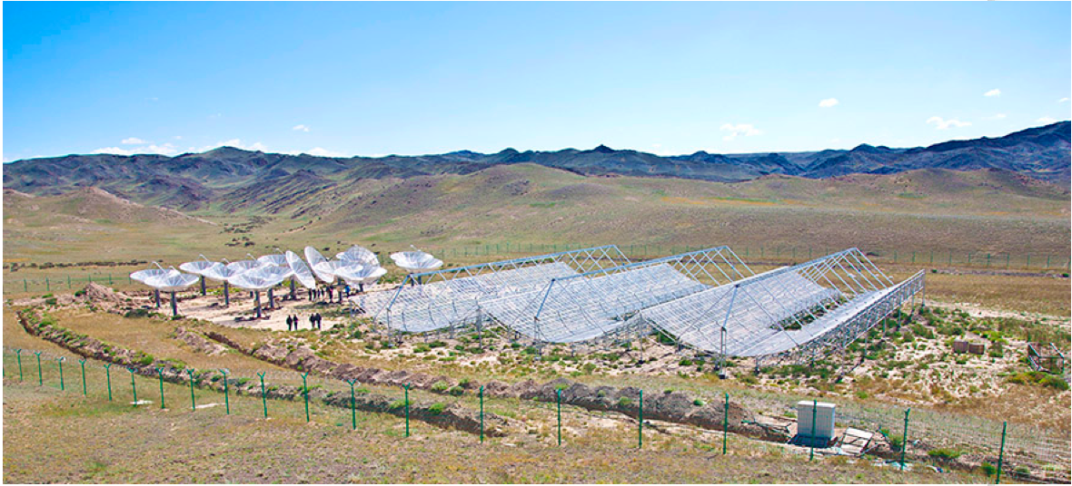
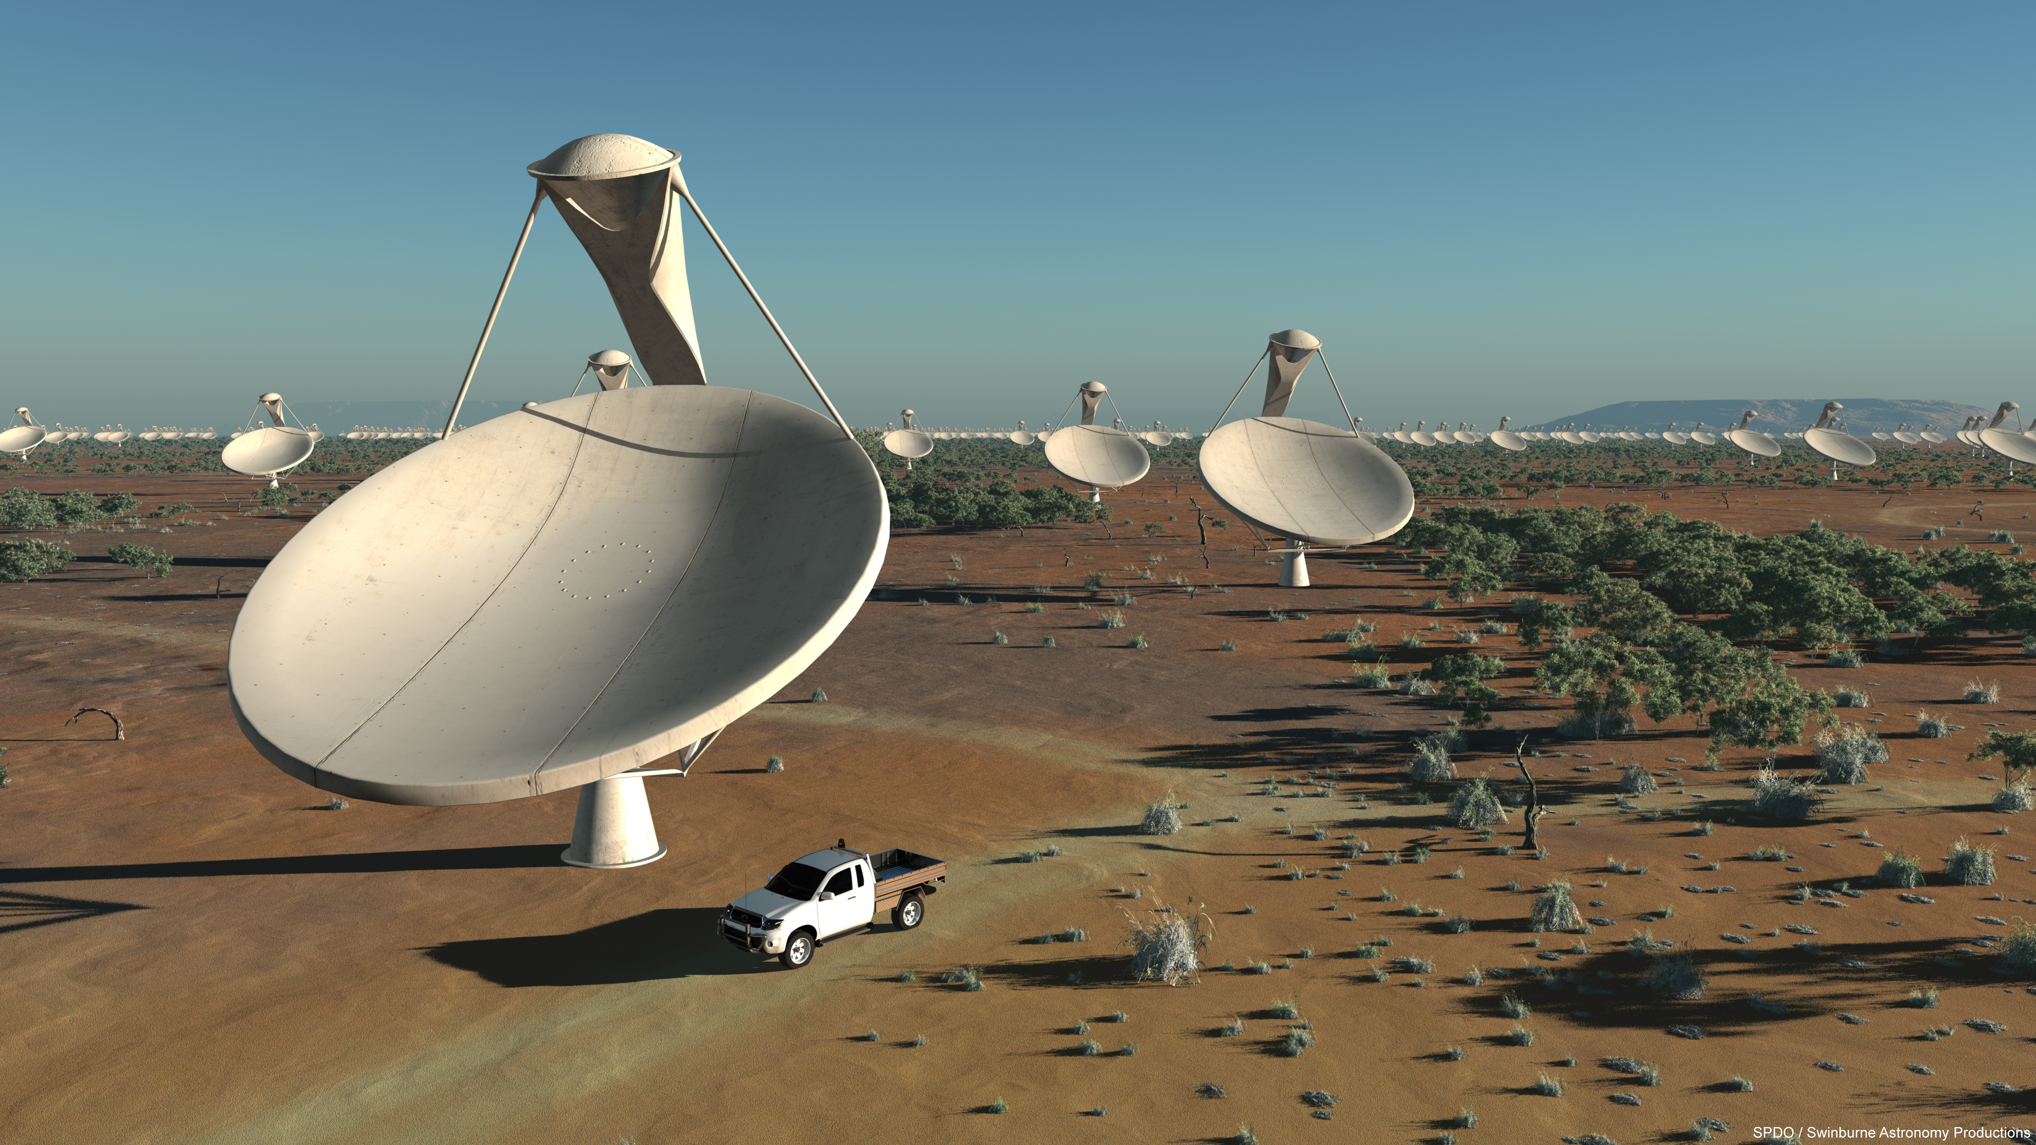
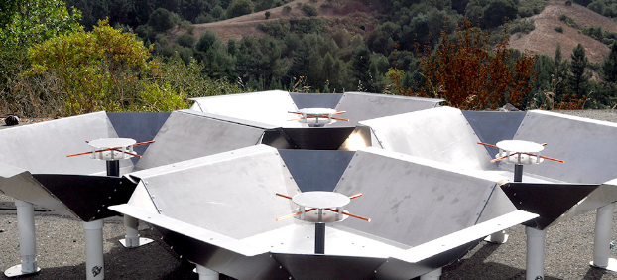
HI IM Experiments: existing and planned
HIRAX (South Africa): 1000x 5m dishes, 400 – 800 MHz (0.8 < z < 2.5)
CHIME (Canada)+ Tianlai (China): 4 cyl. (72x40m), 400 -800 MHz, 13’
BAOBAB (USA): HERA-like dipole grid array w. delay spectrum analysis, 400 – 800 MHz, 49 x 1.5m, FoV = 0.15sr
Single Dish with multibeam arrays: GBT, FAST
SKA1-Mid: 200x 14m antennas, 350 to 1420MHz, z < 3, FoV = 1deg at 1.4GHz – IM Accepted Design Change proposal 2015 (doesn’t come for free!)

Slide 11
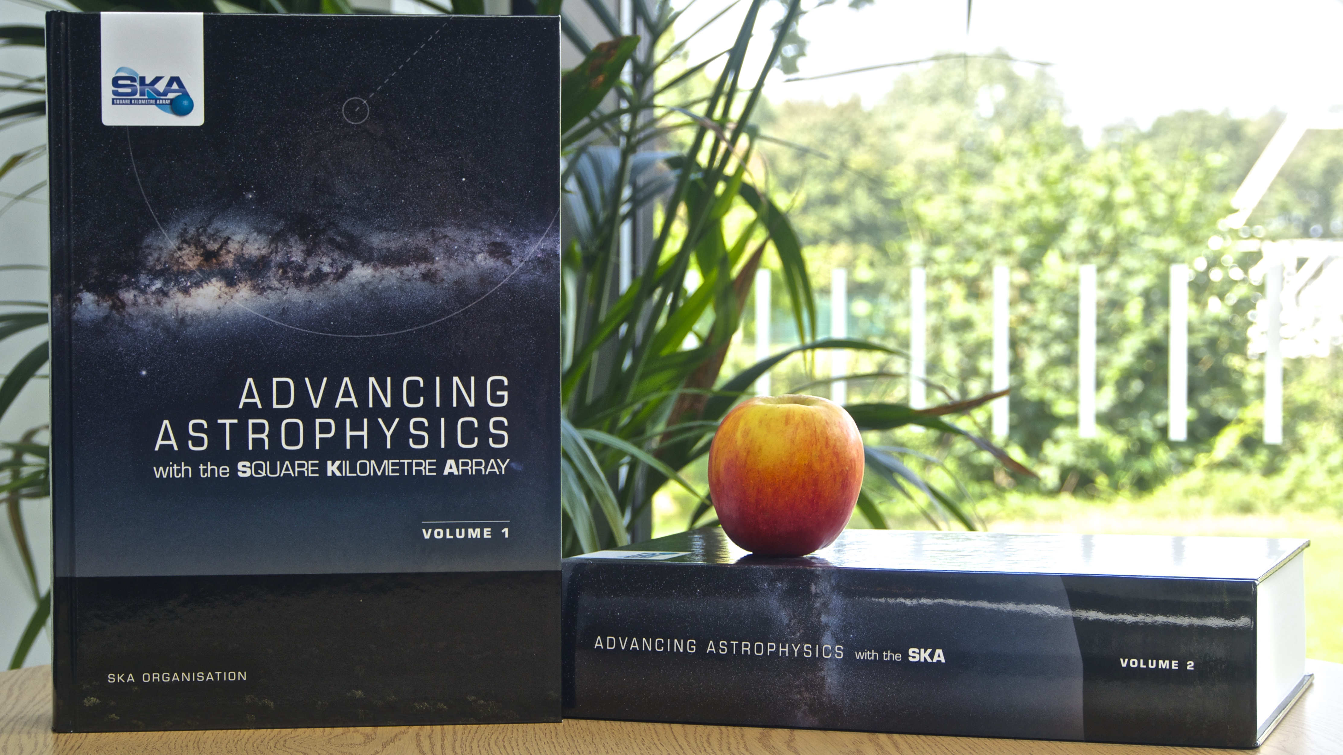
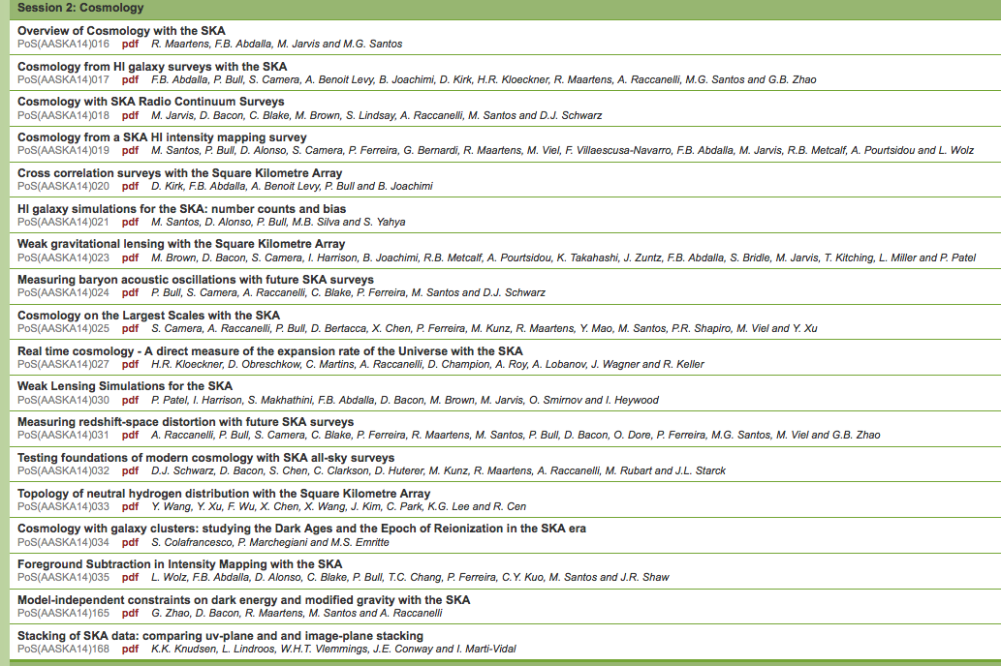
SKA2015
Caution: always check for SKA-1 vs SKA-2!

Slide 12
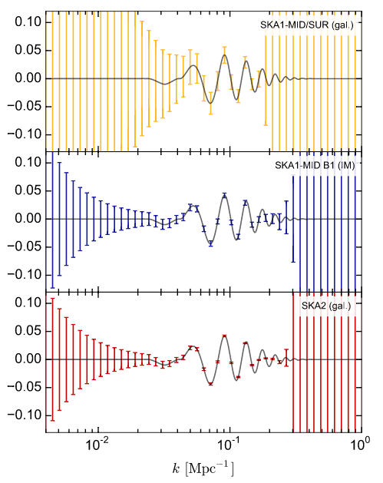
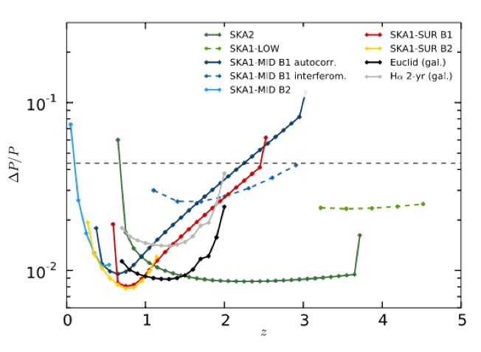
SKA BAO measurements
SKA wide field surveys: 10,000 hours observation, 25,000 deg²
BAO ‘wiggles’ errors averaged over z ~ 0.5 to 3
k = 0.074 h/Mpc
BAO level
SKA1-IM
Euclid-gal
f_{BAO}(k) = P(k)/P_{ref}(k) - 1
SKA2-gal
Power spectrum Noise/Signal from SKA surveys on BAO scales as a function of redshift.
Bull ea. 2015

Slide 13
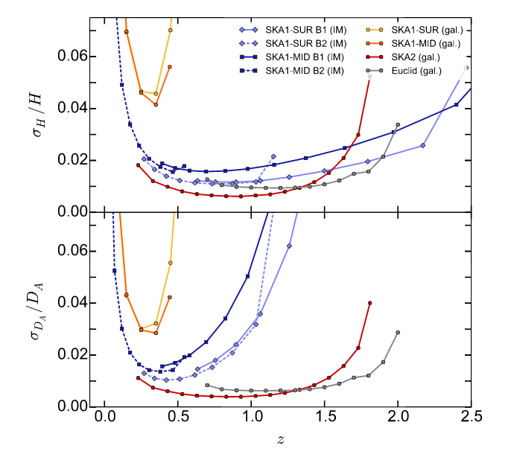
Basic parameter estimation
Top: BAO-only fractional N/S on the expansion rate
Bottom: N/S for angular diameter distance
SKA1,2 IM: important coverage of z<0.7
SKA2-gal: competitive with Euclid-like at z=0.7 to 2
SKA1-Gal
SKA1-IM
Euclid
Bull ea. 2015

Slide 14
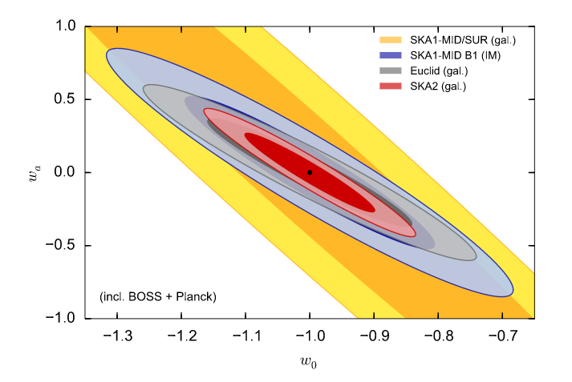
Dark energy EoS
Forecast constraints on dynamical dark energy parameters, w(z) = w_{o} + (z/(1+z))w_{a}, for SKA and Euclid, in combination with Planck and BOSS.

Slide 15
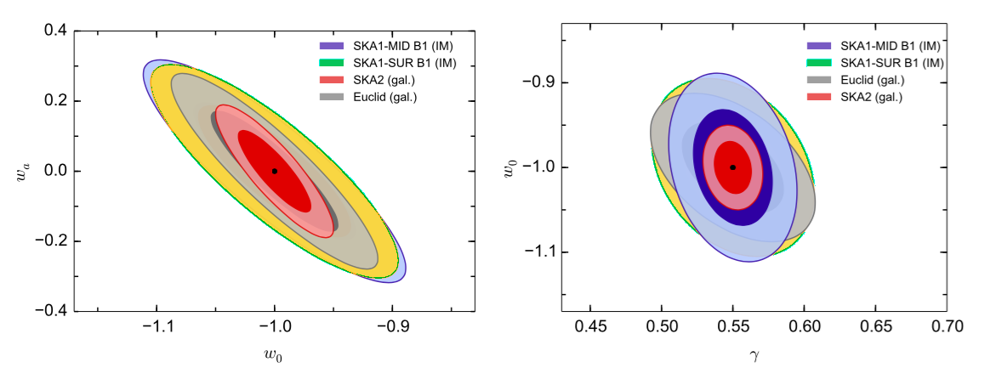
Redshift Space Distortions and DE EoS: complementary constraints based on measurement of velocity field
Left: Constraints from RSD on the dark energy equation of state
Right: on modified gravity (deviations from the GR growth rate; +Planck and BOSS)
Raccanelli et al. 2015

Slide 16
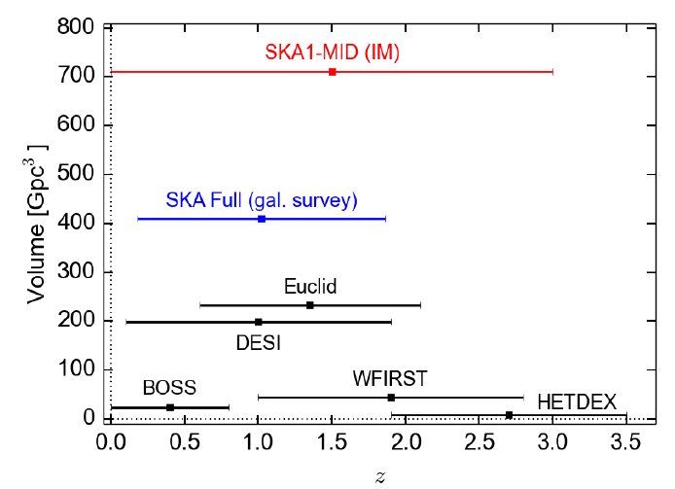
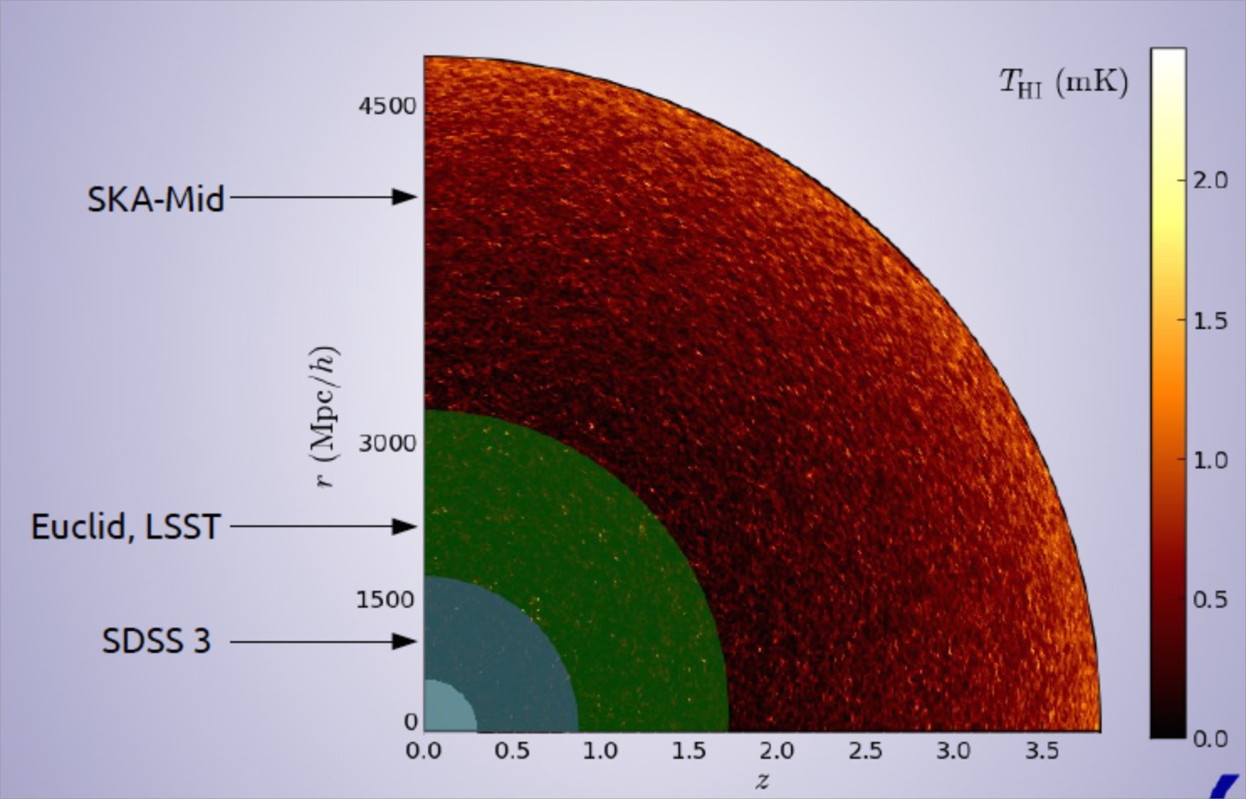
Where does SKA1-Mid Intensity mapping win?
Competitive with large redshift surveys for “precision cosmology” (BAO/RSD/DE…)
Huge available volume → unique new parameter space for tests of physics on very large (‘horizon’) scales
Santos,… 2015
Credit: D. Alonso

Slide 17
Probing very large scales with a SKA1 HI intensity mapping survey
Two year survey covering: 0.5 < z < 3 and 20,000 deg²
Low k cut-off at matter-radiation ‘equality scale’ (horizon at z~3600)
Test cosmological principle on largest scales
Primordial non-Gaussianity: manifest on largest scales?
Test gravity on largest scales
k = 0.01 h/Mpc
Euclid
SKA1 IM
Santos ea 2015
Power spectrum N/S on scales of k = 0.01 h/Mpc

Slide 18
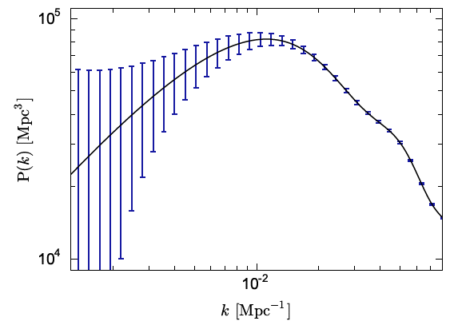
Probing very large scales with a SKA1 HI intensity mapping survey
Bull ea 2015
PS measurements below the matter-radiation equality peak (comoving ’horizon’ at z~3600)
“Game changing” measurements on very large scales: BOSS survey smallest k ~ 0.03 h/Mpc
Boss min k; Anderson ea.

Slide 19
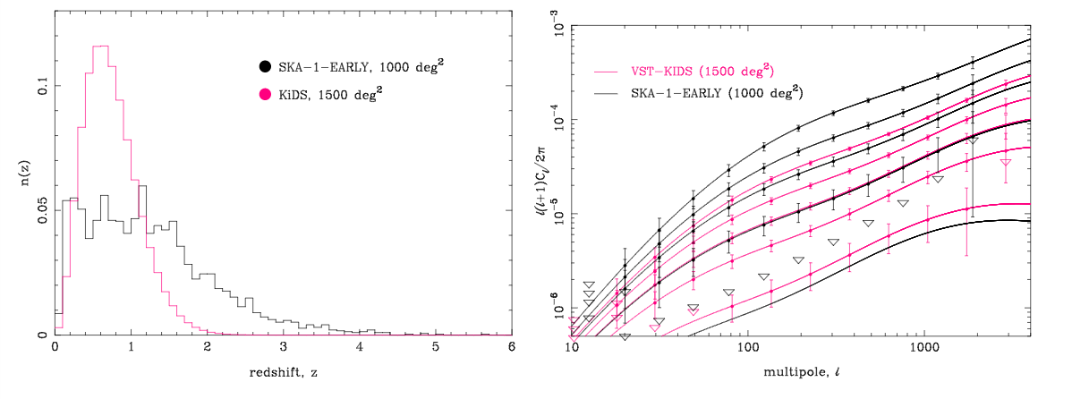
Weak lensing with radio continuum survey
Advantages
Stable and deterministic PSF of an interferometer,
Polarization: unique measure of intrinsic orientation of galaxies (B along major axis)
Higher mean redshift for sources vs. optical
Cross correlation with optical: robust to systematic errors
Disadvantage: Areal density of sources
SKA1 ~ 10 arcmin⁻²
SKA2 ~ 75 arcmin⁻²
z_{bins} = 0.5 to 3
Brown ea 2015
Power spectrum constraints on a 5-bin tomographic shear power spectrum analysis, vs. z

Slide 20
Summary: SKA1 Mid Intensity mapping
IM resurrects HI cosmology on SKA-1 Mid (galaxy surveys very limited in number and z range)
‘precision cosmology’ (BAO scales): Complementary and competitive with optical BAO, RSD, DE missions: check on results, plus cross correlation to remove systematics, ‘calibration’, z coverage
New parameter space: unique view of Very large scale structure, k ~ 0.01 h/Mpc: probe ‘equality’ cutoff, test non-Gaussianity, GR and cosmological principle, on largest scales
Continuum surveys: weak lensing has potential for independent systematics and diagnostics
Billion galaxy survey requires SKA2+ (Bull ea)

Slide 21
High-level SKA Roadmap current
KEY: Blue = SKA1 science & engineering; orange = policy; green = SKA2
Detailed design
Pre-construction Stage 2
SKA1Mid: 200x14m, 0.35 to 14GHz
SKA1 Low: 1e6 dipoles, 50 to 250MHz
Critical Design Reviews (elements then system)
SKA1 construction proposal & approval
July 2018 proposal submission; approval Dec 2018
Procurement
SKA1 construction
SKA1 operations
Key Doc Set & Prospectus
IGO agreements negotiated and complete
Formal negotiations
IGO able to centrally contract
Ratification of Agreements
Advanced Instrumentation Prog.
PDR (MFAA and WBSPF)
SKA2 ~ 10x SKA1 + SUR
SKA2 detailed design
SKA2 procurement
SKA2 construction starts
2015
2016
2017
2018
2019
2020
2021
2022
2023
2024
Andrea Casson, Sept 2016

Slide 22
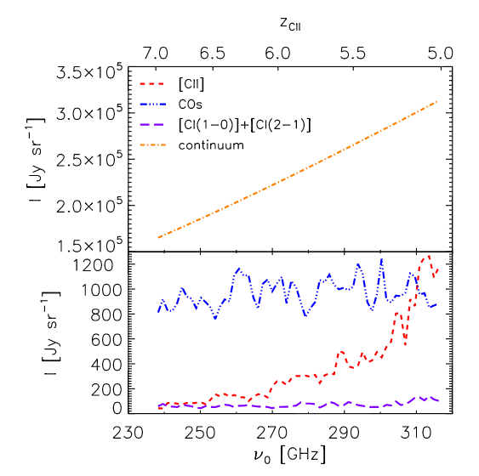
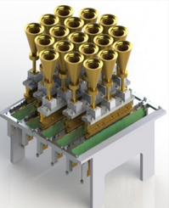
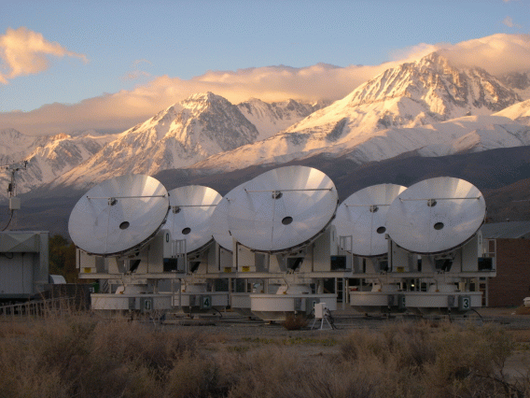
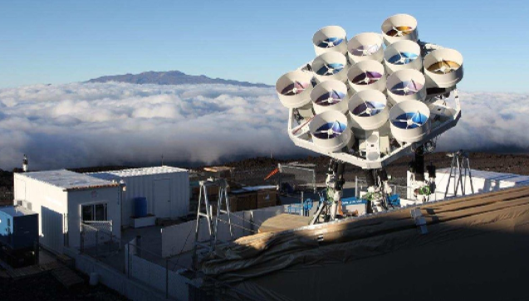
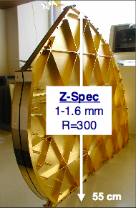
CO and [CII] 158um Intensity Mapping: 30GHz to 300GHz
Pushing to higher redshift (z > 3)
COPSS: Owens Valley S-Z array, 0.7 deg² survey, 27 to 35GHz, CO1-0 z=2.3 to 3.3, CO 2-1 z= 5.5 to 7.5
COMAP: Owens Valley 10m telescope + 19 pixel array, 30 to 34GHz, FoV = 16arcmin² x 19
AIM-CO, Yuan-Tseh Lee Array: 13 x 1.2m co-mounted, 86-102GHz => multiple CO lines over range redshifts, FoV = 13 x 100arcmin²
TIME-PILOT [CII] z > 5: grating IFU (zspec-like), FoV = 13.6’x0.5’, 3Bands in range 135GHz to 323GHz on JCMT or GLT?
Yue ea.
0.4uK

Slide 23
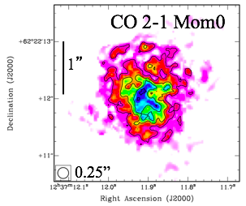
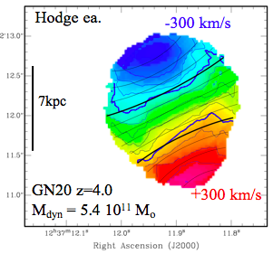
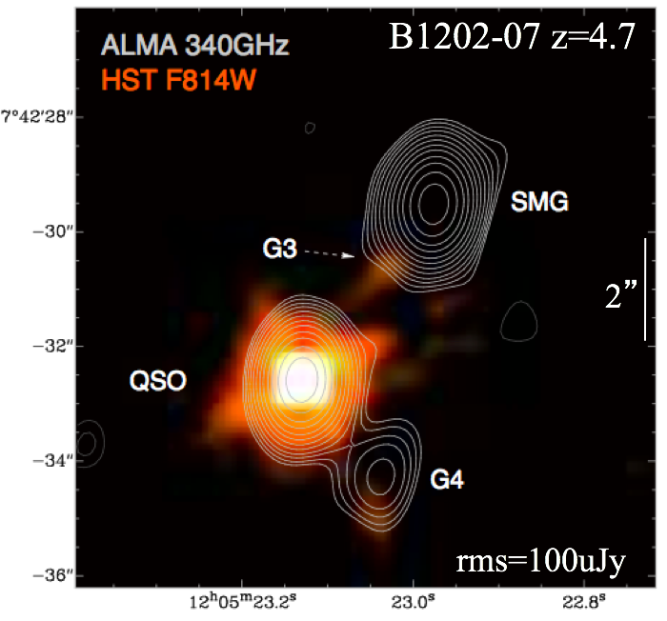
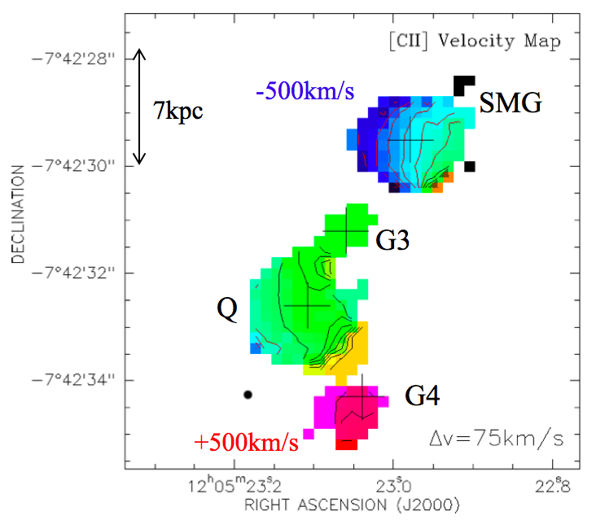
CO, [CII] at high z
Advantage: Easily detect CO, [CII] emission from individual galaxies to highest z w. JVLA, ALMA => ISM, dynamics, Dark Matter
Disadvantage: FoV of eg. ALMA and JVLA are very small ~ 1arcmin (’HST-like’)
Hence, IM is still required to get large area surveys
Current applications still limited in area => focus principally on astrophysics
VLA
ALMA [CII]

Slide 24
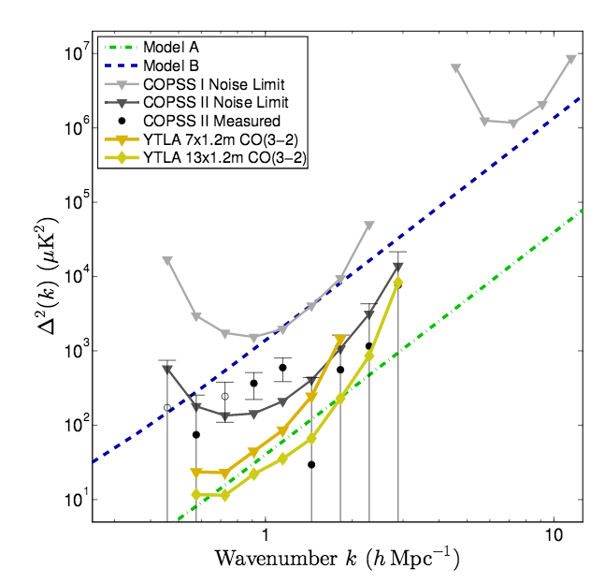
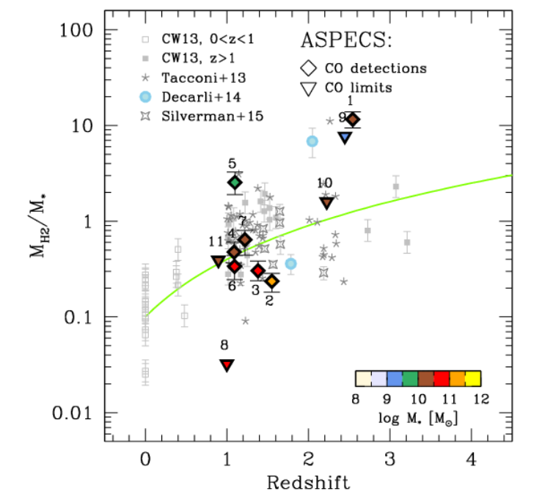
CO intensity mapping: first detection
COPSS II at SZA: fluctuations at 30GHz
Area = 0.7 deg², 3000 hours, 27 - 35 GHz, res ~1’
Most likely dominated by CO 1-0 at z ~ 2.3 to 3.3
variance ~ 400 uK² at k ~ 1 h/Mpc
Keating ea. 2016
Consistent with direct observations of increase of gas baryon fraction (M_{gas}/M*) by order of magnitude back to epoch of peak cosmic star formation

Slide 25
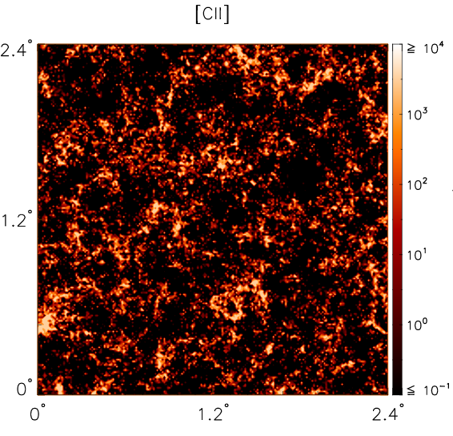
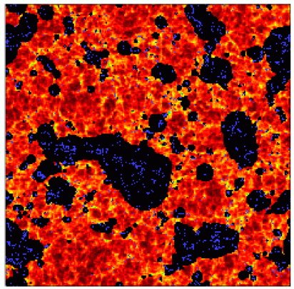
[CII] IM: Large scale structure during cosmic reionization
Inverse view of Universe
HI 21cm
Yue ea. 2015; z ~ 7.5
[CII] trace distribution of galaxies that generate ionized bubbles
HI 21cm shows the distribution of the neutral gas around ionized bubbles

Slide 26

‘Cosmology’ application
Estimating line foregrounds for CMB spectra distortions
Sum ASPECS line detections in 90GHz and 240 GHz bands
Line foreground >> PIXIE sensitivity => need effective removal techniques
Compton y: partial up-scattering of CMB blackbody photons by hot plasma during reionization or in clusters and galaxies at lower z (‘single scattering’)
u-distortion: Dissipation of small-scale fluctuations in the primordial photon-baryon plasma (‘multiple scattering’)
ASPECS
Carilli, Chluba ea

Slide 27


Push to VLSS at high z with CO IM?
Thermal imaging on milliarcsec scales at ~ 1cm
Effective area at 40GHz ~ 10x JVLA, ALMA
Resolution ~ 10x JVLA, ALMA
Frequency range: 1 – 115 GHz
https://science.nrao.edu/futures/ngvla

Slide 28
Getting to Very Large Scales with CO IM
Next Generation VLA intensity mapping at 30GHz
Keating & Bower
Interferometry with ‘core’ = 40% of array (120 ant) inside 0.5km radius
Total power with the core for Very LSS
100 deg², 4GHz BW, 1000hrs
Excellent sensitivity to scales down to k < 0.1 h/Mpc at z ~ 3
Call for Community design studies due Oct 1
https://science.nrao.edu/futures/ngvla/ngvla-community-studies-program-call-for-proposals

Slide 29

VLBI w. ngVLA: uas astrometry (baselines ~ 3000km)
Local group 3D dynamics via proper motions + parallax of masers, weak AGN to 10uas/year
Local group dark matter content
Ultimate fate of Milky Way
Local group proper motions:
10 uas/year = 40 km/s (Darling 2015)

Slide 30

VLBI uas astrometry: Real Time Cosmology (Darling 2013)
Main cosmological observables are functions of time
dz/dt = H_{o}(1+z) – H(z)
dD_{L}/dt / D_{L} = H_{o} + dz/dt (1+z)⁻¹
dD_{A}/dt / D_{A} = H_{o} – dz/dt (1+z)⁻¹
But VERY SMALL
H_{o} ~ 7 x 10⁻¹¹ yr ⁻¹ ~ 15 μas yr ⁻¹
Anisotropy of Hubble expansion, or cosmic rotation, to 0.7% H_{o}
Baryon Acoustic Oscillations at z=0.5
𝜃_{BAO} = 4.5° (l~40)
d𝜃_{BAO}/dt_{o} ~ − H_{o}𝜃_{BAO} ~ –1.2 μas yr ⁻¹
Convergent (E-mode) signal at l ~ 40 showing real-time evolution of the BAO is detectable with ngVLA w. VLBI
Proper motion ‘power spectrum’
ngVLA astrometric grid: 10⁴ AGN each to 10 μas yr ⁻¹
Global detection of correlated signals of 0.1 μas yr⁻¹

Slide 31

Major radio facilities @ 2030, w. IM?
HI IM, z < 2-3
CO IM, z ~3 -- 6
[CII] IM, z > 6
2030
Complementary suite from meter to submm, appropriate for the mid-21st century
< 3mm: ALMA 2030 superb for chemistry, dust, fine structure lines
3cm to 3mm: ngVLA superb for terrestrial planet formation, dense gas history of Universe, baryon cycle
> 3cm: SKA superb for pulsars, reionization, HI surveys

Slide 32



Dark matter in the first galaxies: ALMA imaging gas dynamics using [CII]
Aztec159: flat rotation curve
M_{dyn} ([CII] dyn; R~3.5kpc) = 2.3e11 M_{o}
M* (near IR) = 1.0e11 M_{o}
M_{gas} (CO) = 1.1e10 M_{o}
M_{dust} (submm) = 1.0e9 M_{o}
Karim ea
z=4.6
=> M_{dark} ~ 1.2e11 M_{o} ?
ALMA ~ 25ants, ~1hr, 0.5” res
Near future: decompose spatially resolved dynamical mass (via rotation curve), stellar and gas mass (via near IR and CO imaging) to obtain dark matter content and distribution.
Parallel to historical DM analyses of nearby galaxies in HI, but now at z > 5!

Slide 33

Astrophysics: dense gas history of Universe
Trace molecular gas = fuel driving cosmic star formation
Gas
NGVLA
ASPECS/ALMA
Decarli
Blind surveys beginning to delineate rise and fall of molecular gas cosmic density, commensurate with rise and fall of cosmic star formation rate density.
Baryon fraction (M_{gas}/M*) increases by order of magnitude back to epoch of peak cosmic star formation

Slide 34

CO/[CII] ALMA Spectral Line Survey in the UDF (ASPECS)
3D blind survey of molecular gas throughout Universe: tracing fuel for SF over cosmic time
CO2-1 z=1
CO5-4 z=1.5
[CII]158um z=7
84-115GHz and 212-272MHz, 20hr, 25ant, 1arcmin² in UDF
PI Walter, Co-PIs Decarli, Aravena, Carilli
20 CO lines z=1 to 5; 3 [CII] candidate lines z = 6 to 8
Difficulty: FoV very small (~ arcmin) => still need intensity mapping for LSS

