Slide 1
Configuration
Chris Carilli, NRAO

Slide 2
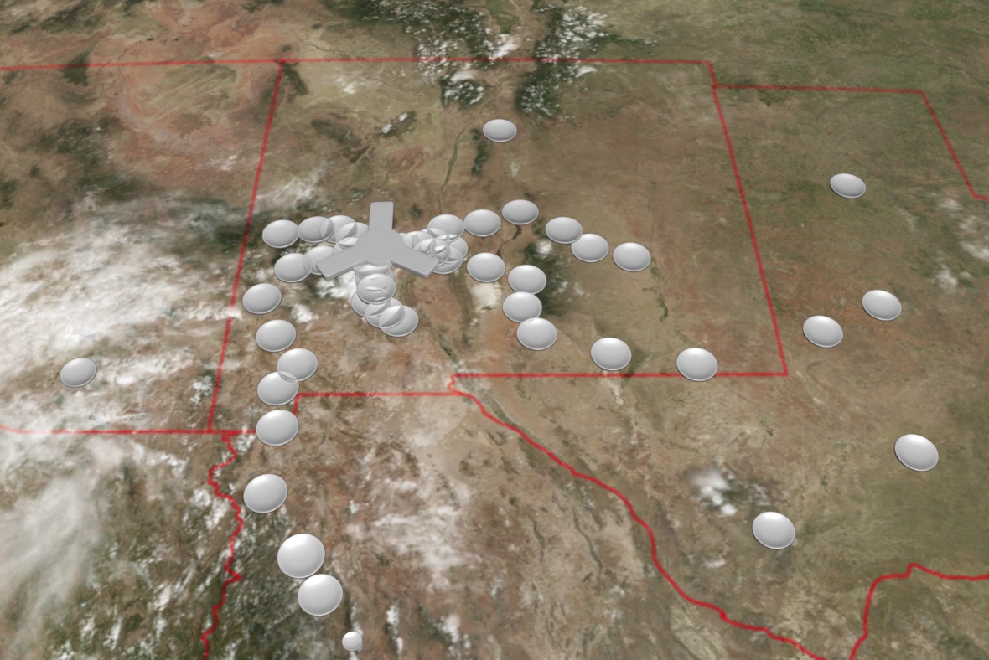
Emerging consensus config: ‘Southwest Array’ (memo 17)
Location: U.S. South West, Mexico
Homogeneous array 214 x 18m, off-axis antennas
50% to core: b < 3km => 1” at 30GHz
80% to mid: b < 30km => 0.1”
100% to long: b < 1000km => 0.003”
550km
Talk
General description
Challenge of tri-scale-array: Sensitivity vs. resolution vs. ‘imaging fidelity’
Options
Reconfiguration: not at loss of 18m antennas
Long baselines: TX to VLBA?
Short baselines: [45m dish + FPA] or [6m array + 18m total power]?
350 miles

Slide 3
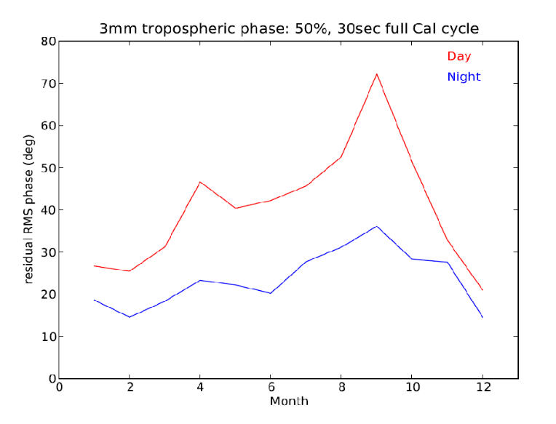
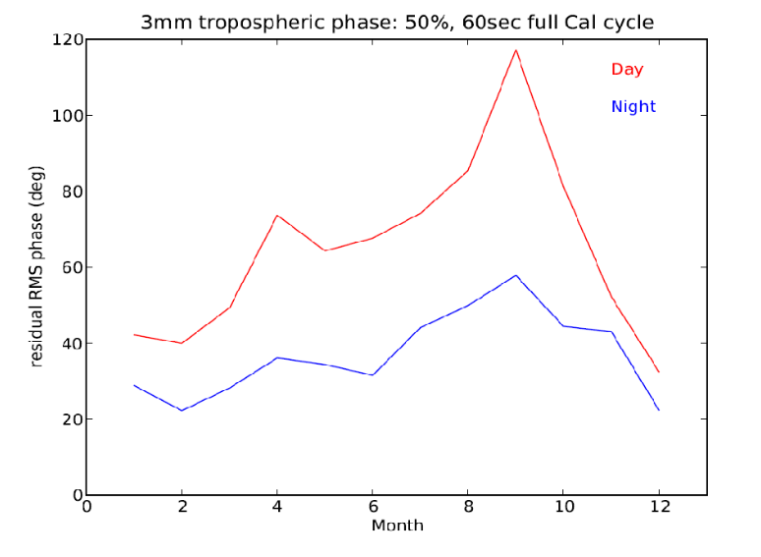
Southwest = Good 3mm site (memos 1 & 2)
3mm rms residual w. 30s calibration cycle
High, dry: Elevation Plains of San Augustin = 2200m
ALMA Test Facility: good 3mm testing conditions
Fast switching phase calibration: Site testing interferometer data over years
  30sec cycle at 3mm => reasonable coherence on longest baselines over most of the year (median rms phase < 40º), except summer day time
  Calibrator density: Typical distance to calibrator of 25mJy at 3mm ~ 2º => adequate to ensure that phase noise due to SNR is not a limiting factor for a 3sec integration
<20% coherence loss on longest baselines
rms residual w. 60s calibration cycle

Slide 4
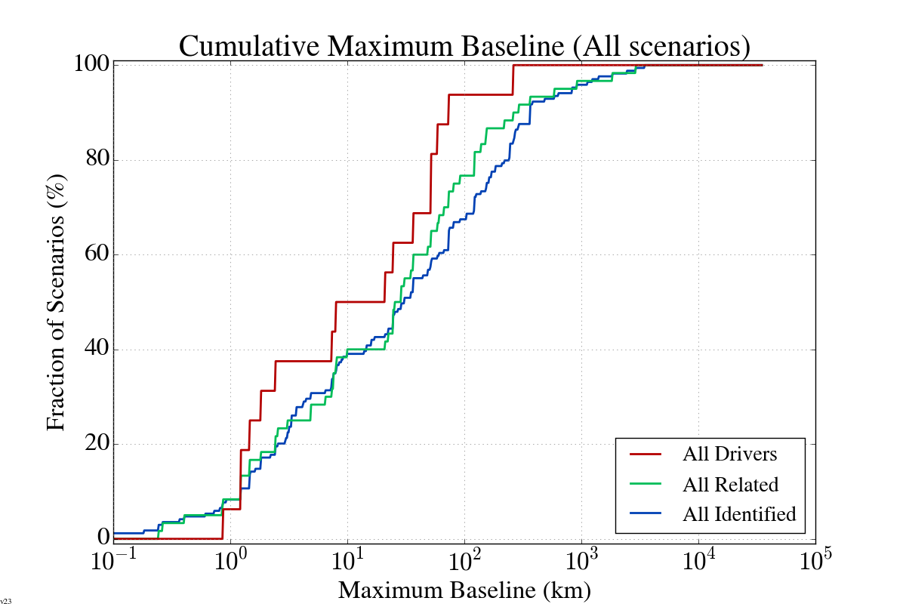
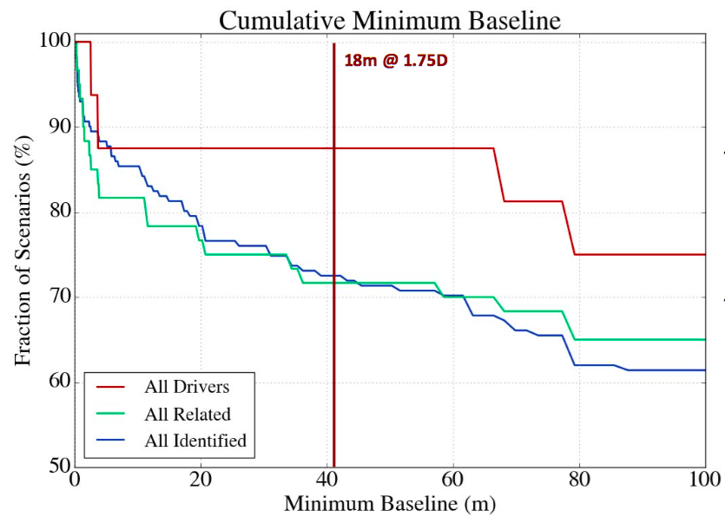
Science Use Case analysis (170 programs; Memo 18)
80% to 90% science can be done with 18m homogeneous SW array
Shortest spacing = 1.75 x 18m (off-set geometry limit)
Maximum spacing ~ 300km
1.75x18m
30 km
300 km

Slide 5
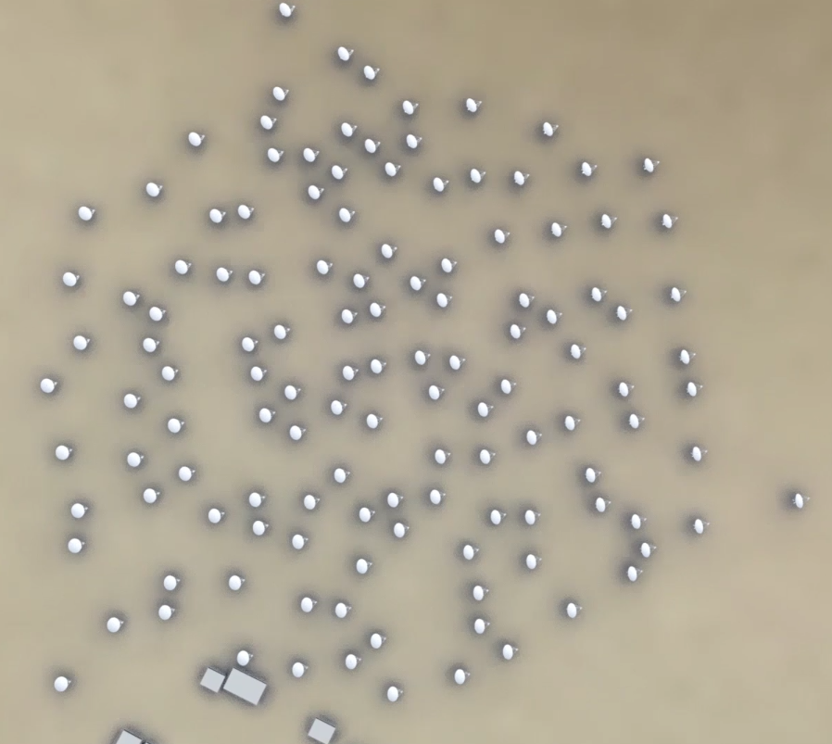
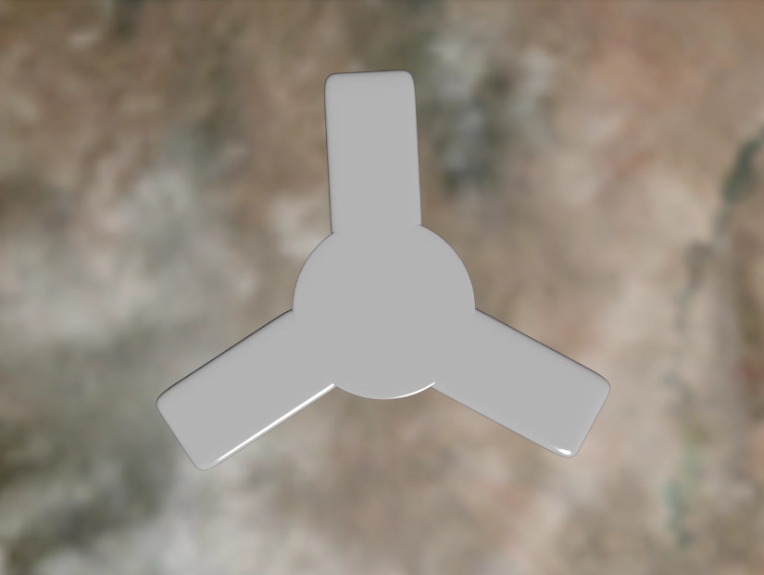
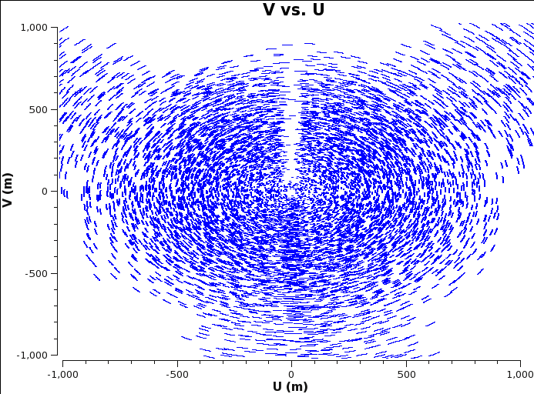
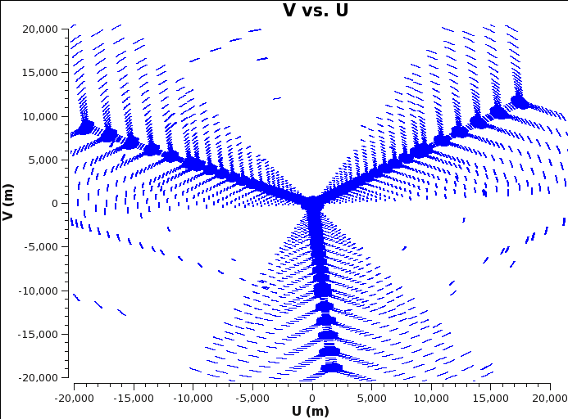
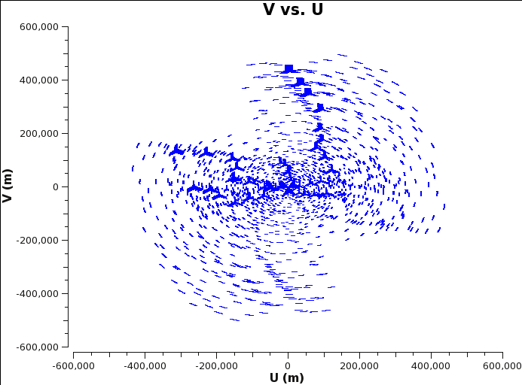
Tri-Scale Array w. real-world constraints
Power, fiber, roads, access (Greisen & Owen memo in prep)
3km
VLA Y
Roads, Power, Fiber
550 km
30km
Monochromatic snapshot UV coverage not brilliant, but bandwidth synthesis with factor 2 to 3 band ratios fills-in holes effectively
Array core on north-edge of extended spiral => lots of sensitivity on long baselines (down-side: subarraying is less attractive)

Slide 6
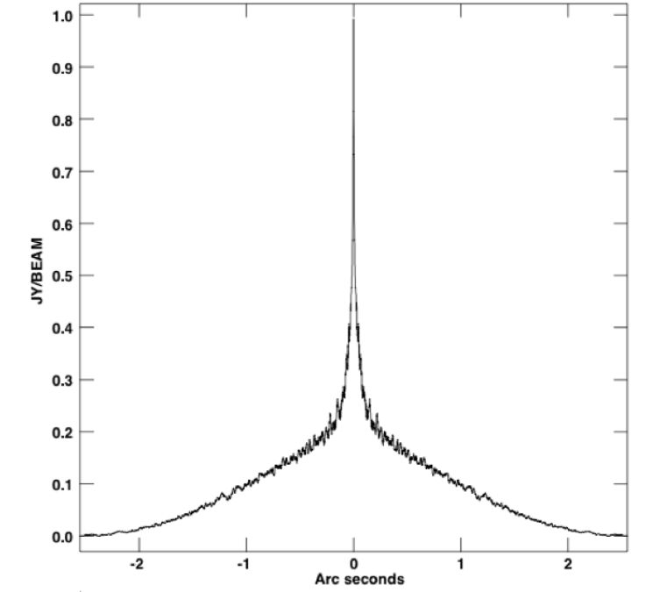
Tri-scale array => tri-scale beam
NA beam at 30GHz
4 hour
0.01”
Challenge: adjust uv-weighting (robust), cell size, taper to get ‘reasonable’ beam while maintaining reasonable sensitivity
Beam quality metric is NOT peak sidelobe, but minimizing broad skirts
0.1” to 0.2”
1” to 2”

Slide 7
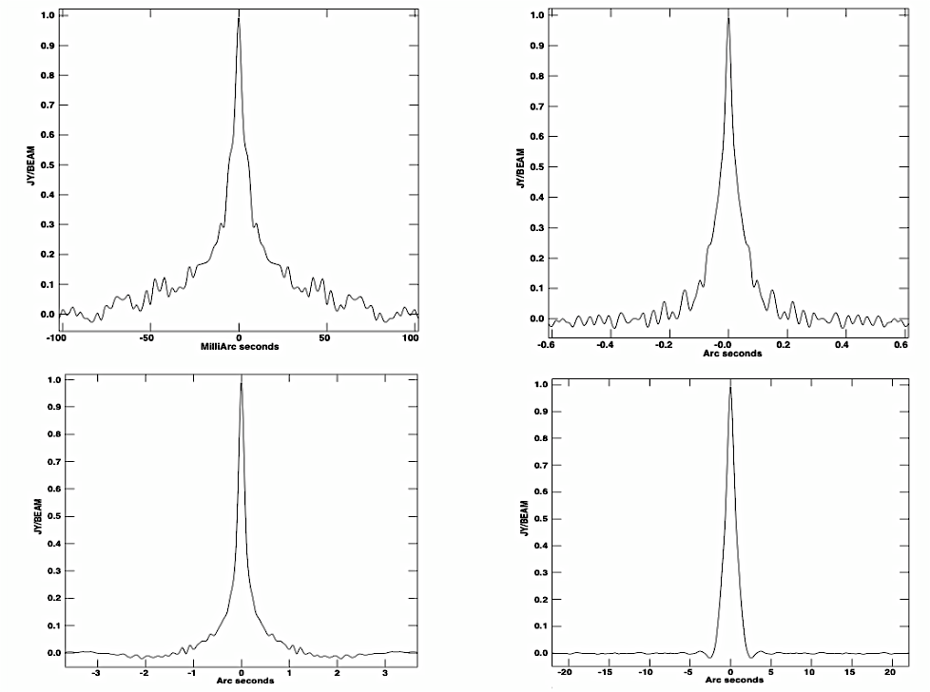
First Foray into parameter space: R, TA, Cell (Memo 16)
R= -0.2
Taper = 4mas
Cell = 1mas
FWHM = 10mas
R= 0.2
Taper = 25mas
Cell = 6mas
FWHM = 55mas
‘Reasonable beam’: skirts < 10% at R > 4x FWHM (see stress-tests)
Representative, not exhaustive, exploration of parameter space
Strongly science application-dependent => requires detailed simulations on case-by-case basis
Q: lose of sensitivity wrt Natural?
0.1
0.05”
0.2”
R= 0.5
Taper = 100mas
Cell = 30mas
FWHM = 240mas
R= 1
Taper = 500mas
Cell = 140mas
FWHM = 1400mas
1”
5”

Slide 8
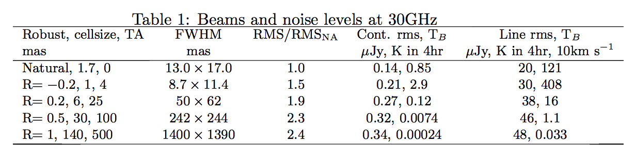
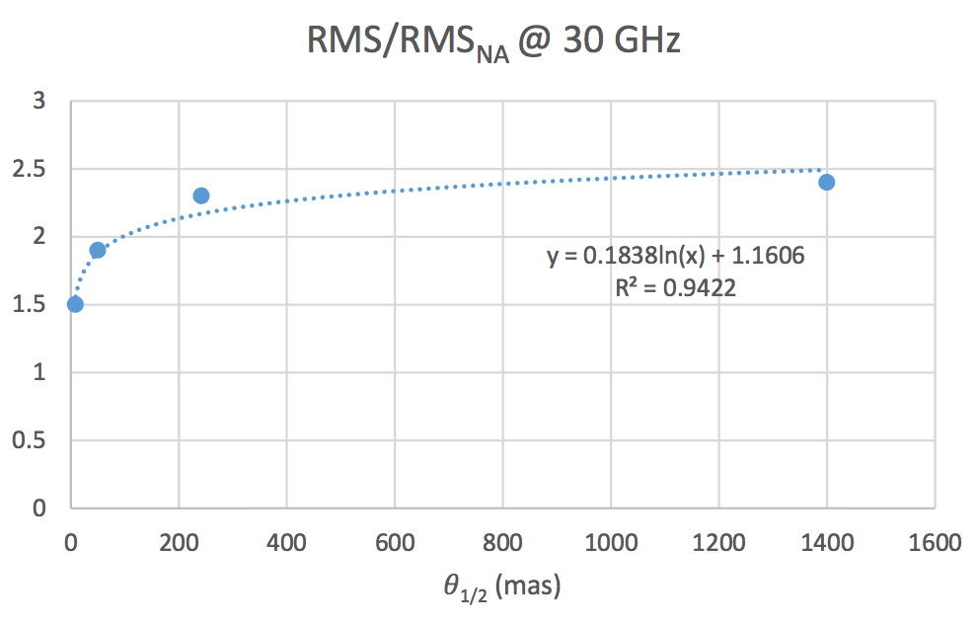
Off-center core => behavior wrt uv-weighting different relative to ALMA or VLA
ALMA: each config arranged to have ~ 20% changes in resolution and sensitivity going from NA to UN
VLA: exponential distribution => factor two changes in resolution and sensitivity going from NA to UN
ngVLA: roughly factor 2 sensitivity loss at all tapers
Note: conservative estimates. Multi-scale imaging algorithms under development should improve (Golap & Bhatnagar)

Slide 9
Strength of the Core (memo 12)
ngVLA has ~ 10x number baselines wrt ALMA and VLA D-config resolution arrays
ALMA only rival ngVLA in the most compact config (max B = 150m)

Slide 10
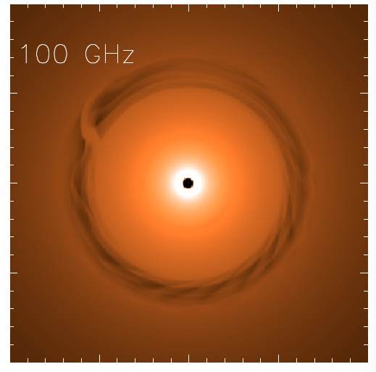
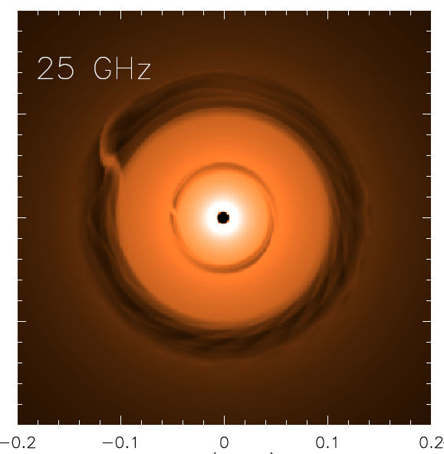
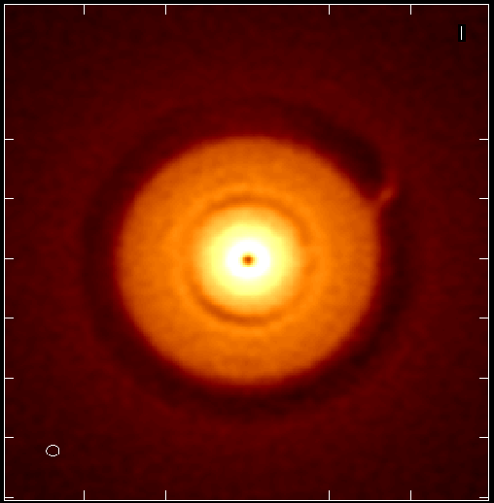
Stress-test @ 10mas, 25GHz: 1Myr Protoplanetary disk at 140pc
(memo 5, 11)
Saturn at 13AU
Jupiter at 6AU
ngVLA 100hr 25GHz
res = 10mas ~ 1AU
0.1” = 13AU
Isella Dust Model
Model
rms = 90nJy/bm = 1K
Inner gap optically thick at 100GHz
ngVLA: Image both gaps + annual motions (‘movies of planet formation’)
Circumplanetary disks: imaging accretion on to planets
Grain size stratification: Image poorly understood transition from dust to planetesimal to planets at 1AU resolution

Slide 11
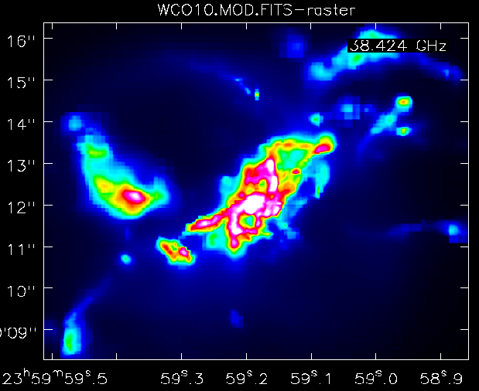
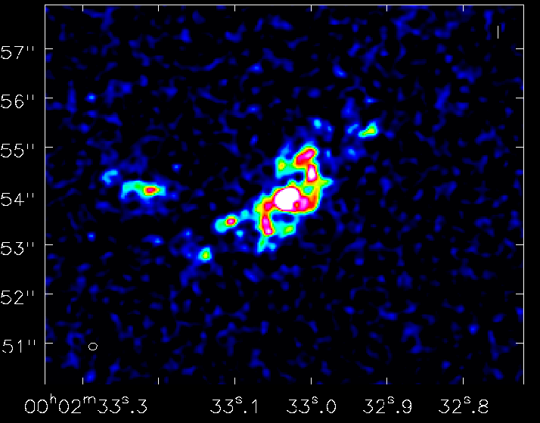
Stress-test @ 150mas, 38GHz: Imaging CO 1-0 in z=2 massive disk galaxy (memo 5, 13)
1” = 7kpc
z=2, CO1-0
Narayanan Model
ngVLA, 10hr, 38GHz
Resolution = 0.15” => 1kpc
Sensitivity = 12uJy (100 km/s, 10hr) => few 10⁸ M_{o} at z ~ 2
Distributed gas dynamics: Fisher-Tully at z=2

Slide 12
Options: Reconfiguration of 30km array
SAC/SWG: Not at the expense of substantial loss of 18m antennas
Parameter | Const. Premium | Ops Premium | Notes
"VLA" of Effective Collecting Area | 11.5% | 10.2% | A "VLA" worth of effective collecting area at 30 GHz. Equiv. to 28 x 18m ngVLA dishes.
Reconfigurability | 11.9% | 10.2% | Reconfigurability up to 30km roughly along existing VLA arms. ~4 configurations. One reconfiguration per year.
1000km Baselines | 4.1% | 0.1% | NOT increasing total collecting area, just reallocation of existing collecting area out to 1000km limit. Added 12 long-baseline stations. Strong dependence on LO and DTS concepts in practice.
Notes:
Option / cost Delta / Description
Values in $ are in the materials for tomorrow.

Slide 13
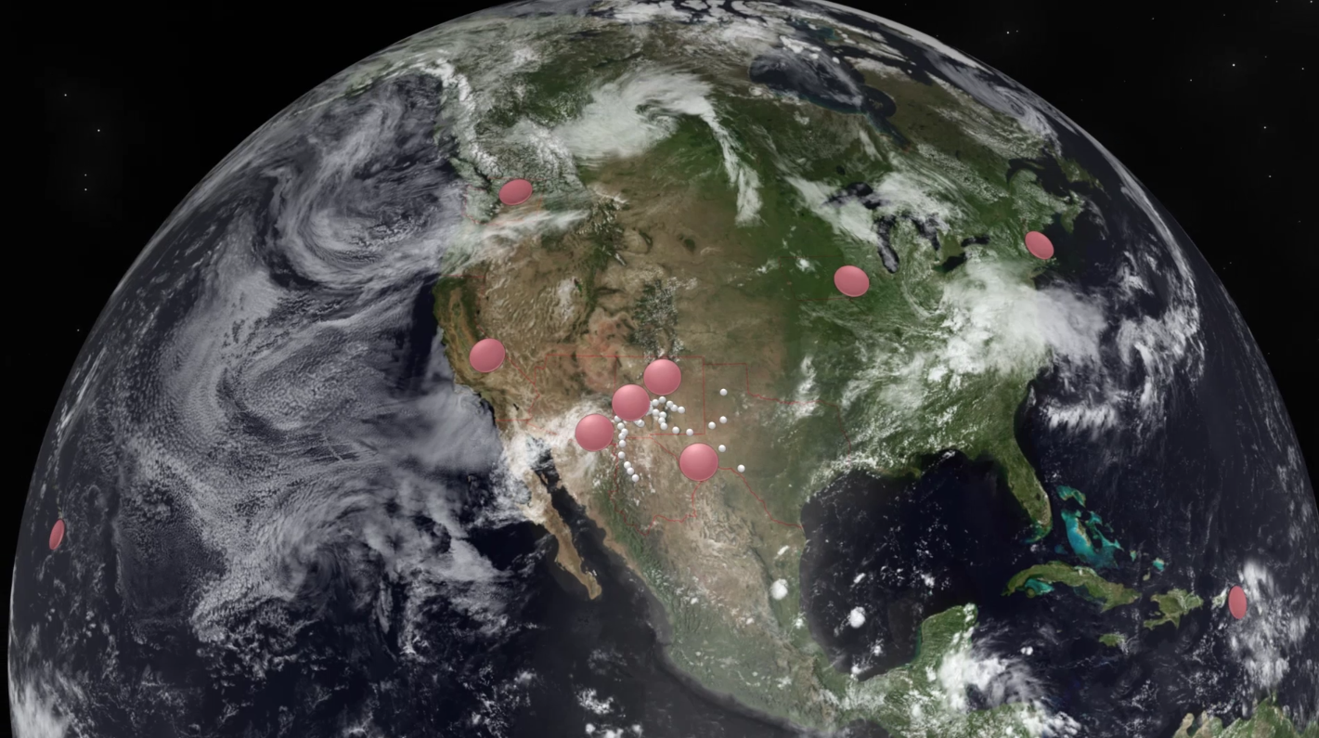
Long Baseline Options
ngVLA integrated into a global scale array: eVLBI, phasing of core are ‘given’
Replace existing VLBA antennas/infrastructure with ngVLA technology, new stations?
Operation: HSA/GMVA (‘campaign-mode’), or dedicated array?
Design and implementation depend on primary science drivers: astrometry vs. imaging vs. time domain…

Slide 14
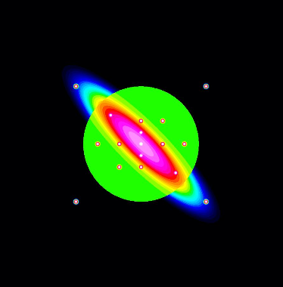
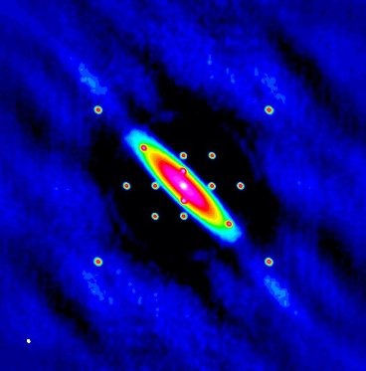
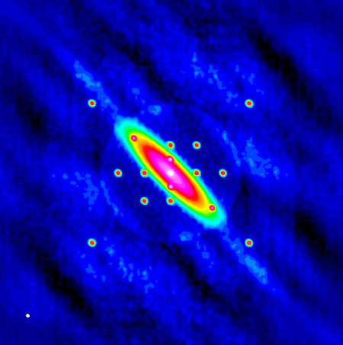
Short spacing option: fill-in below 1.75 x 18m
Short baseline array + 18m total power
Large single dish + Focal Plane Arrays
Mason + Condon memo in prep
Fill in the hole w/o degrading surface brightness sensitivity
Current idea: 16 x 6m antennas, close-packed
Rough cost ~ $35-40M ~ 5 x 18m antennas
Additional costs
  Antenna + Rx design effort
  Software development
  Operations cost and complexity
Frayer memo 14
45m plus > 20 element FPA ‘well matched’ to ngVLA core
Rough cost ~ 25 x 18m antennas
Additional costs
  Antenna + Rx design effort
  Software development
  Operations cost and complexity
model
SW array
SW array + 45m
Notes:
Dynamic range: 90% cases require DR < 40 dB
0.2 uJy/bm in 10hr => 100% of all driving science cases and ~80% of all science cases submitted.
Note – current system at 30 GHz has
* ~0.25 uJy/bm per 10hr with (x2 imaging weights) => 80 nJy/bm ~100 hr
* ~85 uJy/bm/km/s per 10hr with x2 imaging weight. => 10 uJy/bm ~ 720hr
8 K/ 10 hr @ 30 GHz @ 6.4 mas
=> ~0.33 mK/ 10 hr @ 30GHz @ 1” (w/ x2 weights)
=> ~115 mK per km/s per 10hr @ 30 GHz at 1” (w/ 2x weights)

Slide 15
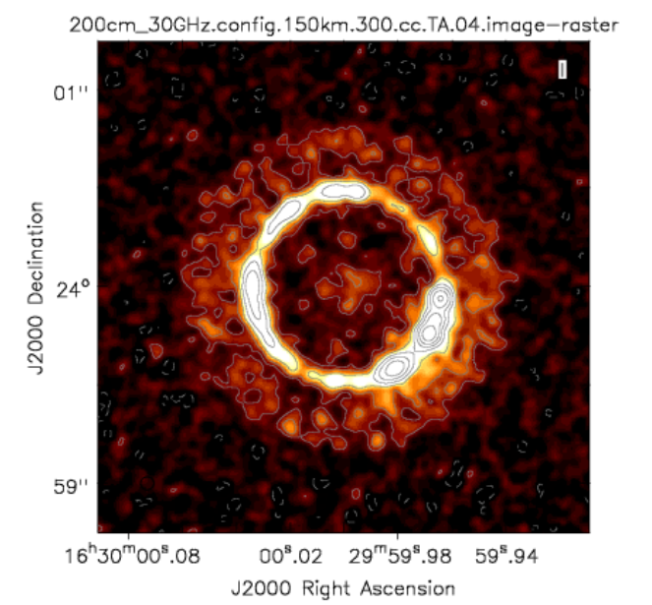
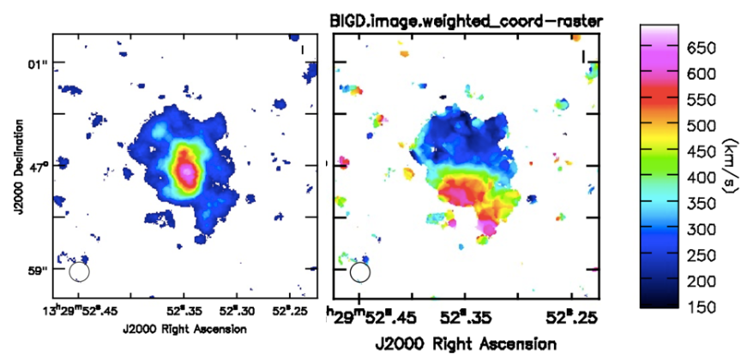
Array Simulation Tools: working and improving
Debris disk 1cm, 10mas
Configurations
  Southwest Configuration (214 x 18m; 1000km)
  Add VLBA (4000km)
  To come: short baseline array
CASA simulator
  Simobserve: generate mock.ms from FITS image cubes
  Add thermal noise
  Explore imaging capabilities (uv weights, subarrays..)
  Explore wide field mosaic
CO dynamics z = 4.2
https://science.nrao.edu/futures/ngvla/documents-publications

Slide 16
Emerging consensus design: ‘Southwest Array’ (memo 17)
Location: U.S. South West, Mexico
Homogeneous array 214 x 18m, off-axis antennas
50% to core: b < 3km => 1” at 30GHz
80% to mid: b < 30km => 0.1”
100% to long: b < 1000km => 0.01”
550km
Science Use Case driven
Includes real-world constraints (G&O)
Performs reasonably under limited stress-testing
On-going efforts
Imaging and UV-weighting parameter space as input to sensitivity calculator
Algorithmic development: multi-scale imaging
VLBI implementation
Short baseline options
350 miles

Slide 17

www.nrao.edu
science.nrao.edu
public.nrao.edu
The National Radio Astronomy Observatory is a facility of the National Science Foundation
operated under cooperative agreement by Associated Universities, Inc.

Slide 18
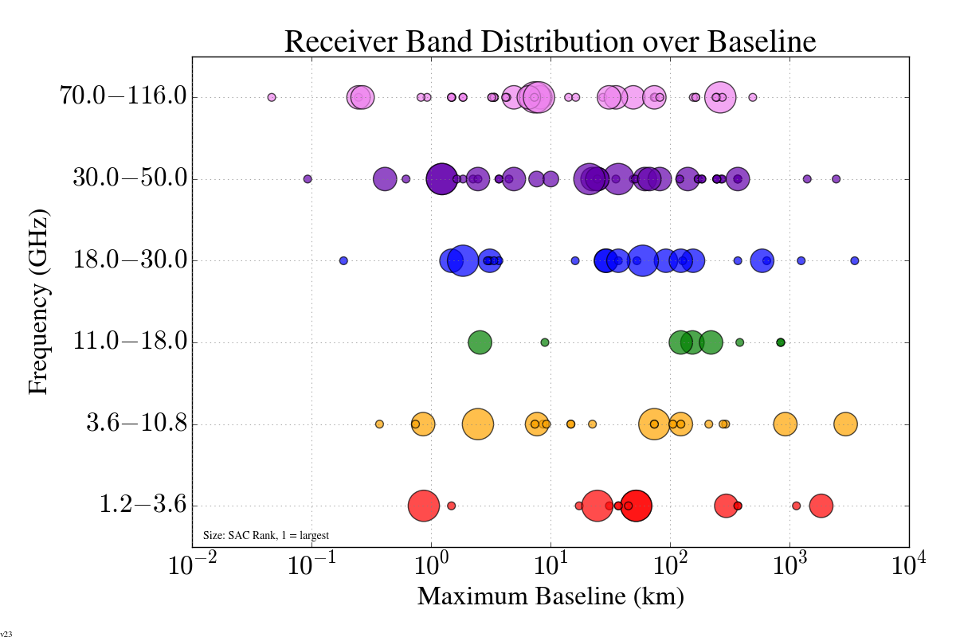
Band 6
Band 5
Band 4
30 km
Band 3
300 km
Band 2
Band 1
Notes:
How does frequency request look as a function of requested resolution (max baseline)
Conclusion – need both low and high frequency bands across the full angular scales supported by the array.
* Implies outfitting all antennas with full suite of receivers.

Slide 19
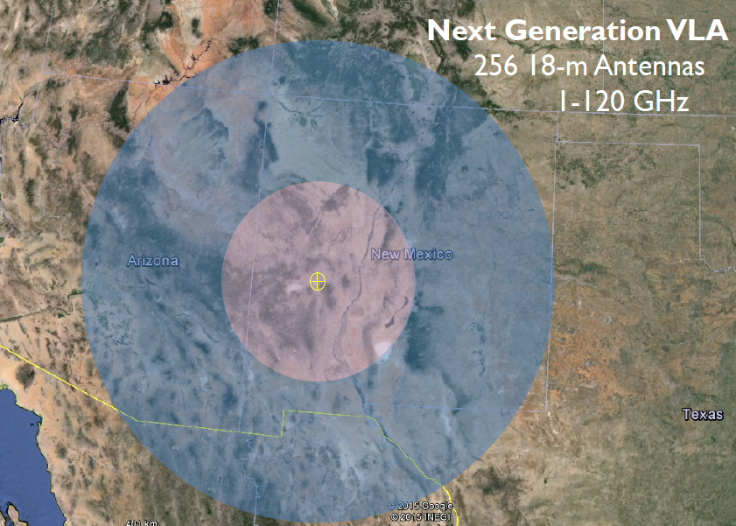
Located in U.S. South West, Mexico
Potential Station Locations
JVLA: Good 3mm site, elev. ~ 2200m
50% in core: b < 3km ~ 1” at 30GHz
80% in mid: b < 30km ~ 0.1”
100% in long: b < 300km ~ 0.01”
350 miles

