Slide 1
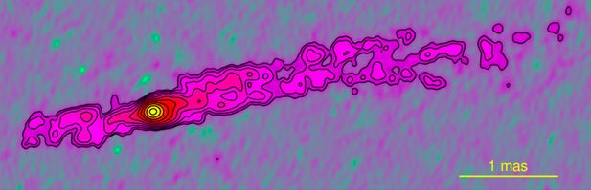
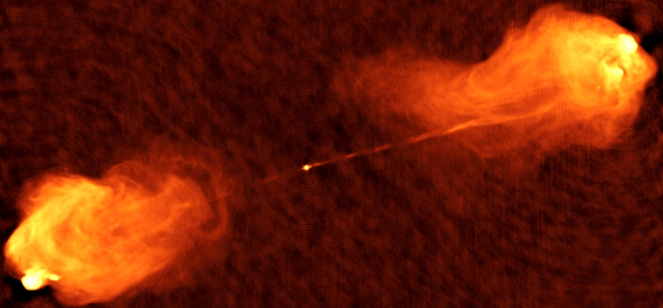
Cygnus A: Rosetta Stone of Powerful Radio AGN
v_{app} ~ c
1pc
43 GHz Krichbaum ea
z = 0.057 => 60” = 60kpc, L_{R} ~ 10⁴⁵ erg/s
8GHz

Slide 2
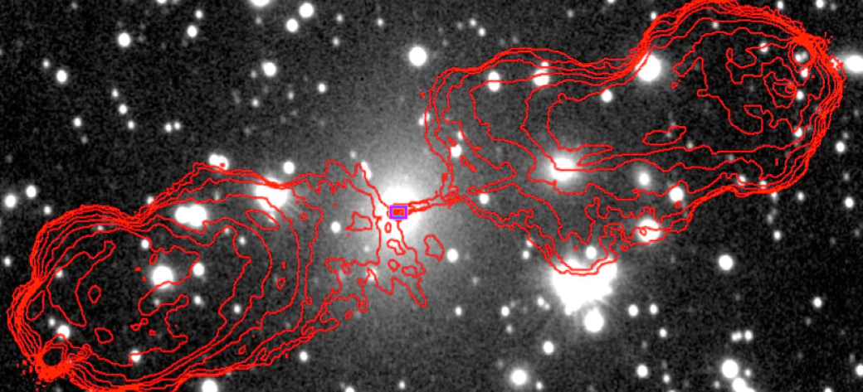
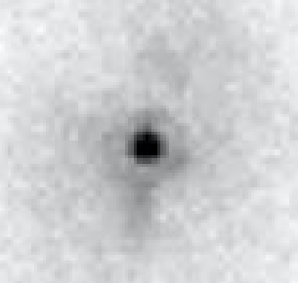
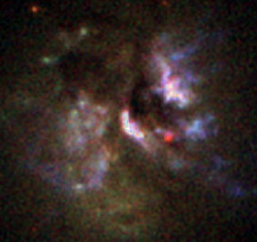
HST 2.2um
3 kpc
HST (Canalizo et al. 2003)
Giant Elliptical w. buried quasar (type II AGN)
N(HI 21cm) > 10²³ cm⁻²
N(X-ray) ~ 3x10²³ cm⁻²
IR – Optical photometry => A_{v} > 50
L_{bol} ~ 2.5x10¹² L_{o} (typical z ~ 1 quasars)
Spectroscopy => SMBH ~ 2.5 x 10⁹ M_{o}

Slide 3
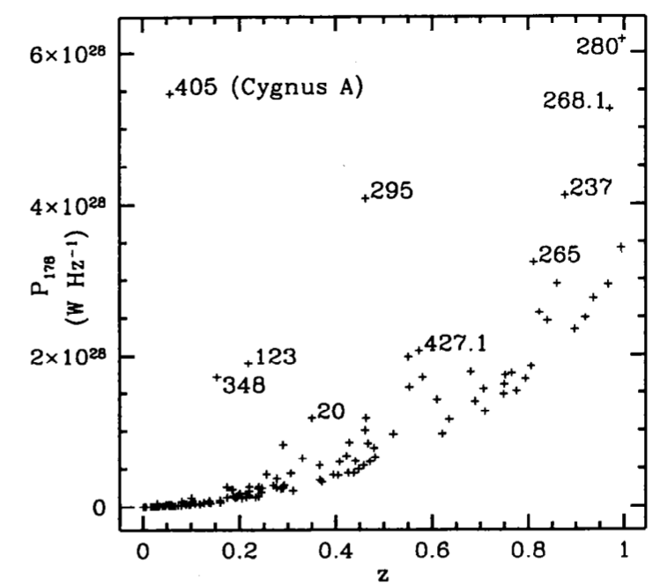
What makes Cygnus A so special? (why study Cygnus A for 35 years?)
10x closer than it ought to be => Fortuitous laboratory to study physics of quasar-like luminosity AGN at 10x the physical resolution, and 100x the sensitivity
Cygnus A ‘firsts’
1st ‘high z’, extreme luminosity AGN: catalyst for the ‘AGN paradigm’ (ie. non-stellar energy source) Baade & Minkowski 1954
1st ‘double radio galaxy’, leading to Jet theory (Blandford & Rees; Scheuer 1974)
1st highly collimated jet discovery with VLA (Perley ea 1984)
1st polarized, scattered broadlines => hidden quasar and AGN unification (Antonucci+ 1994)
1st X-ray cluster cavities (w. perseus) => radio-mode feedback (Carilli+ 1994)
3C sample

Slide 4
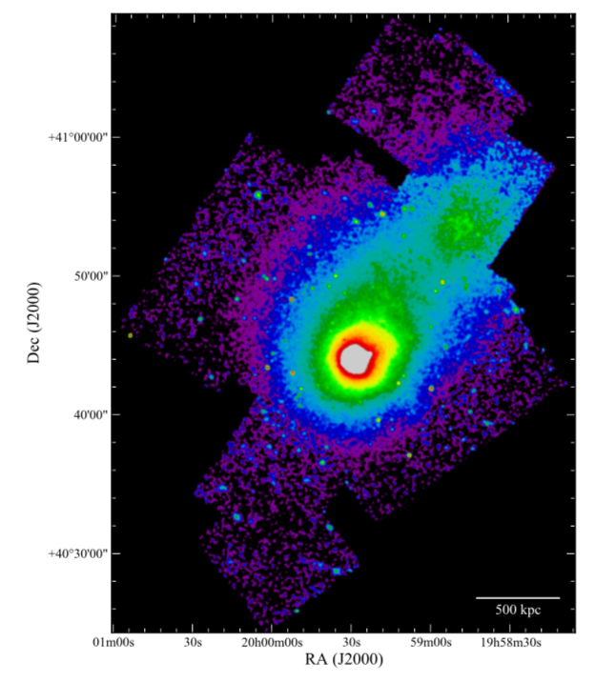
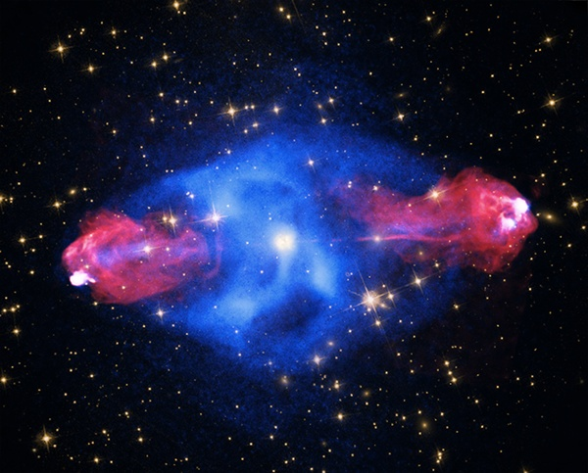
CHANDRA 2.2 Msec Xray observations (M. Wise +, Snios+, Duffy+ 18)
Mpc-scale merging cluster, L_{x} ~ 10⁴⁵ erg/s
Bow shocks, hydrodynamic interaction jet – lobe – ICM (‘radio mode feedback’)
Non-thermal IC Xrays from radio source: relativistic particle physics

Slide 5
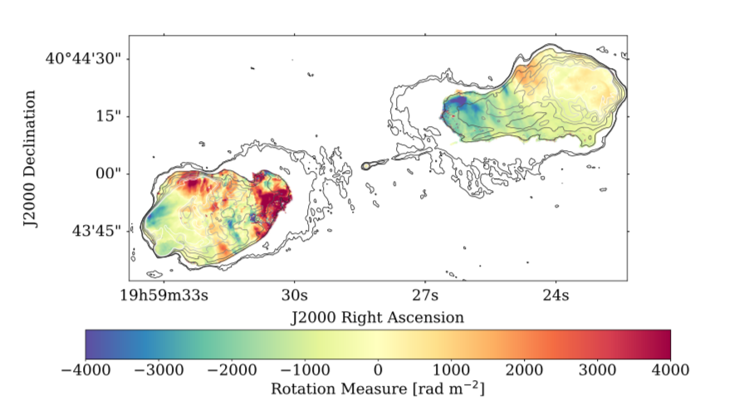
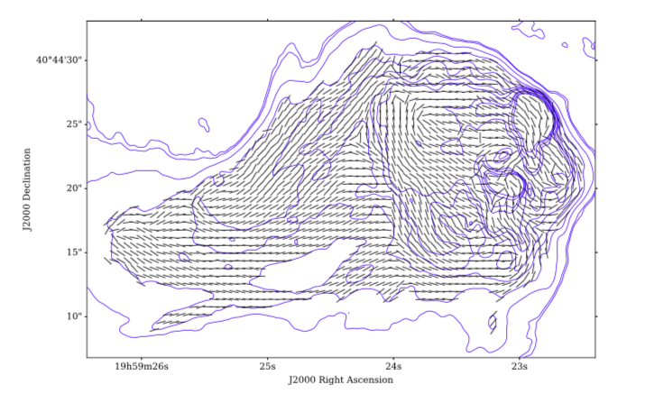
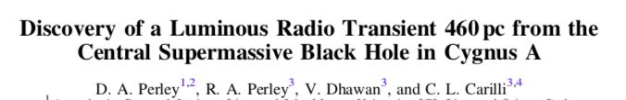

JVLA program (Perley+, Sebokolodi+)
Observed intensively in 1980s, but only three VLA observations of Cygnus A between 1989 and 2014
JVLA: 44 hours, 2 to 50 GHz, all configurations w. 10x BW of old VLA
Goals: deeper polarization study of the lobes, jet, background sources: but surprise, surprise, surprise….
Extreme RM => B_{cl} ~ few uG

Slide 6
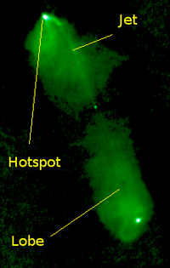
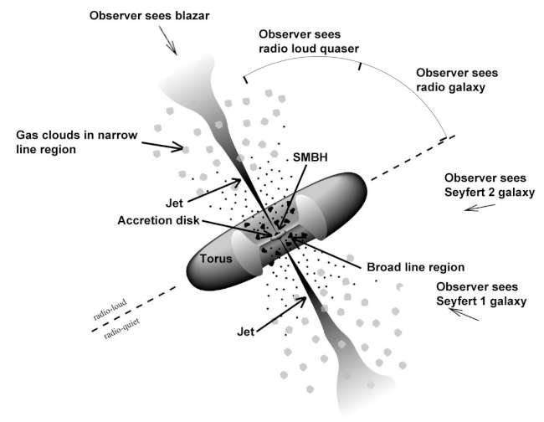
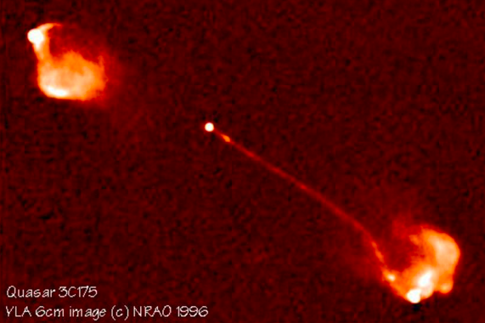
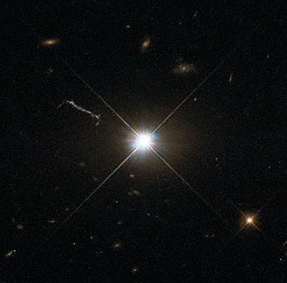
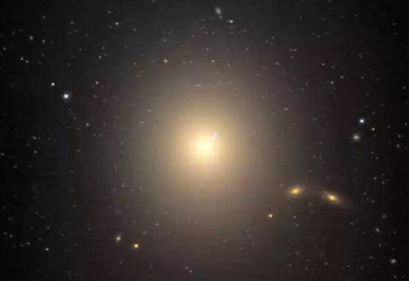
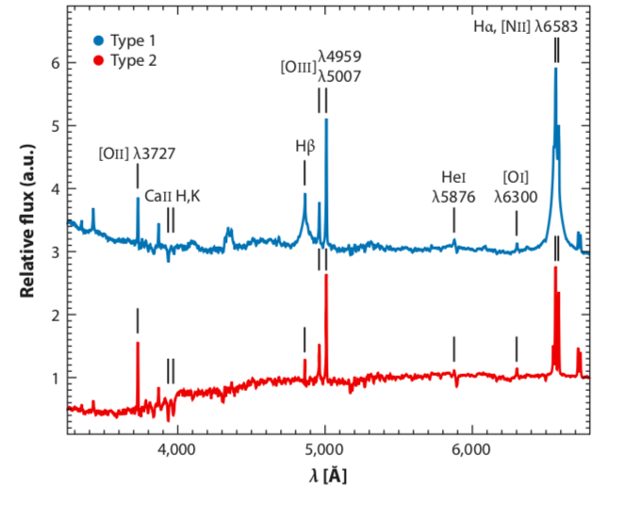
AGN Unification by Orientation: Type 1 and Type 2
Type 1
1 Radio Quasar
2 Radio galaxy
Type 2
NLR ~ 100pc
Type 1 quasar 3C273
Type 2 radio galaxy M87
BLR ~ 1pc
Optical point source
Optical galaxy
Spectrum: Type 1
Broad permitted lines (20,000 km/s)
High ionization
Big Blue Bump
Dusty, Obscuring Torus scales 10 – 100 pc key to simple ‘unification by orientation’ paradigm
Key point: correlation Xray – IR for BOTH Type I and II AGN => large MFP X-rays => Clumpy gas/dust distribution
Type 2
Narrow forbidden lines (<1000 km/s)
Lower ionization
Red stellar continuum

Slide 7
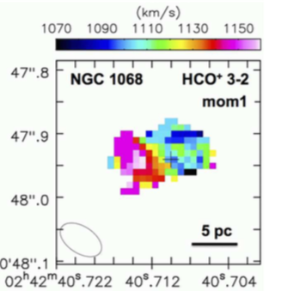
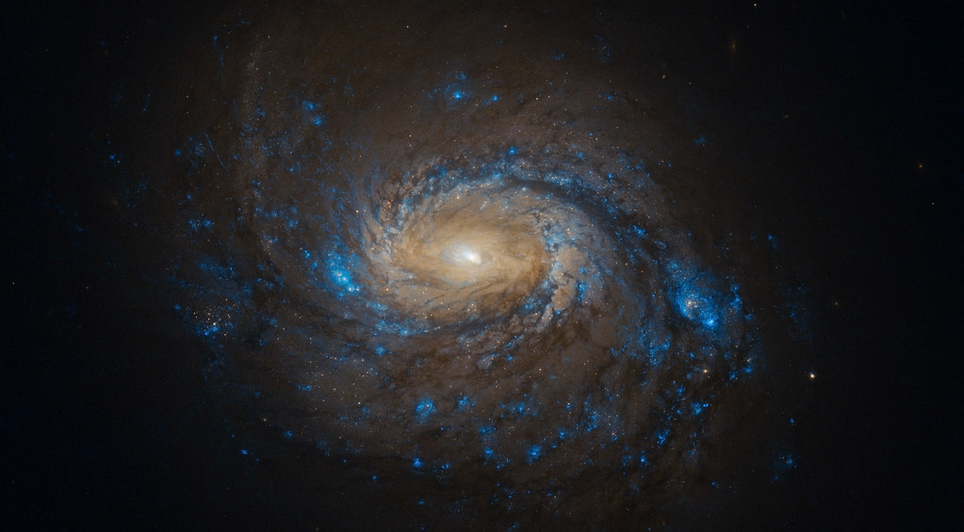
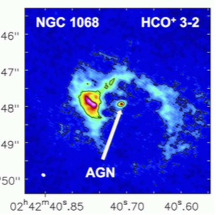
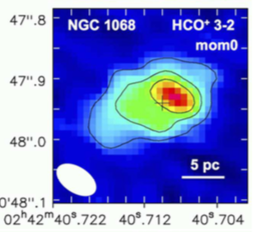
Search for Obscuring Torii: ALMA Molecular Lines
Imanishi etal 2018
Possible rotating molecular torii imaged in nearby low luminosity AGN scales ~ 10pc with M_{BH} ~ 10⁷ M_{o}
No imaging examples of torii in high luminosity, extreme mass SMBH, comparable to z ~ 1 quasars

Slide 8
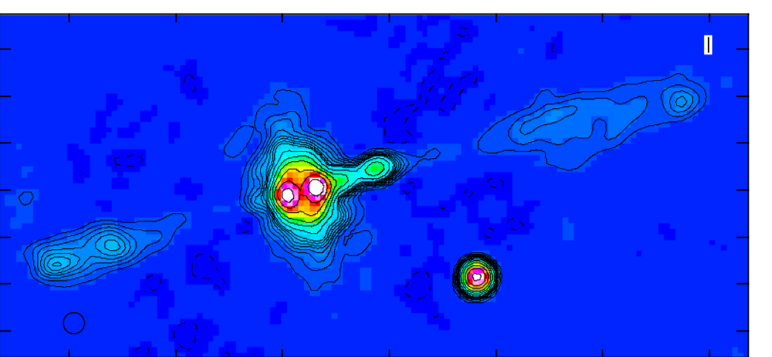
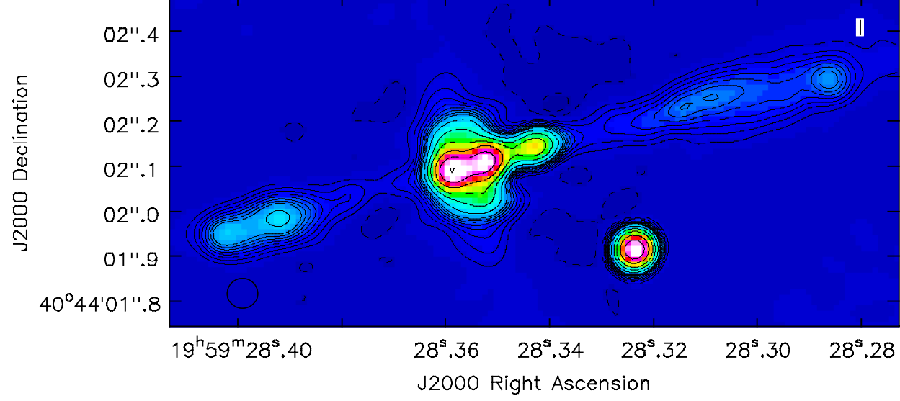
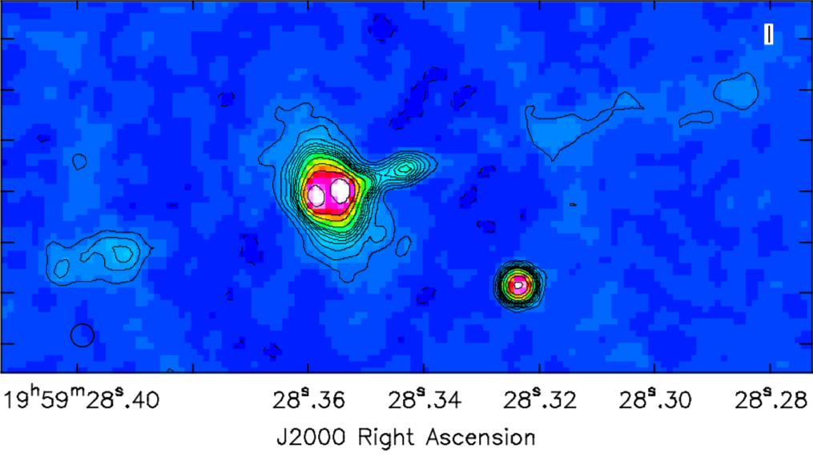
Imaging the ionized gas in the obscuring torus in Cygnus A?
30-38GHz 45mas
0.2” = 200 pc
19-27 GHz 67mas
40-48GHz 45mas
Note: ~1 Jy point source subtracted from uv-data

Slide 9
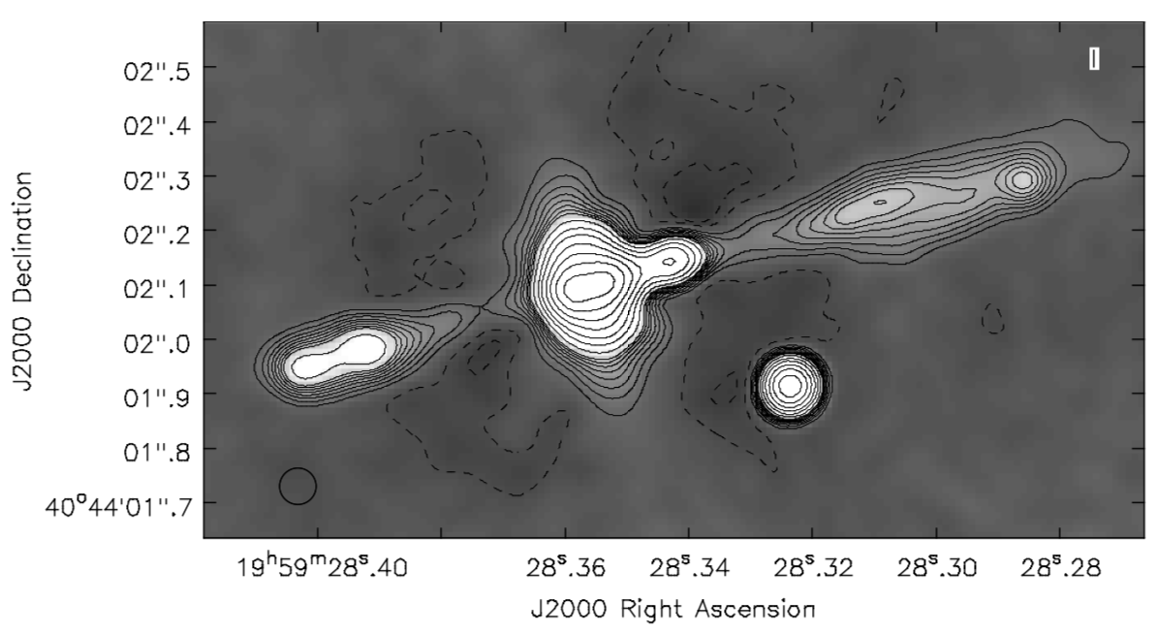
19-47 GHz 67mas
Maj Axis ~ 480mas
Min Axis ~ 260mas
1st contour = 50uJy/bm
19-47 GHz 67mas
30-38GHz 45mas
Maj Axis ~ 480mas
Min Axis ~ 260mas
1st contour = 50uJy/bm
0.2” = 200 pc
19-27 GHz 67mas
40-48GHz 45mas

Slide 10
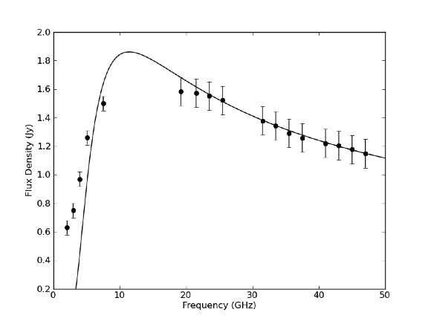
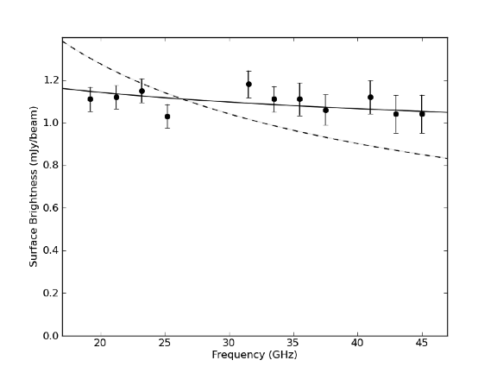
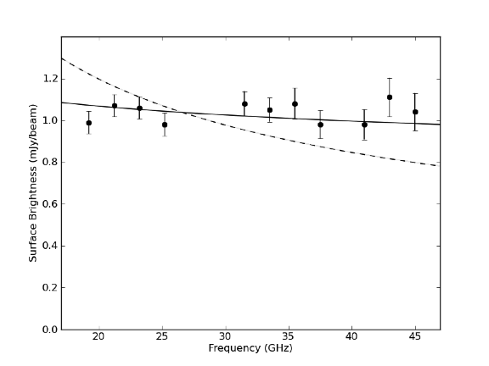
What is it? Radio spectra
Core
+100mas
-100mas
Solid: 𝛂 = -0.5 + free-free w. 𝛕_{e} set by EM = 1.2x 10⁸ pc cm⁻⁶
Solid: 𝛂 = -0.1 = free-free
Dash: 𝛂 = -0.5 = Thomson Scattering
Flat spectra consistent w. free-free, inconsistent w. Thomson scattering of radio emission from core, or diffuse synchrotron
T_{B} (100mas) = 240 K => EM = 1.2x 10⁸ pc cm⁻⁶ => mean density ~ 500 cm⁻³
Core spectrum: fit for alpha at Ka, Q, then set free-free absorption using EM from torus!

Slide 11
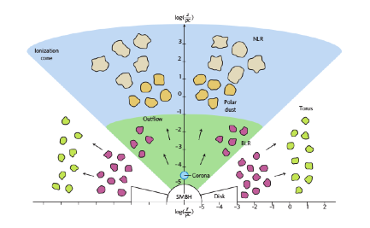
Toy Model
Free-free emission from Cyg A multi-phase, clumpy Torus
max R ~ 260 pc, H ~ 143pc
ionization cone ½ opening angle ~ 62º
EM => mean density ~ 500 cm⁻³
Jet Axis
Polar region
𝜃_{t} ~ 62º
H_{t} ~ 143 pc
Clumpy Torus
Gas and dust clumps
R_{t} ~ 264 pc
Paradox: mean density => 𝛕_{e} ~ 0.26 => 170 mJy from Thomson scattering (total in torus ~ 21mJy)
Solution: FF ∝ n_{e}² , Thomson ∝ n_{e} => Clumpy gas distribution, clump densities > 4000 cm⁻³
Clumpy torus consistent with MFP in X-rays and far IR (Nenkova ea.)
Pressure clumps > 5.5 x 10⁻⁸ dyne cm⁻²
Equipartition pressure in jet ~ 3x larger: pressure confined jet?

Slide 12
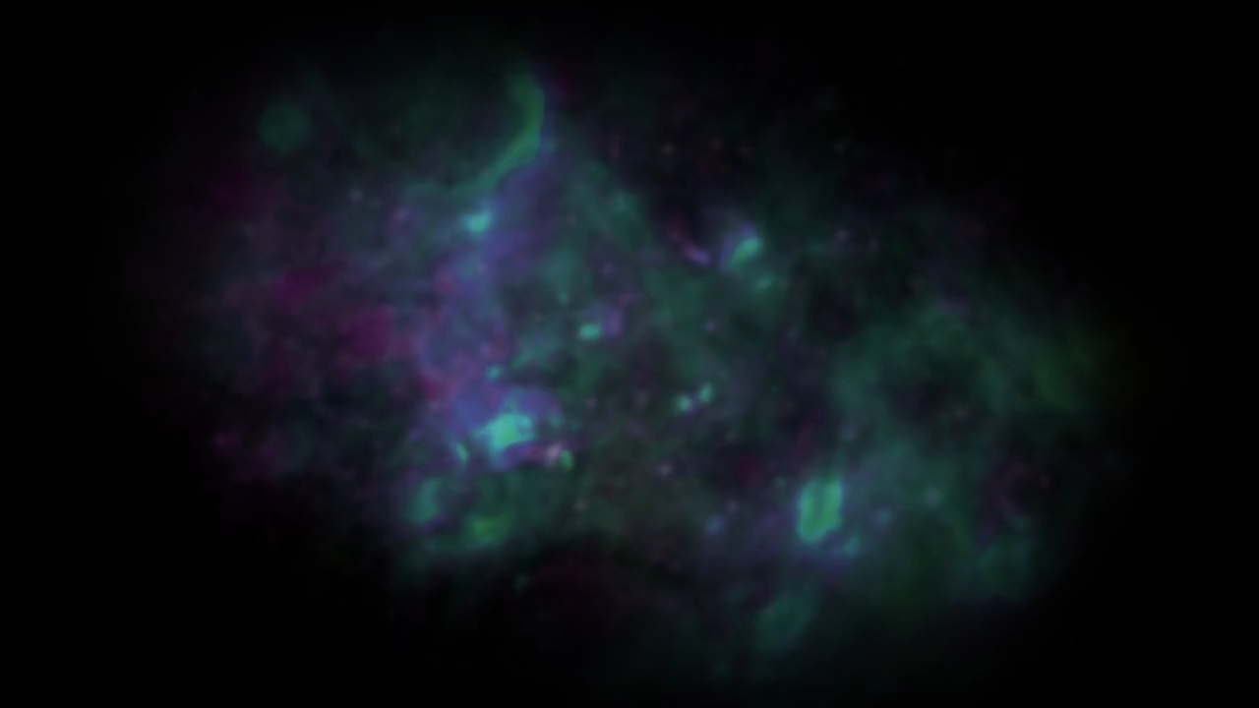
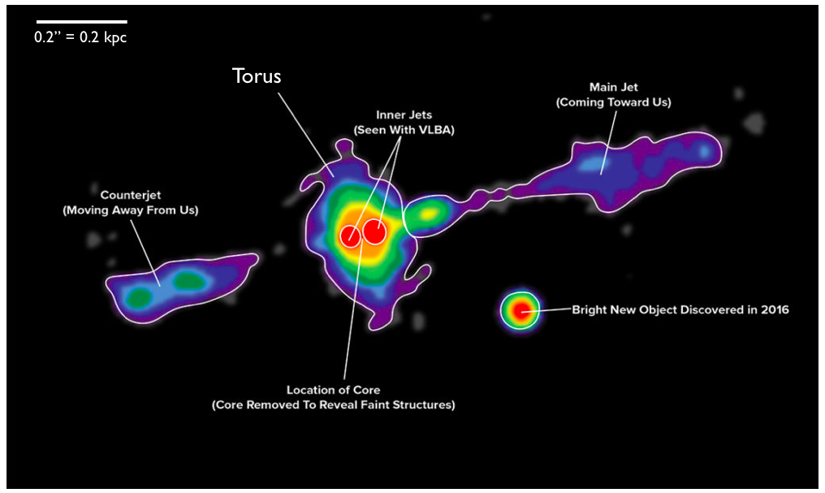
Free-Free emission from the Cygnus A Torus? Model consistency checks
Opening angle ~ 62º consistent with demographics: about 50% to 70% of AGN are type 2 vs. 1 => Opening angle ~ 45º – 63º (Nenkova ea 2008)
Outer radius ~ 264pc ~ size of SMBH gravitational sphere of influence in Cygnus A
Radius NLR for 2.5x10¹² L_{o} AGN ~ 460pc
Cannot rule-out other models (eg. thermal outflow, but wrong geometry?
Next Steps
ALMA search for dust and molecular gas on similar scales
Other examples: will require 10x spatial resolution and > 10x the sensitivity

Slide 13
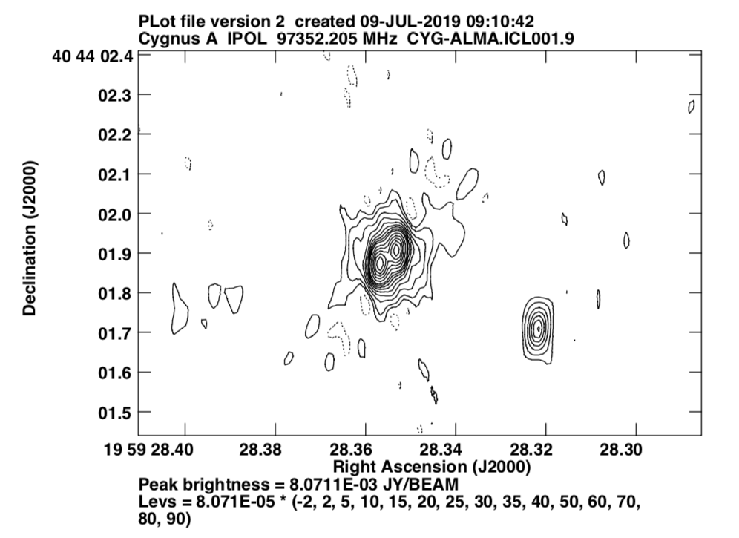

Slide 14
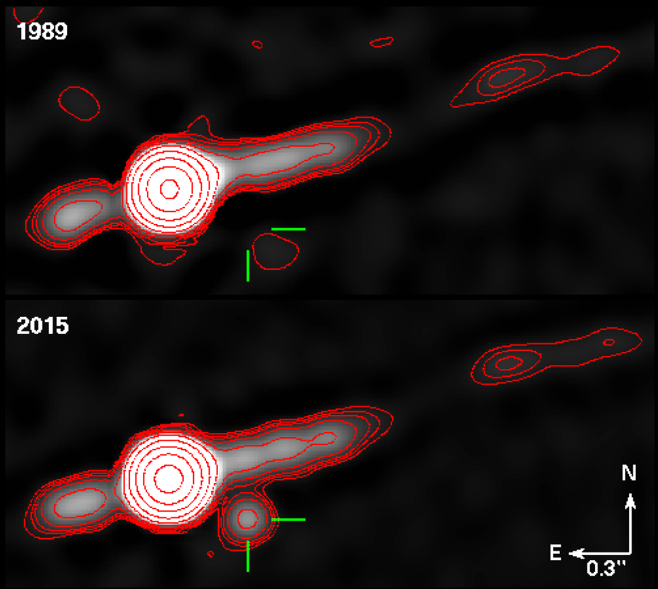
Bigger surprise: new radio source in the nucleus of Cygnus A
VLA 8 GHz
1”
4mJy at 8 GHz

Slide 15
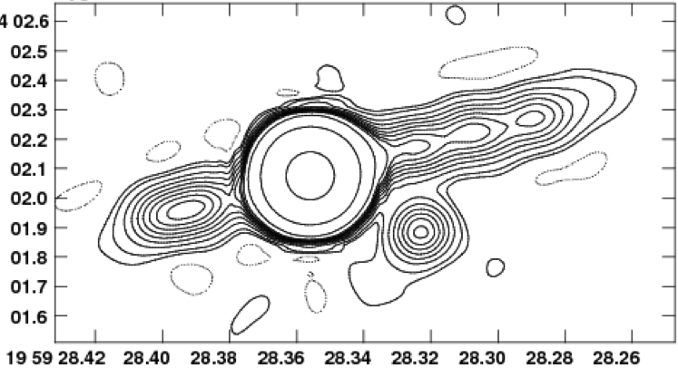
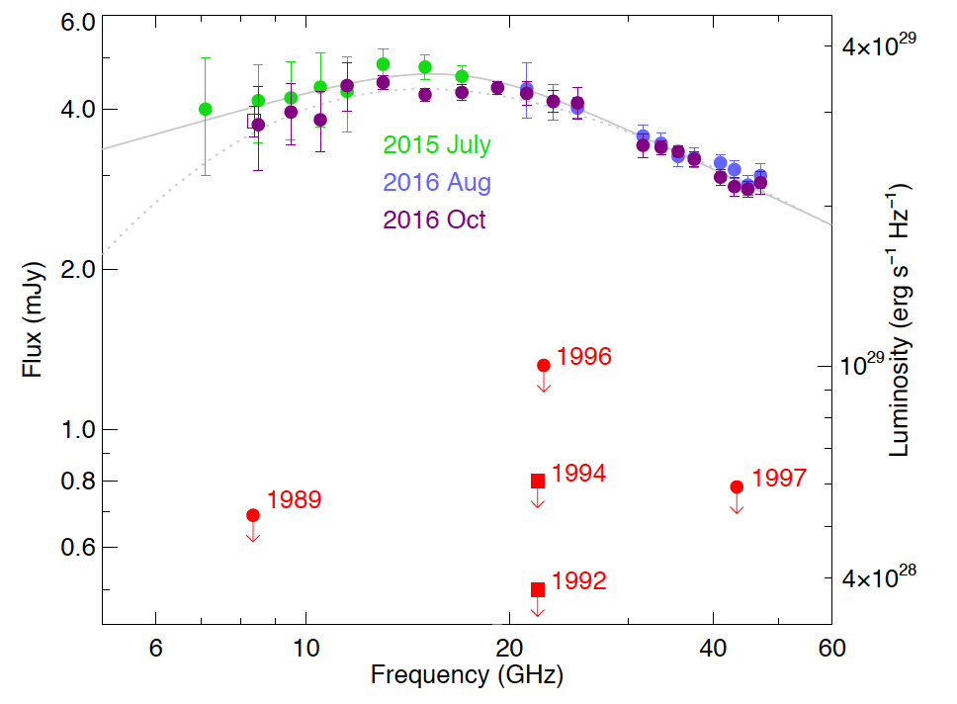
Cygnus A radio transient
460 pc from the nucleus
Source appeared sometime between 1997 and 2015
Flat spectrum, with gradual turnover below 15 GHz.
Marginally fading Jul15 to Oct16

Slide 16
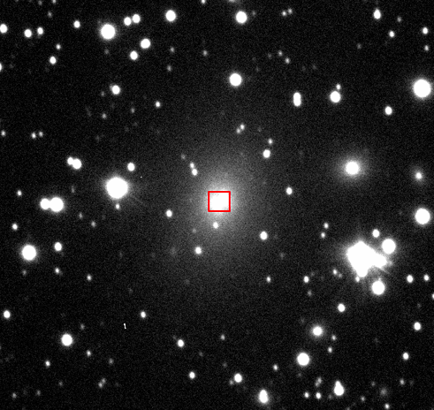
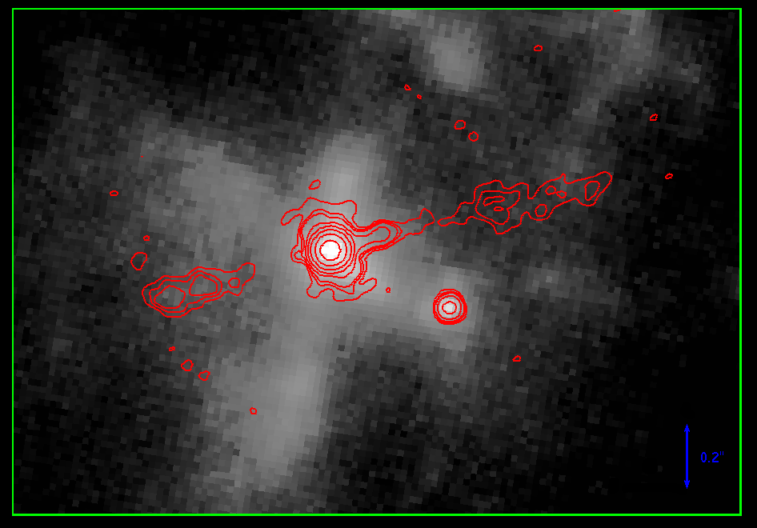
Near-infrared counterpart
Gemini i-band 0.8 μm
Keck K-band 2 μm
35GHz
200pc
Canalizo+2003
84”
A NIR point source at the same location was discovered in 2002 with adaptive optics + HST (no info on variability)
Spectrum not definitive: not young SF region but confused by scattered light from Cyg A nucleus
Interpreted by Canalizo as a stripped galaxy core = old stars

Slide 17
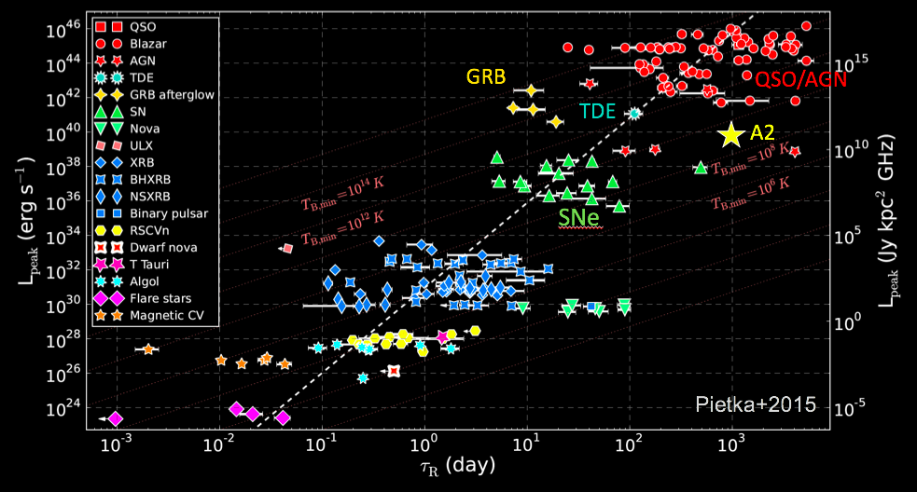
What kind of Transient? Radio Luminosity – time diagram
Stellar explosions: SNe, GRB
SMBH accretion:
Tidal disruption event: star infall
Blazar: gas accretion

Slide 18
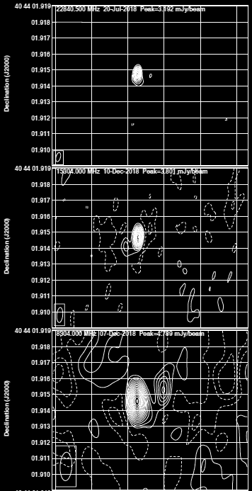
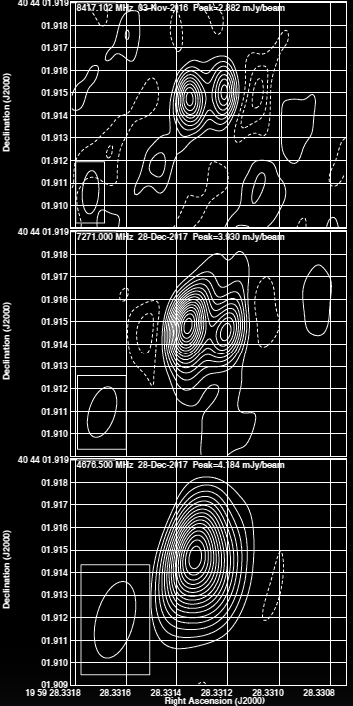

VLBA imaging at five frequencies
23 GHz
8 GHz
15 GHz
7 GHz
1.6 mas = 5.7 ly
A2-E
A2-W
8 GHz
5 GHz
Suggests trans-luminal motion:
v > 0.3c

Slide 19
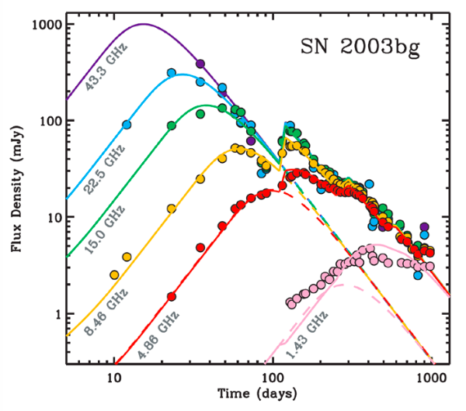
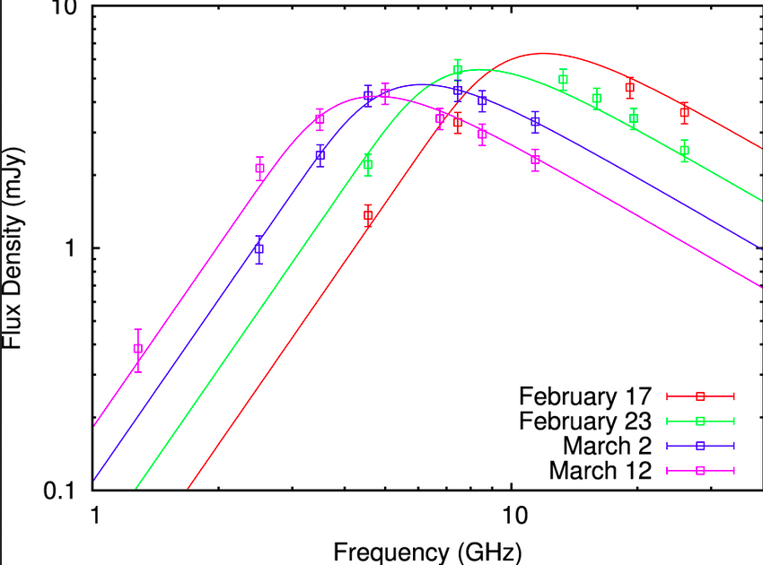
What is it?
Unlikely to be background source: probability << 10⁻⁴
Projected distance from nucleus ~ 460 pc
A Second SMBH (AGN flare or TDE)
Luminosity, timescale, spectrum, all consistent with a flaring/brightening secondary supermassive black
VLBI: trans-luminal expansion
Secondary IR nucleus could be 2nd obscured AGN
A radio supernova
Cyg A nucleus has abundant star-formation
Would be the most luminous radio SNe known (2x)
No simple explanation for near-IR counterpart (no bright star-formation lines)
Flat spectrum and no frequency dependent fading is highly uncharacteristic of SNe and GRB
SNe

Slide 20
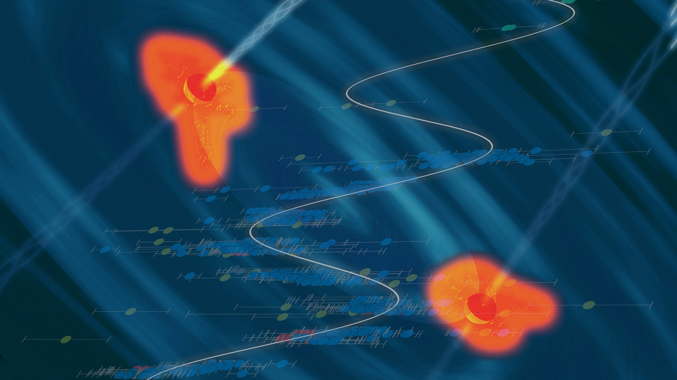
Cygnus A: A Binary SMBH?
Implications
Rare example of sub-kpc SMBH binary: provides insight into in-spiral/merger process
Orbital period ~ 10⁷ years ~ age of radio source: search for dynamical influence on jet/lobe structure (eg. jet ‘helix’)?
Just possible to measure orbital motion w. VLBI over decades
Speculation: Proximity of Cyg A allows for 10x higher physical resolution and 10x higher sensitivity than any other powerful radio AGN.
Perhaps many powerful AGN are binary SMBH? Have we looked?
What are the implications for merging SMBH statistics and the nano-Hz GW background?

Slide 21
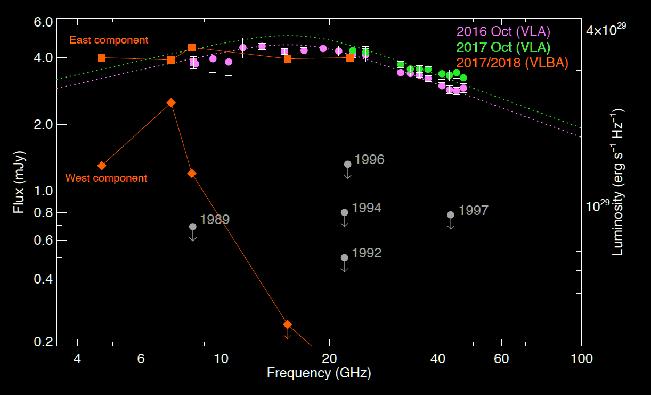
Resolved SED
A2-E: flat spectrum, no rapid changes
A2-E
A2-W:
Steep spectrum, possibly scintillating => very compact
A2-W

