Slide 1
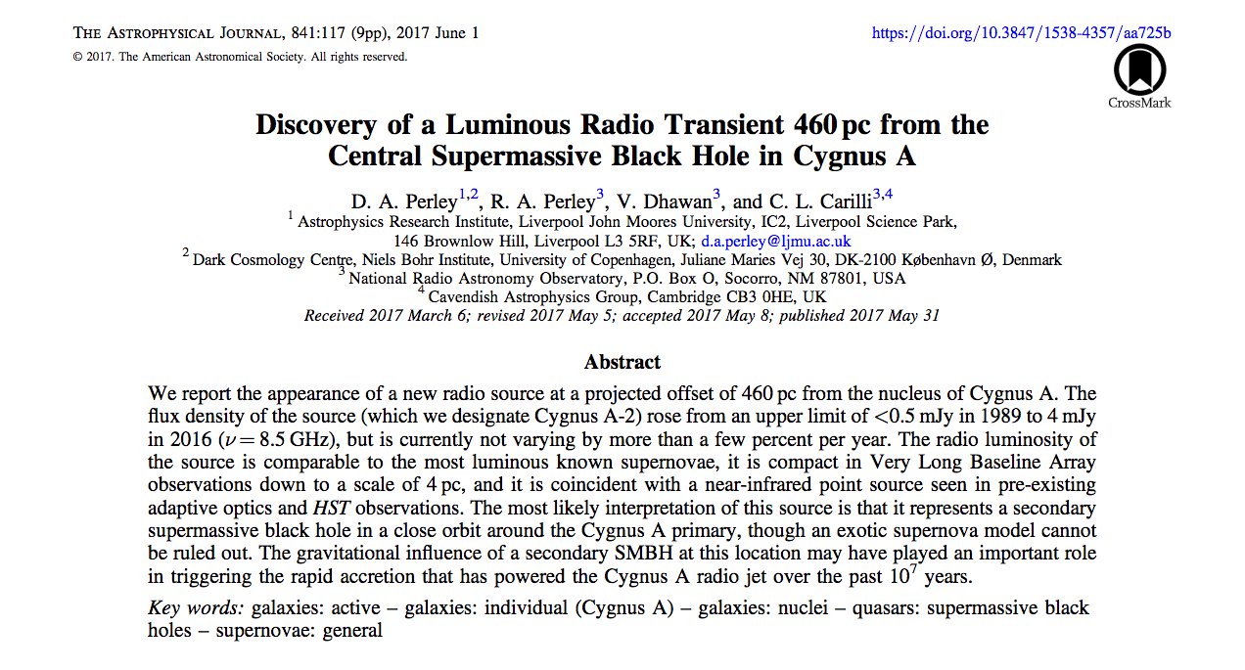
Cygnus A: 10x closer than any radio galaxy of comparable luminosity (z=0.056)
Observed intensively in the 1980s, but only three high resolution VLA observations of Cygnus A were made between 1989 and 2014
Two phased array VLBI observations in 1992/4
Observations at 23 and 43 GHz in 1996/7.

Slide 2
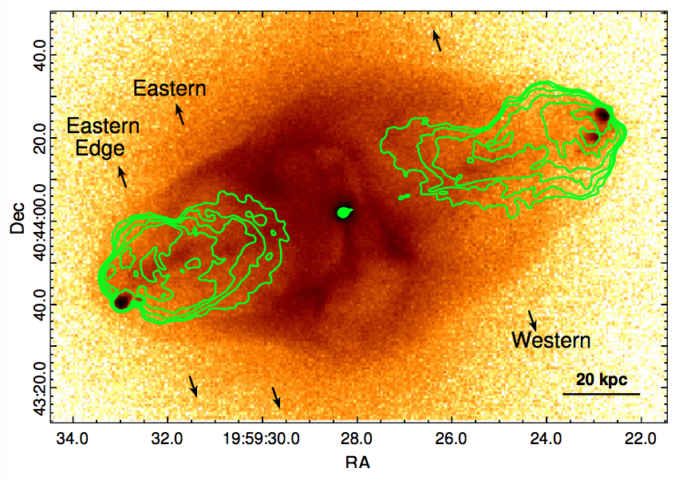
Motivation for new radio obs w. JVLA: CHANDRA 2.2Msec Xray obs
Mpc-scale merging cluster
Bow shocks and jet/lobe – ICM interaction
Non-thermal IC Xrays from radio source
(M. Wise ea)

Slide 3
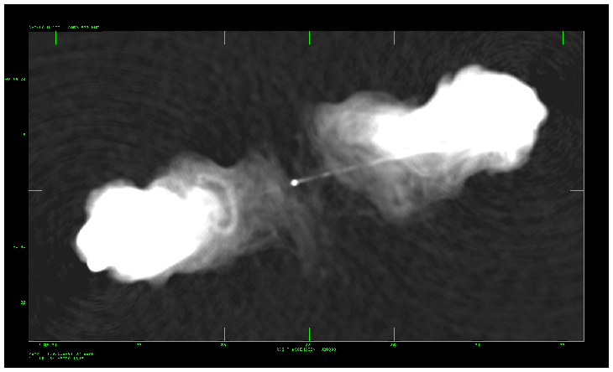
The JVLA Cygnus A Program (Perley)
JVLA: 44 hours, 2 to 18 GHz, all configurations w. 10x BW of old VLA.
Goals: deeper polarization study of the lobes, jet, background sources
First images presented a great surprise!
Deep S-band image (2.0 GHz) showing details of the faint emission. Still dynamic range limited at ~ 10⁴

Slide 4
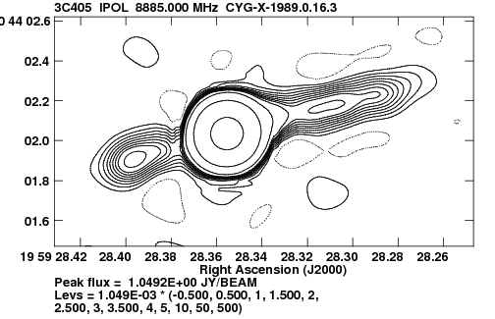
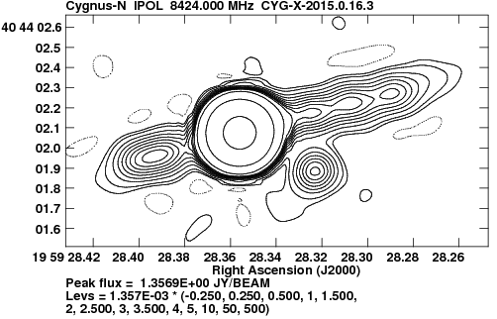
A New Source Appears
1989, 8GHz, 0.2”
New object: = 4 +/- 0.2mJy/beam
0.4 arcseconds from nucleus = 400pc
2016

Slide 5
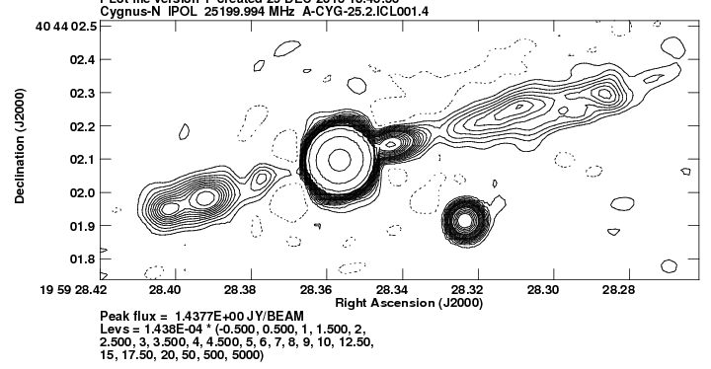
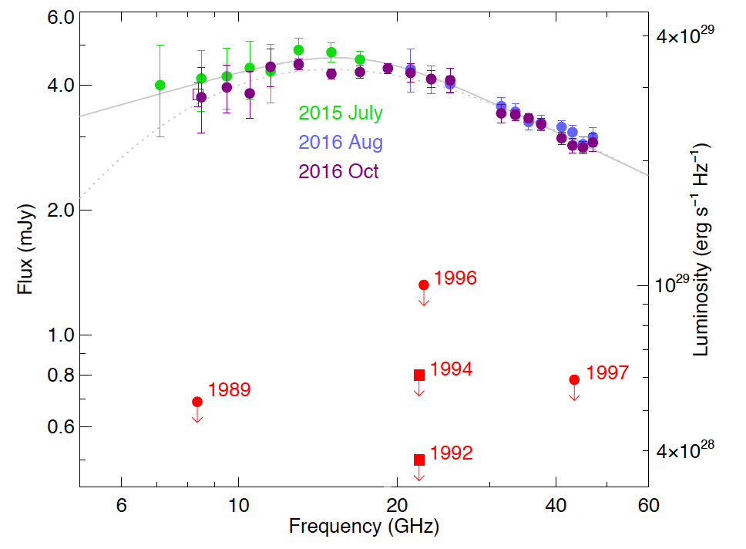
Flat-Spectrum, Brightened Fast, Fading Slowly
25 GHz, 70mas
Two more DDT VLA observations in 2016, 8-50 GHz
Flat spectrum, with low frequency turnover ~15 GHz.
Marginally fading Jul15 to Oct16
Source appeared sometime between 1997 and 2015

Slide 6
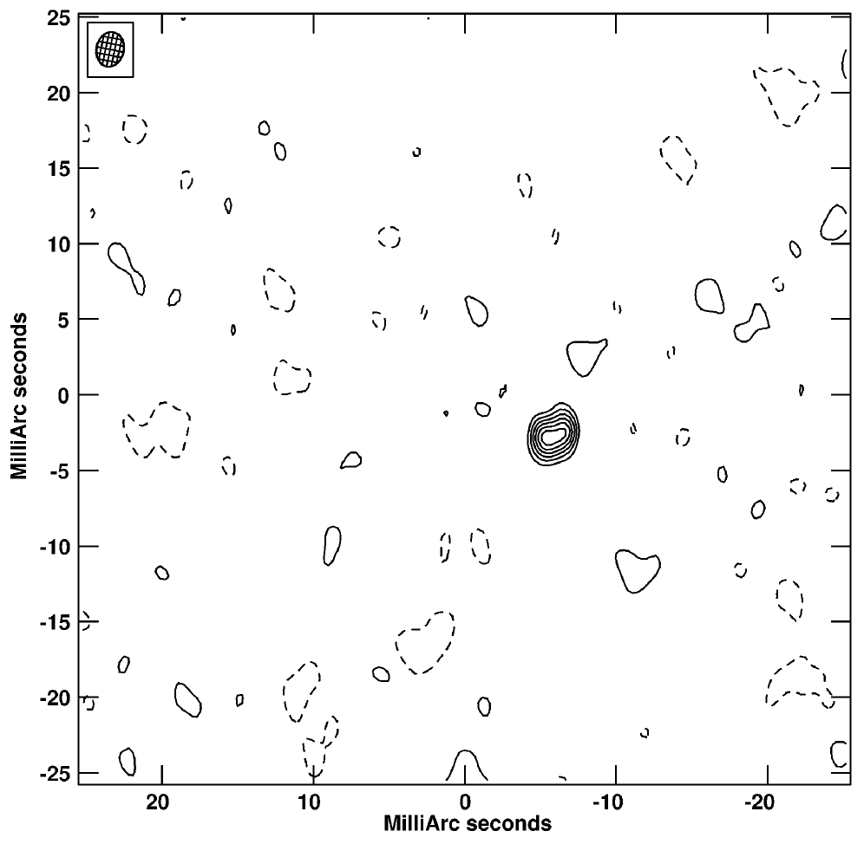
Unresolved, by VLBA
VLBA 8GHz
Unresolved to VLBA (apparent slight resolution likely phase transfer error)
Angular size < 4mas ~ 4 pc
Nonthermal (T_{b}>10⁷ K)
Not expanding superluminally
Lack of scintillation => size > few hundred AU.

Slide 7
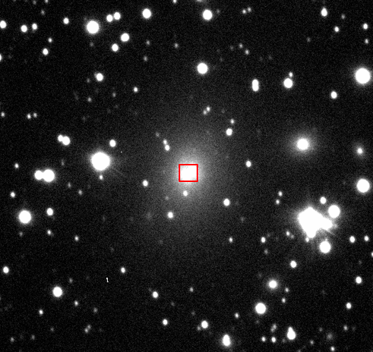
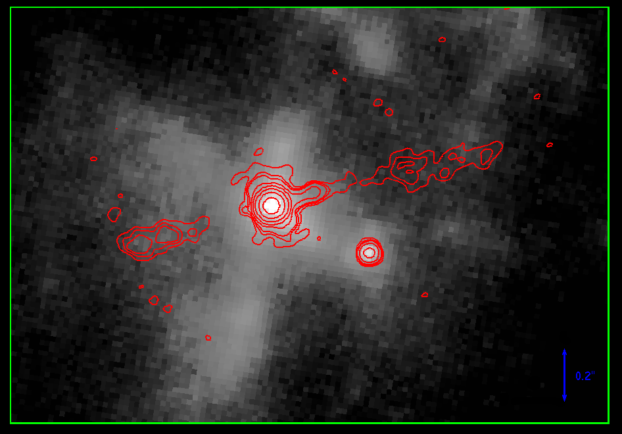
Pre-existing near-infrared counterpart
Gemini i-band 0.8 μm
Keck K-band 2 μm
35GHz
Canalizo+2003
84”
A NIR point source at the same location was discovered in 2002 with adaptive optics + HST
Interpreted by Canalizo as a stripped galaxy core = old stars
Spectrum not definitive: not young SF region but confused by scattered light from Cyg A nucleus

Slide 8
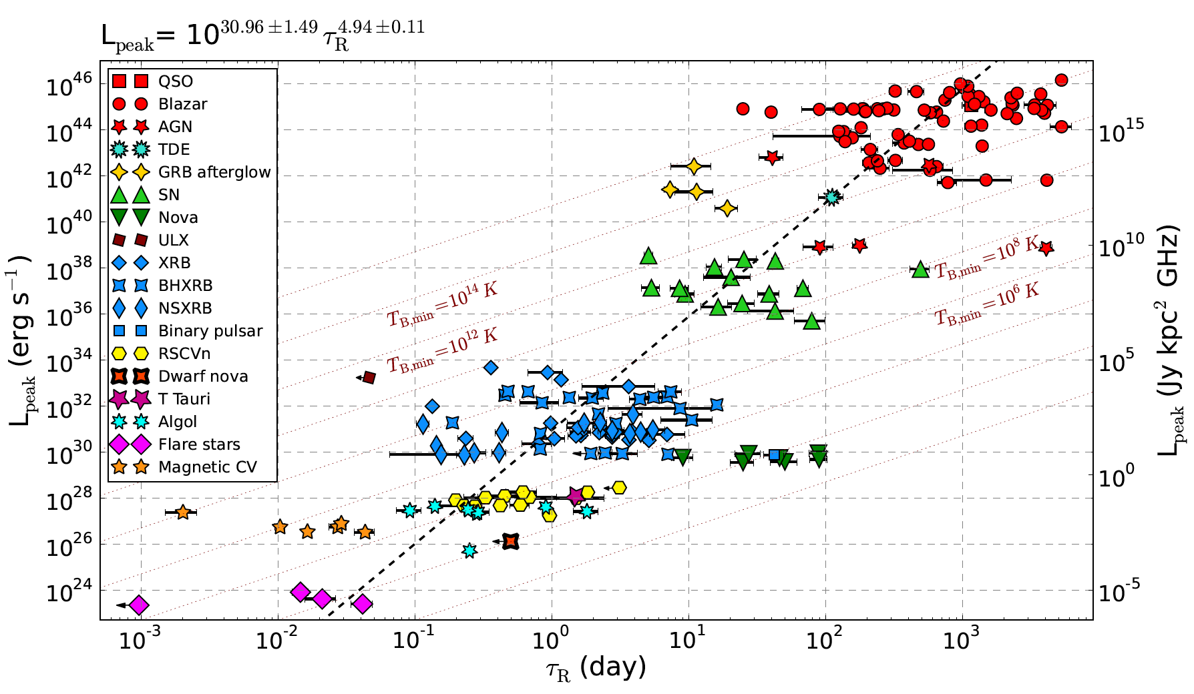
A Luminous Radio Transient
AGN/QSO
GRBs
TDE
SNe
Pietka+2012

Slide 9
Source Properties: Recap
Very likely located in the Cygnus A galaxy (<< 10⁻⁴ chance FG or BG)
Projected distance from nucleus ~400 pc
Smaller than 4pc, larger than 500AU
Luminosity: νF_{ν} ~ 3x10³⁹ erg/s.
About 2x the most luminous known radio supernova, comparable to GRB
Minimal evolution over 15months: much slower than SNe and GBR
Flat-ish spectrum: AGN-like, not SNe-like
Luminosity and time evolution in range of AGN phenomena: TDEs/Jets...
Coincident with bright point-like IR source
Spectrum inconclusive: not a young star-forming region, but dominated by scattered CygA light; no optical variability constraint.

Slide 10
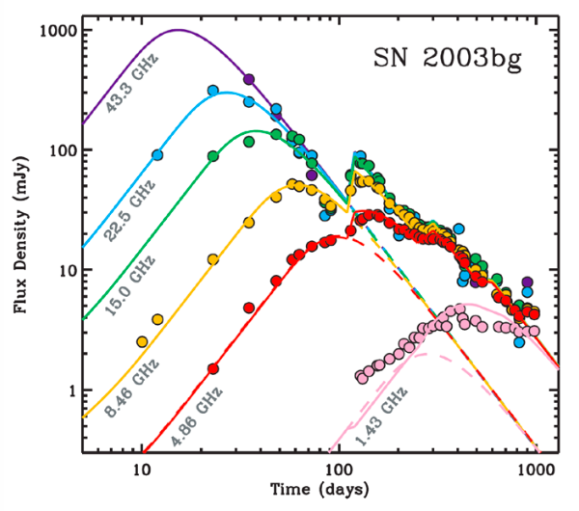
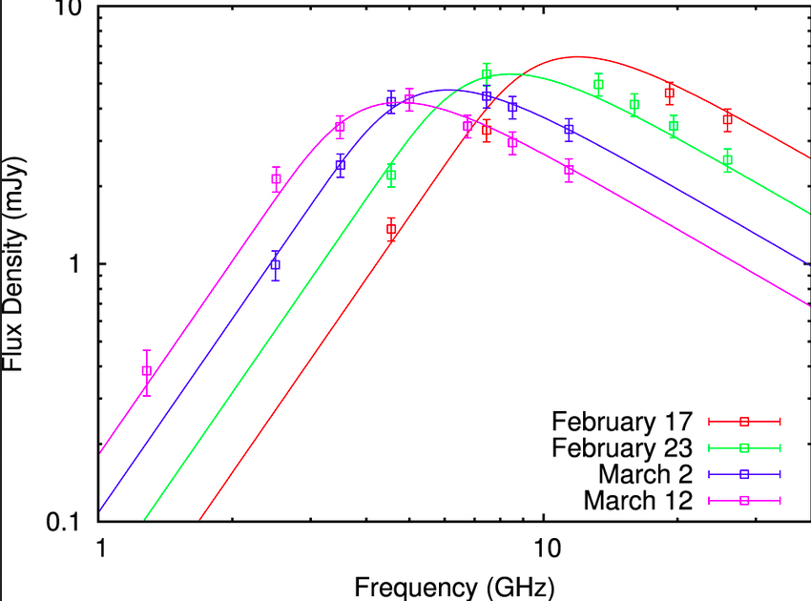
Interpretation
A Binary SMBH (AGN or TDE)
Luminosity, timescale, spectrum, near-IR counterpart all consistent with a flaring/brightening secondary supermassive black hole in Cygnus A.
Consistent with theory that luminous AGNs/QSOs are produced by merger activity.
A radio supernova
Cyg A nucleus does contain abundant star-formation
Would be the most luminous radio SNe ever seen (2x)
No simple explanation for near-IR counterpart (no bright star-formation lines)
Spectrum and no frequency dependent fading is highly uncharacteristic of SNe and GRB

Slide 11
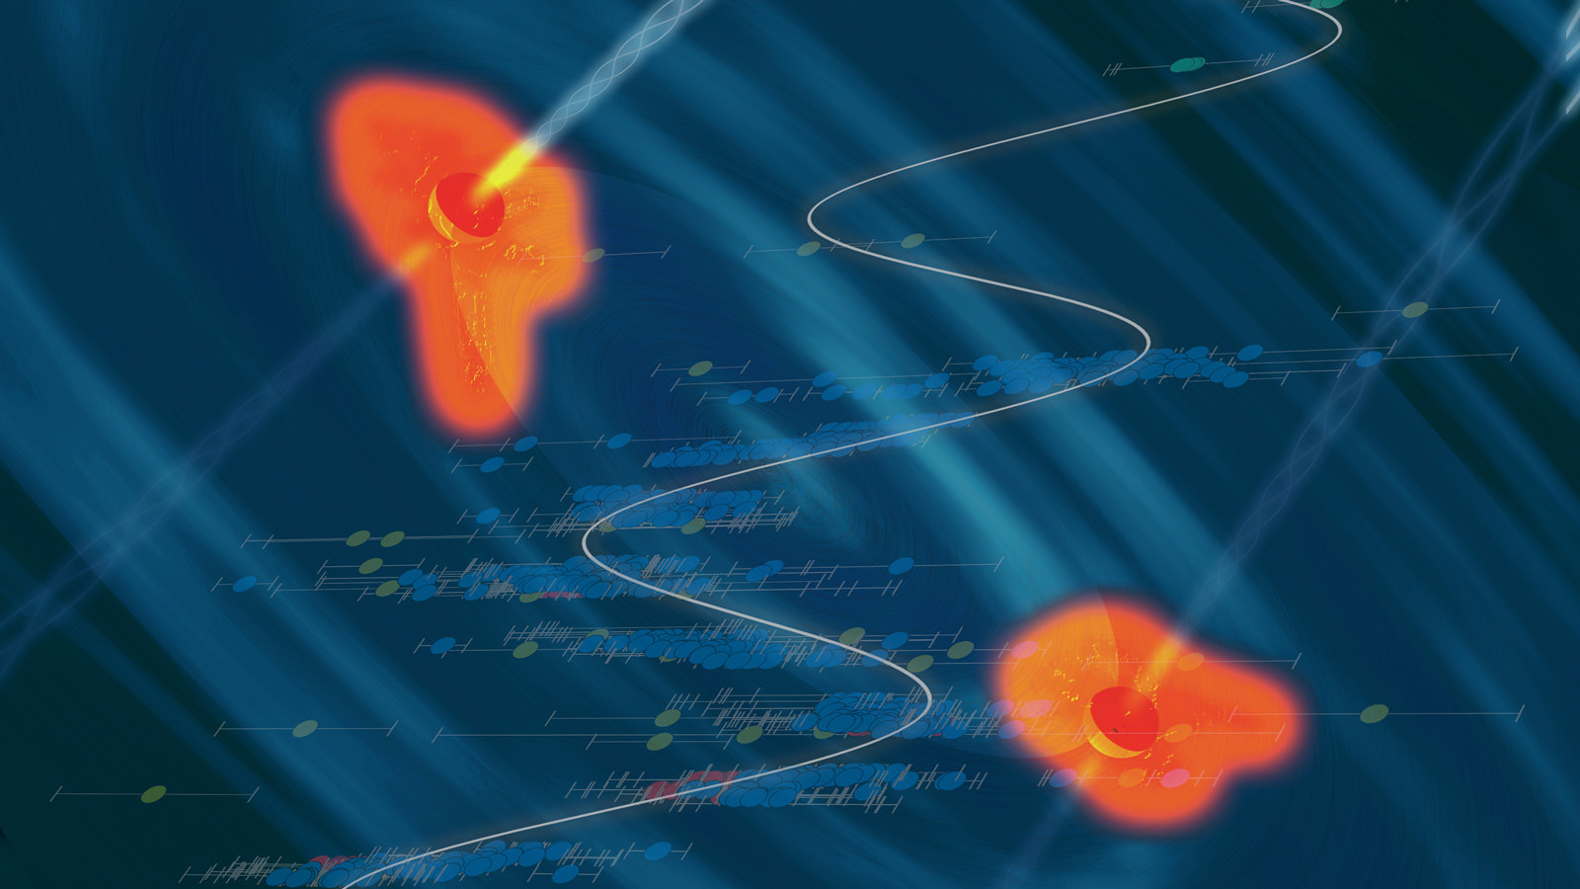
Binary SMBH Implications/Speculations
Rare example of sub-kpc SMBH binary: provides insight into in-spiral/merger process
Orbital period ~10⁷ years ~ age of radio source: search for dynamical influence on jet/lobe structure (eg. jet ‘helix’)?
Just possible to measure orbital motion w. VLBI
Speculation: Proximity of Cyg A allows for 10x higher physical resolution and 100x sensitivity than any other powerful radio AGN. Perhaps many AGN are binary SMBH? Have we looked? What are the implications for eg. merging SMBH statistics and the nano-Hz GW background?

