Slide 1
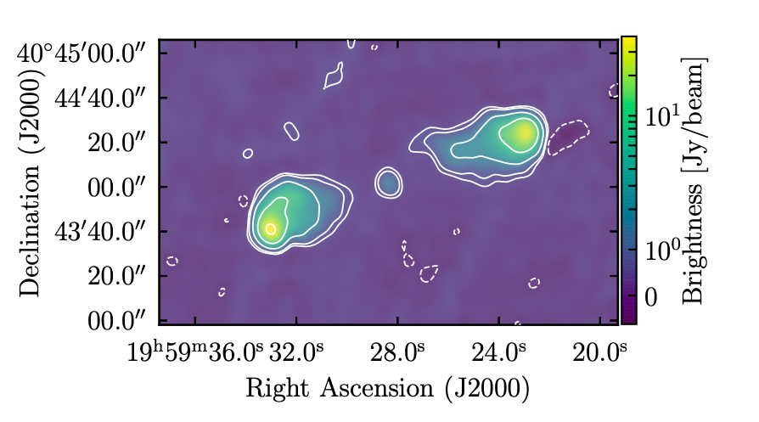
Tests of Image Domain Closure Phase Measurement using VLA data
Visibility phase (wrt reference point), sets fringe position in the image
Shape-Size-Orientation (SSO) Invariance theorem: for a closed triad, resulting image is a true representation of sky brightness, independent of element-based phase corruption (modulo translation)
3C 286 point source: calibrated vs. uncalibrated
9.4 GHz, 20sec, 20 MHz; 𝝈_{th}/vis = 33 mJy
Triad baselines = 7km to 15km
Vis flux = 4.4 Jy
98% correlated flux on selected baselines => 𝝍_{cl} ∼ 0
Cygnus A complex source: calibrated vs. corrupted
8.0 GHz, 8sec, 8 MHz; 𝝈_{th}/vis = 82 mJy
Triad baselines ∼ 0.8km (equilateral)
Vis flux = 23 to 38 Jy
≤ 22% correlated flux on selected baselines => 𝝍_{cl} ≠ 0
Copyright © 2020 AUI/NRAO. All Rights Reserved.
Sebokolodi ea.

Slide 2
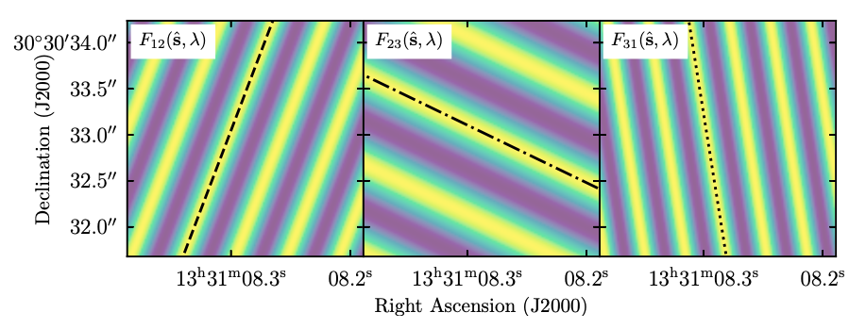
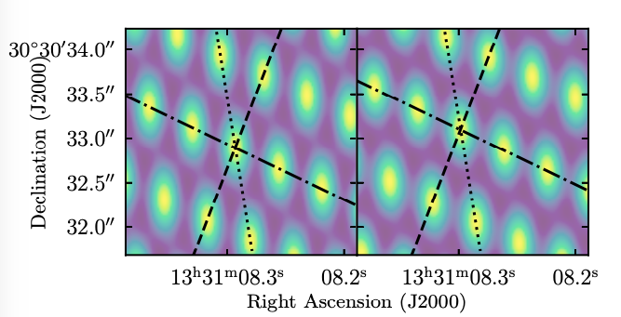
Three Fringes for 3C 286
Image individual baseline fringes, then sum of 3-fringe pattern on closed triad
Visibility phase error => shift perpendicular to fringe direction, w/o changing orientation or fringe spacing
Point source => 𝝍_{cl} ∼ 0 => three fringes intersect in grid of points
calibrated
uncalibrated
Cal vs. uncal on closed triad: shift of pattern, but no change in structure
Copyright © 2020 AUI/NRAO. All Rights Reserved.

Slide 3
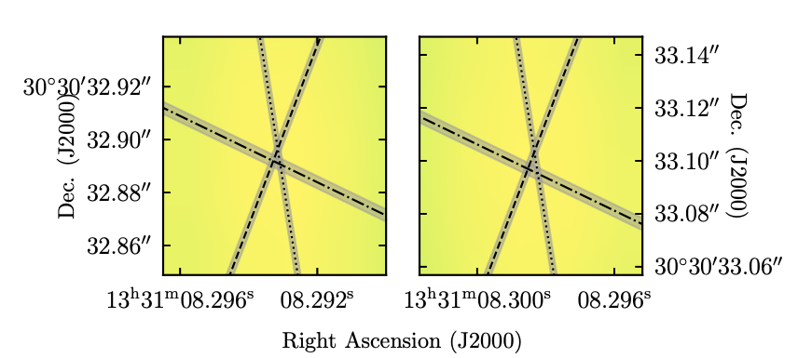
calibrated
uncalibrated
Measurement consistent with zero, within errors
𝛔_{th} of Vis. phase (= image position) ∼ N/S (in radians)
𝜹s’
Corollary: dominant phase corruption terms for VLA are factorizable into antenna-based corrections (ie. not baseline-based)
Image plane closure phase
Calibrated: 1.7 ± 1.3º
Uncalibrated: 2.0 ± 1.3º
Aperture plane closure phase (vis. phases)
Calibrated: 2.6º ± 0.74º
Uncalibrated: 2.0º ± 0.74º
Copyright © 2020 AUI/NRAO. All Rights Reserved.

Slide 4
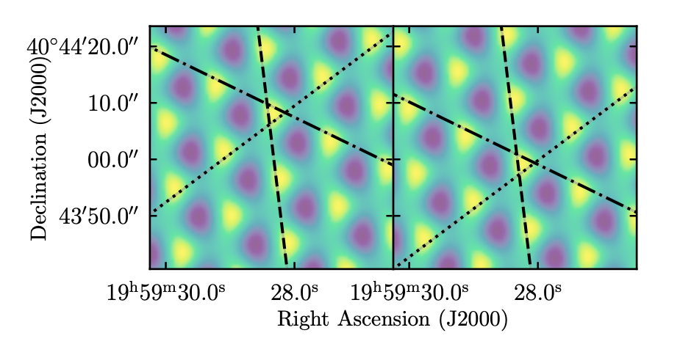
Cygnus A: complex source
calibrated
corrupted
Grid-ish, but not point-like (no 3-fringe intersection) => non-zero 𝝍_{cl}
Calibrated data, then corrupt phase one antenna by 80º
Shift occurs along uncorrupted baseline fringe
Shift along uncorrupted fringe
𝜹s’
Image plane closure phase: 𝜹s’
Calibrated: 113.9º ± 1.5º
Uncalibrated: 112.9º ± 1.5º
Closure phase as visualized in the image plane!
SSO Invariance Theorem: for closed triad of array elements, image is a true representation of the sky brightness, invariant to antenna-based phase corruption (modulo translation).
Note: theorem will not hold for non-closing triad or for baseline-based phase corrutions.
Image plane closure phase: A_{A3} x A_{I3}
Calibrated: 112.5º ± ??º
Uncalibrated: 113.7º ± ??º
Aperture plane closure phase (vis. phases)
Calibrated: 112.7º ± 0.3º
Uncalibrated: 112.7º ± 0.3º
Copyright © 2020 AUI/NRAO. All Rights Reserved.

Slide 5
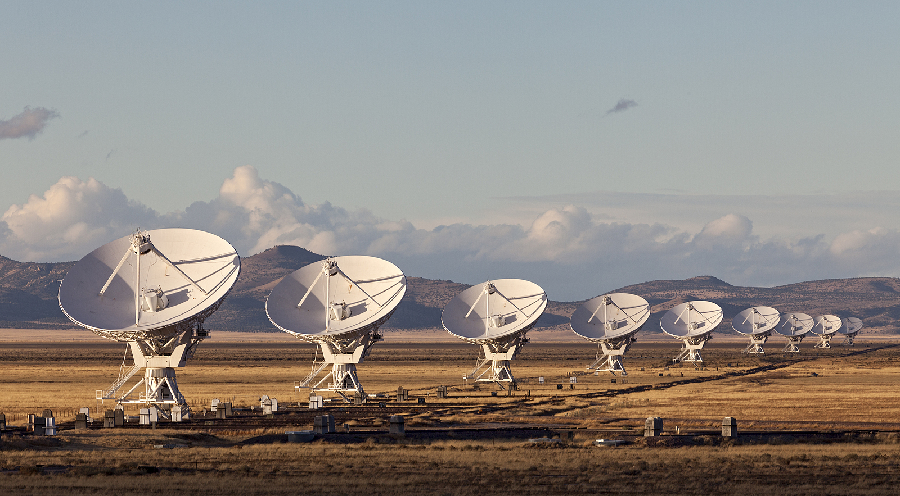
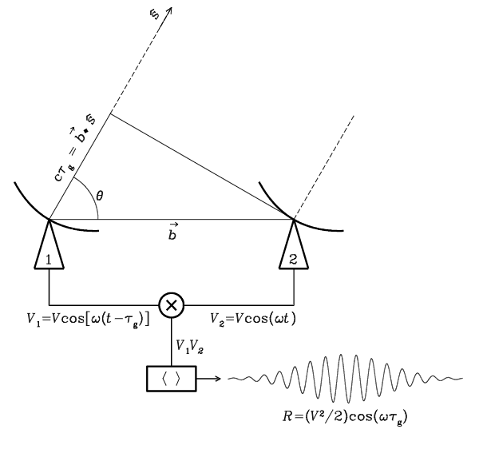

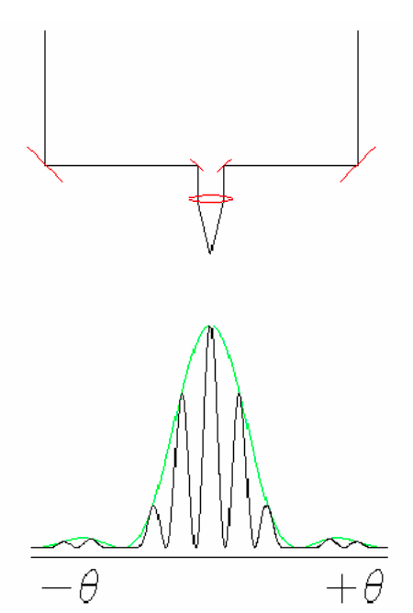
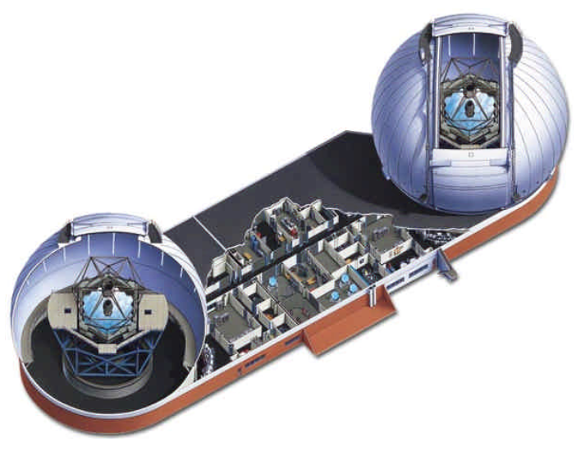
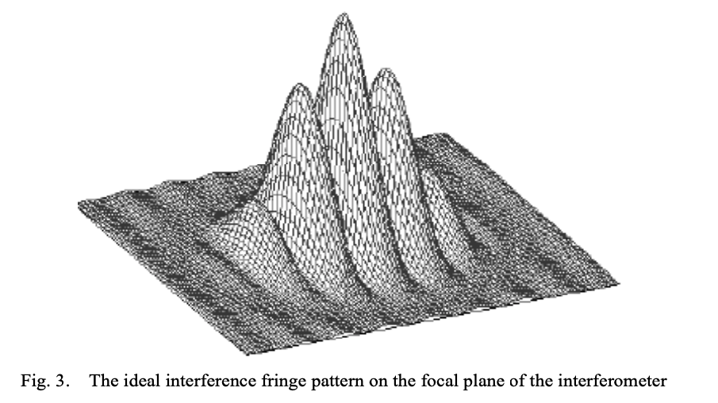
Coherent amplification of voltages, E_{1,2}
Geometric delays set by electronics
Complex cross multiply and average (correlate) directly to aperture plane visibilities
Images made from fourier transform of visibilities w/o ’total power’
Coherence time ~ minutes ~ required calibration time
Radio: direct product are visibilities = aperture plane
E₁ x E₂*
Optical: direct product is image plane
Coherent reflection by mirrors, beam splitters…
Geometric delays set by physical delay lines or primary mirror mask
Correlation via optics and interfere on focal plane, w. ‘total power’
Visibilities generated from FT(image)
Coherence time ~ tens millisec
‘airy disk’ = ‘primary beam’
(E₁ + E₂ )² = E₁² + E₂² + (E₁ x E₂*)
Copyright © 2020 AUI/NRAO. All Rights Reserved.

Slide 6
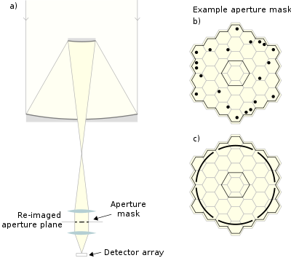
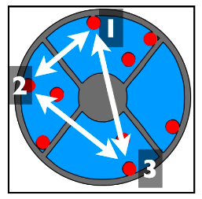
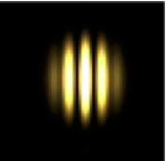
Aperture Masking
Z = to image plane
𝛅𝛟 ~ 𝝳𝓵 ~ 𝝳𝜏
Y
Aperture plane
X
Phase corruption of one element => change optical path-length to focus
Corresponds to a ‘tilt’ of the triad in aperture plane, leading so a shift of the fringe pattern in the image plane (three points define a plane)
Copyright © 2020 AUI/NRAO. All Rights Reserved.

