Slide 1
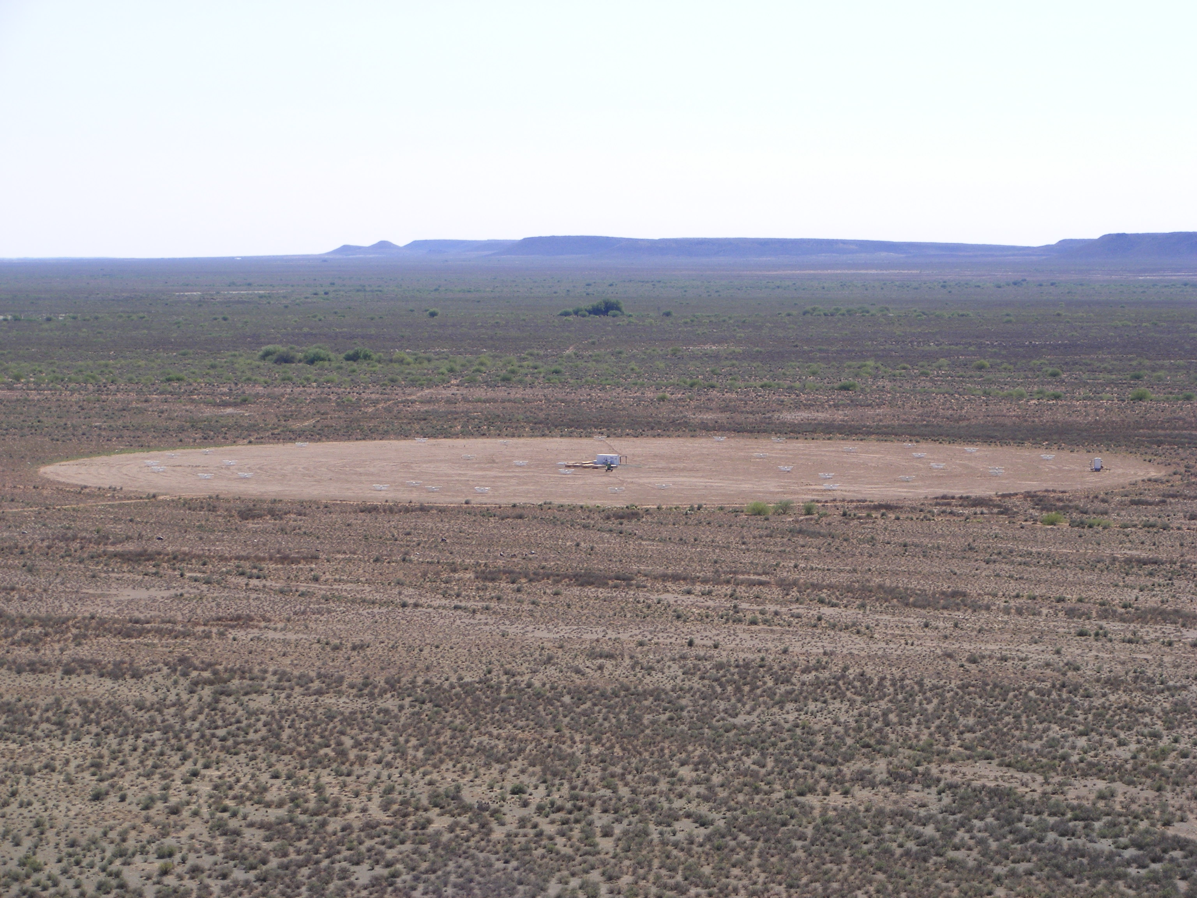
When did the first stars and black holes form, and how did they reionize the Universe?
The last frontier in observational cosmology
Chris Carilli (NRAO)
Chautauqua School, July 2011
Pushing back to first light: introduction to cosmic reionization, and the first observational constraints
The search for the HI 21cm signal from the neutral Intergalactic Medium (IGM) during reionization: low frequency telescopes and challenges

Slide 2
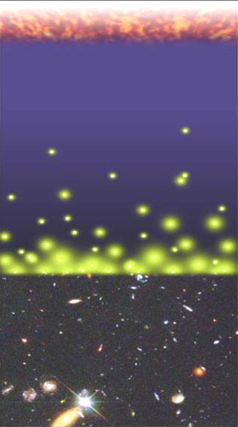
Big Bang: fully ionized
History of Hydrogen (= IGM)
Recombination
0.4 Myr
z = 1000
fully neutral: f(HI) ~ 1
Cosmic time
Redshift
Reionization
1 Gyr
z ~ 7 to 15
fully ionized: f(HI) ~ 10⁻⁵
13.7Gyr
z = 0

Slide 3
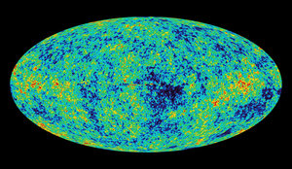
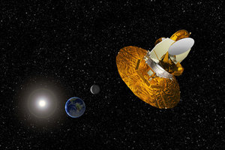
Cosmic microwave background radiation
Chris Carilli (NRAO)
Berlin June 29, 2005
Recombination
Early structure formation
WMAP: imprint of primordial structure from the Big Bang = seeds for galaxy formation

Slide 4
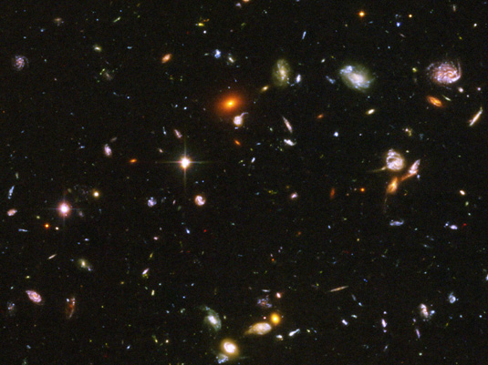
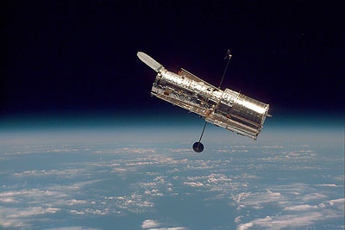
UDF: trace galaxy formation from z = 0 to 7 (t_{univ} < 1Gyr)!
Late structure formation Realm of the Galaxies
Hubble Space Telescope

Slide 5
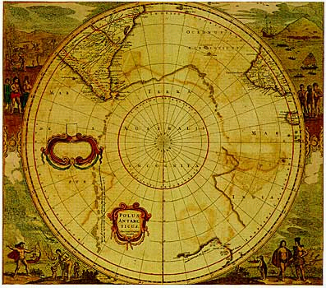
Universum incognito
Dark ages
Cosmic reionization and first (new) light: Last phase of cosmic evolution to be tested and explored
Sets fundamental benchmark in cosmology = formation of first galaxies and quasars
Today’s focus: Evolution of the neutral intergalactic medium = ‘richest of all cosmological data sets’
Cosmic Reionization

Slide 6
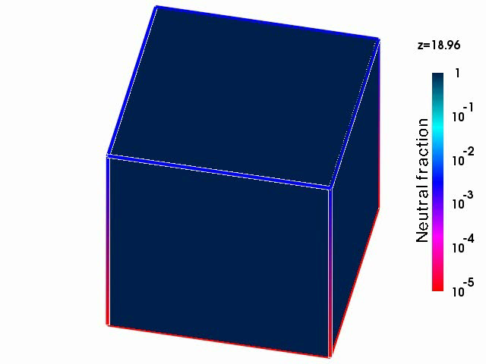
Numerical Simulations of the evolution of the Intergalactic Medium (IGM) through reionization
Scale ~ 30 MLyr
Three phases
Dark Ages
Isolated bubbles (slow)
Percolation: overlapping bubbles (fast)

Slide 7
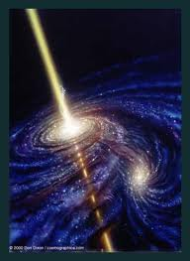
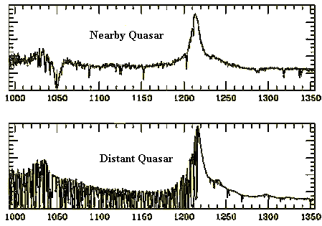
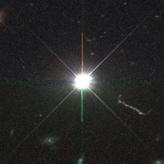
Back to the beginning: search for reionization
Quasar = accreting supermassive black hole. M_{BH} ~ 10⁹ M_{o}
Quasar spectra = beacons to reionization
Lya scattering by neutral clouds in IGM
Ly α emission
Luminosity = 1000x Galaxy
Ly α forest

Slide 8
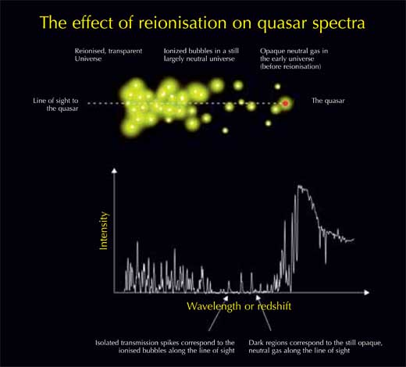
Gunn-Peterson absorption

Slide 9
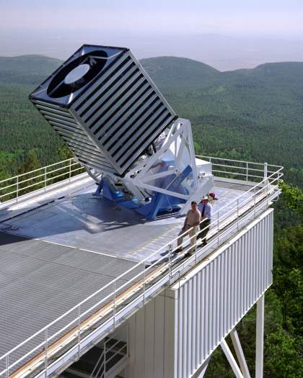
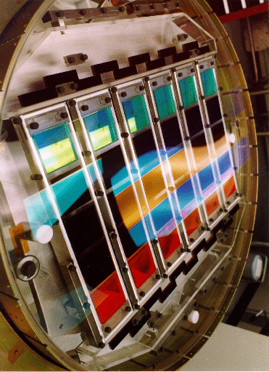
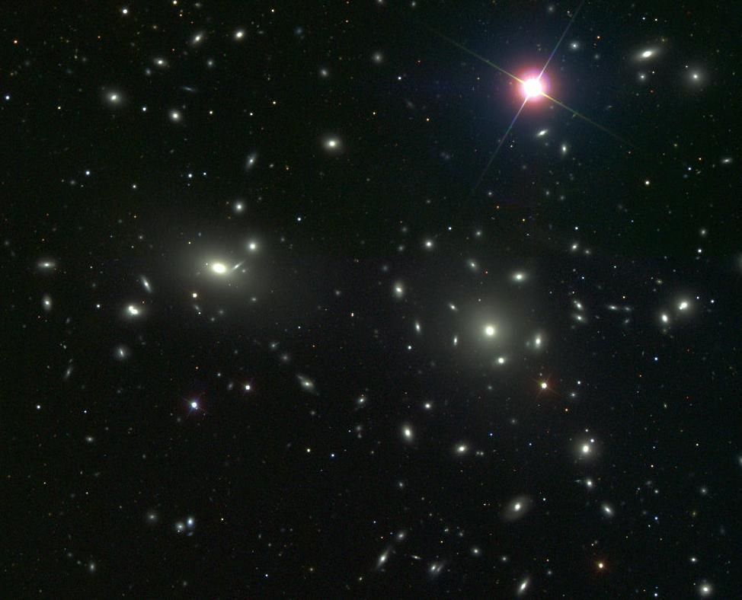
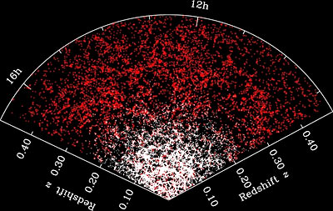
The search for quasars at the edge of the Universe:
Sloan Digital Sky Survey
Digitize the Universe: ‘half-sky’ images in 5 colors
40,000,000 objects cataloged: stars, galaxies, quasars
Problem: sifting!
Notes:
SDSS What 1. The SDSS is a project to digitally map over 10,000 square degrees of the sky in 5 colors and to obtain spectra for all of the brightest objects that the imaging survey finds. It is a private venture among a number of institutions that is funded by the institutions, the Sloan Foundation, NSF, DOE, NASA and the Japanese.

Slide 10
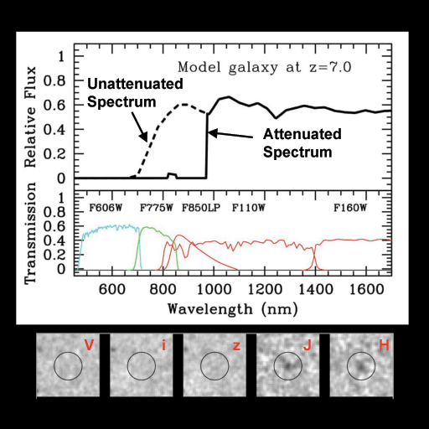
Initial sifting: Optical/nearIR ‘Drop-outs’ = attenuation by Lya forest/IGM.
Select reddest points sources

Slide 11
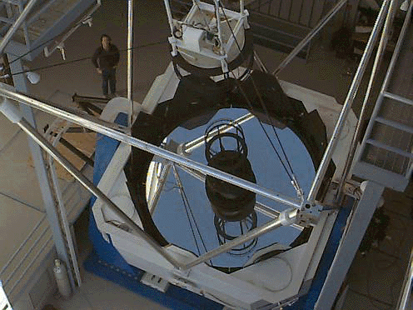
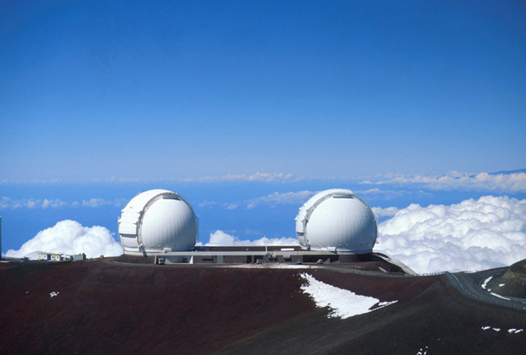
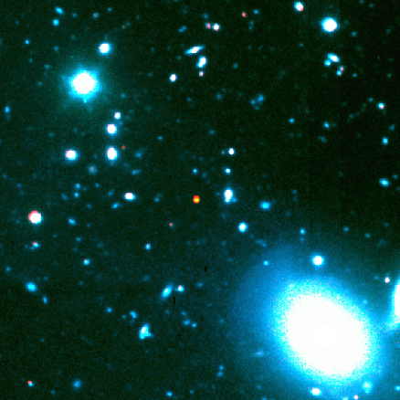
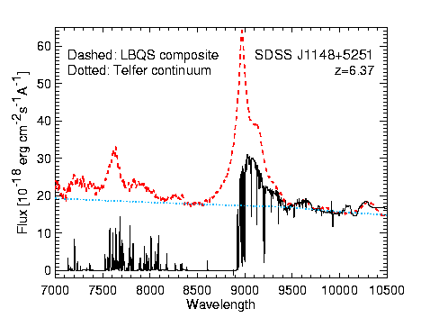
Finding the most distant quasars: needles in a haystack
APO 3.5m
Keck (Hawaii) 10m
1. SDSS database:
40 million objects
3. Spectroscopic identification
~20 objects
4. Detailed spectra
20 quasars at z>6
2. Color selection:
~200 very red objects
0.87Gyr
1 in 4,000,000 objects!

Slide 12
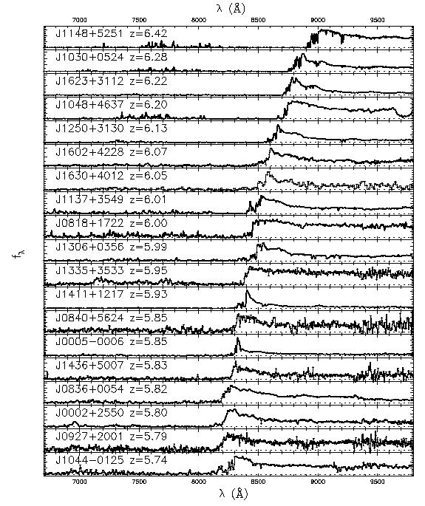
0.87Gyr
Gunn-Peterson effect
SDSS z~6 quasars => Universe is becoming optically thick to Lya => partially neutral IGM?
f(HI) > 10⁻³
z=6.4
1.0 Gyr
Fan et al 2006

Slide 13
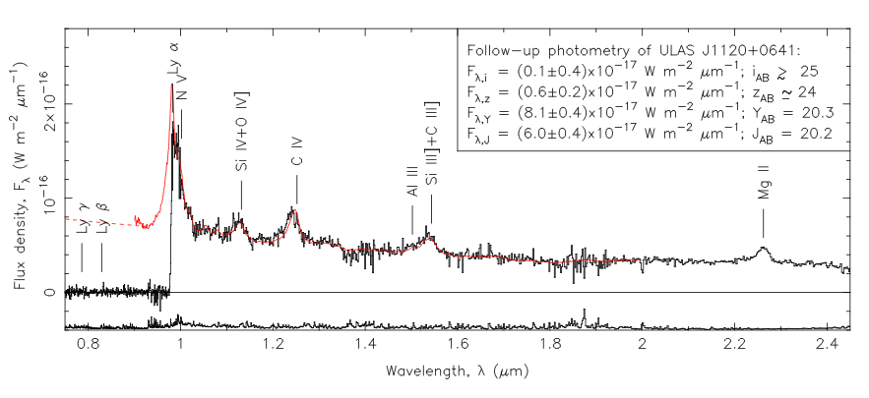
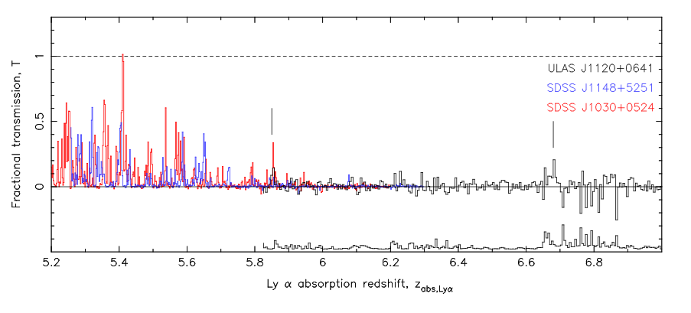
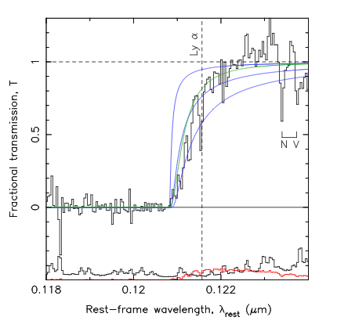
Breaking news: highest redshift quasar, z=7.1
Clear GP absorption trough: τ > 5 => IGM opaque to Lya
Damped Lya profile => N(HI) > 10^{20.5} => f(HI) > 0.1
How to form 10⁹ M_{o} black hole in 750Myr?
Mortlock ea.

Slide 14
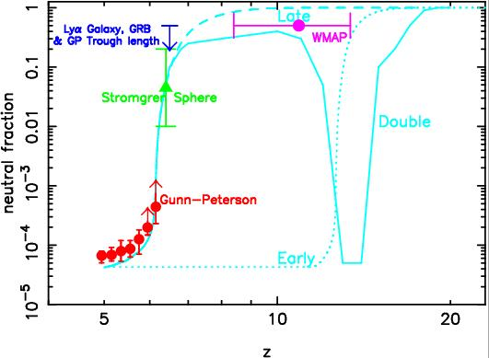
Discovery of the end of cosmic reionization at z ~ 7
DLA z=7.1
Remarkable discovery: first indication of neutral IGM + reionization
Major limitation: GP effect saturates at low neutral fraction
Need alternative means of probing reionization

Slide 15

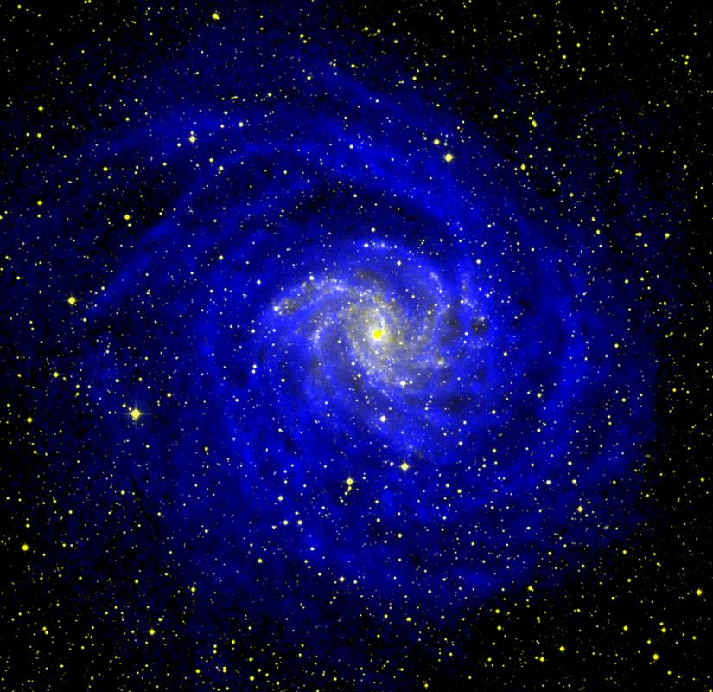

HI 21cm line: Most direct probe of the cosmic reionization
Radio => Hydrogen Gas
HI spin flip => 21cm radiation
z > 6 => redshifts to 1.5m wavelength (<200MHz)
Weak transition => doesn’t saturate

Slide 16
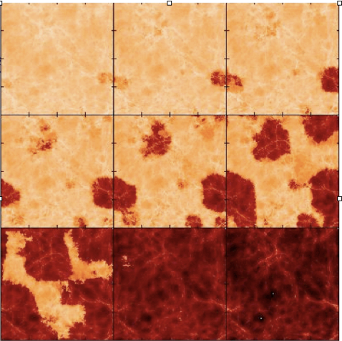
HI 21cm Tomography of the Universe => observe IGM directly
0.4Gyr, 109MHz
ΔTB ~ 20 mK
0.8Gyr, 177MHz
6 MLyr

Slide 17
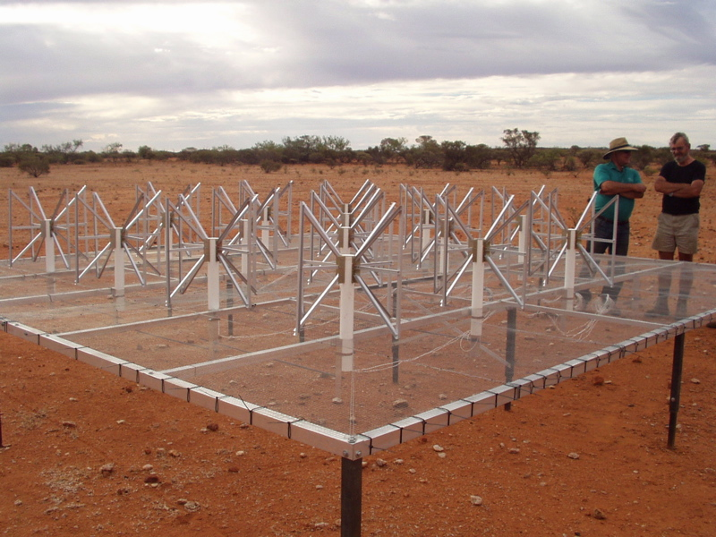
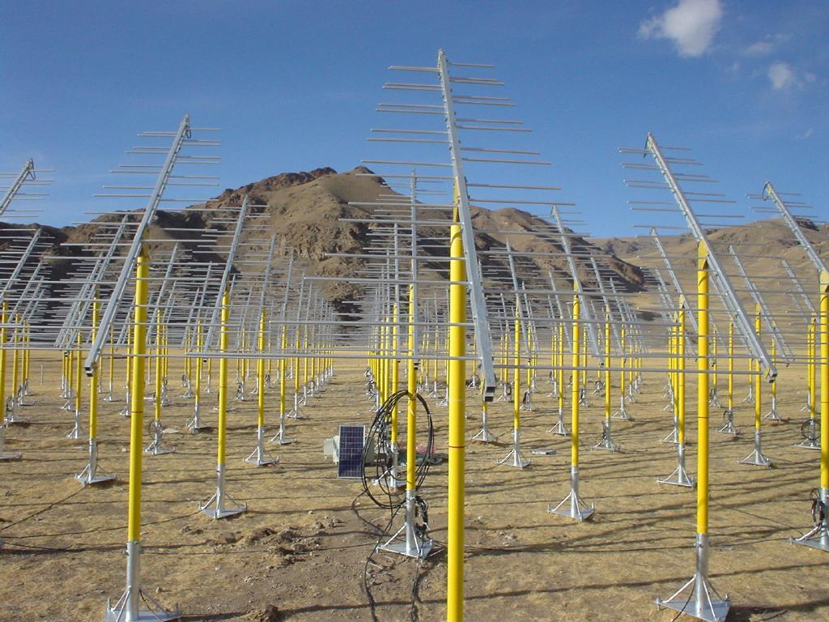
Global race to reionization: low frequency radio arrays
MWA Oz
21CMA: 10,000 Dipoles in Western China
 | Site | Type | Freq MHz | Area m² | Goal | Date
GMRT | India | Parabola | 150-165 | 4e4 | CSS | 2009
21CMA | China | Dipole | 70-200 | 1e5 | PS | 2008
PAPER | GB/SA | Dipole | 110-200 | 5e3 | PS/CSS | 2009
MWAdemo | Oz | Aperture | 80-300 | 1e4 | PS/CSS | 2009
LOFAR | NL | Aperture | 115-240 | 1e5 | PS/CSS | 2010
SKA | ?? | Aperture | 30-300 | 1e6 | Imaging | ??

Slide 18
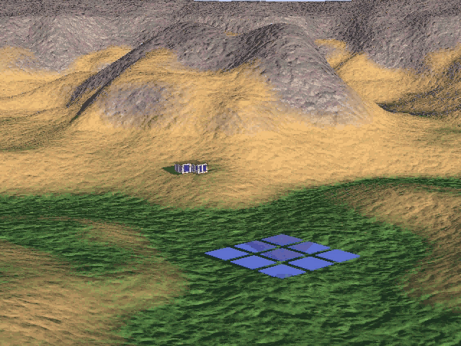

Slide 19
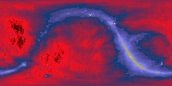
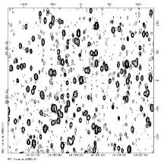
Challenge I: Low frequency foreground – hot, confused sky
Haslam, Eberg 408MHz
Coldest regions: T ~ 200 Κ = 10⁴ x 21cm signal
Highly ‘confused’

Slide 20
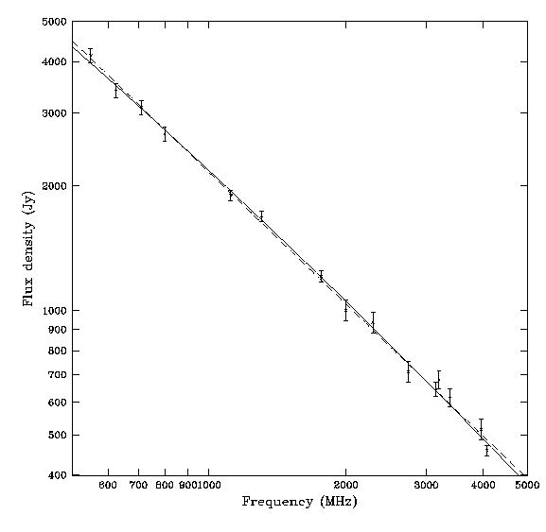
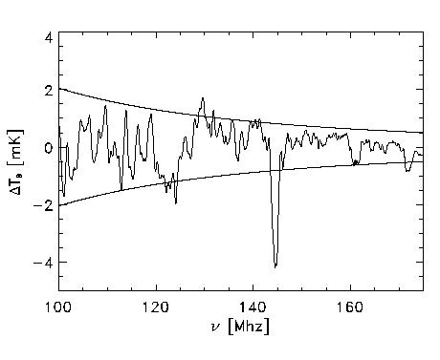
Solution: spectral decomposition (eg. Morales, Gnedin…)
Foreground = non-thermal = featureless over ~ 100’s MHz
Signal = fine scale structure on scales ~ few MHz
Cygnus A
Signal/Sky ~ 2e-5
10’ FoV; SKA 1000hrs
500MHz
5000MHz
Requires gain calibration to ~ 0.1% accuracy

Slide 21
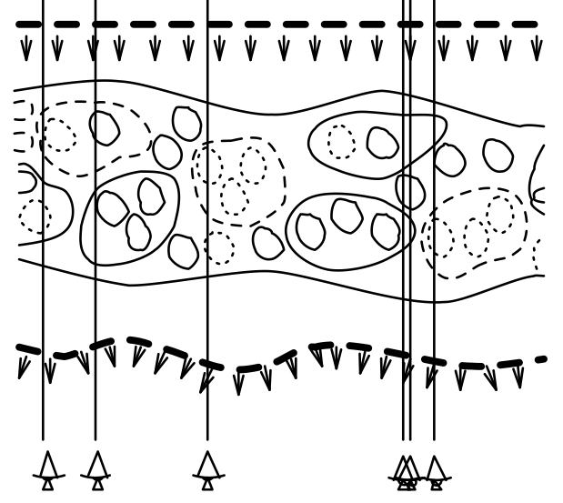
Challenge II: Ionospheric ‘seeing’
Fluctuations in ionospheric electron content causes interferometric phase errors at low radio frequencies ~ ‘radio seeing’

Slide 22
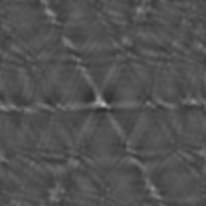
Challenge II: Ionospheric ‘seeing’
TIDs – ‘fuzz-out’ sources
Solution: spatial/temporal calibration = Wide field ‘rubber screen’ phase self-calibration using data-rich sky
15’
Virgo A VLA 74 MHz Lane + 02

Slide 23
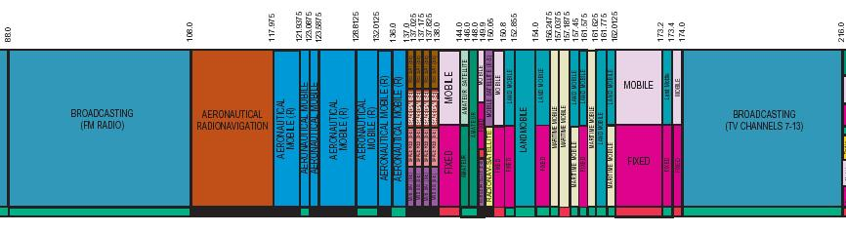
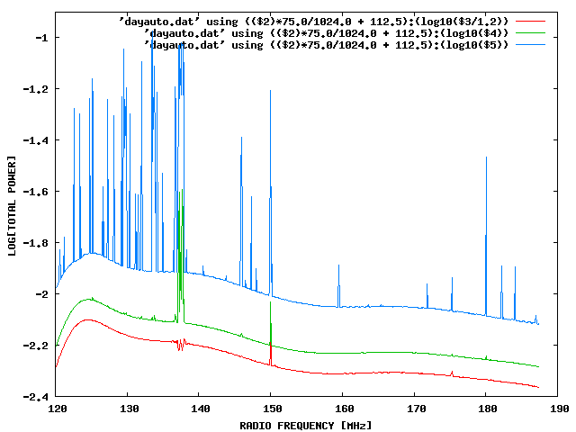
Challenge III: Interference
100 MHz z=13
200 MHz z=6
Solutions -- RFI Mitigation (Ellingson06)
Digital filtering
Beam nulling
Real-time ‘reference beam’
LOCATION!
Aircraft
Orbcomm
TV

Slide 24
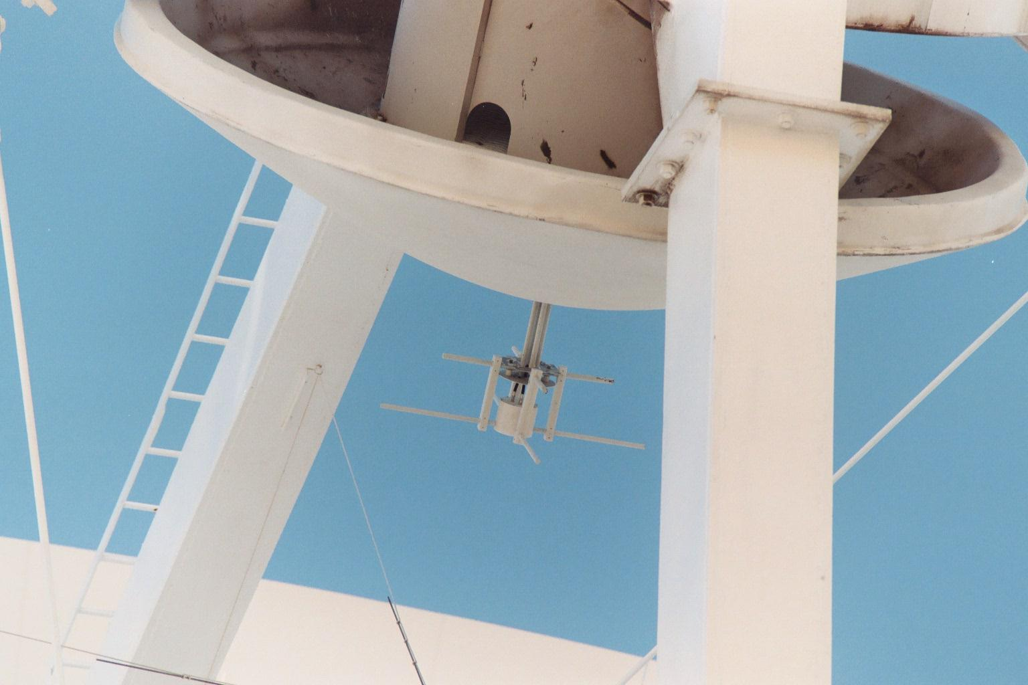
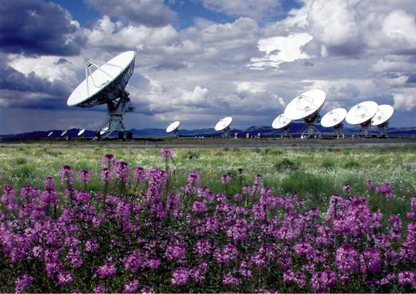
VLA-VHF: 180 – 200 MHz Prime focus X-dipole Greenhill, Blundell (SAO); Carilli, Perley (NRAO)
Leverage: existing telescopes, IF, correlator, operations
$110K design and construction
First light: Feb 16, 05
Four element interferometry: May 05
Goal: first detection Winter 06/07

Slide 25
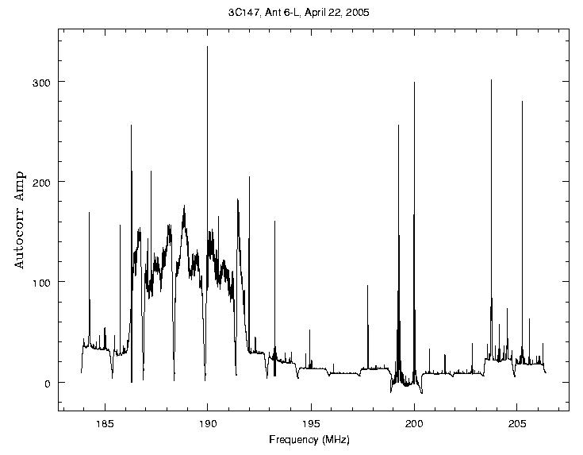
Project abandoned: Digital TV
KNMD Ch 9
150W at 100km

Slide 26
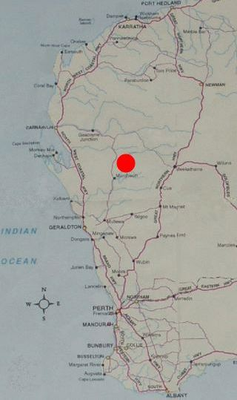
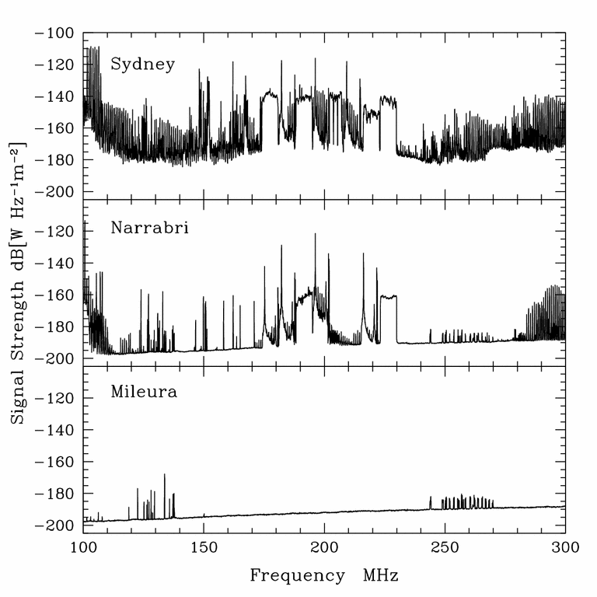
RFI mitigation: location, location location…
100 people km⁻²
~VLA
1 km⁻²
0.01 km⁻²
Chippendale & Beresford 2007

Slide 27
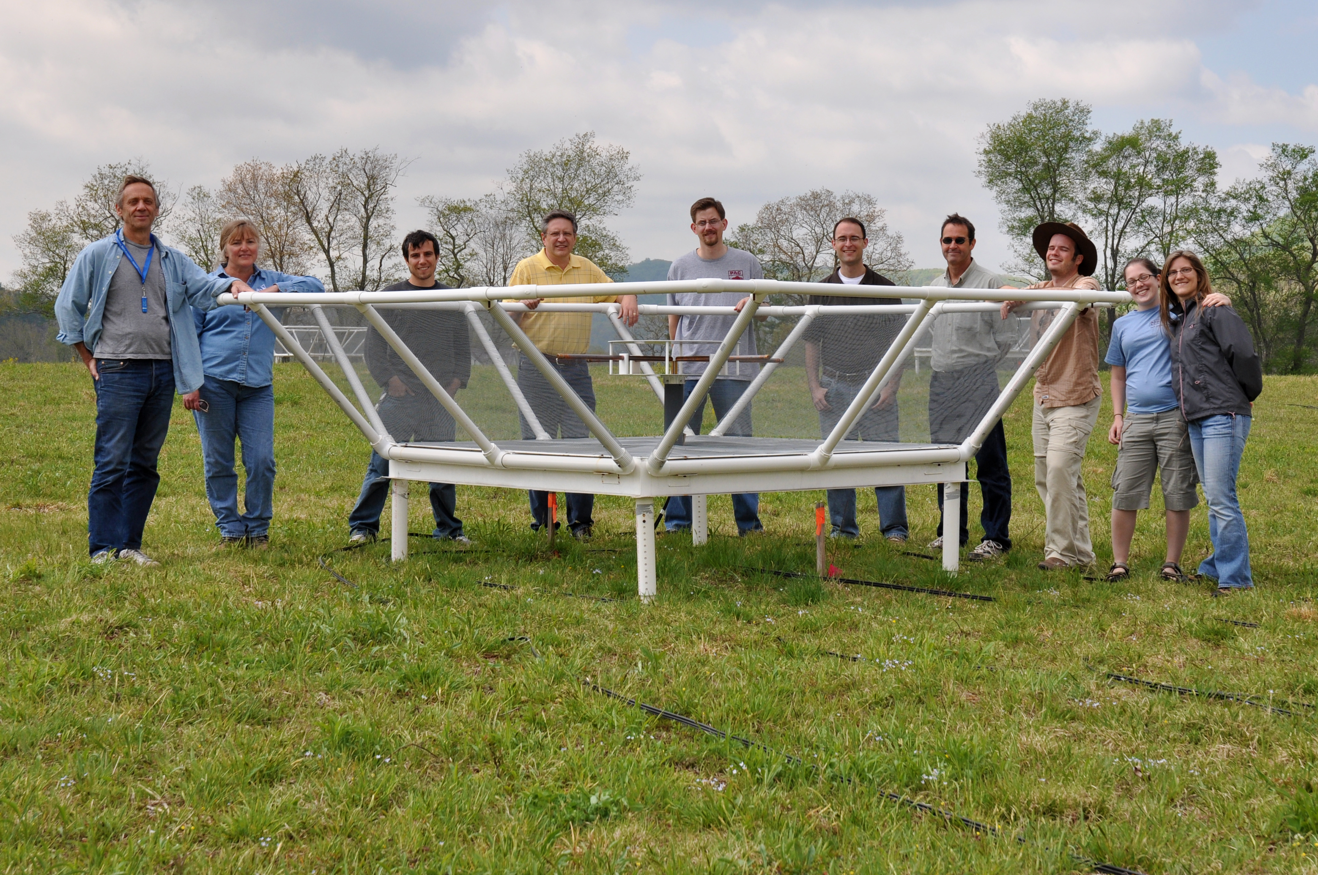
PAPER: Precision Array to Probe the Epoch of Reionization
Engineering array in radio quiet zone, Greenbank: 32 stations
Science array in Karoo, South Africa: 128 stations

Slide 28
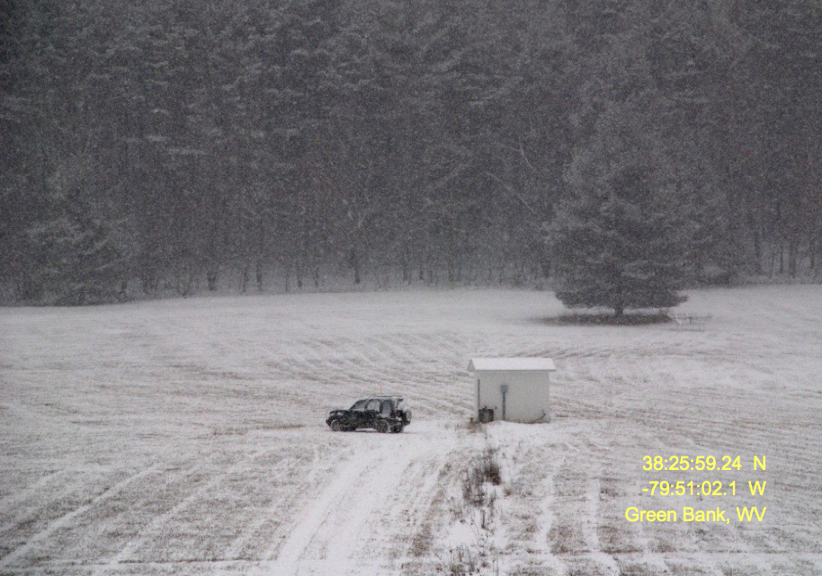
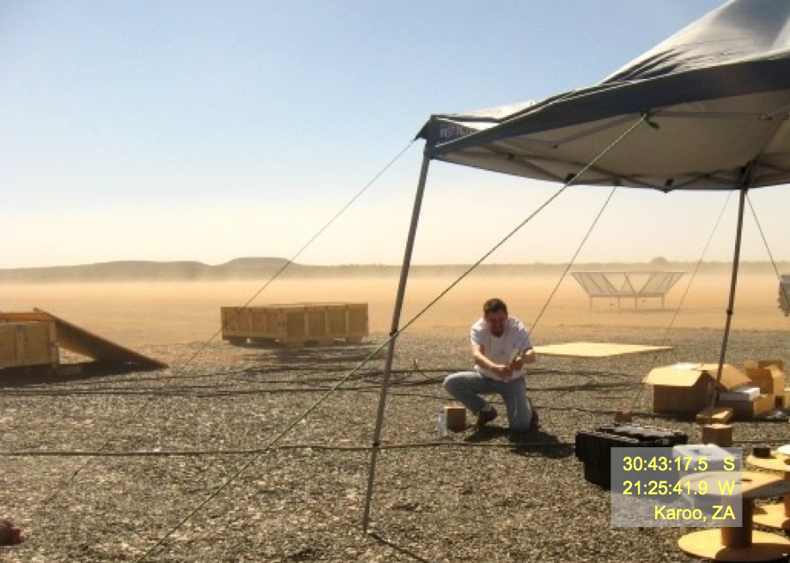
Braving the harsh winters in Green Bank, WV
Braving the harsh summers in Karoo, SA

Slide 29
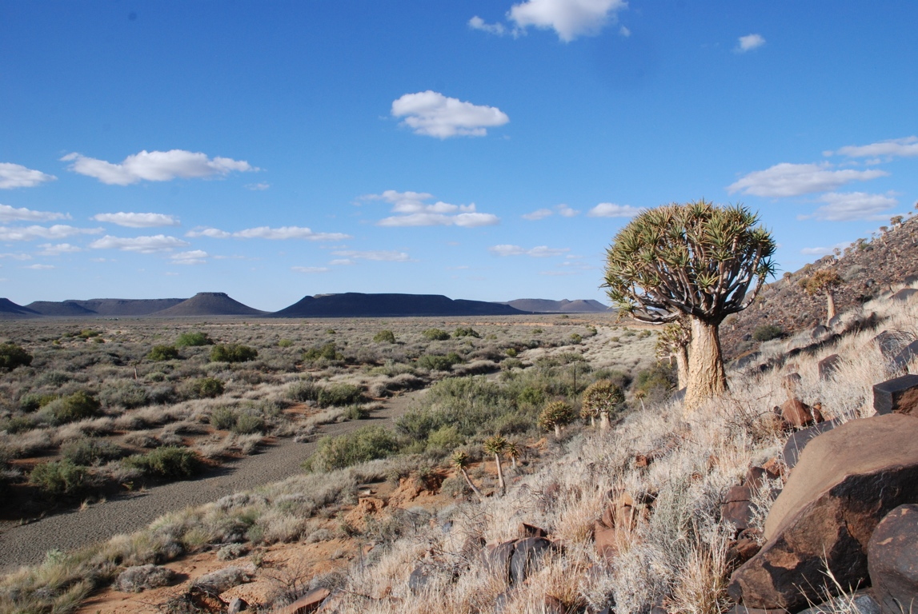
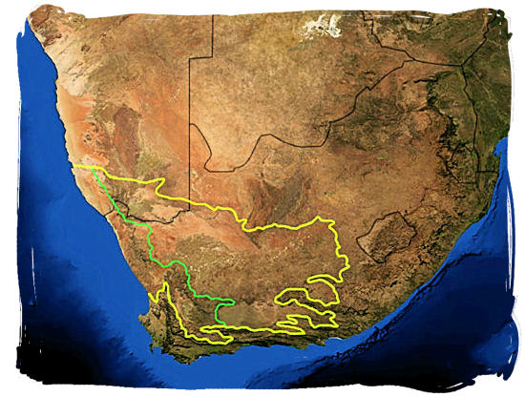
Karoo Site: PAPER
Cape Town

Slide 30
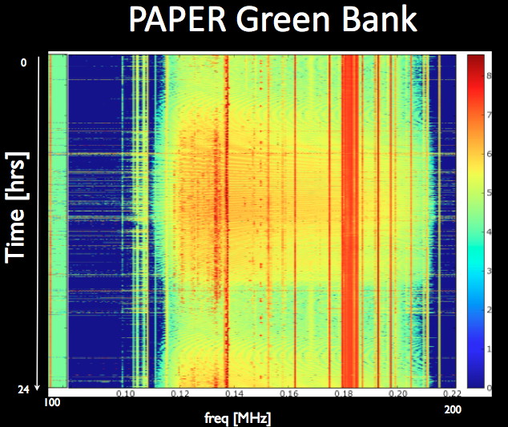

Interference
PAPER South Africa
FM
OrbComm
OrbComm
100MHz
200MHz
100MHz
200MHz

Slide 31



PAPER: Staged Engineering
‘Clean machine’: frequency, angle
Mitigate calibration requirements
100MHz
200MHz
Beam response

Slide 32

PAPER: Staged Engineering
FPGA-based correlator from Berkeley wireless lab (Casper): ‘packetized correlator’ using commercial data routers and 10GbE links
Easily scalable and reconfigurable with increasing number of antennas
Output data rate = 32 GB/hour

Slide 33




Field help from engineering students from Durban, SA, and SKA-SA

Slide 34

PAPER SA Southern Sky
150MHz
Explore foregrounds

Slide 35



PAPER GB
CygX region
G82.2+5.3
Cygnus A
G78.2+2.1
W51 region
Galactic plane
16 elements
Res. = 15’
DNR > 10³
G49.2-0.7

Slide 36

PAPER
Expansion to 64 elements July 2011
Expansion to 128 elements July 2012
First detection of the HI 21cm signal from reionization by 2013!

Slide 37



Destination: Moon!
No interference
No ionosphere
Only place to study dark ages (< 60 MHz)
RAE2 1973
10MHz

Slide 38



J. Burns, PI Colorado
Low frequency array on far side: recognized as top astronomy priority for NASA Lunar exploration
Near-term goal: orbiting lunar dipole for low frequency ‘all sky’ measurements (DARE)
Long term goal: low frequency array on far-side
Relies on future heavy lift capabilities of Ares V (10m diameter faring, 65 tons to moon)

Slide 39


Dark Ages Radio Explorer
All-sky HI 21cm brightness: only way to study pre-reionization/dark ages.
Expect clear spectral features due to evolution of IGM
z= 11 to 35 => 40 to 120 MHz (t_{univ} = 80 to 420 Myr)
Lunar orbit: observe in earth/sun dark time
NASA proposal: 3 year mission, launch 2016
Burns ea

Slide 40
Lunar array: 2weeks of dark => power problem
Solution: polar craters of eternal darkness, peaks of eternal light = eternal power
Tsiolkovsky crater
(100 km diameter)
20°S 129°E
Apollo 15

Slide 41

Depolyment: Javelines?
European Aeronautic Defense and Space Corporation/ASTRON

Slide 42

Cosmic reionization: the last frontier in observational cosmology
First new light in the Universe: galaxies, black holes constraints
GP effect in quasar spectra: first evidence for a neutral IGM!
Low frequency arrays: using the HI 21cm line for 3D tomography of reionization
LUNAR: probing the dark ages from the dark side of the moon
Dark Ages (> 0.4Myr)
Reionization (~ 1Gyr)

Slide 43


Say, its only a PAPER moon
Sailing over a cardboard sea
But it wouldn't be make-believe
If you believed in me

Slide 44

Night sky (OH) lines: closing the window on the early Universe
z_{lya} = 6.2
6.7
7.2

Slide 45



Time = Distance
Looking into the Past
Because the light emitted in the distant past is only now arriving at the Earth.

Slide 46

Age of precision cosmology
The amazing and accelerating universe
Age of Universe = 13.7 +/-0.2 Gyr
Mass/Energy Contents of the Universe:
  70% Dark Energy
  27% Dark Matter
  3% Baryons
Cosmic expansion => light from distant galaxies gets ‘stretched’ or redshifted to longer wavelengths.
Measurement of the redshift => distance

Slide 47

Initial sifting: Optical/nearIR Continuum ‘Drop-outs’
Select reddest point sources = attenuation of blue light by Lya forest

