Slide 1
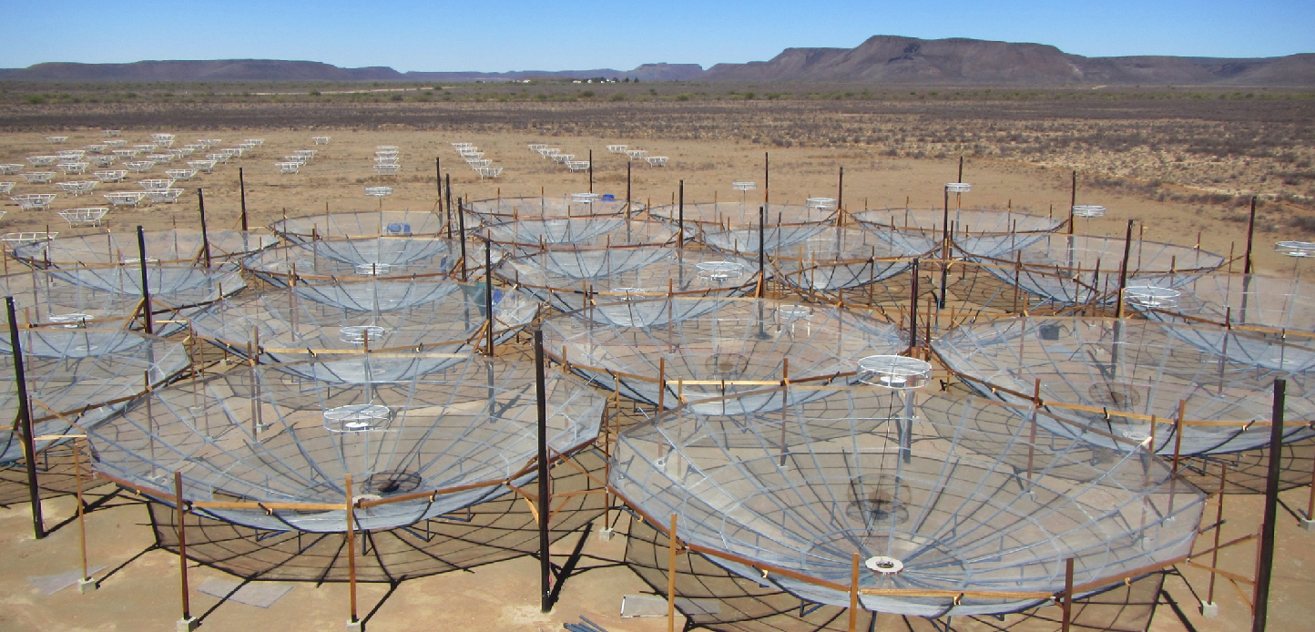
Hydrogen Epoch of Reionization Array
Chris Carilli, CfA, November 2016
Progress in non-21cm measurements of neutral IGM at high z: honing redshift range for reionization; accentuates need for HI 21cm
Progress in HI 21cm measurements: Attacking foreground problem; making first astrophysically relevant measurements
Progress in HERA: active construction and commissioning

Slide 2


Slide 3
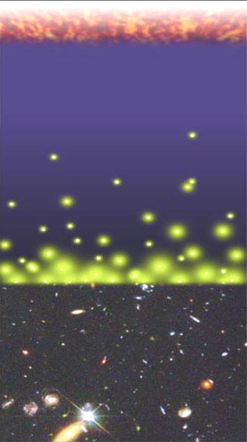
Big Bang f(HI) ~ 0
History of Normal Matter (IGM ~ H)
Recombination
0.4 Myr
z = 1000
f(HI) ~ 1
Reionization
0.4 – 1.0 Gyr
z ~ 6 to 12
f(HI) ~ 10⁻⁵
13.6Gyr
z = 0
Djorgovski/CIT

Slide 4
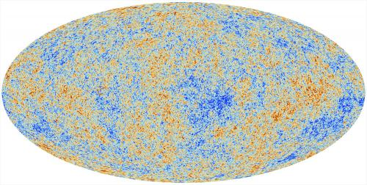
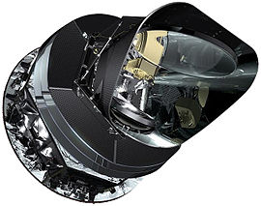
Cosmic microwave background radiation
Recombination
Early structure formation
Imprint of primordial structure from the Big Bang: seeds of galaxy formation
Planck

Slide 5
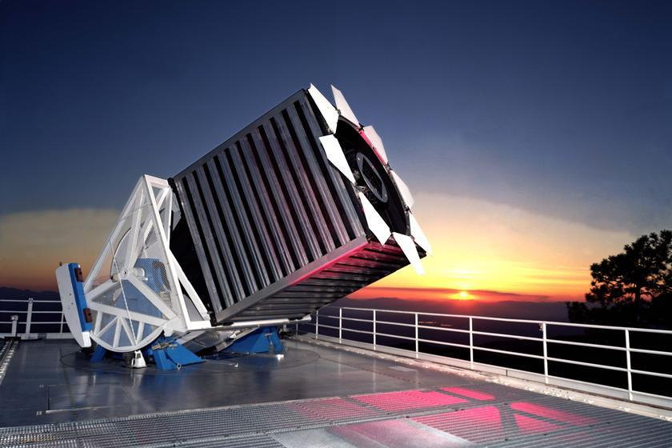
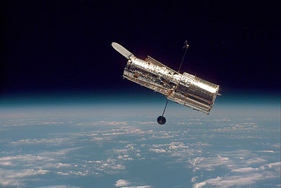
HST, SDSS, VLT, VLA…
Late structure formation Realm of the Galaxies

Slide 6
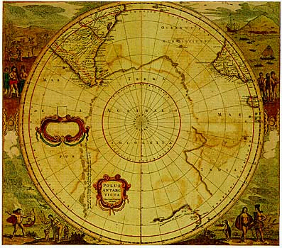
Universum incognitus
Dark ages
Last phase of cosmic evolution to be tested and explored
Cosmological benchmark: formation of first galaxies and quasars
Focus on key diagnostic: Evolution of the neutral IGM through reionization
When?
How fast?
HI 21cm signal
Cosmic Reionization

Slide 7
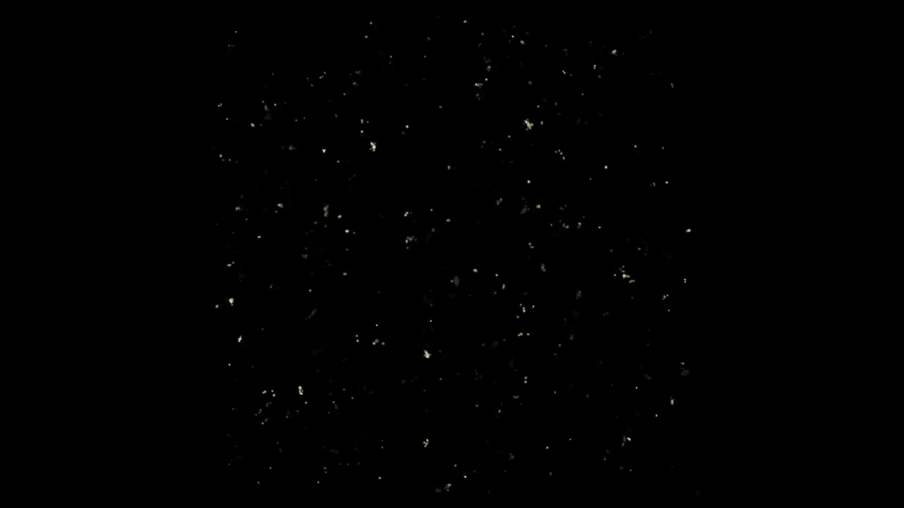
Alvarez & Abell Cosmological simulation of Reionization
Three phases
Dark Ages
Isolated bubbles (slow)
Percolation (bubble overlap): ‘cosmic phase transition’
z = 15 to 6; 1 Gpc

Slide 8
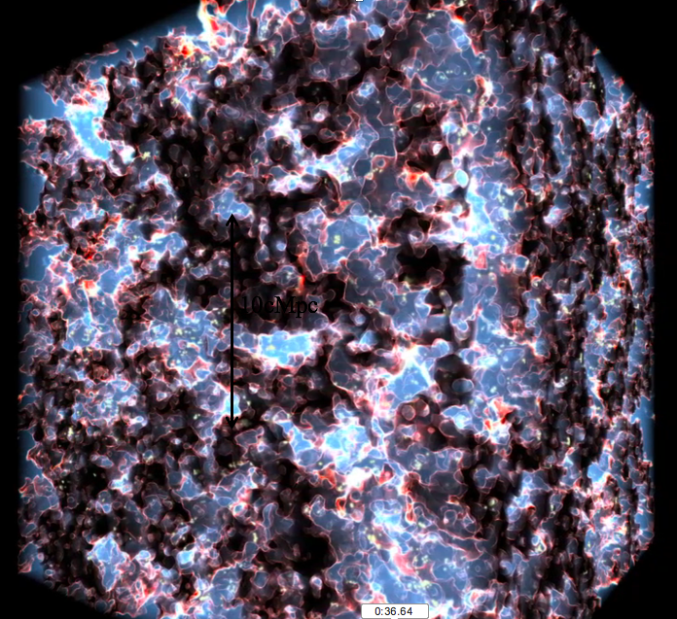
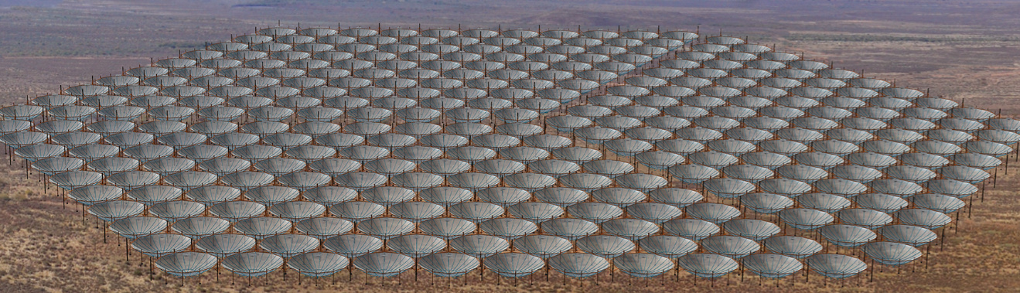
Hydrogen Epoch of Reionization Array
HI 21cm line obs of epoch of reionization
Epoch when space is filled with neutral Hydrogen!
Three dimensional tomography
z ~ 14 to 6
𝜆 = 1.5m to 3m
Frequencies ~ 100 to 200MHz

Slide 9
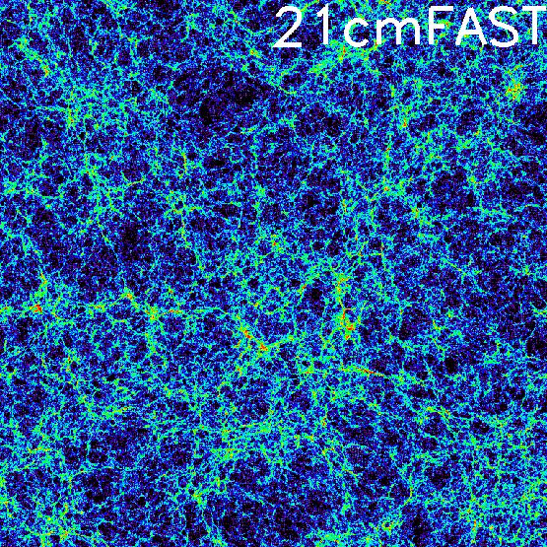
Evolution of the IGM neutral fraction
Fast, semi-numerical, parameterized models of gal formation and reionization: 21cmFAST + 21CMMC²
Bayesian exploration of obs. constraints, model parameters, and implied physical parameters, eg. F(HI) vs. z
Greig & Mesinger (2016)
Lya related
CMB related
QNZ

Slide 10
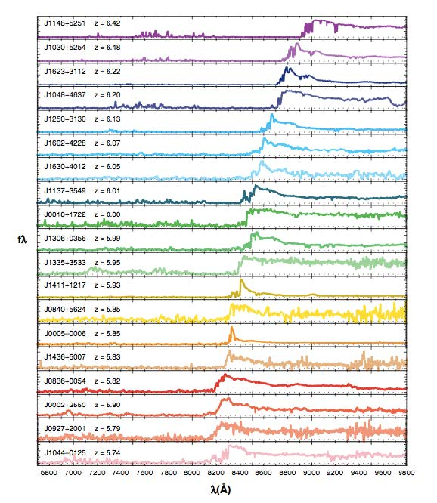
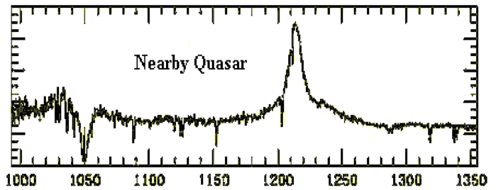
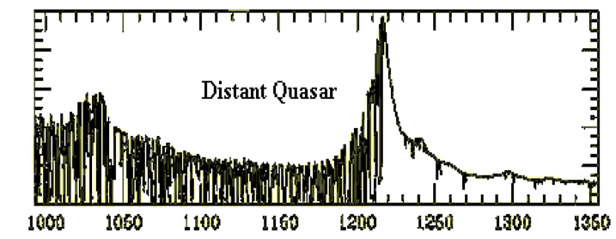
Gunn-Peterson effect
SDSS quasars (FCK 2006)
z=6.4
Neutral gas in IGM: Lya forest resonant scattering
z=0.1
z=3
IGM opaque (τ_{Lya} > 5) at z>6
z=5.7

Slide 11
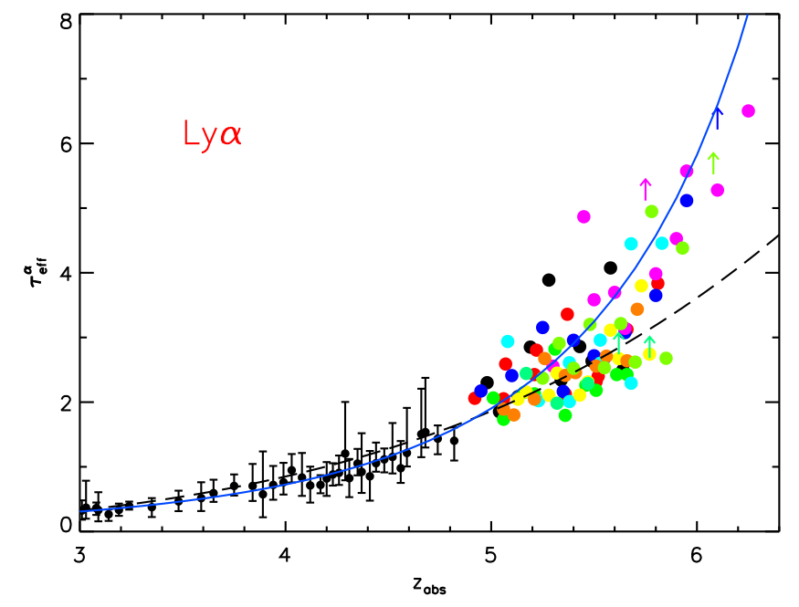
GP effect: 1st indication of cosmic reionization?
τ_{eff}
F(HI)_{v} ≥ few 10⁻⁴
Diffuse IGM
τ_{eff} = 2.6e4 F(HI) (1+z)^{3/2}
Difficulty: Saturates at low neutral fraction
Late-time probe of reionization
F(HI)_{v} ~ few 10⁻⁵
Becker et al. 2011

Slide 12
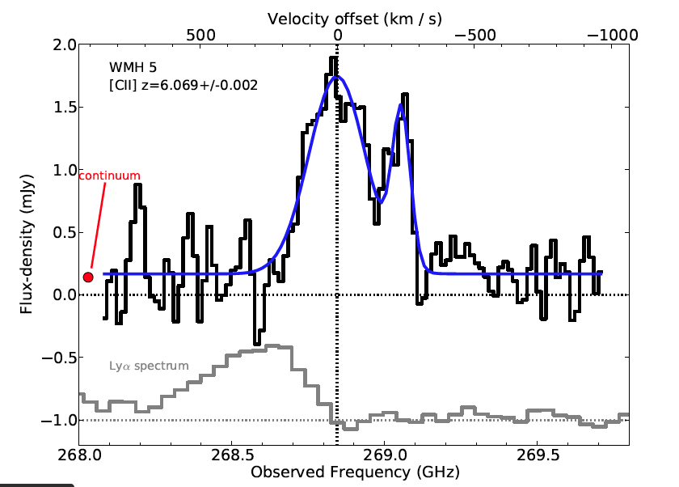
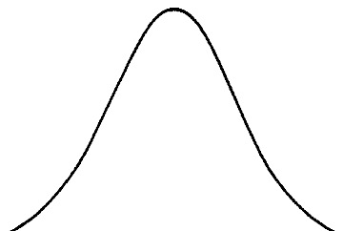
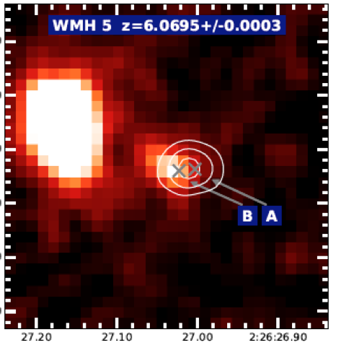
Galaxy demographics: effects of IGM on Lya galaxy counts
[CII] z=6.1
Main sequence galaxies [CII] => z_{host}
Blue-side of Lya highly attenuated: GP scattering by IGM?
Change in Lya strength at z > 6
Number of Lya selected galaxies
Lya Equiv. Width for Ly Break
expected
Lya obs
ALMA [CII] 158um at z ~ 6
Willott ea. 2015

Slide 13
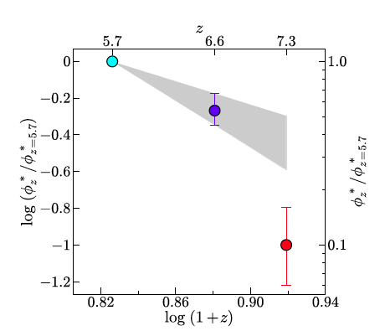
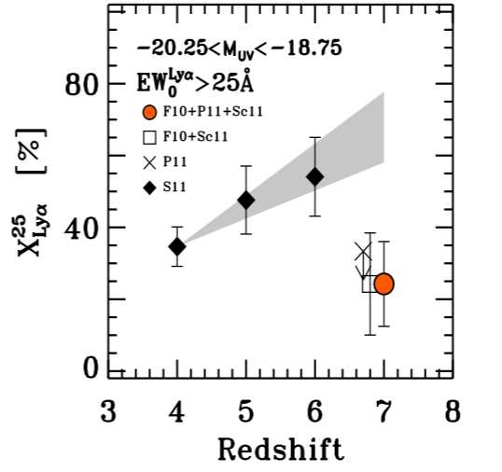
Galaxy demographics: Lyα line strength
Mpc⁻³
Narrow band surveys: density of LAEs decreases rapidly z > 6.5
LBG spectroscopy: Lya line-to-continuum ratio drops at z > 6
Attenuation by partially neutral IGM (Mesinger & Greig) =>
F(HI) > 0.4 at z ~ 7
Difficulty: Separating galaxy from IGM evolution
LAE
Expected 65 z=7.3, detected 7!
Konno ea 2014
LBG
Ono ea 2015

Slide 14
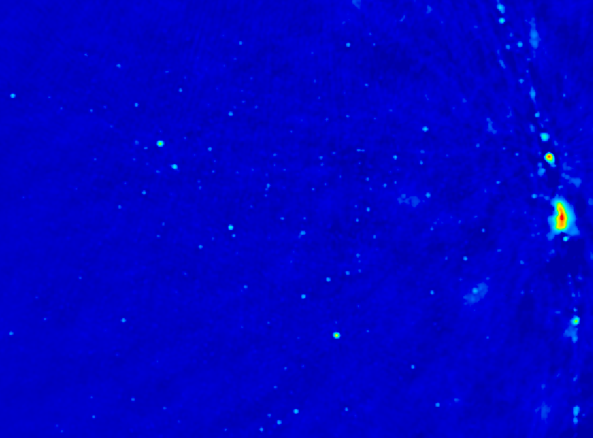
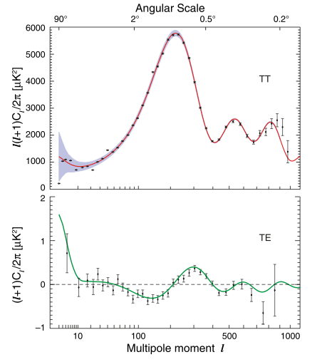
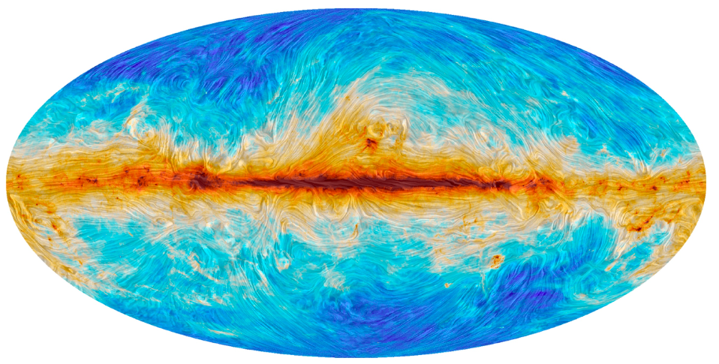
CMB constraints
Thomson scattering during reionization
‘Fuzz-out’ amplitude of fluctuations
CMB quadrupole: large scale polarization
Integral measure of τ_{e-} to recombination
Sachs-Wolfe
BAO: Sound horizon at recombination
Sound horizon at reionization
Jarosik et al 2010

Slide 15
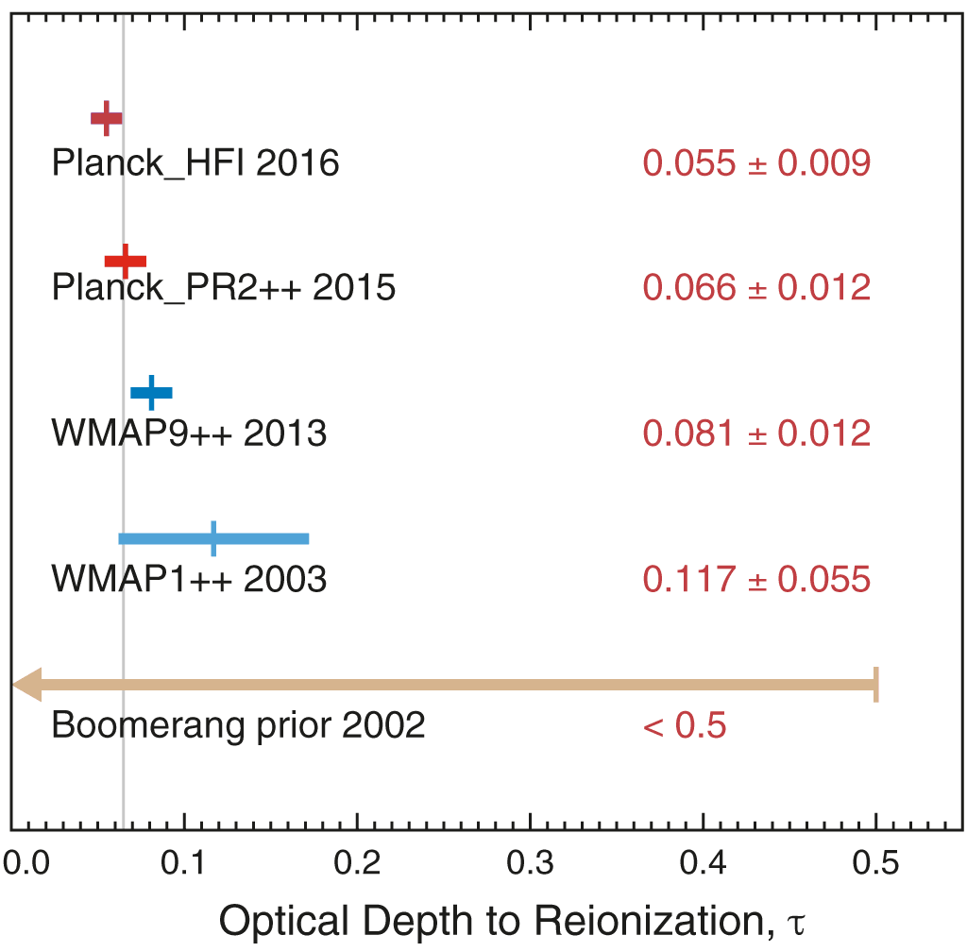
Instantaneous reionization*: 1 + z_{inst} ~ 57 (𝜏_{cmb})^{2/3}
𝜏_{cmb}
z_{inst}
𝜈_{HI}
7.7 +/- 0.9
163MHz
10.2 +/- 1.1
127MHz
0.17 +/- 0.06
17 +/- 4
79MHz
Spergel + 2003 Table 10
History of 𝜏_{cmb}: steady march downward
Challenges
Systematics in extracting large scale signal
Integral measure of τ_{e-} => early-time probe of reionization
*Planck arXiv:1605.02985; Shull & Venkatensan

Slide 16
Evolution of the IGM neutral fraction (Greig & Mesinger 2016)
Lya related
CMB related
QNZ
IGM evolution: z(F_{HI} ~ 0.5) ~ 7 to 8
HI 21cm critical: ‘unfortunately, no current observational set is sufficient to break degeneracies and constrain the astrophysical EoR parameters’

Slide 17
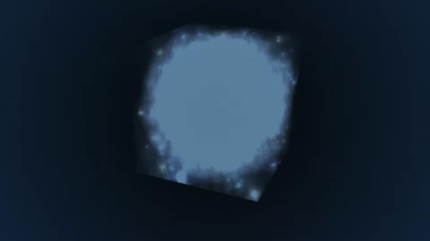
Seeing through the Fog: HI 21cm cosmology
z_{reion} ~ 6 to 12
ν_{rest} = 1420MHz/(1+z) = 100 to 200MHz
Gnedin
Advantages of the 21cm line
Direct probe of neutral IGM
Spectral line signal => full three dimensional image of structure formation
Low freq => very large volume surveys (~ 150 Gpc³)
Hyperfine transition = weak => avoid saturation (‘transluscent’)

Slide 18
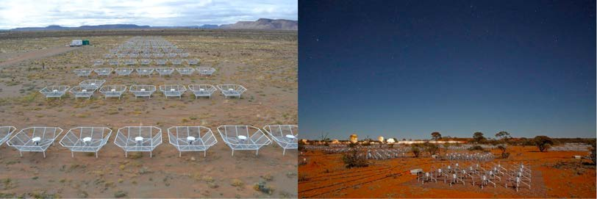
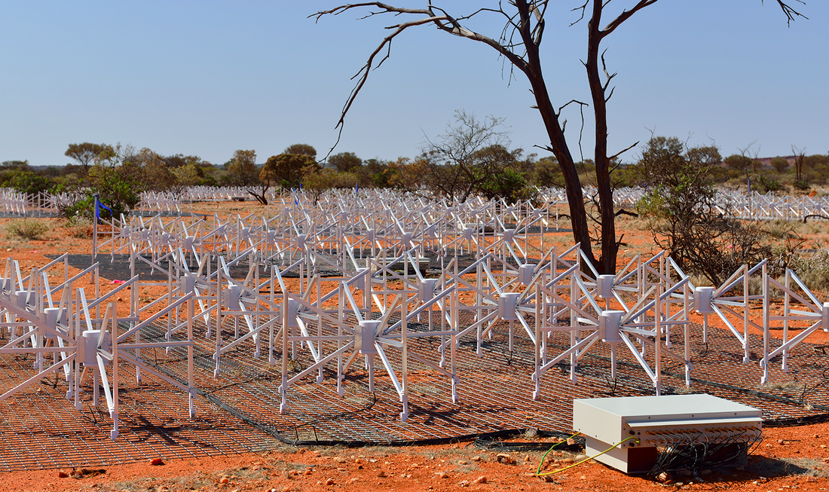
Renaissance at low freq: reionization experiments
PAPER - SA
MWA - Aus
Array | FoV deg² | Area m² | Type | FWHM₁₅₀ arcmin | PS S/N* FG Avoidance | PS S/N* FG Removal | Start date
PAPER-128 | 1600 | 1200 | Dipole | 23 | 1.2 | 4.8 | 2013
MWA-128 | 300 | 3600 | Tile | 10 | 0.6 | 6.4 | 2013
LOFAR | 25 | 36000 | Tile | 5 | 1.4 | 17 | 2013
HERA-331 | 64 | 54000 | Dish | 20 | 23 | 91 | 2018
SKA-I Low | 30 | 420000 | Tile | 5 | 13 | 140 | 2021+
*Power spectrum sensitivity to ‘vanilla’ model: Pober 2014, ‘21cmSense’ cosmology calculator

Slide 19
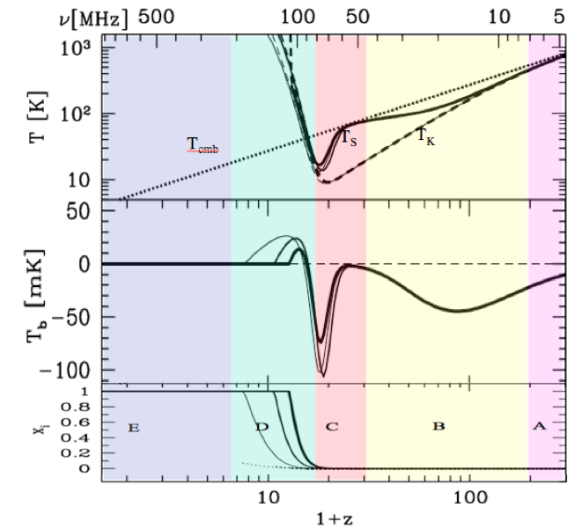
HI 21cm Signal
‘Richest of cosmological data sets’
z>200: T_{CMB} = T_{K}= T_{S}
z∼30 to 200: gas, photons decouple. T_{s} initially follows gas => absorption
z∼15 to 30: first stars => Lyα recouples T_{K} and T_{S} => strong absorption
z∼6 to 15: galaxy formation
Xray pre-heatiing => T_{K} > T_{CMB}
Reionization
(1+z)
(1+z)²
Astrophysics
Linear cosmology
First Galaxies Xray warming
First stars
Reionization
Pritchard & Loeb

Slide 20
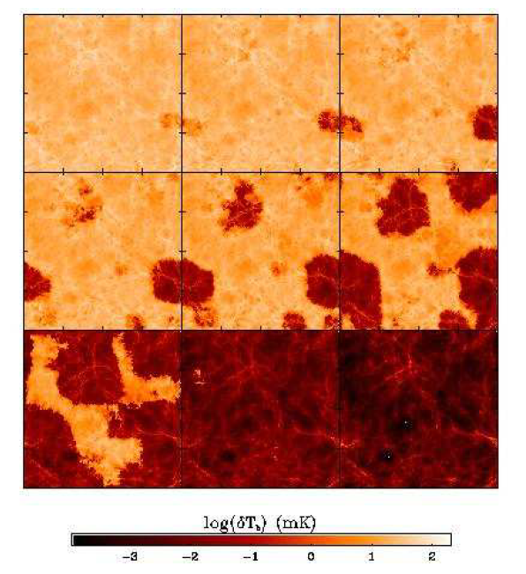
Signal end-game: HI 21cm ‘tomography’ of IGM
Challenge: Sensitivity
z=12, 110MHz
Imaging of typical structures requires full Square Kilometer Array
S_{150MHz} (2’) ~ 8uJy
SKA rms ~ 1.6uJy
Primary science driver for SKA-low
<T_{B}> ~ 20mK
z=6.5, 180 MHz
10cMpc = 4’
Furlanetto ea 2004

Slide 21
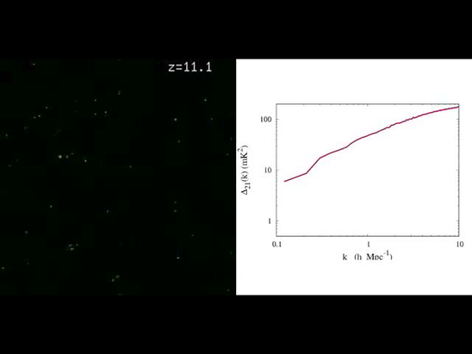
Pathfinder Goal
Evolution of 3D power spectrum in 21cm line
Early: density field
Warming: signal drop
Reionization
z~7: Flat ~ bubble scale for 0.1 – 1 Mpc⁻¹
Δ² (k) ~ 20mK²
30’, 3MHz
3’, 0.3MHz
²
²
h/Mpc
Mcquinn ‘fiducial reionization model’; 10cMpc

Slide 22
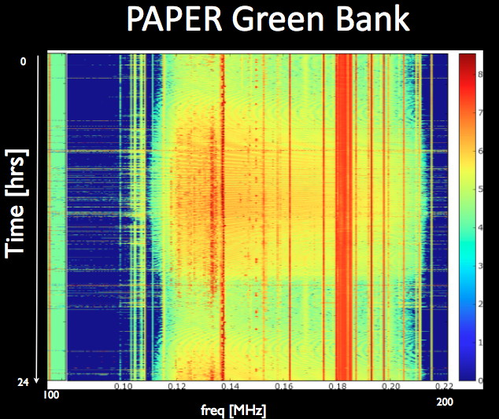
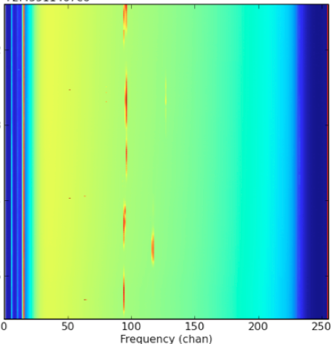
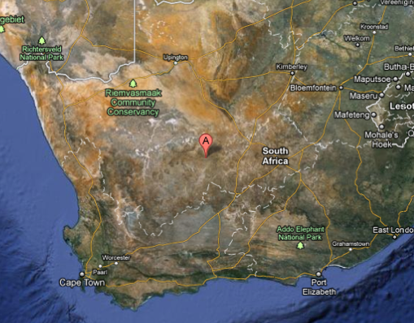
Challenge: Interference
Karoo South Africa
TV
OrbComm
FM
ISS
OrbComm
100MHz
200MHz
100MHz
200MHz
PAPER/HERA
575 km
Cape Town

Slide 23
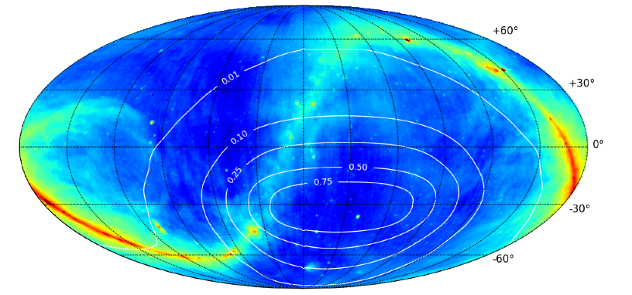
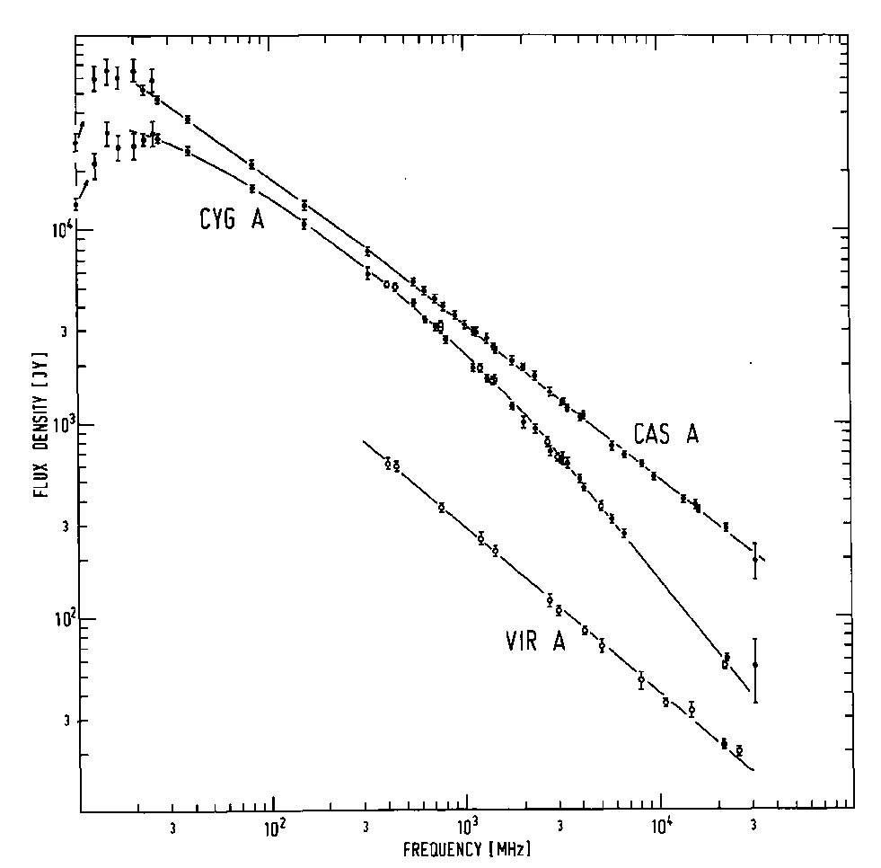
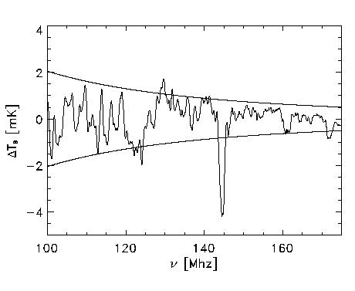
Challenge: Foregrounds
T₁₅₀ ~ 250 K = 10⁴ x 21cm signal
Smooth spectrum => subtract in spectral domain?
Critical to minimize chromatic response of instrument!
408MHz
Signal/Sky < 10⁻⁴
z=13
z=7
30MHz
3GHz

Slide 24
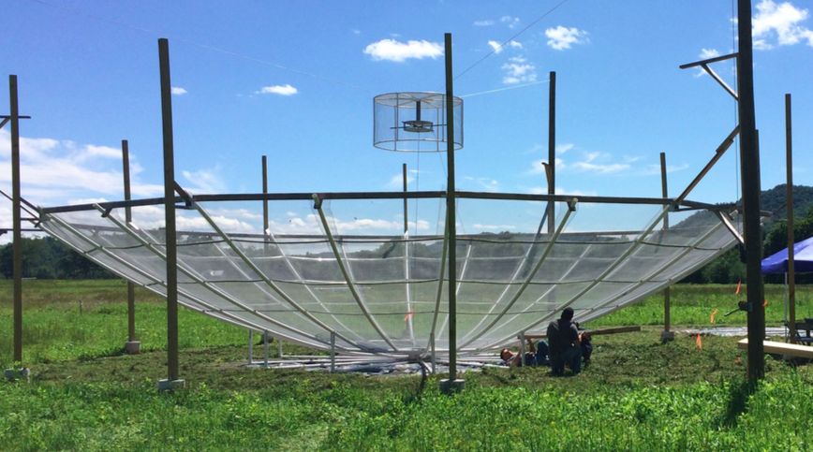
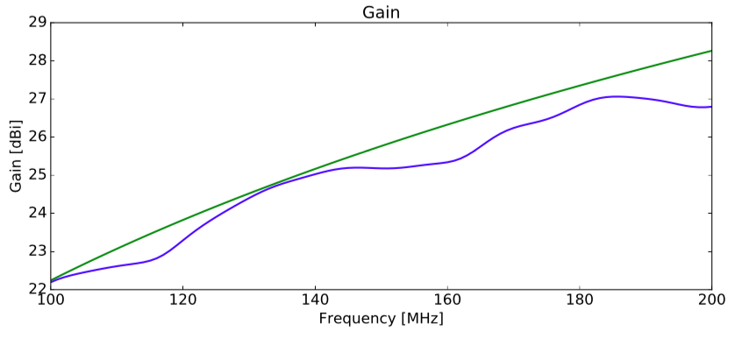
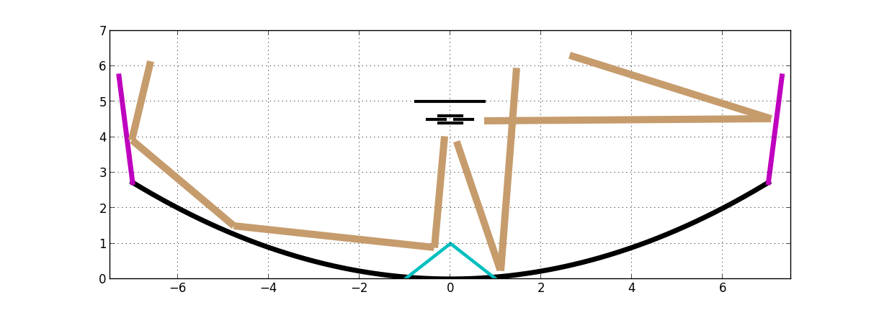
Optimize smooth spectral response of system
Analyze 10MHz spectral segments with 0.1MHz chans => k_{ll} = 0.03 to 3 h/Mpc
Avoid ‘standing waves’ < 20MHz across band = 14m (or delay = 50ns)
10MHz
78%
Notes:
PSA-64, 32 antennas in a maximum-redundancy configuration, 30m between rows, 4m spacing within rows

Slide 25
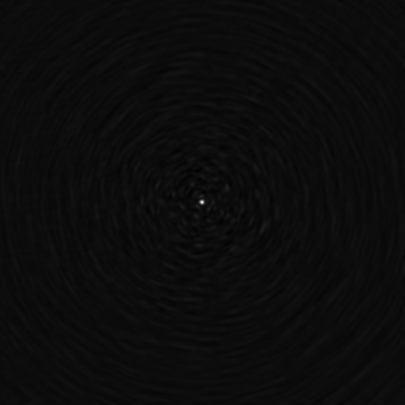
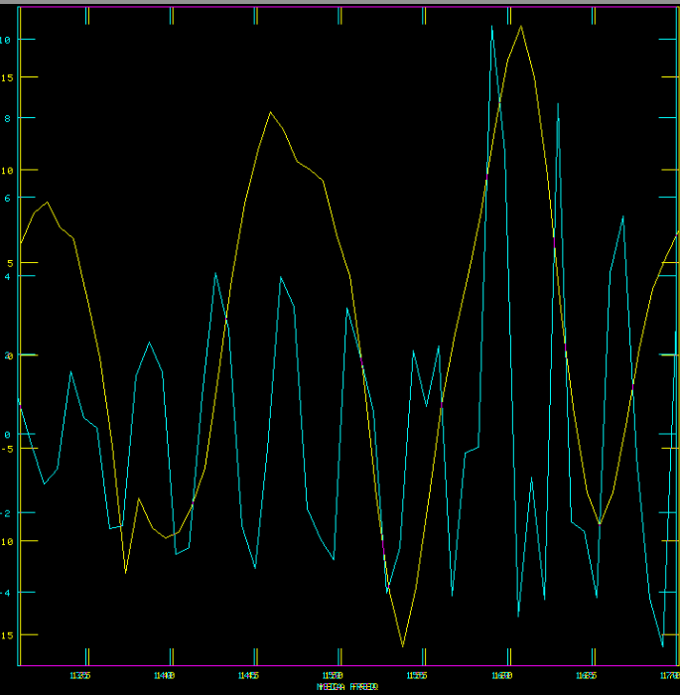
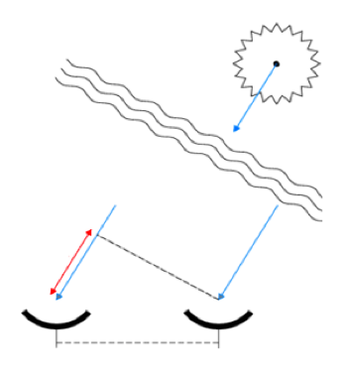
Challenge: chromatic response of interferometer
Synthesized beam (PSF) is chromatic
Smooth spectral fitting over > few MHz bands in Im or Vis does not remove sidelobes of bright sources
Response depend on baseline length
120 to 180 MHz
B=30m
𝝷 ~ 𝝺/B
120m
130MHz
180MHz

Slide 26
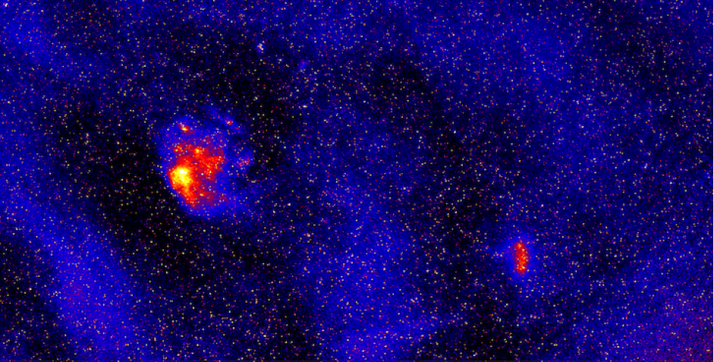
Fighting Foreground and array chromaticity
Imaging: Find sources and subtract
Needs extraordinary precision in calibration (< 0.2%; Datta ea.)
Short baselines dominated by diffuse emission, not point sources, fills antenna beam
Avoidance: line-of-sight PS (‘wedge’)
Lose S/N
Need to avoid other instrument chromaticity
10º
MWA 150MHz Hurley-Walker

Slide 27
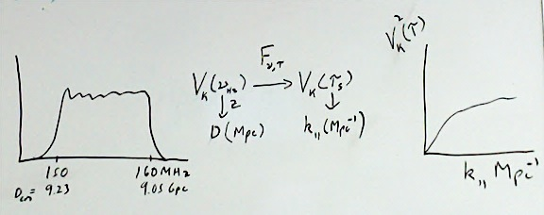
Focus on 3rd Dimension = Frequency (‘Delay spectrum’; Parsons ea.)
V_{Kelvin}(ν)
continuum
Line
Frequency maps to distance => Fourier conjugate (delay) maps to wavenumber (Mpc⁻¹)
Line-of-sight PS (k_{ll}) per baseline, time = square (FT[V_{K}(ν)]) = V²_{K}(τ)
Continuum naturally limited to low k_{ll} depending on baseline length

Slide 28
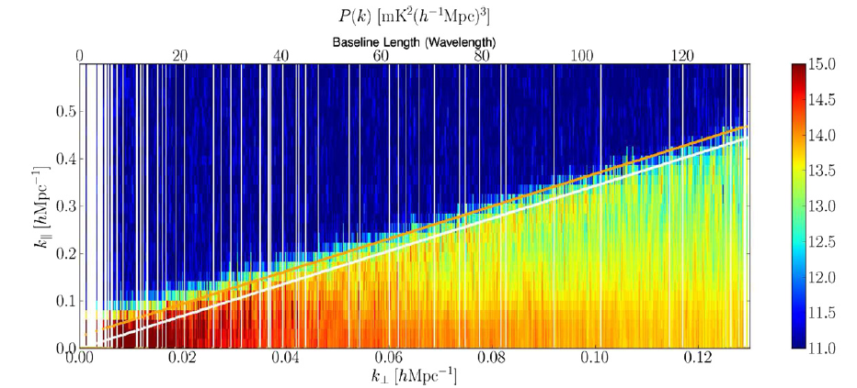
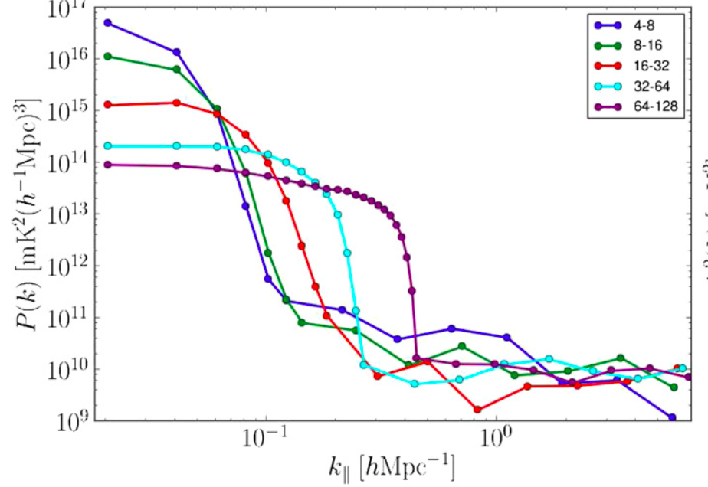
III. EoR window: The Wedge on PAPER
Delay or Freq⁻¹
B~15m
‘EoR Window’
B~150m
Wedge = ‘horizon delay’ for continuum
‘noise’
Baseline or Angle⁻¹
Datta ea. 2010; Pober ea 2013
k⊥ (angle) vs. k_{ll} (freq) => continuum spectral PS naturally limited to max k_{ll} in delay spectrum set by ‘horizon delay’ = baseline length projected to horizon
Line source PS extend beyond wedge = noise limited, uncorrupted by continuum!

Slide 29
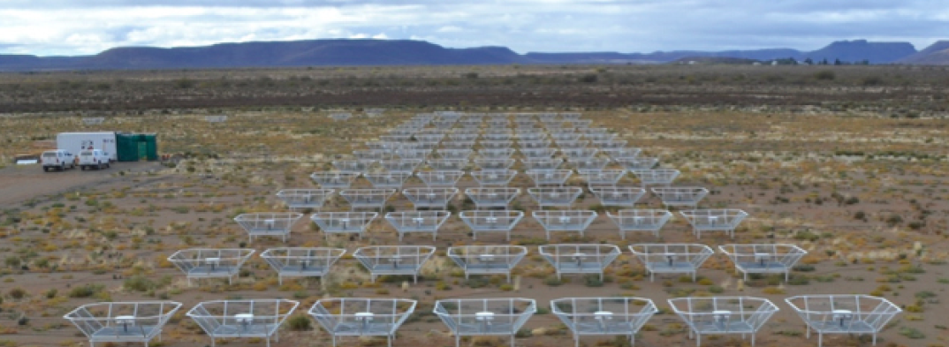
Redundant Configuration: PAPER and HERA approach
Redundant spacing calibration: antenna complex gains (t, υ)
Add redundant spectra coherently per time => ‘signal to noise’ of PS improves linearly with number of measurements, N, vs. as N^{1/2} with incoherent averaging (add and square vs. square and add)
Disadvantage: grating lobes complicate imaging

Slide 30
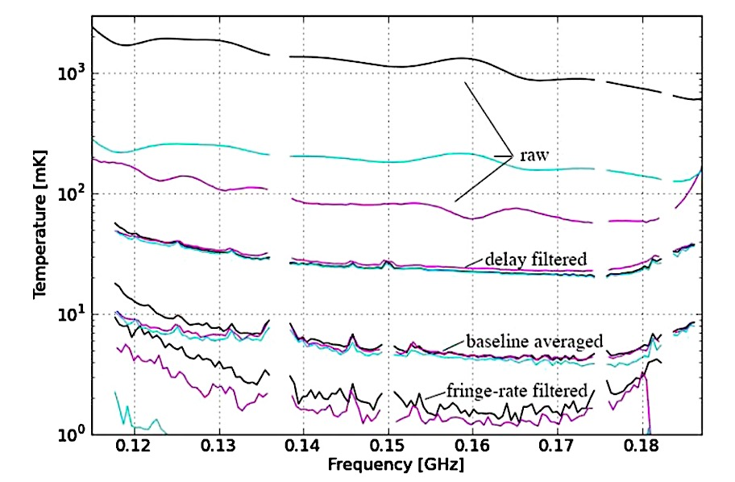
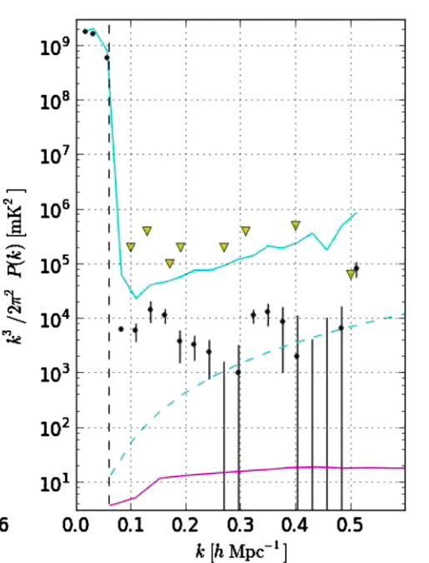
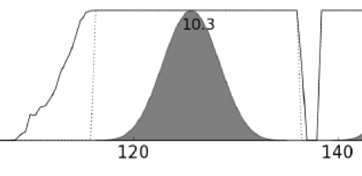
Raw vis spectrum
FG filtering to ~ 10⁶ at horizon for b=30m
Wedge delay filter
Redundant Ave
Time ave
PAPER 32: Parsons ea 2014
Weight vs. freq w. 20MHz Blackman-Harris window function
FT V(freq) → V(delay) = V(k_{ll})
Cross multiply V_{i}(k_{ll})*V_{j}(k_{ll}) to delay PS (i,j = time steps or redundant B to remove noise bias)

Slide 31

PAPER power spectrum: z=8.4 (150MHz)
continuum ‘wedge’ ~ 10⁹ mK²
2years, 64antennas, w. b = 30m
Wedge: 10⁷ cont. avoidance (mK²)
k < 0.15: intrinsic continuum ‘structure’ contamination (+ Cosmic Variance)
k > 0.2: bins consistent w. thermal noise (<2σ)
Most sensitive limit (<k> 0.2 to 0.5):
T_{sys}= 500K
Δ² (k) < 360 mK²
Fiducial 21cmFast
~ 20mK²
Ali ea 2015

Slide 32
Constraining non-’fiducial’ models
continuum ‘wedge’ ~ 10⁹ mK²
Fiducial model z∼6 to 20 assumes IGM heated prior to reionization => T_{K} > T_{CMB}
If no pre-heating, expect 100x stronger absorption variance (mK²)
T_{sys}= 500K
No Xray pre-heating?
Fiducial 21cmFast
~ 20mK²
Ali ea 2015

Slide 33

HI 21cm Signal
Fiducial model: IGM heated by hard X rays from XRBs or AGN, shocks, or decaying DM, prior to reionizing => weaker emission signal
If no pre-heating => strong absorption against CMB: T_{B} ~ 10x stronger than with heating
No warming
First Galaxies Xray warming
First stars
-250mK at z=8
Reionization

Slide 34


Implications for pre-heating
Pober ea
T_{s} > 10K
T_{smin} (z~8) ~ 1.5K
Fialkov ea. Nature, 2015;
Pacuci ea. AA, 2014; Pober et al. 2015
PAPER HI PS limit
At z ~ 8.4: Δ² (k) < 360mK²
=> T_{s} > 10K > T_{smin}~ 1.5K

Slide 35

Progress in HI 21cm cosmology (Aug 2016)
k = 0.2 to 0.5 h/Mpc
MWA
MWA
GMRT
PAPER
No pre-heating
Deboer ea 2016
Limits => some preheating of IGM by z ~ 8
FG mitigation techniques very promising

Slide 36


Collecting area of Arecibo w. 450x FoV (only below 200MHz)
351 x 14m parabolic transit antennas, 50 to 250MHz, in Karoo
MWA+PAPER+MITEoR: Berkeley, MIT, NRAO, Penn, Washington, ASU, Cavendish, SKA-ZA, U. KwaZulu-Natal, Pisa
Build on experience: Optimal design for delay spectrum analysis + large scale structure imaging
Notes:
PSA-64, 32 antennas in a maximum-redundancy configuration, 30m between rows, 4m spacing within rows

Slide 37



14m antenna
Optimized for: Gain, FoV, ‘standing wave delay response’
Test arrays: Lord’s Bridge and Green Bank
Beam map with Orbcom (Neben)
8º FWHM (150MHz), 70% main beam efficiency, few% 1st sidelobe
50x forward gain of PAPER element
Chromatic response: avoid bandpass spectral structure < 20MHz => 𝞃 > 50ns

Slide 38


HERA evolution of PS and F(HI)
Pober ea
1000hr
Pober ea
Nail-down F(HI) vs. z (Greig & Mesinger)

Slide 39

HERA: astrophysics of reionization
Greig & Mesinger semi-numerical modeling
Parameterized Reionization: few% contraints
UV escape fraction (f_{esc})
Mass limit star forming galaxies (T_{vir})
Clumping of IGM (R_{mfp})
HERA
SKA
LOFAR

Slide 40

Liu ea.
21cm HI measurements break cosmological degeneracies

Slide 41



HERA-331: Imaging Large Scale Structure (20’)
z = 10
Sims 2016
0.4mJy/bm
Provide large scale environmental ‘context’ for galaxy formation
Notes:
PSA-64, 32 antennas in a maximum-redundancy configuration, 30m between rows, 4m spacing within rows

Slide 42


NSF Funding: $2.2M + $9.6M
Numerous contributions from partner institutions
Site work led by SKA SA: Antennas 20 to 37 under construction
First science integration Jan to Mar w. 37 ants: 14x area of PAPER

Slide 43




Galactic Center Sky Calibration
Uncalibrated
120MHz
180MHz
0.5º
2.5
Bandpass Cal
2.5
Bandpass solns
0.5

Slide 44




Galactic Center Sky Calibration
Uncalibrated
Delay Cal
200º
-200º
120MHz
180MHz
Gain + BP cal. spectra
60º
Bandpass solns
-60º

Slide 45



HERA first image: Galactic Center (Nikolic/Carilli)
18ants
1.2º res
DNR ~ 200
PB
PAPER 64 imaging, 20’ res (Stefan)

Slide 46


Synthesized beams
FT(UV sampling w. Unif Weighting), w/o Primary beam multiplication
PB FWHM 120, 180MHz
PSF: MFS for BW ~ 2/1
PSF: Single Channel

Slide 47

HERA: Precision 21cm cosmology
Progress in (non-21cm) measurements: z(F_{HI} ~ 0.5) ~ 7 to 8; critical need for HI 21cm
Progress in 21cm measurements: ‘EoR Window’ in delay PS effective in ‘avoiding’ foregrounds. PAPER limits => preheating of IGM by z ~ 8 to T_{K} > 10K
Progress in HERA: 37 antennas by December 2016; 127 by Fall 2017; commissioning in progress

Slide 48


HERA Extra Slides

Slide 49


Challenge: Ionospheric ‘seeing’
Virgo A VLA 74 MHz Lane + 02
15’
Mitigation
Short baselines => one ionospheric screen to solve for
Redundant calibration

