Slide 1
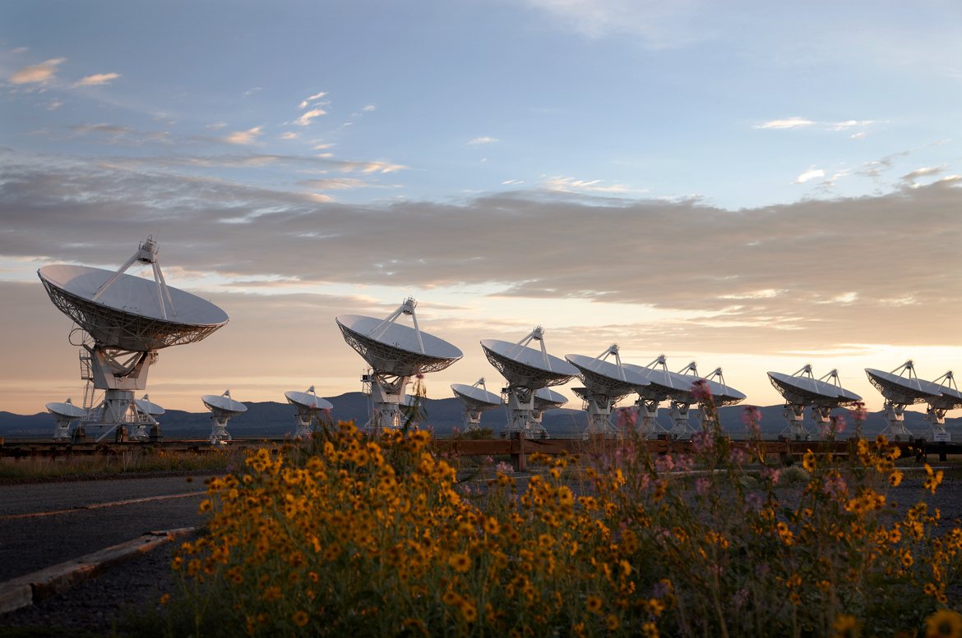
The Very Large Array: 1 min history
1972 – Approved by Congress
1975 – 1st antenna
1980 – Full science operations
2001 – Major upgrade approved by NSF (all new electronics)
2011 – Jansky VLA full science ops

Slide 2
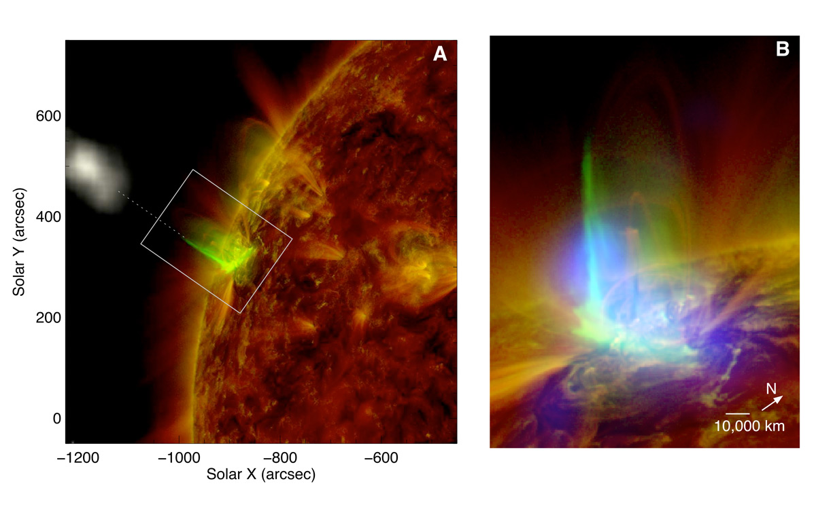
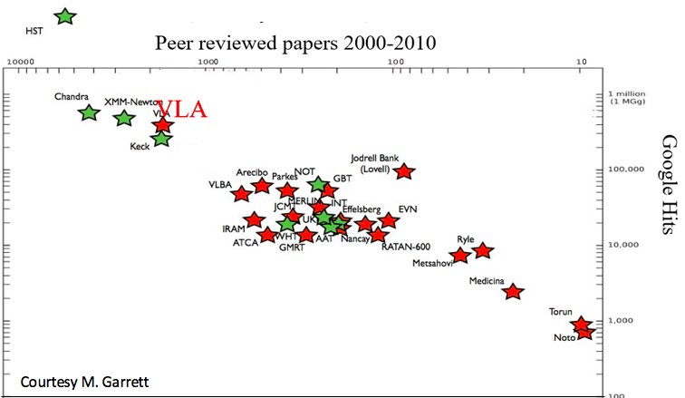
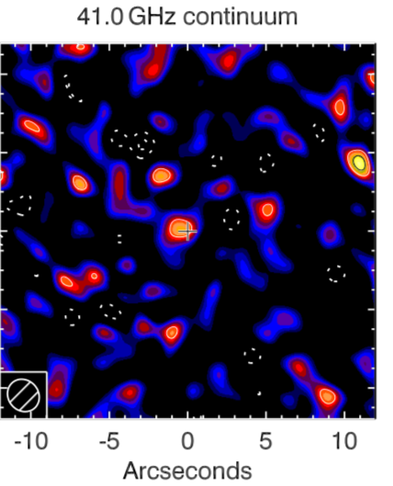
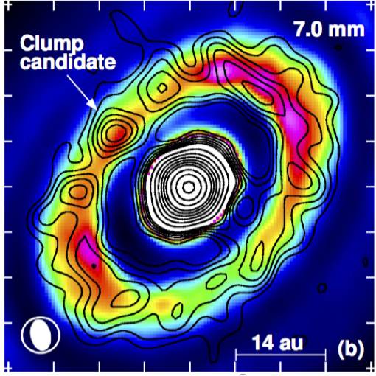
Radio Astronomy Powerhouse from 1980 to present: why? Versatility!
400 proposals per year, oversubscription ~ 3/1 for 4 decades
> 300 PhD theses
Among the most productive telescopes all-time
Solar Flares @ 50msec, 1000km
Chen +
Planet formation @ 10Au
Dust z =7.2
Isella +

Slide 3
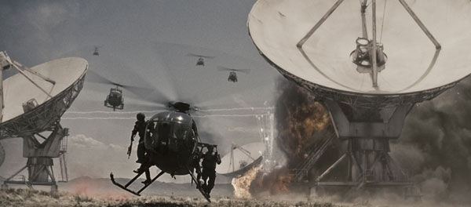

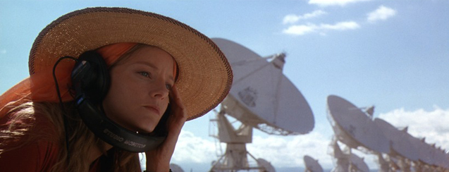
”I've always wanted to see the Very Large Array in New Mexico. It's not the biggest in the world, of course, or the most modern, but it is iconic, and I grew up wanting to see it. It's quite spectacular. Out there in the desert.” John Luther
Contact / T4

Slide 4
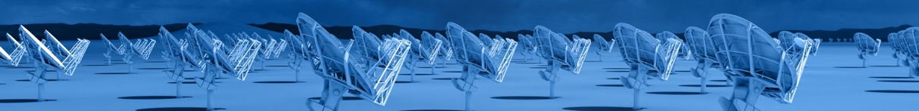
A Next-generation Very Large Array
Core Design Requirements: build on legacy ALMA and JVLA
10x sensitivity of JVLA and ALMA
10x resolution of JVLA and ALMA
Frequency range: 1.2 –116 GHz
Scientific Frontier: Thermal imaging at milliarcsecond resolution
Reference design submitted to Decade Survey 2020
Active community engagement
Low technical risk: measured step beyond current state of the art
Known costing as basis of a Decadal submission
Life-time costing: design choices to minimize operations costs

Slide 5
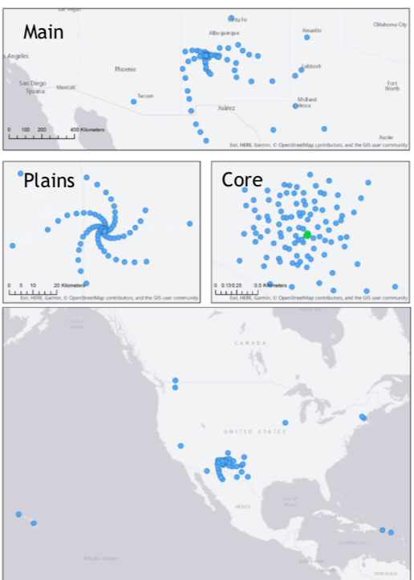
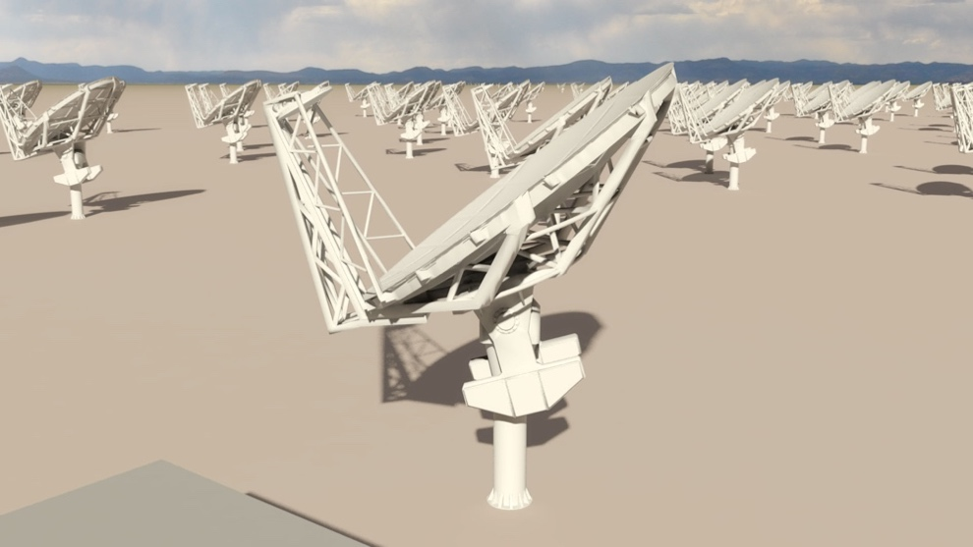
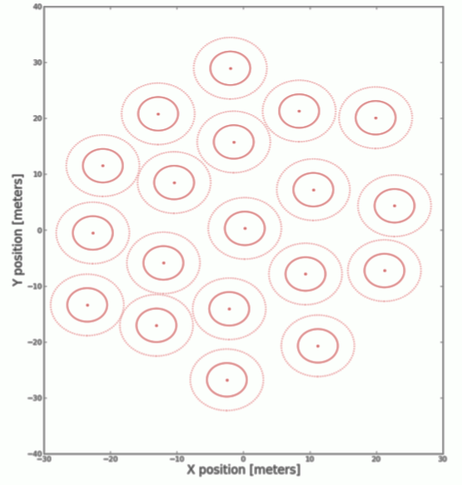
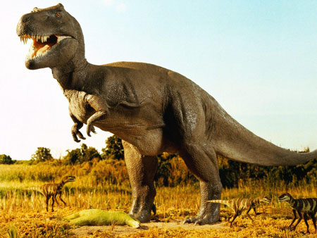
Reference Design Configuration (Rev C)
Subarray | Min B km | Max B km | # Ants. | Res. 30GHz arcsec | Science
Main (18m) | 0.027 | 1005 | 214 | 0.005 | PP Disks
Plains | 0.027 | 36.5 | 168 | 0.1 | High z CO
Core | 0.027 | 1.3 | 94 | 2 | Nearby Gal.
LBA | 32.6 | 8856 | 30 | 0.0004 | High Energy
SBA (6m) | 0.01 | 0.045 | 19 | 60 | Galactic
Total Power | -- | -- | 4 (18m) | 120
400 km
20 km
0.5 km
LBA
SBA
Off-axis feed-low
20 m

Slide 6
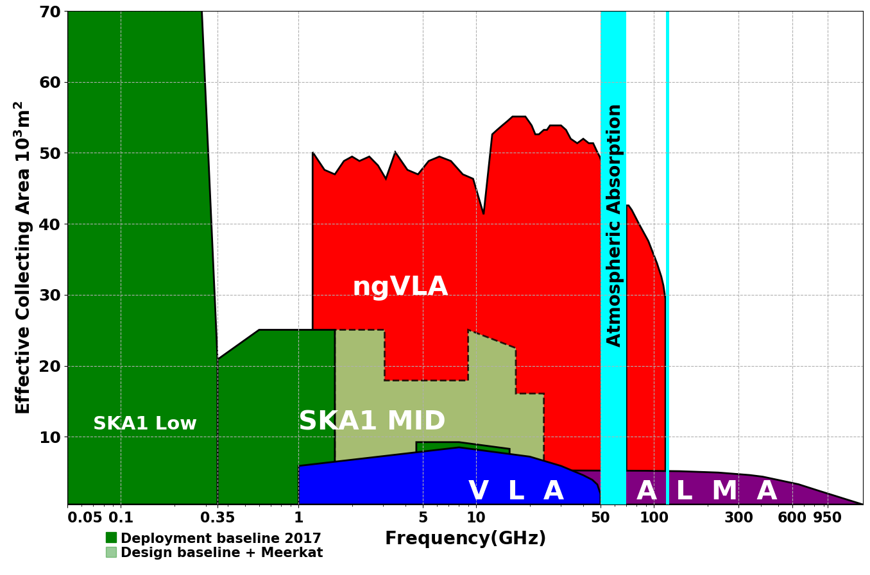
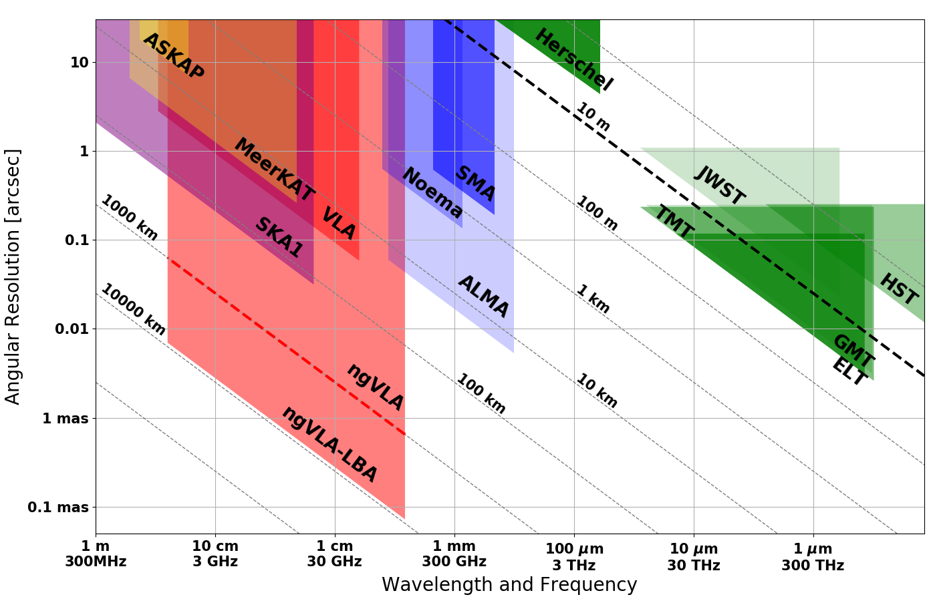
Bridging SKA & ALMA Scientifically
Radio Landscape c. 2030
Terrestrial zone planet formation: 1AU @ 140pc
Complementary suite from cm to submm arrays for the mid-21st century
< 0.3cm: ALMA 2030 superb for chemistry, dust, fine structure lines
0.3 to 3cm: ngVLA superb for terrestrial planet formation, dense gas history, time domain
> 3cm: SKA superb for pulsars, reionization, HI + continuum surveys

Slide 7
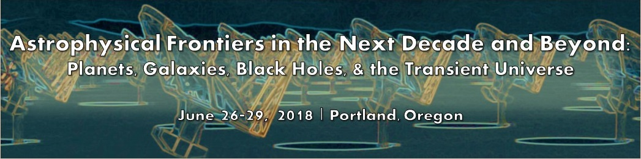
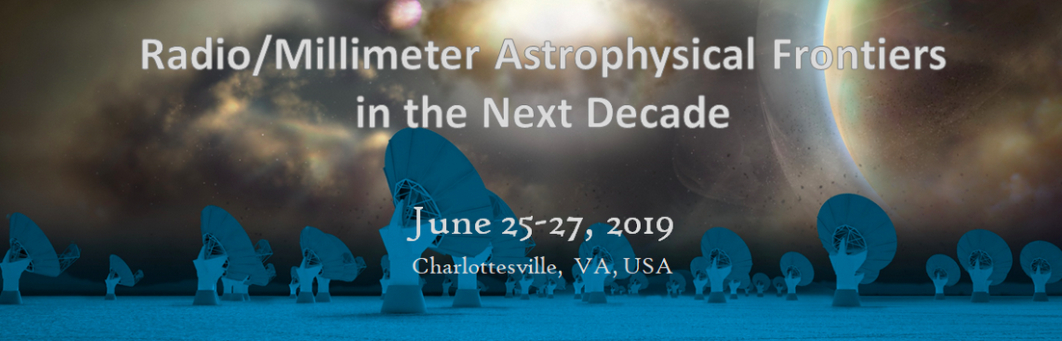
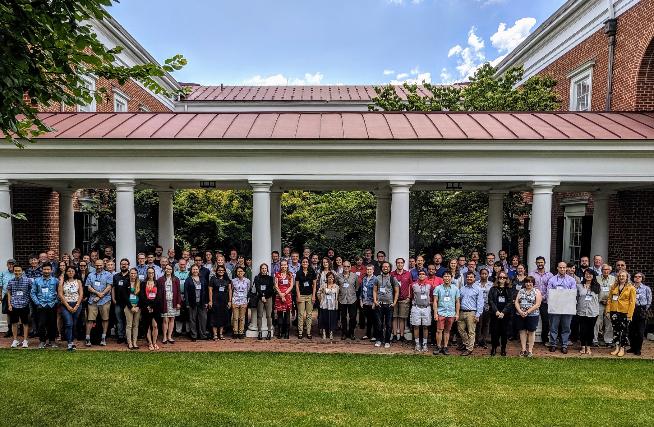
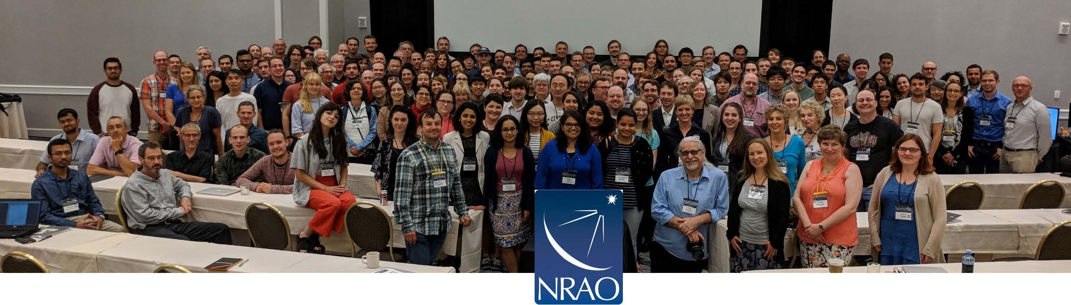
Developing the ngVLA Science Case and Design for DS 2020
Community-Driven, Growing, Evolving
Science Advisory Committee [Co-Chairs: Bolatto, Isella]
Starting Jan 2015 AAS: Numerous Science and Technical meetings
38 Community Design Studies, partially funded by NRAO
Series of large community ‘Frontiers’ meetings: Portland 2018, Charlottesville 2019
80 science and project white papers submitted to DS 2020**
**https://ngvla.nrao.edu/page/astro2020

Slide 8
ngVLA Science Book
https://ngvla.nrao.edu/page/scibook
January 2019 published by the Astronomical Society of the Pacific
90 chapters, 850 pages, 300 authors
Sections
Current Summary of Project
Solar System
Planet Formation
Stellar Systems and Formation
Planetary Systems and Life
Galaxy Ecosystems
Galaxy Formation and Evolution
Formation and Evolution of Black Holes in the Era of multi-messenger Astronomy
Cosmology and Fundamental Physics

Slide 9
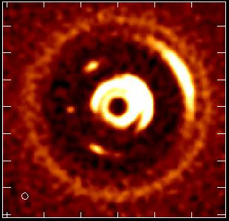
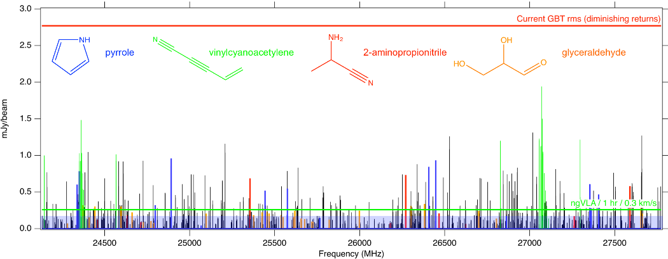
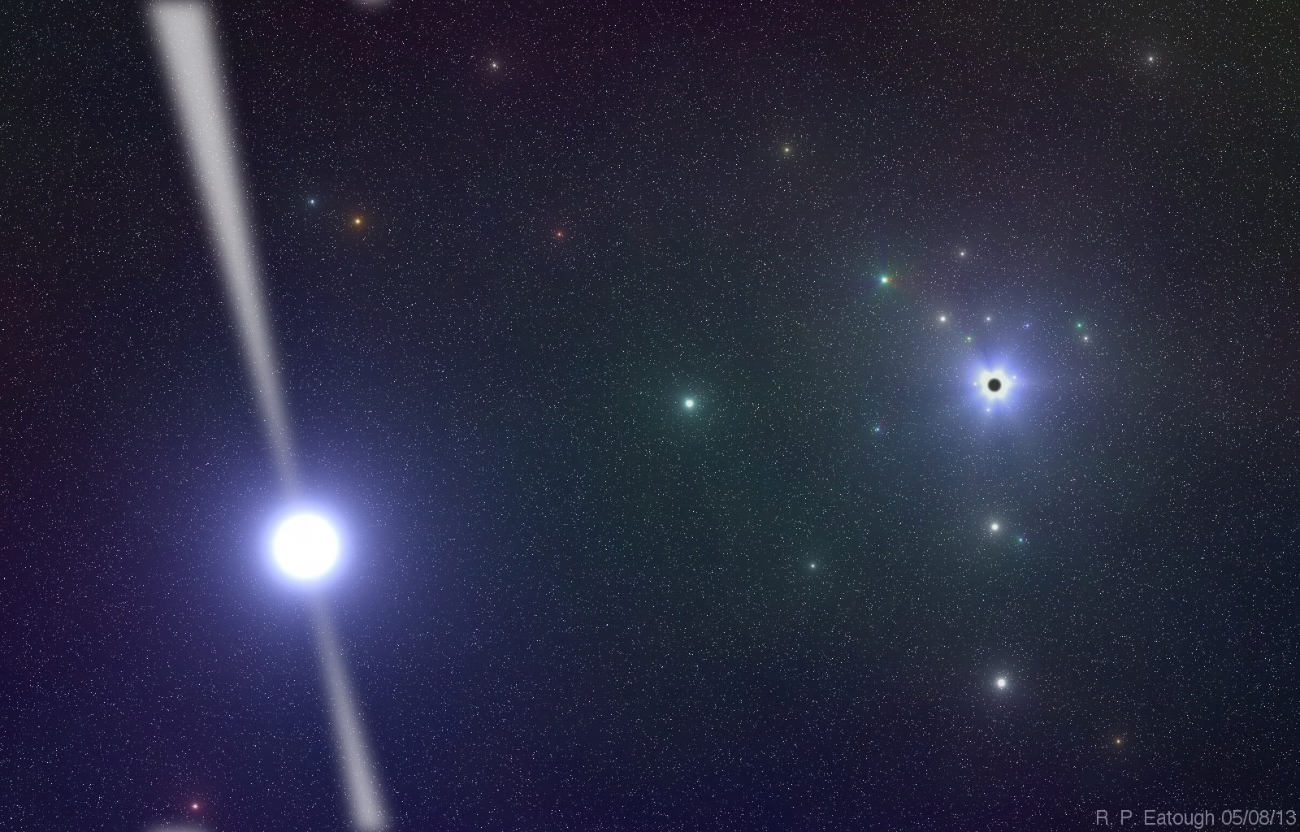
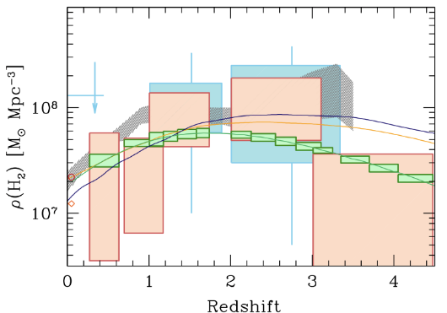
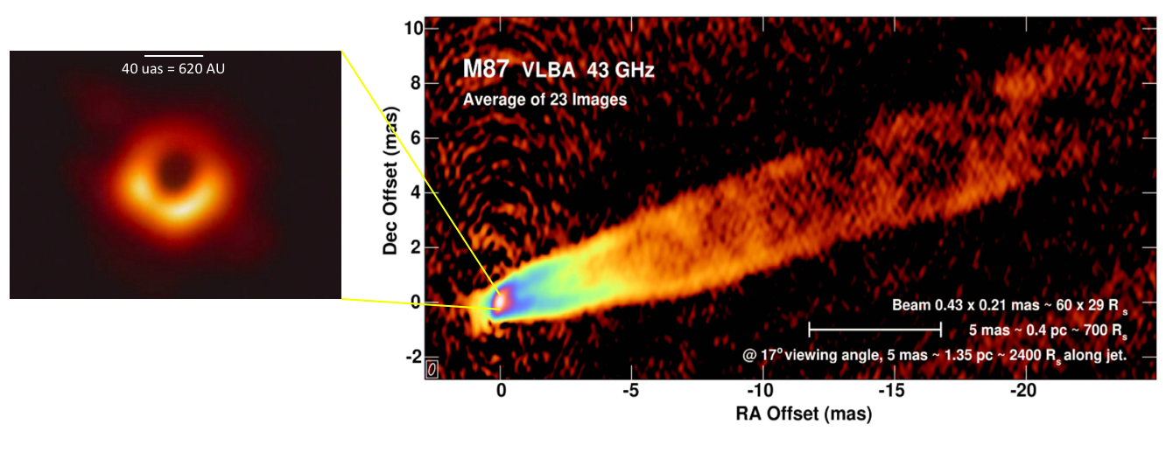
Key Science Mission
Developed by SAC; drive design
Unveiling the Formation of Solar System Analogues
Astrochemistry/biology: Probing the Initial Conditions for Life
Baryon Cycle: Charting the Assembly, Structure, and Evolution of Galaxies Over Cosmic Time
Using Pulsars in the Galactic Center as Fundamental Tests of Gravity
Physics and formation of Black Holes (time domain astronomy)
Gas
NGVLA
ALMA

Slide 10
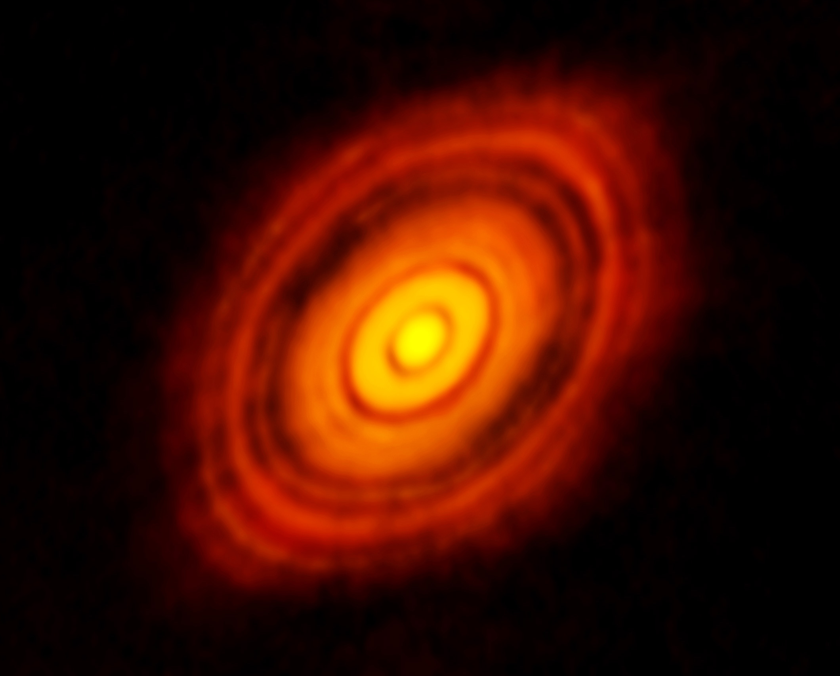
KSG1: Unveiling the Formation of Solar System Analogues
ALMA 250GHz (Brogan ea.) res = 40mas
ALMA and HL Tau: Rosetta Stone of planet formation around Solar-mass protostar
Distance = 140pc
1Myr protostar ~ 1 M_{o} w. 0.1 M_{o} dusty disk
Dust gaps and rings => forming planets
130AU = 1”
Isella ea.
Radius ≤ 10AU optically thick at < 3mm wavelengths = ‘ngVLA zone’

Slide 11
KSG1: Unveiling the Formation of Solar System Analogues
ngVLA: Movies of Planet formation!
Simulated 100 GHz ngVLA observations of a newborn planetary system comprising a Jupiter analogue orbiting at 5 AU from a Solar type star, over ~ 10 years
Probe inner few AU-scales (‘Solar-system scales’): dust rings, gaps, and traps to T_{B} ~ 1 K at 10mas resolution
Image circumplanetary disks and sub-structures in the distribution of mm-size particles created by close-in planets, and measure the orbital motion of these features on monthly timescales
Protoplanetary disk: 1 Myr old protostar at 140pc distance + proto-Jupiter observed at 100 GHz, 10mas resolution

Slide 12
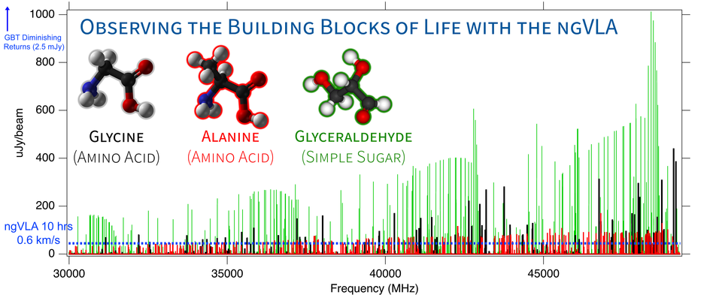
KSG2: Probing the Initial Conditions for Planetary Systems and Life with Astrochemistry
Credit: Brett McGuire, NRAO
Detect the complex, prebiotic species to understand the chemical paths to biogenic molecules
Detect chiral molecules to test ideas about the origins of homochirality in biological systems
Simulations of three biogenic molecules in a typical hot core source based on existing upper limits, assuming T = 80 K, dV = 3 km/s and a 5" source. The ngVLA's sensitivity to detect these lines for the first time in a 10 hr integration is shown as a dashed blue line. Diminishing returns with GBT integrations start around 2.5 mJy, and to detect any new molecules below that limit would require 100s to 1000s of hours.

Slide 13
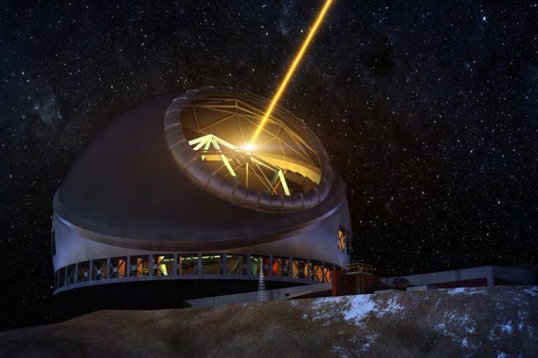
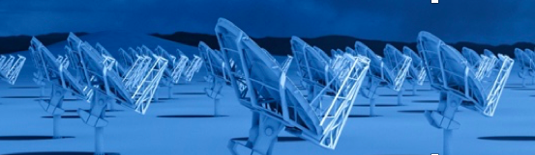
KSG1, 2 ELT/ngVLA Synergy: Solar System Analogues and the development of life
ELTs and exoplanets
Direct imaging of earth-like planets
Search for atmospheric bio-signatures (O₂)
ngVLA
Imaging formation of terrestrial-zone planets
Pre-biotic chemistry

Slide 14
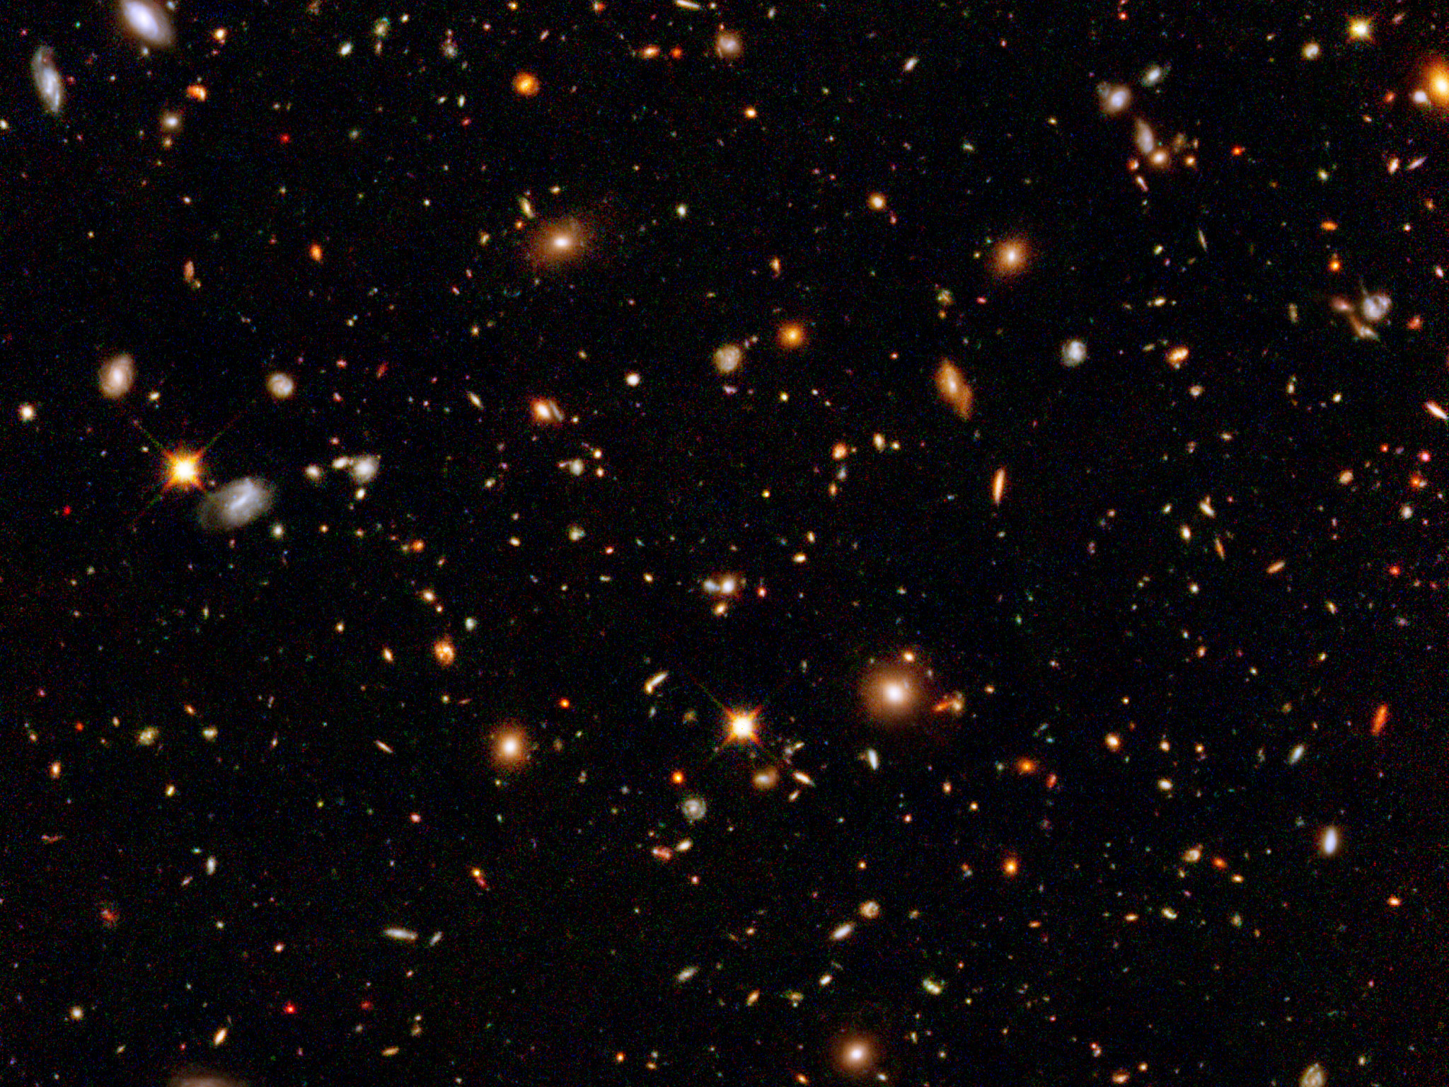
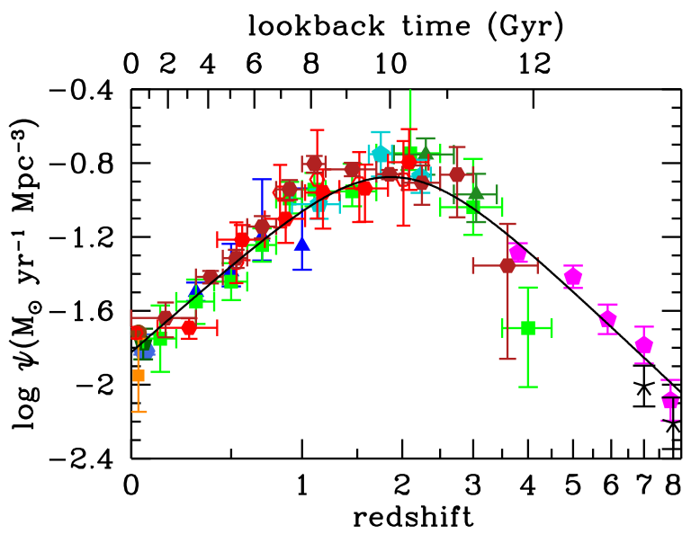
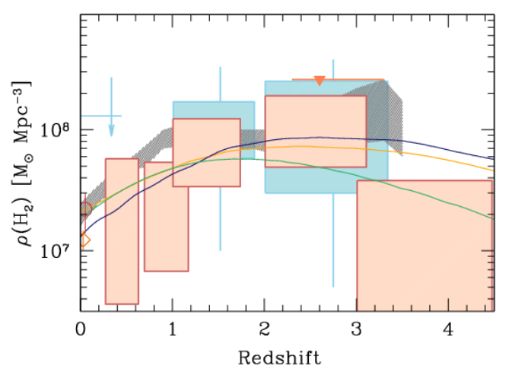
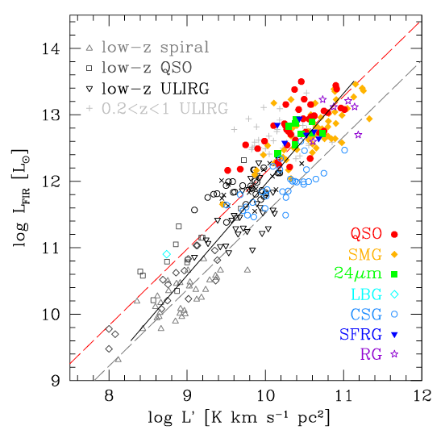
KSG3: Dense Gas History of the Universe
‘Missing half of galaxy formation’
Madua & Dickenson
‘SF Law’
FIR ~ SFR
Decarli ea 2017
FIR ~ SFR
SFHU has been delineated in remarkable detail back to reionization
SF laws => SFHU must result from evolution of dense gas in galaxies
ALMA, JVLA, Noema: first attempts at ‘CO deep fields’ are severely limited by sensitivity: 100’s hours observing => detect 10’s of galaxies in CO
L_{CO} ~ M_{gas}

Slide 15
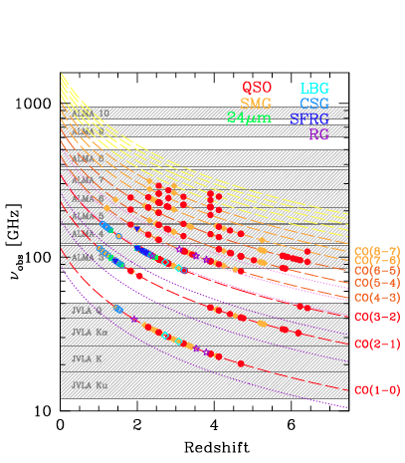
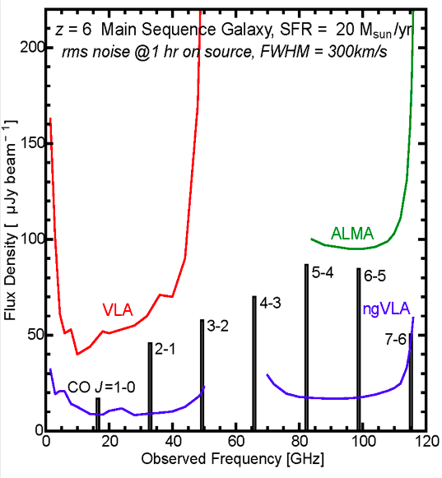
KSG3: Charting the Assembly, Structure, and Evolution of Galaxies Over Cosmic Time
NGVLA Revolution
Frequency range: ideal to study dominant molecular gas tracers (CO, HCN,HCO+…)
10x Sensitivity: ‘main sequence’ galaxies in ~ 1hr (M_{gas} ~ few x10⁹ Mo)
Octave Bandwidth (2.5x current): large cosmic volume surveys
ALMA/Noema
ngVLA ‘sweet spot’
VLA
SKA 1

Slide 16
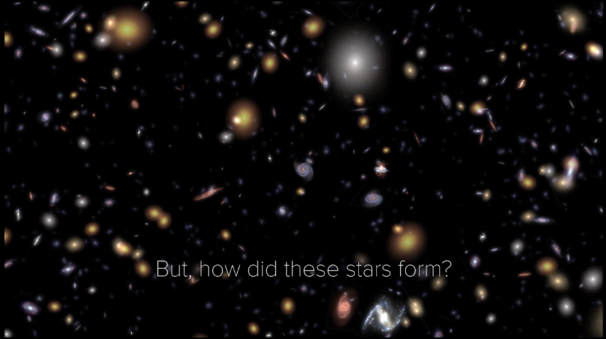
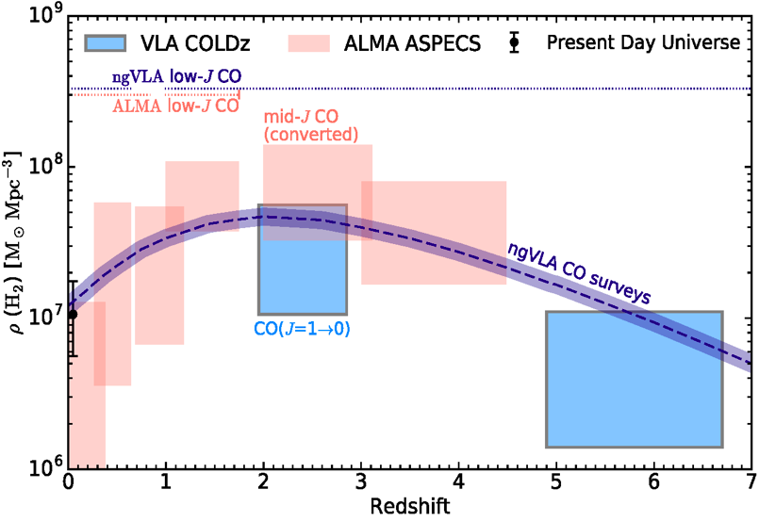
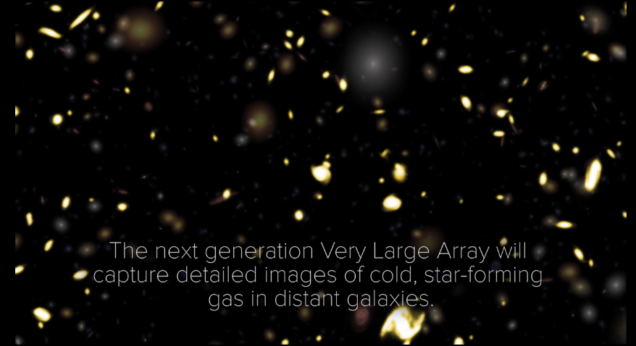
KSG3: Precision measurement of Dense Gas History of the Universe
100-fold increase in gas detections rate over VLA +ALMA => Galaxy counts in CO ~ deepest optical fields, with redshifts!
Precise measurement of Dense Gas History of Universe
HST Stars
ngVLA Gas

Slide 17
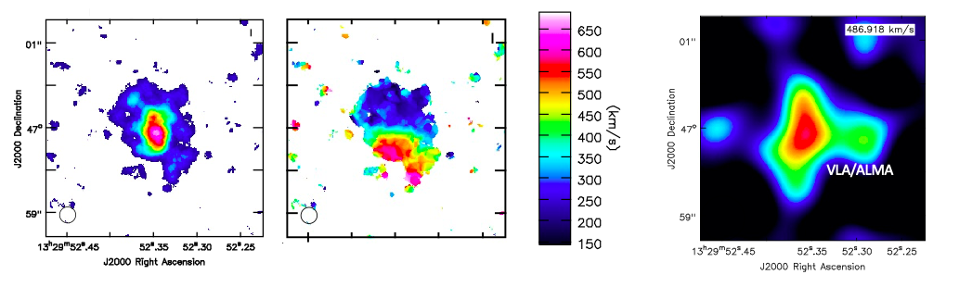
KSG3: Imaging the fuel for star formation during epoch of galaxy assembly
z=4.2, 100M_{o}/yr, CO2-1
44GHz ngVLA 30hr
Resolution = 0.15” => 1kpc
Sensitivity 30hrs ~ few 10⁸ M_{o} at z ~ 2 to 4
Imaging gas dynamics to GMC scales

Slide 18

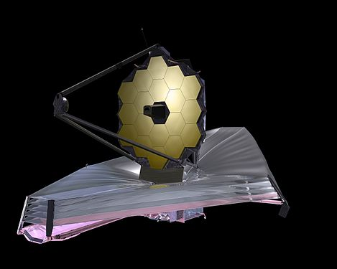
KSG3 JWST/ngVLA Synergy: Cosmic Conversion of Gas to Stars
‘Precision galaxy formation’
Gas
NGVLA
ALMA
Decarli
JWST/ELTs: stars, star formation
ngVLA: cold gas fueling cosmic star formation

Slide 19
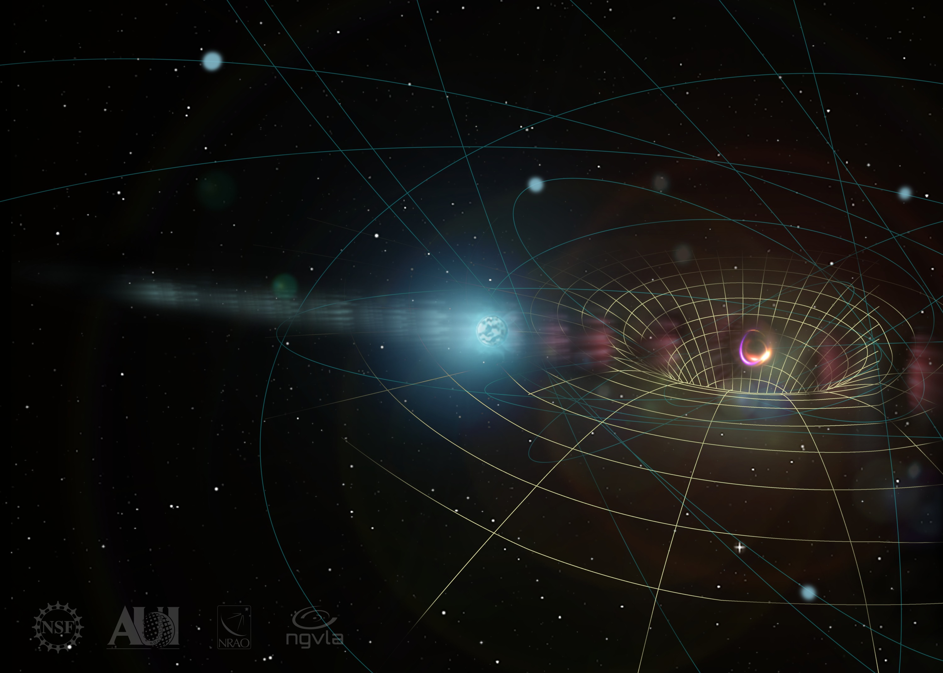
KSG4: Using Pulsars in the Galactic Center as Fundamental Tests of Gravity
Predicted population of pulsars in the Galactic Center: need high frequency due to ISM scattering
Pulsars = clocks moving in the spacetime potential of Sgr A* SMBH: ultimate tests of strong field GR
Use the population of pulsars in the Galactic Center to constrain its
Star formation history
Stellar dynamics
Stellar evolution
Magnetoionic medium
By discovering pulsars around Sgr A*, the ngVLA will provide new opportunities to test theories of gravity.

Slide 20
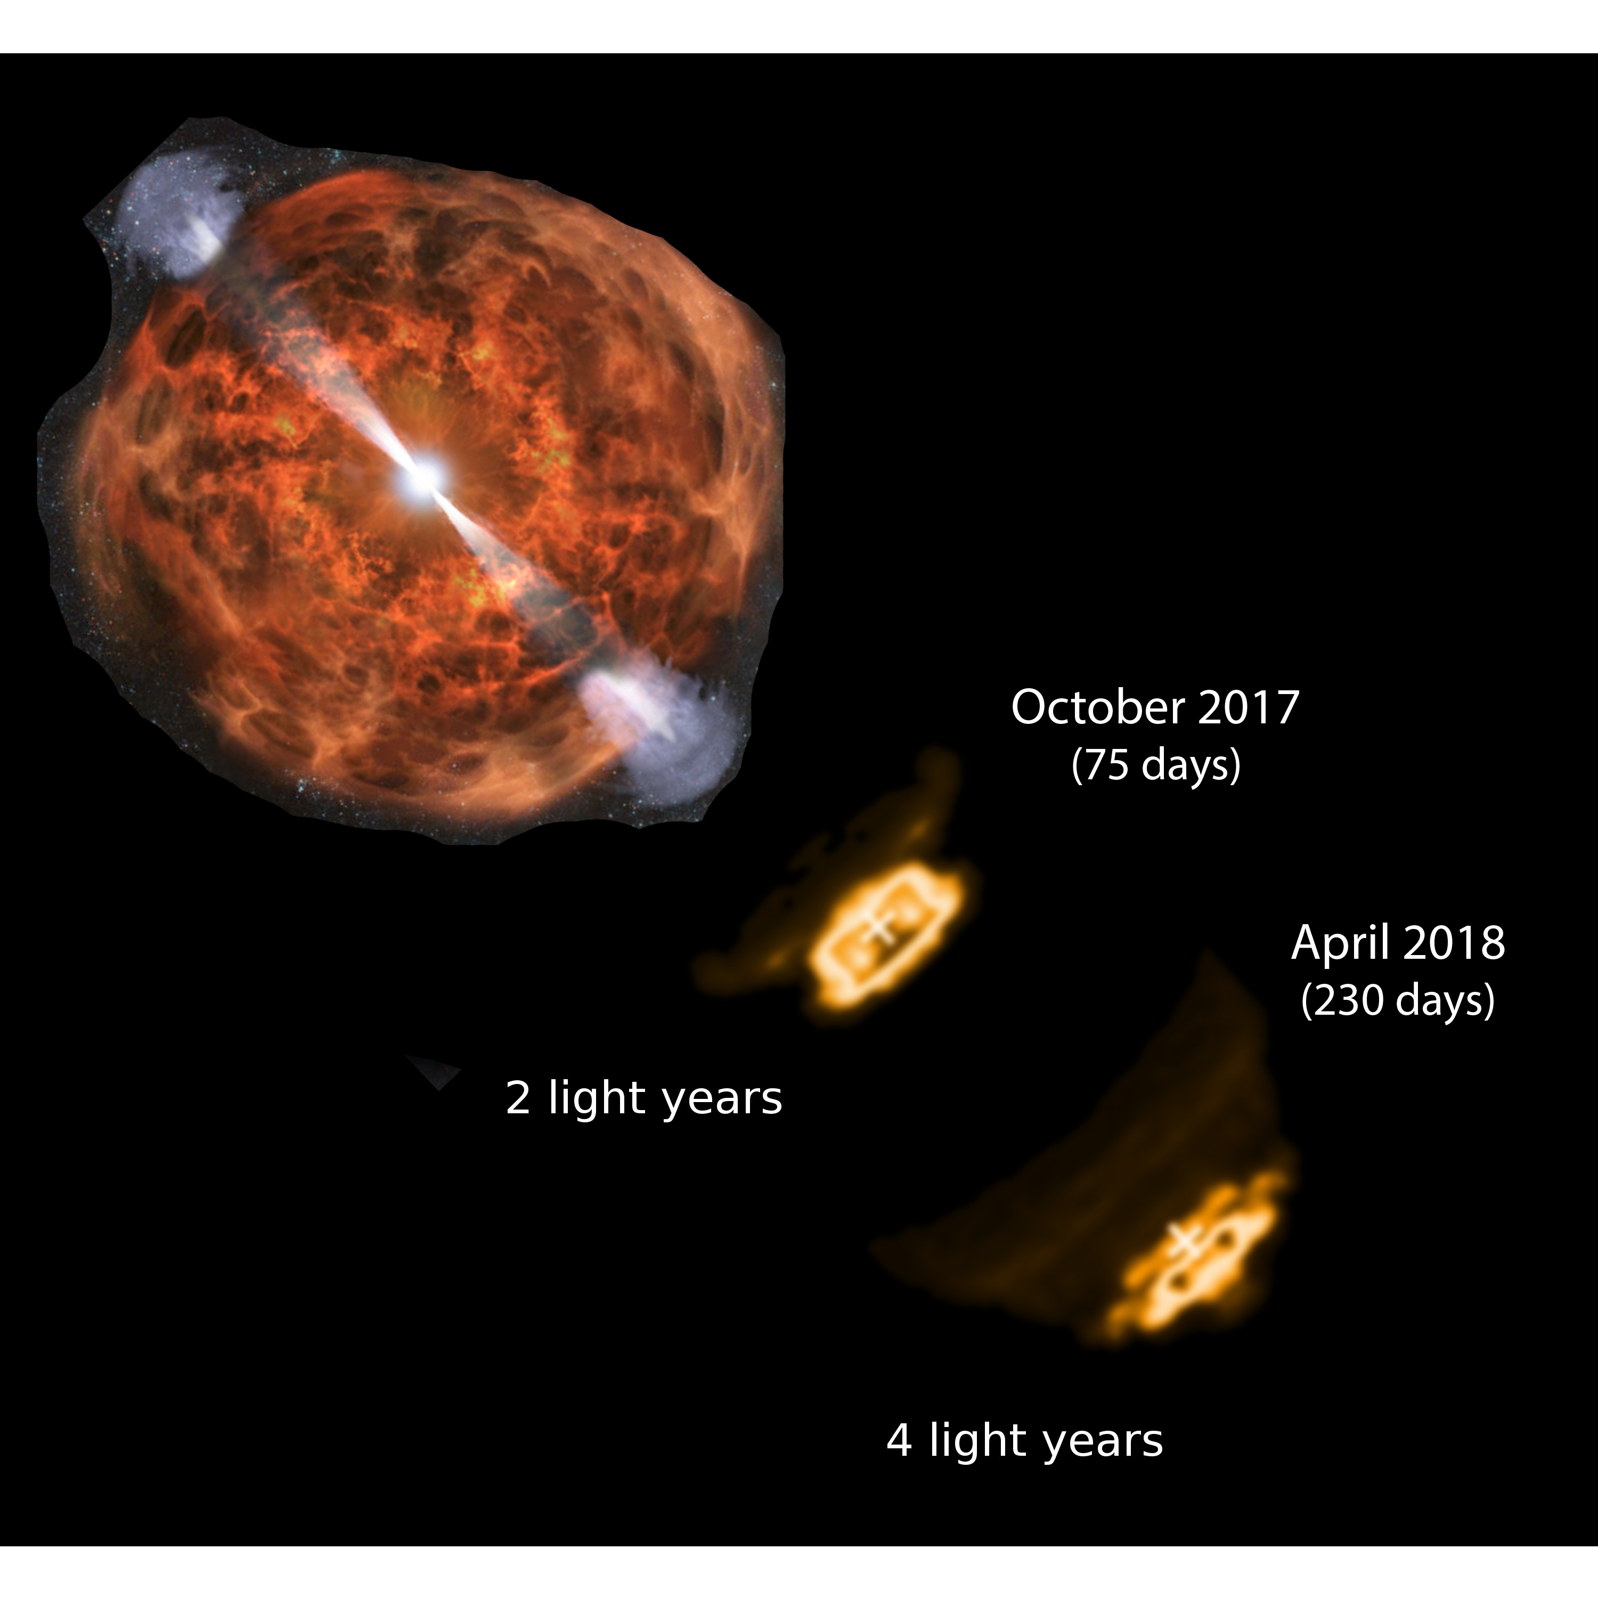
KSG5: Understanding the Formation and Evolution of Stellar and Supermassive Black Holes in the Era of Multi-Messenger Astronomy
Cosmic explosions: Pinpoint the radio counterparts to events discovered by electromagnetic, gravitational wave, or neutrino facilities
Make movies at sub-mas resolution to learn how black holes accrete fuel and launch jets
Study how black holes interact with their environments and drive galaxy evolution
Search for binary BH, and constrain the BH mass function, formation, and growth
VLBI verifies the ‘smothered jet’ model for neutron star merger: VLBI images of GW170817 separated by 150 days imply an apparent jet velocity of 4c.
Artist’s impression
See plenary talk by Alessandra Corsi, Texas Tech U

Slide 21
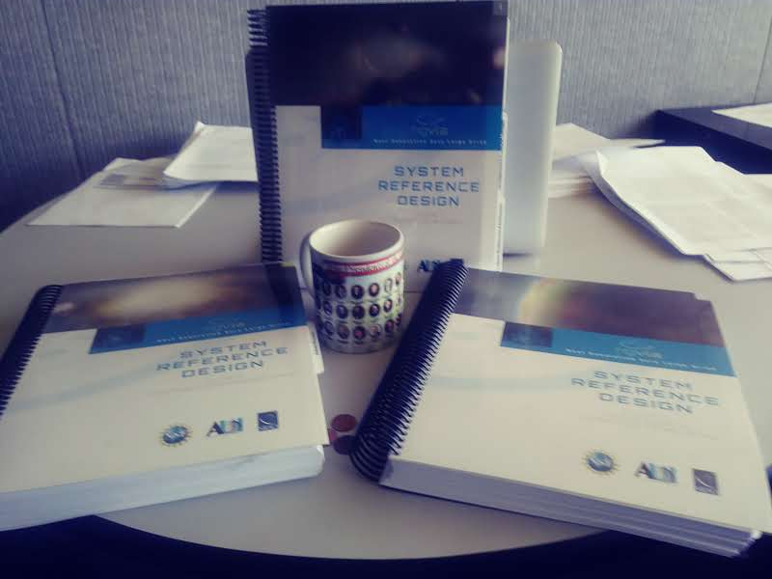
ngVLA: Advancing astronomy into the mid-Century APC White Paper for DS 2020
Released Reference Design: low-technical-risk and costed concept
Received FY20 design funds via new NSF Cooperative Agreement
Possible U.S. Multiagency Interest (DOD, NASA): ICRF, Space Situational Awareness, Spacecraft tracking/imaging, `burst-telemetry’
** Annual operations estimate is BY2018 $92.9 M/yr.

Slide 22


Compact Objects and Energetic Phenomena in the Multi-Messenger Era 2020 July 14 – 16 Saint Paul, Minnesota, USA
SOC
Nicole Lloyd-Ronning (co-chair)
Tom Maccarone (co-chair)
Geoff Bower
Shami Chatterjee
Gregg Hallinan
Jim Hinton
Kelly Holley-Bockelmann
Joe Lazio
William Lee
Jess McIver
Masayuki Nakahata
Marcos Santander
Amanda Weinstein
Joan Wrobel
Meeting Themes
Discuss the current state of compact-object research that leverages on multi-messenger information.
Help planners define an interoperable suite of multi-messenger facilities for the 2030s and beyond. An example suite might include SKA, ngVLA, ELTs, LSST, CE/ET, LISA, and IceCube, as well as future X-ray missions.
The ngVLA is a design and development project of the NSF operated under cooperative agreement by AUI.
https://go.nrao.edu/ngVLA20

Slide 23
Many Thanks to:
The ngVLA Science and Technical Advisory committees.
All ngVLA Science Working Group Participants, White Paper, and Science Book Authors.
ngVLA Community Studies Participants.
National Science Foundation.

