Slide 1
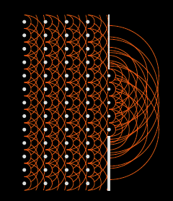
Image Plane Self-Calibration
Interferometric imaging without Fourier transforms
Chris Carilli, Nithya Thyagarajan, Bojan Nikolic
'A geometric view of closure phase in interferometry’, NT, CC 2022, PASA, 39, 14 [Shape-Orientation-Size Conservation]
’Image Plane Self-Calibration,’ CC, BN, NT 2022, JOSA-A, submitted
Copyright © 2020 AUI/NRAO. All Rights Reserved.

Slide 2
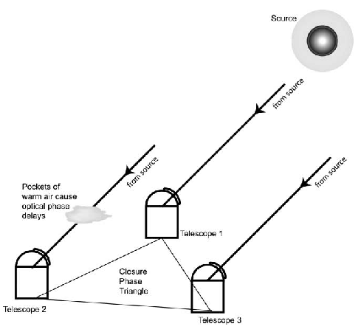
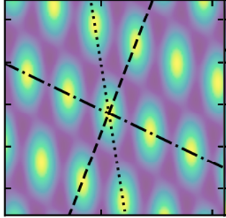
Three Element interferometer
𝜹s₃₁

Slide 3
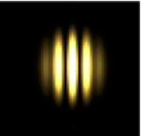
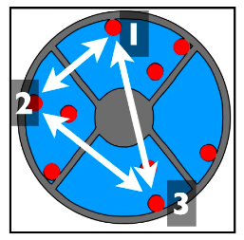
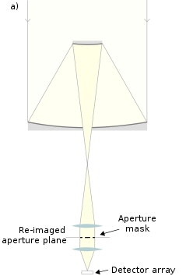
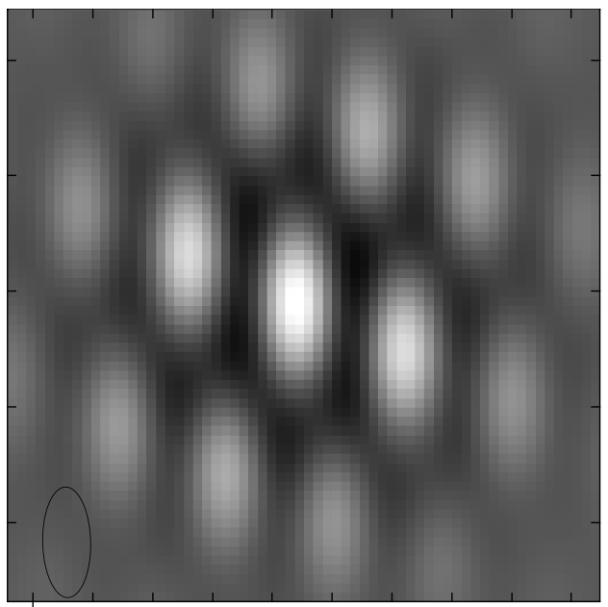
Aperture Masking in Optical Interferometry
2 apertures
Aperture plane
(visibilities)
3 apertures
Image plane
Copyright © 2020 AUI/NRAO. All Rights Reserved.

Slide 4
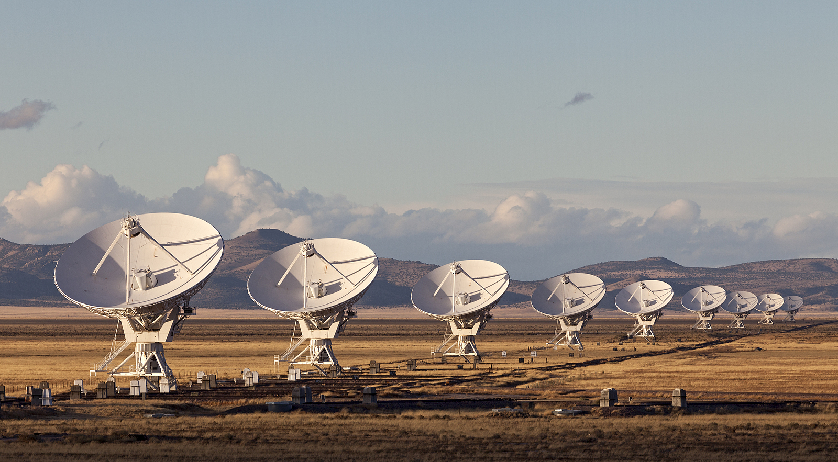
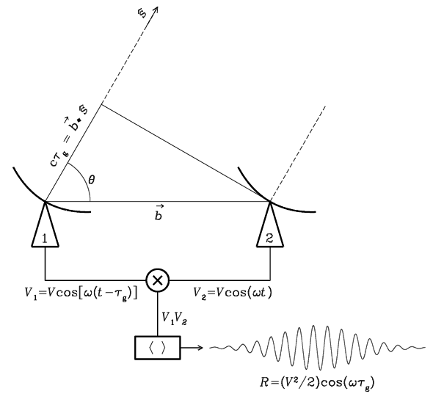

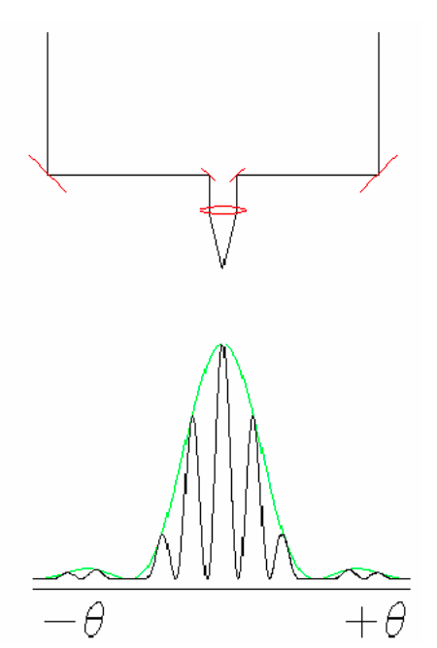
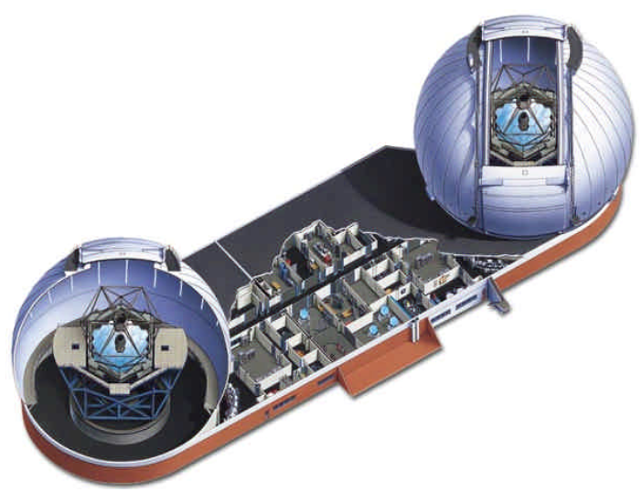
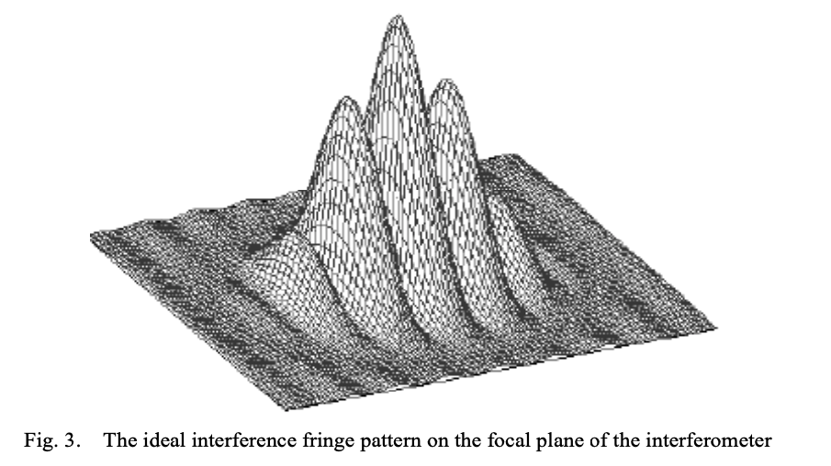
Coherent amplification of voltages, E_{1,2}
Geometric delays set by electronics
Complex cross multiply and average (correlate) directly to aperture plane visibilities
Images made from fourier transform of visibilities w/o ’total power’
Radio: direct product are visibilities = aperture plane
E₁ x E₂*
Optical: direct product is image plane
Coherent reflection by mirrors, beam splitters…
Geometric delays set by physical delay lines or primary mirror mask
Correlation via optics and interfere on focal plane, w. ‘total power’
Visibilities generated from FT(image) (but why bother?)
‘airy disk’ = ‘primary beam’
(E₁ + E₂ )² = E₁² + E₂² + (E₁ x E₂*)
Copyright © 2020 AUI/NRAO. All Rights Reserved.

Slide 5
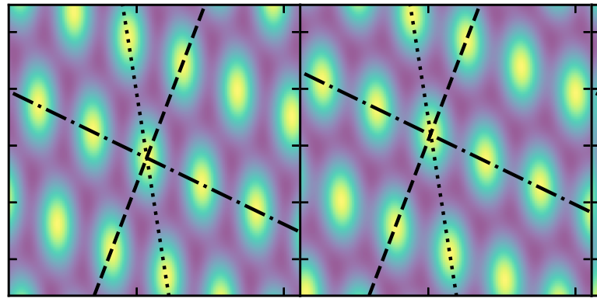
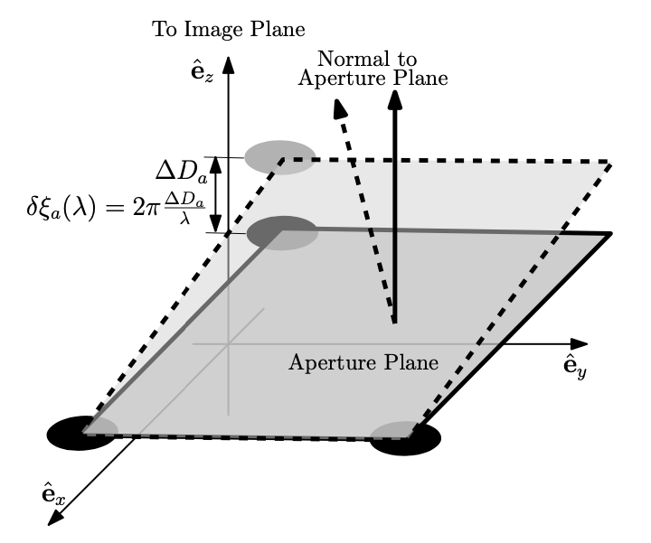
Shape – Orientation – Size Conservation
Delay corruption of one element => change optical path-length to focus = ‘piston delay’
Leads to ‘tilt’ of triad in aperture plane => shift in image plane, no other corruption/decoherence
If delay errors are element-based => all images made with 3 element interferometer are true images of the sky, modulo unknown shifts
Basis for closure phase
Three apertures define a plane
(Four may not)
Thyagarajan & Carilli, 2020, arXiv 2012.05254

Slide 6
SOS conservation with real data: 3C 286
3C286 9.4 GHz
4.4 Jy, 98% point source => 𝝍_{cl} ∼ 0
1”
Antenna-based phase errors
SOS (image) conservation
Only corruption is overall shift
Baseline-based phase errors
SOS (image) not conserved
Decoherence

Slide 7
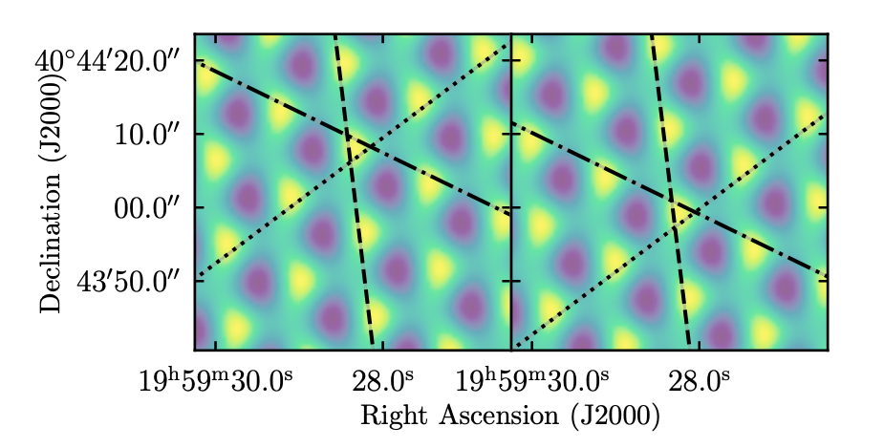
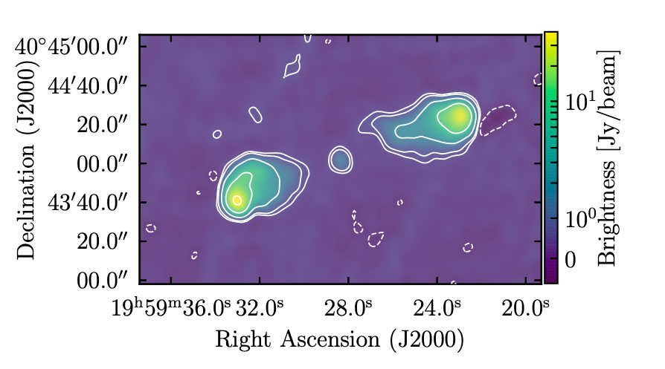
Cygnus A: Calibrated and Corrupted
80º phase error to 1 antenna
calibrated
corrupted
Cygnus A 8GHz
Complex source => 𝝍_{cl} ≠ 0
Shift along uncorrupted fringe

Slide 8
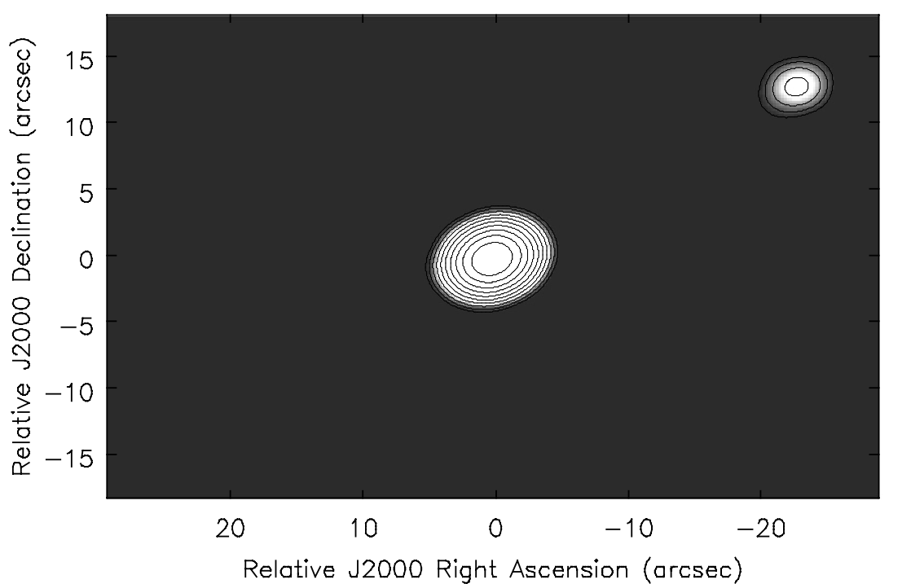
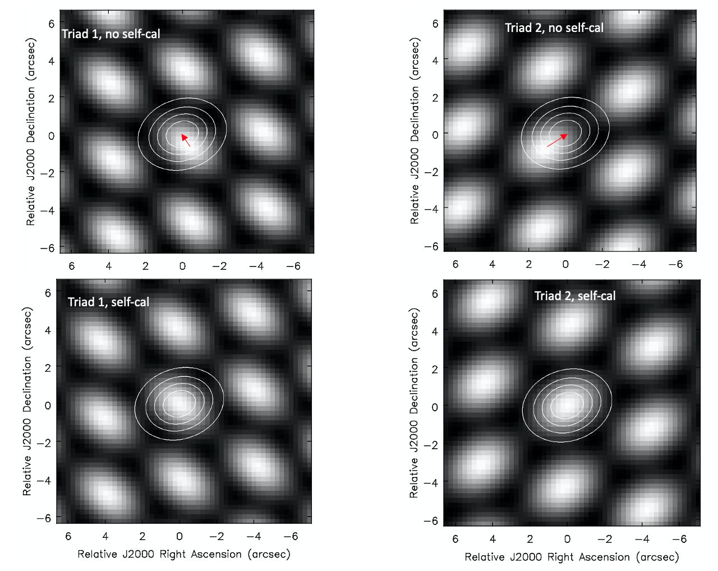
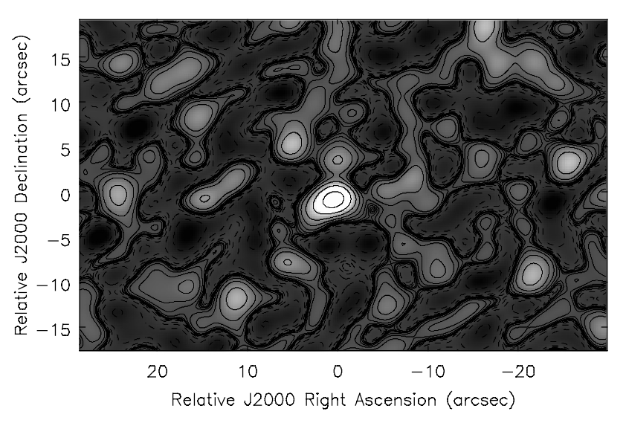
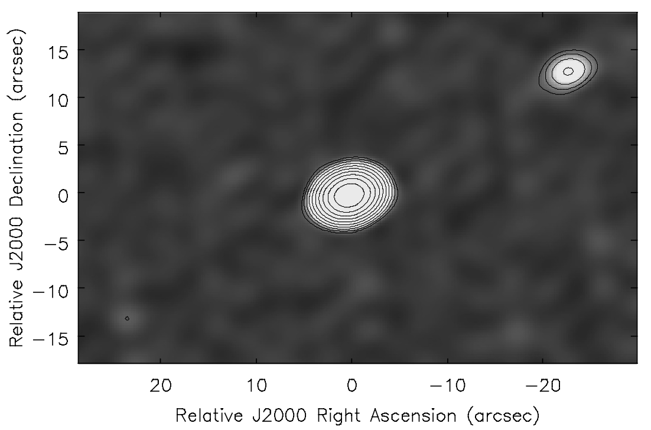
SOS => Image Plane Self-Calibration
Model: star/planet = 100/1
Generate 3-element images = true images, but unknown relative shifts due to antenna-based delay errors
Cross correlate each triad image with model image to derive shifts
Sum shifted images => coherent image of source with full array
80º phase errors, no self-calibration (contours = model; B/W = corrupted data). Arrows indicate required IPSC shifts.
80º errors, no self-calibration
+
+
=
Triads 3, 4, … N_{triads}
80º errors plus self-calibration
80º phase errors, after IPSC shifts are applied (red arrows above)
+
+
=
Triads 3, 4, … N_{triads}

Slide 9
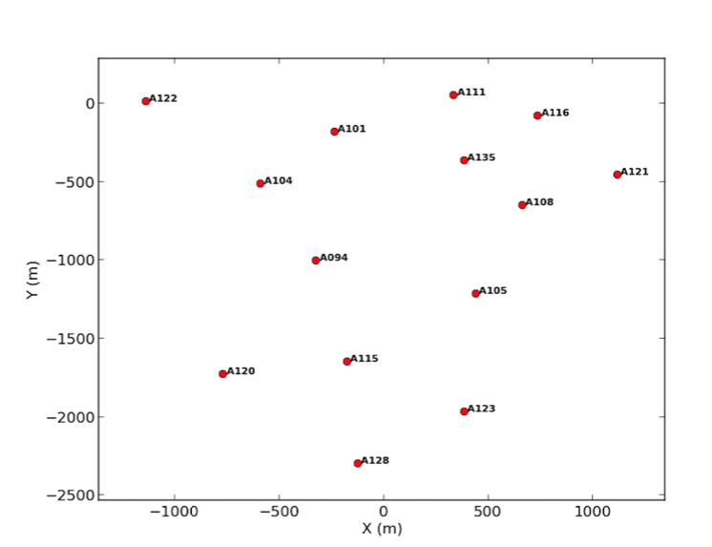
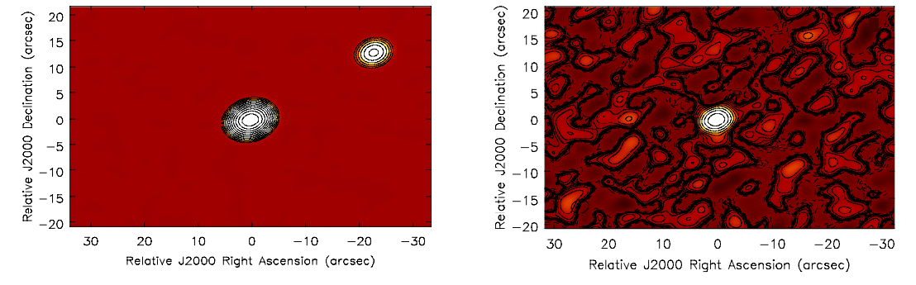
Tests of IPSC
ALMA configuration, removing closest antennas (14 antennas)
Model: Bright point plus faint companion (100/1) (eg. binary stars or dwarf star – giant planet w. 1AU separation at 115pc)
SIMOBSERVE and add antenna phase errors random over +/-10º
Make all triad images (= ‘starting point’)
Spatial cross correlation w. model image, starting with point source
Iterate
Star = 1 Jy, planet = 10 mJy, no errors
10º errors, no Selfcal

Slide 10
Aperture plane self-cal w. point-source model
Planet = 9.9 mJy
Rms = 0.09 mJy
Ghost = 0.20 mJy
Image plane self-cal w. point-source model
Planet = 6.3 mJy
Rms = 0.25 mJy
Ghost = 2.6 mJy
Image plane self-cal w. iteration
Planet = 9.0 mJy
Rms = 0.20 mJy
Ghost = 0.6 mJy

Slide 11
1 mJy planet (1000/1), IPSC w. point source
Planet = 0.71 mJy
Rms = 0.15 mJy
Ghost = 0.025 mJy
100 mJy planet (10/1), IPSC w. point source
Planet = 65 mJy
Rms = 2 mJy
Ghost = 21 mJy

Slide 12
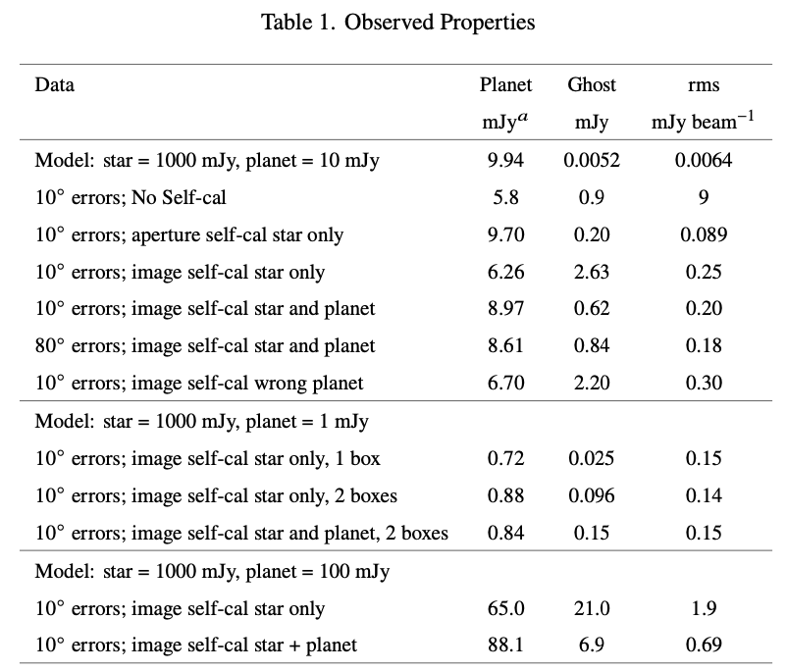
Summary
IPSC converges
APSC converges better (for large N)
Lower rms
Weaker ghost
Over-constraints = N_{vis}/(N_{ant} - 1)
= (N_{ant}(N_{ant} - 1)/2) / (N_{ant} - 1) = N_{ant} / 2
APSC (14 ant) = 7
IPSC (triads) = 3/2
Note: above true for Johnson (receiver) noise, but in optical interferometry, noise is NOT antenna based, but photon-counting and CCD read noise, back-ground…
Ghost source: natural consequence of symmetrization in marginally constrained self-cal (Cornwell & Fomalont 1999; Linfield 1986)

Slide 13
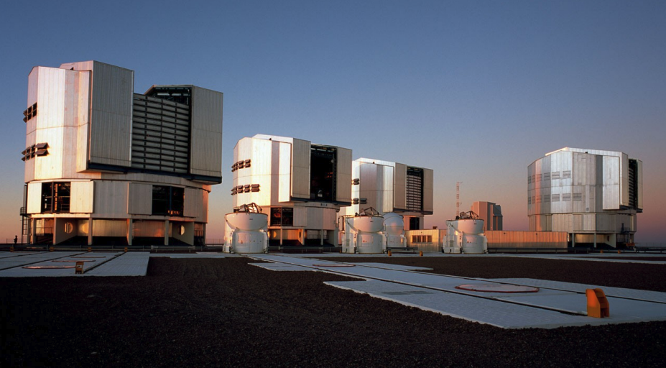
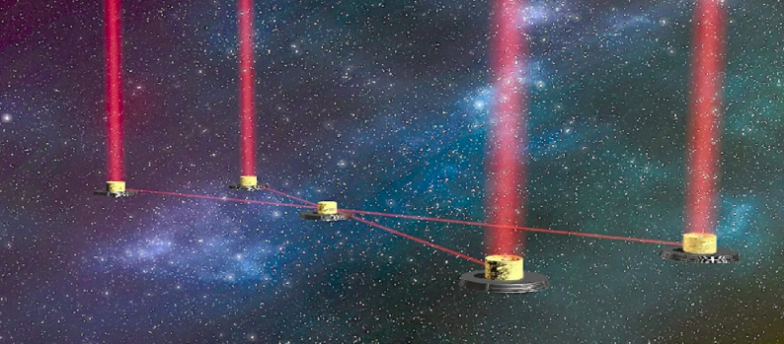
Applications
Small N
Basic measurements in image plane
Amplitude and baseline-based errors small
All typical in optical interferometry
Examples: small N arrays w. image plane detectors
VLTI: 4x8.2m + 4 x 1.8m (only 4 at time)
LIFE: space near-IR 4 x 3m elements
LISA: 3 elements
Design
Instead of 2-element fringe images and FT, generate 3-element images with direct imaging beam combination (preserve array geometry)
Large Interferometer for Exoplanets

Slide 14
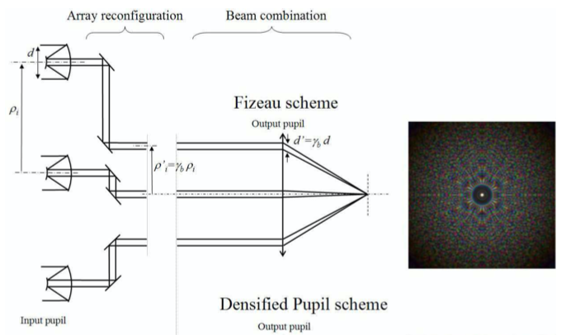
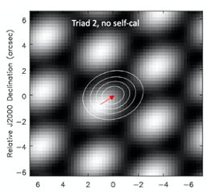
Typical optical interferometers
2-element beam combination (pair-wise or non-redundant beam combination) generates fringe images on CCD
Fourier transform fringe images generates visibilities, from which source images are reconstructed based on amplitudes and closure phases.
Direct imaging interferometers (Fizeau homothetic)
All-to-one beam combination where pattern of apertures is conserved in scaled pupil => direct image creation on CCD
Requires active co-phasing system (adaptive optics, eg. reference star; Lardiere ea 2007)
IPSC scheme
Generate 3-element images using directing imaging beam combination
Self-calibrate using image cross correlation and sum
No need for co-phasing system

Slide 15
Future
Noise (Johnson vs CCD)
APSC ‘by threes’: end up in same place?
Joint constraints for triad images that share antenna/baseline
More complex models
Real data
Real-world applications

