Slide 1
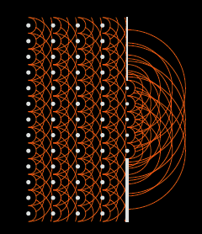
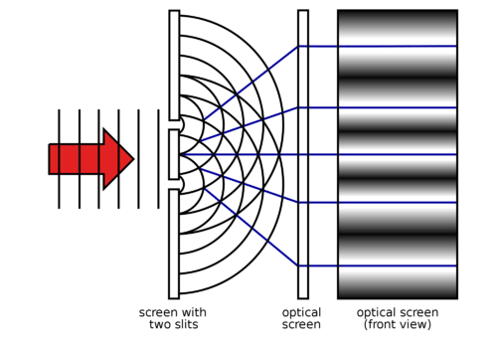
Interferometric Imaging of the ALBA Synchrotron Light Source
Fourier Optics and Huygens Principle
Carilli (NRAO), Nikolic (Cavendish), ), Thyagarajan (CSIRO)
Torino, Iriso (ALBA)
Copyright © 2024 AUI, U. Cambridge, CELLS, CSIRO. All Rights Reserved

Slide 2
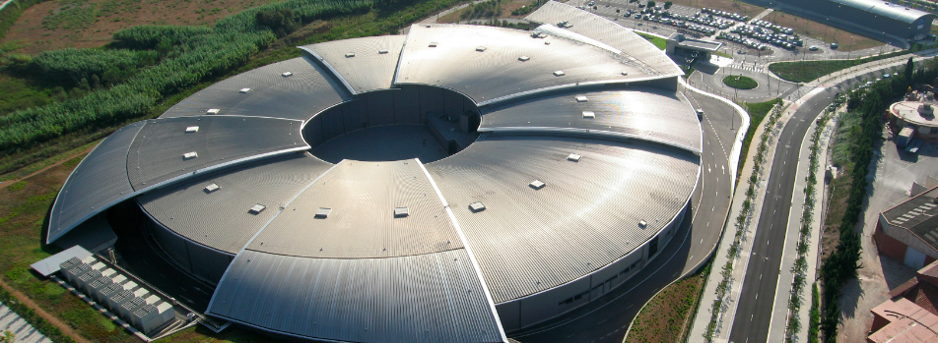
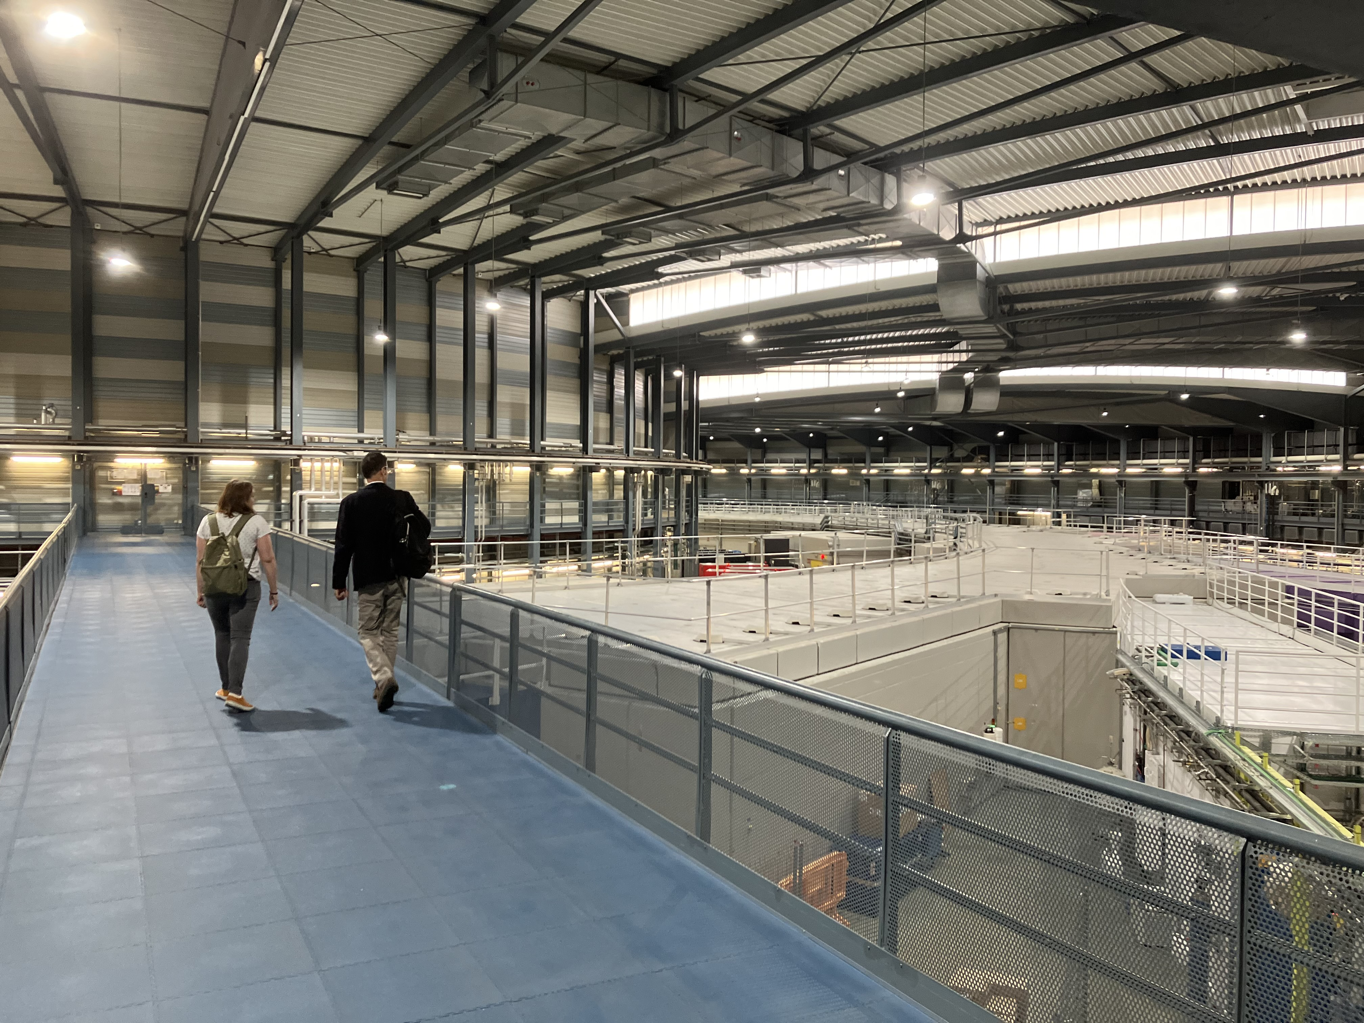
ALBA Synchrotron Light Source, Barcelona, Spain
Circumference = 270m
Electron energy = 3 GeV
Photon energy up to 70 keV
Emittance = 4.5 nm-rad

Slide 3
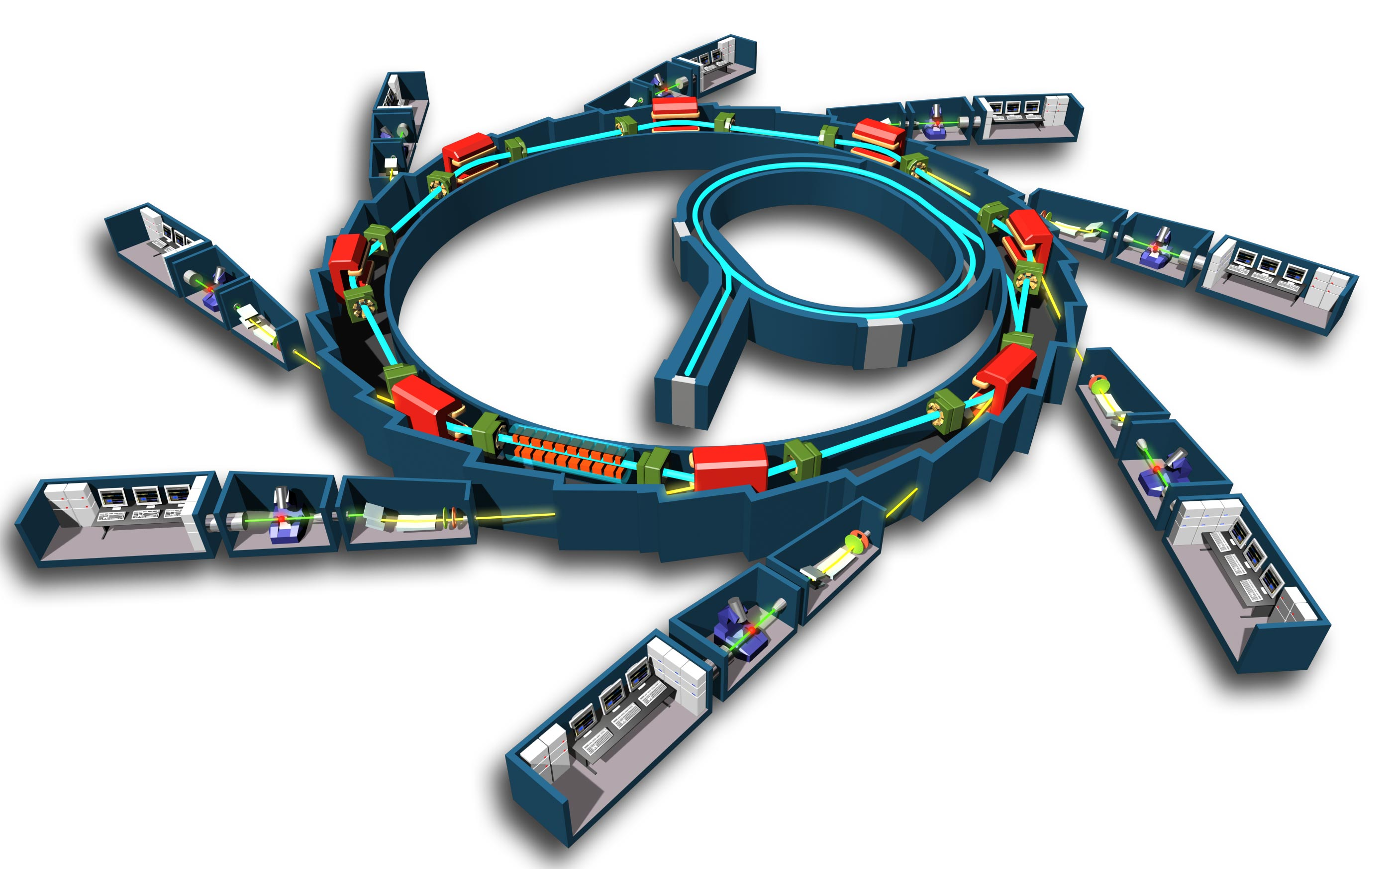
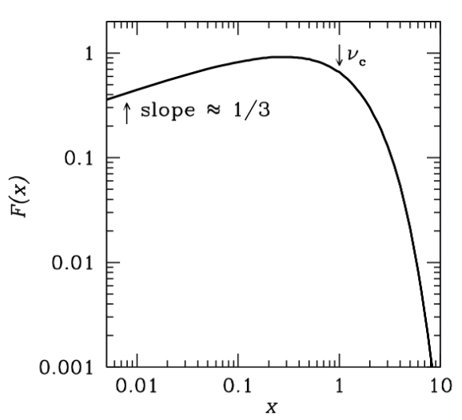
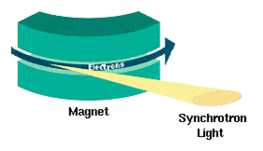
Storage Ring
Photon Beam lines = experiments
Bending magnet
Insertion Ring
e⁻ gun
Undulator or wiggler
Radial acceleration at bending magnets
I_{𝛎} ∝ 𝛎^{𝞪}
Doppler beaming
70keV

Slide 4

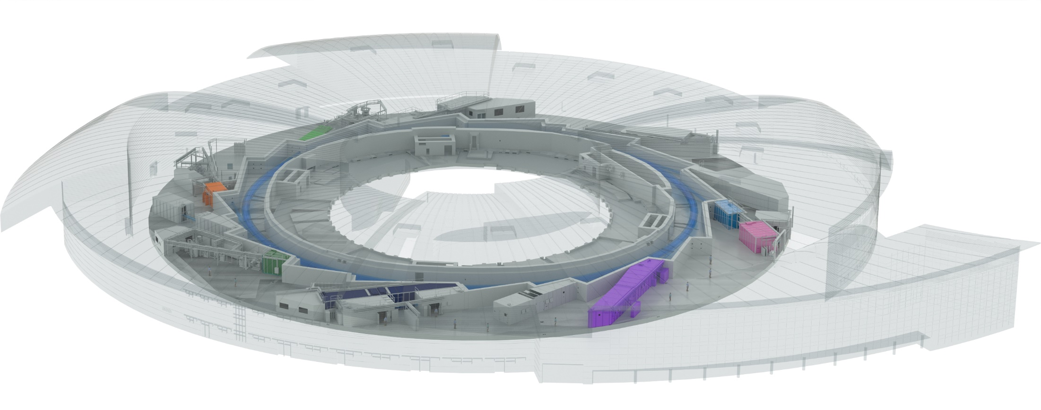

ALBA Today
Public Institution
  50% Spanish “Ministerio de Ciencia”
  50% Catalan “Department de Recerca & Universitats”
12 operating beam lines
2500 experiments/year in metrology, material, and life science
BOREAS
FAXTOR
(in commissioning)
BL34 – Xanadu
MINERVA
CIRCE
MIRAS
CLAESS
MSPD
LOREA
XAIRA
(in commissioning)
Cryo-EM
NOTOS
MISTRAL
TEM
InCAEM
(in constr.)
3SBAR
(in constr.)
XALOC
NCD-SWEET
Metrology Research
Material Science Research
Life Science Research
Accelerator Research

Slide 5
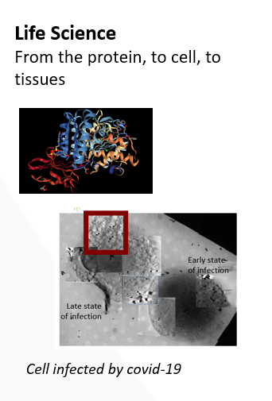
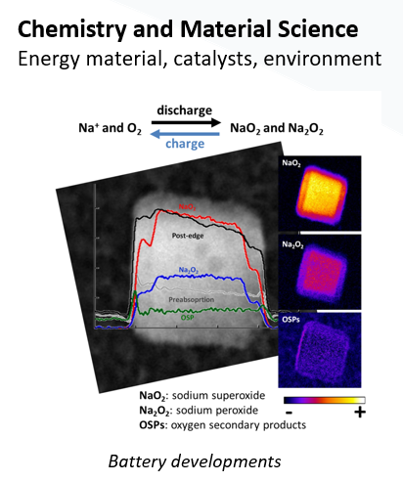
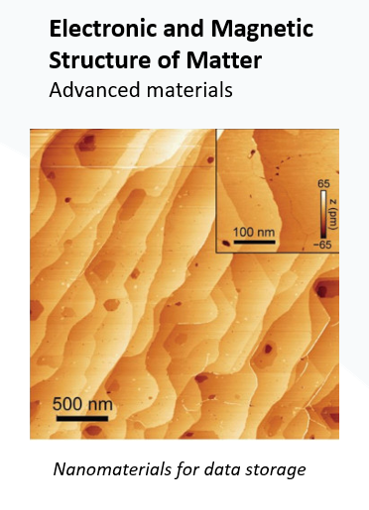
ALBA Synchrotron Research
  X-ray crystallography and tomography
  X-ray spectroscopy
  X-ray metrology (Athena)
  X-ray lithography
  Infrared spectroscopy

Slide 6
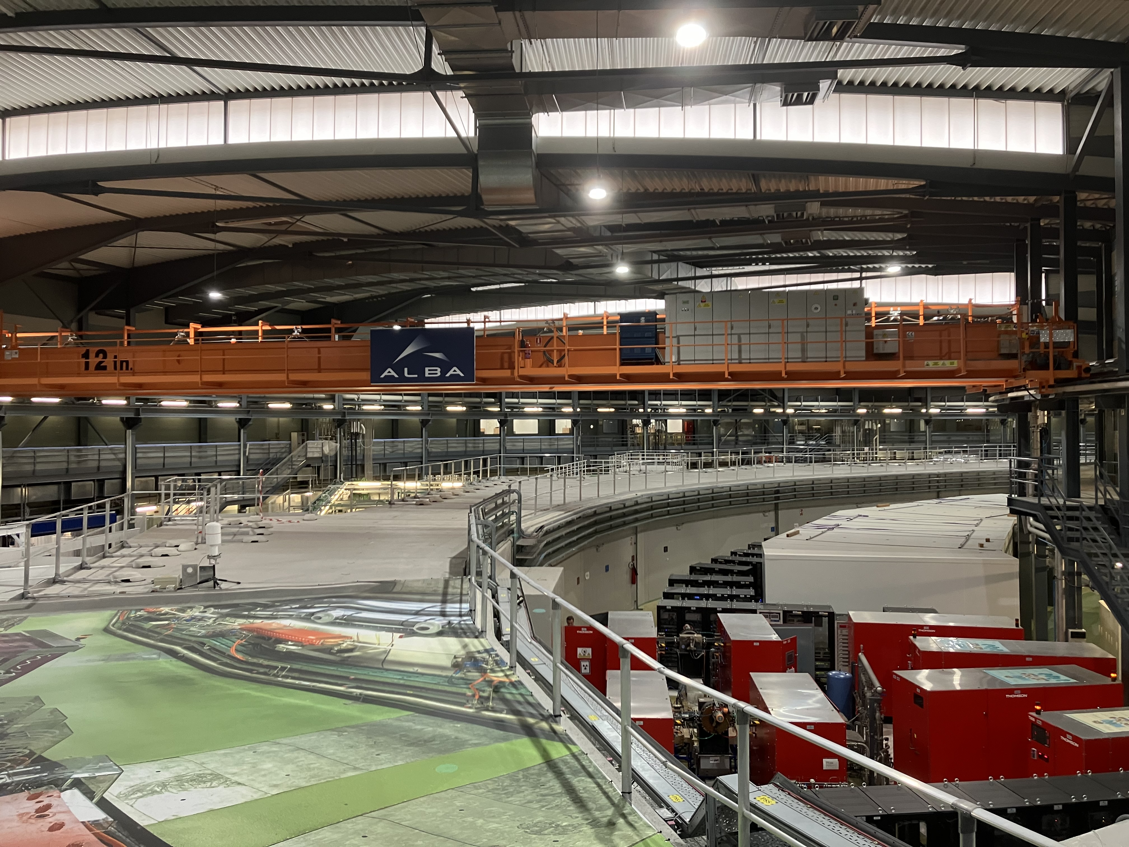
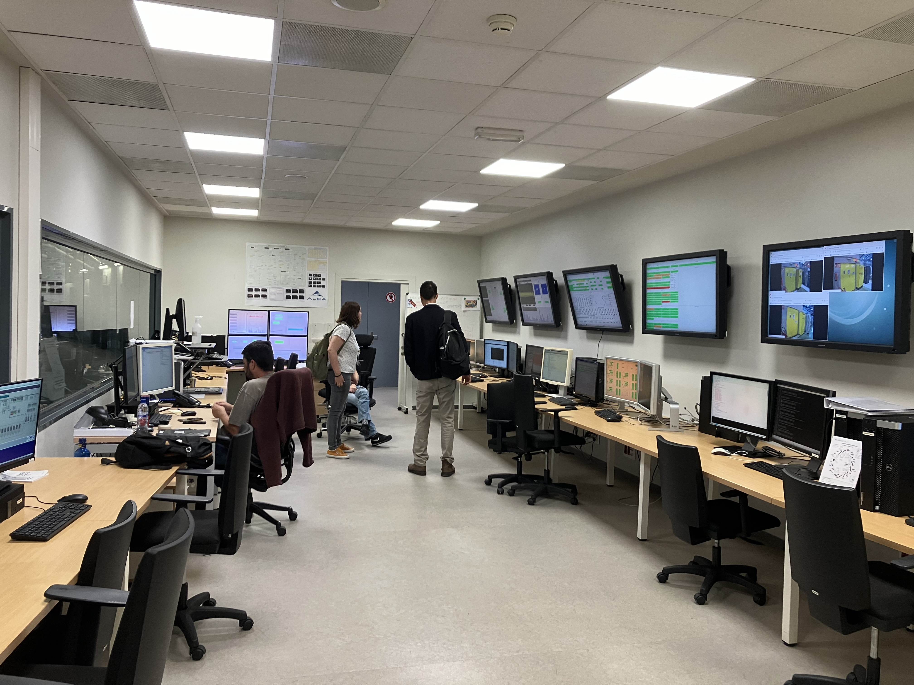
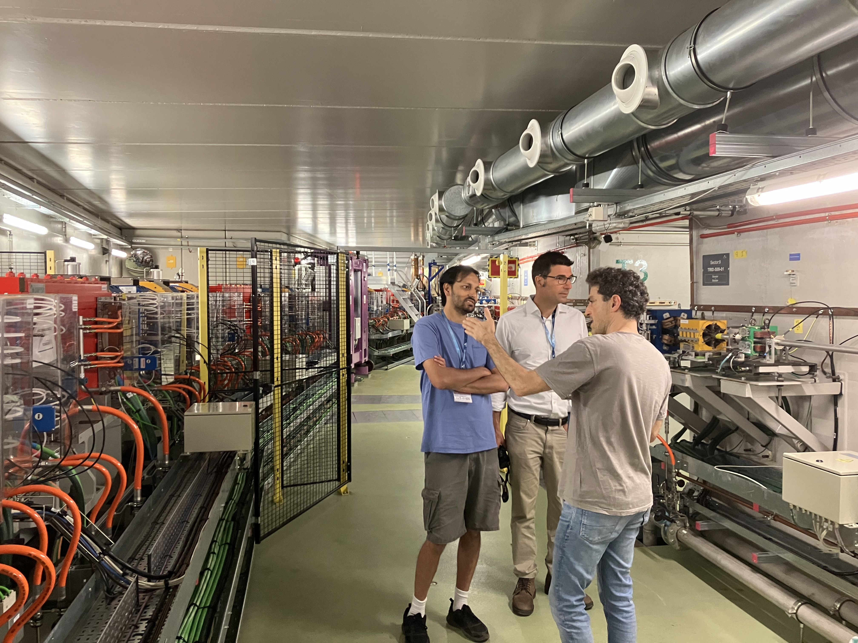
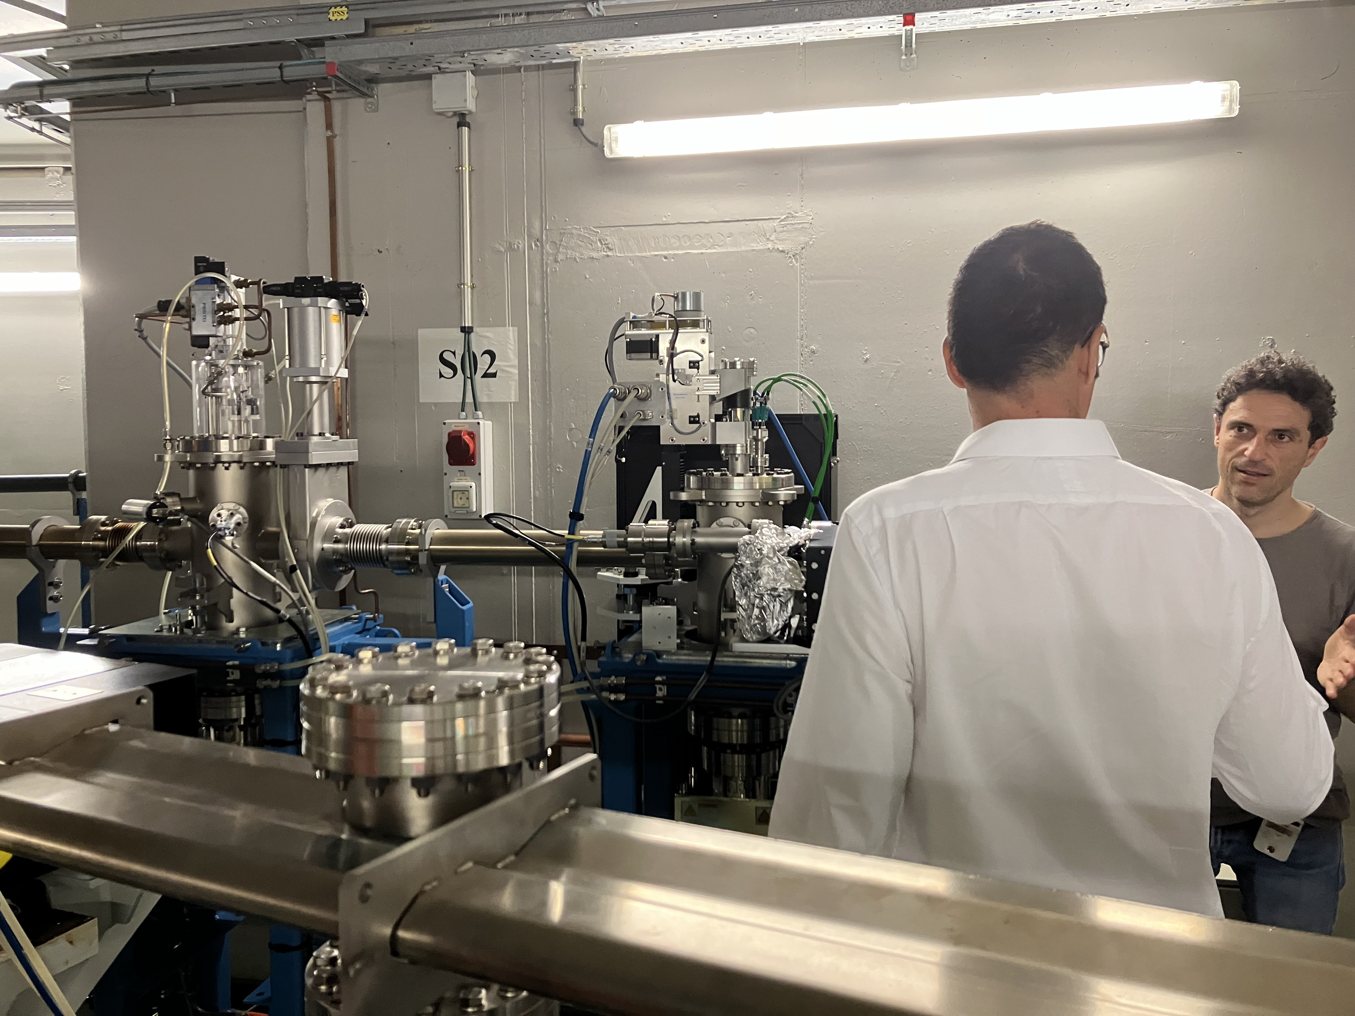

Slide 7
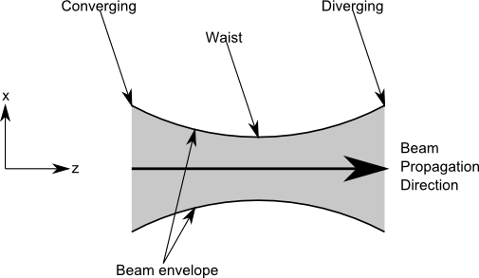
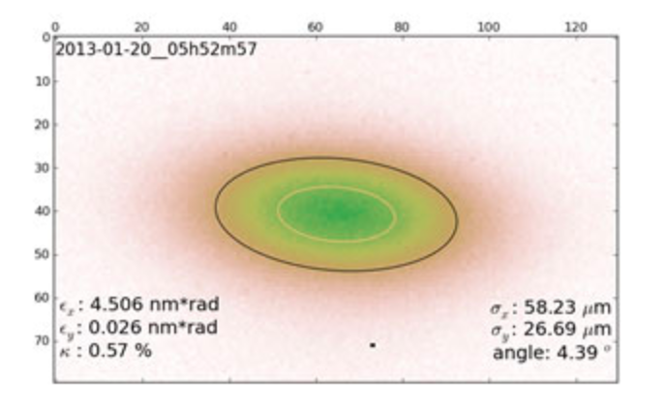
Key Performance Metric: Emittance
Emittance = e⁻ beam area x momentum vectors
Low emittance => concentrated and focused photon beam => higher brightness
Measurement methods
X-ray pinhole camera
LOCO magnetic lattice analysis + beam position monitors
Optical synchrotron radiation interferometry (SRI)
Note: X-ray pinhole => highly Gaussian ~10¹² e⁻

Slide 8
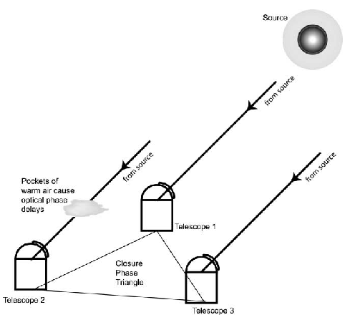

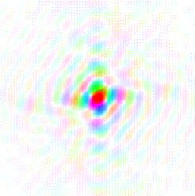






Van Cittert – Zernike Theorem
The cross-correlation, or coherence, between the electromagnetic voltages measured at spatially distinct locations (’apertures’) = Fourier transform of the intensity distribution
V_{i,j} = A_{i,j,} 𝝓_{i,j}
FT
y
v
u_{i,j} = (B_{i,j} / 𝜆)
Image plane
Aperture plane
x
u
‘dirty image’
‘self-calilbration’

Slide 9
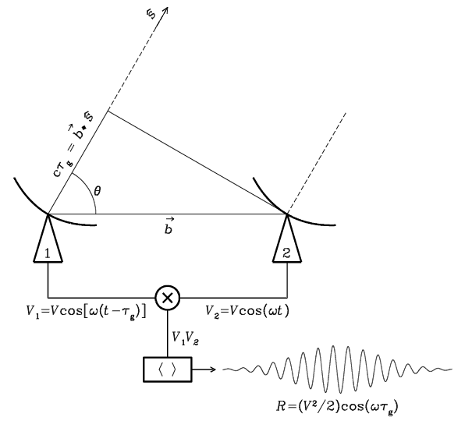
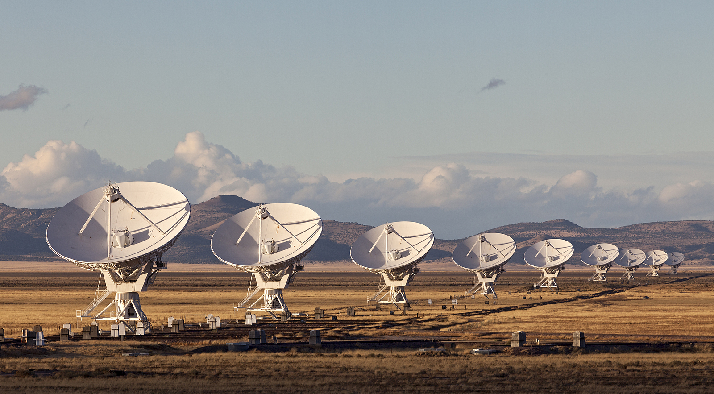

Radio measurements are visibilities = aperture plane
V_{i,j} = E_{i} x E_{j}* = A_{i,j,} 𝝓_{i,j}
Coherent amplification of voltages, E
Geometric delays set by electronics
Complex cross multiply and average (correlate) to visibilities
Images made from Fourier transform of visibilities
Note: negative surface brightnesses => unphysical due to lack of total power

Slide 10
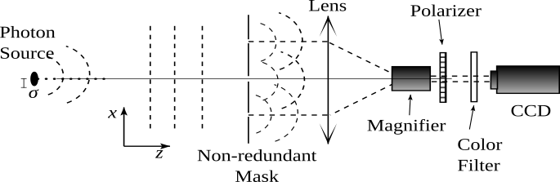
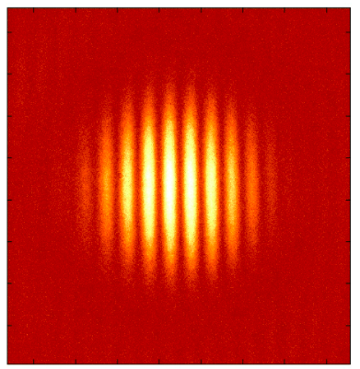
Optical measurements are images
V_{1,2} (A_{i,j,} 𝝓_{i,j}) = FT(Image)
Aperture mask + coherent focus with lens (or mirrors)
Direct imaging of fringe pattern
Visibilities generated from FT(image)

Slide 11
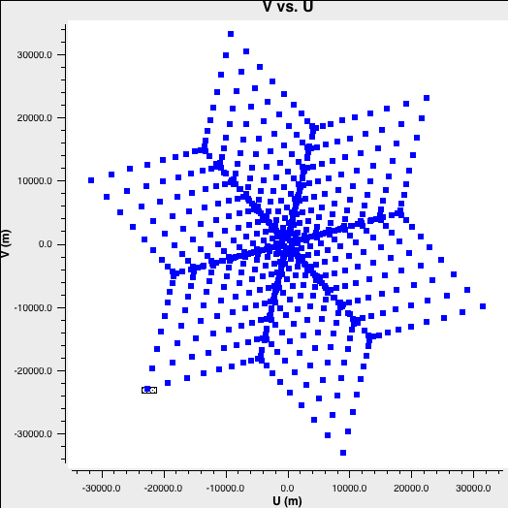
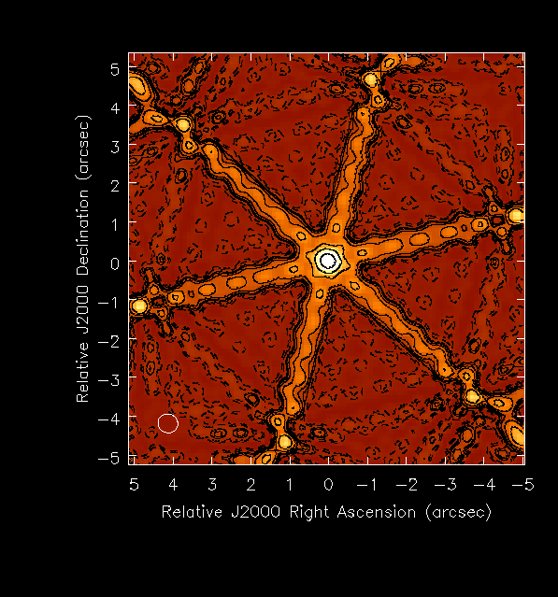
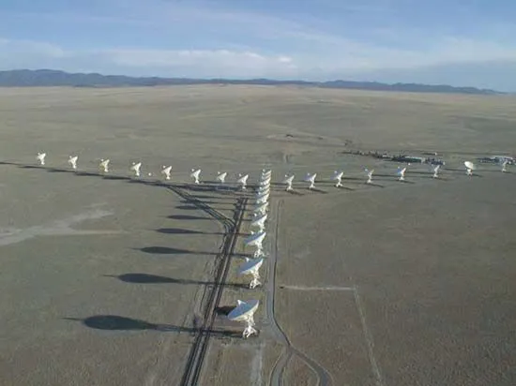
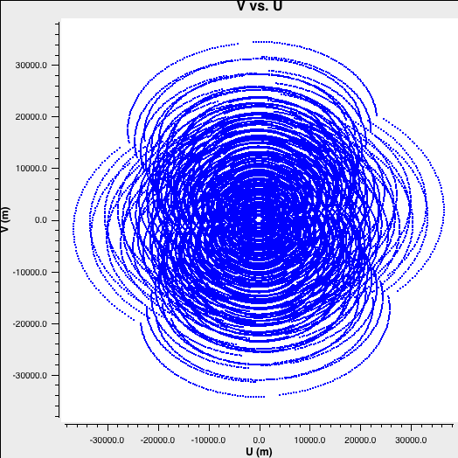
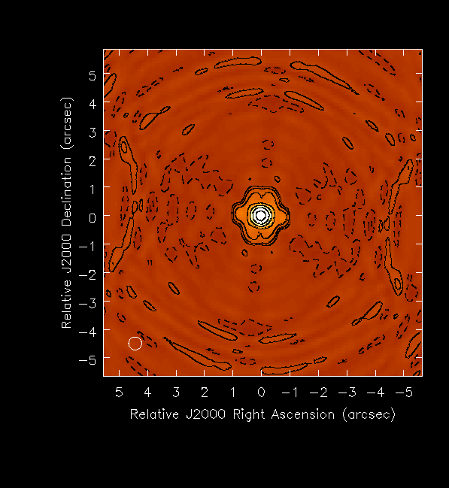
Quality of image depends on number of Fourier components:
N_{uv} = N_{ant}((N_{ant}-1)/2) = 351
PSF
Fourier = u,v coverage
FT
Sidelobes ~ 0.3
Earth rotation and bandwidth
N_{uv} = 351 x n_{t} x n_{ch} > 10⁵
Sidelobes ~ 0.03

Slide 12
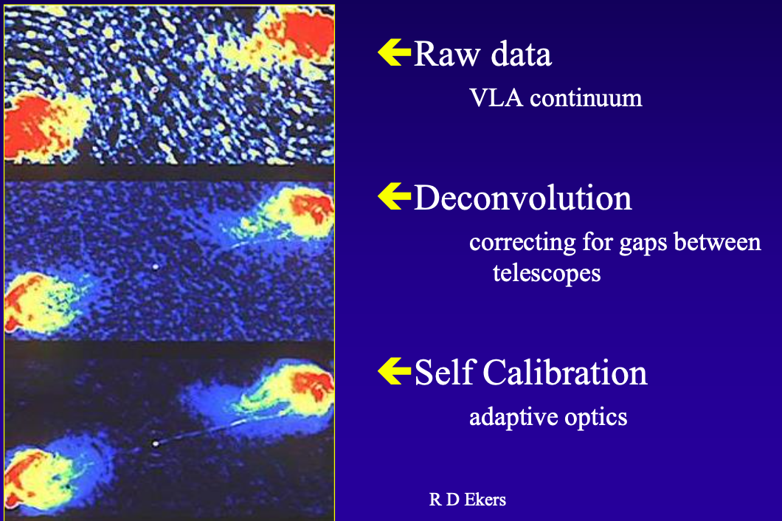
peak/rms ~ 100
Peak/rms ~ 10⁵
= Wavefront sensor
R. Ekers

Slide 13
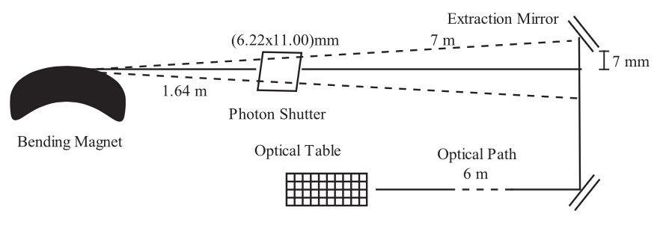
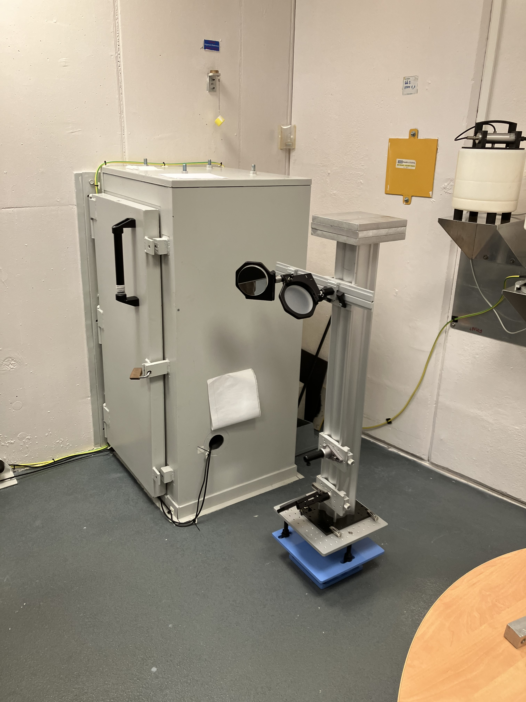
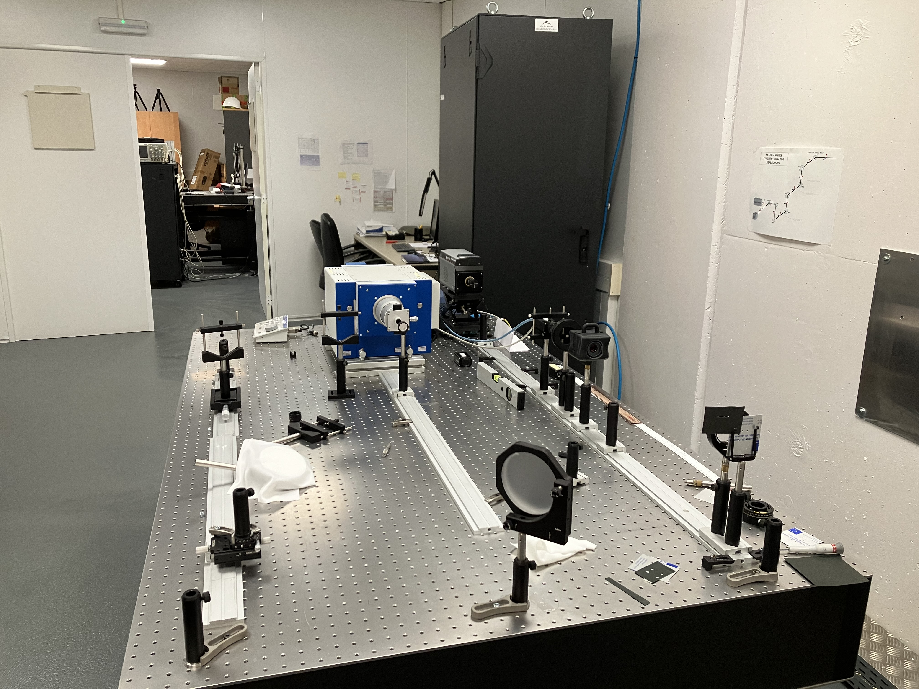
Xanadu: ALBA optical synchrotron radiation interferometry lab
Fast CCD
Magnifier, polarizer, color filter
Mask + lens

Slide 14
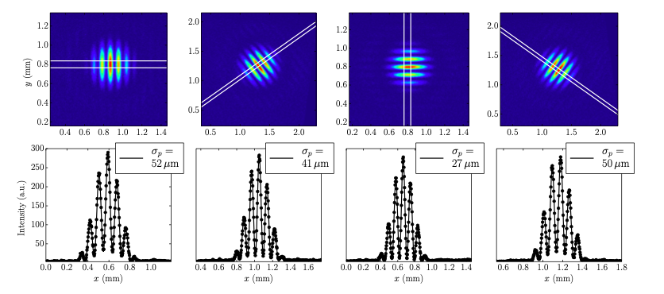
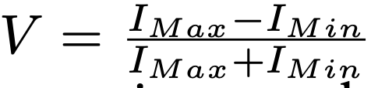
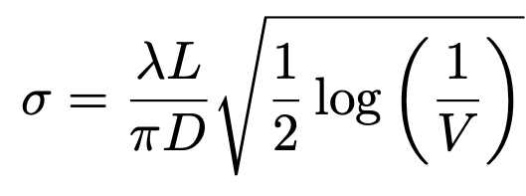
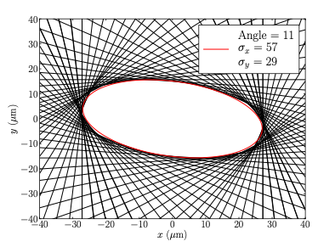
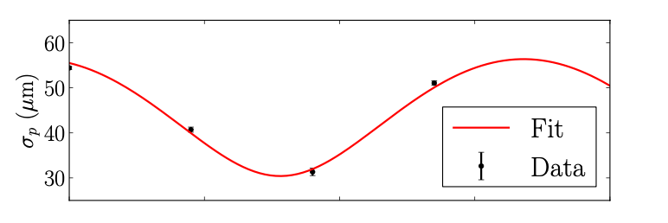
Rotated Two Hole Method: ‘Young’s slit’ w. Gaussian Fitting
Torino & Iriso w. Mitsuhashi method

Slide 15
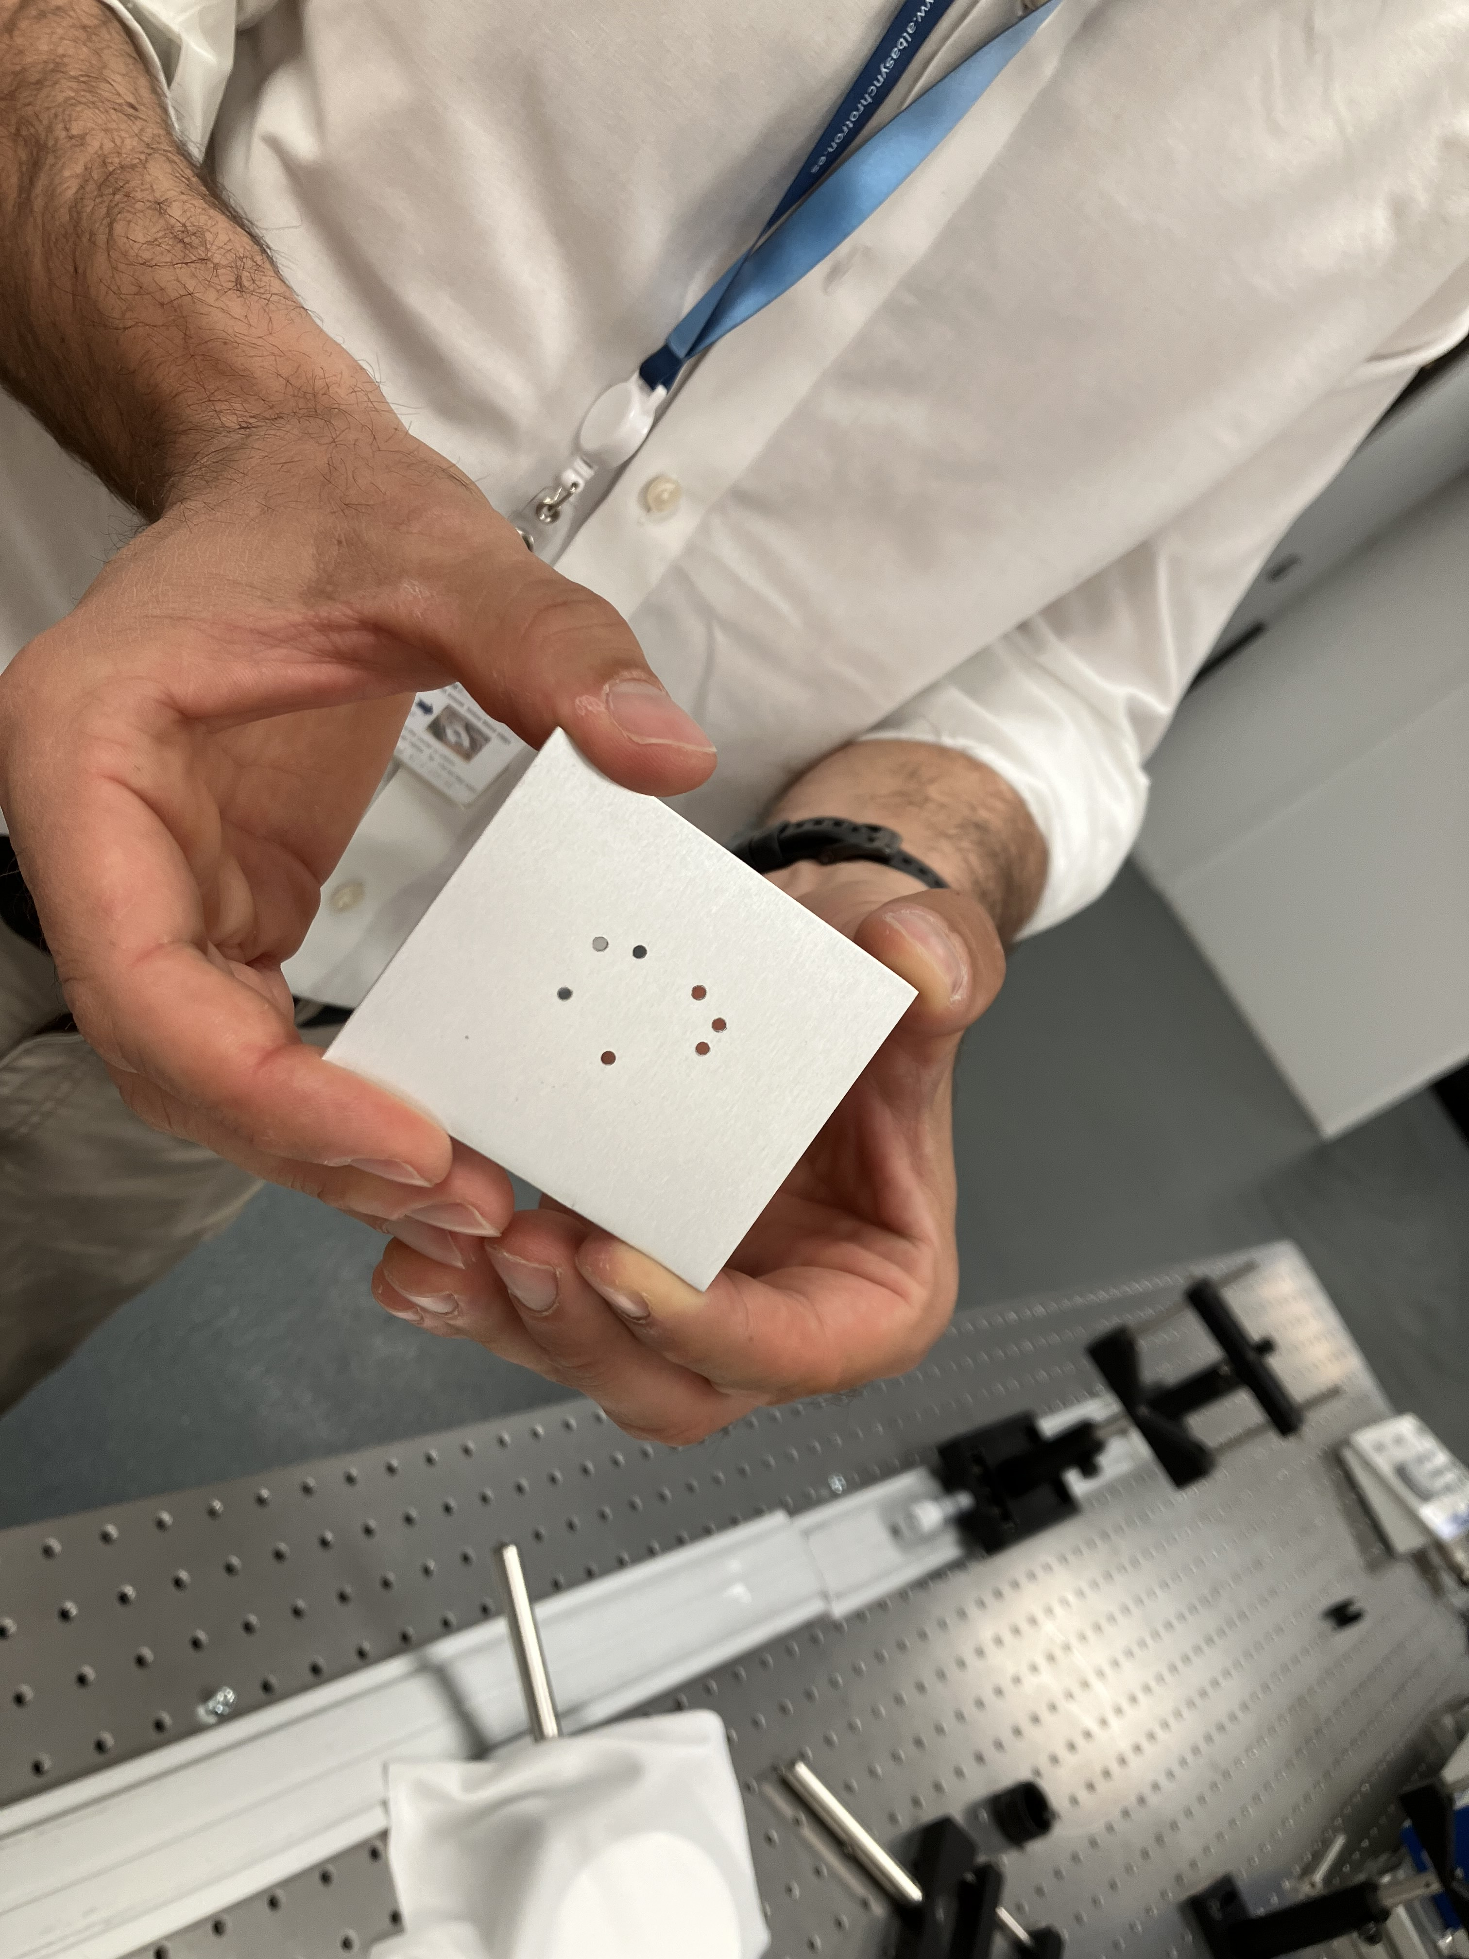
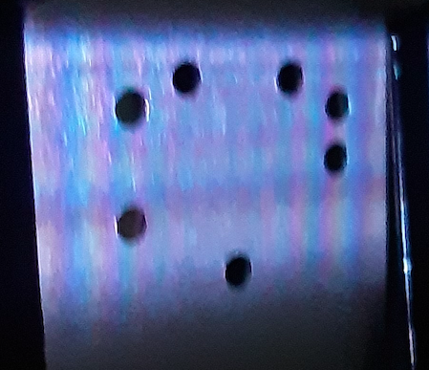
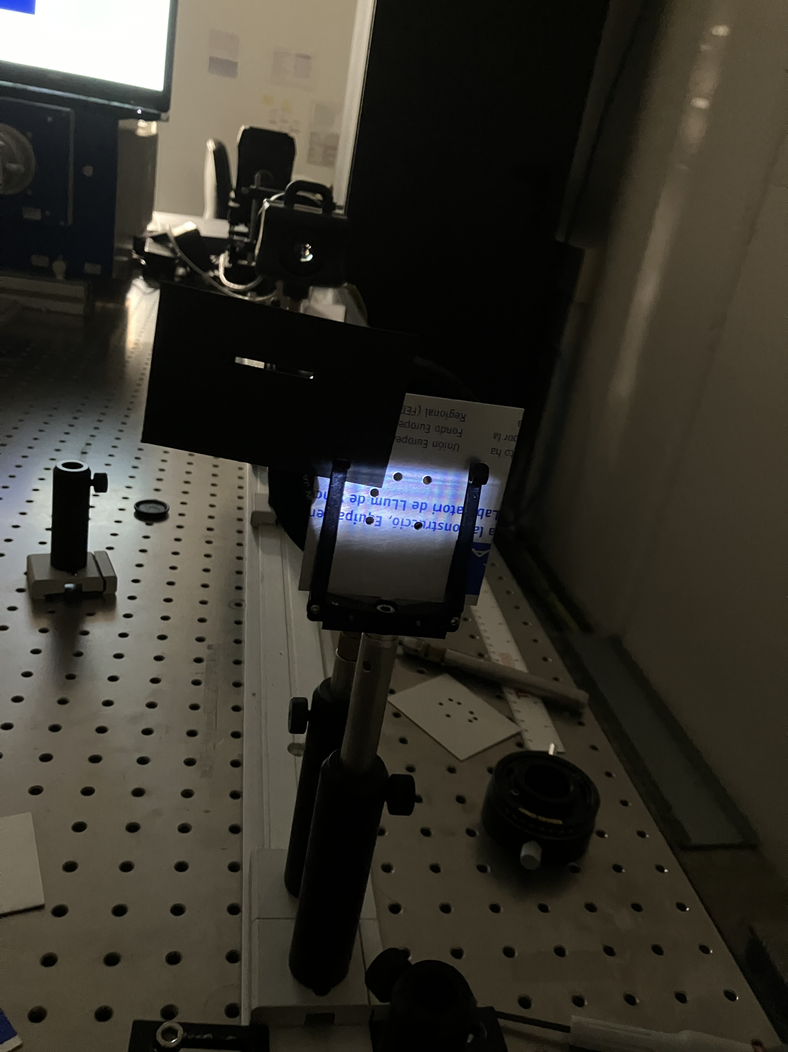
Multi-hole, 2D non-redundant mask SRI w. self-calibration
Experiments
Experiments w. 2, 3, 5, 6, 7 hole masks
Hole sizes = 2mm to 5mm
Wavelength = 400nm and 540nm
30 Frames = 0.3ms to 3ms every 1sec
Max baseline = 27mm at 400nm => 3” fringe
Source major axis = 60um at 15m = 0.8” (but ~10⁷ photons/frame => very high S/N)
Processing
Center on Airy disk + bias subtraction
FT to V_{ij} (A_{i,j,} 𝝓_{i,j})
Challenges: non-uniform illumination and phase fluctuations due to vibrations
  1. Gaussian fit V_{amp} w. G_{amp} self-cal
  2. Hybrid mapping w. G_{amp} & G_{ph} SC

Slide 16
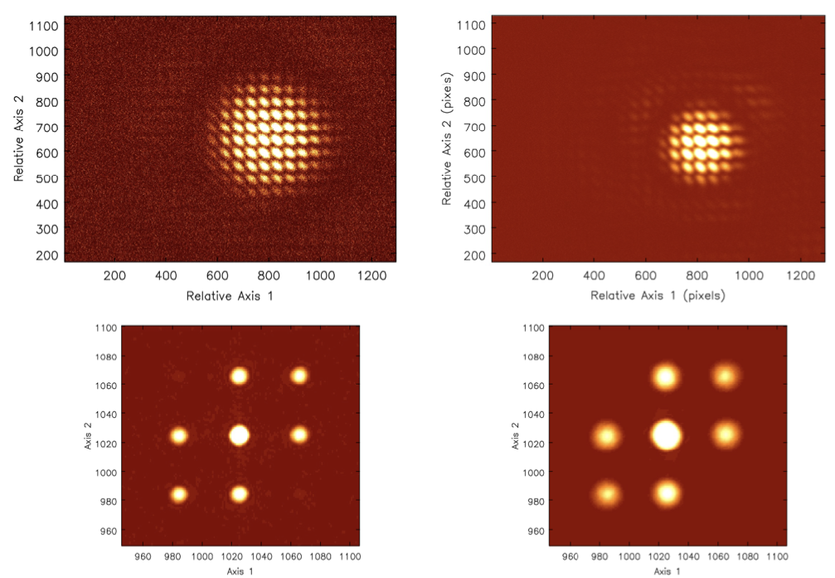
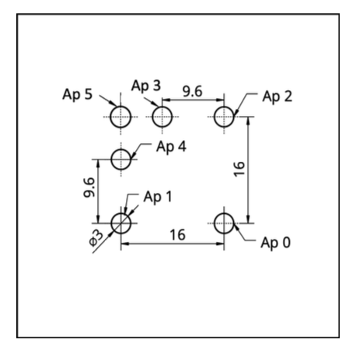
Hole size => Airy disk = ‘primary beam’
FT => u,v ‘smearing’
3mm
5mm
0-2
1-2
v
0-1
u

Slide 17
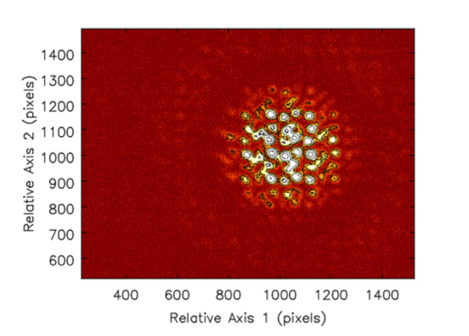
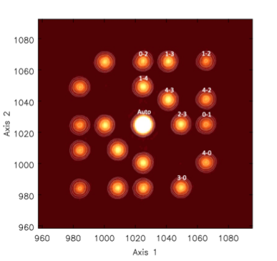
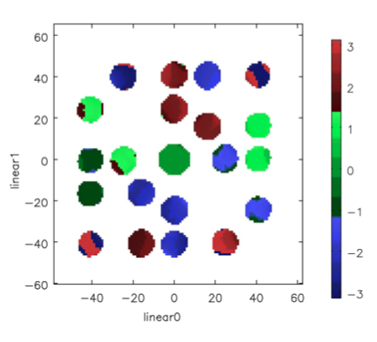
5 Hole non-redundant mask

Slide 18
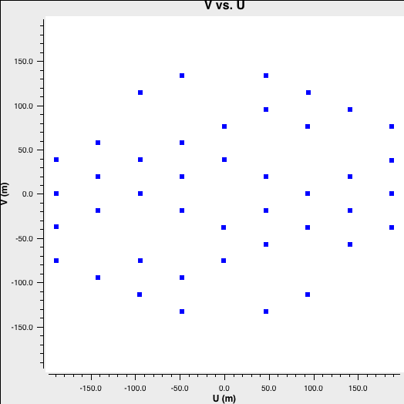
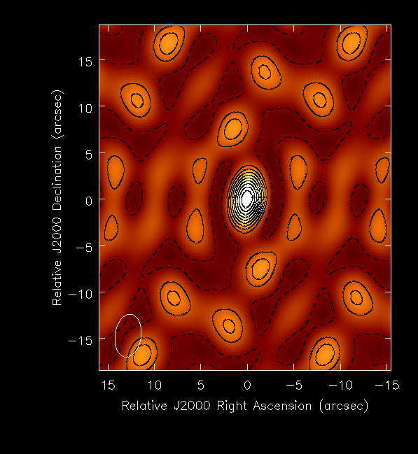
Non-redundant 7 Aperture Mask u,v coverage and PSF
Template = JWST aperture mask (stretched)
N_{uv} = 21
PSF
FT
Sidelobes ~ 0.30

Slide 19
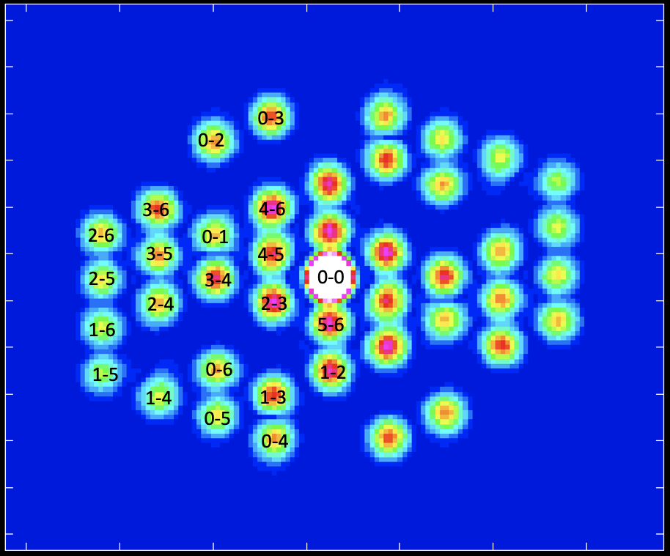
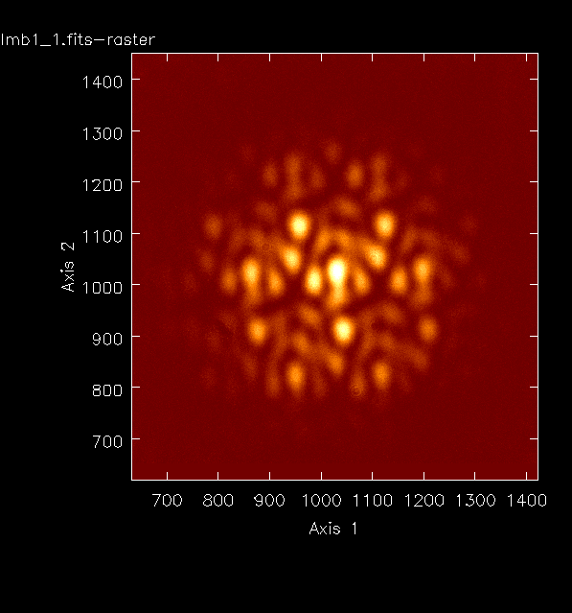
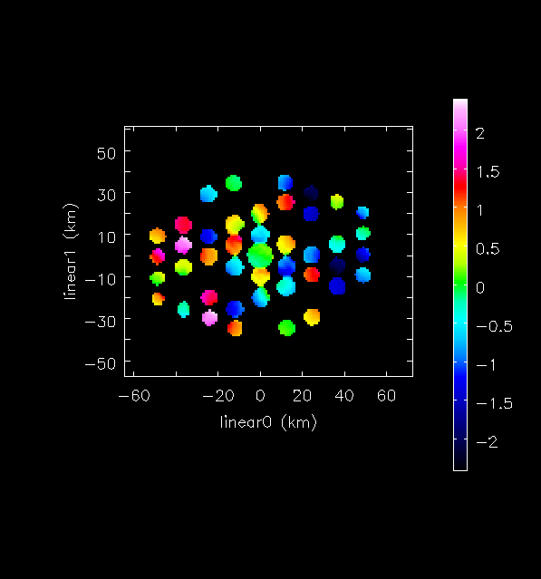
Amp
ALBA 7hole Dirty Image
FT
Phase

Slide 20


Visibilities: 30 exposures, 1ms every 1 sec
A₁₃
𝛟₁₂
𝛟₃₁
A₀₅
𝛟₁₂₃
A₂₄
A₁₂
𝛟₂₃
Phases: rms ~ 15º
Vibrations and/or turbulence
[Closure phase 0º; rms < 1º ]
Stable visibility amplitudes: rms < 1%

Slide 21

Phase stability and time averaging
‘Dropouts’
0-2 1ms rms~ 1%
0-2 3ms rms ~ 5%
Dictates short integration times
Necessitates non-redundant mask

Slide 22




Method 1: Gaussian model fitting to Vis Amp w. G_{amp} Selfcal
Selfcal G_{amp} stable ~ 1%
Differ up to 30%
Coherences > 60%
𝜎 = 60um
Bmaj ~ 59.6 +/- 0.1 um
Bmin ~ 23.8 +/- 0.5 um

Slide 23


Method 1: Gaussian model fitting to Vis Amp w. G_{amp} Selfcal

Slide 24



Method 2: Image reconstruction via visibility Amp +Phase self-calibration and PSF deconvolution
DNR ~ 20
DNR ~ 2000
Hybrid mapping
Image Restoration
𝛔_{maj} ~ 0.85” = 60um
PA = 19º
But not quite Gaussian due to poor u,v coverage

Slide 25
Why Self-Calibration?
Ap3 0.122, 12.6º
Ap4 0.117 -57º
Ap5 0.117 -114º
Ap2 0.121, -20º
Ap6 0.129 -80º
Ap1 0.109, -78º
Ap0; 0.098, 0º
Hole-based gain solutions
Amp: illumination ~31% voltage difference => ~50% error in source size
Phase = msec timescale wavefront sensor: dL_{𝜸} = 𝝺 x (d𝞍/360º)
  gradient: tip/tilt
  Jitter: rms ~ 15º = 22nm

Slide 26


Why non-redundant Mask (and not filled aperture)?
Decoherence on redundant baselines due to phase fluctuations across mask
rms for redundant samples ~ 6x non-redundant

Slide 27
Summary
New SRI method for rapid (msec), accurate, non-invasive 2D beam characterization
Self-calibration corrects for non-uniform illumination
Non-redundancy avoids decoherence and image smearing
Self-cal phase solutions provide precise, rapid wave-front sensor (photon pathlength)
Future
Higher resolution: shorter wavelengths
More holes: generalize to more complex sources
Beam monitor at other facilities: DESY (Germany), SPring8 (Japan)
Improved diagnostics in next-gen instruments (ALBA, Swiss Light Source…) with lower emittance

Slide 28
Possible Applications
The technique presented can be used for accurate, efficient, and rapid characterization of the size and shape of high-intensity light sources even after light propagation through an optical system that may produce phase and amplitude fluctuations in the electromagnetic radiation. Possible applications include:
Beam characterization in accelerator synchrotron light sources
Source shape of laser-induced plasma EUV light sources used in lithographic microchip manufacturing
Free Electron Laser beam characterization
Laser source characterization for fusion reactors
Gain solutions = precise wavefront sensor for optical systems

Slide 29



Closure Phase in Image Domain
Shape-Orientation-Size conservation
3 Hole Mask
5 Hole Mask

Slide 30

arXiv:2405.12176
arXiv:2406.02114
arXiv:2405.12090
2022PASA...39...14T
JOSA-A 2022, 39, 2214

