Slide 1
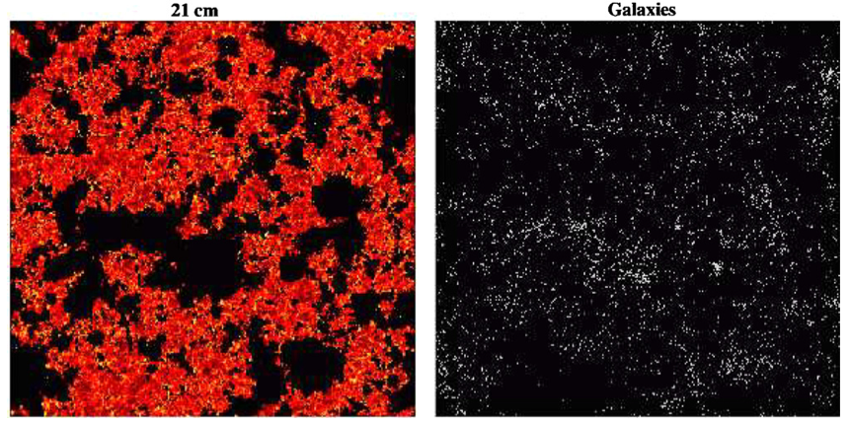
‘Inverse’ views of evolution of large scale structure during reionization
Neutral intergalactic medium via HI 21cm line observations = consequence
Galaxies which drive reionization = sources
20mK
z~ = 7.3
130 cMpc ~ 1º
Lidz et al. 2009

Slide 2
Inverse Views of the Universe: Neutral IGM vs. galaxies
Power
Complete view of physics: sources of reionization and their impact on the IGM
Cross correlation of HI 21cm signal with galaxy distribution mitigates large (but independent) systematic errors (eg. foregrounds) in each measurement (Lidz ea)
Challenge: Problematic to match very (very) large scale of HI measurements with classical galaxy surveys
HI 21cm experiments cover 100 to 1000 deg² and z range ~ 6 to 10
z>6 galaxy surveys by JWST/ALMA have FoV ~ arcmin, dz < 0.5
Solution: Intensity mapping of the aggregate CO emission from the galaxies that reionize the Universe

Slide 3
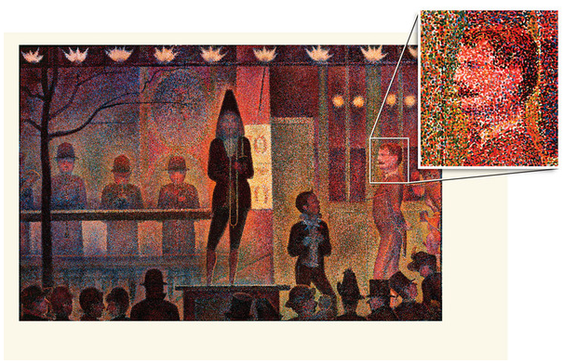
Galaxy distribution
Classical method: one galaxy at time, eg. SDSS 2e7 galaxies
Intensity mapping: low spatial and spectral resolution imaging of summed signal from aggregates of thousands of galaxies on Mpc scales (tens of arcmin).
Classic galaxy surveys (eg. SDSS)
Intensity mapping

Slide 4
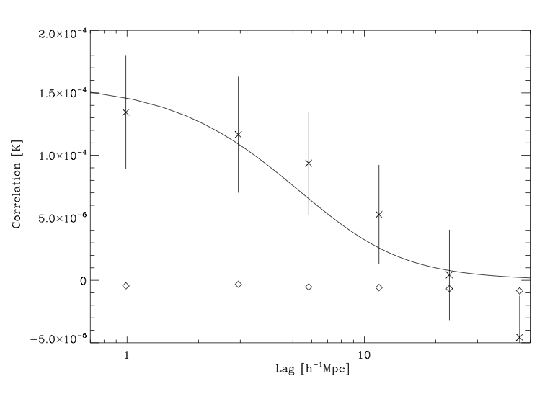
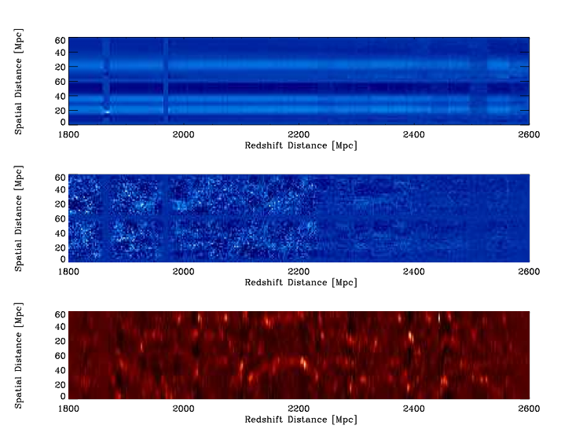
GBT IM of LSS in HI at z ~ 1
Chang ea 2010, Nature
Optical-21cm cross correlation
850MHz, 15’ res, 1000 km/s/ch
Cross correlation with DEEP2 galaxy survey => Detection! = aggregate HI signal from galaxies on Mpc scales.
First detection of HI 21cm emission at substantial redshift => confirms DLA HI mass density
Promise of mapping large scale structure at high redshift, such as the Baryon Acoustic Oscillations

Slide 5
CO intensity mapping: dominant tracer of molecular gas in galaxies (Carilli 2011)
Predicted mean sky brightness temperature in 3 simple steps
1. Cosmic star formation rate density required to reionize the IGM using mean baryon density (Haardt & Madau, Bunker et al.)
f_{esc}^{uv} = ionizing photon escape fraction ~ 0.06 (MW), up to 0.2 for z~3 LBGs
C = IGM clumping factor (recombinations) = 5 to 30 (simulations)
Strong increase with z due to increase in mean cosmic baryon density
2. Conversion of star formation rate to IR luminosity based on known properties of galaxies (eg. Kennicutt 1998 and many others)

Slide 6
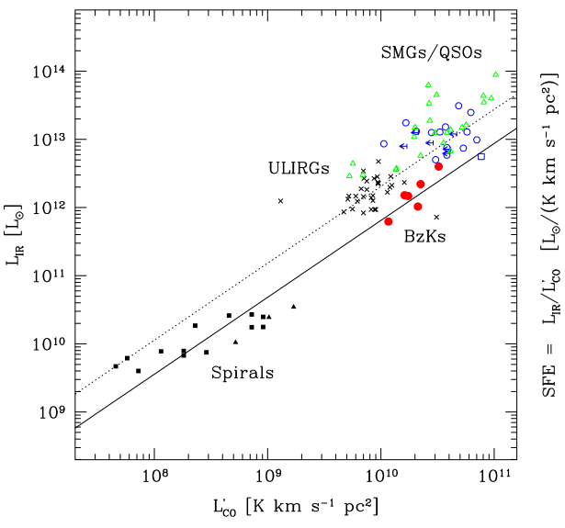
Predicted Mean CO Brightness Temperature
3. Conversion of IR luminosity to CO luminosity based on known properties of galaxies (‘K-S law’; Daddi et al. 2010)
Roughly linear relationship between L’_{CO} and L_{FIR} for disk galaxies at low and high z
Similar slope for merger driven starbursts, with different normalization
Disks likely dominate cosmic star formation rate density

Slide 7
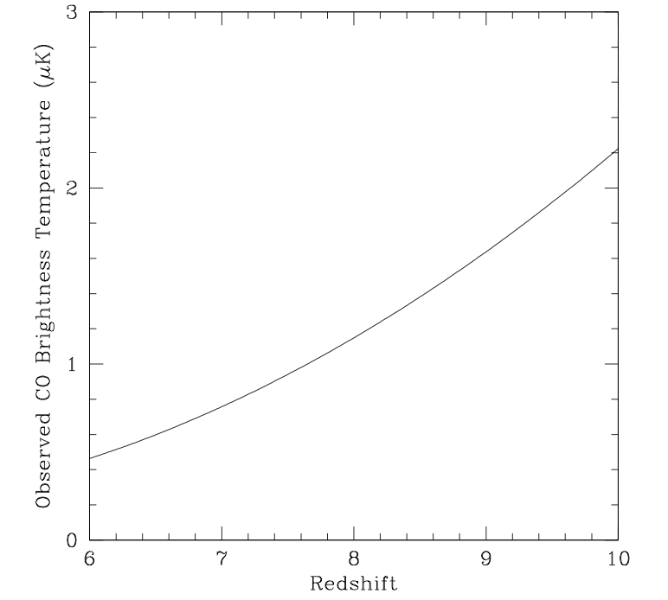
Doing some cosmic algebra => mean brightness temperature of CO emission from the galaxies that reionize the neutral IGM at a given redshift
[Not what we expect to see at all redshifts, but what is required to have reionization occur at that redshift.]
<T_{B}^{sky}>_{z=8} = 1.1 (0.1/f_{esc})⁻¹ (C/5) uK
(1+z)³

Slide 8
Major uncertainties:
f_{esc} – calibrated with JWST observations of 1st galaxies
C – get handle via HI 21m observations (21cm forest absorption?)
Line confusion (30GHz = CO 2-1 z=6.7 or 1-0 at z=2.8): requires dual frequency, cross correlation experiment (eg. 15 and 30GHz). Cross correlation with 21cm will also help (Gong, Visbal)
Early production of CO and dust (SFR – FIR – L’CO relationships)

Slide 9
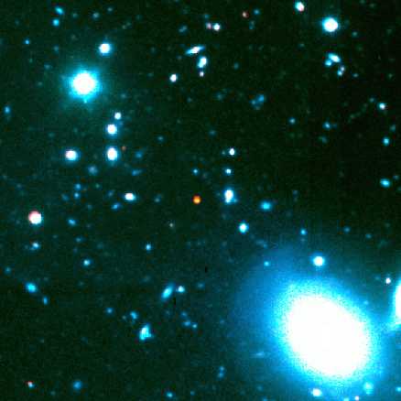
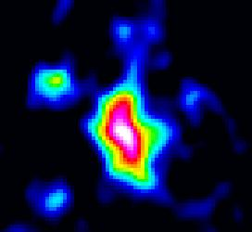
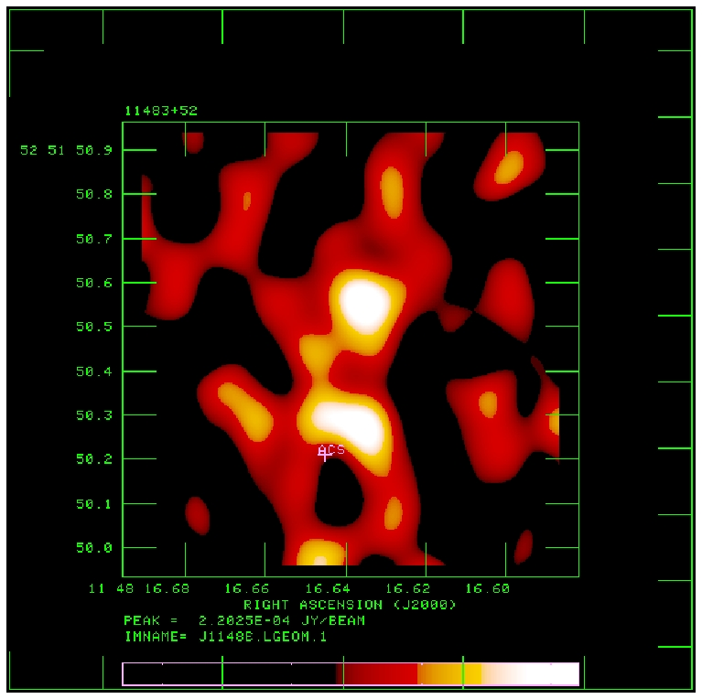
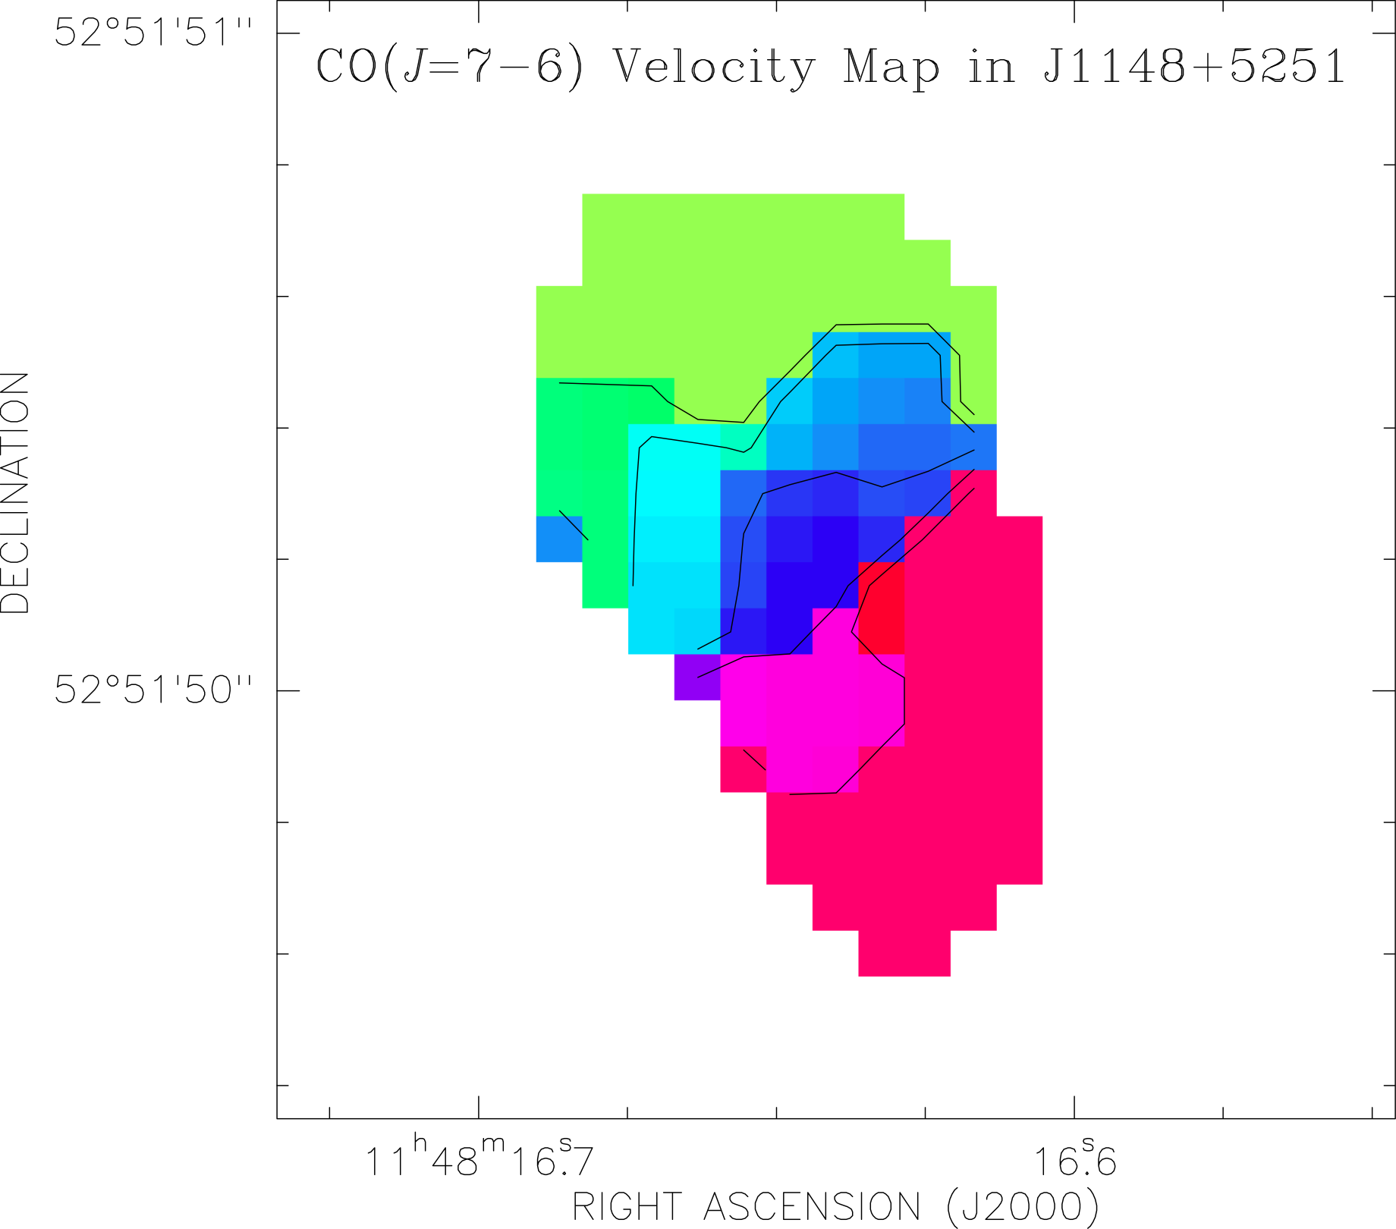
Early production of dust + CO: detections of 8 quasar host galaxies at z~6
M(dust) ~ 10⁸M_{o}, M(H₂) ~ 10¹⁰ M_{o}
z=6.42
CO3-2 VLA
0.15” T_{B} ~ 25K
PdBI
-150 km/s
7kpc
1” ~ 5.5kpc
+
+150 km/s
SFR – FIR – L’_{CO} relationships can be calibrated with ALMA/EVLA/JWST observations of representative z>6 galaxy samples.

Slide 10
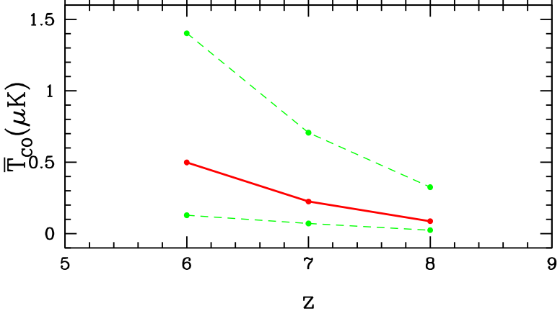
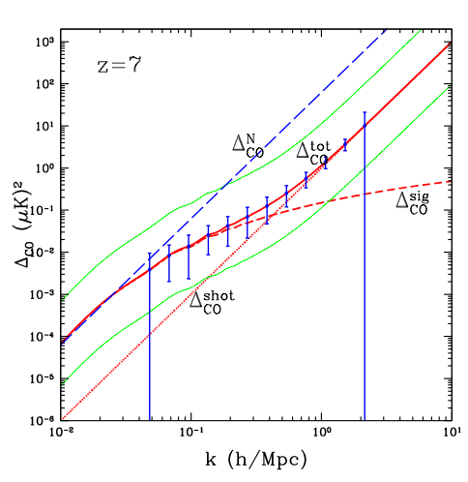
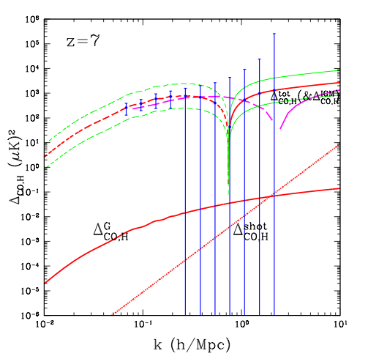
Gong et al.: numerical prediction of T_{B}
Obreschkow & Rawlings CO galaxy catalog based on Millenium simulations
<T_{B}>_{z=7} = 0.1 and 0.7uK
Fluctuations on 10’ scales are factor few smaller
CO auto-power spectrum can be detected at 40σ
CO-HI cross power spectrum: errors dominated by HI measurements!
HI-CO cross
CO auto
7’

Slide 11
Specs: Radiometry equation
COIM: Experimental parameters (to match HI 21cm)
Observing frequencies: 10 to 45 GHz, BW > 1GHz
0.1 to 1 uK sensitivity
Angular resolution ~ 1’ to 10’
spectral resolution ~ 100MHz ~ 1500 km/s
FoV > 25 deg² (LOFAR)
Gong experimental parameters:
1000 elements of 0.7m diameter (area = 385m²; element FoV = 2º)
BW = 1 GHz, channel = 30MHz
Interferometer spacings from 0.7m to 25m (resolution ~ 3’)
20K system at 15 GHz
3000hrs (mosaic?)

Slide 12
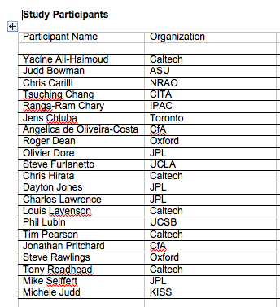
KISS study group: CO and [CII] IM during reionization
Righi ea 2008; Gong et al. 2010; Carilli 2011
Furlanetto et al. 2011; Visbal & Loeb 2010

