Slide 1
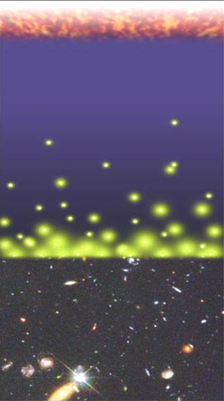
Big Bang f(HI) ~ 0
History of Baryons (mostly hydrogen)
Recombination
z = 1000 (0.4Myr)
f(HI) ~ 1
Reionization: Last phase of cosmic evolution to explore
Bench-mark in cosmic structure formation indicating the formation of the first galaxies
Redshift
Reionization
z ~ 7 to 15 (0.8Gyr)
f(HI) ~ 10⁻⁵
z = 0 (13.6Gyr)

Slide 2
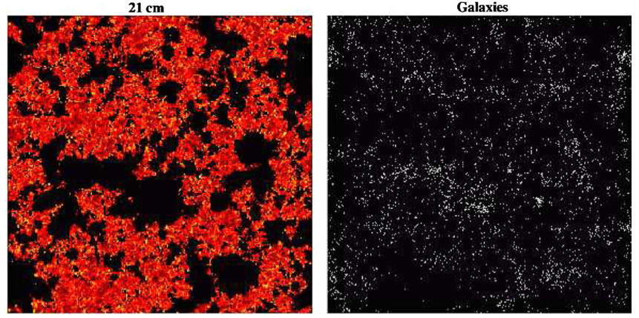
‘Inverse’ views of evolution of large scale structure during reionization
Neutral intergalactic medium via HI 21cm line observations = consequence
Galaxies which drive reionization = sources
20mK
z~ = 7.3
130 cMpc ~ 1º
Lidz et al. 2009

Slide 3
Inverse Views of the Universe: Neutral IGM vs. galaxies
Power
Complete view of physics: sources of reionization and their impact on the IGM
Cross correlation of HI 21cm signal with galaxy distribution mitigates large (but independent) systematic errors (eg. foregrounds) in each measurement
Challenge: Problematic to match very (very) large scale of HI measurements with classical galaxy surveys
HI 21cm experiments cover 100 to 1000 deg² and z range ~ 6 to 10
Galaxy surveys by eg. JWST/ALMA have FoV ~ arcmin, dz < 0.5
Solution: Intensity mapping of the aggregate CO emission from the galaxies that reionize the Universe

Slide 4
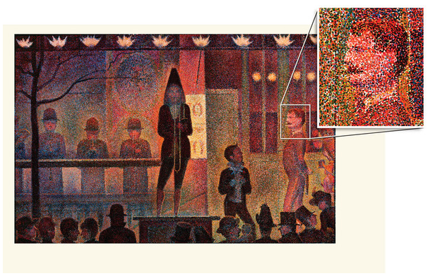
Intensity mapping: image summed signal from aggregates of thousands of galaxies on Mpc scales (tens of arcmin). No need to detect each galaxy individually.

Slide 5

CO intensity mapping: predicted mean brightness temperature in 3 simple steps (Carilli 2011)
1. Cosmic star formation rate density required to reionize the IGM using mean baryon density (Haardt & Madau, Bunker et al.)
f_{esc}^{uv} = ionizing photon escape fraction ~ 0.06 (MW), up to 0.2 for z~3 LBGs
C = IGM clumping factor (recombinations) = 5 to 30 (simulations)
Strong increase with z due to increase in mean cosmic baryon density
2. Conversion of star formation rate to IR luminosity based on known properties of galaxies (eg. Kennicutt 1998 and many others)

Slide 6

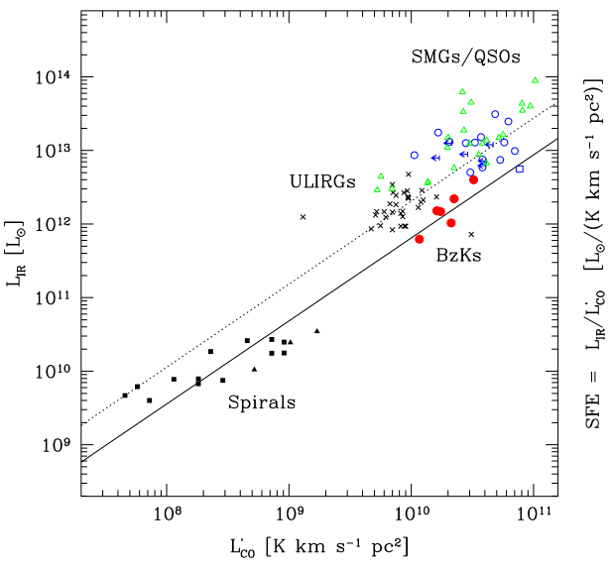
Predicted Mean CO Brightness Temperature
3. Conversion of IR luminosity to CO luminosity based on known properties of galaxies (Daddi et al. 2010)
Roughly linear relationship between L’_{CO} and L_{FIR} for disk galaxies at low and high z
Similar slope for merger driven starbursts, with different normalization
Disks likely dominate cosmic star formation rate density

Slide 7
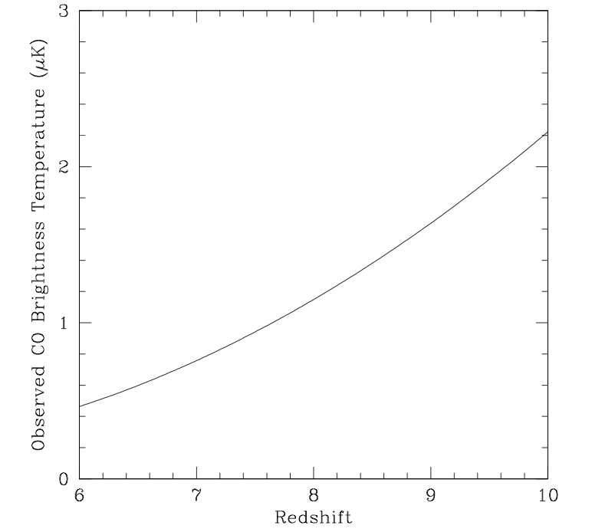
Doing some cosmic algebra => mean brightness temperature of CO emission from the galaxies that reionize the neutral IGM at a given redshift
[Not what we expect to see at all redshifts, but what is required to have reionization occur at that redshift.]
<T_{B}>_{z=8} = 1.1 (0.1/f_{esc})⁻¹ (C/5) uK
(1+z)³

Slide 8
Major uncertainties:
f_{esc} – calibrated with JWST observations of 1st galaxies
C – get handle via HI 21m observations (21cm forest absorption?)
Line confusion (30GHz = CO 2-1 z=6.7 or 1-0 at z=2.8): requires dual frequency, cross correlation experiment (eg. 15 and 30GHz). Cross correlation with 21cm will also help (Gong, Visbal)
Early production of CO and dust (SFR – FIR – L’CO relationships)

Slide 9
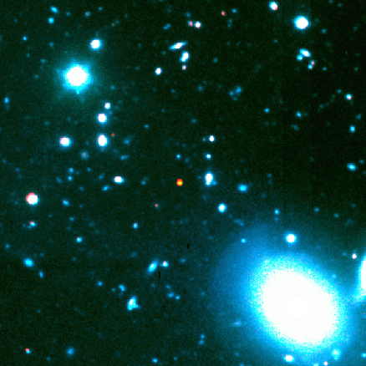
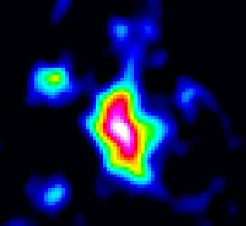
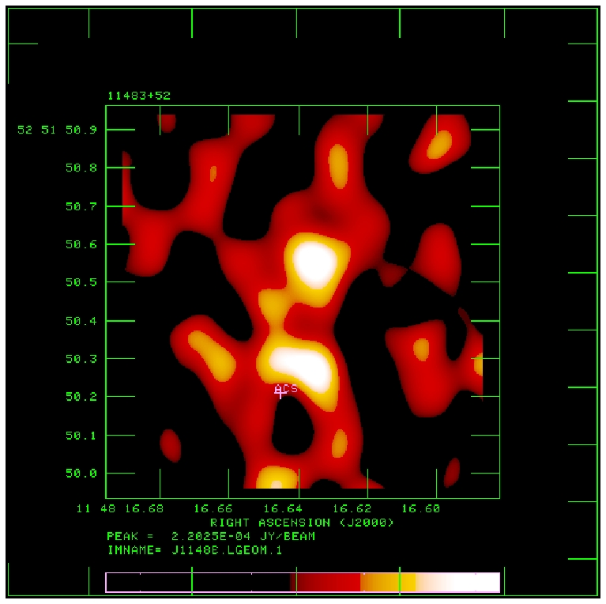
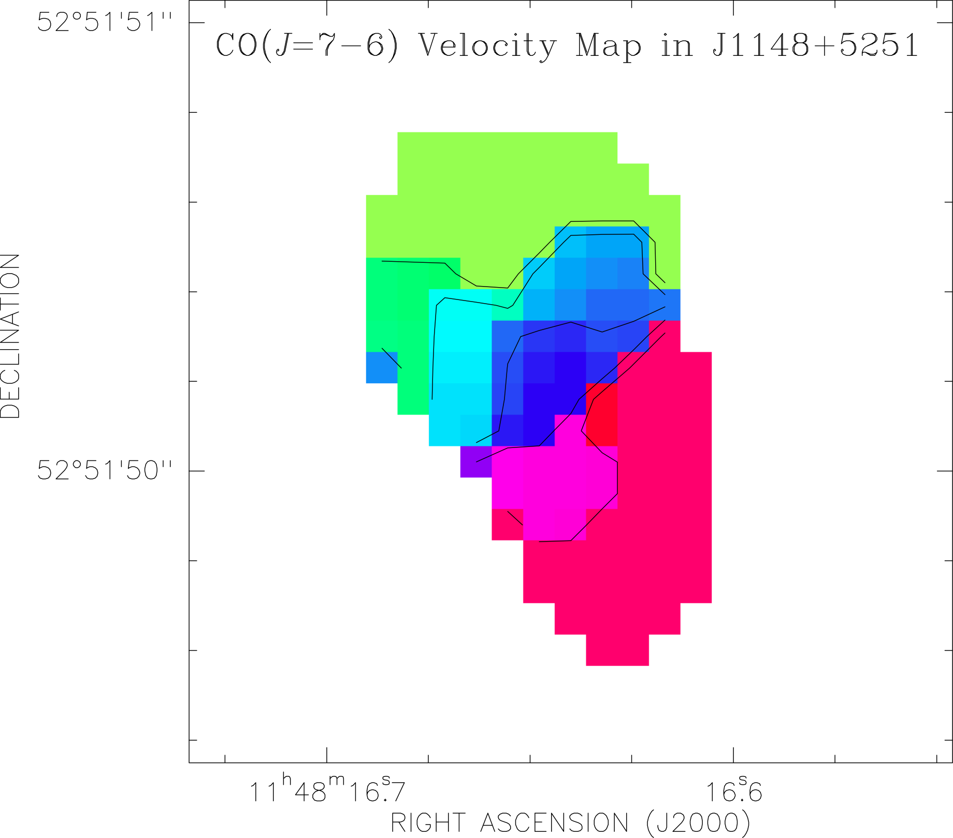
Early production of dust + CO: detections of 8 quasar host galaxies at z~6
M(dust) ~ 10⁸M_{o}, M(H₂) ~ 10¹⁰ M_{o}
z=6.42
CO3-2 VLA
0.15” T_{B} ~ 25K
PdBI
-150 km/s
7kpc
1” ~ 5.5kpc
+
+150 km/s
SFR – FIR – L’_{CO} relationships can be calibrated with ALMA/EVLA/JWST observations of representative z>6 galaxy samples.

Slide 10
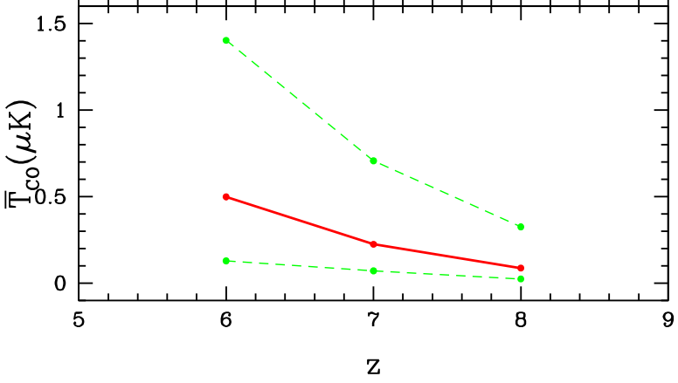
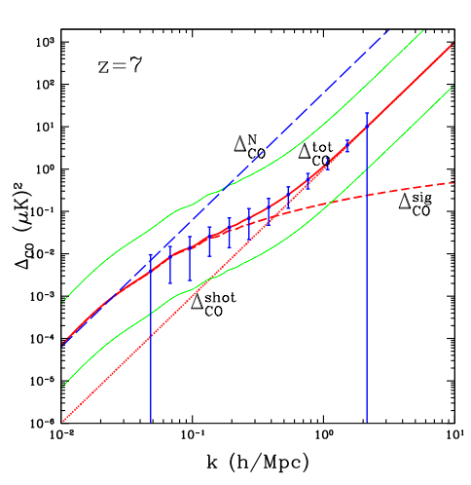
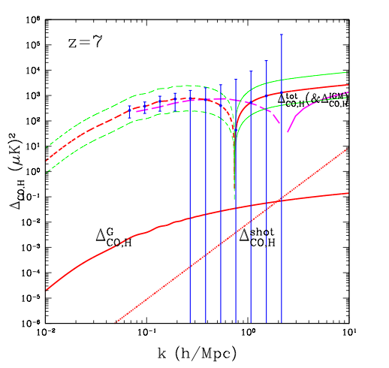
Gong et al.: numerical prediction of T_{B}
Obreschkow & Rawlings CO galaxy catalog based on Millenium simulations
<T_{B}>_{z=7} = 0.1 and 0.7uK
Fluctuations on 10’ scales are factor few smaller
CO auto-power spectrum can be detected at 40σ
CO-HI cross power spectrum: errors dominated by HI measurements!
HI-CO cross
CO auto
7’

Slide 11

COIM: Experimental specs (to match HI 21cm)
Observing frequencies: 10 to 45 GHz, BW > 1GHz
0.1 to 1 uK sensitivity
Angular resolution ~ 1’ to 10’
spectral resolution ~ 100MHz ~ 1500 km/s
FoV > 25 deg² (LOFAR)
Gong experimental parameters:
1000 elements of 0.7m diameter (area = 385m²; element FoV = 2º)
BW = 1 GHz, channel = 30MHz
Interferometer spacings from 0.7m to 25m (resolution ~ 3’)
20K system at 15 GHz
3000hrs (mosaic?)

Slide 12
END

Slide 13
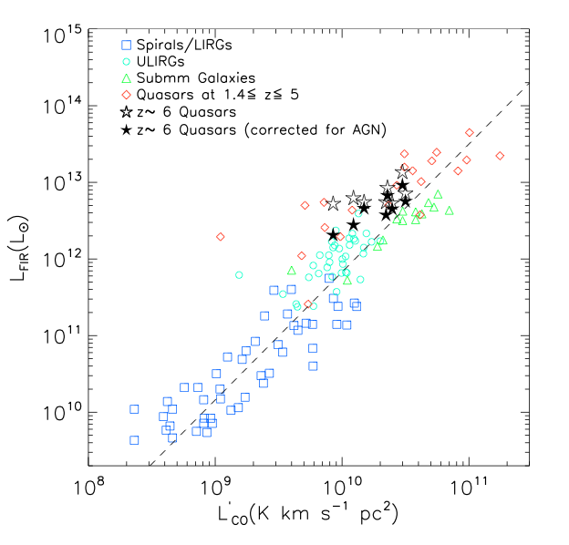
LFIR vs L’(CO): Star Formation Law
Further circumstantial evidence for star formation
Star formation efficiency (FIR/L’CO) increases with SFR => Gas consumption time (Mgas/SFR) decreases with SFR
FIR ~ 10¹⁰ Lo/yr => t_{c} > 10⁸yr
FIR ~ 10¹³ Lo/yr => t_{c} < 10⁷yr
SFR
1e3 Mo/yr
Index=1.5
MW
1e11 Mo
M_{gas}

Slide 14
