Slide 1
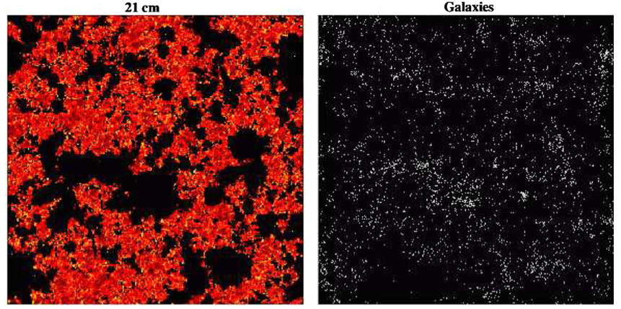
‘Inverse’ views of evolution of large scale structure during reionization
Neutral intergalactic medium via HI 21cm line observations = consequence
First galaxies which drive reionization = sources
20mK
z = 7.3
130 cMpc ~ 1º
Lidz et al. 2009

Slide 2
Inverse Views of the Universe: Neutral IGM vs. galaxies
Power
Complete view of physics: sources of reionization and their impact on the IGM
Cross correlation of HI 21cm signal with galaxy distribution mitigates large (but independent) systematic errors (eg. foregrounds) in each measurement (Lidz ea)
Challenge: Currently detecting individual galaxies into reionization in near-IR through radio, but impossible match very (very) large scale of HI measurements with galaxy surveys
HI 21cm experiments cover 100 to 1000 deg² and z range ~ 6 to 11
z>6 galaxy surveys by JWST/ALMA have FoV ~ arcmin, dz < 0.5
Solution: Intensity mapping of the aggregate CO (or [CII] or Lya) emission from the galaxies that reionize the Universe

Slide 3
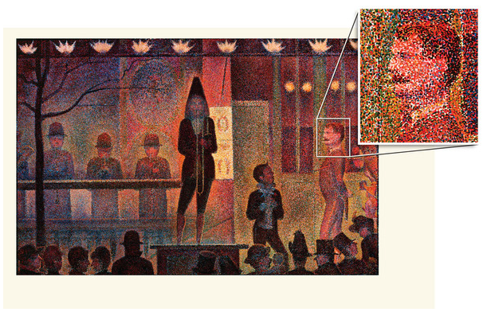
Large scale galaxy surveys
Classical method: one galaxy at time, eg. SDSS 2e7 galaxies
Intensity mapping: low spatial and spectral resolution imaging of summed signal from aggregates of thousands of galaxies on Mpc scales (tens of arcmin).
Classic galaxy surveys (eg. SDSS)
Intensity mapping

Slide 4
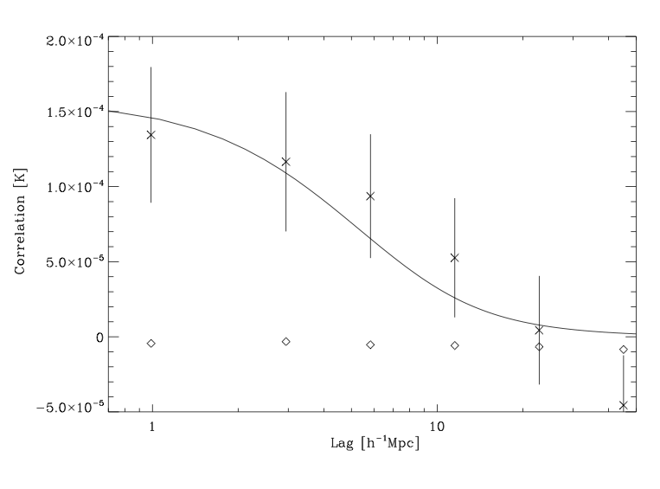
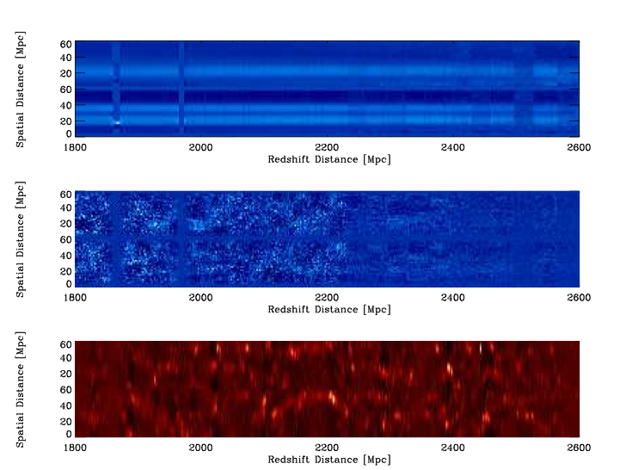
GBT IM of LSS in HI at z ~ 1
Chang ea
Optical-21cm cross correlation
Drift scan survey 670 to 930MHz
15’ res, 1000 km/s/ch
Cross correlation with DEEP2 galaxy survey => Detection! = aggregate HI signal from galaxies on Mpc scales.
First detection of HI 21cm emission at substantial redshift => confirms DLA HI mass density
Promise of mapping large scale structure at high redshift, such as the Baryon Acoustic Oscillations
670MHz
Freq →
930MHz
z=0.53
z=1.12

Slide 5
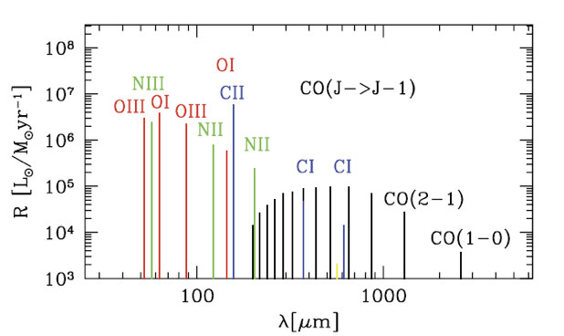
Emission lines from star forming galaxies
1900GHz
230GHz
CO: dominant tracer of molecular gas in galaxies
[CII]: brightest line, and PDR, CNM, WMN tracer
Low order CO (10 to 40GHz)=> relatively bright, easily observable + wide fields

Slide 6

Mean CO sky brightness temperature in 3 simple steps
1. Cosmic star formation rate density required to reionize the IGM using mean baryon density (Haardt & Madau, Bunker et al.)
f_{esc}^{uv} = ionizing photon escape fraction ~ 0.06 (MW), up to 0.2 for z~3 LBGs
C = IGM clumping factor (recombinations) = 5 to 30 (simulations)
Strong increase with z due to increase in mean cosmic baryon density
2. Conversion of star formation rate to IR luminosity based on known properties of galaxies (eg. Kennicutt 1998 and many others)

Slide 7

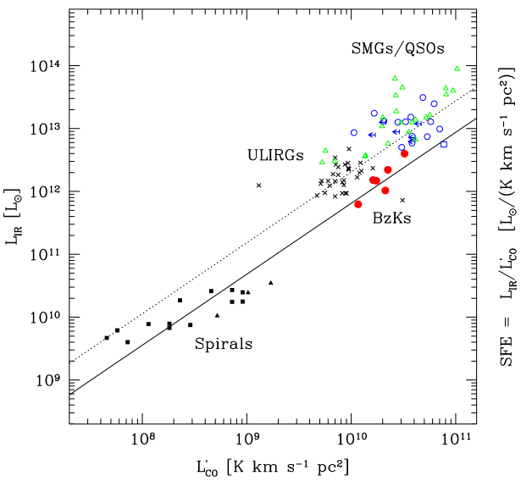
Predicted Mean CO Brightness Temperature
3. Conversion of IR luminosity to CO luminosity based on known properties of galaxies (‘K-S law’; Daddi et al. 2010)
Roughly linear relationship between L’_{CO} and L_{FIR} for disk galaxies at low and high z
Similar slope for merger driven starbursts, with different normalization
Disks likely dominate cosmic star formation rate density

Slide 8
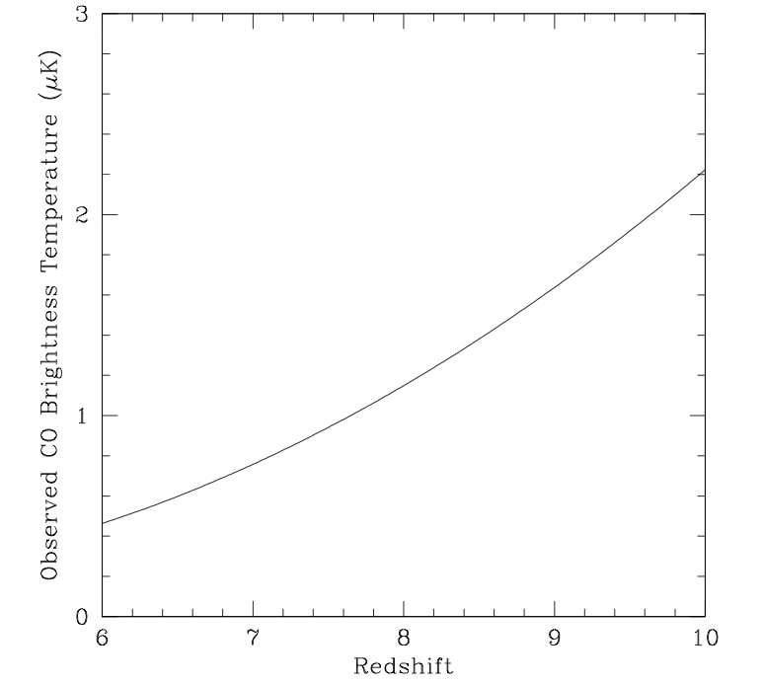
<T_{B}>_{CO} from the galaxies that reionize the IGM at a given redshift
Not what we expect to see at all redshifts, but what is required to have reionization occur at that redshift.
Increases with z due to increasing baryon density
Carilli 2011
(1+z)³
<T_{B}^{sky}>_{z=8} = 1.1 (0.1/f_{esc})⁻¹ (C/5) uK

Slide 9
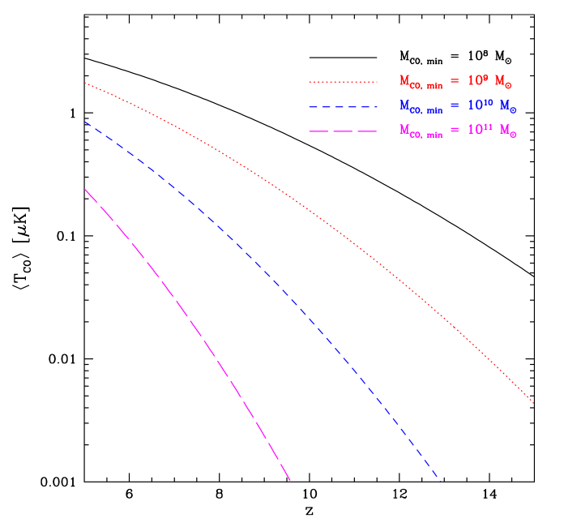
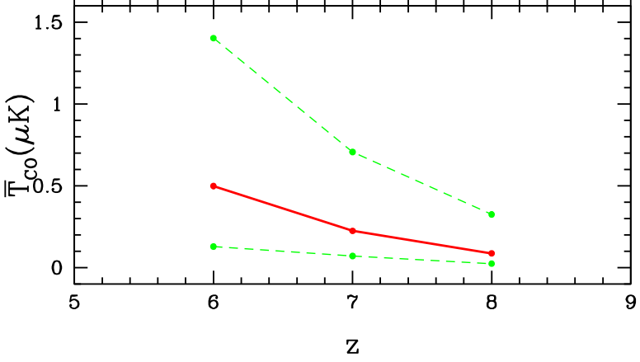
Other predictions
Signal in range ~ 0.1 to 1 uK at z ~ 6 to 8
10⁸ M_{o}
10¹¹ M_{o}
Gong ea: Obreschkow & Rawlings CO galaxy catalog based on Millennium simulations
Lidz: Sheth-Tormen mass function

Slide 10
Major uncertainties:
f_{esc} – calibrated with JWST observations of 1st galaxies
C – get handle via HI 21m observations (21cm forest absorption?)
Line confusion (30GHz = CO 2-1 z=6.7 or 1-0 at z=2.8): requires dual frequency, cross correlation experiment (eg. 15 and 30GHz). Cross correlation with 21cm will also help.
Early production of CO and dust (SFR – FIR – L’CO relationships?)

Slide 11
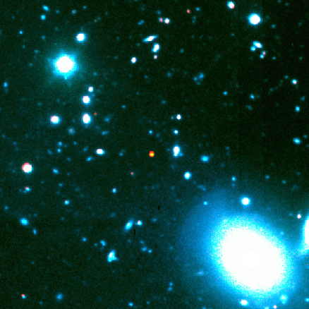
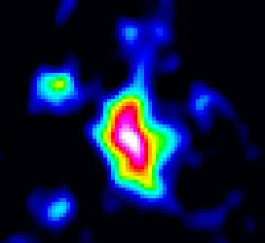
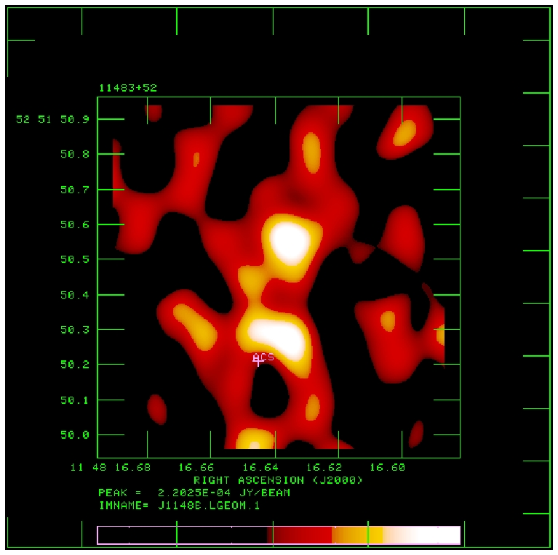
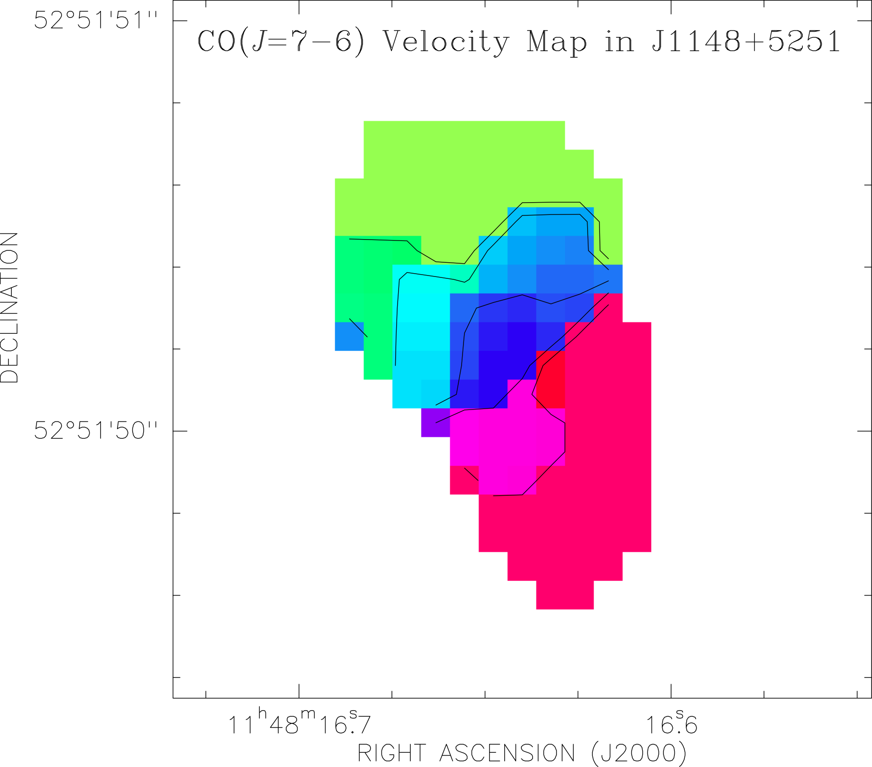
Early production of dust + CO: detections of 8 quasar host galaxies at z~6
M(dust) ~ 10⁸M_{o}, M(H₂) ~ 10¹⁰ M_{o}
z=6.42
CO3-2 VLA
0.15” T_{B} ~ 25K
PdBI
-150 km/s
7kpc
1” ~ 5.5kpc
+
+150 km/s
SFR – FIR – L’_{CO} relationships can be calibrated with ALMA/EVLA/JWST observations of representative z>6 galaxy samples.

Slide 12

Experimental parameters
Radiometry equation
COIM: Experimental parameters to match HI 21cm surveys
z = 6 to 10 => 10 to 16GHz CO1-0; 21 to 33 GHz for CO2-1
BW > 1GHz [dz ~ 0.6 at z ~ 8 for 1-0]
Spectral resolution ~ 100MHz ~ 2000 km/s
Sensitivity = 0.1 to 1 uK per ‘pixel’
Angular resolution ~ 5’ (~ 15 cMpc at z=8)
FoV > 25 deg² (LOFAR)

Slide 13

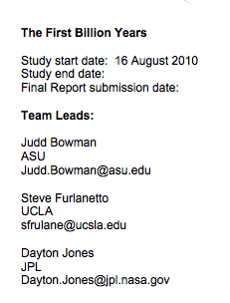
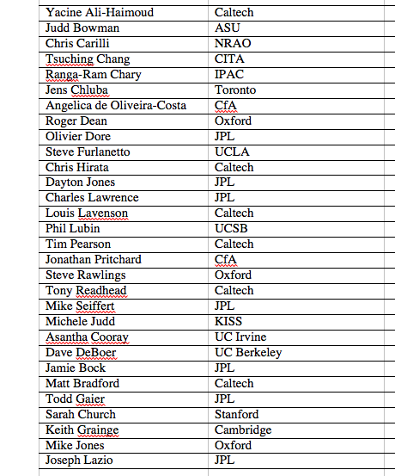
KISS study group: CO and [CII] IM during reionization

Slide 14
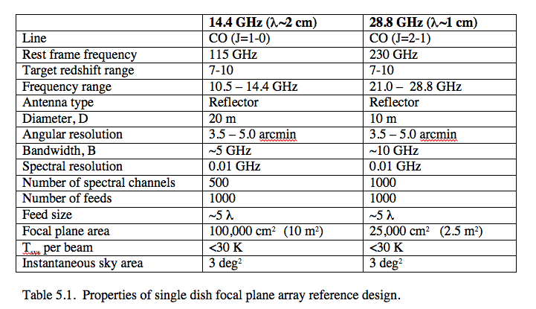
Design I: Keck Institute Study
Large single dish with many element focal plane array
Challenge:
Many feeds in focal plane
Spectral baseline stability

Slide 15
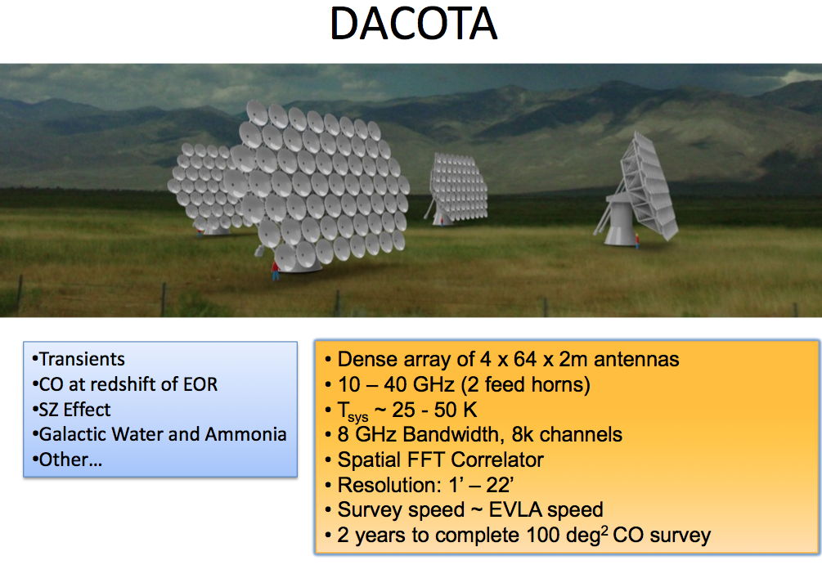
Design II: interferometer with many co-mounted, small elements
UCB (Bower & de Boer)
Challenge: large correlator (6 x EVLA correlator per platform)

Slide 16
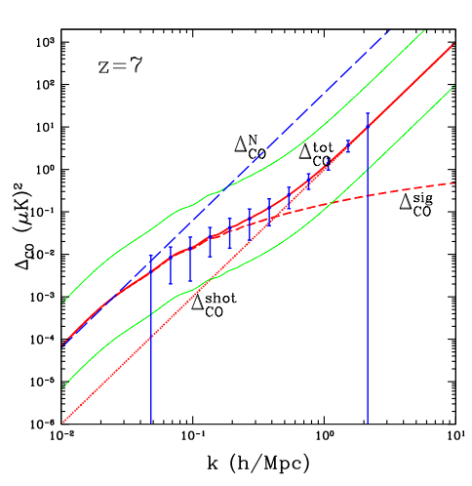
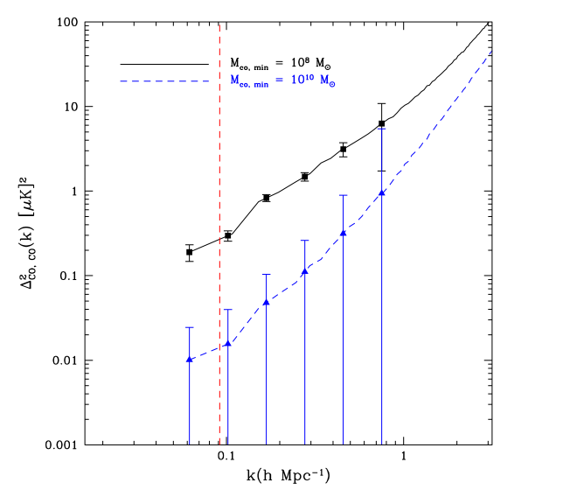
Gong ea 2011
Lidz ea 2011
Should easily detect power spectrum in CO

Slide 17
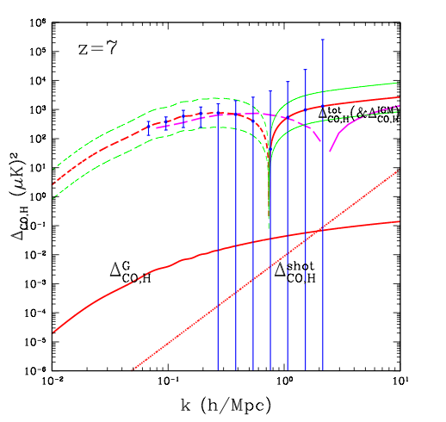
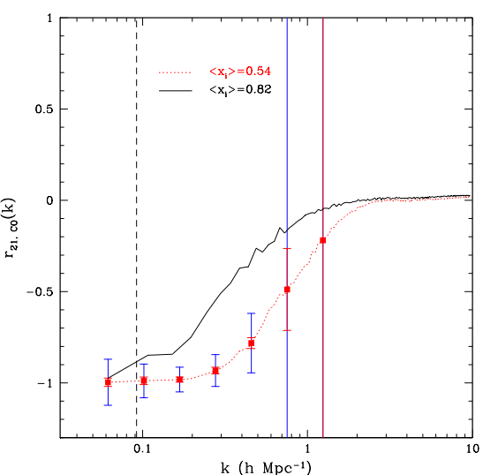
Cross-power CO–HI (10xMWA for HI)
7’
Next generation HI instrument needed
Cutoff set by angular resolution of low freq array

Slide 18
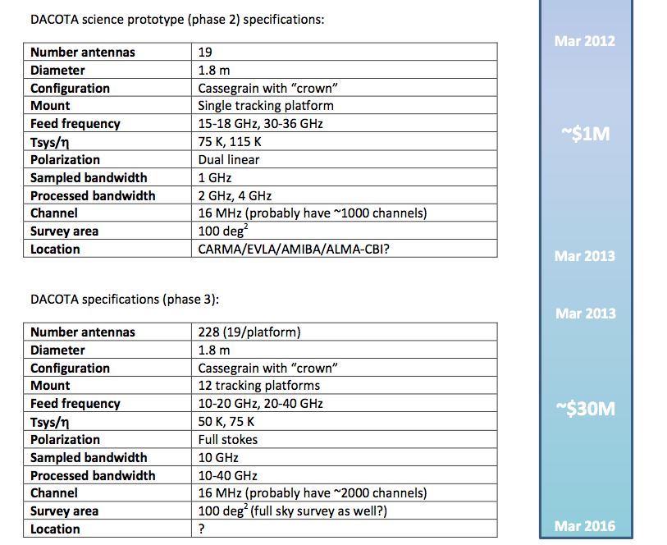

Slide 19
References
Righi ea 2009, A&A, 489, 489
Gong et al. 2011, ApJ, 748, L46
Carilli 2011 ApJ, 730, L30
Lidz et al. 2011 ApJ, 742, 70
Visbal & Loeb 2011, JCAP 8, 10

Slide 20
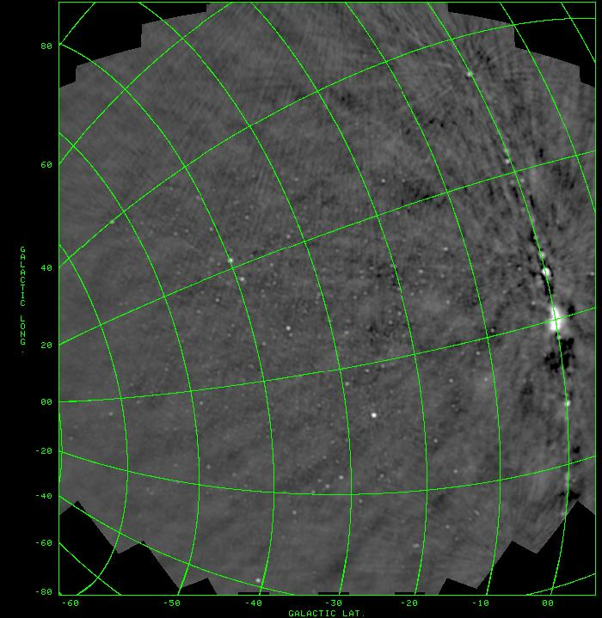

Slide 21

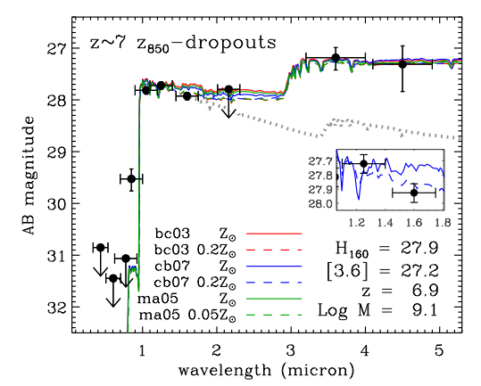
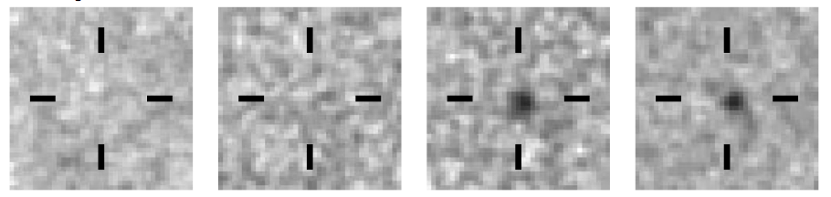
Sources responsible for reionization
Galaxies at z>7
<1um
>1um
HST/WFC3 Bouwens et al. 2010
~ 100 candidates detected to date?
Note: quasars (SMBH) are insufficient to cause reionization

Slide 22
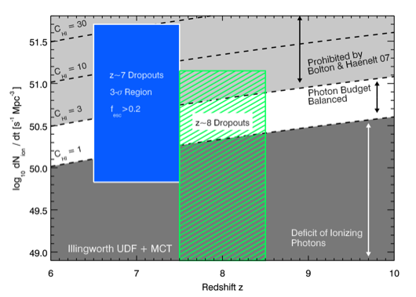
Reionization by normal galaxies
Roberston + Ellis 2010
For f_{esc}^{uv} > 0.2 (typical of z~3 LBG
reionization at z ~ 7 requires C < 30
reionization at z ~ 8 requires C < 10

