Slide 1
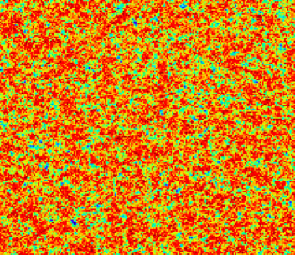
HERA Imaging and Closure
Memos 12, 13
Process
  Models: Sims Continuum and line models
  UV and imaging simulations (Demo?)
Imaging
  PSF
  Line+noise
  Continuum at high latitude
  Galactic Center
Closure spectra
  Equations
  Line vs. Continuum
  Line + Continuum
HERA19: the good and the bad

Slide 2
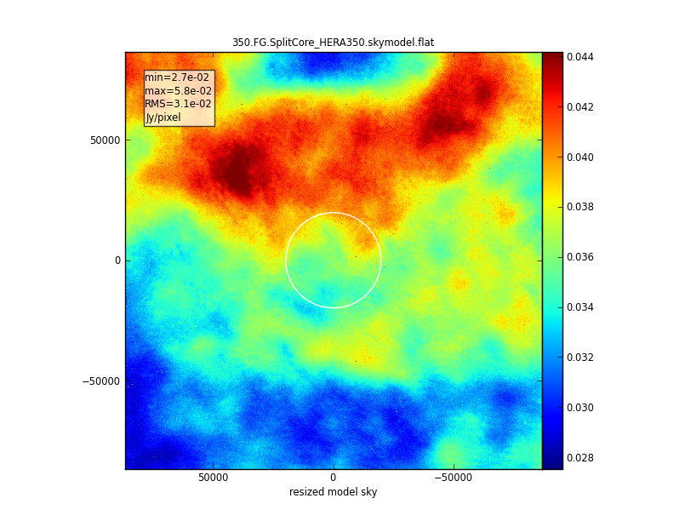
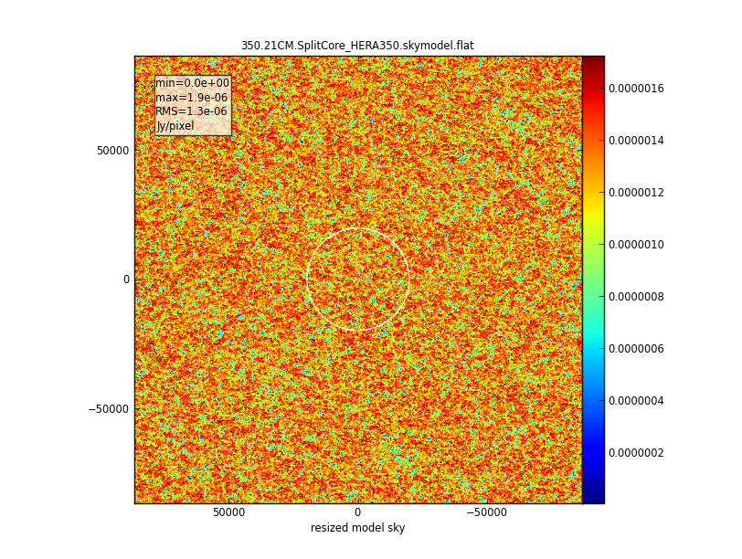
Sims et al. (2016) sky models
Jy/pix at 85” pix
Line ~ 10⁻⁵ x Contin.
PB_{FWHM} = 10º
Sim field = 48º
Galactic diffuse synchrotron: structure extrapolated to few arcmin scales
Galactic Free-Free 1%
Egal point sources: include clustering
All cases: include spectral behavior 100 to 200MHz (eg. SI distribution, SSA…)
HI 21cm line signal: 21cmFAST
Wide field via tiling (of multiple realizations?)
<F_{HI}> ~ 0.5 at given z
Cube: 122MHz to 130MHz, 0.2MHz channels

Slide 3
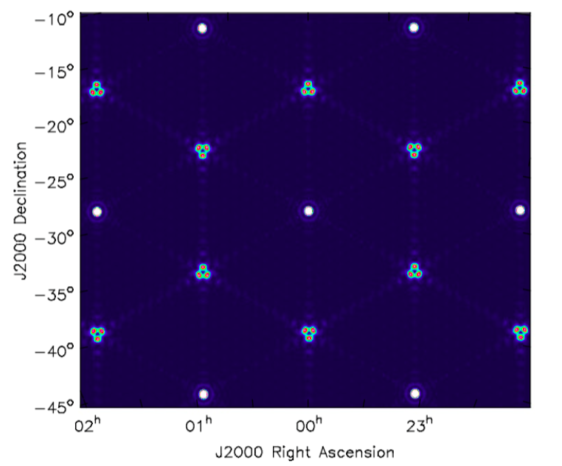
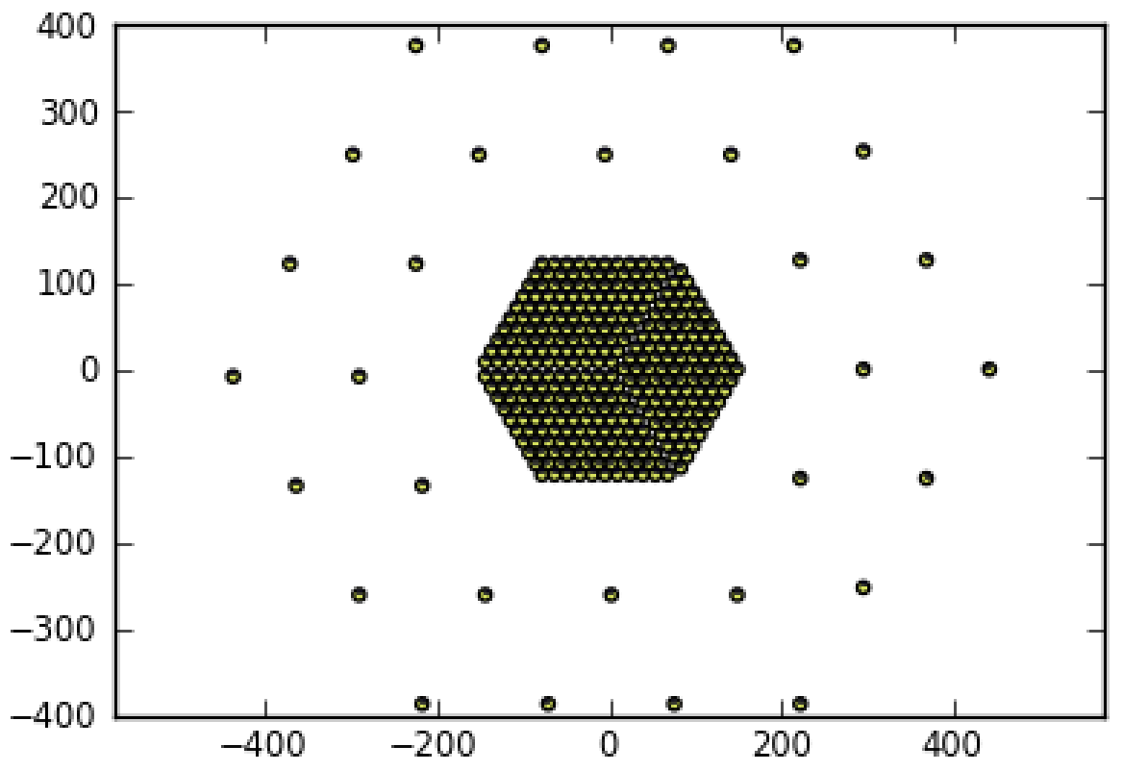
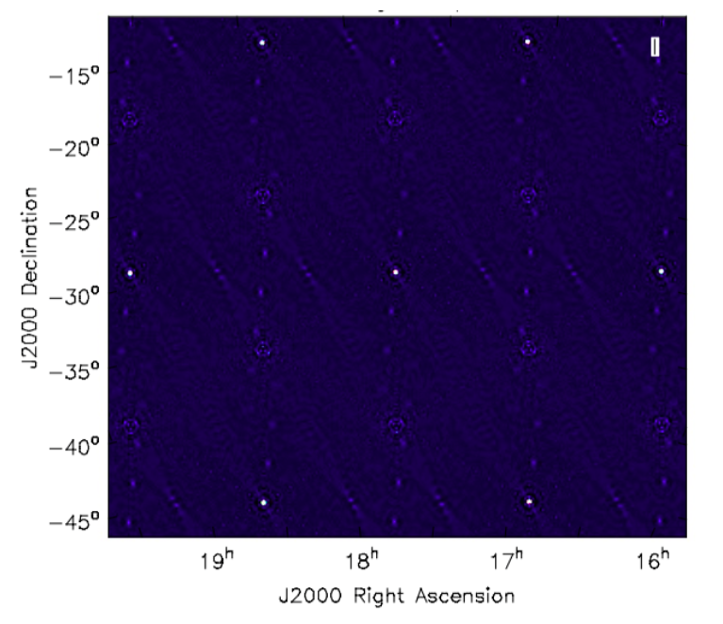
CASA Simulator: UV measurement set
PSF – NA
FWHM = 25’
PSF – R=0
FWHM = 12’
  HERA350 ‘Dillon-Parsons’ configuration
  Noise per channel as per telescope specs in Deboer ea. 2016
  PSF:
    Inner sidelobes @ ~ 2º, ~ few% to 10%
    unity grating lobes at 17º radius => serious aliasing

Slide 4
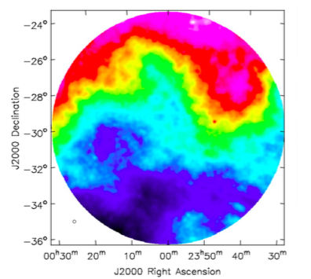
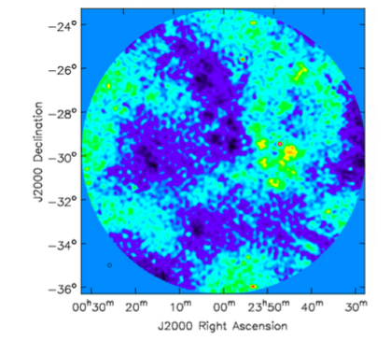
Continuum: High Galactic Latitude
Input model smoothed with 12’ Gaussian, cut at 30% of PB
T_{B} ~ 350K to 450K
HERA350 R=0 CLEAN
PSF FWHM = 12’
T_{B} ~ +/- 10K
Natural spatial filter of interferometer => <FG> is weaker than expected

Slide 5
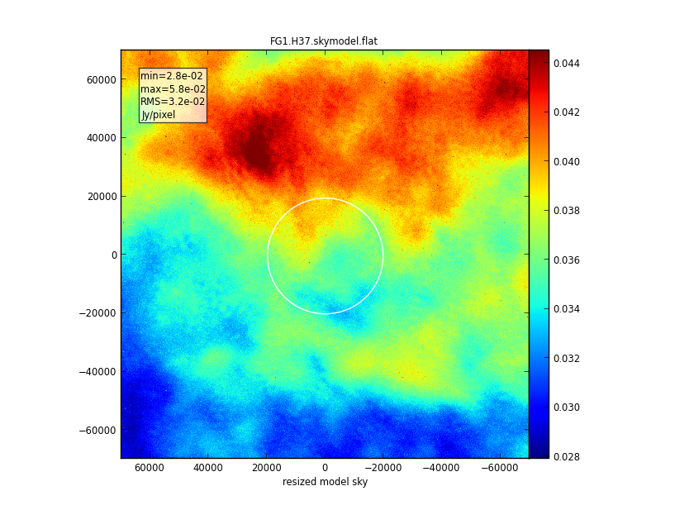
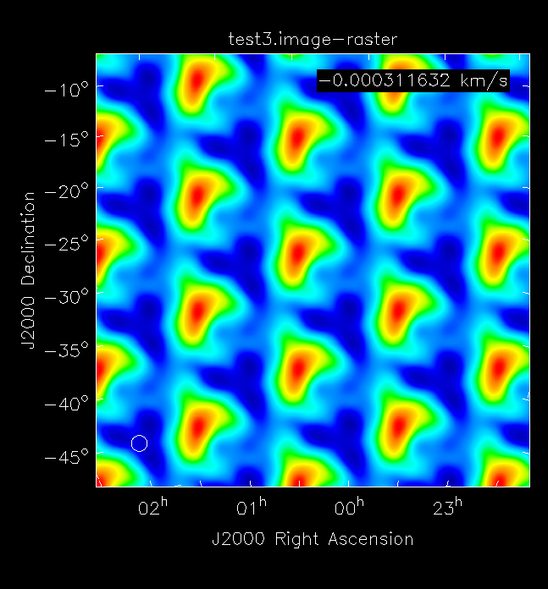
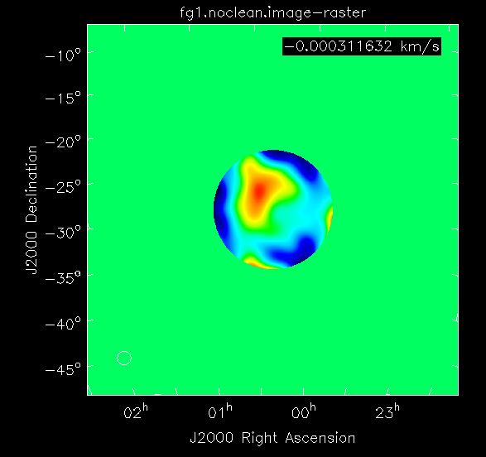
Grid response:
Not problem for Gaussian PB and no strong sources at large distances
Problem: few % far sidelobes + strong sources at large distances?

Slide 6
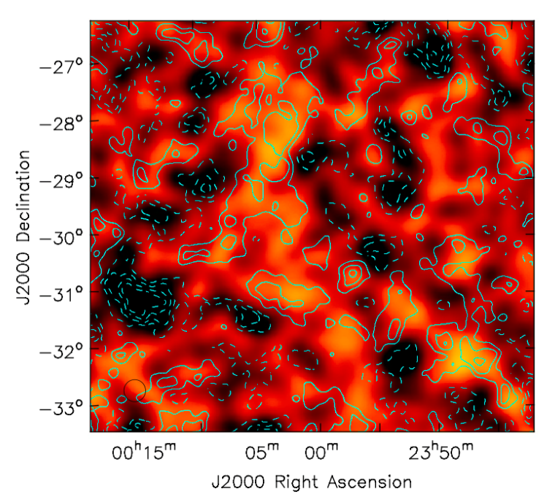
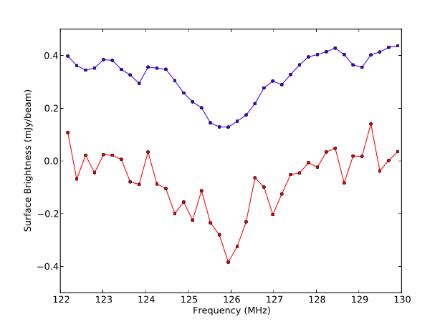
HI 21cm line channel image + noise
127MHz
model
Observed
Color = input model * 25’ Gaussian
Contour = HERA observation
100hrs, 0.2MHz, rms/chan = 50uJy/beam
Natural Weighting: PSF FWHM = 25’
If we can fight through continuum, HERA has good LSS imaging capability

Slide 7
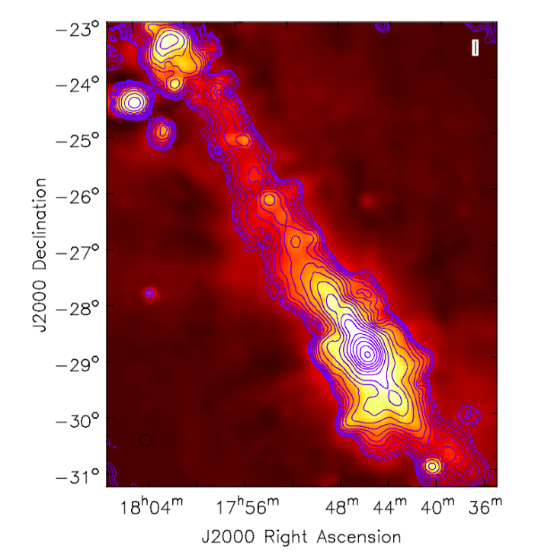
Galactic Center
Color = Model, Eberg 1.4GHz (Reich ea.)
Contour = HERA 150MHz, 12’ res
Peak = 2200Jy/beam, 1st contour = 5 Jy/beam
100 MHz – 200 MHz spectra: FF abs, SSA…

Slide 8
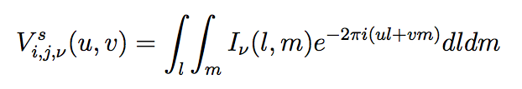





Closure phase: route to detection independent of calibration?
<E_{i} x E_{j}>_{t} ≣
Closure phase is a true measurement of Sky signal, independent of calibration (ie. complex bandpass)
Conjecture: spectral behavior of closures phases of line vs. continuum will be adequate to separate the two via smooth curve fitting in frequency?

Slide 9
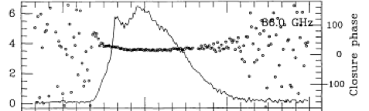

Solar radio bursts BIMA (Lim ea. 1992): no phase calibration applied!
Currently being applied to FRB searches (Law ea.)

Slide 10
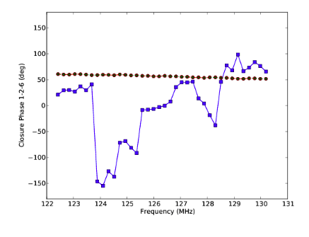
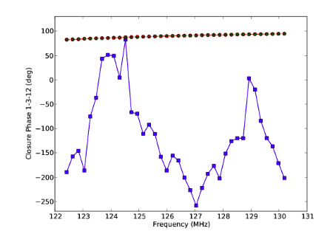
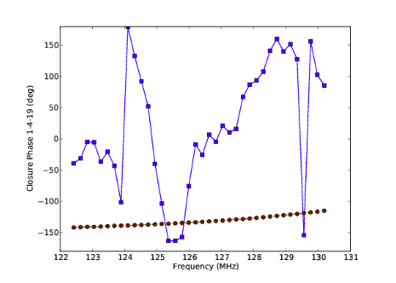
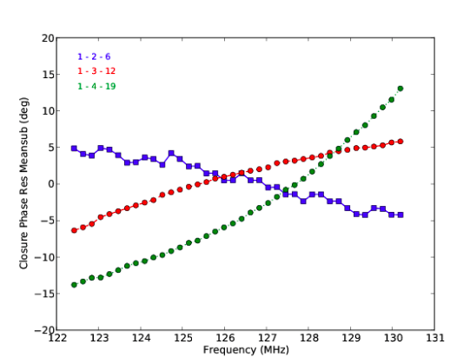
Closure spectra
Three shortest equilateral triangles: line vs. continuum
14m
28m
Encouraging
S/N is adequate to detect line fluctuations in reasonable time (100hr)
Continuum much smoother than line, but is it smooth enough?
42m
Continuum mean subtracted

Slide 11
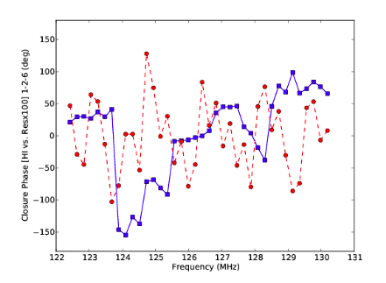
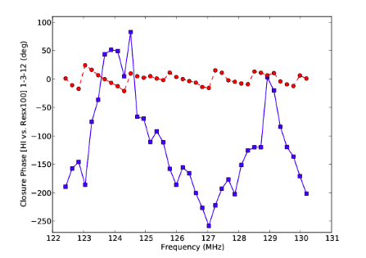
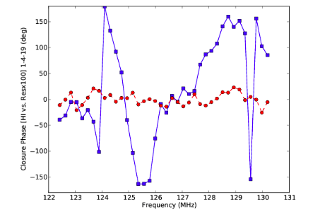
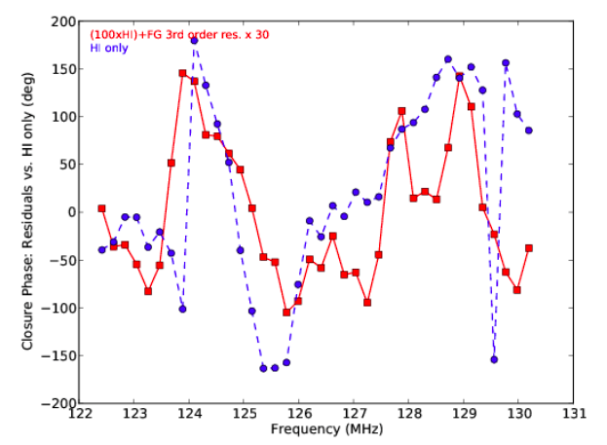
Line + continuum w. 3rd order baseline removed
Residuals x 100
21cm only
Conclusions
Line vs. continuum very different behavior with freq, but…
Residual frequency dependent structure in continuum closure phases not smooth enough to remove via spectral baseline fitting
Possible manifestation of ‘wedge’ = chromatic response of interferometer?
Maybe separable with a ‘delay spectrum-type’ approach?
99% continuum removed, then baseline fit (residuals x 30)

Slide 12
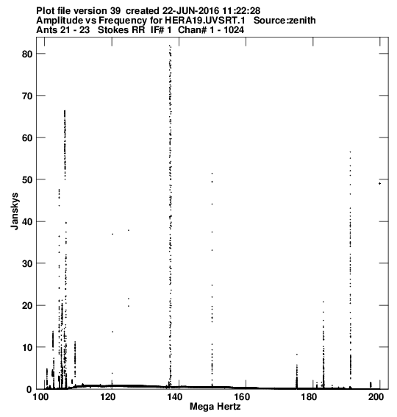
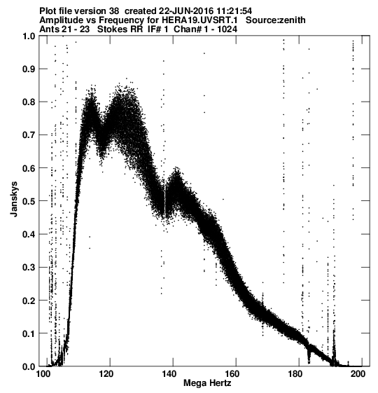
HERA19 raw data
Single baseline, uncalibrated spectra
10min, 11sec records, 0.1 MHz chans, 100-200MHz
Mainly testing FITS converter: AIPS and CASA
Encouraging
Not dominated by RFI or cross-talk = telescope response x Sky
Sky signal x telescope response: coherent in amp, phase vs. frequency

Slide 13
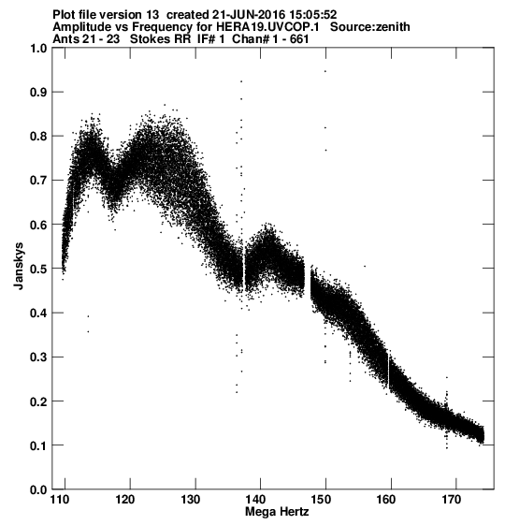
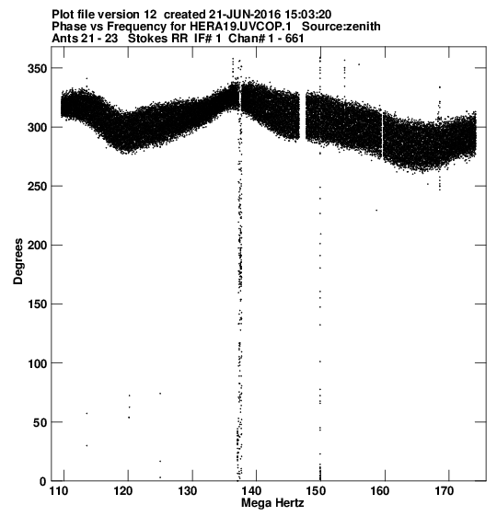
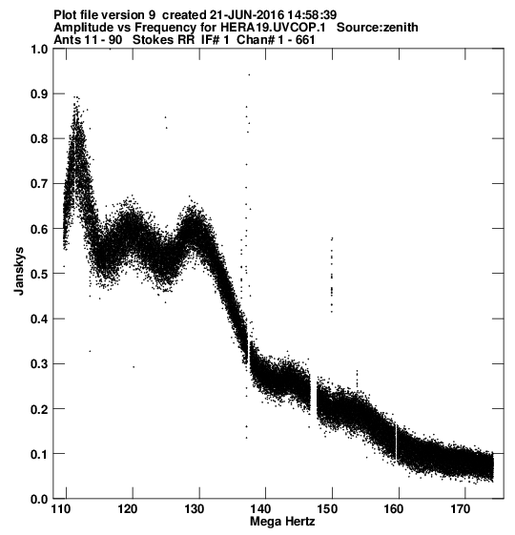
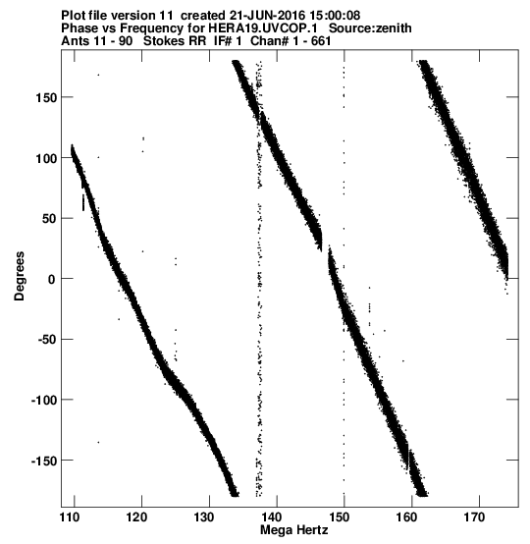
Amp
Phase
Large delay?

Slide 14
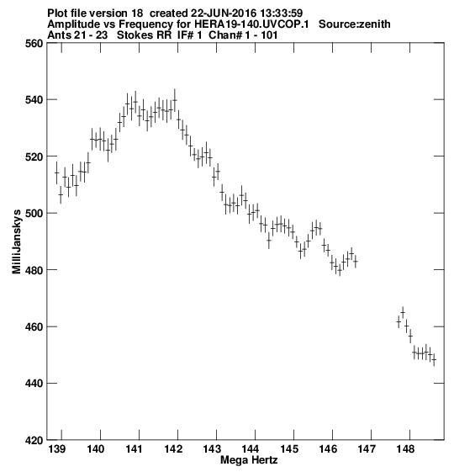
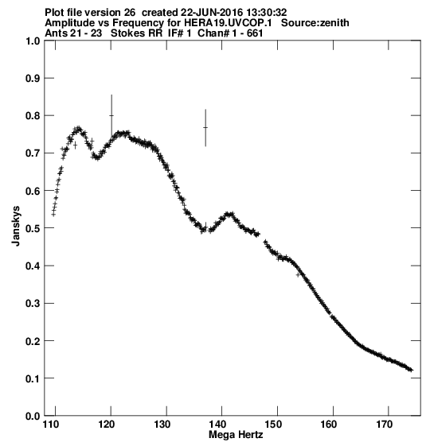
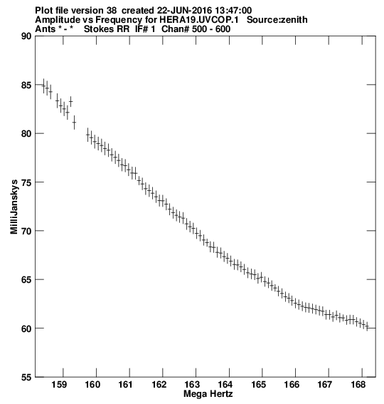
10min average: ripples?
RFI

Slide 15
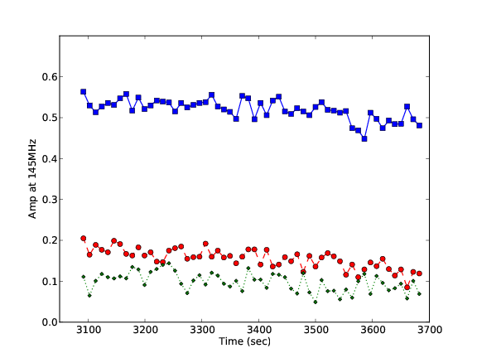
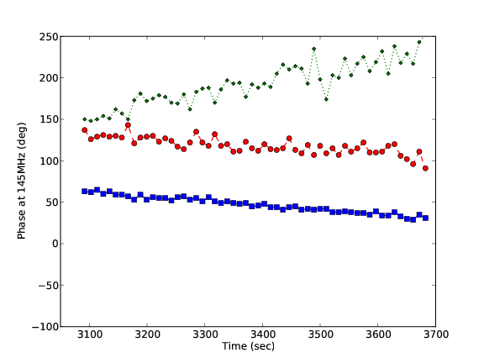
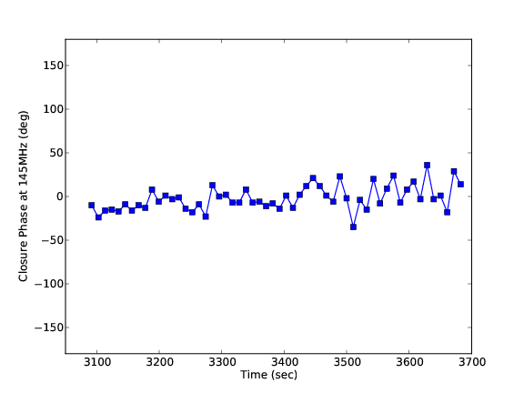
21, 23, 81
145MHz
Amp
Phase
Vis amp, phase vs. time: well behaved
Closure phase: reasonable, too
Closure Phase

Slide 16
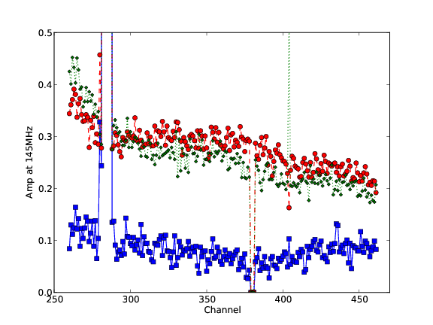
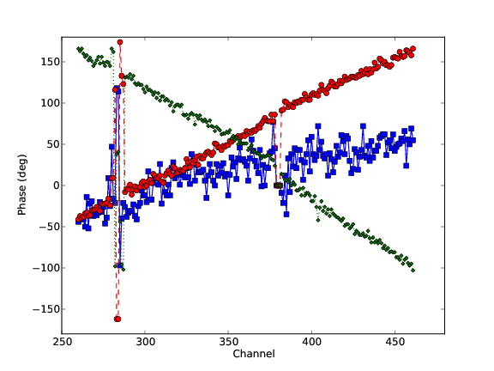
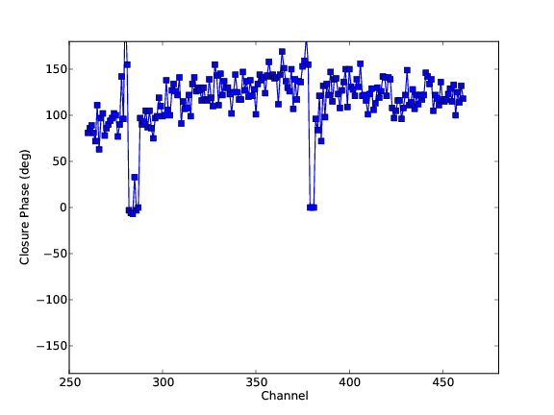
11, 32, 90
Visibility phase
130MHz
155MHz
Why the sky?
Weaker Vis Amp show larger phase noise
Large phase gradients normalize out in closure => slope = uncalibrated antenna-based delay
Closure phase

Slide 17
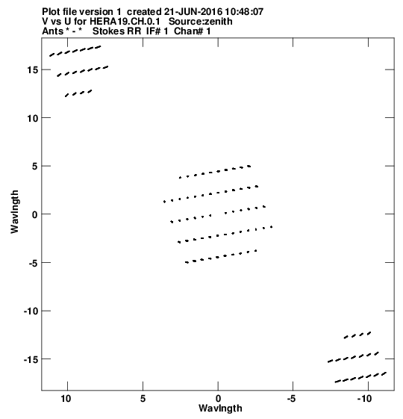
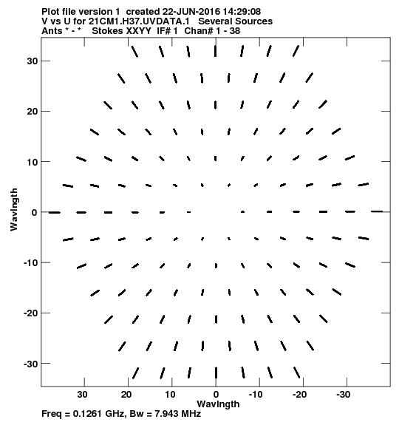
UV coverage snapshot
Encouraging
Not dominated by RFI or cross-talk
Clearly see sky signal: coherent in amp, phase vs. frequency, closure phase
Still technical problems (AN; Vis u,v,w)
HERA19 -- data
HERA37 -- sim

