Slide 1
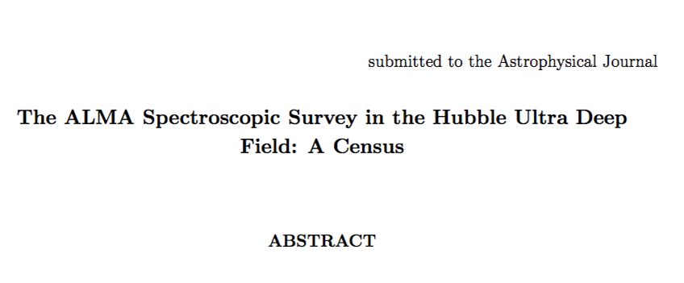
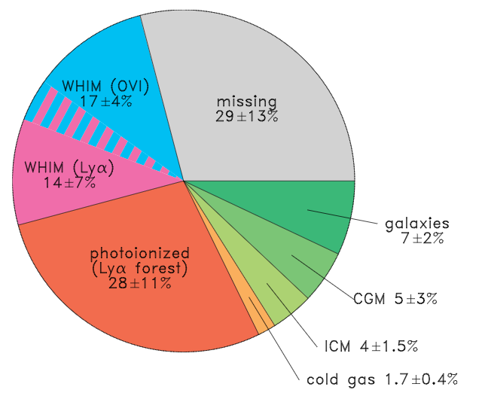
Cosmic Baryon Census at z = 0
Mean co-moving baryon density = 0.0455+/0.0028 (set by BAO scale (v_{s}), D abundance…)
29% ‘missing’
59% in W/H IGM
4% ICM + 5% CGM
In Galaxies ~ 9%
7% (stars)
1.7% (’cold gas’ HI, H₂)
Dust, ionized gas < 0.1%
Shull ea. 2011

Slide 2
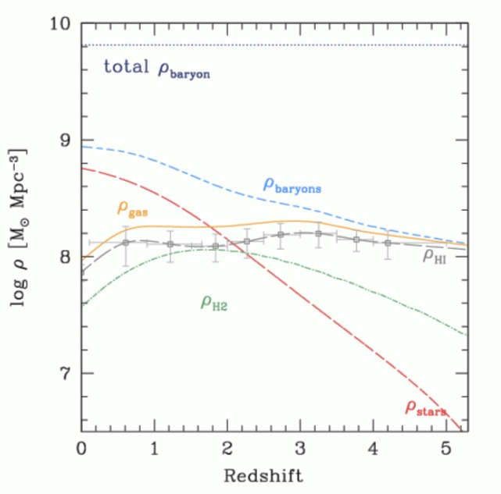
W/HIGM + CGM + missing
z=0 galaxies: star dominated = low mass/WD
_{gal}
21cm
DLA
HI > H₂ all z
nIGM/LyaF or Galaxies?
High z: Gas dominated galaxies => drives SFHU
Decarli +

Slide 3
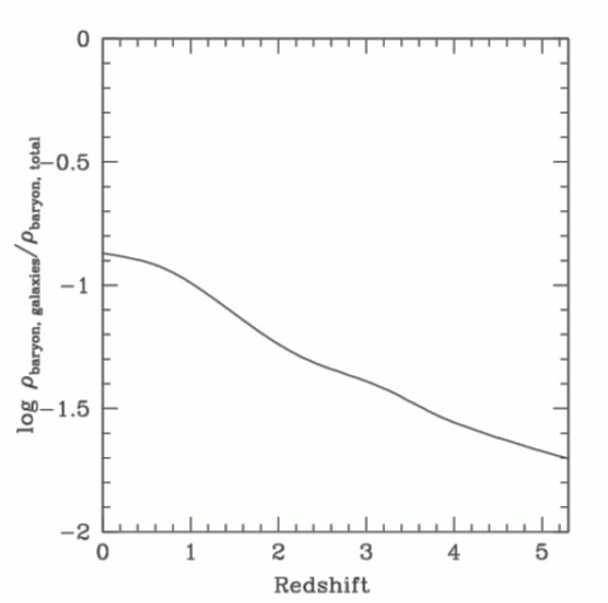
Flattening at late times: what will happen to the IGM in an expanding Universe?
Baryons being captured in galaxies over time = WD/low mass stars

Slide 4
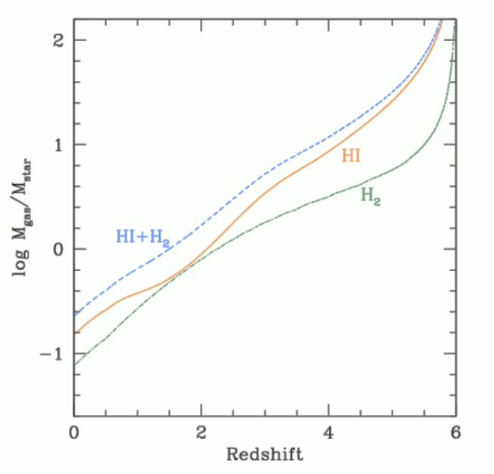
Ramp-up at high z?
Gas being converted to stars over time
Flattening at late times: what happens to IGM in an expanding Universe?
Baryons being captured in galaxies over time = WD/low mass stars
Star dominated
Gas dominated

Slide 5
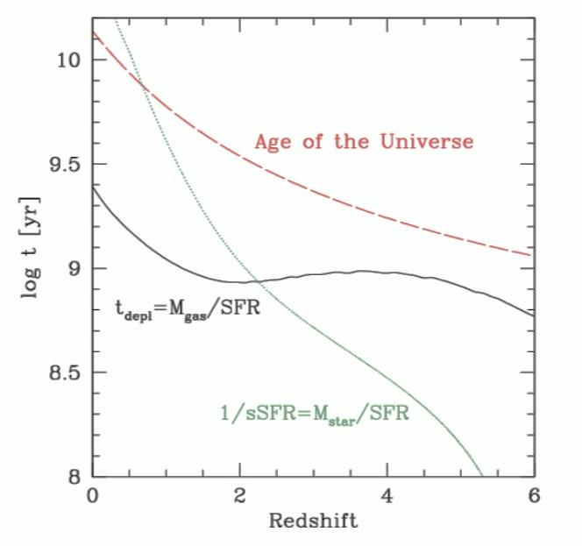
require more active SF in past
Always < T_{univ} => need gas resupply
SF is episodic
Forward: How long can SF persist given M_{gas}?
Backward: How long has SF persisted given M_{stars}

Slide 6
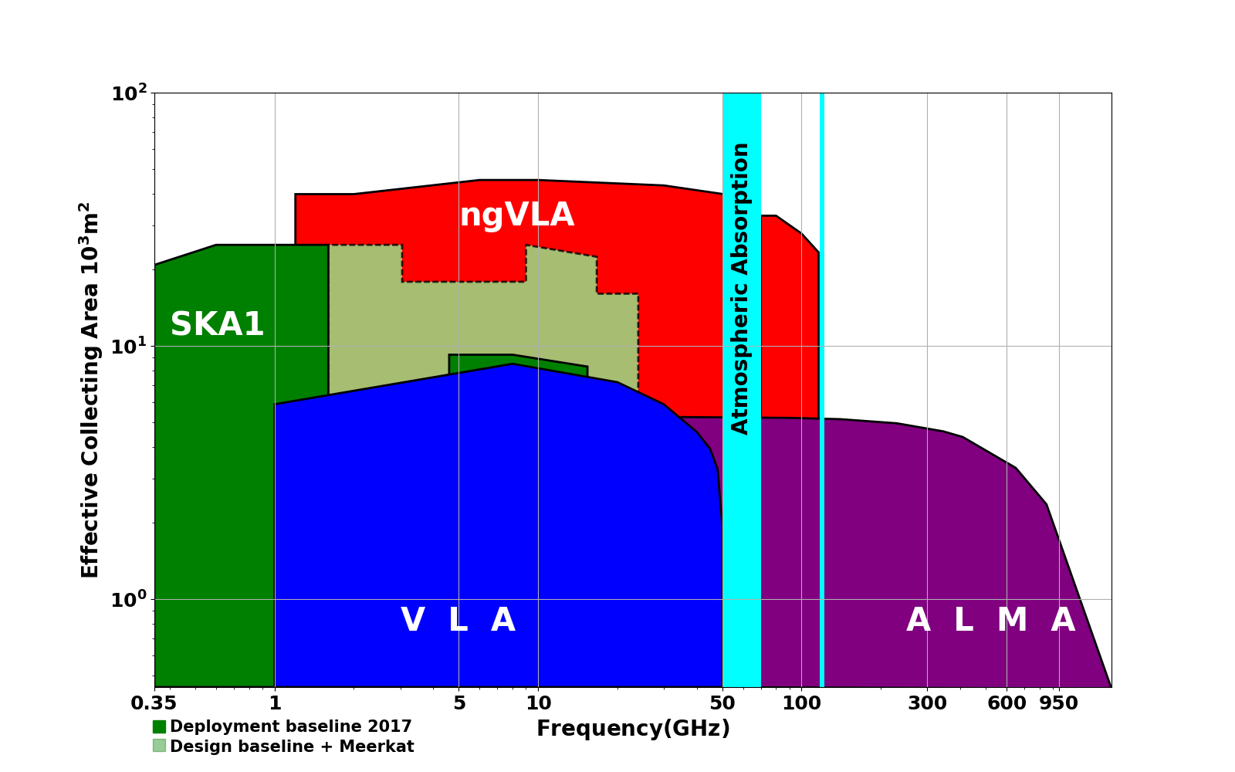
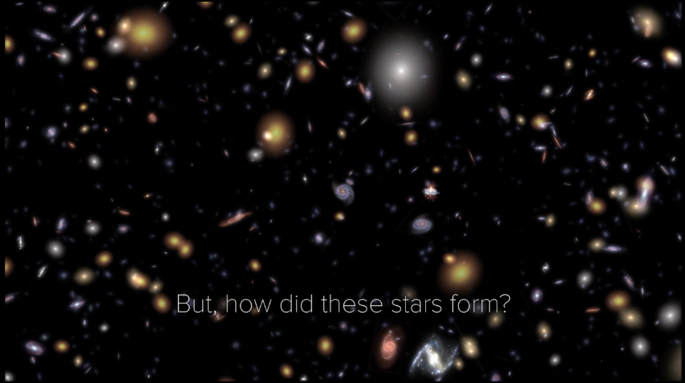
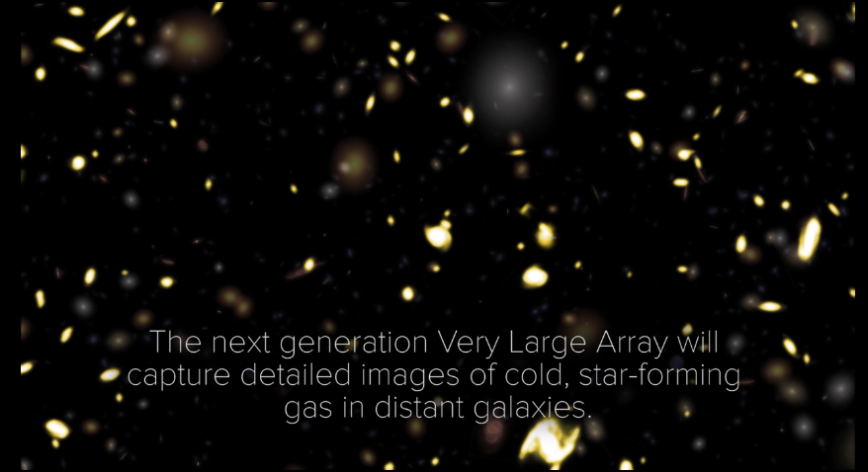
Next Generation Very Large Array A New Array for the mid-21st Century: thermal imaging on milliarcsec scales
10x effective collecting area of JVLA and ALMA
10x resolution of JVLA and ALMA
Frequency range: 1.2 –116 GHz
10x sensitivity + 2:1 band ratio => 50 to 100-fold increase in CO-discovered galaxies per hour:
JVLA ~ 1/hr, M_{gas} > 10¹⁰ M_{o}
ngVLA ~ 100/hr, M_{gas} > 2x10⁹ M_{o}
Galaxy counts in CO ~ deepest optical fields, with redshifts (3D)!
HST stars
ngVLA CO

Slide 7
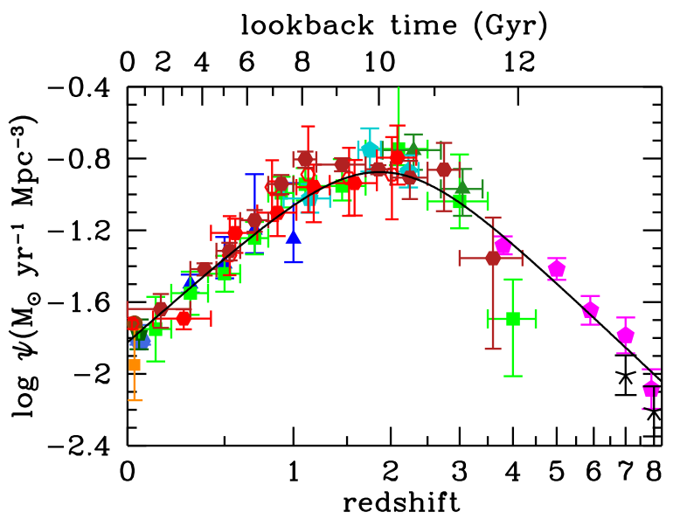
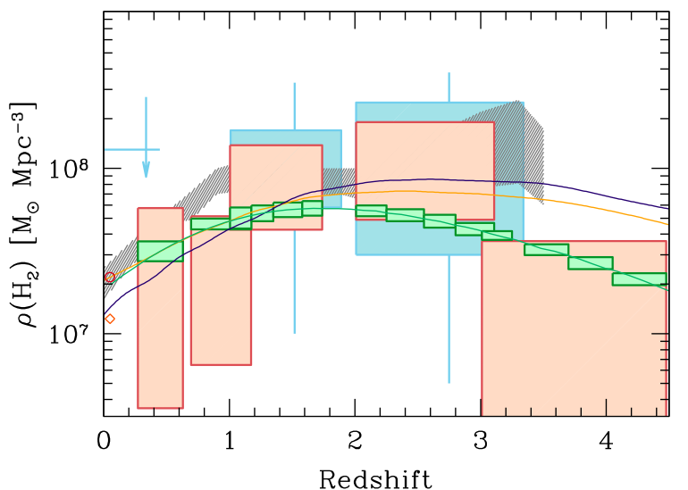
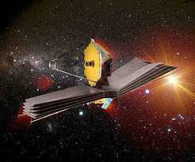
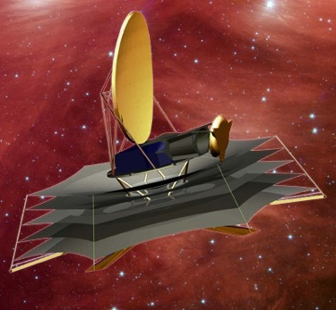
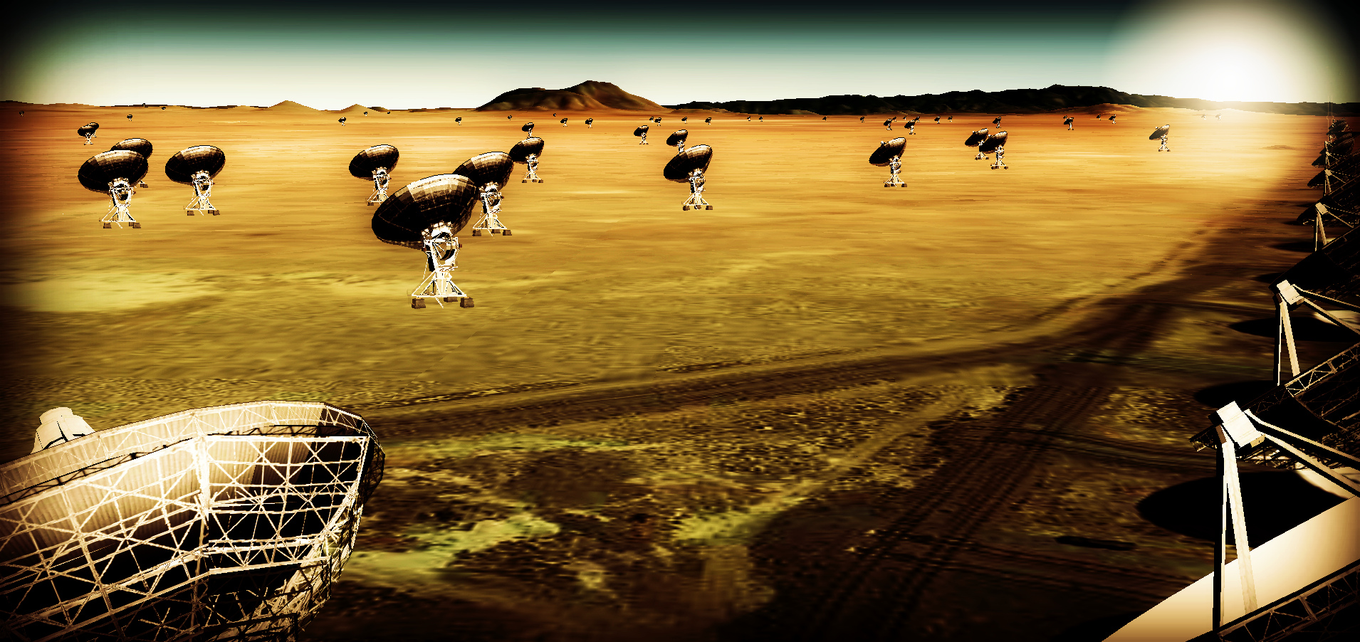
Next-Gen Synergy: Cosmic Conversion of Gas to Stars
‘Precision galaxy formation’
Gas
NGVLA
ALMA
Decarli
JWST/ELT/OST: stars, star formation, dust
ngVLA: cold gas fueling cosmic star formation

Slide 8

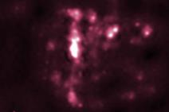
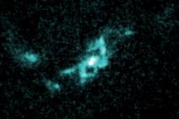
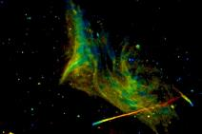
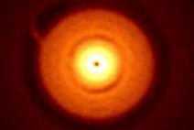
Astrophysical Frontiers in the Next Decade Planets, Galaxies, Black Holes, & the Transient Universe Portland, OR USA June 26-29, 2018
Registration open: http://go.nrao.edu/ngVLA18
New research facilities and the scientific vision outlined by New Worlds, New Horizons have motivated the exploration of vast new discovery space, and astrophysics has seen extraordinary progress in the past decade, opening new frontiers across many fields. Sponsored by the National Radio Astronomy Observatory, this conference will bring together a substantial cross-section of the astronomical community to discuss how to effectively address the highest priority astrophysical questions of our time. Plenary sessions will feature invited speakers, and three parallel sessions of contributed presentations will address (1) Exoplanet and Protoplanetary Disk Origins, (2) Galaxy Evolution Mechanisms, and (3) Black Holes & Transient Phenomena. Each session will canvas recent observational and theoretical progress, address key unanswered questions, and motivate future research directions in the context of next-generation facilities that would span the electromagnetic spectrum, including a Next Generation Very Large Array, the Large Synoptic Survey Telescope, 30m-class optical-infrared telescopes, the Advanced Laser Interferometer Gravitational-Wave Observatory, and the Square Kilometre Array.
SOC co-Chairs
Brenda Matthews (NRC – Cradle of Life)
Caitlin Casey (UT – Galaxy Evolution)
Laura Chomiuk (MSU – BHs and Transients)

Slide 9
3D Power-Spectral Analysis of ASPECs
Low S/N per voxel => shot-noise dominated regime of PS
Good 3D sampling on scales ~ 10cMpc (FoV)
Pencil beam (LoS) on scales to 1000cMpc (BAO at z = 3?!)
Main analysis: cross correlate image cubes made from first/second half of observations
Remove noise bias
Likely will result in limits of undetermined interest (mean CO ’brightness’; CO ‘bias’ eg. Keating ea)?
More promising for detection
Cross correlation with MUSE-based, mag-phys predicted CO galaxy catalog
3D PS in velocity range of known clusters
Issues: many
S/N low
Pencil beam PS: dominated by few clusters
Line confusion w. z

