Slide 1
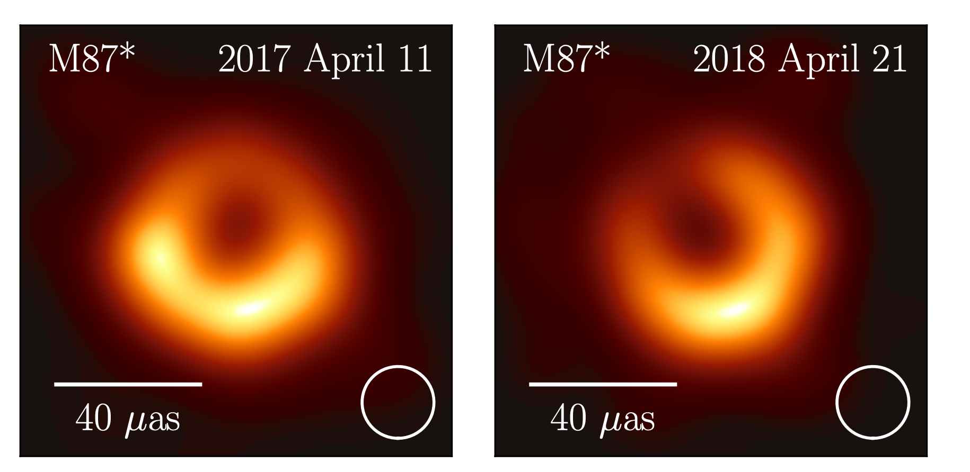
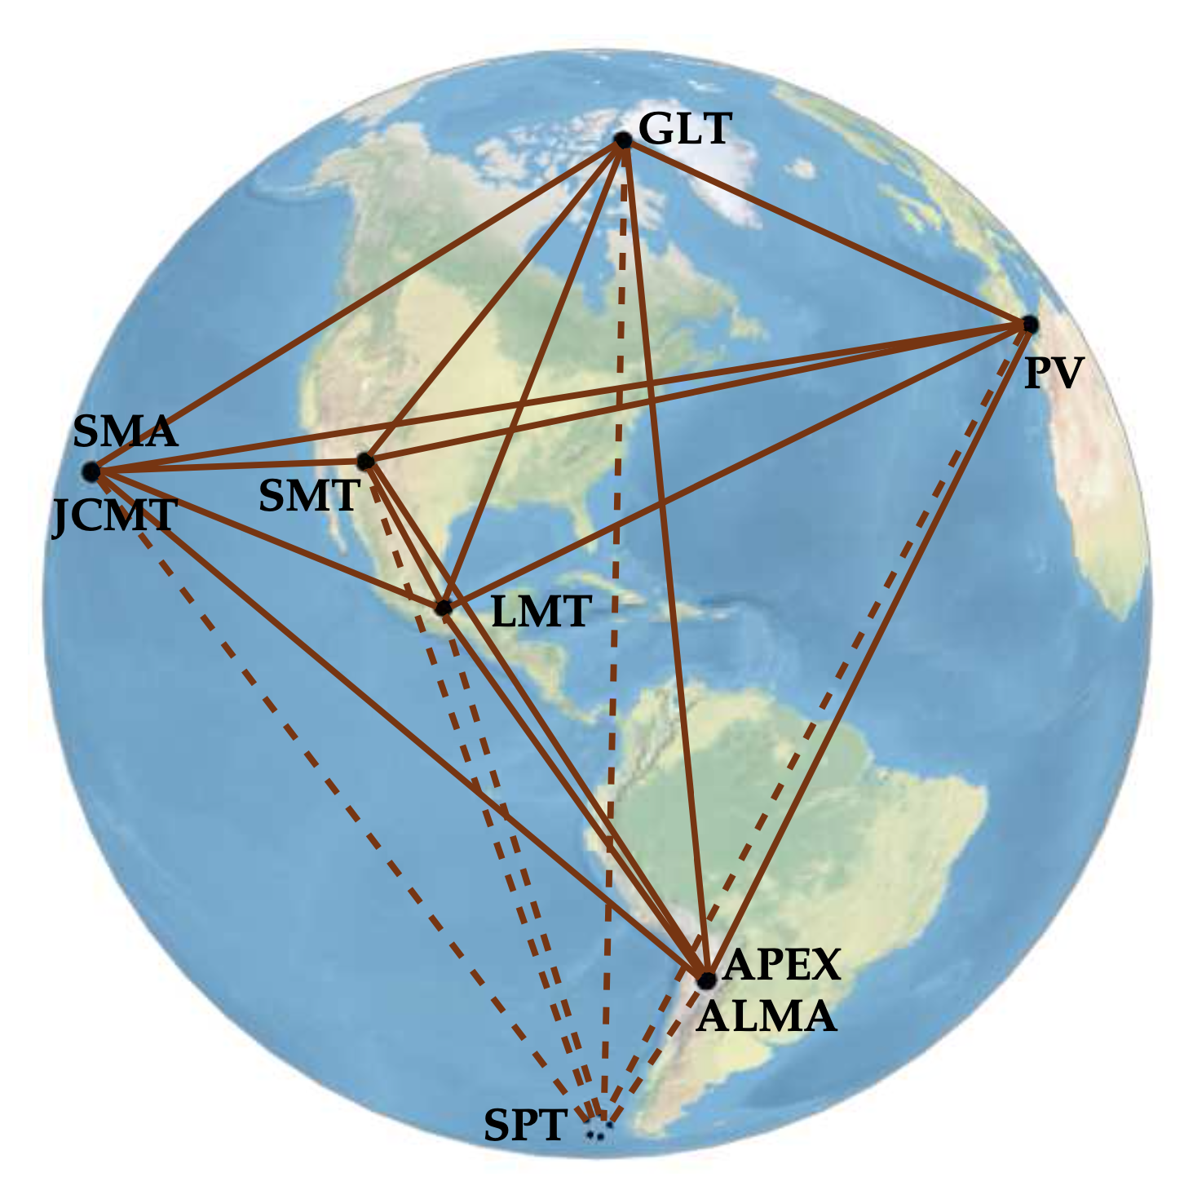
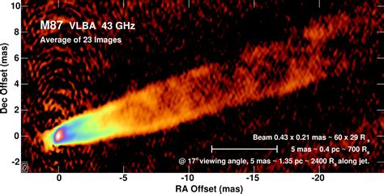
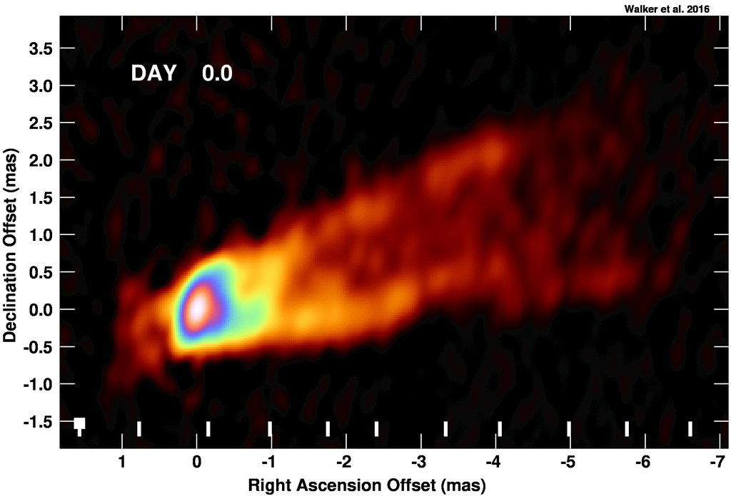
Event Horizon Telescope Collaboration
M87 @ 230 GHz, 20uas resolution
General relativistic shadow
  Diameter = 42 uas = 5.6 R_{s}
M_{SMBH} = 6.5 x 10⁹ M_{o}
v_{app} up to 6c
Walker + 2018
V_{app} up to 6c

Slide 2
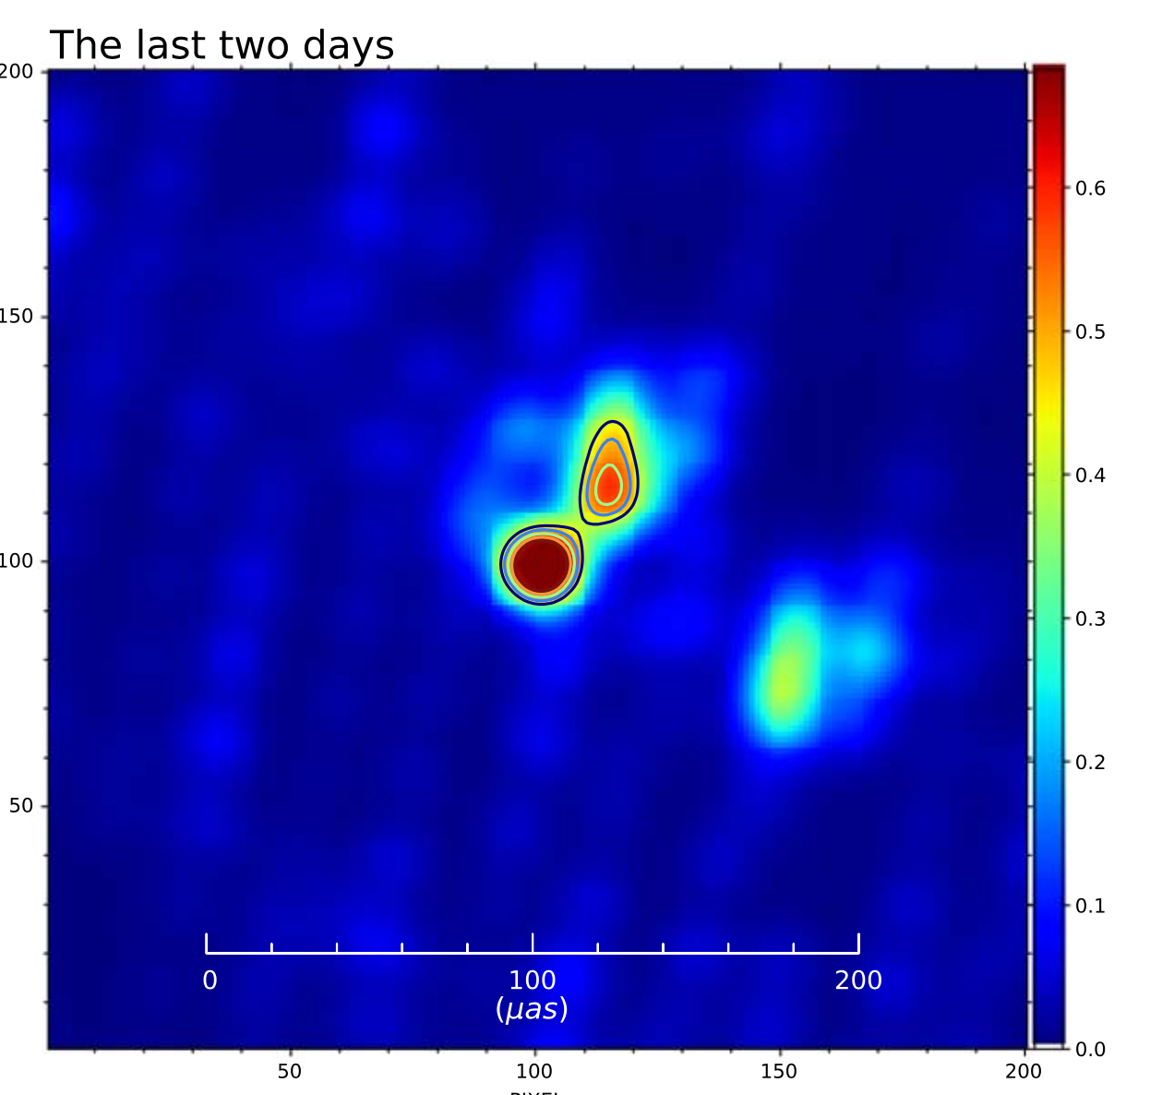
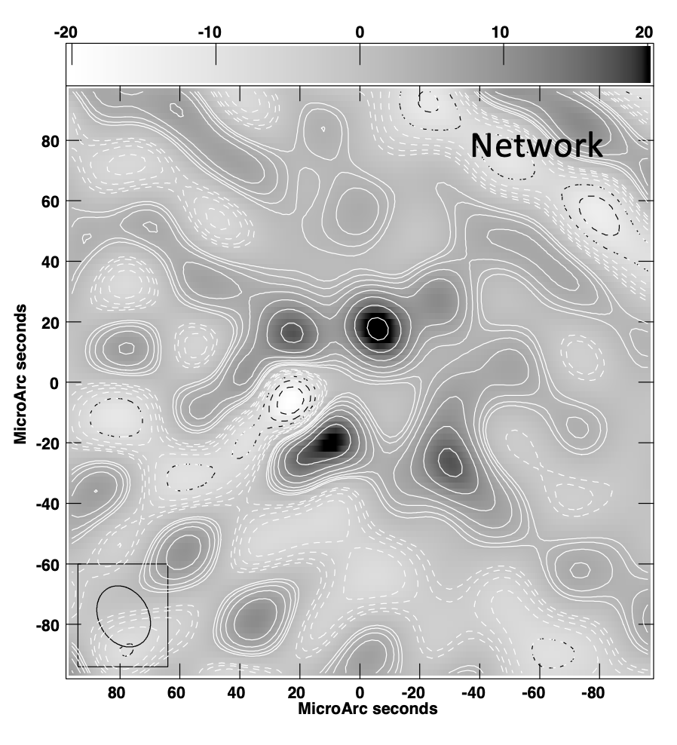
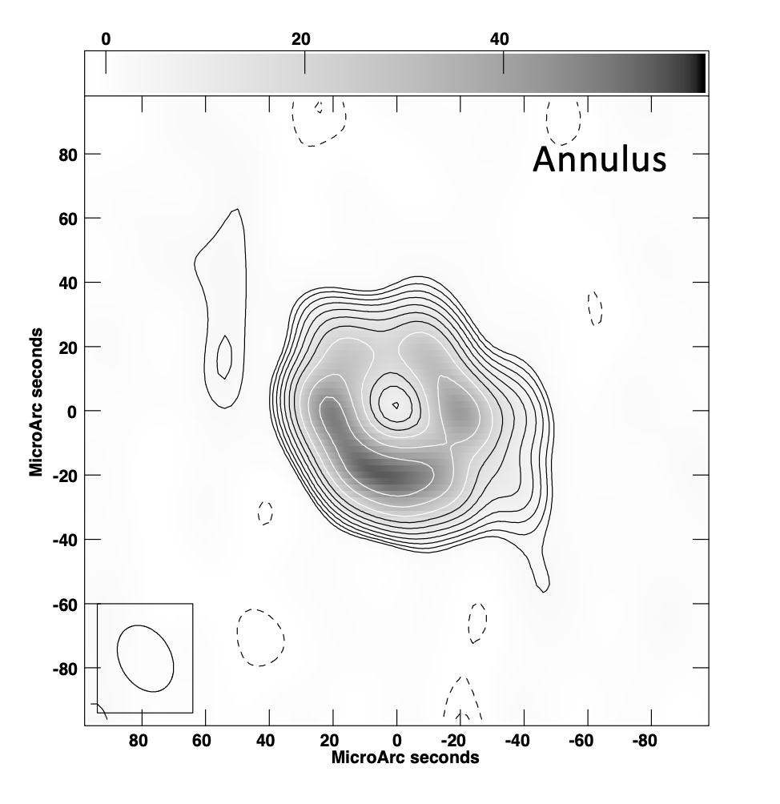
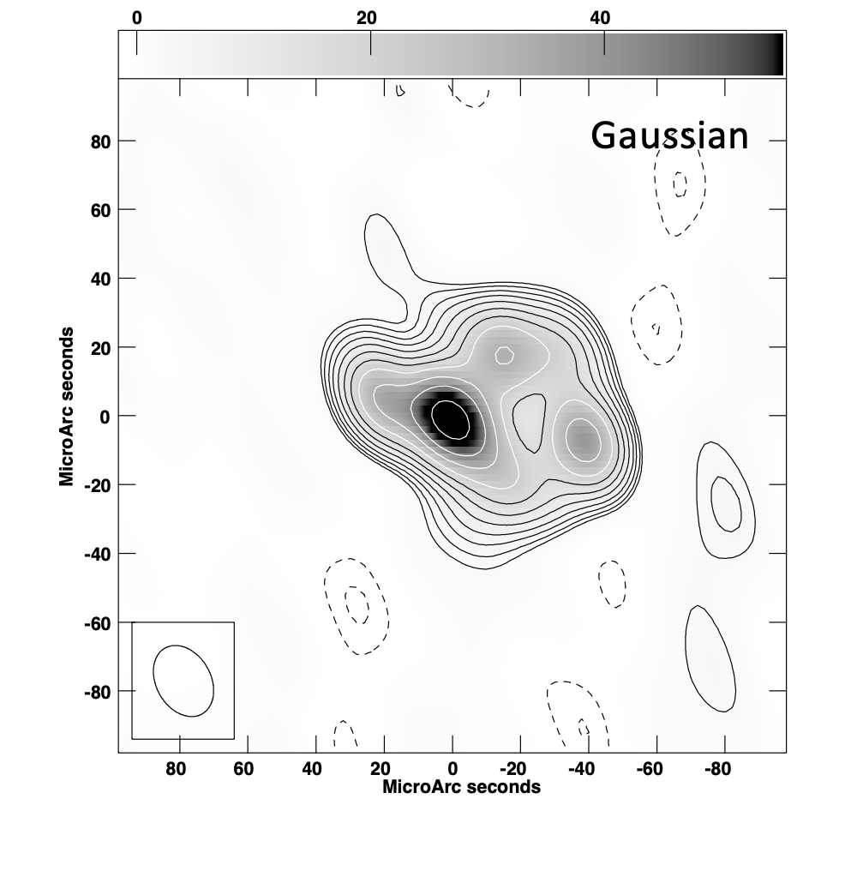
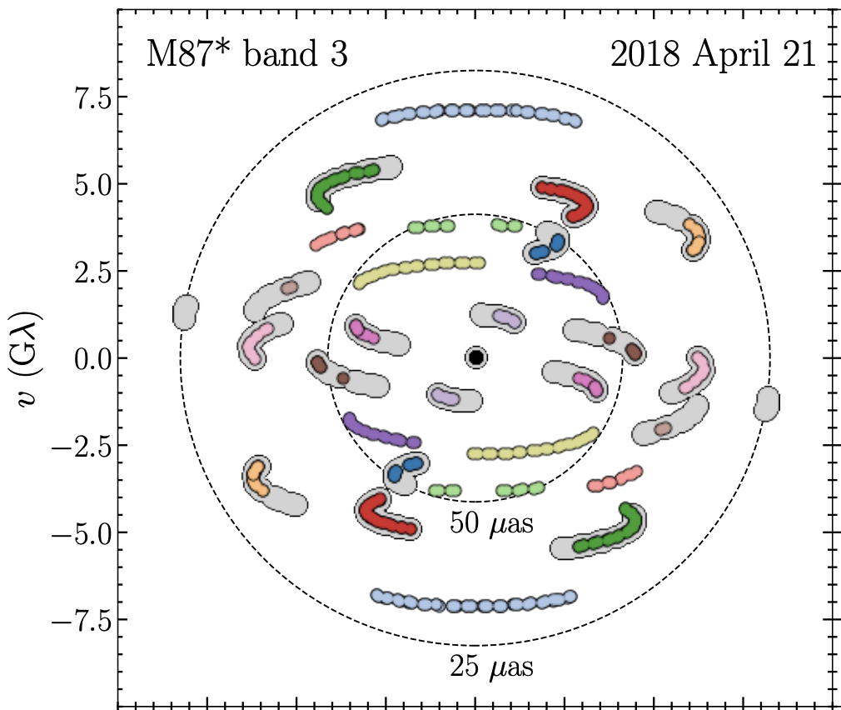
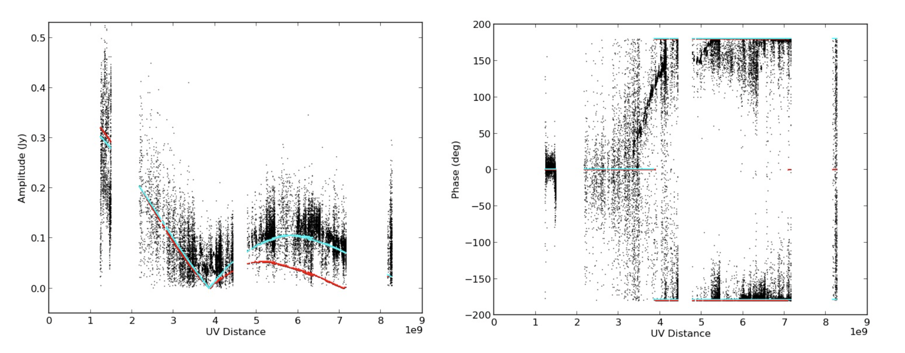
Debate Continues
Alternate data processing for sparse UV coverage
Miyoshi ea.
Carilli&Thyagarajan
Annulus 42uas
Disk 55uas

Slide 3
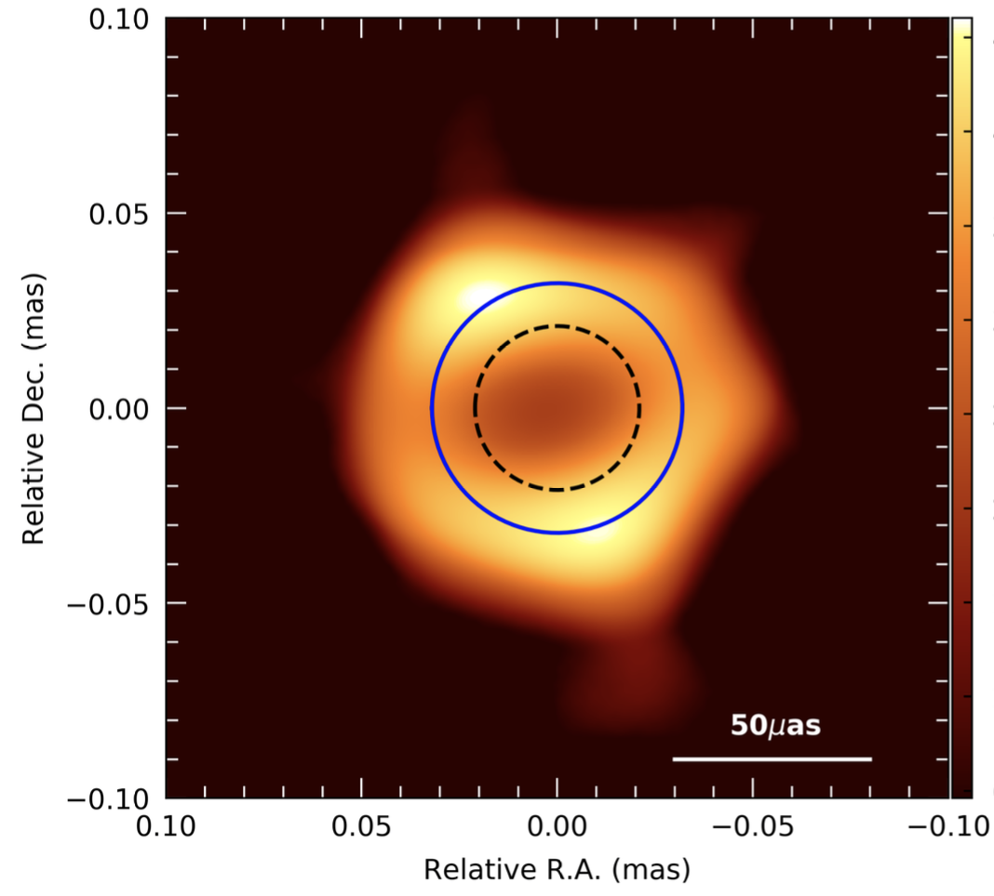
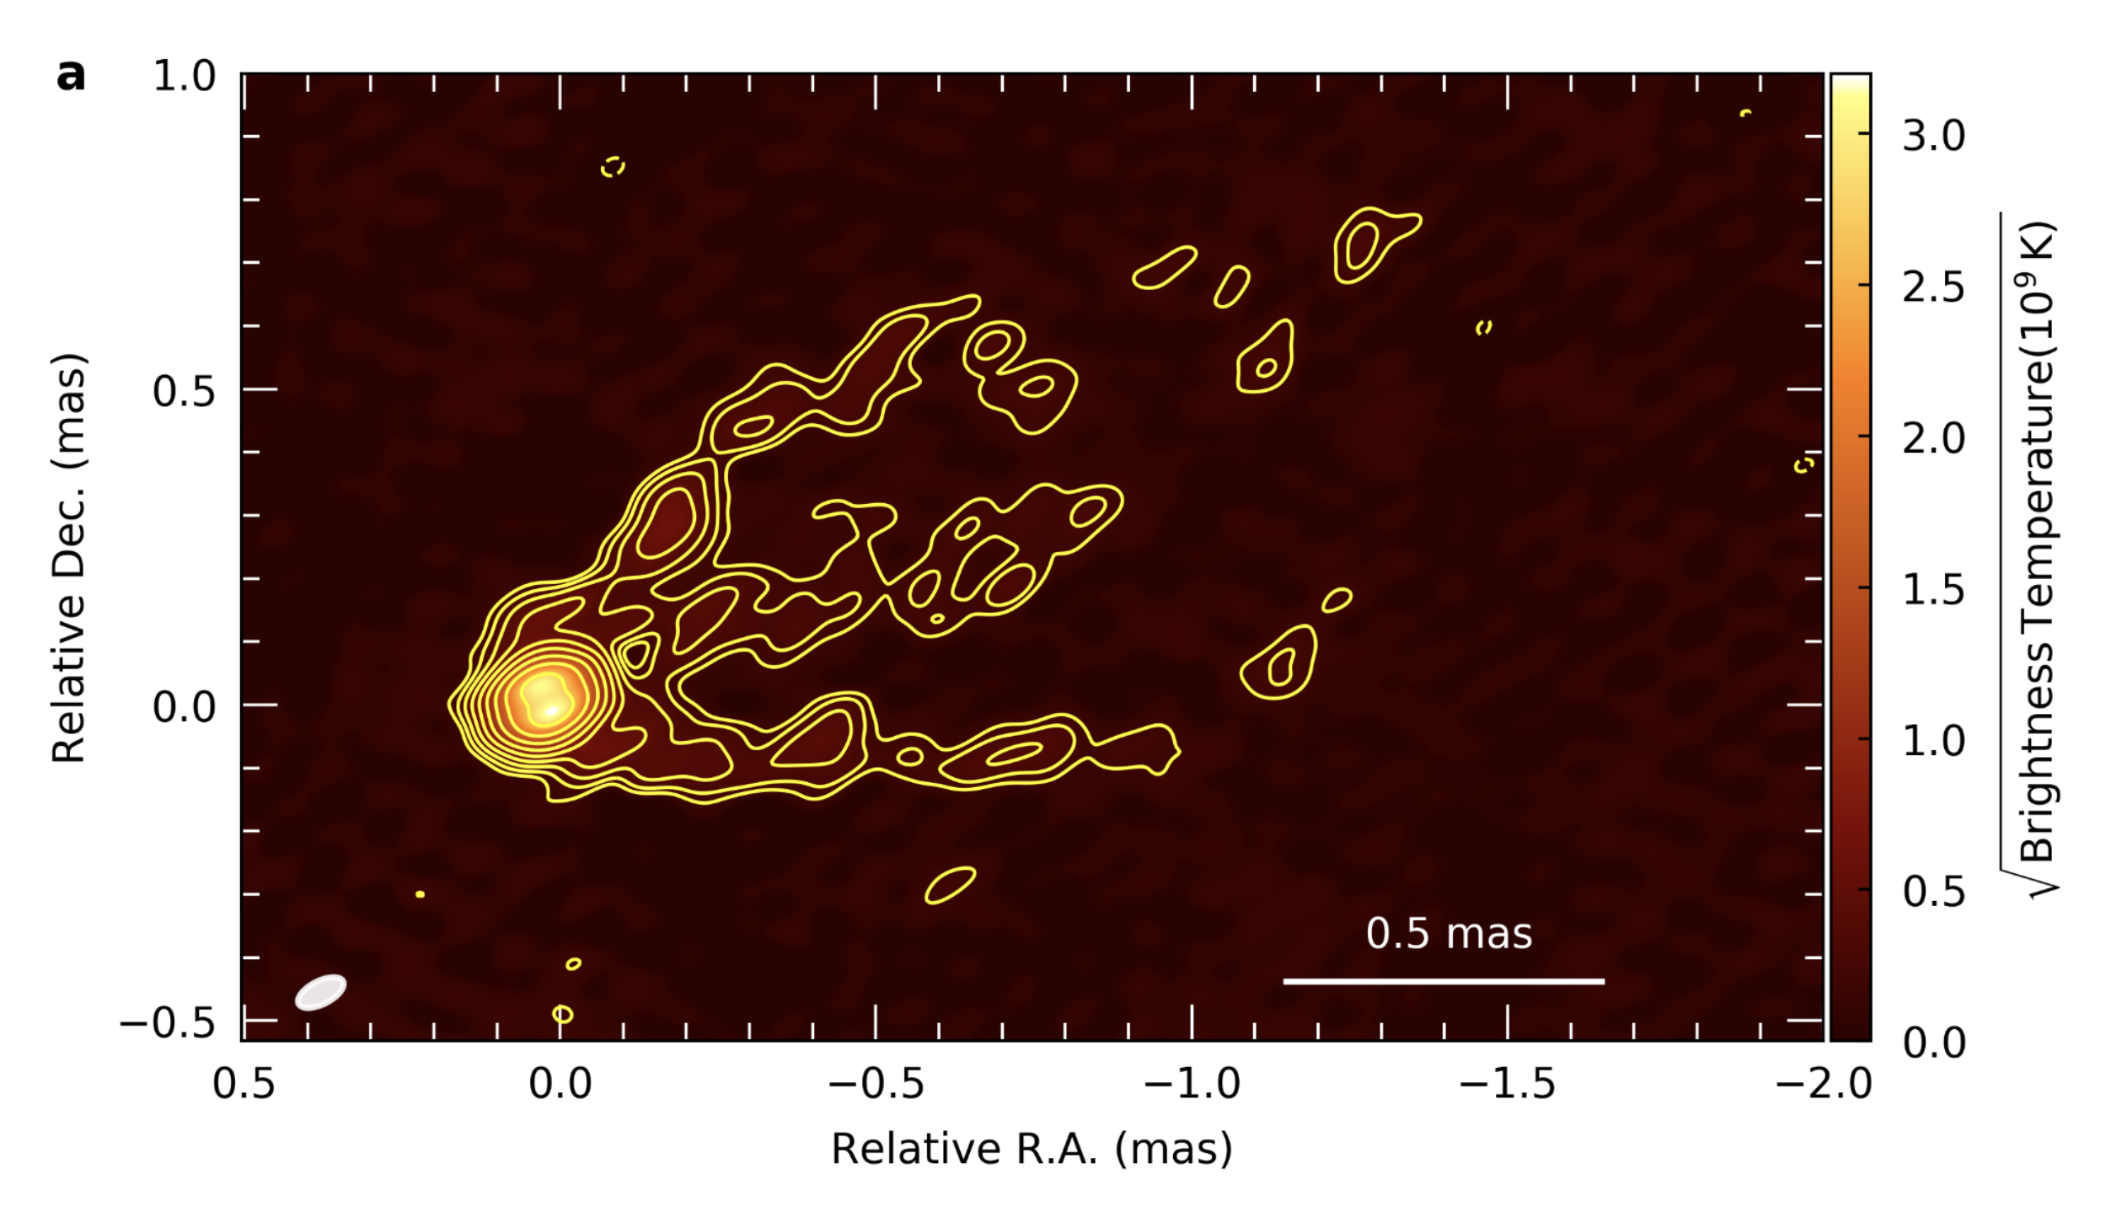
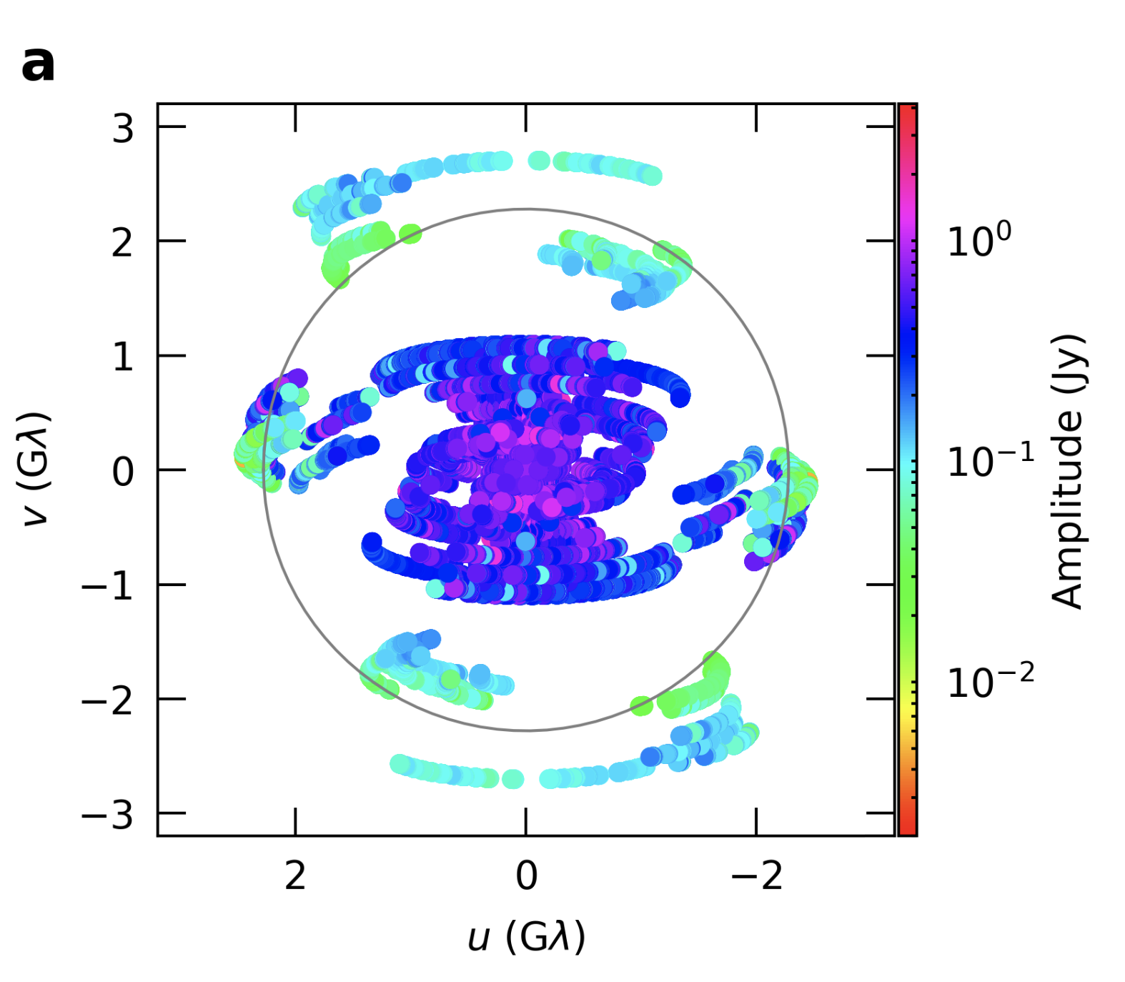
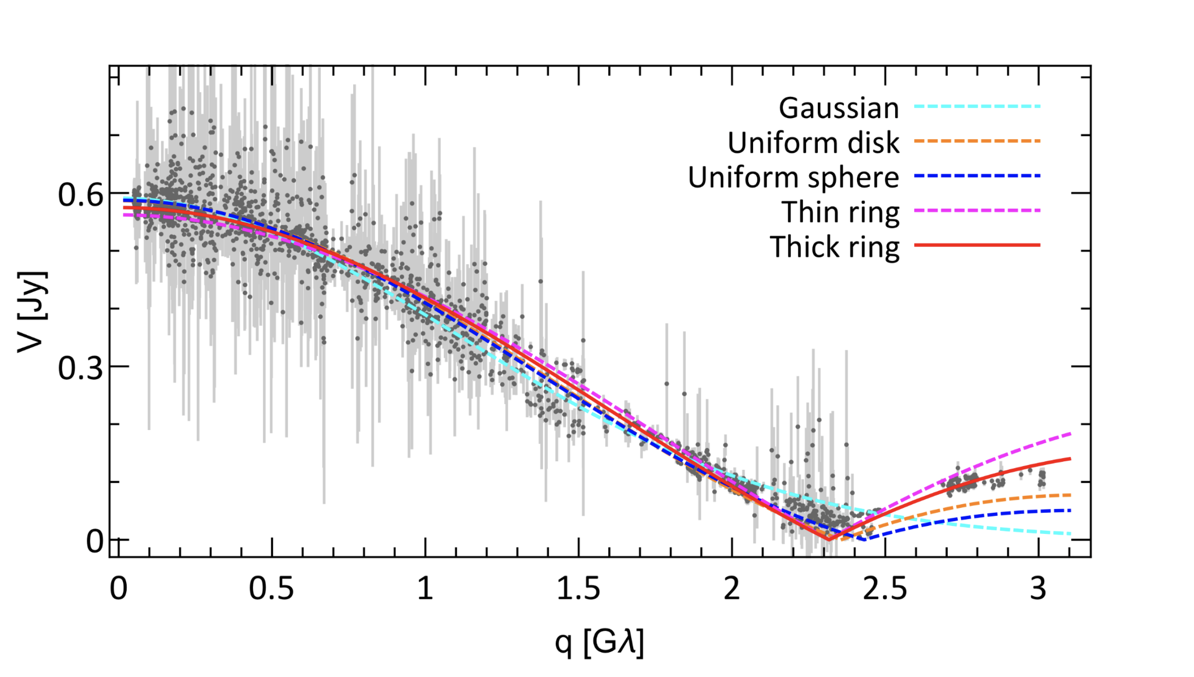
GMVA 90 GHz imaging 80x40uas
14 stations incl. EF, GBT, ALMA, VLBA
‘Ring’ but D = 64uas = 8.4 R_{s} = 1.5x R₂₃₀!! => black hole mass derivation becomes complicated
Jet-core connection to scales ~ 0.1 pc
GMVA results highlight ngVLA key science program: imaging the accretion disk – jet connection on scales down to 10 R_{s}
Lu et al. 2023
M_{SMBH} = 6.5 x 10⁹ M_{o}
Walker + 2018
Walker + 2018
0.5mas

Slide 4
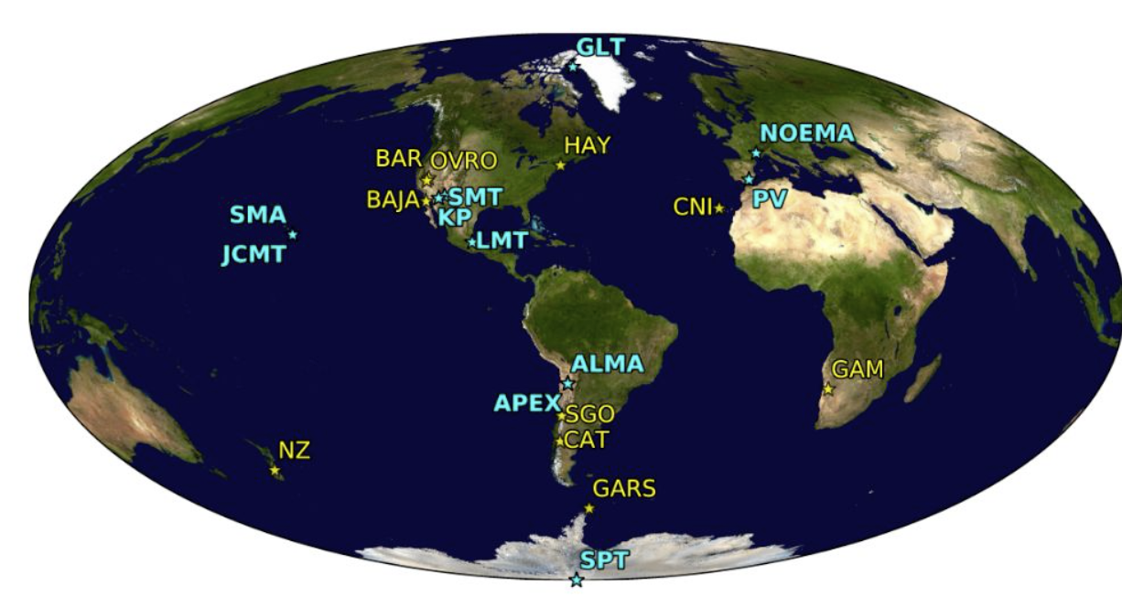
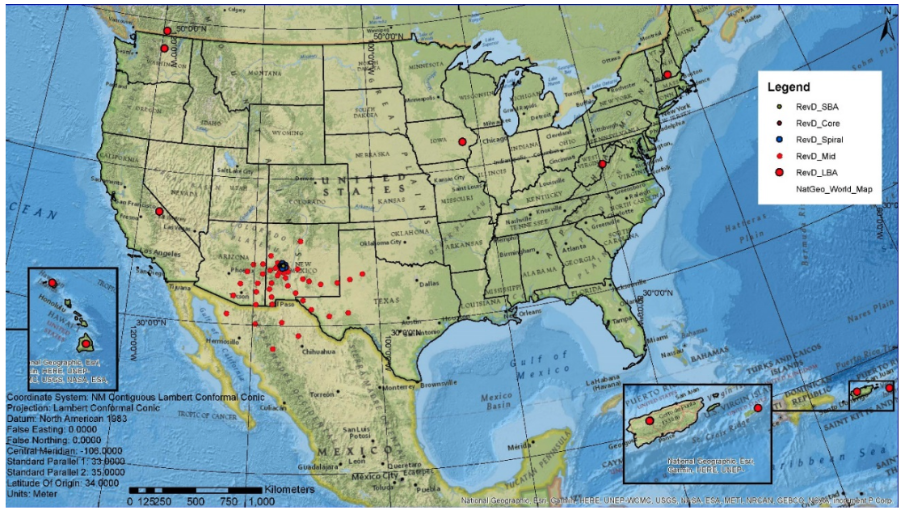
Imaging the Black Hole Disk – Jet connection
Global VLBI at 90 GHz w. ngVLA
Doeleman + 2023
GMVA in next decade ~ ngEHT?
  ALMA, APEX, SMT, OVRO, KP, GLT, JCMT, SMA, SPT, HAY, BAJA, CNI, LAS, JELM, AMT, IRAM 30m, NOEMA, LMT
ngVLA 244 antennas: increases total collecting area by factor ~ 4.5

Slide 5
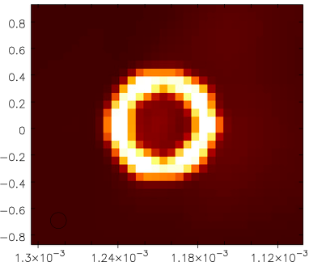
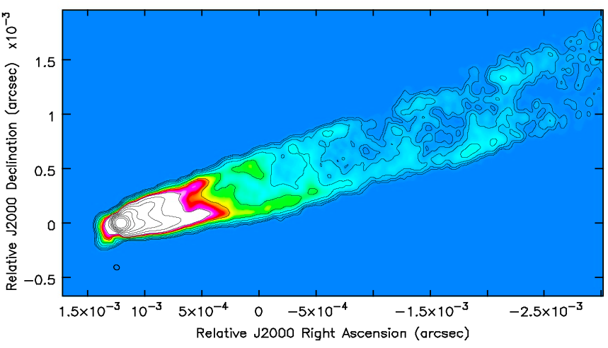
M87 90 GHz Model and Processing
64uas
M87 90 GHz GMVA @ 40uas: R ~ 8 R_{s}
Walker 43 GHz M87 Jet blanked accordingly
Replace Gaussian core with 64 uas annulus of same flux density
86GHz ngEHT and ngEHT+ngVLA 12hr synthesis
Thermal noise added
TCLEAN 6uas cell, 2048 pix, MSC, 20k iter, G=0.03, R=-2, uv-min 30km
uv cell = 67 km => spiral and core in 1 cell!
Explore +/-20º phase errors with time constant = 180s
Lu et al. 2023
90 GHz Model: 64uas ring + scaled Walker 43 GHz VLBA Jet
Factor 2 contours x 20uJy/beam

Slide 6
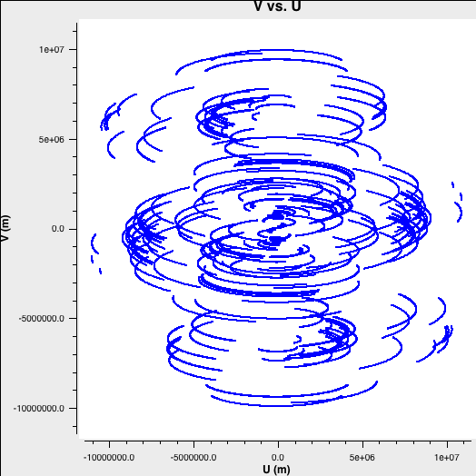
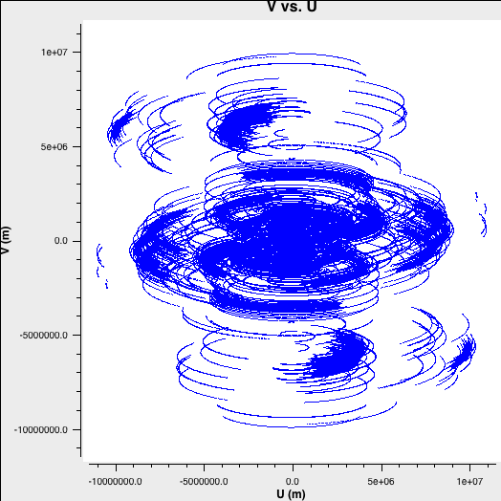
Global VLBI at 90 GHz w. ngVLA
M87 (Dec = 12º): 86 GHz 12hr synthesis
ngEHT
ngEHT + ngVLA
5000km
HI-Euro
US-Namiba
-5000km
US-Chile
GLT-Chile
Does not increase maximum baselines (R_{earth})
Much better uv-coverage baselines <= 6000 km
Much higher sensitivity at some long baselines (US-Africa, US-Chile)
Much improved calibration capabilities

Slide 7
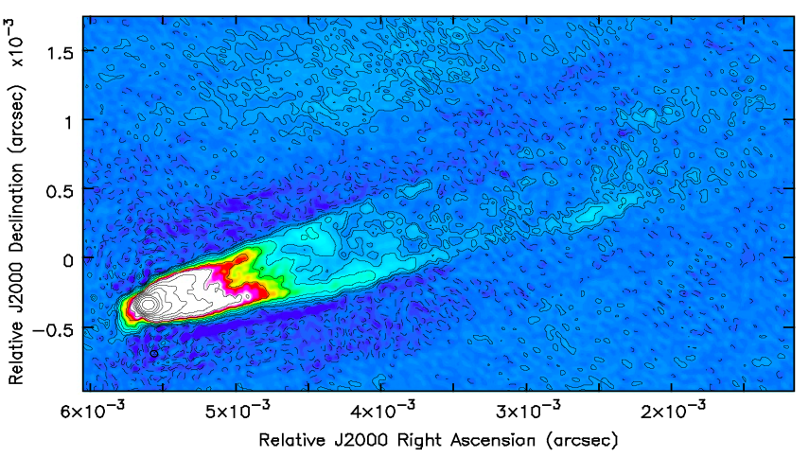
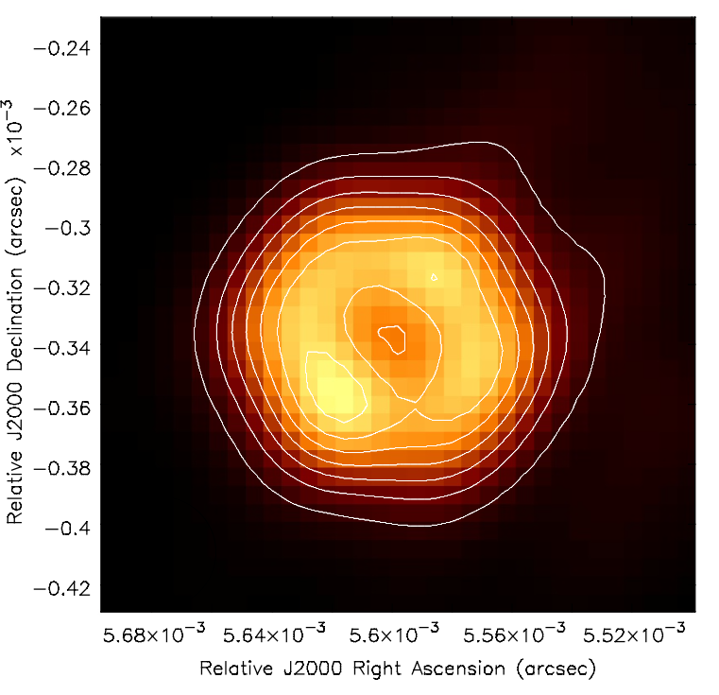
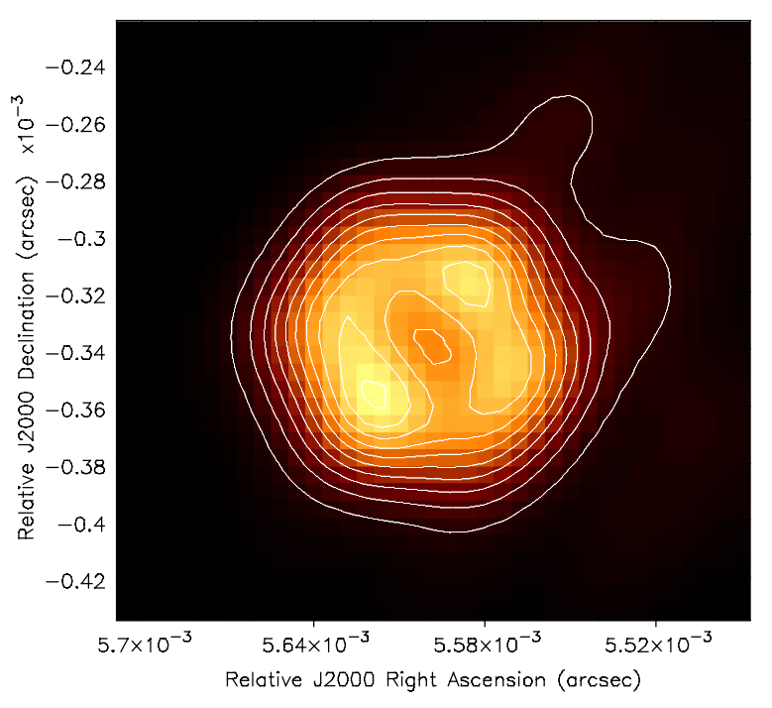
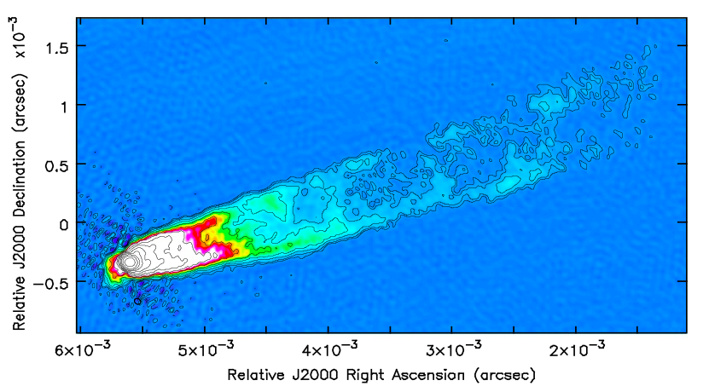
Jet
3.5x lower noise: principally due to large scale artifacts along jet direction. Dynamic range = 10k vs. 35k.
Outer jet (> 1.5mas) is ‘lost’ w/o ngVLA
Core/Ring
Comparable results on longest baselines (< 0.1mas) for bright sources, like M87
Obvious S/N gains for faint sources
M87 90 GHz GMVA @ 40uas: R ~ 8 R_{s}
ngEHT
FWHM = 52x45uas
rms = 20 uJy/bm
ngEHT
ngEHT + ngVLA
ngVLA + ngEHT
FWHM = 54x46uas
rms = 5.8 uJy/bm
Hyper-resolved core: FWHM= 37uas

Slide 8
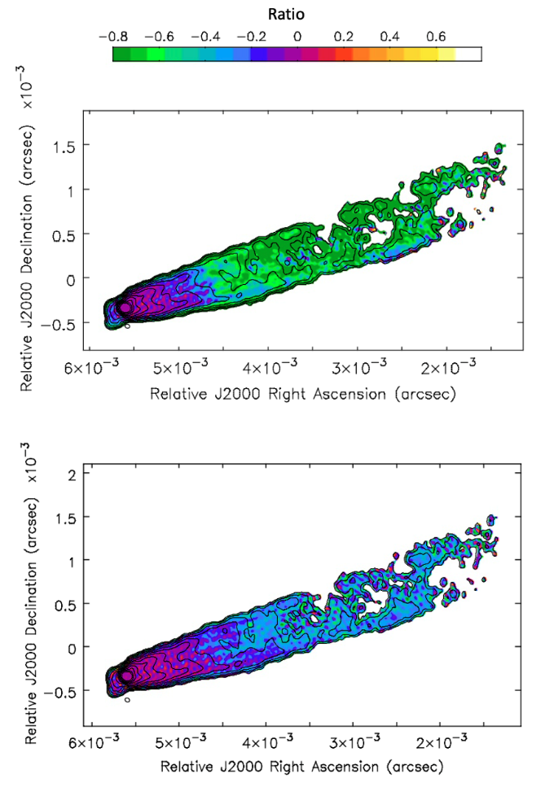
Fidelity
F = (Model – Image)/Model
ngEHT: poor fidelity on outer jet > 1mas (|F| > 0.8)
Add ngVLA: much improved to 4mas (|F| < 0.3)
Potential for even larger (arcsec) scales, given the 10⁵ range of continuous baseline coverage of ngVLA

Slide 9
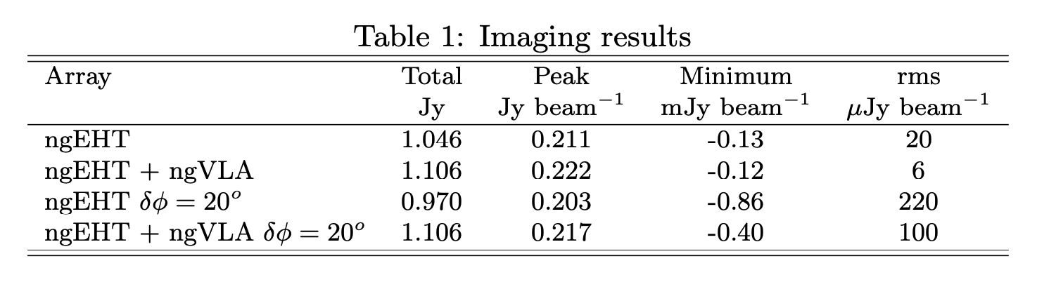
Phase errors
Per antenna: +/-20º, 180s
DNR = peak/rms ~ M_{t}^{0.5}N_{ant} / 𝜹𝝋_{rad}
Predicted ngEHT DNR = 3100, ngVLA+ngEHT = 9700
Measured = 1000, 2200 [N is affected by weighting and gridding]
General calibration improvement w. ngVLA
  Better fringe fitting for antenna-based delay offsets for averaging in time and frequency
  Higher S/N => better self-calibration for residual phase and amplitude errors (weather, clocks, gains)
  LONG 3 antenna stations: paired antenna phase calibration and a priori gain cross-checks

Slide 10
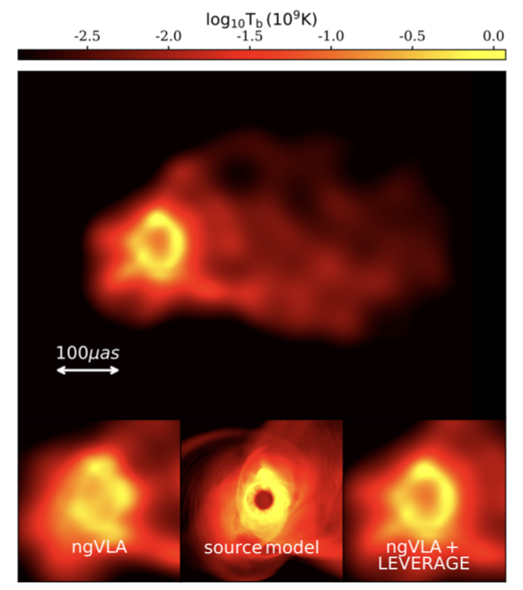
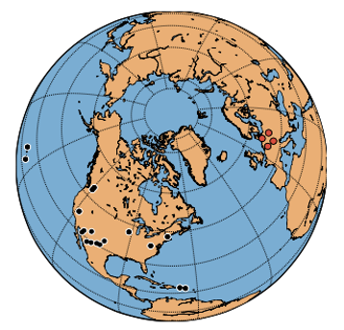
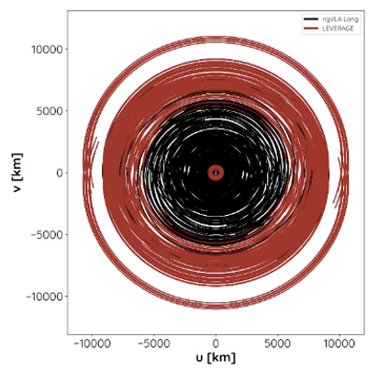
LEVERAGE
Kadler et al.
M87 90 GHz GMVA @ 40uas: R ~ 8 R_{s}
4 LONG stations in Germany
Image M87 w. ngVLA
Image Jet – accretion disk transition out to 1mas ~ 0.07pc
= 13 R_{s}
Lu et al. 2023

Slide 11
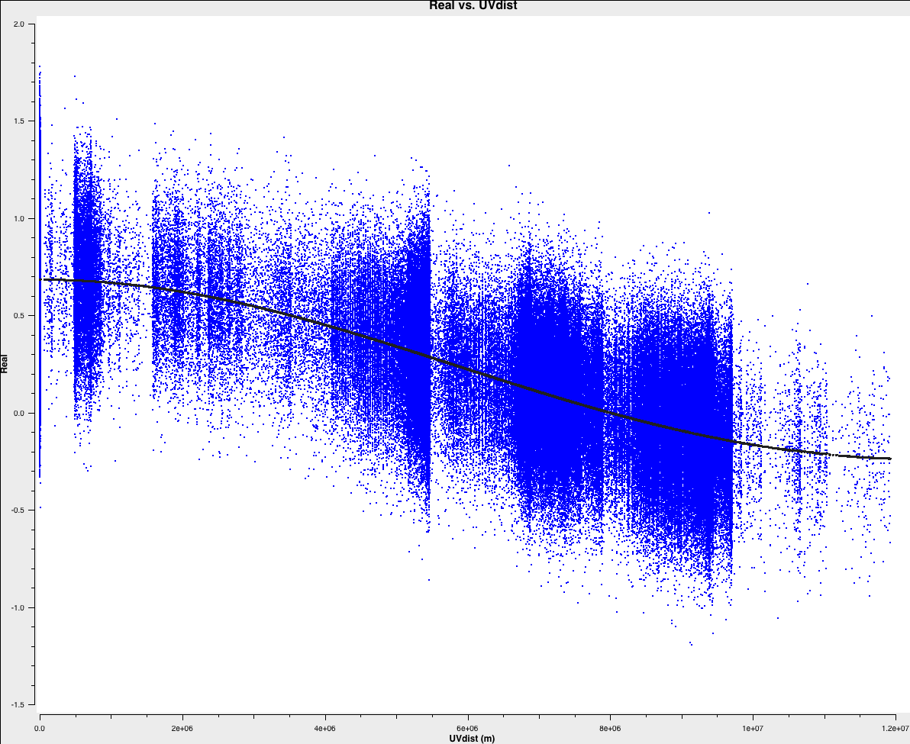
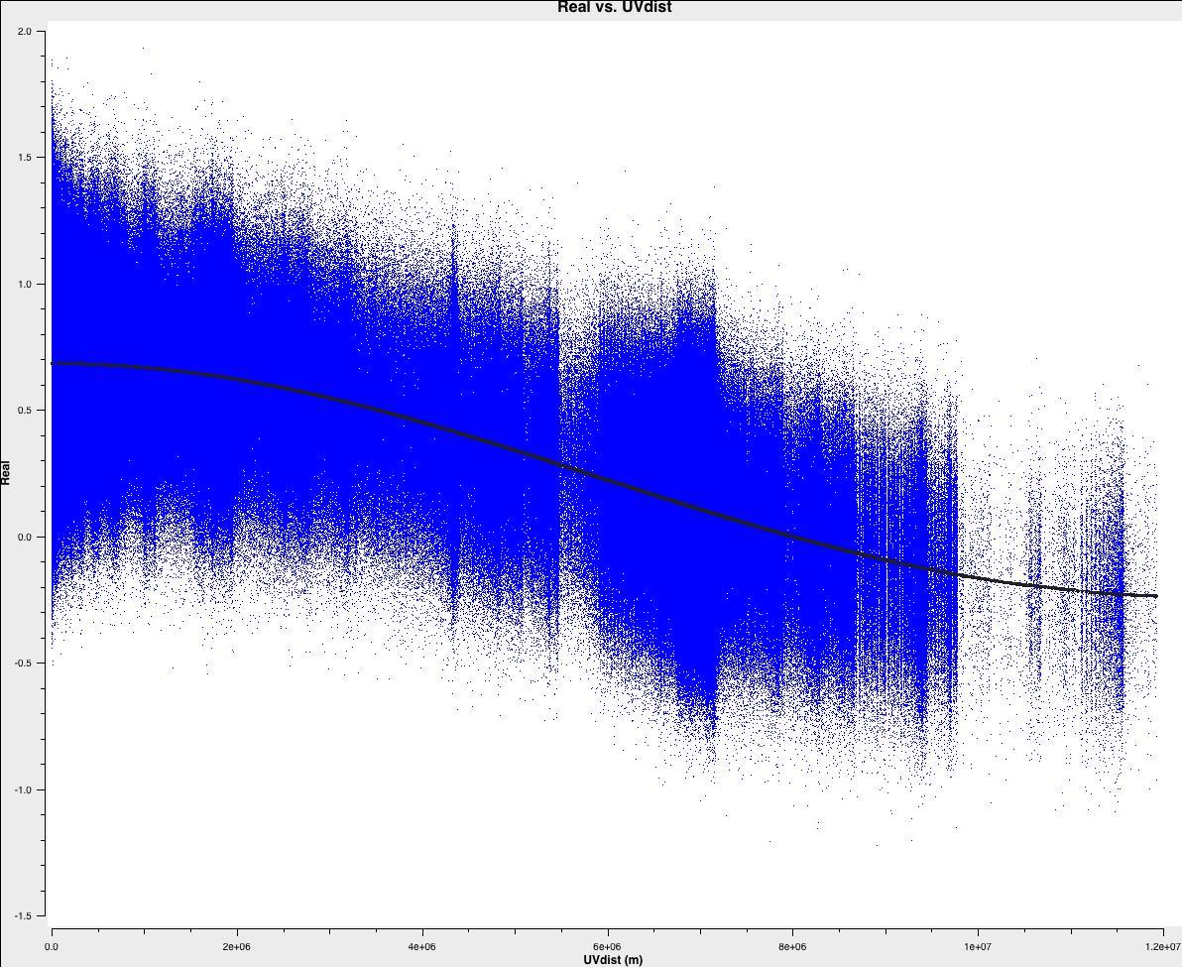
Improved model fitting
ngEHT
Max Baseline doesn’t change (smallest fringe spacing)
But S/N on longest baselines improves dramatically => information on scales < fringe spacing
M87 ring model: 0.67 Jy, 64uas annulus + noise
1 Jy
Real
0 Jy
64uas annulus
2000km
10000km
ngEHT + ngVLA

Slide 12
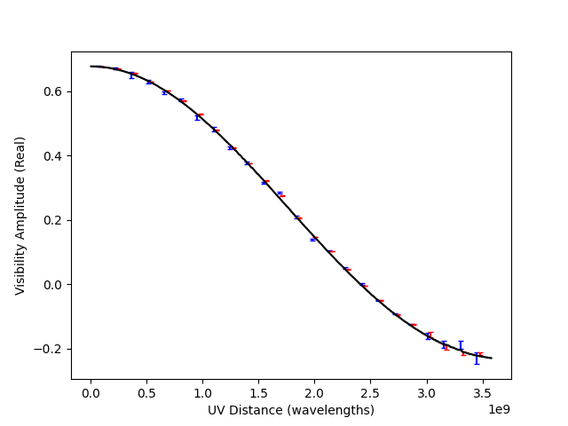
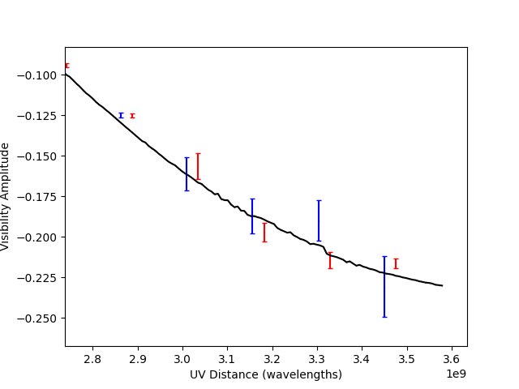
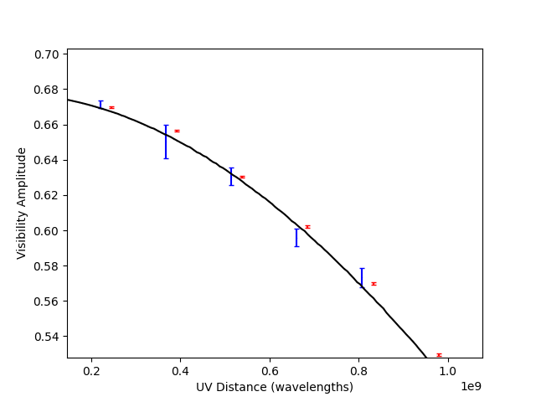
Binned visibilities + rms scatter (~ N_{vis}^{0.5})
Improved S/N as function of baseline length

Slide 13
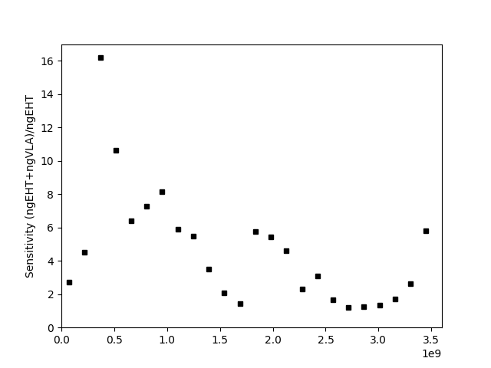
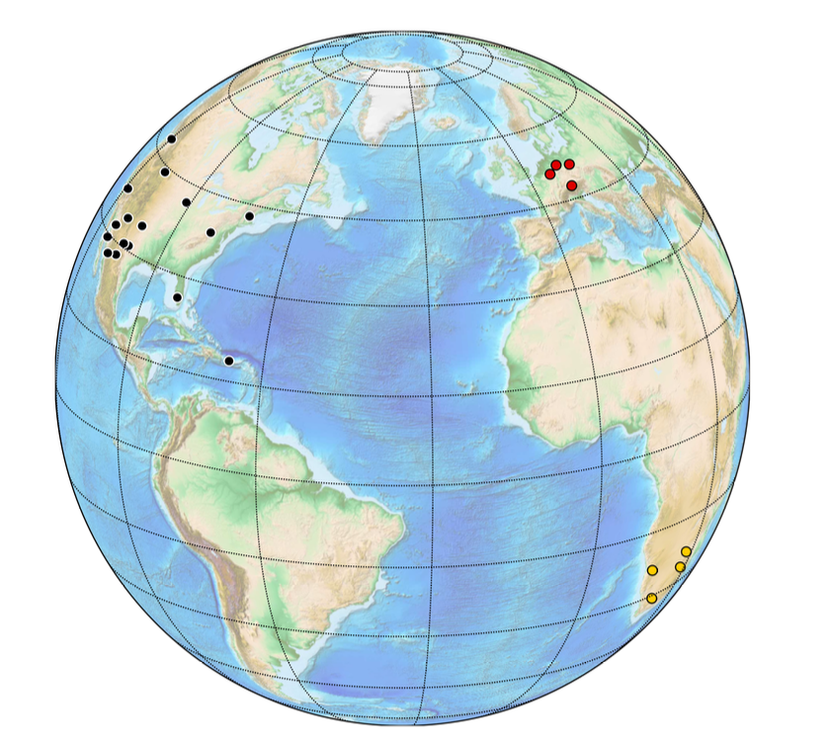
Binned visibilities + rms scatter
Improved S/N as function of baseline length
LONG - MID - ngVLA core
.
.
.
.
.
.
.
Namibia – ngVLA core
.
.
EU – ngVLA core
.
.
Namibia – NA-east
.
.
.
400 𝝁as
1500km
100 𝝁as
6000km
Null
60 𝝁as
10000km

