Slide 1
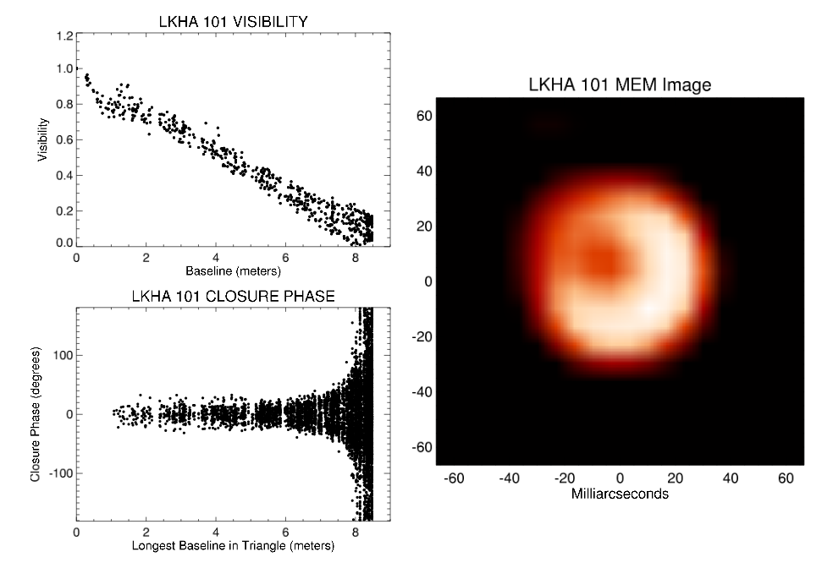
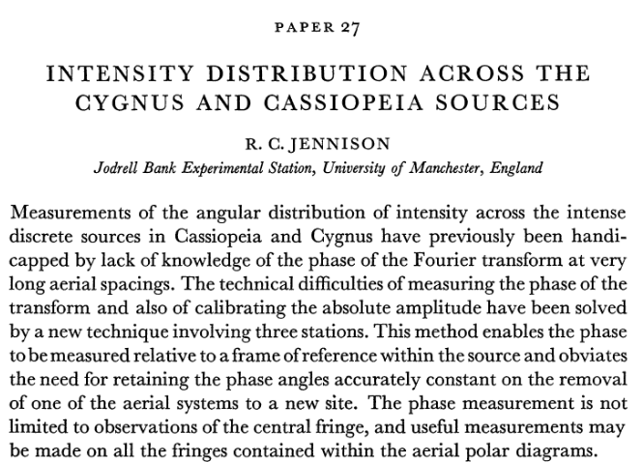
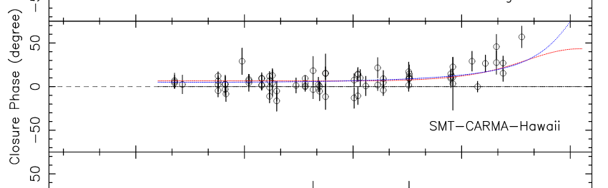
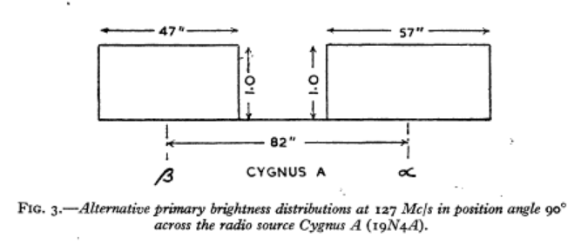
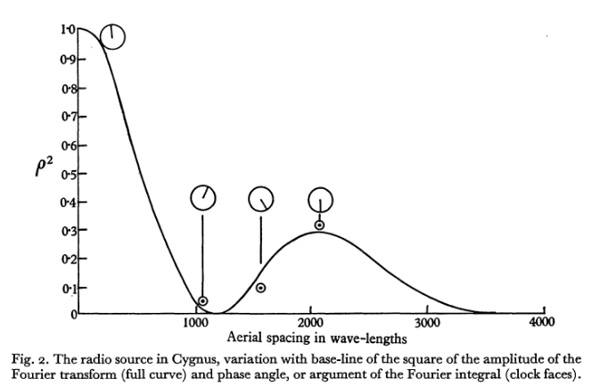
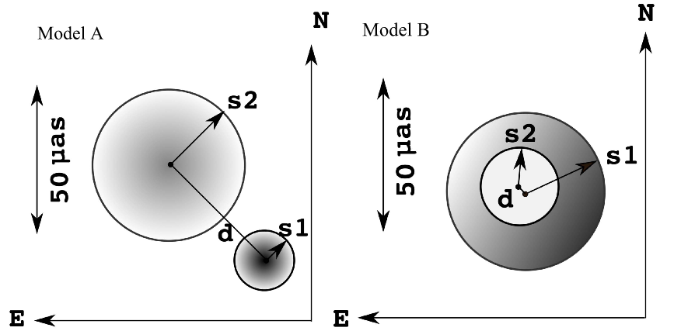
Closure Power Spectra: Provenance
1956
Optical Interferometry and aperture masking (Baldwin 1976; Monnier 2006)
EHT: Submm VLBI (Lu 2018)

Slide 2
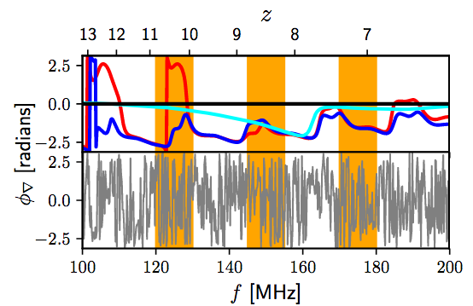
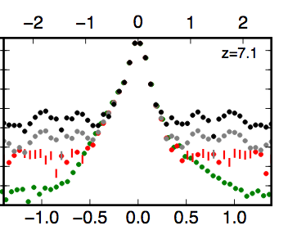
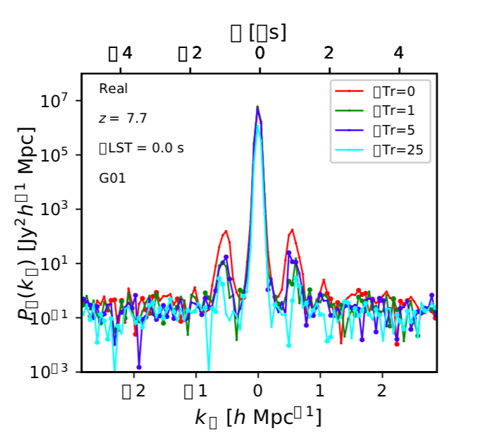
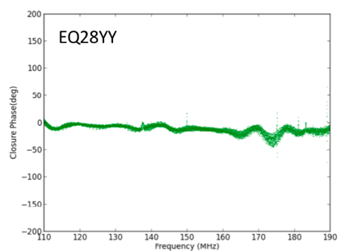
HERA Bispectrum Phase Power Spectral Analysis
Thyagarajan et al. PRL, 2018, 120, 251301: Demonstrate effectiveness of technique with modeling
Carilli et al. 2018, Radio Science, 53, 845: redundancy tests
Kent et al. 2018, HERA memo 48: demonstrate the ‘gift’ of Fornax A
Nikolic et al. 2018, HERA memo 54: details of closure spectra IDR2.1
Kent et al 2018, HERA memo 55: simple diagnostic tools to explore power spectra
Thyagarajan et al. 2018: Noise-limited PS for IDR2

Slide 3
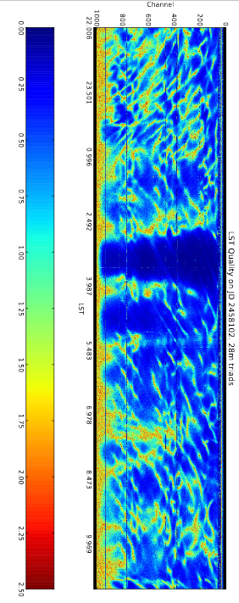
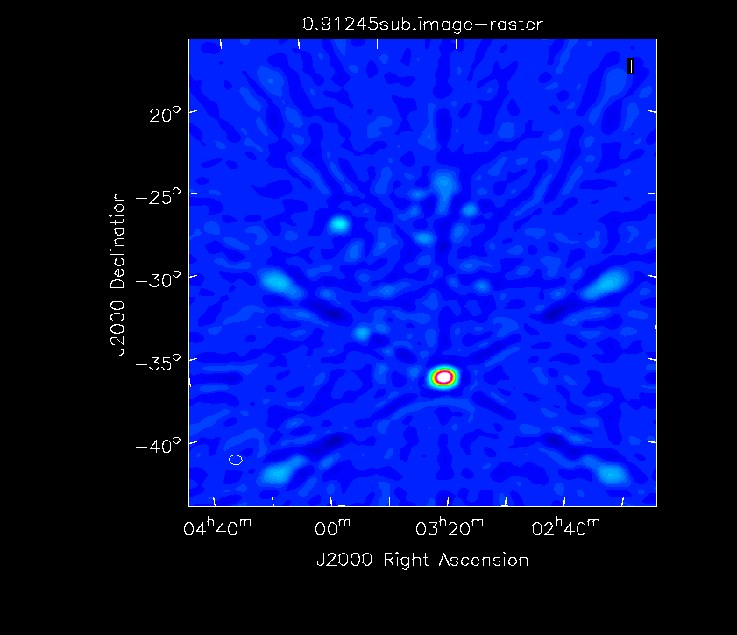
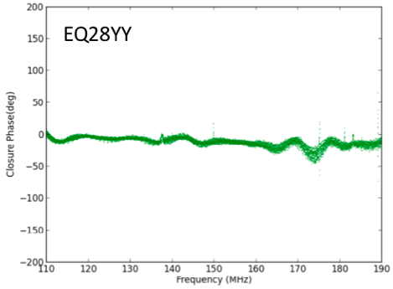
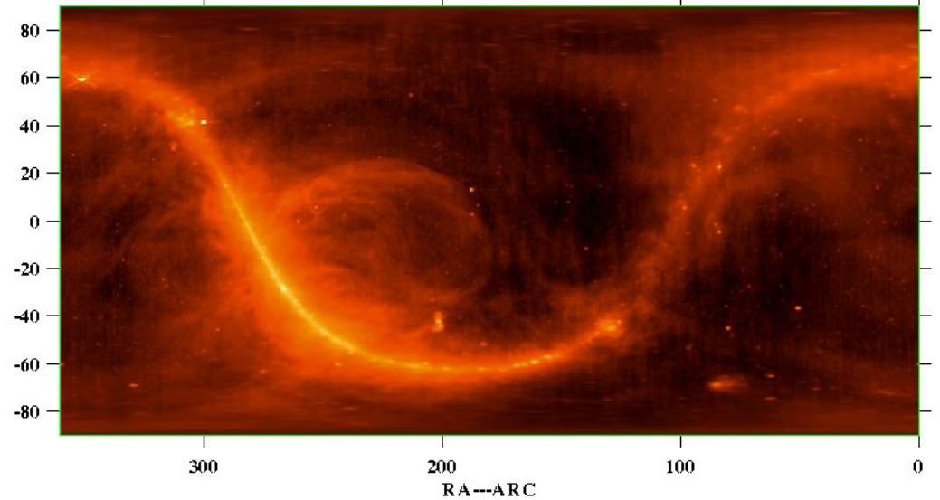
Fornax A: a Gift
𝜎 ~ fewº
15Jy
105Jy
Dominant point source: 𝜃_{cl} → 0º
Middle of Cold patch: dec = -37º => 14% PB => 100 Jy (not 700 Jy)
Improves redundancy (less dependent on PB?)
Easier modeling for PS analysis
Narrow ‘core’ of power spectrum

Slide 4
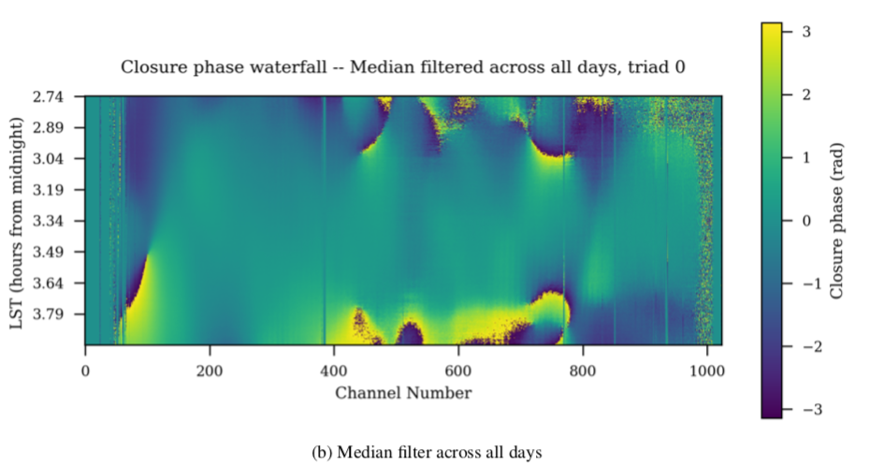
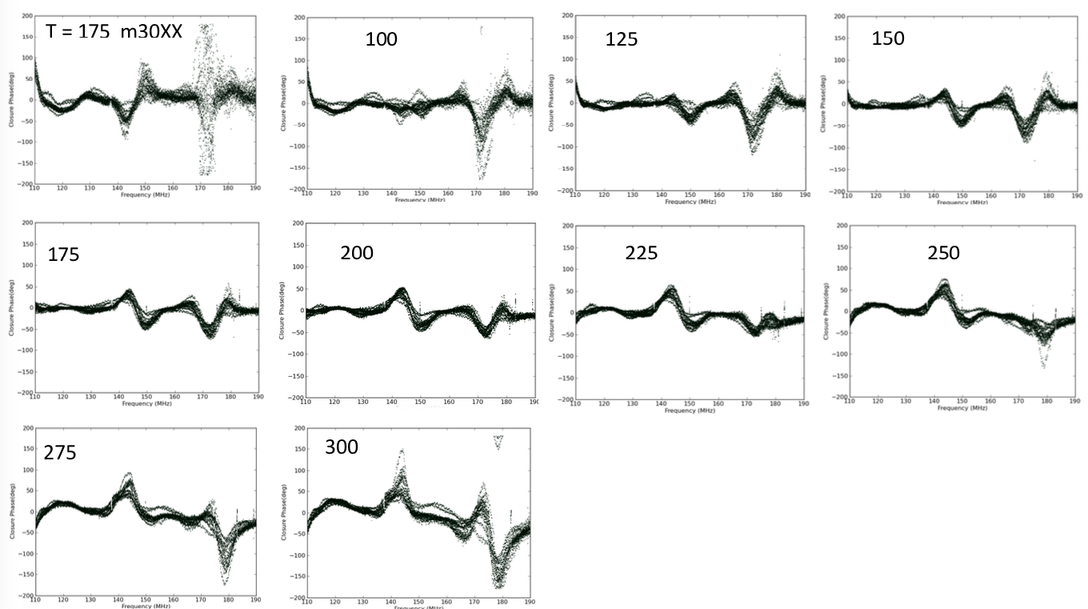
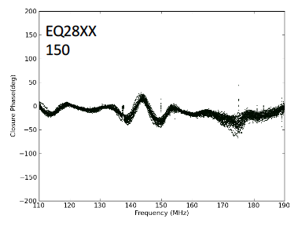
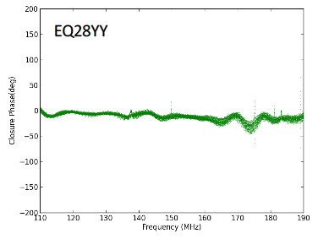
Data: IDR2.1 18 days, raw data (no calibration or flagging)
Best time range ~ +/-15 around Fornax transit
RFI-free frequency ranges: 110 – 136MHz and 151 – 174 MHz

Slide 5
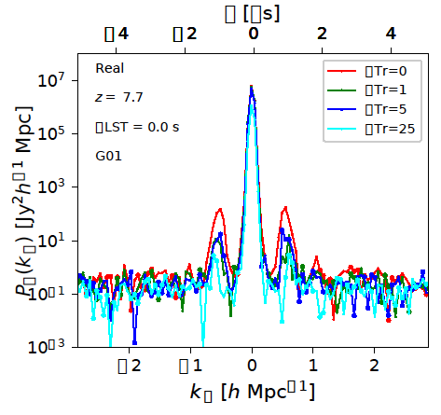
Results PRISim – https://github.com/nithyanandan/PRISim
40 minutes from 18 days around Fornax A transit
18 days binned into 2 halves and coherently averaged.
Coherent averaging in LST intervals of 1 min.
Triads assumed to be non-redundant
Averaging in cross-power spectra, no flagging, no calibration)
Noise-limited dynamic range of 10⁸
Dynamic range is same independent of triad self- or cross-multiplication
1 microsecond resonance prominent but can be mitigated significantly
Memo 56, Thyagarajan et al. (in prep)

Slide 6
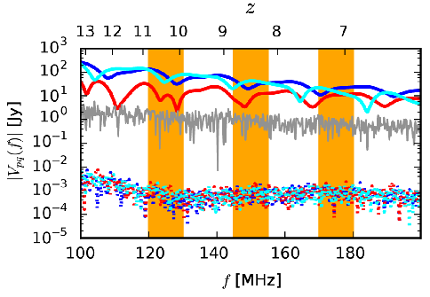
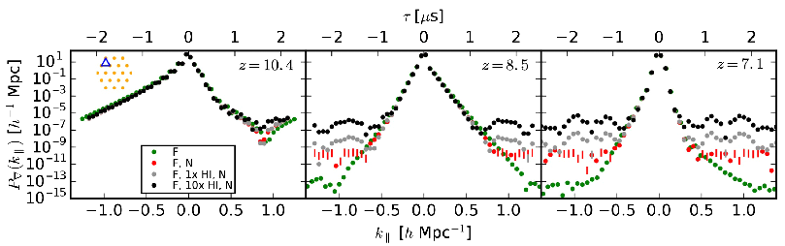
Modeling is critically valuable
10⁸ dynamic range is interesting from an EoR models perspective
FG modeling specific to Fornax A field underway
Noise modeling
EoR modeling to match data with expectation
Thyagarajan et al. (2018)

Slide 7
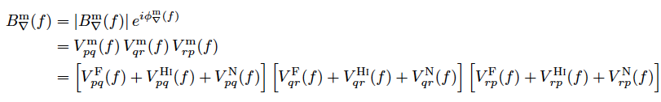
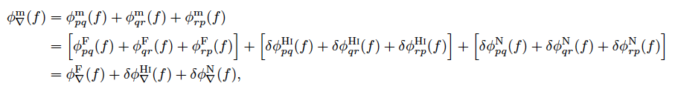

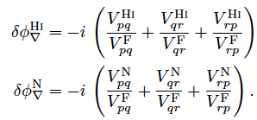

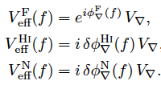



Bispectrum phase connection to Power Spectrum
Expand as Taylor series
Keep only up to linear terms
Where,

Slide 8
Bispectrum Phase Pspec Summary
Bispectrum phase is a very valuable quantity – calibration-independent way to measure true sky structure
Independent and complimentary to standard Pspec
Fornax A field simplifies the data – flatter spectral structure, higher redundancy
IDR 2.1: 40 min around Fornax A from 18 days and 30 EQ29 triads gives ~10⁸ noise-limited dynamic range (PRISim results confirmed by independent analysis from Cambridge – Chris’ talk)
No flagging, no calibration, no assumption about redundancy
Modeling indicates 10⁸ dynamic range gets interesting
Fornax A field modeling underway to understand and interpret data including noise and error bars
Connection to visibility-based standard power spectrum established using linear-order perturbation theory
More avenues being pursued to improve dynamic range further
More fields, polarizations, k-bins, better coherence and averaging, more observations

Slide 9
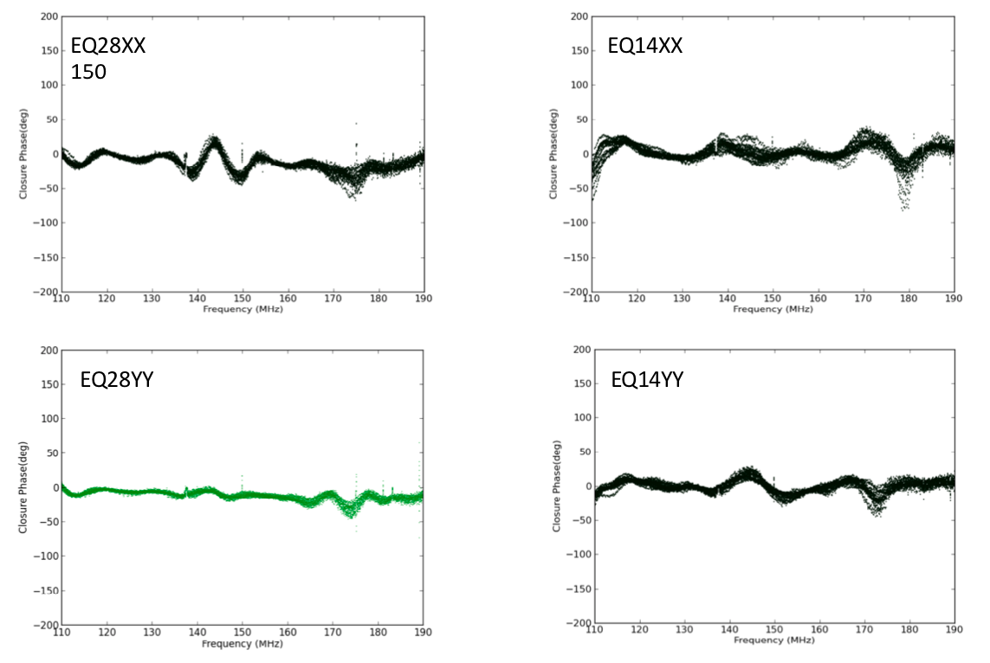
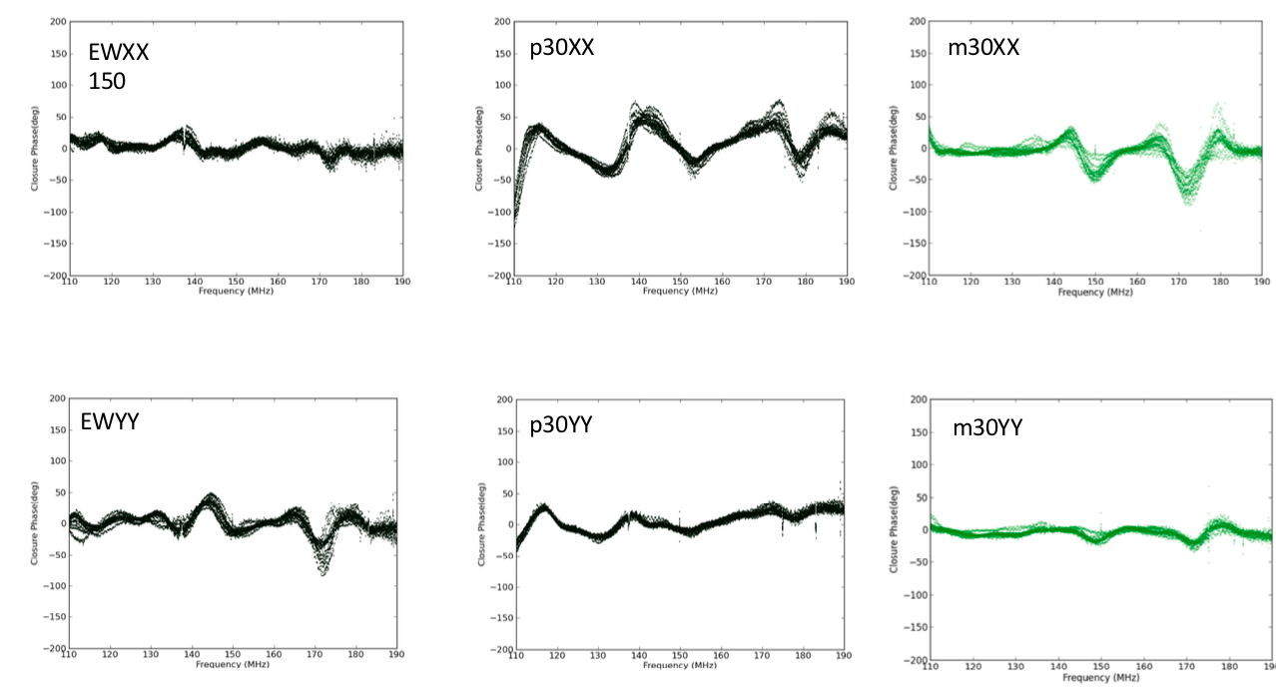

Slide 10
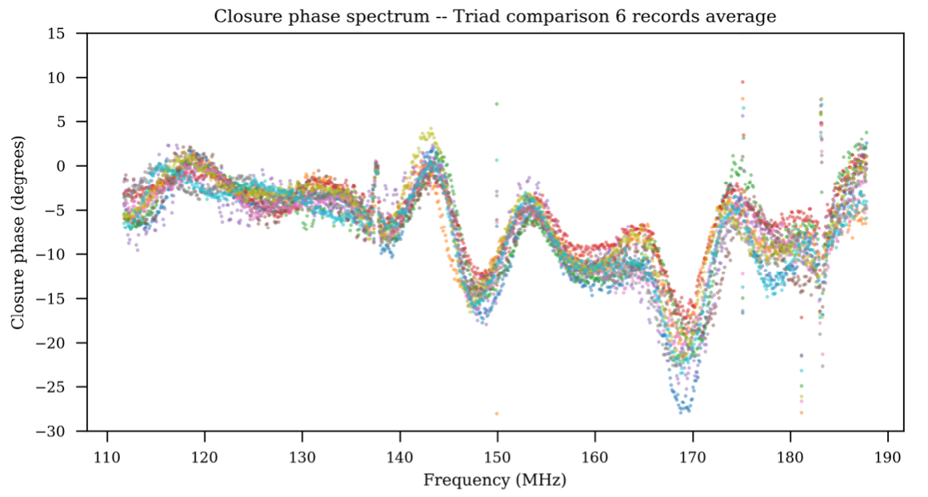
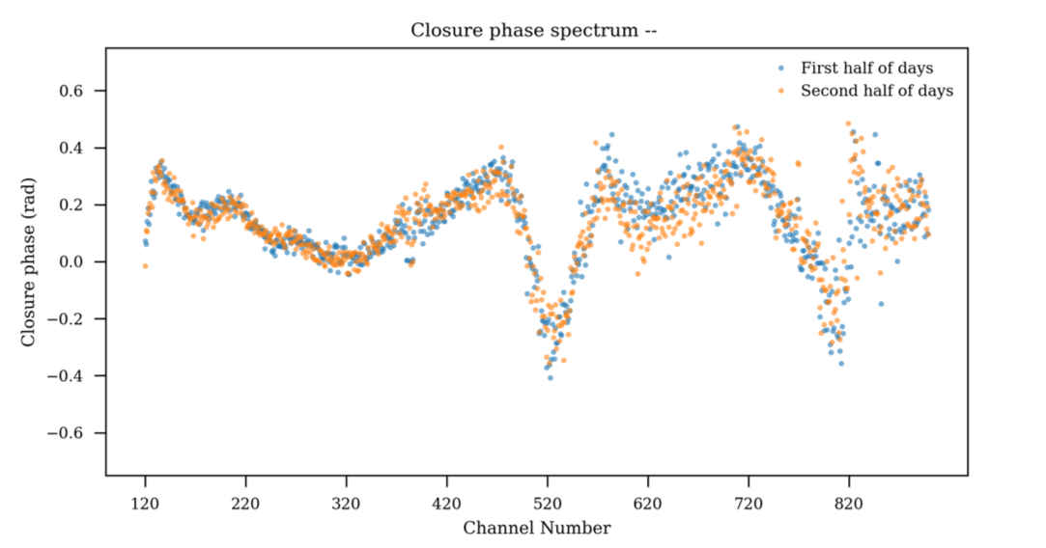
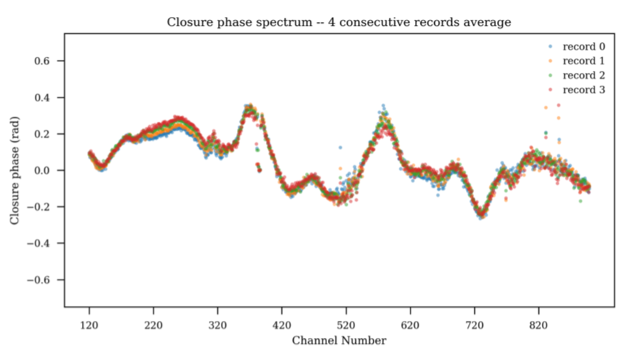
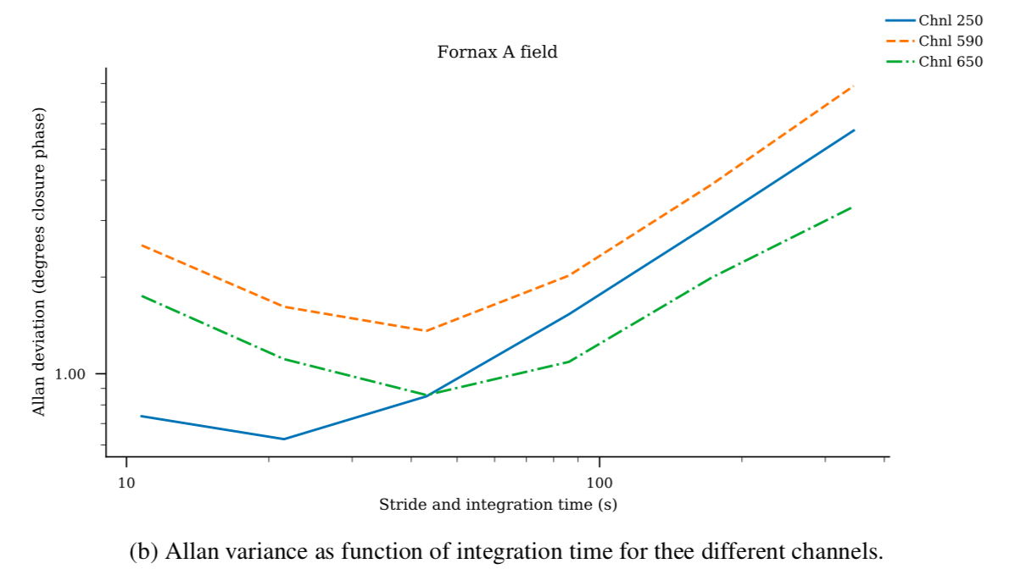
T_{ave} ~ 40 to 60sec

Slide 11
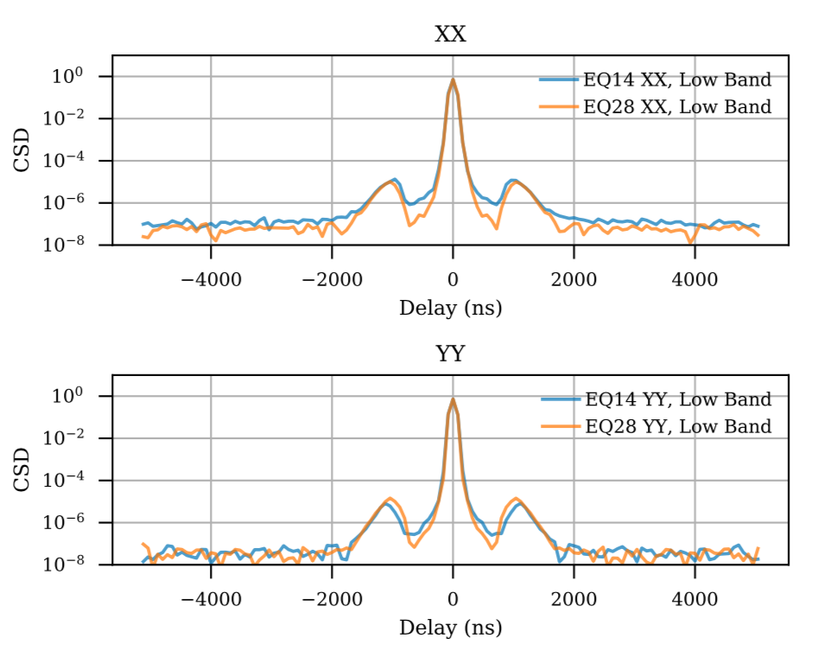
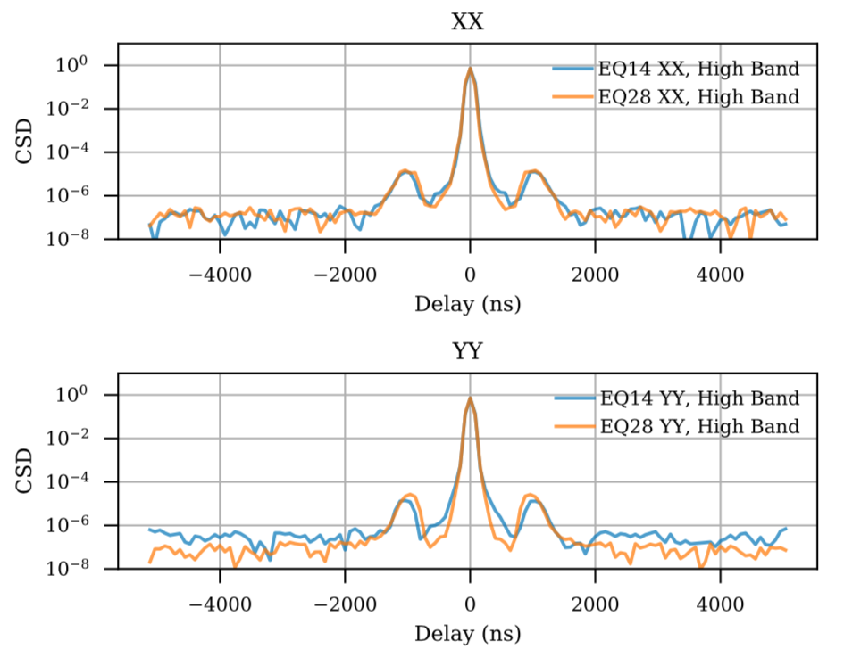
Cambridge PS Diagnostic Tools
https://github.com/HERA-Team/ClosurePS
Narrow core unresolved
Bin 𝜽_{cl} in LST 1st and 2nd halves and xcorr
Average PS incoherently over 30min and triads

Slide 12
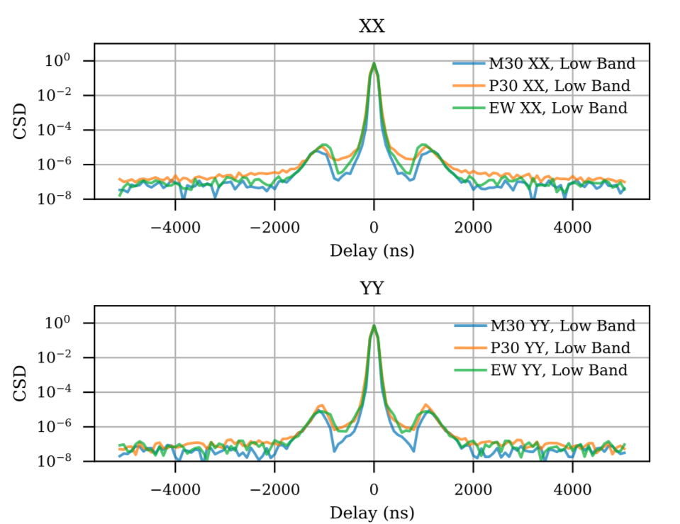
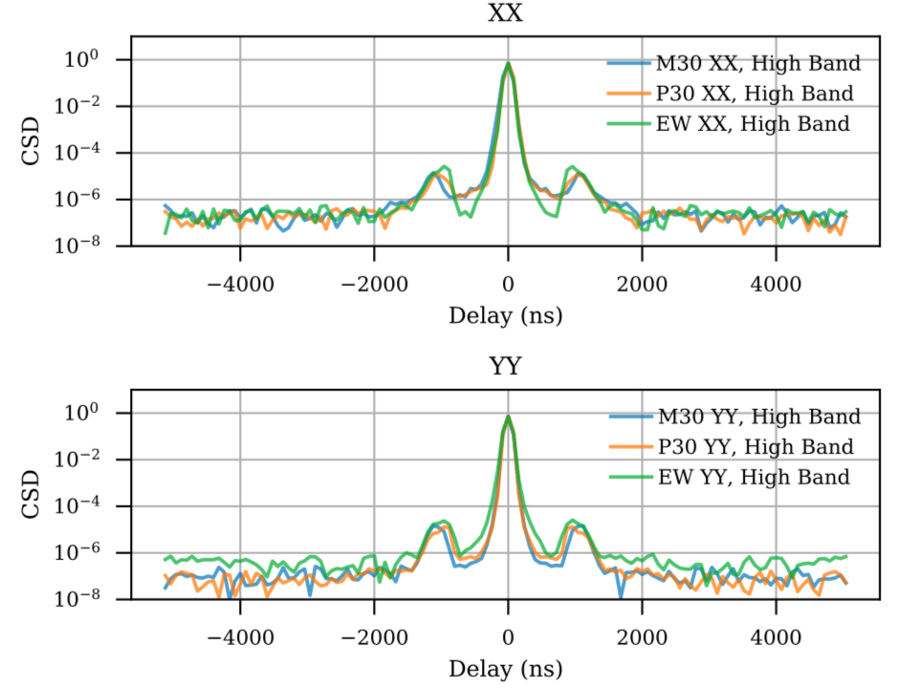

Slide 13
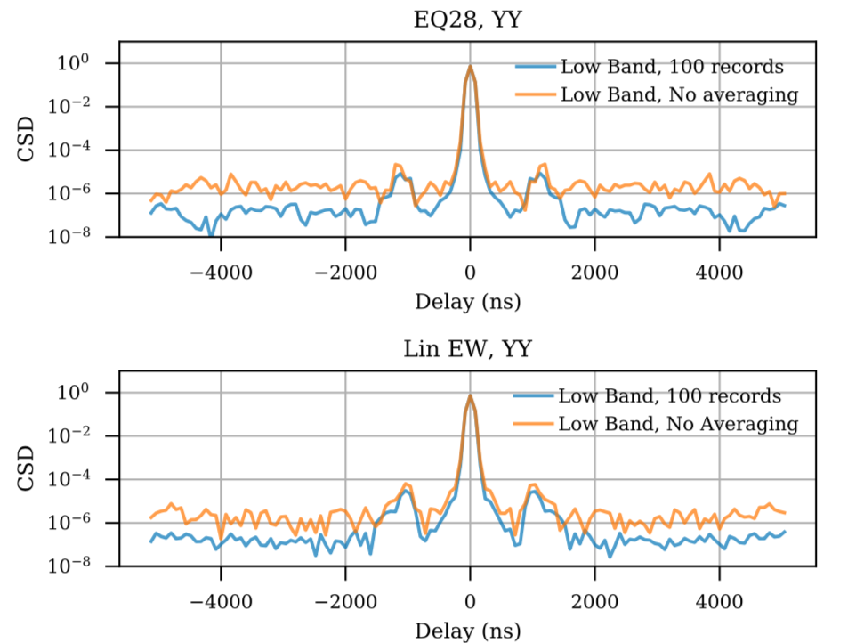
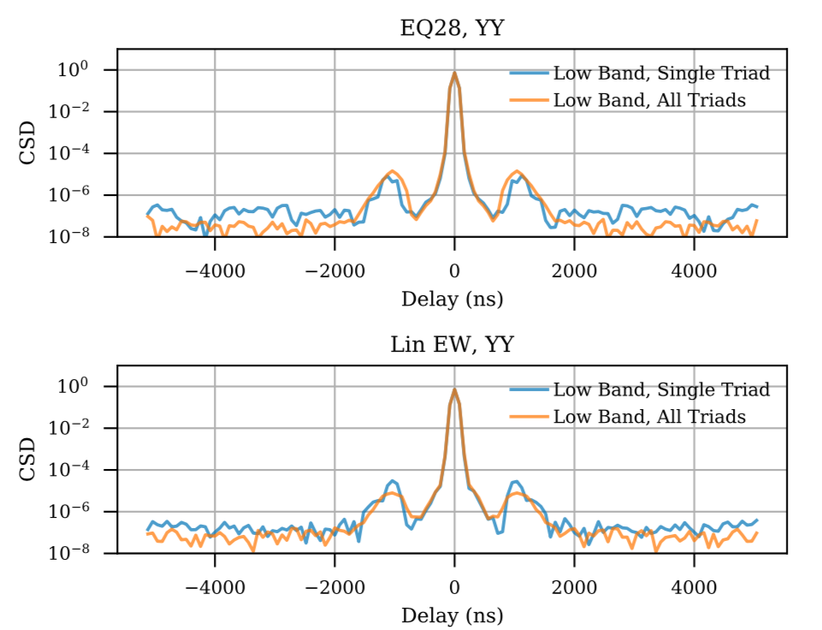
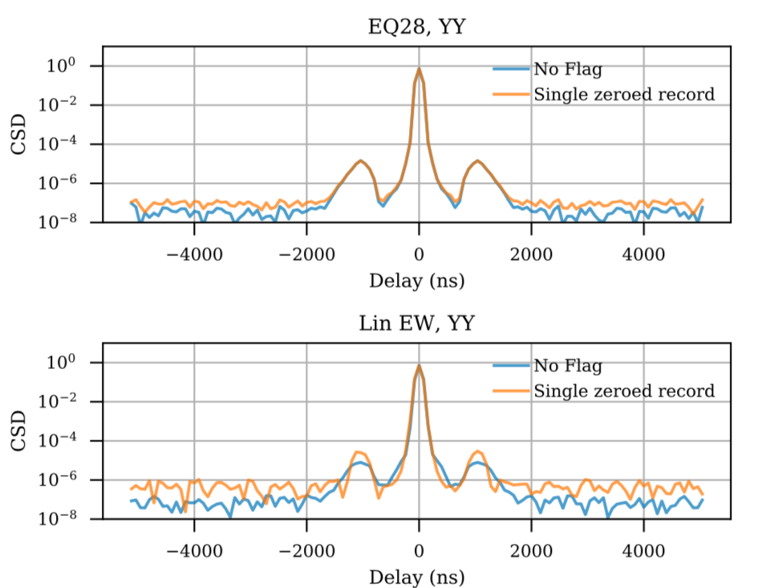

Slide 14
Why Closure PS?
Advantages
Completely independent, competitive approach (~10⁸)
Completely robust to antenna-based gains
Robust to RFI
Extraordinarily simple, fast analysis: No Signal Loss!!
No wedge and narrow continuum PS core in Fornax
No reliance on redundancy
Disadvantage
Non-closing effects? (if due to PB => broad in frequency?)
Polarized sky and leakage?
Signal loss in triad xcorr? (but can live without)
Next steps:
Simple modeling for comparison
Noise check: k-rms, bootstrap, model
Add 100 days
Memo 56, Thyagarajan et al. (in prep)
Future RTP considerations:
Can live with
Time and freq averaging
Possibly flagging prior
Cannot live with: calibration before time averaging
LST binning?

