Slide 1
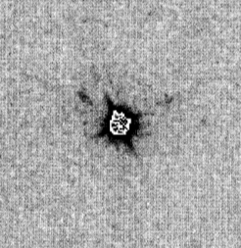
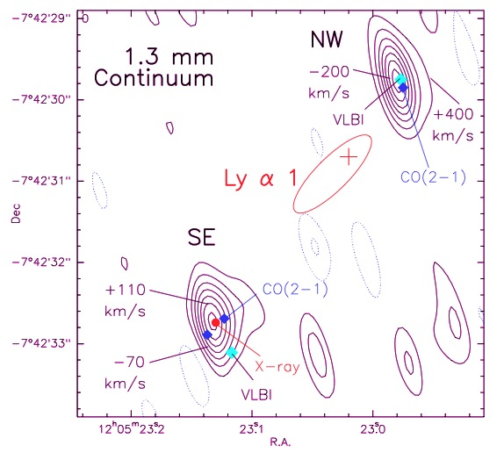
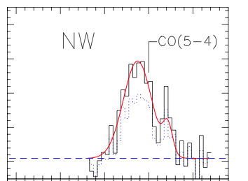
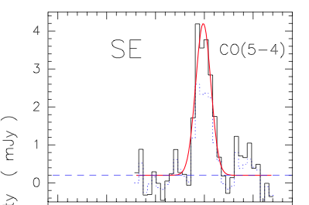
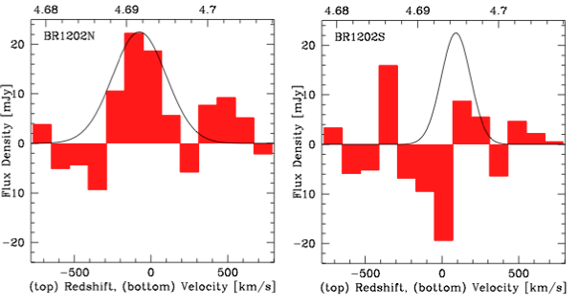
BRI1202-0725 z=4.7
HyLIRG (10¹³L_{o}) pair:
  Quasar host
  Obscured SMG
SFR ~ 10³; M_{H2} ~ 10¹¹
+
4”
+
HST 814 Hu ea 96
Salome ea. 2012
SMA
[CII] 158um
334GHz, 20hrs
Iono ea 2007

Slide 2
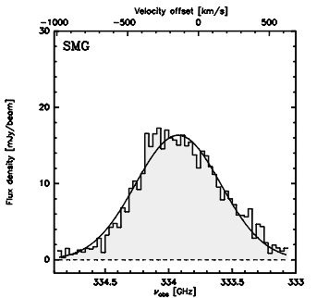
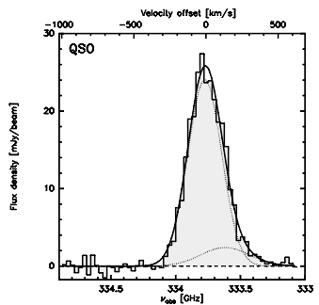
[CII] in 1202-0725
Wagg ea
ALMA SV
20min, 16 ants
334GHz
SMA 20hrs

Slide 3
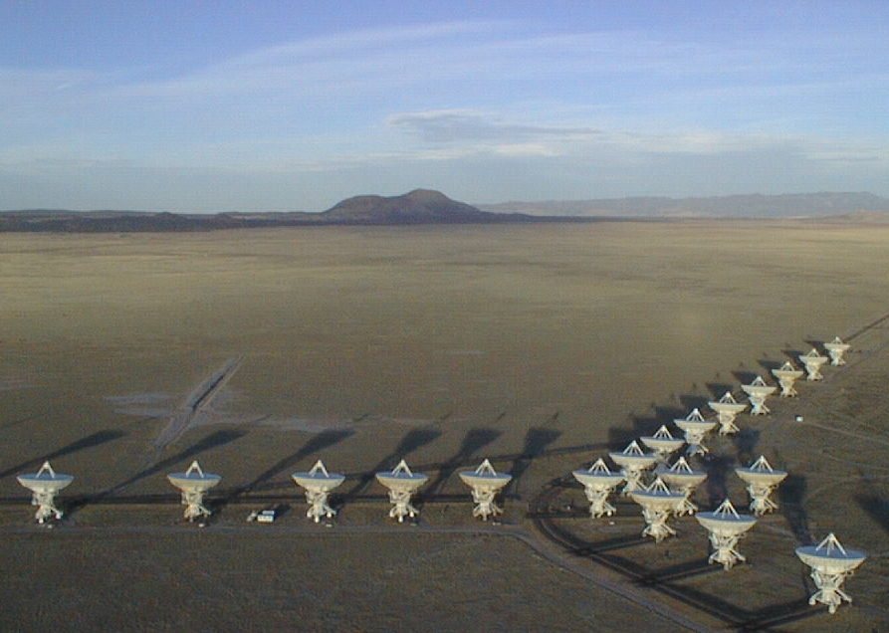
Cool gas in the distant Universe
Chris Carilli, Arizona, February 2013
Introduction: general concepts and the JVLA/ALMA revolution
Epoch of galaxy assembly (z~1 to 5): cm to submm line obs
  Massive galaxy formation: imaging hyper-starbursts
  Color selected galaxies: gas dominated ‘main sequence’ disks
First light and cosmic reionization (z>6)
  z > 6 quasar host galaxies
  The crucial role of [CII] for spectroscopic redshifts
  Imaging the neutral IGM using the HI 21cm line: PAPER
Carilli & Walter 2013, ARAA, arXiv:1301.0371
Collaborators: F. Walter, D. Riechers, E. Daddi, R. Wang, X. Fan, M. Aravena, L. Lentati, J. Wagg,I Stefan, J. Hodge, R. Decarli, K. Menten, F. Bertoldi, P. Cox

Slide 4
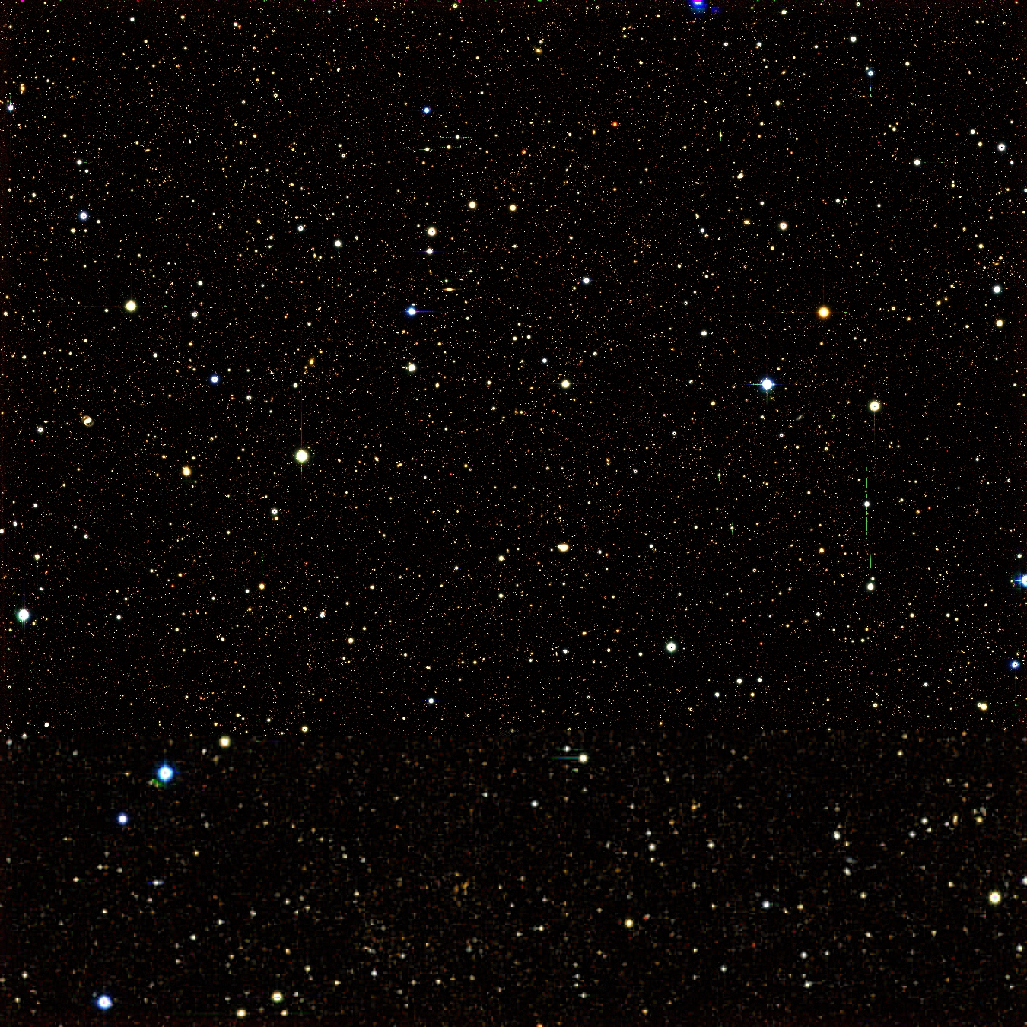
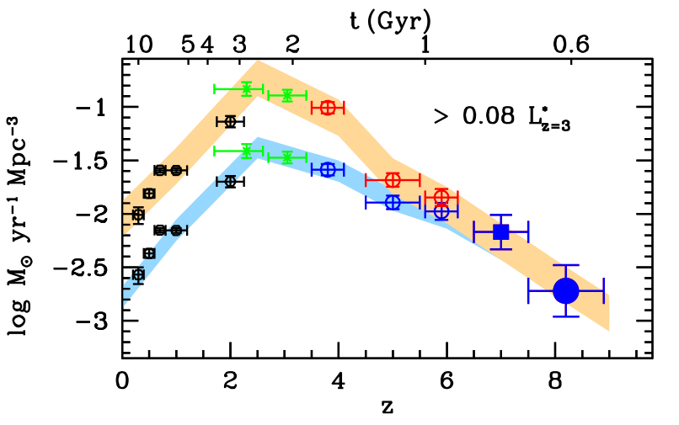
Star formation history of the Universe: fundamental result from cosmological deep fields
First light + cosmic reionization
‘epoch of galaxy assembly’
~50% of present day stellar mass produced between z~1 to 3
Cosmic demise
Bowens +
Bouwens +

Slide 5
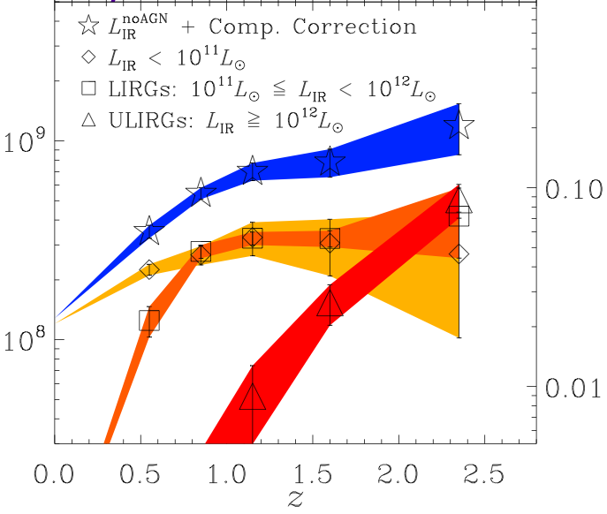


Star formation history as a function of L_{FIR} (~ SFR)
Murphy ea
SFR < 30 M_{o}/yr
SFR ~ 100 M_{o}/yr
SFR > 300 M_{o}/yr FIR > 10¹²L_{o}
SFRD shifts to higher SFR galaxies with redshift
Massive galaxies form most stars quickly and early (eg. Renzini)
  Stellar populations at z=0
  Old, red galaxies at z~2 to 3

Slide 6
Limitation 1: Dust
Dust correction in UV
Factor 5 at z < 4
No correction at z > 6 ?
Bouwens +

Slide 7
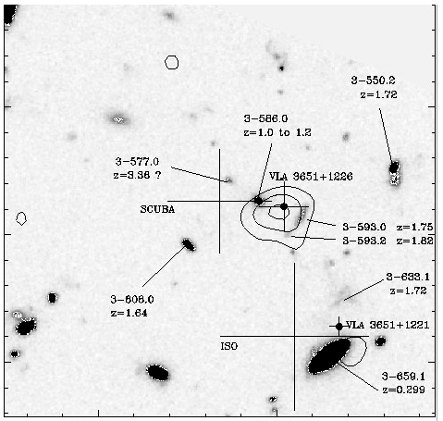
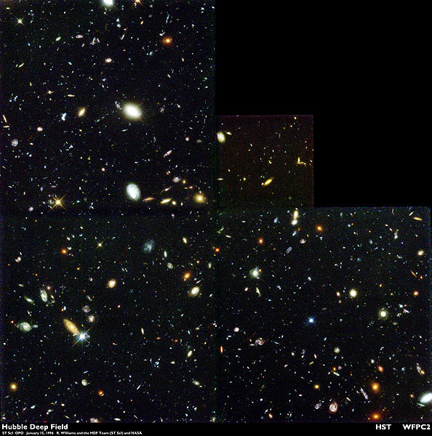
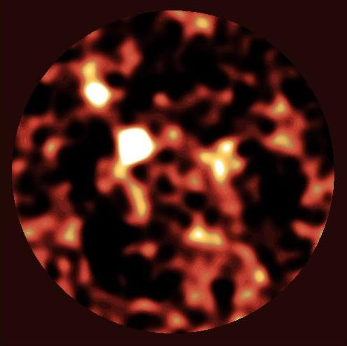
HDF850.1
Dust obscured galaxy formation: HDF
HST
SCUBA Hughes ea 98
2.5’
10³ galaxies: disks + ellipticals z=0 to 8
5 sources w. S₃₅₀ > 2mJy
submm galaxies: high z, extreme starbursts (FIR ~ 10¹³ L_{o}, SFR ~ 10³ M_{o}/yr), but
Still no opt ID or z for 850.1
Total SFR SCUBA ~ HST

Slide 8
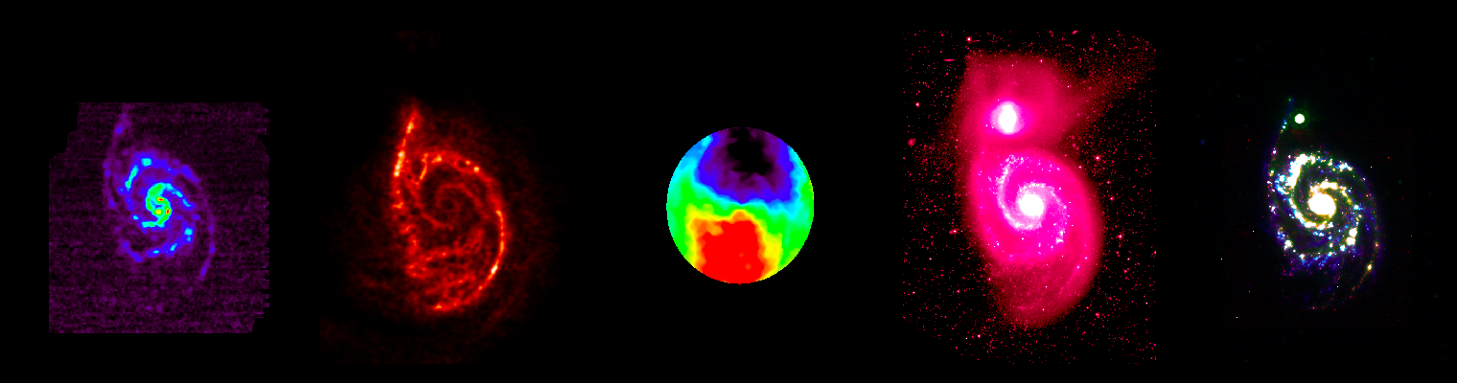
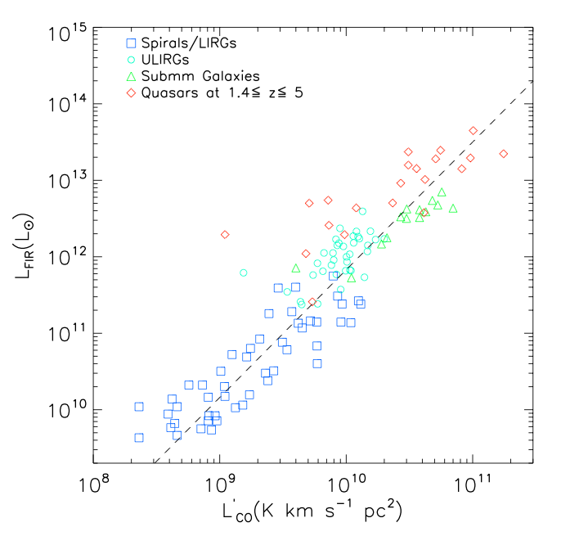
Limitation 2: Cool gas = fuel for star formation in galaxies
‘Missing half of galaxy formation studies’
CO2-1
Ha/UV/IR
Stars form in Giant Molecular Clouds, best traced by CO (low T_{ex}, abundant)
  GMC (30 pc), T ~ 20K, n_{GMC} ~ 10² cm⁻³
  SF cores (1pc), n_{core} > 10⁴ cm⁻³ , T > 50K
Evidence: correlation between CO-FIR
‘integrated KS law’
SFR
Index ~ 1.4
M_{gas}

Slide 9
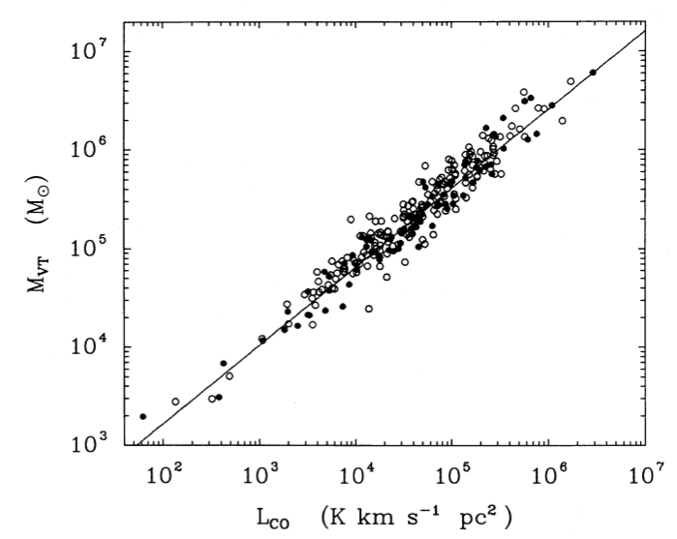
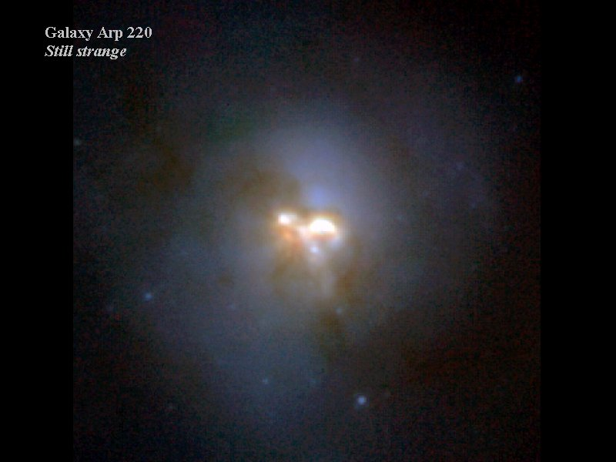
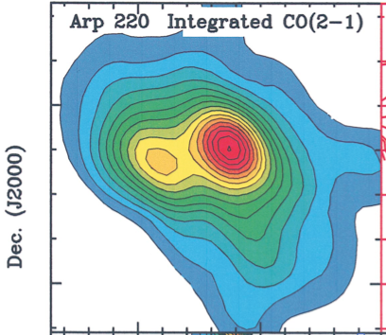
Molecular gas mass: M(H₂) = α L_{CO(1-0)}
Spirals: α_{CO} ~ 4 M_{o}/(K km/s pc²)
Nuc. Starburst/merger: α_{CO} ~ 0.8
SFR ~10 M_{o}/yr in kpc disk
SFR ~ 100 M_{o}/yr in 100pc disks
Solomon ea
M_{dyn}
L_{CO}
10kpc
0.5kpc
Downes + Solomon
Need M_{dyn} > M_{gas}: Radiative transfer + dyn. model
M(H₂) ~ 10⁹ M_{o}
t_{dep} < 10⁷ yr (‘starburst’)
Self-gravitating GMCs
M(H₂) ~ 10⁹ M_{o}
t_{dep} = M_{gas}/SFR ~ 10⁸ yr

Slide 10
Karl G. Jansky Very Large Array
80x Bandwidth (8 GHz, full stokes), with 4000 channels
5x frequency coverage (continuous 1 to 50 GHz)
10x continuum sensitivity (<1uJy)
Spatial resolution ~ 40mas at 43 GHz
=> 30% FBW, ie. 19 to 27 GHz (CO1-0 at z=3.2 to 5.0) => large cosmic volume searches for molecular gas

Slide 11
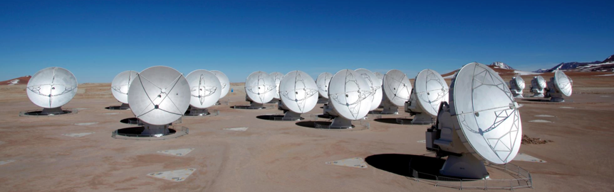
Atacama Large Milllimeter Array
High sensitivity array = 54x12m
Wide field imaging array = 12x7m
Frequencies = 80 GHz to 900 GHz
Resolution = 20mas at 800 GHz
Sensitivity = 13uJy in 1hr at 230GHz
> 10² times more sensitive than existing submm arrays!
ALMA + JVLA represent an order of magnitude, or more, improvement in observational capabilities from 1 GHz to 1 THz!

Slide 12
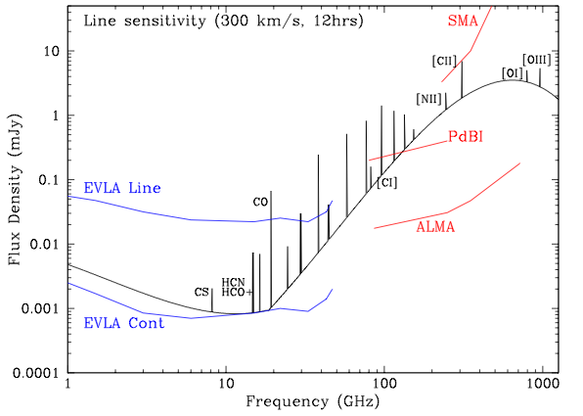
cm → submm diagnostics of galaxy formation
100 M_{o} yr⁻¹ at z=5
Low J CO emission: total gas mass, dynamics
High density gas tracers (HCN, HCO+)
Synch. + Free-Free = star formation
EVLA and GBT Line
High J molecular lines: gas excitation, physical conditions
Dust continuum = star formation
Atomic FIR fine structure lines: ISM gas coolant

Slide 13
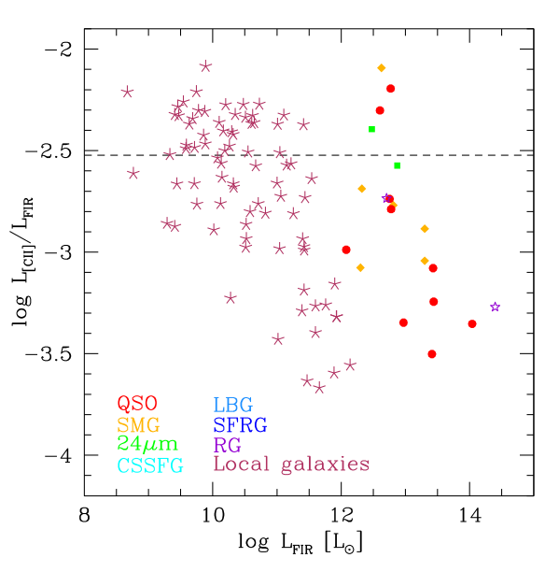
[CII] 158um FSL line
Mag. Clouds
Dominant coolant of cool ISM gas.
Brightest line from cool gas in star forming galaxies: ~0.3% of FIR for MW-type galaxies
FIR > 10¹¹: large scatter (~ 20dB)
  AGN-dominated: low
  SF dominated: ‘MW’
[CII] powerful tool for:
  Gas dynamics (CNM – PDR)
  Redshift determinations z>6
Low metallicity: enhanced [CII]/FIR (lower dust attenuation => large UV heating zone)
MW
11
Carilli & Walter 2013

Slide 14
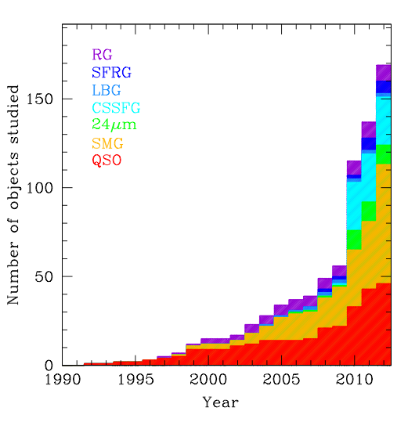
Cool gas detections at z>1 over time
CSG (FIR≤10¹² L_{o})
‘main sequence’:
SFR ≤ 10² M_{o}/yr,
ρ ≥ 10⁻⁴ Mpc⁻³
HyLIRG (FIR~10¹³ L_{o})
‘starburst’:
SFR ≥ 10³ M_{o}/yr
ρ ≤ 10⁻⁵ Mpc⁻³
Rapid rise in last 3 years:
  New instrumentation (Bure, VLA, GBT)
  New population: ‘normal’ color-selected SF galaxies (sBzK/BX/BM…)

Slide 15
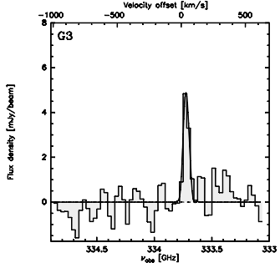
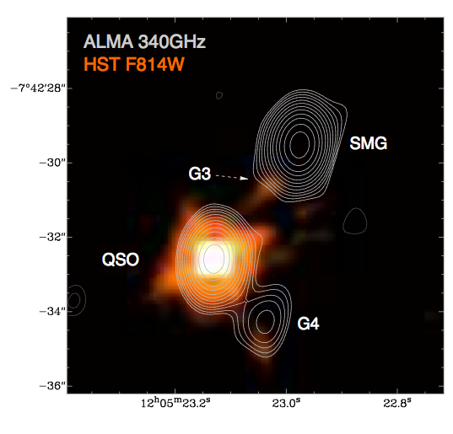
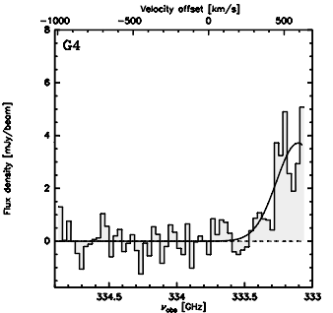
SMGs: Dust-obscured hyper-starbursts
Imaging massive galaxy formation
G3
B1202-07 z=4.7
SMG
G3
700km/s
G4
2”
QSO
G4
rms=100uJy
Two hyper-starbursts (SMG and quasar host): SFR ~ 10³ M_{o}/yr
Two ‘normal’ LAE: SFR ≤ 10² M_{o}/yr

Slide 16
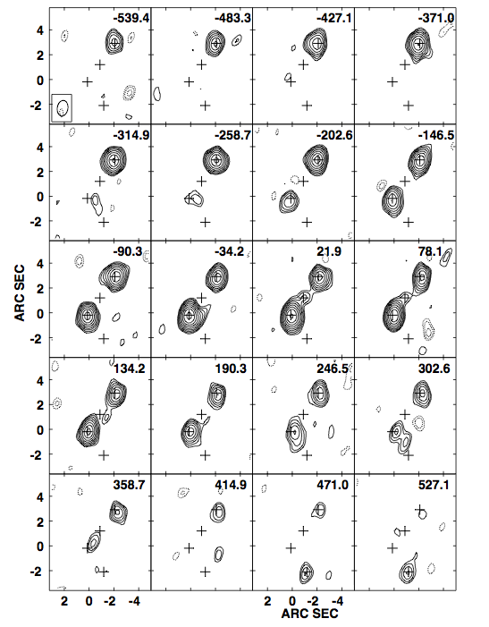
SMG
[CII] in 1202: Imaging cool gas dynamics at z=4.7
Quasar, SMG: Broad, strong lines
Tidal bridge across G3, as expected in gas-rich merger
Possible quasar outflow, or further tidal feature, toward G4
G3
Q
G4

Slide 17
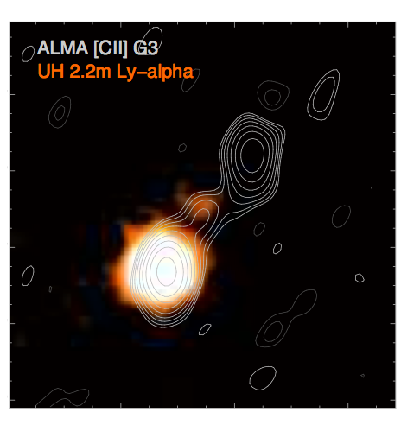
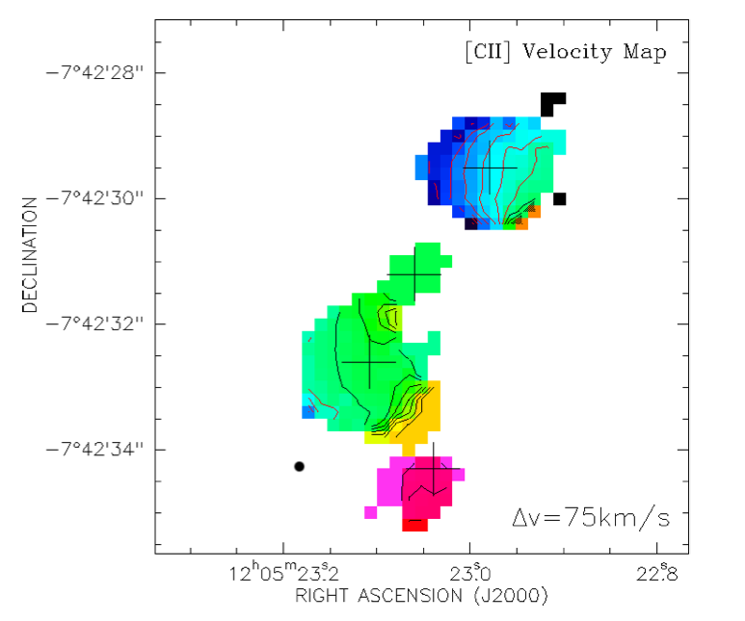
BRI1202: ‘smoking gun’ for major merger of gas rich galaxies
-500km/s
SMG
7kpc
G3
Q
G4
+500km/s
ALMA: 20min, 17ant
Tidal stream connecting hyper-starbursts
SMG: warped disk, highly optically obscured
HyLIRG QSO host, with outflow seen in [CII] and CO
G3: Ly-alpha + [CII] in tidal gas stream
G4: dust and [CII] in normal LAE

Slide 18
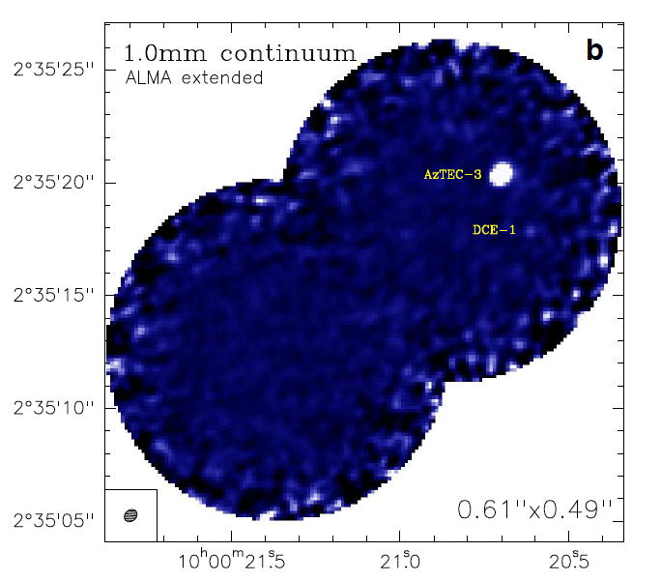
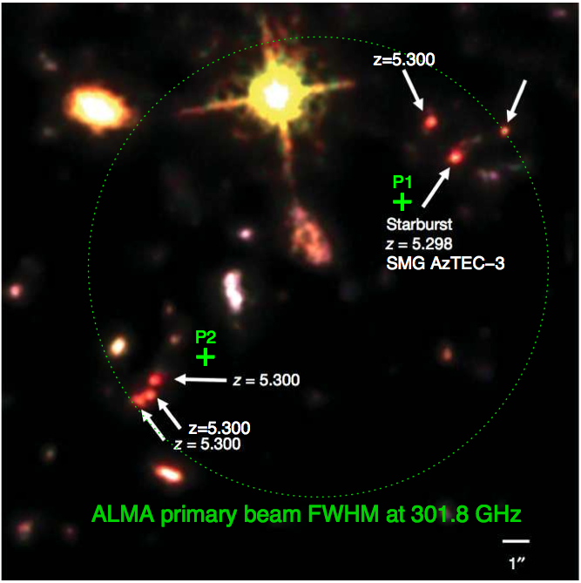
Aztec 3: massive cluster formation at z=5.3
ALMA 1hr, 17ant
Riechers ea
rms = 70uJy
Capak ea 2012
Most distant SMG: SFR ~ 1800, M_{gas} ~ 5e10 (α/0.8) M_{o}
Most distant proto-cluster: 11 LBGs in ~ 1’; 5 w. z_{spec} ~ 5.30
Discover 2nd dust obscured star forming galaxy (450 M_{o}/yr)

Slide 19
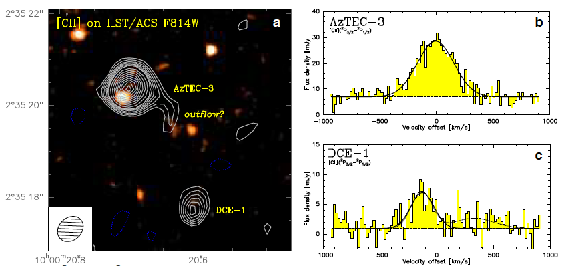
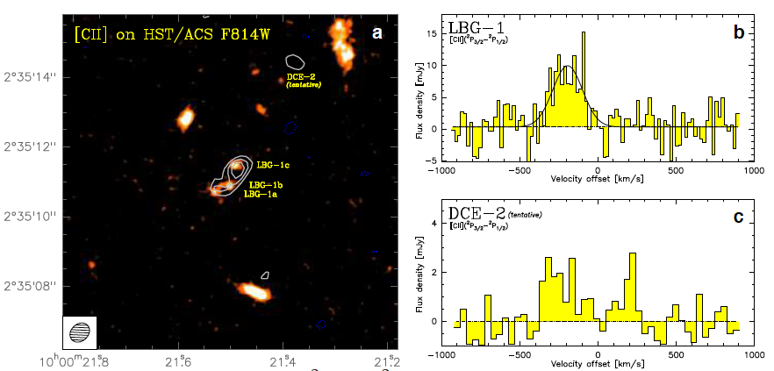
ALMA early science: [CII] imaging, 2hrs, 17ant
Easily detect SMG
Detect ‘dark CII emitter’
[CII]/FIR ≤ 0.001 ~ ‘starburst/AGN’
SMG tidal tail or outflow ~ 10kpc
Detect LBG group in [CII]
S₃₀₀ < 0.2mJy => SFR < 80 M_{o}/yr
[CII]/FIR > 0.0023 ~ MW
Possible second DCE?

Slide 20
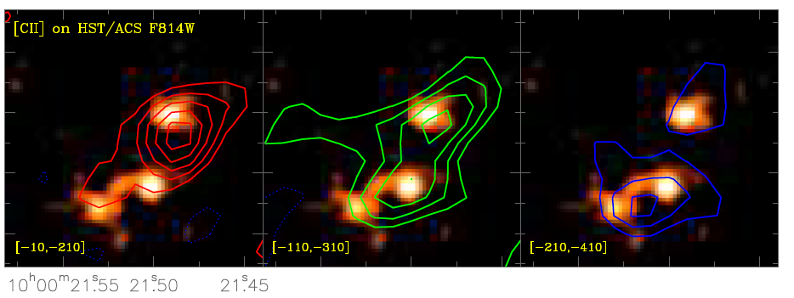
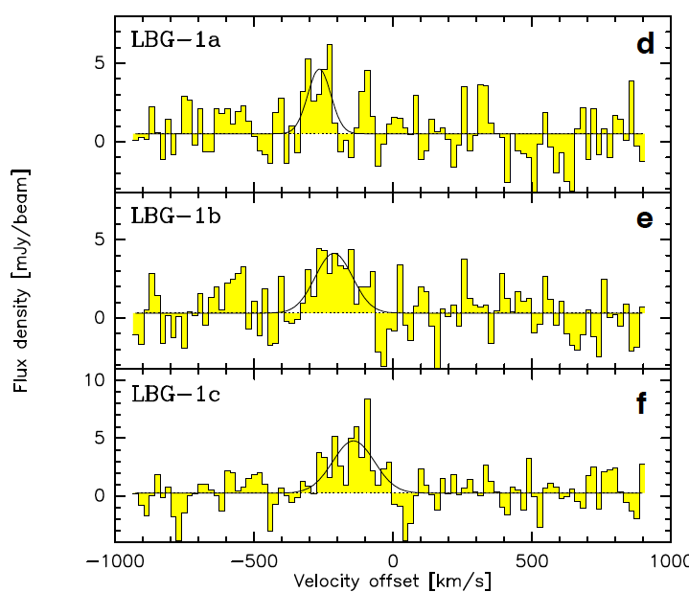
1”
LBGs easily detected w. subset ALMA: new window on distant galaxies
Imaging gas dynamics in interacting LBG group: scales ~ 3kpc, narrow velocity dispersions (< 200 km/s)
Serendipity: discover DCE1 & 2

Slide 21
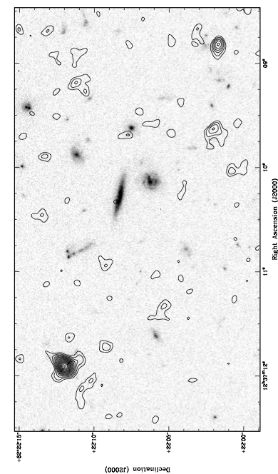
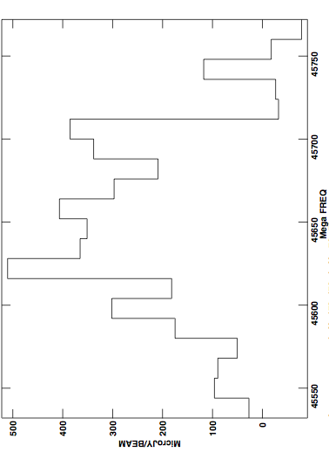
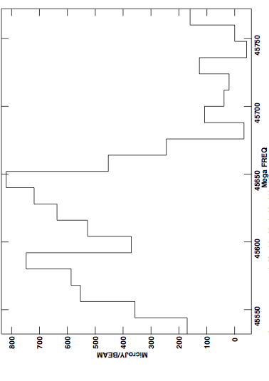
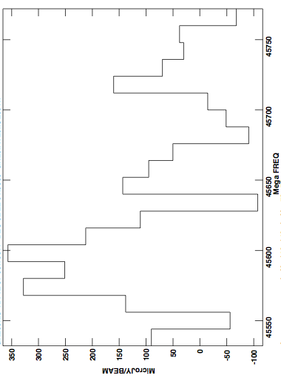
JVLA early science
GN20 ‘SMG group’ at z=4.05
0.4mJy
0.7mJy
+
GN20 z=4.055
+
+
+
5”
0.3mJy
GN20.2b 4.056
+
+
+
+
GN20.2a 4.051
+
+
Over-density: 19 LBGs at z_{ph} ~ 4 within ~ 1 arcmin
VLA 45GHz, 256MHz BW: CO2-1 from 3 SMGs

Slide 22
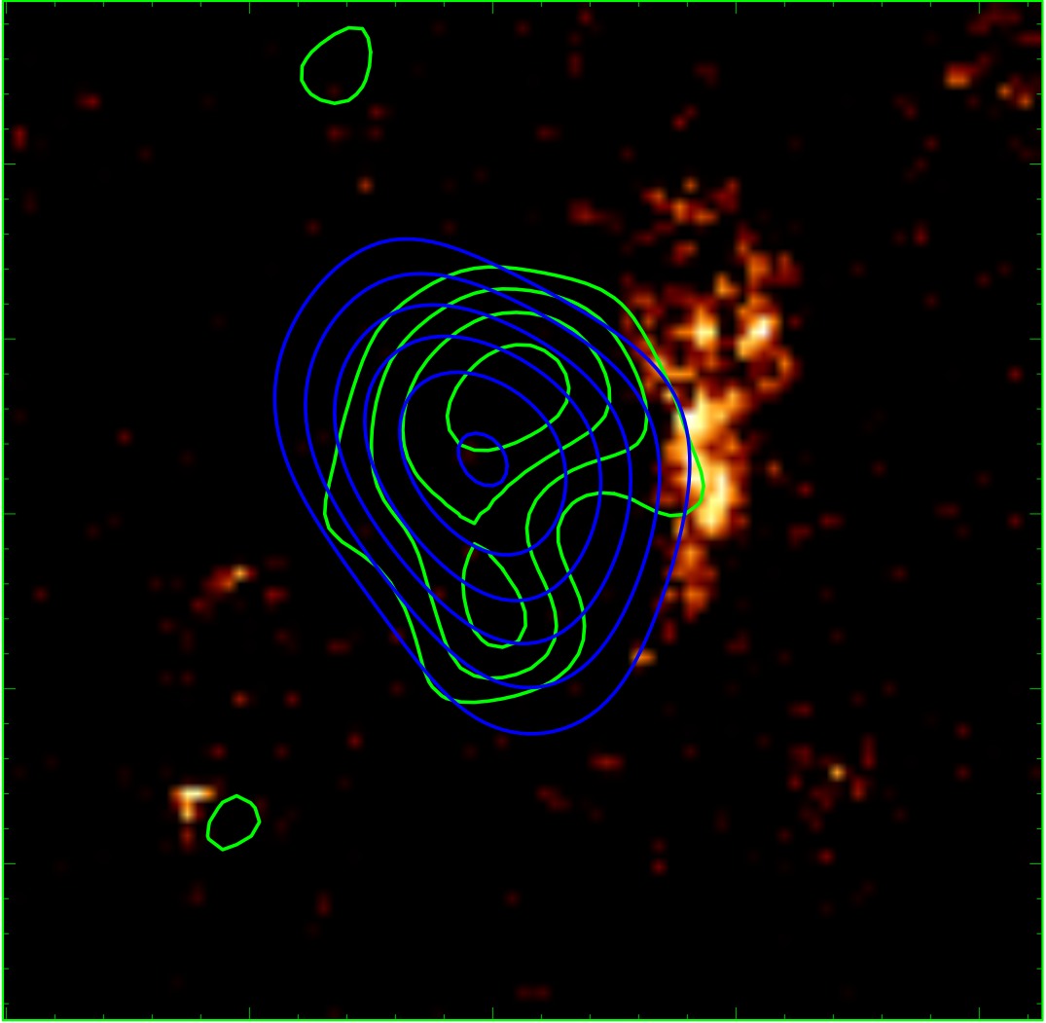
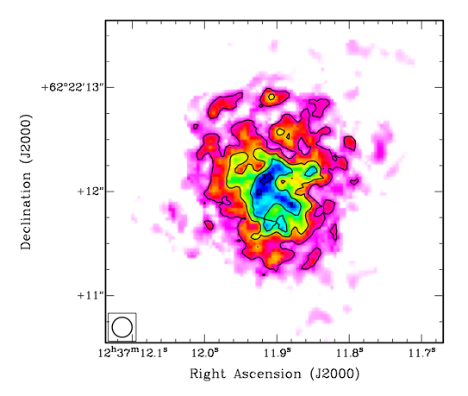
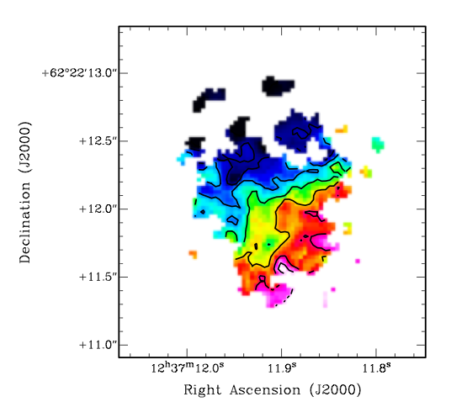
CO 2-1 Mom0
1”
1”
0.25”
HST/CO/SUBMM
Mom1
GN20 z=4.05
FIR = 2 10¹³ L_{o}
Highly obscured at I band
CO: large, rotating, disk ~ 14 kpc
M_{dyn} = 5.4 10¹¹ M_{o}
M_{gas} = 1.3 10¹¹ (α/0.8) M_{o}
-250 km/s
+
+250 km/s
Hodge ea 2012

Slide 23
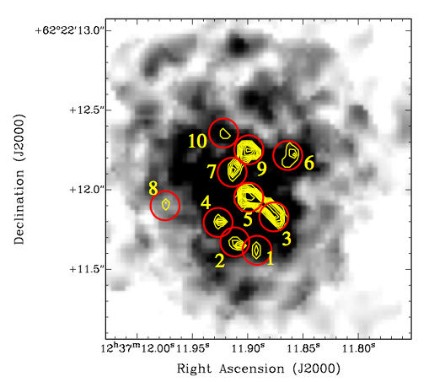
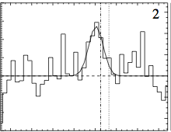
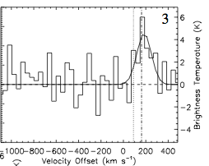
CO at HST-resolution: 0.15“ ~ 1kpc
0.5”
T_{b} ~ 20K, σ_{v} ~ 100 km/s
Self-gravitating clouds?
  M_{dyn} ~ M_{gas} ~ 10⁹ (α/0.8) M_{o}
Hodge ea 2012

Slide 24
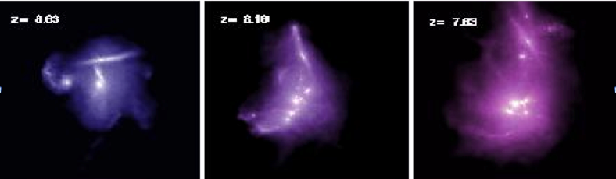
Imaging gas in clustered, massive galaxy formation at t_{univ}< 2Gyr
Early formation of large elliptical galaxies in dense environments in major starburst events
  Clear gas kinematic signs of strong gravitational interaction (tidal bridges/tails) => merging gas rich galaxies
  Also cases of large, clumpy, rotating disks ~ 10kpc, v_{rot} ~ 300 km/s
  kpc-resolution => self gravitating super-GMCs?
  Possible evidence for AGN outflows
Normal SF galaxies (LAE/LBG) also easily detected in [CII], often w/o submm continuum
Discover lower luminosity companion galaxies via line emission

Slide 25
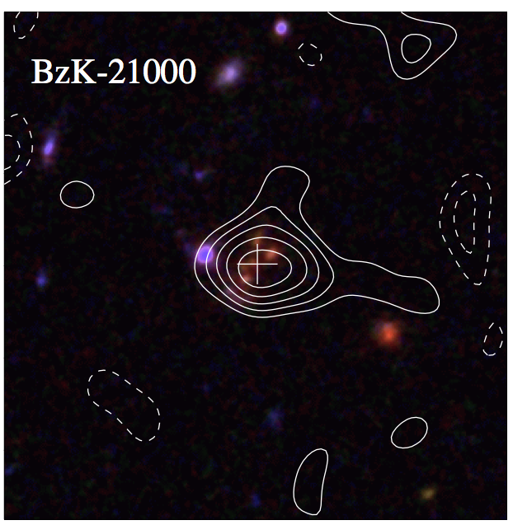
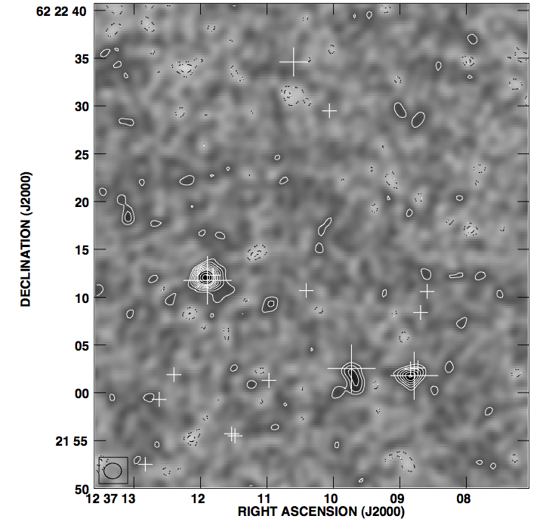
EVLA detects CO in same 1’ field, 256MHz band, from 3 z=4 SMGs + sBzK at z=1.5
CO1-0
z=1.5
CO2-1 z=4.0
Serendipity will become the norm!
Every observation with JVLA at ≥ 20GHz, w. 8 GHz BW will detect CO in distant galaxies

Slide 26
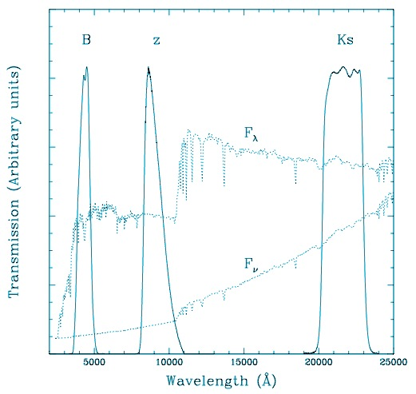
Color selected galaxies: gas dominated disks during EGA
HST
z=1.7
4000A
Ly-break
color-selection: identify thousands z~1–3 star forming galaxies
SFR ~ 10 to 100 M_{o}/yr, M* ~ 10¹⁰ M_{o}
‘typical z~2 SF galaxies’

Slide 27
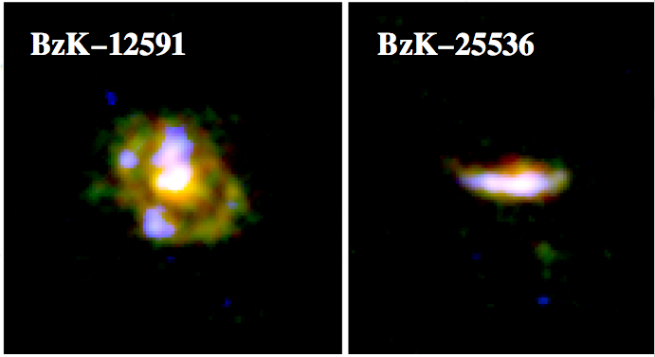

Color selected galaxies
SMGs
Elbaz ea
~SFR
10kpc
sBzK/BX/BM – ‘main sequence’
~M_{star}
HST => clumpy disk, sizes ~ 1”, punctuated by massive SF regions
Define a ‘main sequence’ in M_{star} – SFR, clearly delineated from SMGs (‘starburst’)
Common ~ 5 arcmin⁻² ~ 100x SMG

Slide 28

Daddi ea (2010): Bure CO obs of 6 z~1.5 CSG/‘MS’ galaxies, z~1.5
6 of 6 sBzK detected in CO
CO luminosities approaching SMGs but,
FIR (SFR) ≤ 10% SMGs
Massive gas reservoirs without hyper-starbursts

Slide 29

CSG: PdBI imaging (Tacconi ea 10,13)
CO galaxy size ~10 kpc
Clear rotation: v_{rot} ~ 200 km/s
SF clump physics
  Giant clumps ~ 1 kpc
  M_{gas} ~ 10⁹M_{o}
  Turbulent: σ_{v} > 20 km/s

Slide 30



Conversion factor: L’_{CO} = α M_{H2}
Hodge ea.
-300 km/s
M_{dyn}: using CO imaging, w. norm. factors from simulations
Subtract M*, M_{DM} , assume rest is M_{gas} =>
  CSG: α _{CO} ~ 4 ~ MW GMCs
  SMG: α_{CO} ~ 0.8 ~ nuc. SB
7kpc
GN20 z=4.0
M_{dyn} = 5.4 10¹¹ M_{o}
+300 km/s
Consistent with:
Analysis based on SF laws (Genzel)
Analysis of dust-to-gas ratio vs. metallicity (Magdis ea)
Radiative transfer modeling (Ivison)
Likely increases w. decreasing metalicity (Tacconi, Genzel)
M_{dyn} = 2 10¹¹ M_{o}
z=1.1
Tacconi ea. 2010

Slide 31

Star formation ‘laws’: relating gas to star formation
α=4
SB
SB
α=0.8
CSG
CSG
Overall, PL index = 1.4, or
Possibly 2 sequences: t_{d} = M_{gas}/SFR
  starburst: t_{d} ~ few (α/0.8) x 10⁷ yrs
  disk: t_{d} ~ few (α/4) x 10⁸ yrs

Slide 32

CO excitation
quasars ~ constant T_{b} to high order ~ Arp220 nucl. ~ GMC SF core
SMGs: intermediate between nuc. SB and MW
Often large, cooler gas component
CSG ~ MW excitation (1 case)
quasars
ν²
Arp220
.
SMGs
.
CSG
MW
MW ~ GMC (30 pc), T ~ 20K, n_{GMC} ~ 10² cm⁻³
Arp220 ~ SF cores (1pc), n_{core} > 10⁴ cm⁻³ , T > 50K

Slide 33


CSG: Baryon fraction is dominated by cool gas, not stars
Daddi ea 2010
Tacconi ea 2013
sBzK z~1.5
z~0 spirals
Possibly increases with decreasing M_{star}

Slide 34


Emerging paradigm in galaxy formation: cold mode accretion (Keres, Dekel…)
Galaxies smoothly accrete cool gas from filamentary IGM onto disk at ~ 100 M_{o}/yr (high density allows cooling w/o shock heating)
Fuels steady star formation for ~ 1Gyr
Form turbulent, rotating disks with kpc-scale star forming regions, which migrate inward over ~ 1 Gyr to bulge
‘Dominant mode of star formation in Universe’
T<10⁵K, N>10²⁰ cm⁻²
Cerverino + Dekel

Slide 35

Evolution of gas fraction: epoch of peak cosmic SF rate density (z~2) = epoch of gas-dominated disks
~ L’_{CO}/R_{rest}
(1+z)²
All star forming disk galaxies w. M* ≥ 10¹⁰ M_{o}
All points assume α~ 4 => empirical ratio ~ L’_{CO}/R_{rest}

Slide 36




Good news for molecular deep fields: PdBI pilot search
Spectral scan: 80 to 115GHz
Detect 5 candidate CO galaxies
  HDF 850.1: z = 5.2 (finally!)
  ‘Mark Dickinson’s favorite galaxy’: CSG z = 1.78
JVLA/ALMA searches in progress
850.1
1’
850.1 z=5.2
z_{ph} = 1.78

Slide 37


Cool Gas History of the Universe
SF Law
SFR
M_{gas}
SFHU[environment, luminosity, stellar mass] has been delineated in remarkable detail back to reionization
SF laws => SFHU is reflection of CGHU: study of galaxy evolution is shifting to CGHU (source vs sink)
Epoch of galaxy assembly = epoch of gas dominated disks

Slide 38


Big Bang f(HI) ~ 0
First light and cosmic reionization
Recombination z~1000
Dark Ages
f(HI) ~ 1
Universum incognitus
Reionization z~6-14
t_{univ} < 1Gyr
Last phase of cosmic evolution to be tested and explored
Cosmological benchmark: formation of first galaxies and quasars
F(HI): HI 21cm experiments
f(HI) ~ 10⁻⁵

Slide 39


Lower bound: Gunn-Peterson effect
6.4
SDSS z~6 quasars
Resonant Lya scat. by IGM: Opaque (τ > 5) at z>6 => pushing into reionization?
F(HI) > 10⁻⁴
SDSS quasars
Fan et al 2006
5.7

Slide 40


Pushing to edge of reionization: cm-submm obs of quasar host galaxies at z = 6 to 7
SDSS J1148+5251 z=6.42
Why quasar hosts?
  Rapidly increasing samples (~40)
  Spectroscopic redshifts
  Massive galaxies
13 Dust detections (~ 30%): FIR ~ 10¹³ L_{o} (SFR ~ 10³ M_{o}/yr)
11 CO detections: M_{gas} ~ few x10¹⁰ M_{o}
Coeval formation of SMBHs and host galaxies at t_{univ} < 1Gyr
Host galaxy CO 3-2 VLA
1”=5.5kpc
Walter ea

Slide 41


Dust Wang ea
Gas
-200 km/s
+300 km/s
300GHz, 0.5” res
1hr, 17ant
ALMA Cycle 0: 5/5 detected [CII] + dust
Sizes ~ 2-3kpc, clear velocity gradients
M_{dyn} ~ 5e10 M_{o,} M_{H2} ~ 3e10 (α/0.8) M_{o}
Maximal SB disk: SFR/area ~ 1000 M_{o} yr⁻¹ kpc⁻² (Thompson ea 2005)
  Self-gravitating gas disk, support by radiation pressure on dust grains
  ‘Eddington limited’ SFR/area ~ 1000 M_{o} yr⁻¹ kpc⁻²
  eg. Arp 220 on 100pc scale, Orion < 1pc scale

Slide 42


J1120+0641: z=7.084
Most distant z_{spec}
Mortlock ea;Venemans ea.
GP effect: damped profile of neutral IGM wipes-out Lya line: τ_{IGM} > 5
[CII] and dust detected with Bure => SFR ~ 300 Mo/yr
ISM of host galaxy substantially enriched (but not IGM; Simcoe ea.)

Slide 43



Pushing further into reionization: z~9 near-IR dropouts
Bouwens et al. 2012
Drop-out technique: z~9 galaxies?
SFR ~ few to ten M_{o}/yr: low SFR galaxies that reionize the Universe (for f_{esc} >0.2; C<10; Robertson & Ellis)?
Difficulty: confirming redshifts (no Lya!)
ALMA: [CII] from 5M_{o}/yr at z=7 in 1hr; 8GHz BW => Δz ~ 0.3
Low Metalicities => [CII]/FIR increases!
Band 5 (z=8 to 11) under development
z=7.1 quasar

Slide 44



Precision Array to Probe Epoch of Reionization
Ultimate study of cool gas in the distant Universe: direct imaging of neutral IGM using the HI 21cm line (120 to 180MHz)
‘Inverse view of Universe’
8cMpc
Berkeley, NRAO, Penn, SKA/South Africa
Build-out to 128 element science array in Karoo, South Africa in 2013

Slide 45
Cool Gas History of the Universe
SF Law
Massive galaxy formation: major mergers of gas rich galaxies
Main sequence galaxies: Epoch of galaxy assembly = epoch of gas dominated disks
[CII] is proving a key dynamical tracer, and redshift determinant

Slide 46


Slide 47

Signal end-game: HI 21cm ‘tomography’ of IGM
z= 12
ν₂₁= 109 MHz
9
‘Richest of all cosmological data sets’ (Loeb & Barkana)
cosmic density, ρ
neutral fraction, f(HI)
Temp: T_{CMB}, T_{spin} [T_{K}, T_{lya}]
z=7.6
ν₂₁= 165 MHz
10cMpc = 4’
Furlanetto ea 2004

Slide 48
Challenge: Sensitivity
z= 12
ν₂₁= 109 MHz
9
Imaging of typical structures requires full Square Kilometer Array
ΔTB(2’) ~ 20 mK ~ 8uJy
SKA rms ~ 4mK
z=7.6
ν₂₁= 165 MHz
10cMpc = 4’
Furlanetto ea 2004

Slide 49

Near-term Reionization: Pathfinder science goals
3D power spectrum in 21cm line
characteristic bubble scale
z==12, f(HI) = 0.9
PAPER z=10
z=7, f(HI) = 0.02
Barkana 2009

Slide 50

32 station engineering array in Greenbank, WV
PAPER basics
Freq = 115 to 190 MHz (z= 6.5 to 11)
Single dipole elements + ‘flaps’ => FoV_{FWHM} ~ 40º
Max baseline = 300m => res ~ 15’
Build-out to 128 (256?) science array in Karoo, South Africa in 2012 [currently 64 stations]

Slide 51


Reconfigurable => optimize for science goal
Minimum redundancy array
maximize u,v coverage => imaging
Delay spectrum analysis (Parsons): pile-up measurements in few u,v cells => coherently add spectra for PS analysis in freq = z

Slide 52


Solution: location!
PAPER South Africa
OrbComm
FM
ISS
OrbComm
100MHz
200MHz
100MHz
200MHz
US ‘radio quiet zone’
ZA ‘radio quiet zone’

Slide 53

PSA64, July 2011
10min snapshots
BW = 60MHz
DNR ~ 1000
Weakest src ~ 1Jy
10º

Slide 54


Slide 55


Slide 56


Slide 57


Slide 58


Slide 59

Centaurus A (Stefan ea)
Closest giant radio galaxy
4days x 3hrs/day
rms=0.5Jy
10º ~ 600 kpc

Slide 60


Cen A: imaging and spectra
Parkes: 1.4 GHz
(Feain ea)
PAPER: 120 to 180MHz
Stefan ea 2012

Slide 61



SI
Spectral flattening in regions of ‘heavy weather’: Vortices shells, rings, waves (Feain ea) => local particle acceleration

Slide 62


Rosat All Sky Survey
Xray: correlations (and anti-correlations)
‘Cavity in North’?
Knots in South = IC: B ~ 1 uG ~ B_{MP}
Lobe press.~ IGM ~ 10⁻¹³ dyn cm⁻²

Slide 63

Galactic studies
SNR searches, spectra, imaging: find the missing large SNR?
Galactic HII regions: free-free abs => 3D study of thermal/nonthermal ISM
W28-SNR + M8-HII
SgrA*
10º
CTB37-SNR

Slide 64



GBT 1.4 GHz (Zadeh ea)
PAPER 0.15GHz
1º
Galactic center: free-free abs
GBT 1.4GHz: clear GC peak
PAPER 150MHz: ‘flat’
GC: inverted spectrum = FF abs: EM > 10⁴ pc cm⁻⁶
‘Funnel’ to SE = thermal outflow: n_{e} > 10 cm⁻³ (or foreground HII)?
SI: 1.4 – 0.15GHz

Slide 65


Constraints on neutral fraction z~7: Quasar near zones
Accurate host galaxy redshift from [CII]: z=7.0842
Quasar Lya spectrum => photons leaking down to z=7.041
Time bounded Stromgren sphere ionized by quasar
Difference in z_{host} and z_{GP} =>
R_{NZ} =2Mpc ~ [L_{γ} t_{Q}/F_{HI}]^{1/3} (1+z)⁻¹
[CII] and CO: key to determining accurate host galaxy redshifts

Slide 66


Quasar Near-Zones: 28 GP quasars at z=5.7 to 7.1
Carilli ea
L_{UV}
R L_{γ}^{1/3}
L_{UV}
No correlation of UV luminosity with redshift
Correlation of R_{NZ} with UV luminosity
Note: significant intrinsic scatter due to local environ., t_{q}

Slide 67


z ≤ 6.4
z=7.1
Decreasing NZ size with z => significant increase neutral fraction of IGM from z ~ 5.7 to 7.1
[factor 4 NZ size => factor 64 f(HI)]

Slide 68

3.34
0.95
0.65
0.48
0.38Gyr
CMB_{pol}
Q-DLA
Gnedin & Fan model
QNZ
GP
ALMA Band 5 [CII]
z>6 quasars => rapid change in IGM neutral fraction
‘Cosmic phase transition’: z~7 to 10 critical for 1st galaxies
Band 5 is hypercritical to cover [CII] during reionization

Slide 69
Cosmic reionization and first galaxies with ALMA
Cool gas and dust: fuel for star formation, ISM physics…
[CII] key gas dynamical tracer: anatomy of mergers, rotation, masses…
[CII]: Key redshift determinant at z>7
FSL: physical diagnostics
z>6 quasar spectra: powerful probe of f(HI) vs. z

Slide 70










Blind CO searches: 5 best
  MultiNEST: Baysian UV and image plane with multiple spatial/spectral models (Lentati)
  Standard sigma-clip search (SERCH AIPS)
sBzK
z=1.78
HDF850.1

Slide 71

Stern, Dickinson
z_{sp} =5.15 to 5.22
GOODS
z_{sp}
HDF
HDF850.1 is part of large scale structure at z=5.15 to 5.22 in GOODS North

Slide 72


Extremely metal-poor gas just outside galaxy: [Z/H] < 10⁻⁴ solar
  enriched ISM in host, but pristine IGM within 2Mpc
  Highly inhomogeneous IGM as expected during reionization?
Simcoe ea.

Slide 73

Star formation rates
Well characterized SEDs from UV to IR and radio
Use multiple diagnostics:
  FIR
  UV – midIR SED
  Hα
  Radio
(see Kennicutt & Evans 2012)
Magdis ea

Slide 74


HDF850.1: finally!
z = 5.183
M_{H2} = 4 10¹⁰ (α/0.8) M_{o}
flux in [CII] ~ 40x CO
[CII] size ~ 6 kpc
Still no optical/nearIR ID
Bure 307GHz
Bure 80GHz
JVLA 37GHz
Intermediate CO excitation ~ GN20

Slide 75

Spectroscopic imaging ‘n_{ch} x 1000 words’
Bure
VLA
VLA
CSG
Quasar
SMG
CSG: SFR ≤ 10² M_{o}/yr, ρ ≥ 10⁻⁴ Mpc⁻³, clumpy, turbulent, rotating 10kpc disks
Quasars:SFR ≥ 10³ M_{o}/yr, ρ ≤ 10⁻⁵ Mpc⁻³, highly disturbed, chaotic CO
SMG: SFR ≥ 10³ M_{o}/yr, ρ ≤ 10⁻⁵ Mpc⁻³, Mixed bag: major mergers and large disks

Slide 76

Black hole-Bulge mass relation in early universe
Low z: M_{BH} ~ 0.0014 M_{bulge} => ‘causal relation between formation of SMBH and galaxies’
High z quasars:
M_{bulge} from gas dynamics
M_{BH} from line widths, L_{Edd}
large scatter, but systematically lower bulge mass than expected by factor ~ 15
Suggests black holes for before host galaxies? (Khandai et al. 2012)
M_{bulge}
Wang ea

