Slide 1
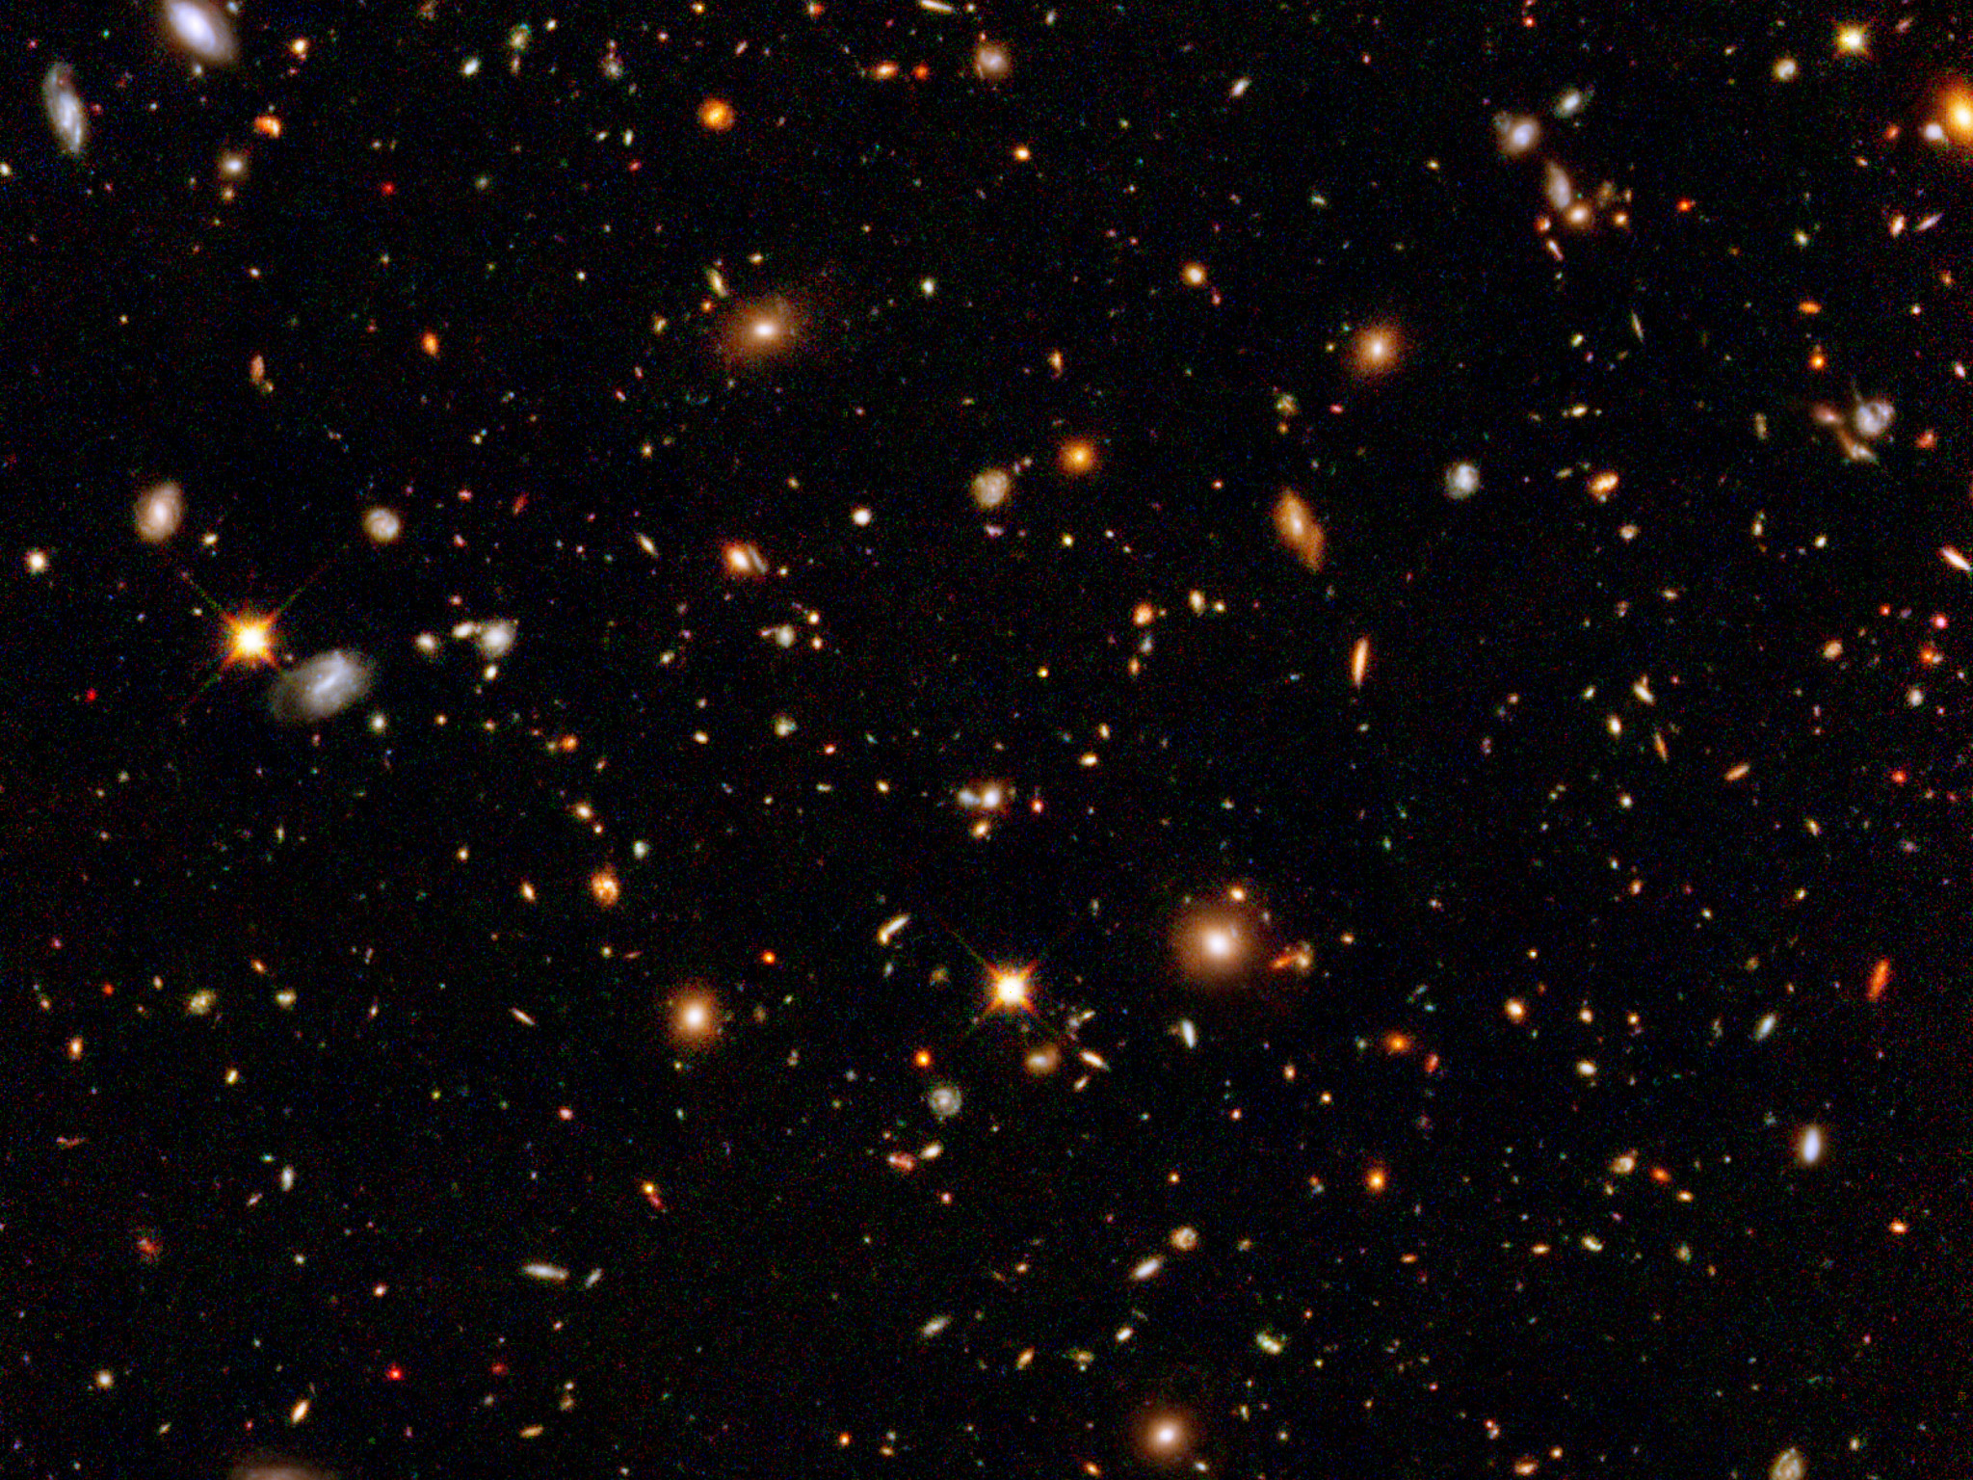
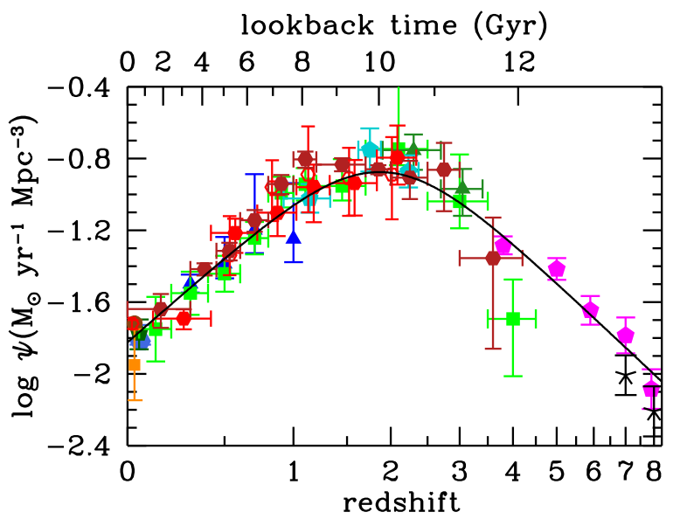
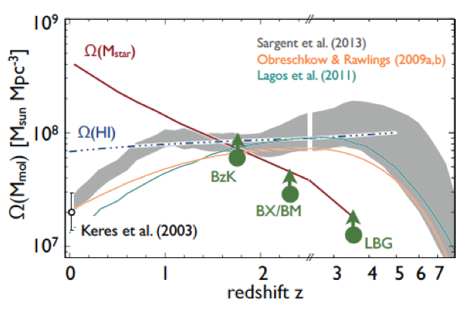
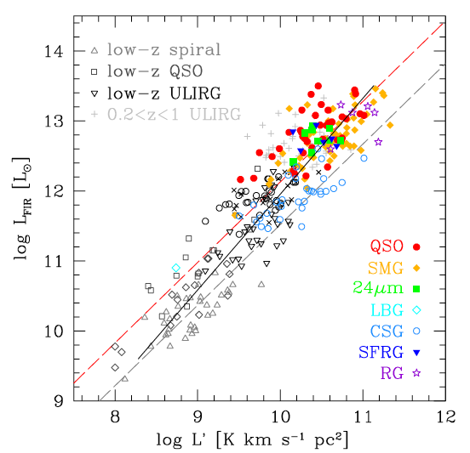
Dense Gas History of the Universe ‘Missing half of galaxy formation’
‘SF Law’
FIR ~ SFR
FIR ~ SFR
L_{CO} ~ M_{gas}
SFHU has been delineated in remarkable detail back to reionization
SF laws => SFHU is comsequence of DGHU
ALMA, JVLA, Noema: study of galaxy evolution is shifting to DGHU

Slide 2
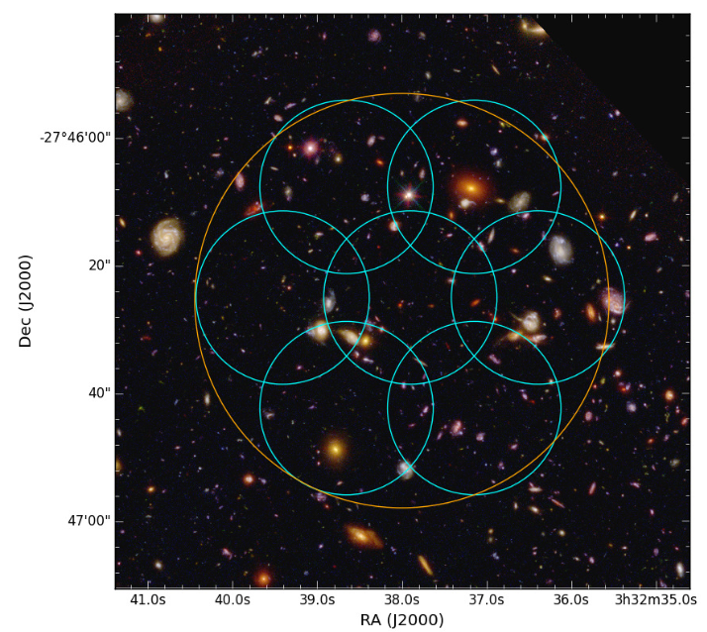
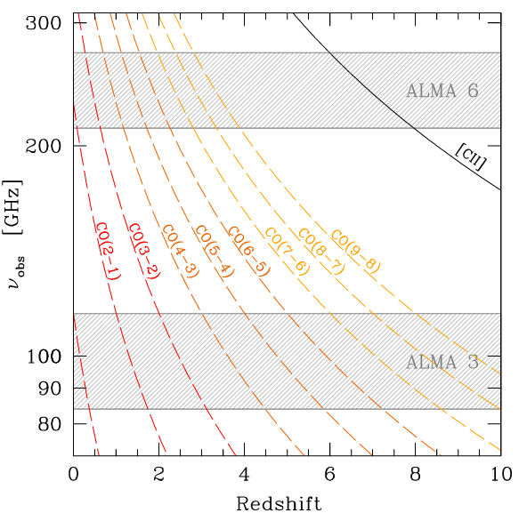
ALMA Spectral Line Survey in UDF (ASPECS-I)
1st volumetric ‘molecular deep field’
PI Walter, Decarli (EU), Co-PI Aravena (Chile), Co-PI Carilli (USA)
Bands 3 and 6: 20hr/band, 35ants; line rms ~ 0.3mJy, cont. rms ~ 10uJy
1arcmin² in UDF: best multi-𝜆 field
Molecular gas masses to ‘knee’ mass function ~ few x 10⁹ M_{o}
Dust continuum: SFR ~ 10 M_{o}/yr at z =1 to 6
[CII] from z > 6 LBG/LAEs

Slide 3
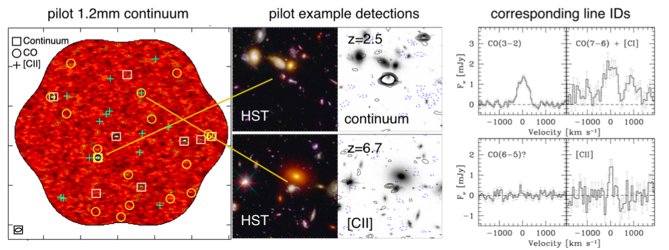
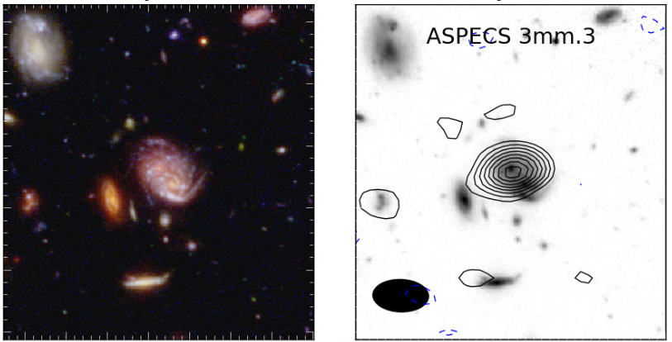
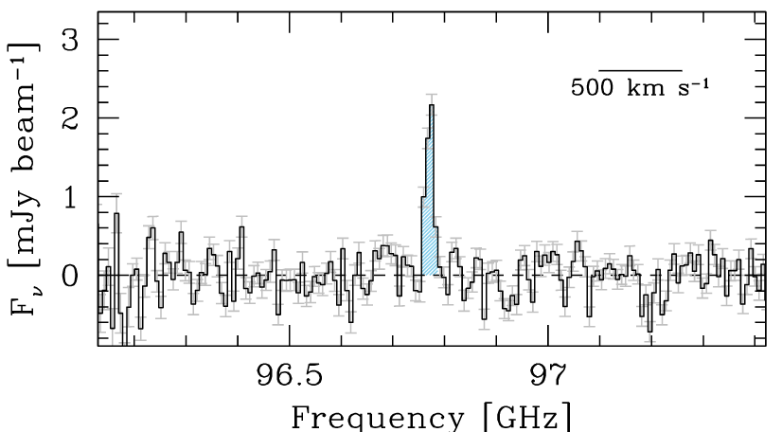
ASPECS-I 7 papers, Oct. 2016
z=1.4
CO 2-1
10 line candidates band 3: CO various redshifts (Walter, Decarli)
11 line candidates band 6: CO, [CII] (Walter, Decarli)
9 dust continuum sources band 6 (Aravena)
LBG Stacking: Dust corrected SFHU from z=1 to 10 (Bouwens)
Possible ~ 6 [CII] detection of LBG candidates at z=6 to 8 (Aravena)
Implications for CO intensity mapping and CMB spectrum (Carilli)

Slide 4
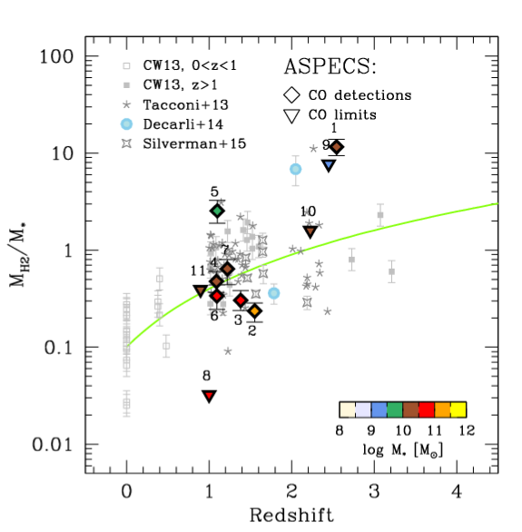
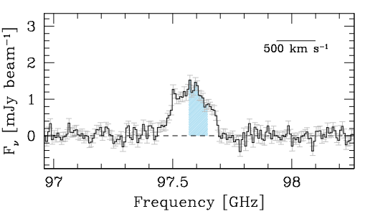
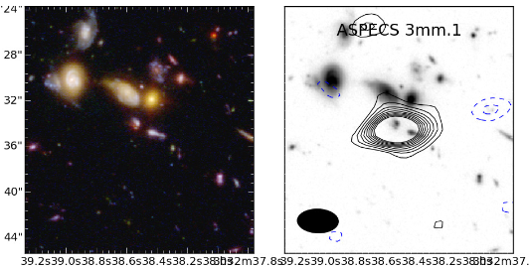
Evolution of gas fraction: fundamental change in ‘main sequence’ galaxies
CO 3-2
z=2.5
Order magnitude increase in mean gas ’baryon fraction’ (M_{H2} / M*) from z=0 to 2
M_{gas} = 2.0e11 (𝛼/3.6) M_{o}
M* = 1.6e10 M_{o}

Slide 5
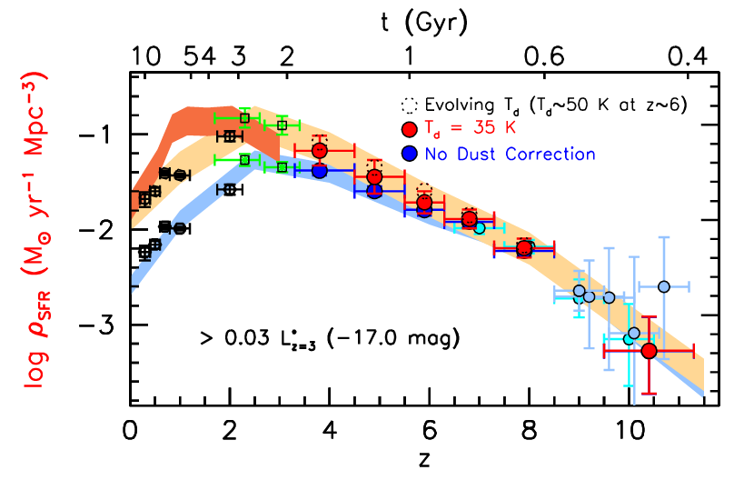
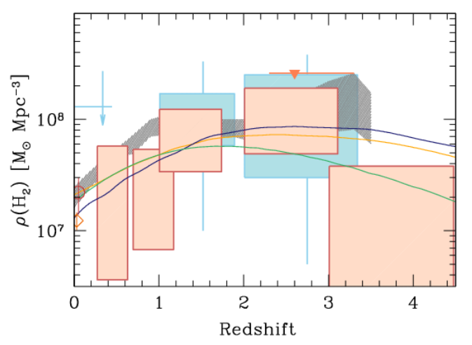
1st Unbiased Dense Gas History of Universe, and
New dust-corrected SFHU
Epoch of peak cosmic SF rate density (z~2) = epoch of gas-dominated ‘main sequence’ disk galaxies

Slide 6
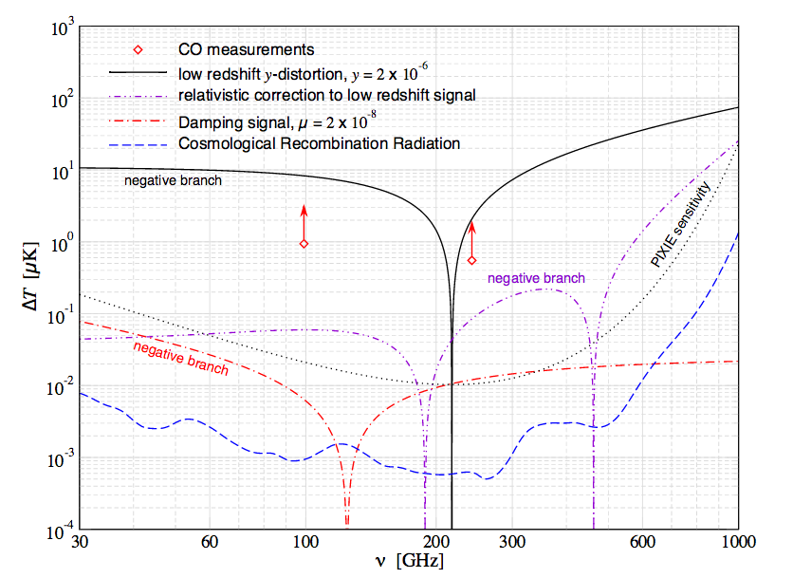
‘Cosmology’ application
Estimating line foregrounds for CMB spectra distortions
Sum ASPECS line detections in 90GHz and 240 GHz bands ~ 1uK
Line foreground >> PIXIE sensitivity => need effective removal techniques
Compton y: partial up-scattering of CMB blackbody photons by hot plasma during reionization or in clusters and galaxies at lower z (‘single scattering’)
u-distortion: Dissipation of small-scale fluctuations in the primordial photon-baryon plasma (‘multiple scattering’)
ASPECS
Carilli, Chluba ea

Slide 7
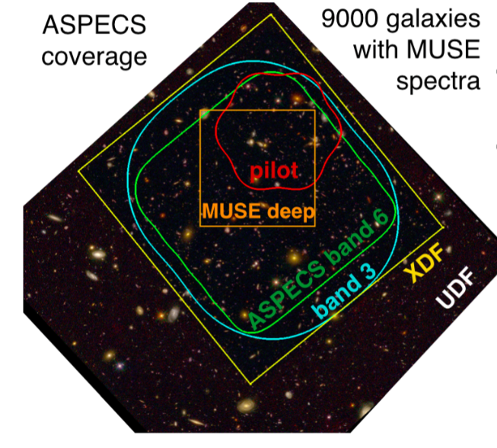
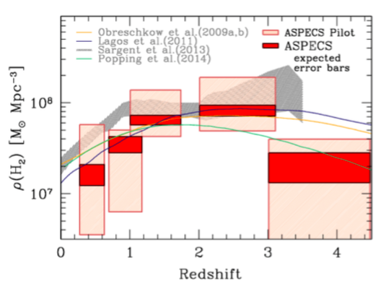
ASPECS - II
Band 3 64hrs, Band 6 85hrs, 40antennas
Wider and Deeper
5x area of pilot survey
70% deeper in pilot field
Observations: Dec 2016 to Mar 2017
Well constrained, unbiased census of cool gas that fuels the star formation history of the Universe

Slide 8
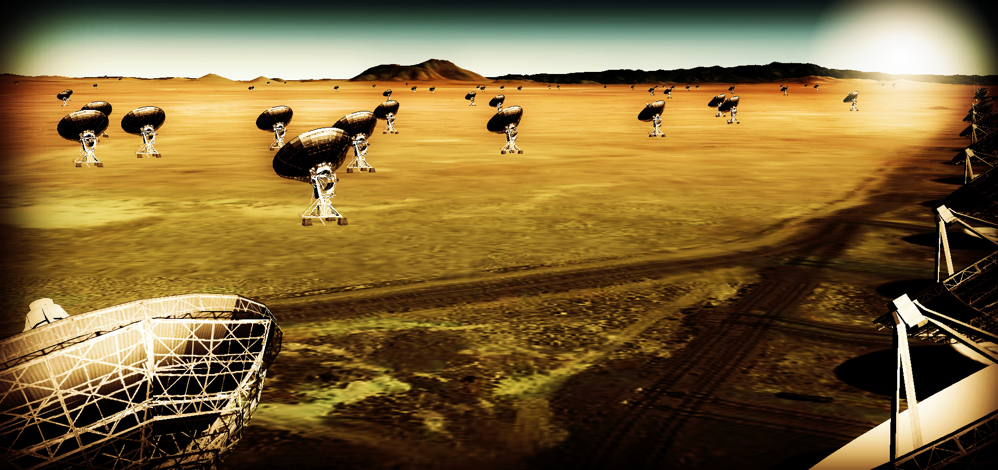
Thermal imaging on milliarcsecond scales at ~ 1cm
Sensitivity ~ 10x JVLA, ALMA
Resolution ~ 10x JVLA, ALMA
Frequency range ~ 1 – 115 GHz
https://science.nrao.edu/futures/ngvla

Slide 9
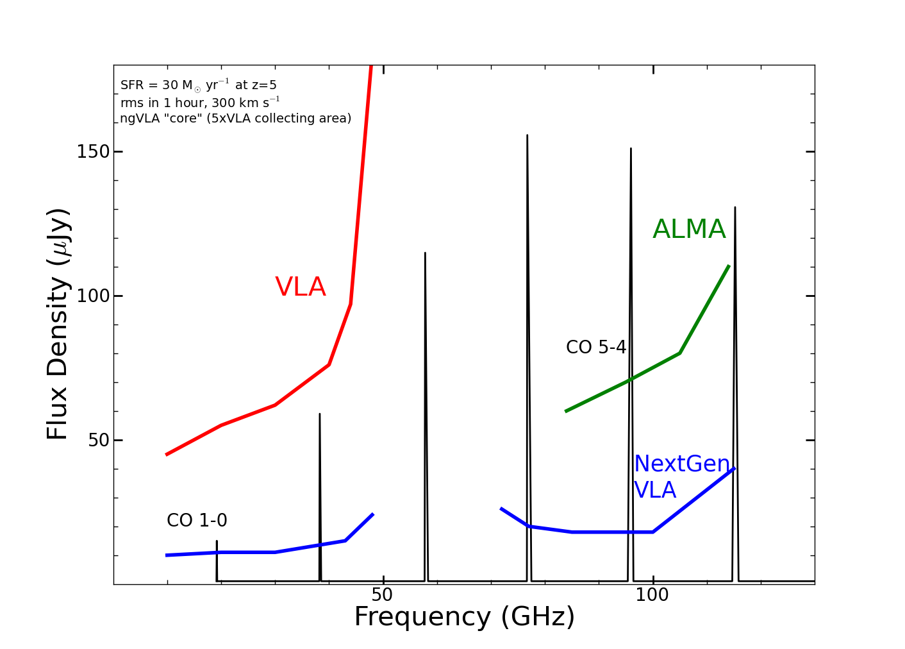
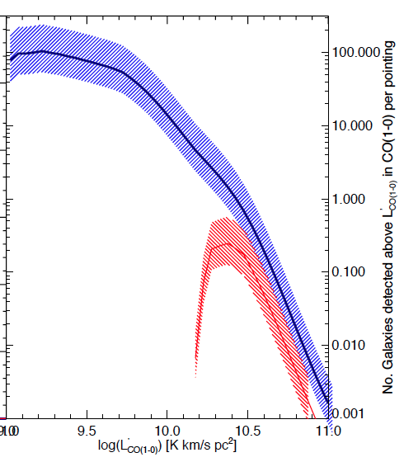
Revolutionize Molecular deep fields
CO emission from ‘main sequence’ galaxies at high z in 1 hour
HST-like galaxy densities
z=5, 30 M_{o}/yr, 1hr, 300 km/s
ngVLA
Number of CO galaxies/hour:
JVLA ~ 0.1 to 1, M_{gas} > 10¹⁰ M_{o}
ngVLA ~ 100, M_{gas} > 2x10⁹ M_{o}
JVLA, ALMA
Casey ea

Slide 10
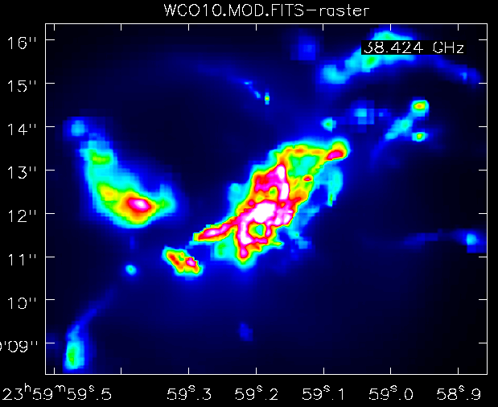
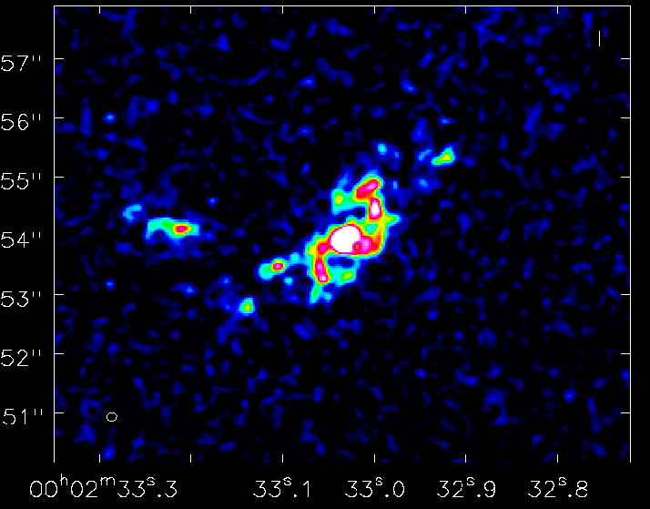
Imaging ’fuel for star formation’ during epoch of galaxy assembly
1” = 7kpc
z=2, CO1-0
Narayanan Model
ngVLA, 10hr, 38GHz
Resolution = 0.15” => 1kpc
Sensitivity = 12uJy (100 km/s, 10hr) => few 10⁸ M_{o} at z ~ 2
Low order transitions key total gas mass tracer

Slide 11
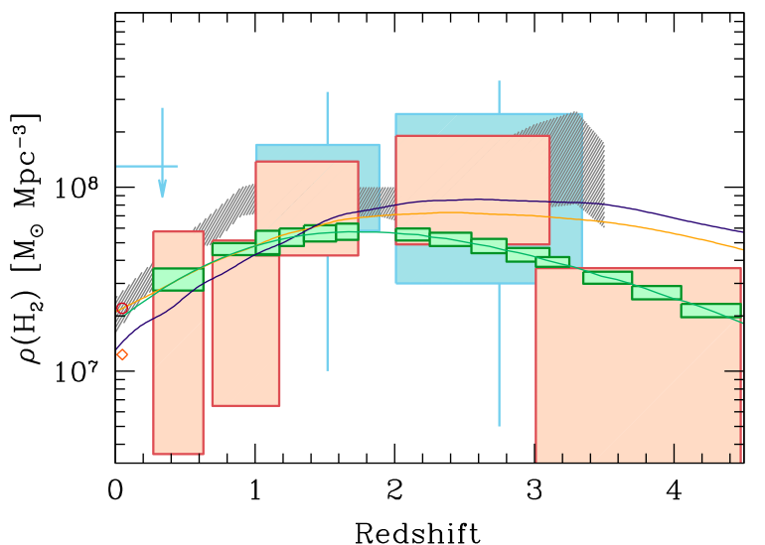
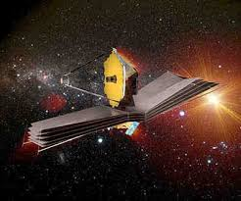
Next-Gen Synergy: Cosmic Cycle of Gas to Stars
Gas
NGVLA
ALMA
Decarli
JWST/TMT: stars and star formation
ngVLA: cold gas driving cosmic star formation

Slide 12
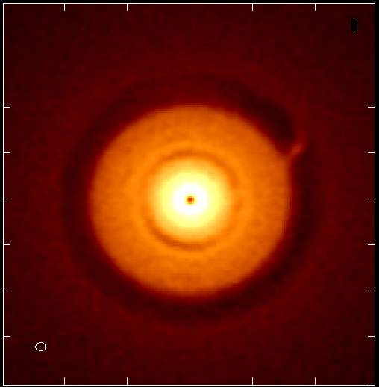
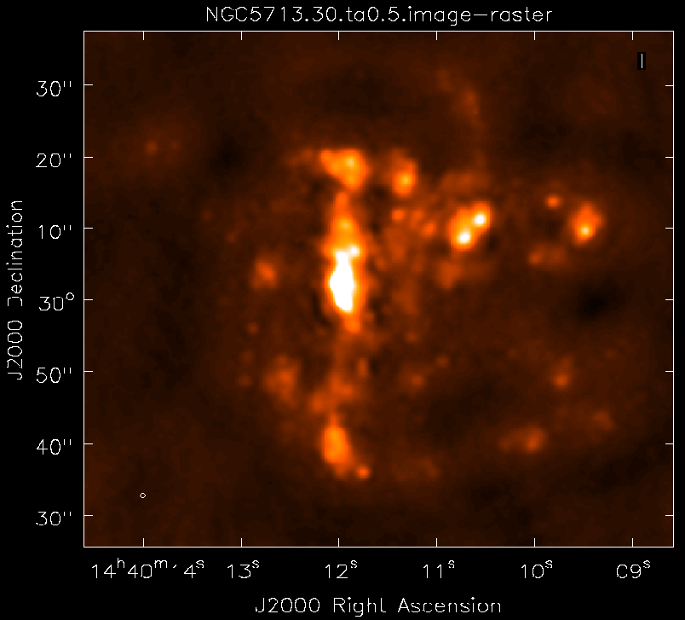
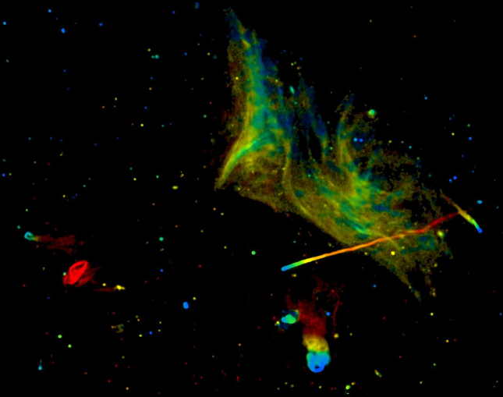
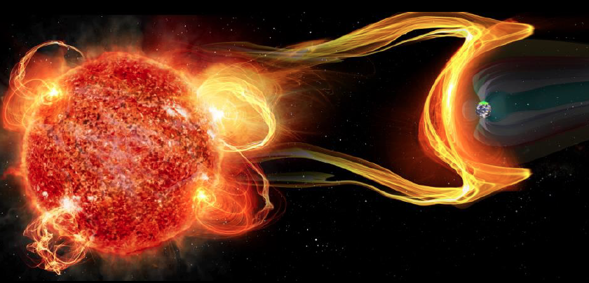
Next step: Sci. Requirements to Tel. Specifications and design
Science and Technical Advisory Committees
Community Design Studies
Science Working group reports: http://library.nrao.edu/ngvla.shtml
Circle of Life (Isella, Moullet, Hull)
Galaxy ecosystems (Murphy, Leroy)
Galaxy assembly (Lacy, Casey, Hodge)
Time domain, Cosmology, Physics (Bower, Demorest)
Goal | Science Requirement | Array Specification
Terrestrial zone | Optically thin | Freq ~ 15 to 50GHz
planet formation | 1AU at 130pc @ 30GHz | B ~ 300km
 | 1K in 10hrs @ 10mas, 30GHz | A_{full} ~ 300 x 18m; BW ~ 20GHz
Dense gas history | CO 1-0 to z=8 | Freq = 15 to 115GHz
of the Universe | M_{gas} = 10⁹ M_{o} at z = 3 in 1hr | A_{mid} ~ 70% to B ~ 30km
 | 500pc resolution at z = 3 (60mas) | 30km
 | Large volume surveys | Octave Band Ratio
Baryon cycle | T_{B} < 0.2K (1hr, 10 km/s, 80GHz, 1”) | A_{core} ~ 30% to B ~ 2km
 | Continuum science | Octave BR; Linear pol to 0.1%
Time domain | Explosive follow-up (GRBs, GW) | Minute trigger response time
 | Blind discoveries (eg. FRBs) | millisec searches
 | Exo-space weather: 1uJy in 1min | Freq ~ 1 to 20GHz A_{full} ~ 300 x 18m

Slide 13
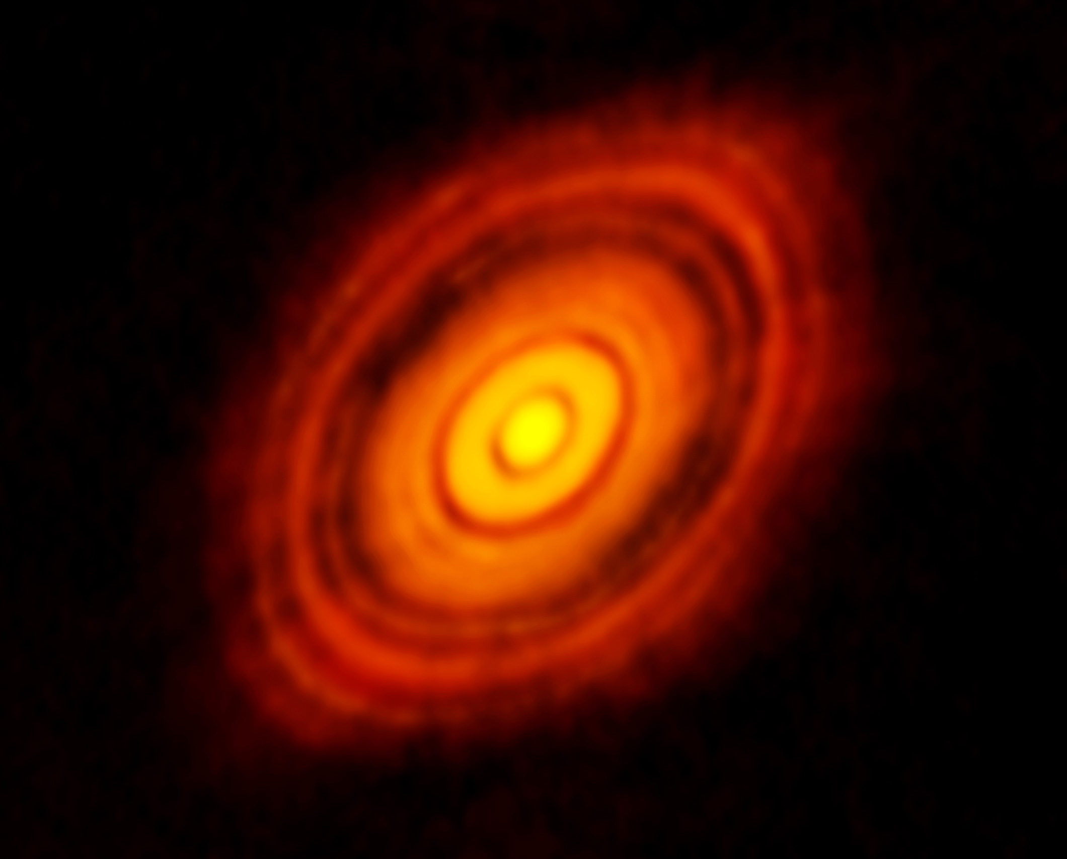
ALMA 250GHz Brogan ea.
Imaging Terrestrial zone planet formation
Protoplantary disks: Inner ~ 20AU optically thick in mm/submm
ngVLA @ 1 cm: Probe 1AU scales at 130pc
Jupiter at 13AU, Saturn at 6AU: annual motions
Circumplanetary disks: planet accretion
Pre-biotic molecules: rich spectra in 0.3cm to 3cm regime
100AU 0.7” at 140pc
ngVLA 25GHz @ 10mas
rms = 90nJy = 1K
model
model
Glycine
Jimenez-Sierra ea 2014

Slide 14
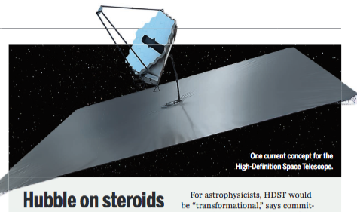
ng-Synergy: Terrestrial zone exoplanets
Full Evolutionary sequence, from birth to maturity
High Definition Space Telescope Terrestrial planets = top science goal
Direct detection of earth-like planets
Search for atmospheric bio-signatures
ngVLA
Imaging formation of terrestrial planets
Pre-biotic chemistry

Slide 15
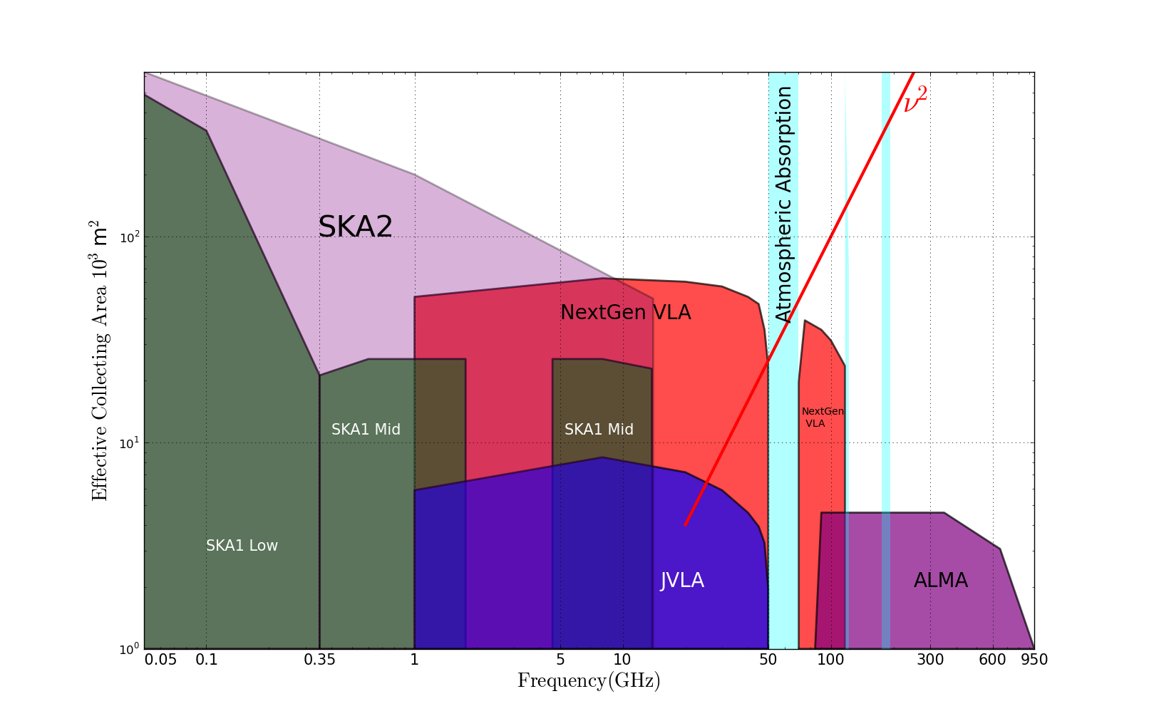
Radio facilities @ 2030
https://science.nrao.edu/futures/ngvla
2030
Complementary suite from meter to submm, appropriate for the mid-21st century
< 3mm: ALMA 2030 superb for chemistry, dust, fine structure lines
3cm to 3mm: ngVLA superb for terrestrial planet formation, dense gas history of Universe, baryon cycle
> 3cm: SKA superb for pulsars, reionization, HI surveys

