Slide 1
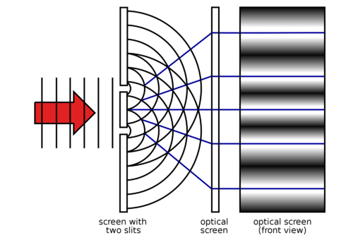
Optical Masking Interferometry with Self-Calibration
A new method for bright source characterization and wavefront sensing
Measuring the size and shape of extreme brightness, micron-scale light sources: synchrotrons, EUV lasers, free-electron lasers, plasma light sources, LEDs…
High precision wavefront sensing: nanometer metrology and manufacturing, ophthalmology, millisecond adaptive optics…
C. Carilli (NRAO), B. Nikolic (Cavendish), L. Torino (CELLS/ALBA), U. Iriso (CELLS/ALBA), N. Thyagarajan (CSIRO)
Copyright © 2024 AUI, U. Cambridge, CELLS/ALBA, CSIRO. All Rights Reserved

Slide 2
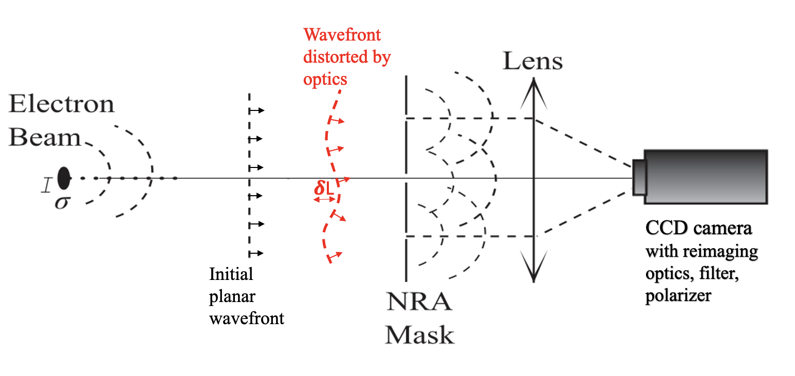
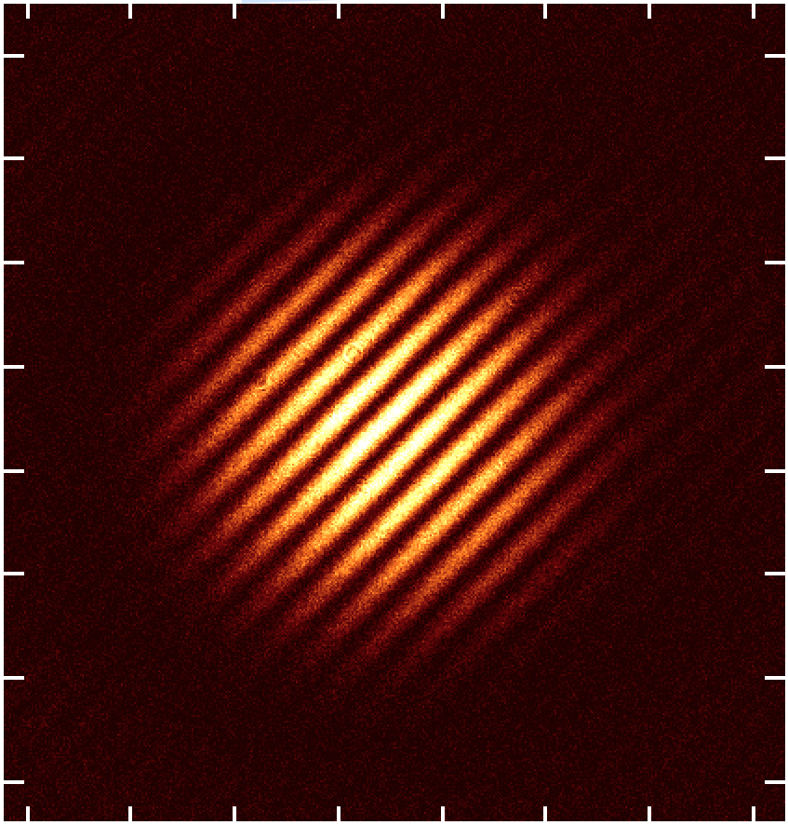
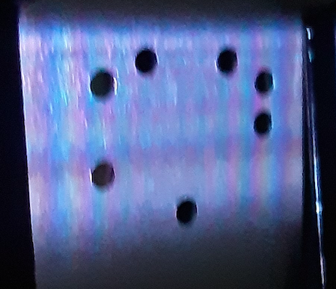
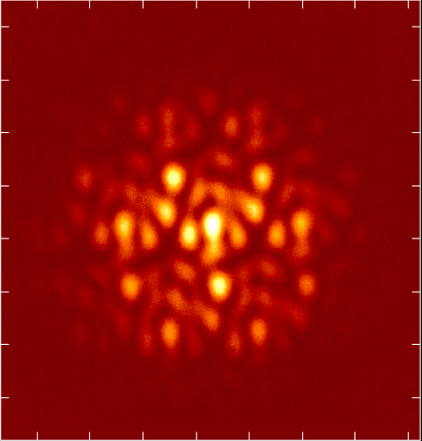
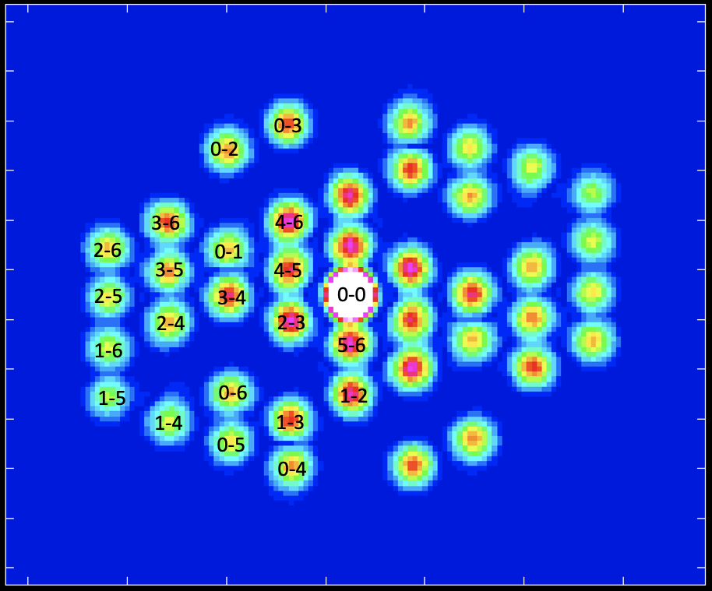
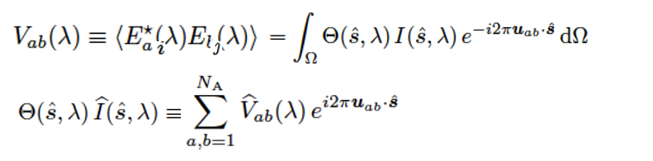
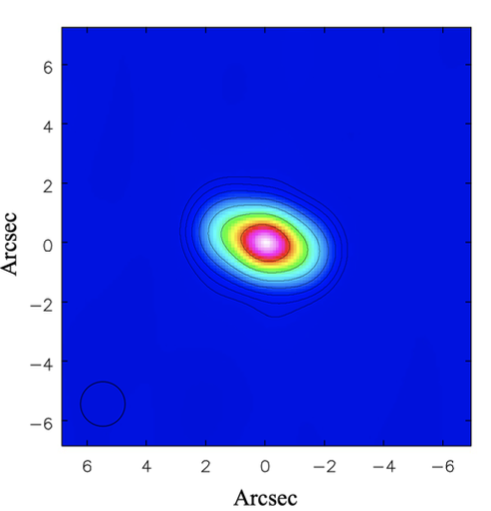
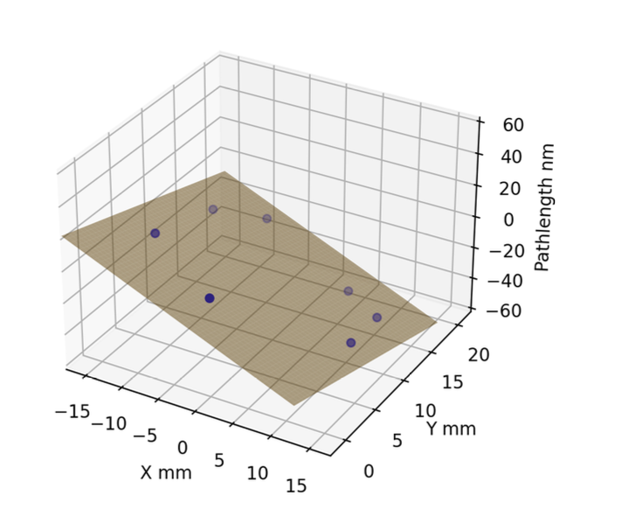
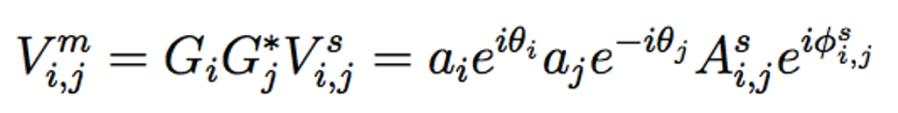
Technical Overview
Light from source directed to non-redundant aperture mask; Imaging optics generates ‘interferogram’ on CCD
Interferograms are Fourier transformed to generate ‘visibilities’ (baseline sinusoids)
Visibilities are modeled and self-calibrated
  Accurate reconstruction of 2D source
  Self-cal voltage gains
    Amp, a_{i} = mask illumination pattern
    Phase, θ_{i} ∝ photon pathlength
Light Source
A
B
C
Image
D
E

Slide 3
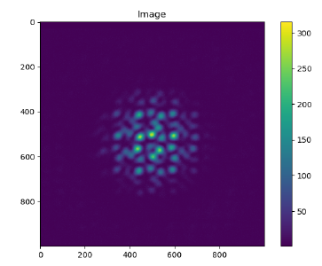
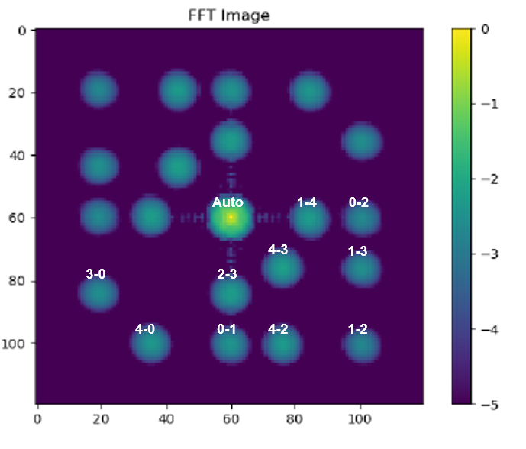
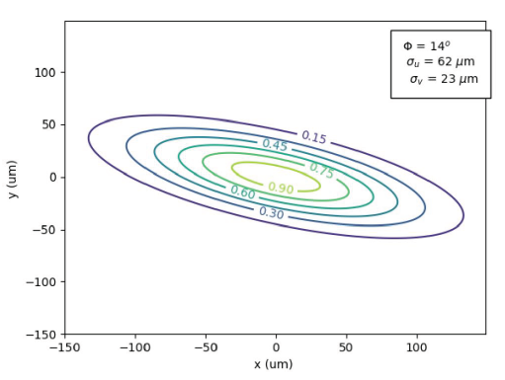
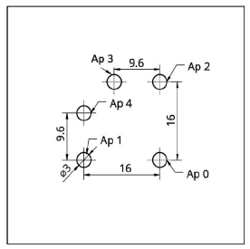
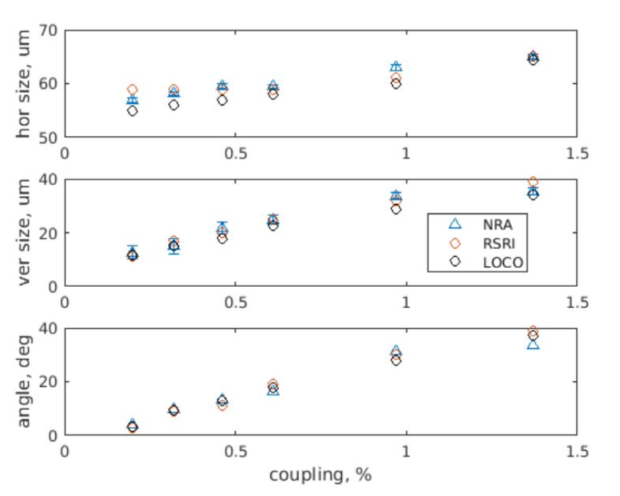
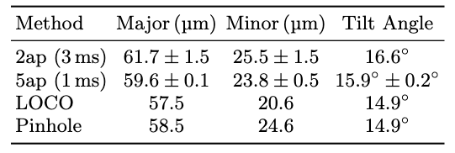
ALBA Results with 5-apertures at 400nm
Mask
Raw Image
2D FFT
Gaussian beam
Vary beam coupling
Minimum size measured at ALBA = 11um
Independent NRA methods
  Gaussian + Amp SC
  Gaussian + Closure amps
  CLEAN deconvolution + complex SC
mín = 11um
Without SC 66 40 5º

Slide 4
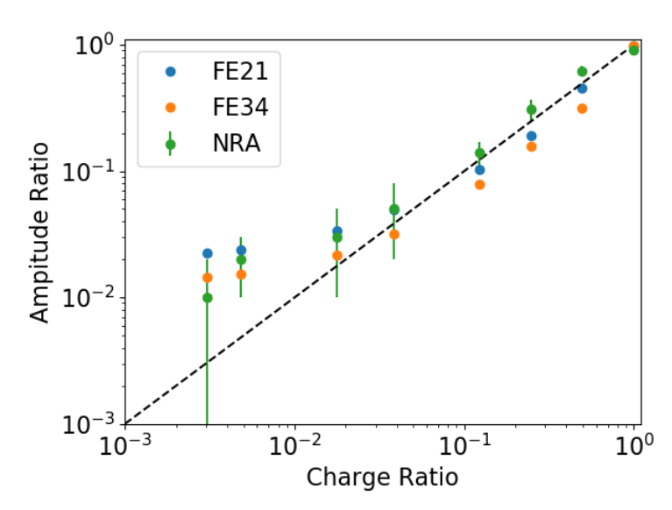
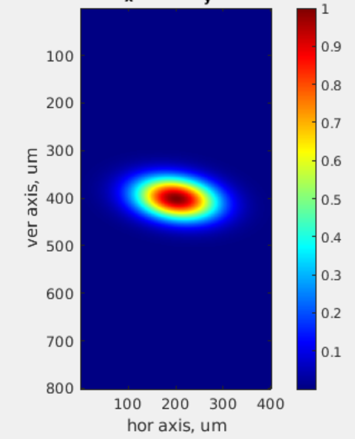
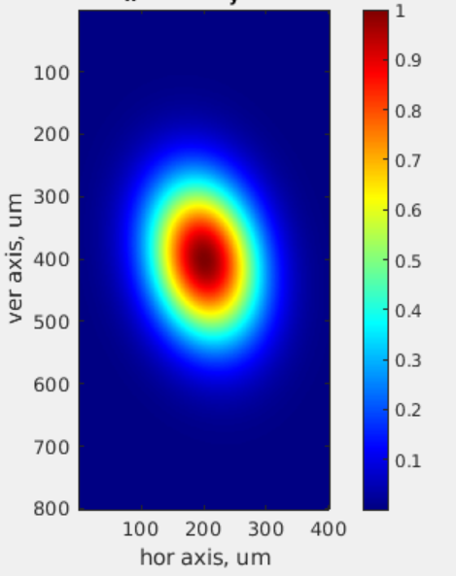
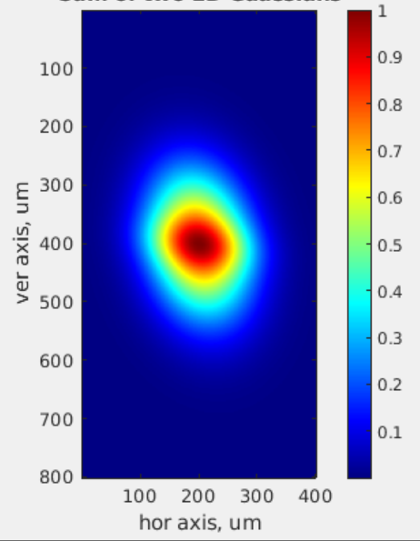
Imaging Double-Gaussian Beams (‘core-halo’)
Create double Gaussian beams using the ALBA bunch-by-bunch system
Fit double Gaussian to 7-hole interferograms
Pinhole Images
A
B
C
Beam stable (as in Operation): (s_{x}, s_{y}) = (60, 30)um; f = 8º
B. Coherent Excitation (Qv+Qs): (s_{x}, s_{y}) = (60, 90)um; f = 12º
C. 100 bchs of “A” + 340 bchs of “B”
Measure ’halo’ reliably down to ~1% bunch ratio (electron counts)

Slide 5
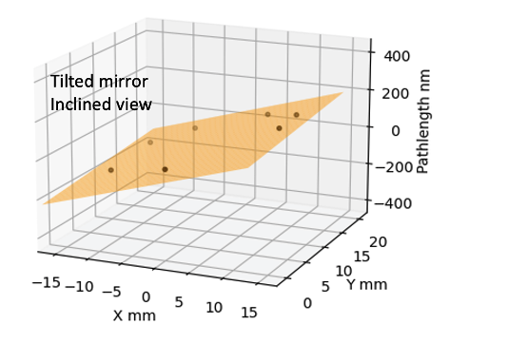
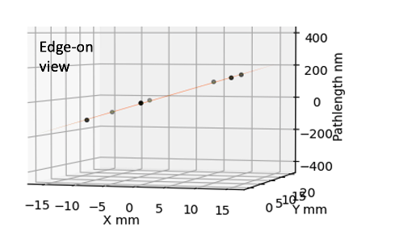
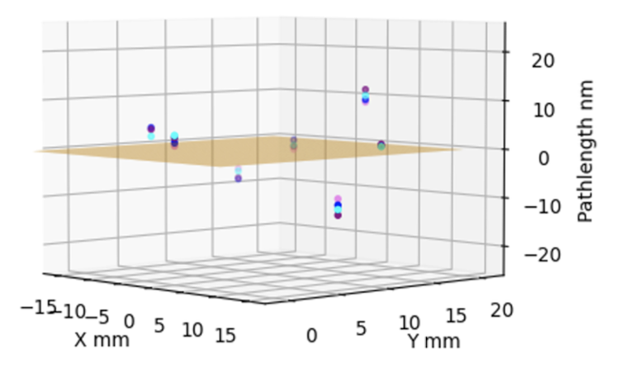
Application: Wavefront Sensing
Self-cal gain phases measure photon pathlengths: 𝜹L_{𝜸} = 𝝺 x (θ_{G}/360º)
Accuracy ~ small fraction of wavelength 𝝺 (nm precision per millisec exposure)
Non-planar static metrology distortions seen up to 12 nm: repeatable between experiments to rms ~ 2 nm at each hole
Tilted mirror tests: reproduce WF tilts to ~ 0.1” (5e-7 rad)

Slide 6
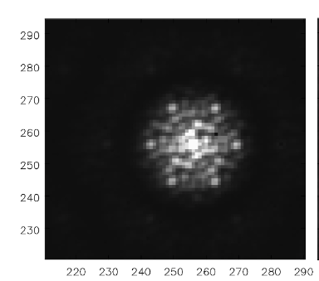
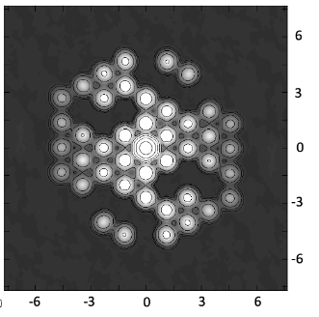
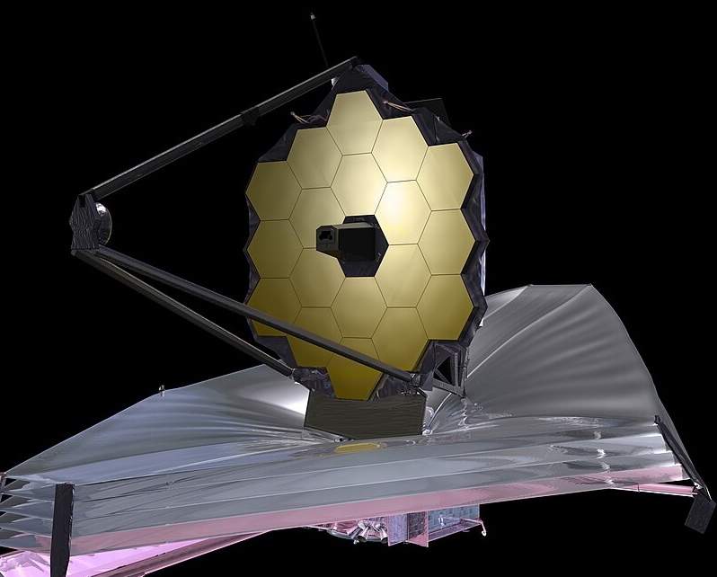
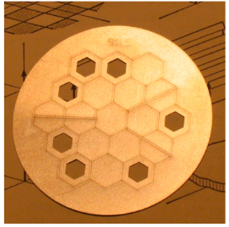
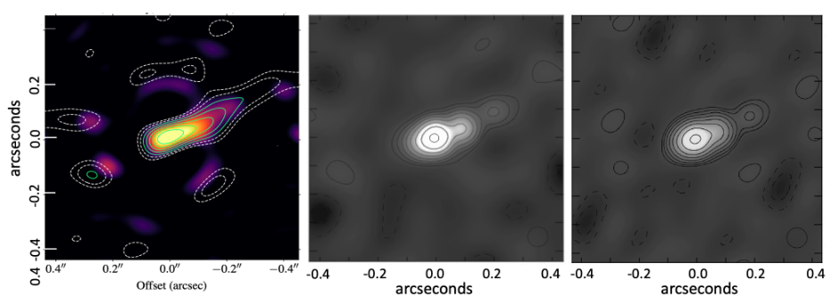
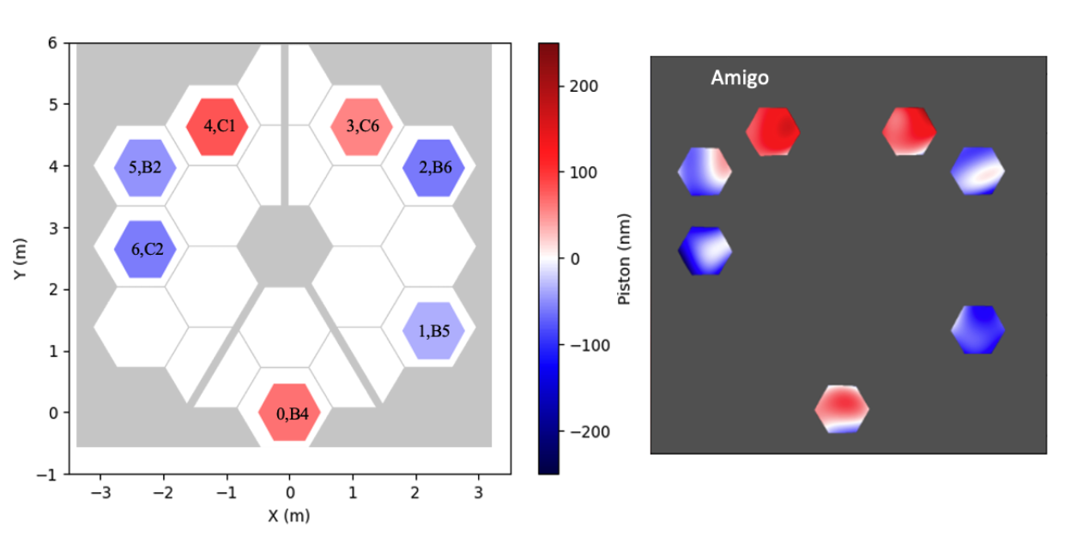
Application on JWST 7-hole AMI system
Standard closure phase method
Self-cal + CLEAN
Selfcal
Dusty Binary Star at 4.8um and 3.8um ~ 0.1” resolution
Mirror segment pistons to < 27nm

Slide 7
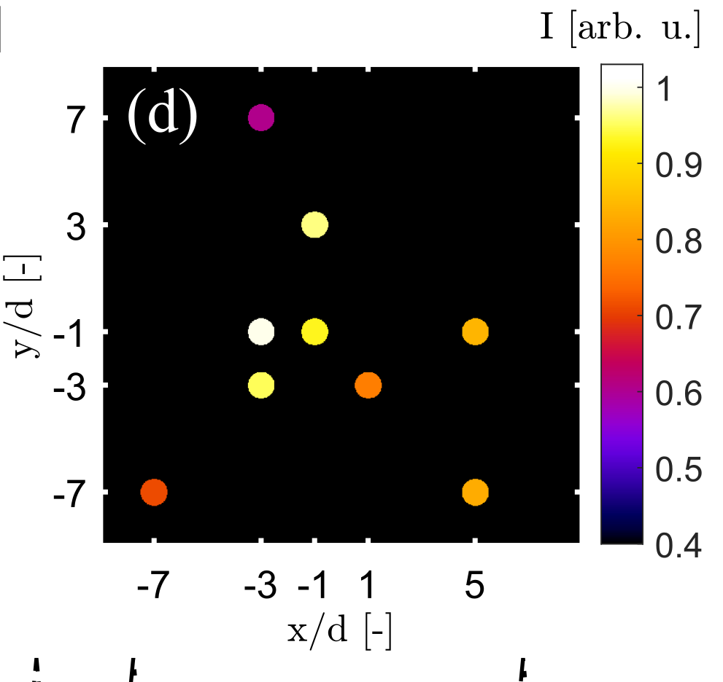
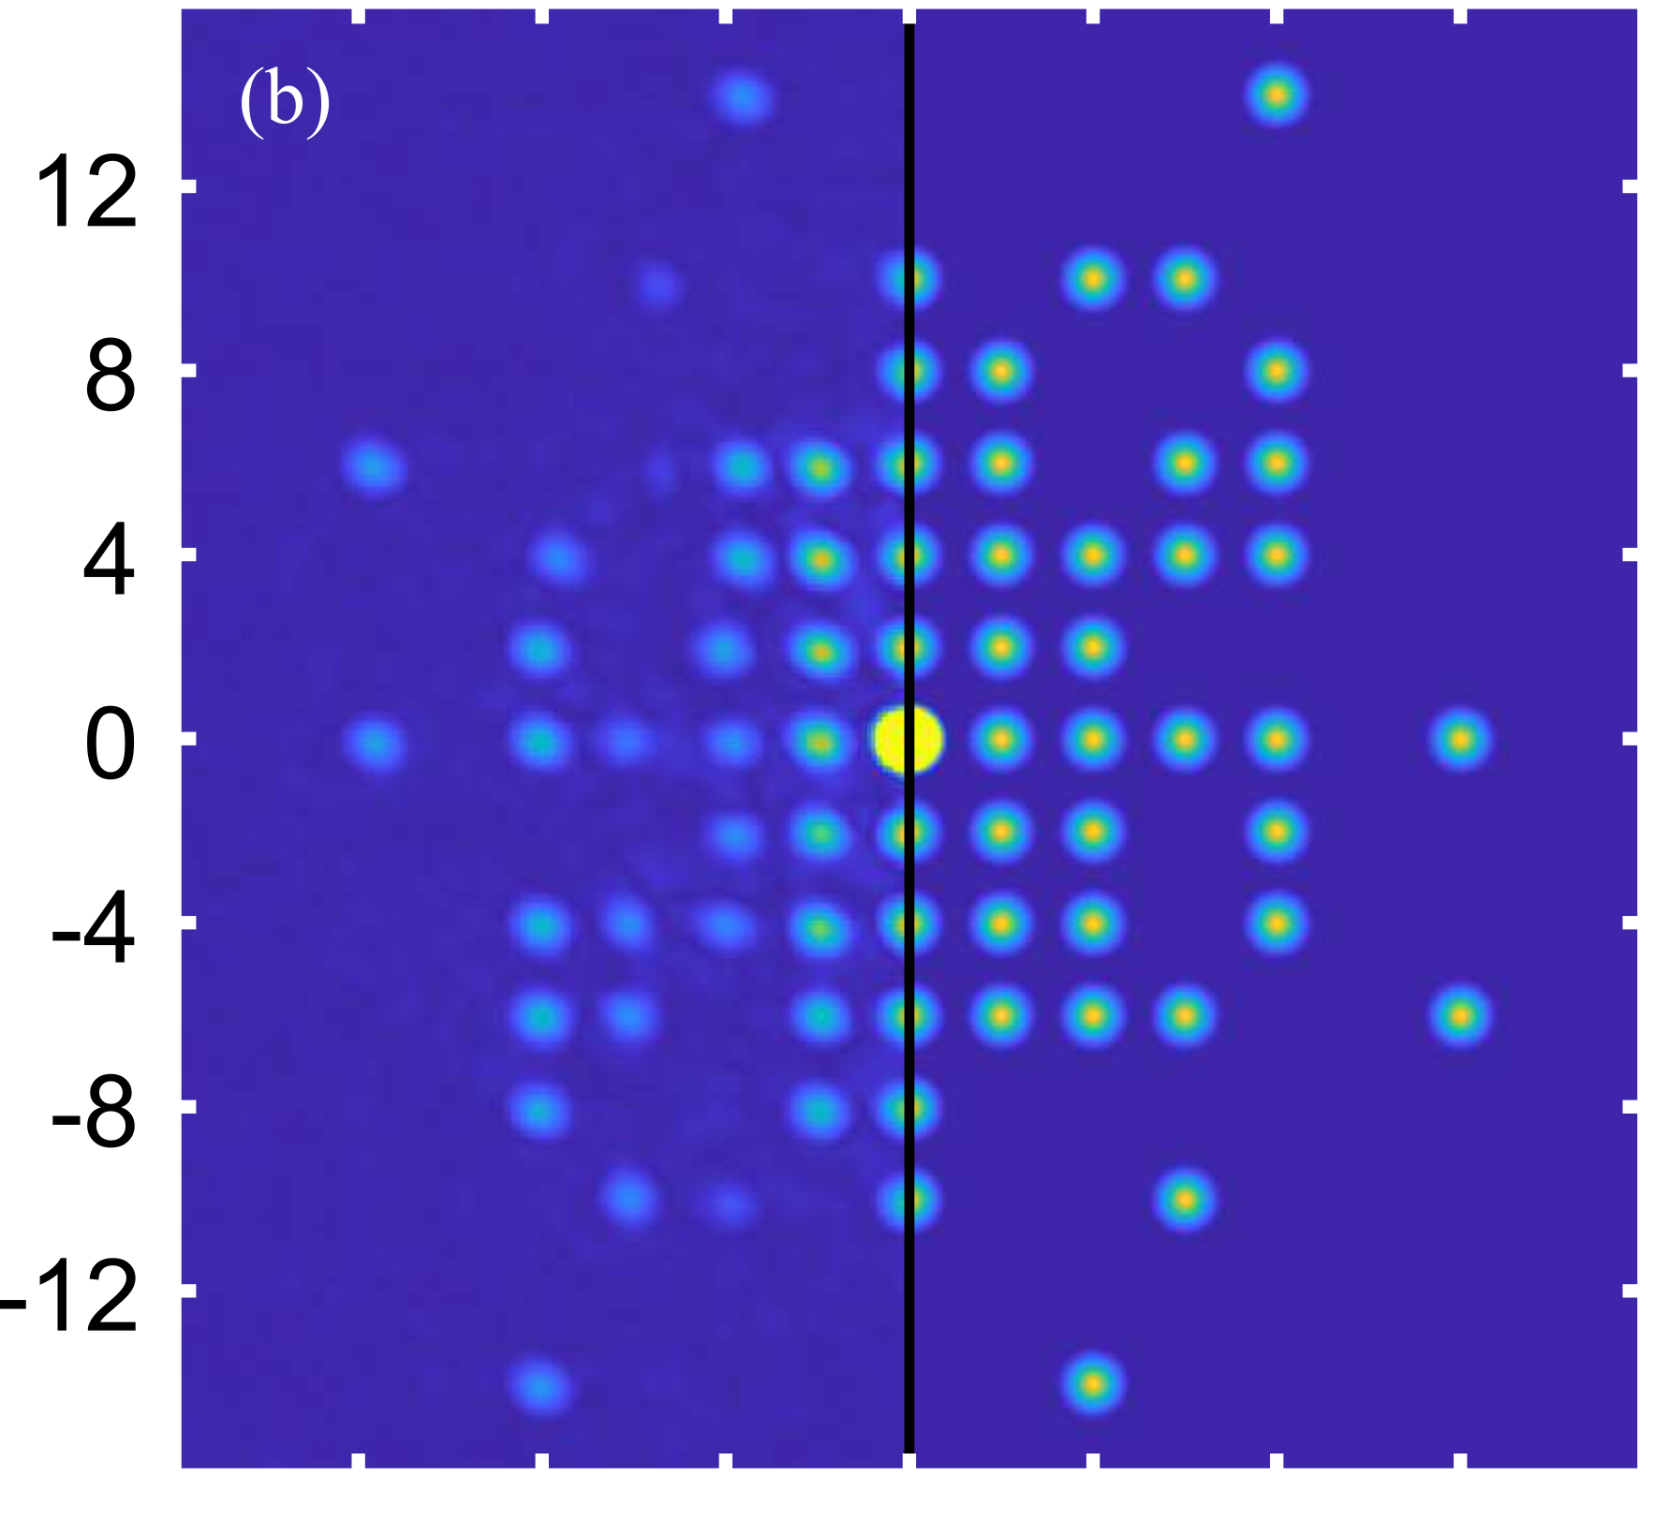
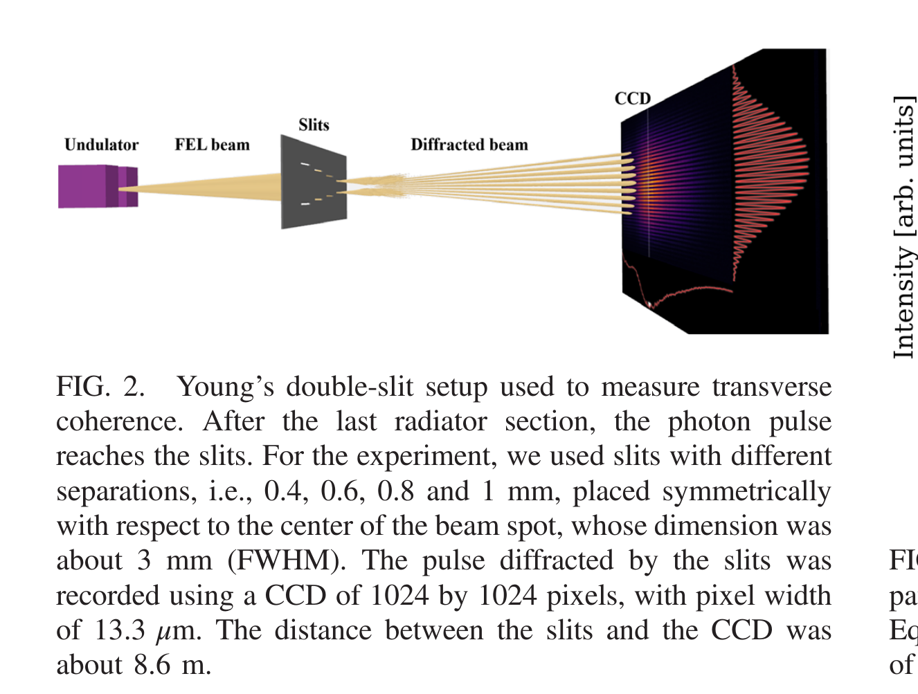
Extension to X-Rays & XFELs
NRA measurement of soft-X-ray (23nm) Plasma Laser
Albrecht et al 2023
v
v
Lensless Double-Slit at XFEL (14nm) Pop et al (2022)
Observed visibilities
9 hole mask

Slide 8
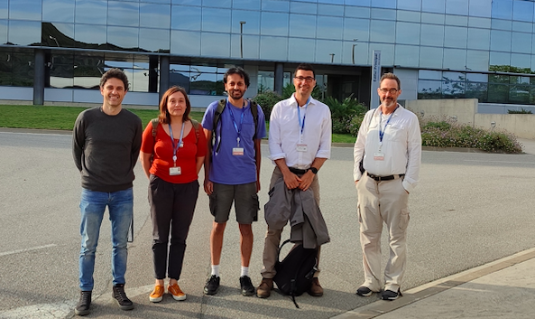
Advantages / Topics
Single-shot, no need for reference image
Real-time, joint derivation of source shape and optics/wavefront
No moving parts, non-invasive
Scalable to shorter λ (X-ray), higher resolution (dθ = λ/B)
Can be designed for more complex sources: more holes; sub-aperture and/or redundant self-cal
Optical bench at APS?
https://journals.aps.org/prab/abstract/10.1103/PhysRevAccelBeams.27.112802 , Two-dimensional synchrotron beam characterization from a single interferogram, Nov. 2024.
https://meow.elettra.eu/90/pdf/TUPMO09.pdf , Exploiting NRA Interferometry as a Diagnostics Tool for Synchrotron Light Characterization, Sept. 2025
http://dx.doi.org/10.1117/12.3062598 , A new method for wavefront sensing using optical masking interferometry. Proc. SPIE 13619, Unconventional Imaging, Sensing, and Adaptive Optics 2025, 136190V (18 September 2025)
https://arxiv.org/abs/2504.02036 Two-dimensional Light Beam Shape Characterization using Interferometric Closure Amplitudes, JOSA, Sept 2025
US patent 12,104,901
US patent app. No. 18/878,488
US patent app. No. 19/079,876

