Slide 1
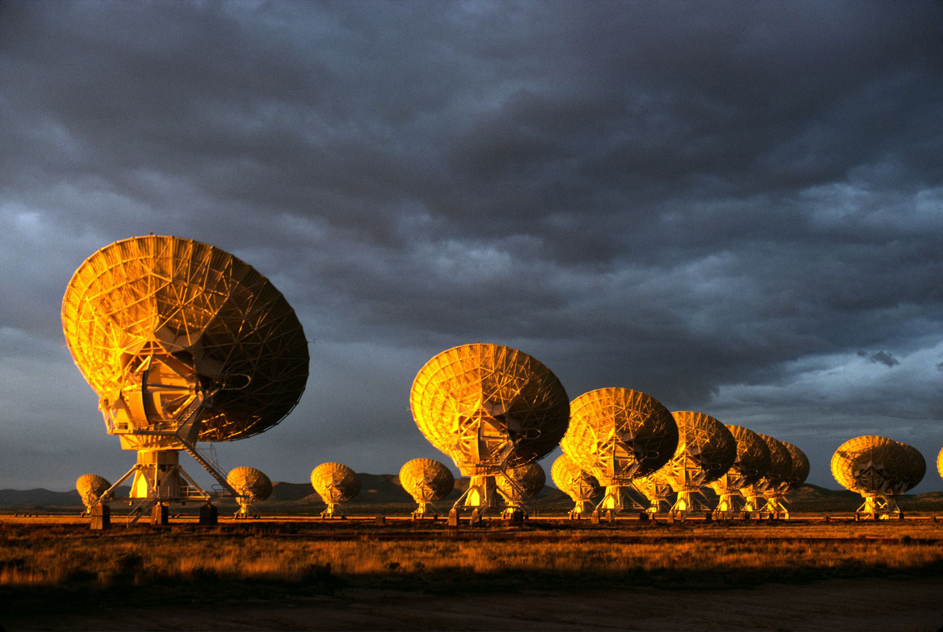
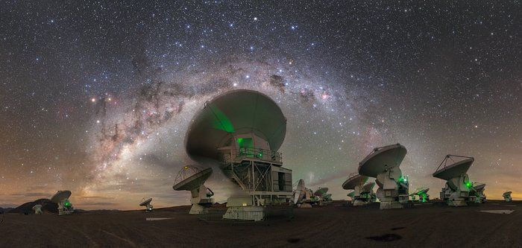
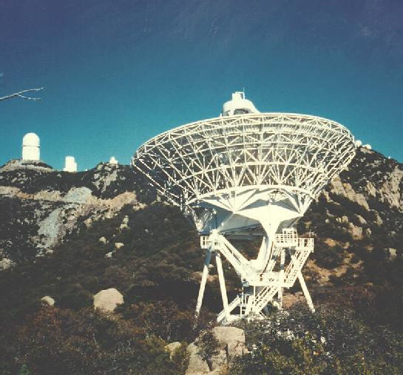
National Radio Astronomy Observatory, Interferometry, and ALBA SRI
Jansky Very Large Array
Atacama Large Millimeter Array
Very Long Baseline Array
1

Slide 2
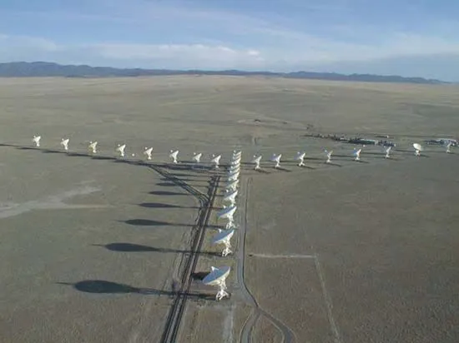
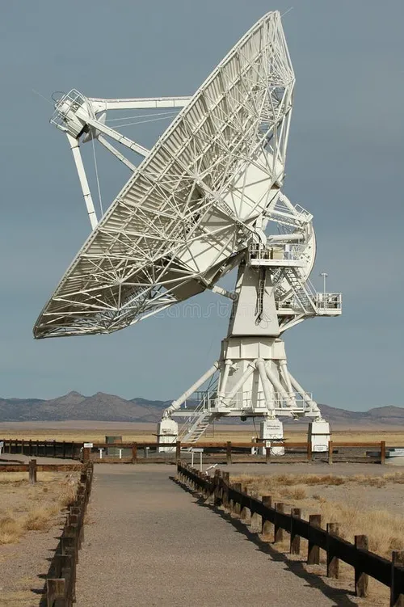
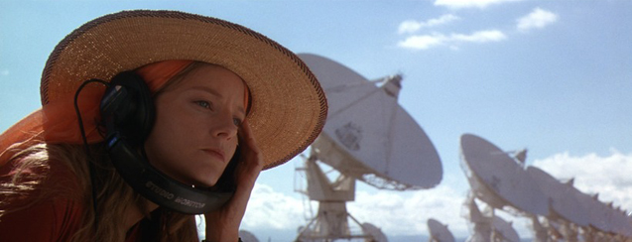
Very Large Array 1980 - present
27 x 25m antennas in Socorro NM USA (2000m)
75 MHz to 50 GHz
Baselines 30m to 40 km (resolution 70” to 50mas @ 32 GHz)

Slide 3
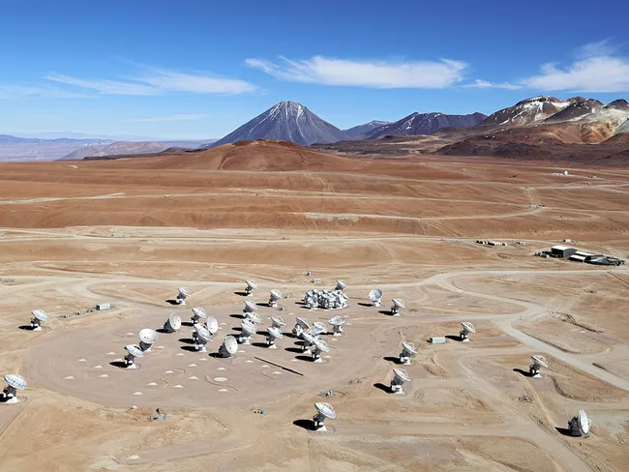
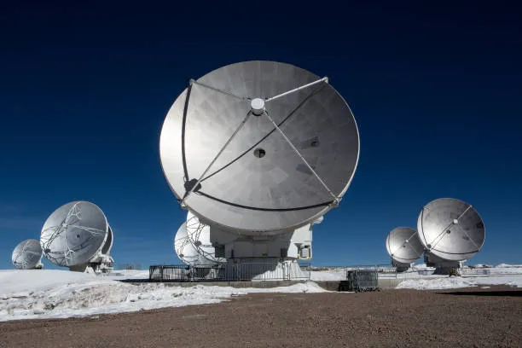
Atacama Large Millimeter Array 2011 - Present
54 x 12m antennas in Atacama Desert, Chile, 5000m
32 GHz to 950 GHz
Baselines 20m to 16 km (resolution 12” to 15mas @ 230 GHz)

Slide 4
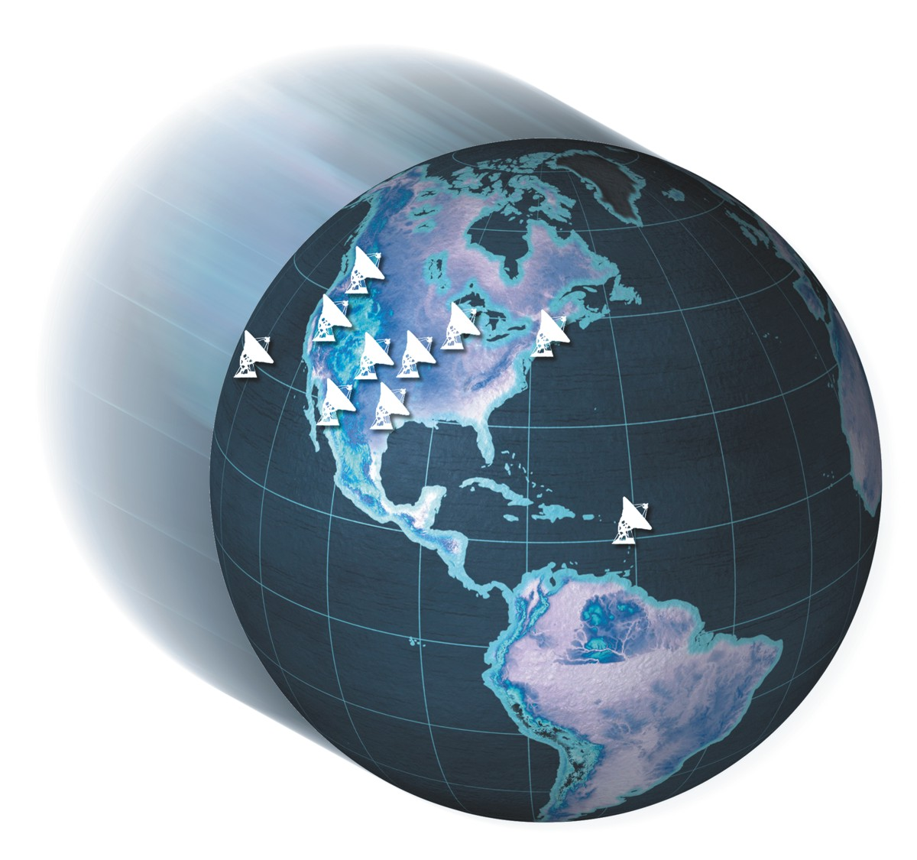
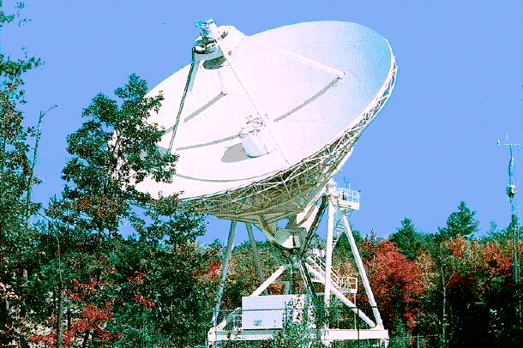
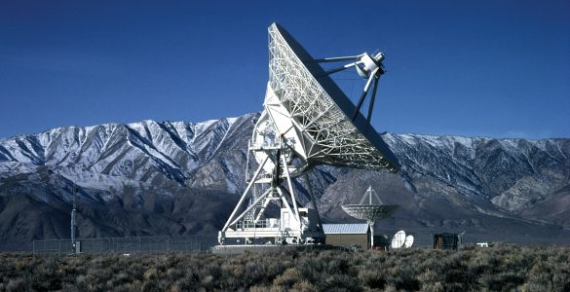
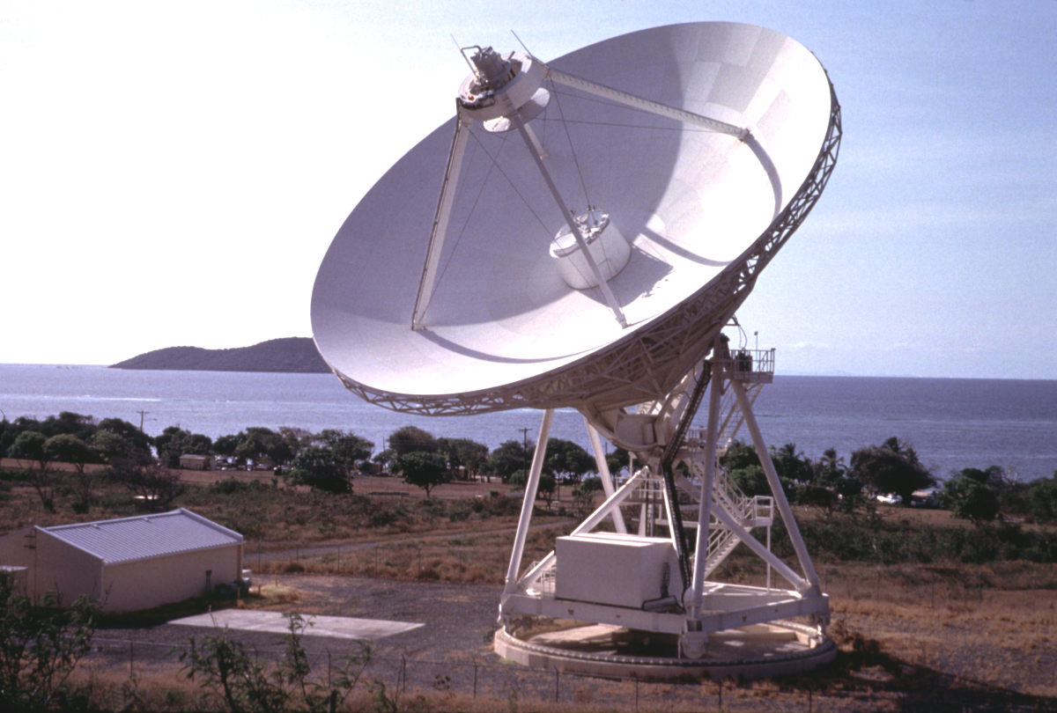
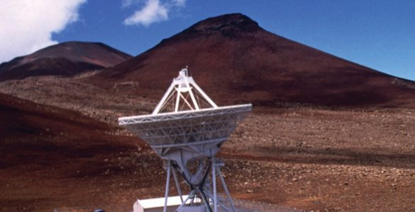
Very Long Baseline Array 1993 - Present
10 x 22m antennas across USA Hawaii to St. Croix
1.0 GHz to 90 GHz
Baselines 80km to 8000 km (resolution 0.1” to 1mas @ 8 GHz)
10 x 22m antennas across USA Hawaii to St. Croix
1.0 GHz to 90 GHz
Baselines 80km to 8000km (resolution 0.1” to 0.1mas @ 8 GHz)
Hancock 300m
Owens Valley 1000m
Saint Croix 0m
Mauna Kea 4000m

Slide 5
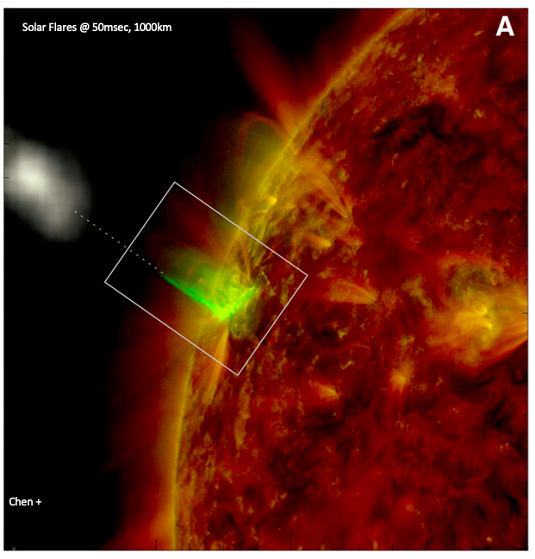
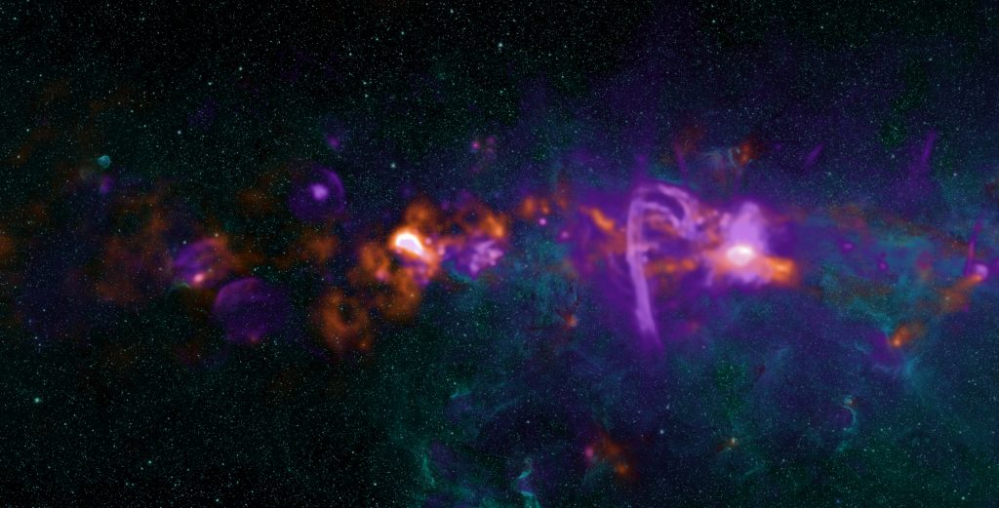
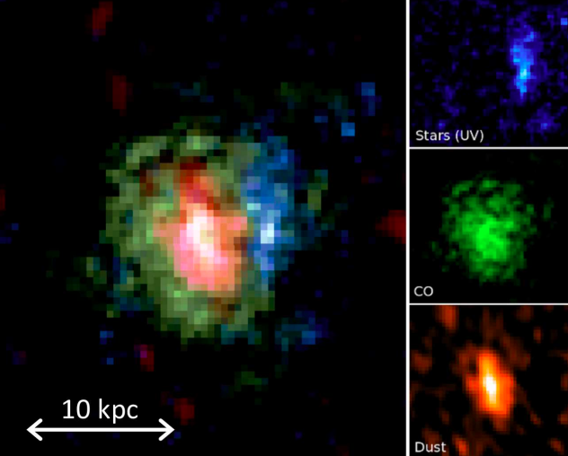
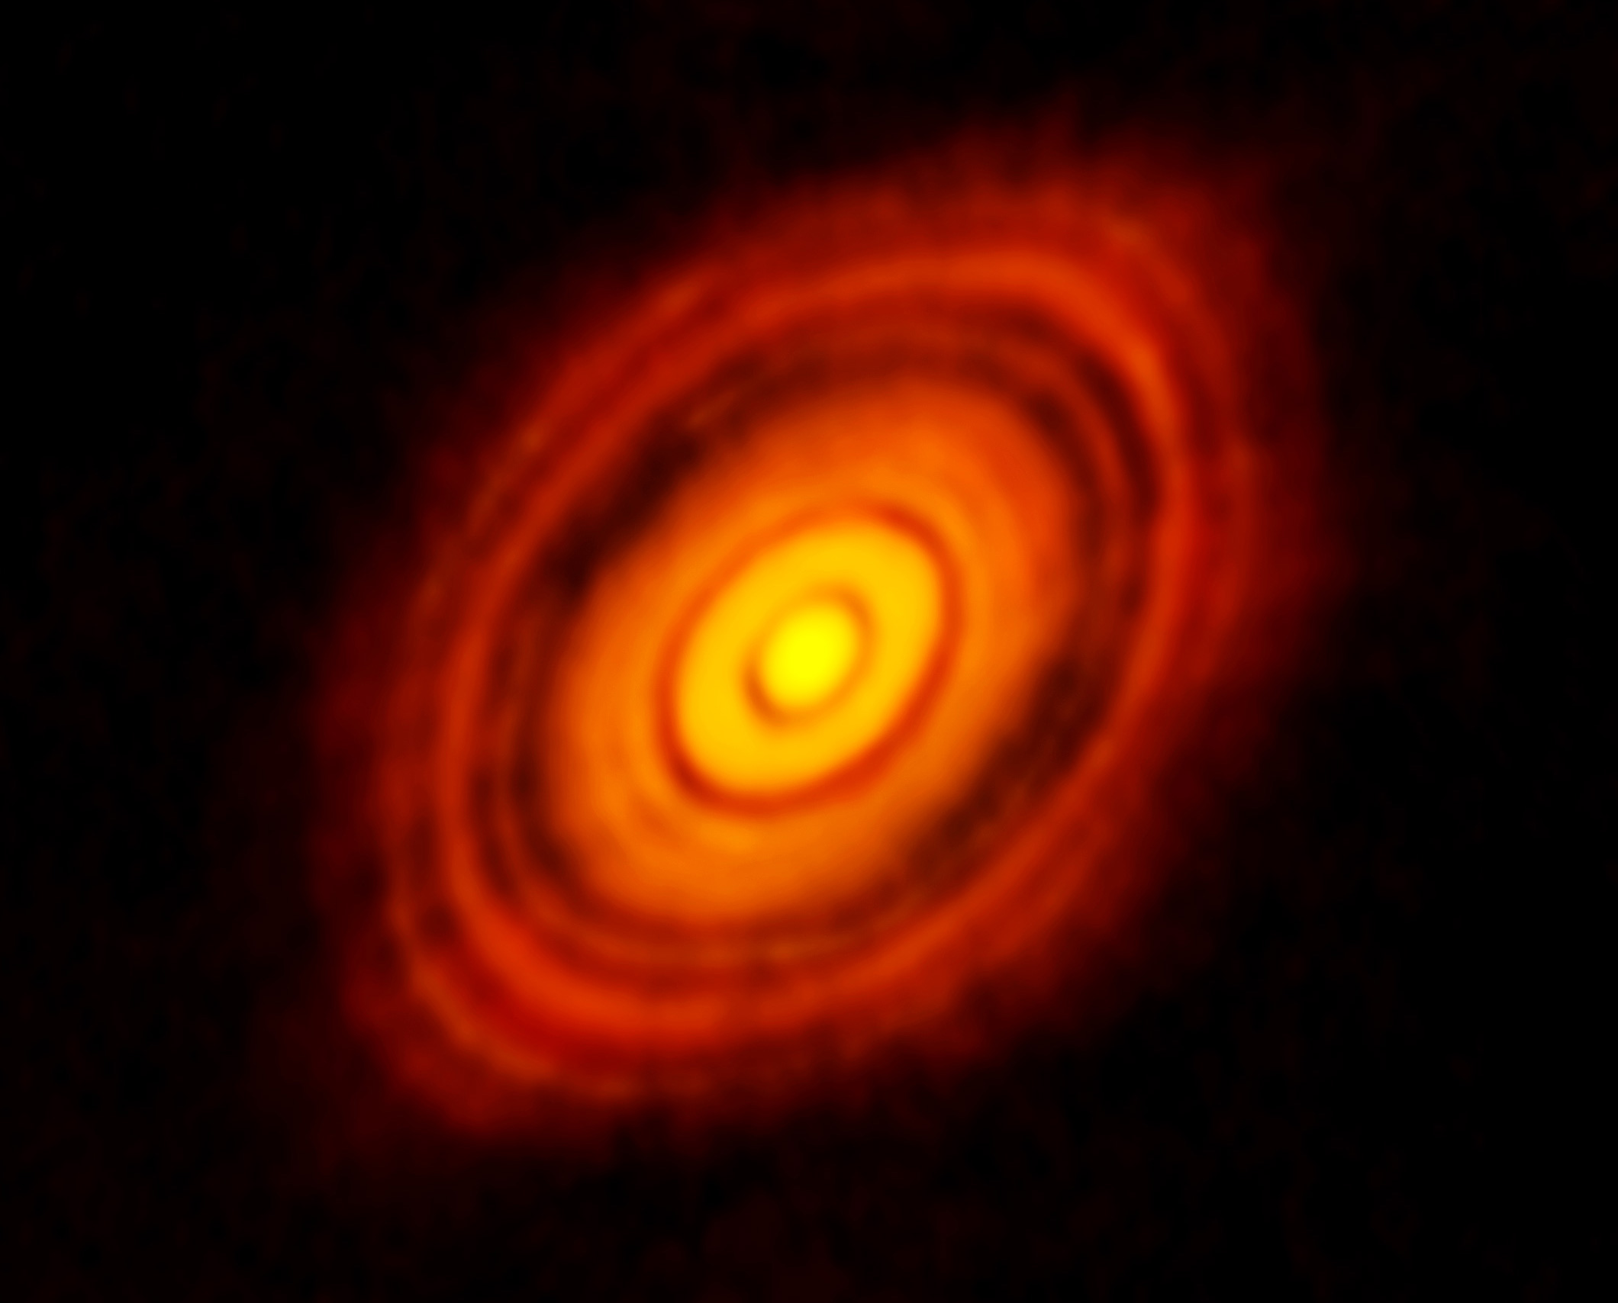
Science: the Sun to the Big Bang
t_{univ} ~ 2 Gyr
ALMA 250GHz (Brogan ea.)
130AU = 1”

Slide 6
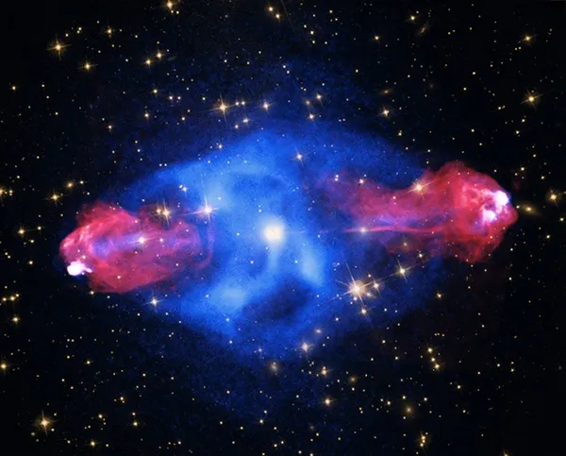
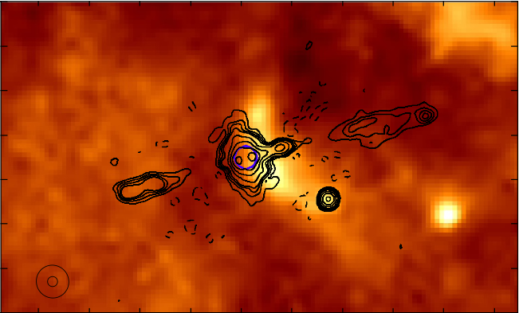
Size ~ 120 kpc = 360 klt-yr
V_{J} ~ 0.3c
n_{eR} < 10⁻⁵ cm⁻³ ; n_{eX} ~ 10⁻³ cm⁻³
T_{X} ~ 10⁸ K, M_{gas} ~ 10¹⁴ M_{o}
M_{BH} ~ 10⁹ M_{o}
L_{R} ~L_{X} ~L_{opt} ~10⁴⁵ erg/s = 10¹² L_{o}
E_{tot} ~ 10⁶⁰ erg
Powerful Radio Galaxies: the most extreme objects in the Universe and ultimate cosmic synchrotron lab

Slide 7
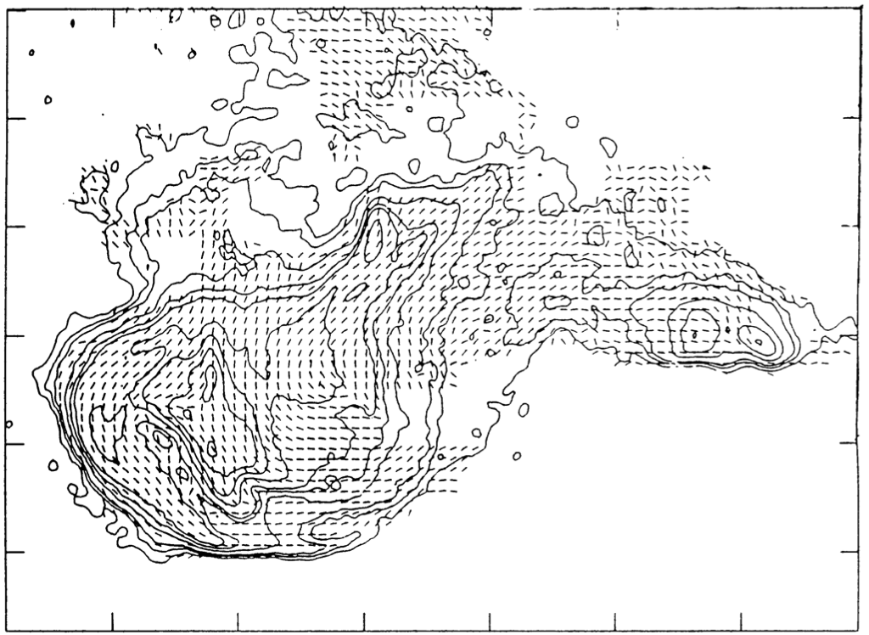
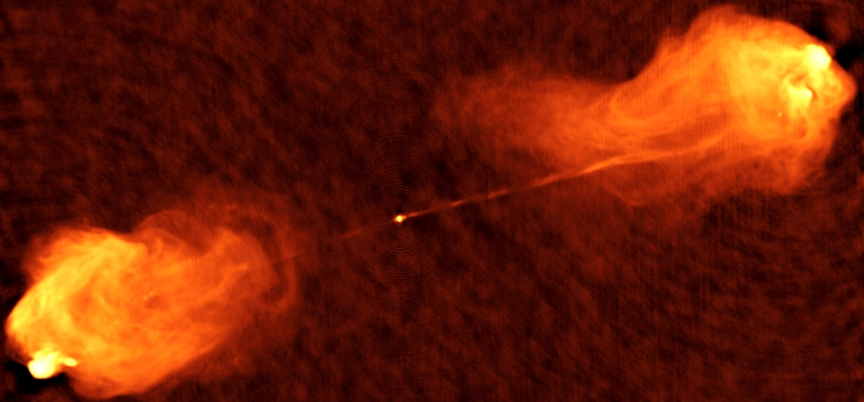
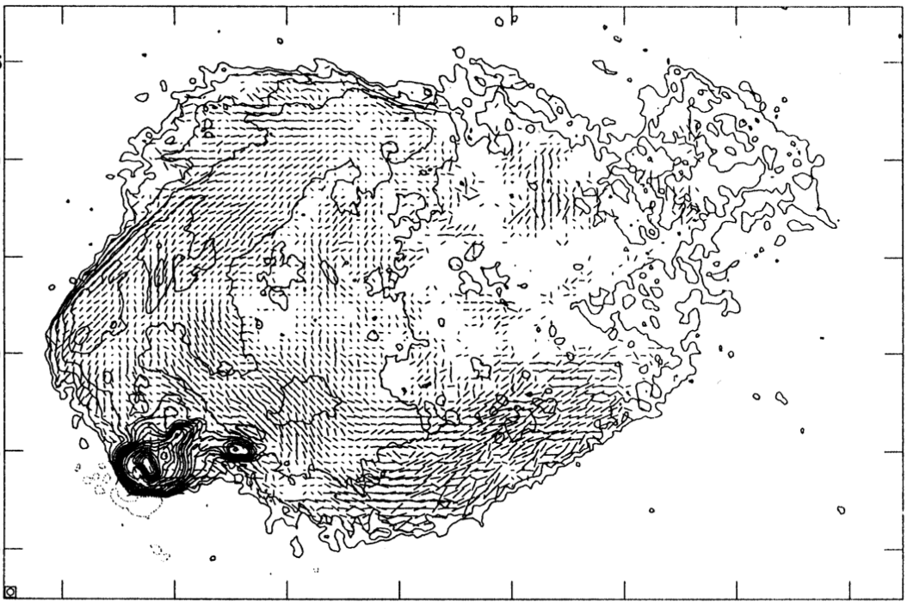
Cosmic Synchrotron Laboratory
F_{pol} ≤ 70%
B_{Requ} ~ 60 uG
B_{Xrm} ~ 5 uG

Slide 8
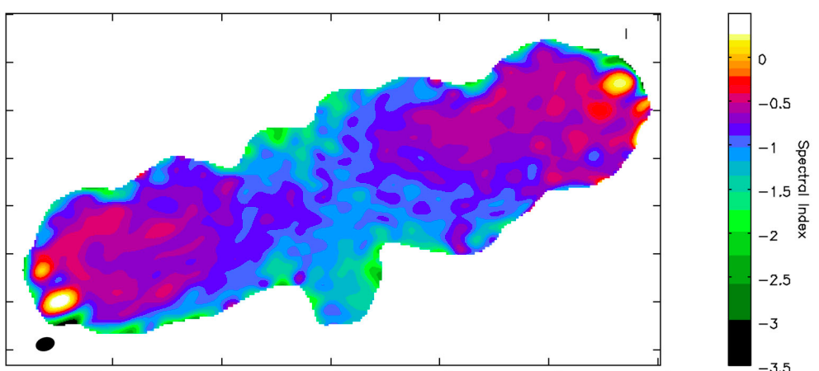
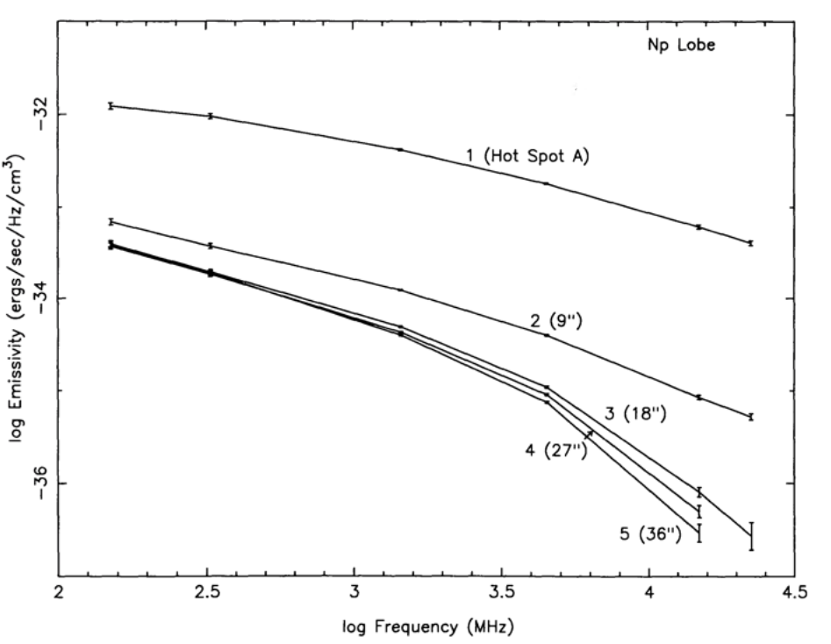
Synchrotron Aging
N_{e} ∝ E^{s}
I_{𝛎} ∝ 𝛎^{𝞪} ; 𝞪 = (s+1)/2
d𝜸/dt ∝ 𝜸² B²
𝛎_{B} ∝ 𝜸² B
t_{e} ∝ 𝛎_{B}^{-1/2} B^{-3/2}
t_{max} ~ 30 Myr
v_{adv} ~ 0.01c

Slide 9
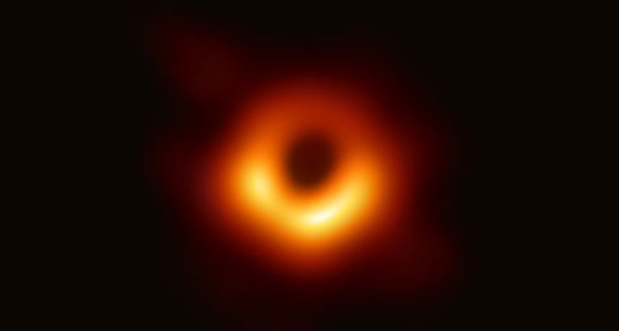
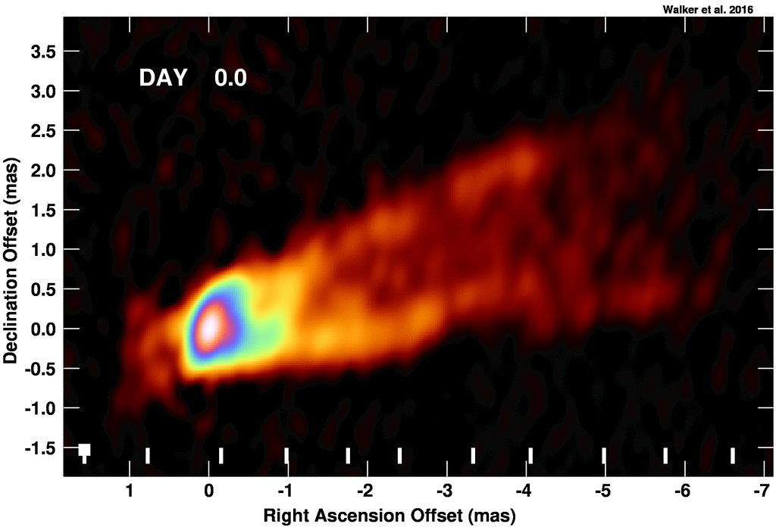
M87 EHT 230 GHz @ 20uas resolution
M_{SMBH} = 6.5 x 10⁹ M_{o}
42uas = 5.6 R_{s}
V_{app} up to 6c
Walker + 2018

Slide 10
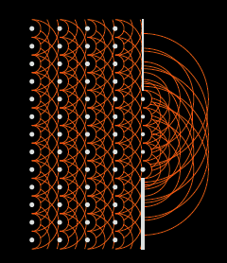
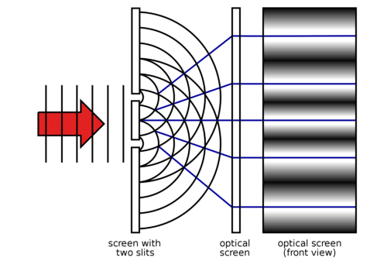
Interferometric Imaging at ALBA
Fourier Optics and Huygens Principle

Slide 11

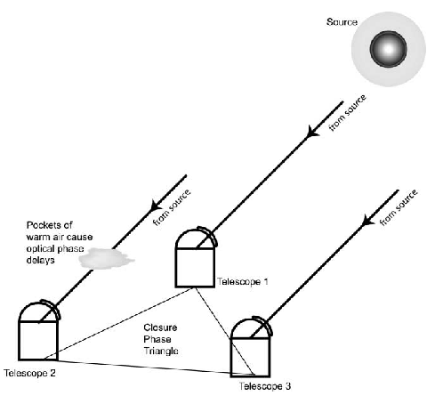

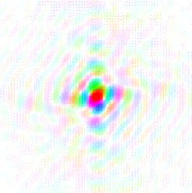





Van Cittert – Zernike Theorem
The cross-correlation, or coherence, between the electromagnetic voltages measured at spatially distinct locations (’apertures’) = Fourier transform of the intensity distribution of light from the source
Image plane
V_{i,j} = A_{i,j,} 𝝓_{i,j}
FT
y
v
Aperture plane
u_{i,j} = (B_{i,j} / 𝜆)
u
x
‘dirty image’
‘self-calilbration’

Slide 12
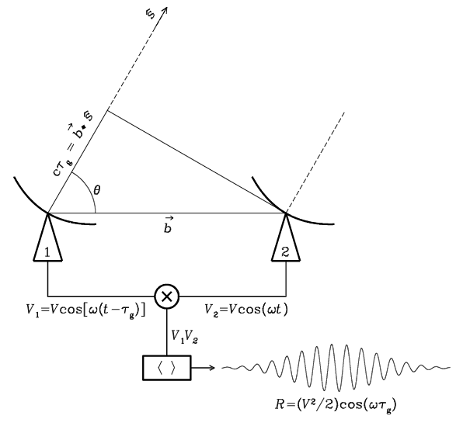
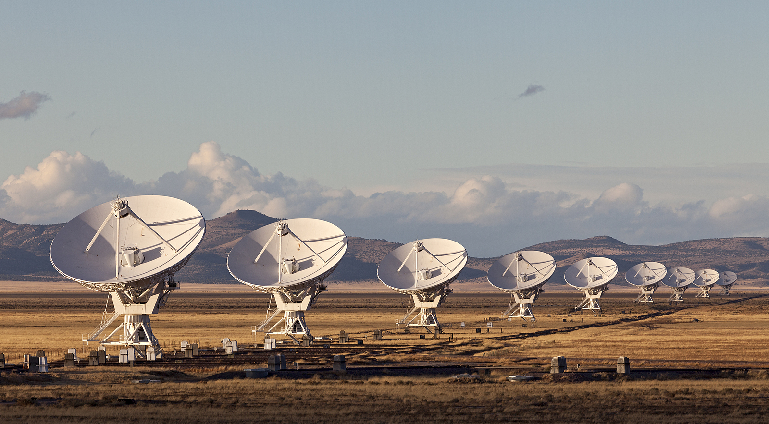

Radio measurements are visibilities = aperture plane
V_{i,j} = E_{i} x E_{j}* = A_{i,j,} 𝝓_{i,j}
Coherent amplification of voltages, E
Geometric delays set by electronics
Complex cross multiply and average (correlate) to visibilities
Images made from Fourier transform of visibilities

Slide 13
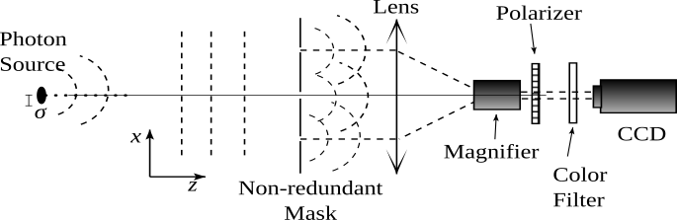
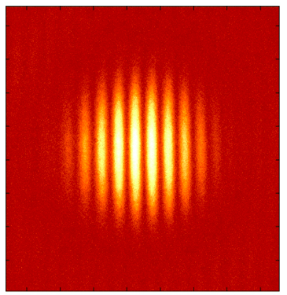
Optical measurements are images
V_{1,2} (A_{i,j,} 𝝓_{i,j}) = FT(Image)
Aperture mask + coherent focus with lens (or mirrors)
Direct imaging of fringe pattern
Visibilities generated from FT(image)

Slide 14
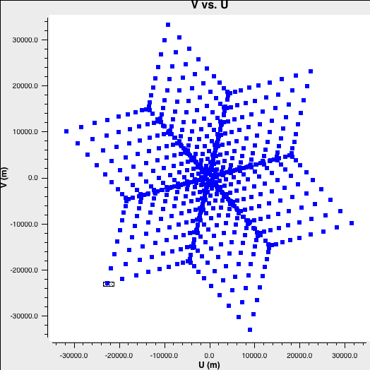
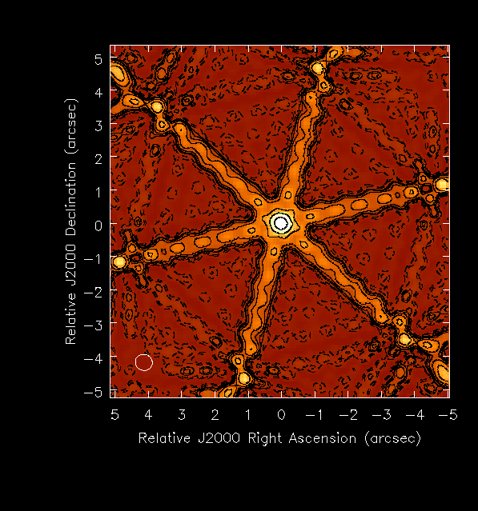
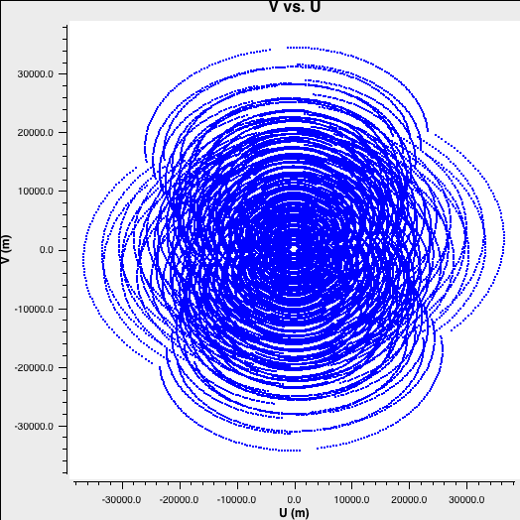
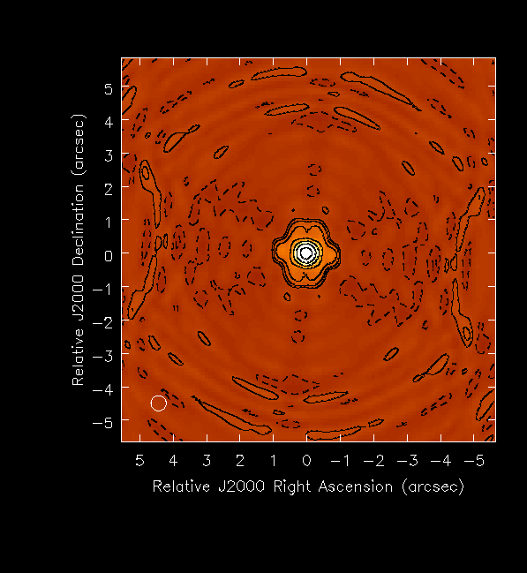
Quality of image depends on number of Fourier components:
N_{uv} = N_{ant}((N_{ant}-1)/2) = 351
PSF
Fourier = u,v coverage
FT
Sidelobes ~ 0.3
Earth rotation and bandwidth
N_{uv} = 351 x n_{t} x n_{ch} > 10⁵
Sidelobes ~ 0.03

Slide 15
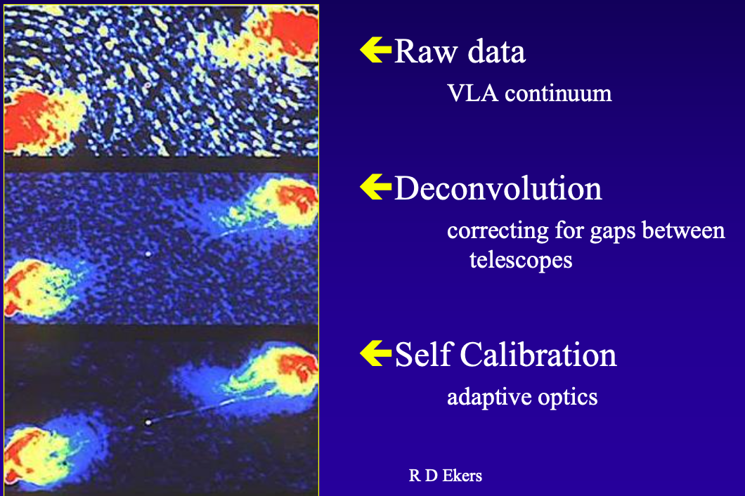
DNR ~ peak/rms ~ 100
= Wavefront sensor
DNR ~ 10⁵

Slide 16
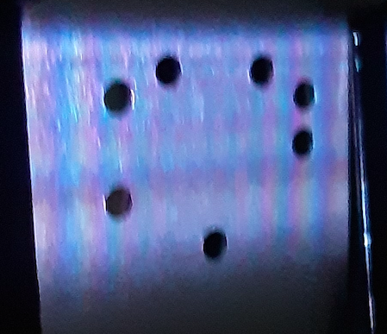
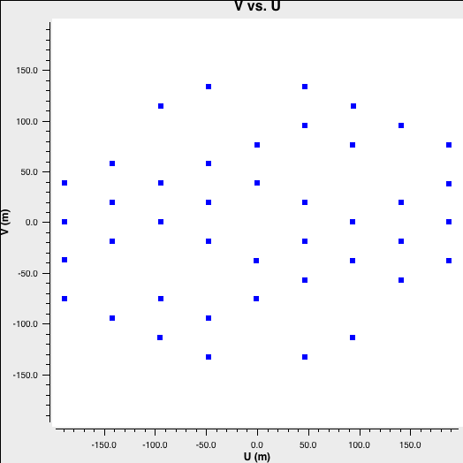
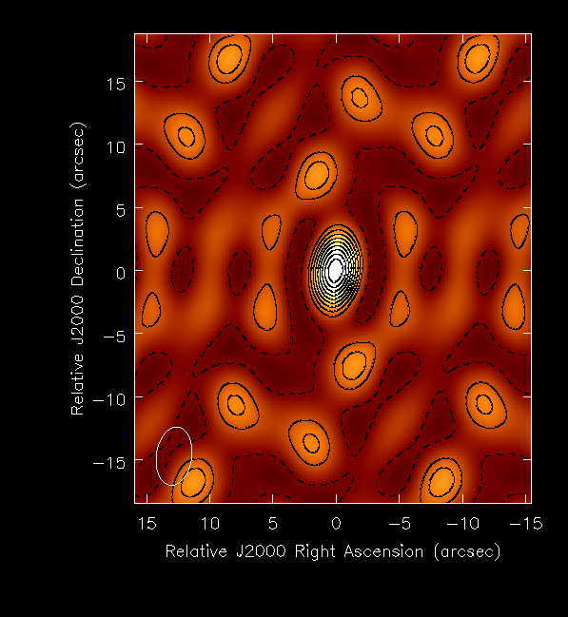
Non-redundant 7 Aperture Mask for ALBA SRI
N_{uv} = 21
PSF
FT
Sidelobes ~ 0.25

Slide 17
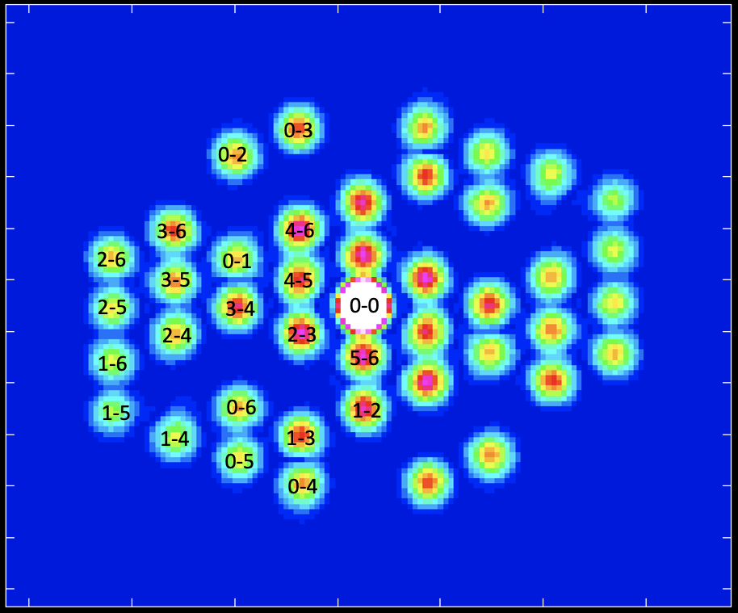
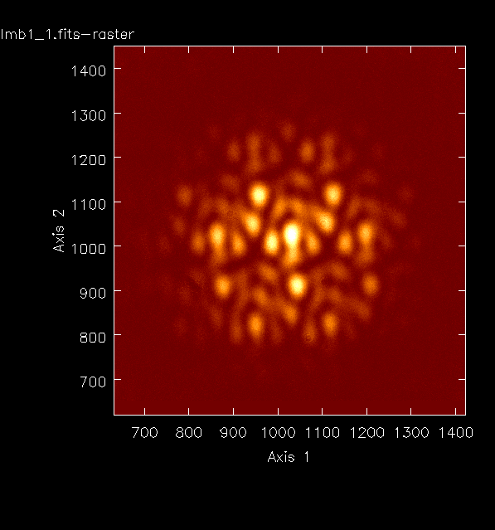
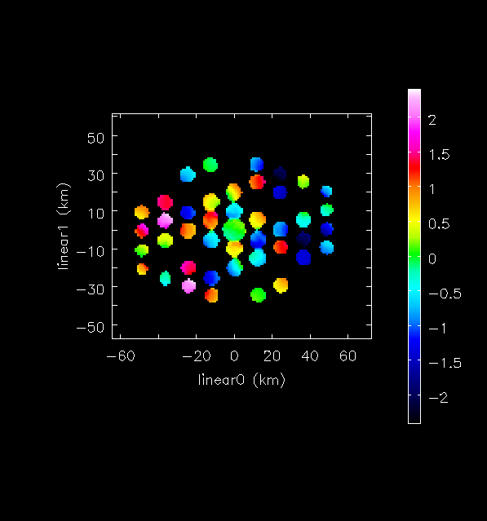
Amp
ALBA 7hole Dirty Image
FT
Phase

Slide 18
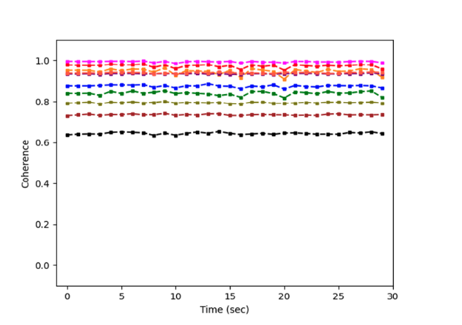
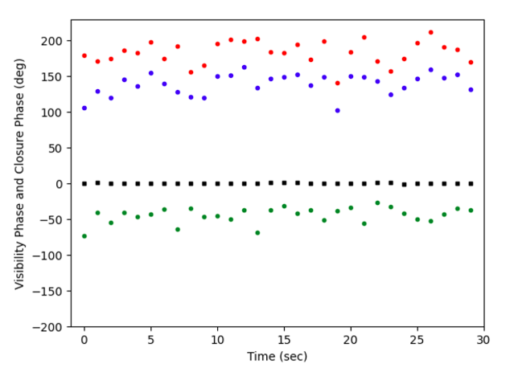
Visibilities: 30 exposures, 1msec every 1 sec
Stable amplitudes: rms < 1%
High coherences > 60%
Phases: rms ~ 15º
Vibrations and/or turbulence
[Closure phase 0º; rms < 1º ]

Slide 19
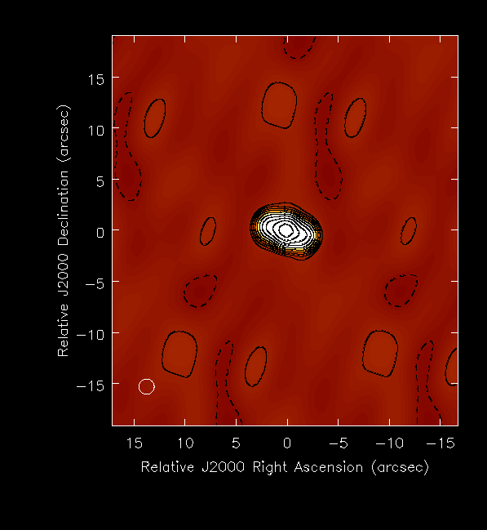
Visibility Self-cal + CLEAN deconvolution
DNR ~ 20
DNR ~ 2000
FWHM ~ 2” = 140um

Slide 20
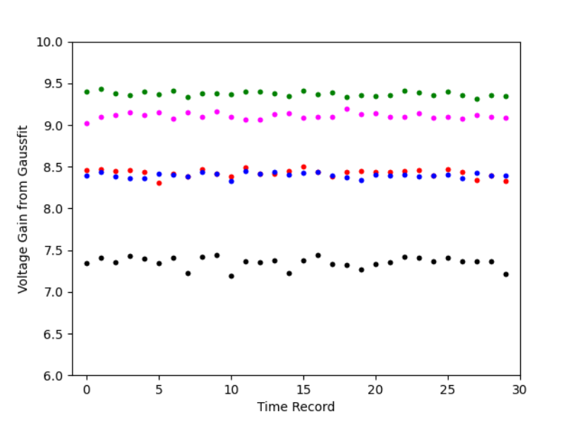
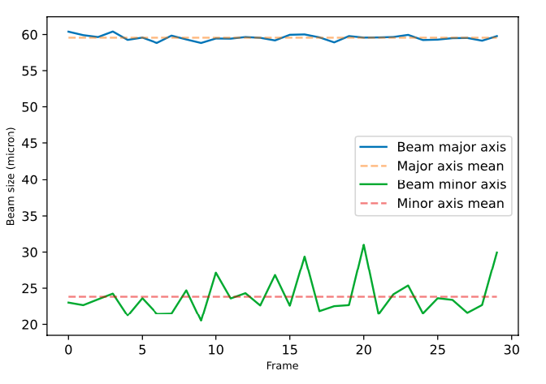


Gaussian model fitting to data
Selfcal gains: stable < 1%

Slide 21
Why Self-Calibration?
Ap3 0.122, 12.6º
Ap4 0.117 -57º
Ap5 0.117 -114º
Ap2 0.121, -20º
Ap6 0.129 -80º
Ap1 0.109, -78º
Ap0; 0.098, 0º
Hole-based gain solutions
Amp: illumination ~ 31% voltage differences
Phase = wavefront sensor: dL_{𝜸} = 𝝺 x (d𝞍/360º)
gradient: tip/tilt
Jitter: rms ~ 15º = 22nm

Slide 22


Why non-redundant Mask?
rms fluctuations: redundant samples ~ 6x non-redundant

Slide 23
Summary
New SRI method for rapid (msec), accurate, non-invasive 2D beam characterization
Self-calibration corrects for non-uniform illumination
Non-redundancy avoids decoherence and image smearing
Self-cal phase solutions provide precise, rapid wave-front sensor (photon pathlength)
Future
Higher resolution: shorter wavelengths
More holes: generalize to more complex sources

