Slide 1
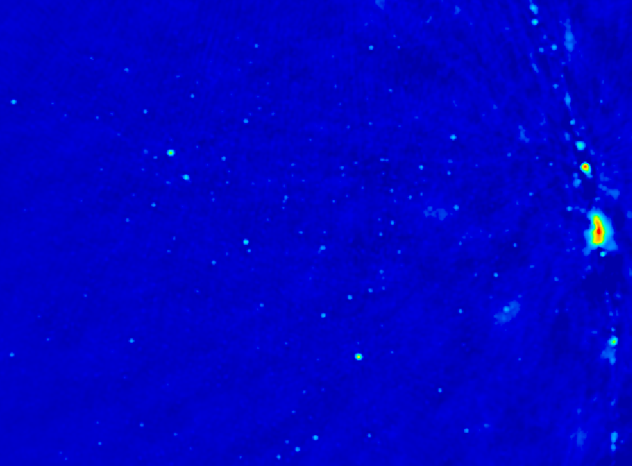
Imaging on PAPER: science on the way to reionization
Unique imaging parameter space
  Extremely wide fields: Continuous ‘all-sky’ monitor (RSST)
  Sensitive to LSS (15’ to 15º)
  Broad freq range (120 to 180MHz)
Important tests of high dynamic range calibration and imaging techniques: AIPS and CASA
First results
  Cen A
  Galactic Center

Slide 2
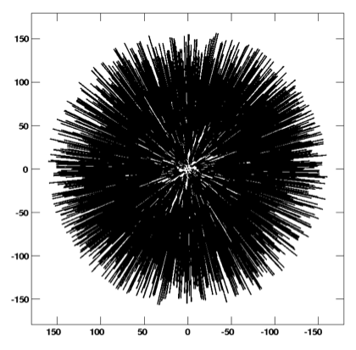
PAPER snap shot UV coverage – 64 antennas

Slide 3
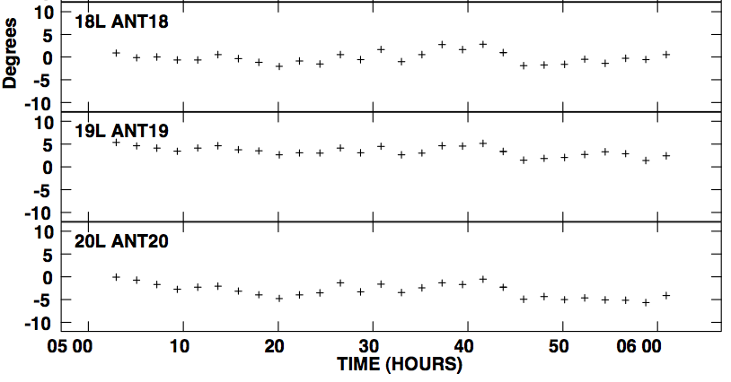
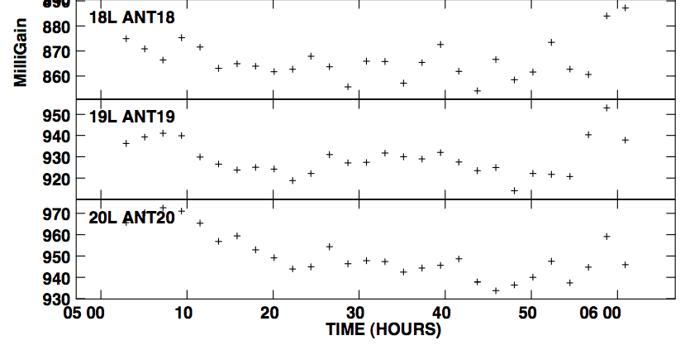
Stable system: selfcal gain solutions
Few deg over 1hr
Few % over 1hr
10º
2%

Slide 4
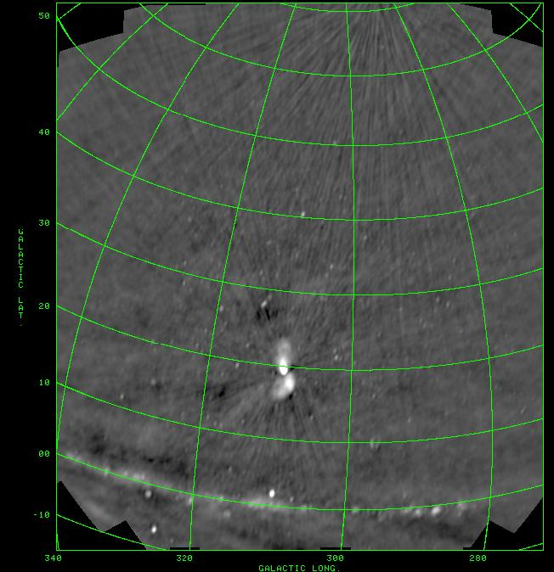
PSA64, July 2011
10min snapshots
BW = 60MHz
DNR ~ 1000
Weakest src ~ 1Jy
10º

Slide 5
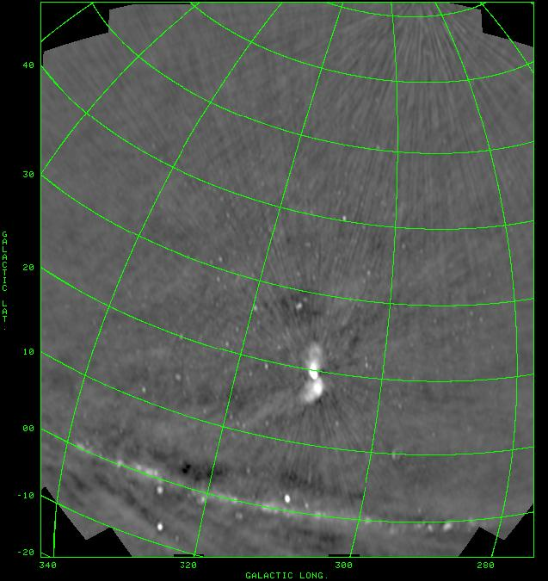

Slide 6
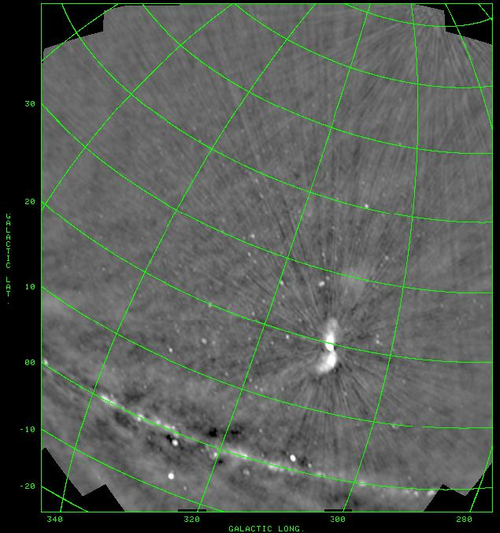

Slide 7
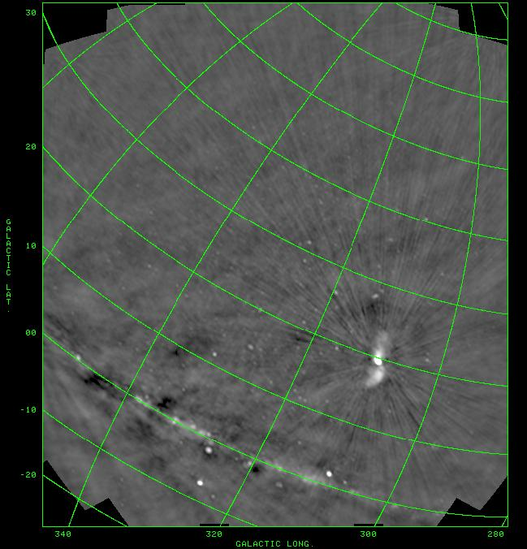

Slide 8
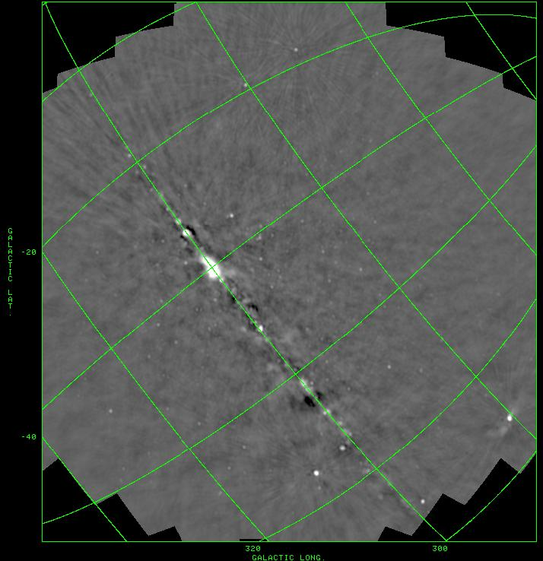

Slide 9
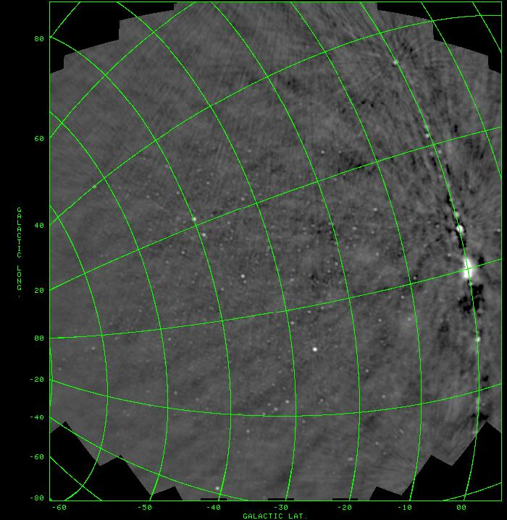

Slide 10
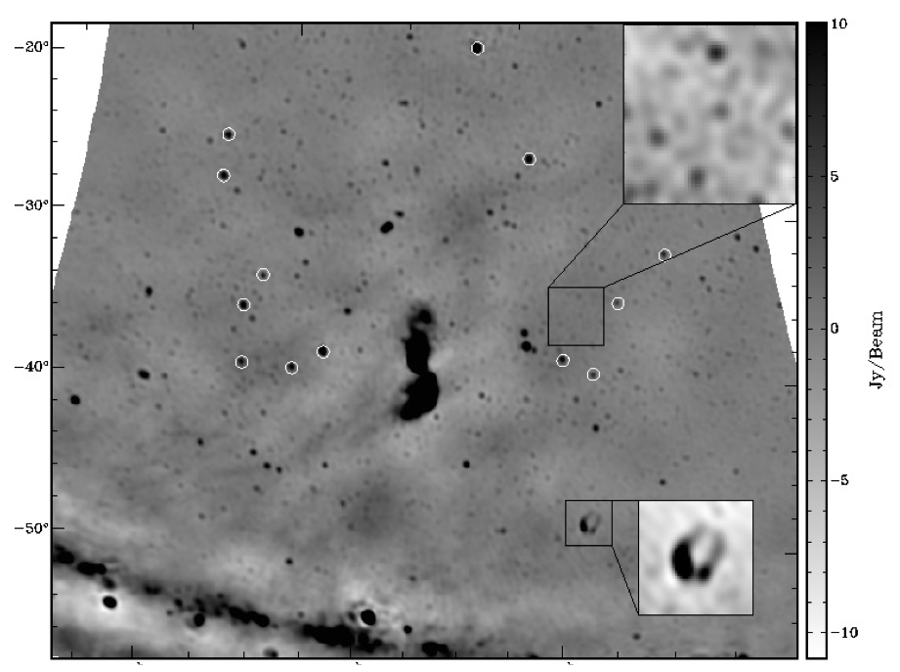
Centaurus A (Stefan ea)
Closest giant radio galaxy
4days x 3hrs/day
rms=0.5Jy
10º ~ 600 kpc

Slide 11
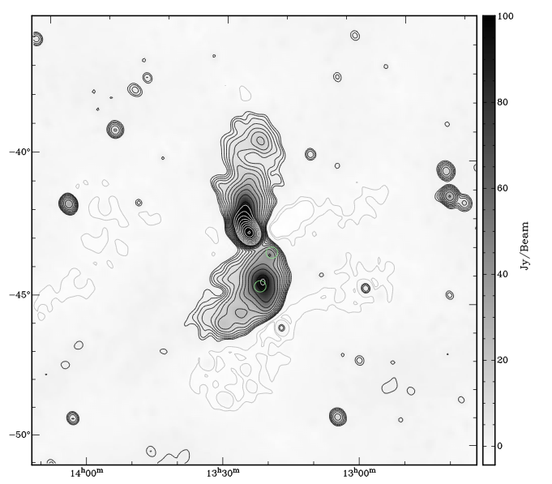
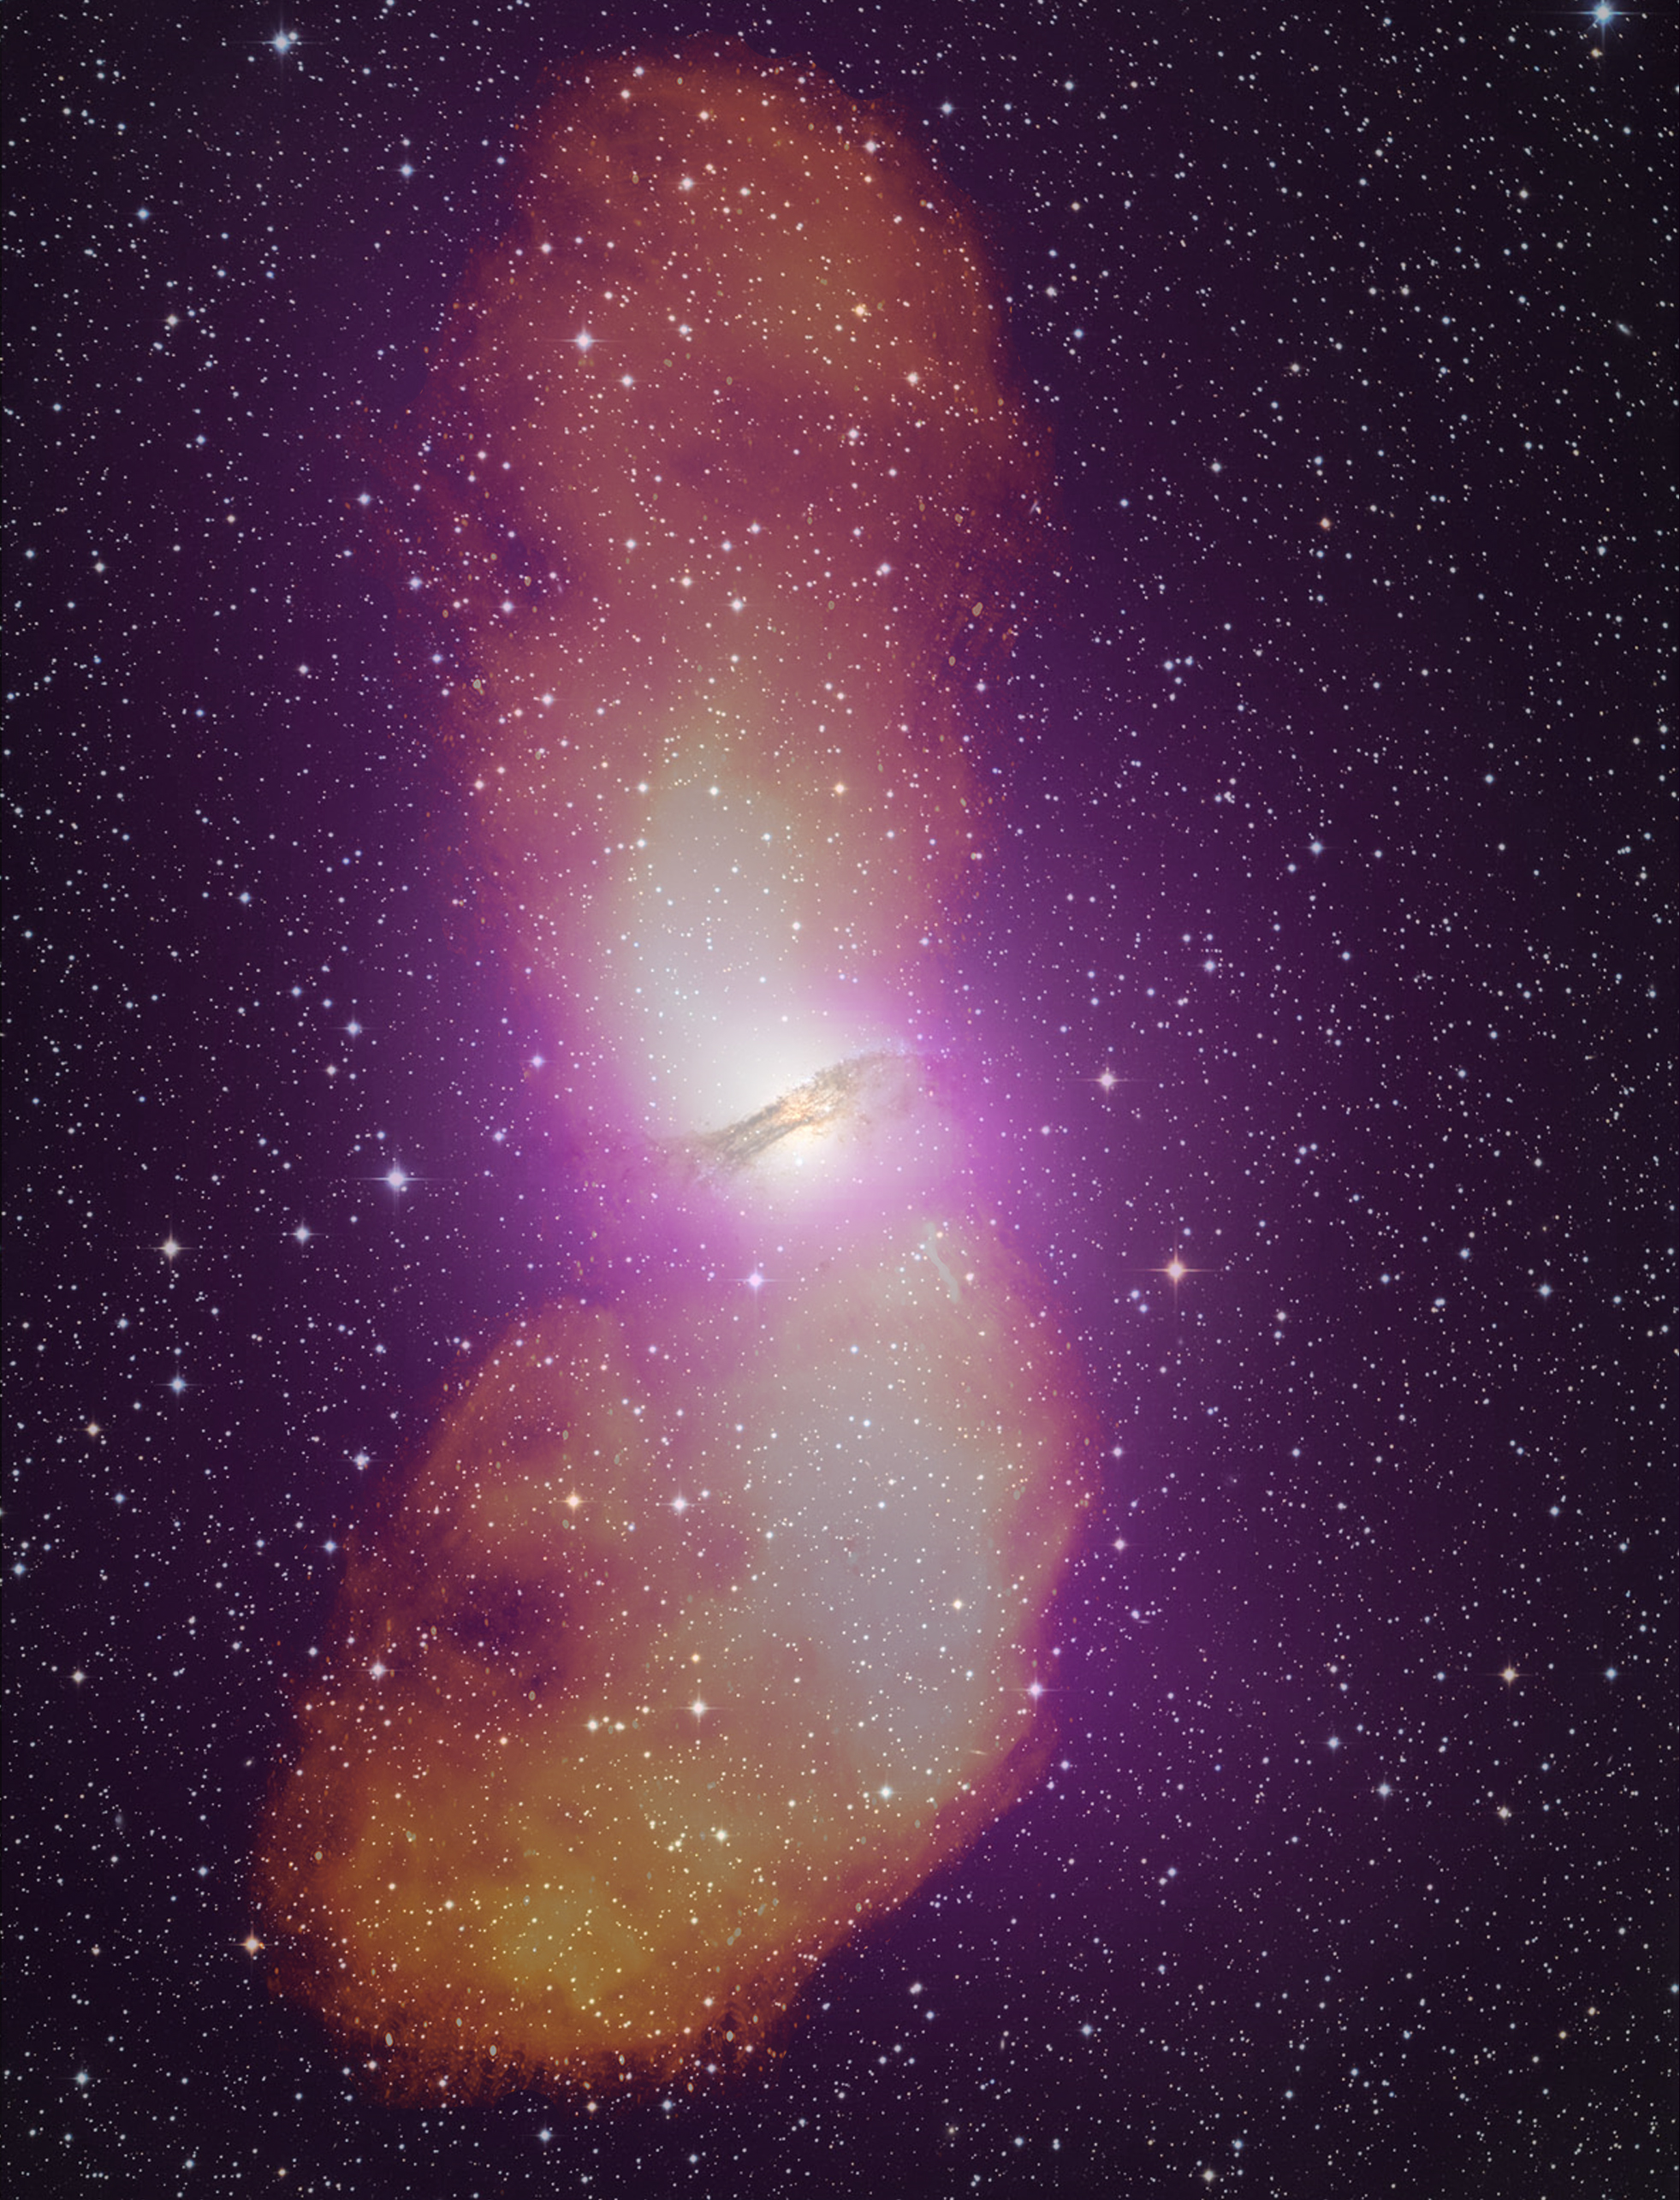
Cen A: imaging and spectra
Parkes: 1.4 GHz
(Feain ea)
PAPER: 120 to 180MHz
Stefan ea 2012

Slide 12
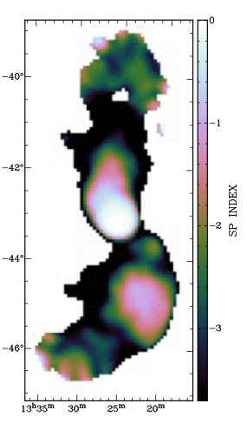
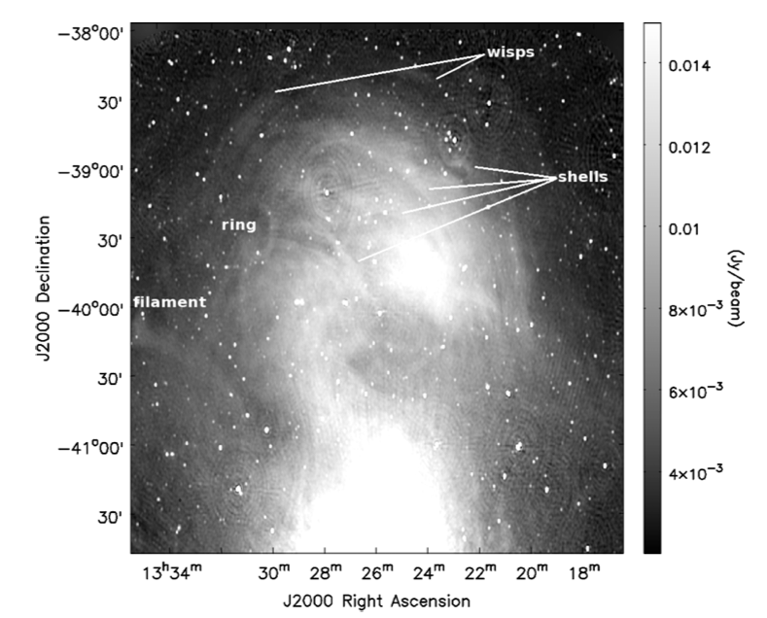
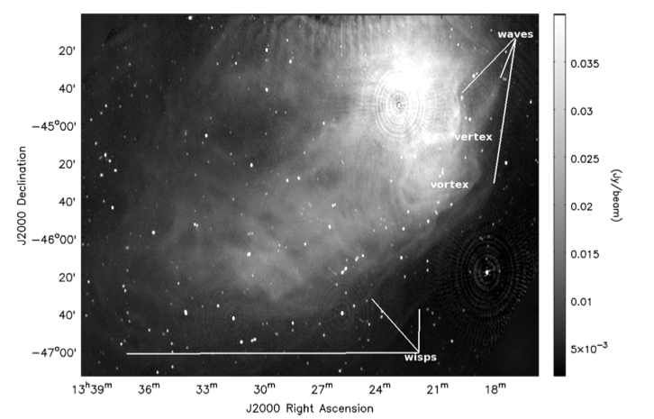
SI
Spectral flattening in regions of ‘heavy weather’: Vortices shells, rings, waves (Feain ea) => local particle acceleration

Slide 13
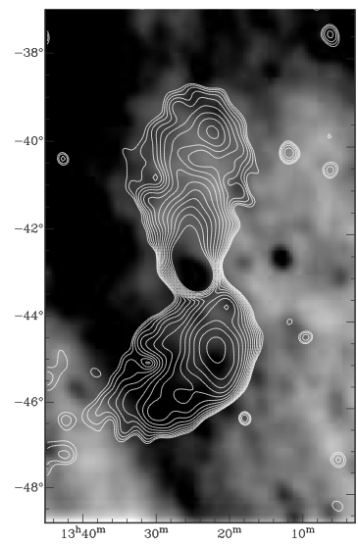
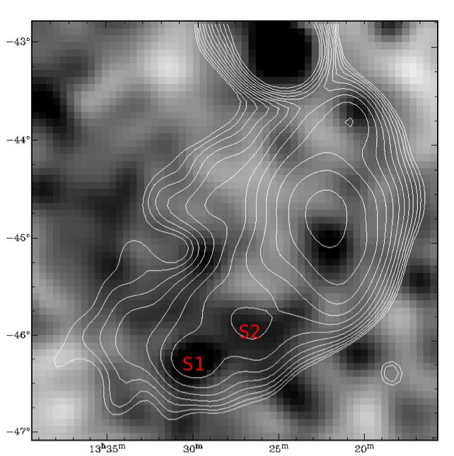
Rosat All Sky Survey
Xray: correlations (and anti-correlations)
‘Cavity in North’?
Knots in South = IC: B ~ 1 uG ~ B_{MP}
Lobe pressure ~ IGM ~ 10⁻¹³ dyn cm⁻²

Slide 14
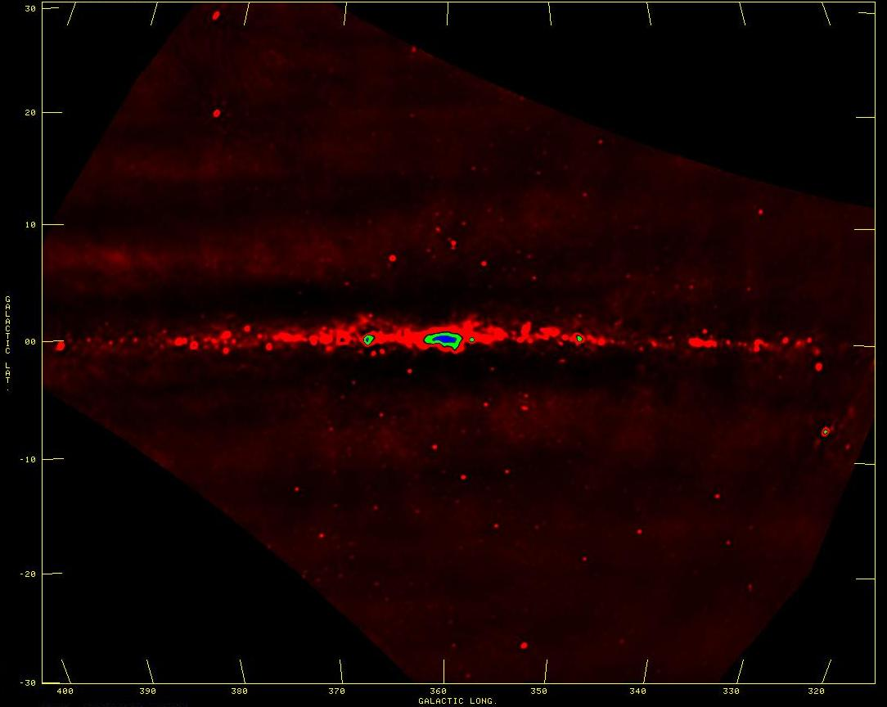
Galactic studies
SNR searches, spectra, imaging: find the missing large SNR?
Galactic HII regions: free-free abs => 3D study of thermal/nonthermal ISM
W28-SNR + M8-HII
SgrA*
10º
CTB37-SNR

Slide 15
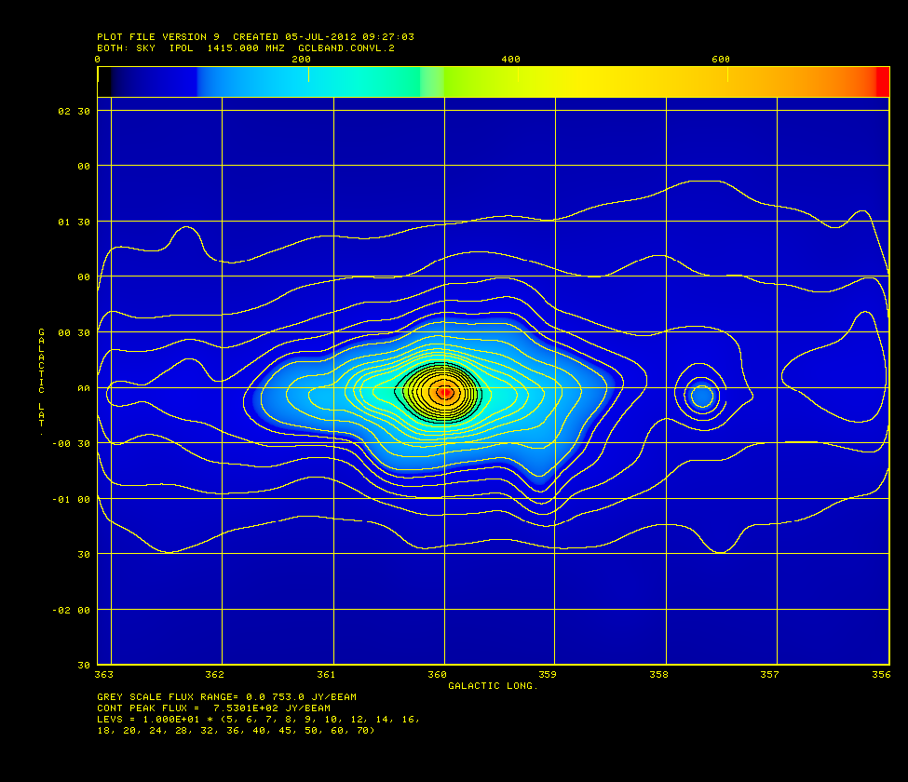
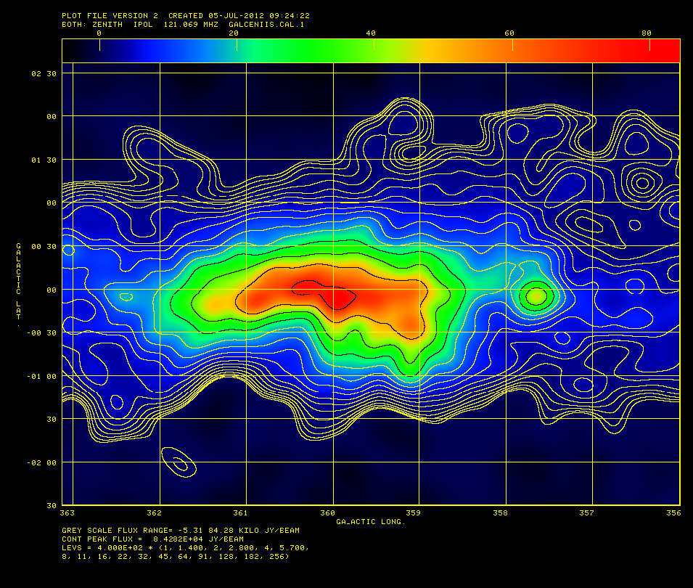
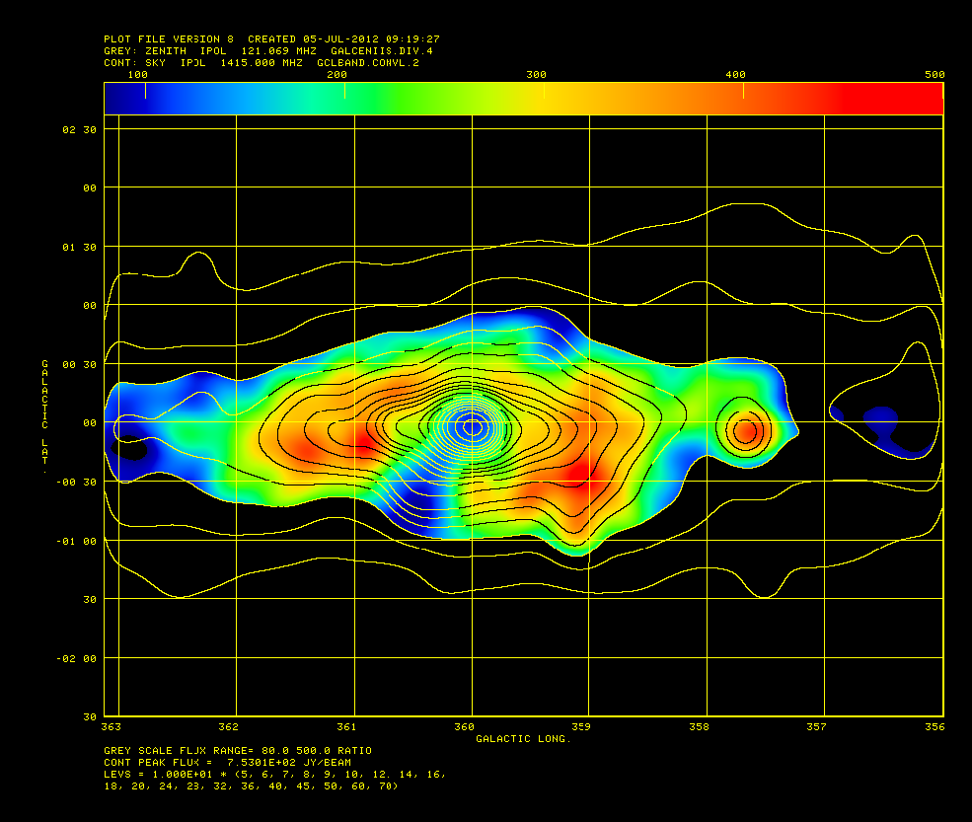
GBT 1.4 GHz (Zadeh ea)
PAPER 0.15GHz
1º
Galactic center: free-free abs
GBT 1.4GHz: clear GC peak
PAPER 150MHz: ‘flat’
GC: inverted spectrum = FF abs: EM > 10⁴ pc cm⁻⁶
‘Funnel’ to SE = thermal outflow: n_{e} > 10 cm⁻³ (or foreground HII)?
SI: 1.4 – 0.15GHz

Slide 16
Imaging on PAPER
Violates all assumptions in synthesis imaging (eg. SIRA)
  Transit array => image in snapshots in time (10min)
  Very wide field (‘full sky’) => require 3D FT (facets)
  Very wide band (octave) => require multifreq synthesis (currently image snapshots in freq ~ 10MHz)
  Very high dynamic range > 10⁵: requires extensive iteration in selfcal/deconvolution
  Structure on all scales => require ‘multiscale clean’
  Strong and weak RFI: multiple layers of flagging

