Slide 1
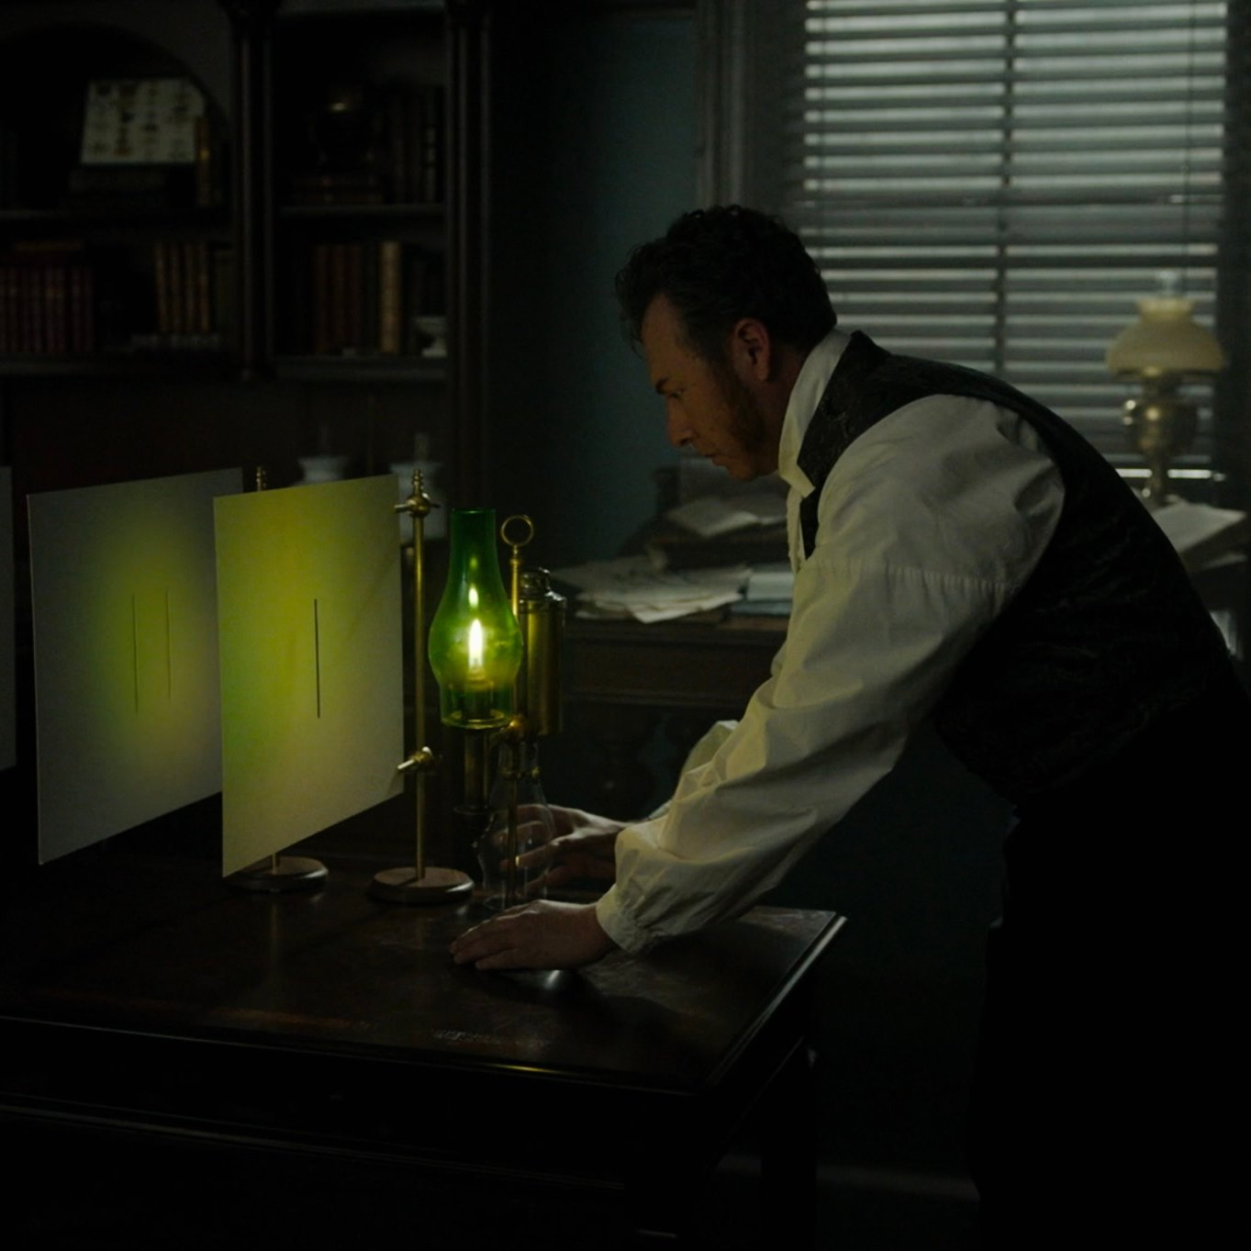
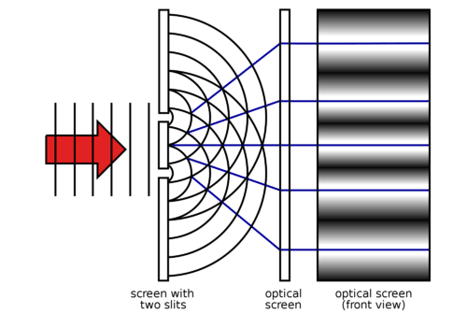




Optical Interferometry using Radio Astronomy Techniques
New method real-time, non-invasive micron-size source characterization
New method in sub-nanometer wave-front sensing
Fourier optics, Huygens principle, and Young’s two slits
Carilli (NRAO), Nikolic (Cavendish), Thyagarajan (CSIRO), Torino, Iriso (ALBA)
Copyright © 2024 AUI, U. Cambridge, CELLS, CSIRO. All Rights Reserved

Slide 2
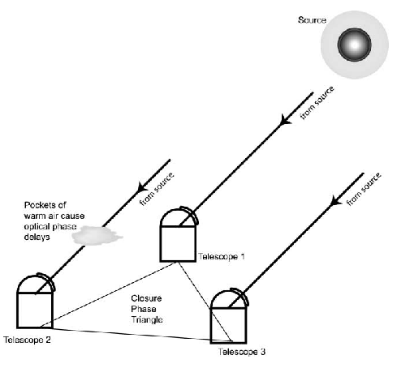
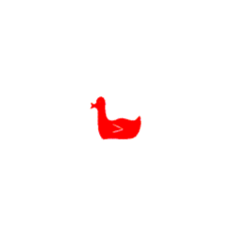
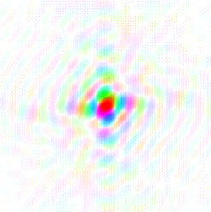
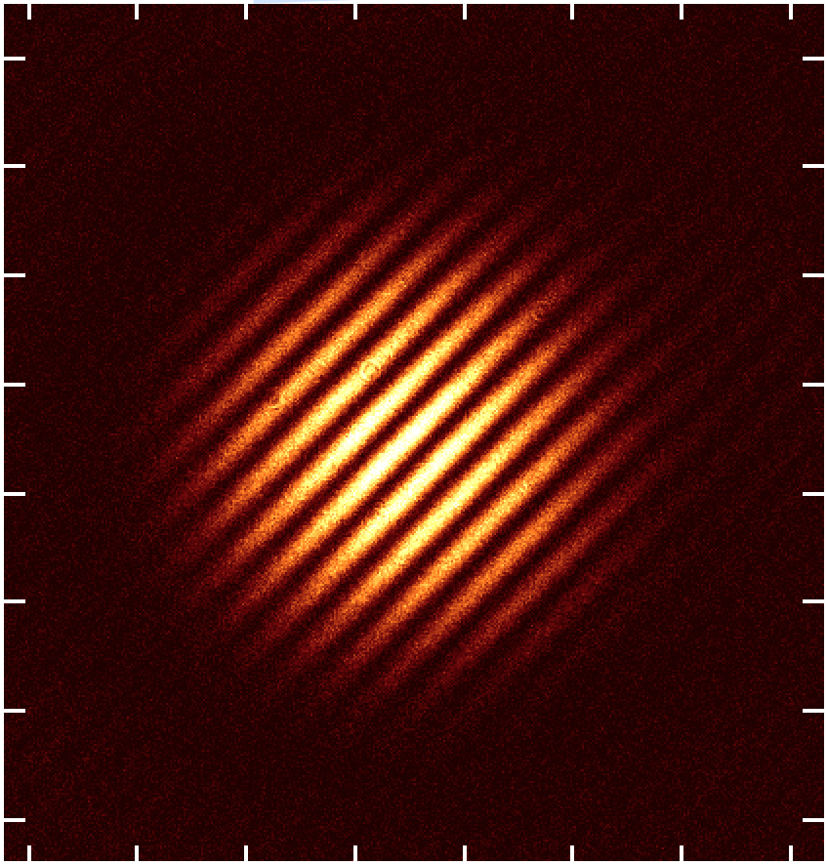
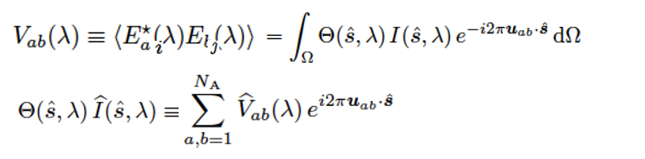
van Cittert – Zernike Theorem
The cross-multiplication, or coherence, between the electromagnetic voltages measured at spatially distinct locations (’apertures’) = Fourier transform of the intensity distribution
Image plane
Aperture plane (complex)
FT
y
v
.
V_{i,j} = A_{i,j} e^{-i𝝓i,j}
u_{i,j} = (B_{i,j} / 𝜆) rad⁻¹
x
u
𝛉 = 𝛌/B = 1/u
Image
Orientation and spatial frequency set by geometry of baseline (u_{i,j})
Brightness determined by amplitude of visibility (A_{i,j} = coherence)
Position of fringe determined by phase (𝝓_{i,j})

Slide 3
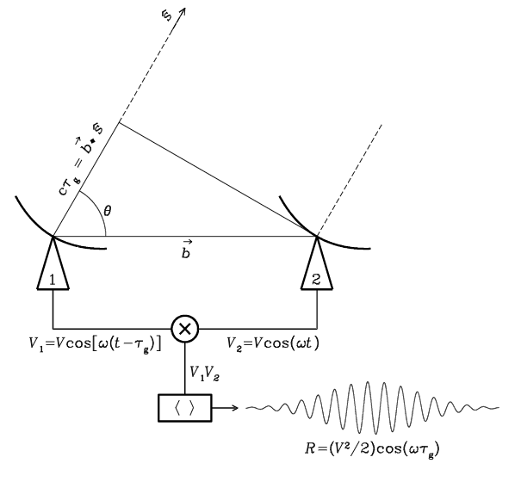

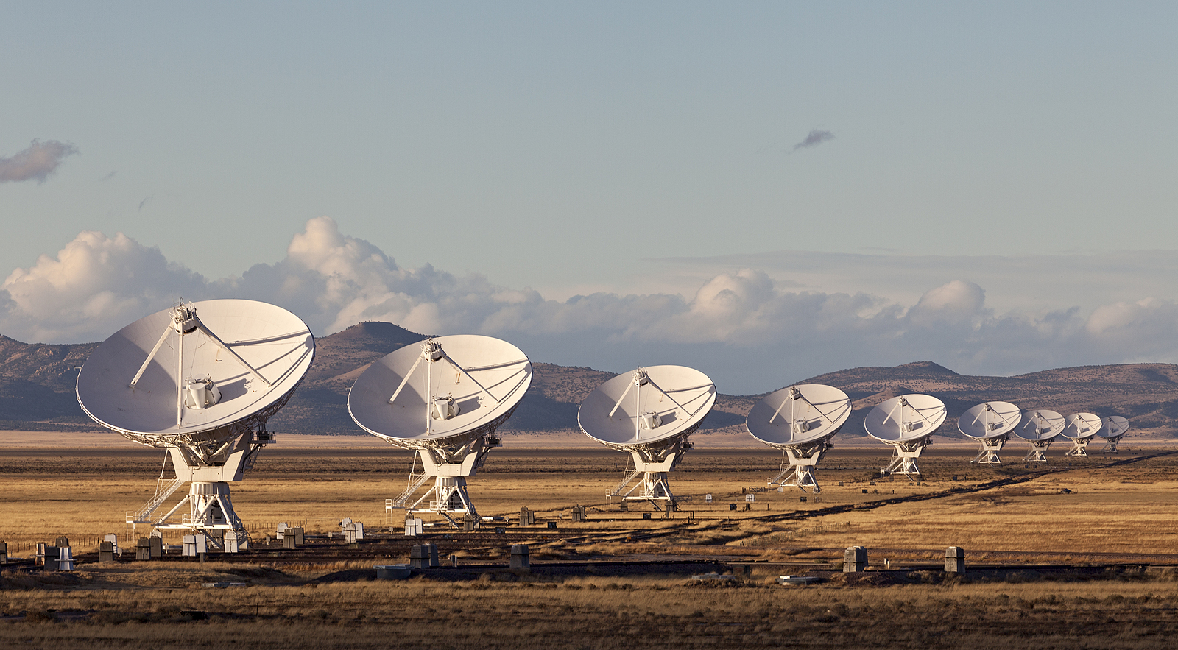
Radio measurements are visibilities = aperture plane
_{o}
𝜃
V_{i,j} = E_{i} x E_{j}* = A_{i,j} e^{-i𝝓i,j}
Coherent amplification of voltages, E
Geometric delays set by electronics
Complex cross multiply and average to visibilities = FT(source structure)
Images made from Fourier transform of visibilities

Slide 4
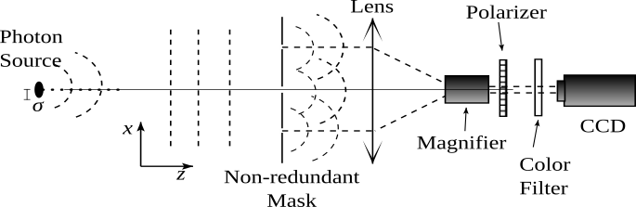
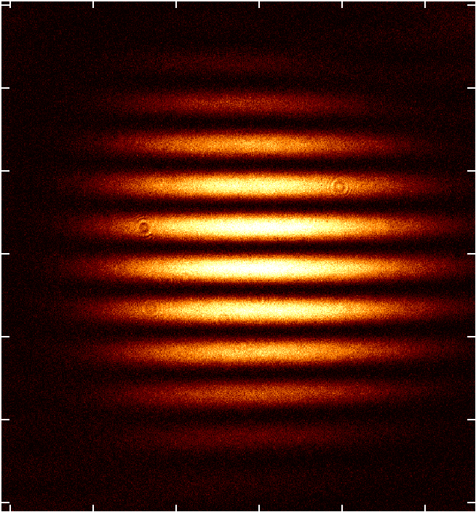
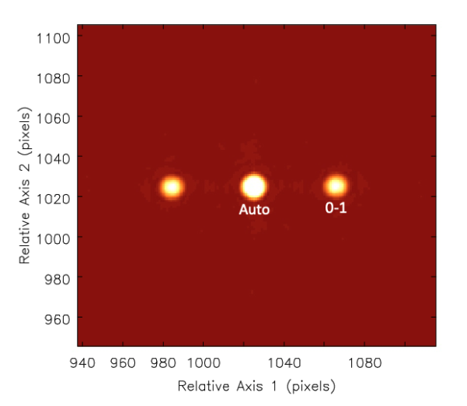
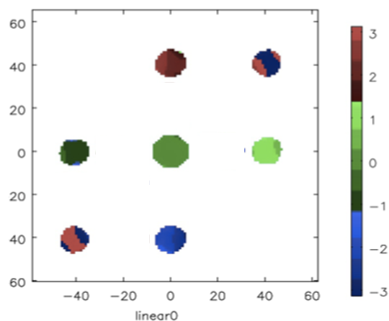
Optical: aperture mask + focusing optics => image of fringe
1
𝛉 = 𝛌/B
0
Complex visibilities = FT(image)
Autocorrelation = I₀ + I₁ = all photons in image
I₀₁ = photons in u,v sample 0-1
V₀₁ = visibility or mutual coherence = I₀₁ / (I₀ + I₁)
Michelson 1891
V₀₁ = (S_{max} – S_{min})/(S_{max} + S_{min})
v
v = B/𝛌 = 𝛉⁻¹
1-0
u
V_{i,j} = A_{i,j} e^{-i𝝓i,j} = FT(Image)

Slide 5
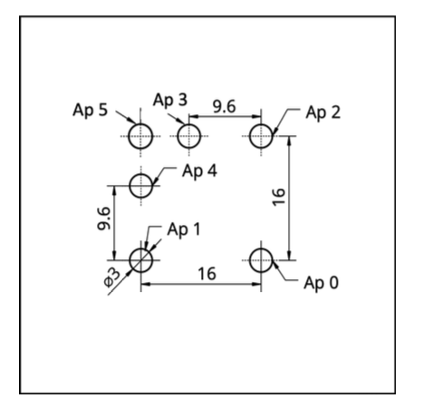
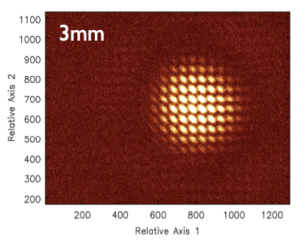
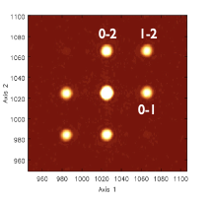
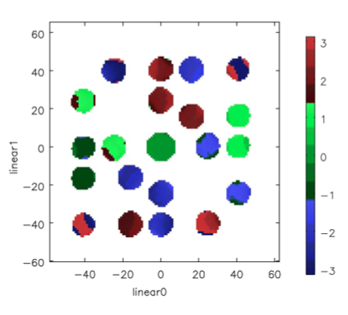
3 Hole Mask
Auto = I₀ + I₁+ I₂
V₀₁ = I₀₁ / (I₀ + I₁)
V₁₂ = I₁₂ / (I₁ + I₂)
V₂₀ = I₂₀ / (I₂ + I₀)
Challenge 1
Deriving V_{ij} requires knowing I₀, I₁, I₂ separately = ‘Illumination pattern of aperture’
v
Auto
u

Slide 6
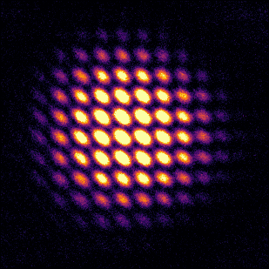
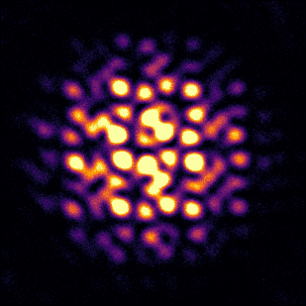
Challenge 2
Phase = Position
Phase fluctuations => Decoherence/blurring
3 Hole Mask
5 Hole Mask
1ms frames
Closure Phase in Image Domain
Shape-Orientation-Size conservation

Slide 7
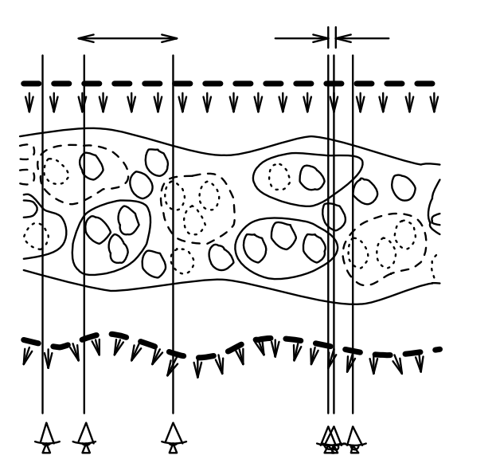
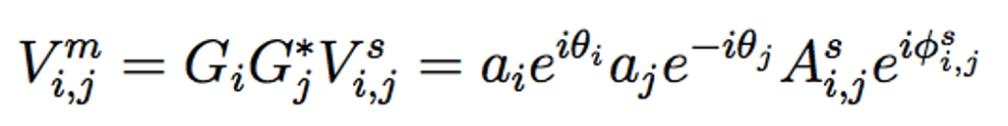
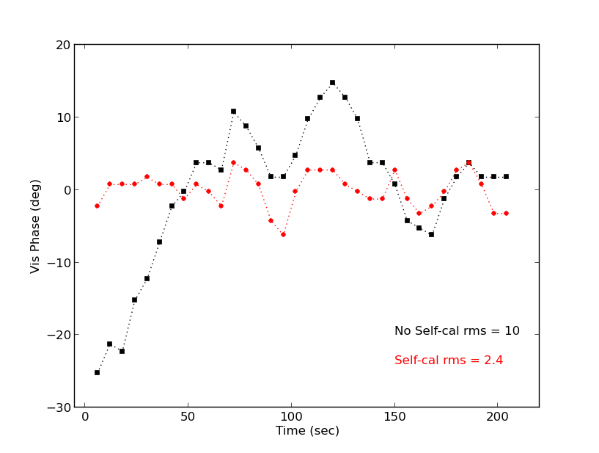
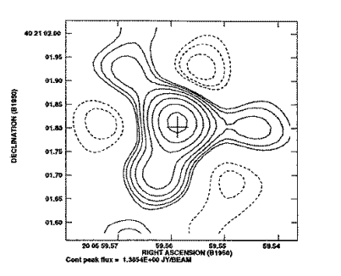
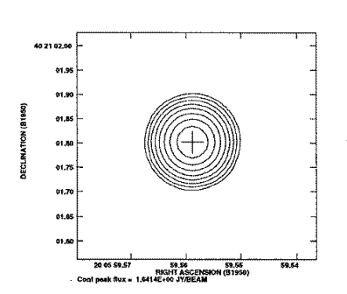
Self-Calibration: joint fit complex voltage gains and source structure
Start: measurements, 𝑉^{m}_{i,j} and simple source model, 𝑉^{s}_{i,j}
Invert equation to derive complex element-based voltage gains, 𝐺_{i}
Derive new source model from the gain-corrected 𝑉^{m}_{i,j} through model fitting or imaging and deconvolution
Iterate to convergence: more measurements than free parameters ([𝑁(𝑁 − 1)]/2 cross correlations vs. N gains plus source parameters)
𝛅L
VLA 8 GHz
Gain amp, a_{i} = aperture plane illumination
Gain phases, 𝛉_{i} ∝ photon path-length delay through system: 𝛅L = 𝛌 × 𝛉_{i}/360º
= Wavefront sensor!
Self-cal has never been done in optical interferometry!

Slide 8
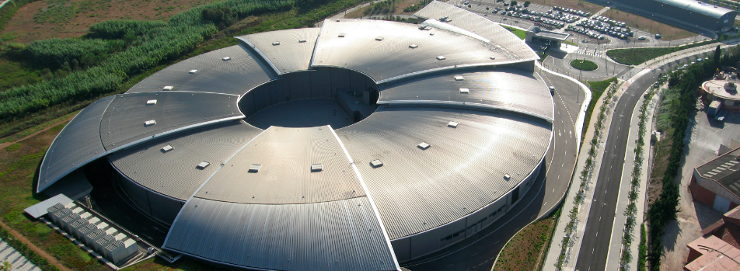
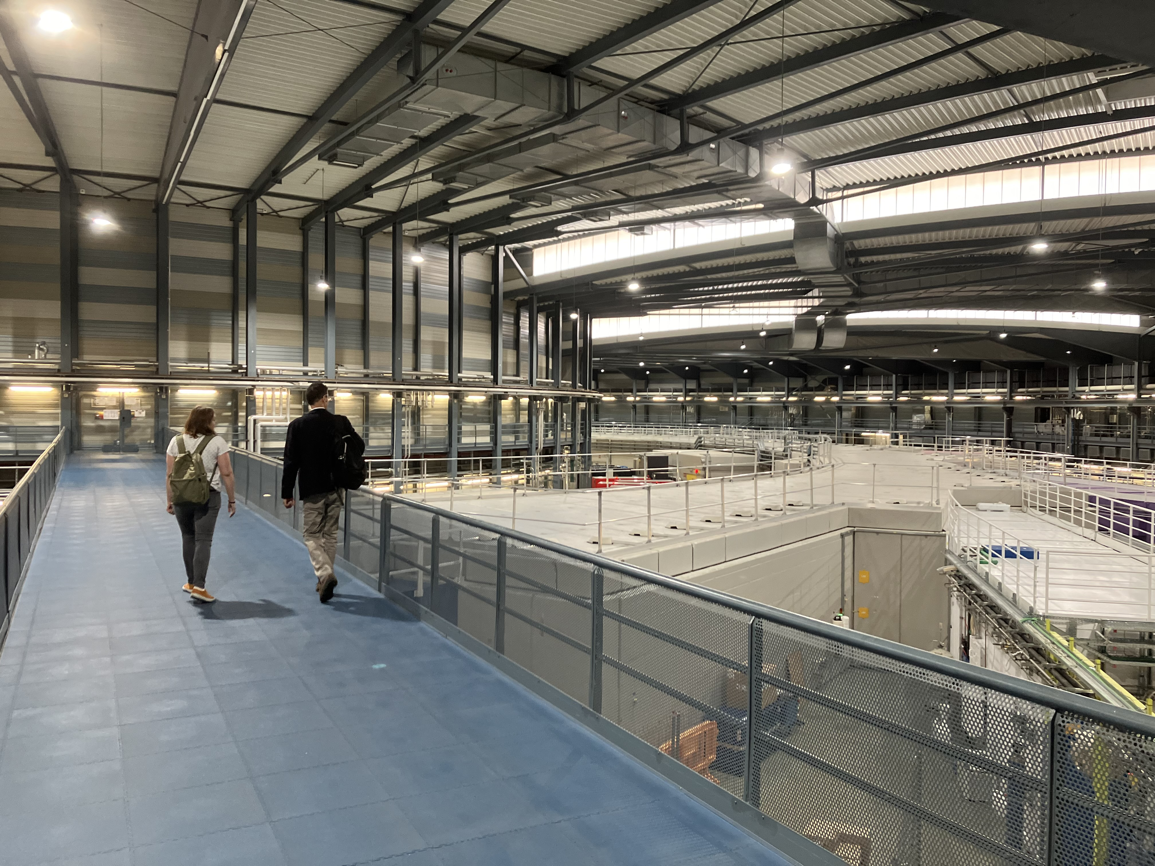
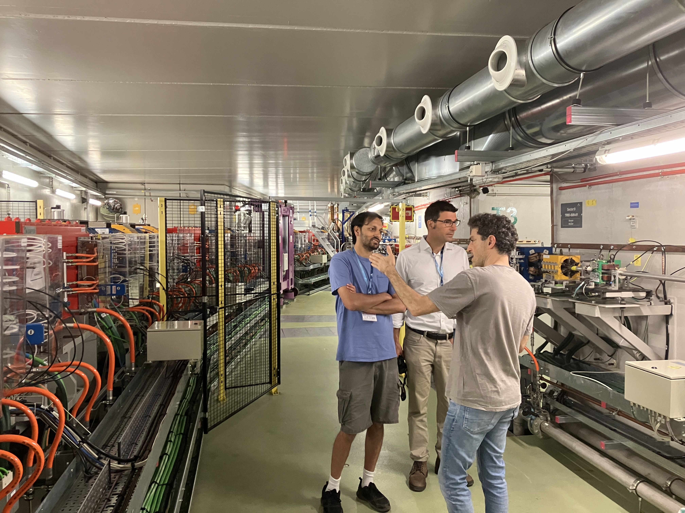
ALBA Synchrotron Light Source Barcelona, Spain
Circumference = 270m
Electron energy = 3 GeV
Photons IR to X-ray
>10¹⁰ optical photons/ms

Slide 9
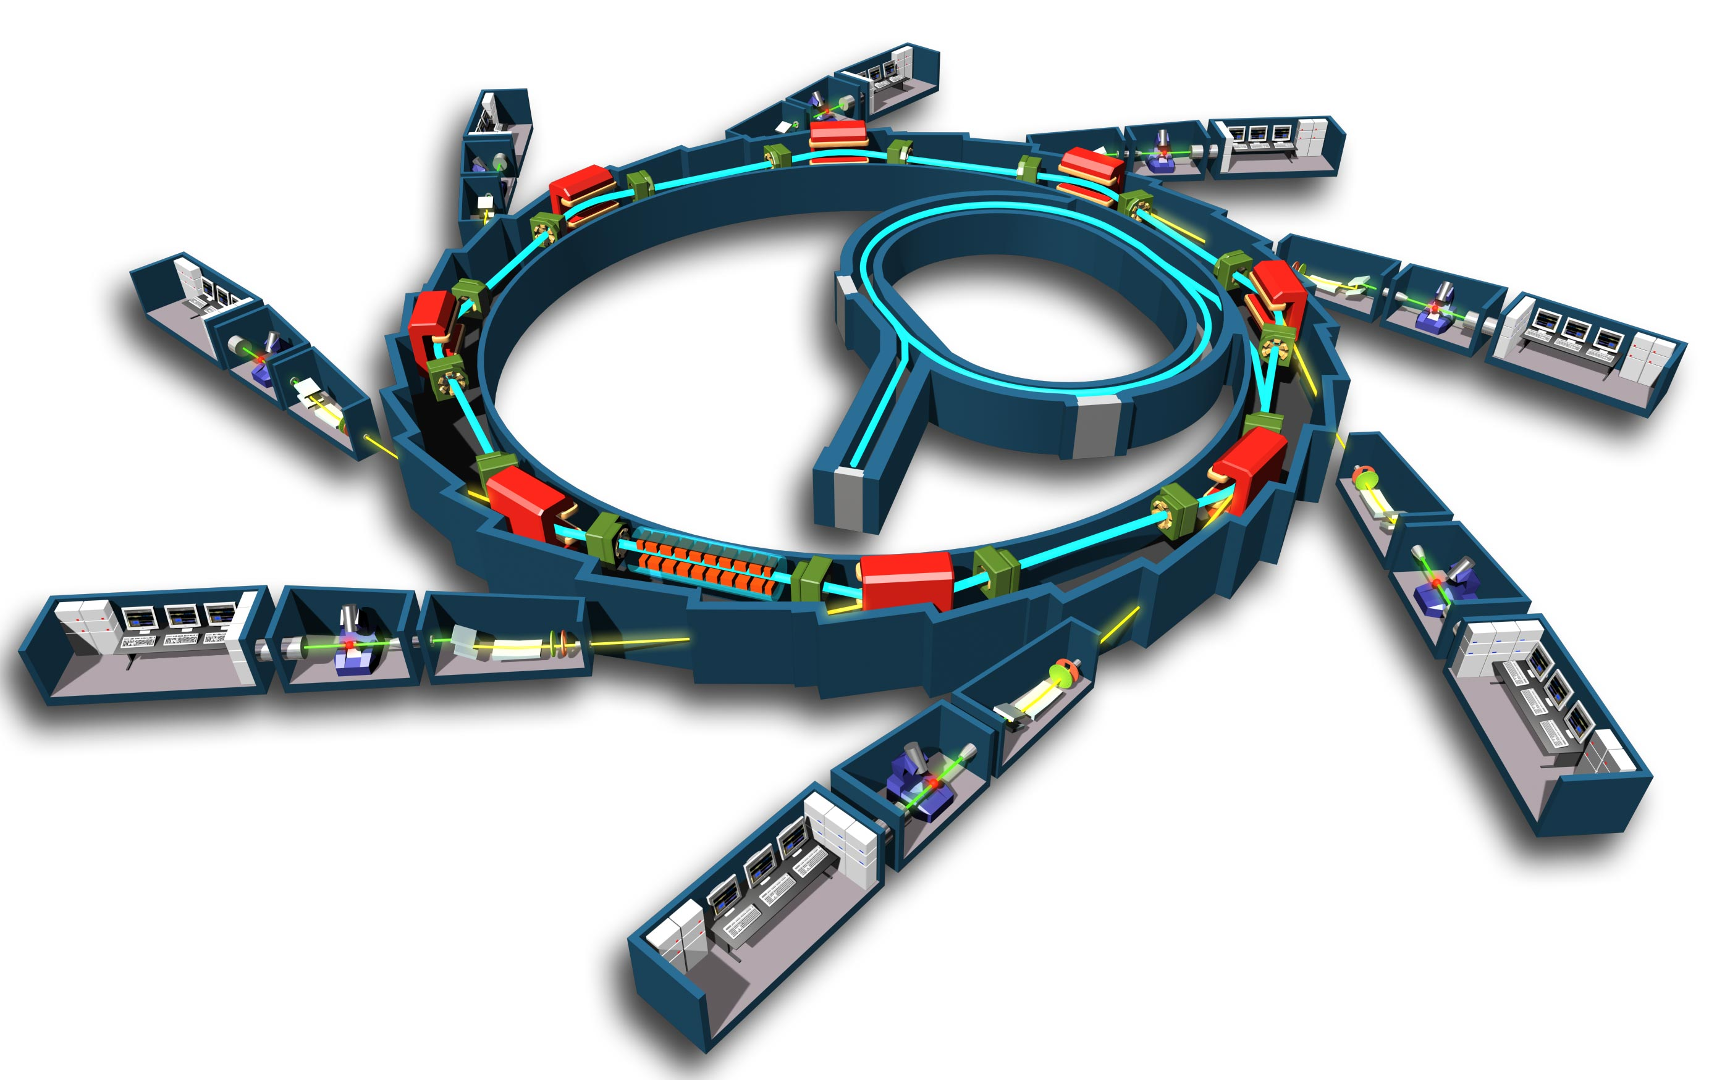
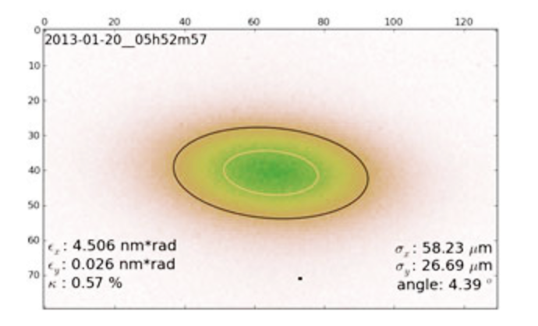
Storage Ring
Photon Beam lines = experiments
Bending magnet
Insertion Ring
e⁻ gun
Undulator or wiggler
X-ray crystallography
X-ray spectroscopy
X-ray lithography
Infrared spectroscopy
Optical interferometry
Key performance metric: Gaussian e⁻ beam size
smaller => better

Slide 10
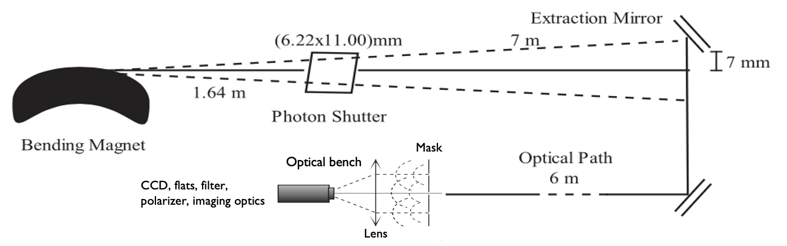
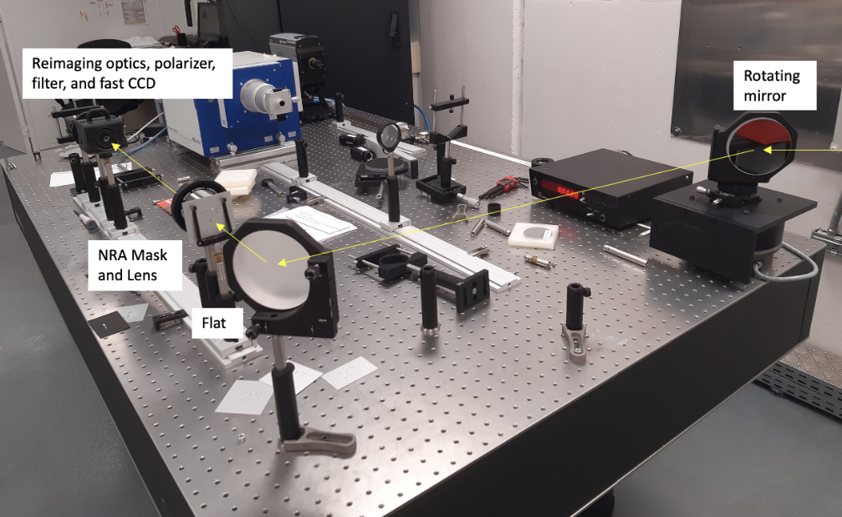
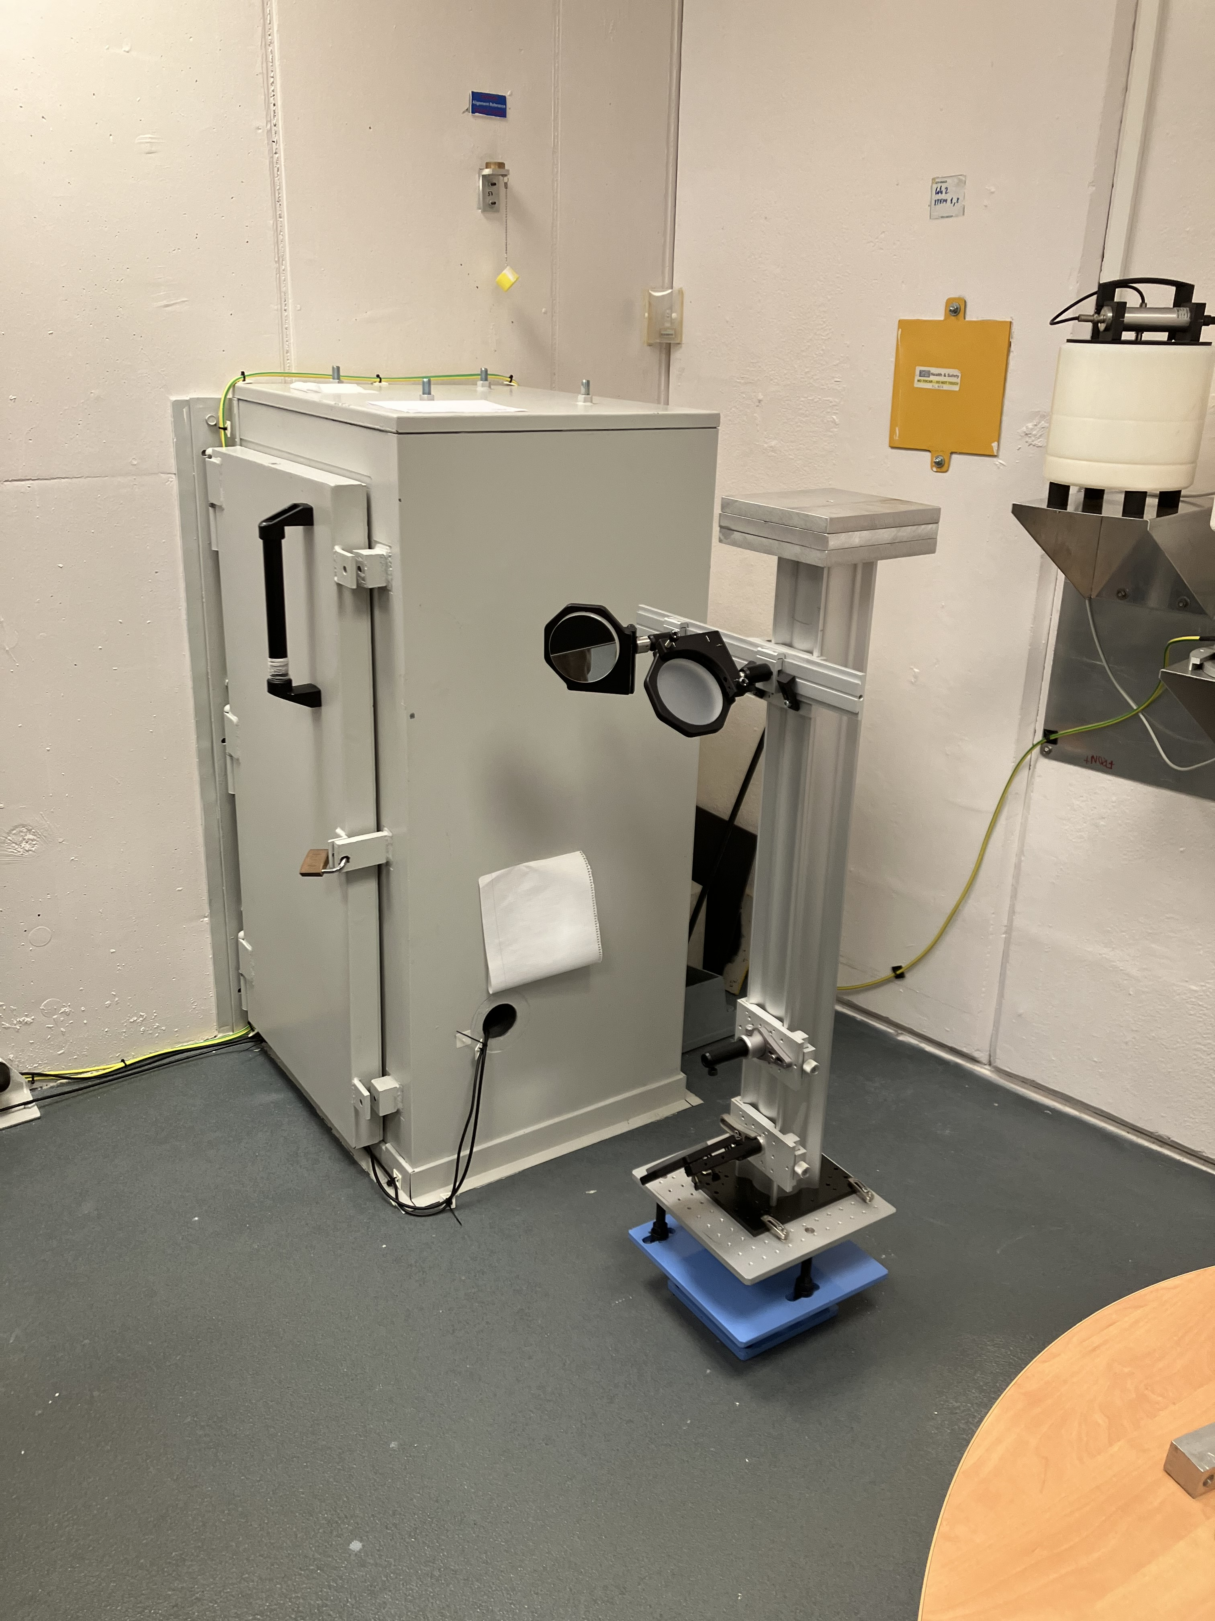
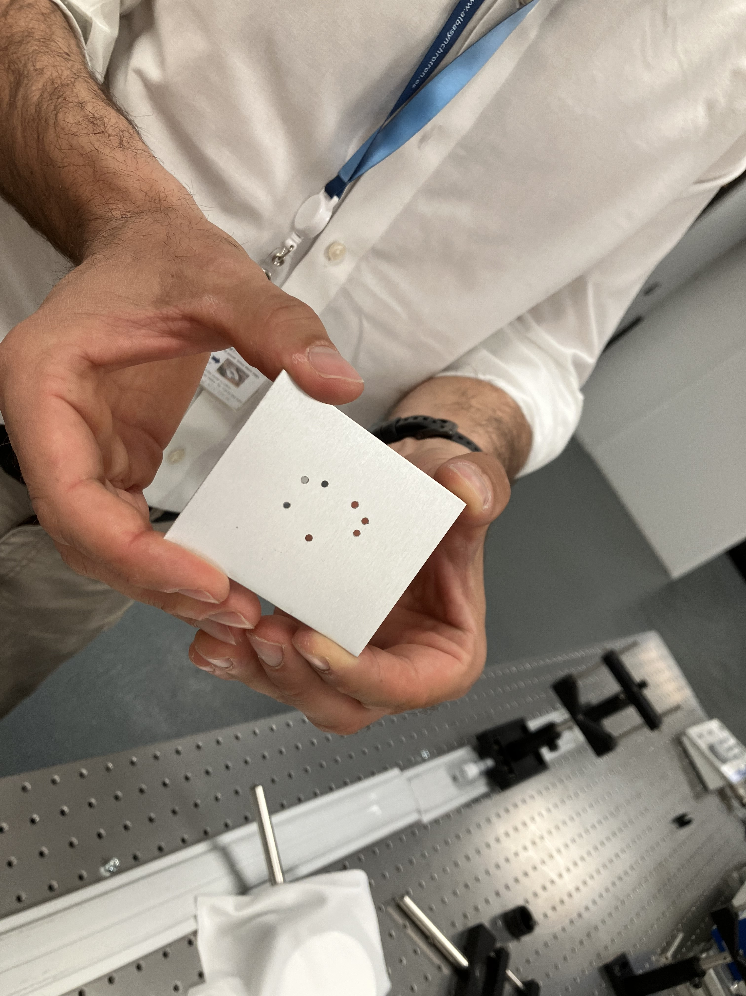
Xanadu: ALBA optical synchrotron radiation beam line
Experiments
7 hole mask
2mm diameter holes
Baselines 5mm to 24mm (3.7”)
Wavelength = 400nm
30 frames = 1ms every 1sec
Rotating mirror for WFS tests

Slide 11
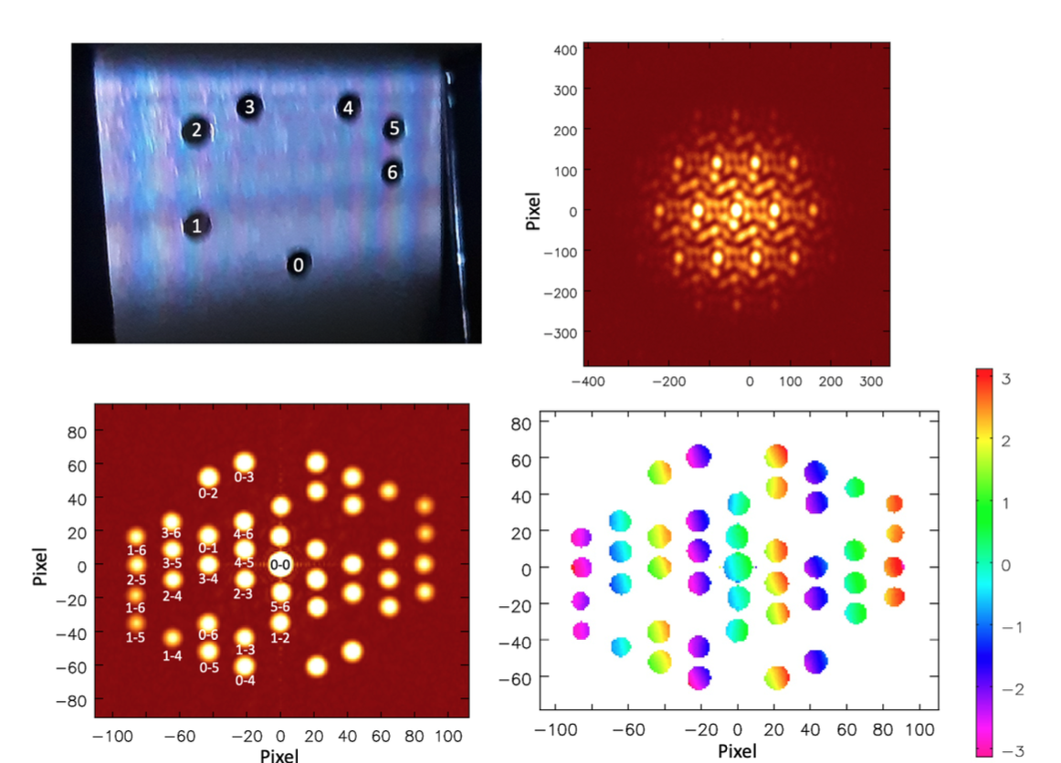
Non-redundant 7 hole Mask: JWST Template
v
u

Slide 12
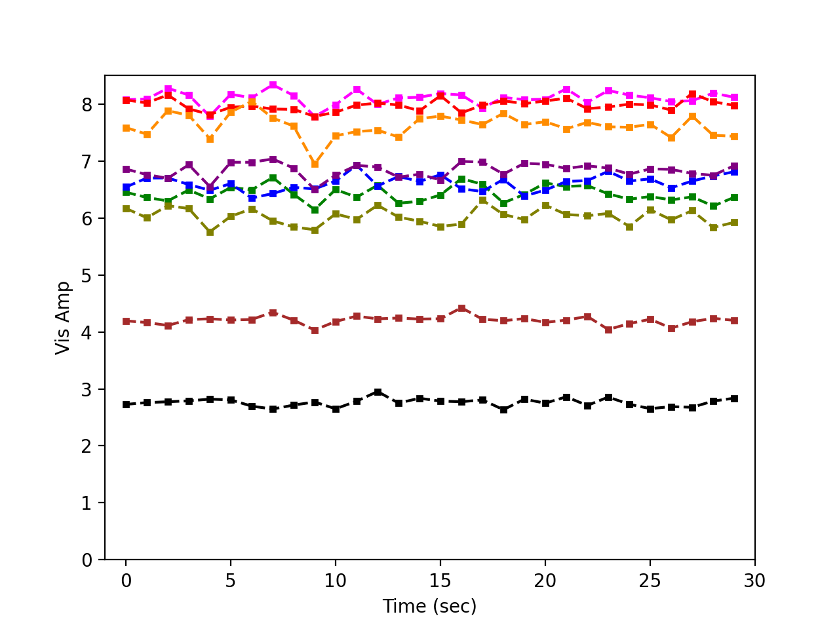
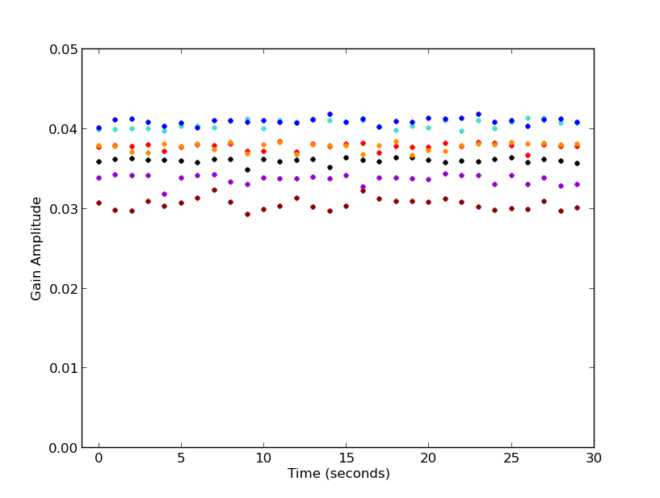
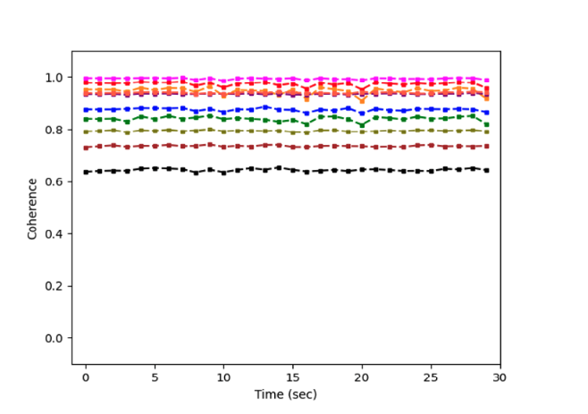
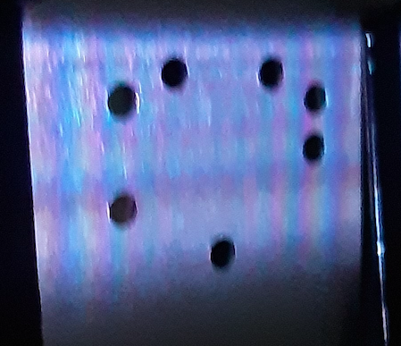
Gaussian model self-calibration in CASA
amplitudes = illumination
Selfcal G_{amp} stable ~ 1%
Voltage gains differ by up to 30%
1.24
1.19
1.23
1.19
1.31
Coherences > 60%
Stable < 1%
1.11
1.00

Slide 13
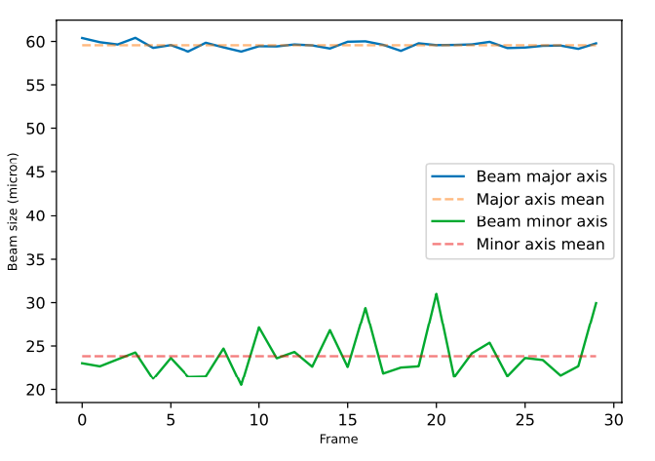
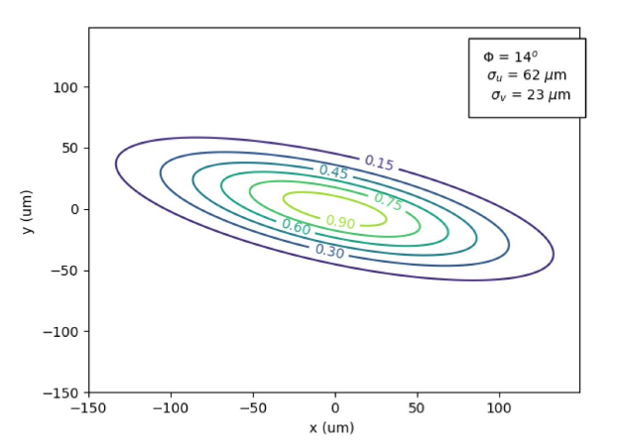
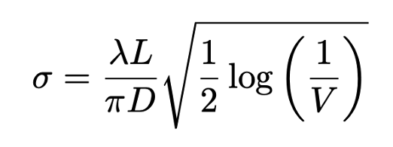
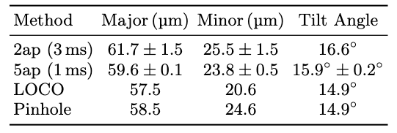
Gaussian model fitting
Real-time 2D Electron Beam Shape to ≤ 1% accuracy
Gaussian model fit to coherences
7ap 59.0 ± 0.1 23.5 ± 0.3 16 ± 0.2º
Without SC 66 40 5º

Slide 14
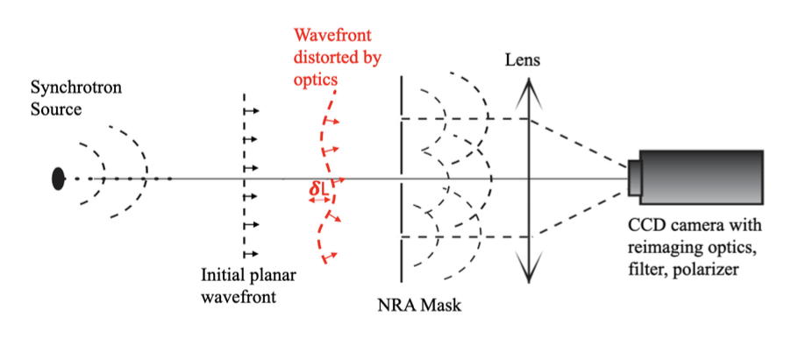
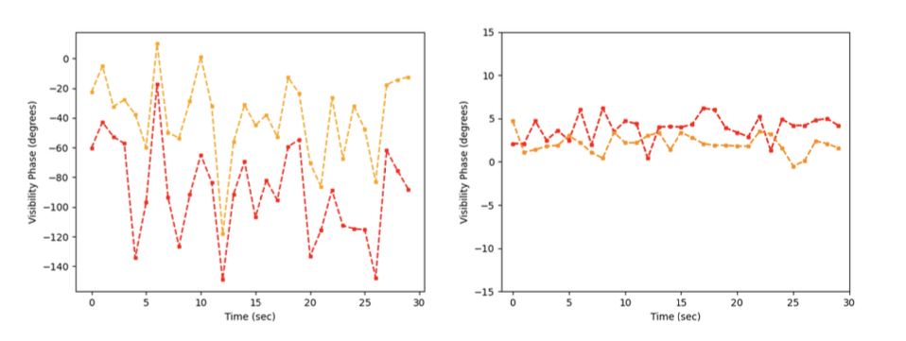
Wavefront Sensing
Surface of constant phase of EM wave: 𝛅L = 𝛌 × 𝛉_{i}/360º
Vis phase before Self-cal
After Self-cal
1-6, 2-5
rms = 28º = 31nm
rms ~ 1.2º = 1.3nm
Mean = static pathlength differences (’metrology’)
Variations (millisec) = vibrations and turbulence (‘adaptive optics’)
𝛅𝚽 is correlated between baselines => systematic 𝛅L, not noise
rms after self-cal much lower => measuring frame 𝛅L to high significance

Slide 15
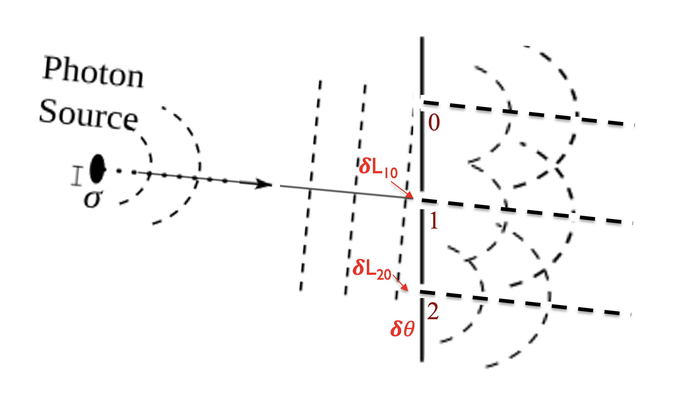
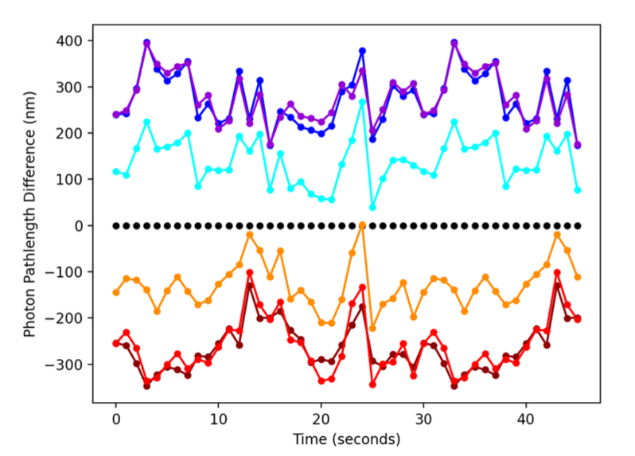
Wavefront Sensing
Self-cal gain phase solutions encode path-length delay through system to each hole wrt reference hole: 𝛅L = 𝛌 × 𝛉_{i}/360º
Rotating mirror tests
Wavefront tilts = 0”, 2”, 4”, 6”, 8”
Mean 𝛉_{i} = tilt
Variations 𝛉_{i}
rms ~ 30º (33 nm)
correlated between neighboring holes
4” tilt
3
4
5,6
2
5
6
4
1
0
3
1,2

Slide 16
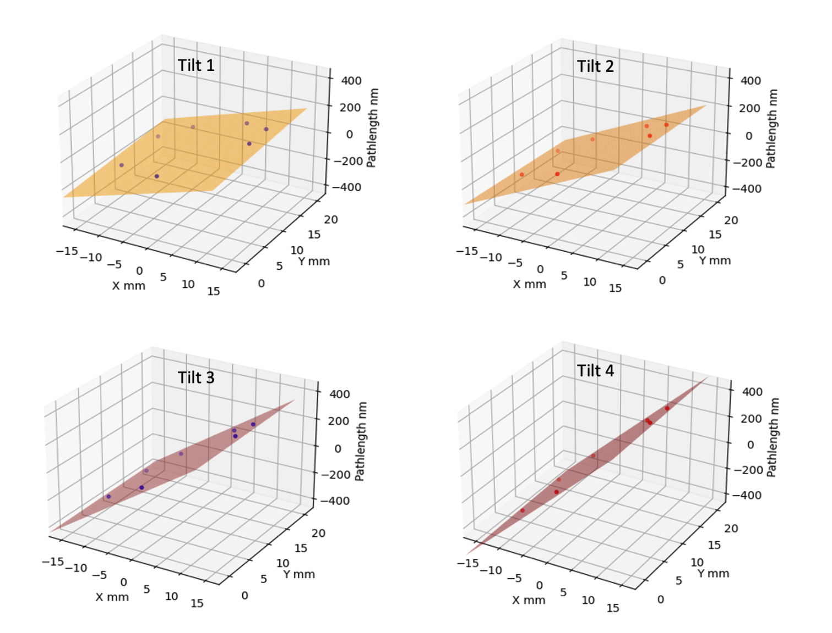
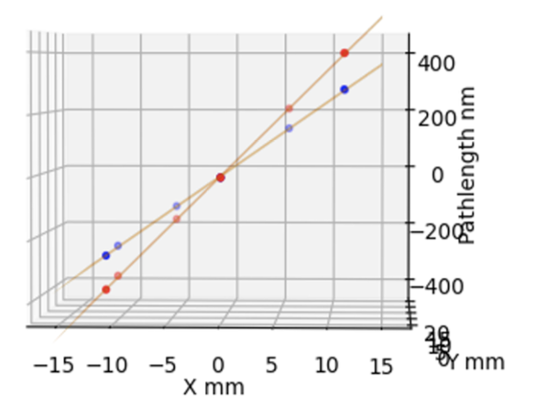
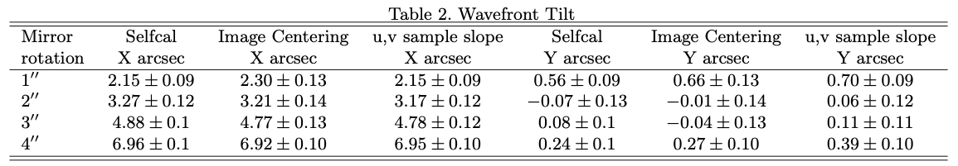
Mean best fit plane: reproduce WF tilts to ~ 0.1” (5e-7 rad)
4
3

Slide 17
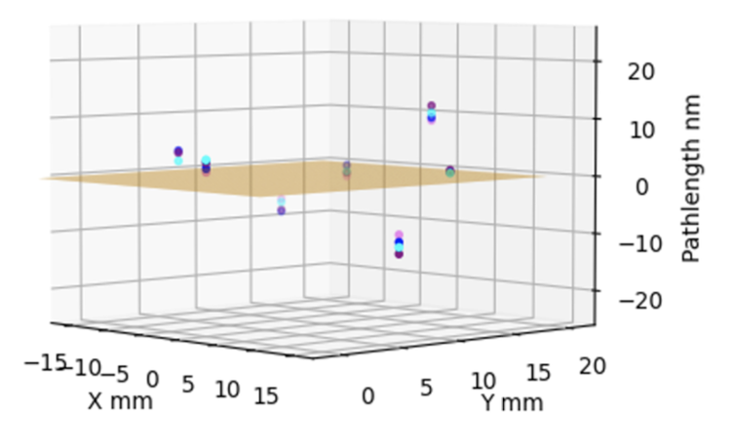

Static non-planar metrology
+400
-400
0
Non-planar static metrology distortions seen up to 12 nm: repeatable between experiments to rms ~ 2 nm at each hole
Fitting higher order (Zernike) modes: 7-holes insufficient to constrain all but tip-tilt
Focus test: +/-400um focus change
Path-length pattern inverts
Pattern matches model predictions
Magnitudes difficult to model

Slide 18




Variations adaptive optics: tip-tilt wave-front variations due to vibration
1ms exposures every 1 sec
Tilts up to 0.5”
Random frame-to-frame

Slide 19
Noise, Precision, Dynamic Range, Sampling
Measured visibility phase rms after calibration = 1.2º
6 visibilities per gain solution => rms ~ 1.2º/root(6) ~ 0.5º => pathlength precision: 𝛅L_{rms} ~ 0.6 nm
Photon counting phase noise per visibility ~ 1/root(10⁷) × 360º ~ 0.11º => shot noise limit to pathlength ~ 0.05 nm
Dynamic range set by phase wraps => 1 wavelength between pairs of elements
Fitting wavefront (Zernike) across mask could improve by factor few
Add spectral axis => improve dramatically: eg. measurements separated by 5% in 𝛌 increase dynamic range by factor 20 (‘global fringe fitting’ in VLBI)
Aperture sampling is limited by requirement of non-redundant mask
Use fibers, lens, micro-mirror array to fully sample aperture and generate series of non-redundant interferograms (w. one common reference hole)
Use ’over-constrained’ nature of self-cal to limit analysis to non-redundant u,v samples

Slide 20

Wavefront sensing via interferometric self-calibration
𝛅L = 𝛌 × 𝛉_{i}/360º
Mean phase = static pathlength differences to nm-precision (’metrology’)
Variations (millisec) = vibrations and turbulence (‘adaptive optics’)
Measure full shape of wavefront = total photon path-length to each aperture element relative to reference position
Not ‘reference wave interference’ (Fizeau): no need for reference surface or source
Not ‘1st derivative-based’ (Shack-Hartmann): no need for function fitting to gradient field
Not generalized Foucault knife-edge (pyramid): no moving parts
Not ‘phase diversity’ method: no need for out of focus measurements
Agnostic to source shape: joint fit of source and element gains
US patent 12,104,901
US patent app. No. 18/878,488
US patent app. No. 19/079,876
‘The wavefront cannot be directly measured, because it is determined by phase,’ Yi et al Nature Comm 2021
arXiv:2503.10820
arXiv:2405.12090
arXiv:2409.11135
arXiv:2406.02114
JOSA-A 2024, 41, 1513
2022PASA...39...14T
JOSA-A 2022, 39, 2214

