Slide 1
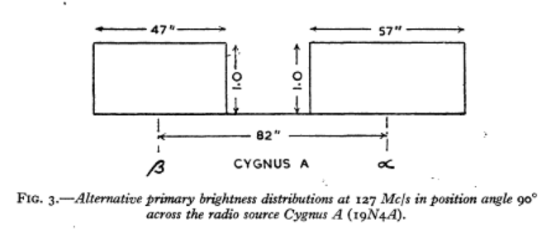
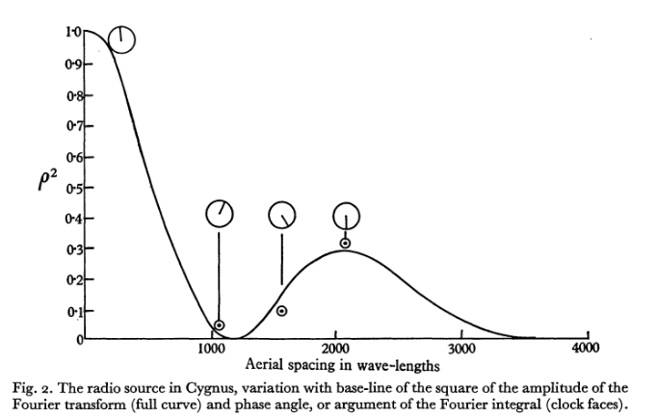
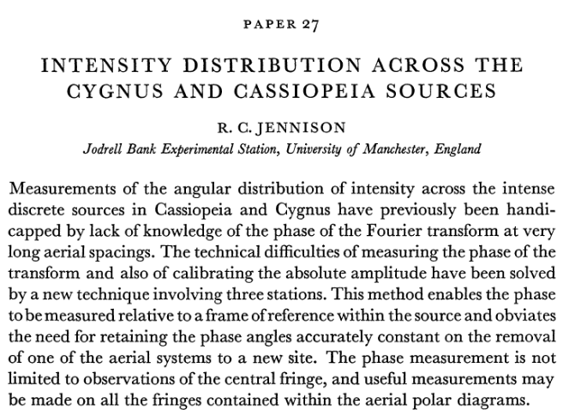
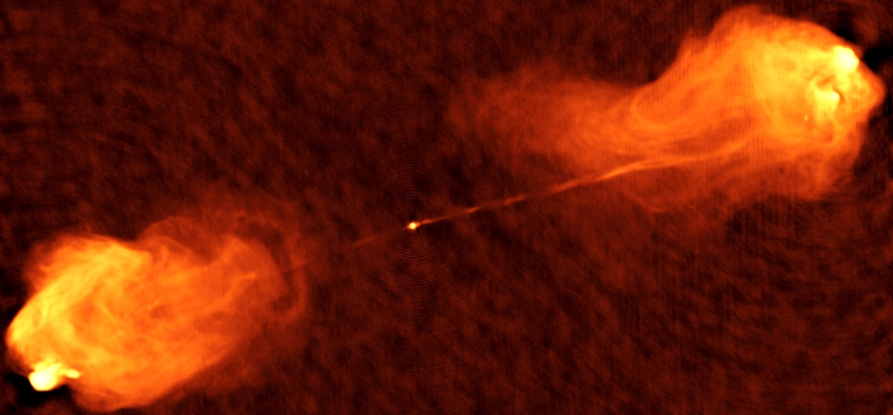
Close Phase in Images
Shape-Orientation-Size Conservation
1956
Cygnus A: symmetric double source on which all of relativistic jet theory was predicated.

Slide 2
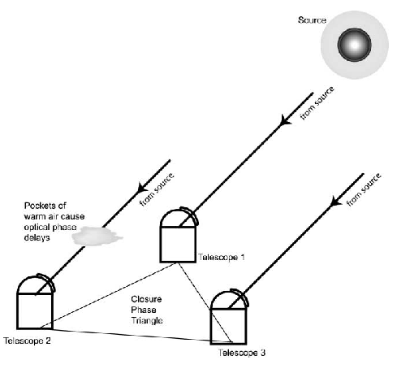





Closure phase in aperture plane
𝜹s₃₁
Triple Product or Bispectrum on closed triad
𝜙_{i,j} = 2𝜋 u_{i,j} 𝛿s_{i,j} = 2𝜋 𝛿s_{i,j} / (𝜆/ B_{i,j})
Closure phase reflects the true sky-brightness distribution, independent of antenna-based phase errors and calibration

Slide 3
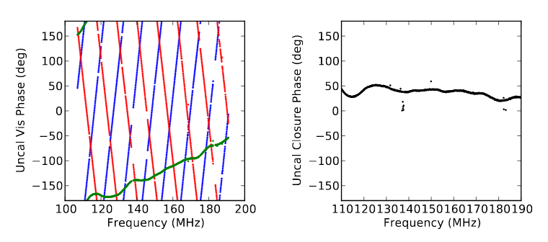
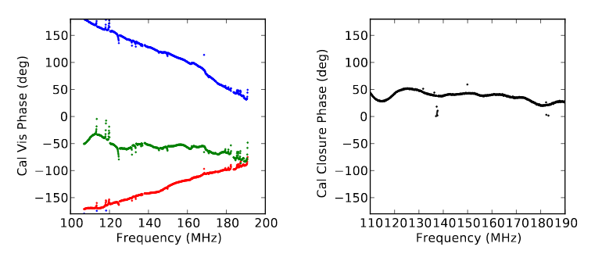
Galactic Center: uncalibrated
HERA closure phase data: independent of antenna-based gain calibration
Carilli et al. Radio Science, 2017
Galactic Center: calibrated

Slide 4
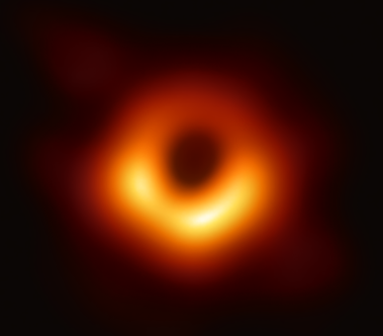
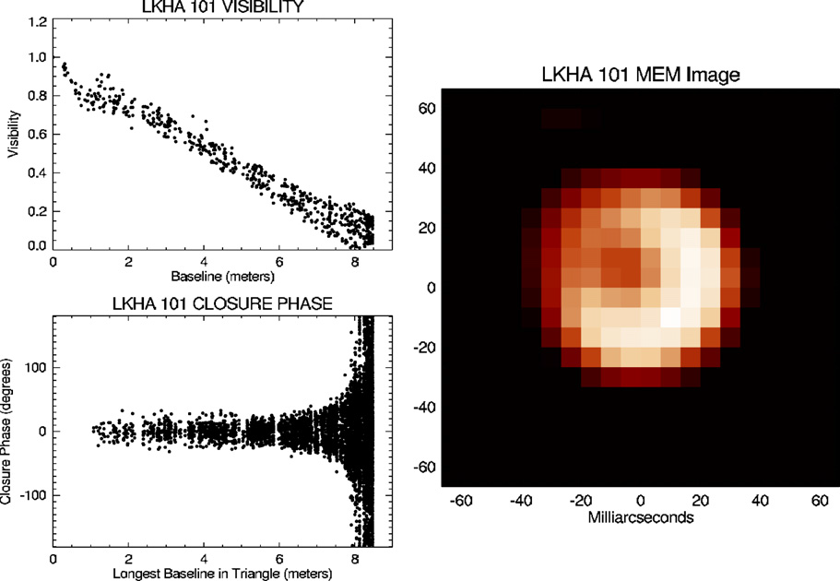
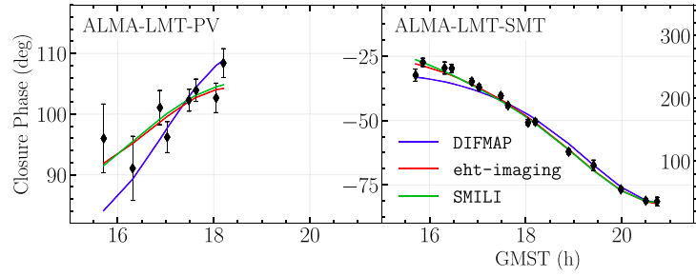
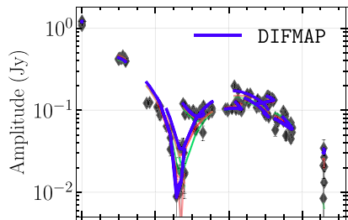

Long established usage in astronomical interferometric imaging, in situations when phase coherence is difficult to track
Conserved quantity in antenna-based self-calibration
Key measurement for model optimization in forward-modeling approaches
240 GHz Very Long Baseline Interferometry
EHT image of M87 SMBH; EHT+ 2019
40uas
Optical Interferometry
Dust shells around stars
Monnier+2007
Copyright © 2020 AUI/NRAO. All Rights Reserved.

Slide 5
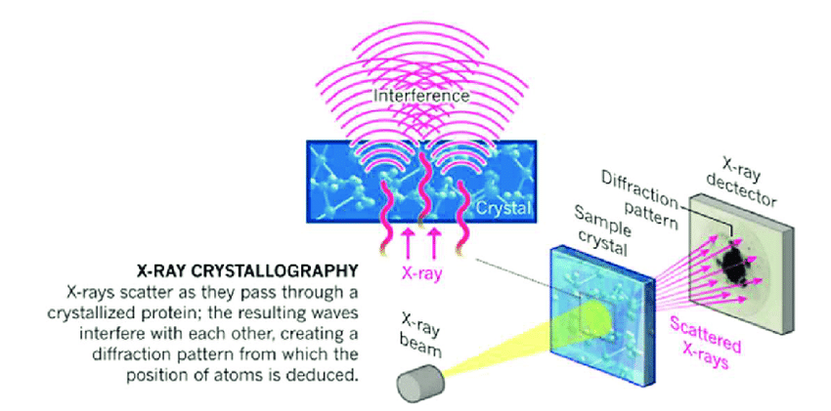
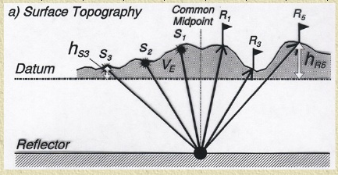
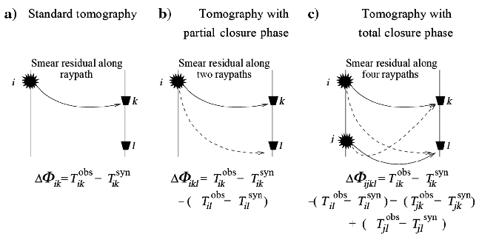

Seismic Fourier Imaging/Geophysics
Solves surface geology ‘statics’ problem
Schuster+ 2014
X-ray/electron/neutron Crystallography
Hauptmann & Karle 1985
Source statics
Receiver statics
Diffraction pattern is FT of electron distribution
Only intensities of diffraction pattern available → phases are lost (the “phase problem”)
Use structure invariants -- triplet and quartet phases (or closure phases)* -- to determine phases with a priori knowledge of symmetries and structures

Slide 6
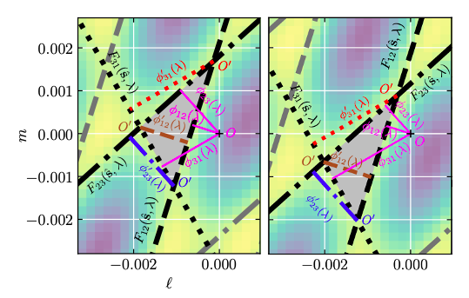
How does closure phase manifest itself in Image Plane? Shape-Orientation-Size Conservation
Model
Model + phase error Ant 3
Three fringe model on closed triad: ‘image triangle’
Corrupt phase on antenna 3 by 80º = 𝜹𝜙₃
Baselines lengths and orientations unchanged => parallel displacements of fringes
𝜹𝜙₃ affects 𝜙₂₃ and 𝜙₃₁ phases equally and oppositely => Constrained displacements of fringes
Shape, orientation, and size (SOS) of image triangle is preserved: only translation allowed
𝜹𝜙₃
𝜹𝜙₃
SOS conservation: if phase errors are antenna-based, every 3-fringe image on closed-triads is a true image of the sky, modulo translation, independent of calibration or corruption.

Slide 7
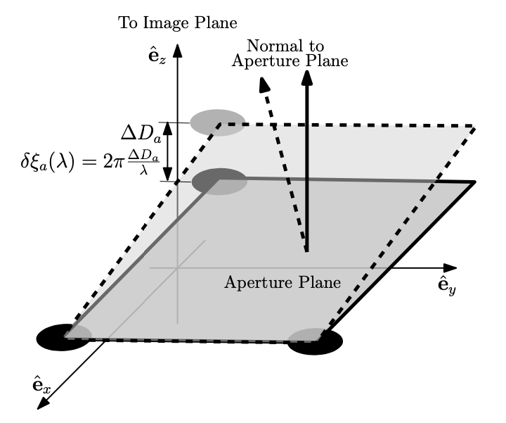
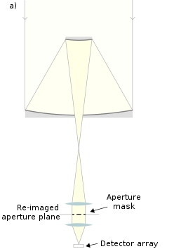
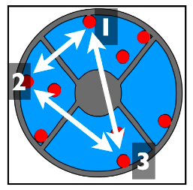
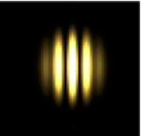
Aperture Masking in Optical Interferometry
Thyagarajan & Carilli, 2020, arXiv 2012.05254
Three points define a plane
Phase corruption of one element => change optical path-length to focus ‘piston delay’
Corresponds to a ‘tilt’ of the triad in aperture plane => shift of the fringe pattern in the image plan = Closure phase in image plane = SOS conservation
Copyright © 2020 AUI/NRAO. All Rights Reserved.

Slide 8


SOS application: Image plane measurements of closure phase
1. Phase re-center method
2. “Product of Areas” method
Choose phase center at one of the intersections from two NPCs
Measure perpendicular position offset to third NPC (the other two have zero offsets)
Use phase-position relation
Calculate area of triangle enclosed by array elements in the aperture plane
Calculate area of triangle enclosed by fringe NPCs in the image plane
X
=
Thyagarajan & Carilli, 2020, arXiv 2012.05254

Slide 9
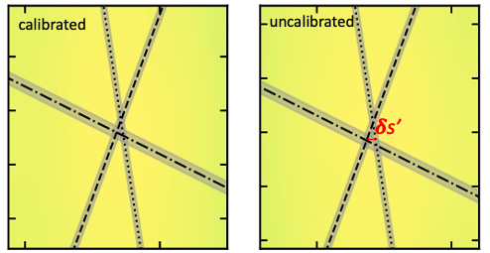
Tests of SOS conservation and image plane closure phase measurement using VLA data
3C286 9.4 GHz
4.4 Jy, 98% point source => 𝝍_{cl} ∼ 0
1”
Antenna-based phase errors
constrained translation of fringes
SOS conservation
Closure phases preserved
Baseline-based phase errors
unconstrained translation
SOS not conserved
Closure phases not preserved
Aperture plane closure phase
Calibrated: 2.6º ± 0.74º
Uncalibrated: 2.0º ± 0.74º
Image plane closure phase
Calibrated: 1.7 ± 1.3º
Uncalibrated: 2.0 ± 1.3º
0.02”

Slide 10
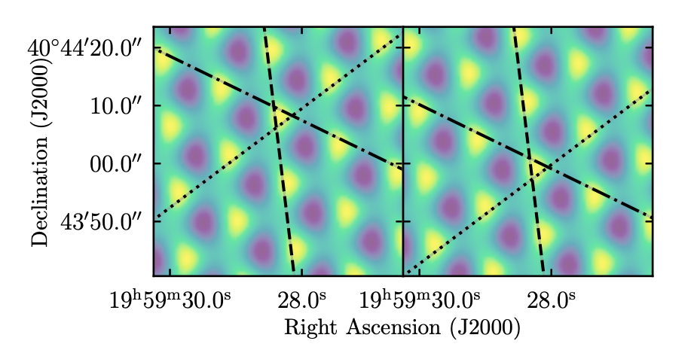
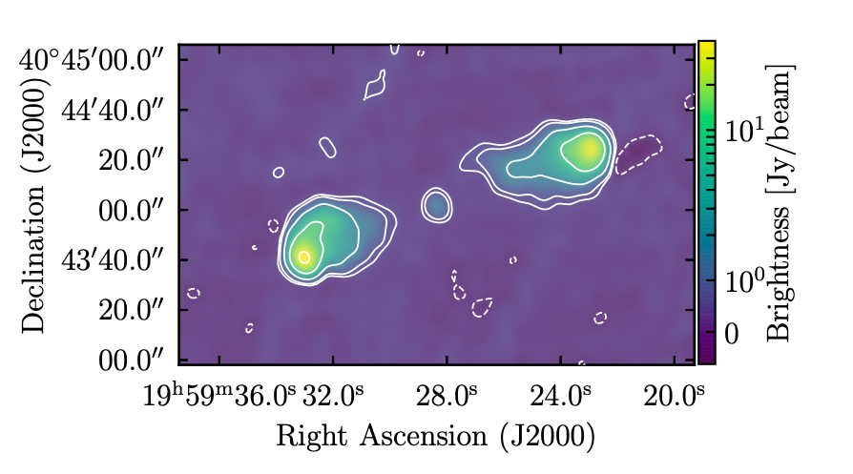
Cygnus A: Calibrated and Corrupted
80º phase antenna-based phase error
calibrated
corrupted
Cygnus A 8GHz
Complex source => 𝝍_{cl} ≠ 0
Shift along uncorrupted fringe
𝜹s’
Image plane closure phase: 𝜹s’
Calibrated: 113.9º ± 1.5º
Uncalibrated: 112.9º ± 1.5º
Aperture plane closure phase (vis. phases)
Calibrated: 112.7º ± 0.3º
Uncalibrated: 112.7º ± 0.3º
Image plane closure phase: A_{A3} x A_{I3}
Calibrated: 112.5º ± 1.3º
Uncalibrated: 113.7º ± 1.4º

Slide 11
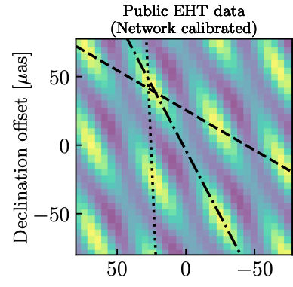
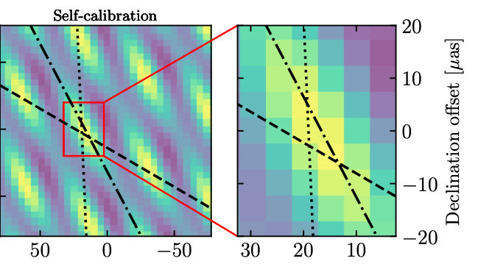
VLBI EHT imaging of M87
240 GHz at 20uas resolution => requires phase self-calibration for coherent imaging
Closed triad images: SOS conserved, modulo translation, independent of antenna-based phase calibration or corruption.
No phase cal
Phase selfcal
𝝍_{cl} = 38º from aperture-plane and both image-plane methods

Slide 12
Summary: Shape-Orientation-Size Conservation for closed-triad imaging in Fourier Interferometry
Image plane realization of closure phase
Three fringe images on closed triads = true images of the sky brightness, modulo translation, independent of antenna-based phase errors or calibration
Applications
Two methods for image-plane measurement of closure phase
Baseline-based phase error diagnostic
Image-plane-only self-calibration in situations where measurements are made in the image plane, such as optical interferometry, X-ray crystallography

