Slide 1
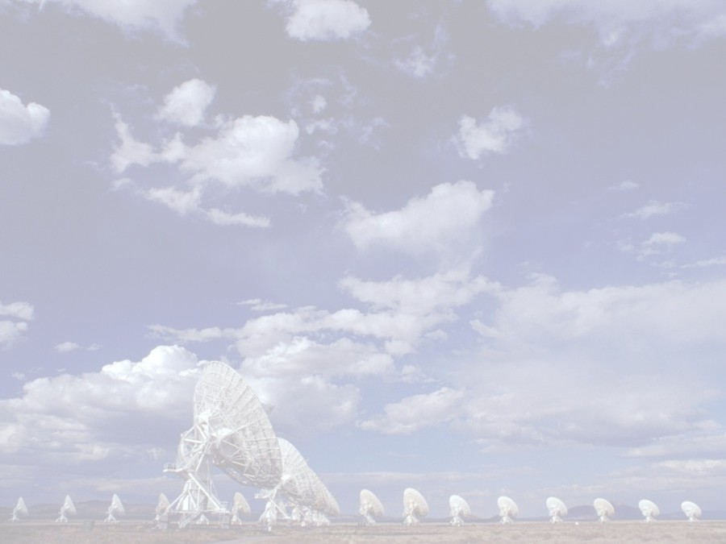
EVLA Goals, Progress, Status, and Projections
National Radio Astronomy Observatory
SAGE Committee Meeting – December 19 & 20, 2008
Rick Perley
Mark McKinnon

Slide 2
Top-Level Project Goals
Key goal: Improve the observational capabilities of the VLA (except for angular resolution) by a factor of ten or more.
Provide a new monitor and control system, which must allow operation of EVLA and VLA antennas in transition.
  This goal partially due to requirement that EVLA antennas be returned to service for continued VLA operations.
Perform careful astronomical observations to verify that EVLA hardware and software function properly.
Provide new data management software, including data post processing, for better access to array data products (effort distributed across divisions of NRAO)

Slide 3
Key EVLA Deliverables
Full frequency coverage from 1 to 50 GHz.
  8 frequency bands with cryogenic receivers.
  Two separately-tunable polarization pairs of up to 8 GHz BW
Unmatched sensitivity:
  1 μJy/beam in full bandwidth continuum (1-σ, 9 hr).
  1 mJy/beam line sensitivity (1 km/sec, 1-σ, 9hr)
New correlator with 8 GHz/polarization capability
  16384 minimum channels/baseline with full polarization
  Spectral resolution varying from 0.1 Hz to 2 MHz.
  64 independently tuned sub-band pairs.
  Recirculation capability and flexible correlator resource allocation to match correlator capabilities to science requirements.
  Full range of special modes: sub-arrays, pulsar gating and pulsar binning, VLBI-enabled, phased array.
Complete all hardware components by end of CY2012.

Slide 4
Overall EVLA Performance Goals
The EVLA’s performance will be vastly better than the VLA’s:
Parameter | VLA | EVLA | Factor
Continuum Sensitivity (1-σ, 9 hr.) | 10 μJy | 1 μJy | 10
Maximum BW in each polarization | 0.1 GHz | 8 GHz | 80
# of frequency channels at max. BW | 16 | 16,384 | 1024
Maximum number of freq. channels | 512 | 4,194,304 | 8192
Coarsest frequency resolution | 50 MHz | 2 MHz | 25
Finest frequency resolution | 381 Hz | 0.12 Hz | 3180
# of full-polarization sub-correlators | 2 | 64 | 32
(Log) Frequency Coverage (1 – 50 GHz) | 22% | 100% | 5

Slide 5
EVLA Sensitivity Goals
Band GHz | Band Code | S_{E} (req.) Jy | S_{E} (actual) Jy | Cont. Sens. 1-σ, 9 Hr., full BW μJy | Line Sens. 1-σ, 1 km/sec, 9 Hr mJy
1 -- 2 | L | 325 | 335 | 1.6 | 0.5
2 -- 4 | S | 235 | TBD | TBD | TBD
4 -- 8 | C | 245 | 250 | 0.5 | 0.2
8 -- 12 | X | 300 | TBD | TBD | TBD
12 -- 18 | Ku | 385 | TBD | TBD | TBD
18 - 26.5 | K | 650 | 450 | 0.6 | 0.2
26.5 - 40 | Ka | 760 | 675 | 0.85 | 0.2
40 -- 50 | Q | 1200 | 1400 | 1.8 | 0.4
Black: Final systems
Blue: Interim systems
Red: Under Design
Purple: Prototype

Slide 6
Snapshot of Project Status
Project is going well
Budget: Financial health of the project is good
  Project contingency remains at historically high levels.
  No plans to reduce scope of project
Technical issues largely resolved
Project is on schedule:
  Antenna retrofits will be complete in Q3 2010
  Receiver installation complete in late 2012
  Correlator scheduled for completion in Q1 2010
  Software development on track to support commissioning and early science

Slide 7
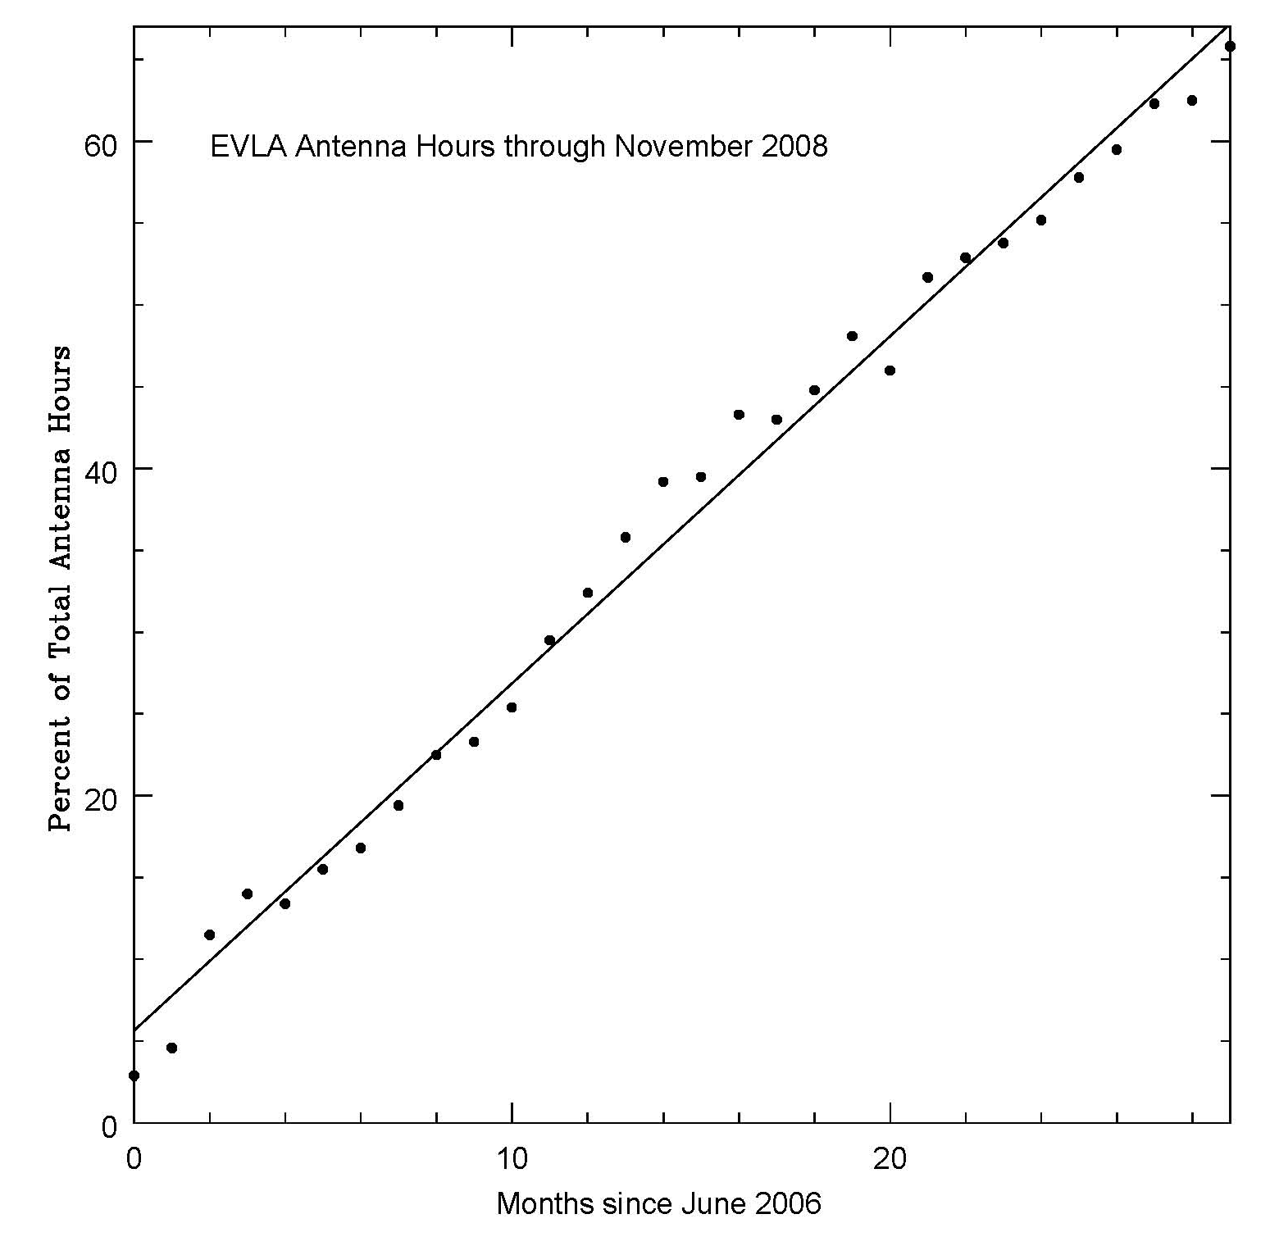
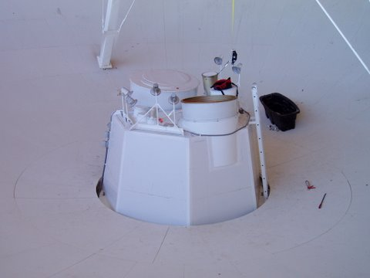
Antenna Conversion Progress
Antenna conversions on track for completion in Q3 2010
  Antennas placed in operation immediately after conversion is complete
    18 EVLA antennas now in use
    Electronics outfitting of 19th antenna is nearly complete
    Mechanical overhaul of 20th antenna is well underway
  Proceeding at desired rate of about 6 per year

Slide 8
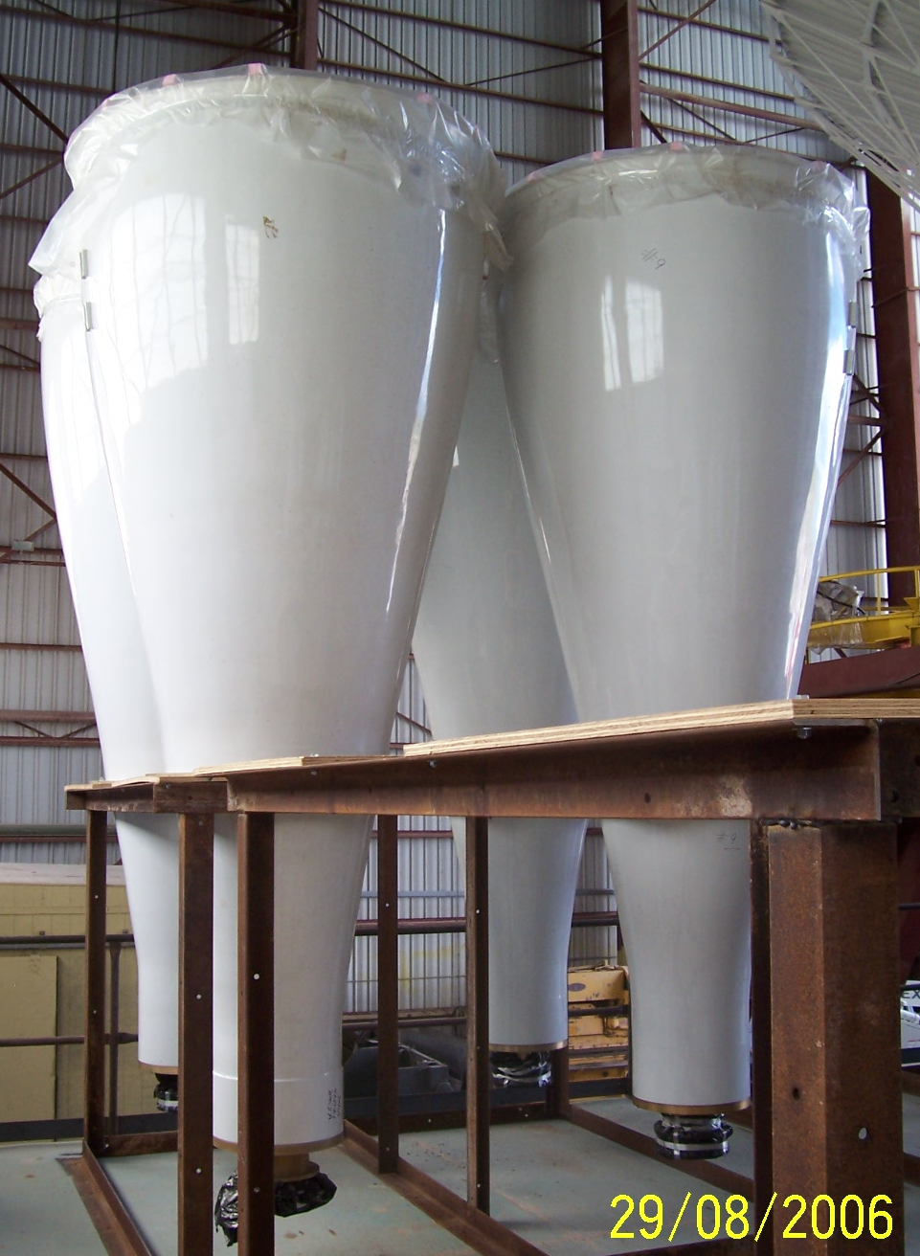
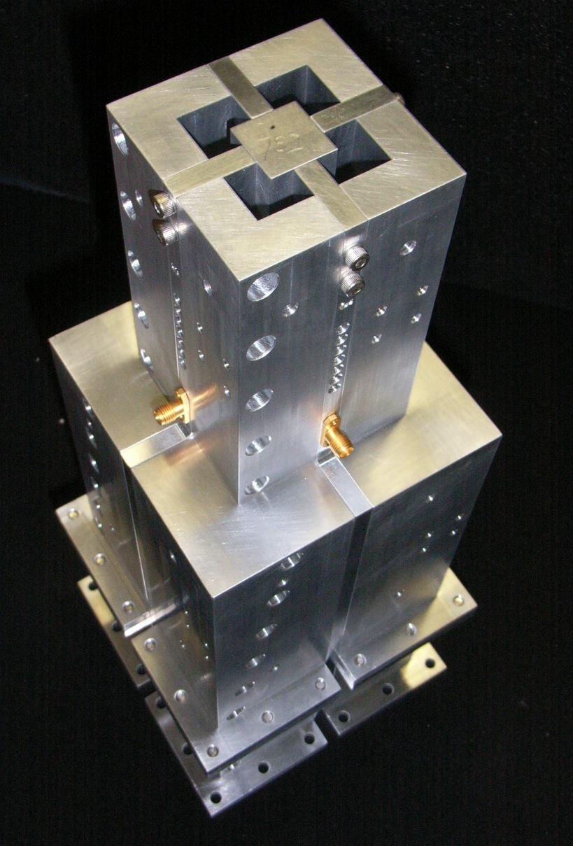
Receiver Progress
Excellent progress on feed horn fabrication
  All horns fabricated for L, C, and Ka-bands
  Fabrication of S-band horns underway
Full production of Ka-band receivers underway
  First fringes on single baseline on Aug 8, 2008
  6 receivers installed in array now
Design and fabrication issues with OMTs resolved
  L, C, and S-band OMTs meeting specifications
L-band horns
S-band OMT

Slide 9
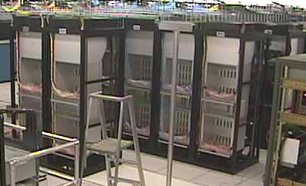
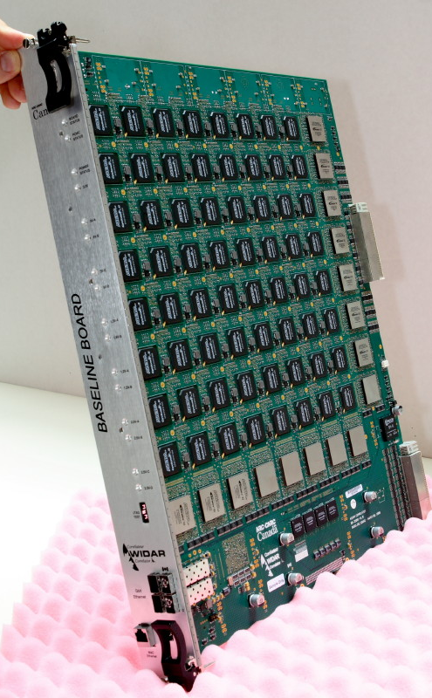
WIDAR Correlator Progress
Custom chips (12,000) received in Apr 2008
High speed data cables and all 16 racks installed in Jun-Aug 2008
On-the-sky tests of prototype began in Jul 2008
First fringes with prototype on Aug 7
Production review of printed circuit boards successfully completed on Dec 2-3
Full production of boards to start in Mar 2009
Rack installation
Baseline board

Slide 10
Additional Progress
Wideband upgrade to LO/IF system started in June 2008
  Production order of 3-bit, 4Gsps digitizers received
Fiber infrastructure completed
  Provides flexibility in locating antennas on the array
Achieved goal of retiring VLA Modcomp control computers in Jun 2007.
  30 years worth of VLA M&C software replicated in new suite of EVLA M&C software
Completed joint ALMA/EVLA definition of binary data format for visibilities
Support for Ka-band observing with VLA correlator built into Observation Preparation Tool

Slide 11
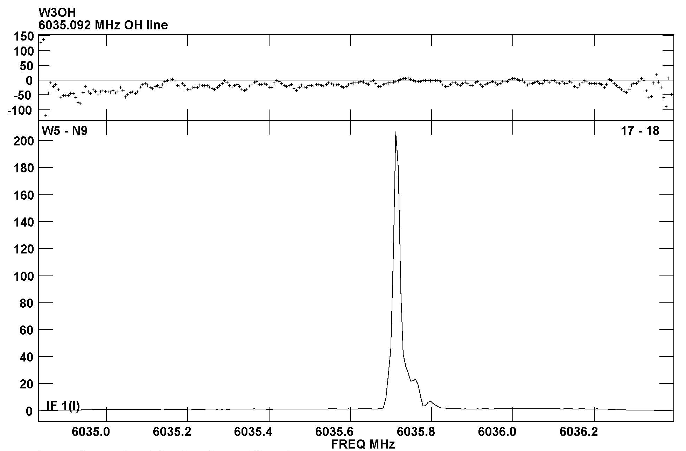
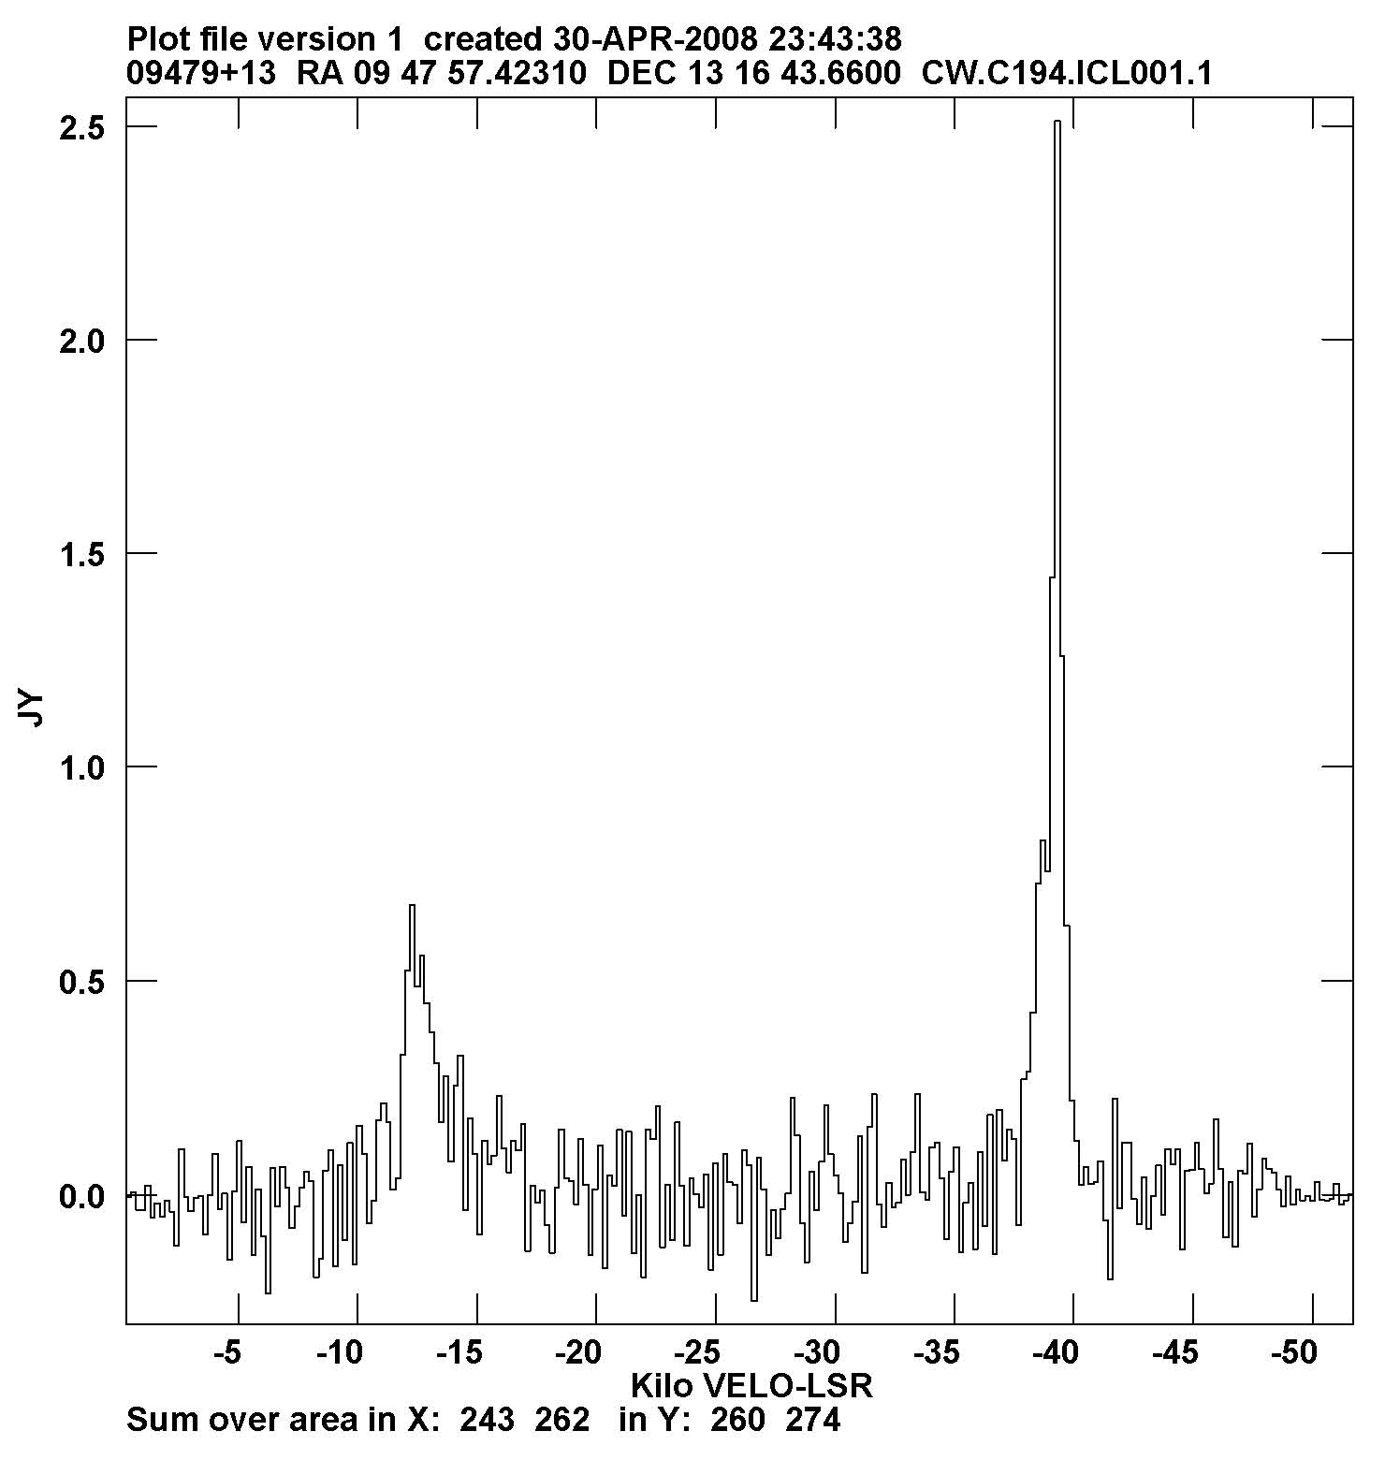
New EVLA Science:
C-Band and K-Band Results
C-band:
  Traditional band is 4.5-5 GHz
  Transition band is 4.2-7.7 GHz
  First EVLA-only science: OH masers
    AU Gem & NML Cyg: Sjouwerman et al. ( 2007, ApJL 666, 101)
    ON1: Fish (2008, ApJL 669, 8)
K-Band:
  Traditional VLA K-band: 21.2 - 25.2 GHz
  EVLA band: 18.0 - 26.5 GHz
  First interferometric detection of SiS (1-0) at 18.154 GHz
    IRC+10216 (CW Leo)
    Claussen & Wooten
W3OH
OH
6.035 GHz
IRC+01216
SiS (1-0)
18.154 GHz

Slide 12
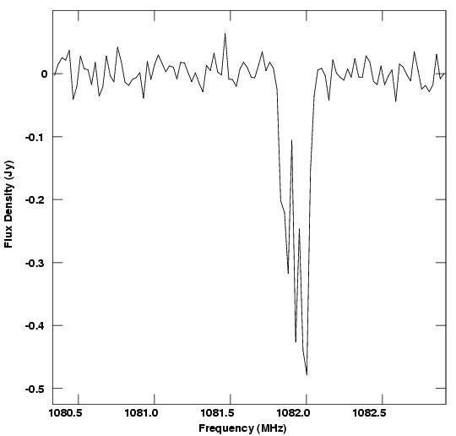
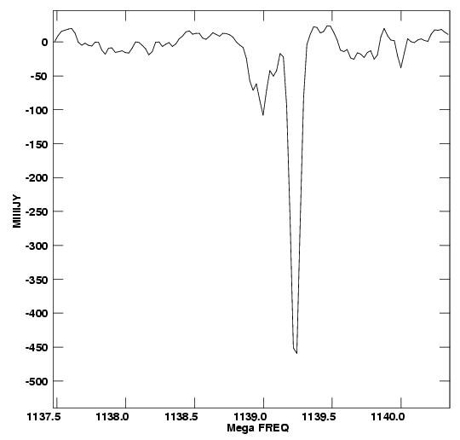
EVLA Imaging of HI Absorption at 1082 and 1139 MHz
Emmanuel Momjian observed two redshifted absorption lines with transition system, in D-configuration, in daytime.
Frequencies used lie in aircraft ‘DME’ bands.
About 25% of data flagged for RFI of some sort.
Sensitivity will increase dramatically with new OMT.
EVLA only
1082 MHz
EVLA and VLA
1139 MHz
1127-145
1413+135

Slide 13
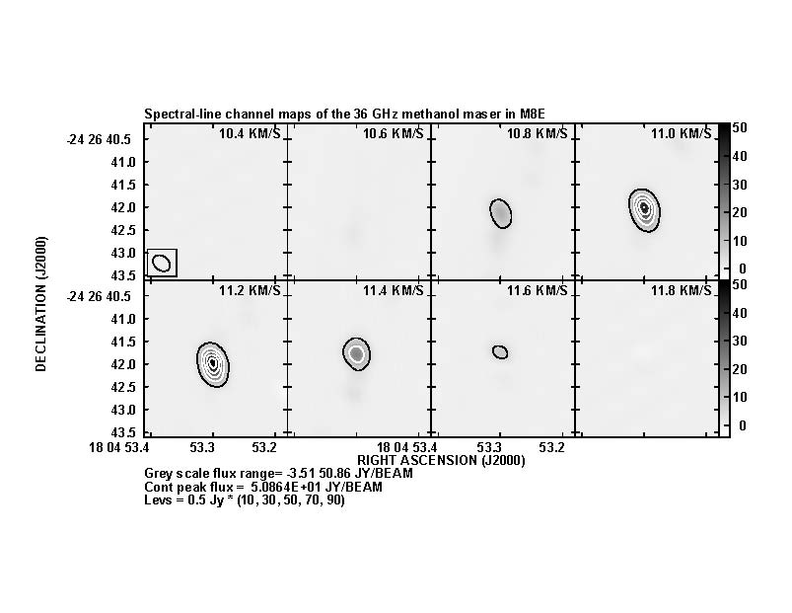
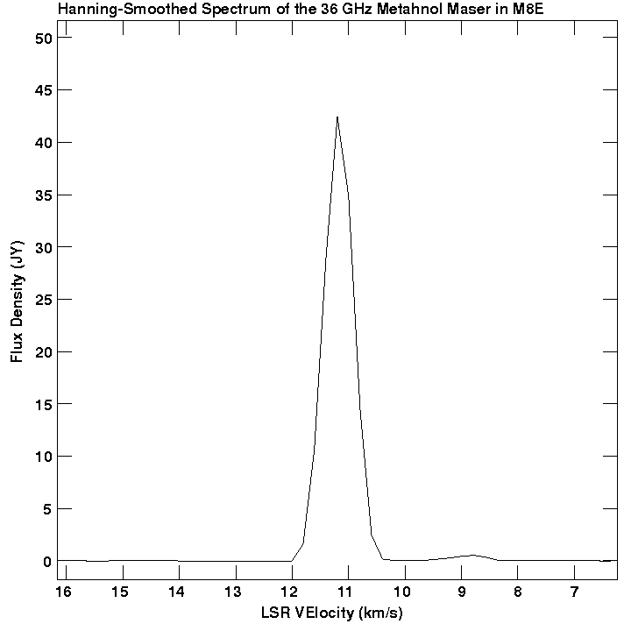
EVLA Science: Ka-band Spectroscopy
Six new Ka-band (27 – 40 GHz) antennas now available.
Ten available by March 2009 --- good for new science.
As part of commissioning tests, Emmanuel Momjian has made imagines of the 36 GHz methanol maser in M8E.

Slide 14
Other Unique EVLA Projects Now Scheduled
Users have noted the increased frequency access:
  32 proposals accepted for C-band frequencies outside the VLA 4.5 – 5.0 GHz window.
    Galactic science proposals involve methanol, excited OH, and formaldehyde masers in star forming regions.
    Extragalactic science involves H₂O masers near z = 2.
  9 proposals accepted for expanded K-band coverage.
    Science goals mostly involving high-redshift (z ~ 2 – 5) molecular emission from young galaxies.
With more frequencies opening up, the interest in observing in these new bands will increase.
  Most significant new capability in 2009 will be availability of Ka-band (26.5 – 40 GHz)

Slide 15
Antenna and Wideband Receiver Availability
VLA antennas are being converted to EVLA antennas at a rate of 6/year.
  18 now converted. Conversion completed mid 2010.
Upon conversion, EVLA antennas are outfitted with:
  available wideband receivers (K, Q initially, now C, K, Ka, Q),
  An existing VLA narrowband receiver, (X)
  An ‘interim’ EVLA receiver – full tuning range, but limited sensitivity and polarization (C, L initially, now only L),
  No receiver (Ku, S)
New receivers will be outfitted on EVLA antennas in the field, as designs are finalized, and production enables.
Three bands still to be designed/tested: S, X, Ku
All receiver outfitting/retrofitting will be completed by end of 2012.

Slide 16
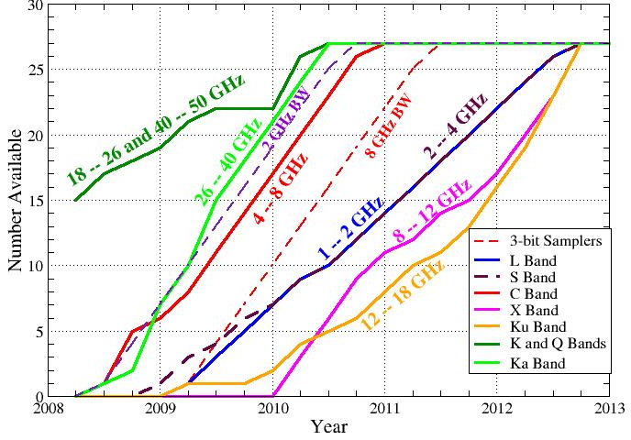
Wideband Availability Timescale
When will full wideband tuning capability be available?
VLA Correlator
WIDAR Correlator

Slide 17
It’s Better Than It Looks!
Wideband availability plot does not include capabilities of VLA antennas and ‘interim’ EVLA bands.
Next two slides detail the capabilities growth for each band.

Slide 18
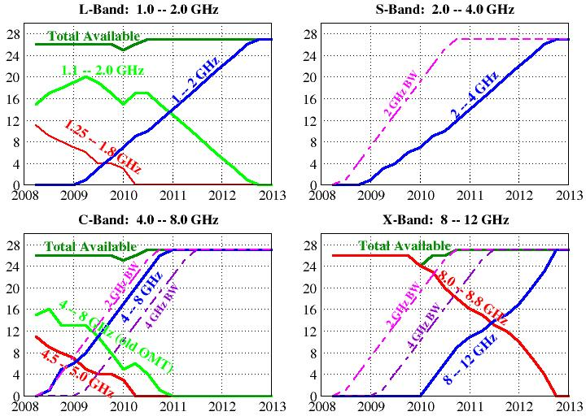
Low Frequency Bands Capability Growth

Slide 19
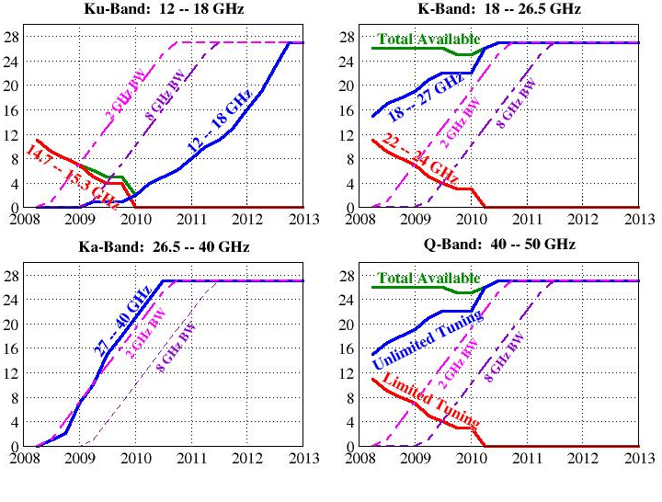
High Frequency Bands Capabilities Growth

Slide 20
Notes for the Previous Slides
To describe the evolution of frequency access, we must define three kinds of receivers/antennas:
  Old VLA – the old narrowband receivers, and the < 400 MHz frequency separation restriction between the two IF pairs.
  Interim EVLA: (C, L bands) Full tuning range, no restriction on IF pair frequency separation, but great degradation in sensitivity and polarization outside the traditional VLA bands.
  Final EVLA: Full bandwidths, no tuning restrictions.
With this, the growth in tuning capability using the VLA correlator can be described fairly simply.
  Still two IF pairs, maximum 50 MHz BW, maximum 512 channels.
  A maximum of 22 EVLA antennas will be available to the VLA correlator.
  Hence, after August 2009, the total number of antennas available will decrease with time, until WIDAR is on-line.
In January 2010, remaining (~3) VLA antennas will be turned off when WIDAR correlator is brought on-line.

Slide 21
Increasing the Bandwidth
Obtaining wider bandwidths and more channels requires the WIDAR correlator.
The switchover to WIDAR cannot be a ‘1-step’ process.
New hardware needed to enable wider BW: a second LO pair, a second downconverter pair, and the 3-bit samplers.
  All EVLA antennas provide 1 GHz BW now.
  5 EVLA antennas can provide 2 GHz BW now, rising at 1/month.
  Full 8 GHz BW upgrade starts early next year, completed by mid 2011.
WIDAR station boards, baseline boards.
New software – both within WIDAR and in post-processing -- needed to manage the dataflow and increased flexibility.

Slide 22
The Growth of WIDAR
Critical on-sky tests (just completed) with 4-station WIDAR prototype.
Initial implementation of the final WIDAR will be a 10-station system for further testing (known as WIDAR-0).
  Planned to begin February, 2009.
  Not available for science!
In January 2010, WIDAR-0 will expand to handle all available EVLA antennas in a ‘VLA Emulation’ mode.
What is this?

Slide 23
‘VLA Emulation Mode’
We plan to replace the existing VLA correlator with WIDAR in mid-January, 2010.
The initial WIDAR setup will provide, for all EVLA antennas, two basic modes:
  Two independent sub-band pairs of 128 MHz each, with full polarization, and 64 channels/correlation.
  One sub-band pair, RR and LL polarizations, 128 MHz BW, 256 channels per correlation.
For both modes, the bandwidth can be divided by powers of two while keeping the number of channels fixed.
We will remain in this state for some time to ensure reliability and stability.

Slide 24
OSRO WIDAR modes (1)
Continuum applications and spectro-polarimetry
  Two independently-tunable sub-bands (IFs), full polarization, each with bandwidth 128/2^{n} MHz (n=0,..,12), 64 channels
Sub-band BW (MHz) | Number of poln. products | Number of channels/poln product | Channel width (kHz) | Channel width (kms⁻¹ at 1 GHz) | Total velocity coverage (kms⁻¹ at 1 GHz)
128 | 4 | 64 | 2000 | 600/ν(GHz) | 38,400/ν(GHz)
64 | 4 | 64 | 1000 | 300 | 19,200
32 | 4 | 64 | 500 | 150 | 9,600
16 | 4 | 64 | 250 | 75 | 4,800
8 | 4 | 64 | 125 | 37.5 | 2,400
4 | 4 | 64 | 62.5 | 19 | 1,200
2 | 4 | 64 | 31.25 | 9.4 | 600
1 | 4 | 64 | 15.625 | 4.7 | 300
0.5 | 4 | 64 | 7.813 | 2.3 | 150
0.25 | 4 | 64 | 3.906 | 1.2 | 75
0.125 | 4 | 64 | 1.953 | 0.59 | 37.5
0.0625 | 4 | 64 | 0.977 | 0.29 | 18.75
0.03125 | 4 | 64 | 0.488 | 0.15 | 9.375

Slide 25
OSRO WIDAR modes (2)
Spectral line applications
  One tunable sub-band (IF), dual polarization, with bandwidth 128/2^{n} MHz (n=0,..,12), 256 channels
Sub-band BW (MHz) | Number of poln. products | Number of channels/poln product | Channel width (kHz) | Channel width (kms⁻¹ at 1 GHz) | Total velocity coverage (kms⁻¹ at 1 GHz)
128 | 2 | 256 | 500 | 150/ν(GHz) | 38,400/ν(GHz)
64 | 2 | 256 | 250 | 75 | 19,200
32 | 2 | 256 | 125 | 37.5 | 9,600
16 | 2 | 256 | 62.5 | 19 | 4,800
8 | 2 | 256 | 31.25 | 9.4 | 2,400
4 | 2 | 256 | 15.625 | 4.7 | 1,200
2 | 2 | 256 | 7.813 | 2.3 | 600
1 | 2 | 256 | 3.906 | 1.2 | 300
0.5 | 2 | 256 | 1.953 | 0.59 | 150
0.25 | 2 | 256 | 0.977 | 0.29 | 75
0.125 | 2 | 256 | 0.488 | 0.15 | 37.5
0.0625 | 2 | 256 | 0.244 | 0.073 | 18.75
0.03125 | 2 | 256 | 0.122 | 0.037 | 9.375

Slide 26
WIDAR Science, 2010 and Beyond
All WIDAR hardware components will be here by December 2009.
Expanded WIDAR observational capabilities will be commissioned through 2011. (Is earlier possible?)
  Growth path not finalized.
  Most likely path is to maximize bandwidth quickly, with limited flexibility.
  Expanded capabilities to be made available to RSRO participants.
More complicated and flexible modes to be added later – timescales set by availability of resources.
  Increased number of channels
  Greatly increased frequency resolution
  Flexible correlator resource allocation
  Pulsar mode observing
  Phased array mode observing

Slide 27
Major Future Milestones
Test 4-station prototype correlator on the sky July ’08 – Feb. ‘09
  Four antenna test and verification system
Testing of 10-station correlator: Feb. ’09 – Jan. ‘10
Full Correlator Installation May ’09 – Dec. ’09
VLA’s correlator turned off Jan. 2010
  WIDAR correlator capabilities will be much greater
  About 25 EVLA antennas will be available.
Shared Risk Observing Begins Jan. 2010
Last antenna retrofitted Sept. 2010
Last receiver installed Sept. 2012

