Slide 1
Low Frequency Radio Astronomy
Steven Tremblay (NRAO)

Slide 2
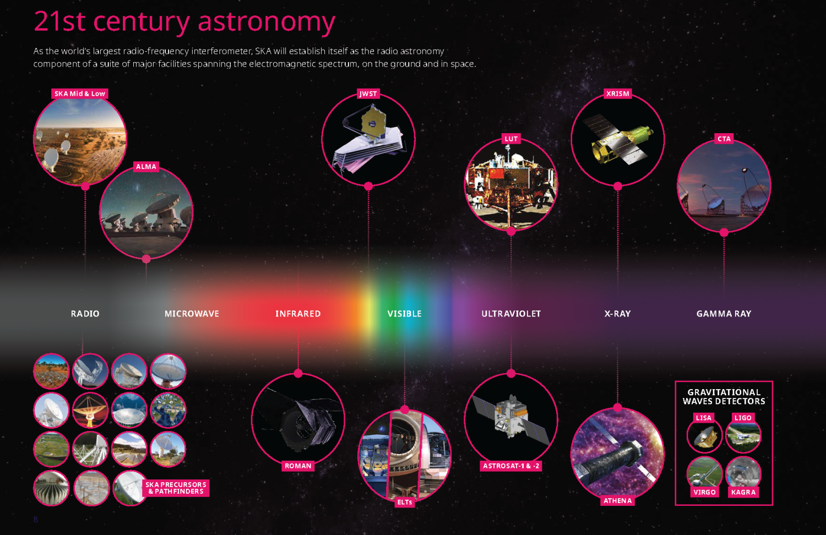
Low Frequency: What do we mean by ‘Low’?
Credit: SKAO

Slide 3
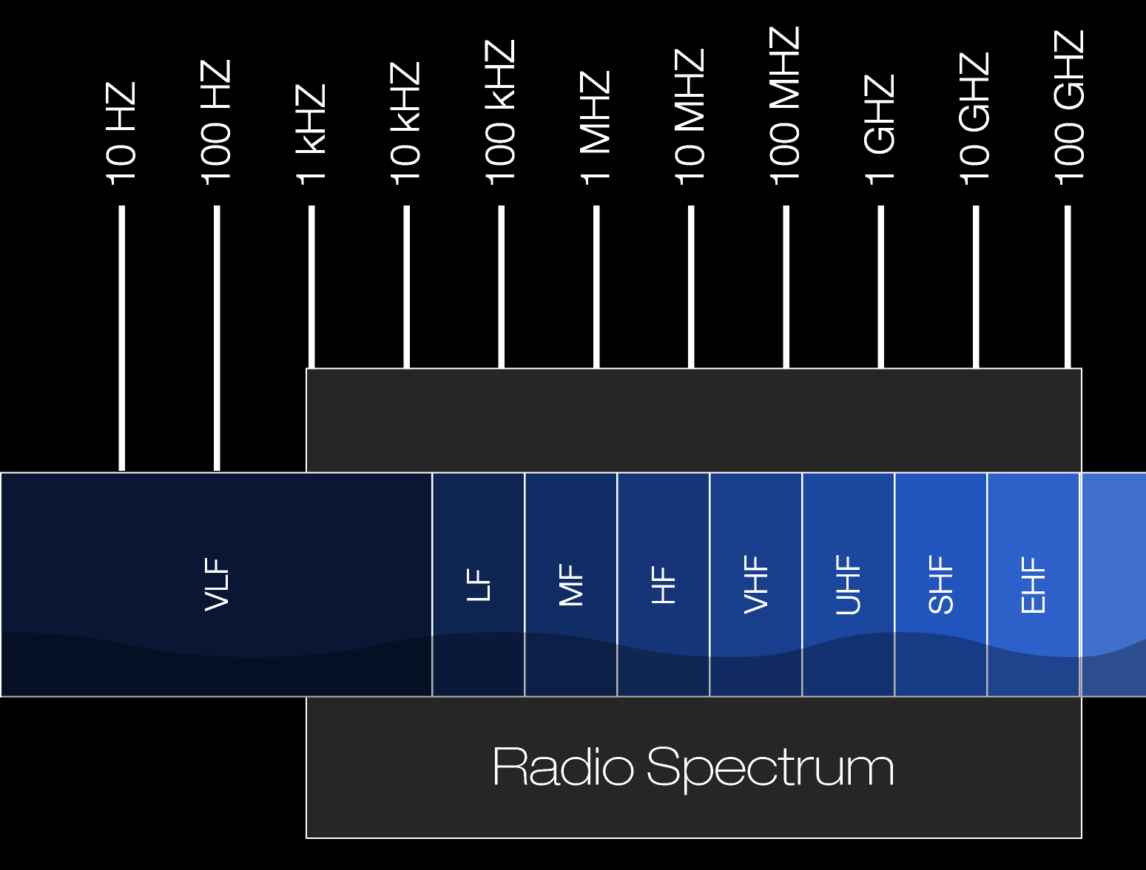
Low Frequency: What do we mean by ‘Low’?
Radio Spectrum (ITU):
Very Low Frequency
(3 kHz – 30 kHz )
Low Frequency
(30 kHz – 300 kHz)
Medium Frequency
(300 kHz – 3 MHz)
High Frequency
(3 MHz – 30 MHz)
Very High Frequency
(30 MHz – 300 MHz)
Ultra High Frequency
(300 MHz – 3 GHz)
Super High Frequency
(3 GHz – 30 GHz)
Extremely High Frequency
(30 GHz – 300 GHz)
(ELF)
(SLF)
(ULF)
Credit:
Adapted from
NASA

Slide 4
Low Frequency:
The Good, the Bad, and the Ugly

Slide 5
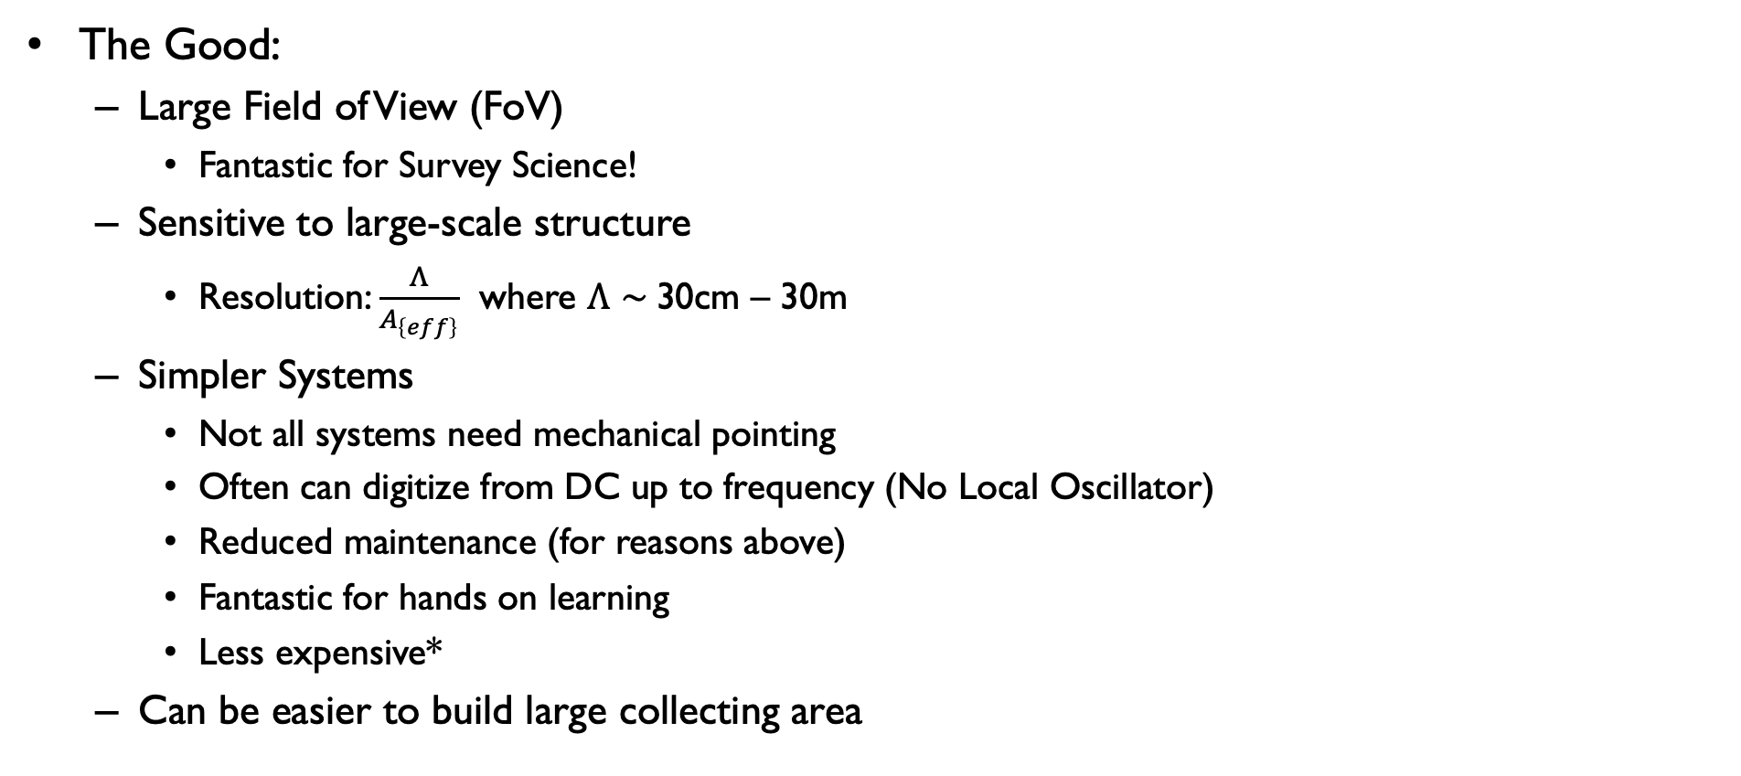
Low Frequency: The Good, the Bad, and the Ugly
The Good:
  Large Field of View (FoV)
    Fantastic for Survey Science!
  Sensitive to large-scale structure
    Resolution: $\frac{Λ}{A_{\left\{eff\right\}}}$ where $Λ∼$30cm – 30m
  Simpler Systems
    Not all systems need mechanical pointing
    Often can digitize from DC up to frequency (No Local Oscillator)
    Reduced maintenance (for reasons above)
    Fantastic for hands on learning
    Less expensive*
  Can be easier to build large collecting area

Slide 6
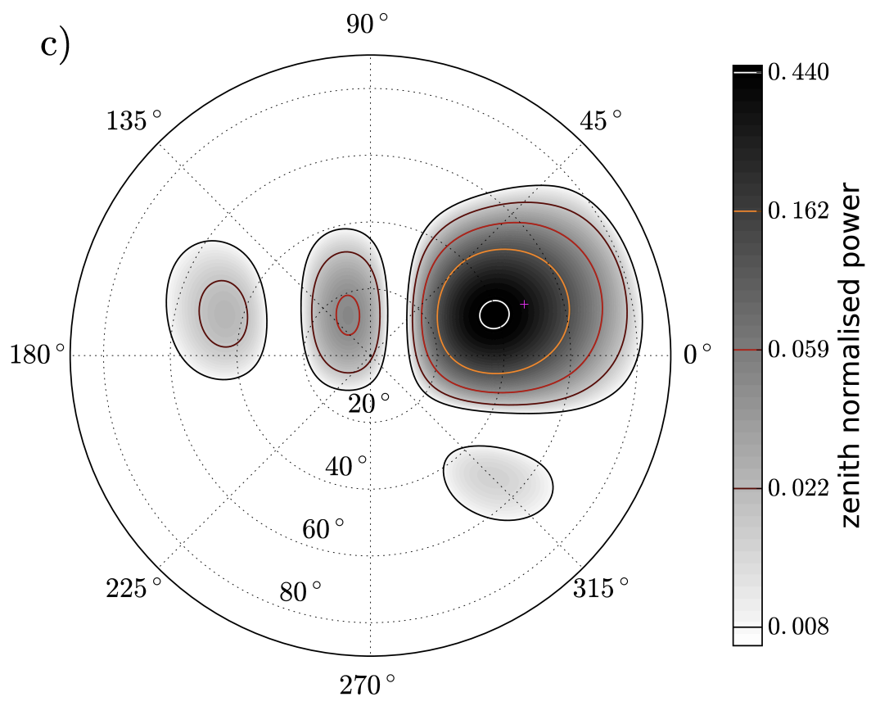
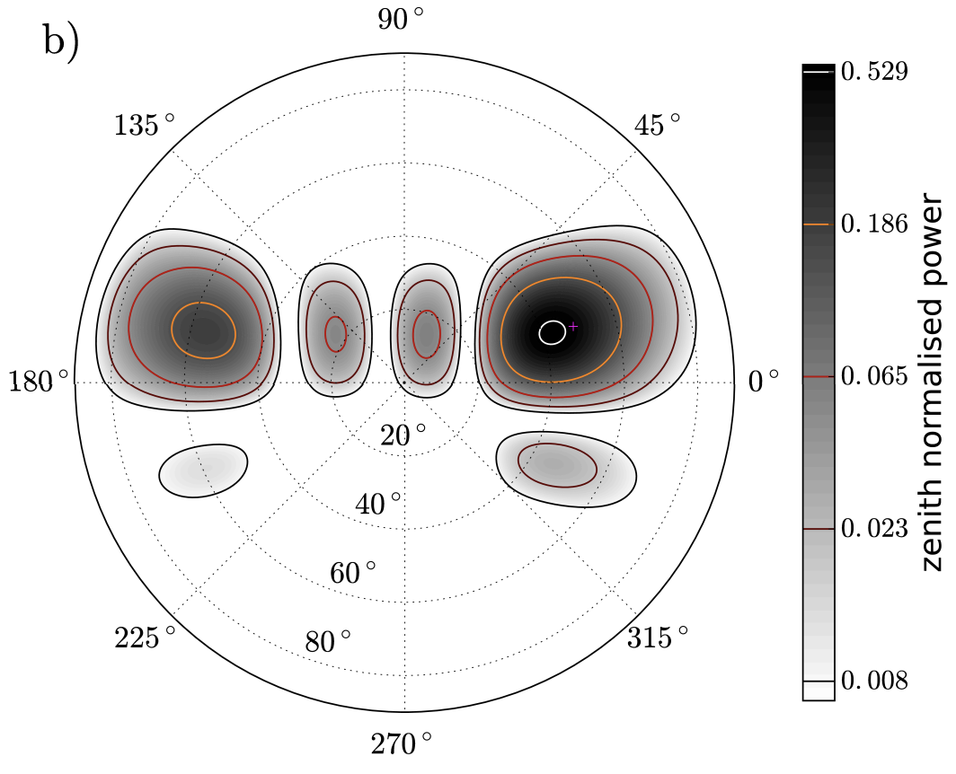
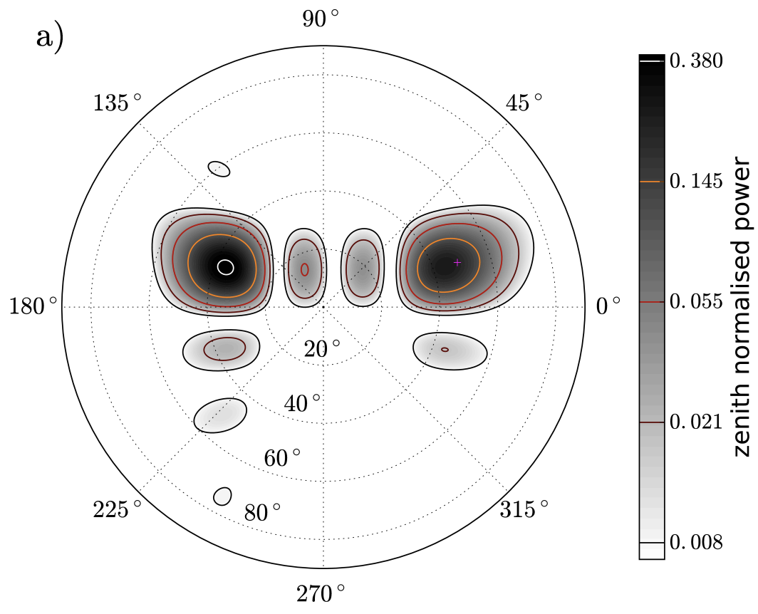
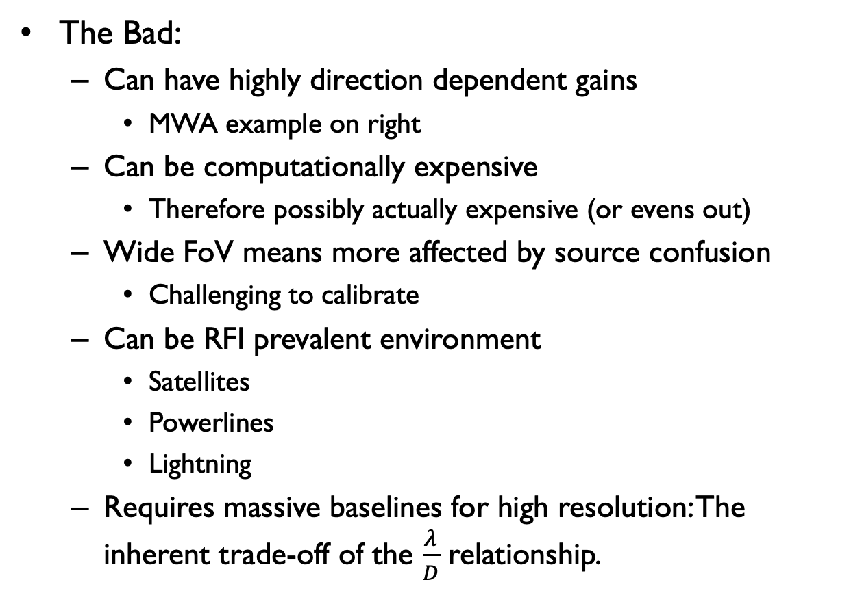
Low Frequency: The Good, the Bad, and the Ugly
The Bad:
  Can have highly direction dependent gains
    MWA example on right
  Can be computationally expensive
    Therefore possibly actually expensive (or evens out)
  Wide FoV means more affected by source confusion
    Challenging to calibrate
  Can be RFI prevalent environment
    Satellites
    Powerlines
    Lightning
  Requires massive baselines for high resolution: The inherent trade-off of the $\frac{λ}{D}$ relationship.
120.96 MHz
156.56 MHz
Meyers et al. 2017
210.56 MHz

Slide 7
Low Frequency: The Good, the Bad, and the Ugly
The Ugly:
  Ionosphere
“After you find a bigger task to dread, the little chores will be a breeze. Here’s another reason to have a devil on hand. It does make all the little demons more . . . bearable.”
― Chuck Palahniuk, Haunted

Slide 8
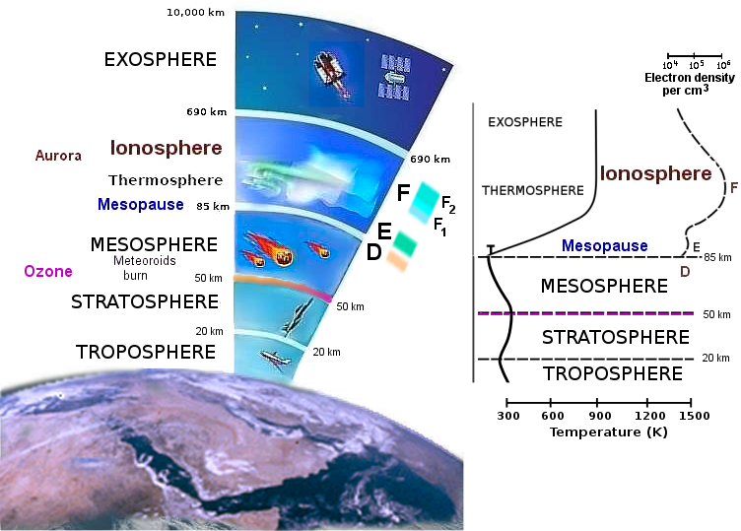
Ionosphere
Region of atmosphere between ~80 and ~600 km where extreme ultraviolet (EUV) and x-ray solar radiation ionizes the atoms and molecules thus creating a layer of electrons
Brown & Lombry 2004

Slide 9
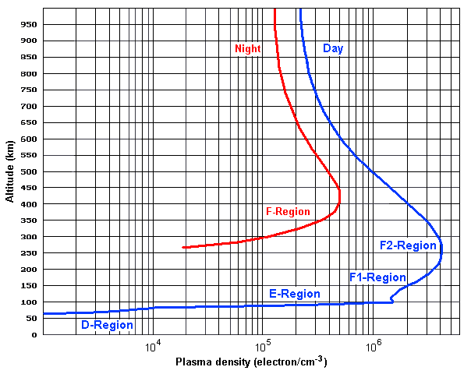
Ionosphere
Region of atmosphere between ~80 and ~600 km where extreme ultraviolet (EUV) and x-ray solar radiation ionizes the atoms and molecules thus creating a layer of electrons
Time variable on multiple time-scales
  (Years) 11 year Solar Activity Cycle
  (Hours) Day/Night
  (Minutes) Space Weather and TIDs
Brown & Lombry 2004

Slide 10
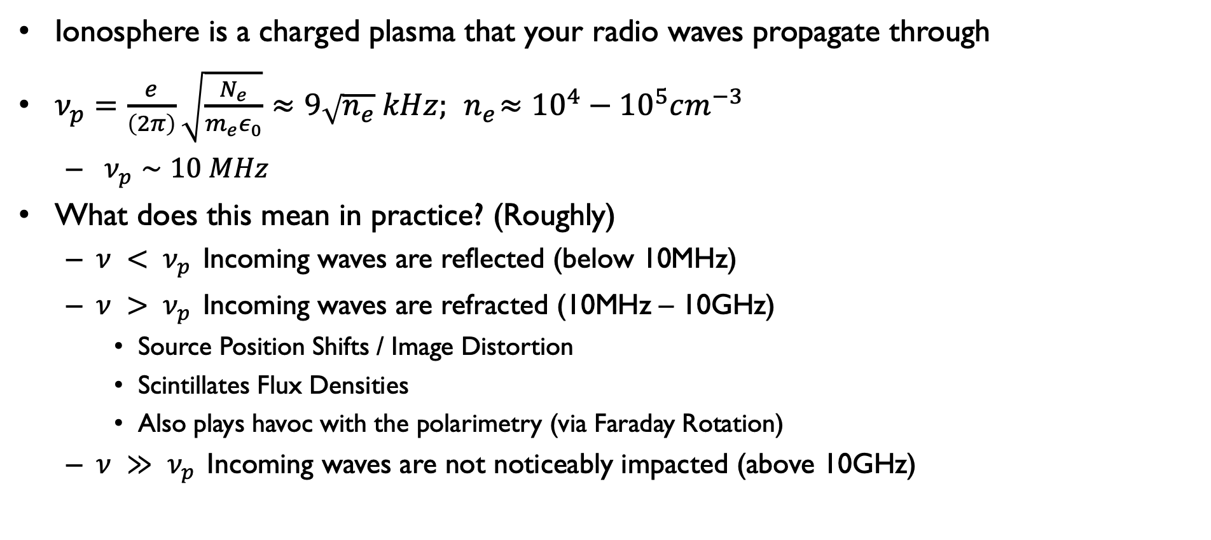
Ionosphere: What does it do?
Ionosphere is a charged plasma that your radio waves propagate through
$ν_{p}=\frac{e}{\left(2π\right)}\sqrt{\frac{N_{e}}{m_{e}ε_{0}}}≈9\sqrt{n_{e}} kHz;{ n}_{e}≈{10}^{4}−{10}^{5}cm^{−3}$
  $ν_{p}∼10 MHz$
What does this mean in practice? (Roughly)
  $ν {< ν}_{p }$Incoming waves are reflected (below 10MHz)
  $ν {> ν}_{p }$Incoming waves are refracted (10MHz – 10GHz)
    Source Position Shifts / Image Distortion
    Scintillates Flux Densities
    Also plays havoc with the polarimetry (via Faraday Rotation)
  $ν {≫ ν}_{p }$Incoming waves are not noticeably impacted (above 10GHz)

Slide 11
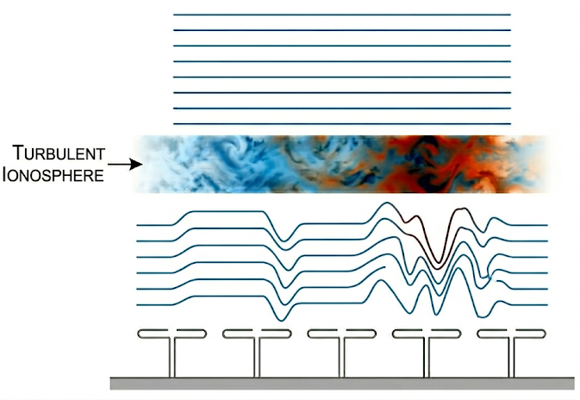
Ionosphere: What can we do?
Spatial Structure
  Simple slab: Uniform phase offset for narrow fields of view
  Wedge: Phase gradient to model source position shifts
  Zernike polynomials: Maps higher-order ripples and image distortion
Temporal Evolution
  Ionosphere is highly dynamic
  Spatial models must continuously track moving turbulent cells
Calibration Strategy
  Can use position offsets and image distortions as your input
  Corrections applied to:
    Visibilities
    Direction dependent gains to (u,v) plane
    Directly to the (l, m) image grid

Slide 12
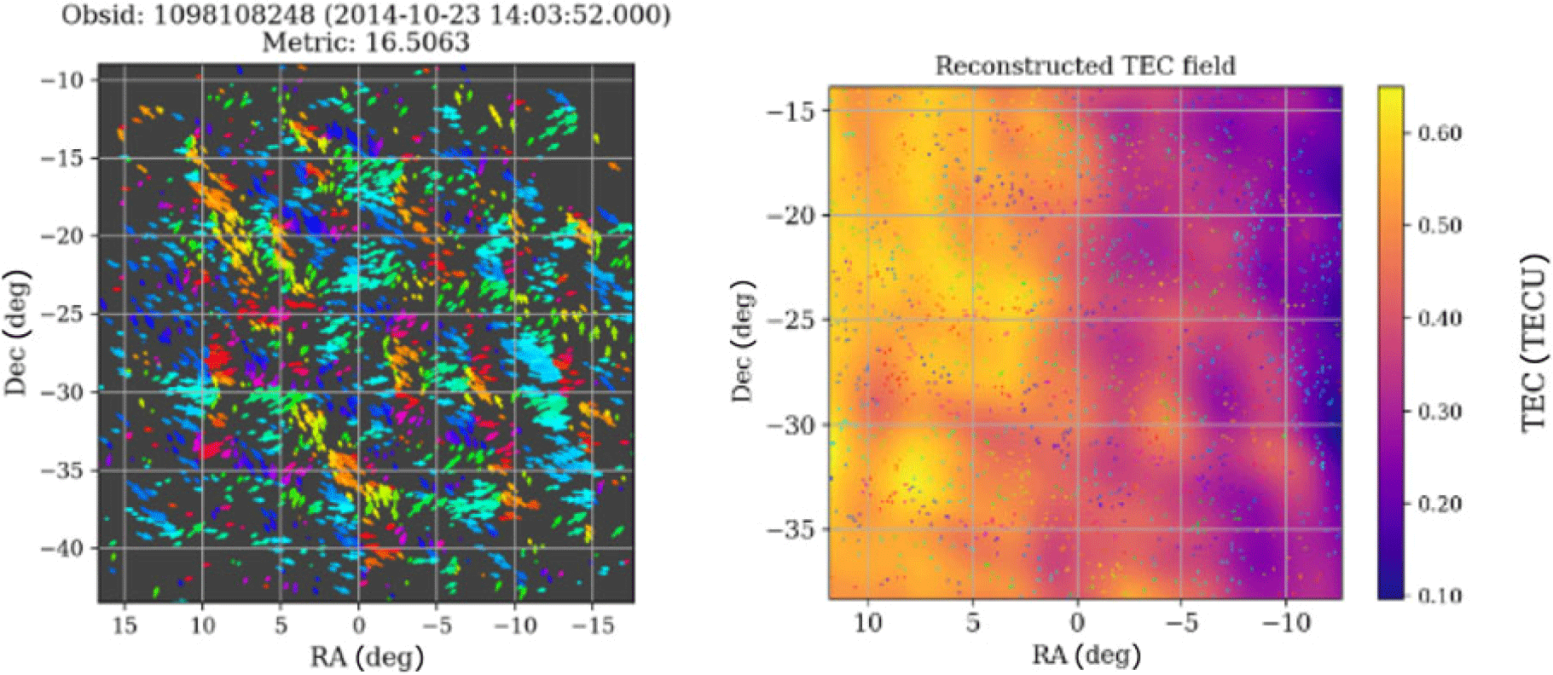
Ionosphere
Chege et al. 2021
Vector source offsets
(154 MHz)

Slide 13
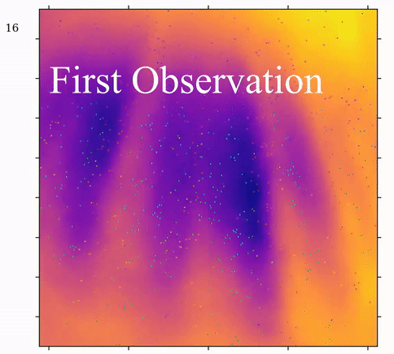
Ionosphere
Credit: Chris Jordan

Slide 14
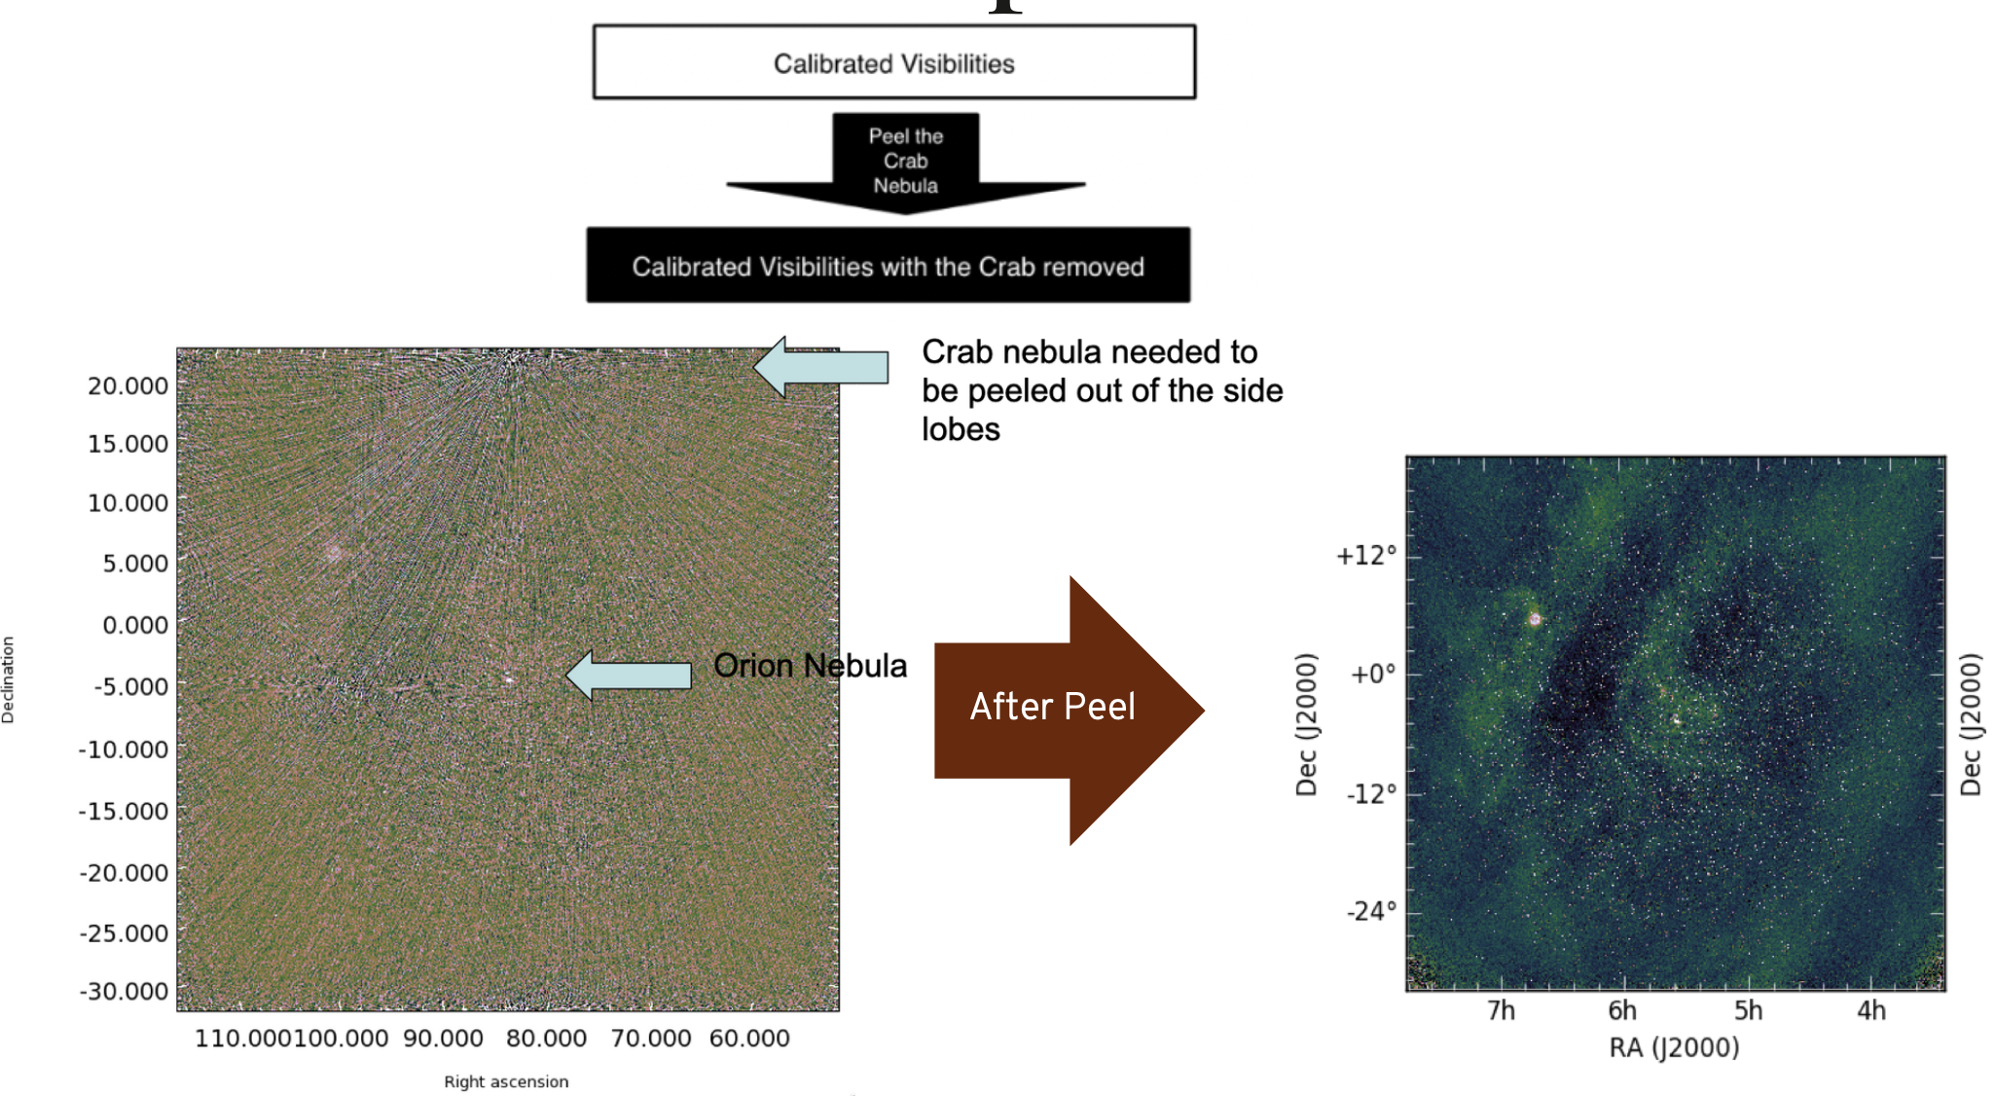
Low frequency Calibration
Direction dependent gains must be accounted for:
  ‘Easy’ to model based on simulations/empirical data
Ionosphere must be tamed
  FoV actually helps
Confusion needs to be dealt with:
  Peeling and its successors
All of these add to increased computational burden
Credit: C. Tremblay

Slide 15
Low Frequency:
What are we looking at?

Slide 16
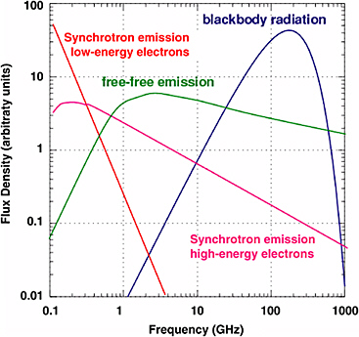
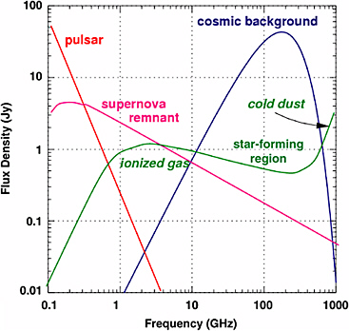
What emits at low frequency?
Handbook of Frequency Allocation and Spectrum Protection
for Scientific Uses (2007)

Slide 17
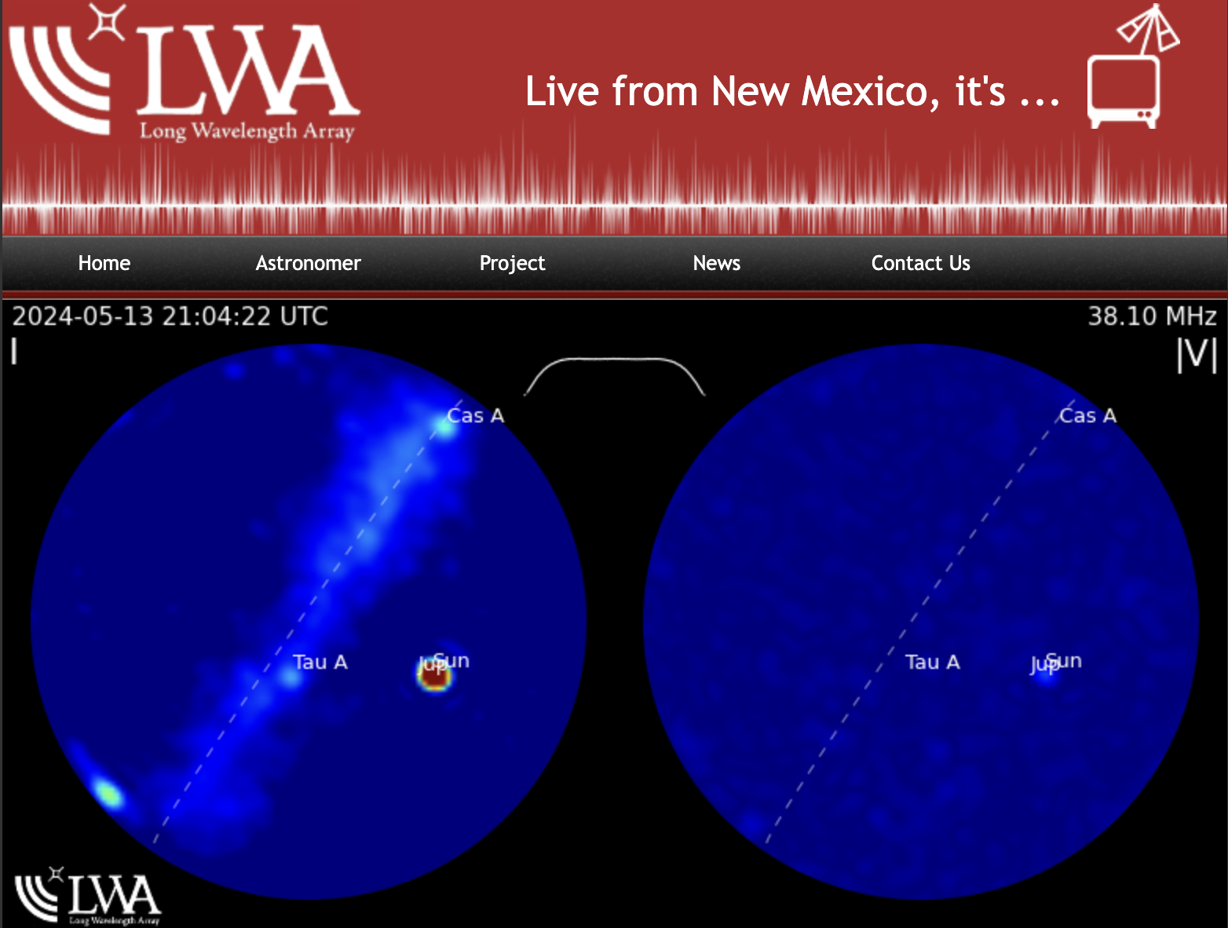
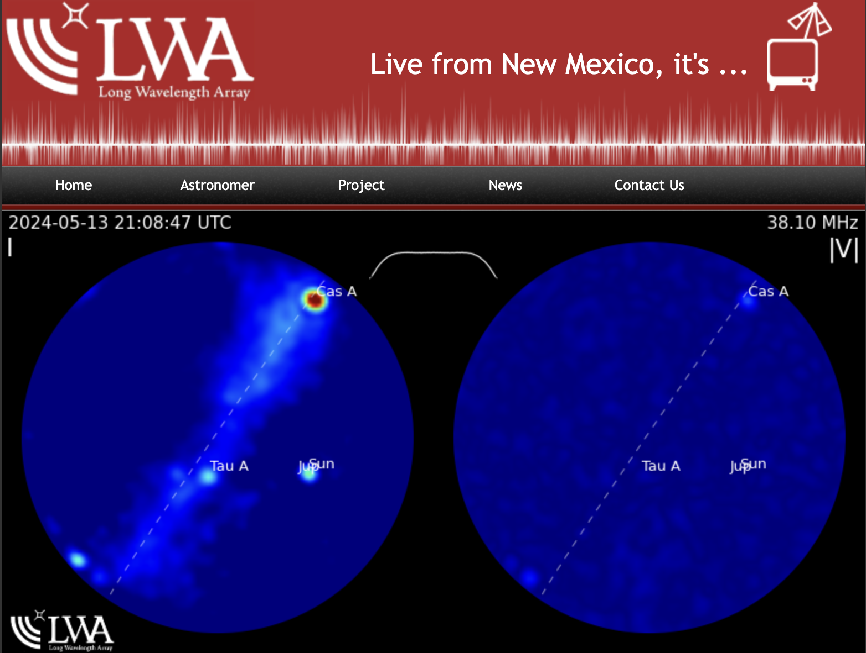
What emits at low frequency?
https://leo.phys.unm.edu/~lwa/lwatv.html

Slide 18
Low frequency science
Early Universe (EoR, Dark Ages)
Pulsars (Surveys, MSPs, Single-pulse)
Shocks / Turbulence / Jets (Active Galactic Nuclei, Supernova Remnants)
Transients (Fast Radio Bursts, Tidal Disruption Events)
Solar / Heliospheric
Survey Science
Ionospheric*
Cosmic Ray
Radio Recombination Lines / Spectral Lines
Interstellar / Interplanetary Medium
Serendipity
Etc.

Slide 19
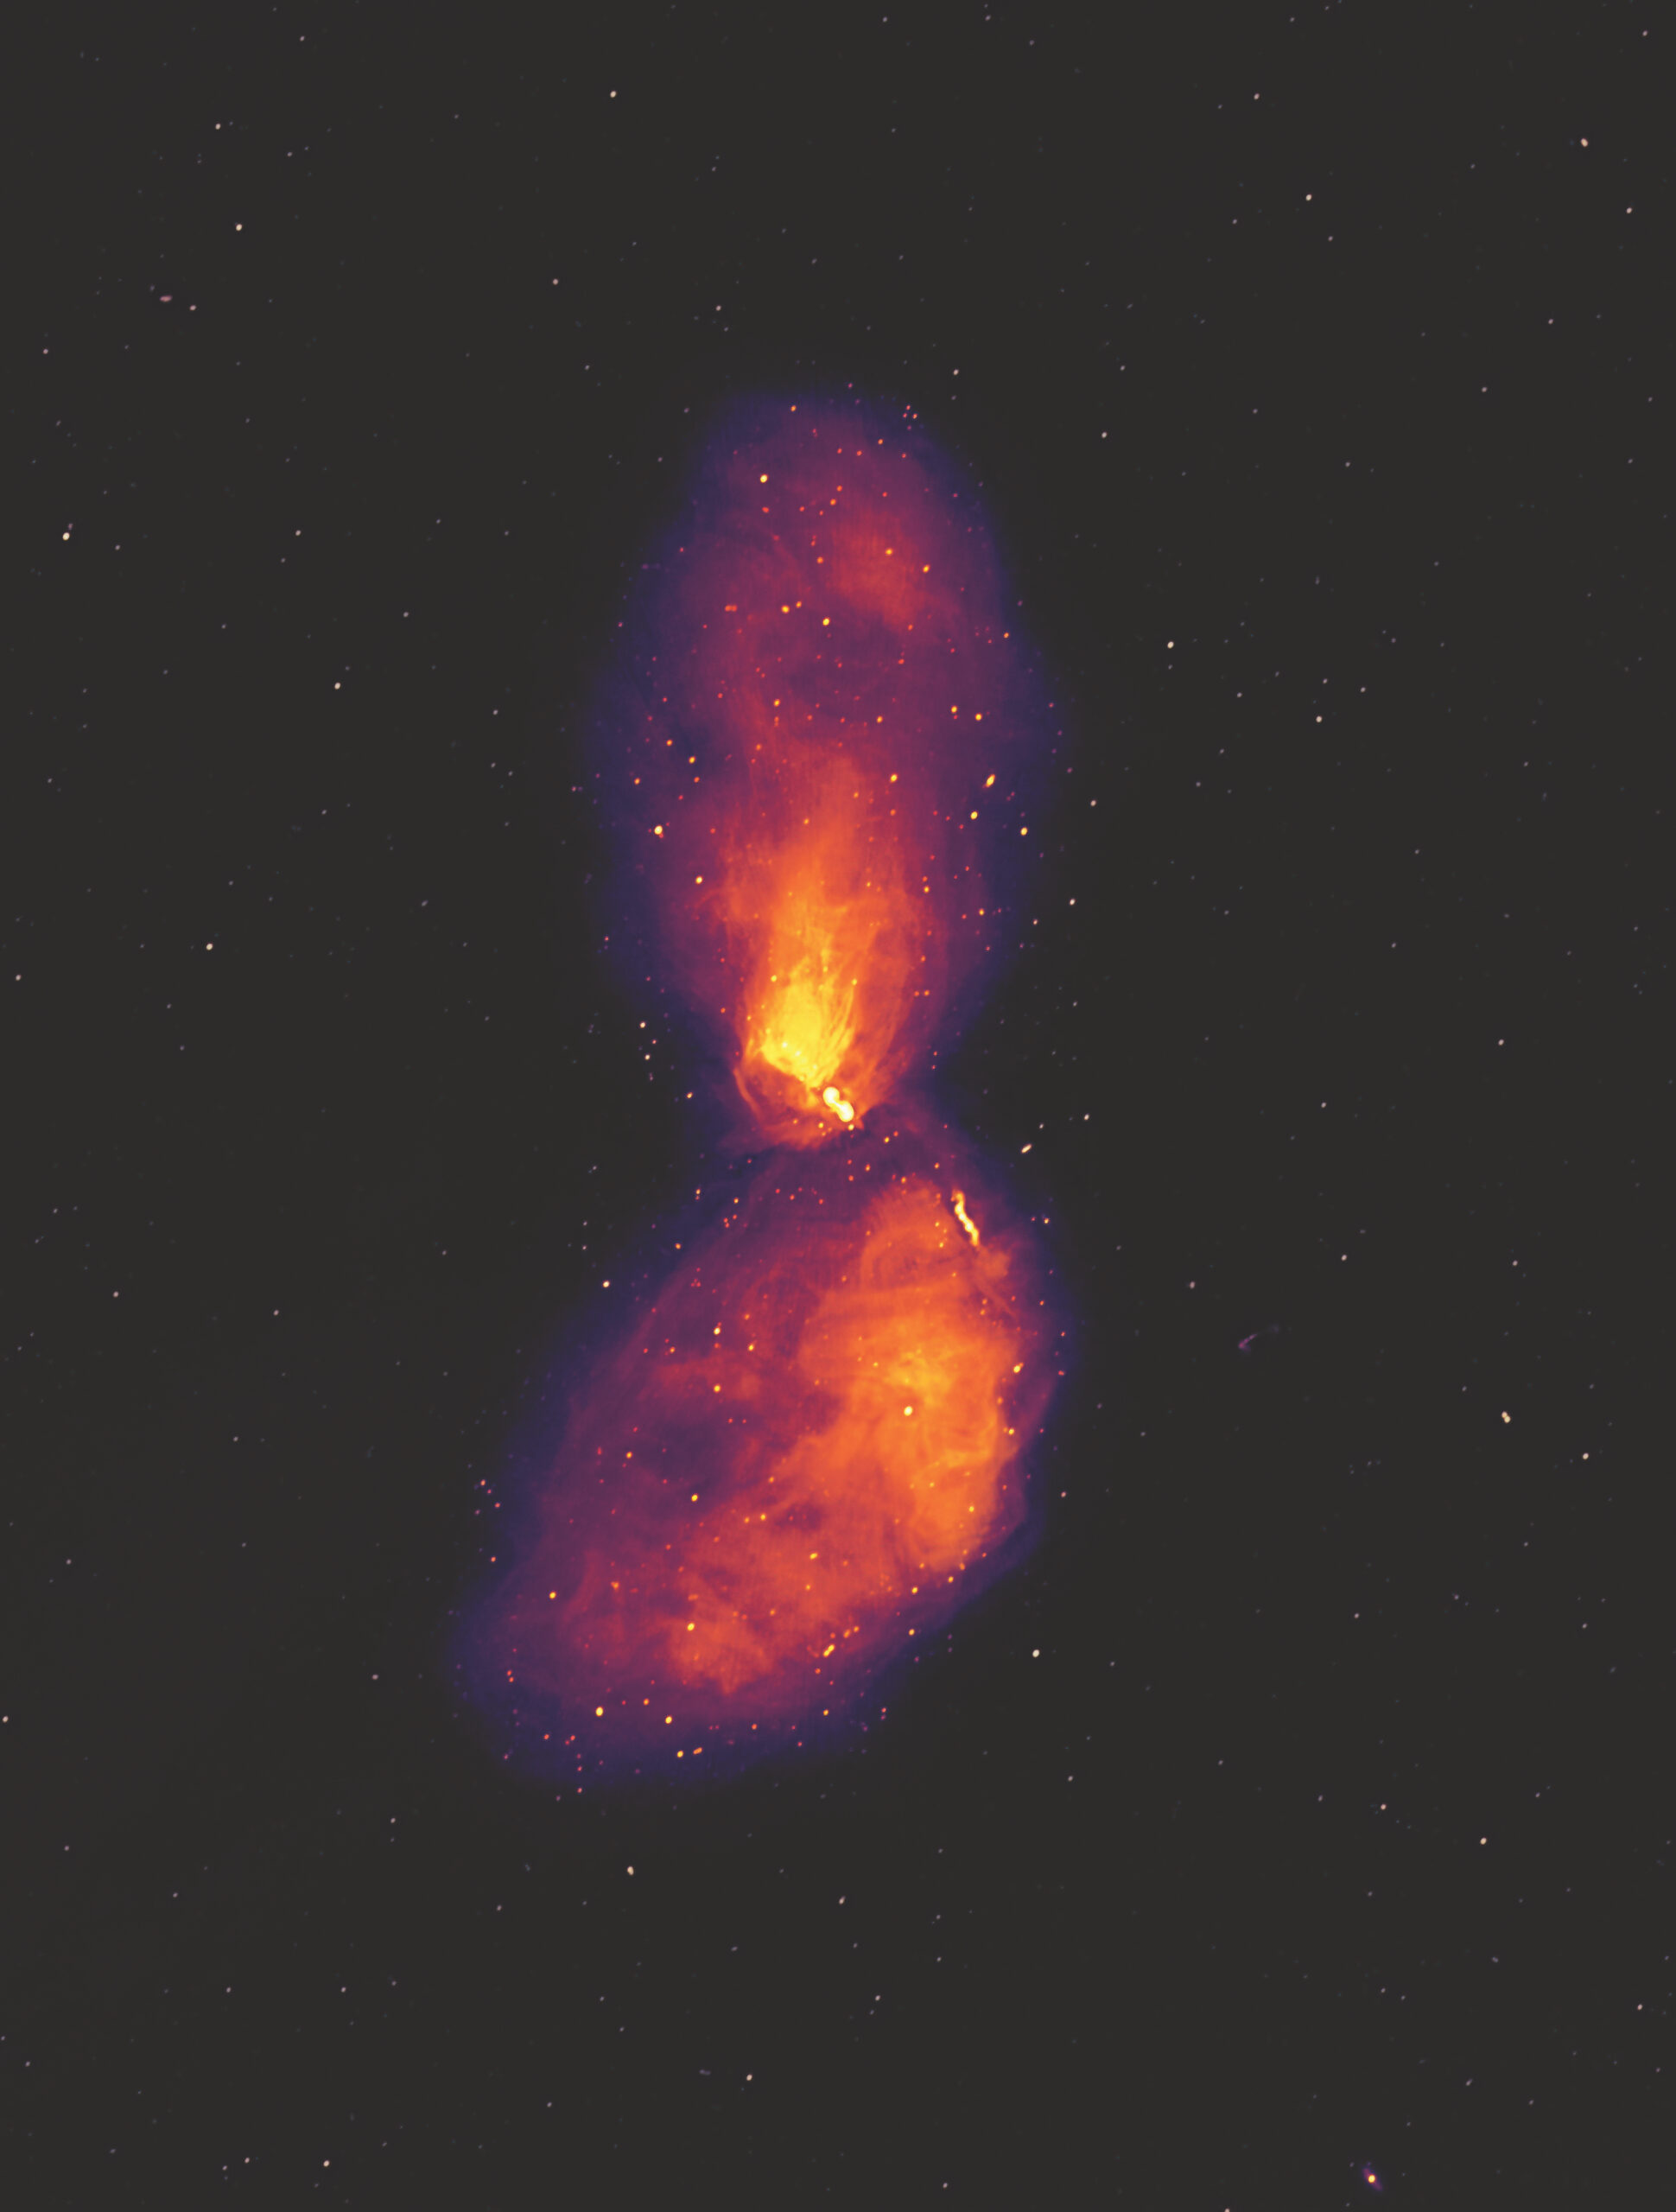
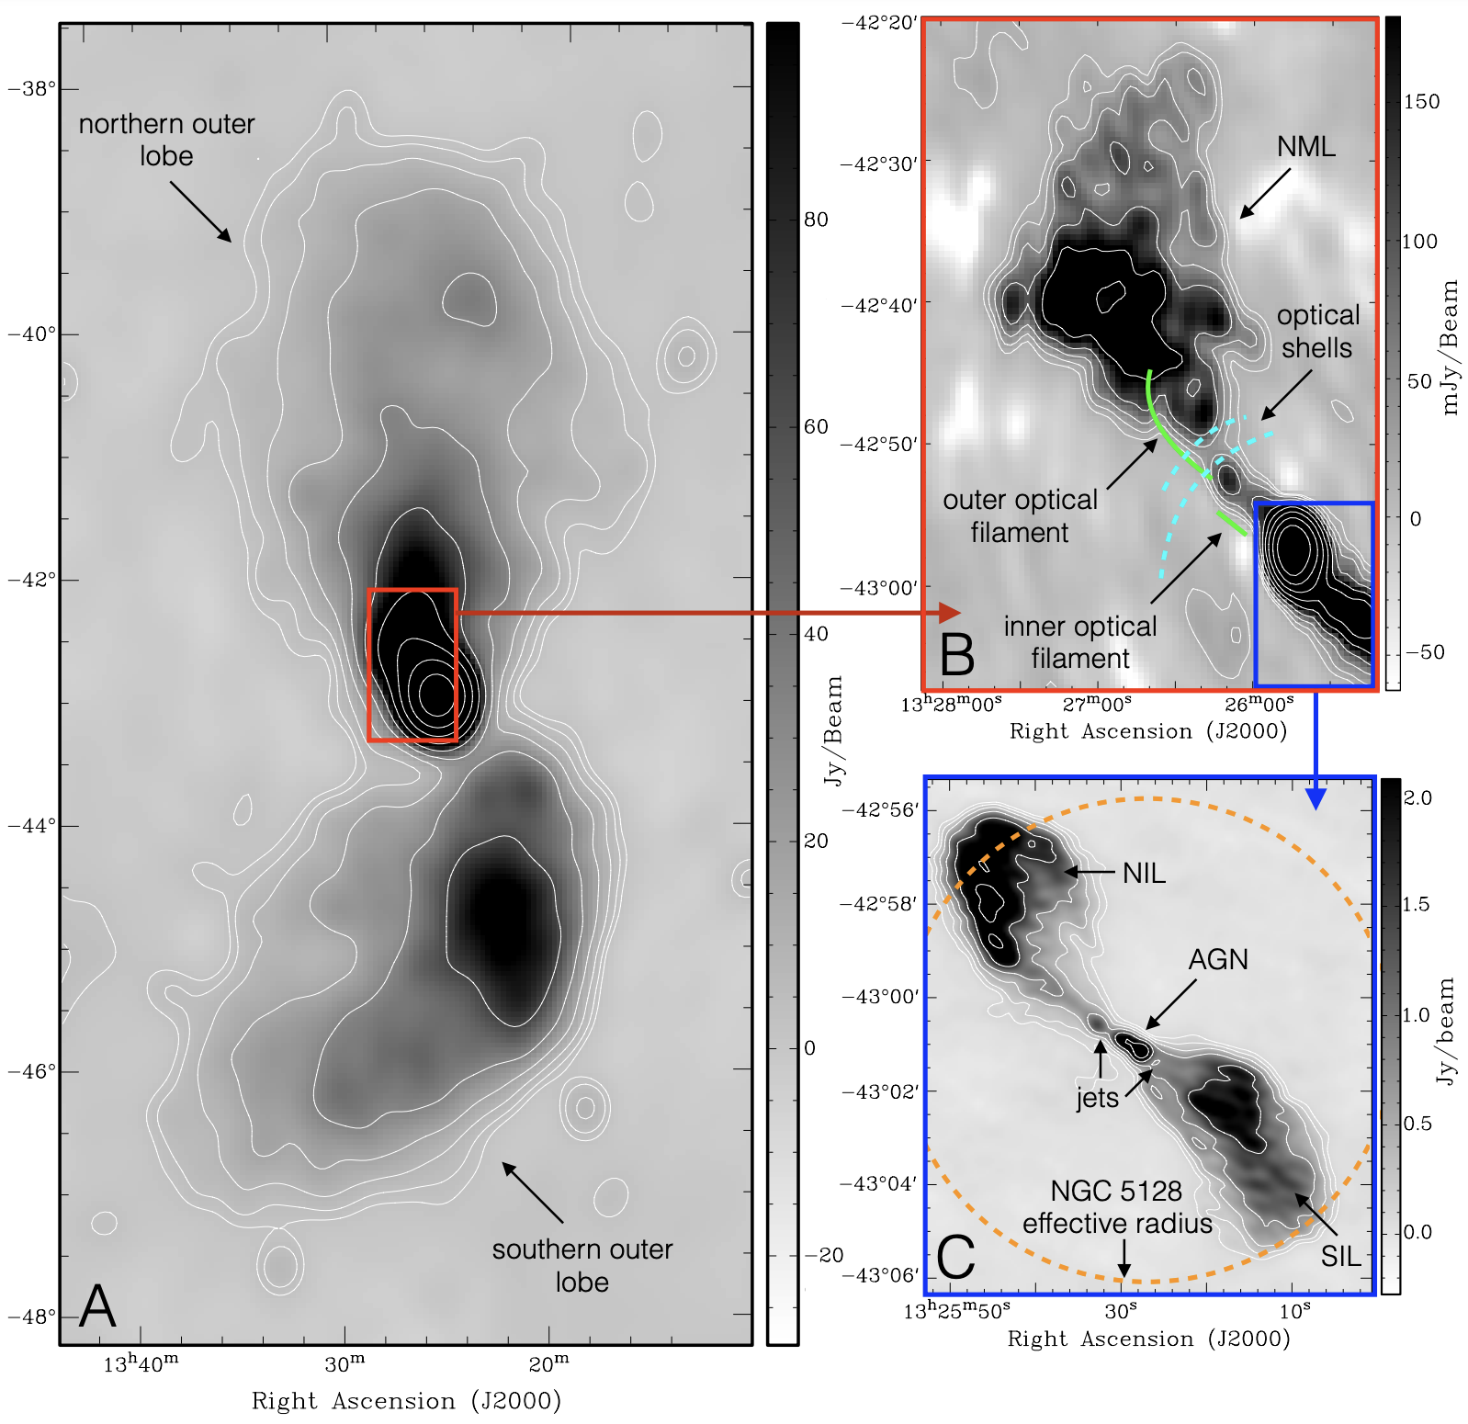
Imaging:
Centaurus A imaged
with the MWA 32 MHz bandwidth centered @154 MHz
9 deg extent
‘Science’ images from 112 seconds of data in a ‘drift scan’ mode
McKinley et al. 2017
McKinley & Matherne 2021

Slide 20
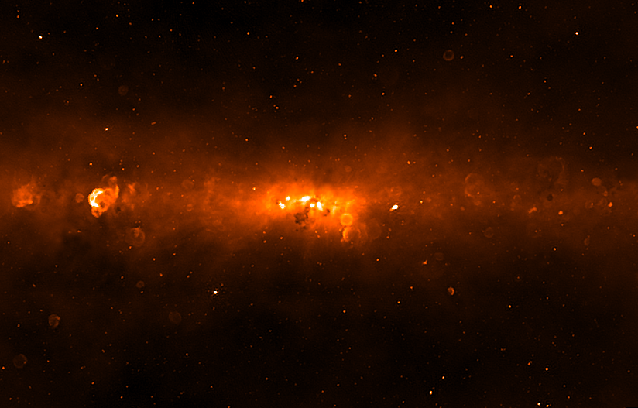
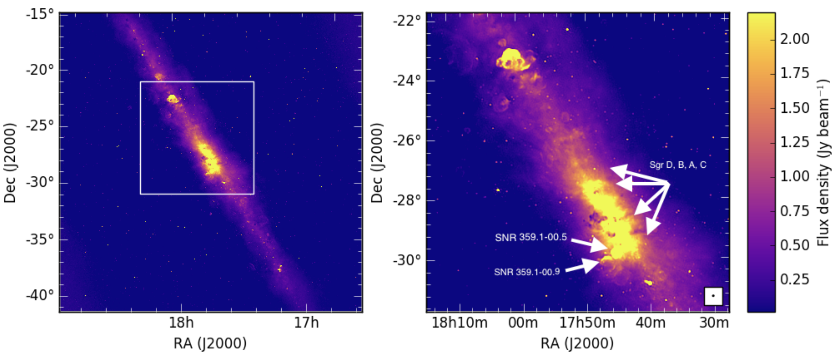
Imaging:
Galactic Center imaged with the MWA
Part of spectral line search
Nominal detections of NO
C. Tremblay et al. 2017
C. Tremblay 2018
PhD Thesis

Slide 21
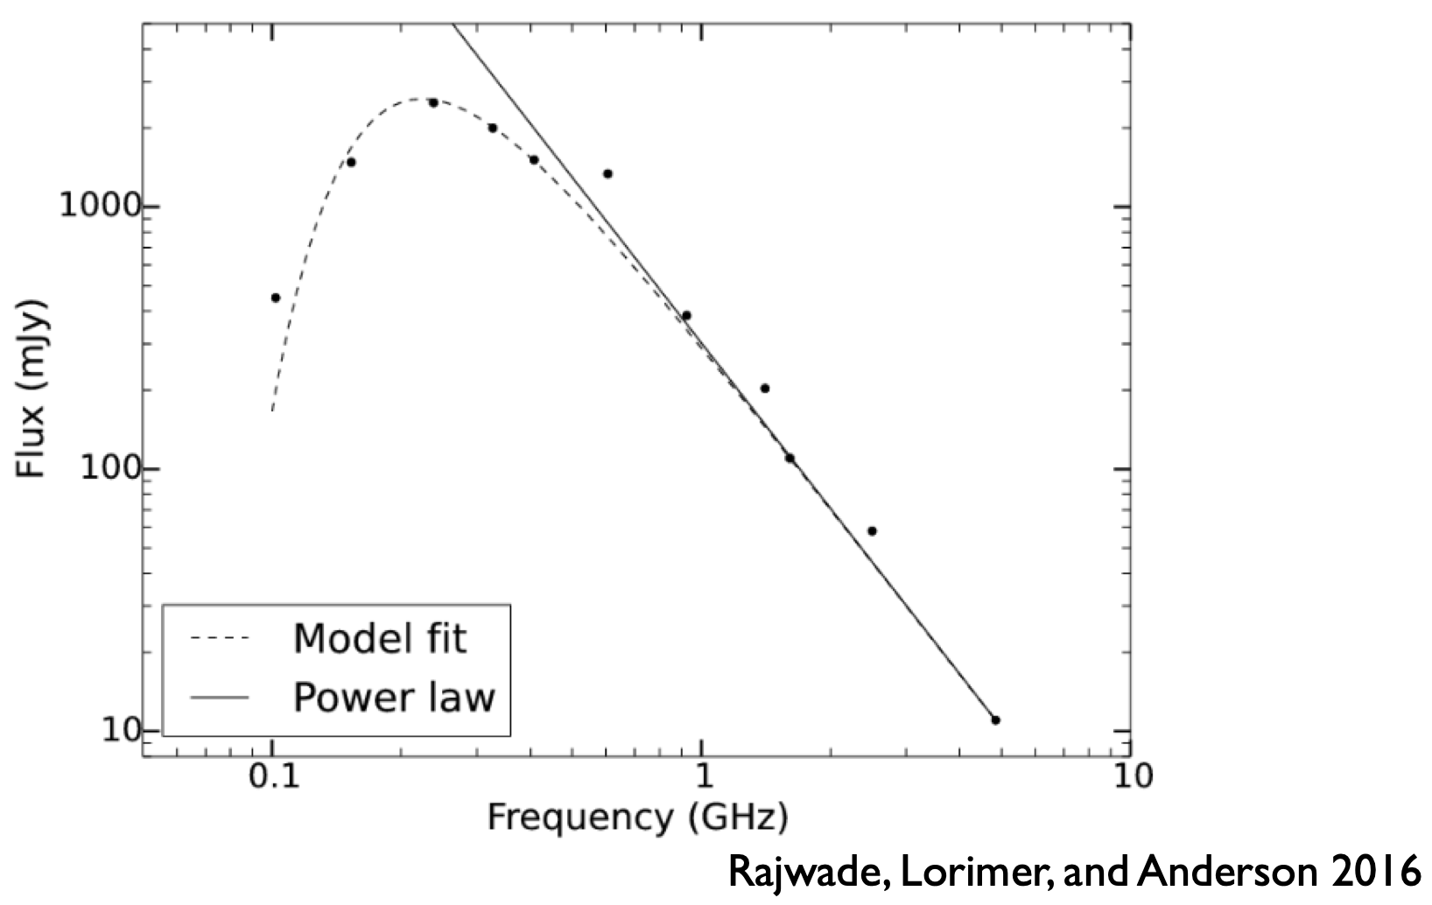
Low frequency science
Pulsars: Spectral Index
Turnover currently poorly understood
Important clues to understanding pulsar emission mechanism
Other consequences:
  Great frequency range to survey pulsars
  Allows more single-pulse studies of individual pulsars

Slide 22
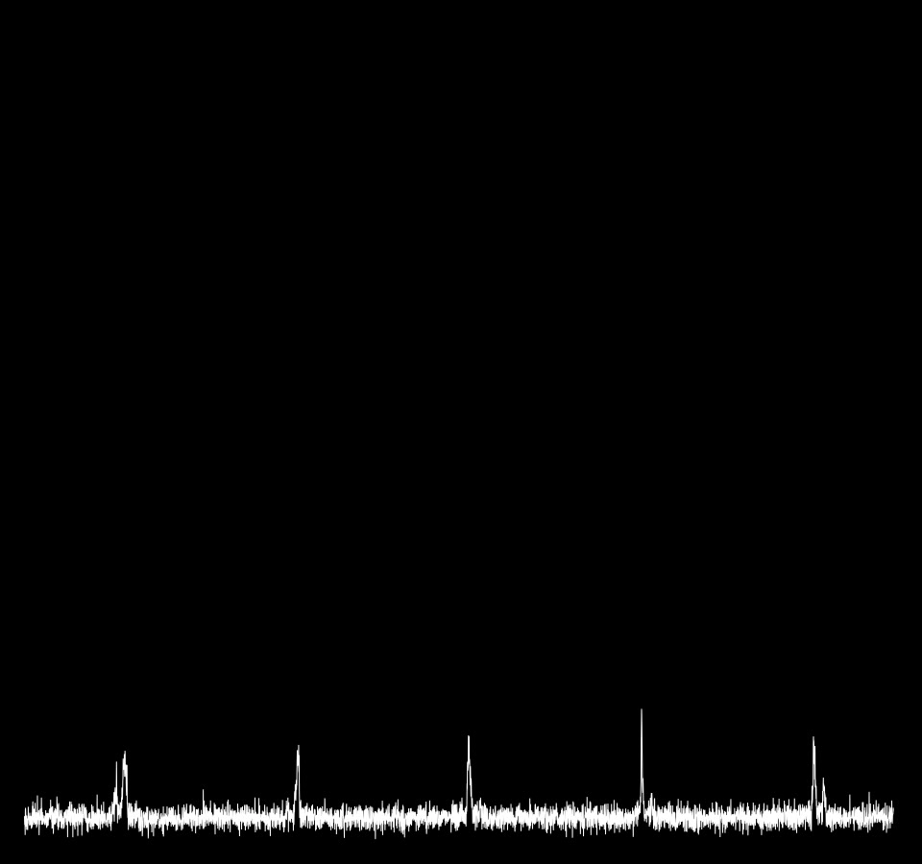
Low frequency science
Single-pulse analysis of a
‘sub-pulse drifter’ with MWA
Not all pulsars exhibit this behavior
Ones that do often have multiple ‘modes’
These can also exhibit ‘nulling’, consecutive spin rotations where no emission is detected
McSweeney et al. 2017 and subsequent papers
J0034-0702
Credit:
Sammy McSweeney

Slide 23
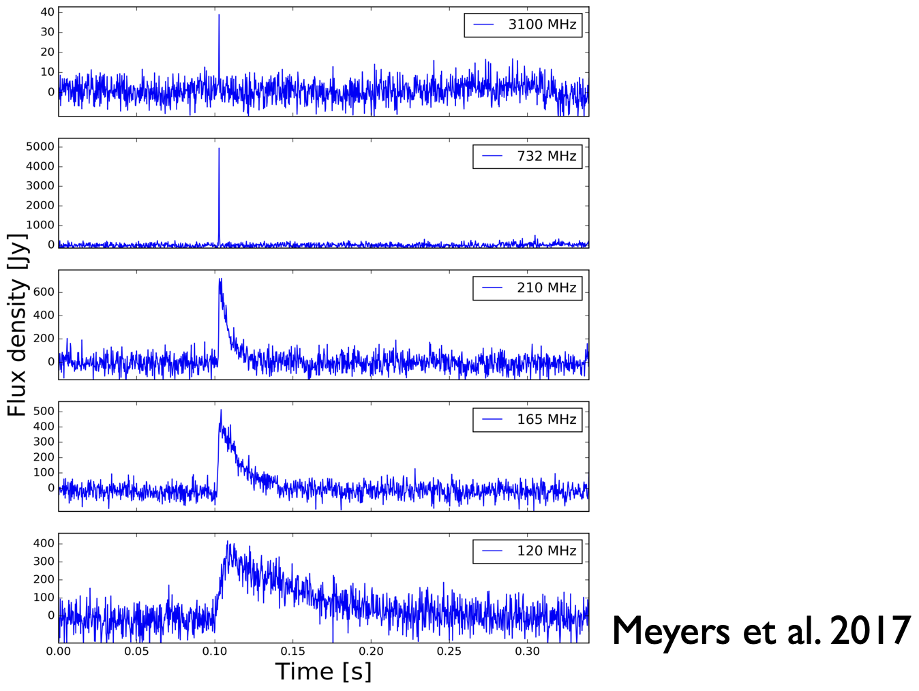
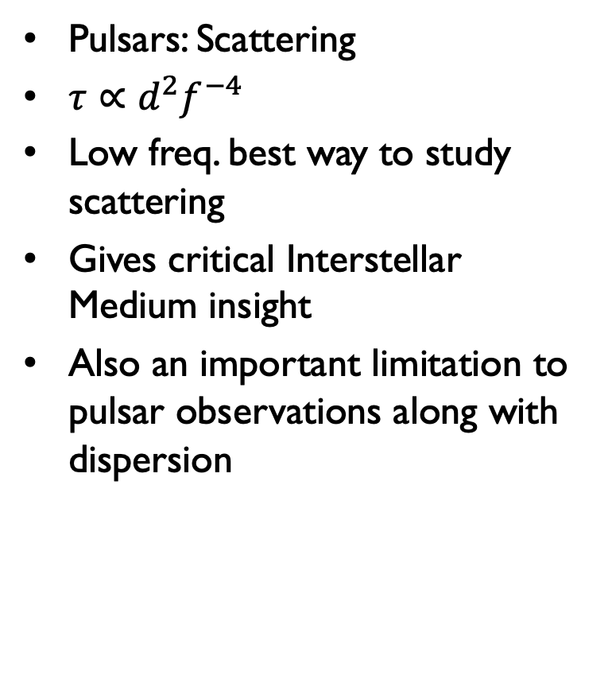
Low frequency science
Pulsars: Scattering
$τ∝d^{2}f^{−4}$
Low freq. best way to study
scattering
Gives critical Interstellar Medium insight
Also an important limitation to pulsar observations along with dispersion

Slide 24
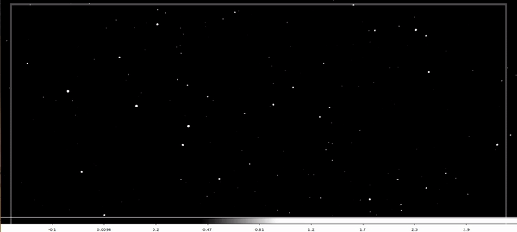
Low frequency science
Solar/Heliospheric: Interplanetary Scintillation (IPS)
Imaged 900deg²
79 & 158 MHz
350 scintillating
sources
4x real-time
Morgan et al. 2008

Slide 25
Low Frequency:
Instruments

Slide 26
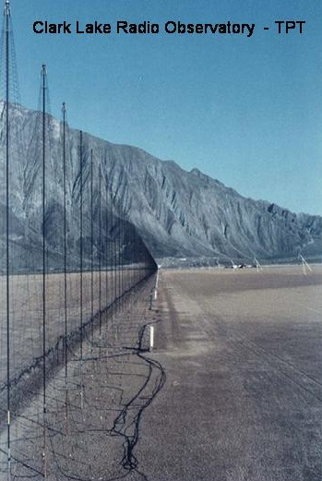
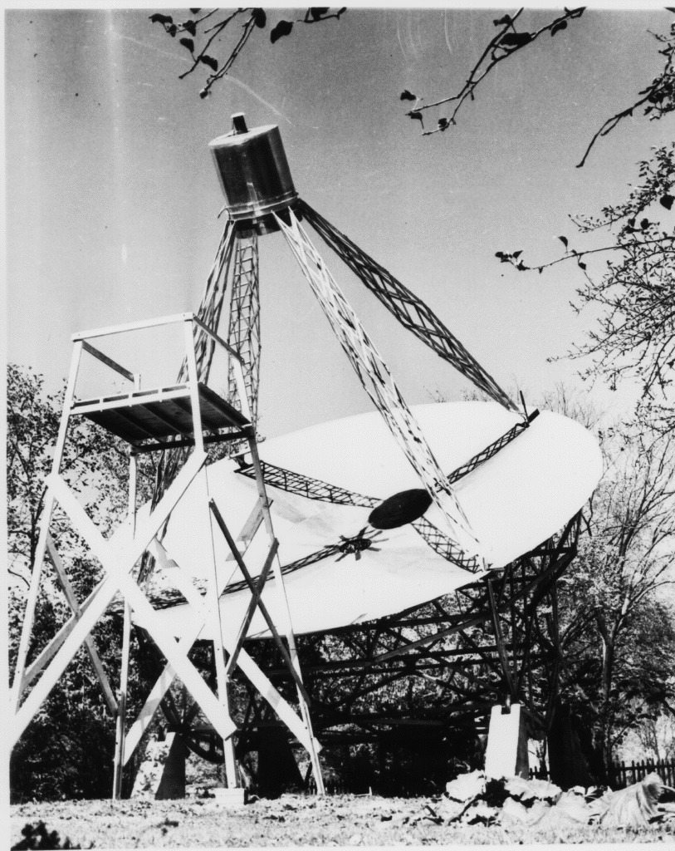
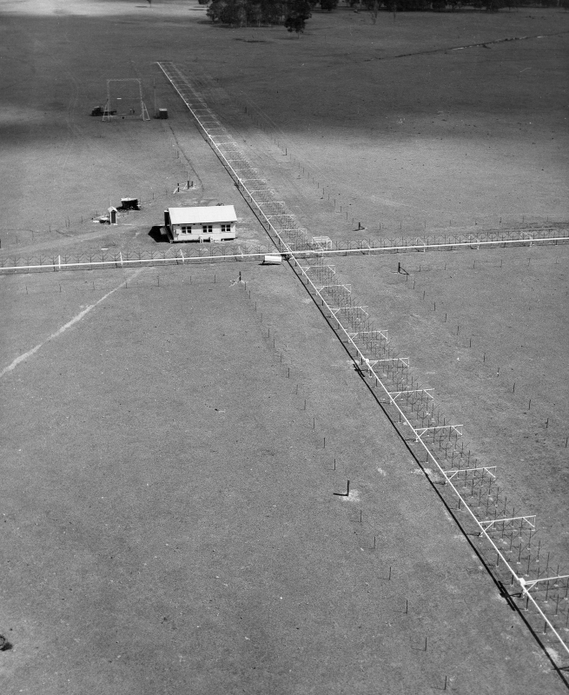
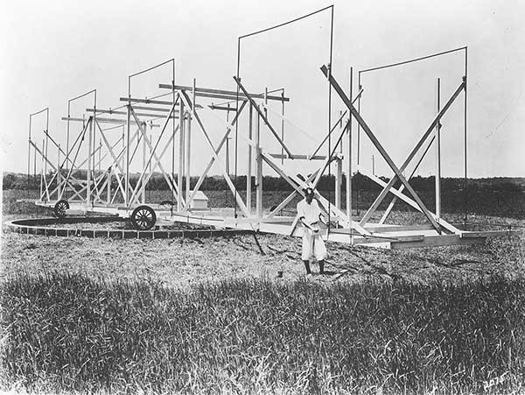
Low Frequency Legacy
The Beginning: Proof of Concept
K.G. Jansky (1932): The "Merry-Go-Round" bare dipole array (20.5 MHz). Discovered the steady hiss of the Galactic Center.
Grote Reber (1937): Transitioned to a dish architecture (160 MHz, 900 MHz, 3.3 GHz).
The Middle: Scaling the Arrays
Bernard Mills (1954): The 'Mills Cross' (85.5 MHz). Utilized massive 450m static arms to achieve resolution.
Bill Erickson (1960s-1970s): Clark Lake Radio Observatory (20–125 MHz). Championed massive static arrays over massive moving dishes.
Credit:
Bell Telephone
Laboratories

Slide 27
Low Frequency Instruments: Dishes

Slide 28
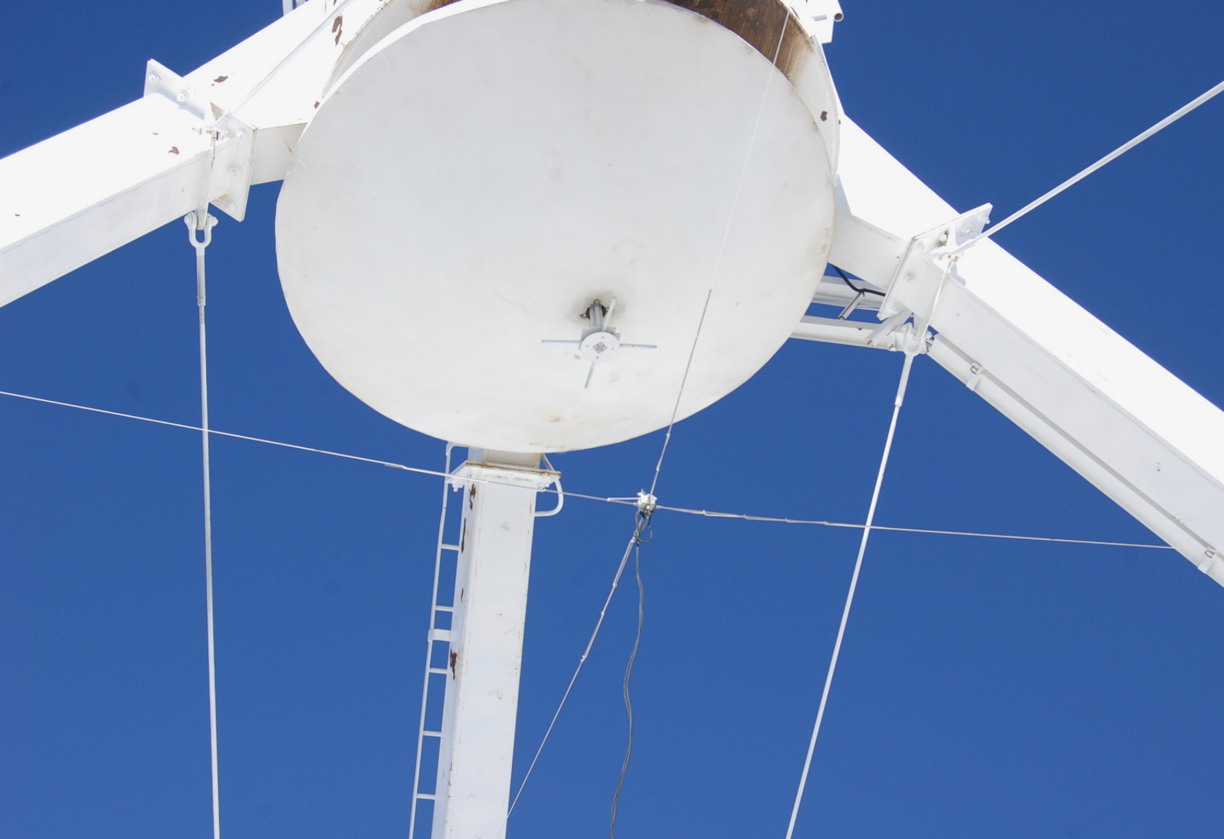
Low frequency instruments: VLA
4 band
(56-88 MHz)
P band
(240-470 MHz)
Naval Research Lab led effort
VLA Low-band Ionosphere and Transient Experiment (VLITE) operating 24/7 at P band on
18 VLA antennas
  Reference:
  Clarke et al. SPIE, 2016
P band
4 band

Slide 29
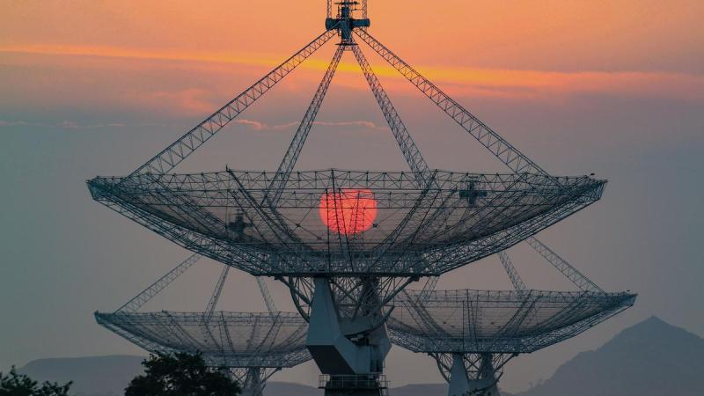
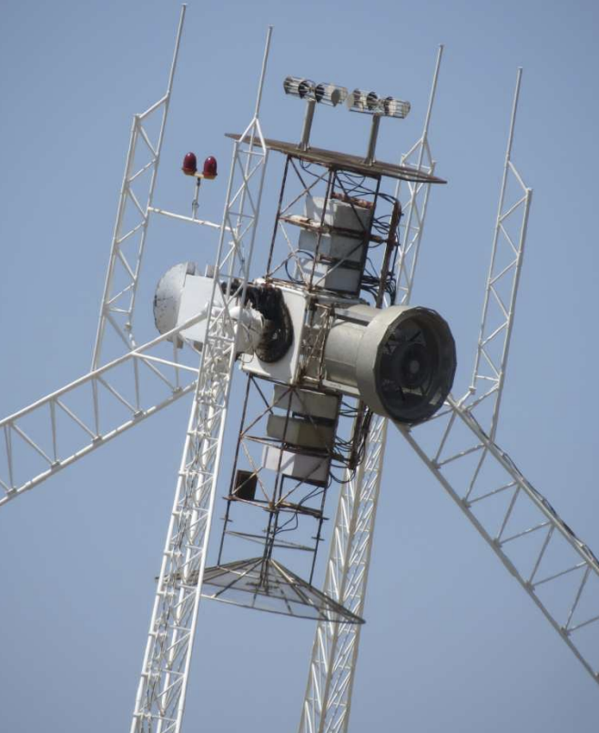
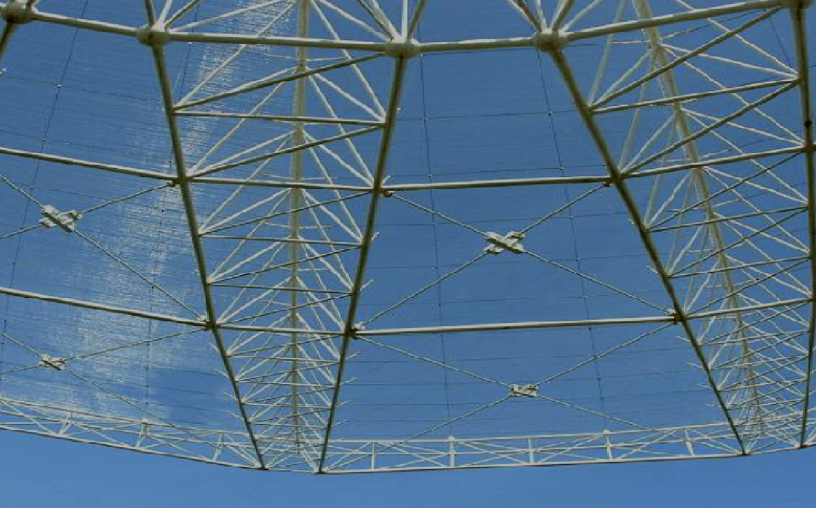
Low frequency instruments: GMRT
30 x 45m Dishes
80 km North of Pune, India
7% Solidity
Up to 400 MHz instantaneous bandwidth
Bands:
  120-250 MHz
  250-500 MHz
  550-850 MHz
  (1050-1450 MHz)

Slide 30
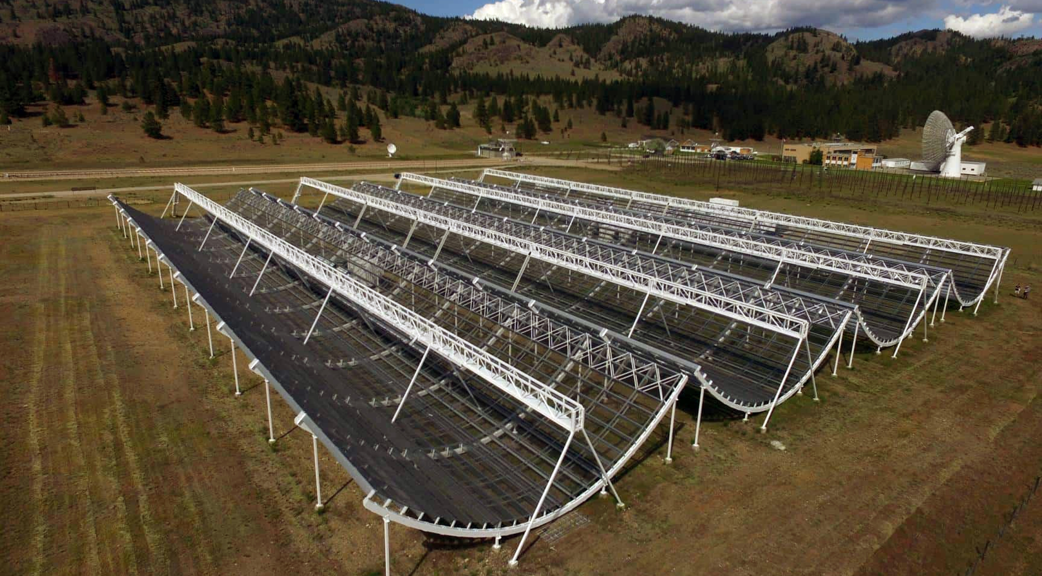
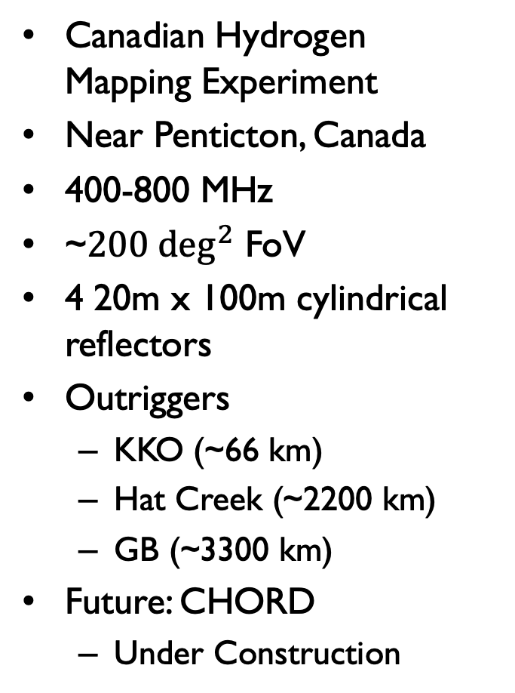
Low frequency instruments: CHIME
Canadian Hydrogen Mapping Experiment
Near Penticton, Canada
400-800 MHz
~$200 \deg^{2}$ FoV
4 20m x 100m cylindrical reflectors
Outriggers
  KKO (~66 km)
  Hat Creek (~2200 km)
  GB (~3300 km)
Future: CHORD
  Under Construction

Slide 31
Low Frequency Instruments:
Bare Dipoles

Slide 32
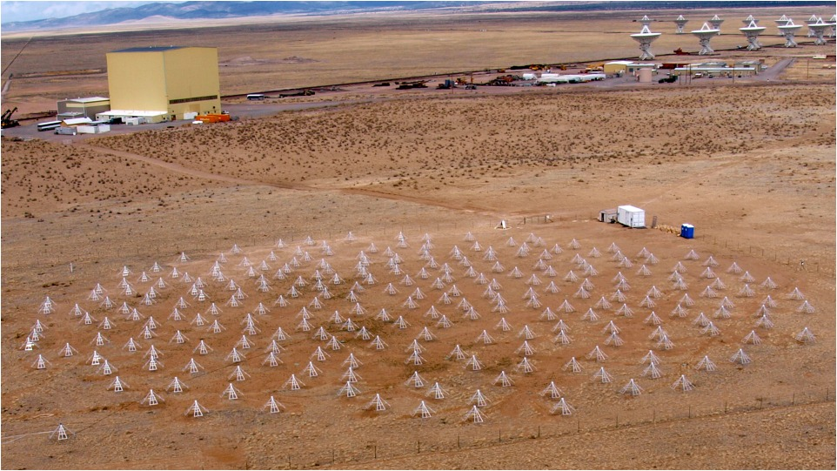
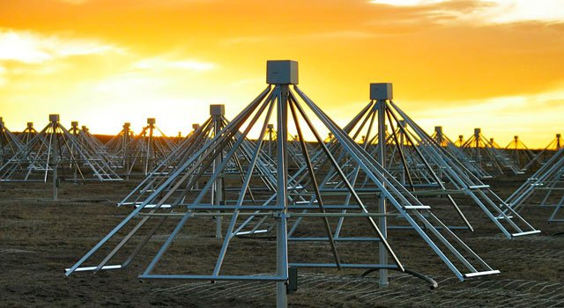
Low frequency instruments: LWA
10-88 MHz
256 dual-pol angled dipoles
Stations designed to be used independently or combined
Sky-noise dominated
3* Full Stations
  LWA1
  SV
  OVRO* (288 dipoles, 1.5 km)

Slide 33
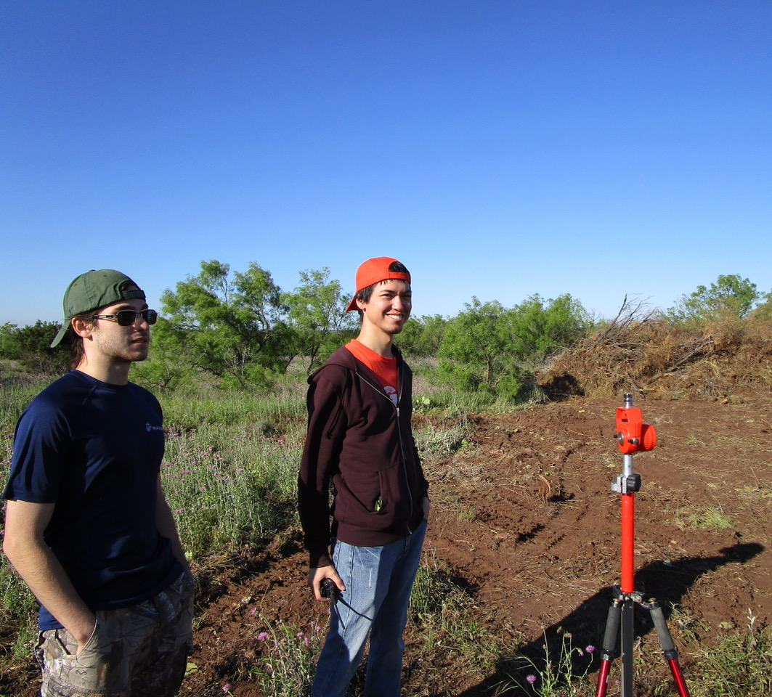
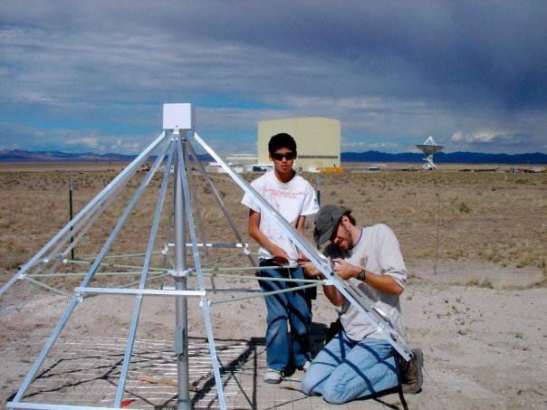
Low frequency Instruments: LWA
LWA-CS Surveying 2024
LWA1 Construction 2009

Slide 34
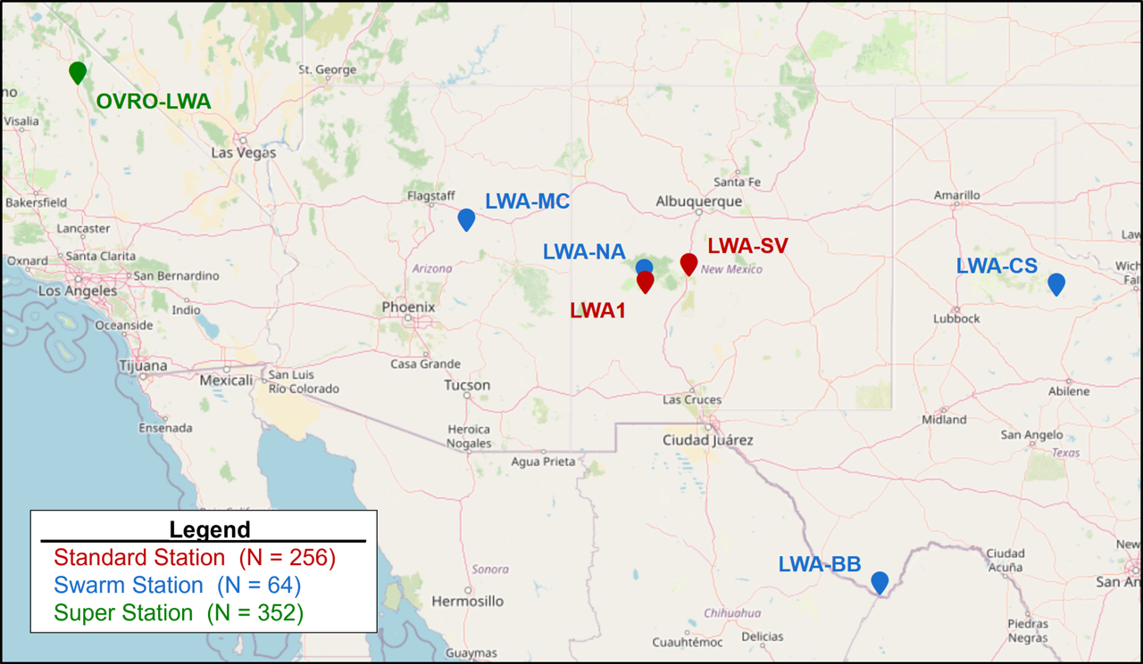
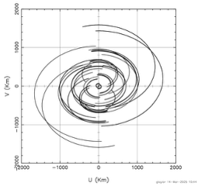
Low frequency instruments: LWA
LWA Swarm: mini-stations
64 antennas distributed
within 80m diameter

Slide 35
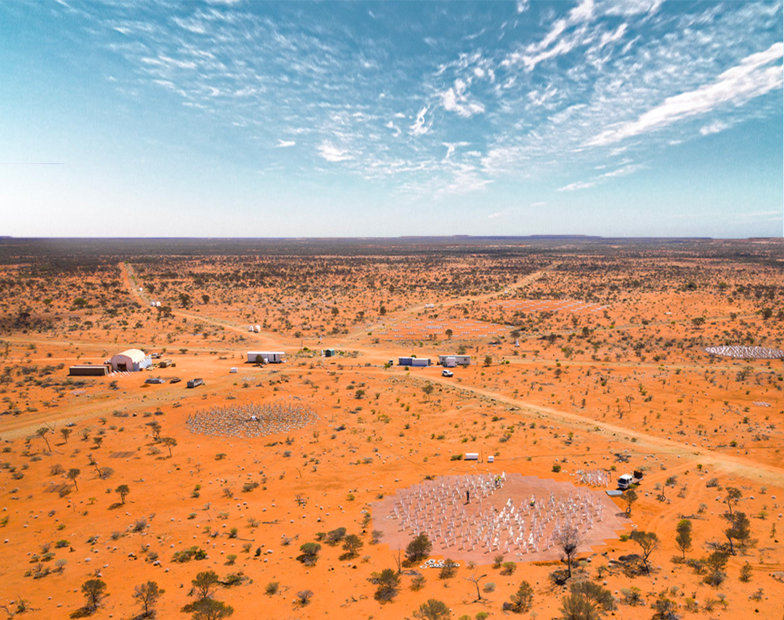
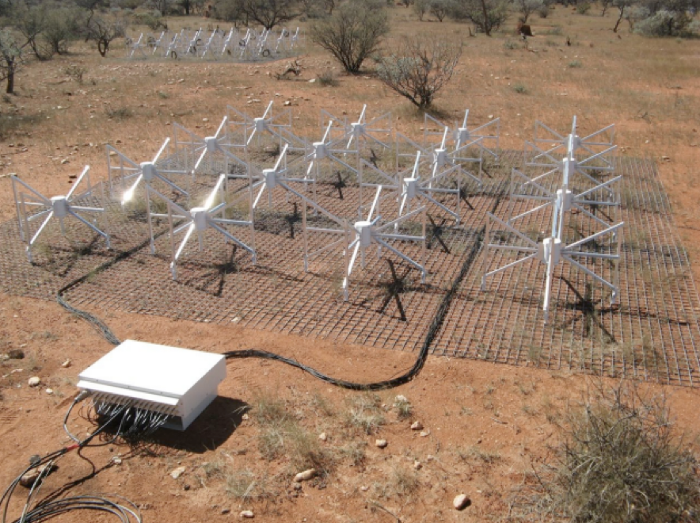
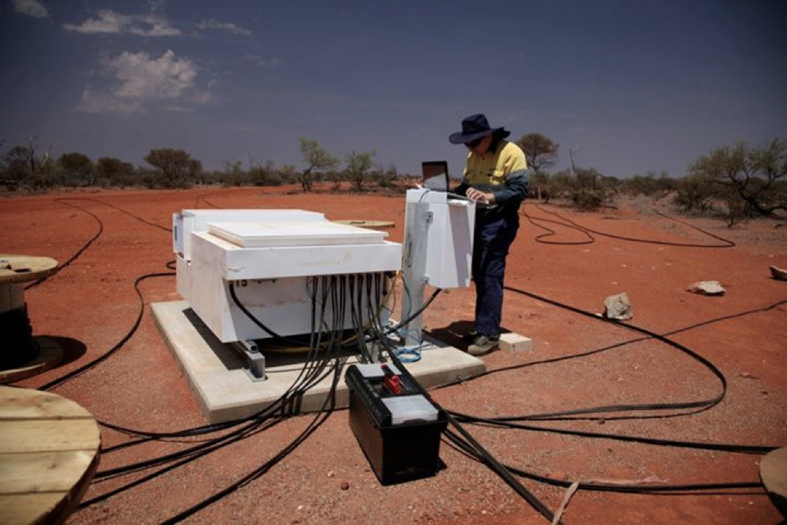
Low frequency instruments: MWA (Recently Upgraded)
Murchison, Australia
70-300 MHz
Consists of ‘Tiles’
  4x4 grid of cross-dipoles
256 Tiles
‘Reconfigurable’
  Compact: ~800 m
  Extended: ~5 km
Both of these previous ‘configurations’ can be simultaneously correlated now with upgraded MWAX correlator

Slide 36
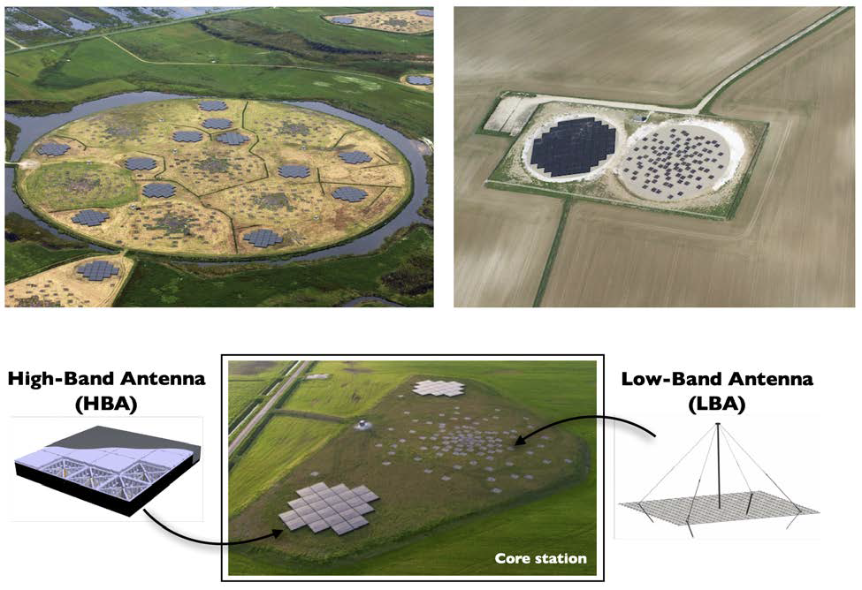
Low frequency instruments: LOFAR (Recently Upgraded)
Europe
  Netherlands centered
10-80 MHz (LBA)
120-240 MHz (HBA)
Can now correlate both simultaneously!
52 Stations (+2 more soon)
  Core & Remote stations consist of 48 HBA's and 96 LBA’s
  International stations consist of 96 HBA’s and 96 LBA’s

Slide 37
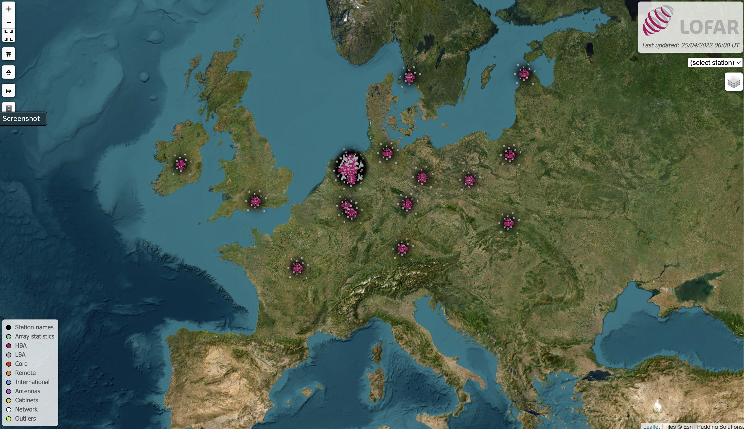
Low frequency instruments: LOFAR
LOFAR is a dedicated low frequency very long baseline interferometer
See Justin Linford’s VLBI talk!

Slide 38
Low Frequency Instruments:
The Future…

Slide 39
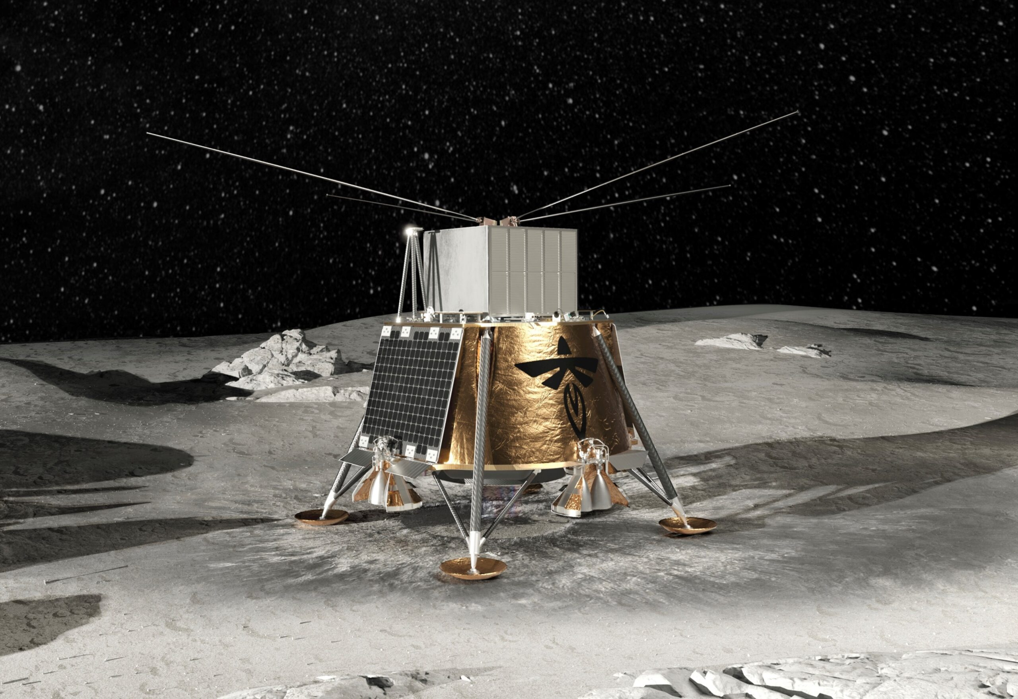
Low frequency instruments: LuSEE-Night
0.1-50 MHz
4 monopole antennas
in cross formation
Far side of the Moon
Late 2026
NASA & DoE collaboration
Study ‘Dark Ages’
ITU’s Shielded Zone of the Moon
regulations (0-30 MHz, 300-2000 MHz)

Slide 40
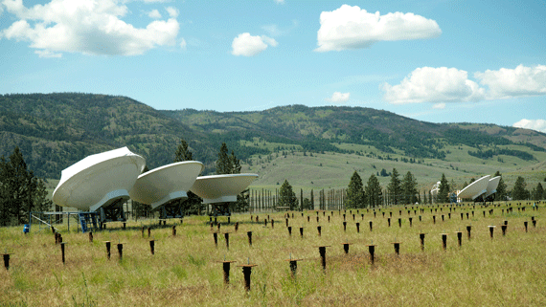
Low frequency instruments: CHORD
Canadian Hydrogen Observatory and Radio-transient Detector
Frequency: 300 to 1500 MHz
Architecture: 512 ultra-wideband 6m dishes tightly packed in a core, plus continental outriggers.
Science: Next-generation mapping of cosmic structure and ultra-precise FRB localization (an order of magnitude leap over CHIME).
Status: Currently under construction.

Slide 41

Low frequency instruments; SKA-Low
50 MHz - 350 MHz
Western Australia
131,072 log-periodic antennas spread between 512 stations
Collecting area: 419,000m²
Extent: 74km
Phase | Milestone / Objective | Target Timeline
AA0.5 | First 4 stations (1,024 antennas) working together. | Completed (2024-2025)
AA1 | 18 stations acting as a fully functional interferometer. | Ongoing (2026)
AA2 (First Light) | 64 stations online. This serves as the major "Science Verification" milestone where the community can propose early test science. | Expected ~2027
Full Operations | All 512 stations online and fully integrated. | Expected ~2028–2029

Slide 42
Low Frequency:
Selected Surveys

Slide 43

Rapid ASKAP Continuum Survey (RACS)
Telescope
  ASKAP
Frequency
  887.5 MHz
Resolution
  15”
Sensitivity
  0.025 to 0.040 mJy/beam
Reference
  McConnel et al. 2020

Slide 44

VLITE Commensal Sky Survey (VCSS)
Telescope
  VLA (10 Antennas)
Frequency
  320 to 384 MHz
Resolution
  15”
Sensitivity
  7 to 10 mJy/beam

Slide 45

TGSS
Telescope
  GMRT
Frequency
  150 MHz
Resolution
  25”
Sensitivity
  3 to 5 mJy/beam

Slide 46

LoTSS
Telescope
  LOFAR
Frequency
  120 to 168 MHz
Resolution
  6”
Sensitivity
  0.083 mJy/beam

Slide 47

GLEAM
Telescope
  MWA
Frequency
  87 to 215 MHz
Resolution
  120”
Sensitivity
  6 to 10 mJy/beam

Slide 48

VLSSr
Telescope
  VLA
Frequency
  73.8 MHz
Resolution
  75”
Sensitivity
  100 mJy/beam

Slide 49

LWA1 Low Frequency Sky Survey
Telescope
  LWA1
Frequency
  35 to 80 MHz
Resolution
  4.7 to 2.0 degrees
Thermal noise
  38 to 5 Jy/beam
Confusion noise
  163 to 18 Jy/beam
Reference
  Dowell et al. 2017

Slide 50

Low Frequency Radio Astronomy
Really easy…but also kinda hard
Fantastic regime to learn Radio Astronomy in a ‘hands on’ environment
Ionosphere can dominate errors
MHz regime opens up new areas of study for many science topics
This is an amazing age for <1GHz Radio Astronomy with a plethora of instruments across the globe
Use the survey data that’s being gifted to you
Have fun with it!
SKA-Low AA0.5 First Image (March 2025): Using the first 4 stations (1,024 antennas). The 7-hour integration at 163 MHz captures a 25-square-degree field centered on PKS 0521-36, mapping ~85 galaxies. (Moon added for scale)

Slide 51

Low Frequency Radio Astronomy
Thank You

