Slide 1
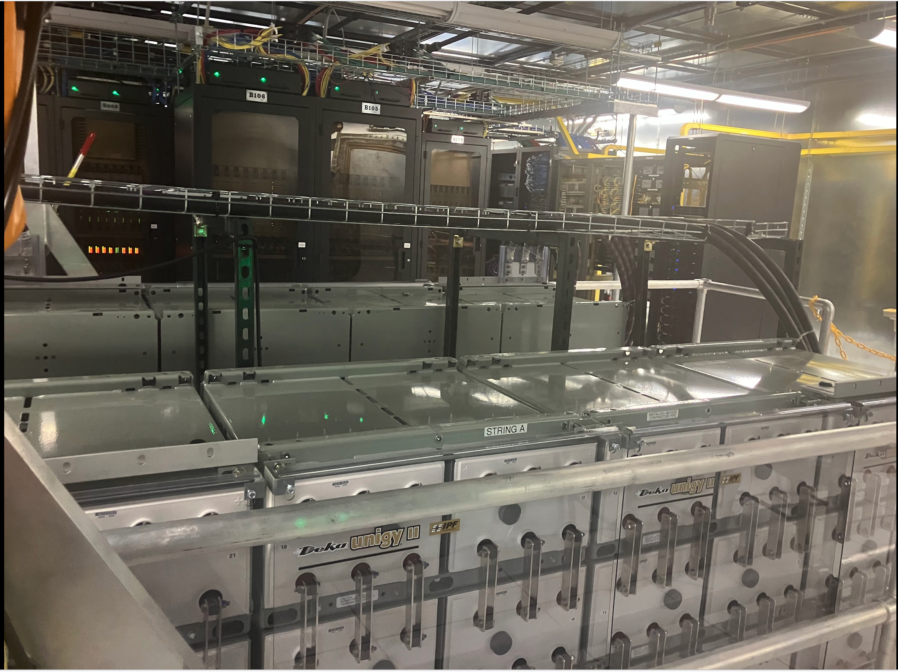
Digital Signal Processing and Correlators
Kathryn Plant
Synthesis Imaging Workshop, May 29 2026

Slide 2
Overview of this lecture
Goals:
1. Understand what a correlator calculates and why.
2. Be able to answer DSP-related questions you may be asked in observing proposals.
3. Discuss a few design tradeoffs in modern correlators.
Outline
Introduction
Some math
Analog to digital conversion
Delay compensation
FX correlators
XF correlators
Spectral response
Polarization products
Hardware
Conclusion

Slide 3
Introduction
Correlators produce visibilities
This is where the interferometry happens!
Voltage from receiver
Analog filters and/or gain
Down conversion
Analog to digital conversion
Frequency-dependent visibility
Correlator
Voltage from receiver
Analog filters and/or gain
Down conversion
Analog to digital conversion

Slide 4
Introduction
Correlators produce visibilities
This is where the interferometry happens!
This lecture
Voltage from receiver
Analog filters and/or gain
Down conversion
Analog to digital conversion
Frequency-dependent visibility
Correlator
Voltage from receiver
Analog filters and/or gain
Down conversion
Analog to digital conversion
Notes:
The part in orange is what we’ll cover in this lecture. The box labelled correlator is wrapping up several steps in addition to the actual cross correlation.

Slide 5
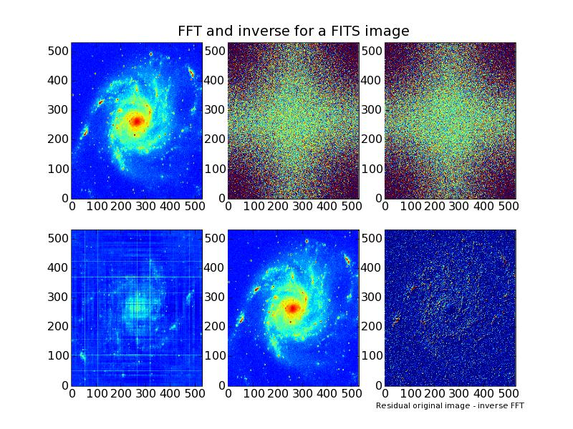
Correlators and Interferometry
We want to know this
l
u
Measure this from the spatial correlation of the electric field measured far from the source!
m
F
v
Sky brightness at
frequency ν₀
Visibilities (real component
shown, unit is λ₀ = c / ν₀)
Images from Adam Deller’s 2024 SIW Lecture
Notes:
On the left, image of the sky; on the right, 2D Fourier Transform of that image. That is complex – I show real part here. As established in last couple of lectures, if you had two antennas in a plane perpendicular to source direction, multiplying antenna elements together gets you 1 pair of pixels on the right hand side of the image. Rick showed visually how this works, and two very clever guys called van Cittert and Zernike proved it mathematically a long time ago. You should go and follow the maths through sometime – it’s not that hard, but we don’t have time now. So we take it as a given: visibilities are FT of sky brightness, and multiplying/averaging antenna pairs measures visibilities. What we do is make real life bend to this picture. Multiple pairs of antennas and Earth rotation let you fill up that plane. All kinds of thorny problems because we can’t measure every visibility pixel… But that is for later.

Slide 6
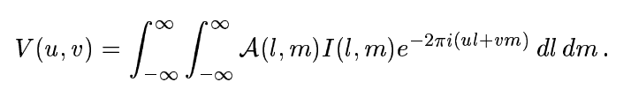
Monochromatic plane wave?
Spatial coherence =
u × l + v × m is supposed to be constant, but both u and v depend on frequency
No truly monochromatic radiation!
Fortunately, “fairly narrow” band of Δν (quasi-monochromatic) can suffice:
  if Δu × l ≪ 1 and Δv × m ≪ 1 then the different frequency components stay in phase and we’re ok
  Correlator needs to slice at least this finely
Adapted from Adam Deller’s 2024 SIW Lecture
Notes:
There’s a small problem: this beautiful relationship formally only holds at one infinitesimally narrow frequency – a monochromatic signal. And these don’t exist in reality (need to go on forever). But fortunately we can get away with bending the rules, as long as we don’t bend them too far. How far? Well, if you look up the formulas governing the transformation from visibilities to image, you’ll see that ul + vm is supposed to be constant. But as long as it is nearly constant: Deltaul << 1 and Deltavm << 1, we don’t break things. This immediately tells you that for longer baselines or wider images, you need to slice finer. In the real world..

Slide 7
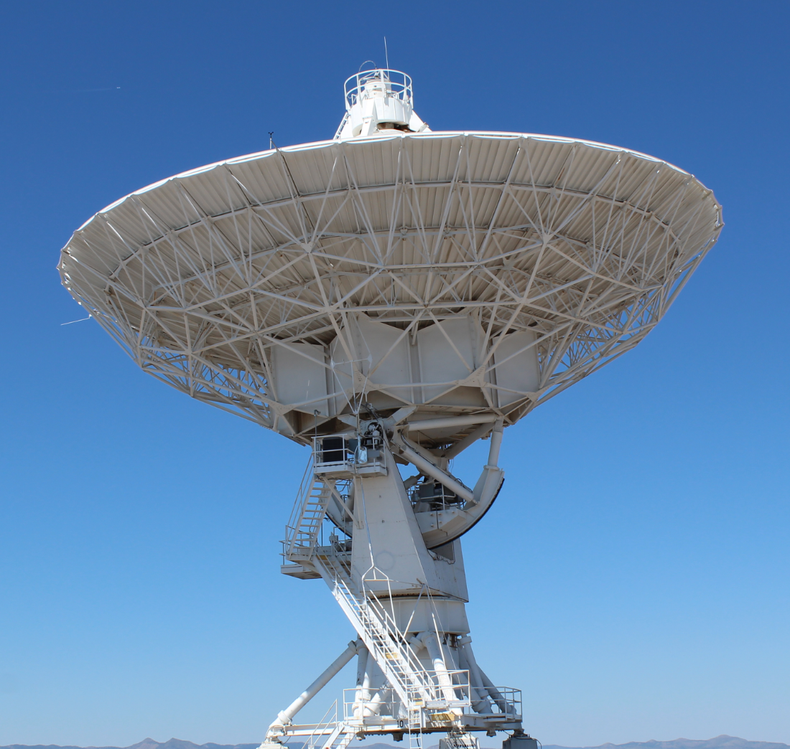
Quasi-monochromatic if frequency components stay “in phase” as wavefront propagates across array
l
u
Adapted from Adam Deller’s 2024 SIW Lecture
Notes:
As an illustration, let me show you it in 1D. So are we done? 8 minutes in and finished? Not quite. If all we could do with a beautiful wide band was whittle it down to a sliver and correlate it, that would be pretty sad. High sensitivity needs *lots* of bandwidth! So how do we sidestep this problem?

Slide 8
Correlators and Interferometry
F
Sky brightness at
frequency ν₀
Visibilities (real component
shown, unit is λ₀ = c / ν₀)
Adapted from Adam Deller’s 2024 SIW Lecture
Notes:
Here, nature has been kind to us. We go back to our original picture of the relationship between sky brightness and visibility. Maxwell’s equations says that electric fields are linear, and Fourier transforms are also linear.

Slide 9
Correlators and Interferometry
F
Sky brightness at
frequency ν’= ν₀ + δν
Visibilities (real component
shown, unit is λ’ = c / ν’)
Adapted from Adam Deller’s 2024 SIW Lecture
Notes:
That means we can consider the sky brightness at some nearby frequency nu + delta nu completely independently and treat it in exactly the same fashion as we did to the signal at frequency nu. Our baseline was a fixed length in metres, which means we’ll be measuring a different place in the visibility plane (where the coordinates are in wavelengths, and the wavelength has changed)

Slide 10
We have several reasons to separate the signal into narrow frequency channels
Approximately satisfy the monochromatic plane wave assumption

Slide 11
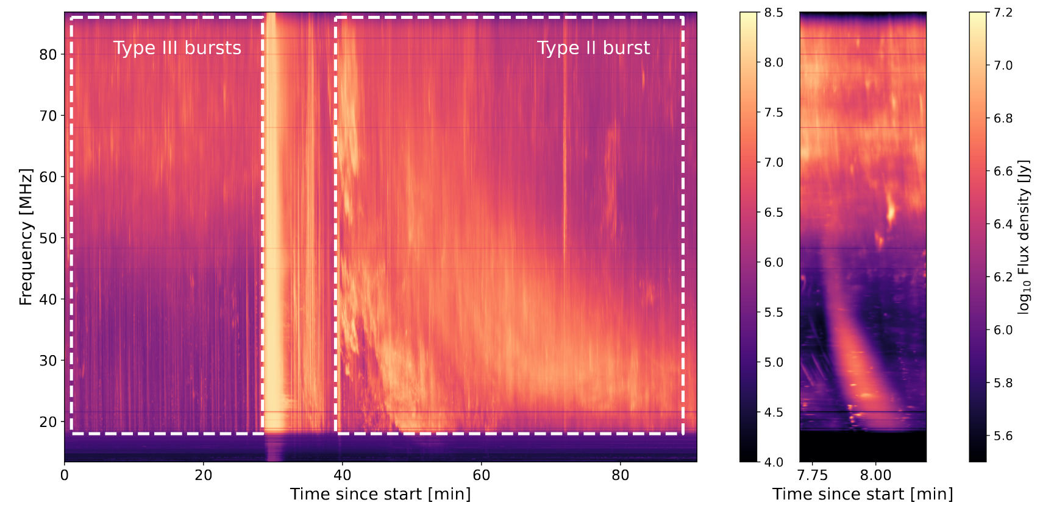
We have several reasons to separate the signal into narrow frequency channels
Approximately satisfy the monochromatic plane wave assumption
Frequency information may be useful to the science goal (e.g. spectral line)
Davis et al 2025
Solar burst with OVRO-LWA beamformer

Slide 12
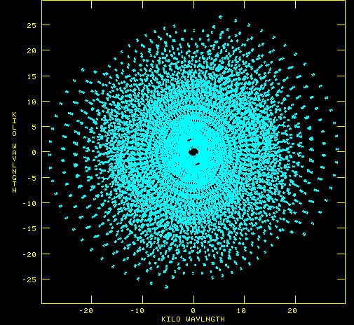
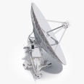
We have several reasons to separate the signal into narrow frequency channels
Approximately satisfy the monochromatic plane wave assumption
Frequency information may be useful to the science goal (e.g. spectral line)
For a continuum source, sample more points in the UV plane
20
10
0
Baseline
Kilo-wavelengths
-10
-20
-20 -10 0 10 20
Kilo-wavelengths
Figure adapted from Adam Deller’s 2024 SIW Lecture
Notes:
For the output of the first correlator, wavelength is X cm, so your baseline is B divided by X. For the next one, wavelength is X minus a little, so baseline is slightly longer when measured in wavelengths. And so on. You average for a while, and boom! There’s your visibility points for that time, for that baseline. The symmetry gives you two points (doesn’t matter whether you consider antenna 1 to antenna 2, or 2 to 1; same value except conjugated), because the sky brightness is real.

Slide 13
What we need from the correlator:
V_{ν}(u,v) = < x_{ν}(r_{a})x_{ν}*(r_{b})>
Spatial coherence function
  Sampled by each antenna pair
  In quasi-monochromatic frequency channels
Antenna a measures voltage x_{ν}(t,r_{a})
[u,v]
r_{a}
r_{b}
Antenna b measures voltage x_{ν}(t,r_{b})

Slide 14
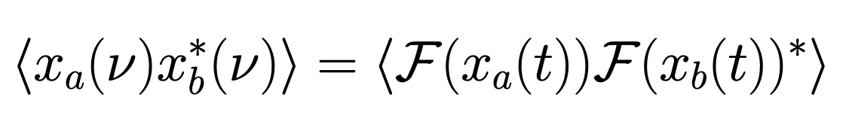
Two approaches to get visibilities in narrow frequency channels:
Fourier transform
Voltage from antenna a
Spatial correlation function aka visibility
Voltage from antenna b
Notes:
One way is to take the fourier transform of each voltage timeseries and then multiply the two antennas together in each channel and take the ensemble average. Other way is to compute the cross correlation of the two signals as a function of delay, and then fourier transform that. I don’t have time to show the proof that these two are equivalent, but it relies on the convolution theorem and on the assumptions that the signals are stationary and ergodic, which well-behaved radio signals are. You might notice that this is a lot like the Wienar Khinchin theorem, which says that you can get a power spectrum by squaring the fourier transform of a time series, or by computing its autocorrelation and then taking the fourier transform of that. This strict equivalency only holds in continuous time and breaks when we sample the time series in practice. So, before we dive into the details of these two types of correlators, we need to discuss what happens when we take a signal from the real world and put it in computers.

Slide 15
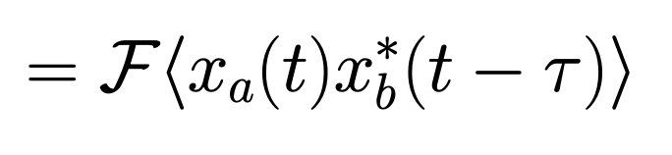
Two approaches to get visibilities in narrow frequency channels:
Fourier transform
Voltage from antenna a
Spatial correlation function aka visibility
Voltage from antenna b
Cross correlation function evaluated at lag 𝜏
Notes:
One way is to take the fourier transform of each voltage timeseries and then multiply the two antennas together in each channel and take the ensemble average. Other way is to compute the cross correlation of the two signals as a function of delay, and then fourier transform that. I don’t have time to show the proof that these two are equivalent, but it relies on the convolution theorem and on the assumptions that the signals are stationary and ergodic, which well-behaved radio signals are. You might notice that this is a lot like the Wienar Khinchin theorem, which says that you can get a power spectrum by squaring the fourier transform of a time series, or by computing its autocorrelation and then taking the fourier transform of that. This strict equivalency only holds in continuous time and breaks when we sample the time series in practice. So, before we dive into the details of these two types of correlators, we need to discuss what happens when we take a signal from the real world and put it in computers.

Slide 16
Two approaches to get visibilities in narrow frequency channels:
Fourier transform
Voltage from antenna a
Spatial correlation function aka visibility
Voltage from antenna b
Equivalent in continuous time, only approximate in discrete (sampled) time series.
Cross correlation function evaluated at lag 𝜏
Notes:
One way is to take the fourier transform of each voltage timeseries and then multiply the two antennas together in each channel and take the ensemble average. Other way is to compute the cross correlation of the two signals as a function of delay, and then fourier transform that. I don’t have time to show the proof that these two are equivalent, but it relies on the convolution theorem and on the assumptions that the signals are stationary and ergodic, which well-behaved radio signals are. You might notice that this is a lot like the Wienar Khinchin theorem, which says that you can get a power spectrum by squaring the fourier transform of a time series, or by computing its autocorrelation and then taking the fourier transform of that. This strict equivalency only holds in continuous time and breaks when we sample the time series in practice. So, before we dive into the details of these two types of correlators, we need to discuss what happens when we take a signal from the real world and put it in computers.

Slide 17
Two approaches to get visibilities in narrow frequency channels:
Fourier transform
Voltage from antenna a
Spatial correlation function aka visibility
Voltage from antenna b
Equivalent in continuous time, only approximate in discrete (sampled) time series.
Radio telescopes have used either strategy.
Cross correlation function evaluated at lag 𝜏
Notes:
One way is to take the fourier transform of each voltage timeseries and then multiply the two antennas together in each channel and take the ensemble average. Other way is to compute the cross correlation of the two signals as a function of delay, and then fourier transform that. I don’t have time to show the proof that these two are equivalent, but it relies on the convolution theorem and on the assumptions that the signals are stationary and ergodic, which well-behaved radio signals are. You might notice that this is a lot like the Wienar Khinchin theorem, which says that you can get a power spectrum by squaring the fourier transform of a time series, or by computing its autocorrelation and then taking the fourier transform of that. This strict equivalency only holds in continuous time and breaks when we sample the time series in practice. So, before we dive into the details of these two types of correlators, we need to discuss what happens when we take a signal from the real world and put it in computers.

Slide 18
Two approaches to get visibilities in narrow frequency channels:
Fourier transform
Voltage from antenna a
Spatial correlation function aka visibility
Voltage from antenna b
FX Correlator
Equivalent in continuous time, only approximate in discrete (sampled) time series.
Radio telescopes have used either strategy.
XF Correlator
Cross correlation function evaluated at lag 𝜏
Notes:
One way is to take the fourier transform of each voltage timeseries and then multiply the two antennas together in each channel and take the ensemble average. Other way is to compute the cross correlation of the two signals as a function of delay, and then fourier transform that. I don’t have time to show the proof that these two are equivalent, but it relies on the convolution theorem and on the assumptions that the signals are stationary and ergodic, which well-behaved radio signals are. You might notice that this is a lot like the Wienar Khinchin theorem, which says that you can get a power spectrum by squaring the fourier transform of a time series, or by computing its autocorrelation and then taking the fourier transform of that. This strict equivalency only holds in continuous time and breaks when we sample the time series in practice. So, before we dive into the details of these two types of correlators, we need to discuss what happens when we take a signal from the real world and put it in computers.

Slide 19
A reminder about Real and Complex voltages
The physical quantity is always real-valued
But, waves have amplitude and phase, so it’s easy and very useful to think of voltage as complex
Two ways to get a complex voltage in a narrow band:
  1. Fourier transform of a real timeseries produces complex output
  2. Sample 2 copies of a narrow-band signal, giving one copy a 90 degree delay first (in phase and quadrature)

Slide 20
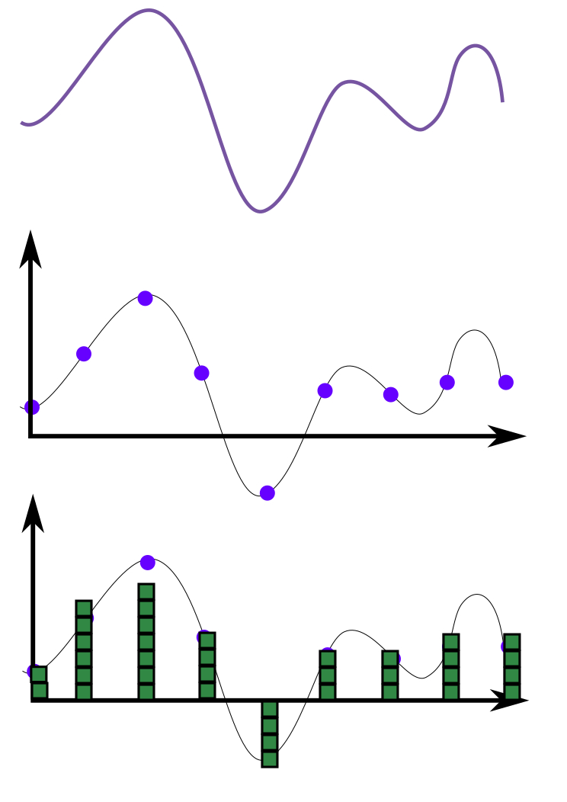
Getting signals into computers: Analog-to-Digital Conversion
Real, analog voltage
Sampled signal
Quantized signal

Slide 21
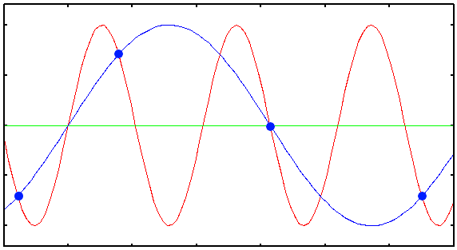
Sampling
Nyquist-Shannon sampling theorem:
  real-valued signal is sampled every Δt sec
  Original signal can be reconstructed perfectly so long as contains no power at frequencies ≥ 1 / (2 Δt) Hz (band-limited)
Adequately sampled
Undersampled,
cannot be
reconstructed
Figure from Adam Deller’s 2024 SIW lecture
Notes:
Starting with sampling: the basis for digital signal processing is the Nyquist-Shannon sampling theorem. This says… Illustrated here. Blue signal has no frequency component higher than half the sampling frequency (easy to tell here because it is a sine wave, and there are more than two samples per cycle). But the red does not, and so we would not be able to reconstruct the red signal. If we tried, we’d get the blue one (which is obviously completely different).
KP note: make aside about Heisenberg

Slide 22
Aliasing
Spectrum of continuous timeseries
Band you care about
RFI
More RFI
-f
0
f
Frequency
Should you simply choose Δt such that f = 1 / (2 Δt) Hz ?
Notes:
You might choose the sampling rate delta t to sample this whole band.

Slide 23
Aliasing
Band you care about
RFI
other RFI
-3/(2Δt)
-1/(2Δt)
0
1/(2Δt)
3/(2Δt)
Frequency
Spectrum of continuous timeseries
Spectrum of discrete timeseries

Slide 24
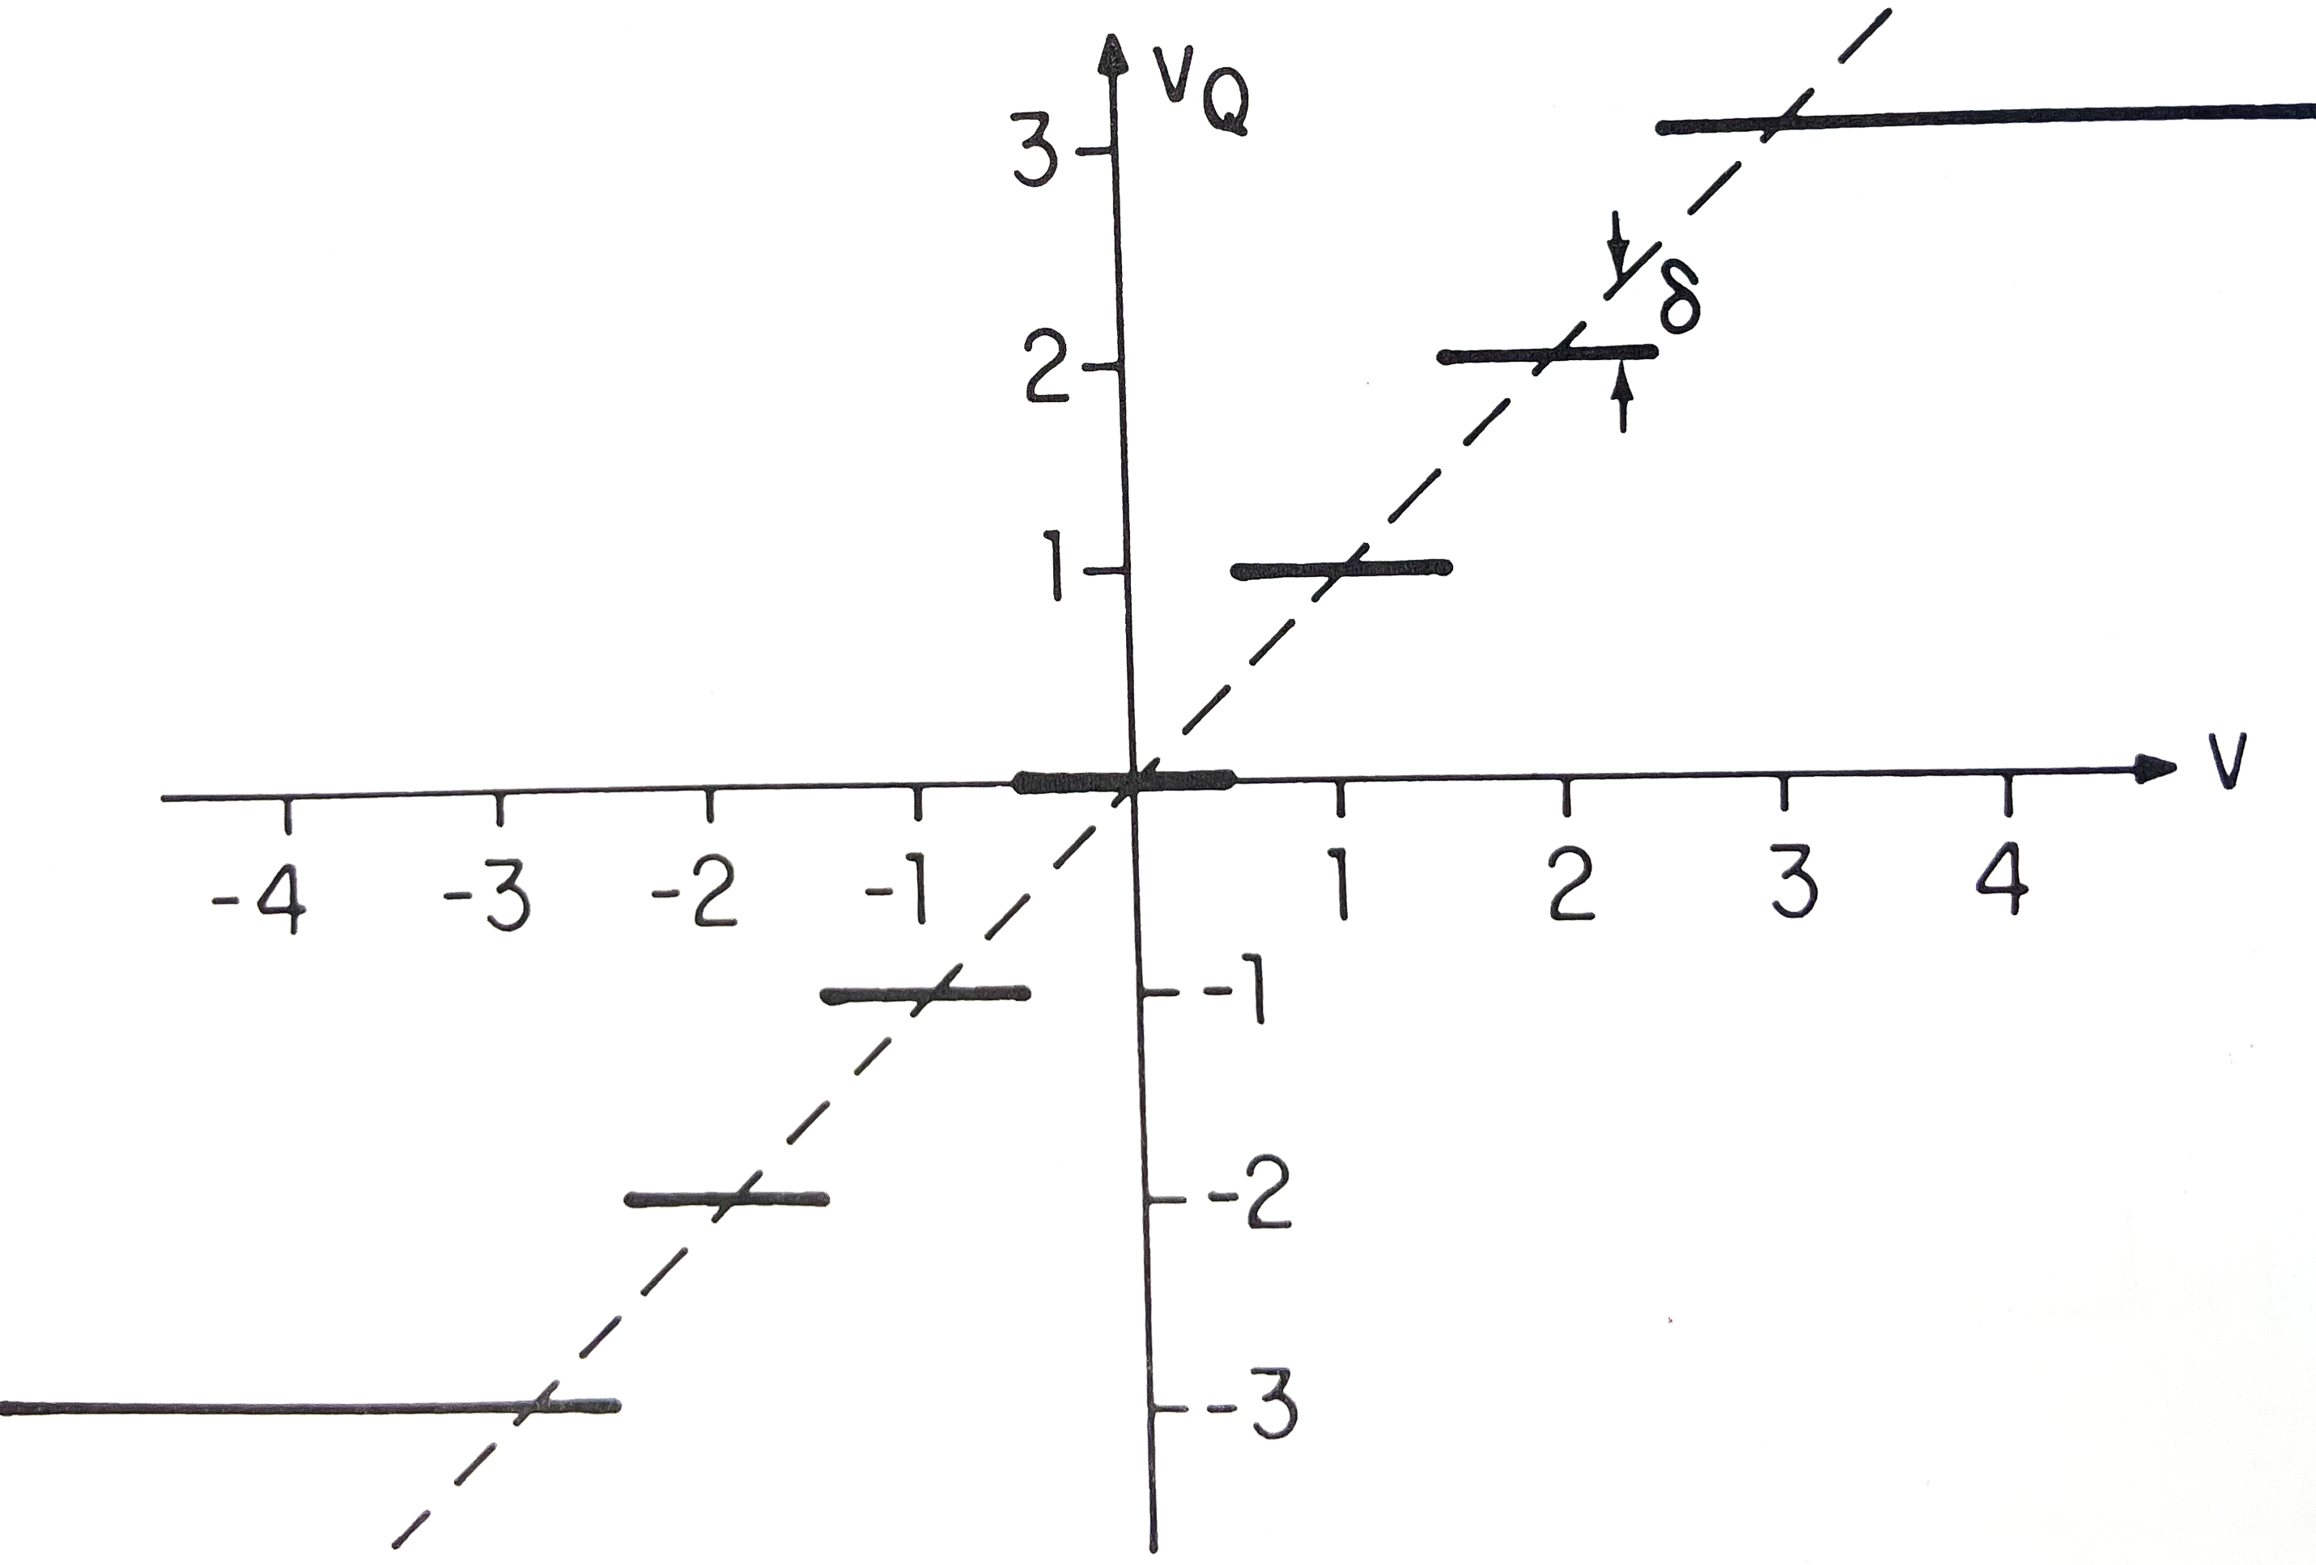
Quantization
If V is Gaussian distributed, so is 𝛿
Even if V is bandlimited, 𝛿 is not!
V
V_{q}
V = V_{q} + 𝛿
Quantization noise
Quantized voltage
Real-valued voltage
Quantization noise
No longer bandlimited
RFI
Precision Data rate?
Notes:
Quantization noise is not bandlimited, but usually small enough not to cause large problems.

Slide 25
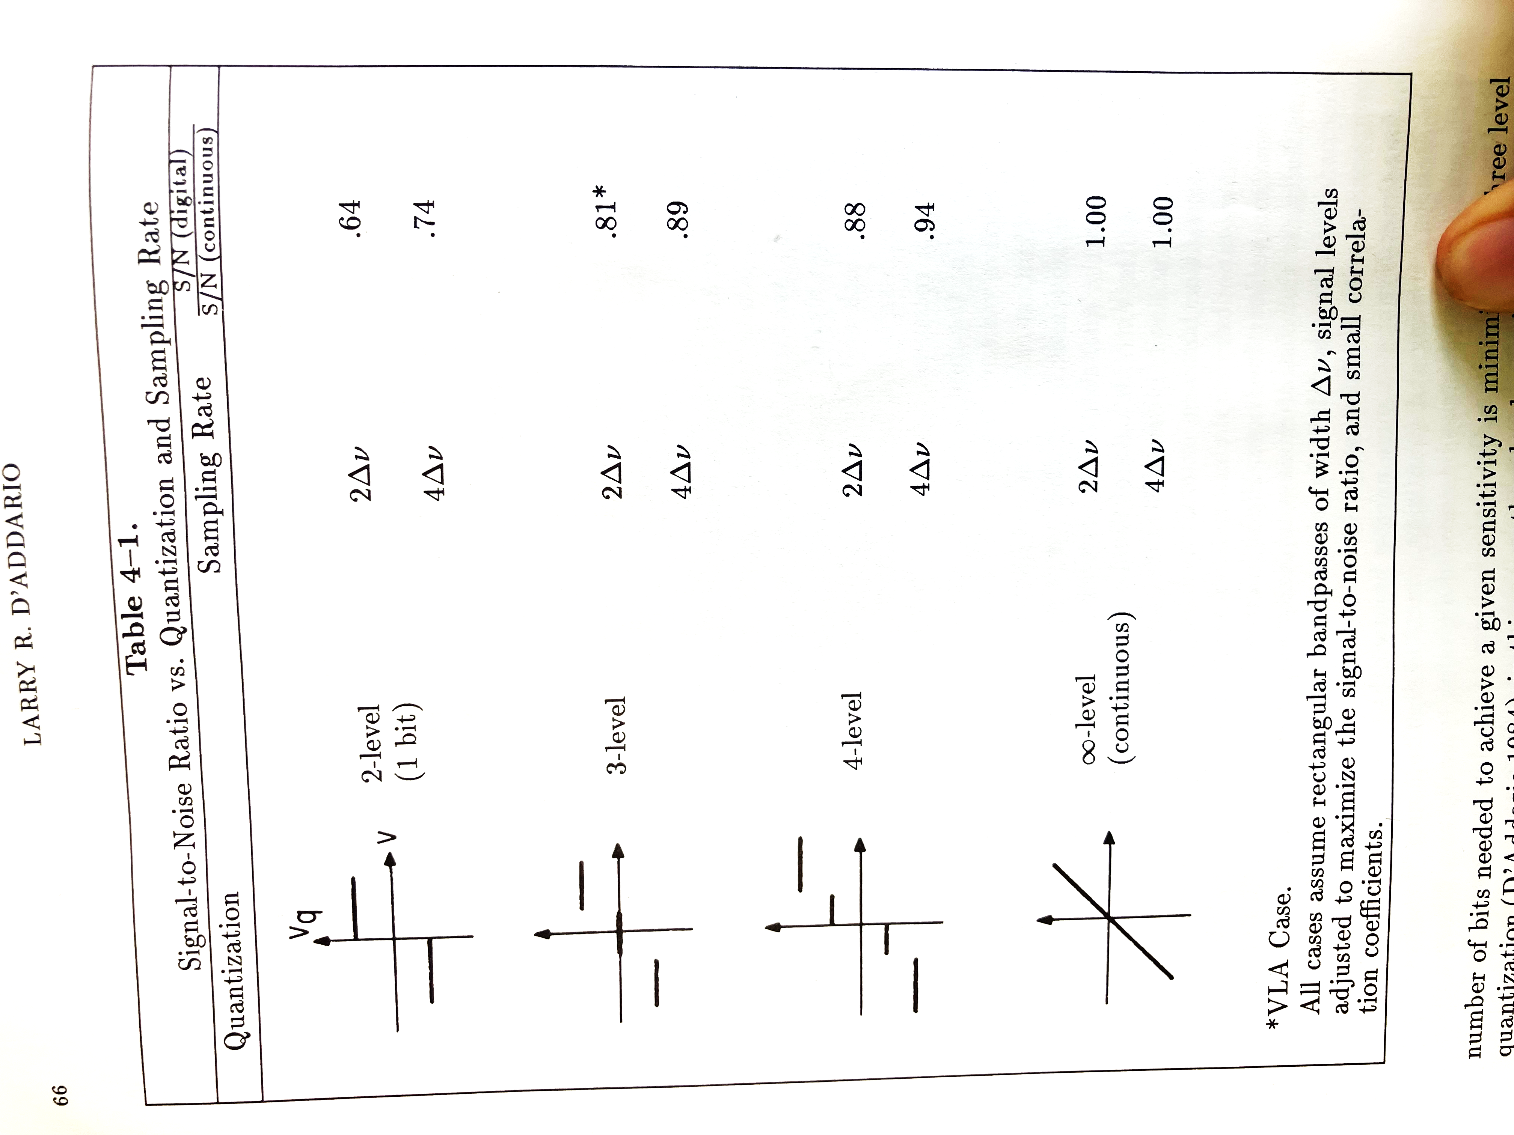

Quantization & Sensitivity
Number of levels
$$\frac{S/Ndigitized}{S/Ncontinuous}$$
More bits = more computationally expensive
VLA has 8 bit and 3 bit digitizers, 3 bit is 15% worse sensitivity (if equal bandwidth)
Assumes Nyquist sampling and small astronomical signal compared to noise
0.64
0.88
1.0
Adapted from Larry D’Addario’s 1989 SIW chapter
Notes:
Quantization noise is not bandlimited, but usually small enough not to cause large problems.
Mention that you want to control the power level at the digitizer inputs to get this optimum sensitivity. If you have an 8 bit digitzer and the input power is so low that effectively it’s only using 2 bits, then bits are wasted.

Slide 26
Quantization - Dynamic range & Saturation effects
Number of bits determines dynamic range of digitizer
Control the input amplitude to avoid saturation
Saturating the digitizers causes bad artifacts
Next slides will demonstrate an example
Notes:
Quantization noise is not bandlimited, but usually small enough not to cause large problems.

Slide 27
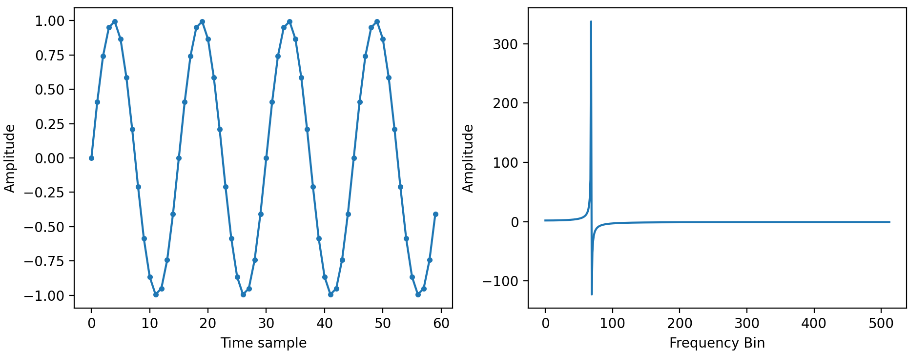
Quantization - Dynamic range & Saturation effects
Simple sine wave tone
Only the 1st four periods are shown
1024-pt FFT
Notes:
Quantization noise is not bandlimited, but usually small enough not to cause large problems.

Slide 28
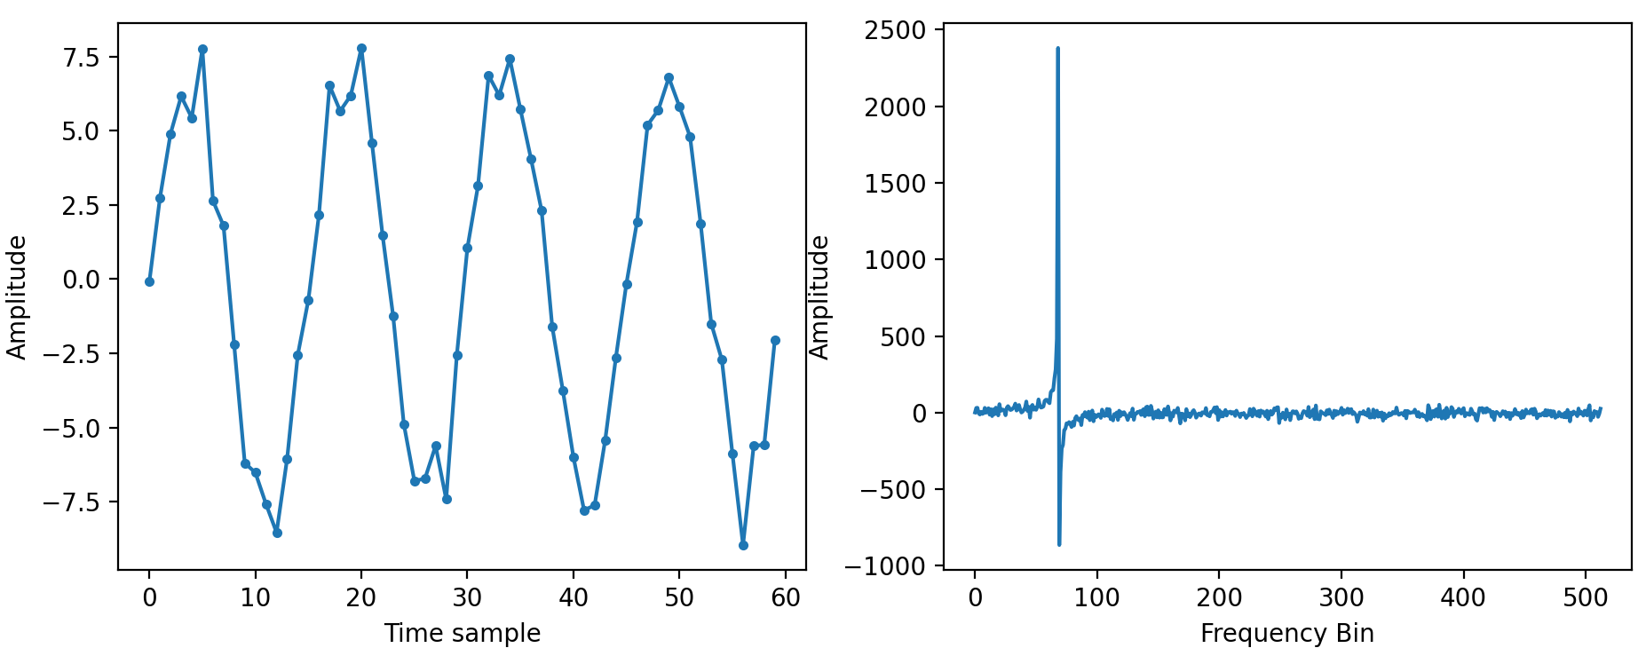
Quantization - Dynamic range & Saturation effects
Same tone, scaled with some gain (x7) and added Gaussian noise (RMS=1)
Notes:
Quantization noise is not bandlimited, but usually small enough not to cause large problems.

Slide 29
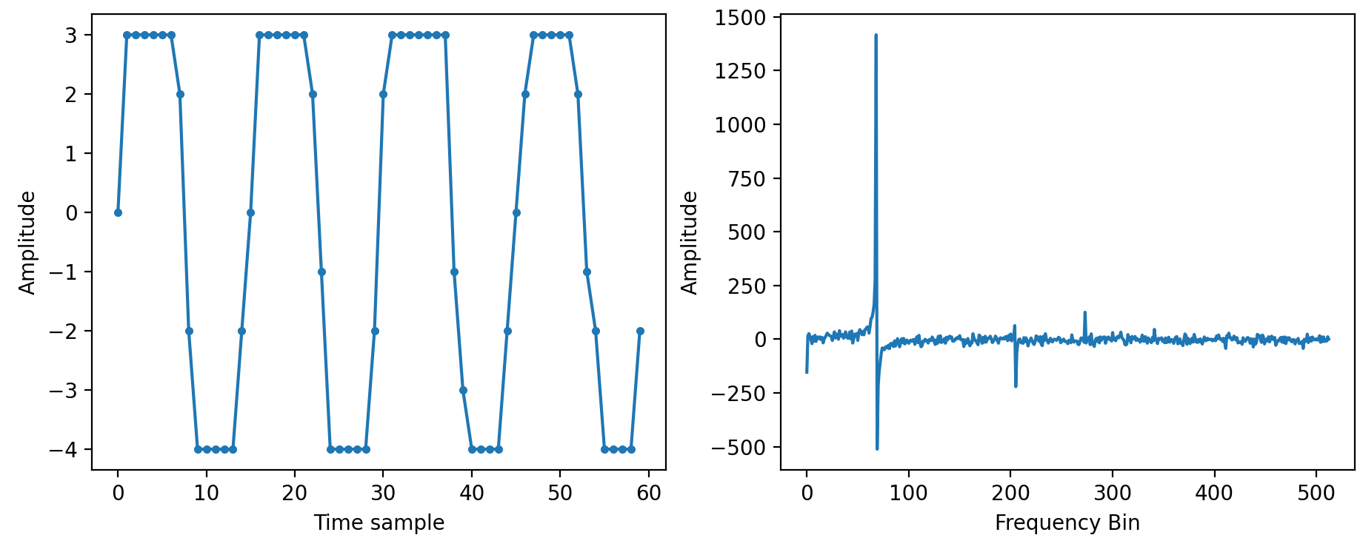
Quantization - Dynamic range & Saturation effects
Simulated 3 bit quantization before the FFT
Artifacts not in original signal
DC bias, not from the saturation
Sine wave is clipped, new frequency structure appears
Notes:
Quantization noise is not bandlimited, but usually small enough not to cause large problems.

Slide 30
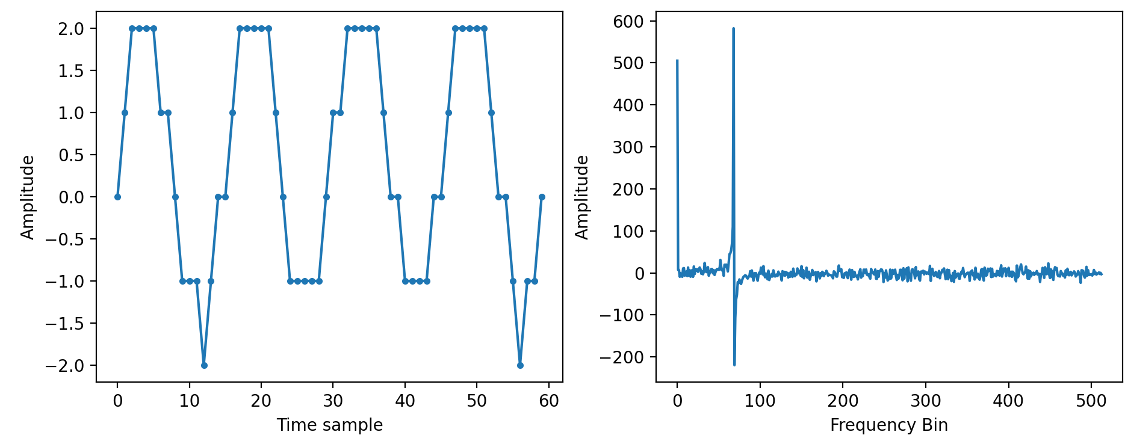
Quantization - Dynamic range & Saturation effects
Signal scaled with gain=0.25 to avoid saturation before same 3 bit quantization
No artifacts
Notes:
Quantization noise is not bandlimited, but usually small enough not to cause large problems.

Slide 31
Discussion question
The VLA proposal technical justification asks you to explain your choice of digitizers.
You want to observe a very faint continuum source with the VLA at a high frequency band where you have a choice between covering an ~8 GHz wide band with the VLA’s 3 bit digitizers or ~2 GHz with the VLA’s 8 bit digitizers.
What do you choose if sensitivity is your top priority?

Slide 32
Discussion question
The VLA proposal technical justification asks you to explain your choice of digitizers.
You want to observe a very faint continuum source with the VLA at a high frequency band where you have a choice between covering an ~8 GHz wide band with the VLA’s 3 bit digitizers or ~2 GHz with the VLA’s 8 bit digitizers.
What do you choose if sensitivity is your top priority?
Choose the 3 bit digitizers!
With only 3 bits you have ~85% of the sensitivity you would have with 8 bits, but the extra bandwidth boosts the sensitivity by a factor of 2

Slide 33
Delay compensation
Delay to the nearest
sample is easy:
τ
Slide borrowed from Adam Deller’s 2024 SIW Lecture

Slide 34
Delay compensation
Delay to the nearest
sample is easy:
τ
τ
Slide borrowed from Adam Deller’s 2024 SIW Lecture

Slide 35
Delay compensation
τ₁
In practise, delay all to
common reference
τ₂
τ₁
τ₂
Slide borrowed from Adam Deller’s 2024 SIW Lecture
Notes:
Since there are more than 2 antennas, it makes sense to delay them all to the same spot (since we need to cross-multiply all baselines). We also need to take care of the fact the the Earth is rotating between the time when the signal arrives at the antenna and the time when it would have arrived at the reference point. For short baseline instruments, fairly rudimentary model will do; just antenna position and source direction. But for very widely separated elements (like you will hear more about on Thursday, where we discuss using antennas separated by thousands of kilometres) the models are EXTREMELY complex… Earth Orientation (wobble in the rotation axis), deformation of the Earth’s surface due to ocean loading, solid tides, … crazy!

Slide 36
Fractional-sample correction
Sampling prevents perfect alignment of data streams; always a small error
Voltage amplitude
τ
time
ε
Slide borrowed from Adam Deller’s 2024 SIW Lecture
Notes:
So say you have a 100 MHz bandwidth so a 5 ns sampling time, and your delay model says you need to delay this datastream by 75001 nanoseconds. You can shift backwards 15000 samples, and you’re almost right, but an error of 1 ns remains. How do we correct for this small error?

Slide 37
Fractional-sample correction
Sampling prevents perfect alignment of data streams; always a small error
Voltage amplitude
τ
Visibility phase
time
0
frequency
ε
Slide borrowed from Adam Deller’s 2024 SIW Lecture
Notes:
You just say – well, I do have the right samples! They’re just shifted a bit (by a fraction of a sample) And go on, and do the FFT. Because there is another very handy relationship between the time domain and the frequency domain: a shift in the time domain corresponds to a slope in the frequency domain. So we get exactly the right answer from the FFT – just with a slope in phase in the output. The lowest frequency channel is completely unaffected, but the phase is progressively further away from where it should be as you go to the higher frequency channels. But no worries, we can just correct that! We multiply the output of the FFT by the appropriate complex (unity amplitude, opposite phase) and we have completely corrected the problem.

Slide 38
Fractional-sample correction
Sampling prevents perfect alignment of data streams; always a small error
Voltage amplitude
τ
Visibility phase
φ = ν x ε
time
0
frequency
ε
Slide borrowed from Adam Deller’s 2024 SIW Lecture
Notes:
You just say – well, I do have the right samples! They’re just shifted a bit (by a fraction of a sample) And go on, and do the FFT. Because there is another very handy relationship between the time domain and the frequency domain: a shift in the time domain corresponds to a slope in the frequency domain. So we get exactly the right answer from the FFT – just with a slope in phase in the output. The lowest frequency channel is completely unaffected, but the phase is progressively further away from where it should be as you go to the higher frequency channels. But no worries, we can just correct that! We multiply the output of the FFT by the appropriate complex (unity amplitude, opposite phase) and we have completely corrected the problem.

Slide 39
Fractional-sample correction
Sampling prevents perfect alignment of data streams; always a small error
Note that correlators also handle fringe rotation (covered in other lectures)
Voltage amplitude
τ
Visibility phase
φ = - ν x ε
time
0
frequency
ε
Correction applied
with a complex
multiplication to
rotate phase
Adapted from Adam Deller’s 2024 SIW Lecture
Notes:
You just say – well, I do have the right samples! They’re just shifted a bit (by a fraction of a sample) And go on, and do the FFT. Because there is another very handy relationship between the time domain and the frequency domain: a shift in the time domain corresponds to a slope in the frequency domain. So we get exactly the right answer from the FFT – just with a slope in phase in the output. The lowest frequency channel is completely unaffected, but the phase is progressively further away from where it should be as you go to the higher frequency channels. But no worries, we can just correct that! We multiply the output of the FFT by the appropriate complex (unity amplitude, opposite phase) and we have completely corrected the problem.

Slide 40
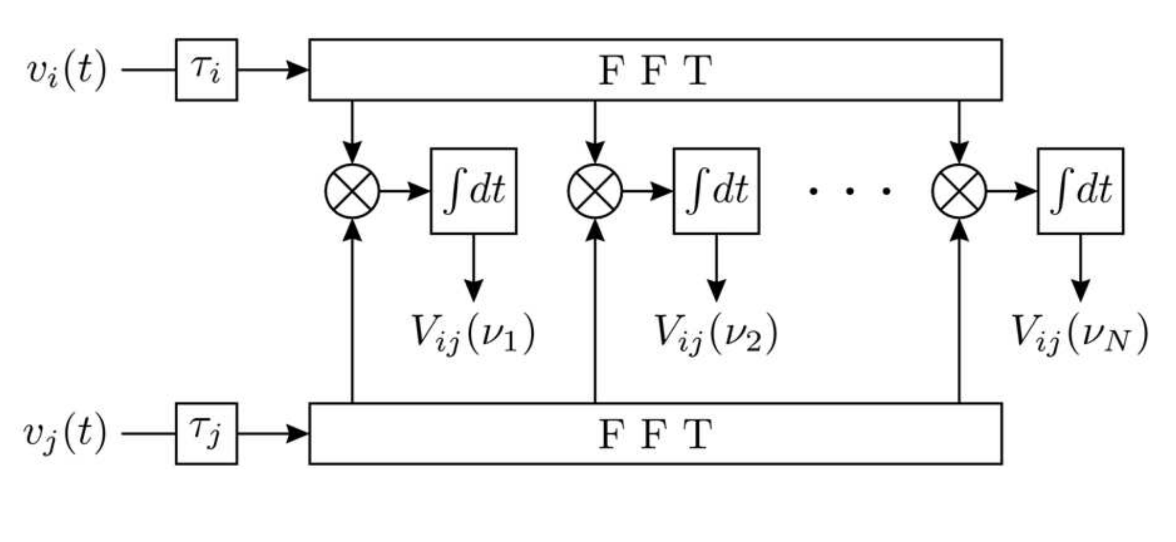
The FX Correlator
Figure from Walter Brisken’s 2004 SIW lecture
Notes:
These integrals are sums, this is all discrete math.

Slide 41
The FX correlator
Each of these frequency channels is still a time series, representing a voltage that represents an electric field. It’s just that now, it represents a really narrow chunk of bandwidth (and is stored as a complex quantity – complex multiplication [conjugate antenna 2] rather than separate cosine + sine correlators)
window,
FFT
window,
FFT
window,
FFT
window,
FFT
f₁
f₂
f₃
f₄
f₅
Adapted from Adam Deller’s 2024 SIW Lecture
Notes:
Digitize the data stream, and use digital signal processing to split it up into many narrower channels. To do this, we take a window of the datastream and run it though a Fast Fourier Transform. The spectral resolution is set by the window size (the length of the FFT). Longer FFT means more spectral points, and hence a higher spectral resolution. Obviously your hardware has to be capable of doing an FFT big enough (bigger FFTs cost more operations, and take more memory). Now, for each station you have your narrow channel, and you just multiply/accumulate (MAC). Repeat for next window. After you’re finished integrating, you’ll see the visibility as a function of frequency for this baseline (amplitude and phase, as shown on the right).

Slide 42
The FX correlator
(unnormalized)
Visibility
amplitude
(Pseudo-)correlation
coefficients
window,
FFT
window,
FFT
window,
FFT
window,
FFT
x
x
x
x
x
x
x
x
x
x
x
x
x
x
x
x
x
x
x
x
Wavelength
Adapted from Adam Deller’s 2024 SIW Lecture
Notes:
Digitize the data stream, and use digital signal processing to split it up into many narrower channels. To do this, we take a window of the datastream and run it though a Fast Fourier Transform. The spectral resolution is set by the window size (the length of the FFT). Longer FFT means more spectral points, and hence a higher spectral resolution. Obviously your hardware has to be capable of doing an FFT big enough (bigger FFTs cost more operations, and take more memory). Now, for each station you have your narrow channel, and you just multiply/accumulate (MAC). Repeat for next window. After you’re finished integrating, you’ll see the visibility as a function of frequency for this baseline (amplitude and phase, as shown on the right).

Slide 43
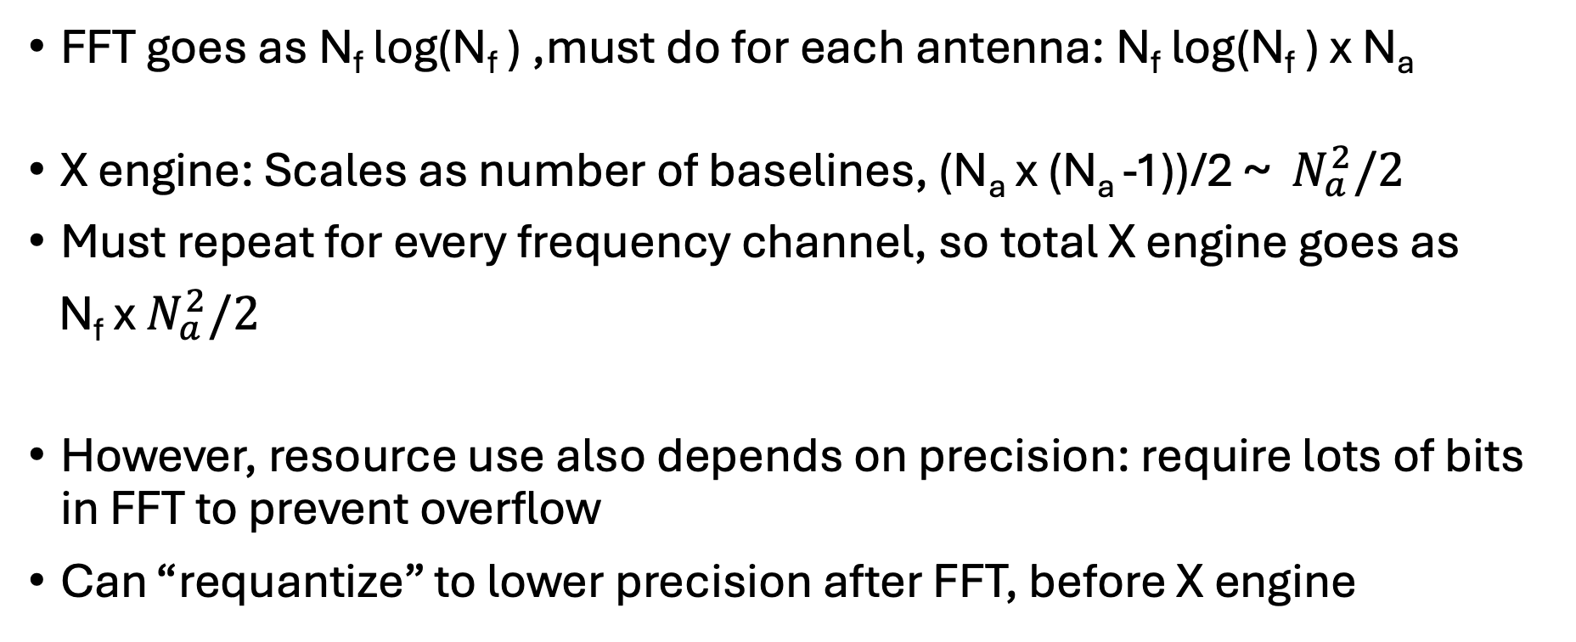
FX correlator resource use
FFT goes as N_{f} log(N_{f} ) ,must do for each antenna: N_{f} log(N_{f} ) x N_{a}
X engine: Scales as number of baselines, (N_{a} x (N_{a} -1))/2 ~ $N_{a}^{2}/2$
Must repeat for every frequency channel, so total X engine goes as
N_{f} x $N_{a}^{2}/2$
However, resource use also depends on precision: require lots of bits in FFT to prevent overflow
Can “requantize” to lower precision after FFT, before X engine

Slide 44
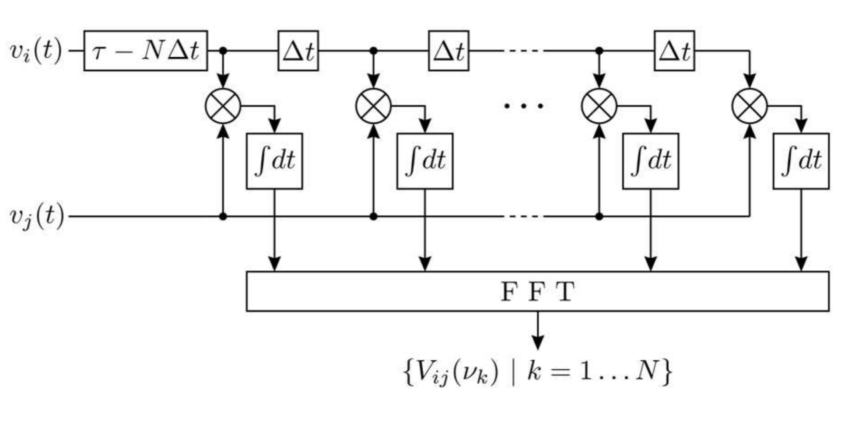
The XF Correlator
Figure from Walter Brisken’s 2004 SIW lecture

Slide 45
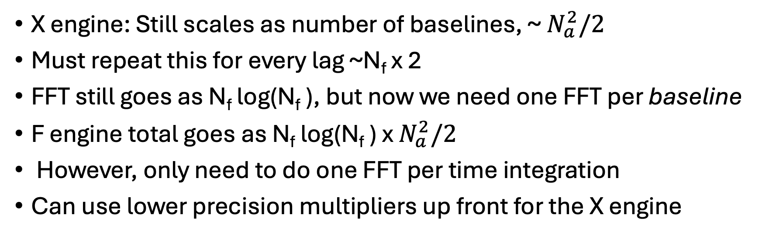
XF correlator resource use
X engine: Still scales as number of baselines, ~ $N_{a}^{2}/2$
Must repeat this for every lag ~N_{f} x 2
FFT still goes as N_{f} log(N_{f} ), but now we need one FFT per baseline
F engine total goes as N_{f} log(N_{f} ) x $N_{a}^{2}/2$
However, only need to do one FFT per time integration
Can use lower precision multipliers up front for the X engine

Slide 46
Discussion question
You are designing a radio interferometer to be built on the moon. The data rate you will be able to afford to downlink to Earth is extremely small, but sending all your computers to the moon to do your whole research project there is too expensive.
What are some important design considerations for the correlator in light of this data bottleneck?

Slide 47
Discussion question
You are designing a radio interferometer to be built on the moon. The data rate you will be able to afford to downlink to Earth is extremely small, but sending all your computers to the moon to do your whole research project there is too expensive.
What are some important design considerations for the correlator in light of this data bottleneck?
Integration time
Bandwidth
Bit depth
Number of antennas
FX vs XF architecture

Slide 48
Spectral response
The continuous Fourier transform is an integral with bounds at infinity.
The Discrete Fourier Transform has finite bounds.
window,
FFT
Figure from Adam Deller’s 2024 SIW Lecture

Slide 49
Spectral response
The continuous fourier transform is an integral with bounds at infinity.
The Discrete Fourier Transform has finite bounds.
window,
FFT

Slide 50
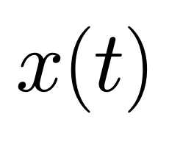
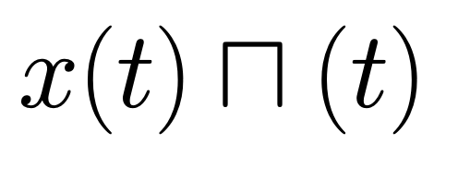
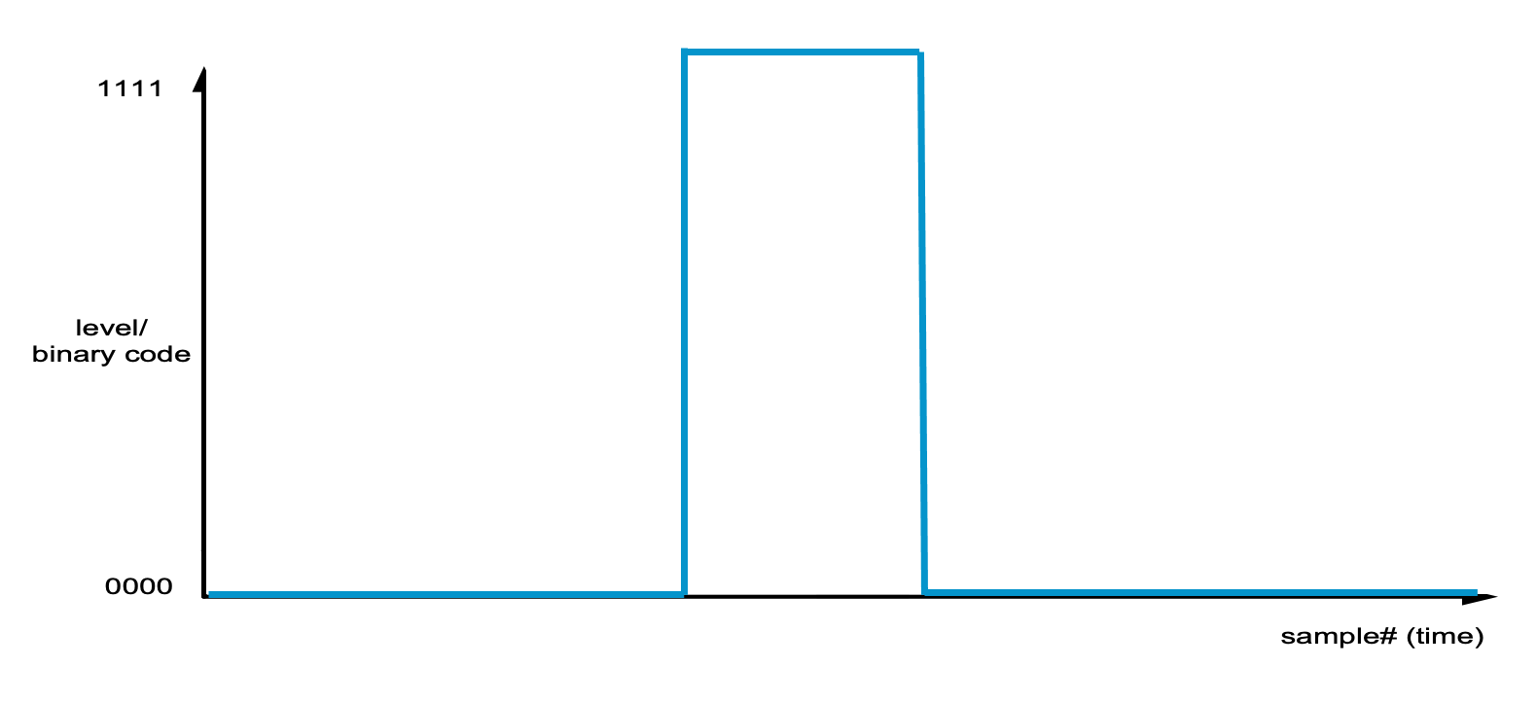
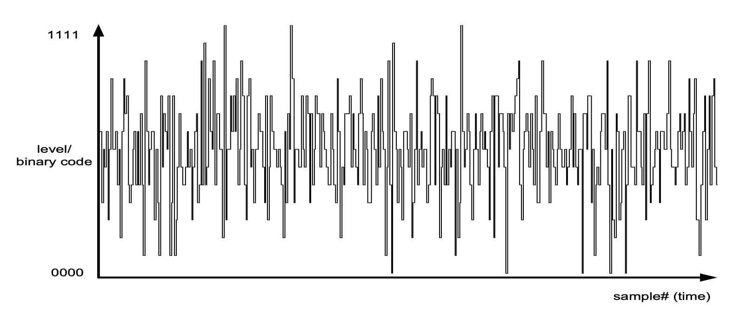
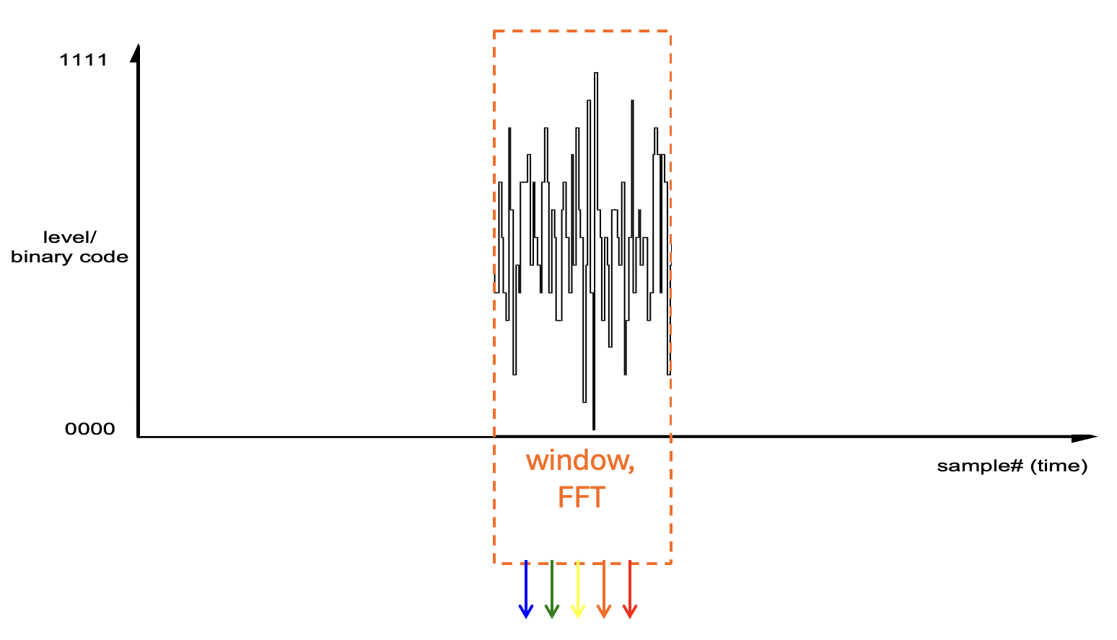
Spectral response
The continuous fourier transform is an integral with bounds at infinity.
The Discrete Fourier Transform has finite bounds.
x
=

Slide 51
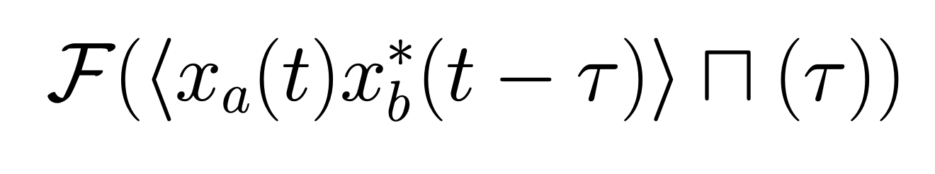
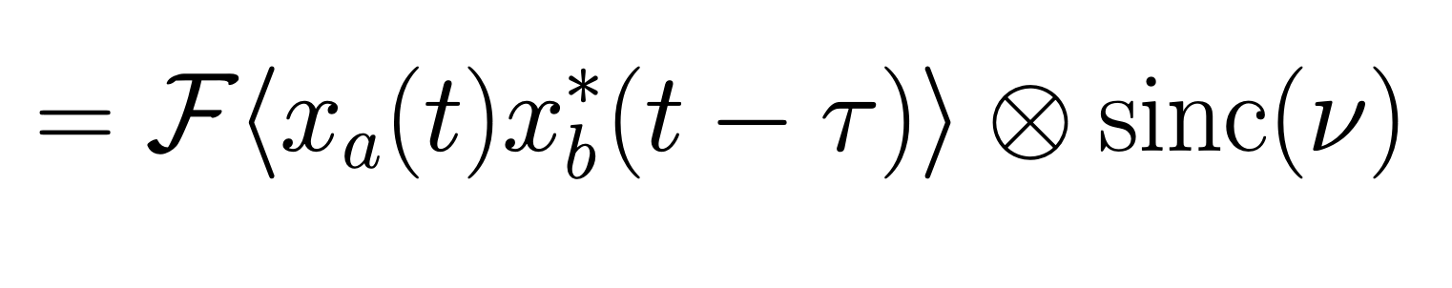
XF Correlator spectral response
Instead of the ideal:
We are actually calculating:
Notes:
T, tau, nu all evaluated at regularly spaced values

Slide 52
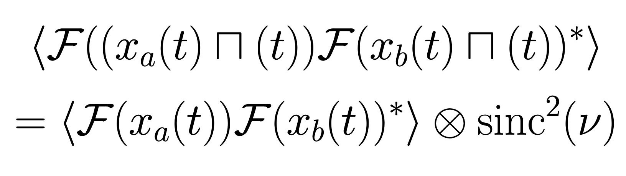
FX correlator spectral response
Instead of the ideal:
We are actually calculating:

Slide 53
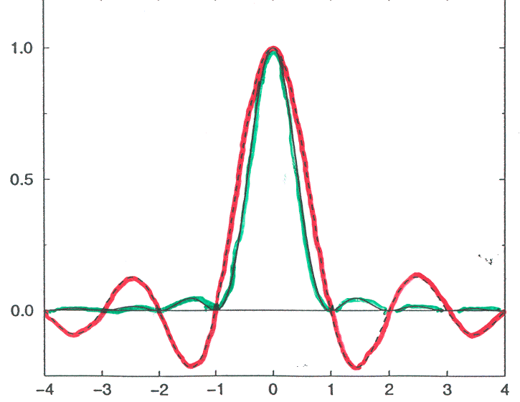
XF vs FX Spectral Response
Lag weighting
Spectral Response
XF
Sinc
Sinc²
FX
Channel
Notes:
This is one of the “consumer-level” things everyone needs to know about a correlator. Because we effectively multiply the data with a window function in the time domain (whether its an FX or XF) we convolve the frequency domain response with the Fourier transform of that window function. In effect, the response to a narrow feature in the frequency domain is not actually confined to one channel in the output. For the XF correlator the window function is a top hat, and the FT of a top hat is a sinc. For the FX correlator, the effective lag function is a triangle, as shown earlier, and the FT of a triangle is sinc^2. Much lower sidelobes – good for RFI rejection and spectral line studies. You can Hanning smooth XF correlator output, which gets to similar sidelobe levels at the cost of ~2x worse spectral resolution. More advanced filtering possible in FX, but rarely implemented. But so: don’t Hanning smooth data from an FX correlator, for instance! Note it is all positive response, you won’t cancel anything out.

Slide 54

XF vs FX Spectral Response
Lag weighting
Spectral Response
XF
5% sidelobes
FX
22% sidelobes!
Channel
Notes:
This is one of the “consumer-level” things everyone needs to know about a correlator. Because we effectively multiply the data with a window function in the time domain (whether its an FX or XF) we convolve the frequency domain response with the Fourier transform of that window function. In effect, the response to a narrow feature in the frequency domain is not actually confined to one channel in the output. For the XF correlator the window function is a top hat, and the FT of a top hat is a sinc. For the FX correlator, the effective lag function is a triangle, as shown earlier, and the FT of a triangle is sinc^2. Much lower sidelobes – good for RFI rejection and spectral line studies. You can Hanning smooth XF correlator output, which gets to similar sidelobe levels at the cost of ~2x worse spectral resolution. More advanced filtering possible in FX, but rarely implemented. But so: don’t Hanning smooth data from an FX correlator, for instance! Note it is all positive response, you won’t cancel anything out.

Slide 55
Improving the spectral response
XF correlator: Hanning smoothing improves response at some cost to sensitivity and spectral resolution
FX correlator:
  Many options for windowing functions that are better than boxcar.
  Modern FX correlators may use overlapping, non-boxcar window functions, often polyphase filterbanks

Slide 56
XF vs FX: which is better?
Desire for reduced artifacts favours FX
Main advantage of XF: can use very efficient low-precision integer multipliers up-front
But FX many fewer operations overall, unaffected by trend to higher bit depth
FX also: access to frequency domain at short timescale allows neat tricks and higher precision correction of delay effects
Modern correlators mostly FX-style, and often have multiple cascaded filter steps (~GHz recorded band chopped into ~100 MGz chunks and correlated separately)
Notes:
Both are used, which should tell you straight away: there are advantages and disadvantages to both. Cost of higher spectral resolution is linear for XF, only logN with FX. In general you can do more and do better with an FX: the transform to the frequency domain allows all kinds of nifty tricks. But it can get into trouble at very high spectral resolution. But the main thing, as always, is money. In an FFT, you need moderate to high precision in the internals (at least 16 bits), and you don’t gain any efficiency by feeding low precision (1 or 2 bit data) in. But with an XF, you can do the multiplies using 1 or 2 bit multipliers REALLY cheaply (1 bit is just a single gate!) depending on the hardware it is running on. And that leads us naturally to the next segment of the talk, which is: how do you actually implement a correlator?

Slide 57
VLA: FXF
WIDAR (VLA’s Correlator)
Four 2GHz basebands
Digital filterbank → 16 subbands per baseband
Correlation as a function lag computed for each subband
Then compute 16,384 channels/baseline
Up to 4 million channels possible for smaller subset of band
(F)
(X)
(F)

Slide 58
Discussion question
You collected visibilities with an XF correlator and unfortunately there is an intense RFI tone in the band. Even though this RFI is intrinsically very narrow band, lots of frequency channels in your spectrum appear spiky. What can you do to make more of your bandwidth usable?

Slide 59
Discussion question
You collected visibilities with an XF correlator and unfortunately there is an intense RFI tone in the band. Even though this RFI is intrinsically very narrow band, lots of frequency channels in your spectrum appear spiky. What can you do to make more of your bandwidth usable?
Try Hanning smoothing!

Slide 60
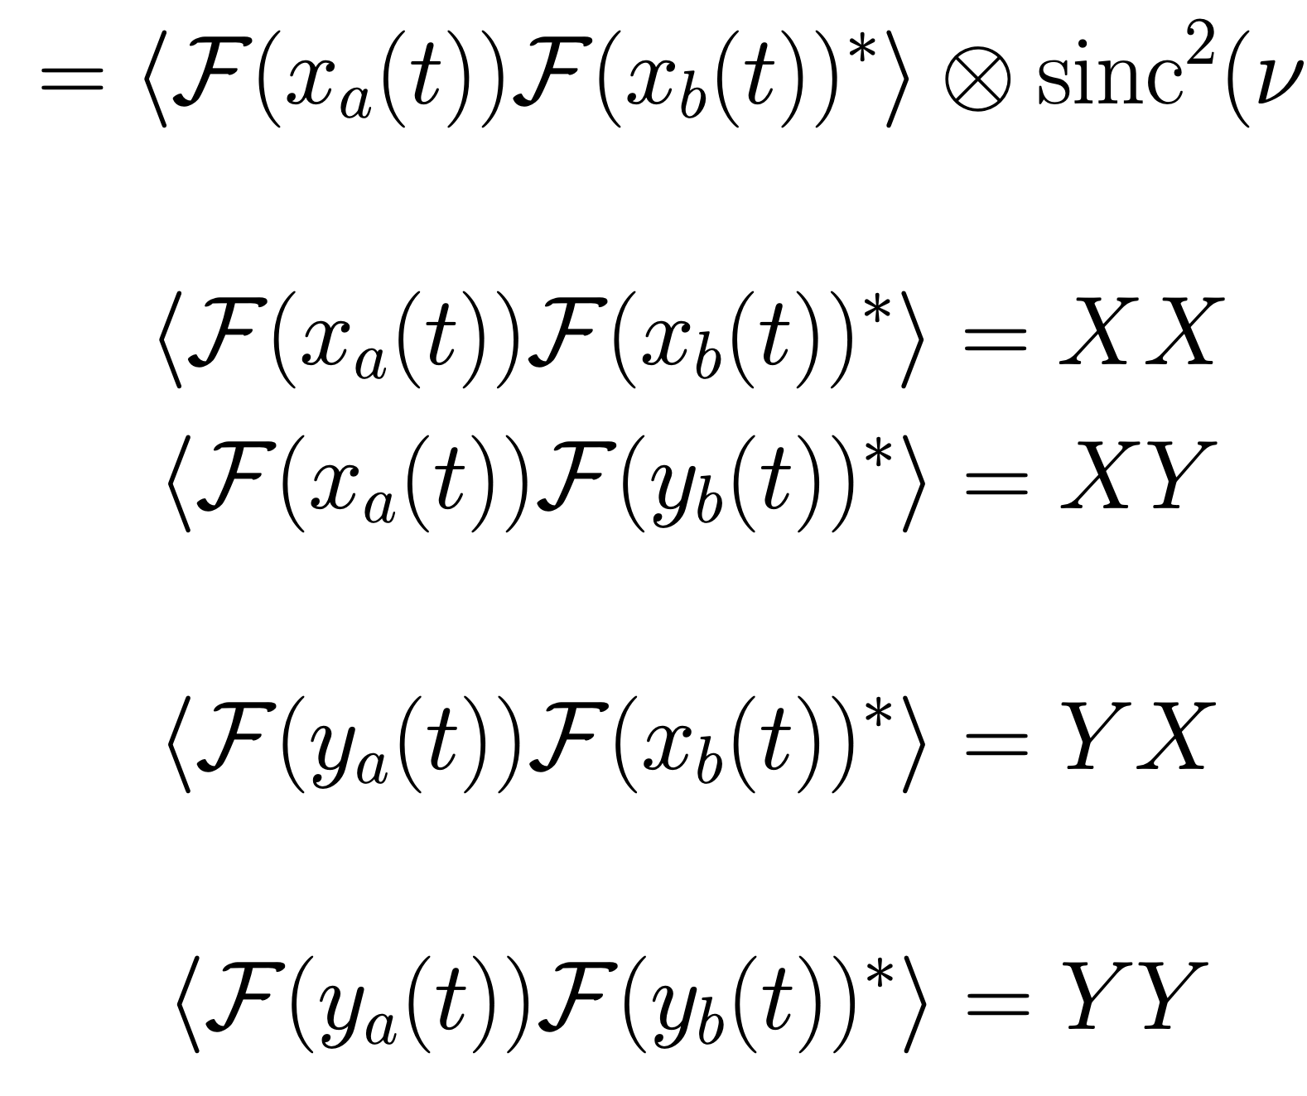
What about polarization?
If antenna provides 2 polarization feeds
Then you need 4 copies of the machinery of a single-polarization correlator
FX shown below, same idea for XF

Slide 61
What about polarization?
If antenna provides 2 polarization feeds
Then you need 4 copies of the machinery of a single-polarization correlator
FX shown below, same idea for XF
Voltage from linear-polarized feed X from antenna a
Voltage from linear-polarized feed Y from antenna b

Slide 62
What about polarization?
If antenna provides 2 polarization feeds
Then you need 4 copies of the machinery of a single-polarization correlator
FX shown below, same idea for XF

Slide 63
What about polarization?
If antenna provides 2 polarization feeds
Then you need 4 copies of the machinery of a single-polarization correlator
FX shown below, same idea for XF

Slide 64
Obtaining Stokes Parameters from correlator products
I = XX +YY = RR + LL
Q = XX – YY = 2 RL cos(δ)
U = 2 XY cos (δ) = 2 RL sin (δ)
V = 2 XY sin (δ) = RR – LL
δ is polarization angle
For linearly polarized feeds
For circularly polarized feeds

Slide 65
Correlator Hardware
Voltages
Visibilities
Something
that can
multiply
and add
Slide borrowed from Adam Deller’s 2024 SIW Lecturec
Notes:
OK, so now you know how to make a working correlator, mathematically. Two ways, in fact. So for the remainder of the time I want to switch gears a little and talk about what makes a working correlator in the real world: how do you implement these algorithms. It’s going to be a little less intense than the first part of the lecture, and the idea is really to get a flavour of what’s out there and what the possibilities are now and into the future. I’m going to describe 4 different platforms you could build a correlator on, and give a few ideas of what the advantages and disadvantages of each are (and how they map to the two algorithms already described). First: CPUs. How would you implement a correlator on a CPU? Well, you just write code! Buy a cluster of nodes like the one shown here, feed the station data in via ethernet or infiniband and get the visibilities off the same way.

Slide 66
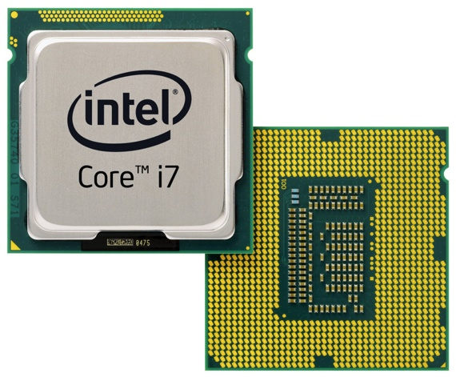
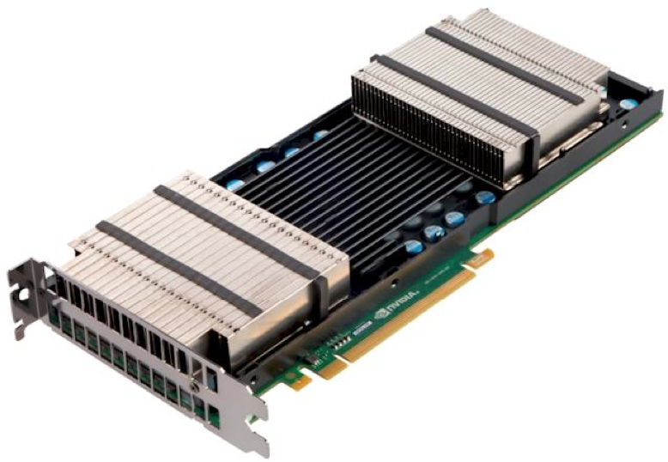
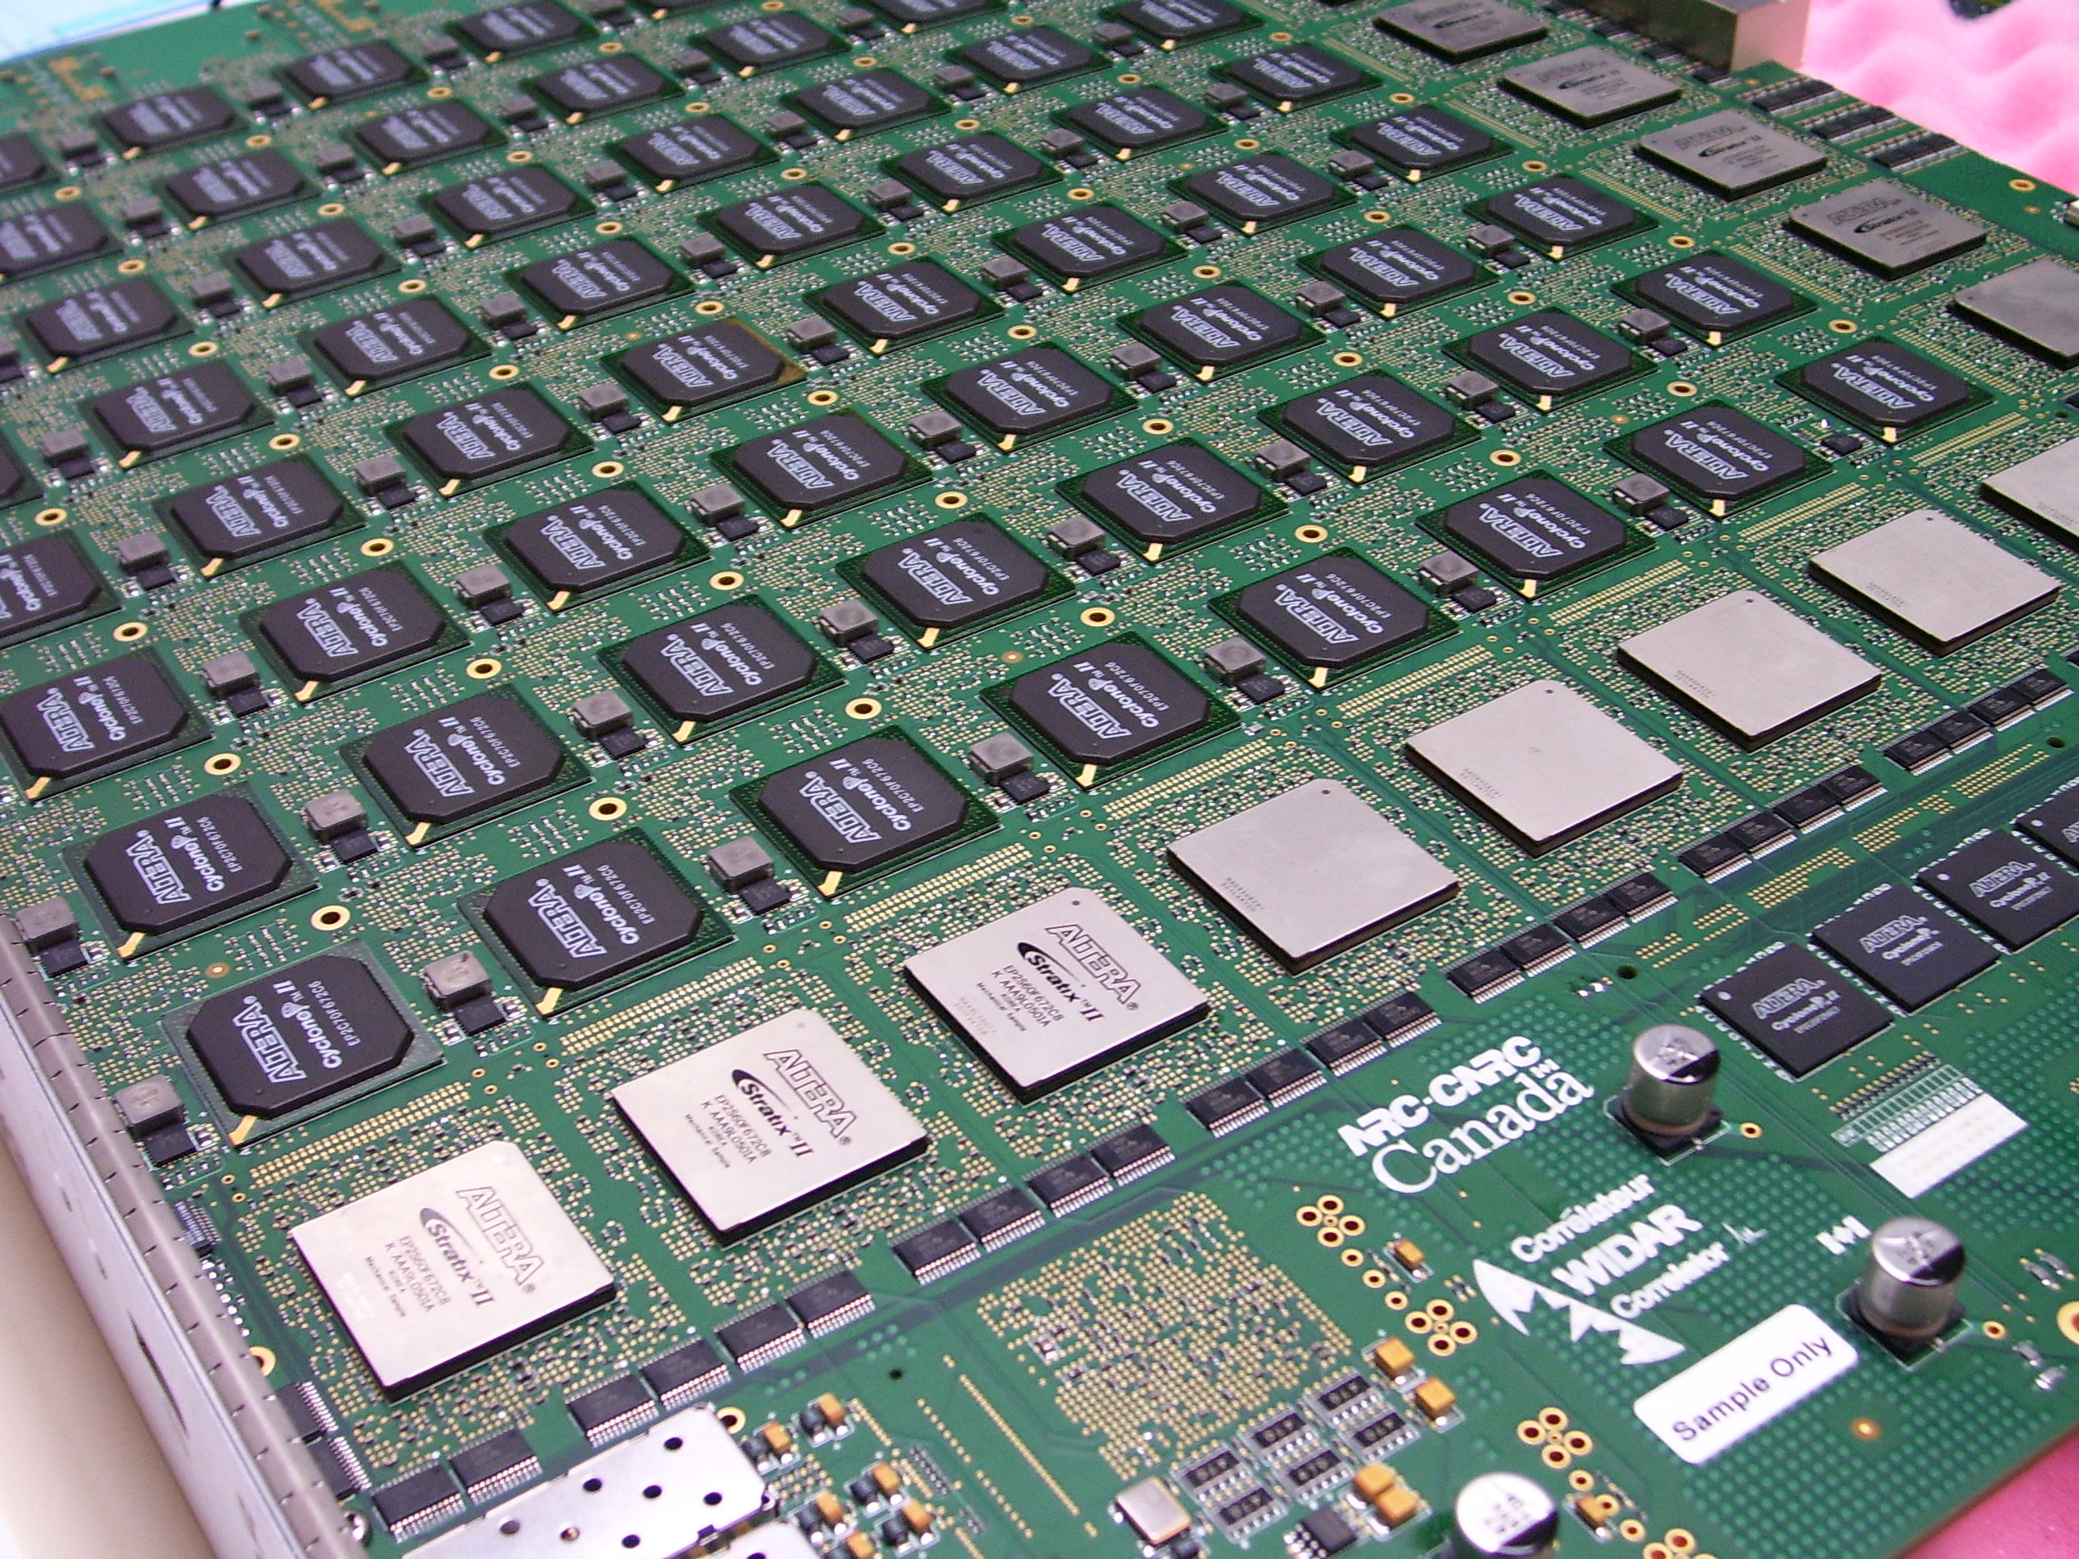
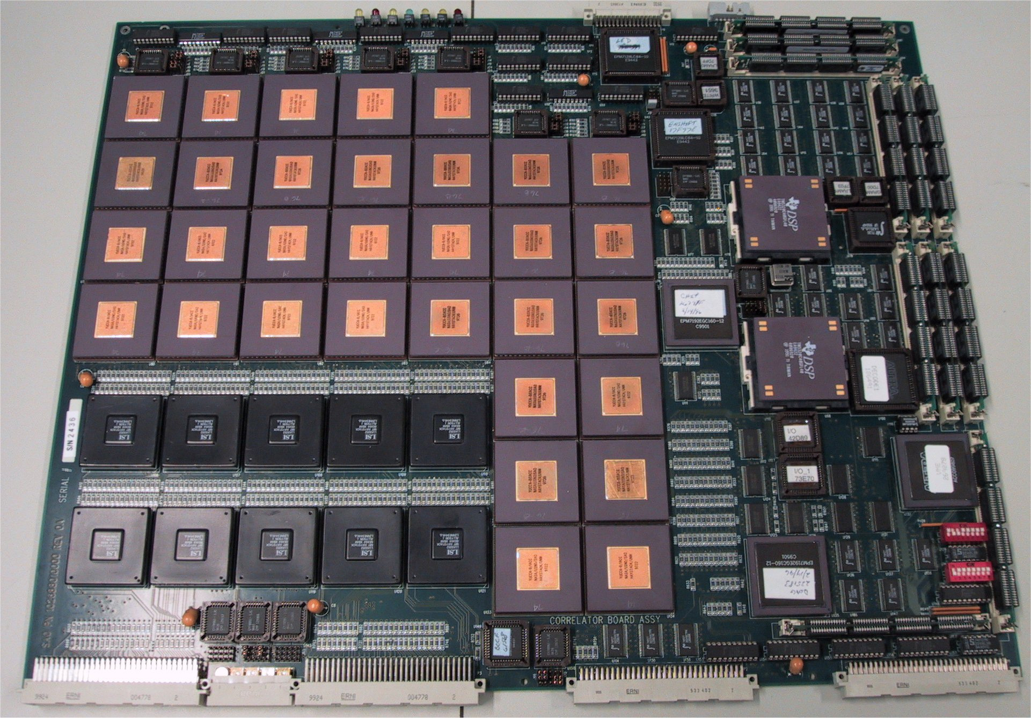

Machines that multiply and add
Development effort required
 | Programmable? | Optimized hardware for your algorithm? | Quick to implement?
ASIC | NO | YES | Hardest
FPGAs | YES! | somewhat
Correlator
capacity per
hardware $$
CPU
Reusability
GPU
CPUs/GPUs | YES | NO | Easiest
FPGA
Note CASPER collaboration tools
ASIC
Figure from Adam Deller’s 2024 SIW Lecture
https://casper-astro.github.io/
Notes:
So you can see there is a fairly linear trade-off; more upfront investment delivers more power per hardware dollar at the end. For small arrays and narrow bandwidths (low frequencies), I think you’d be crazy to do anything other than one of these two options (CPU/GPU). There are software correlator packages available that you can just download and run, with very minimal configuring, and it will just work without you doing virtually any development. But for very large systems, the hardware cost and especially running cost of a CPU/GPU system would be too high (millions of CPUs costs a lot to run) and so you are still forced into this corner of the diagram (FPGA/ASIC). Its worth noting as well that the CPU/GPU systems are really well matched to the FX architecture, because of the floating point capability, and that gives extra flexibility like I already said, and that can be especially interesting for small systems too.

Slide 67
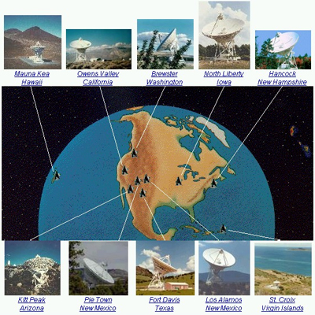
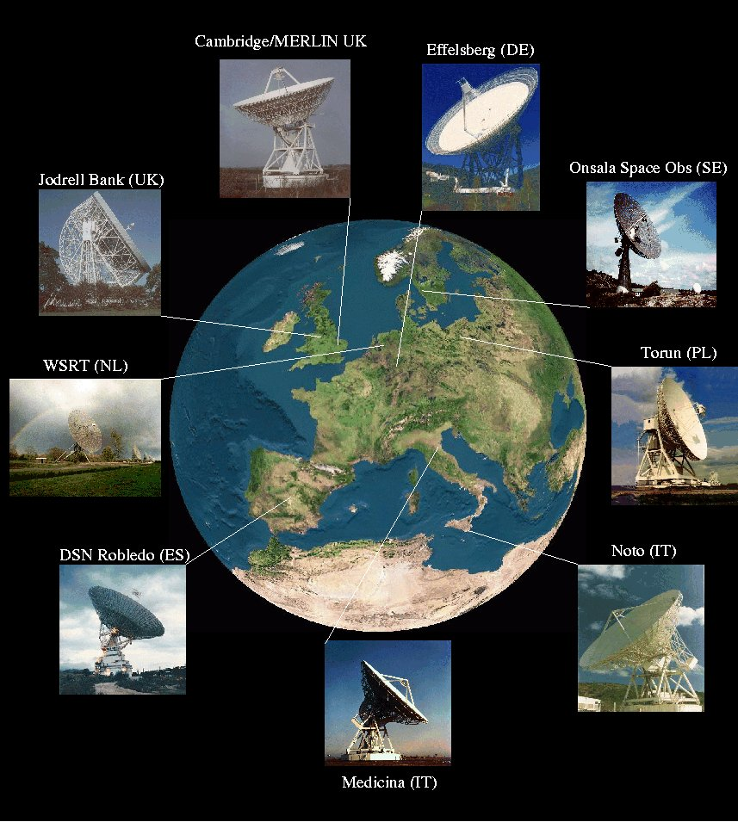
Correlators on CPUs
The Very Long
Baseline Array,
10 stations
Many positive points:
  Can implement in “normal” code (e.g., C++); maintainable, many skilled coders
  Development effort transferrable across generations of hardware
  Incremental development is trivial
  Natively good at floating point (good for FX), no cost to do high precision
One major disadvantage:
  CPUs not optimised for correlation; teraflop++ systems would take many CPUs.
The European
VLBI Network,
~30 stations
Slide borrowed from Adam Deller’s 2024 SIW Lecture
Notes:
So what are the advantages and disadvantages?

Slide 68
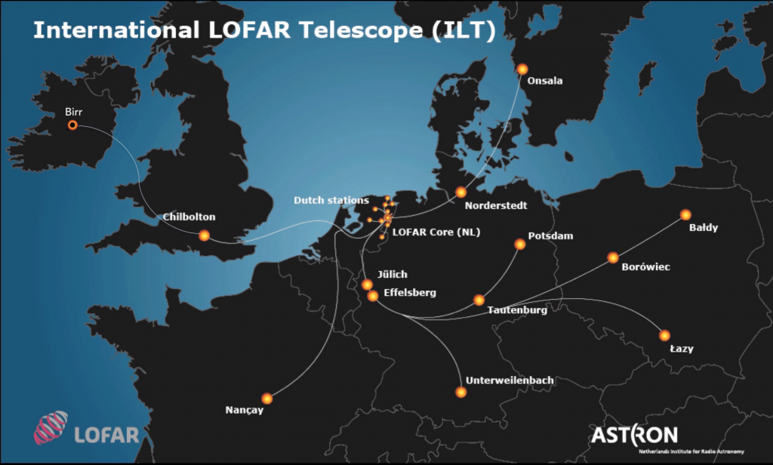
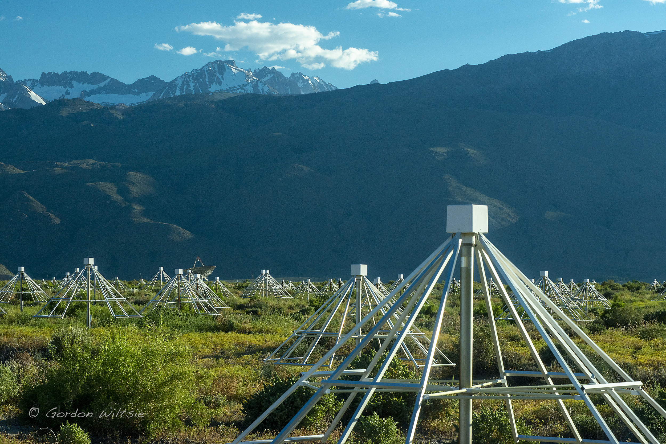
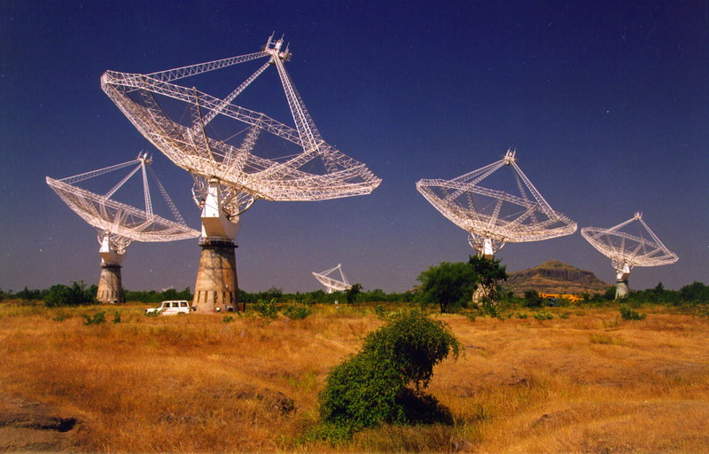
Correlators on GPUs
The Low Frequency
Array (LOFAR),
76 stations
OVRO-LWA
352 stations
Advantages:
  More powerful/efficient than CPUs
  Also good at floating point
  Made for vector maths!
Disadvantages:
  Writing code is more difficult (GPUs are more specialized, less flexible: need to carefully manage data transfers)
  Fewer expert GPU programmers available
  Transfer-ability of code across hardware generations (was) harder (capabilities change faster, need new code to use)
  Compete for hardware against bitcoin miners, AI LLMs
GMRT, India,
30 stations
Slide adapted from Adam Deller’s 2024 SIW Lecture
Notes:
Now underway: adding GPU acceleration to “general purpose” software correlators

Slide 69
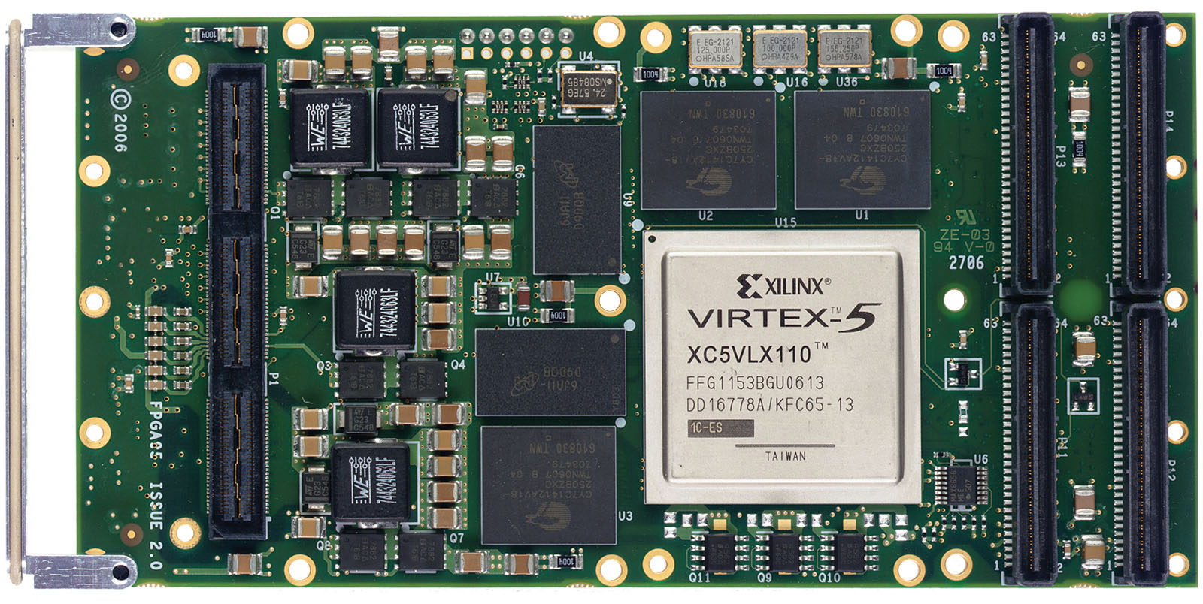
Correlators on FPGAs
Advantages:
  More efficient than CPUs
  or GPUs, particularly for
  integer multiplication –
  big power savings
Disadvantages:
  Programming is harder again (especially debugging), yet fewer experts
  Transfer-ability across hardware generations even more limited
  Synchronous (clocked) system, less robust to perturbations c.f. CPUs/GPUs
Slide borrowed from Adam Deller’s 2024 SIW Lecturec
Notes:
Field Programmable Gate Arrays, or FPGAs, are reprogrammable logic devices. Basically, a little hunk of silicon with a bunch of logic elements (multipliers, adders, etc) and memory, where you can tell it which blocks to connect to which other blocks. Data then gets fed in one side and read out the other. Well suited to correlation, which is just doing the same thing over and over again at high speed. As opposed to CPUs/GPUs, they are synchronous – clunk clunk clunk. That’s more hassle to organise.
With FPGAs you can start to get quite close to optimal utilisation of the underlying hardware (you can use the appropriate precision a lot easier, for instance). But with that flexibility comes extra overhead in the development. Because you’re really starting to get down to a low level, its not as easy as defining variables and writing operations any more. There are graphical development tools and various programming languages, but the learning curve is a fair bit steeper. So you’re needing to invest more time and effort up-front before the thing is ready.

Slide 70
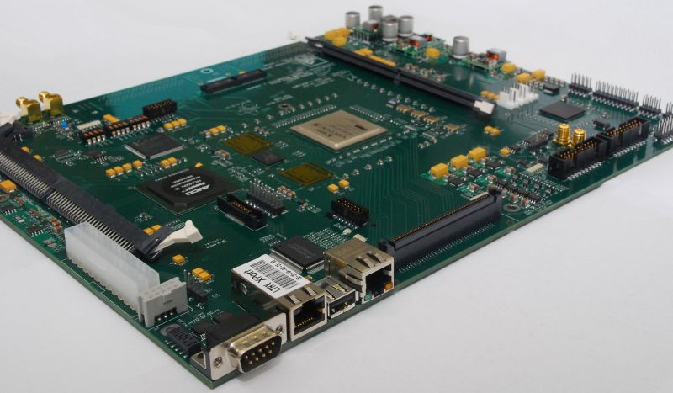
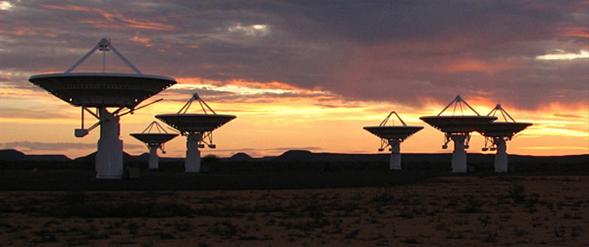
Correlators on FPGAs
“Roach” reconfigurable
FPGA board used for
correlation
MeerKAT, 64 dishes
Slide borrowed from Adam Deller’s 2024 SIW Lecturec
Notes:
Papar is an Epoch of Reionisation experiment located in South Africa with 128 elements. They use a CASPER FPGA correlator

Slide 71
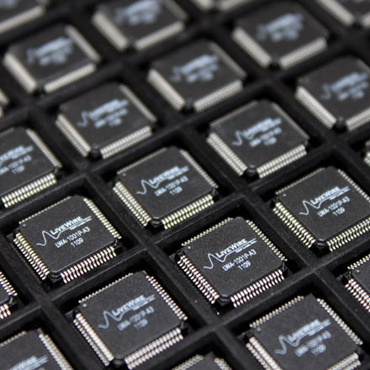
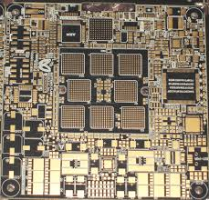
Correlators on ASICs
Advantages:
  Highest possible efficiency, low per-unit cost
Disadvantages:
  Highest development cost (time and manufacturing setup)
  Specialized knowledge required
  Can’t be changed / very difficult to upgrade during lifetime
As with FPGAs, ASICs
are mounted on boards
Slide borrowed from Adam Deller’s 2024 SIW Lecturec
Notes:
Application Specific integrated Circuits are like FPGAs, but without the reprogrammability. So you can design them exactly to do what you want – not a single gate wasted.

Slide 72
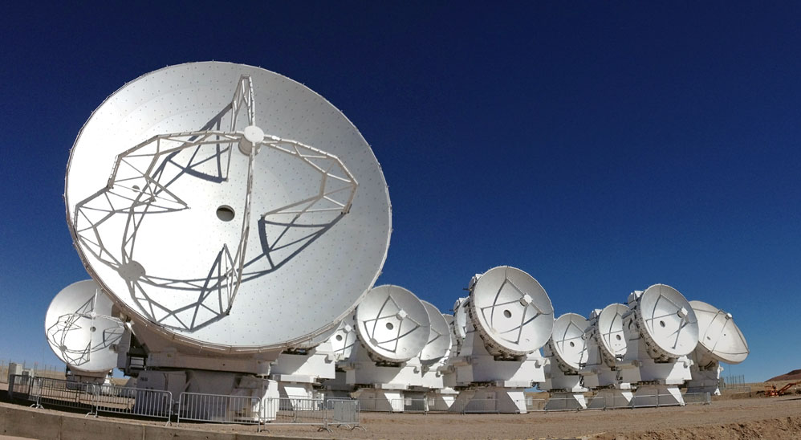
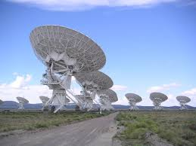
Correlators on ASICs
The Very Large Array,
New Mexico
The Atacama Large Millimetre
Array, Chile
Slide borrowed from Adam Deller’s 2024 SIW Lecture
Notes:
The old VLA correlator was build purely on ASICs, but most modern very large correlators are a mix of FPGAs and ASICs. For instance: upgraded VLA, ALMA. FPGAs are used for the bits where you want to be able to change parameters (e.g., number of spectral channels) and ASICs for where you know you always want to do the same thing (e.g., the multiplication/accumulate; of which the VLA correlator does over 1000 million million of per second (so you can see it is worth optimizing)!

Slide 73
Heterogenous systems
Implement “F engine” and “X engine” on different hardware
Example: OVRO-LWA
  352 antennas
  FPGA F-engine + GPU X-engine
  Each FPGA handles all frequencies for a subset of antennas
  Each GPU handles all antennas for a subset of frequencies
  Matrix transpose (“Corner turn”) handled by 40Gb ethernet switch
Image credit Gordon Wiltsie

Slide 74
Summary and conclusions
A correlator is the hardware and algorithms that transforms signals from pairs of antennas into complex visibilities
The monochromatic plane wave assumption can be approximated by working with narrow frequency channels
XF correlators compute cross correlations as a function of lag and then use a Fourier transform to obtain the visibility as a function of frequency
FX correlators compute complex spectra for each antenna first, and then cross multiply these for pairs of antennas
Digital signal processing deals with some effects that you don’t have in continuous, analog signals:
  Quantization noise
  Nyquist-Shannon theorem & aliasing
  Window functions that affect spectral response

