Slide 1
Antennas & Receivers in Radio Astronomy
Jay Blanchard
Notes:
Sergio
So now that Rick has introduced the fundamentals, we can dive in to real systems and how they behave, starting with ..

Slide 2
Purpose & Outline
Purpose: describe how realizable antenna elements can affect the quality of images produced by an aperture synthesis array
Antennas
  Fundamentals (antenna types and terminology)
  Reflector antenna mounts and optics
  Aperture efficiency
  Pointing
  Polarization
Receivers and Noise Temperature
Based on slides from:
Rob Selina
Mark McKinnon
Craig Walker
And others!
Notes:
Transmissive and reflective analysis analogy.

Slide 3
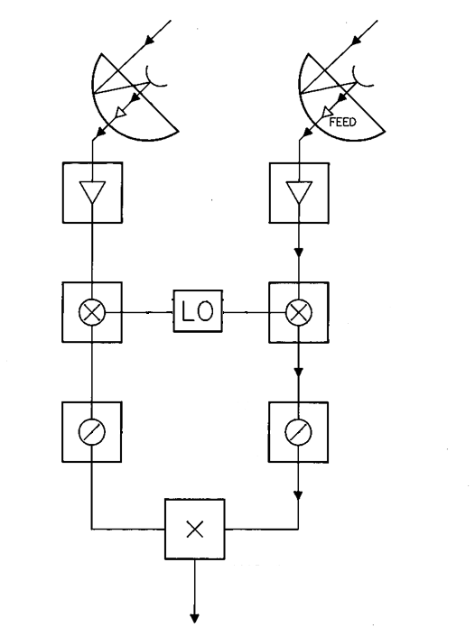
Antenna Electronics Block Diagram
Sky EM
Antennas
EM to Electric Current, w/ Gain
Signal Amplification
G ~ 80 dB (x10⁸ in power)
Low-Noise
Amplifiers
Local Oscillator
Frequency Down-conversion
(when needed)
Freq. Converters
Analog to Digital Converter Input:
Electric Current
~1mW
Limited Frequency
Digitizers
Correlator
Notes:
EM wave -> LNA
Field collection (amp), impedance match to waveguide input
Electrical RF signal
Digitization
G=(kT_sys*BW)/P_out
Heterodyne

Slide 4
Effects of Antenna Properties on Data
Antenna amplitude pattern causes amplitude to vary across the source.
Antenna phase pattern causes phase to vary across the source.
Polarization properties of the antenna can modify the apparent polarization of the source.
Antenna pointing errors can cause time varying amplitude and phase errors.
Variation in noise pickup from the ground can cause time variable amplitude errors.
Deformations of the antenna surface can cause amplitude and phase errors, especially at short wavelengths.
Notes:
Intensity distribution on sky
Antenna has own amplitude/phase distribution.
Multiply together

Slide 5
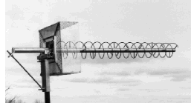

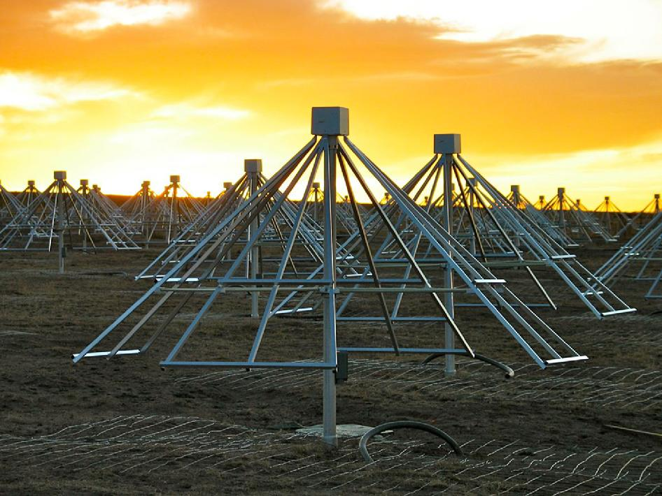
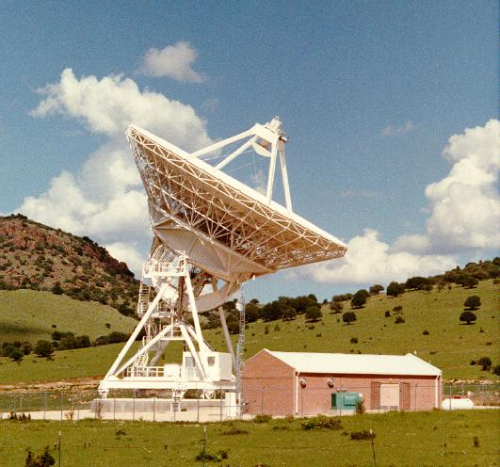
Antenna Types
Purpose of an antenna: capture radiation from an object and couple it to a receiver for detection, digitization, and analysis
Wire antennas
  Dipole, Yagi, Helix, or small arrays of each type
Reflector antennas
Hybrid antennas
  Wire reflectors
  Reflectors with dipole feeds
Notes:
300 MHz = 1m

Slide 6
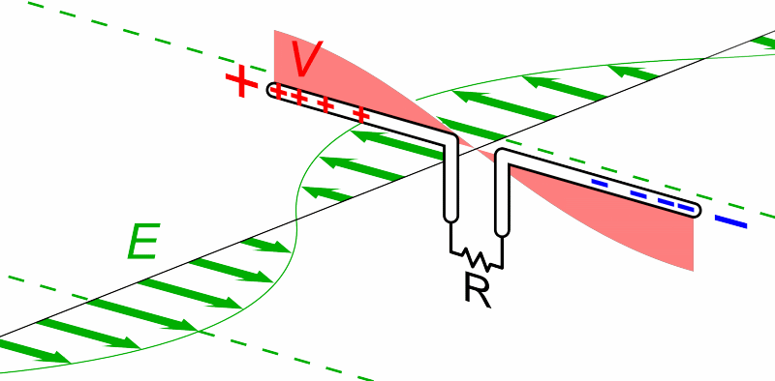
Dipole Antenna
Incoming EM wave ‘pushes’ electrons to each end.
Electrons build up on each end.
Current flow as the wave moves.
Sets up a standing voltage wave.
Receiver at center.
Credit chetvorno

Slide 7
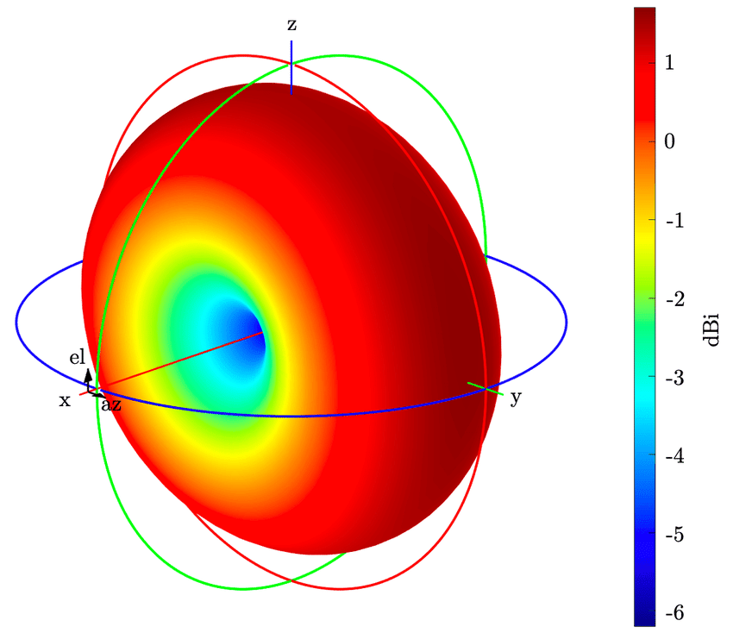
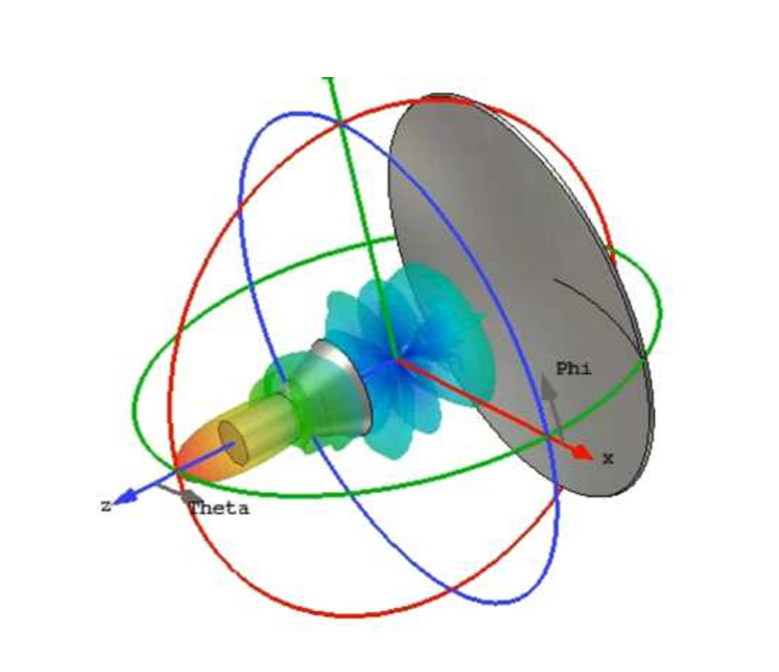
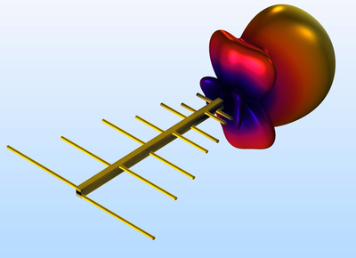
Beam Patterns
Half wave dipole
Yagi
Parabolic
Credit Timmons 2022
Credit COMSOL
Credit Phaebua 2021

Slide 8
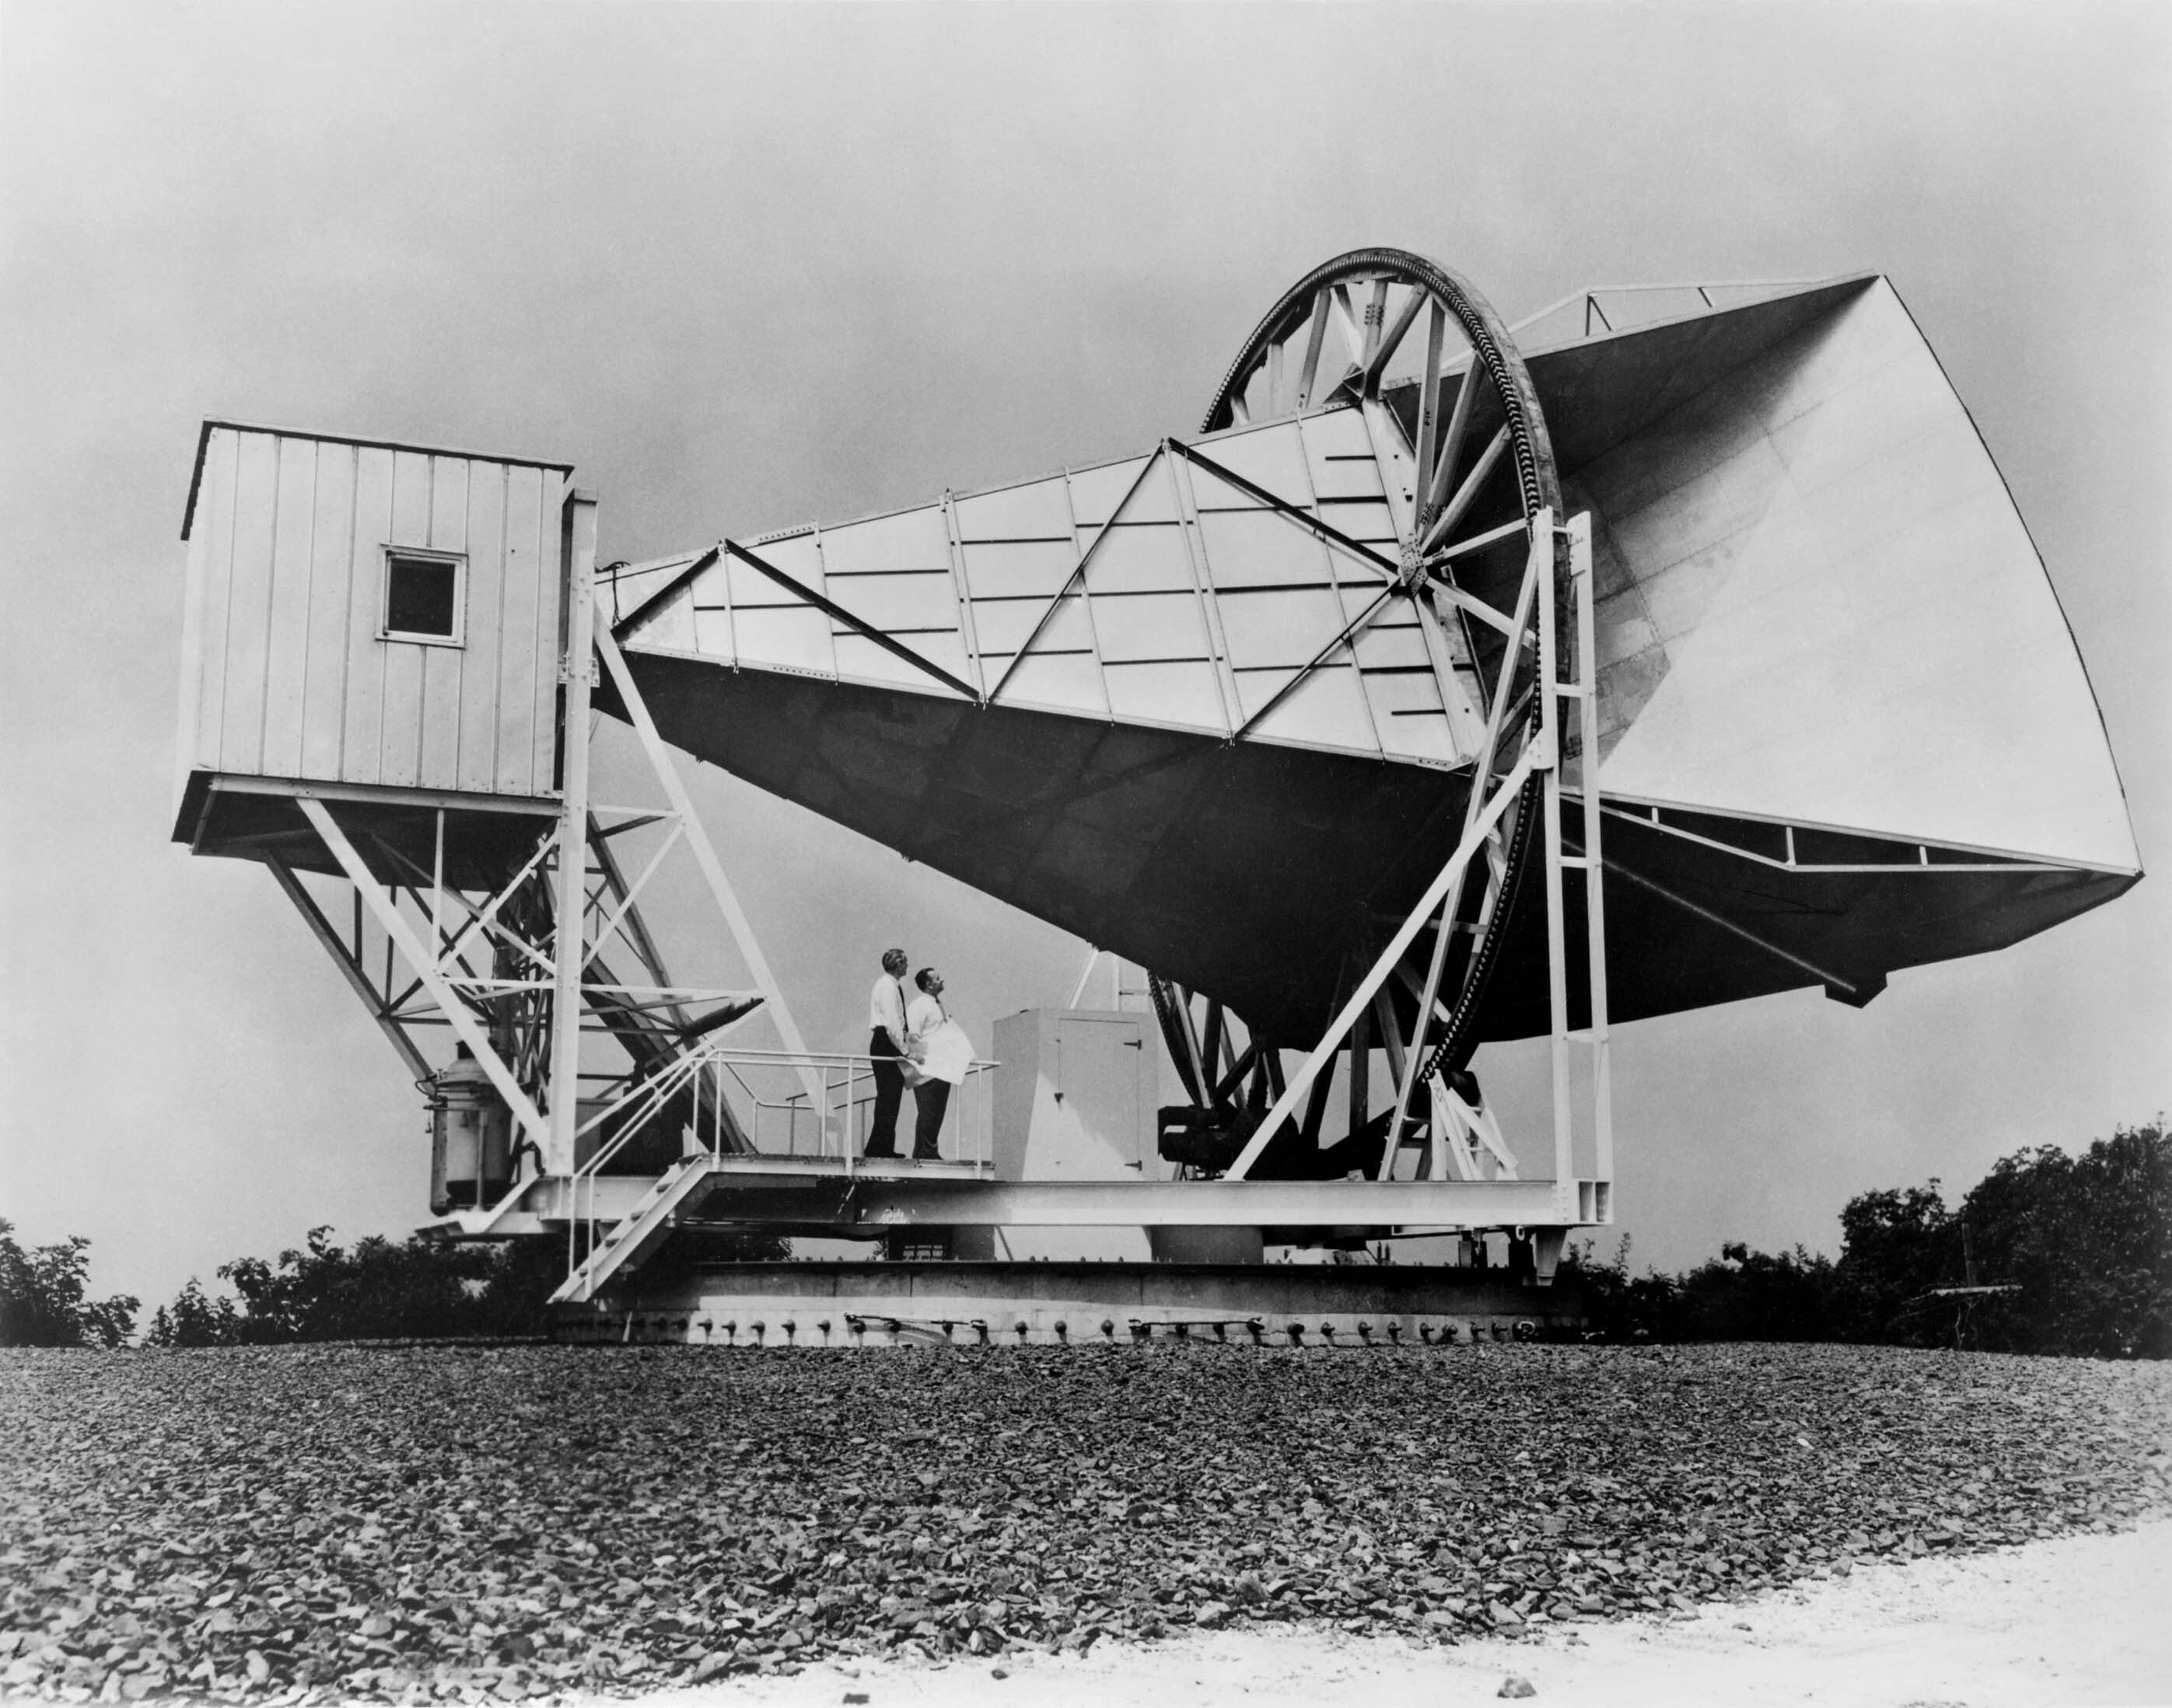
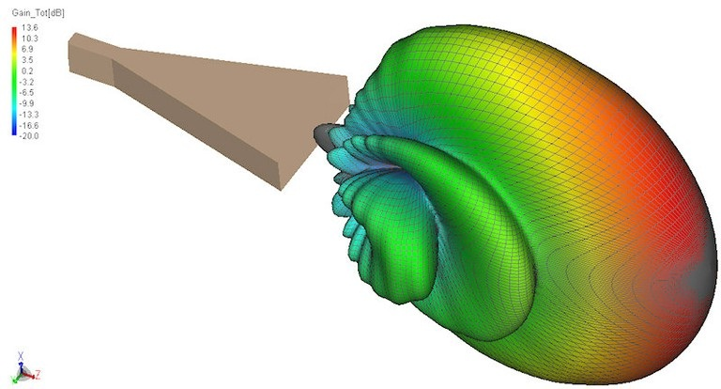
Horn Antenna
Used to detect CMB!
Still in use for RA today.
Easy to build
Provides illumination of the main dish/subreflector.

Slide 9
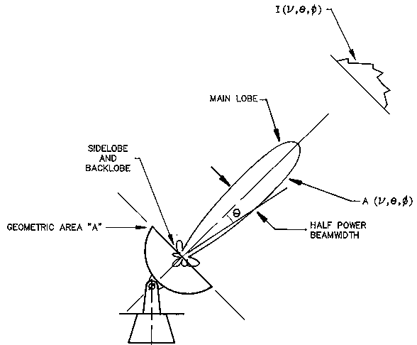
Terminology & Definitions - I
Effective collecting area, A(ν,θ,φ) m²
On-axis response, A₀ = ηA
= aperture efficiency
Normalized pattern (primary beam)
A(ν,θ,φ) = A(ν,θ,φ)/A₀
Beam solid angle (field of view)
Ω_{A}= ∫∫ A(ν,θ,φ) dΩ
^{all sky}
Notes:
Frequency and direction coordinates (spherical). Theta offset from boresight (polar), phi is azimuth around it.
Radiation power received over a given bandwidth and solid angle is given by … Intensity as a function of frequency and direction.
“antenna receiving/reception pattern” (power pattern)
“beam solid angle of the power pattern” integral over the full sky

Slide 10
Terminology & Definitions - II
A₀ Ω_{A} = λ² Effective area (gain) & solid angle (field of view)
  Can have large effective area or large solid angle, but not both at the same time
Antenna sidelobes and backlobes
  Increase system temperature due to ground pick up
  Make antenna susceptible to RFI
  Sidelobes can limit image dynamic range by detecting strong background sources
What determines the beam shape? …
Notes:
Wavelength squared goes as effective area times beam solid angle. Physically impossible.

Slide 11
Illumination-Beam Shape Comparisons
Antenna’s far-field radiation pattern (beam) is related to the Fourier transform of its aperture distribution (illumination pattern)
Credit: Hunter
θ_{3dB} = 1.02/D
First null = 1.22/D
D = diameter in wavelengths
Notes:
‘Illumination’ Engineering convention – transmit and receive analogy

Slide 12
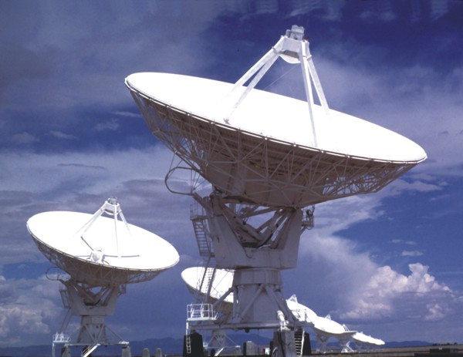
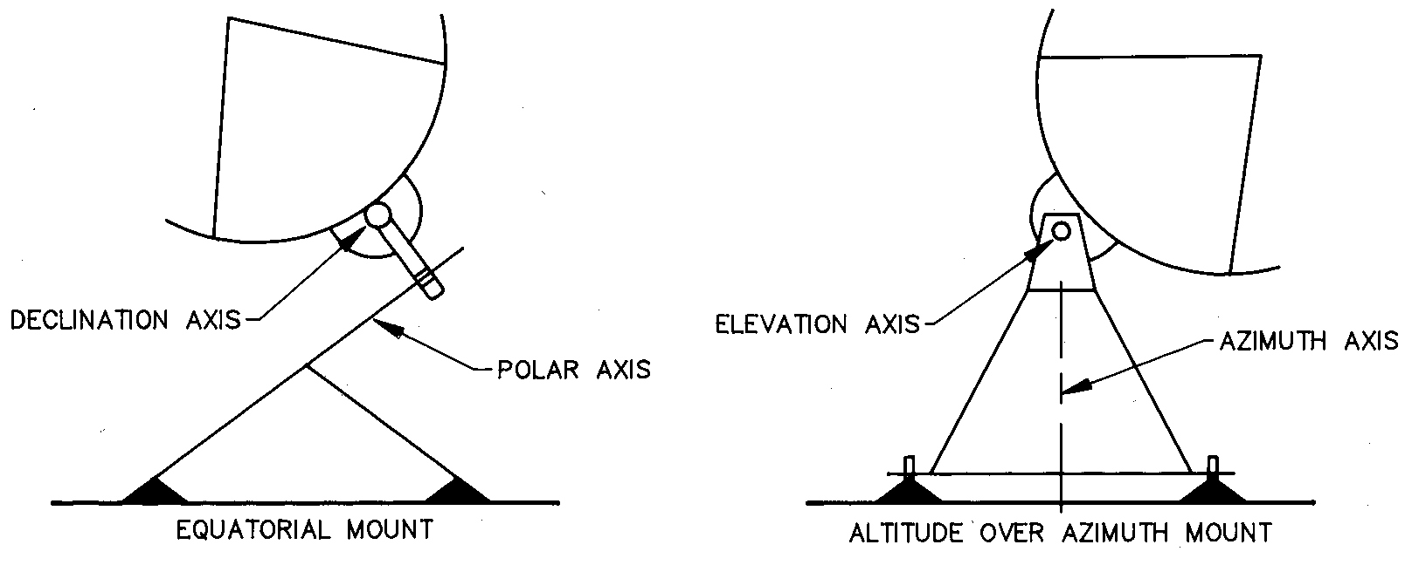
Antenna Mounts: Altitude over Azimuth
Advantages
  Cost
  Gravity performance
Disadvantages
  Zone of avoidance
  Beam rotates on sky
Notes:
Key enabler was two-axis servo control electronics.
180 deg spin or over-the-top example
Gravity – only elevation dependent.

Slide 13
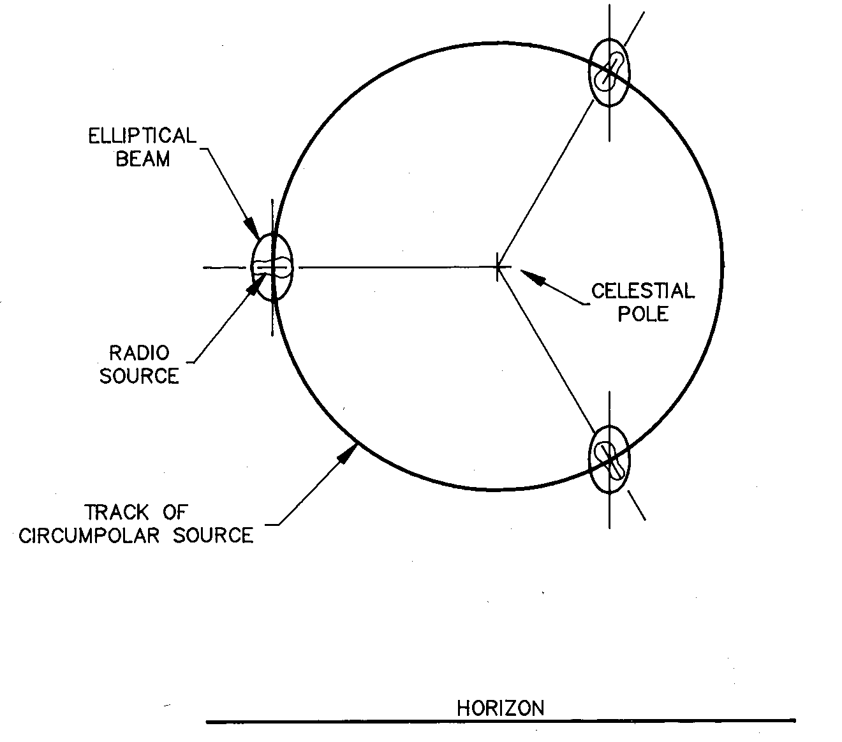
Alt-Az: Beam Rotation on the Sky
Parallactic angle
Notes:
Move counterclockwise in our reference frame
Response changes due to orientation in beam. Especially relevant for a polarized source.

Slide 14
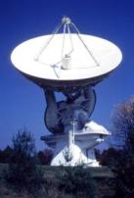
Antenna Mounts: Equatorial
Advantages
  Tracking accuracy
  Beam doesn’t rotate
Disadvantages
  Cost
  Gravity performance
  Sources on horizon at pole
Notes:
GB Specs? 140’ (43m)
Normal pointed at Polaris
Earth spins east, telescope spins west
1965

Slide 15
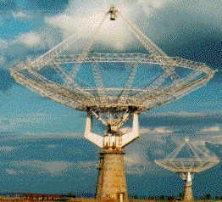
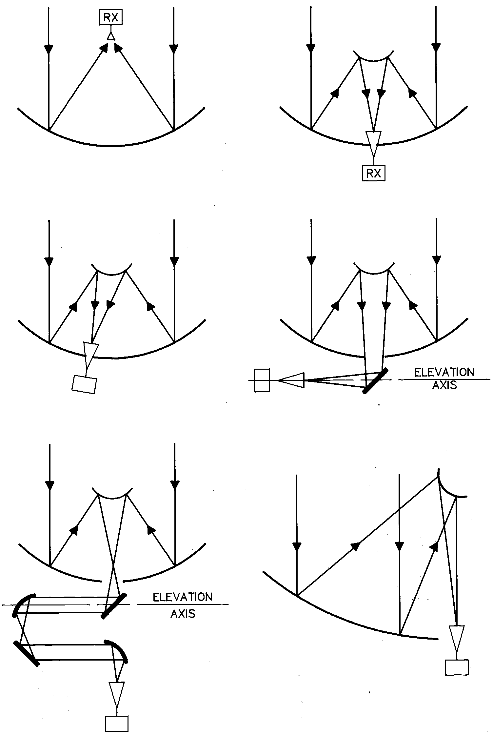
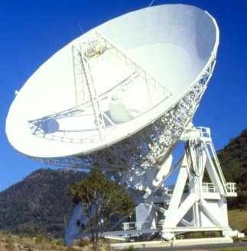
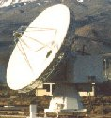
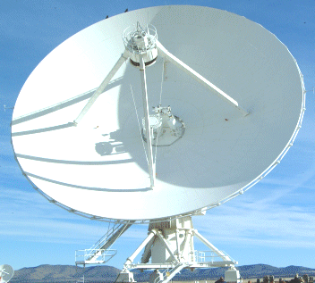
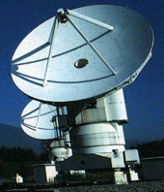
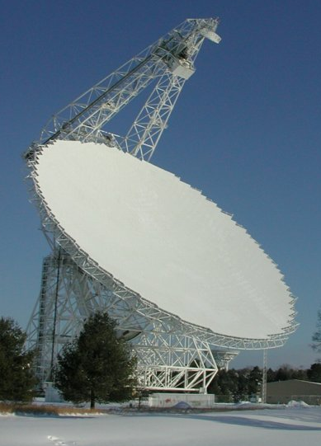
Antenna Optical Configurations
Prime Focus
Cassegrain
GMRT
ATCA
Offset Cassegrain
Naysmyth
VLA
VLBA
ALMA
CARMA
Beam Waveguide
Dual Offset
GBT
SKA
ngVLA
NRO
Notes:
ALMA? Offset Cass
Nobeyama
Australia telescope compact array

Slide 16
Optical Configurations, Pros & Cons - I
Prime Focus
  Can be used over entire frequency range of the reflector
  Over-illumination (spillover) can increase system temperature due to ground pick-up
  Number of receivers and access to them is limited
Multiple reflector Cassegrain systems
  More space, easier access to receivers, reduced ground pick-up
  Any spillover is on cold sky; better for low system noise
  Can limit low frequency capability. Feed horn too large
  Over-illumination by feed horn can exceed the gain of the primary reflector’s sidelobes
    Strong sources a few degrees from the antennas’ main bean may limit image dynamic range

Slide 17
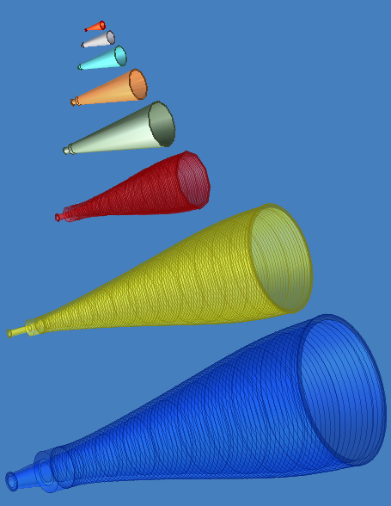
JVLA Feed Horns
Credit: Ruff & Hayward

Slide 18
Optical Configurations, Pros & Cons - I
Prime Focus
  Can be used over entire frequency range of the reflector
  Over-illumination (spillover) can increase system temperature due to ground pick-up
  Number of receivers and access to them is limited
Multiple reflector Cassegrain systems
  More space, easier access to receivers, reduced ground pick-up
  Any spillover is on cold sky; better for low system noise
  Can limit low frequency capability. Feed horn too large
  Over-illumination by feed horn can exceed the gain of the primary reflector’s sidelobes
    Strong sources a few degrees from the antennas’ main bean may limit image dynamic range

Slide 19
Optical Configurations, Pros & Cons - II
Offset optics (Gregorian or Cassegrain)
  Unblocked aperture:
    higher aperture efficiency, lower sidelobes, less scatter / lower system temperature
  Practical low-frequency feed designs.
  Support structure of offset geometry is more complex and expensive
  No rotational symmetry – more expensive panel tooling due to multiple panel sizes

Slide 20
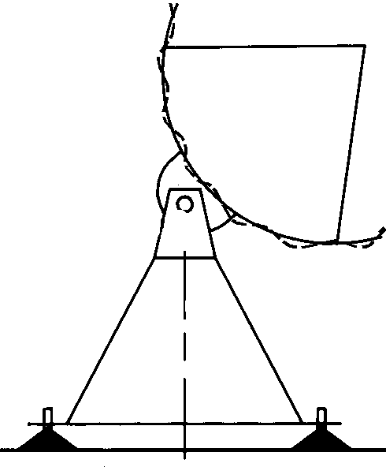
Aperture Efficiency
On axis response: A₀ = ηA, Efficiency: η = η_{sf} . η_{bl} . η_{s} . η_{t} . η_{misc}
η_{sf} = Reflector surface efficiency
Due to random imperfections in reflector surface
η_{sf} = exp(−(4πσ/λ)²) e.g., σ = λ/16 , η_{sf} = 0.5 (Ruze)
η_{bl} = Blockage efficiency. Caused by subreflector and its support structure
η_{s} = Feed spillover efficiency. Fraction of power radiated by feed intercepted by subreflector
η_{t} = Illumination taper efficiency. Outer parts of reflector illuminated at lower level than inner part
η_{misc}= Reflector diffraction, feed position phase errors, feed match and loss
rms error σ
Notes:
Check Ruze math.
1m, 300 MHz, 6 cm rms
1cm, 30 GHz, 600 um

Slide 21
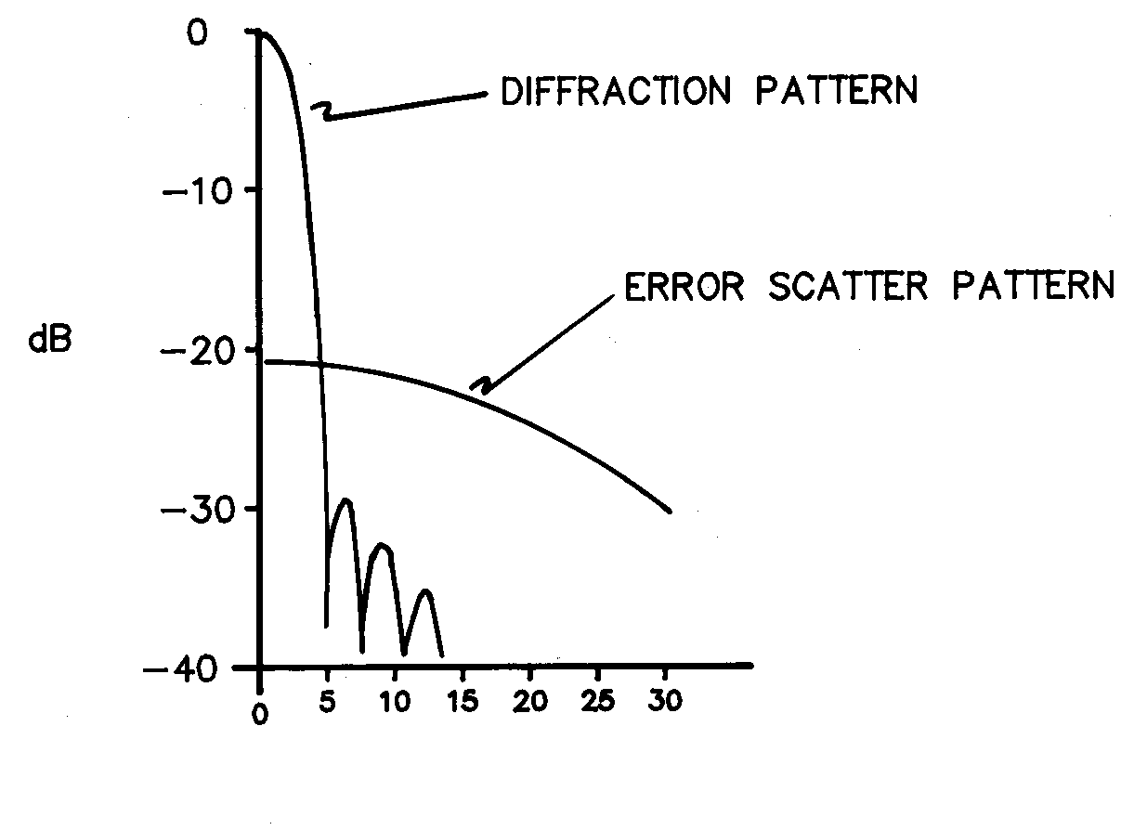
Surface Errors
Correlated surface errors can produce an error scatter pattern
  Pattern width determined by size-scale of correlations (e.g. panel size)
  Level could exceed that of sidelobes
ALMA surface panel
adjustment: phase map
Notes:
Mm – bands? (scale in um)

Slide 22
Antenna Gain - I
Antenna gain (on-axis response) varies with elevation, primarily due to the redistribution of gravitational forces within the antenna backup structure
credit: Hunter

Slide 23
Antenna Gain - II
Gravitational distortions and elevation-dependent gain can be compensated with an active surface
GBT active surface: 2004 surface panels, 2209 surface actuators
20 GHz
Credit: Prestage & Maddalena
Notes:
Richard, Ron.

Slide 24
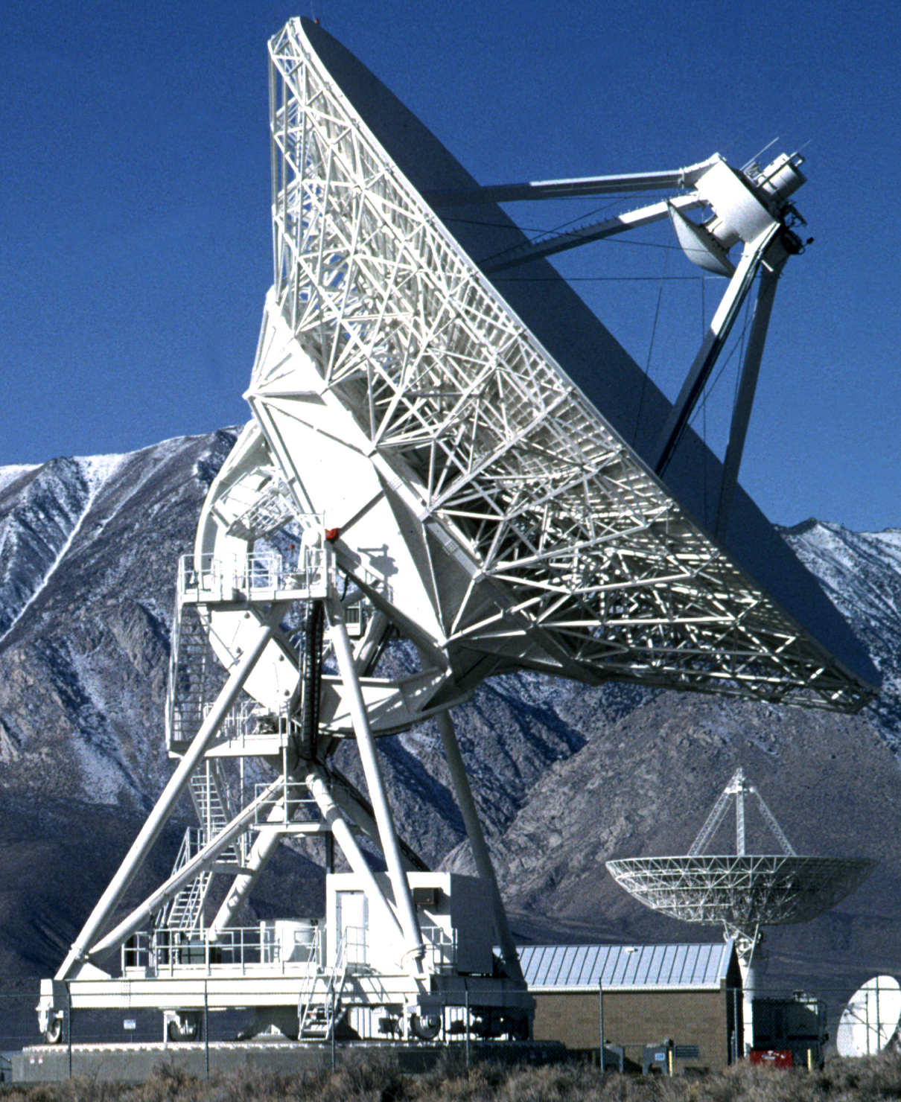
Antenna Pointing: Practical Considerations
Subreflector mount
Reflector structure
Quadrupod
El encoder
Alidade structure
Rail flatness
Foundation
Az encoder

Slide 25
Antenna Pointing
“Blind” pointing: ALMA - 2”; VLA - 20”; VLBA – 15”
Pointing performance can be improved by measuring pointing errors via frequent observations of a nearby calibration source
  Offset or reference pointing: ALMA – 0.6”; VLA -10”;VLBA-5”
Desired accuracy: Δθ < θ_{3dB} /20
Large intensity variations at
beam edge with Δθ < θ_{3dB} /10
credit: Hunter

Slide 26
Antenna Polarization Properties
Instrumental polarization can:
  cause an unpolarized source to appear polarized
  alter the apparent polarization of a polarized source
Two components of instrumental polarization
  constant or variable across the beam
Sources of instrumental polarization
  Antenna structure:
    Symmetry of the optics
    Reflections in the optics
    Curvature of the reflectors
  Circularity of feed radiation patterns
  Quality of FE polarization separation (constant across the beam)

Slide 27
Polarization Beam Patterns
ALMA Band 3 (100GHz)
Credit: Hunter
Co-polarization pattern
Cross-polarization pattern

Slide 28
Front End Polarization Separation - I
Dual-polarization receivers needed for best sensitivity and polarization observations
Two types of devices in use: OMT and wire grid
Waveguide-type Orthomode Transducer (OMT)
  After the feed horn; longer wavelength
(Gonzalez and Shinichiro, NAOJ)
ALMA Band 3 OMT
ALMA Band 2+3 OMT (inside)
VLA S-band OMT
Notes:
Modified Boifot double-ridged waveguide junction; septum

Slide 29
Front End Polarization Separation - II
Quasi-optical: Wire Grid
  Before the feed horn; shorter wavelength
  Grid reflects one polarization, passes the other
Credit: Hunter

Slide 30
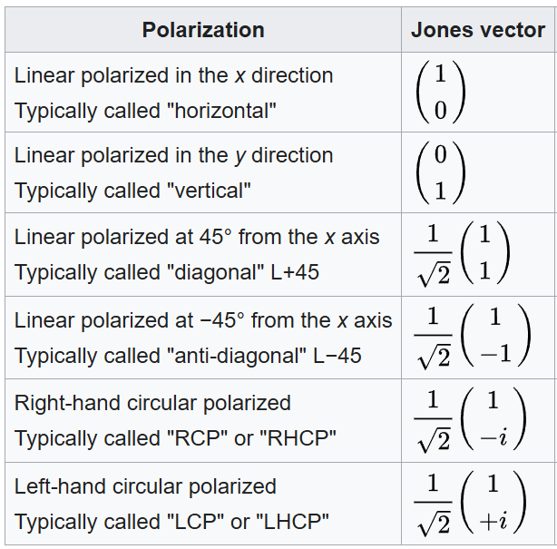
Jones Calculus
Jones vector describes fully polarized light in an easy way
Allows for Jones Matrixes to do e.g. rotations.
Partially polarizes light requires Mueller calculus.
Stokes Parameters.

Slide 31
Receivers: Noise Temperature
Reference the received power to the equivalent temperature of a matched load at the input to the receiver
Rayleigh-Jeans approximation to Planck radiation law for a blackbody
P_{in} = k_{B}T Δν (W)
k_{B} = Boltzman’s constant (1.38*10⁻²³ J/ºK)
When observing a radio source, T_{total} = T_{A} + T_{sys}
  Tsys = system noise when not looking at a discrete radio source
  T_{A} = source antenna temperature

Slide 32
Receivers: SEFD
EVLA Antenna Sensitivities
T_{sys} = T_{receiver} + T_{ground} + T_{sky}
T_{sky} = T_{atm}×(1 − e^{−t sin(elv)}) + T_{CMB} + T_{RB}
T_{A} = ηAS/(2k_{B}) = KS
S = source flux (Jy)
SEFD = system equivalent flux density
SEFD = Tsys/K (Jy)
Band (GHz) | η | T_{sys} | SEFD
1-2 | .50 | 21 | 236
2-4 | .62 | 27 | 245
4-8 | .60 | 28 | 262
8-12 | .56 | 31 | 311
12-18 | .54 | 37 | 385
18-26 | .51 | 55 | 606
26-40 | .39 | 58 | 836
40-50 | .34 | 78 | 1290
Notes:
SEFD – source flux that would be needed to double system temperature
k_b – J/K (watt*sec)
k_b - W/Hz/K
Jy = 10^(-26) w/m^2/Hz
K_b = 1.38e3 Jy*m^2/K

Slide 33
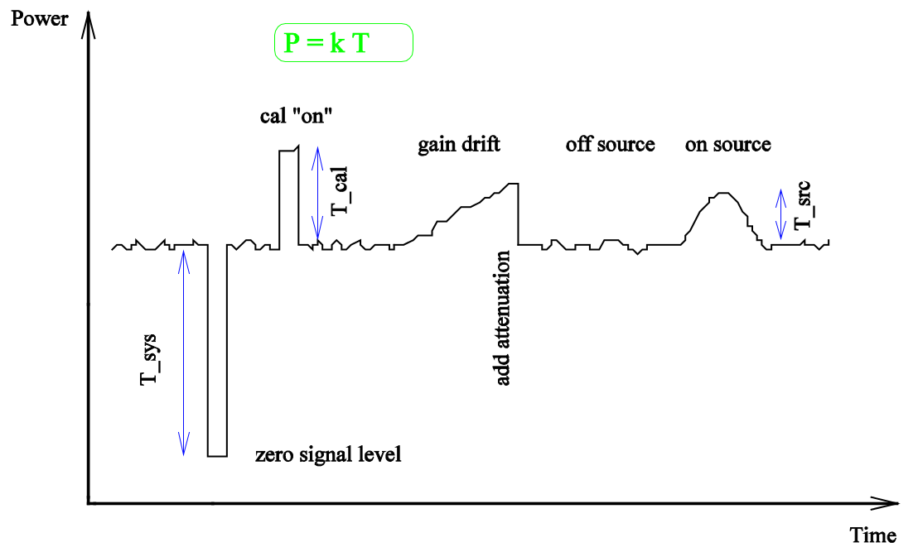
Receivers: Noise Temperature

Slide 34
Receivers: SEFD
EVLA Antenna Sensitivities
Tsys = T_{receiver} + T_{ground} + T_{sky}
T_{A} = ηAS/(2k_{B}) = KS
S = source flux (Jy)
SEFD = system equivalent flux density
SEFD = Tsys/K (Jy)
Band (GHz) | η | T_{sys} | SEFD
1-2 | .50 | 21 | 236
2-4 | .62 | 27 | 245
4-8 | .60 | 28 | 262
8-12 | .56 | 31 | 311
12-18 | .54 | 37 | 385
18-26 | .51 | 55 | 606
26-40 | .39 | 58 | 836
40-50 | .34 | 78 | 1290
Notes:
SEFD – source flux that would be needed to double system temperature
k_b – J/K (watt*sec)
k_b - W/Hz/K
Jy = 10^(-26) w/m^2/Hz
K_b = 1.38e3 Jy*m^2/K

Slide 35
JVLA Receivers – RF Sections
Credit: Harden & Hayward

Slide 36
JVLA Receiver Performance
Credit: Hayward

Slide 37
ALMA Receivers
Receivers are dual linear polarization
credit: Hunter

Slide 38
ALMA Front End Cryostat

Slide 39
Closing Thoughts
Antenna amplitude/phase pattern causes amplitude/phase to vary across the source.
Polarization properties of the antenna can modify the apparent polarization of the source.
Antenna pointing errors can cause time varying amplitude and phase errors.
Deformations of the antenna surface can cause amplitude and phase errors, especially at short wavelengths.
Even state-of-the-art receivers add thermal noise that is often larger than the source signal.
Receiver gain and noise can fluctuate with time and physical temperature.
However, knowledge of the system and its behaviors enables you to compensate/correct many of these effects through Calibration.
Notes:
Jy = 10^(-26) w/m^2/Hz

Slide 40
Additional Information
General: Synthesis Imaging in Radio Astronomy II: ed. Taylor, Carilli, & Perley
  https://leo.phys.unm.edu/~gbtaylor/astr423/s98book.pdf
ALMA antennas and receivers: ALMA Technical Handbook
  https://almascience.nrao.edu/proposing/technical-handbook
EVLA receivers:
  http://www.aoc.nrao.edu/evla/admin/projbook/chap5.pdf
ngVLA Antennas & Receivers:
  https://ngvla.nrao.edu/page/projdoc

