Slide 1
Solar System Objects
Bryan Butler
National Radio Astronomy Observatory

Slide 2
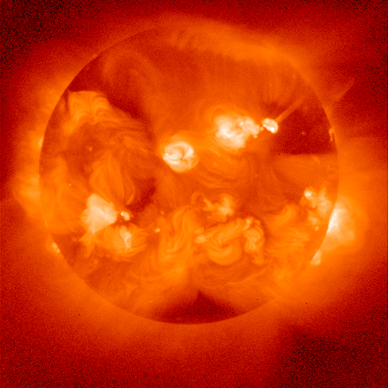
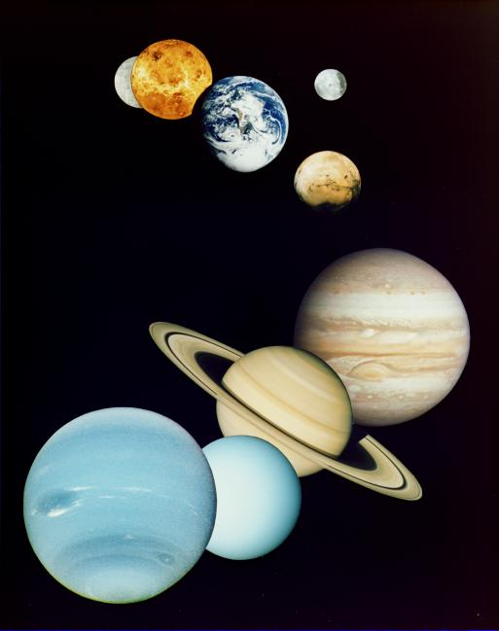
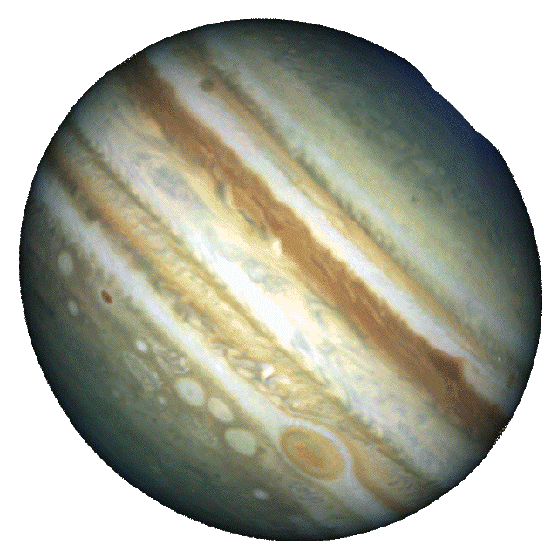
Solar System Bodies
Sun
IPM
Giant planets
Terrestrial planets
Moons
Small bodies

Slide 3
Why Interferometry?
resolution, resolution, resolution!
maximum angular extent of some bodies:
Sun & Moon - 0.5º Venus – 60”
Jupiter – 50”
Mars – 25”
Saturn – 20”
Mercury – 12”
Uranus – 4”
Neptune - 2.4”
Galilean Satellites - 1-2”
Titan – 1”
Triton - 0.1”
Pluto - 0.1”
MBA - .05 - .5”
NEA, KBO - 0.005 - 0.05”
(interferometry also helps with confusion!)

Slide 4
Solar System Oddities
Radio interferometric observations of solar system bodies are similar in many ways to other observations, including the data collection, calibration, reduction, etc…
So why am I here talking to you? In fact, there are some differences which are significant (and serve to illustrate some fundamentals of interferometry).

Slide 5
Differences
Object motion
Time variability
Confusion
Scheduling complexities
Source strength
Coherence
Source distance
Knowledge of source
Optical depth

Slide 6
Object Motion
All solar system bodies move against the (relatively fixed) background sources on the celestial sphere. This motion has two components:
“Horizontal Parallax” - caused by rotation of
the observatory around the Earth.
“Orbital Motions” - caused by motion of the
Earth and the observed body around the Sun.

Slide 7
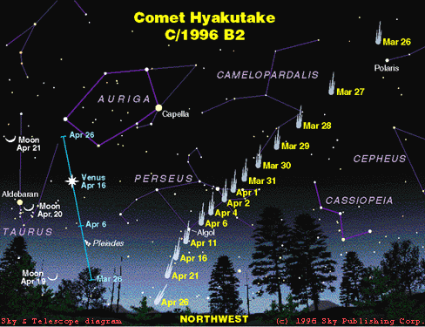
Object Motion - an example

Slide 8
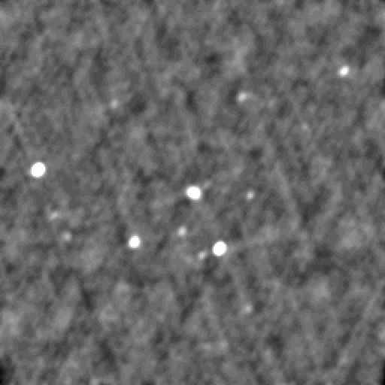
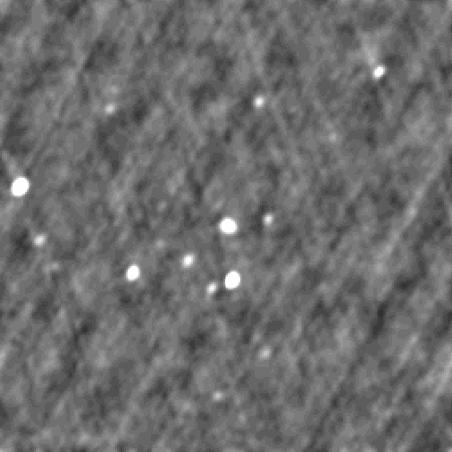
Object Motion - a practical example
1998 September 19
1998 September 20
2.1º
Jupiter
4C-04.89 4C-04.88
de Pater & Butler 2003

Slide 9
Time Variability
Time variability is a significant problem in solar system observations:
Sun - very fast fluctuations (< 1 sec)
Jupiter, Venus (others?) – lightning (< 1 sec)
Others - rotation (hours to days), plus other intrinsic
variability (clouds, seasons, etc.)
Distance may change appreciably (need “common”
distance measurements)
These must be dealt with.

Slide 10
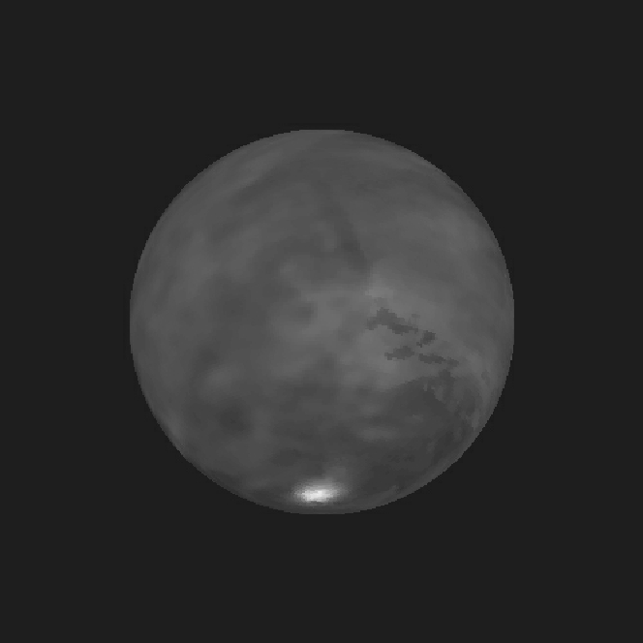
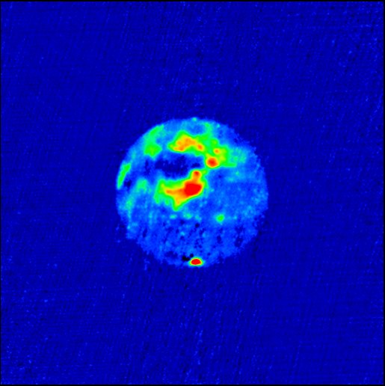
Time Variability - an example
Mars radar
snapshots made
every 10 mins
Butler, Muhleman &
Slade 1994

Slide 11
Implications
Often can’t use same calibrators
Often can’t easily add together data from different days
Solar confusion
Other confusion sources move in the beam
Antenna and phase center pointing must be tracked (must have accurate ephemeris)
Scheduling/planning - need a good match of source apparent size and interferometer spacings

Slide 12
Source Strength
Some solar system bodies are very bright. They can be so bright that they raise the antenna temperature:
- Sun ~ 6000 K (or brighter)
- Moon ~ 200 K
- Venus, Jupiter ~ 1-100s of K
In the case of the Sun, special hardware may be required. In other cases, special processing may be needed (e.g., Van Vleck correction). In all cases, the system temperature (the noise) is increased.

Slide 13
Coherence
Some types of emission from the Sun are coherent. In addition, reflection from planetary bodies in radar experiments is coherent (over at least part of the image). This complicates greatly the interpretation of images made of these phenomena, and in fact violates one of the fundamental assumptions in radio interferometry.

Slide 14
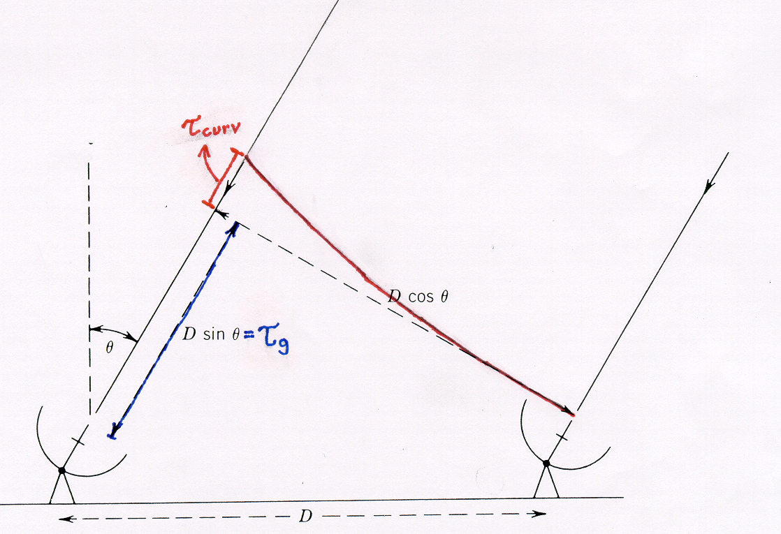
Source Distance - Wave Curvature
Objects which are very close to the Earth may be in the near-field of the interferometer. In this case, there is the additional complexity that the received radiation cannot be assumed to be a plane wave. Because of this, an additional phase term in the relationship between the visibility and sky brightness - due to the curvature of the incoming wave - becomes significant. This phase term must be accounted for at some stage in the analysis.

Slide 15
Short Spacing Problem
As with other large, bright objects, there is usually a serious short spacing problem when observing the planets. This can produce a large negative “bowl” in images if care is not taken. This can usually be avoided with careful planning, and the use of appropriate models during imaging and deconvolution.

Slide 16
Source Knowledge
There is an advantage in most solar system observations - we have a very good idea of what the general source characteristics are, including general expected flux densities and extent of emission. This can be used to great advantage in the imaging, deconvolution, and self-calibration stages of data reduction.

Slide 17
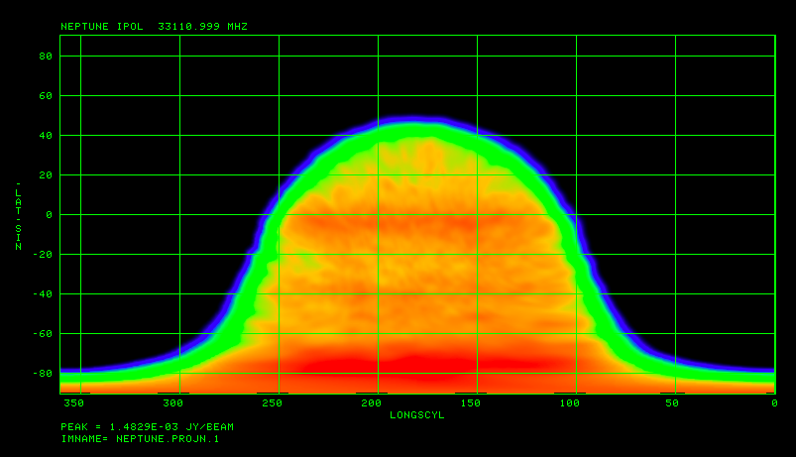
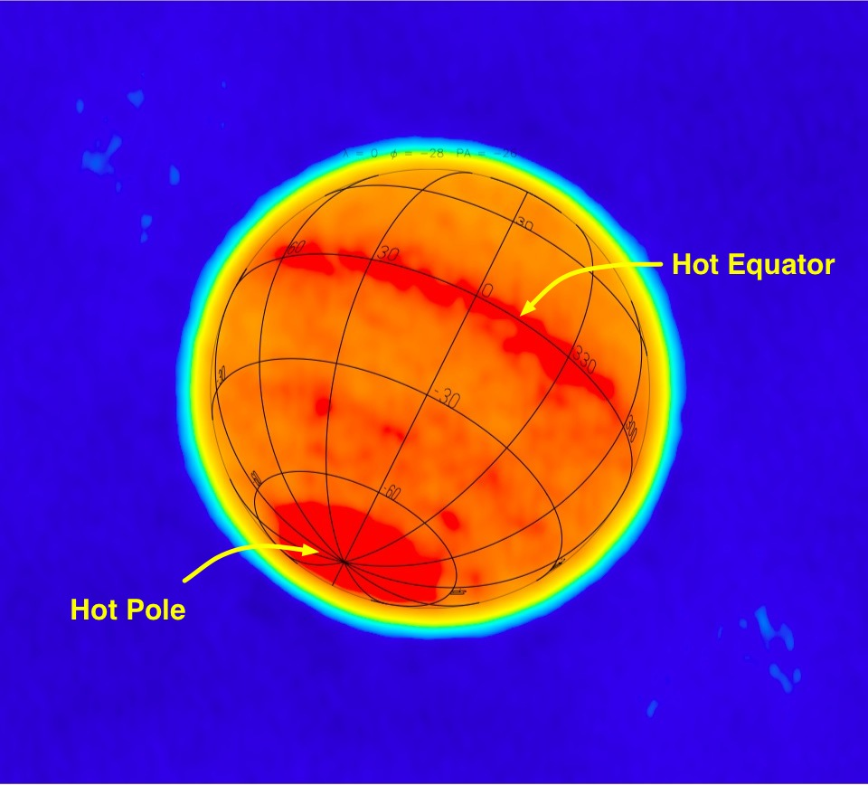
Conversion of Coordinates
If we know the observed object’s geometry well enough, then sky coordinates can be turned into planetographic surface coordinates - which is what we want for comparison, e.g., to optical images.

Slide 18
Correcting for Rotation
If a planet rotates rapidly, we can either just live with the “smearing” in the final image (but note also that this violates our assumption about sources not varying), or try to make snapshots and use them separately (difficult in most cases because SNR is low). There are now two techniques to try to solve this problem; one for optically thin targets like Jupiter synchrotron radiation (Sault et al. 1997; Leblanc et al. 1997; de Pater & Sault 1998), one for optically thick targets (described in Sault et al. 2004). This is possible because we know the viewing geometry and planetary cartographic systems precisely.

Slide 19
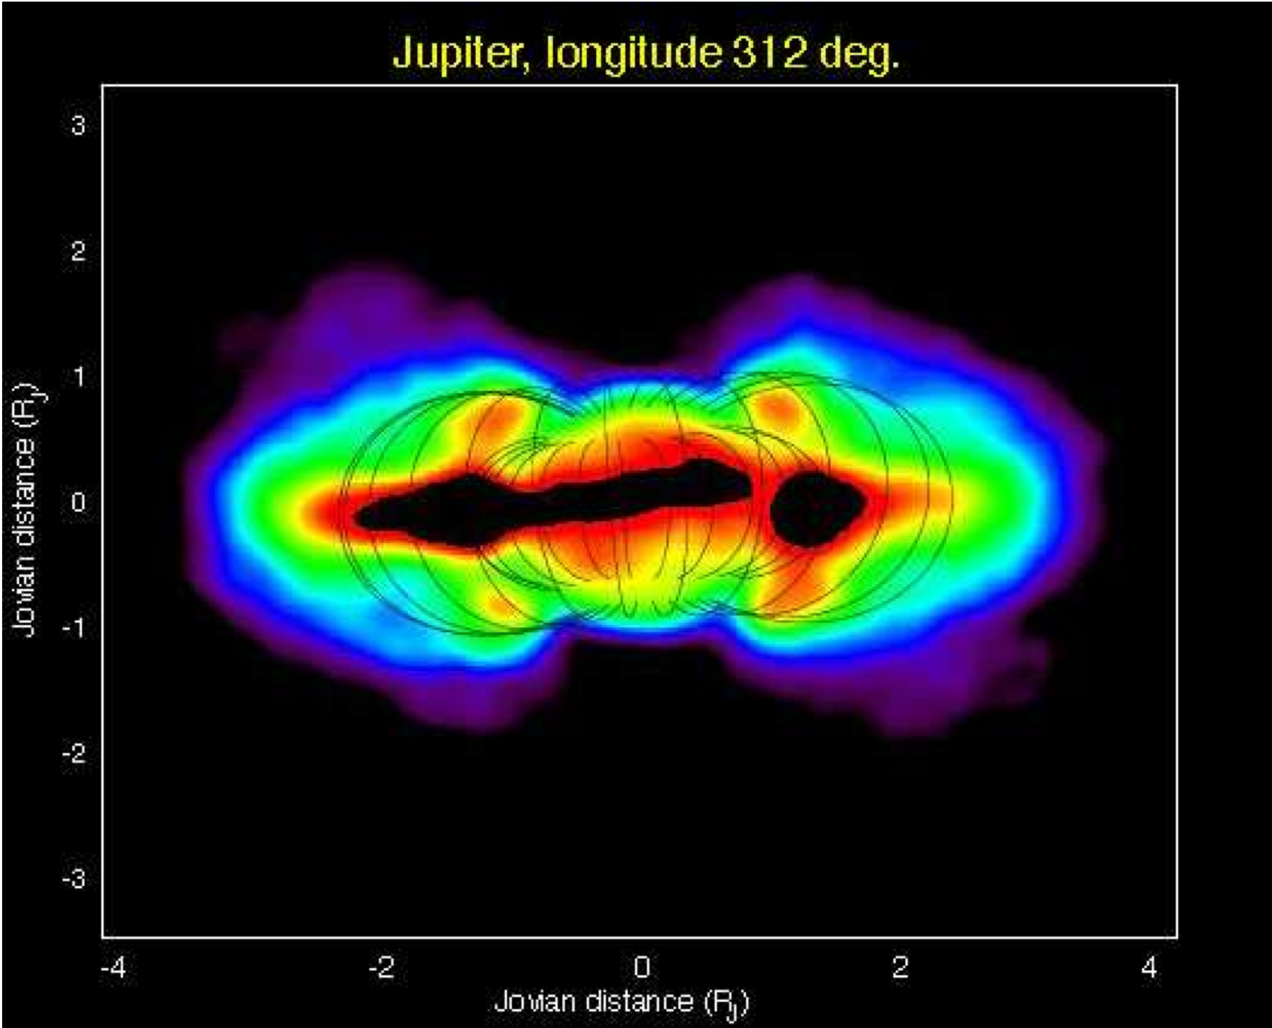
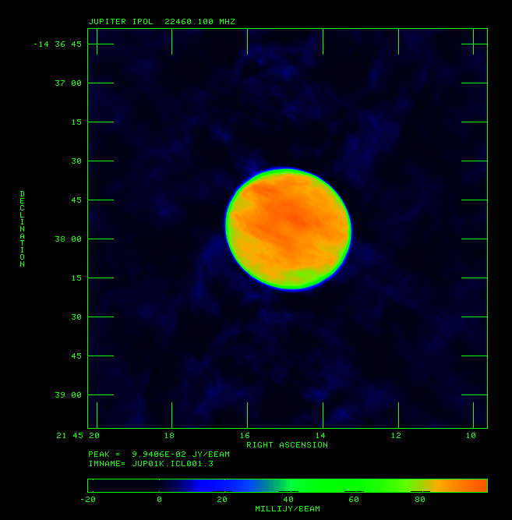
Correcting for Rotation - Jupiter
Jupiter at 20 cm (de Pater et al. 1997) and 1.3 cm (Butler et al. 2009) averaged over full track (period is ~10h):

Slide 20
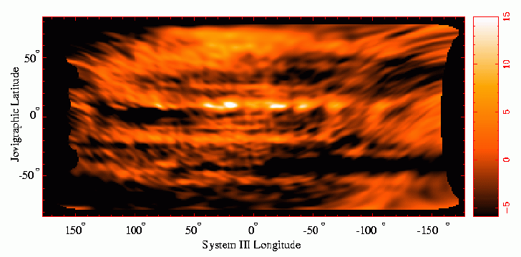
Correcting for Rotation - Jupiter
Jupiter at 2cm from several tracks - Sault et al. 2004:

Slide 21
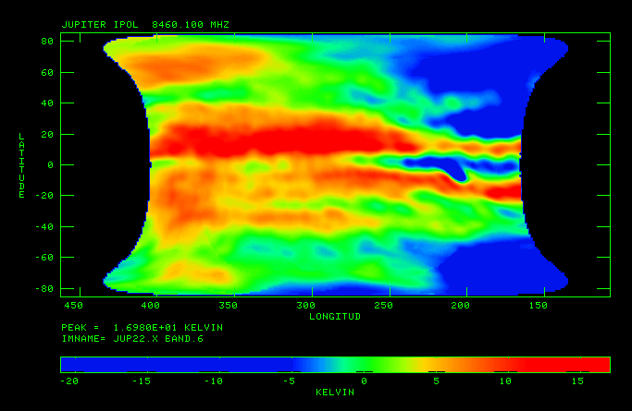
Correcting for Rotation - Jupiter
Jupiter at 3.5cm from four tracks - Butler et al. 2009 (looking for the signature of the impact into Jupiter in summer 2009):

Slide 22
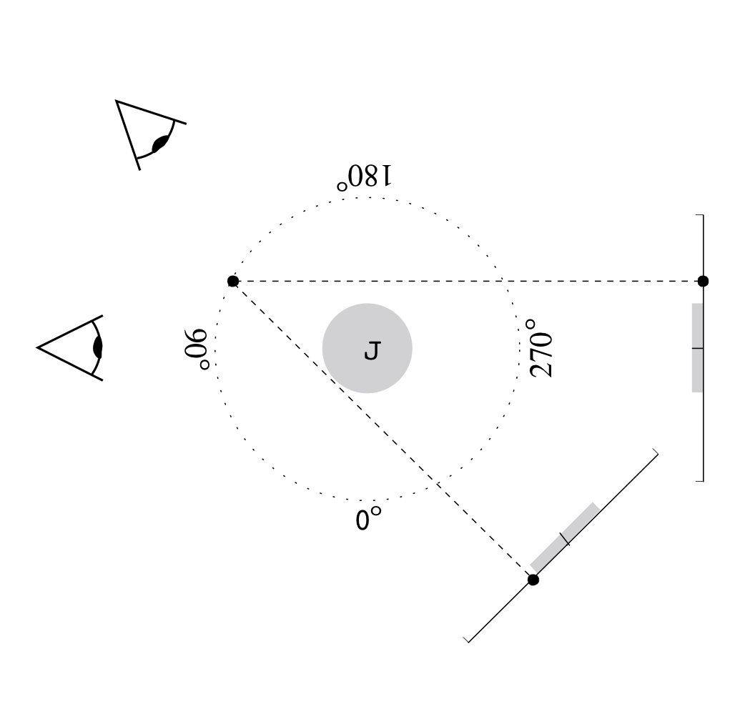
Correcting for Rotation - Jupiter
If the emission mechanism is optically thin (this is only the case for the synchrotron emission), then we can make a full 3-D reconstruction of the emission:

Slide 23
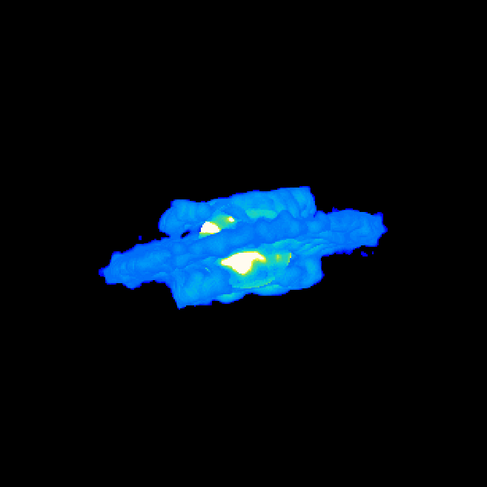
Correcting for Rotation - Jupiter

Slide 24
Lack of Source Knowledge
If the true source position is not where the phase center of the instrument was pointed, then a phase error is induced in the visibilities.
If you don’t think that you knew the positions beforehand, then the phases can be “fixed”. If you think you knew the positions beforehand, then the phases may be used to derive an offset.

Slide 25
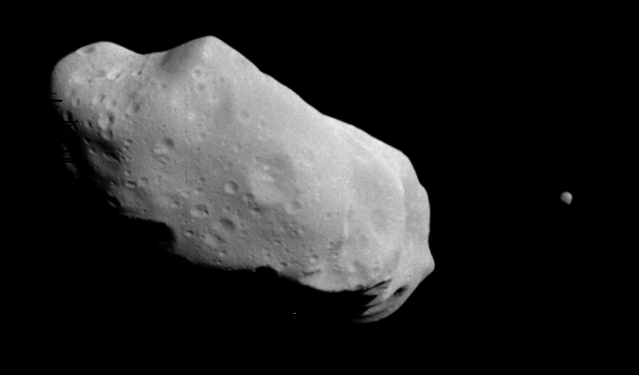
Real Data - what to expect
But…
They’re all round!

Slide 26
Real Data - what to expect
If the sky brightness is circularly symmetric, then the 2-D Fourier relationship between sky brightness and visibility reduces to a 1-D Hankel transform:
For a “uniform disk” of total flux density F, this reduces to:
and for a “limb-darkened disk” (of a particular form), this reduces to:

Slide 27
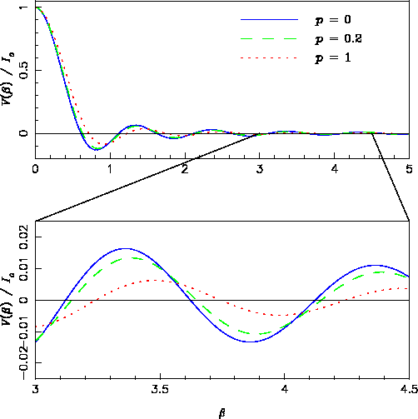
Real Data - what to expect
Theoretical visibility functions for a circularly symmetric “uniform disk” and 2 limb-darkened disks.

Slide 28
Real Data - polarization
For emission from solid surfaces on planetary bodies, the relationship between sky brightness and polarized visibility becomes (again assuming circular symmetry) a different Hankel transform (order 2):
this cannot be solved analytically. Note that roughness of the surface is a confusion (it modifies the effective Fresnel reflectivities). For circular measured polarization, this visibility is formed via:

Slide 29
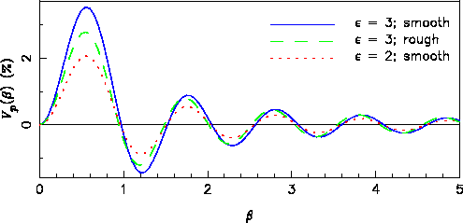
Real Data - polarization
Examples of expected polarization response:

Slide 30
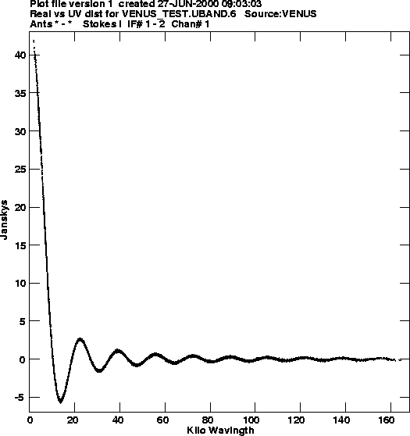
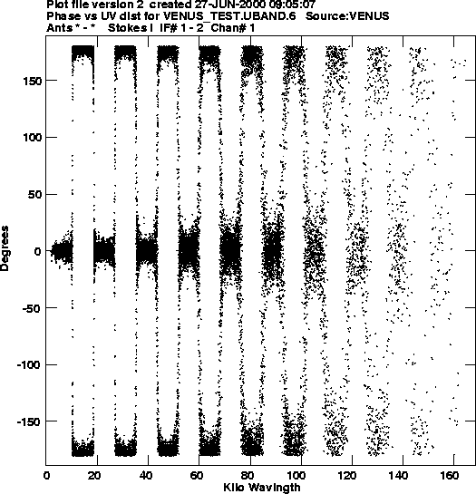
Real Data - measured
Visibility data for an experiment observing Venus at 0.674 AU distance in the VLA C configuration at 15 GHz:

Slide 31
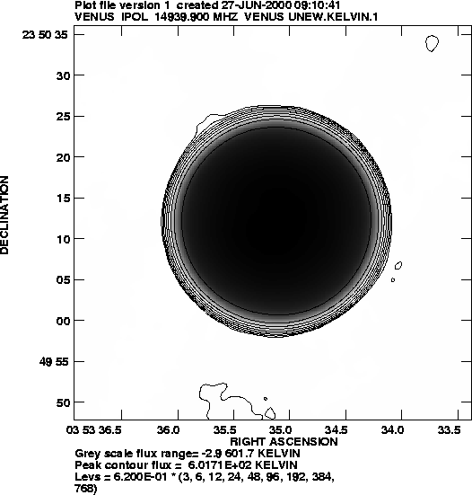
Real Data - an example
The resultant image:

Slide 32
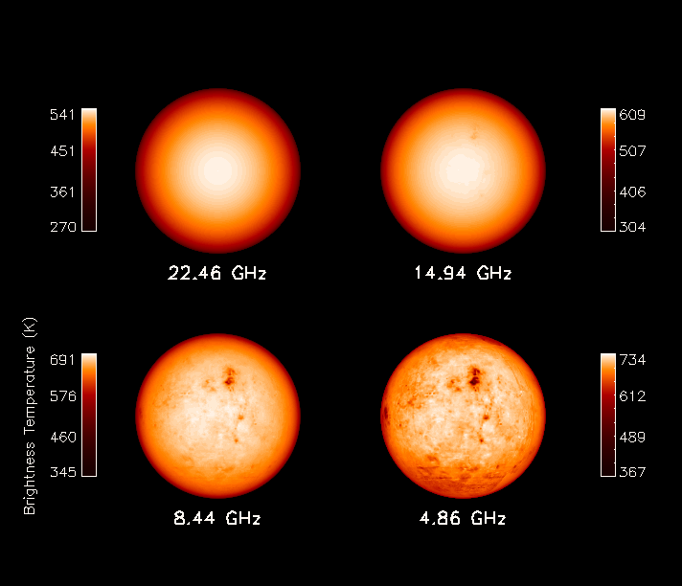
Real Data - an example
Venus models at C, X, Ku, and K-bands:

Slide 33
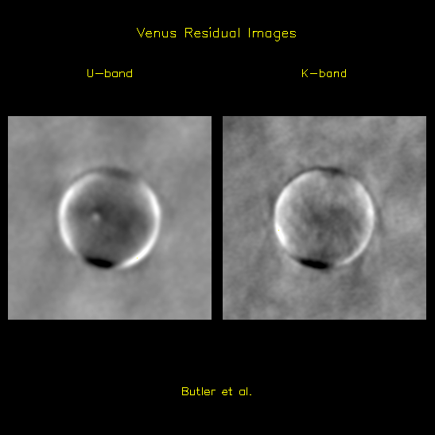
Real Data - an example
Venus residual images at U- and K-bands:

Slide 34
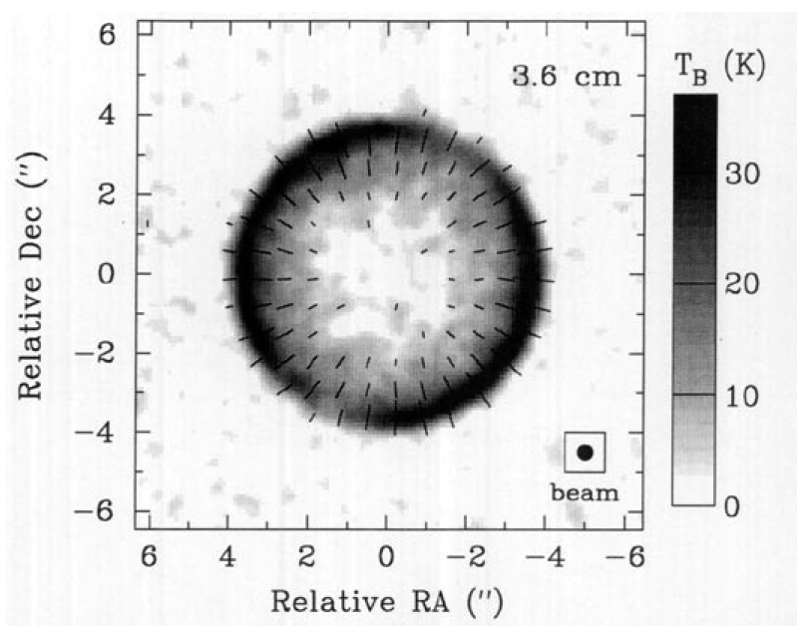
Real Data - a polarization example
Mitchell & de Pater (1994) observations of Mercury showing the polarization pattern on the sky:

