Slide 1
Radio Telescopes Around the World
Lincoln Greenhill

Slide 2
Radio Telescopes Around the World
What drives location?
  m/cm-wave
    RF quiet conditions
      e.g., the AU SKA site: 600 km into the WA desert
  mm/submm
    dry conditions
      Atacama, Greenland, Antarctica, Mauna Kea
      baloons, space
    absent tropospheric O₂ line
  VLBI
    geographic distribution (diversity a/o filling)
    super-terrestrial baselines

Slide 3
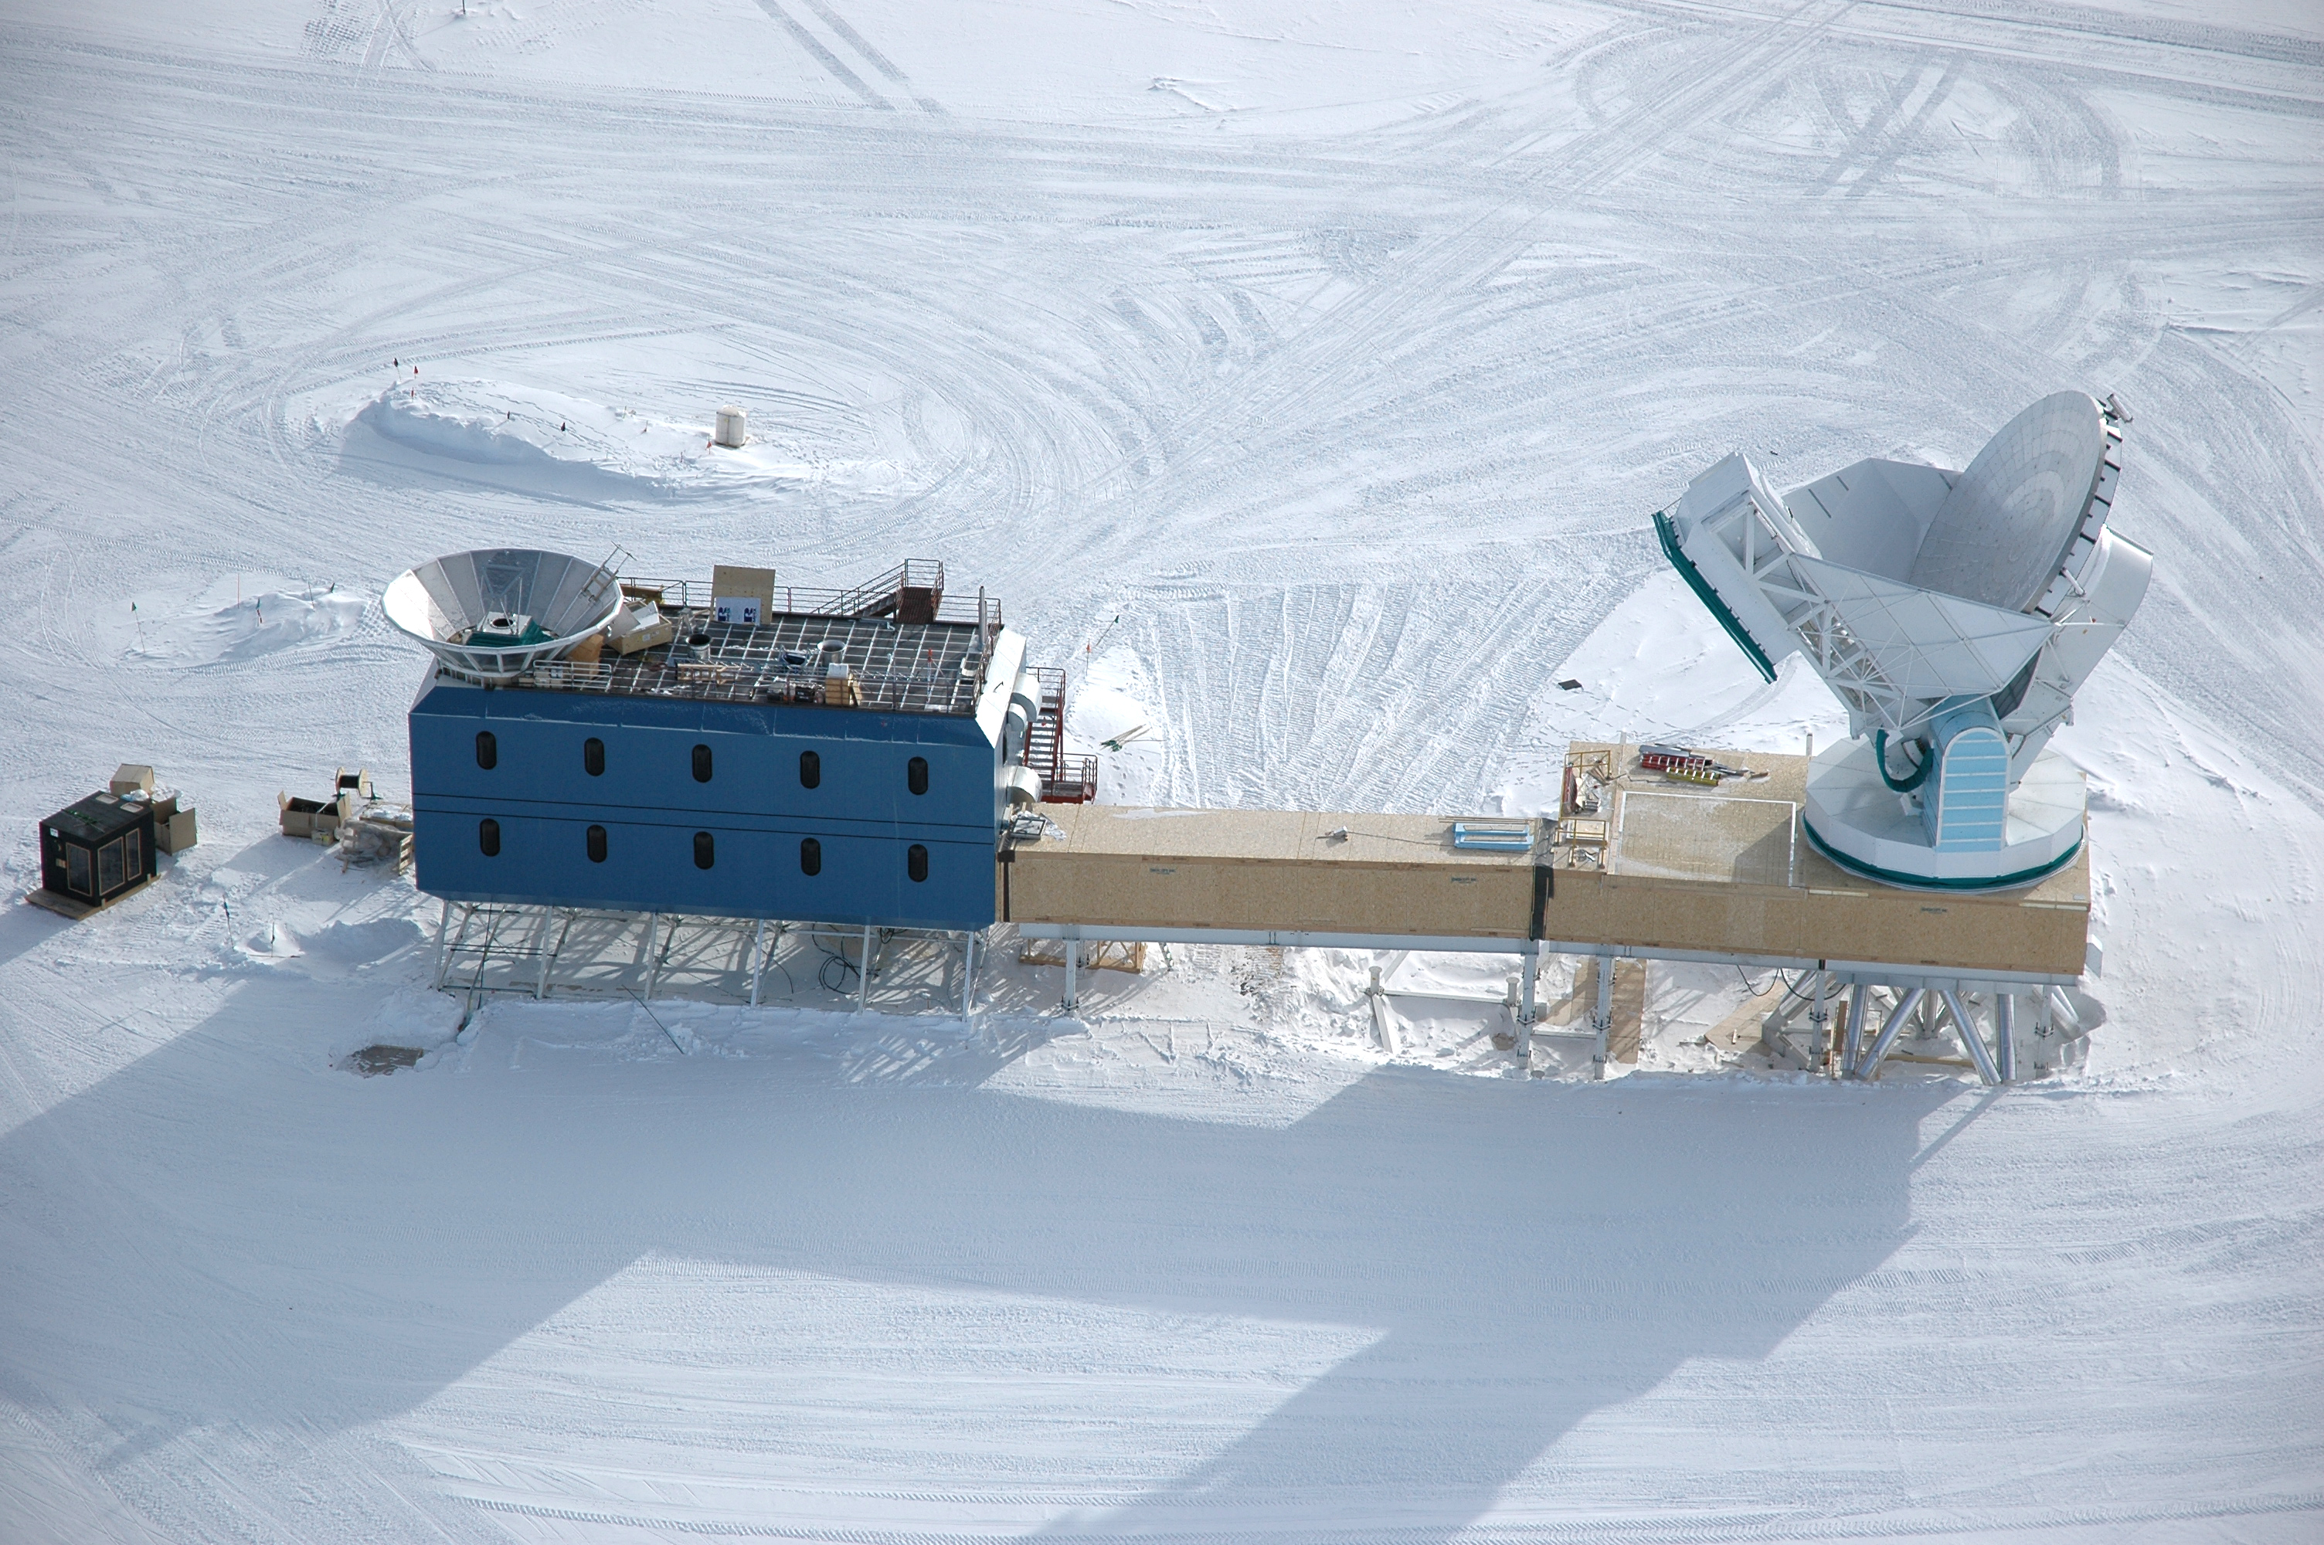
Radio Telescopes Around the World
CMB polarization
Kinetic SZ effect
South Pole Station

Slide 4
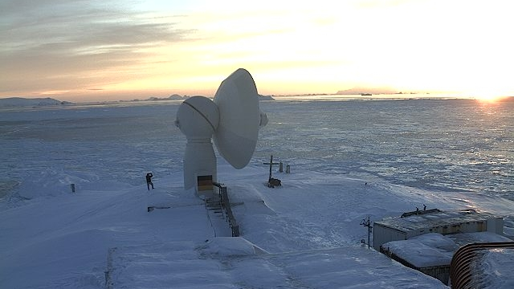
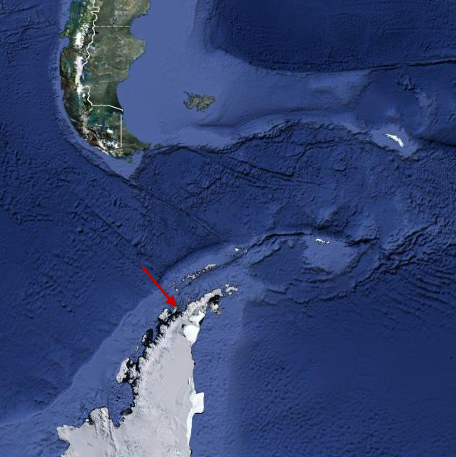
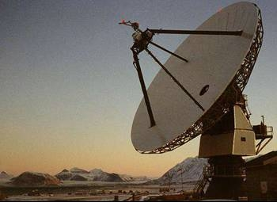
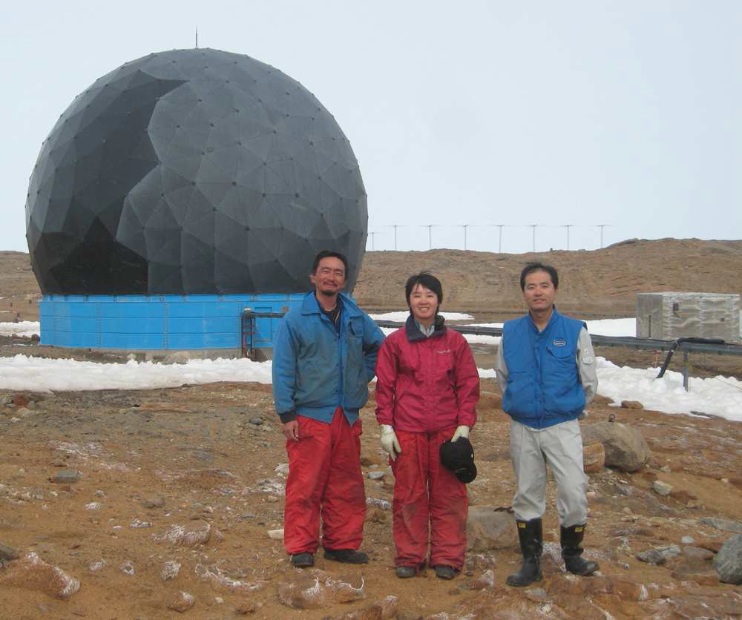
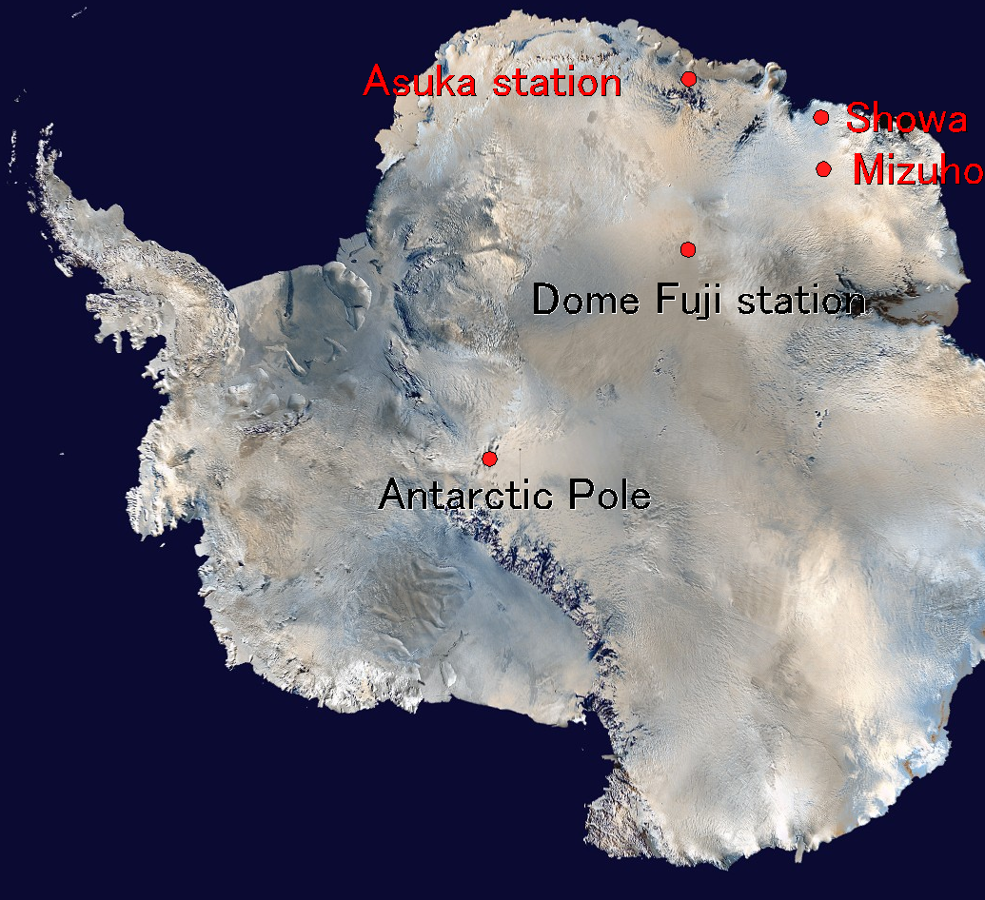
Radio Telescopes Around the World
Telescopes at extremes
  Antarctica:
    Syowa, O’Higgins
  Arctic:
    Ny Alesund
  VLBI stations
http://www.tacdata.co/home/2012/1/4/german-antarctic-receiving-station-ohiggins.html

Slide 5
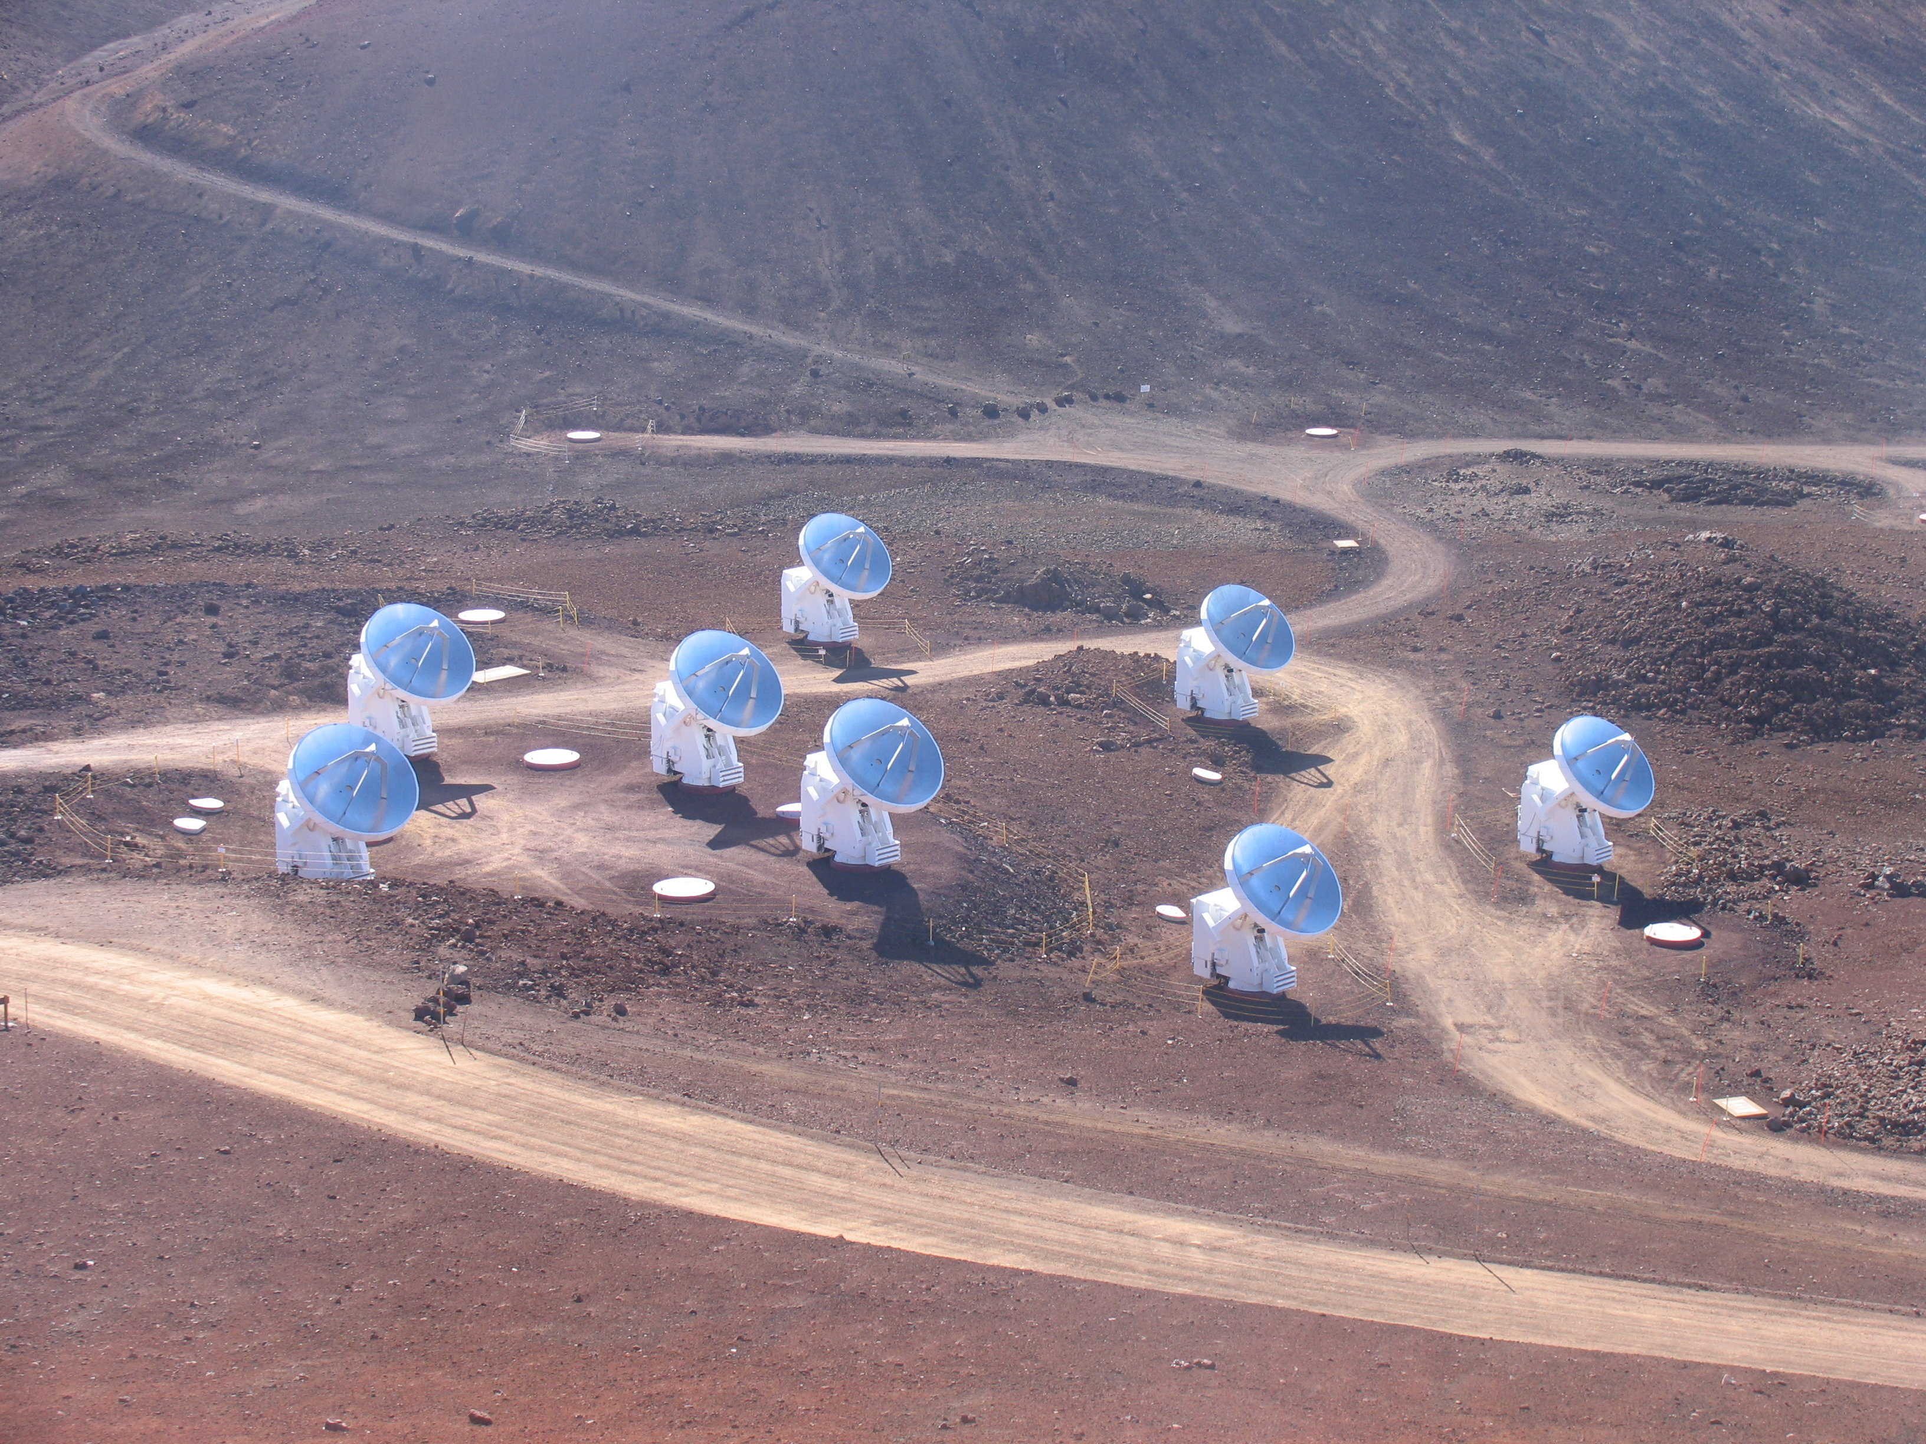
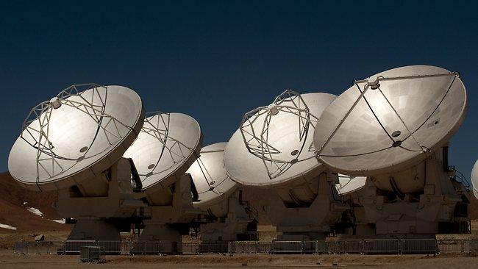
Radio Telescopes Around the World
Opting for Altitude
SAO Submillimeter Array
Mauna Kea (180-700 GHz)
ALMA
Atacama (84-950 GHz)

Slide 6
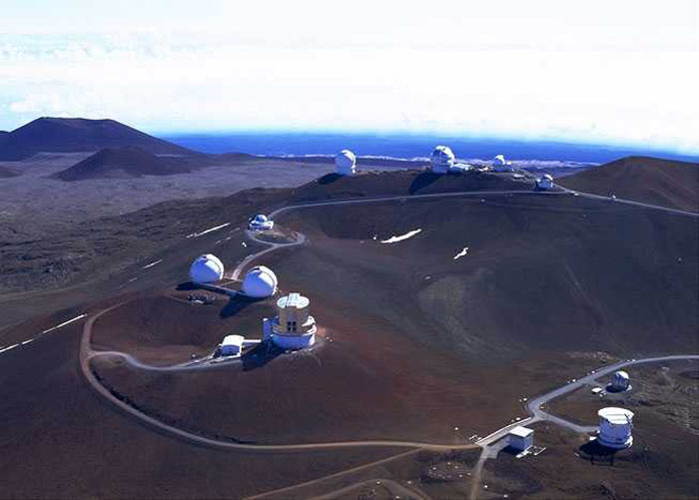
Radio Telescopes Around the World
Opting for Altitude
CSO
JCMT

Slide 7
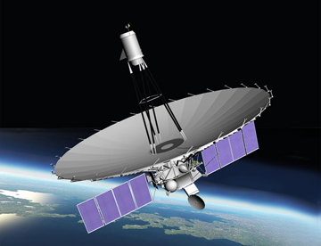
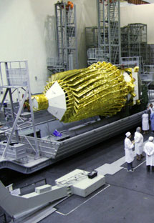
Radio Telescopes Around the World
RadioAstron/Spektr-R (1-22 GHz)
10,000-390,000 km orbit

Slide 8
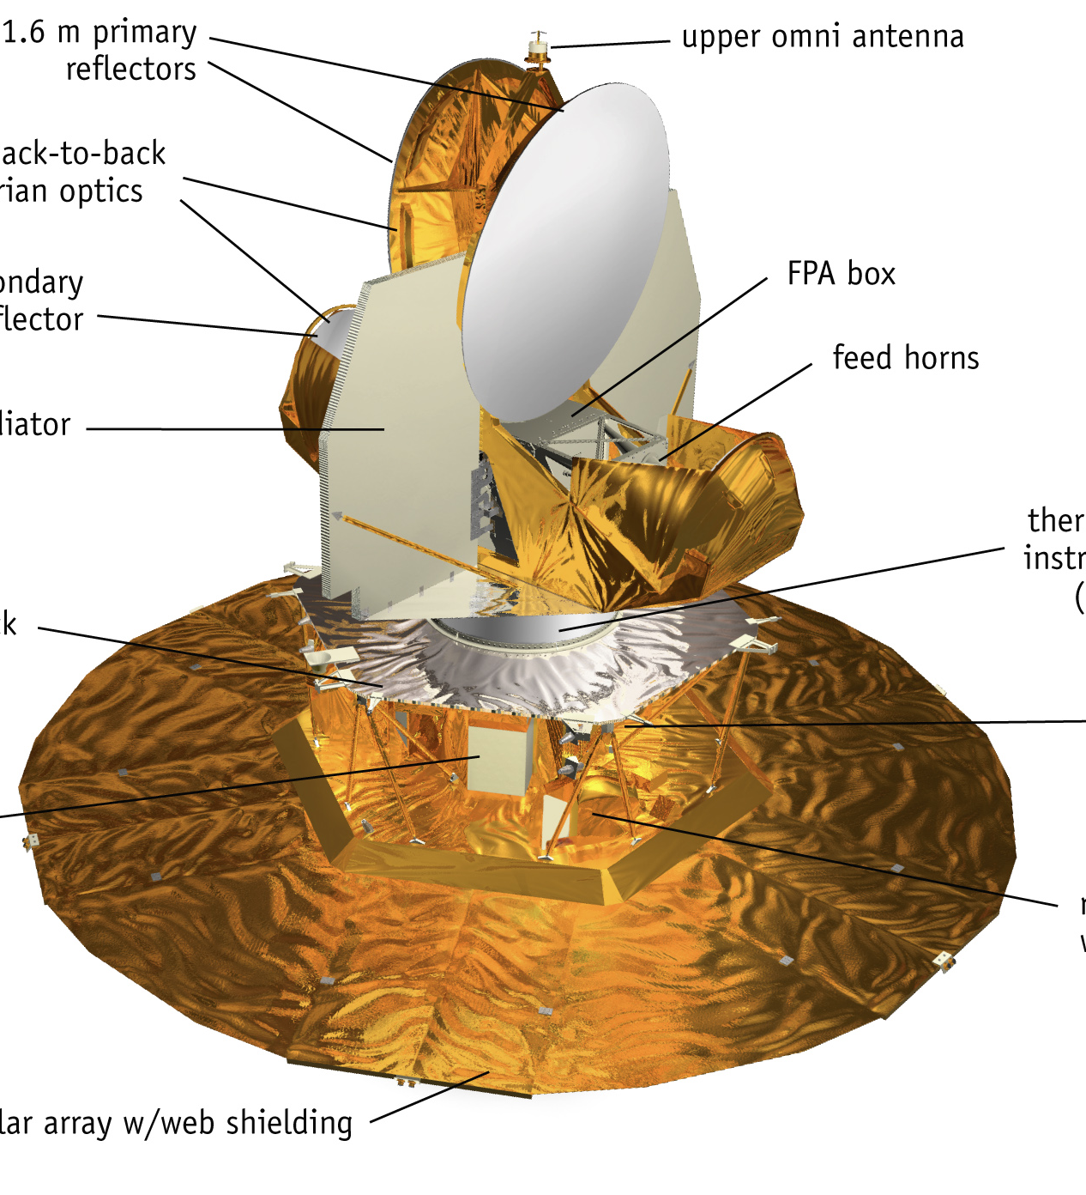
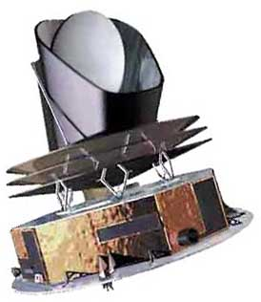
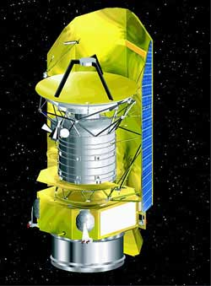
Radio Telescopes Around the World
WMAP (23-94 GHz)
Planck (100-857 GHz)
Herschel (>480 GHz)

Slide 9
“Radio Telescopes Around the World”
How many are there?
First stop … Google
2nd Hit

Slide 10
Radio Telescopes Around the World
www.kuriositas.com/2012/03/
10-spectacular-radio-telescopes-around.html

Slide 11
Radio Telescopes Around the World
www.kuriositas.com/2012/03/10-spectacular-radio-telescopes-around.html

Slide 12
Radio Telescopes Around the World
www.kuriositas.com/2012/03/10-spectacular-radio-telescopes-around.html
not rec. for Rick Perley

Slide 13
Radio Telescopes Around the World
www.kuriositas.com/2012/03/10-spectacular-radio-telescopes-around.html

Slide 14
Radio Telescopes Around the World
www.kuriositas.com/2012/03/10-spectacular-radio-telescopes-around.html

Slide 15
Radio Telescopes Around the World
For the experts:
do you
recognize this
antenna?
www.kuriositas.com/2012/03/10-spectacular-radio-telescopes-around.html

Slide 16

Radio Telescopes Around the World
www.kuriositas.com/2012/03/10-spectacular-radio-telescopes-around.html
www.kuriositas.com/2012/03/10-spectacular-radio-telescopes-around.html

Slide 17
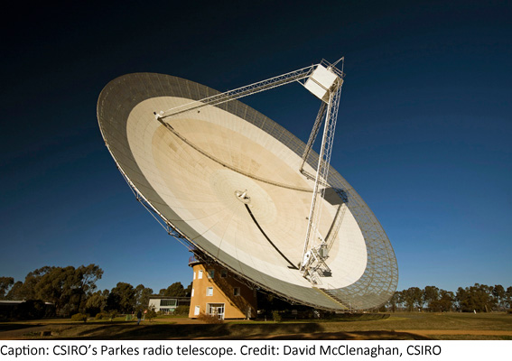
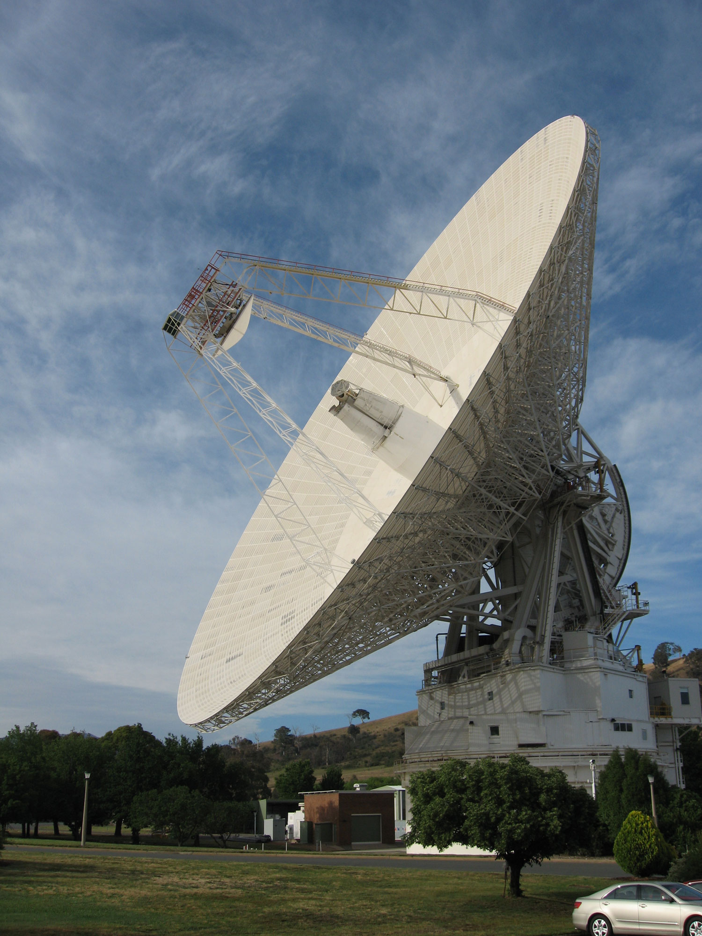
Radio Telescopes Around the World
Parkes 64m
Digression: what do these telescopes have in common?
Canberra 70m

Slide 18
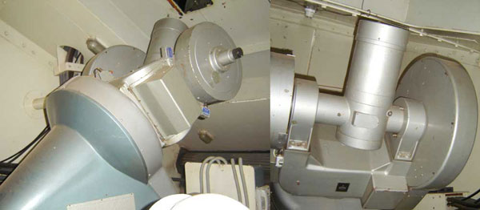
Radio Telescopes Around the World
Parkes
www.jeffstanger.net
The heritage of a Master Equatorial
Innovative solution to a difficult engineering problem

Slide 19
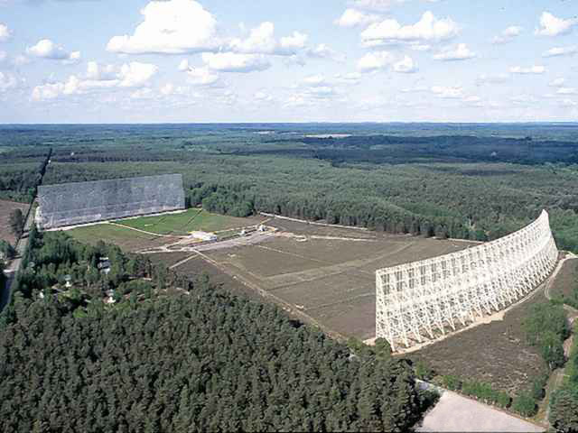
Radio Telescopes Around the World
“unusual”
configurations
Nancay
transit instr.
tilting flat refl.

Slide 20
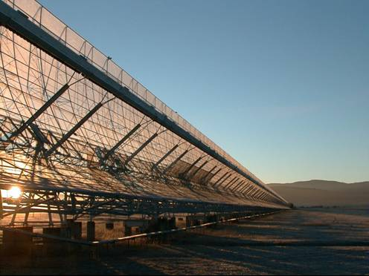
Radio Telescopes Around the World
“unusual”
configurations
innovative solution to building A_{e}
Molonglo
steerable
synthesis instr.
multiple feeds fan beam

Slide 21
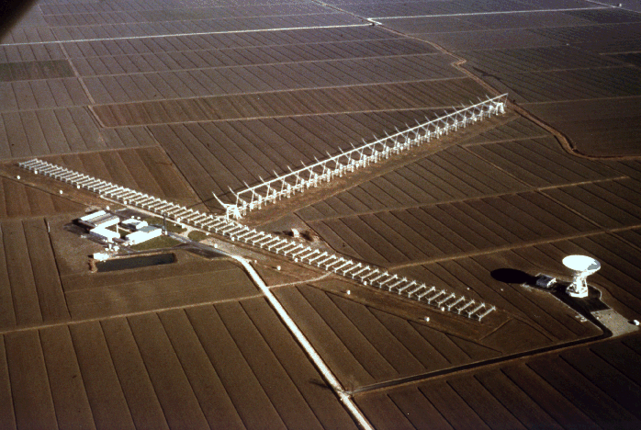
Radio Telescopes Around the World
Northern Cross
steerable
synthesis instr.
multiple feeds fan beam
off-axis

Slide 22
“Radio Telescopes Around the World”
How many are there?
First stop … Google
1st Hit

Slide 23
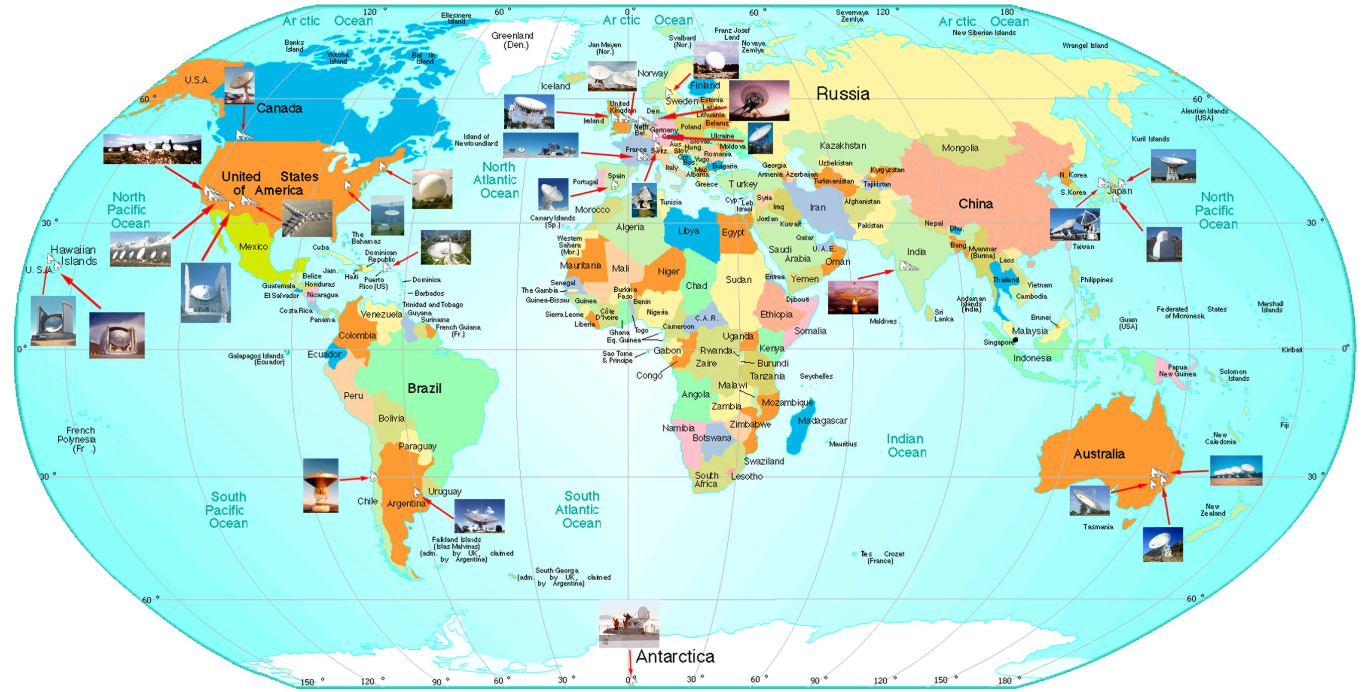
Radio Telescopes Around the World – 26
www.astro.uni-bonn.de/~rcbruens/links/world_map.html

Slide 24
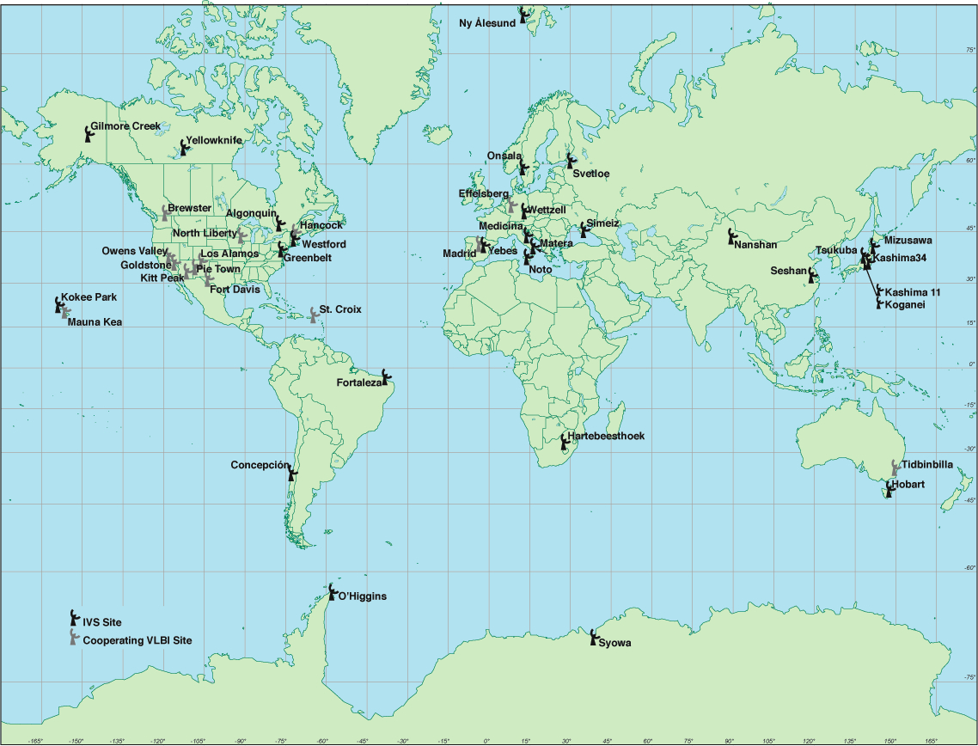
Radio Telescopes Around the World – 40
Obvious omissions
Some additions
IVS Network

Slide 25
Radio Telescopes Around the World – 45
mainly VLBI apertures
www.jb.man.ac.uk/vlbi/gallery/radtel.html

Slide 26
Radio Telescopes Around the World – 108
Some retired
Some perhaps not well instrumented
Excludes: geodetic network, VLBA, VERA, EAVN, KVN, …
Excludes: WMAP, Planck, Herschel
Excludes: imaging riometers

Slide 27
Radio Telescopes Around the World
What is an imaging riometer?
  relative ionospheric opacity …
  low frequency array
    20, 30, 38 MHz
  measures apparent changes in galactic emission due to plasma variability
  obtain ‘quiet day’ data (a map of the galaxy) and subtract it
    aeronomy pursues the residual
  a curiosity from our perspective (perhaps)
    angular resolution O(1-10°)
    ≪300 kHz bandwidth

Slide 28
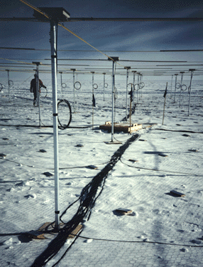
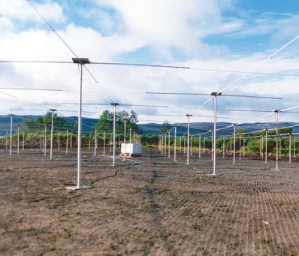
Radio Telescopes Around the World
Imaging Riometers
Kilpisjarvi, Finland
Lancaster Univ.
South Pole Station
UMd - Rosenberg

Slide 29
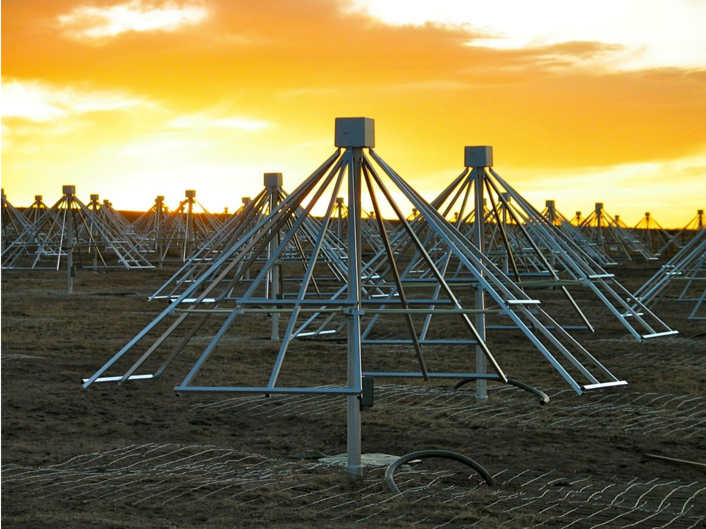
Radio Telescopes Around the World
LWA (10-88 MHz)

Slide 30
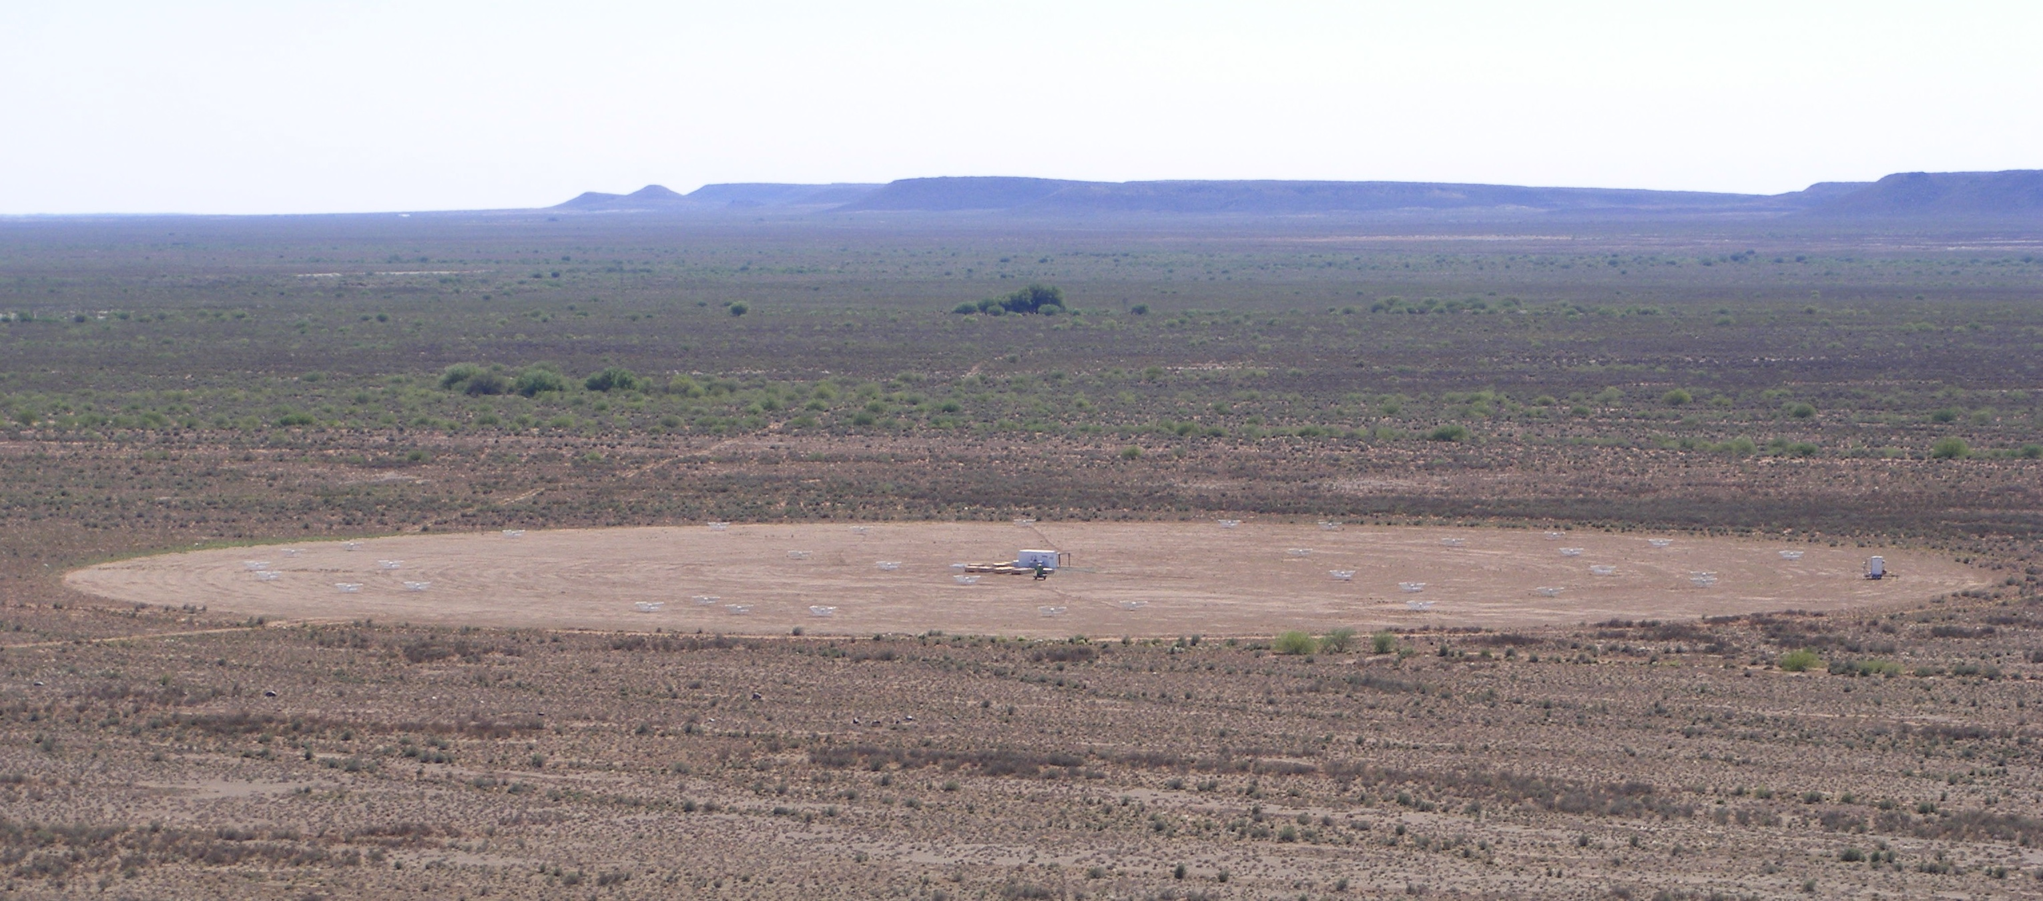
Radio Telescopes Around the World
PAPER @ 25%

Slide 31
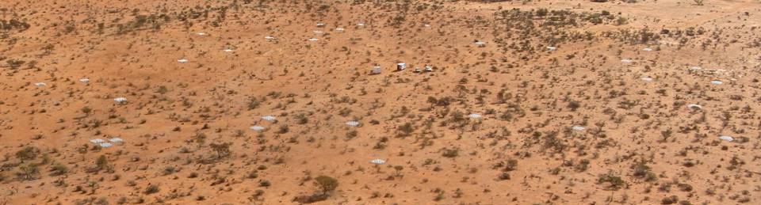
Radio Telescopes Around the World
MWA 25% prototype

Slide 32
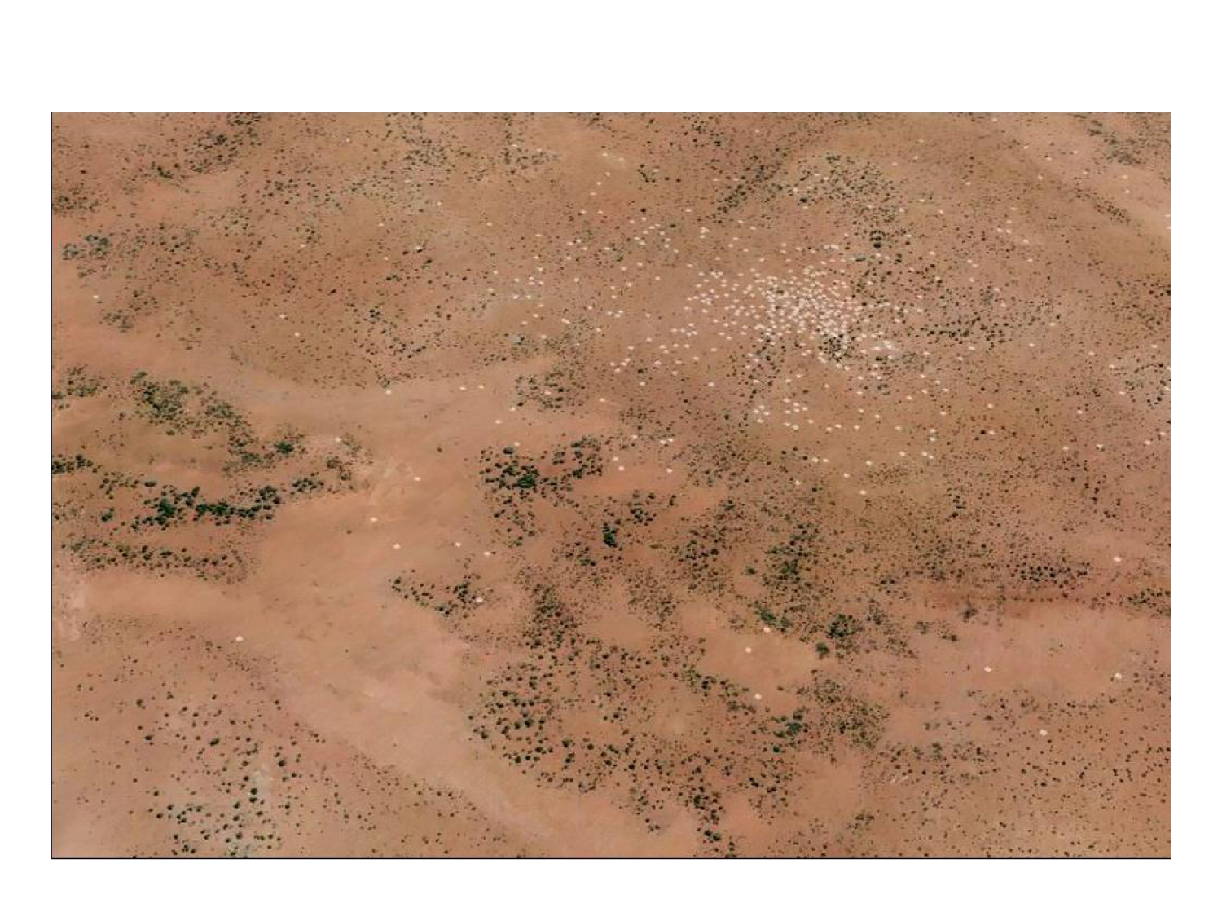
Radio Telescopes Around the World
Hypothetical Large-N Configuration

Slide 33
Summary
How many are there?
  over 100
  amazing
space, ground
mid-latitude, polar
individual dishes, interferometers

