Slide 1
Low-frequency Interferometry
Lincoln Greenhill

Slide 2
Science
Key science drivers at low frequencies:
- Dark Ages (spin decoupling)
- Epoch of Reionization (highly redshifted 21 cm lines)
- Early Structure Formation (high z RG)
- Large Scale Structure evolution (diffuse emission)
- Evolution of Dark Matter & Dark Energy (Clusters)
- Wide Field (up to all-sky) mapping
- Large Surveys
- Transient Searches (including extrasolar planets) (Hallinan talk)
- Galaxy Evolution (distant starburst galaxies)
- Interstellar Medium (CR, HII regions, SNR, pulsars)
- Solar Burst Studies
- Ionospheric Studies
- Ultra High Energy Cosmic Ray Airshowers
- Serendipity (exploration of the unknown)

Slide 3
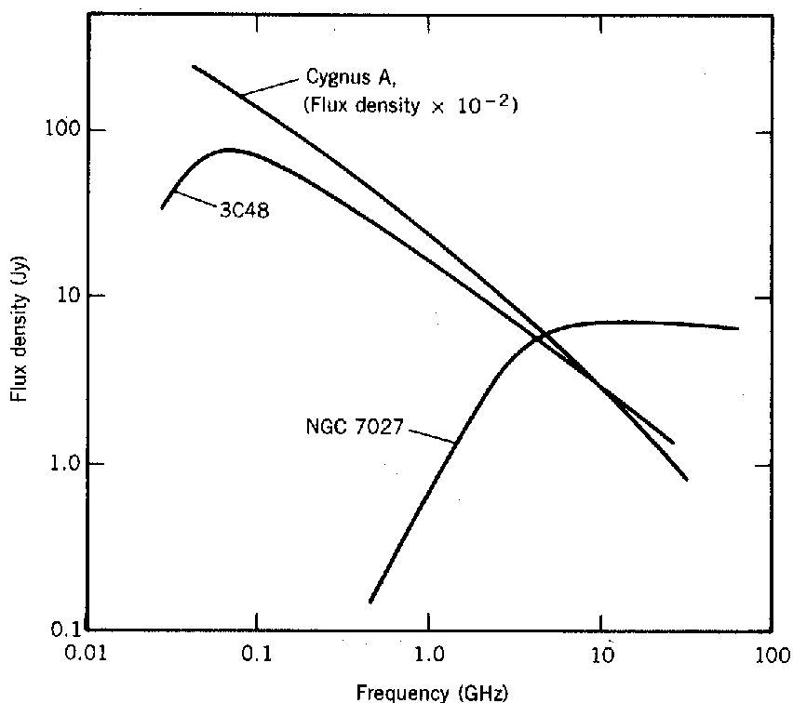
The Low Frequency Sky
Mainly two emission processes
synchrotron emission
  prominent @ meter λ (≪1 GHz)
  relativistic e– spiraling around B field
  function of e– energy, density, and B
  emission is polarized
  coherent or incoherent
Bremsstrahlung (thermal free-free)
  prominent @ cm λ (≫1 GHz)
  acceleration of e– by ions
  function of density and temperature
  possibly seen in absorption if thick
also radio recombination lines
a story of two skies
Synchrotron
Synchrotron self absorption or free-free absorption
Thermal:
Rayleigh-Jeans
HF
VHF
Thompson, Moran, & Swenson
ionospheric cutoff

Slide 4
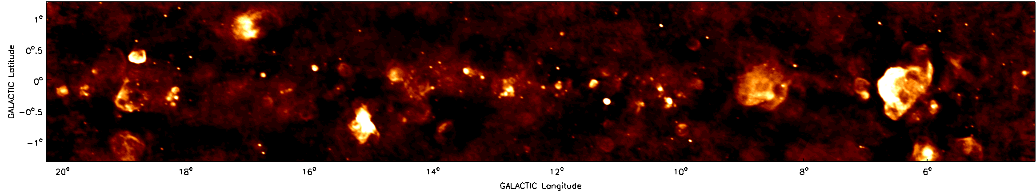
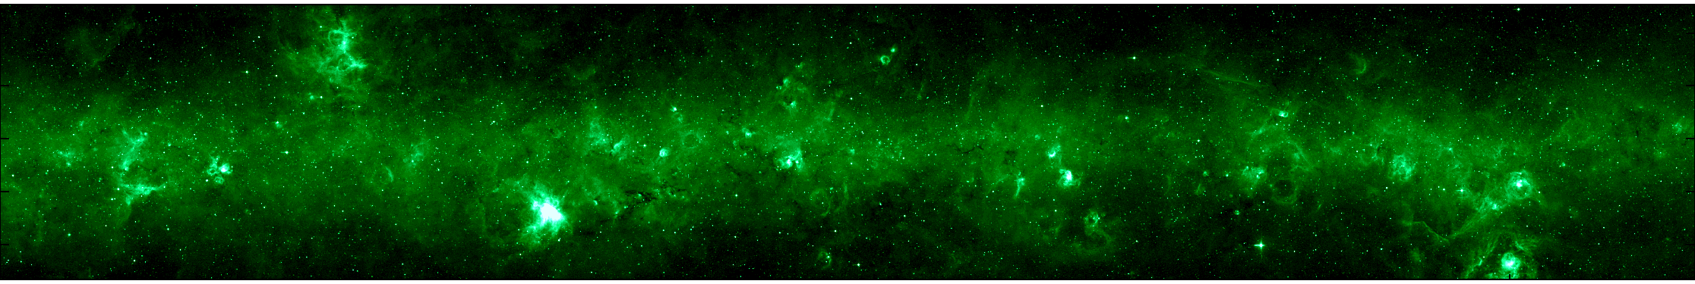
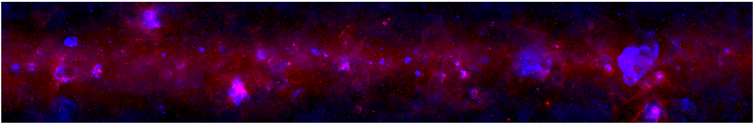
The Low Frequency Sky
non-thermal
330 MHz
thermal
8 μm
MSX 8μm
Red: MSX Blue: VLA
Brogan et al. 2006

Slide 5
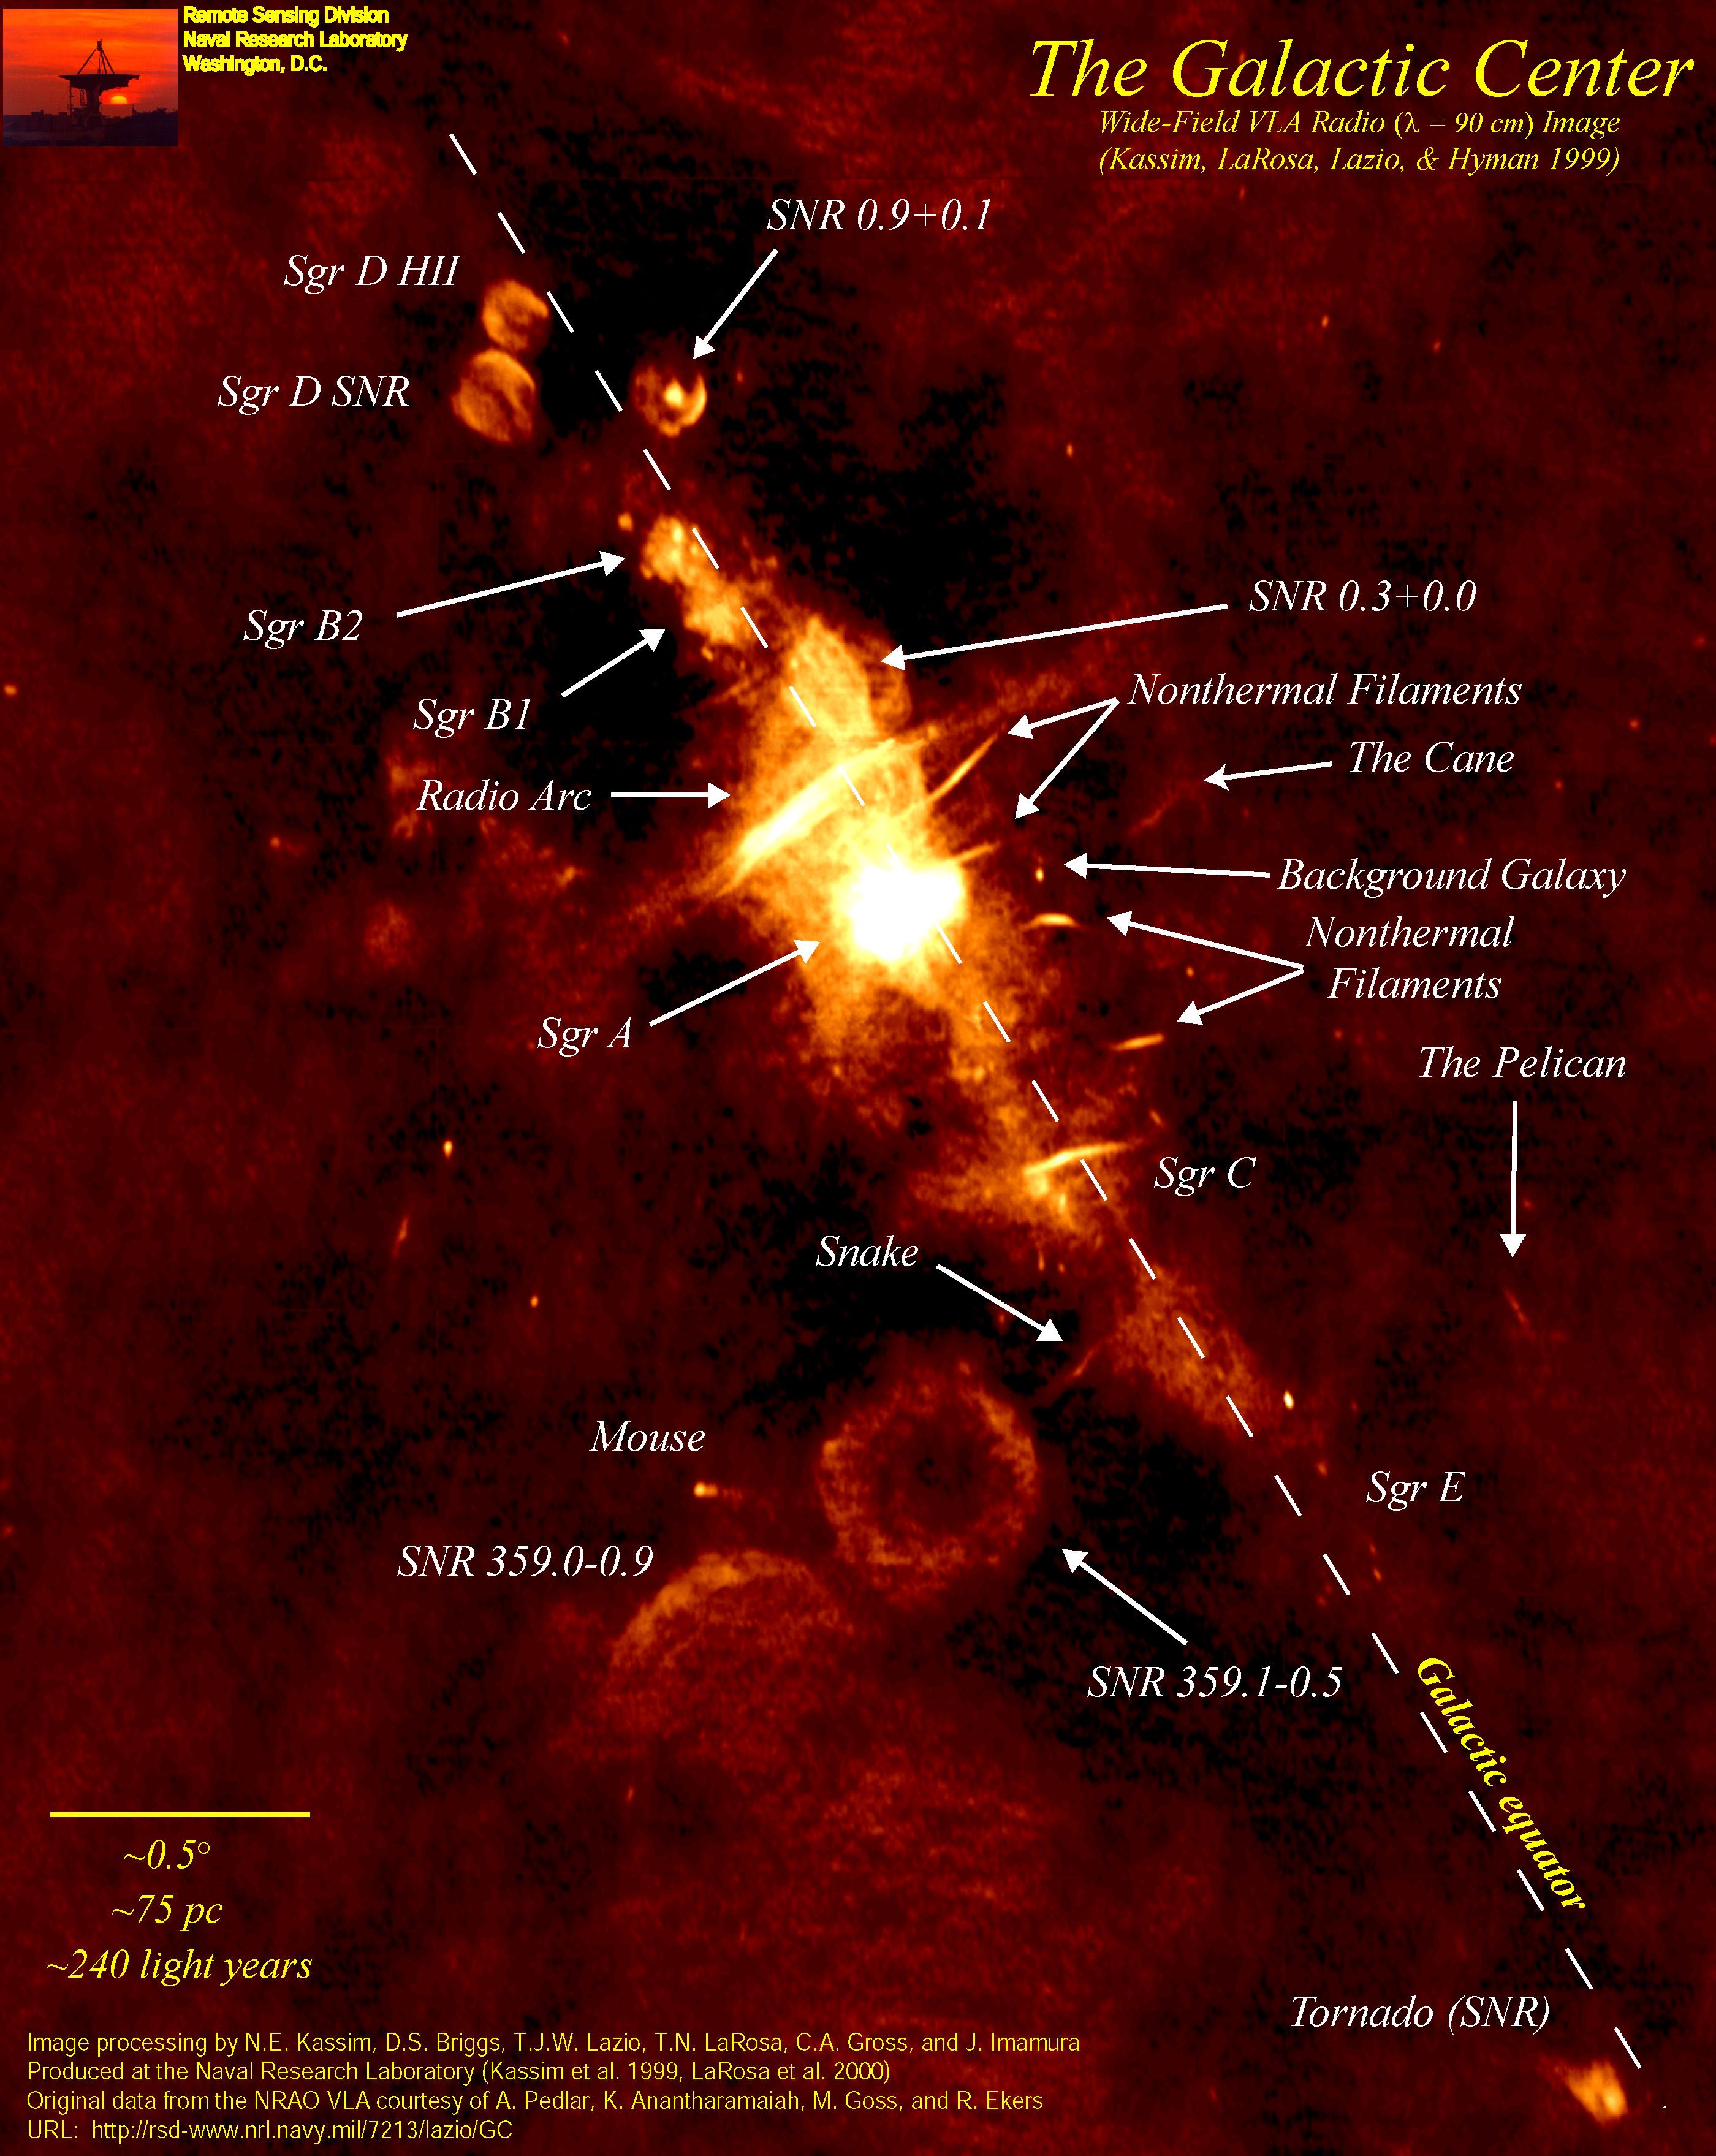
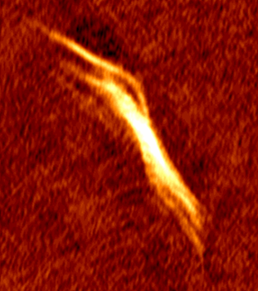
The Low Frequency Sky
Galactic Center
Synchrotron
Emission
VLA 330 MHz
Kassim et al. 1999

Slide 6
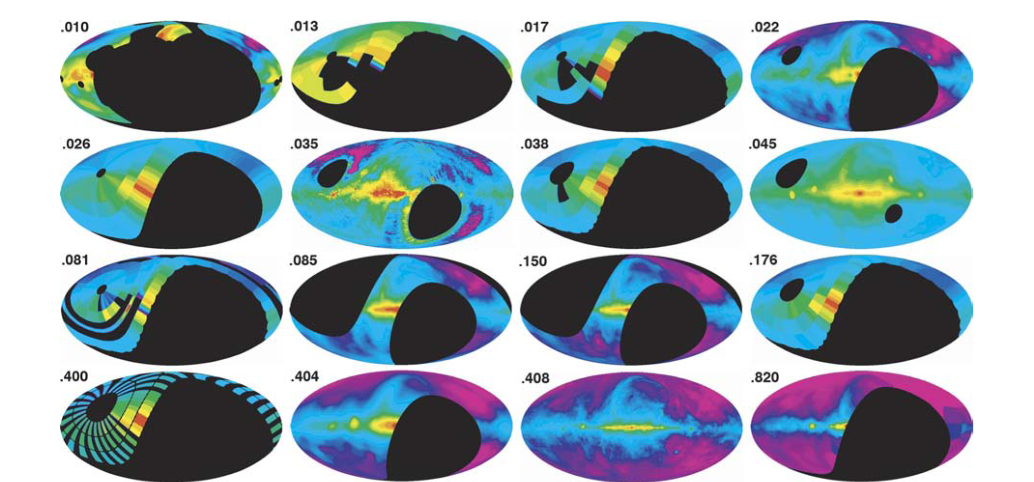
Resources: All sky surveys
GHz
Costa et al. 2008
Understanding of the low frequency sky is limited
  an observational frontier
  a few surveys sensitive to O(1°)-scale emission
  two all sky surveys sensitive to compact emission
    74 & 150 MHz

Slide 7
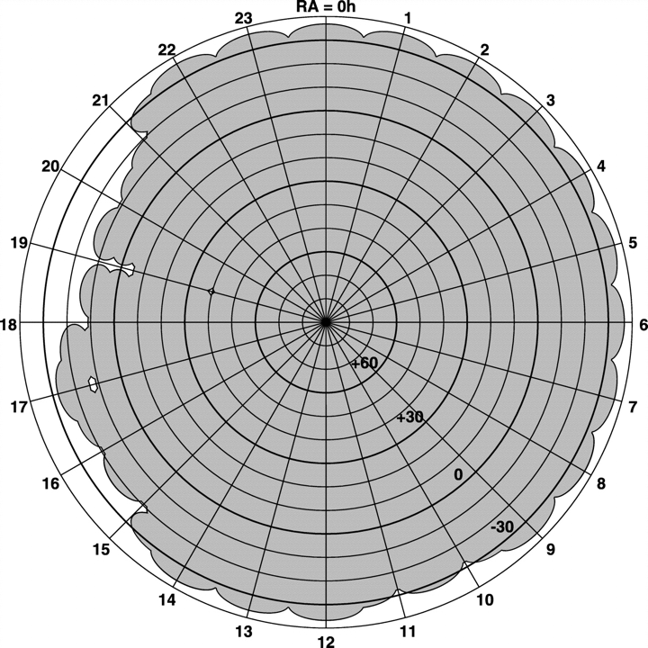
Resources: VLA Low Frequency Sky Survey
survey parameters: ν = 74 MHz, δ > -30°,
Θ = 80″ resolution,
RMS~100 mJy/beam
N ~ 70,000 sources in ~ 95% of sky > -30°
Statistical sample of mundane & rare populations
➟ fast pulsars, distant radio galaxies, cluster radio
halos and relics
calibration grid for low-frequency instruments
data online at NED & http://lwa.nrl.navy.mil/VLSS
successor ELVA low-frequency system in development
  10x bandwidth @ 74 MHz
  leverages increased correlator capability
Cohen et al. (2007)

Slide 8
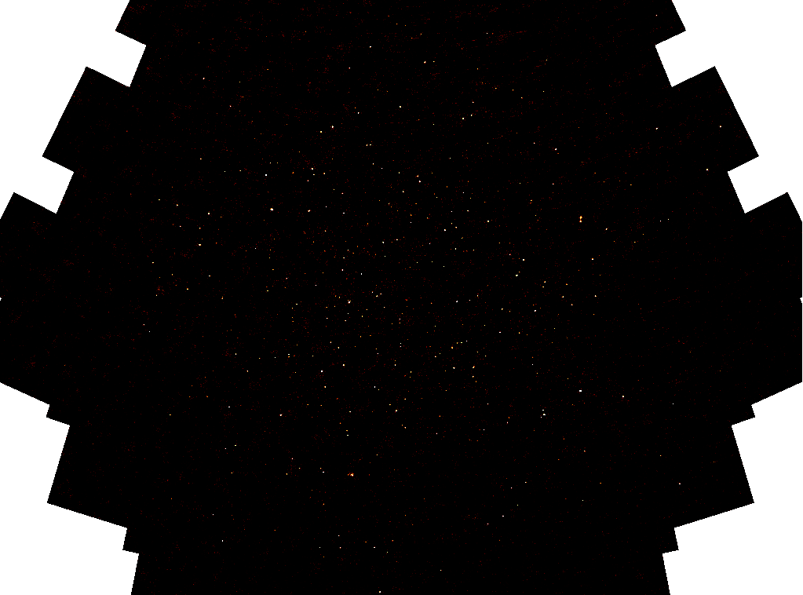
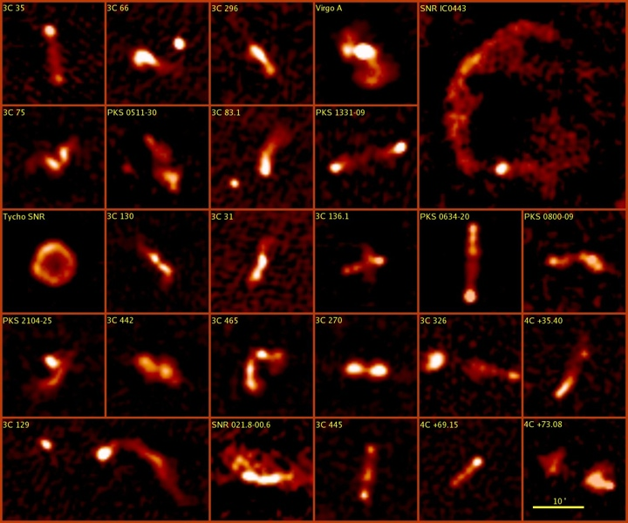
VLSS FIELD 1700+690
74 MHz, θ~80″, rms ~50 mJy
19
(Cohen et al. 2007)
~20º

Slide 9
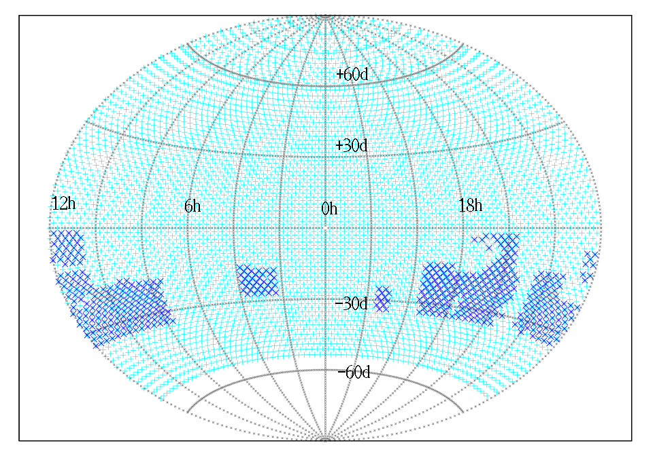
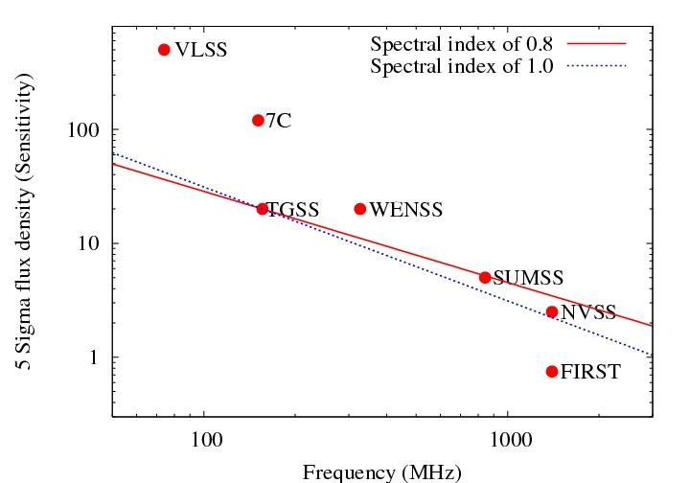
Resources: GMRT/TGSS
in progress (DR4 online April 2012)
survey parameters:
  = 150 MHz, δ ≳ -55°
  θ = 20″, σ ~ 10 mJy/beam
N ~ 10⁶ sources anticipated
  statistical samples of populations...
enhances low-freq. calibration grid
data online at http://tgss.ncra.tifr.res.in/150MHz/
pointing
centers
Sirothia et al.

Slide 10
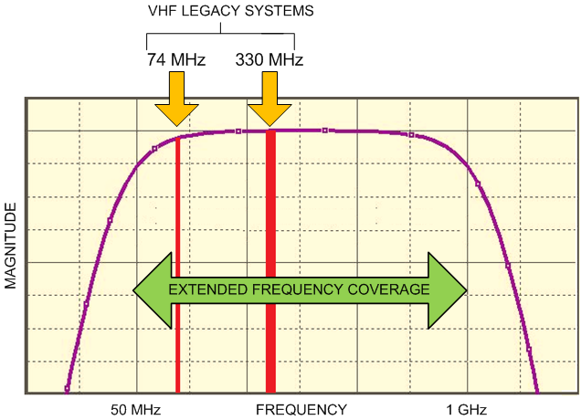
Sucessor EVLA Low-Band System
    receivers (in development) and single broadband feed (in study)
    P-band: BW increased, 40 ➟ 240 MHz (230 to 470 MHz)
      demonstrated
    4-band: BW Increase, 1.5 ➟ 16 MHz (66 to 82 MHz)
      Limited on low end by present EVLA IF system
      Limited on high end by the FM band (88 MHz)
    more flexible RFI rejection enabled by WIDAR
    Improved algorithms for large FOV

Slide 11
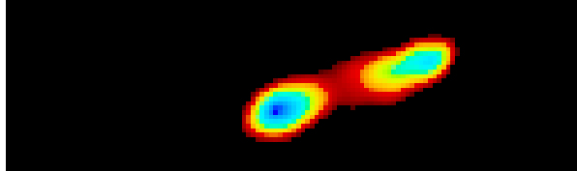
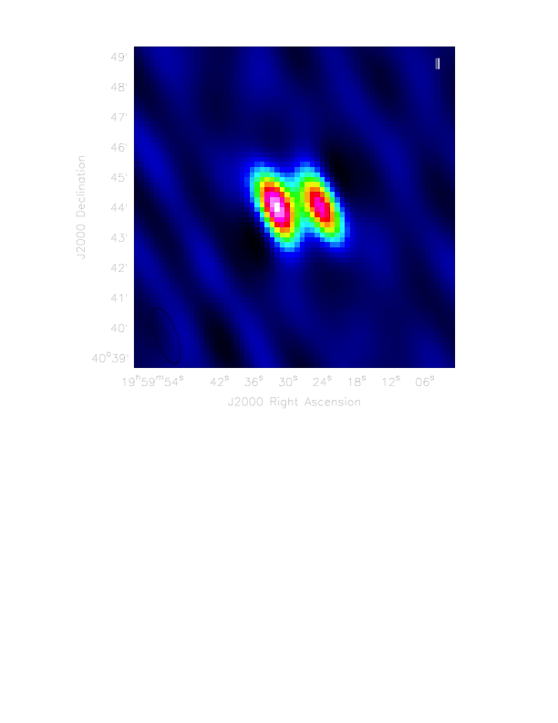
Early Results EVLA @ P-band
Cyg A
12 May 01
270-480 MHz (New Capability!)
4 antennas; 10^{m}
CASA learning curve: 3 weeks
GMRT
240 MHz
Subrahmanyan, Owen, et al.
Kantharia et al.

Slide 12
Low Frequency Receptors
feeds (Hayward talk)
  horns at high/mid frequency
    impractical below ~ 1 GHz: size > λ ➟ massive, awkward
  bare dipoles at low frequency
    basic model: λ/2 resonant (narrow-band) antenna
    ‘electrically short’ dipoles are effective
    diversity of space-saving configurations
    BUT broadband designs involve many trade-offs
      messy circuit elements (variable impedance, ugly gain patterns,…)
two common configurations
  dipole + dish: large collecting area per dipole ($$$)
  dipole + ground screen: small area, A_{e} ~ Gλ²/4π ($)
    motivates ‘large-N’ arrays or beam forming ⇐ crazy-new architectures

Slide 13
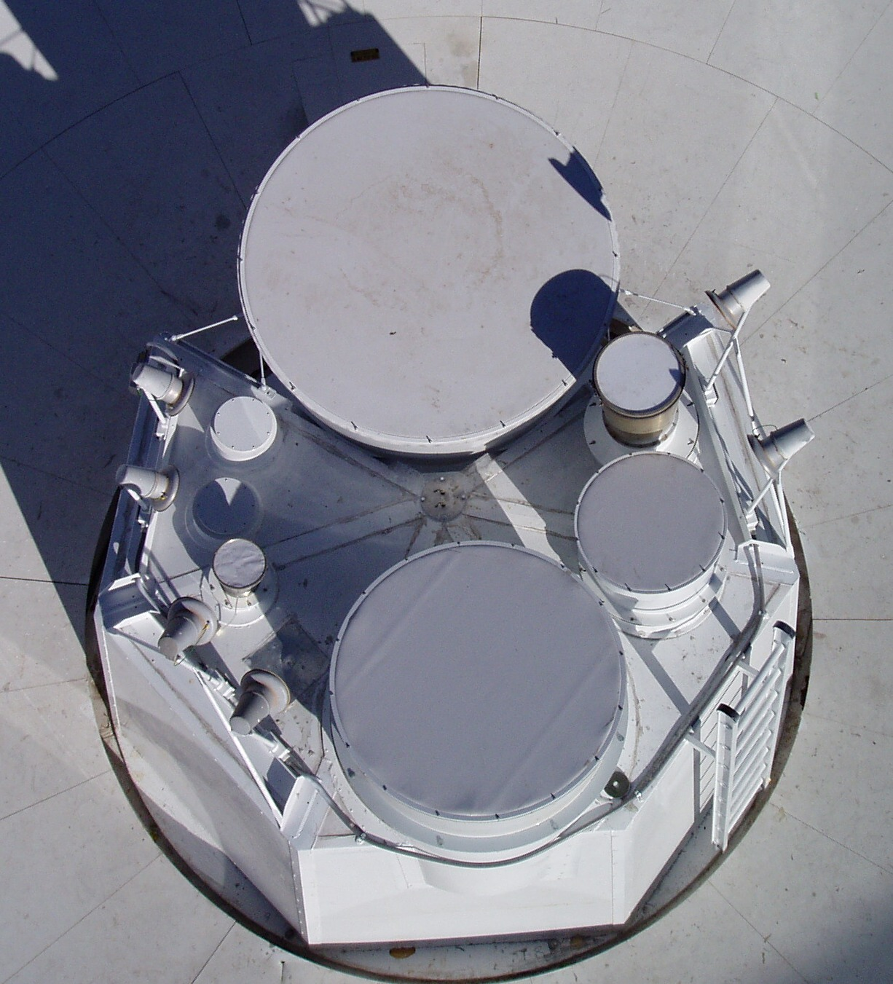
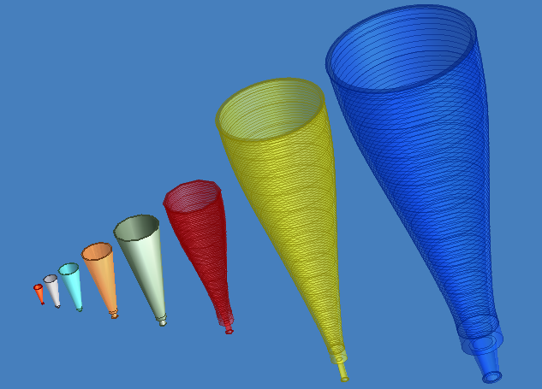
JVLA Feeds
Notes:
1) X-Band Feed is the old JPL unit
2) U-Band Feed not yet installed
Offset Cassegrain Feed Circle
Q
Letter designations have historical context and are second nature to microwave engineers.
Ka
L
K
Ku
X
X
Ka
C
Q
C
Ku
S
U
S
L
Courtesy R. Hayward
Jim Ruff’s Web Pages - http://www.aoc.nrao.edu/~jruff/A1Vertex.jpg

Slide 14
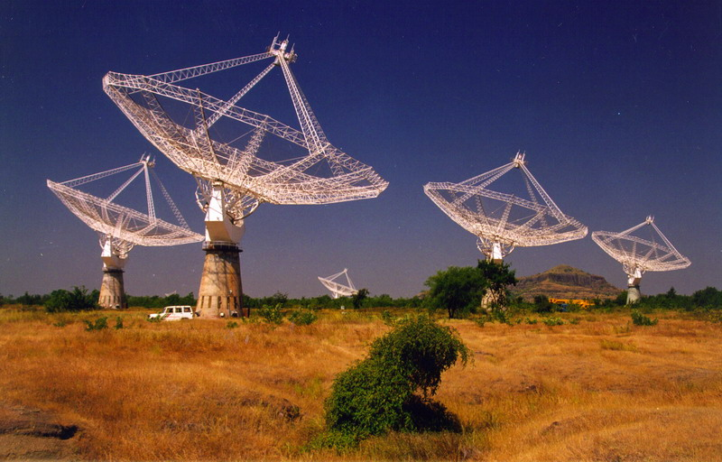
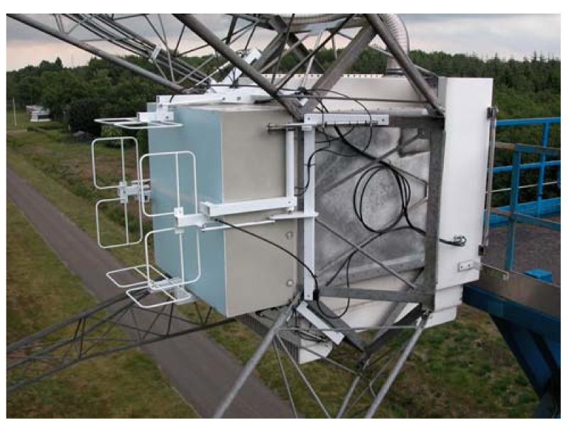
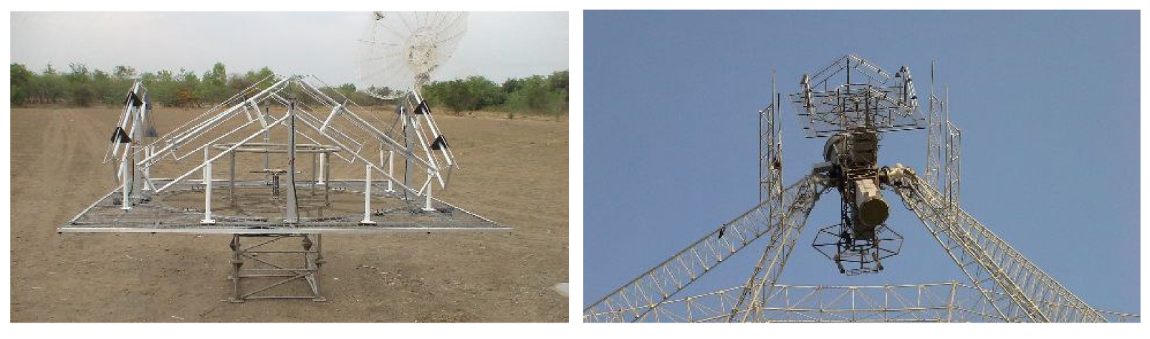
Low Frequency Receptors
150 MHz feed: folded dipole
http://www.ncra.tifr.res.in/ska/snl2.htm
GMRT
30-80 MHz feed:
folded dipole

Slide 15
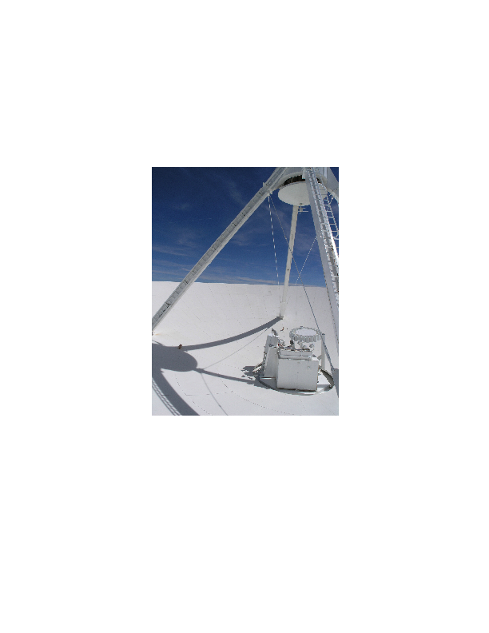
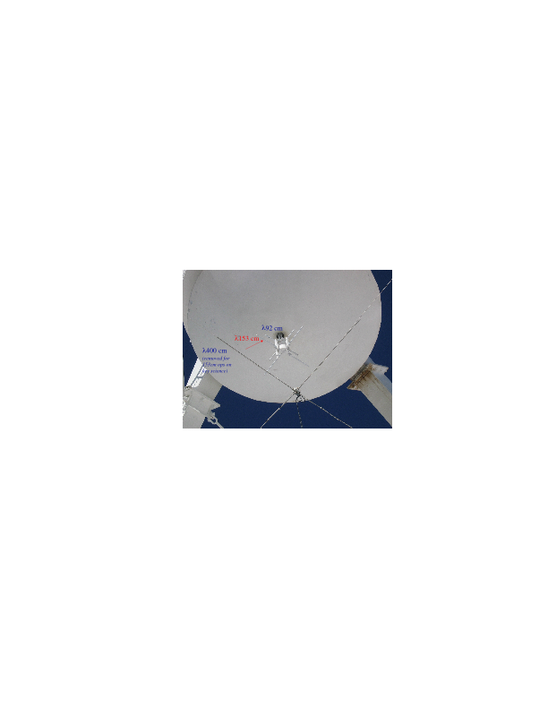
Low Frequency Receptors
74, 190, 330 MHz dipoles
sub-reflector acts as
ground screen
VLA
(c.2005)

Slide 16
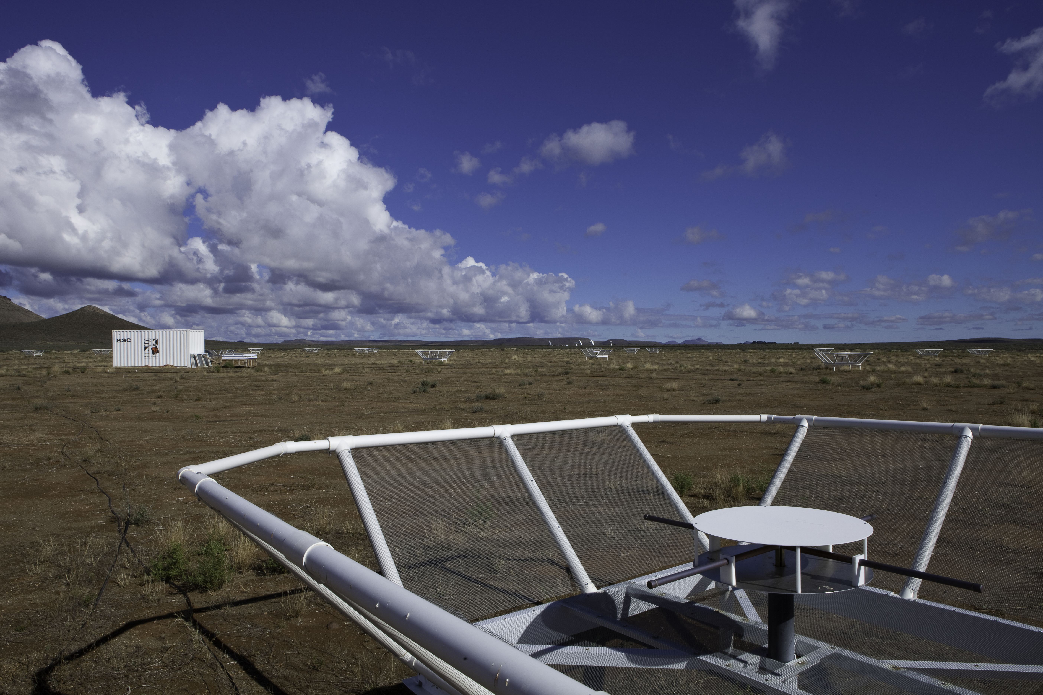
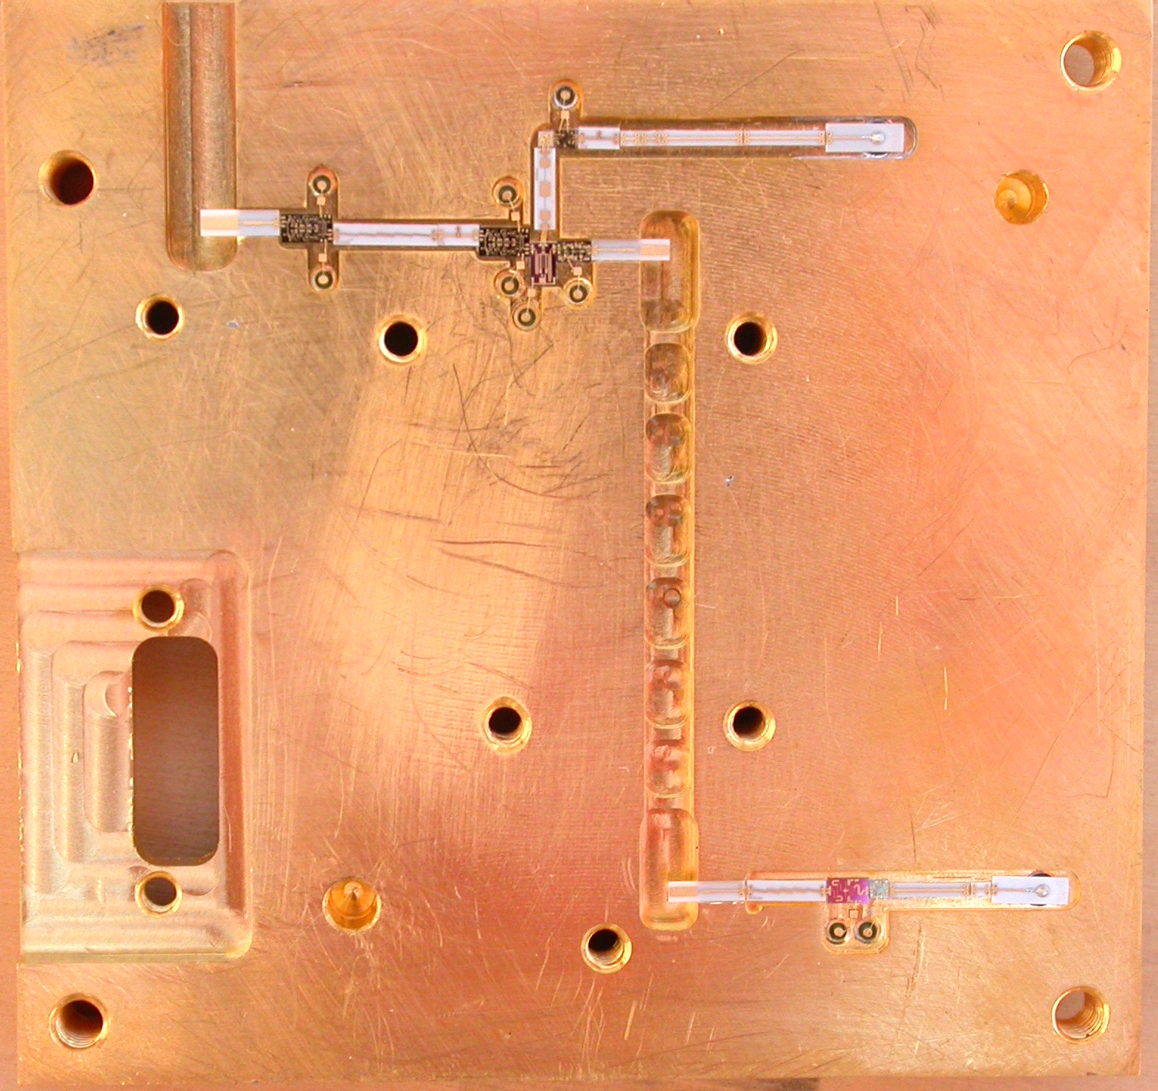
Low Frequency Receptors
bare dipoles
PAPER
  Precision Array to Probe the Epoch of Reionization
  100-200 MHz dipoles
  ground screen crib increases A_{e} (~8 m²)
  drift scan operation
  smooth, stable gain pattern
  eor.berkeley.edu/
structural details affect characteristics

Slide 17
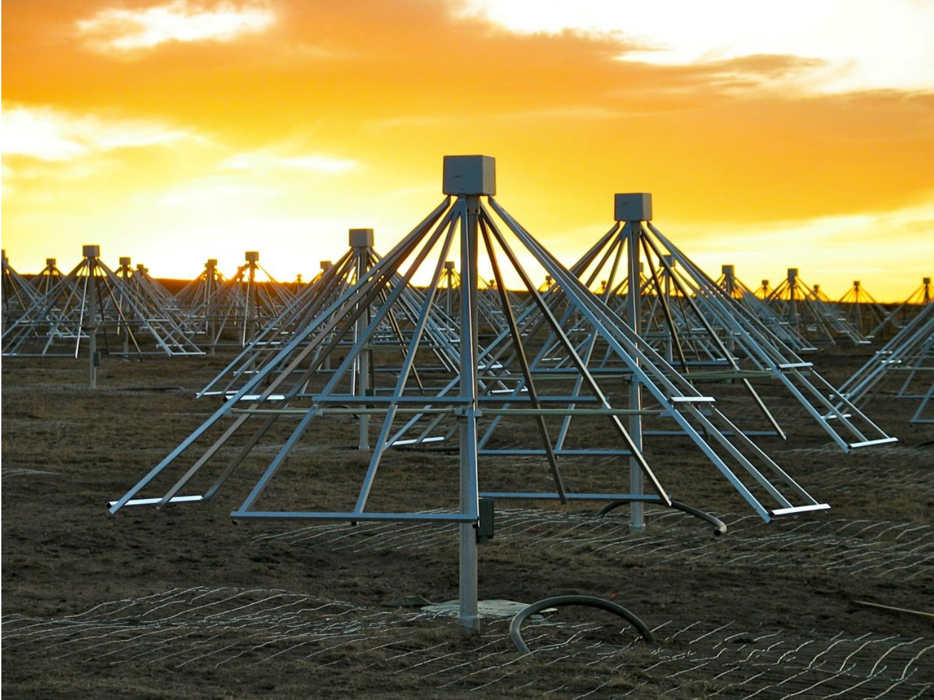
Low Frequency Receptors
bare dipoles
LWA
  Long Wavelength Array
  10-88 MHz dipoles
  dipole size ∝ λ
  A_{e}~7 m²
  drift scan
  close packing (0.5-1.4λ)
    mutual coupling perturbs gain patterns…
  open access facility adjacent to VLA
2.1m

Slide 18
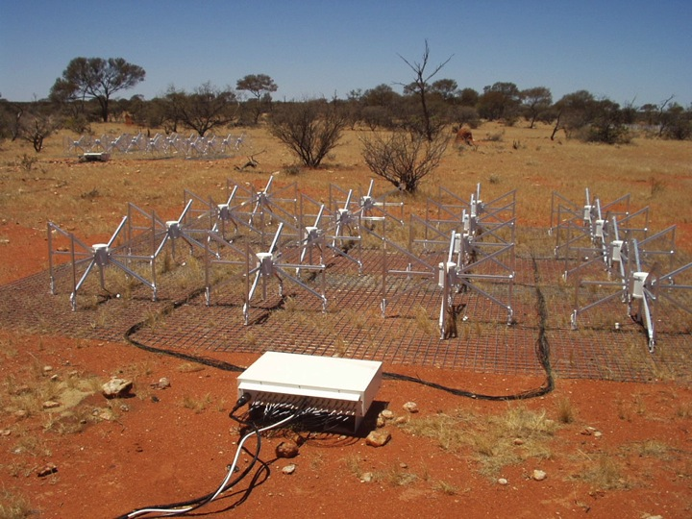
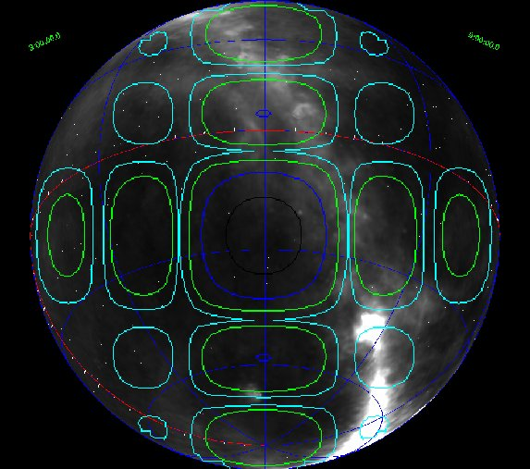
Low Frequency Receptors
bare dipoles (phased)
MWA
  Murchison Wide-field Array
  80-300 MHz dipoles
  bowtie geometry
  tiling increases A_{e} (~20 m²)
  tracking via crude phasing
  complicated beam pattern
  multiplies costs
  mwatelescope.org

Slide 19
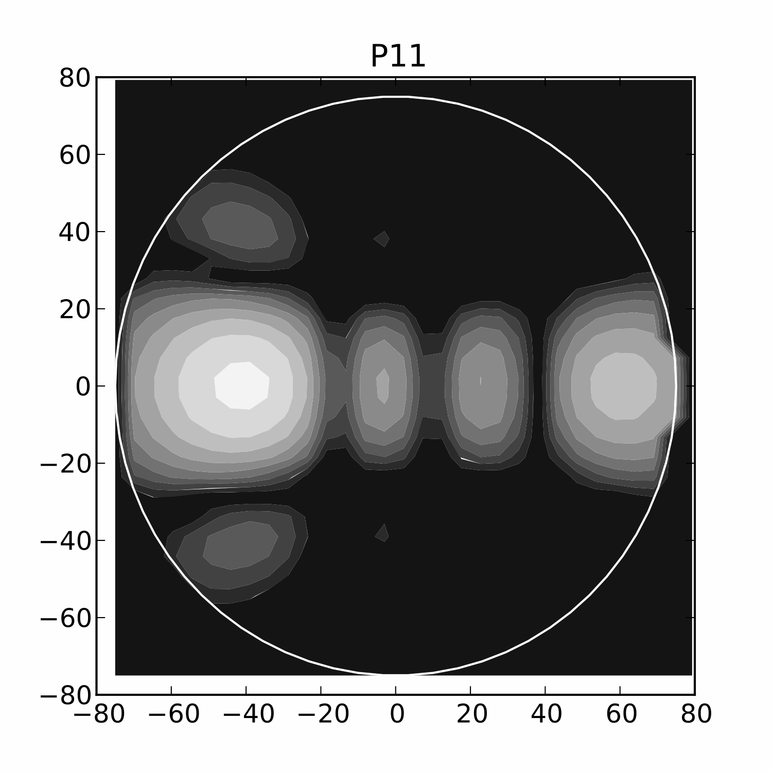
discrete tracking
complex sidelobes
rotate on the sky
beam former electronics determine stability/repeatability

Slide 20
Mixed Blessings
dipole + dish
  the good
    sensitive
    continuous, accurate tracking
    stable receptor gain pattern
    effective for small N
    moderate computation
    moderate algorithm development
    narrow FOV
  the bad
    expensive
    snapshots deliver limited DNR
    narrow FOV
bare dipoles
  the good
    inexpensive
    wide FOV
    steerable when arrayed
  the bad
    inexpensive
    wide FOV
    steerable when arrayed
  the ugly
    require very large N
    computationally demanding
    difficult algorithmic challenges

Slide 21
Low Frequency Challenges
Sky brightness
Source confusion
Ionospheric distortion
Radio Frequency Interference (RFI)
Wide fields of view (FOV)
Variable dipole response (for fixed dipole arrays)

Slide 22
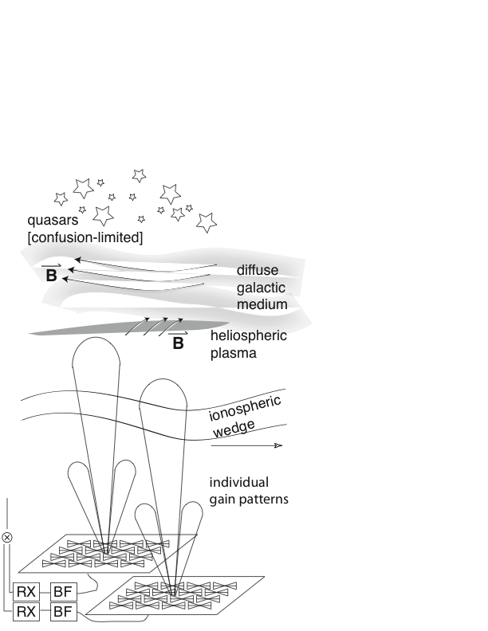
RFI

Slide 23
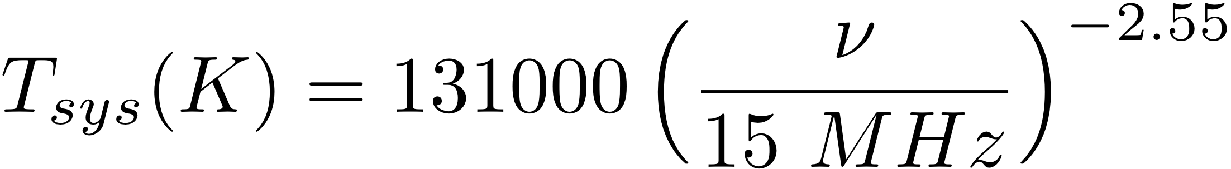
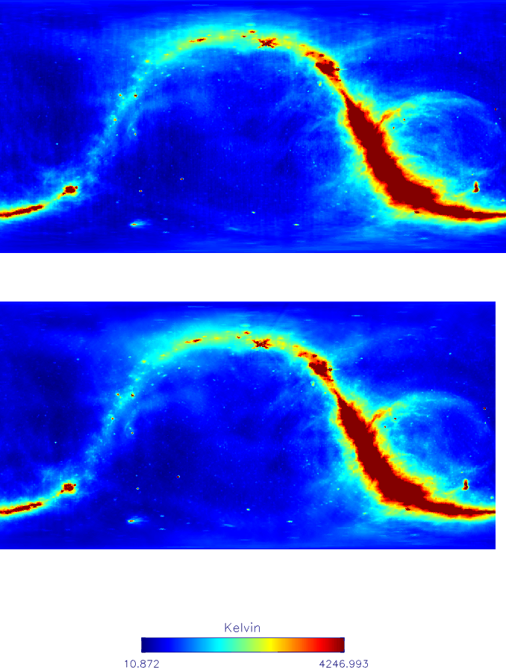
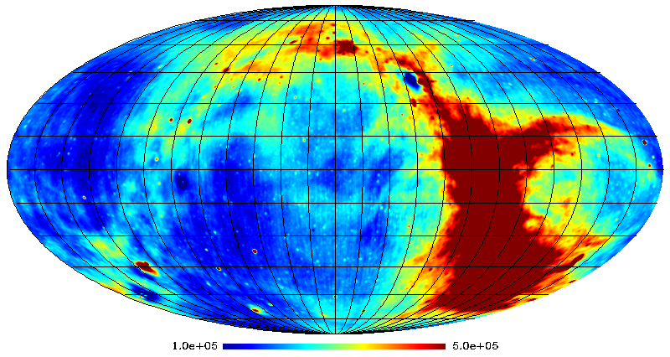
Sky brightness
408 MHz
10 MHz
Haslam et al. 1982
Peak: 500,000 K
Peak: 4200 K
adapted from Costa et al. 2008
courtesy G. Bernardi

Slide 24
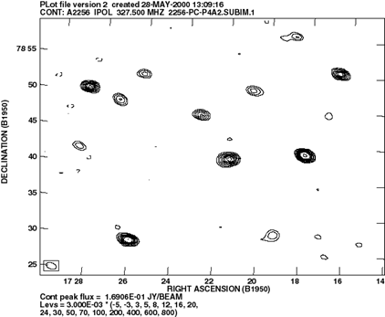
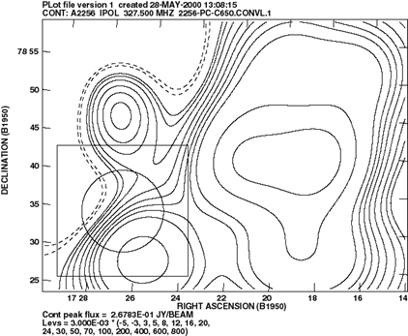
Confusion
source counts rise to lower F_{ν}
for any angular resolution θ
  there is a confusion limit
  individual weak sources blend
  the resulting sky noise may exceed thermal noise
  such cases are “confusion limited”
F_{ν} ~ 3 mJy (θ/2′)(150 MHz / nu)^{0.7}
  (Bernardi et al. 2010)
θ ~ 1’, rms ~ 3 mJy/beam
θ ~ 10’, rms ~ 30 mJy/beam

Slide 25
Low Frequency Challenges
Sky brightness
Source confusion
Ionospheric distortion
Radio Frequency Interference (RFI)
Wide fields of view (FOV)
Variable dipole response (for fixed dipole arrays)

Slide 26
Ionosphere
Waves in the ionosphere introduce rapid phase variations (~1°/s on 35 km BL)
Phase coherence is preserved on BL < 5km (gradient)
BL > 5 km have limited coherence times
Without proper algorithms this limits the capabilities of low frequency instruments
~ 50 km
<5 km
> 5 km
F-layer 400 km
Correlation preserved
Correlation destroyed

Slide 27
Ionosphere
Wedge: characterized by
TEC = ∫n_{e}dl ~ 10¹⁷ m⁻²
ΔL α λ² ∗ TEC
Δφ ~ ΔL⁄λ ~ λ * TEC
Waves: <1% fluctuations
superimposed
Turbulence &
Waves
~ 50 km
Wedge
~ 1000 km
wedge – refraction, absorption (< 30 MHz), Faraday rotation
wave and turbulence – rapid phase winding, differential refraction, source distortion…
wedge introduces thousands of turns of phase at 74 MHz per LOS
interferometers sense differences among antennas and across FOV’s
  primarily culprits: waves and turbulence

Slide 28
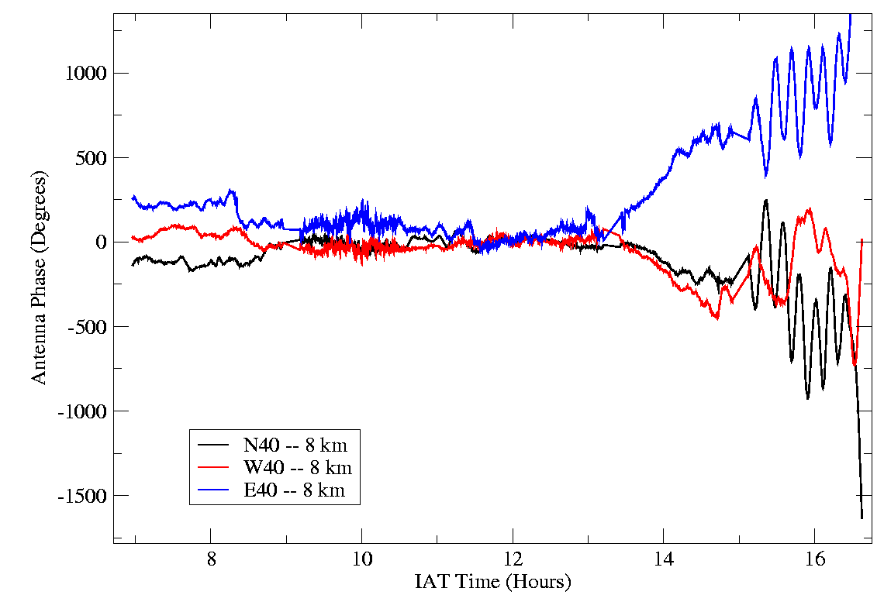
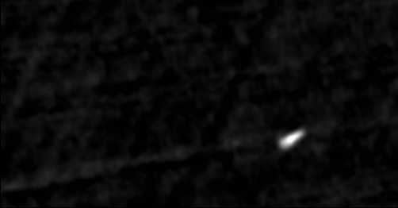
Antenna Phase as a Function of Time
a range of phenomena observed over 12^{h} @ night
daytime (but not dawn) can have good conditions
three 8-km baselines
Refractive wedge
At dawn
Scintillation
‘Midnight wedge’
VirA; 30′ FOV; λ=4m; ΔT=2^{m}
Quiesence
TIDs
ftp://ftp.cv.nrao.edu/NRAO-staff/bcotton/
Perley et al.

Slide 29
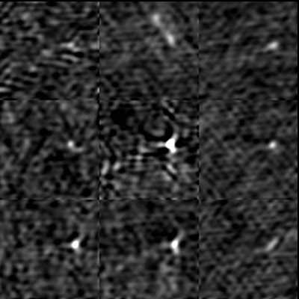
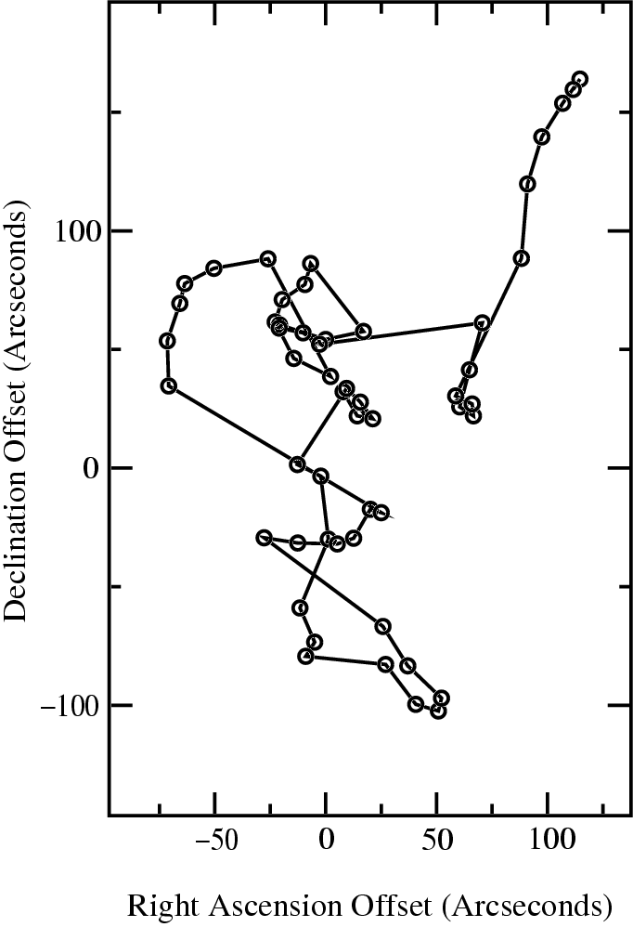
Ionospheric Refraction & Distortion
λ=4m; ΔT=2^{m}; self-cal
wander due to wedge
1 minute sampling
intervals
common mode & differential refrac’n
variability over 1 min or less
length scales @ altitude < 10km
ftp://ftp.cv.nrao.edu/NRAO-staff/bcotton/
(NRL group; Kassim)

Slide 30
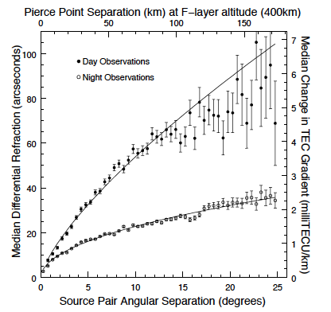
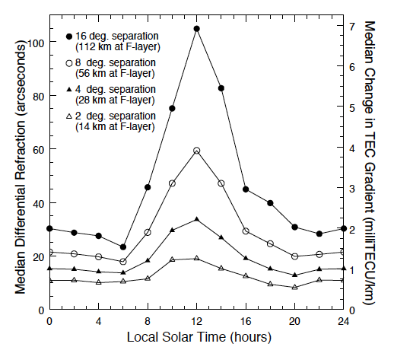
Ionospheric Differential Refraction
Cohen et al (2009)

Slide 31
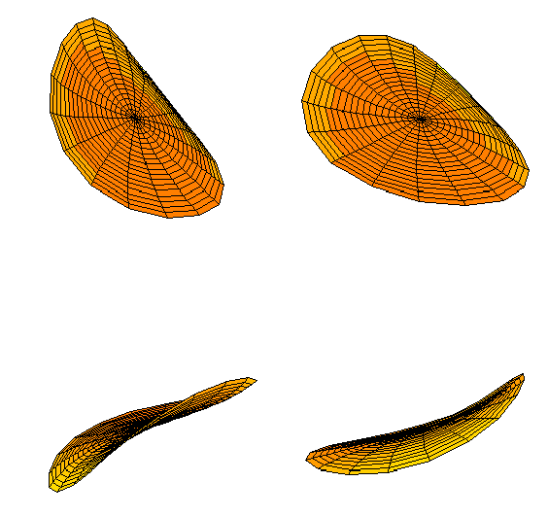
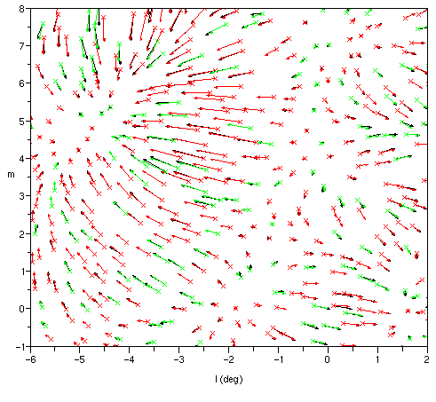
Correcting for the Ionosphere
Intema; Cotton
frontier in research
assumptions
  2D sheet
    refractive model (Intema et al. 2009; Cotton: Lane et al. 2012)
  3D sheet
    tomography for a power spectrum in n_{e} (Koopmans 2010) TBD
corrections may be applied in
  l, m grid
    rubber sheet; Mitchell et al. 2008
  visibility model calc. during deconvolution
    Intema et al. 2009
  u,v plane, in combination w/ direction-dependent gridding
    CASA plan - U. Rao, S. Bhatnagar, p.c.
Time-variable Zernike
Polynomial Phase Screens
Mitchell

Slide 32
Low Frequency Challenges
Sky brightness
Source confusion
Ionospheric distortion
Radio Frequency Interference (RFI)
Wide fields of view (FOV)
Variable dipole response (for fixed dipole arrays)

Slide 33
Radio Frequency Interference
natural & man-generated RFI at low frequencies is pervasive
  power lines
  broadcast, communications, & radar
  digital hardware
  keeping sites clean requires care / easily spoiled
at GMRT & LWA: power line noise has been a problem
at VLA: many signatures between 74 and 330 MHz
  narrowband, wideband, time varying, ‘wandering’
  can be wideband (affecting C & D configurations)
  solar effects – unpredictable
    quiet sun is a benign 2000 Jy disk at 74 MHz
    solar bursts can be 10⁹ Jy and lead to geomagnetic storms
mitigation is done first in a processing path
  usually requires high spectral resolution and short time averaging

Slide 34
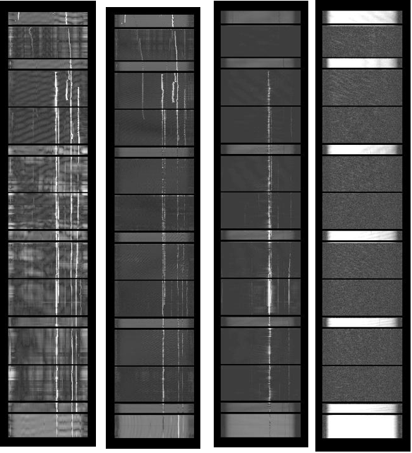
RFI Examples
Short baseline
Long baseline
RFI is worst on short baselines
Several 'types': narrow band, wandering, wideband, ...
Wideband interference can degrade automated routines
Time
Time
Frequency

Slide 35
Spectral Kurtosis
Kurtosis estimator:
Comparison:
(Nita et. al. 2010b)
Kurtosis characterizes Gaussian nature of noise
  e.g., power in a spectral channel
Estimate V_{k}² for each spectral channel
  M: no. of time samples
  N: sample pre-averaging before accumulation (N=1)
  S₁: accumulated power spectral density ~ Σx²
  S₂: accumulated square of power spectral density ~ Σx⁴
  d = 1
Notes:
3 stages:
Look at SK for every 256 samples, across 512 freq channels, flag > 3sigma (> 3*sqrt(Var(V^2_k)))
If a certain number of samples flagged, blank that time (set of 256 samples) across the board
Also blank across freq for 1s average (dump rate)

Slide 36
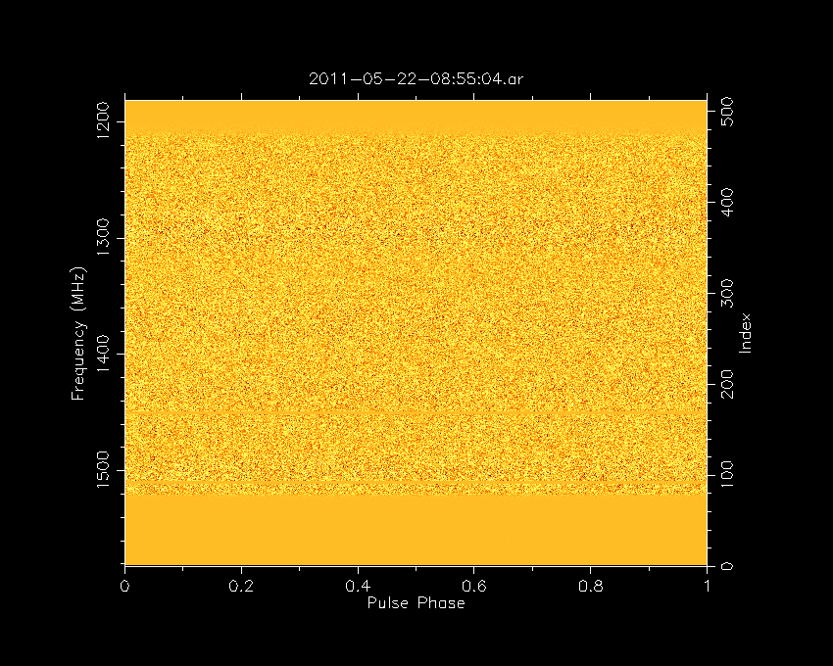
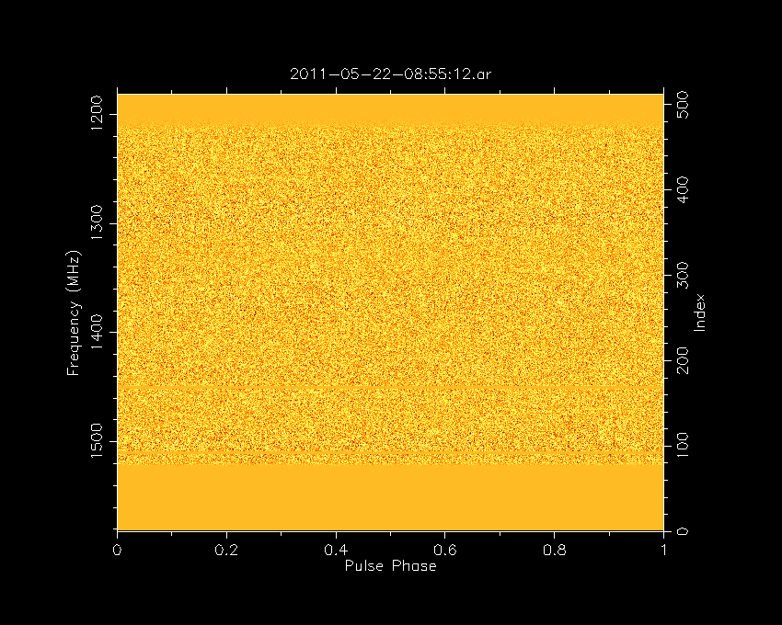
Excision via Spectral Kurtosis Analysis
Parkes CASPSR time-series data intended for pulsar detection
movies with and without excision based on real-time kurtosis calculation
  evaluate V_{k}² every 256 τ-samples, across 512 ν-channels
  flag for V_{k}² > 3 × var(V_{k}²)
without excision
with excision
1500 1200
Frequency (MHz)
courtesy A. Jameson

Slide 37
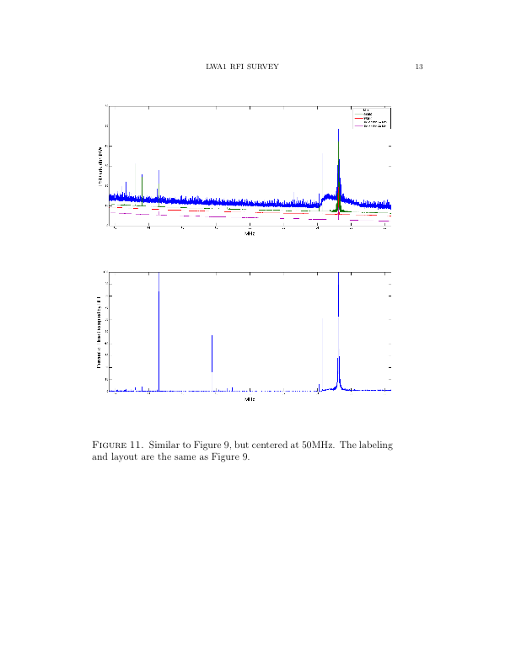
Excision via Spectral Kurtosis Analysis
Analysis of spectral kurtosis ➟ time occupancy estimate
LWA 2200 – 0600 Local
99th%
max
90th%
median Gal. min. 1^{h}
42 MHz
58 MHz
LWA / Obenberger & Dowell

Slide 38
Low Frequency Challenges
Sky brightness
Source confusion
Ionospheric distortion
Radio Frequency Interference (RFI)
Wide fields of view (FOV)
Variable dipole response (for fixed dipole arrays)

Slide 39
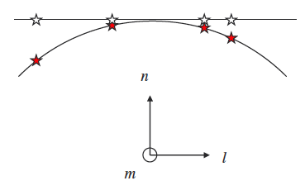
Wide FOV
dipoles: PAPER: 60°; MWA: 20°; LWA/LEDA: 130°
dishes: VLA: 11° (74 MHz); GMRT: 3° (150 MHz)
requires advanced techniques if non-coplanar
  faceting (well understood)
  w-correction + various (uv) deconvolution schemes (Bhatnagar talk)
  potentially computationally expensive
can use warped snapshot imaging if coplanar (Ord et al. 2010)
  enables geometric correction alone
  effective in combination with peeling for large-N_{ant}

Slide 40
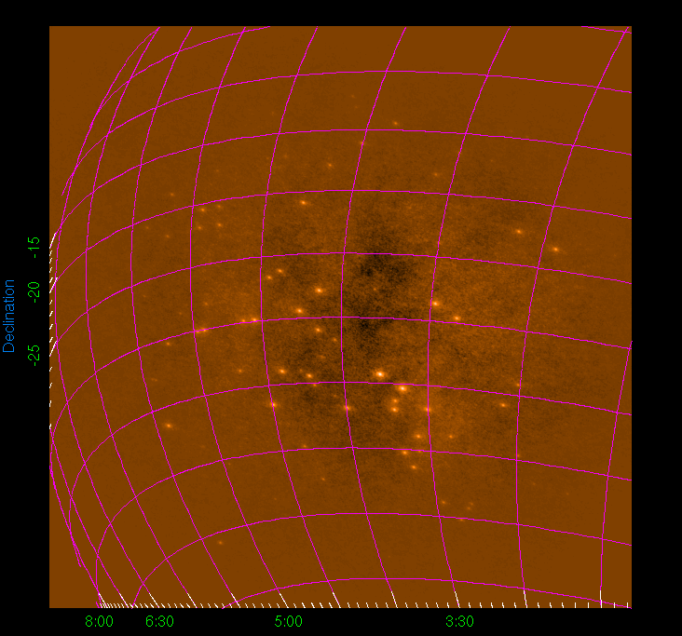
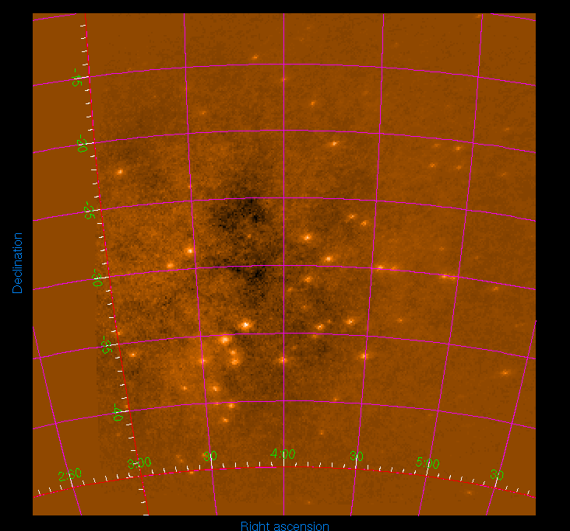
Wide FOV
(l,m) grid from FFT
ΔHA = ±3.5^{h} FOV = 45°
re-sample to a fixed coordinate frame
Demonstration for a fixed dipole array
courtesy D. Mitchell

Slide 41
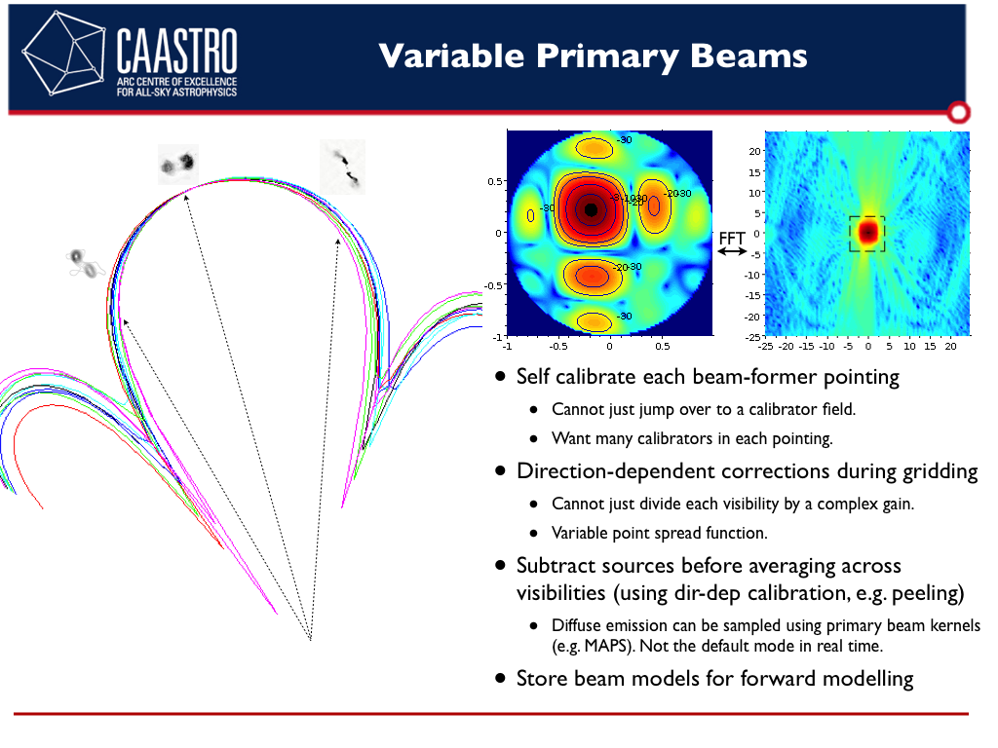
Gain Patterns
cutting edge
  A-projection in CASA (Bhatnagar, Rao)
  cuWARP package (Mitchell et al. 2012)
    MWA, LEDA
dipole arrays may admit variation in gain pattern, receptor to receptor
  downside of low cost
  downside of beam forming
    e.g., MWA, LOFAR
  mutual coupling
    e.g., LWA (Ellingson et al. 2012)
cannot repair via image-plane correction
can repair during gridding (u,v)
  convolve each visibility w/ a FT kernel representing the gain pattern
  different FT pair for each visibility! ($$)

Slide 42

Summary
low-frequency interferometry is wild
  challenges everywhere: sky brightness, confusion, ionospheric variability, RFI, FOV approaching 2 rad, and fundamental instrument calibration
  new algorithms & implementations are providing solutions
dish arrays: deep high resolution sky surveys
  active programs expand capability
dipole arrays: past 1st light – pursuing cosmology to exoplanets
  breaking all the rules of the game
    “…may I please have a high frequency, narrow band dataset on an isolated unpolarized pt source?”

Slide 43
Summary
This is our motivation:
- Dark Ages (spin decoupling)
- Epoch of Reionization (highly redshifted 21 cm lines)
- Early Structure Formation (high z RG)
- Large Scale Structure evolution (diffuse emission)
- Evolution of Dark Matter & Dark Energy (Clusters)
- Wide Field (up to all-sky) mapping
- Large Surveys
- Transient Searches (including extrasolar planets) (Hallinan talk)
- Galaxy Evolution (distant starburst galaxies)
- Interstellar Medium (CR, HII regions, SNR, pulsars)
- Solar Burst Studies
- Ionospheric Studies
- Ultra High Energy Cosmic Ray Airshowers
- Serendipity (exploration of the unknown)

Slide 45
-end-

