Slide 1
Analyzing Spectral Cubes
Calibration, Imaging and Analysis
David S. Meier (NMT)

Slide 2
Outline:
Why spectral line (multi-channel) observing?
  Not only for spectral lines, but there are many advantages for continuum experiments as well
Calibration specifics
  Bandpass, flagging, continuum subtraction
Imaging of spectral line data
Visualizing and analyzing cubes

Slide 3
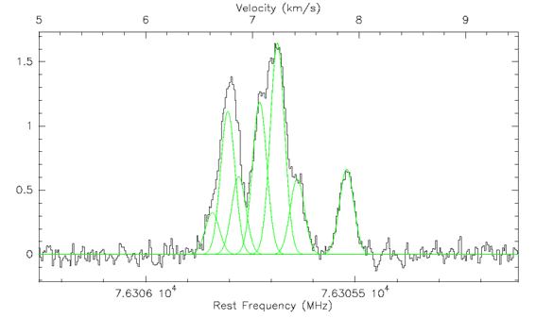
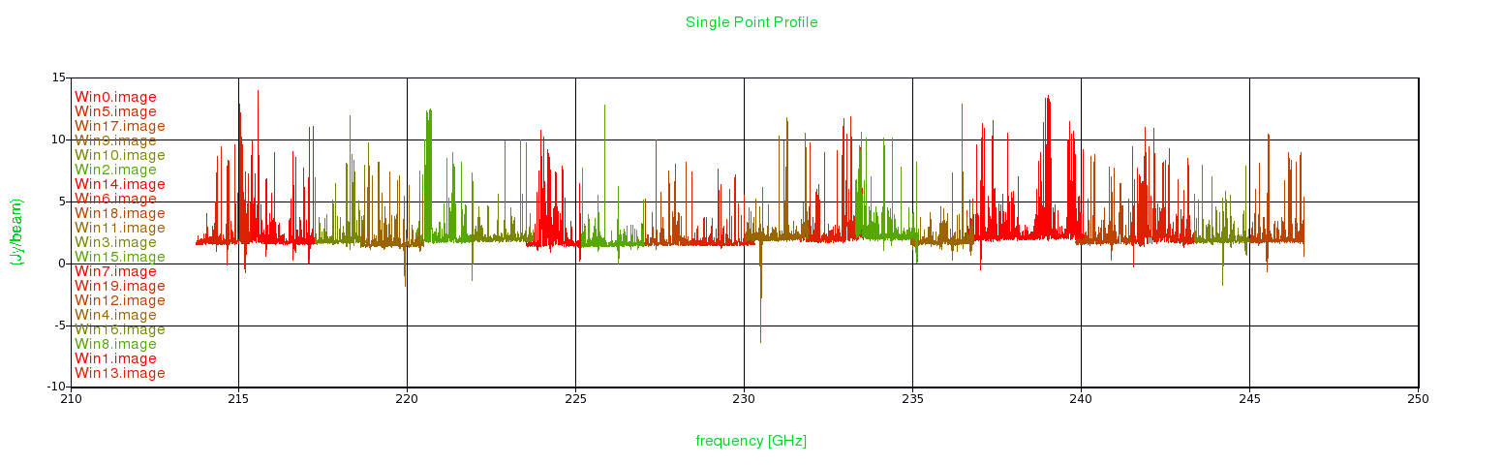
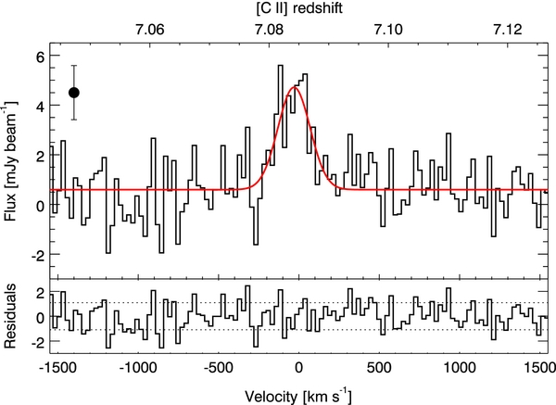
Radio Spectroscopy:
There is a vast array of spectral lines available, covering a wide range of science.
van der Tak et al. (2009)
ALMA SV – Orion KL
Courtesy A. Remijan
[CII] at a redshift of 7.1
Venemans et al. (2012)

Slide 4
Introduction:
Spectral line observers use many channels of width δν, over a total bandwidth Δν. Why?
Science driven: science depends on frequency (spectroscopy)
  Emission and absorption lines, and their Doppler shifts
  Ideally we would like δv < 1 km/s over bandwidths of several GHz which requires thousand and thousands of channels
    ALMA multiple lines: over 8 GHz, < 1km/s resolution~1 MHz ⇒ >8,000 channels
    EVLA HI absorption: 1-1.4 GHz, < 1km/s resolution ~4 kHz ⇒ >100,000 channels

Slide 5
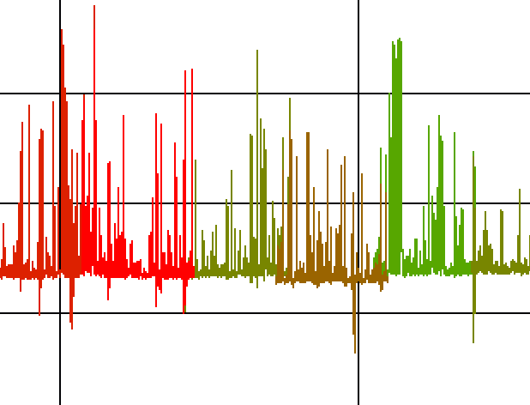
Radio Spectroscopy:
CM lines Both MM lines
Morphology and Kinematics
Atomic: HI
Molecular: CO, ¹³CO
Masers OH, H₂O, CH₃OH, SiO
Ionized: H186α – H50α
H42α – H22α
Dense Molecular Gas
HCN, HNC, HCO⁺, CS, NH₃, HC₃N
Chemistry
PDRs
Shocks & Outflows
Hot Cores
CH, CN, CCH, c-C₃H₂
SiO, CH₃OH, HNCO, H₂S
CH₃CN, ‘big floppy things’
http://www.physics.nmt.edu/Department/homedirlinks/dmeier/echemprimer/

Slide 6
Introduction:
Science driven: science depends on frequency (pseudo-continuum).
Want maximum bandwidth for sensitivity [Thermal noise ∝ 1/sqrt(Δν)]
  BUT achieving this sensitivity also requires high spectral resolution:
    Source contains continuum emission with a significant spectral slope across Δν
    Contaminating narrowband emission:
      line emission from the source
      RFI (radio frequency interference)
    Changes in the instrument with frequency
    Changes in the atmosphere with frequency
Technical reasons: science does not depend on frequency (pseudo-continuum) – particularly in the era of wide-band datasets
  Changing primary beam with frequency
  Limitations of bandwidth smearing

Slide 7
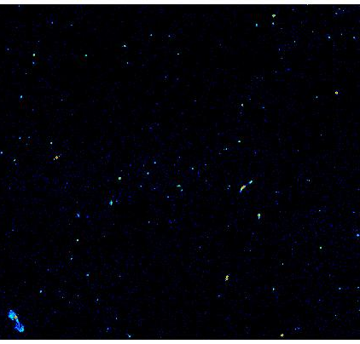
Effects of Broad Bandwidth:
Changing Primary Beam (θ_{PB} = λ/D)
    θ_{PB} changes by λ₁/λ₂
  More important at longer wavelengths:
  VLA 20 cm: 1.03 ; 2 cm: 1.003
  JVLA 20 cm: 2.0 ; 2 cm: 1.5
  ALMA 1mm: 1.03
2λ_{1}
λ₁

Slide 8
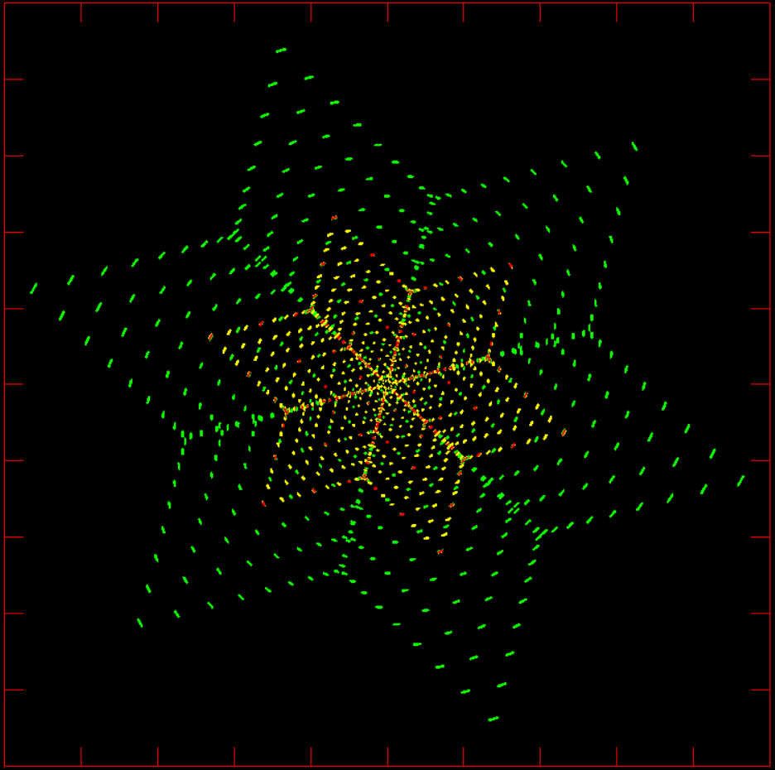
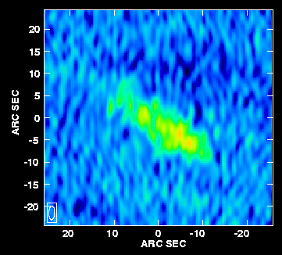
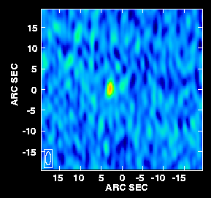
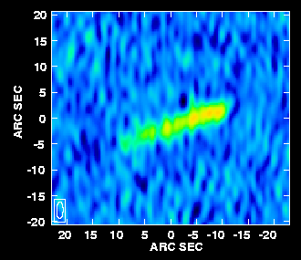
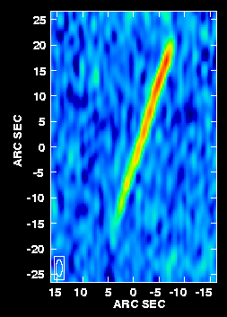
Effects of Broad Bandwidth:
(u,v) for JVLA A-array, ratio 2.0
Bandwidth Smearing (chromatic aberration)
Fringe spacing = λ/B
  Fringe spacings change by λ₁/λ₂
  u,v samples smeared radially
  More important in larger configurations, and for lower frequencies
Huge effects for JVLA
  Multi-frequency synthesis
11arcmin
18arcmin
VLA-A 6cm: 1.01
Courtesy C. Chandler

Slide 9
Spectroscopy with Interferometers (Simple):
s
s
Simplest concept: filter banks
Output from correlator is r(u,v,ν)
Very limited in its capabilities scientifically
b
ν₁
X
ν₁
ν₂
X
ν₂
ν₃
X
ν₃
ν₄
X
ν₄

Slide 10
Spectroscopy with Interferometers (Lag):
Lag (XF) correlator: introduce extra lag τ and measure correlation function for many (positive and negative) lags; FT to give spectrum
s
s
b
X
SIRA 2

Slide 11
Spectroscopy with Interferometers (Lag):
In practice, measure a finite number of lags, at some fixed lag interval, Δτ
Total frequency bandwidth = 1/(2Δτ)
For N spectral channels have to measure 2N lags (positive and negative), from −NΔτ to +(N−1)Δτ (zero lag included)
Spectral resolution δν = 1/(2NΔτ) (Nyquist)
Note: equal spacing in frequency, not velocity
Very flexible: can adjust N and Δτ to suit your science

Slide 12
Gibbs Ringing:
For spectroscopy in an XF correlator (EVLA) lags are introduced
  The correlation function is measured for a large number of lags.
  The FFT gives the spectrum.
We don't have an infinite amount of time, so we don't measure an infinite number of Fourier components.
A finite number or lags means a truncated lag spectrum, which corresponds to multiplying the true spectrum by a box function.
  The spectral response is the FT of the box, which for an XF correlator is a sinc(πx) function with nulls spaced by the channel separation: 22% sidelobes!
"Ideal" spectrum
Measured spectrum
Amp
Amp
Frequency
Frequency

Slide 13
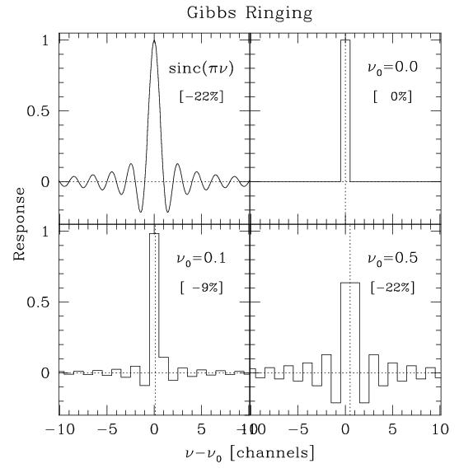
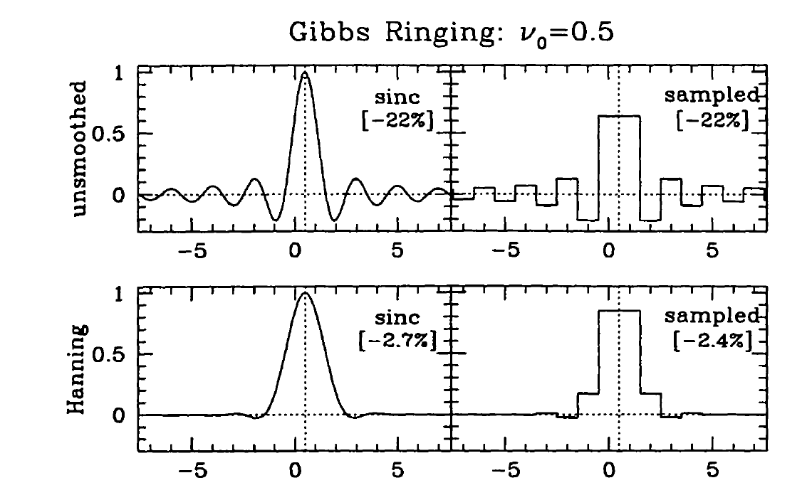
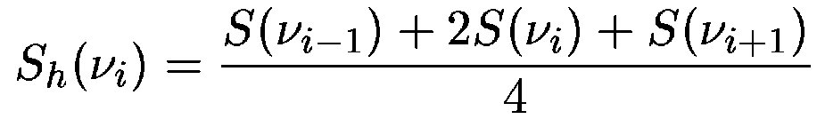
Gibbs Ringing (Cont.):
Sampled:
Increase the number of lags, or channels.
  Oscillations reduce to ~2% at channel 20, so discard affected channels.
  Works for band-edges, but not for spectral features.
Smooth the data in frequency (i.e., taper the lag spectrum)
  Usually Hanning smoothing is applied, reducing sidelobes to <3%.
SIRA 2

Slide 14
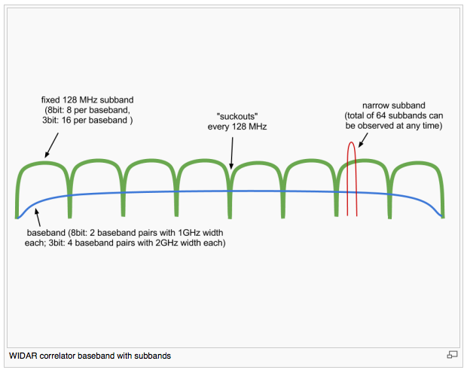
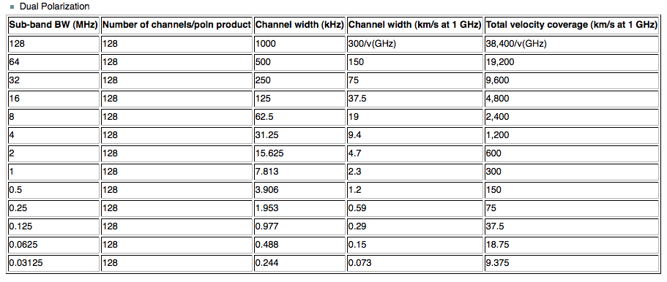
JVLA Spectral Line Capabilities:
2 x 1 GHz basebands
16 tunable subbands per baseband (except avoid suckouts) with between 0.03125 – 128 MHz
Dual polarization: Up to 2000 channels per subband (up to 16,384 per baseband)
  But data rate limitations
2 x 1 GHz
Up to 2000

Slide 15
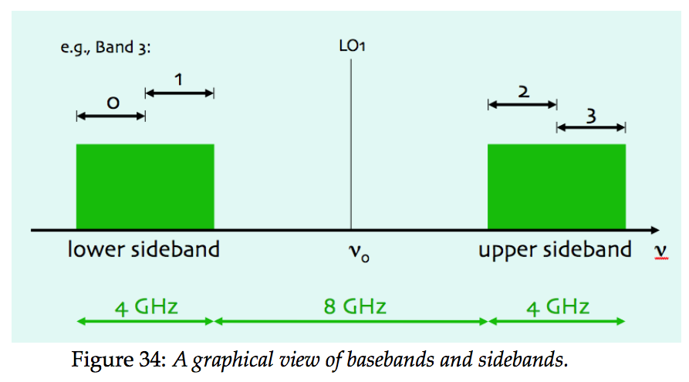
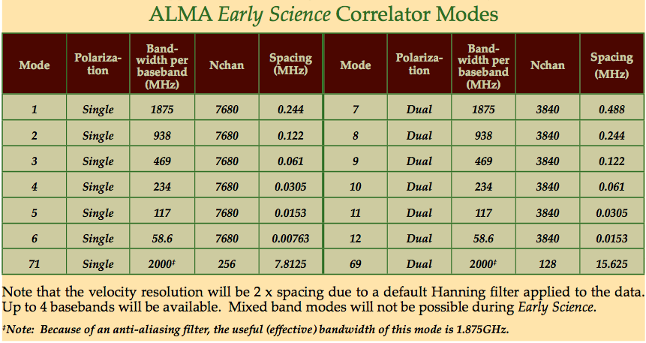
ALMA Spectral Line Capabilities:
Summary (Cycle 0):
  Band 3,7 (6): 2 x 4(5) GHz sidebands, separated by 8 (10) GHz
  4 x 2 GHz basebands, with 0,2,4 distributed per sideband
  1 Spectral Windows per baseband, for a total of up to 4
  For dual polarization, bandwidths of each spectral window range from 0.0586 – 2 GHz
  For dual polarization spectral resolution ranges from 0.0306 MHz – 0.976 MHz
  Single polarization: you can get ~7.5 GHz simultaneously at ≤1.5 km/s

Slide 16
Calibration:
Data editing and calibration is not fundamentally different from continuum observations, but a few additional items to consider:
  Bandpass calibration
  Presence of RFI (data flagging)
  Doppler corrections

Slide 17
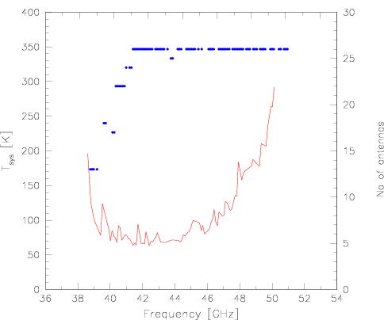
Calibration - Bandpass:
We need the total response of the instrument to determine the true visibilities from the observed visibilities:
      ^{obs}V_{ij}(t,ν) = G_{ij}(t,ν) V_{ij}(t,ν)
The bandpass shape is a function of frequency, and is mostly due to electronics of individual antennas.
    Atmosphere
    Front end system
    Cables
    Inacurate clocks and antenna positions
    Gibbs Phenomena
    But typically not standing waves
G/T @ 20cm
Tsys @ 7mm JVLA

Slide 18
Calibration - Bandpass (cont.):
      Usually varies slowly with time, so we can break the complex gain G_{ij}(t) into a fast varying frequency independent part, G’_{ij}(t) and a slowly varying frequency dependent part, B_{ij}(t,ν).
G_{ij}(t,ν) = G’_{ij}(t) B_{ij}(t,ν)
The demands on B_{ij}(t) are different from those of G’_{ij}(t,ν).
  G’_{ij}(t): point source, near science target
  B_{ij}(t,ν): very bright source, no spectral structure, does not need to be a point source (though preferable).
Observe a bright calibrator with the above properties at least once during an observation
  Sometimes a noise source is used to BP, especially at high frequencies and when channels are very narrow
    Still observe a BP calibrator
Bij(t,ν) can often be solved on an antenna basis: B_{ij}(t,ν) = b_{i}(t,ν)b_{j}*(t,ν)
  Computationally less expensive
  Solutions can be found for antennas even with missing baselines

Slide 19
Calibration - Bandpass (Issues):
Important to be able to detect and analyze spectral features:
  Frequency dependent phase errors can lead to spatial offsets between spectral features, imitating Doppler motions.
      Rule of thumb: θ/θ_{B} ≅ Δϕ/360º
  Frequency dependent amplitude errors can imitate changes in line structures.
    Need to spend enough time on the BP calibrator so that SNR_{BPcal} >> SNR_{target}.
      Rule of thumb: t_{BPcal} > 9×(S_{target} /S_{BPcal})² t_{target}
      When observing faint lines superimposed on bright continuum more stringent bandpass calibration is needed.
        SNR on continuum limits the SNR achieved for the line
For pseudo-continuum, the dynamic range of final image is limited by the bandpass quality.

Slide 20
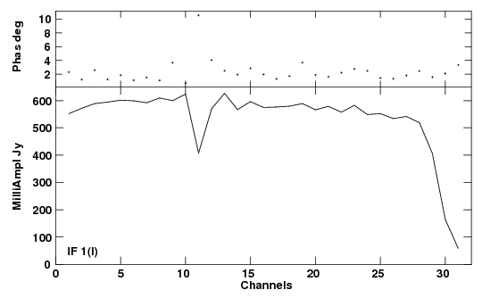
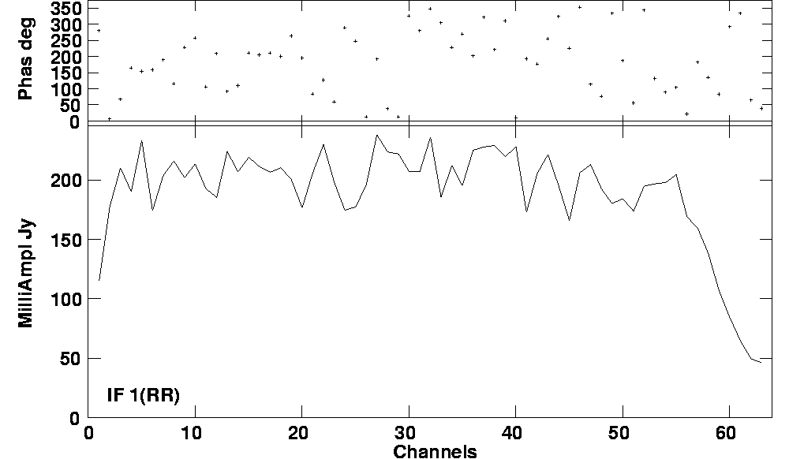
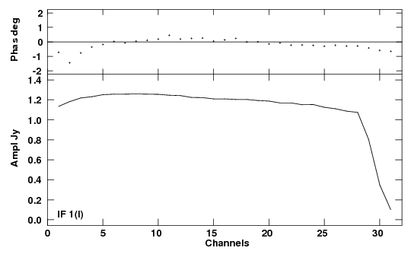
Calibration - Bandpass:
Solutions should look comparable for all antennas.
Mean amplitude ~1 across useable portion of the band.
No sharp variations in amplitude and phase; variations are not dominated by noise.
Not good, line feature
Too weak
Good

Slide 21
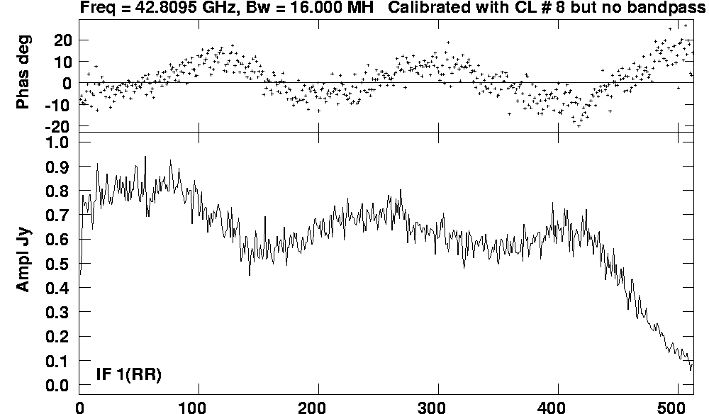
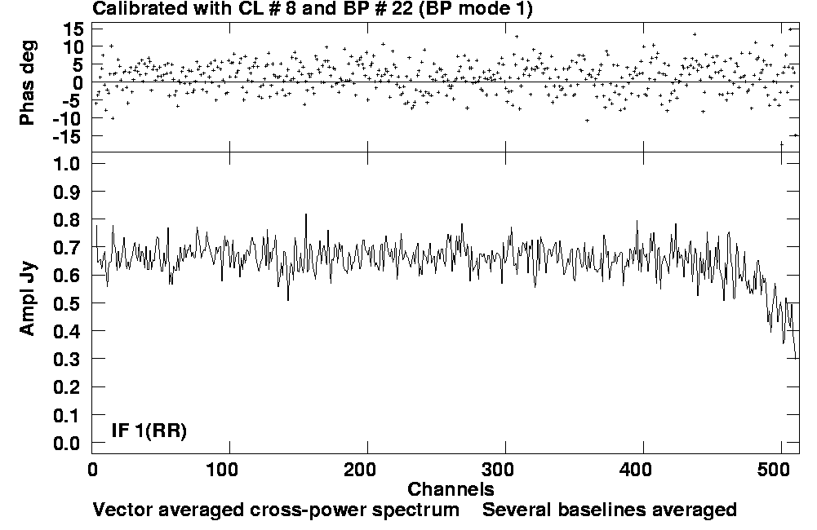
Calibration - Bandpass:
Always check BP solutions: apply to a continuum source and use cross-correlation spectrum to check:
  That phases are flat
  That amplitudes are constant across band (continuum)
  Absolute fluxes are reasonable
  That the noise is not increased by applying the BP
Before bandpass calibration
After bandpass calibration
Courtesy L. Matthews

Slide 22
Calibration:
Data editing and calibration is not fundamentally different from continuum observations, but a few additional items to consider:
  Bandpass calibration
  Presence of RFI (data flagging)
  Doppler corrections
  Correlator setup

Slide 23
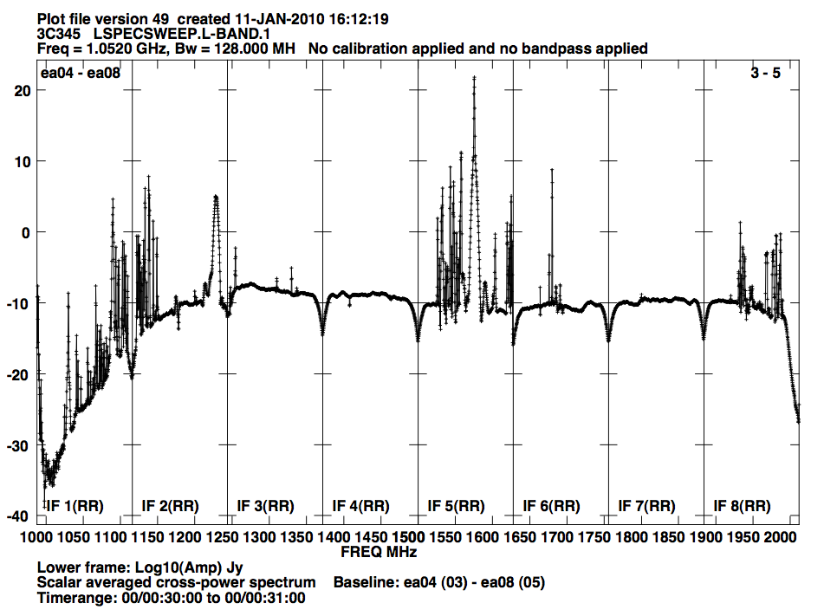
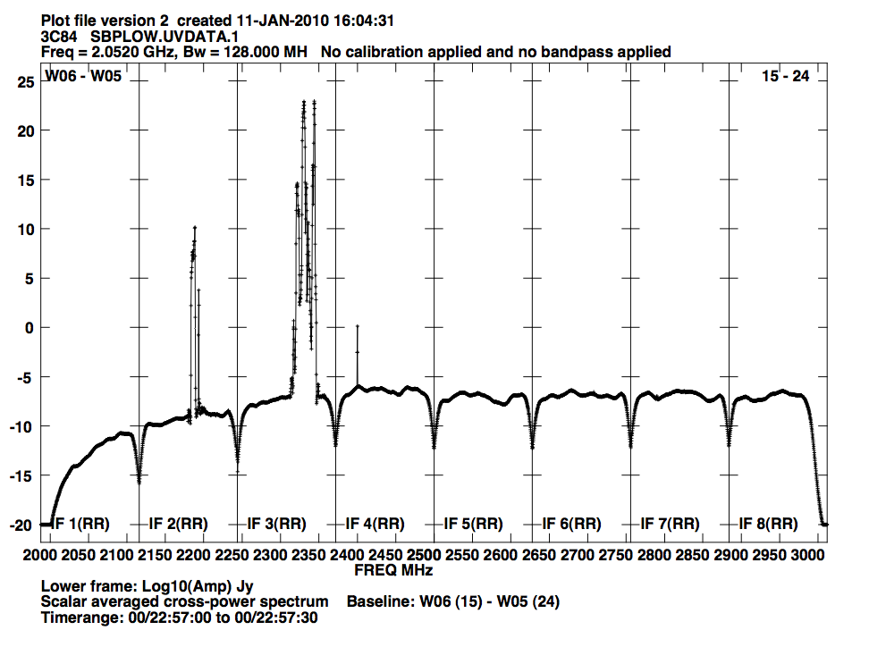
Flagging Spectral Line Data (RFI):
Primarily a low frequency problem (for now)
Avoid known RFI if possible, e.g. by constraining your bandwidth (if you can)
Use RFI plots posted online for JVLA & VLBA
RFI at the JVLA L-Band
RFI at the JVLA S-Band

Slide 24
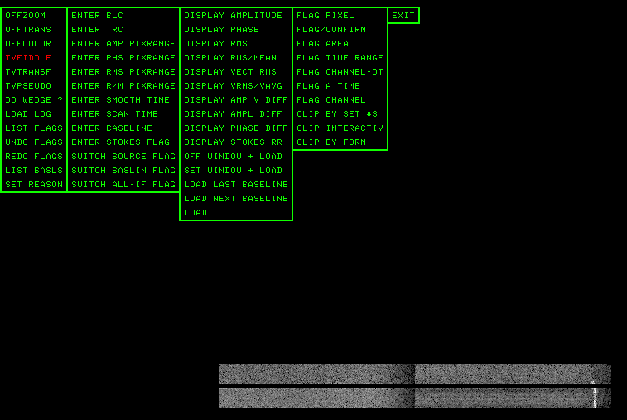
Flagging Spectral Line Data:
Start with identifying problems affecting all channels, but using a frequency averaged 'channel 0' data set.
  Has better signal-to-noise ratio (SNR)
  Copy flag table to the line data
Continue checking the line data for narrow-band RFI that may not show up in averaged data.
  Channel by channel is very impractical, instead identify features by using cross- and total power spectra (POSSM)
  Avoid extensive channel by channel editing because it introduces variable (u,v) coverage and noise properties between channels (AIPS: SPFLG, CASA:MSVIEW)
time
channel

Slide 25
Calibration:
Data editing and calibration is not fundamentally different from continuum observations, but a few additional items to consider:
  Bandpass calibration
  Presence of RFI (data flagging)
  Doppler corrections

Slide 26
Doppler Tracking:
Observing from the surface of the Earth, our velocity with respect to astronomical sources is not constant in time or direction.
Doppler tracking can be applied in real time to track a spectral line in a given reference frame, and for a given velocity definition:
      V_{rad} = c (ν_{rest} –ν_{obs})/ν_{rest} (approximations to relativistic formulas)
      V_{opt} = c (ν_{rest} –ν_{obs})/ν_{obs} = cz
    Differences become large as redshift increases
    For the V_{opt} definition, constant frequency increment channels do not correspond to constant velocities increment channels

Slide 27
Doppler Tracking:
Note that the bandpass shape is really a function of frequency, not velocity!
  Applying Doppler tracking will introduce a time-dependent and position dependent frequency shift.
  If differences large, apply corrections during post-processing instead.
  With wider bandwidths are now common (JVLA, SMA, ALMA) online Doppler setting is done but not tracking (tracking only correct for a single frequency).
Doppler tracking is done in post-processing (AIPS/CASA: CVEL/CLEAN)
  Want well resolved lines (>4 channels across line) for good correction
Amp
Amp
Channel
Channel

Slide 28
Velocity Reference Frames:
Correct for | Amplitude | Rest frame
Nothing | 0 km/s | Topocentric
Earth rotation | < 0.5 km/s | Geocentric
Earth/Moon barycenter | < 0.013 km/s | E/M Barycentric
Earth around Sun | < 30 km/s | Heliocentric
Sun/planets barycenter | < 0.012 km/s | SS Barycentric (~Heliocentric)
Sun peculiar motion | < 20 km/s | Local Standard of Rest
Galactic rotation | < 300 km/s | Galactocentric
Start with the topocentric frame, the successively transform to other frames. Transformations standardized by IAU.

Slide 29
Imaging:
We have edited the data, and performed bandpass calibration. Also, we have done Doppler corrections if necessary.
Before imaging a few things can be done to improve the quality of your spectral line data
  Image the continuum in the source, and perform a self-calibration. Apply to the line data:
    Get good positions of line features relative to continuum
    Can also use a bright spectral feature, like a maser
  For line analysis we want to remove the continuum

Slide 30
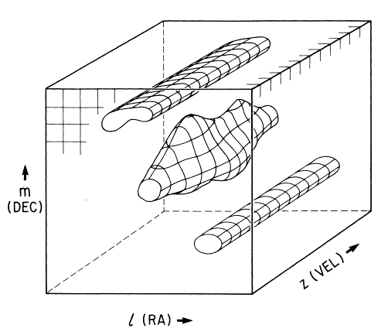
Continuum Subtraction:
Spectral line data often contains continuum emission, either from the target or from nearby sources in the field of view.
  This emission complicates the detection and analysis of lines
    Easier to compare the line emission between channels with continuum removed.
Use channels with no line features to model the continuum
  Subtract this continuum model from all channels
Always bandpass calibrate before continuum subtracting
Deconvolution is non-linear: can give different results for different channels since u,v - coverage and noise differs
  results usually better if line is deconvolved separately
Continuum subtraction changes the noise properties of the channels
Roelfsma 1989
Spectral line cube with two continuum sources (structure independent of frequency) and one spectral line source.

Slide 31
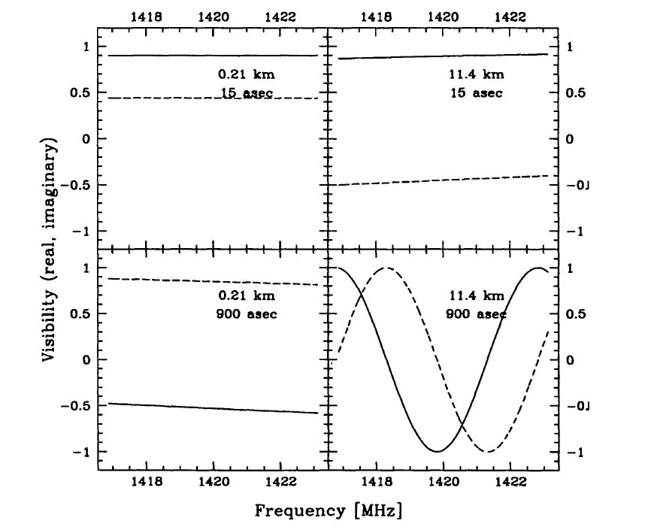
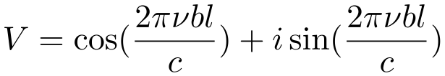
Continuum Subtraction (UVLIN):
A low order polynomial is fit to a group of line free channels in each visibility spectrum, the polynomial is then subtracted from whole spectrum.
Advantages:
  Fast, easy, robust
  Corrects for spectral index across spectrum
  Can do flagging automatically (based on residuals on baselines)
  Can produce a continuum data set
Restrictions:
  Fitted channels should be line free (a visibility contains emission from all spatial scales)
  Only works well over small field of view
      θ << θ_{B} ν / Δν_{tot}
SIRA 2
For a source at distance l from phase center observed on baseline b:

Slide 32
Continuum Subtraction (IMLIN):
Fit and subtract a low order polynomial fit to the line free part of the spectrum measured at each spatial pixel in cube.
Advantages:
  Fast, easy, robust to spectral index variations
  Better at removing point sources far away from phase center (Cornwell et al.1992).
  Can be used with few line free channels.
Restrictions:
  Can't flag data since it works in the image plane.
  Line and continuum must be simultaneously deconvolved.

Slide 33
Continuum Subtraction (UVSUB):
A visibility + imaging based method
  Deconvolve the line-free channels to make a ‘model’ of the continuum
  Fourier transform and subtract from the visibilities
Advantages:
  Accounts for chromatic aberration
  Channel-based flagging possible
  Can be effective at removing extended continuum over large fields of view
Restrictions:
  Computationally expensive
  Errors in the ‘model’ (e.g. deconvolution errors) will introduce systematic errors in the line data

Slide 34
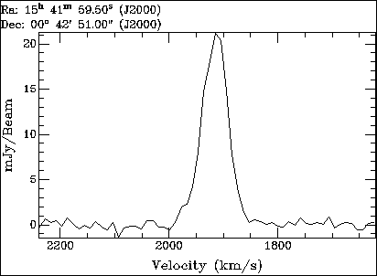
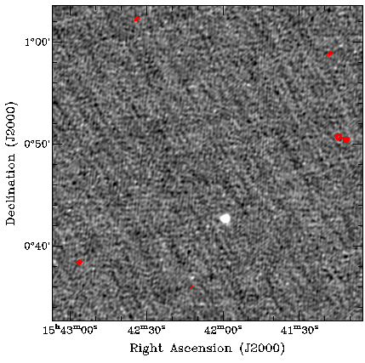
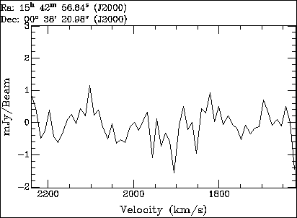
Continuum Subtraction:
Again check results: Look at spectrum with POSSM, and later (after imaging) check with ISPEC: no continuum level, and a flat baseline.
Courtesy L. Matthews

Slide 35
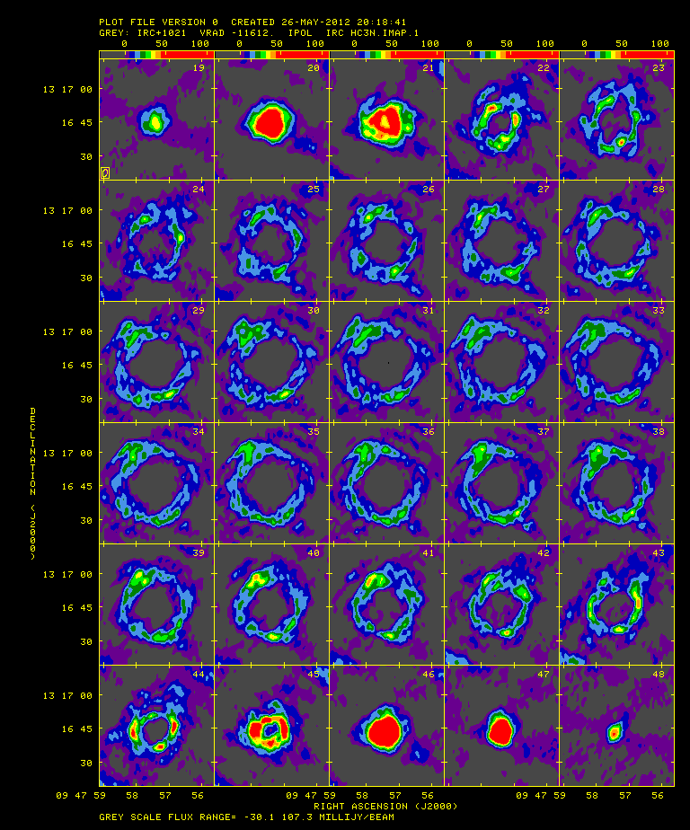
Deconvolution (Spectral Line):
CLEANing:
  Remove sidelobes that would obscure faint emission (masers, significant extended emission)
  Interpolate to zero spacings to estimate flux
Deconvolution poses special challenges
  Spectral line datasets are inherently detailed comparisons of the morphology of many maps
  Emission structure can change radically from channel to channel
  Large data volumes / computationally expensive
HC₃N – IRC 10216
EVLA spectral line tutorial

Slide 36
Deconvolution (Spectral Line):
Spatial distribution of emission changes from channel to channel:
    Try to keep channel-to-channel deconvolution as similar as possible (same restoring beam, same CLEANing depth, etc.)
    May have to change cleaning boxes from channel to channel
  Want both:
    Sensitivity for faint features and full extent of emission
    High spectral & spatial resolution for kinematics
      Averaging channels will improve sensitivity but may limit spectral resolution
      Choice of weighting function will affect sensitivity and spatial resolution
        Robust weighting with -1<R <1 is often a good compromise
  Interferometer response is sensitive to velocity structure of object
    Response to continuum and spectral line is not necessarily the same

Slide 37
Smoothing (Spectral Line):
In frequency:
Smoothing in frequency can improve S/N in a line if the smoothing kernel matches the line width ("matched filter").
  And reduce your data size (especially if you oversampled)
  Smoothing doesn’t propagate noise in a simple way
    Example: data are Hanning smoothed to diminish Gibbs ringing
      Spectral resolution will be reduced from 1.2Δν to 2.0Δν
      Noise equivalent bandwidth is now 2.67Δν
      Adjacent channels become correlated: ~16% between channels i and i+1; ~4% between channels i and i+2.
Spatially:
Smoothing data spatially (through convolution in the image plane or tapering in the u-v domain) can help to emphasize faint, extended emission.
  This only works for extended emission.
  Cannot recover flux you didn’t sample

Slide 38
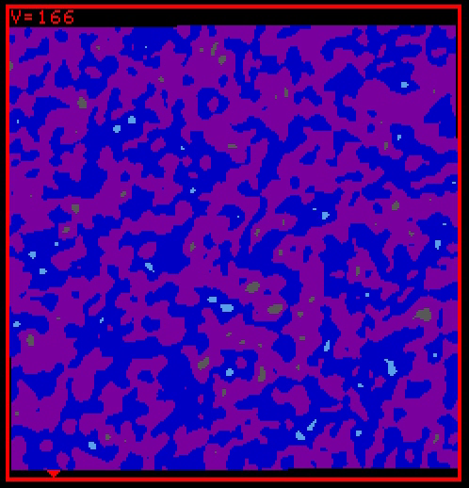
Visualizing Spectral data:
Imaging will create a spectral line cube, which is 3-dimensional: RA, Dec and Velocity.
Movies:
HI - NGC 3741
Courtesy J. Ott (VLA-ANGST)

Slide 39
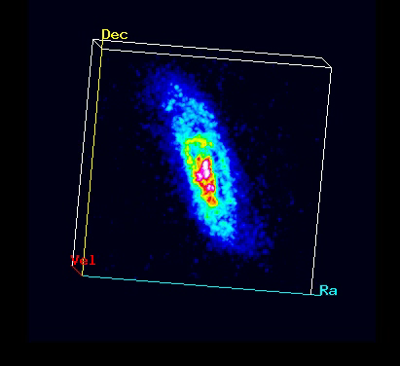
Visualizing Spectral data:
Imaging will create a spectral line cube, which is 3-dimensional: RA, Dec and Velocity.
HI – NGC 3741
  3rd axis not the same as the first two
3-D Rendering:
Displayed with the ‘xray’ program in the visualization package ‘Karma’
(http://www.atnf.csiro.au/computing/software/karma/)

Slide 40
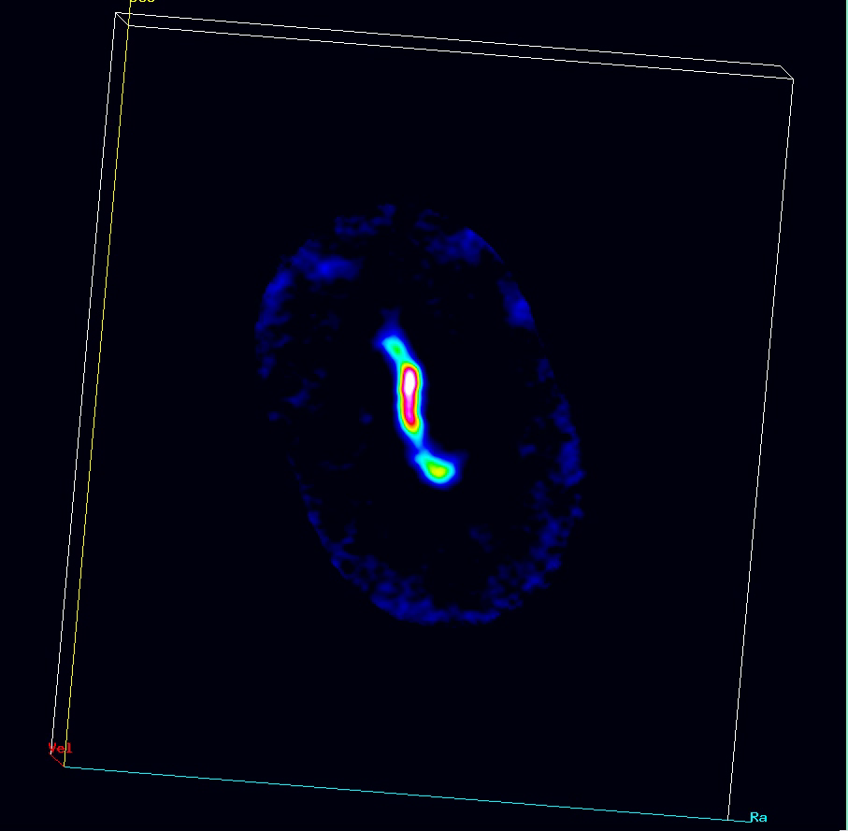
Visualizing Spectral data:
Imaging will create a spectral line cube, which is 3-dimensional: RA, Dec and Velocity.
¹³CO(1-0) – Maffei 2
3-D Rendering:
Displayed with the ‘xray’ program in the visualization package ‘Karma’
(http://www.atnf.csiro.au/computing/software/karma/)
Meier et al. (2008)

Slide 41
Channel Maps:
HC₃N – IRC 10216
Channel maps show how the spatial distribution of the line feature changes with frequency/velocity.
CASA spectral line tutorial

Slide 42
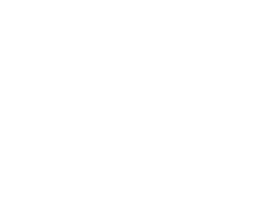
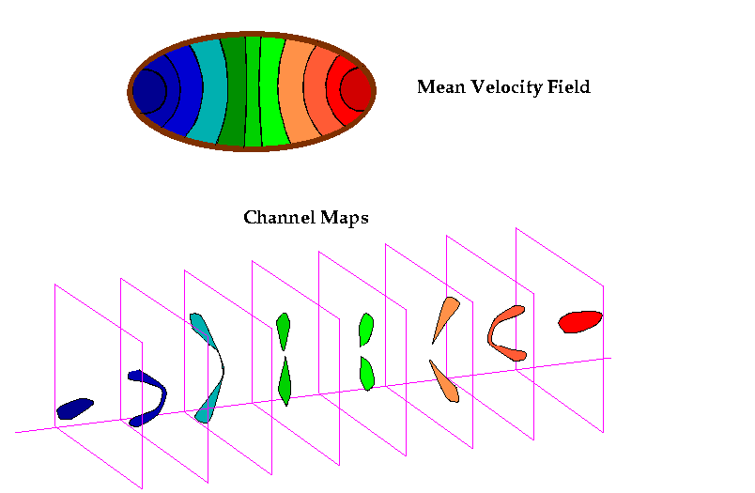
Inclined Disks:
‘Butterfly Pattern’:
+V_{cir} sin i cosΘ
+V_{cir} sin i
Θ
-V_{cir} sin i
-V_{cir} sin i cosΘ

Slide 43
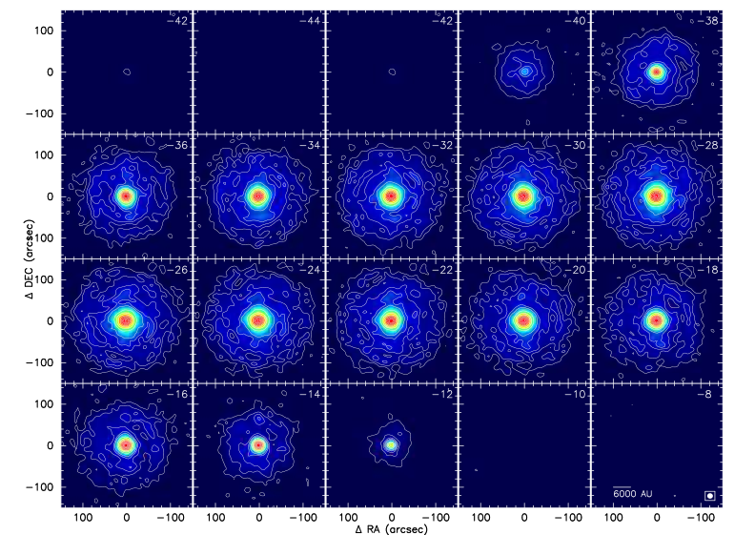
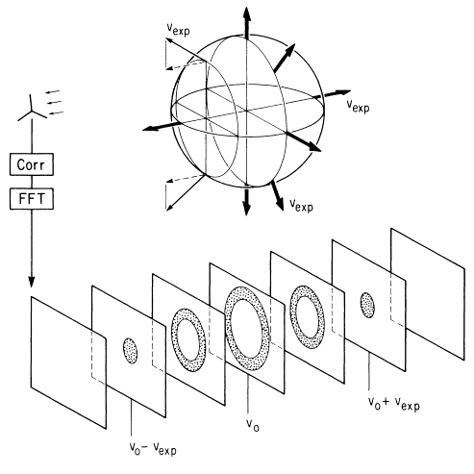
Spherical Shells:
CO(1-0) – IRC 10216
Fong et al. (2003)

Slide 44
Visualizing Spectral data:
Imaging will create a spectral line cube, which is 3-dimensional: RA, Dec and Velocity.
With the cube, we usually visualize the information by making 1-D or 2-D projections:
  Moment maps (integration along the velocity axis)
  Line profiles (1-D slices along velocity axis)
  Channel maps (2-D slices along velocity axis)
  Position-velocity plots (slices along spatial dimension)
  Renzograms (superposed contours of different channels)

Slide 45
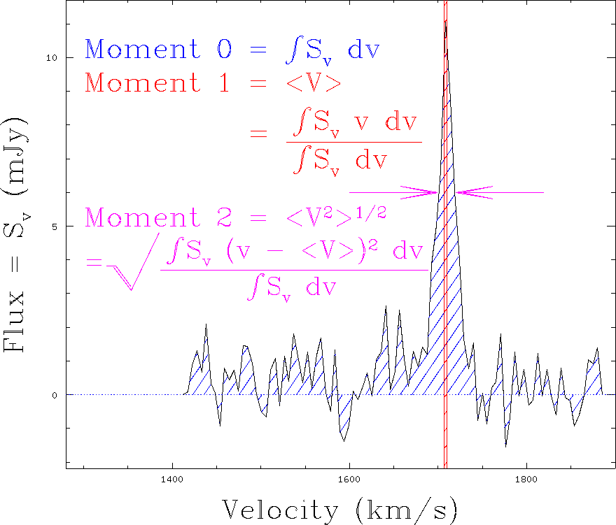
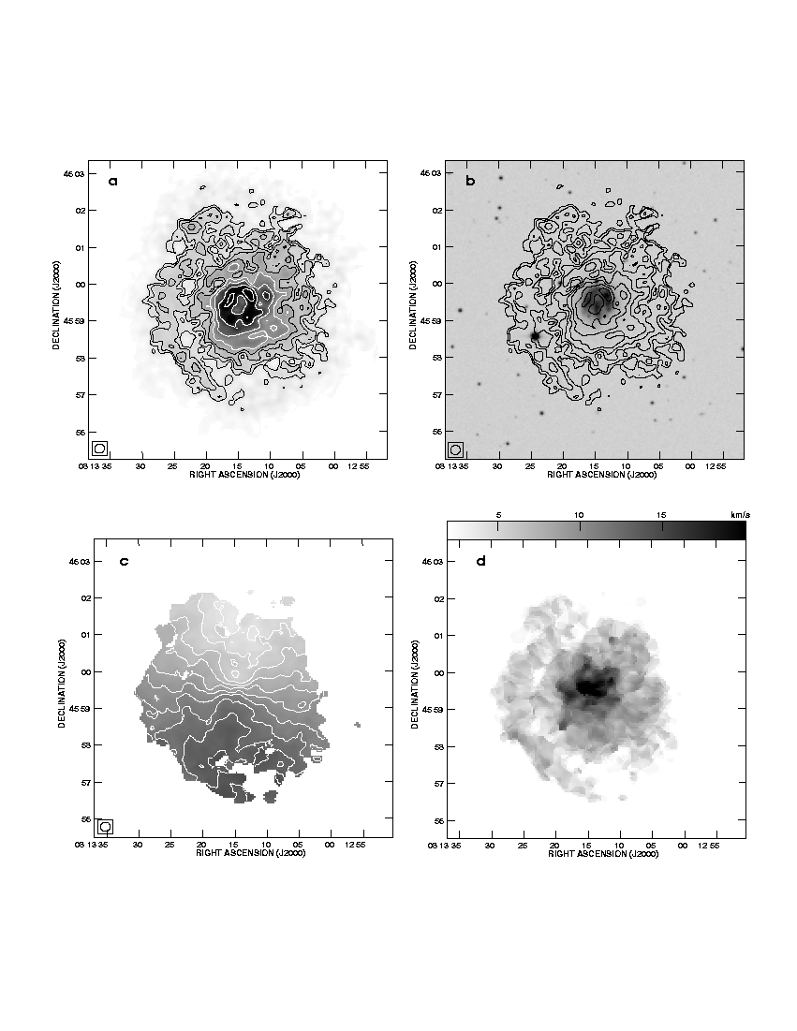
Moment Maps:
You might want to derive parameters such as integrated line intensity, centroid velocity of components and line widths - all as functions of positions. Estimate using the moments of the line profile:
Courtesy L. Matthews
Moment 0 Moment 1 Moment 2
(Total Intensity) (Velocity Field) (Velocity Dispersion)

Slide 46
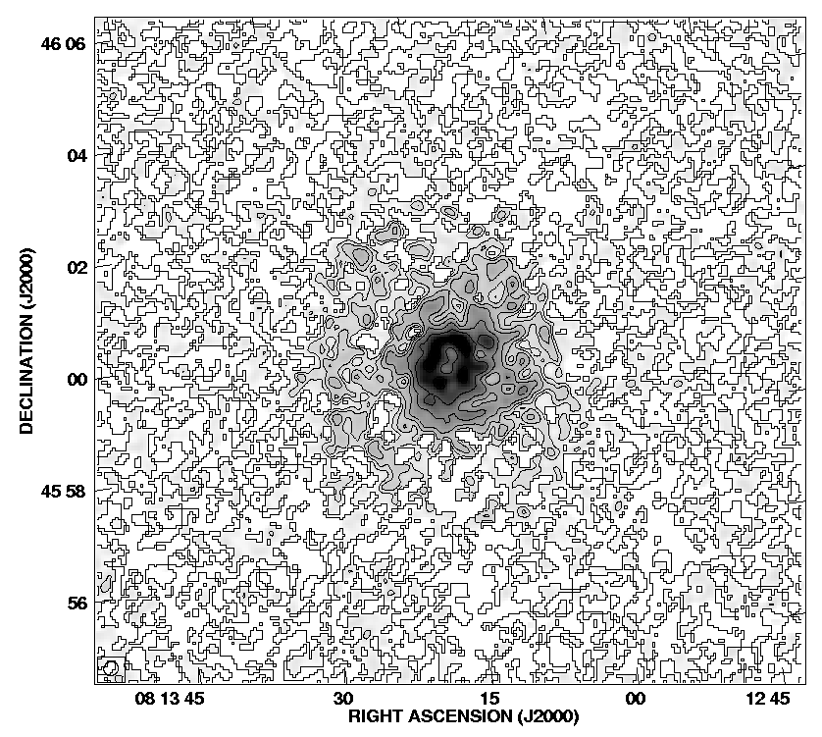
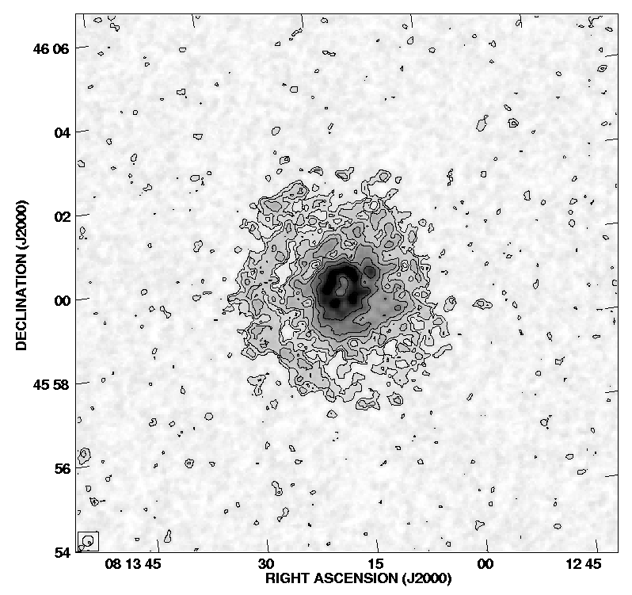
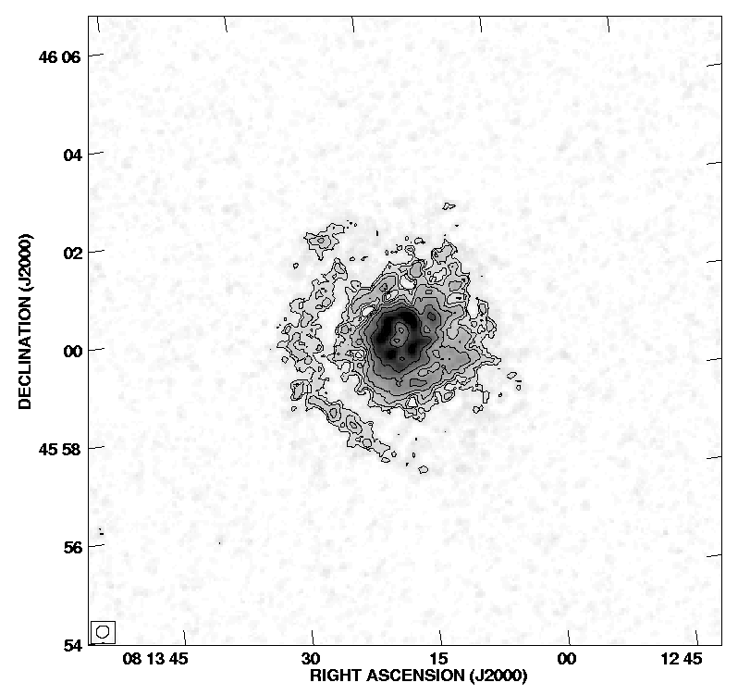
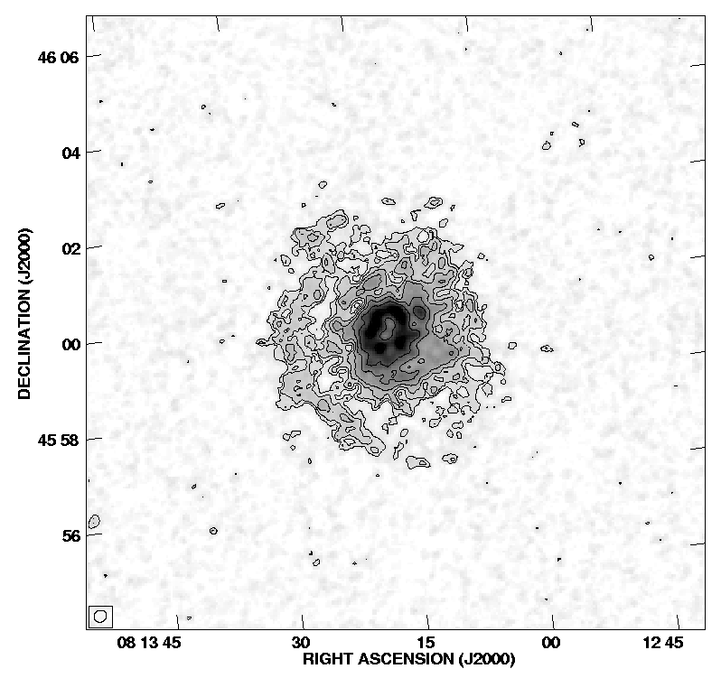
Moment Map Issues:
Moments sensitive to noise so clipping is required
  Higher order moments depend on lower ones so progressively noisier.
Straight sum of
all channels
containing
line emission
Summed after
clipping below 1σ
Summed after
clipping below 2σ
Clipping below
1 σ, but based on masking with a cube smoothed x2 spatially and spectrally
Courtesy L. Matthews

Slide 47
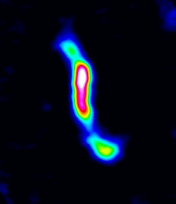
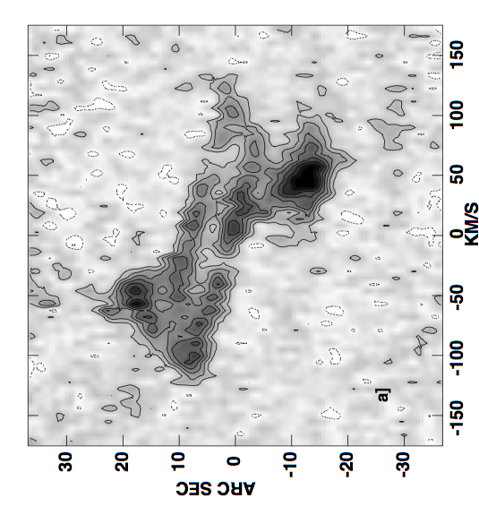
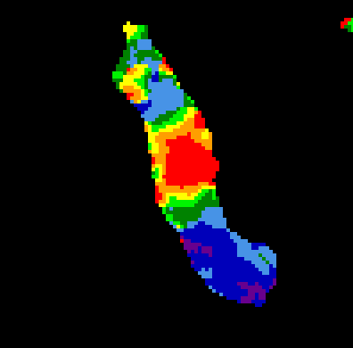
Moment Map Issues (cont.):
Hard to interpret correctly:
  Non-monotomic emission/absorption or velocity patterns lead to misleading moment maps
  Biased towards regions of high intensity.
  Complicated error estimates: number or channels with real emission used in moment computation will greatly change across the image.
Use as guide for investigating features, or to compare with other λ.
Moment 0
Moment 2
Meier et al. (2008)

Slide 48
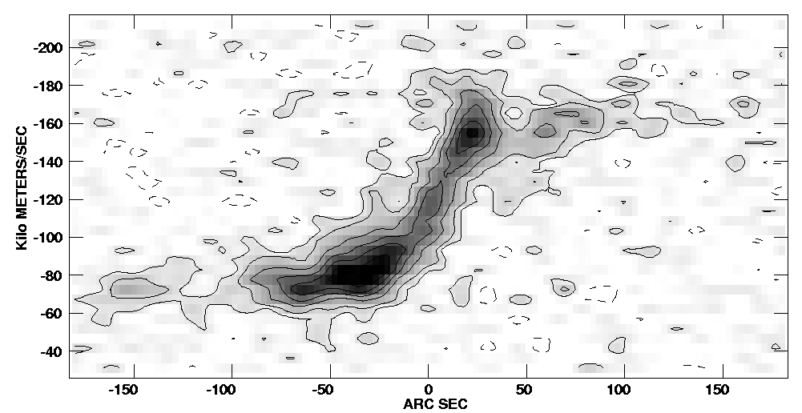

Position-Velocity diagrams:
Courtesy L. Matthews
PV-diagrams show, for example, the line emission velocity as a function of radius.
  Here along a line through the dynamical center of the galaxy
Velocity profile
Meier et al. (2008)
Distance along slice

Slide 49


Renzograms:
Hatchell et al. (2007)
Contour selected planes (usually redshifted, systemic and blueshifted), and superpose onto one plane
  Often done when velocity structure is very simple or very complex
Zuckerman et al. (2008)

Slide 50

Line profiles (spectra):
3
3
1
4
10
5
2
6
11
Line profiles show changes in line shape, width and depth as a function of position.
  AIPS task ISPEC
7
12
4
8
13
9
10
5
1
11
6
2
12
7
13
8
9
Courtesy Y. Pihlstrom

Slide 51

Going the Way of the
Many (most?) of these techniques are likely to have to go the way of the dinosaur with the datasets on the horizon
  A 16,000 channel cube played at 10 frames/sec will take ~30 min!
  Anyone interested in generating (and comparing) 4000 moment 0 maps?
We need new visualization tools
  3D slicers
  Volume Rendering
  Isosurface analysis
    Clumpfind
More sophisticated analysis tools:
  Direct modeling of velocity fields
  Principle Component Analysis
  Fractal properties
  Global spectrum fitting (line identification)

Slide 52
Summary:
Most synthesis observations are now ‘spectral line’ observations
  With most new instruments observing is in multi-channel mode:
  Large bandwidths implying bandwidth smearing effects
  RFI removal necessary (see talk later in the week)
  Must correct for atmospheric and instrumental gain variations
Better, it also implies:
  Avoid line contamination
  Much improved line searches
  Multi-frequency synthesis
  enabled
Have fun ---There are plenty of spectral lines out there !!!

Slide 53
References:
Cornwell et al. 1992, A&A, 258, 583
Fong et al. 2003, ApJL, 582, L39
Hatchell et al. 2007, A&A, 472, 187
Helfer et al. 2003, ApJS, 145, 259
Meier et al. 2008, ApJ, 675, 281
Roelfsma 1989, SIRA I
SIRA 2 1998, Ed. Taylor, Carilli, Perley, chp. 11-12
Van der Tak et al. 2009, A&A, 507, 347
Venemans et al. 2012, ApJL, 751, L25
Zuckerman et al. 2008, ApJ, 683, 1085

