Slide 1
Practicalities of Radio Interferometry
Rick Perley, NRAO/Socorro

Slide 2
Topics
Practical Extensions to the Theory:
  Finite bandwidth
  Rotating reference frames (source motion)
  Finite time averaging
  Local Oscillators and Frequency Downconversion
Coordinate systems
  Direction cosines
  2-D (‘planar’) interferometers
  3-D (‘volume’) interferometers
U-V Coverage and synthesized beams.

Slide 3
Review
In the previous lecture, I set down the principles of Fourier synthesis imaging.
I showed:
  Where the intensity I_{ν} is a real function, and the visibility V(b) is complex and Hermitian.
The model used for the derivation was idealistic:
  Signals are Quasi-Monochromatic
  ‘RF’ signal throughout
  Stationary source and reference frame.
We now relax, in turn, these restrictions.

Slide 4
The Effect of Bandwidth.
Real interferometers must accept a range of frequencies. So we now consider the response of our interferometer over frequency.
Define the frequency response functions, G(ν), as the amplitude and phase variation of the signal over frequency.
The function G(ν) is primarily due to the gain and phase characteristics of the electronics, but can also contain propagation path effects.
G(ν) is a complex function, describing both amplitude and phase variations of the signal paths.
Δν
G
ν
ν₀

Slide 5
The Effect of Bandwidth.
To find the finite-bandwidth response, we integrate our fundamental response over a frequency width Δν, centered at ν₀:
If the source intensity does not vary over the bandwidth, and the instrumental gain parameters G₁ and G₂ are square and identical, then
Where I have assumed |G|=1, and
the fringe attenuation function, sinc(x), is defined as:

Slide 6
The Bandwidth/FOV limit
This shows that the source emission is attenuated by the spatially variant function sinc(x), (also known as the ‘fringe-washing’ function).
The attenuation is small when:
which occurs when the source offset θ is less than: (exercise for the student)
The ratio ν₀/Δν is the inverse fractional bandwidth – for the EVLA, this ratio is never less than ~500.
The fringe attenuation is total (zero response) when x=1, or:
Independent of frequency!!!

Slide 7
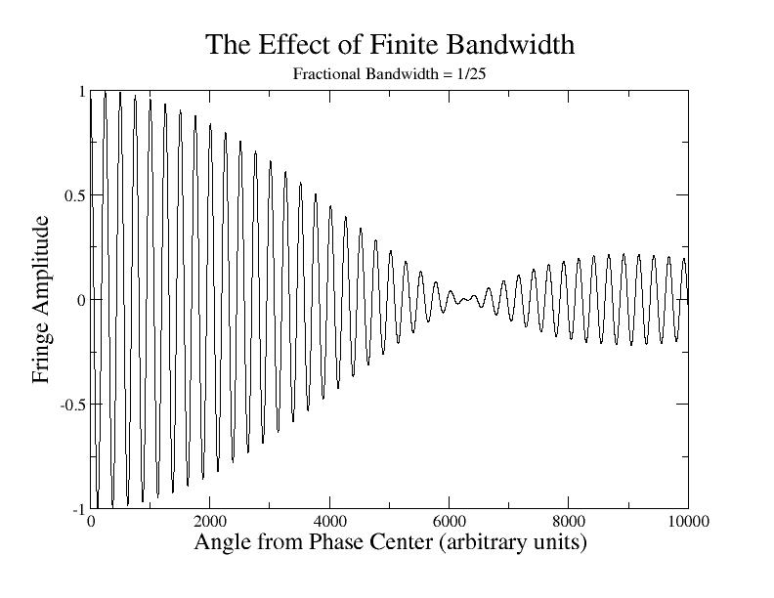
Bandwidth Effect Example
For a square bandpass, the bandwidth attenuation reaches a null at an angle equal to the fringe separation divided by the fractional bandwidth: Δν/ν₀.
For the old VLA, and its 50 MHz bandwidth, the null was ~1.3 degrees away.
For the EVLA, Δν = 2 MHz, and B = 35 km, then the null occurs at about 27 degrees off the meridian.
Fringe Attenuation function:
Note: The fringe-attenuation function depends only on bandwidth and baseline length – not on frequency.

Slide 8
Observations off the Meridian
In our basic scenario -- stationary source, stationary interferometer -- the effect of finite bandwidth will strongly attenuate the visibility from sources far from the meridional plane.
Since each baseline has its own plane, the only point on the sky free of attenuation is a small angle around the zenith.
Suppose we wish to observe an object far from that plane?
One solution is to use a very narrow bandwidth – this loses sensitivity, which can only be made up by utilizing many channels – feasible, but computationally expensive.
Better answer: Shift the fringe-attenuation function to the center of the source of interest.
How? By adding time delay.

Slide 9
The Effect of Adding Time Delay, τ₀
s₀
s
s₀
s
S₀ = reference (delay)
direction
S = general
direction
τ₀
τ_{g}
b
A sensor
X
τ₀
The entire fringe pattern has been shifted over by angle
sin θ = cτ₀/b

Slide 10
Illustrating Delay Tracking
Top Panel:
  Delay has been added and subtracted to move the delay pattern to the source location.
Bottom Panel:
  A cosinusoidal sensor pattern is added, to illustrate losses from a fixed sensor.

Slide 11
Observations from a Rotating Platform
Real interferometers are built on the surface of the earth – a rotating platform. From the observer’s perspective, sources move across the sky.
Since we know that adding delay moves its coherence pattern to the direction of interest, we simply add the delay needed to steer the pattern in the direction we want.
The accuracy must be better than 1/Δν seconds to minimize bandwidth decorrelation (500 microseconds for 2 MHz bandwidth.)
For the ‘radio-frequency’ interferometer we are discussing here, this will automatically track both the fringe pattern and the fringe-washing function with the source.
If, however, the delay cannot be continuously slipped, but must be inserted in steps, then to track the phase, the rate of delay steps must be quite rapid.
For 1 degree accuracy, the delays must be reset every 38λ/B seconds (38 microseconds for a 1 million wavelength baseline.

Slide 12
Time Averaging Loss
So – we can track a moving source, occasionally (or frequently) adjusting the delay to track the fringes and to prevent bandwidth losses.
Tracking the fringes means that the COS and SIN fringe patterns move with the source – very convenient!
From this, you might think that you can increase the time averaging for as long as you please.
But you can’t – because the convenient tracking only works perfectly for the object at the delay tracking center’.
All other sources are moving w.r.t. the fringes (alternative view – their delay tracking rates are different).

Slide 13
Time-Smearing Loss Timescale
Simple derivation of fringe period, from observation at the NCP.
Turquoise area is antenna primary beam on the sky – radius = λ/D
Interferometer coherence pattern has spacing = λ/B
Sources in sky rotate about NCP at angular rate:
ω_{e} =7.3x10⁻⁵ rad/sec.
Minimum time taken for a source to move by λ/B at angular distance θ is:
This is 10 seconds for a 35-kilometer baseline and a
Source
ω_{e}
θ
NCP
λ/D
Interferometer
Fringe Separation
λ/B
Primary Beam Half Power
For sources at the half power distance

Slide 14
Time-Averaging Loss
In our scenario moving sources and a ‘radio frequency’ interferometer, adding time delay to eliminate bandwidth losses also moves the fringe pattern.
A major advantage of ‘tracking’ the target source is that the rate of change of visibility phase is greatly decreased – allowing us to integrate longer, and hence reduce database size.
How long can you integrate before the differential motion shifts the source through the fringe pattern?
Worst case: (whole hemisphere) for a 35-km baseline:
  t = λ/(Bω_{e}) sec = 83 msec at 21 cm.
Worst case for a 25-meter antenna and 35-km baseline:
  t = D/(Bω_{e}) = 10 seconds. (independent of wavelength)
To prevent ‘delay losses’, your averaging time must be much less than this.
  Averaging time 1/10 of this value normally sufficient to minimize time loss.

Slide 15
The Heterodyne Interferometer:
LOs, IFs, and Downcoversion
This would be the end of the story (so far as the fundamentals are concerned) if all the internal electronics of an interferometer would work at the observing frequency (often called the ‘radio frequency’, or RF).
Unfortunately, this cannot be done in general, as high frequency components are much more expensive, and generally perform more poorly than low frequency components.
Thus, most radio interferometers use ‘down-conversion’ to translate the radio frequency information from the ‘RF’ to a lower frequency band, called the ‘IF’ in the jargon of our trade.
For signals in the radio-frequency part of the spectrum, this can be done with almost no loss of information.
But there is an important side-effect from this operation in interferometry which we now review.

Slide 16
Downconversion
At radio frequencies, the spectral content within a passband can be shifted – with almost no loss in information, to a lower frequency through multiplication by a ‘LO’ signal.
Sensor
LO
Filtered
IF Out
RF In
IF Out
X
Filter
P(ν)
P(ν)
P(ν)
ν
ν_{LO}
ν
ν
Original Spectrum
Lower and Upper Sidebands, plus LO
Lower Sideband Only
This operation preserves the amplitude and phase relations.

Slide 17
Signal Relations, with LO Downconversion
The RF signals are multiplied by a pure sinusoid, at frequency ν_{LO}
We can add arbitrary phase φ_{LO} on one side.
τ_{g}
Local
Oscillator
Phase
rotation
E cos(ω_{RF}t)
X
ω_{LO}
φ_{LO}
X
Multiplier
Local
Oscillator
Phase
Shifter
E cos(ω_{IF}t-φ_{LO})
(ω_{RF}=ω_{LO}+ω_{IF})
Delay
τ₀
Complex Correlator
X
E cos(ω_{IF}t−ω_{RF}τ_{g})
E cos(ω_{IF}t−ω_{IF}τ₀-φ_{LO})
Not the same phase as the RF interferometer!

Slide 18
Recovering the Correct Visibility Phase
The correct phase (RF interferometer) is:
The observed phase, with frequency downconversion, is:
These will be the same when the LO phase is set to:
This is necessary because the delay, τ₀, has been added in the IF portion of the signal path, rather than at the frequency at which the delay actually occurs.
The phase adjustment of the LO compensates for the delay having been inserted at the IF , rather than at the RF.

Slide 19
A Side Benefit of Downconversion
The downconversion interferometer allows us to independently track the interferometer phase, separate from the delay compensation.
Note there are now three ‘centers’ in interferometry:
  Sensor (antenna) pointing center
  Delay (coherence) center
  Phase tracking center.
All of these are normally at the same place – but are not necessarily so.

Slide 20
Geometry – 2-D and 3-D Representations
To give better understanding, we now specify the geometry.
Case A: A 2-dimensional measurement plane.
Let us imagine the measurements of V_{ν}(b) to be taken entirely on a plane.
Then a considerable simplification occurs if we arrange the coordinate system so one axis is normal to this plane.
Let (u,v,w) be the coordinate axes, with w normal to this plane. Then:
u, v, and w are always measured in wavelengths.
The components of the unit direction vector, s, are:

Slide 21
Direction Cosines
w
The unit direction vector s is defined by its projections (l,m,n) on the (u,v,w) axes. These components are called the Direction Cosines.
s
n
θ
β
α
l
v
m
The baseline vector b is specified by its coordinates (u,v,w) (measured in wavelengths). In this special case, w = 0, and
b
u

Slide 22
The 2-d Fourier Transform Relation
Then, b.s/λ = ul + vm + wn = ul + vm, from which we find,
which is a 2-dimensional Fourier transform between the projected brightness and the spatial coherence function (visibility):
And we can now rely on a century of effort by mathematicians on how to invert this equation, and how much information we need to obtain an image of sufficient quality. Formally,
With enough measures of V, we can derive an estimate of I.

Slide 23
Interferometers with 2-d Geometry
Which interferometers can use this special geometry?
  a) Those whose baselines, over time, lie on a plane (any plane).
    All E-W interferometers are in this group. For these, the w-coordinate points to the NCP.
      WSRT (Westerbork Synthesis Radio Telescope)
      ATCA (Australia Telescope Compact Array) (before the third arm)
      Cambridge 5km telescope (almost).
  b) Any coplanar 2-dimensional array, at a single instance of time.
      VLA or GMRT in snapshot (single short observation) mode.
What's the ‘downside’ of 2-d arrays?
  Full resolution is obtained only for observations that are in the w-direction.
    E-W interferometers have no N-S resolution for observations at the celestial equator.
    A VLA snapshot of a source will have no ‘vertical’ resolution for objects on the horizon.

Slide 24
3-d Interferometers
Case B: A 3-dimensional measurement volume:
What if the interferometer does not measure the coherence function on a plane, but rather does it through a volume? In this case, we adopt a different coordinate system. First we write out the full expression:
(Note that this is not a 3-D Fourier Transform).
We orient the w-axis of the coordinate system to point to the region of interest. The u-axis points east, and the v-axis to the north.
We introduce phase tracking, so the fringes are ‘stopped’ for the direction l=m=0. This means we multiply the phases by
Then, remembering that we get:

Slide 25
General Coordinate System
This is the coordinate system in most general use for synthesis imaging.
w is the delay, and points to the source. u points towards the east, and v towards the north.
The direction cosines l and m then increase to the east and north, respectively.
‘Projected
Baseline’
w
s₀
s₀
b
v
u-v plane – always perpendicular to direction to the source.

Slide 26
3-d to 2-d
The expression is still not a proper Fourier transform. We can get a 2-d FT if the third term in the phase factor is sufficient small.
The third term in the phase can be neglected if it is much less than unity:
This condition holds when: (angles in radians!)
If this condition is met, then the relation between the Intensity and the Visibility again becomes a 2-dimensional Fourier transform:

Slide 27
The Problem with Non-coplanar Baselines
Use of the 2-D transform for non-coplanar interferometer arrays (like the VLA) always results in an error in the images.
Formally, a 3-D transform can be constructed to handle this problem – see the white textbook for the details.
The errors increase linearly with array resolution, and quadratically with image field of view.
For interferometers whose field-of-view is limited by the primary beam, the maximum angle is λ/D.
  Then,
Or, if you’ve got trouble!

Slide 28
Example for the VLA
The VLA has four configurations, with maximum baselines of 1, 3.5, 10 and 35 Km for the D, C, B, and A configurations.
The VLA has 27 antennas of 25-meter diameter.
We can then compute when ‘3-D’ problems are serious, using:
 | D | C | B | A | Primary Beam
λ=90cm | 104’ | 56’ | 23’ | 17’ | 130’
λ=21cm | 50’ | 27’ | 11’ | 8.4’ | 30’
λ=2cm | 16’ | 8.5’ | 3.5’ | 2.7’ | 3’

Slide 29
Coverage of the U-V Plane
Obtaining a good image of a source requires adequate ‘coverage’ of the (u,v) plane.
To describe the (u,v) coverage, adopt an earth-based coordinate grid to describe the antenna positions:
  X points to H=0, δ=0 (intersection of meridian and celestial equator)
  Y points to H = -6, δ = 0 (to east, on celestial equator)
  Z points to δ = 90 (to NCP).
Then denote by (Bx, By, Bz) the coordinates, measured in wavelengths, of a baseline in this earth-based frame.
(Bx, By) are the projected coordinates of the baseline (in wavelengths) on the equatorial plane of the earth.
By is the East-West component
Bz is the baseline component up the Earth’s rotational axis.
Then, if (δ₀, H₀) denote the declination and hour angle of the source,

Slide 30
(U,V) Coordinates
Then, it can be shown that
The u and v coordinates describe E-W and N-S components of the projected interferometer baseline.
The w coordinate is the delay distance in wavelengths between the two antennas. The geometric delay, τ_{g} is given by
Its derivative, called the fringe frequency ν_{F} is

Slide 31
Fringe Frequencies, etc.
The quantitity is critical in interferometry.
It is a measure of the rate at which a celestial source crosses the interferometer coherence pattern.
At either pole, the fringe frequency is zero. (no surprise!)
Its maximum rate is on the celestial equator: Hz
  (Remember that u = baseline in wavelengths, ω_{E} = 7.27x10⁻⁵ rad sec⁻¹)
A 1-million wavelength baseline then has a maximum fringe frequency of 72.7 Hz.
An important related quantity is the Delay Rate – the rate at which delay must be added to compensate for this motion (‘stop the fringes’):
This rate is 0.24 B_{X} cosδ nsec/sec, with B_{X} in Km.

Slide 32
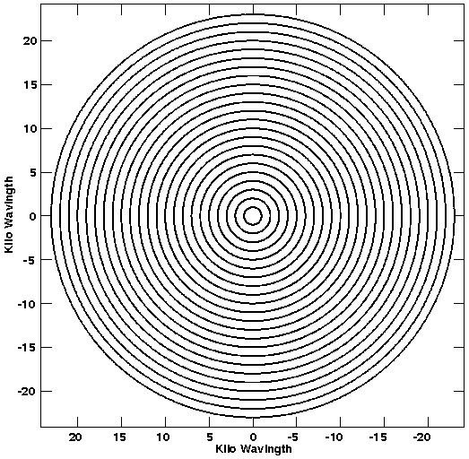
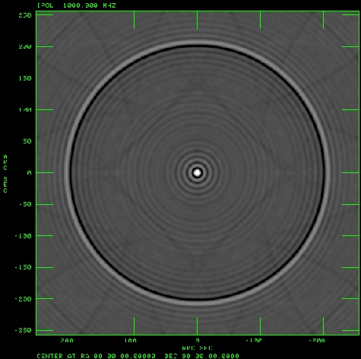
E-W Array Coverage and Beams
The simplest case is for E-W arrays, which give coplanar coverage.
Consider a ‘minimum redundancy array’, with eight antennas located at
0, 1, 2, 11, 15, 18, 21 and 23 km along an E-W arm.
o o o o o o o o
Of the 28 simultaneous spacings, 23 are of a unique separation.
The U-V coverage (over 12 hours) at δ = 90, and the synthesized beam are shown below, for a wavelength of 1m.

Slide 33
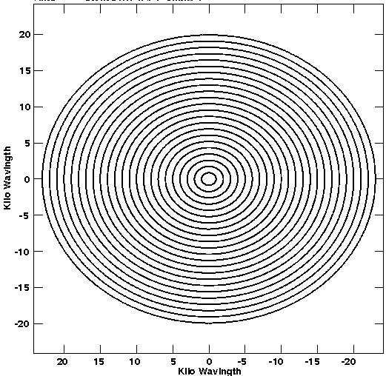
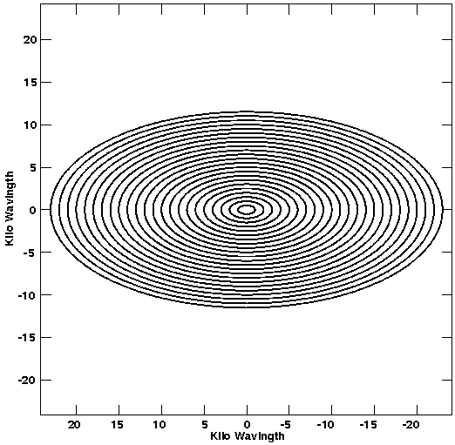
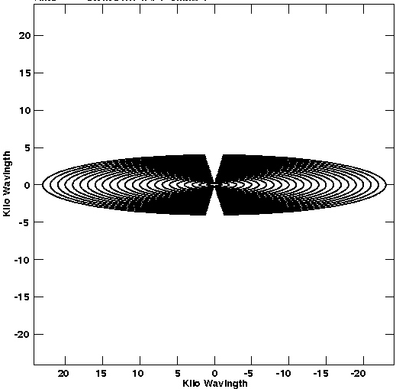
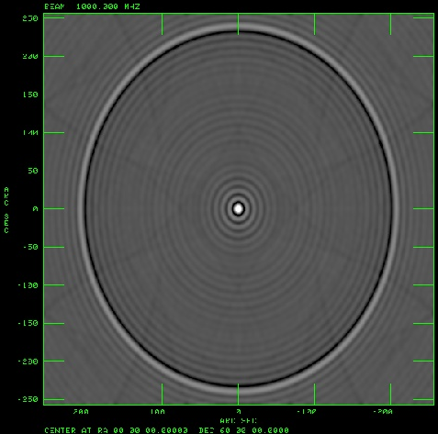
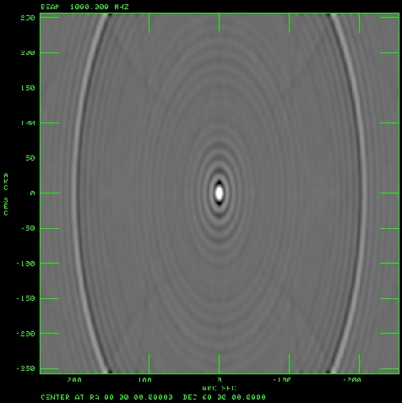
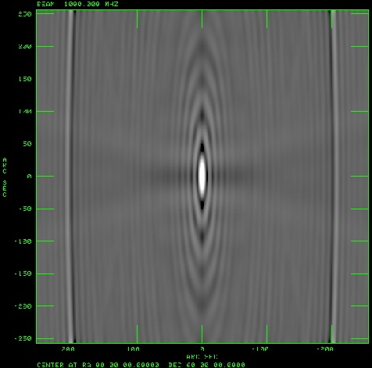
E-W Arrays and Low-Dec sources.
But the trouble with E-W arrays is that they are not suited for low-declination observing.
At δ=0, coverage degenerates to a line.
δ=60
δ=30
δ=10

Slide 34
Baseline Locus – the General Case
Each baseline, over 24 hours, traces out an ellipse in the (u,v) plane:
Because brightness is real, each observation provides us a second point, where: V(-u,-v) = V*(u,v)
E-W baselines have no ‘v’ offset in the ellipses.
V
A single Visibility: V(u,v)
Good UV Coverage requires many simultaneous baselines amongst many antennas, or many sequential baselines from a few antennas.
U
Its Complex Conjugate
V(-u,-v)

Slide 35
Getting Good Coverage near δ = 0
The only means of getting good 2-d angular resolution at all declinations is to build an array with N-S spacings.
Many more antennas are needed to provide good coverage for such geometries.
The VLA was designed to do this, using 9 antennas on each of three equiangular arms.
Built in the 1970s, commissioned in 1980, and undergoing a major upgrade now, the VLA vastly improved radio synthesis imaging at all declinations.
Each of the 351 spacings traces an elliptical locus on the (u,v) plane.
Every baseline has some (N-S) component, so none of the ellipses is centered on the origin.

Slide 36
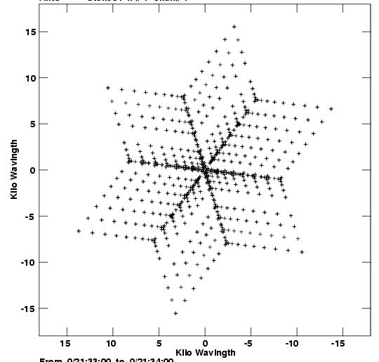
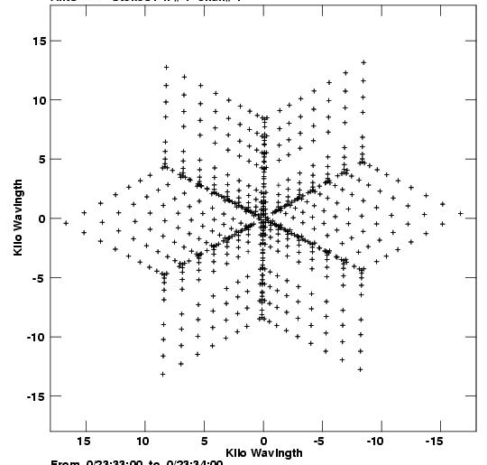
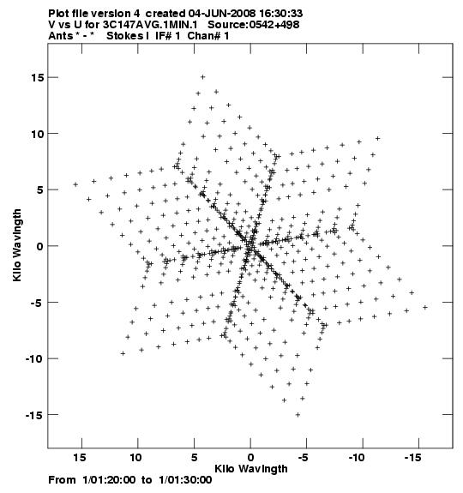
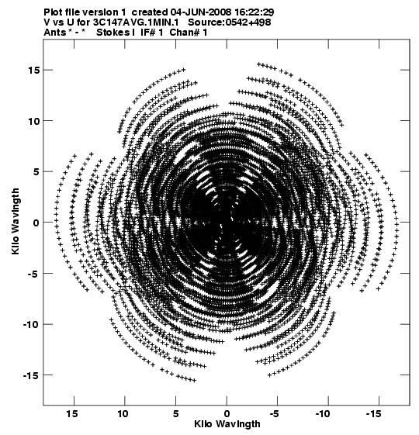
Sample VLA (U,V) plots for 3C147 (δ = 50)
Snapshot (u,v) coverage for HA = -2, 0, +2 (with 26 antennas).
HA = -2h
HA = 0h
HA = 2h
Coverage over all four hours.

Slide 37
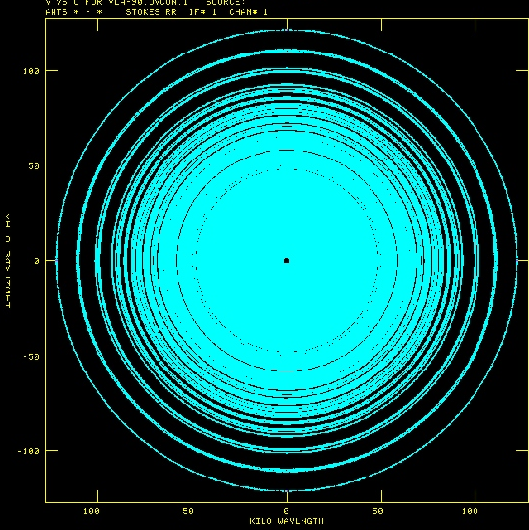
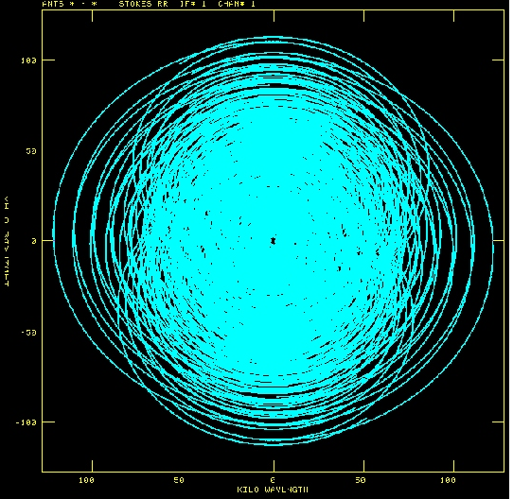
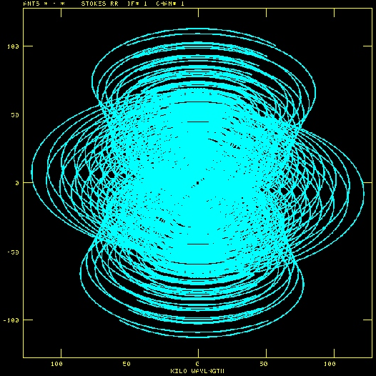
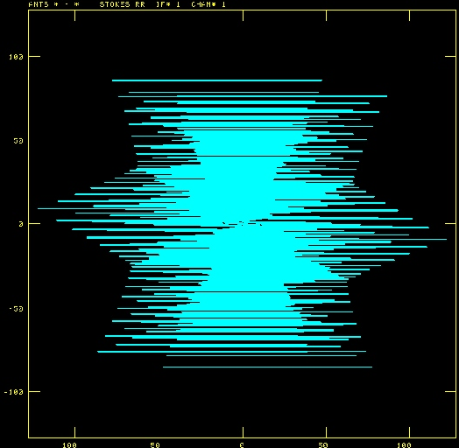
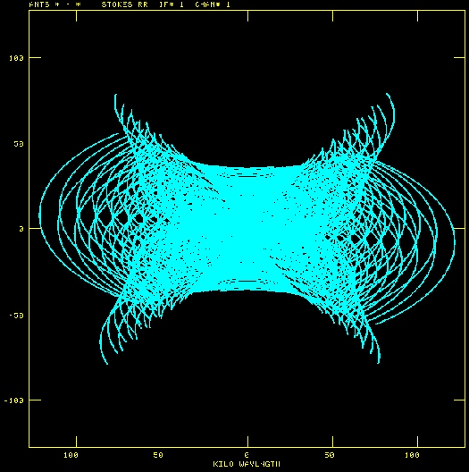
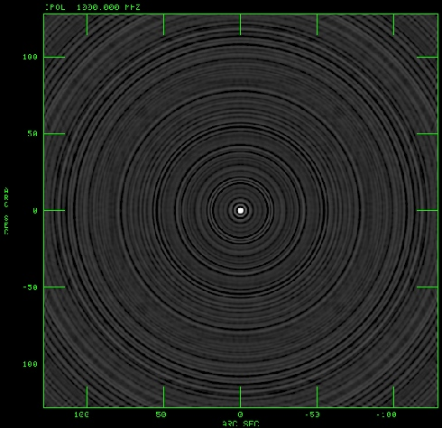
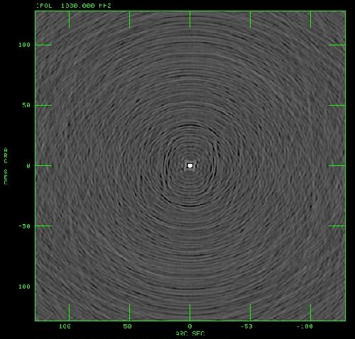
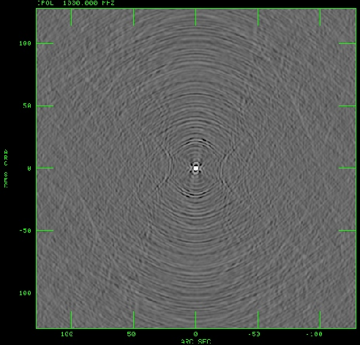
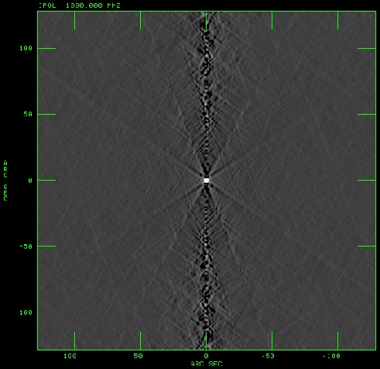
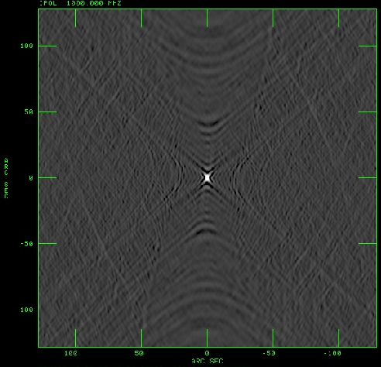
VLA Coverage and Beams
δ=90 δ=60 δ=30 δ=0 δ=-30
All of these presume maximum (u,v) coverage – observing over all times that the source is above the horizon.

Slide 38
UV Coverage and Imaging Fidelity
Although the VLA represented a huge advance over what came before, its UV coverage (and imaging fidelity) is far from optimal.
The high density of samplings along the arms (the 6-armed star in snapshot coverage) results in ‘rays’ in the images due to small errors.
A better design is to ‘randomize’ the location of antennas within the span of the array, to better distribute the errors.
Of course, more antennas are a good idea.
The VLA’s wye design was dictated by its 220 ton antennas, and the need to move them. Railway tracks are the only answer.
Future major arrays will utilize smaller, lighter elements which must not be positioned with any regularity.

