Slide 1
Fundamentals of Radio Interferometry
Rick Perley, NRAO/Socorro

Slide 2
Topics
Some Definitions: Intensity, Flux Density, etc.
The Role of the ‘Sensor’ (a.k.a. ‘Antenna’)
Key Properties of Antennas
The Basic Interferometer

Slide 3
Spectral Flux Density and Brightness
Our Goal: To measure the characteristics of celestial emission from a given direction s, at a given frequency ν, at a given time t.
  In other words: We want a map, or image, of the emission.
Terminology/Definitions: The quantity we seek is called the brightness (or specific intensity): It is denoted here by I(s,ν,t), and expressed in units of: watt/(m² Hz ster).
It is the power received, per unit solid angle dΩ from direction s, per unit collecting area dA, per unit frequency dν at frequency ν.
Do not confuse I with Spectral Flux Density, S -- the integral of the brightness over a given solid angle:
The units of S are: watt/(m² Hz)
Note: 1 Jy = 10⁻²⁶ watt/(m² Hz).

Slide 4
Intensity and Power.
Imagine a distant source of emission, described by brightness I(ν,s) where s is a unit direction vector.
Power from this emission is intercepted by a collector (`sensor’) of area A(ν,s).
The power, dP (watts) from a small solid angle dΩ, within a small frequency window dν, is
The total power received is an integral over frequency and angle, accounting for variations in the responses.
Solid Angle
Sensor Area
Filter width
Power collected
dΩ
s
Α
dν
P

Slide 5
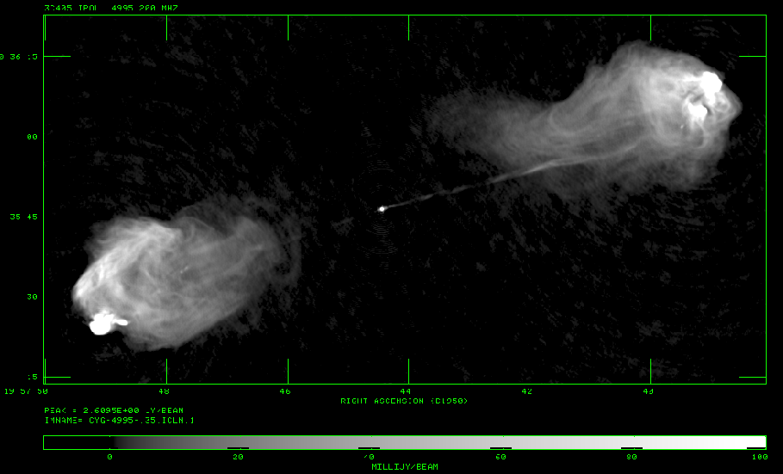
An Example – Cygnus A
I show below an image of Cygnus A at a frequency of 4995 MHz.
The units of the brightness are Jy/beam, with 1 beam = 0.16 arcsec²
The peak is 2.6 Jy/beam, which equates to 6.5 x 10⁻¹⁵ watt/(m² Hz ster)
The flux density of the source is 370 Jy = 3.7 x 10⁻²⁴ watt/(m² Hz)

Slide 6
The Role of the Sensor
Coherent interferometry is based on the ability to correlate the electric fields measured at spatially separated locations.
To do this (without mirrors) requires conversion of the electric field E(r,ν,t) at some place to a voltage V(ν,t) which can be conveyed to a central location for processing.
For our purpose, the sensor (a.k.a. ‘antenna’) is simply a device which senses the electric field at some place and converts this to a voltage which faithfully retains the amplitudes and phases of the electric fields.
EM waves in
Voltage out (preserving amplitude and phase of all input fields)

Slide 7
Ideal vs. Real Sensor (Antennas)
An ideal antenna converts only the fields of interest, and adds no additional signal of its own.
One can imagine two kinds of ideal sensors:
  An ‘all-sky’ sensor: All incoming electric fields, from all directions, are converted with no direction modulation.
  The ‘limited-field-of-view’ sensor: Only the fields from a given direction and solid angle (field of view) are collected and conveyed.
Sadly – neither of these is possible.
Nor is it possible to build a sensor which does not add in additional power.
  For even the best antennas, at cm-wave frequencies, a 1 Jy source contributes less than 0.5% of the antenna output power!

Slide 8
Antennas – the Single Dish
Antennas designs span a wide range – from simple elements with nearly isotropic responses, to major mechanical structures designed for high gain and angular resolution.
The most common antenna is a parabolic reflector – a ‘single dish’.
Understanding how it works will help in our later discussion of interferometry.
There are four critical characteristics of sensors (antennas):
  A directional gain (‘main beam’)
  An angular resolution given by: θ ~ λ/D.
  The presence of ‘sidelobes’ – finite response at angles away from the main beam.
A basic understanding of the origin of these characteristics will aid in understanding the functioning of an interferometer.

Slide 9
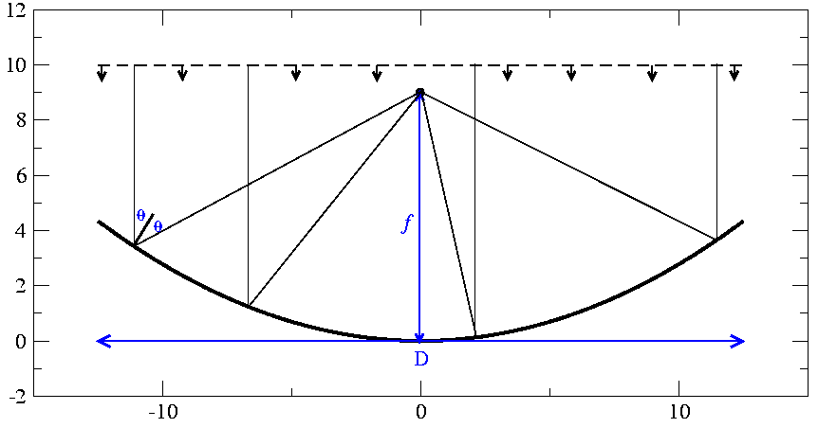
The Parabolic Reflector
Key Point: Distance from incoming phase front to focal point is the same for all rays.
The E-fields will thus all be in phase at the focus – the place for the receiver.
The parabola has the remarkable property of directing
all rays from in incoming wave front to a single point
(the focus), all with the same distance.
Hence, all rays arrive at the focus with the same phase.
Incoming phase front
focus

Slide 10
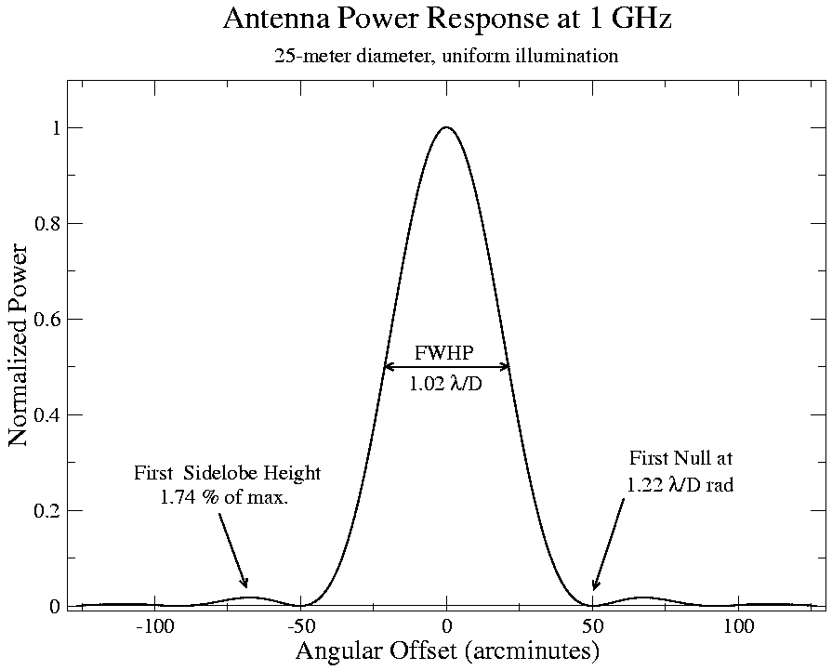
The Standard Parabolic Antenna Response
The power response of a uniformly illuminated circular parabolic antenna of 25-meter diameter, at a frequency of 1 GHz.
The FWHM, and the angle to the first null are both approximately λ/D (radians).
There must always be some response outside the main beam – these are called the ‘sidelobes’.

Slide 11
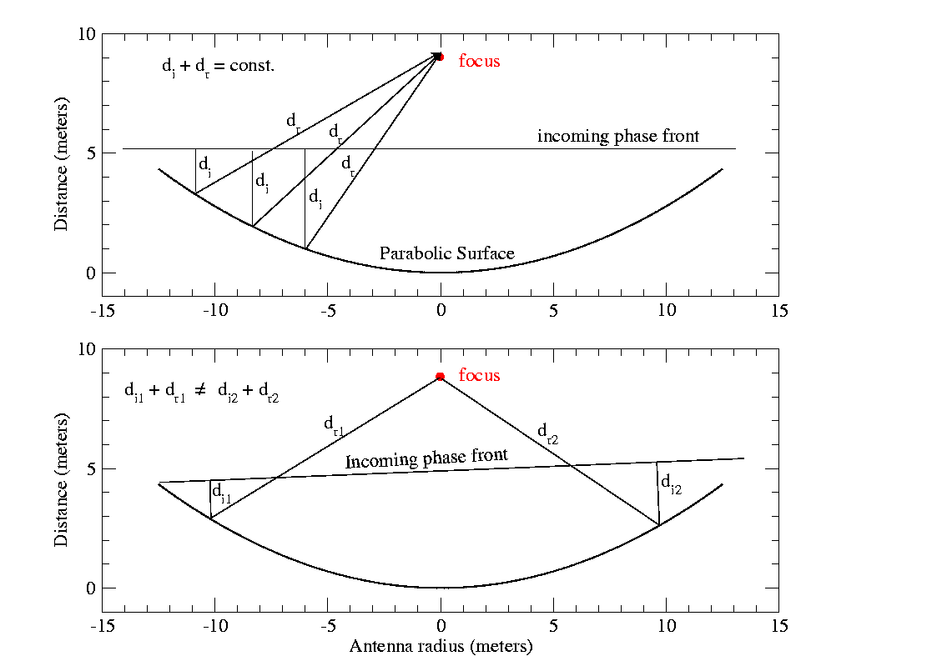
Beam Pattern Origin – Why is there a Null?
An antenna’s response is a result of coherent phase summation of the electric field at the focus.
First null will occur at the angle where one extra wavelength of path is added across the full width of the aperture:
θ ~ λ/D
(Why?)
On-axis
incidence
Off-axis
incidence
θ
λ

Slide 12
Specifics: First Null, and First Sidelobe
When the phase differential across the aperture is 1, 2, 3, … wavelengths, we get a null in the total received power.
  The nulls appear at (approximately): θ = λ/D, 2λ/D, 3λ/D, … radians.
When the phase differential across the aperture is ~1.5, 2.5, 3.5, … wavelengths, we get a maximum in total received power.
  But, each successive maximum is weaker than the last.
  These maxima appear at (approximately): θ = 3λ/2D, 5λ/2D, 7λ/2D, … radians.

Slide 13
Why Interferometry?
Radio telescopes coherently sum electric fields over an aperture of size D.
For this, diffraction theory applies – the angular resolution is:
In ‘practical’ units:
To obtain 1 arcsecond resolution at a wavelength of 21 cm, we require an aperture of ~42 km!
The (currently) largest single, fully-steerable aperture is the 100-m antennas in Bonn, and Green Bank. Nowhere big enough!
Can we synthesize an aperture of that size with pairs of antennas?
The methodology of synthesizing a continuous aperture through summations of separated pairs of antennas is called ‘aperture synthesis’.

Slide 14
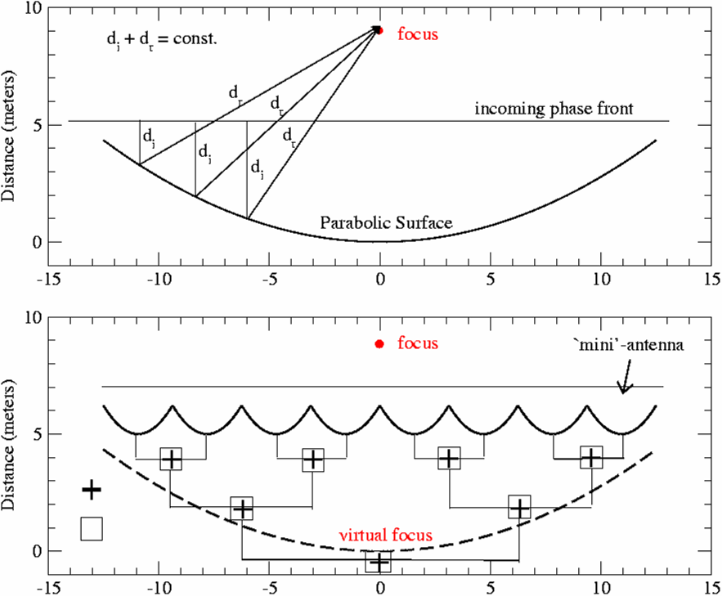
Interferometry – Basic Concept
We don’t need a single parabolic structure!
We can consider a series of small antennas, whose individual signals are summed in a network.
This is the basic concept of interferometry.
Aperture Synthesis is an extension of this concept.

Slide 15
Quasi-Monochromatic Radiation
Analysis is simplest if the fields are perfectly monochromatic.
This is not possible – a perfectly monochromatic electric field would both have no power (Δν = 0), and would last forever!
So we consider instead ‘quasi-monochromatic’ radiation, where the bandwidth dν is finite, but very small. Then, for times periods dt < 1/dν, we can consider the field to have a constant amplitude and phase:
Consider then the electric fields from a small sold angle dΩ about some direction s, within some small bandwidth dν, at frequency ν.
The amplitude and phase remain unchanged to a time duration of order dt ~1/dν, after which new values of E and φ are needed.

Slide 16
Simplifying Assumptions
We now consider the most basic interferometer, and seek a relation between the characteristics of the product of the voltages from two separated antennas and the distribution of the brightness of the originating source emission.
To establish the basic relations, the following simplifications are introduced:
  Fixed in space – no rotation or motion
  Quasi-monochromatic
  No frequency conversions (an ‘RF interferometer’)
  Single polarization
  No propagation distortions (no ionosphere, atmosphere …)
  Idealized electronics (perfectly linear, perfectly uniform in frequency and direction, perfectly identical for both elements, no added noise, …)

Slide 17
The Stationary, Quasi-Monochromatic
Radio-Frequency Interferometer
s
s
Geometric
Time Delay
b.s
b
The path lengths from sensors
to multiplier are assumed equal!
X
multiply
average
Unchanging
Rapidly varying,
with zero mean

Slide 18
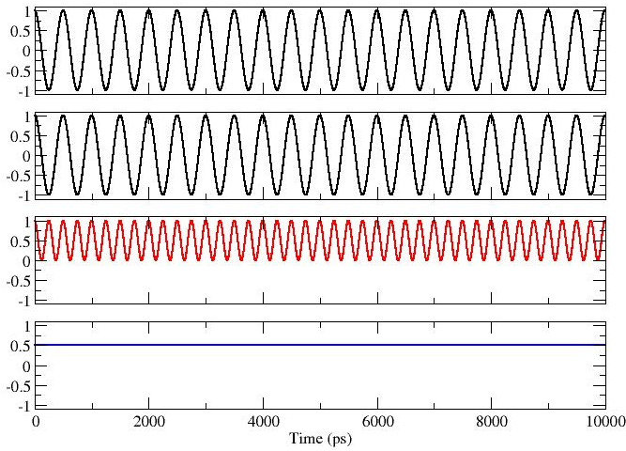
Pictorial Example: Signals In Phase
2 GHz Frequency, with voltages in phase:
b.s = nλ, or τ_{g} = n/ν
Antenna 1 Voltage
Antenna 2 Voltage
Product Voltage
Average

Slide 19
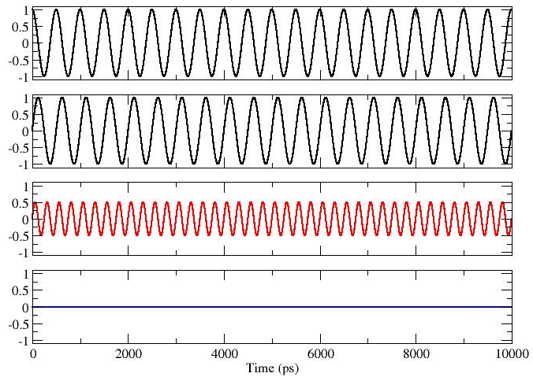
Pictorial Example: Signals in Quad Phase
2 GHz Frequency, with voltages in quadrature phase:
b.s=(n +/- ¼)λ, τ_{g} = (4n +/- 1)/4ν
Antenna 1 Voltage
Antenna 2 Voltage
Product Voltage
Average

Slide 20
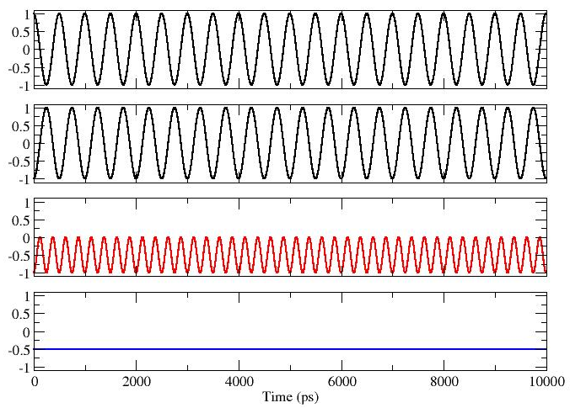
Pictorial Example: Signals out of Phase
2 GHz Frequency, with voltages out of phase:
b.s=(n +/- ½)λ τ_{g} = (2n +/- 1)/2ν
Antenna 1 Voltage
Antenna 2 Voltage
Product Voltage
Average

Slide 21
Some General Comments
The averaged product R_{C} is dependent on the received power, P = E²/2 and geometric delay, τ_{g}, and hence on the baseline orientation and source direction:
Note that R_{C} is not a a function of:
  The time of the observation -- provided the source itself is not variable!
  The location of the baseline -- provided the emission is in the far-field.
  The actual phase of the incoming signal – the distance of the source does not matter, provided it is in the far-field.
The strength of the product is dependent on the antenna areas and electronic gains – but these factors can be calibrated for.

Slide 22
Pictorial Illustrations
To illustrate the response, expand the dot product in one dimension:
Here, u = b/λ is the baseline length in wavelengths, and θ is the angle w.r.t. the plane perpendicular to the baseline.
is the direction cosine
Consider the response R_{c}, as a function of angle, for two different baselines with u = 10, and u = 25 wavelengths:
s
θ
α
b

Slide 23
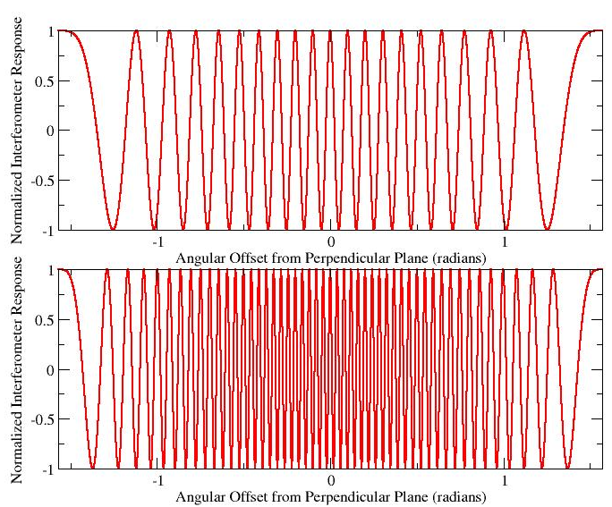
Whole-Sky Response
-10
-8
-5
-3
0
2
5
7
9
10
Top:
u = 10
There are 20 whole fringes over the hemisphere.
Bottom:
u = 25
There are 50 whole fringes over the hemisphere
-25
25

Slide 24
From an Angular Perspective
θ
0
3
Top Panel:
The absolute value of the response for u = 10, as a function of angle.
The ‘lobes’ of the response pattern alternate in sign.
Bottom Panel:
The same, but for u = 25.
Angular separation between lobes (of the same sign) is
δθ ~ 1/u = λ/b radians.
5
7
+
-
+
9
-
+
10

Slide 25
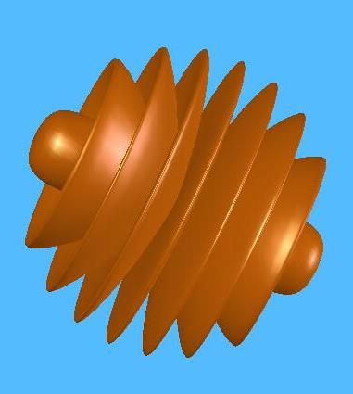
Hemispheric Pattern
The preceding plot is a meridional cut through the hemisphere, oriented along the baseline vector.
In two-dimensional space, the coherence pattern consists of a series of coaxial cones, oriented along the baseline vector.
The figure is a two-dimensional representation when u = 4.
As viewed along the baseline vector, the fringes show a ‘bulls-eye’ pattern – concentric circles.

Slide 26
The Effect of the Sensor
The patterns shown presume the sensor has isotropic response.
This is a convenient assumption, but (sadly, for some) doesn’t represent reality.
Real sensors impose their own patterns, which modulate the amplitude and phase of the output.
Large sensors (a.k.a. ‘antennas’) have very high directivity --very useful for some applications.

Slide 27
The Effect of Sensor Patterns
Sensors (or antennas) are not isotropic, and have their own responses.
Top Panel: The interferometer pattern with a cos(θ)-like sensor response.
Bottom Panel: A multiple-wavelength aperture antenna has a narrow beam, but also sidelobes.

Slide 28
The Response from an Extended Source
The response from an extended source is obtained by summing the responses at each antenna to all the emission over the sky, multiplying the two, and averaging:
The averaging and integrals can be interchanged and, providing the emission is spatially incoherent, we get
This expression links what we want – the source brightness on the sky, I_{ν}(s), – to something we can measure - R_{C}, the interferometer response.
Can we recover I_{ν}(s) from observations of R_{C}?

Slide 29
A Schematic Illustration in 2-D
The correlator can be thought of ‘casting’ a cosinusoidal coherence pattern, of angular scale ~λ/b radians, onto the sky.
The correlator multiplies the source brightness by this coherence pattern, and integrates (sums) the result over the sky.
λ/b radians
Orientation set by baseline geometry.
Fringe separation set by (projected) baseline length and wavelength.
  Long baseline gives close-packed fringes
  Short baseline gives widely-separated fringes
Physical location of baseline unimportant, provided source is in the far field.
Source
brightness
− + − + − + −
Fringe Sign

Slide 30
Odd and Even Functions
Any real function, I(x,y), can be expressed as the sum of two real functions which have specific symmetries:
  An even part:
  An odd part:
I
I_{E}
I_{O}
I_{E}
I_{O}
I
=
+

Slide 31
But One Correlator is Not Enough!
The correlator response, R_{c}:
is only sensitive to the even part of the sky brightness.
Suppose that the source of emission has a component with odd symmetry:
I_{ο}(s) = -I_{ο}(-s)
Since the cosine fringe pattern is even, the response of our interferometer to the odd brightness distribution is 0!
Hence, we need more information if we are to completely recover the source brightness.

Slide 32
Why Two Correlations are Needed
The integration of the cosine response, R_{c}, over the source brightness is sensitive to only the even part of the brightness:
since the integral of an odd function (I_{O}) with an even function (cos x) is zero.
To recover the ‘odd’ part of the intensity, I_{O}, we need an ‘odd’ fringe pattern. Let us replace the ‘cos’ with ‘sin’ in the integral.
We get:
since the integral of an even times an odd function is zero.
Thus, the even part of the image is ‘seen’ by the COS correlation, while the odd part is ‘seen’ by the SIN correlation.
Hence, to get the full image, we need both.

Slide 33
Making a SIN Correlator
We generate the ‘sine’ pattern by inserting a 90 degree phase shift in one of the signal paths.
s
s
b.s
b
A Sensor
X
90º
multiply
average

Slide 34
Define the Complex Visibility
We now DEFINE a complex function, the complex visibility, V, from the two independent (real) correlator outputs R_{C} and R_{S}:
where
This gives us a beautiful and useful relationship between the source brightness, and the response of an interferometer:
Under some circumstances, this is a 2-D Fourier transform, giving us a well established way to recover I(s) from V(b).

Slide 35
The Complex Correlator and Complex Notation
A correlator which produces both ‘Real’ and ‘Imaginary’ parts – or the Cosine and Sine fringes, is called a ‘Complex Correlator’
  For a complex correlator, think of two independent sets of projected sinusoids, 90 degrees apart on the sky.
  In our scenario, both components are necessary, because we have assumed there is no motion – the ‘fringes’ are fixed on the source emission, which is itself stationary.
The complex output of the complex correlator also means we can use complex analysis throughout: Let:
Then:

Slide 36
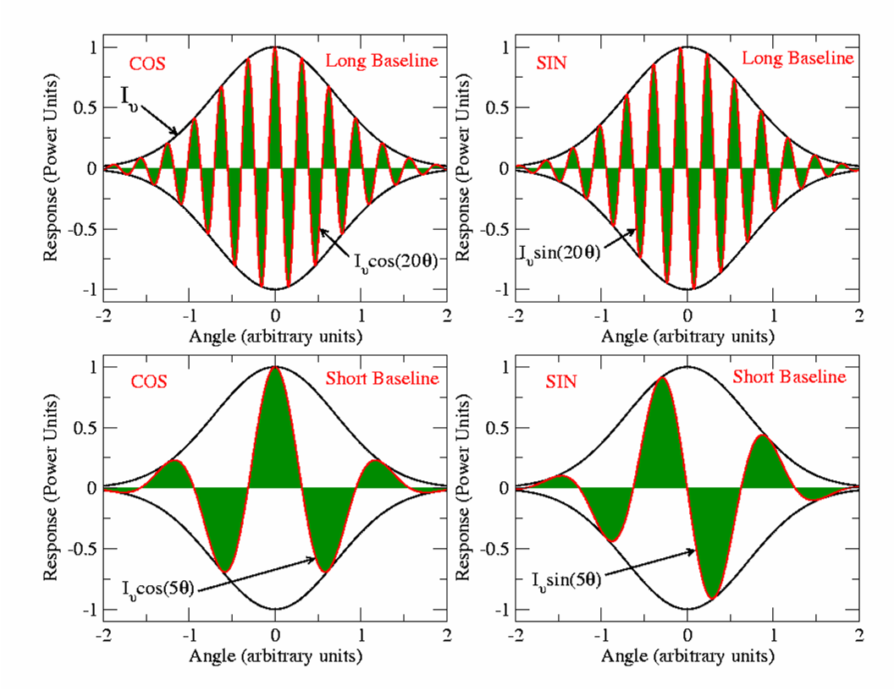
Picturing the Visibility
The source brightness is Gaussian, shown in black.
The interferometer ‘fringes’ are in red.
The visibility is the integral of the product – the net dark green area.
R_{C}
R_{S}
Long Baseline
Long
Baseline
Short Baseline
Short
Baseline

Slide 37
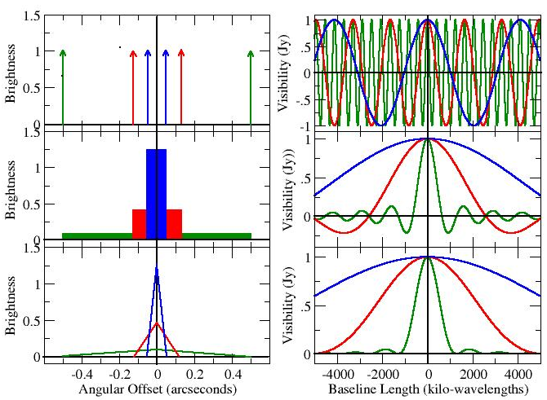
Examples of 1-Dimensional Visibilities
Simple pictures are easy to make illustrating 1-dimensional visibilities.
Brightness Distribution Visibility Function
Unresolved Doubles
Uniform
Central Peaked

Slide 38
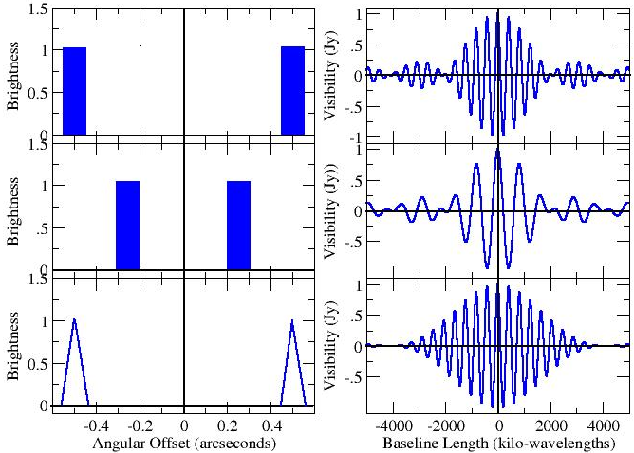
More Examples
Simple pictures are easy to make illustrating 1-dimensional visibilities.
Brightness Distribution Visibility Function
Resolved Double
Resolved Double
Central Peaked Double

Slide 39
Basic Characteristics of the Visibility
For a zero-spacing interferometer, we get the ‘single-dish’ (total-power) response.
As the baseline gets longer, the visibility amplitude will in general decline.
When the visibility is close to zero, the source is said to be ‘resolved out’.
Interchanging antennas in a baseline causes the phase to be negated – the visibility of the ‘reversed baseline’ is the complex conjugate of the original.
Mathematically, the visibility is Hermitian, because the brightness is a real function.

Slide 40
Some Comments on Visibilities
The Visibility is a unique function of the source brightness.
The two functions are related through a Fourier transform.
An interferometer, at any one time, makes one measure of the visibility, at baseline coordinate (u,v).
Sufficient knowledge of the visibility function (as derived from an interferometer) will provide us a reasonable estimate of the source brightness.
How many is ‘sufficient’, and how good is ‘reasonable’?
These simple questions do not have easy answers…

