Slide 1
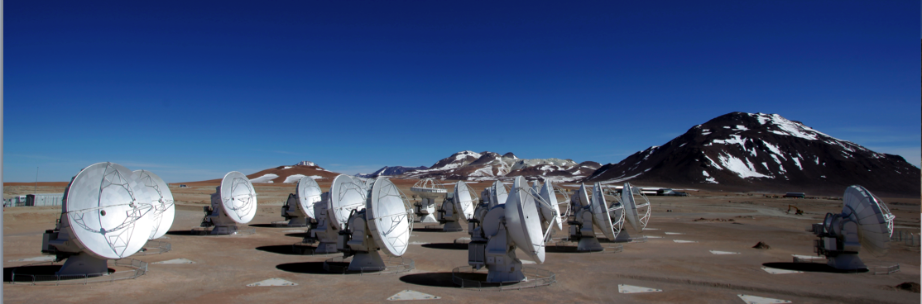
Planning ALMA Observations
Atacama Large mm/sub-mm Array
Mark Lacy
North American ALMA Science Center
Atacama Large Millimeter/submillimeter Array
Expanded Very Large Array
Robert C. Byrd Green Bank Telescope
Very Long Baseline Array
Notes:
Quick overview of what I’ll say.

Slide 2


Talk Outline
ALMA
ALMA Overview and Status
The Key Decisions When Proposing for ALMA
Notes:
Quick status

Slide 3
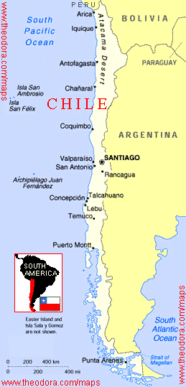
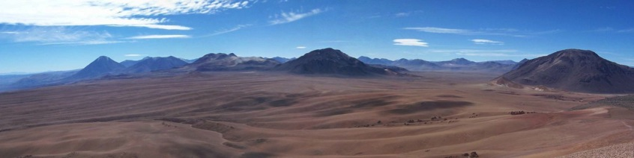
ALMA Basics
ALMA
Global partnership (shared cost ~1.3 billion):
  North America (US, Canada, Taiwan)
  Europe (ESO)
  East Asia (Japan,Taiwan)
  In collaboration with Chile
Unique high, dry site:
  5000m (16,500 ft) in Chilean Atacama desert
At least 66 submillimeter/millimeter telescopes:
12-m Array – 50 x 12-m
Atacama Compact Array (ACA) - 12x7-m, 4x12-m
On budget and on time for completion in 2013
Notes:
Vital stats
~ 1.3 billion 2006 dollar project
~ unique high dry site in the Chilean Andes

Slide 4
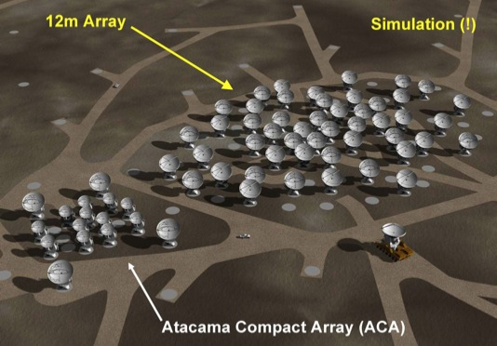
ALMA Basics
ALMA
Global partnership (shared cost ~1.3 billion):
  North America (US, Canada, Taiwan)
  Europe (ESO)
  East Asia (Japan,Taiwan)
  In collaboration with Chile
Unique high, dry site:
  5000m (16,500 ft) in Chilean Atacama desert
At least 66 submillimeter/millimeter telescopes:
12-m Array – 50 x 12-m
Atacama Compact Array (ACA) - 12x7-m, 4x12-m
On budget and on time for completion in 2013
Notes:
And for those who don’t know, important for Cycle 1
… there are three types of Antennas
~ final 66 antennas – mixture of 12-m antennas in the main area
~ smaller 7-m dishes, dedicated total power dishes, short spacing
~ expected completion around the end of 2013

Slide 5
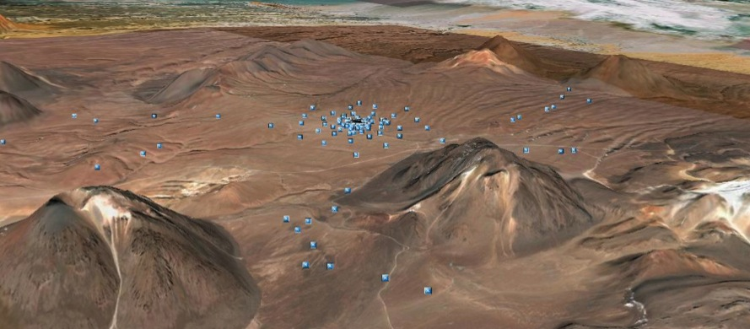
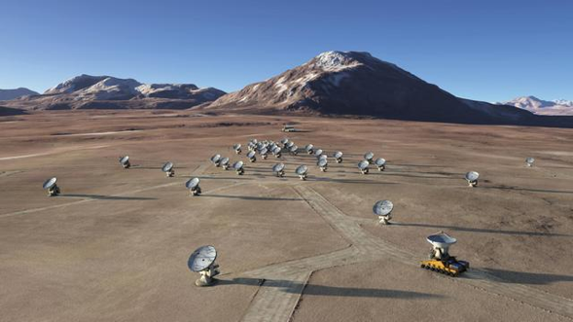
Full Science Capabilities
ALMA
10-100× better sensitivity and resolution than current mm arrays.
Baselines to ~15 km (0.015” at 300 GHz) in “zoom lens” configurations
Sensitive, precision imaging 84 to 950 GHz
(3 mm to 315 µm)
State-of-the-art low-noise, wide-band SIS receivers (8 GHz bandwidth per polarization)
Flexible correlator with high spectral resolution at wide bandwidth
Full polarization capabilities
Notes:
On completion
… the capabilities of ALMA are 10-100 times better
… in both resolution and sensitivity
… than present day arrays
Baselines out to 15 km
… imaging from 84 to 950 GHz
… kick ass receivers
… 8 GHz bandwidth
… and a crazy-flexible correlator
… with full polarization cpabilities

Slide 6
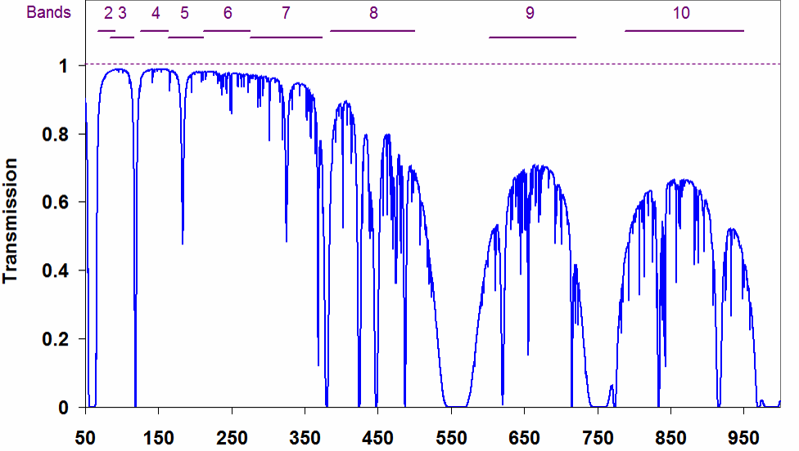
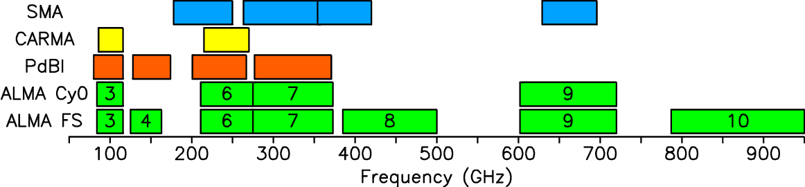
Frequency Coverage
ALMA
Early Science (now)
Full Operations
Frequency [GHz]
3
6
7
9
Notes:
The frequency coverage right now
… is a bit more limited
… right now four receiver bands are available on all telescopes
… these are so-called bands 3, 6, 7, and 9
… operating at roughly 100, 250, 350, and 650 GHz
These other bands will be filled in as the array moves towards compeltion

Slide 7
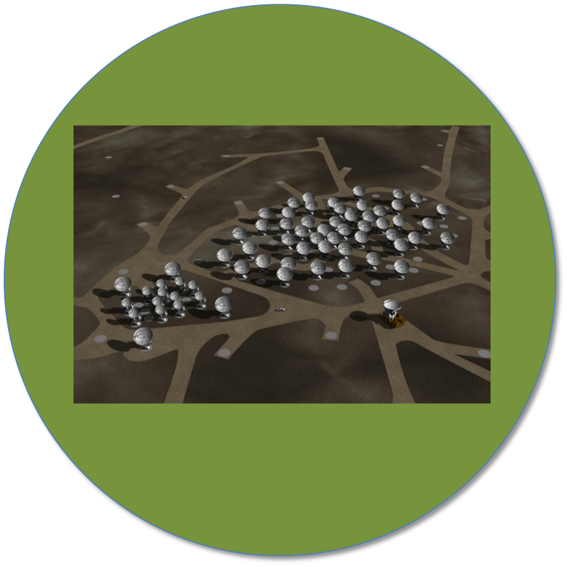
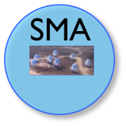


Collecting Area & Baselines
ALMA
ALMA
Full Science
50+12+4 (1225+66)
8 (28)
CARMA
Cycle I
32+9+2 (496+36.)
23 (253)
6 (15)
Circles Show Collecting Area (sensitivity)
Captions give # of antennas and # of baselines (fidelity)
Notes:
To give you the cartoon view
… of where we are moving toward completion
… here are the graphically represented collecting area
… and in parentheses baselines
… of present day arrays
The collecting area dictates sensitivity
… the number of baselines dictate image fidelity
… you can see that Cycle 1 is a big jump towards
… full science from Cycle 0… offering a lot more
… image fidelity and senstivity

Slide 8
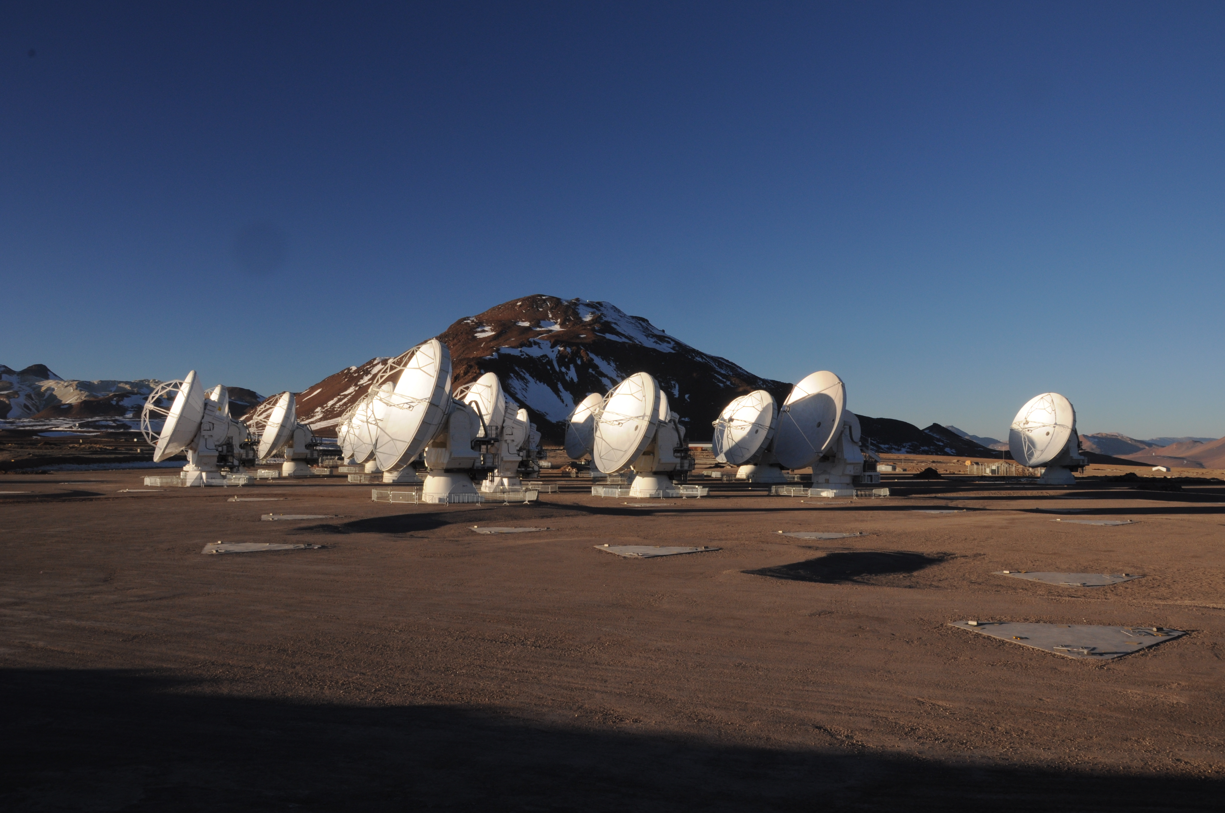
Current Status
ALMA
Cycle 0 observing began 30 Sep ’11.
Cycle 1 call for proposals out (12 July)
Data delivered to PIs.
Commissioning ongoing.
31+ antennas at high site.
Correlators (ACA and main) working.
All antennas: B3, 6, 7, and 9 receivers.
Science verification ongoing, data publicly available.
20 September 2011
Notes:
Where are we right now?
… so Cycle 0 observing began 30 September
… the first round of data has been delivered to Pis
… but mostly Cycle 0 is just building up steam
… both commisioning and science verification are ongoing
… with about 26 antennas at the high site, more than 50 in some stage of completion
… and both correlators – the main array and the one for the small compact array working
… like I mentioned there are four receiver bands installed for all four telescopes

Slide 9
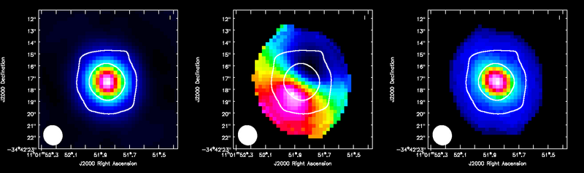
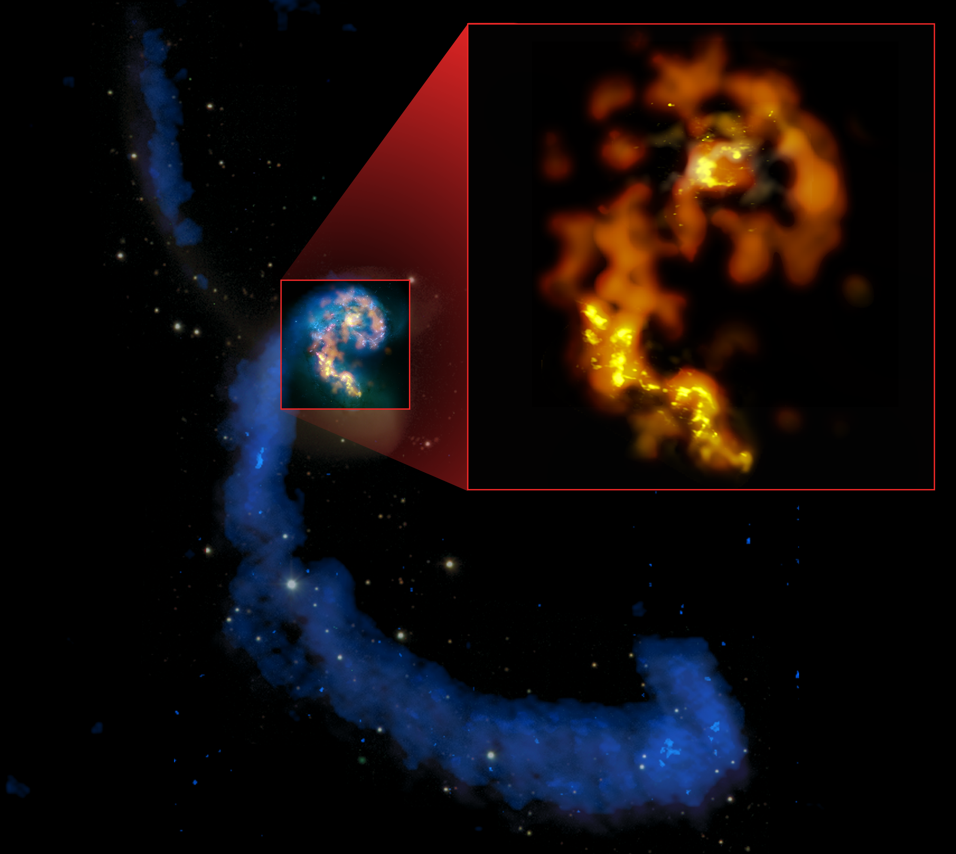
Science Verification Data
ALMA
ALMA data released for:
Tw Hydra*
The Antennae Galaxies*
NGC 3256*
Sgr A-star
M100
IRAS 16923
BR1202 (high redshift quasar)
download from ALMA Science Portal
http://almascience.org/
Calibrated & uncalibrated data, images.
* - CASA guide available at
http://casaguides.nrao.edu
HCO+ J=4-3 in TW Hya
CO J=3-2 in the Antennae
Notes:
Cycle 0 data are starting to go out to Pis
… but in the meantime there are a number of released data
… obtained as part of the Science Verification program
… you can see a list of released data here
… that you can download from the Science Portal
… these include calibrated and uncalibrated data
… and for a subset of these, guides explaining their reduction
… and imaging are available in detail at this CASA guides website

Slide 10
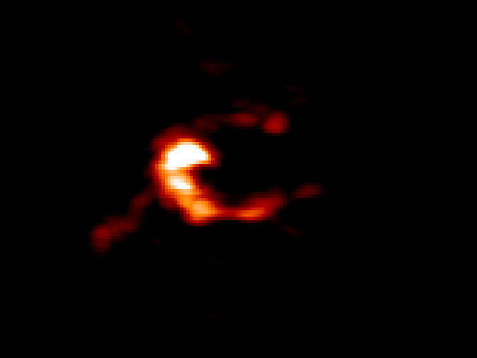
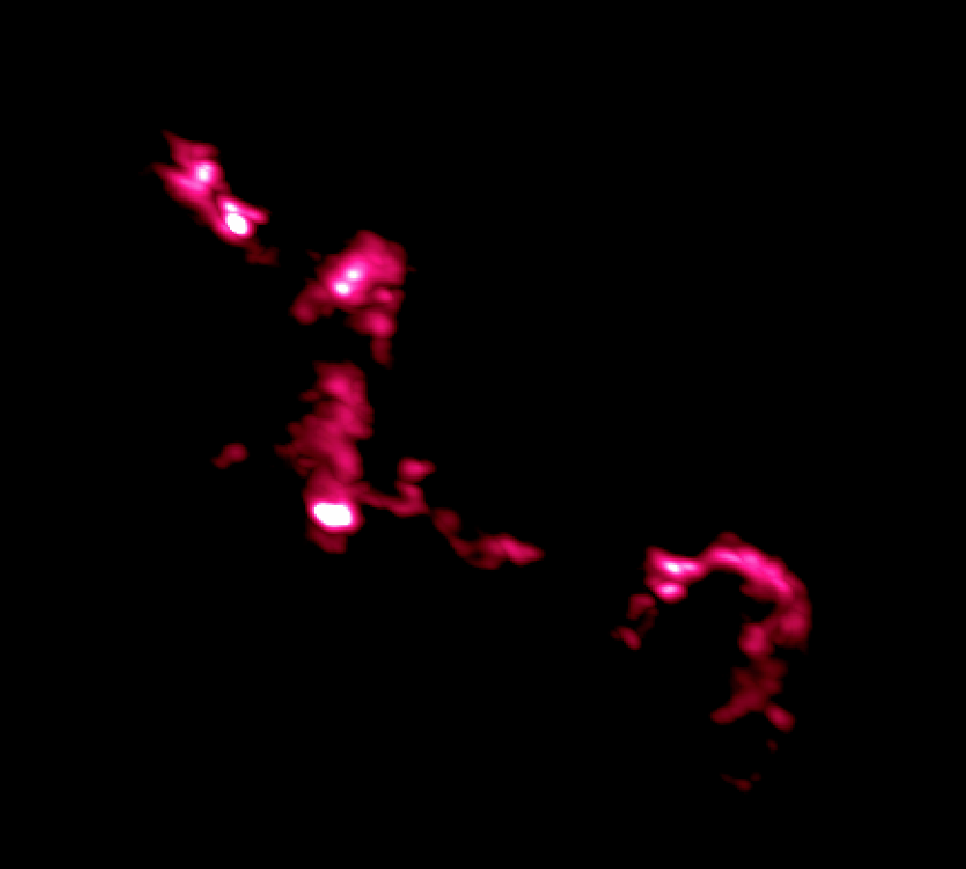
ALMA Images Nearby Galaxies
Science verification imaging of the Antennae Galaxies
CO 2-1
CO 3-2
HI, CO 3-2, CO 1-0
Notes:
If you take away a second thing from this talk
… I’d like it to be that ALMA is working
… and has demonstrated the power to image galaxies in exquisite detail
… though if Crystal’s talk didn’t convince you of that you’re not awake
I’m showing you here imaging of the Antennae Galaxies
… obtained and publicly released as part of ALMA’s science verification program
In a limited, roughly 11 telescope, configuration
… ALMA imaged low-J CO emission in three transitions
… across the body of these nearest colliding galaxies
That shows up in gold over here
… and then in more detail over here
… the resolution and sensitivity even in this limited form
… are sufficient to pick out individual star-forming clouds and complexes

Slide 11
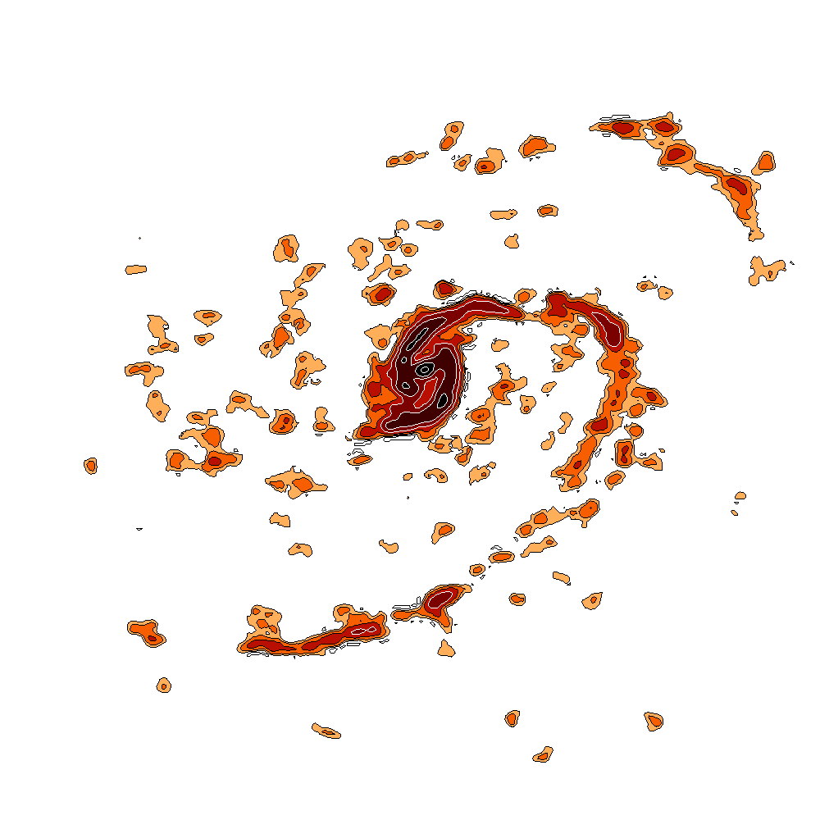
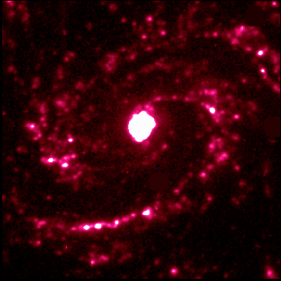
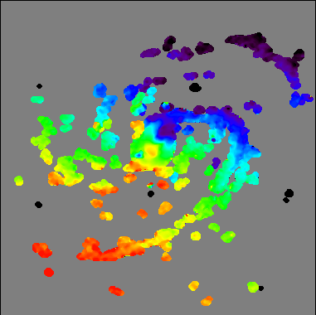
ALMA Images Nearby Galaxies
Science verification imaging of M100
Hα
CO 1-0
47-pt mosaic
Velocity
Notes:
You can see the same power at work in these just-released data
… on M100, a bright Virgo cluster spiral galaxy
This is a big, 50-point mosaic
… obtained in about 6 hours using 13 antennas
… so spending a total of around 7 minutes per point
Again, you see the distribution of star forming gas in detail
… including individual star-forming knots
… along sharp, well-defined spiral arms

Slide 12
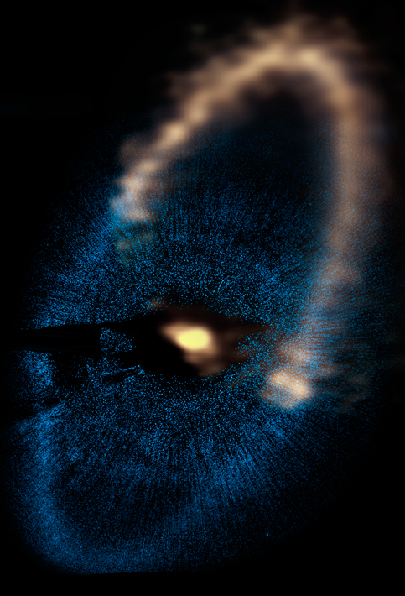

ALMA Images Debris Disks
PI Boley (U. Florida) Data on Fomalhaut Debris Disk
ALMA
HST Scattered Light

Slide 13
Talk Outline
ALMA
ALMA Overview and Status
The Key Decisions When Proposing for ALMA
Notes:
Quick status

Slide 14
Key Proposal Factors
ALMA
Framework: Science Goals
Spectral Setup
Spatial Setup
Control and Performance Specifications
Logistics
Notes:
Quick status

Slide 15
Science Goal (Cycle I)
ALMA
One correlator + front end setup in one ALMA band
spectral windows, rest frequency, polarization, line vs. continuum
Subject to one set of control parameters
spatial resolution, largest angular scale, sensitivity, dynamic range
Using one mapping strategy
mosaic, offsets, single fields
Using one calibration strategy
system or user defined
Applied to Sky Targets within 15°
up to 15 per science goal or 150 fields per mosaic, up to 5 different velocities
Notes:
So that’s where we are
… you’re presumably here because you are interested in Cycle 1
… here are the basics
… expect a proposal deadline in the first half of 2012
… with observing beginning after the end of Cycle 0
… in total Cycle 1 should last about 10 months
… with 1500 hours allocated for science, about 3 times what was given out in Cycle 0
There’s prospect for standard, target of opportunity
… and director’s discretionary proposals
… the time sharpness of time critical obserations is limited to
… a couple of weeks due to the commisioning duty cycle
… and we don’t know but would guess that there will not be
… large proposals or carryover between cycles

Slide 16
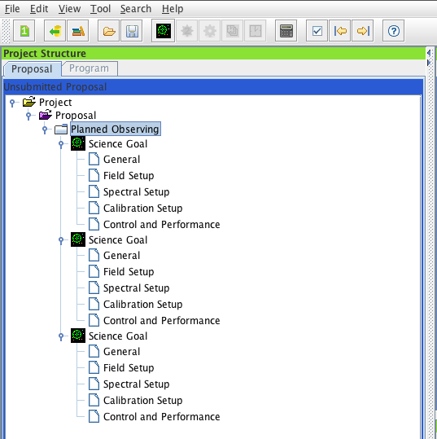
Science Goal (Cycle I)
ALMA
Fundamental unit (below proposal) in the ALMA OT
Five Science Goals allowed per proposal in Cycle 1
In practice:
• Up to 5 Science Goals
• Specify control & performance, spectral setup, field setup for each
Notes:
So that’s where we are
… you’re presumably here because you are interested in Cycle 1
… here are the basics
… expect a proposal deadline in the first half of 2012
… with observing beginning after the end of Cycle 0
… in total Cycle 1 should last about 10 months
… with 1500 hours allocated for science, about 3 times what was given out in Cycle 0
There’s prospect for standard, target of opportunity
… and director’s discretionary proposals
… the time sharpness of time critical obserations is limited to
… a couple of weeks due to the commisioning duty cycle
… and we don’t know but would guess that there will not be
… large proposals or carryover between cycles

Slide 17
Key Proposal Factors
ALMA
Framework: Science Goals
Spectral Setup
Spatial Setup
Control and Performance Specifications
Logistics
Notes:
Quick status

Slide 18
Spectral Setup: Receiver
ALMA
Four receiver “bands,” set spectral coverage
observing frequency also affects resolution, primary beam
Band | Frequency (GHz) | Primary beam (arcsec) | Angular Resolution (arcsec) | Continuum Sensitivity (mJy min^{1/2})
3 | 84 - 116 | 62 | 0.6 - 4.1 | 0.09
6 | 211 - 275 | 25 | 0.3 - 1.7 | 0.14
7 | 275 - 373 | 19 | 0.2 - 1.2 | 0.25
9 | 602 - 720 | 9 | 0.1 - 0.6 | 2.5
Notes:
The supports observing modes
… will be single field interferometry
… and mosaics up to 150 points
… with up to 5 science goals per proposal
… Mark will tell you about the science goal structure

Slide 19
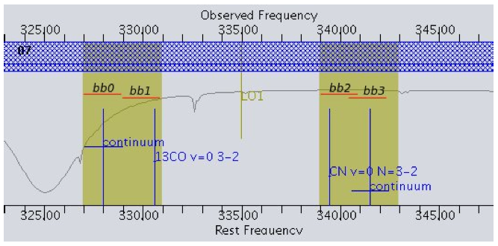
Spectral Setup

Slide 20
Sidebands
Receivers sensitive to two separate ranges of sky frequency: sidebands
Sideband width varies by receiver band
Band 3: 4 GHz, Band 6: 5 GHz, Band 7: 4 GHz, Band 9: 8 GHz
Fixed separation between sidebands
Bands 3, 7, 9: 8 GHz, Band 6: 10 GHz

Slide 21
Basebands
Each antenna has 4 digitizers which can each sample 2 GHz of bandwidth
These 2 GHz chunks are termed basebands (they may overlap)
Basebands must be distributed in the frequency covered by the sidebands
(all 4 in one sideband, or two in each; Band 9 does not have this restriction)
Local Oscillator Frequency
2 GHz Basebands

Slide 22
Spectral Windows
To collect data, you set up a spectral window in one or more basebands
These regions of the spectrum are processed by the correlator
The correlator allows tradeoff of frequency resolution and bandwidth
In Cycle 1, 4 spectral windows are available.
Spectral windows must lie within the baseband, sideband, receiver range.
Spectral Windows

Slide 23
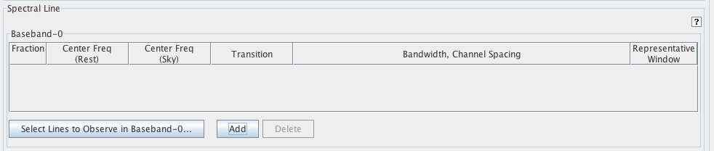
In Practice
Pick a frequency (by hand or source + line) for each SPW
Pick a correlator mode for each SPW
The OT will configure the LO and basebands to match (if possible)
Select a line, with your source velocity, this defines a frequency.
Add a spectral window by hand.

Slide 24
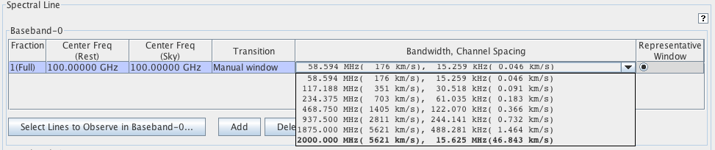
In Practice
Pick a frequency (by hand or source + line) for each SPW
Pick a correlator mode for each SPW
This involves trading off between resolution and bandwidth.
The OT will configure the LO and basebands to match (if possible)
Pick a correlator mode from the drop-down menu.

Slide 25
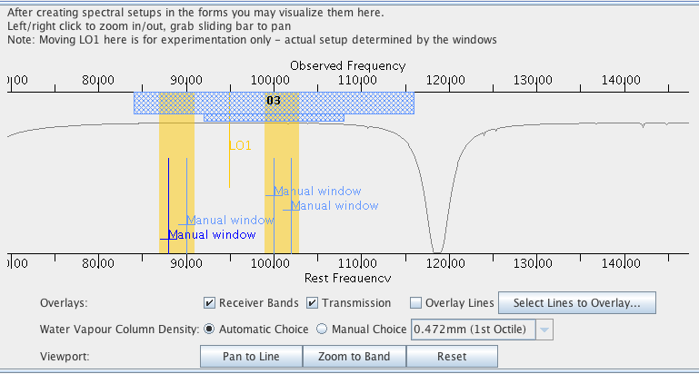
In Practice
Pick a frequency (by hand or source + line) for each SPW
Pick a correlator mode for each SPW
The OT will configure the LO and basebands to match (if possible)
Visualizing the Spectral Setup in the OT

Slide 26
In Practice
Pick a frequency (by hand or source + line) for each SPW
Pick a correlator mode for each SPW
The OT will configure the LO and basebands to match (if possible)
Atmospheric Transmission
Sideband Coverage
Receiver Range
Spectral
Windows
Visualizing the Spectral Setup in the OT

Slide 27
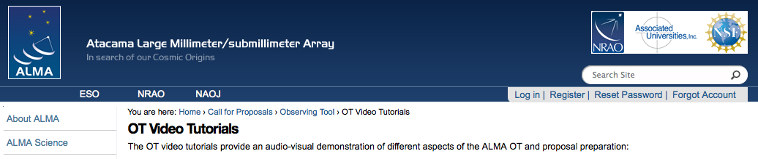
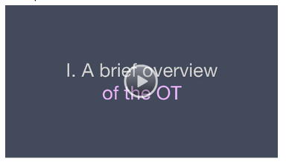
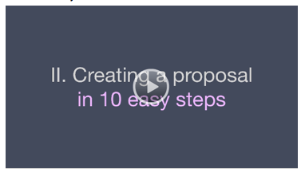
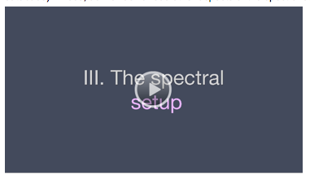
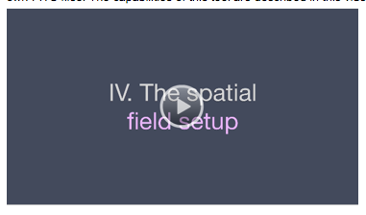
Practical Introduction
Video Tutorials and Quickstart Guides
https://almascience.nrao.edu/call-for-proposals/observing-tool/video-tutorials

Slide 28
Key Proposal Factors
ALMA
Framework: Science Goals
Spectral Setup
Spatial Setup
Control and Performance Specifications
Logistics
Notes:
Quick status

Slide 29
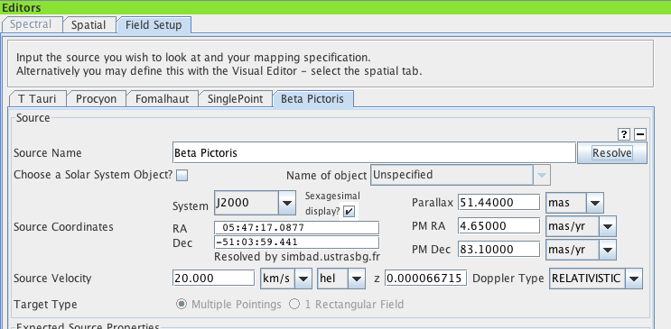
Target Definition
Single field
Up to 15 individual fields in one Science Goal if they are within 15°
Up to 5 different velocities in each Science Goal
Mosaic
offsets are mosaics, mosaics sacrifice efficiency for imaging quality
up to 150 points (total: mosaic, offset, or source) per proposal
Multiple sources in one Science Goal

Slide 30
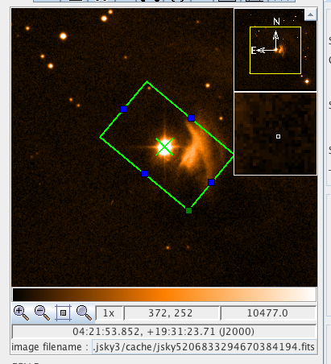
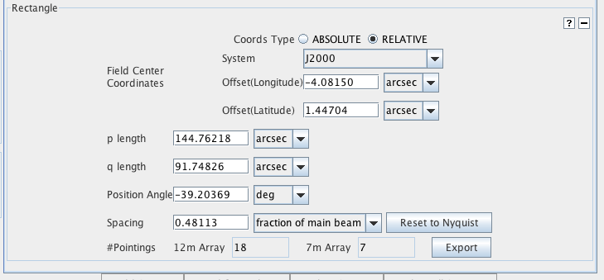
Target Definition
Single field
Up to 15 individual fields in one Science Goal if they are within 15°
Up to 5 different velocities in each Science Goal
Mosaic
offsets are mosaics, mosaics sacrifice efficiency for imaging quality
up to 150 points (total: mosaic, offset, or source) per proposal

Slide 31
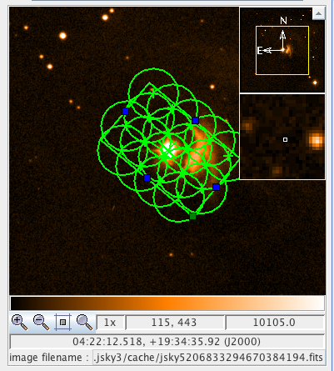
Target Definition
Single field
Up to 15 individual fields in one Science Goal if they are within 15°
Up to 5 different velocities in each Science Goal
Mosaic
offsets are mosaics, mosaics sacrifice efficiency for imaging quality
up to 150 points (total: mosaic, offset, or source) per proposal
Orientation and Extent
Field Spacing
Number of Fields

Slide 32
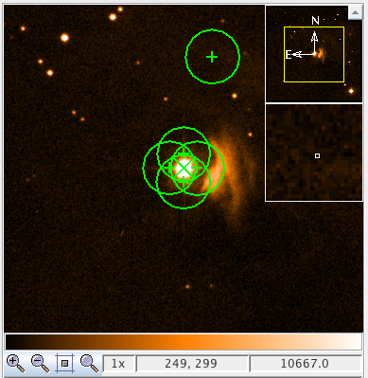
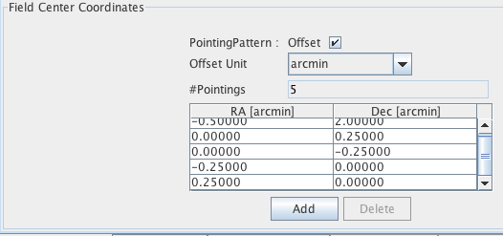
Target Definition
Single field
Up to 15 individual fields in one Science Goal if they are within 15°
Up to 5 different velocities in each Science Goal
Mosaic
offsets are mosaics, mosaics sacrifice efficiency for imaging quality
up to 150 points (total: mosaic, offset, or source) per proposal
Individual Offset Field Centers

Slide 33
Key Proposal Factors
ALMA
Framework: Science Goals
Spectral Setup
Spatial Setup
Control and Performance Specifications
Logistics
Notes:
Quick status

Slide 34
Control and Performance
ALMA
Target angular resolution
Constrains telescope configuration allowed when data are taken
Largest angular scale expected for target
Largest angular extent of target.
Target RMS noise
for a fiducial frequency and bandwidth (both user specified)
Request for ACA observations
Largest angular scale + target angular resolution will recommend
Notes:
So that’s where we are
… you’re presumably here because you are interested in Cycle 1
… here are the basics
… expect a proposal deadline in the first half of 2012
… with observing beginning after the end of Cycle 0
… in total Cycle 1 should last about 10 months
… with 1500 hours allocated for science, about 3 times what was given out in Cycle 0
There’s prospect for standard, target of opportunity
… and director’s discretionary proposals
… the time sharpness of time critical obserations is limited to
… a couple of weeks due to the commisioning duty cycle
… and we don’t know but would guess that there will not be
… large proposals or carryover between cycles

Slide 35
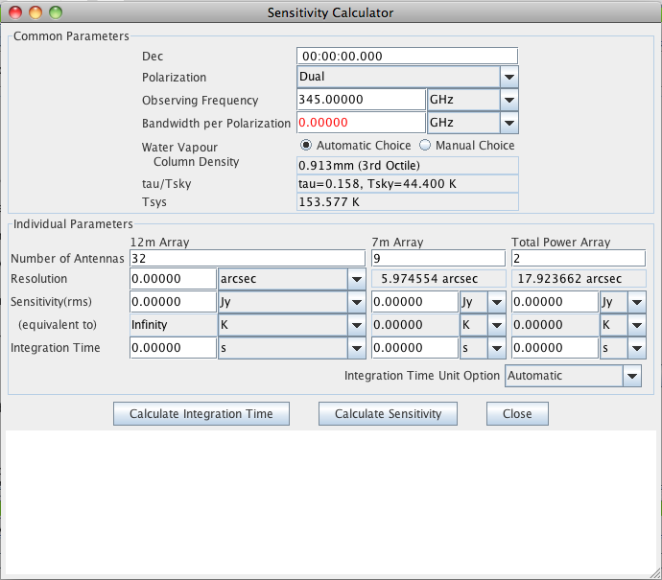
Sensitivity
ALMA
Target RMS noise
for a fiducial frequency and bandwidth (both user selected)
Notes:
So that’s where we are
… you’re presumably here because you are interested in Cycle 1
… here are the basics
… expect a proposal deadline in the first half of 2012
… with observing beginning after the end of Cycle 0
… in total Cycle 1 should last about 10 months
… with 1500 hours allocated for science, about 3 times what was given out in Cycle 0
There’s prospect for standard, target of opportunity
… and director’s discretionary proposals
… the time sharpness of time critical obserations is limited to
… a couple of weeks due to the commisioning duty cycle
… and we don’t know but would guess that there will not be
… large proposals or carryover between cycles

Slide 36
Sensitivity
ALMA
Target RMS noise
for a fiducial frequency and bandwidth (both user selected)
Fiducial Frequency
Fiducial
Bandwidth
Cycle 1
Capabilities
Notes:
So that’s where we are
… you’re presumably here because you are interested in Cycle 1
… here are the basics
… expect a proposal deadline in the first half of 2012
… with observing beginning after the end of Cycle 0
… in total Cycle 1 should last about 10 months
… with 1500 hours allocated for science, about 3 times what was given out in Cycle 0
There’s prospect for standard, target of opportunity
… and director’s discretionary proposals
… the time sharpness of time critical obserations is limited to
… a couple of weeks due to the commisioning duty cycle
… and we don’t know but would guess that there will not be
… large proposals or carryover between cycles

Slide 37
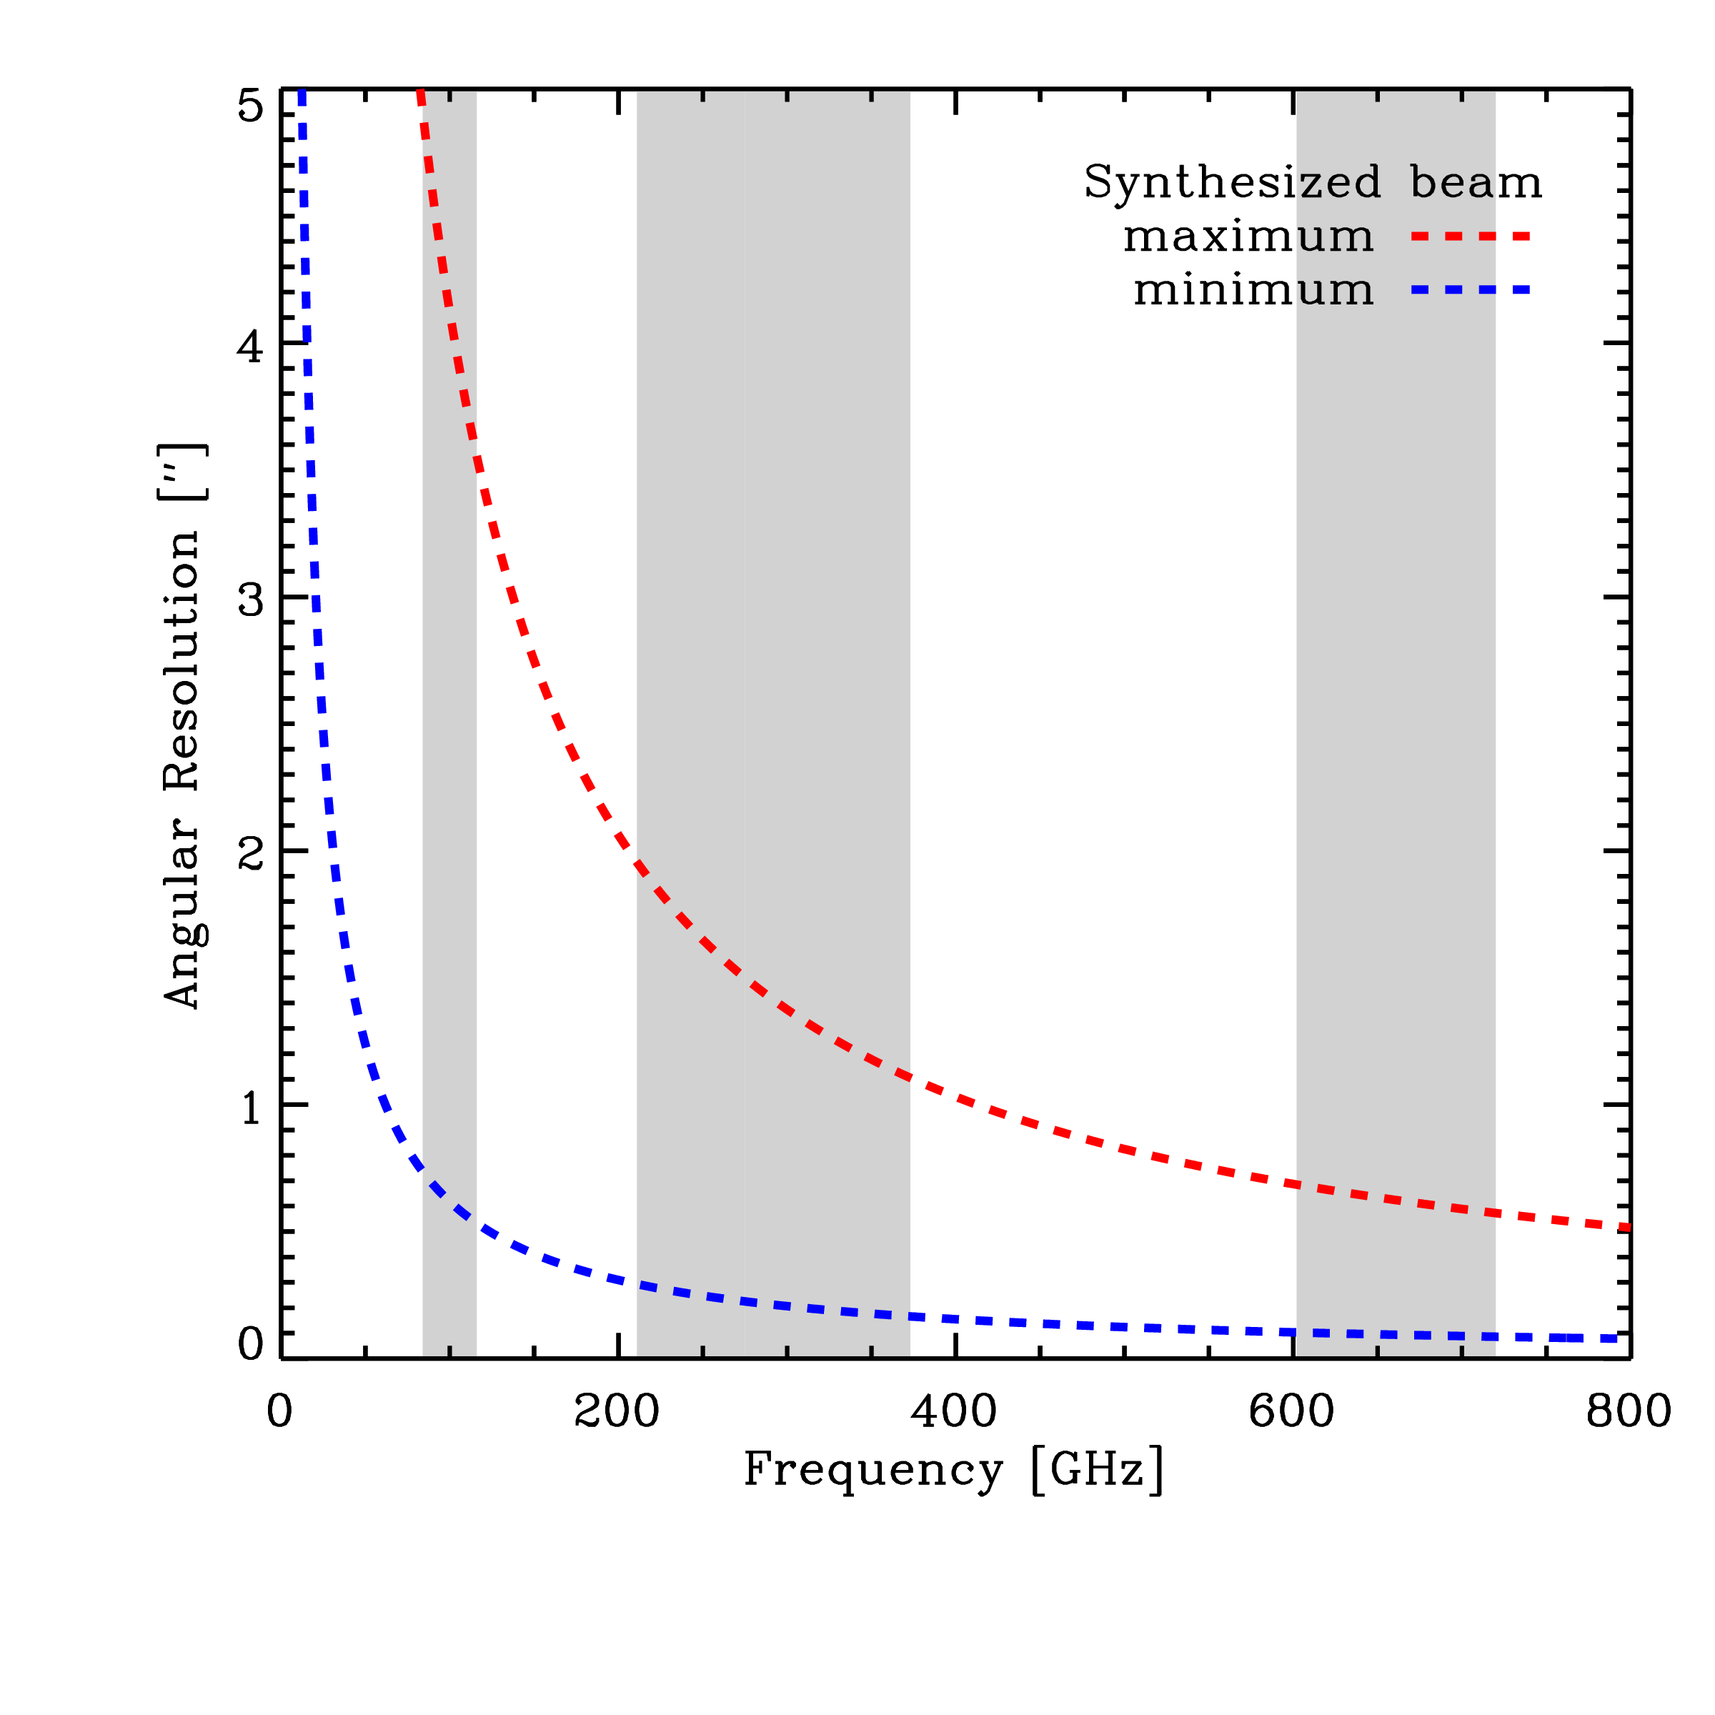
Resolution
ALMA
Target angular resolution
Constrains telescope configuration allowed when data are taken
High resolution leads to lower surface brightness sensitivity
RMS proportional to beamwidth² holding all other factors fixed.
Notes:
So that’s where we are
… you’re presumably here because you are interested in Cycle 1
… here are the basics
… expect a proposal deadline in the first half of 2012
… with observing beginning after the end of Cycle 0
… in total Cycle 1 should last about 10 months
… with 1500 hours allocated for science, about 3 times what was given out in Cycle 0
There’s prospect for standard, target of opportunity
… and director’s discretionary proposals
… the time sharpness of time critical obserations is limited to
… a couple of weeks due to the commisioning duty cycle
… and we don’t know but would guess that there will not be
… large proposals or carryover between cycles

Slide 38
Maximum Angular Scale
ALMA
Maximum angular scale (MAS) recovered by array
Band | Frequency (GHz) | Primary beam (“) | Range of Scales (“) C32-1 C32-6
3 | 84-116 | 72 - 52 | 4.2 - 24.6 | 0.7 - 15.1
6 | 211-275 | 29 - 22 | 1.8 - 10.7 | 0.3 - 6.6
7 | 275-373 | 22 - 16 | 1.2 - 7.1 | 0.2 - 4.4
9 | 602-720 | 10 – 8.5 | 0.6 - 3.6 | 0.1 - 2.2
Smooth structures larger than MAS begin to be resolved out.
All flux on scales larger than λ/B_{min} (~2 x MAS) completely resolved out.
Need additional observations with a single-dish or a compact array of small telescopes.
Notes:
So that’s where we are
… you’re presumably here because you are interested in Cycle 1
… here are the basics
… expect a proposal deadline in the first half of 2012
… with observing beginning after the end of Cycle 0
… in total Cycle 1 should last about 10 months
… with 1500 hours allocated for science, about 3 times what was given out in Cycle 0
There’s prospect for standard, target of opportunity
… and director’s discretionary proposals
… the time sharpness of time critical obserations is limited to
… a couple of weeks due to the commisioning duty cycle
… and we don’t know but would guess that there will not be
… large proposals or carryover between cycles

Slide 39
Maximum Angular Scale
ALMA
Maximum angular scale (MAS) recovered by array
Band | Frequency (GHz) | Primary beam (“) | Range of Scales (“) C32-1 C32-6
3 | 84-116 | 72 - 52 | 4.2 - 24.6 | 0.7 - 15.1
6 | 211-275 | 29 - 22 | 1.8 - 10.7 | 0.3 - 6.6
7 | 275-373 | 22 - 16 | 1.2 - 7.1 | 0.2 - 4.4
9 | 602-720 | 10 – 8.5 | 0.6 - 3.6 | 0.1 - 2.2
Smooth structures larger than MAS begin to be resolved out.
All flux on scales larger than λ/B_{min} (~2 x MAS) completely resolved out.
Need additional observations with a single-dish or a compact array of small telescopes.
Notes:
So that’s where we are
… you’re presumably here because you are interested in Cycle 1
… here are the basics
… expect a proposal deadline in the first half of 2012
… with observing beginning after the end of Cycle 0
… in total Cycle 1 should last about 10 months
… with 1500 hours allocated for science, about 3 times what was given out in Cycle 0
There’s prospect for standard, target of opportunity
… and director’s discretionary proposals
… the time sharpness of time critical obserations is limited to
… a couple of weeks due to the commisioning duty cycle
… and we don’t know but would guess that there will not be
… large proposals or carryover between cycles

Slide 40
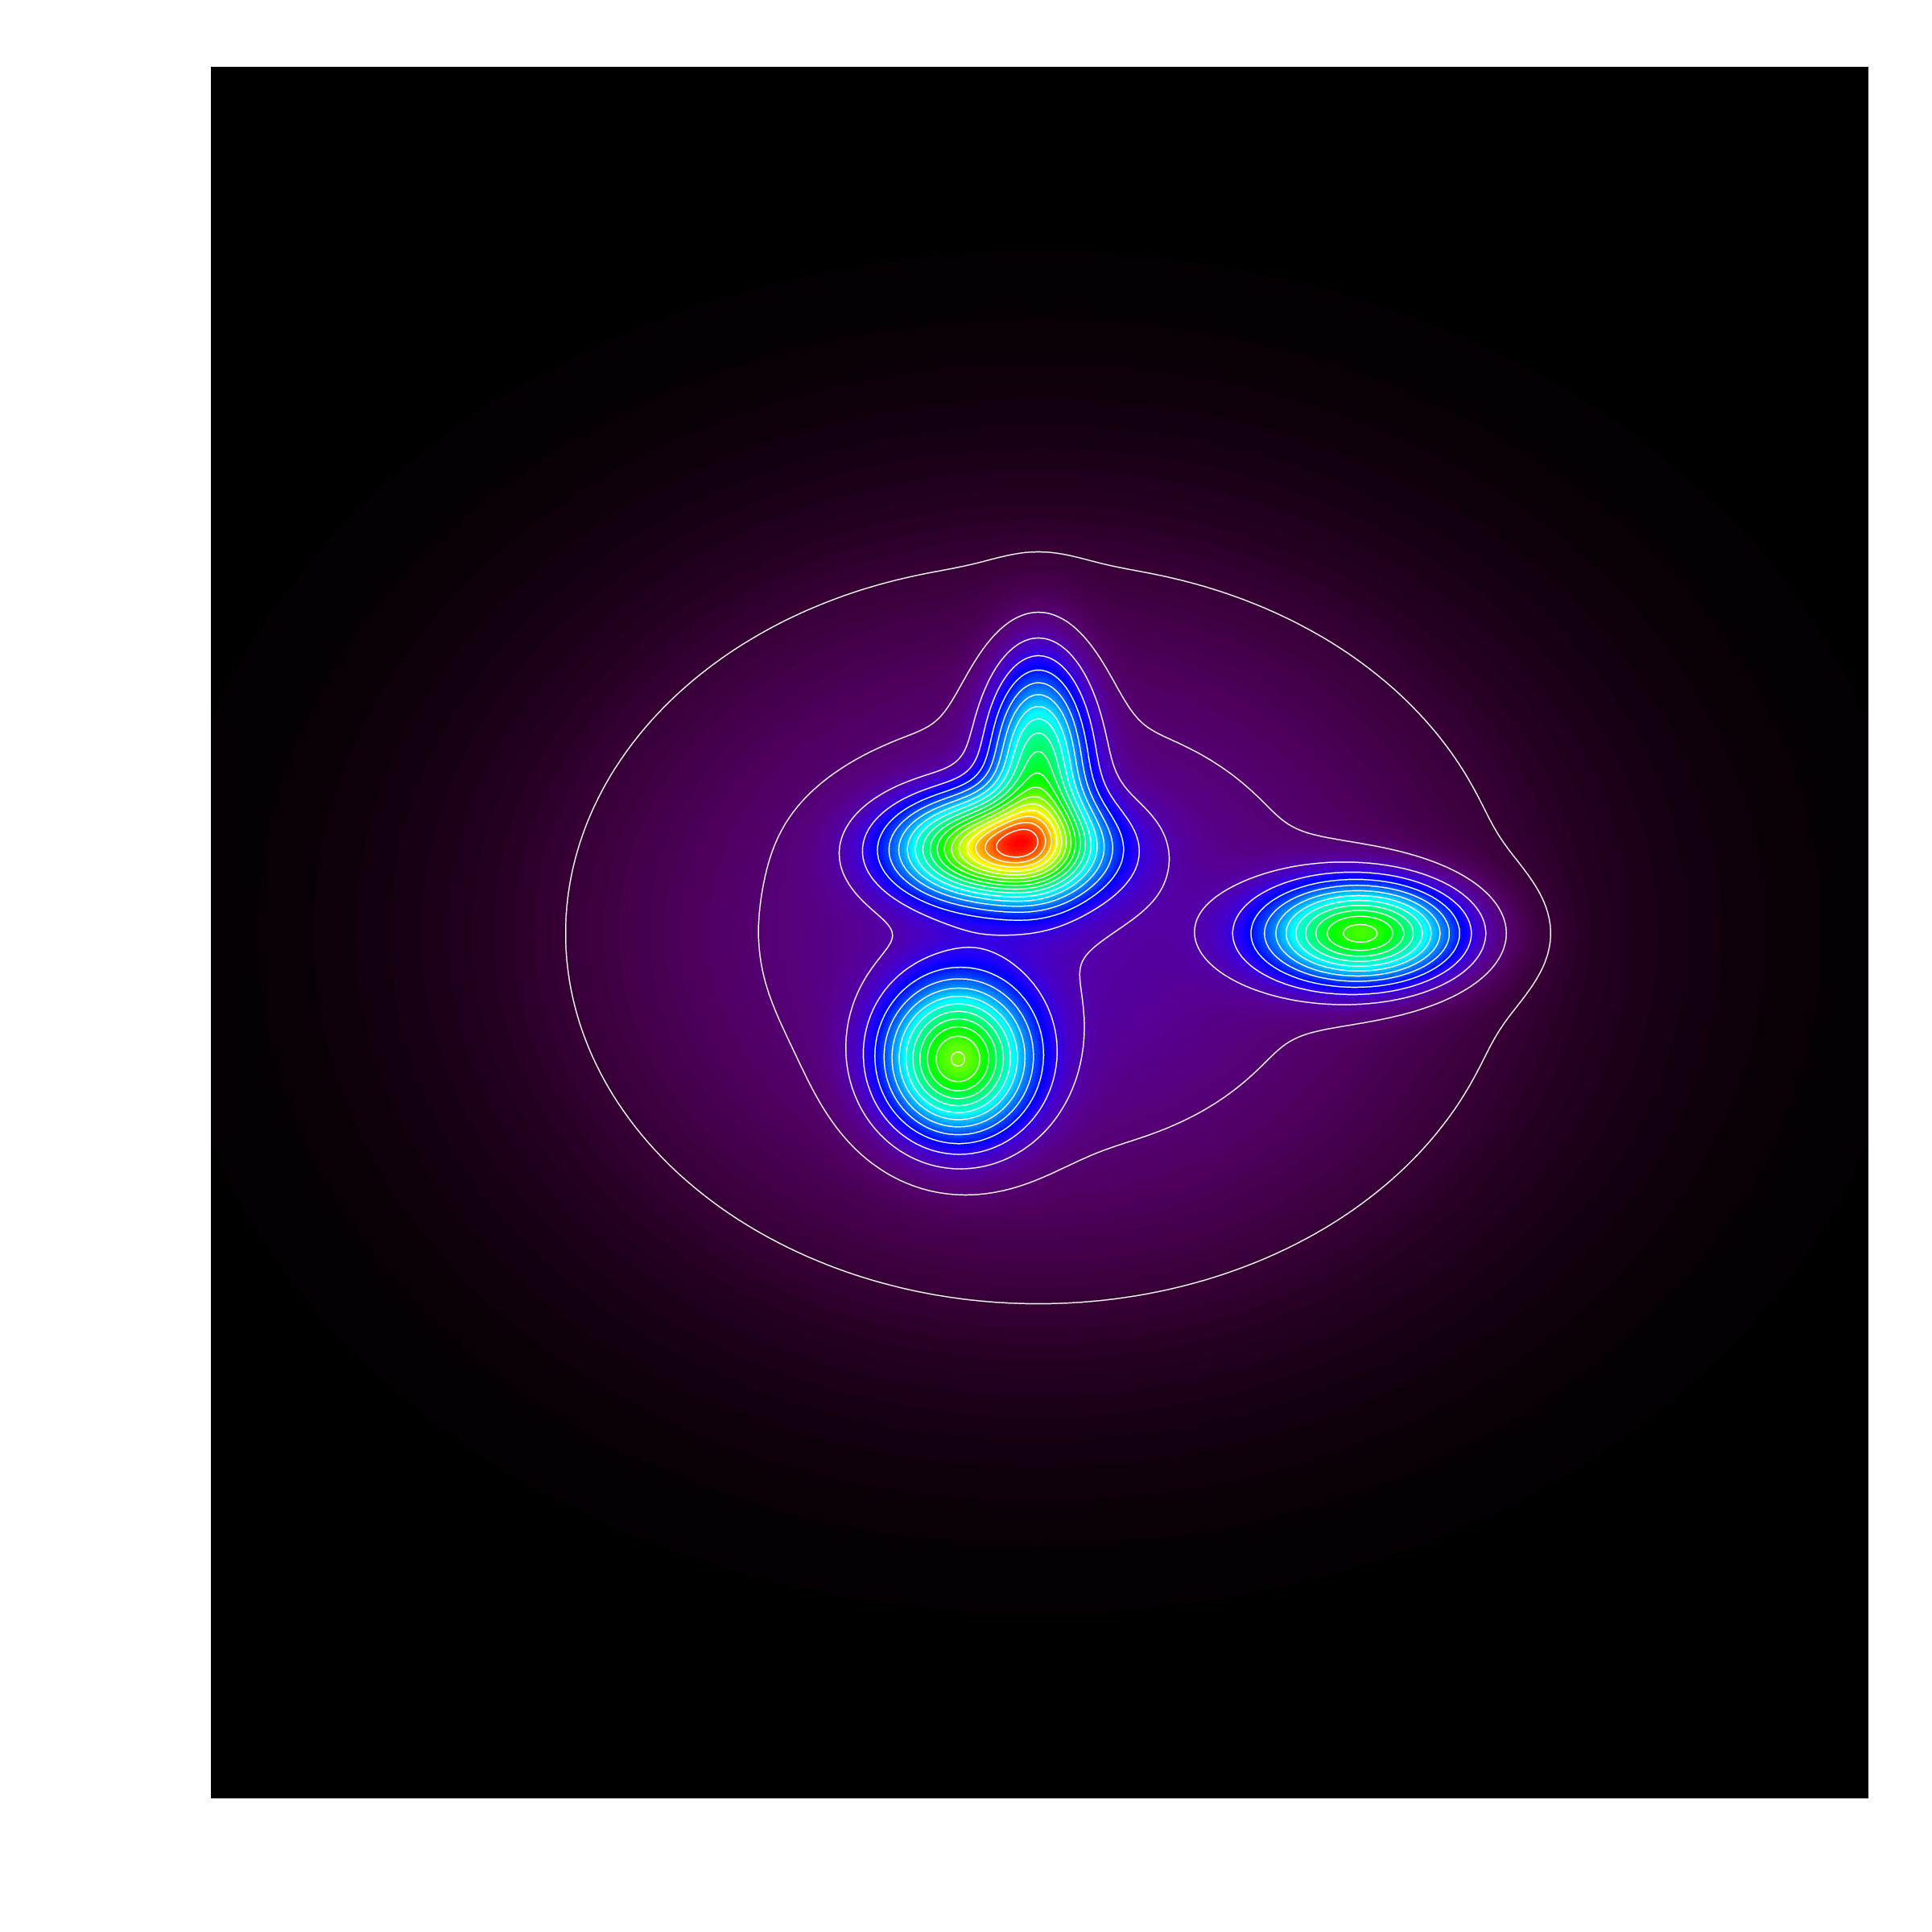
Largest Angular Scale (LAS)
ALMA
Largest angular scale of interest for target
Depends on source structure and science aims
e.g., compact sources embedded in a smooth superstructure holding ~65% of flux
(here with perfect S/N)
Notes:
So that’s where we are
… you’re presumably here because you are interested in Cycle 1
… here are the basics
… expect a proposal deadline in the first half of 2012
… with observing beginning after the end of Cycle 0
… in total Cycle 1 should last about 10 months
… with 1500 hours allocated for science, about 3 times what was given out in Cycle 0
There’s prospect for standard, target of opportunity
… and director’s discretionary proposals
… the time sharpness of time critical obserations is limited to
… a couple of weeks due to the commisioning duty cycle
… and we don’t know but would guess that there will not be
… large proposals or carryover between cycles

Slide 41
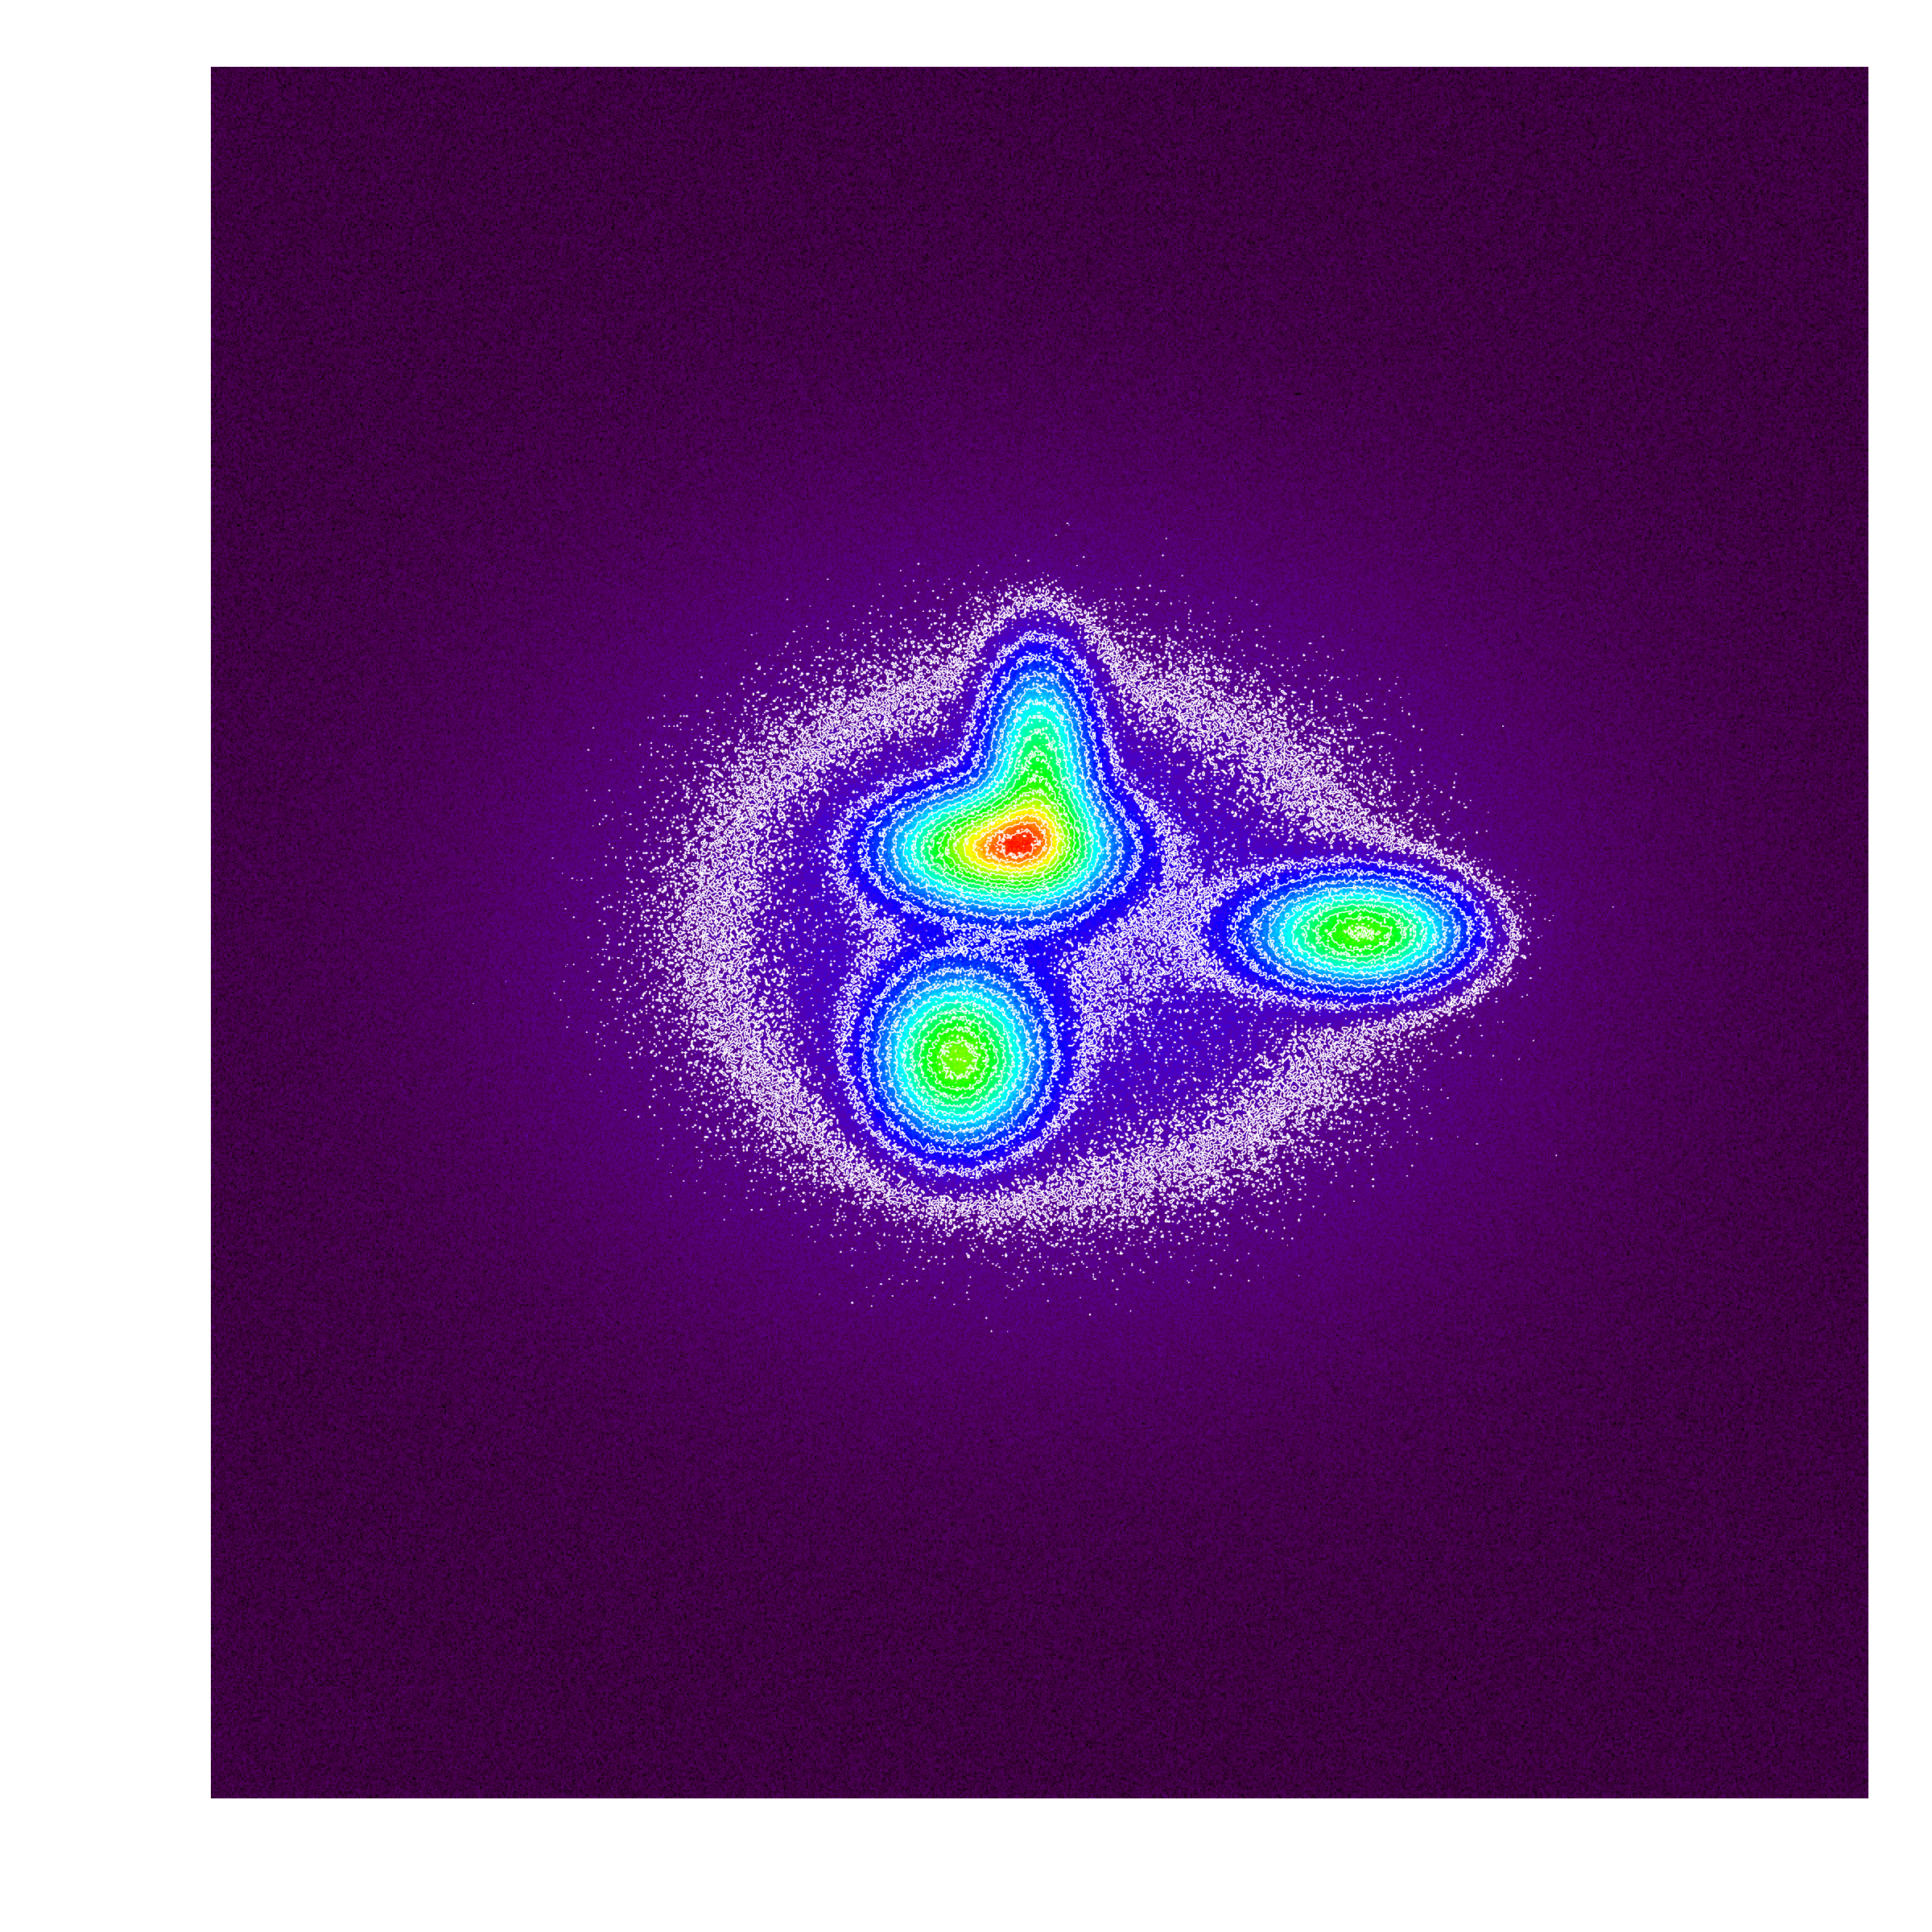
Largest Angular Scale (LAS)
ALMA
Superstructure of scientific interest?
Then your RMS and LAS must reflect that.
Largest Angular Scale
RMS set to detect superstructure and LAS input to reflect size of structure.
Notes:
So that’s where we are
… you’re presumably here because you are interested in Cycle 1
… here are the basics
… expect a proposal deadline in the first half of 2012
… with observing beginning after the end of Cycle 0
… in total Cycle 1 should last about 10 months
… with 1500 hours allocated for science, about 3 times what was given out in Cycle 0
There’s prospect for standard, target of opportunity
… and director’s discretionary proposals
… the time sharpness of time critical obserations is limited to
… a couple of weeks due to the commisioning duty cycle
… and we don’t know but would guess that there will not be
… large proposals or carryover between cycles

Slide 42
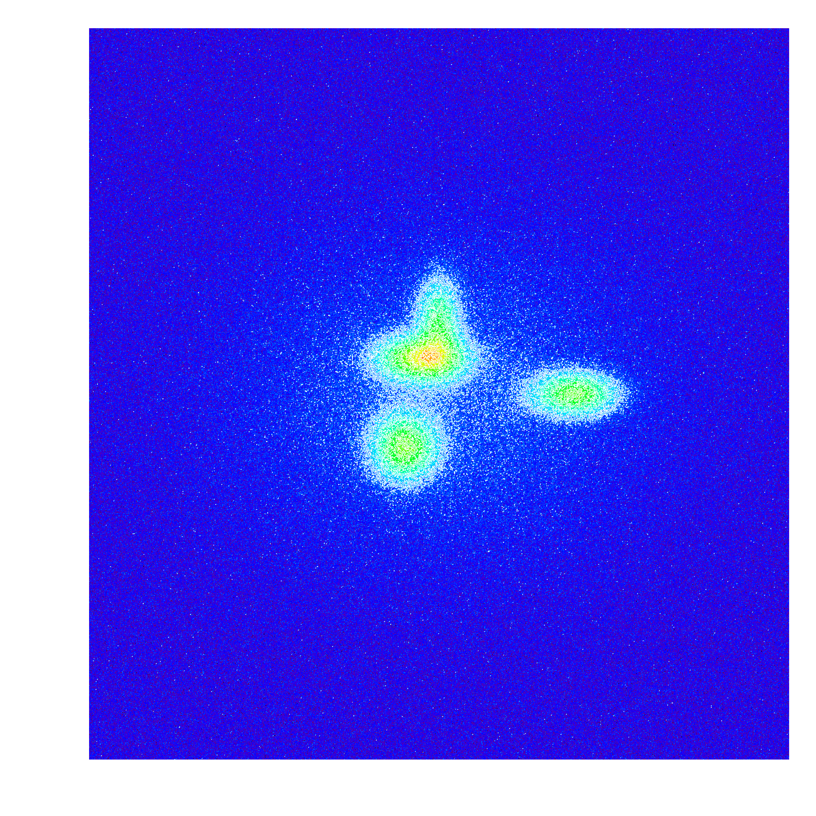
Largest Angular Scale (LAS)
ALMA
Only embedded compact sources of interest?
Largest
Angular
Scale
RMS set to detect compact sources and LAS input to reflect compact source size.
Notes:
So that’s where we are
… you’re presumably here because you are interested in Cycle 1
… here are the basics
… expect a proposal deadline in the first half of 2012
… with observing beginning after the end of Cycle 0
… in total Cycle 1 should last about 10 months
… with 1500 hours allocated for science, about 3 times what was given out in Cycle 0
There’s prospect for standard, target of opportunity
… and director’s discretionary proposals
… the time sharpness of time critical obserations is limited to
… a couple of weeks due to the commisioning duty cycle
… and we don’t know but would guess that there will not be
… large proposals or carryover between cycles

Slide 43
To Use the ACA?
ALMA
Largest Angular Scale of Source
Property of the source and your science.
Maximum Angular Scale Recovered by Array
Related to target angular resolution (in Cycle 1) because that drives the configuration of antennas used.
ACA Recommended?
If Largest Angular Scale too big for Maximum Angular Scale of 12-m Array, then the OT will recommend the inclusion of the ACA.
Ultimately YOUR Decision
ONLY ~250 hours (1/3 of total time) will go to projects needing ACA.
Notes:
So that’s where we are
… you’re presumably here because you are interested in Cycle 1
… here are the basics
… expect a proposal deadline in the first half of 2012
… with observing beginning after the end of Cycle 0
… in total Cycle 1 should last about 10 months
… with 1500 hours allocated for science, about 3 times what was given out in Cycle 0
There’s prospect for standard, target of opportunity
… and director’s discretionary proposals
… the time sharpness of time critical obserations is limited to
… a couple of weeks due to the commisioning duty cycle
… and we don’t know but would guess that there will not be
… large proposals or carryover between cycles

Slide 44
To Use the ACA?
ALMA
Largest Angular Scale of Source
Property of the source and your science.
Maximum Angular Scale Recovered by Array
Related to target angular resolution (in Cycle 1) because that drives the configuration of antennas used.
ACA Recommended?
If Largest Angular Scale too big for Maximum Angular Scale of 12-m Array, then the OT will recommend the inclusion of the ACA.
ACA not available for highest resolutions (not enough overlap in u-v coverage)
Ultimately YOUR Decision
ONLY ~250 hours (1/3 of total time) will go to projects needing ACA.
Notes:
So that’s where we are
… you’re presumably here because you are interested in Cycle 1
… here are the basics
… expect a proposal deadline in the first half of 2012
… with observing beginning after the end of Cycle 0
… in total Cycle 1 should last about 10 months
… with 1500 hours allocated for science, about 3 times what was given out in Cycle 0
There’s prospect for standard, target of opportunity
… and director’s discretionary proposals
… the time sharpness of time critical obserations is limited to
… a couple of weeks due to the commisioning duty cycle
… and we don’t know but would guess that there will not be
… large proposals or carryover between cycles

Slide 45
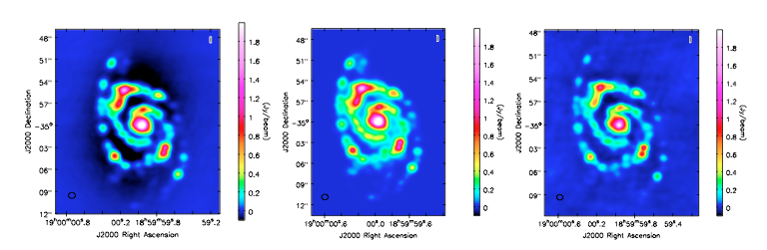
To Use the ACA?
ALMA
When in doubt, simulate!
“Observe” a model of your target with 12-m and 12-m+ACA, compare
12-m Array Only
Model
12-m + 7-m ACA
Image reconstruction artifact (“bowls”)
Not present when 7-m antennas included
Notes:
So that’s where we are
… you’re presumably here because you are interested in Cycle 1
… here are the basics
… expect a proposal deadline in the first half of 2012
… with observing beginning after the end of Cycle 0
… in total Cycle 1 should last about 10 months
… with 1500 hours allocated for science, about 3 times what was given out in Cycle 0
There’s prospect for standard, target of opportunity
… and director’s discretionary proposals
… the time sharpness of time critical obserations is limited to
… a couple of weeks due to the commisioning duty cycle
… and we don’t know but would guess that there will not be
… large proposals or carryover between cycles

Slide 46
Key Proposal Factors
ALMA
Framework: Science Goals
Spectral Setup
Spatial Setup
Control and Performance Specifications
Logistics
Notes:
Quick status

Slide 47
Proposal Checklist
ALMA
Read Primer and Proposer’s Guide
Create an ALMA account by registering at the Science Portal
Download the Observing Tool (OT)
Familiarize yourself with the OT via the Quickstart Video
Define your Science Goals within the OT
use the OT to understand if your science goals match ALMA’s capabilities
use CASA simdata for a more thorough exploration
take advantage of the TA Checklisted generated by the OT
Prepare the Science & Technical Justifications (one PDF file)
Annotated LaTeX template available
Make use of the Helpdesk & the Knowledgebase
Submit to Archive!
Required Step

Slide 48
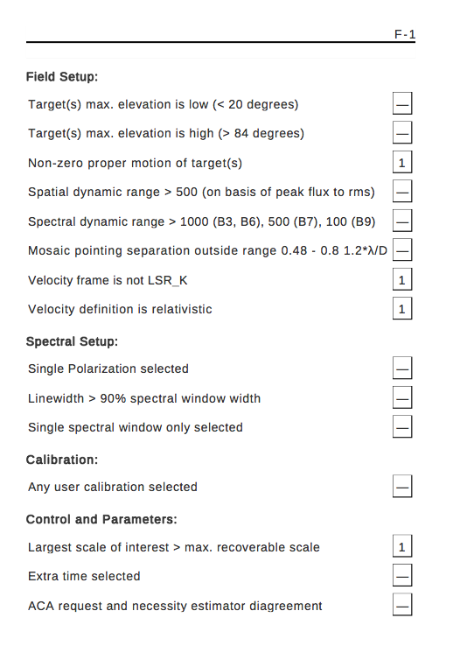
TA Checklist
ALMA
Checklist of technical concerns generated by the OT as part of PDF output
Notes:
So that’s where we are
… you’re presumably here because you are interested in Cycle 1
… here are the basics
… expect a proposal deadline in the first half of 2012
… with observing beginning after the end of Cycle 0
… in total Cycle 1 should last about 10 months
… with 1500 hours allocated for science, about 3 times what was given out in Cycle 0
There’s prospect for standard, target of opportunity
… and director’s discretionary proposals
… the time sharpness of time critical obserations is limited to
… a couple of weeks due to the commisioning duty cycle
… and we don’t know but would guess that there will not be
… large proposals or carryover between cycles

Slide 49
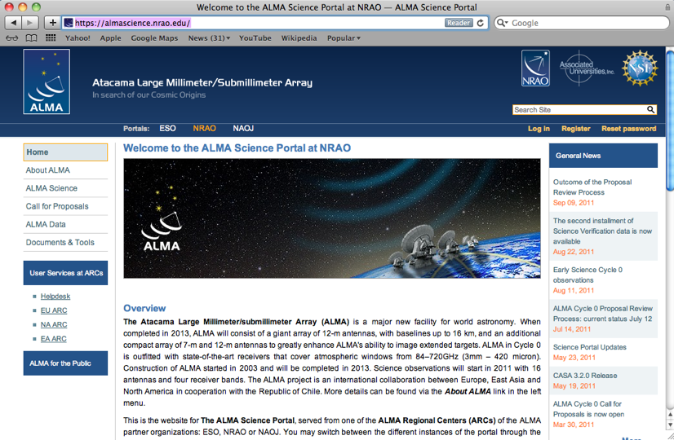
The ALMA Science Portal
ALMA
https://almascience.nrao.edu
Hub for project-wide material.
Observing Tool
Sensitivity Calculator
Proposer’s Guide
Technical Handbook
Science Verification Data
CASA & Simulations
Tutorials
Helpdesk
Registration required to propose.

Slide 50
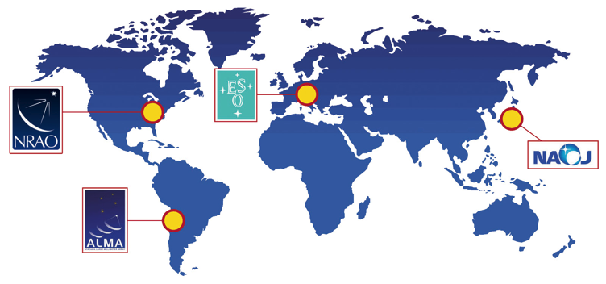
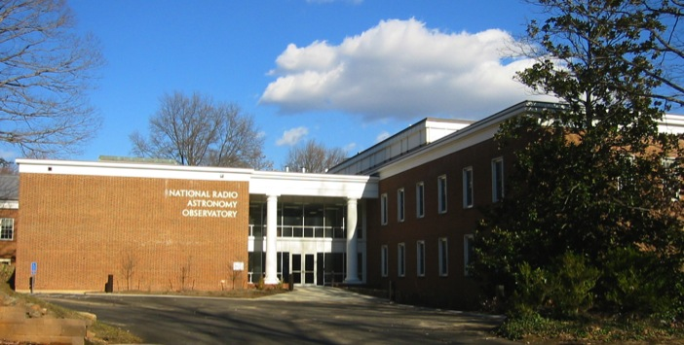
The NAASC
ALMA
https://science.nrao.edu/facilities/alma
The North American ALMA Science Center
One of three ALMA Regional Centers
Offers science support to NA
Any Taiwain or world members who request.
Support for:
Proposal preparation & submission
Observation preparation
Data archive
Data processing
Face-to-face visits for data reduction
Workshops, tutorials, and outreach
Some publication and student support

