Slide 1
Planning JVLA Observations
Capabilities & practicalities
Michael P. Rupen
Project Scientist for the WIDAR Correlator

Slide 2
What is the JVLA?
A very quick introduction

Slide 3
The JVLA
VLA came on-line in the 1980s
Huge upgrade (x10 in major parameters) over the past decade
Super-powerful
Super-flexible
Available now

Slide 4
28x25m antennas, 8 feeds, 0.035-36.4 km

Slide 5
28x25m antennas, 8 feeds, 0.035-36.4 km

Slide 6
28x25m antennas, 8 feeds, 0.035-36.4 km

Slide 7
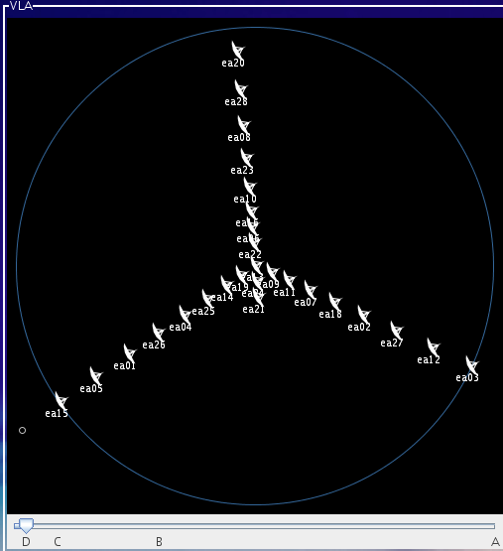
28x25m antennas, 8 feeds, 0.035-36.4 km
Reconfigured every 4 months
Spatial dynamic range in 1 cfg: ~20-100
Currently D→C→B→A (x3.3 in baseline length)
“Hybrids” for southern sources
Short baselines retained in C cfg

Slide 8
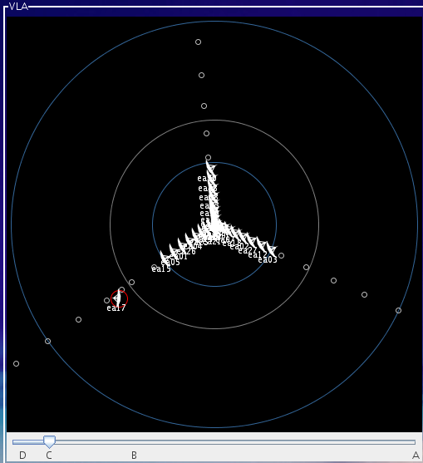
28x25m antennas, 8 feeds, 0.035-36.4 km
Reconfigured every 4 months
Spatial dynamic range in 1 cfg: ~20-100
Currently D→C→B→A (x3.3 in baseline length)
“Hybrids” for southern sources
Short baselines retained in C cfg

Slide 9
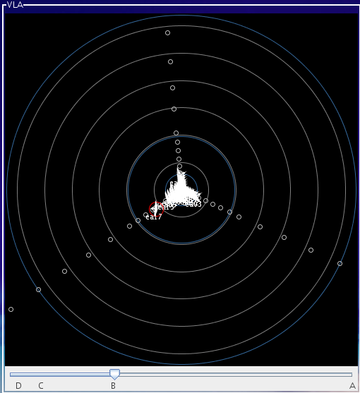
28x25m antennas, 8 feeds, 0.035-36.4 km
Reconfigured every 4 months
Spatial dynamic range in 1 cfg: ~20-100
Currently D→C→B→A (x3.3 in baseline length)
“Hybrids” for southern sources
Short baselines retained in C cfg

Slide 10
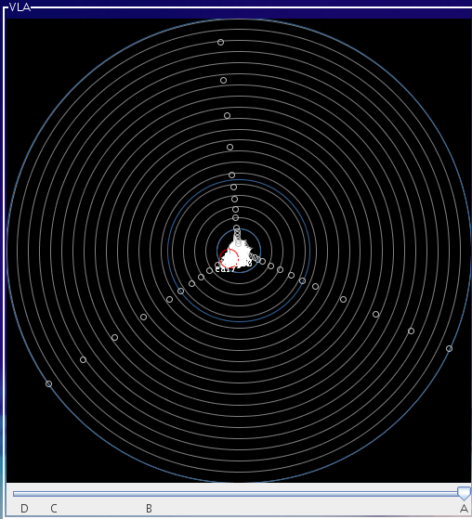
28x25m antennas, 8 feeds, 0.035-36.4 km
Reconfigured every 4 months
Spatial dynamic range in 1 cfg: ~20-100
Currently D→C→B→A (x3.3 in baseline length)
“Hybrids” for southern sources
Short baselines retained in C cfg

Slide 11
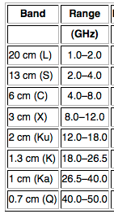
1-50 GHz in 8 bands
Can switch bands in ~20 sec

Slide 12
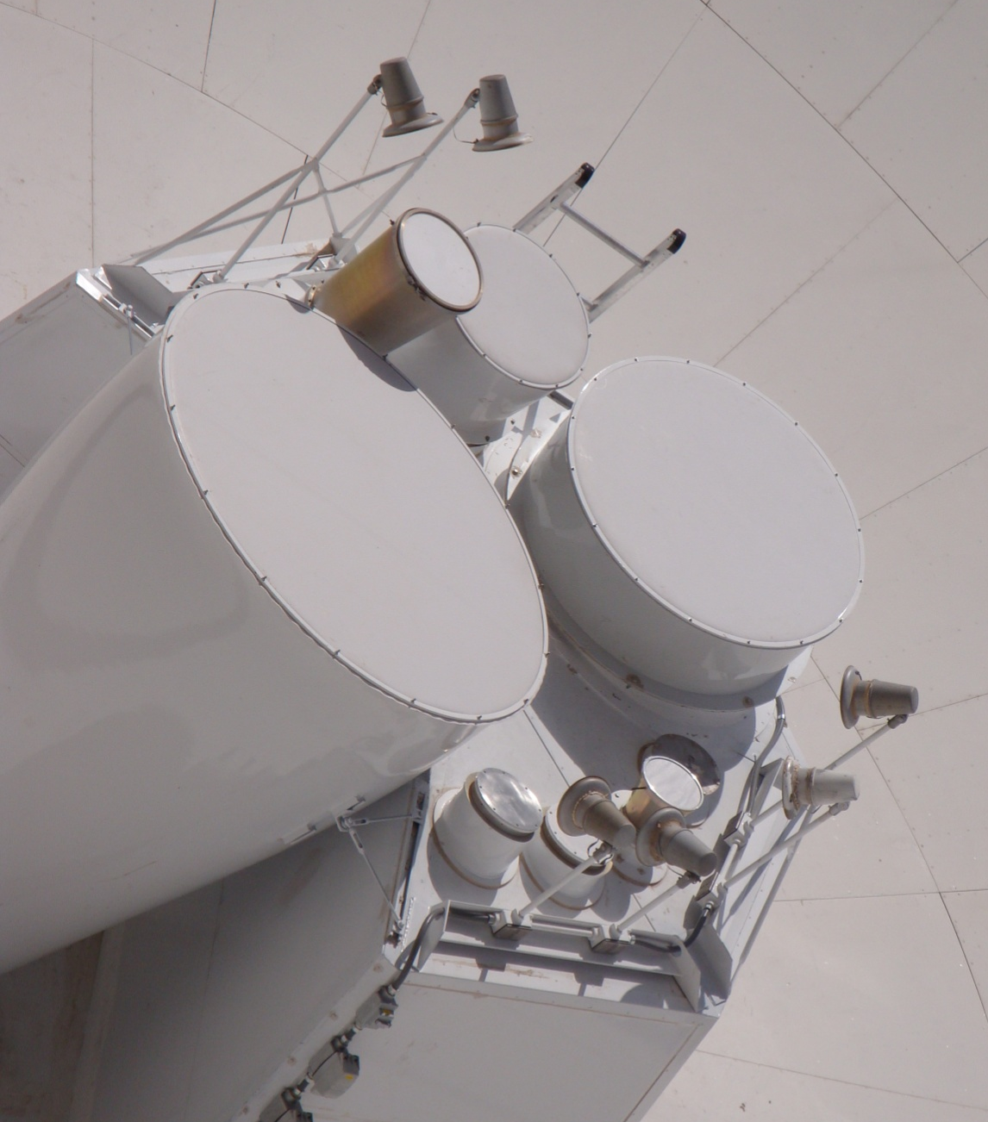
1-50 GHz in 8 bands
Can switch bands in ~20 sec
Feed
Heaters
X
C
L
S
Ku
K
Ka
Q

Slide 13
Basic scientific capabilities

Slide 14
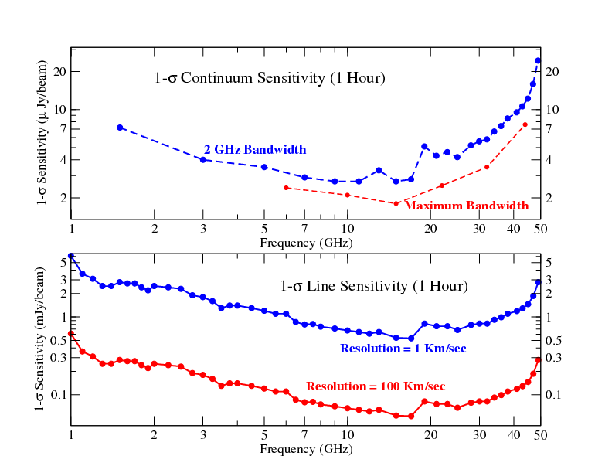
Sensitivity & frequency coverage
1 GHz
10 GHz
50 GHz
Continuum: ~few microJy/sqrt(hr)
Line 1km/s: ~few mJy/sqrt(hr)
L
S
C
X
Ku
K
Ka
Q
8-bit: 2 x 1 GHz basebands within a given band
3-bit: 4 x 2 GHz basebands within a given band (only offered for wideband)

Slide 15
Sensitivity & frequency coverage

Slide 16
Sensitivity & frequency coverage
Up to 2:1 bandwidth ratios
Worst spectral resolution: 2 MHz/channel (full pol’n products)
Bandwidth synthesis for better uv-coverage
Instantaneous spectral indices

Slide 17
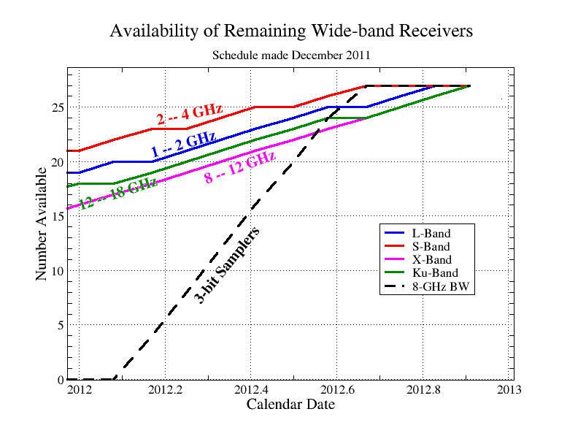
Receiver Availability
Most receivers are installed
21 antennas have wideband (3-bit) samplers (8 GHz/pol’n)
Complete:
C: 4-8 GHz
K: 18-26.5 GHz
Ka: 26.5–40GHz
Q: 40-50GHz
8 GHz capability

Slide 18
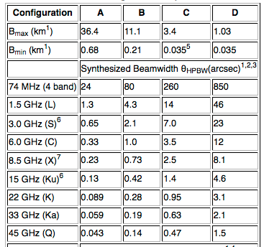
Angular resolution
4 configurations: A → big; D → small
~4 months in each configuration, cycling D C B A
(plus hybrids for southern sources)

Slide 19
Largest angular scale & field-of-view
Field of view
(depends on
diameter of a
single antenna)
608’
30’
15’
7.5’
5.3’
3’
2’
1.4’
1’
Smaller configurations give better surface brightness sensitivity and don’t filter out larger structures
Imaging beyond primary beam requires mosaicking

Slide 20
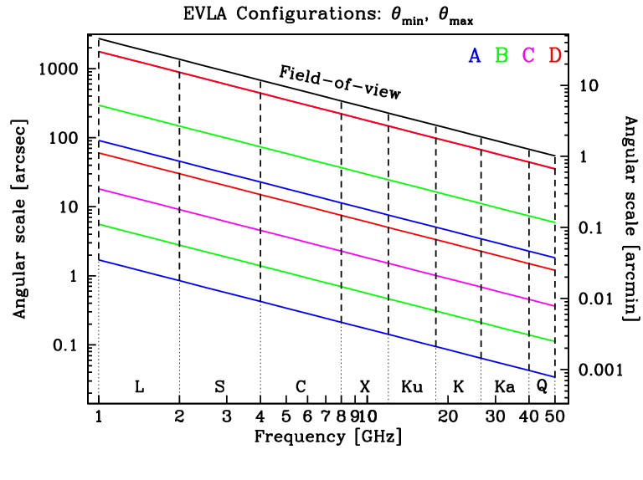
Angular resolution, largest angular scale, & field-of-view

Slide 21
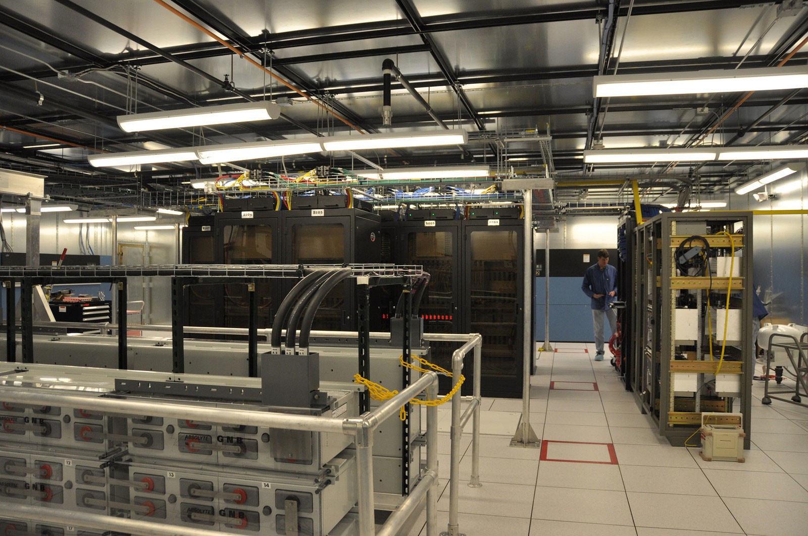
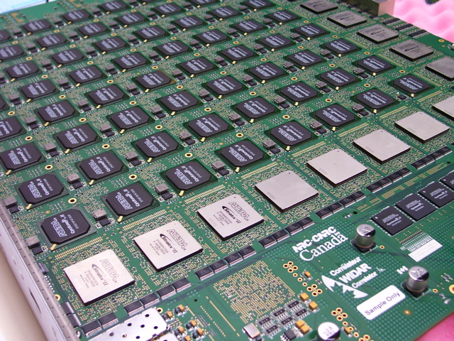


WIDAR Correlator
WIDAR: Wideband Interferometric Digital Architecture
10¹⁶ calculations/s (10 P-ops)
Fiber bandwidth: 3 Tbits/s
16 GHz per antenna = 2600 TV channels
175 kW
128 Gbits/s output ~ 3 DVDs/s
128 baseline boards
128 station boards
NRC-CNRC

Slide 22

WIDAR Overview
 | VLA | WIDAR-now | WIDAR-2013
Quantization | 3-level | 16/256-level | 16/256-level
# antennas | 27 | 28 | (32)
Max. bandwidth | 0.2 GHz | 16 GHz | 16 GHz
# subband pairs | 1 - 2 | 1 – 64 | 1 – 64
# channels (total) | 2-512 | 256 – 32,768 | 256 – (4,194,304)
Max./min. δν | 50 MHz / 381 Hz | 2 MHz / 122 Hz | 2 MHz / (0.12 Hz)
dt_{min} | 1.7 sec | 0.01 sec | 0.01 sec
Max. data rate | 3.3 x 10³ vis/sec | ~10 x 10⁶ vis/sec | (1600-16000 x 10⁶ vis/sec)
Extras | Phasing VLBI Subarrays | Phasing Subarrays Auto-correlation | Phasing VLBI Subarrays (Pulsar phase bins) (Burst mode) Auto-correlation

Slide 23
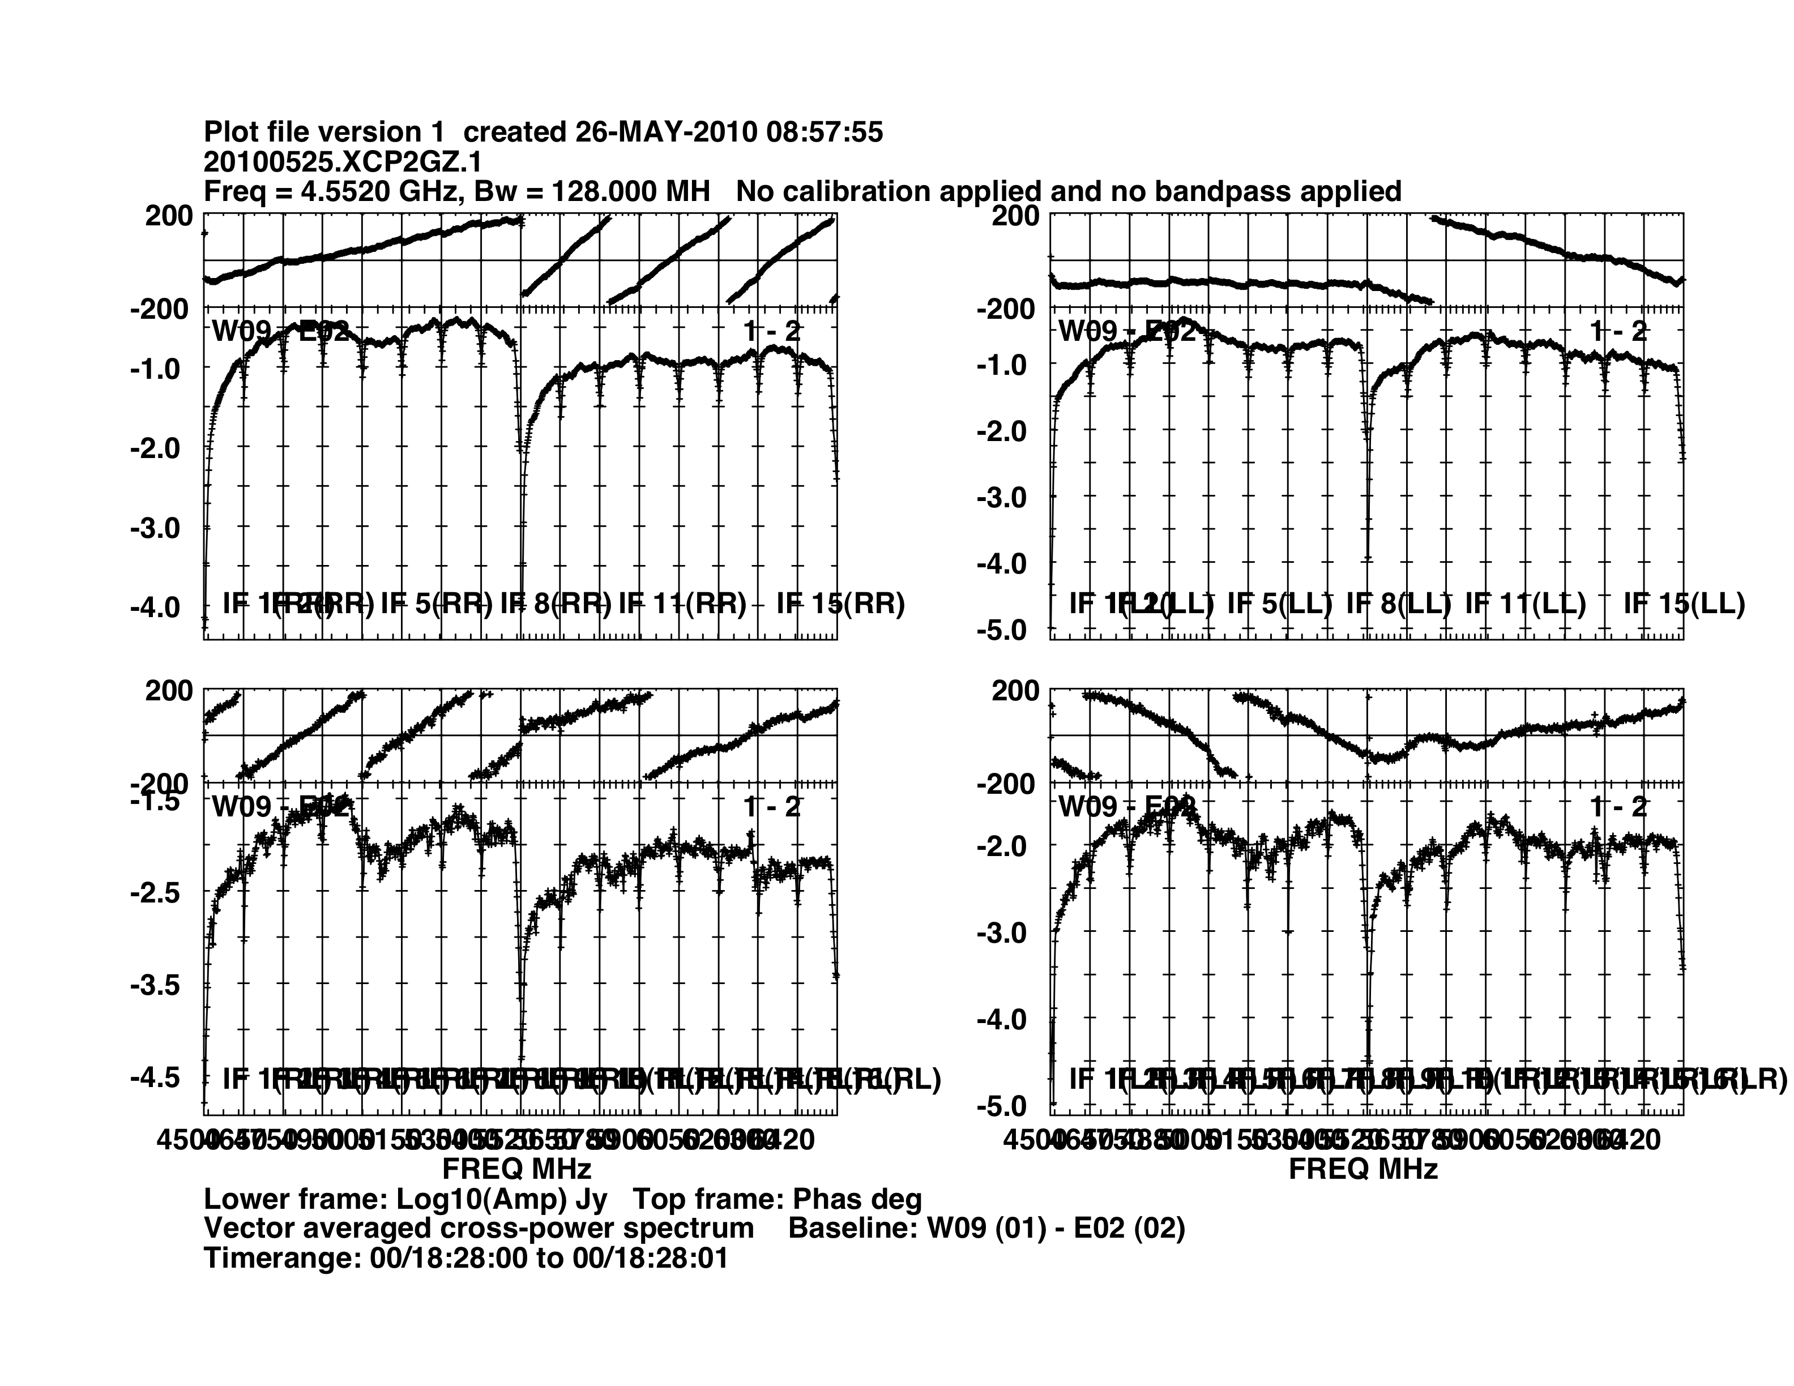
One baseline, one dump
2 x 1 GHz baseband pairs
= 16 x 128 MHz subband pairs
64 ch/pp/sb → 4096 x 2 MHz channels
One baseline, one dump!

Slide 24
Flexibility: truly independent subbands
64 independent Spectral Windows
Ability to make simultaneous continuum & multiple line measurements
Example: L band, all at once:
continuum
galactic + extragalactic HI imaging & absorption
OH lines
>10 radio recombination lines

Slide 25
Flexibility: truly independent subbands
64 independent Spectral Windows
Tuning
Bandwidth (31.25 kHz – 128 MHz)
Number of polarization products (single, dual, full)
Number of channels
Trade subbands for channels (hardware stacking)
Trade time resolution for channels (recirculation)
Dump rates

Slide 26
Dynamic scheduling
Everything is dynamically scheduled
Can’t tell exactly when your schedule will run, or what will have been observed just before that
  Initial slew is uncertain
Scheduling is based on:
  TAC priority (A B C, science, etc.) – i.e., competition
  Current weather (rms phase, wind – by-band defaults, which you can override) – note we do not yet look at the ionosphere, weather predictions, solar activity, opacity, RFI
  Efficiency

Slide 27
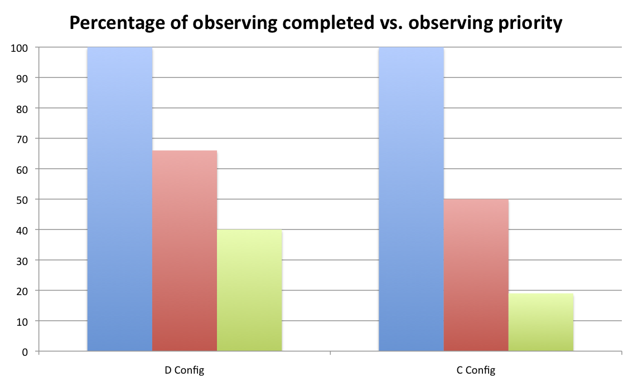
Scheduling considerations
Priority A: observe during requested observing conditions, long SBs are fine
Priority B: number of projects approved designed to fit into available hours per configuration, but shorter SBs help with scheduling around priority A projects
Priority C: filler, short SBs (0.5 to 1.0 hr) will improve chances of observation
A
A
B
B
C
C

Slide 28
Dynamic scheduling
Getting on the telescope:
  Get your observing schedules in early
  Short blocks are easier…but require more overhead
  Can request `filler’ time (short bad weather blocks) – note we are accepting much more Priority C than in the past
  Daytime is harder (competes with commissioning, maintenance)
  The weather changes during the year

Slide 29
Computing challenges
The EVLA produces a LOT of data: ~50 MB/s now, ~75 MB/s for this proposal cycle
  1 hour= 180 GB @ 50 MB/s
  Simply transferring the data is painful → internet or disks
Complete frequency coverage and wide bandwidths
  Radio frequency interference (RFI) everywhere
  Instruments vary (e.g., field-of-view goes as wavelength)
  Sources vary (e.g., freq^2 → factor 4 different in flux over 2:1 bandwidth ratio)
  Extremely sensitive → sidelobes and dynamic range issues
  LOTS more science: lines, spectral shapes, polarization, mosaics, on-the-fly mapping

Slide 30
Proposing for the EVLA
A preview of the July 7, 2012 call for proposals

Slide 31
Initial capabilities for full operations, 2013A
The move to D configuration in Jan 2013 will mark the start of full operations for the JVLA; at that time we will offer:
8-bit sampler system with:
  Independent and flexible sub-bands, up to 32 total sub-bands, max. 16,384 spectral channels distributed over 2 GHz bandwidth per polarization
3-bit sampler system with:
  Low spectral resolution with full 8 GHz bandwidth per polarization for “continuum” observations and high frequency extragalactic line work
Multiple sub-arrays:
  Up to 3 independent sub-arrays, any band, using low spectral resolution (“continuum” mode) with 2 GHz bandwidth/polarization
Phased array for VLBI:
  Up to 128 MHz BW for 2 sub-bands to match VLBA 2 Gbps system
Data dump times >=50 ms, data rates <=20 MB/s standard

Slide 32
Wideband with low res’n: 8 GHz/pol’n
Full pol’n products: 2 MHz/channel
Dual pol’n products: 1 MHz/channel
Single pol’n product: 0.5 MHz/channel

Slide 33
Flexible subbands over 2 x 1 GHz basebands
Two independently-tunable 1 GHz basebands
Up to 16 subbands in each baseband
  Each independently tunable, but can’t cross 128 MHz boundaries
  128, 64, 32, …, 0.03125 MHz bandwidths
  Can choose different bandwidths, polarization products, and channelization for each subband
  All must share the same dump time
Total of 16384 channels spread flexibly over subbands and polarization products: “Baseline Board stacking”

Slide 34
Flexible subbands over 2 x 1 GHz basebands

Slide 35
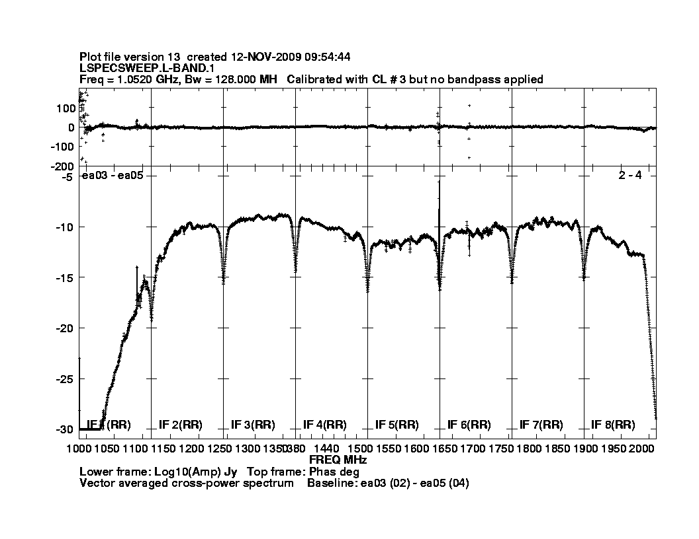
Edge effects
Subband edges (few channels) are noisier
Can lose 10s of channels for narrowest subbands

Slide 36
Up to 3 “continuum” subarrays
2 x 1 GHz bandwidth
  Independently tunable
Spectral resolution:
  2 MHz with full pol’n products
  1 MHz with dual pol’n products
  0.5 MHz with single pol’n product

Slide 37
Dump times and data rates
Standard allows: >= 50msec, <= 20 MB/s
  20 MB/s = 70 GB/hr
Special justification needed for dump times faster than the defaults (1sec A & B-high, 3sec B-low/C, 5sec D)
Data rate limit is set by disk space (!), which translates directly to $$$

Slide 38
Phased VLA for VLBI
Two independently-tunable subband pairs
  Cannot change bandwidth during the observation – think hard about phasing!
2 bit sampling → max 2 Gbps

Slide 39
Shared Risk observing, semester 2013A
In order to push boundaries of standard capabilities we will continue to offer a Shared Risk observing program
  Correlator set-ups that are not well tested but can be scheduled through dynamic scheduler
  Programs will receive test time to verify feasibility
  Residence not required (unless the tests fail)
  Examples:
    Sub-arrays with 3-bit samplers
    Fast dump modes up to 60 MB/s (8-bit)
    3-bit with sub-band BWs narrower than 128 MHz

Slide 40
RSRO program, semester 2013A
RSRO program will continue for technically challenging capabilities driven by the community
  Residency requirements will be relaxed over current (no 3-month minimum)
  Examples:
    On-the-fly (OTF) mosaics
    Phased array for non-VLBI
    General recirculation set-ups (more channels)
    Real-time transient detection
    Pulsar observing modes

Slide 41
Proposals

Slide 42
August1, 2012 deadline
Any configuration
D config currently scheduled Jan 25- Apr 27, 2013
Regular, Rapid response, Large proposals (>200 hrs)
    Key science
    Proprietary period normally 12months since last observations
  Observing time includes overheads (flux, phase, bandpass calibration; slew time; dummy scans)
Joint proposals with Chandra, Fermi, Spitzer
Future calls: Feb 1, Aug 1
  DDT (ToO/Exploratory/EPO) proposals anytime (<=6 mos. proprietary period)

Slide 43
Proposal Submission Tool (PST)
http://my.nrao.edu, click on Proposals

Slide 44
Proposal Submission Tool (PST)
General

Slide 45
Proposal Submission Tool (PST)
Authors

Slide 46
Proposal Submission Tool (PST)
Scientific Justification
PROPRIETARY!
4 pages PDF

Slide 47
Proposal Submission Tool (PST)
Sources

Slide 48
Proposal Submission Tool (PST)
Resources

Slide 49
Proposal Submission Tool (PST)
Resources

Slide 50
Proposal Submission Tool (PST)
Sessions
Session= observing sessions (SBs)

Slide 51
Proposal Submission Tool (PST)
Preview, verify, & submit!

Slide 52
Things to think about
Overhead: >50% at high frequencies in big configurations
  Moving the antennas, calibration, …
  Huge overhead for short Scheduling Blocks
Available time: more time is available at night, and some parts of the sky are highly over-subscribed (e.g., Galactic Center)
Weather: high-frequency daytime observations in the summer will be painful. Low-frequency during solar max won’t be fun either.
Sensitivity: see JVLA Exposure Calculator
Spatial scales: resolution, largest angular scales, field-of-view
Uv-coverage: 10sec may get you the sensitivity, but you can’t image a complex source
RFI

Slide 53
What NRAO can do for you

Slide 54
Documentation on the Web
Go to www.nrao.edu, click on astronomer, then EVLA:
Observational Status Summary: basic introductory guide with (almost) everything in this talk, and more!
EVLA Exposure Calculator: how long does it take to get to 1microJy/beam?
FAQs: how much overhead do I need?
eNews: late-breaking news for our observing community
Data archive: all VLA, VLBA, EVLA data are accessible through the NRAO archive
Plus information on proposal submission, observing scripts, memo series, RFI plots and lists, data reduction…

Slide 55
Support
Travel support
Observing/data reduction visits
Preprint and page charges
Large proposal/key science support
Students (undergraduate and graduate)
  Summer students
  Student observing support (also class observations in some cases)
  Co-op program (undergraduates)
  Graduate student internships
  Graduate fellowships
Postdoctoral fellowships (Jansky and others)
Short- or long-term visits
  PhD astronomers or radio engineers, preferably junior

Slide 56
NRAO staff
Helpdesk: pundits on demand!
E-mail, telephone
Wide variety of radio expertise
  Data analysts
  Software engineers
  Hardware gurus
  Scientific staff
Friendly, helpful (well, at least we try our best…)
  We really do like working in a national observatory
  You can’t possibly have crazier ideas than we do

