Slide 1
Calibration
George Moellenbrock, NRAO

Slide 2
Synopsis
Why do we have to calibrate?
Idealistic formalism → Realistic practice…. data!
Editing
Fundamental Calibration Principles
Practical Calibration Considerations
Baseline-based vs. Antenna-based Calibration
Scalar Calibration Example
Generalizations
Full Polarization
A Dictionary of Calibration Effects
Calibration Heuristics and ‘Bootstrapping’
New Calibration Challenges
Summary

Slide 3
Why Calibration and Editing?
Synthesis radio telescopes, though well-designed, are not perfect (e.g., surface accuracy, receiver noise, polarization purity, gain stability, geometric model errors, etc.)
Need to accommodate deliberate engineering (e.g., frequency conversion, analog/digital electronics, filter bandpass, etc.)
Hardware or control software occasionally fails or behaves unpredictably
Scheduling/observation errors sometimes occur (e.g., wrong source positions)
Atmospheric conditions not ideal
Radio Frequency Interference (RFI)
Determining instrumental properties (calibration)
is a prerequisite to
determining radio source properties

Slide 4
From Idealistic to Realistic
Formally, we wish to use our interferometer to obtain the visibility function:
….a Fourier transform which we intend to invert to obtain an image of the sky:
V(u,v) describes the amplitude and phase of 2D sinusoids that add up to an image of the sky
Amplitude: “~how concentrated?”
Phase: “~where?”
How do we measure V(u,v)?

Slide 5
From Idealistic to Realistic
In practice, we correlate (multiply & average) the electric field (voltage) samples, x_{i} & x_{j}, received at pairs of telescopes (i,j) and processed through the observing system:
x_{i} & x_{j} are mutually delay-compensated for a specific point on the sky
Averaging duration is set by the expected timescales for variation of the correlation result (~seconds)
J_{ij} is an operator characterizing the net effect of the observing process for antennas i and j on baseline ij, which we must calibrate
Sometimes J_{ij} corrupts the measurement irrevocably, resulting in data that must be edited or “flagged”

Slide 6
What Is Delivered by a Synthesis Array?
An enormous list of complex visibilities! (Enormous!)
At each timestamp (~1-10s intervals): N(N-1)/2 baselines
EVLA: 351baselines
VLBA: 45 baselines
ALMA: 1225-2016 baselines
For each baseline: up to 64 Spectral Windows (“spws”, “subbands” or “IFs”)
For each spectral window: tens to thousands of channels
For each channel: 1, 2, or 4 complex correlations (polarizations)
EVLA or VLBA: RR or LL or (RR,LL), or (RR,RL,LR,LL)
ALMA: XX or YY or (XX,YY) or (XX,XY,YX,YY)
With each correlation, a weight value and a flag (T/F)
Meta-info: Coordinates, antenna, field, frequency label info
N_{total} = N_{t} x N_{bl} x N_{spw} x N_{chan} x N_{corr} visibilities
~few 10⁶ x N_{spw} x N_{chan} x N_{corr} vis/hour →10s to 100s of GB per observation
Notes:
Update numbers, esp. for ALMA

Slide 7
A Typical Dataset (Polarimetry)
Array:
EVLA D-configuration (Apr 2010)
Sources:
Science Target: 3C391 (7 mosaic pointings)
Near-target calibrator: J1822-0938 (~11 deg from target)
Flux Density calibrator: 3C286
Instrumental Polarization Calibrator: 3c84
Signals:
RR,RL,LR,LL correlations
One spectral window centered at 4600 MHz, 128 MHz bandwidth, 64 channels

Slide 8
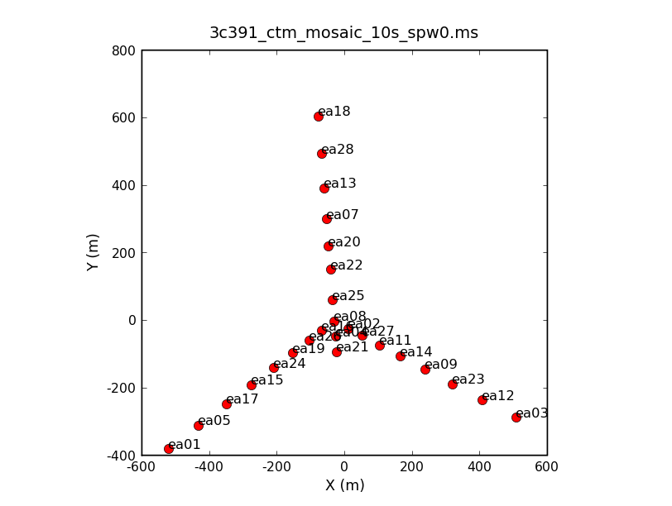
The Array

Slide 9
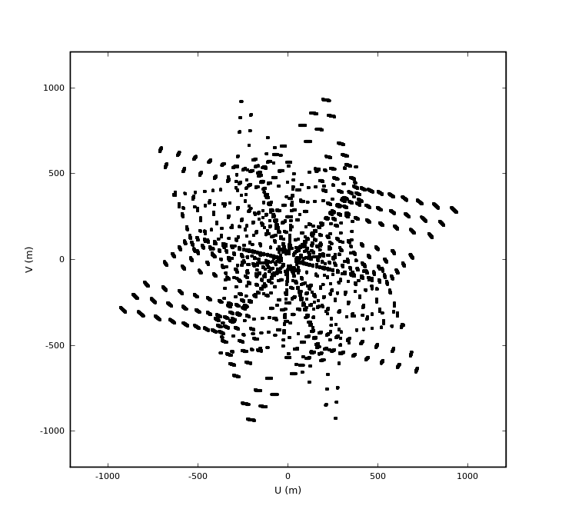
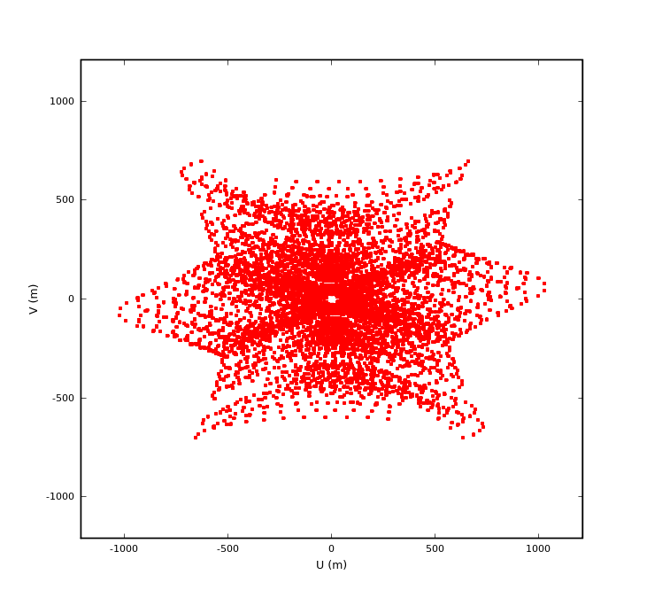
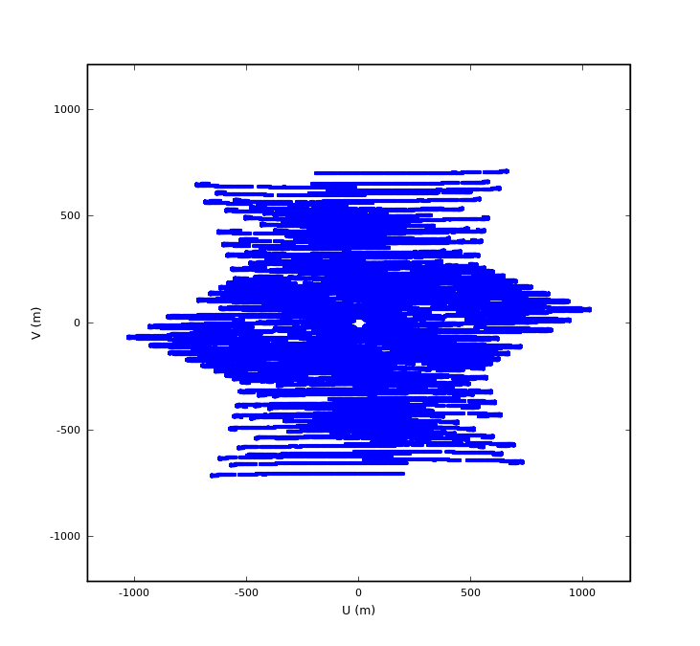
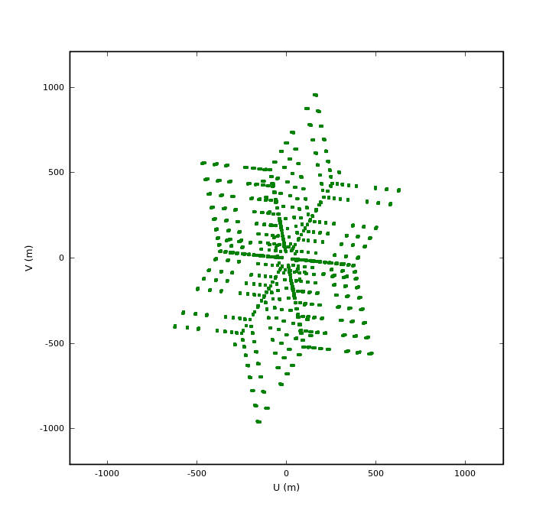
UV-coverages
3C286
Flux Density
J1822-0938
Gain Calibrator
3C391
Science Target
3C84
Instr. Poln Calibrator

Slide 10
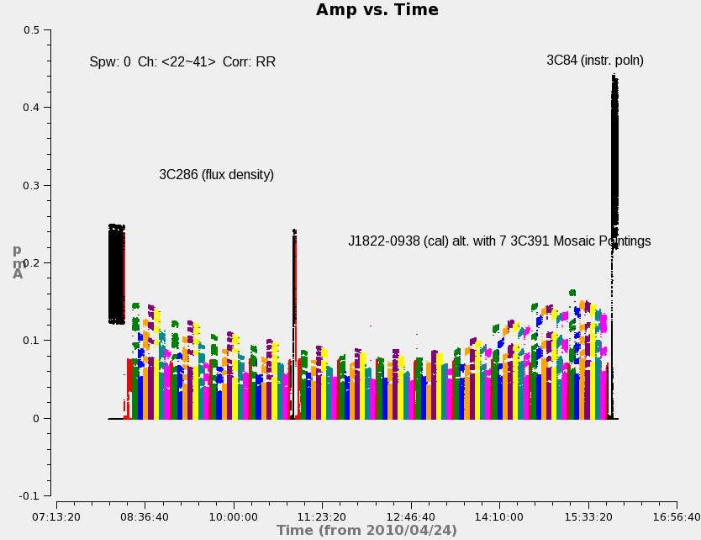
The Visibility Data (source colors)
Amp

Slide 11
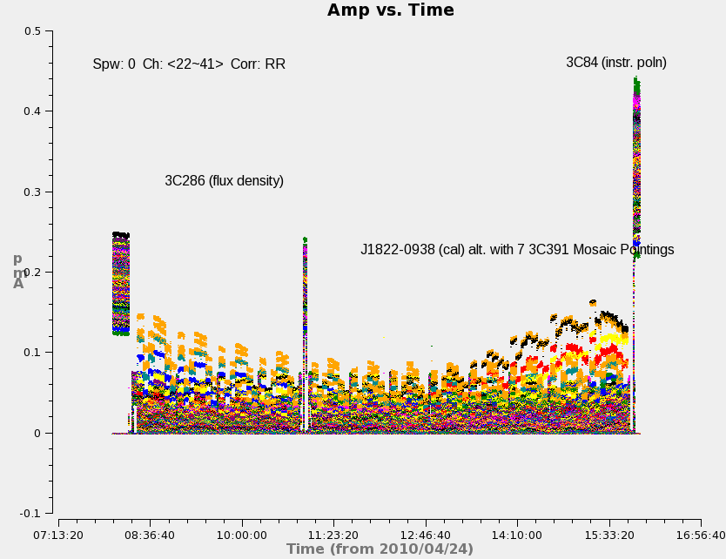
The Visibility Data (baseline colors)
Amp

Slide 12
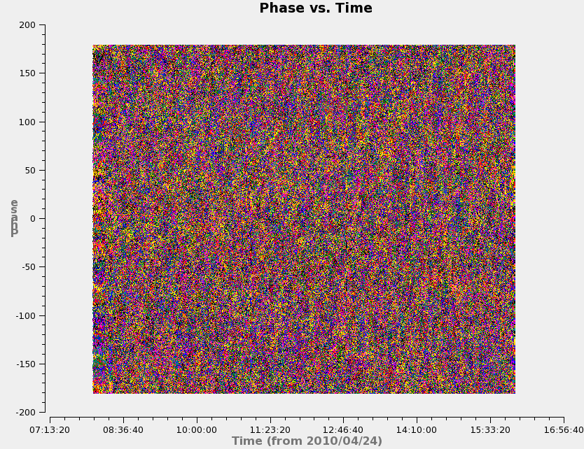
The Visibility Data (baseline colors)
Phase

Slide 13
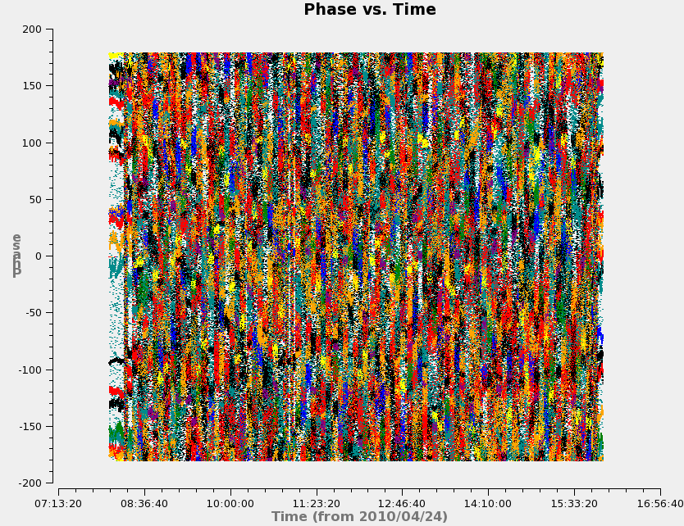
The Visibility Data (baseline colors)
Baselines to
antenna ea21
Phase

Slide 14
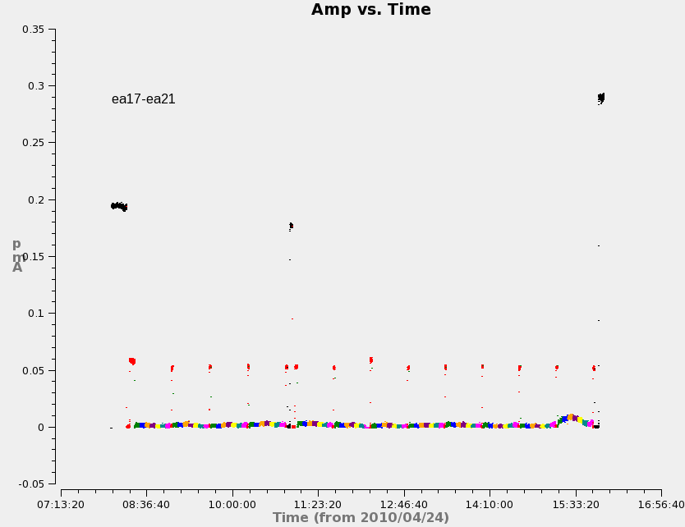
A Single Baseline - Amp
Amp

Slide 15
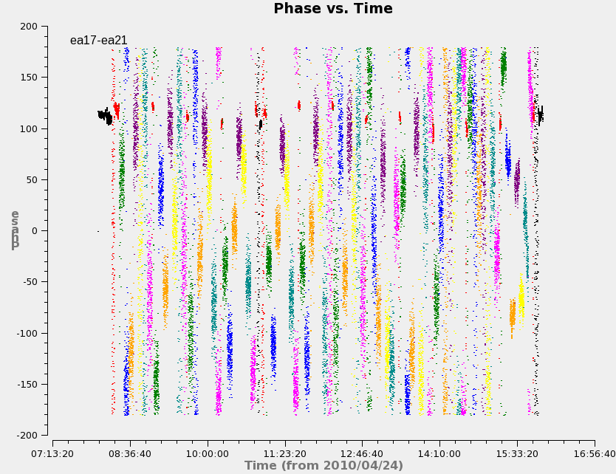
A Single Baseline - Phase
Phase

Slide 16
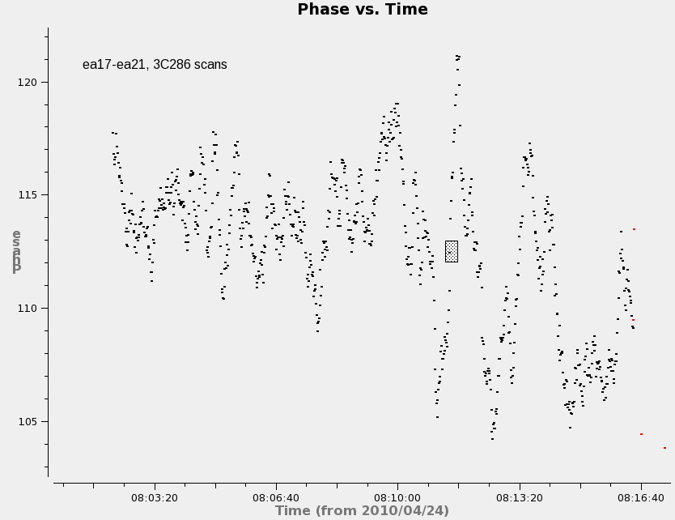
A Single Baseline – 2 scans on 3C286
Phase

Slide 17
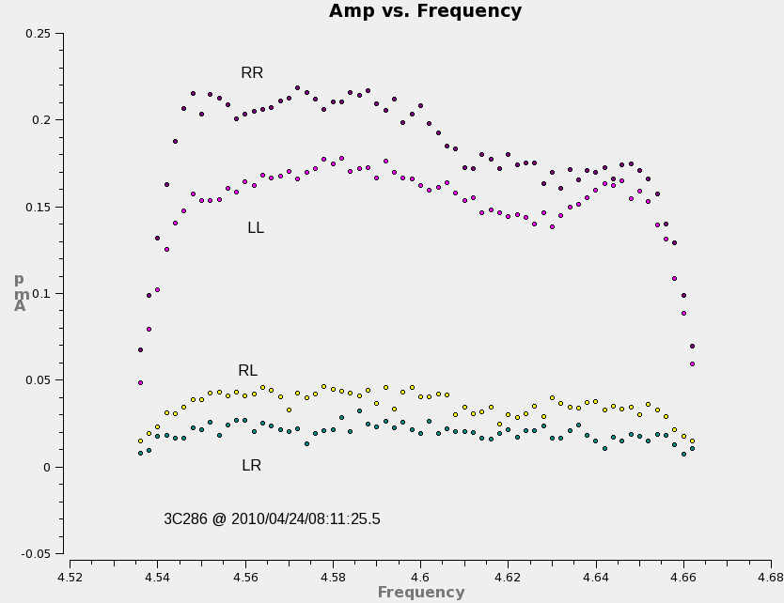
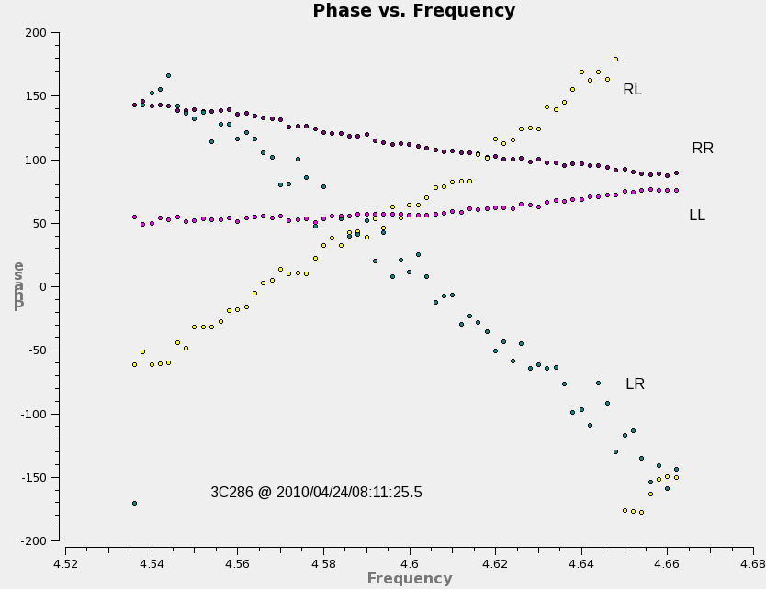
Single Baseline, Single Integration Visibility Spectra (4 correlations)
Amp
Phase
baseline ea17-ea21

Slide 18
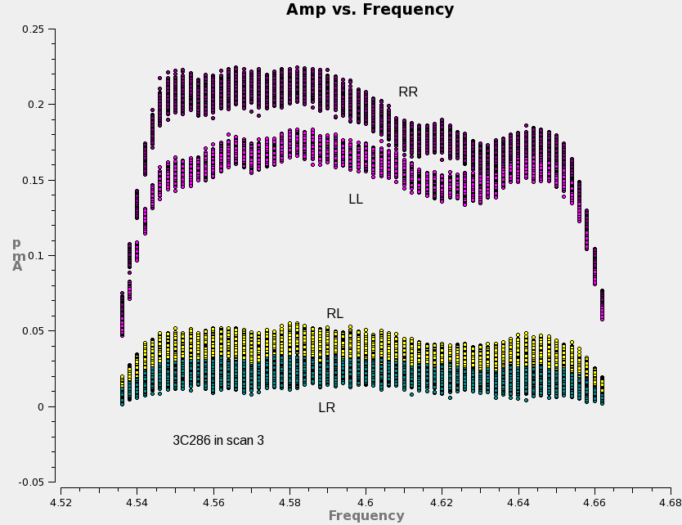
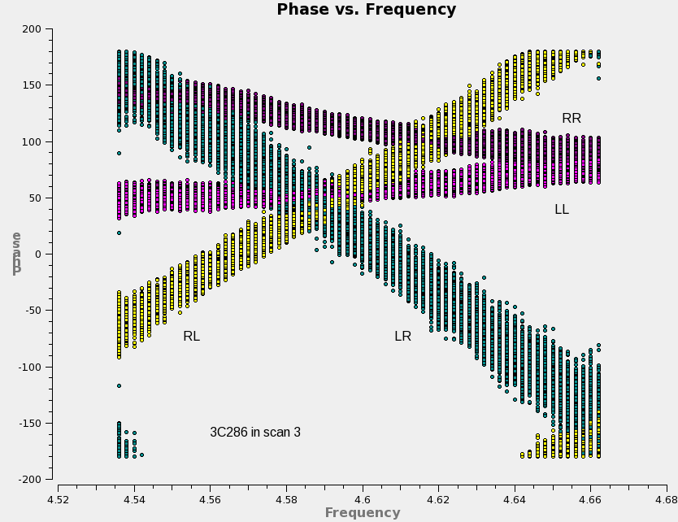
Single Baseline, Single Scan Visibility Spectra (4 correlations)
Amp
Phase
baseline ea17-ea21

Slide 19
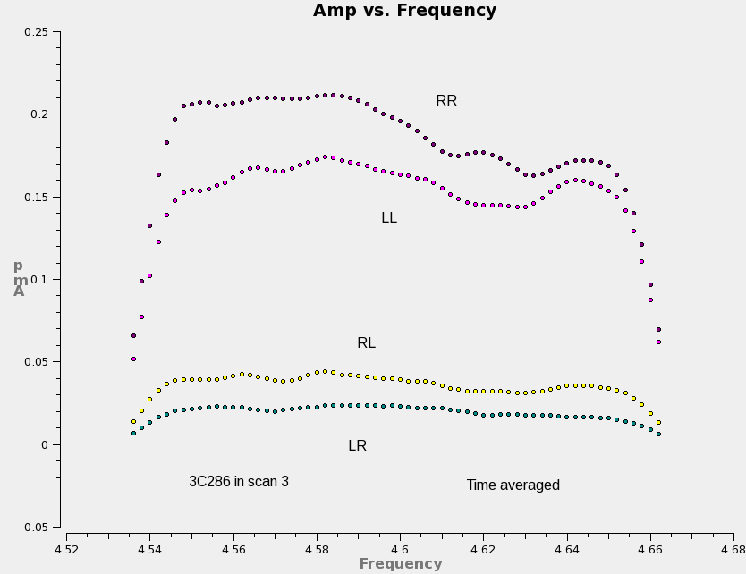
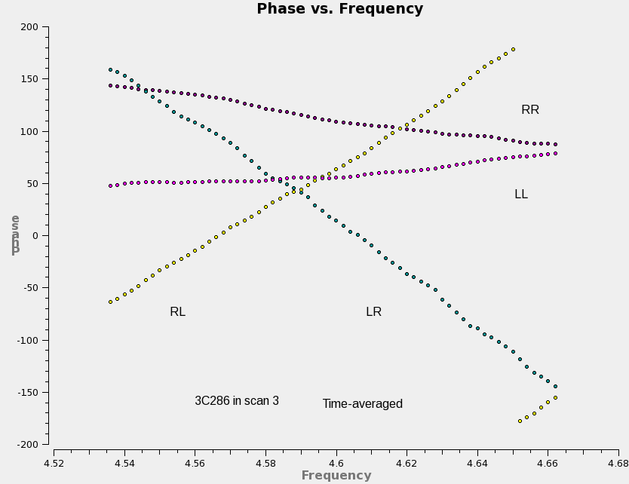
Single Baseline, Single Scan (time-averaged) Visibility Spectra (4 correlations)
Amp
Phase
baseline ea17-ea21

Slide 20
Data Examination and Editing
After observation, initial data examination and editing very important
Will observations meet goals for calibration and science requirements?
What to edit (much of this is automated):
Some real-time flagging occurred during observation (antennas off-source, LO out-of-lock, etc.). Any such bad data left over? (check operator’s logs)
Any persistently ‘dead’ antennas (check operator’s logs)
Periods of especially poor weather? (check operator’s log)
Any antennas shadowing others? Edit such data.
Amplitude and phase should be continuously varying—edit outliers
Radio Frequency Interference (RFI)?
Caution:
Be careful editing noise-dominated data.
Be conservative: those antennas/timeranges which are bad on calibrators are probably bad on weak target sources—edit them
Distinguish between bad (hopeless) data and poorly-calibrated data. E.g., some antennas may have significantly different amplitude response which may not be fatal—it may only need to be calibrated
Choose (phase) reference antenna wisely (ever-present, stable response)
Increasing data volumes increasingly demand automated editing algorithms…

Slide 21
Editing Example
Amp

Slide 22
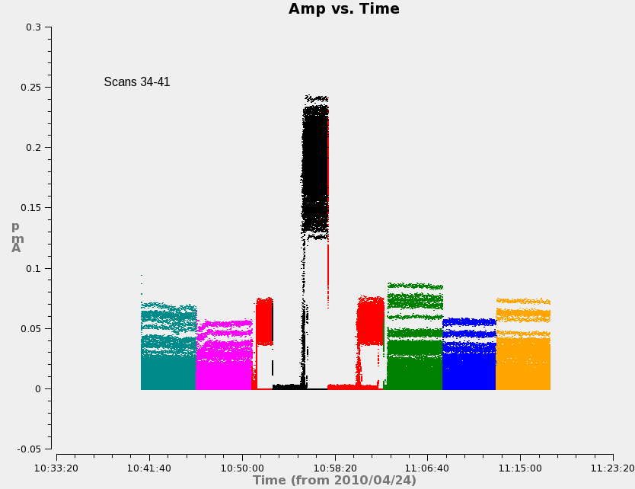
Editing Example
Scan transitions/setup
Amp
Dead antenna Slew

Slide 23
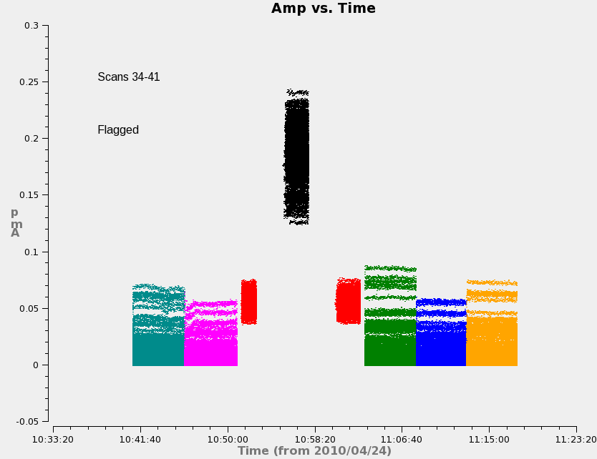
Editing Example
Amp

Slide 24
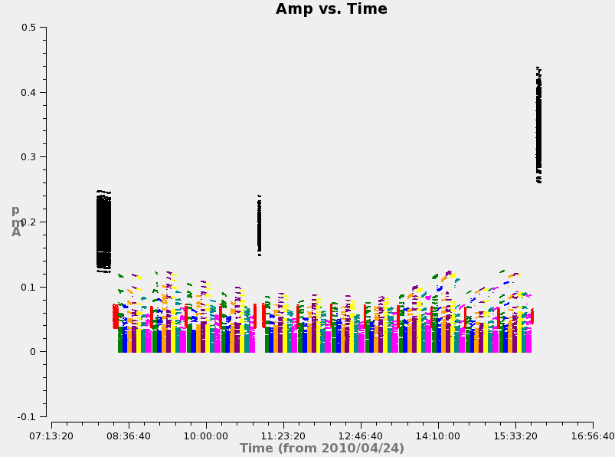
Editing Example
Amp
Amp

Slide 25
Practical Calibration Considerations
A priori “calibrations” (provided by the observatory)
Antenna positions, earth orientation and rate, clocks
Antenna pointing, voltage pattern, gain curve
Calibrator coordinates, flux densities, polarization properties
Absolute engineering calibration (dBm, K, volts)?
Amplitude: episodic (ALMA) or continuous (EVLA/VLBA) Tsys/switched-power monitoring to enable calibration to nominal K (or Jy, with antenna efficiency information)
Phase: practically impossible (relative antenna phase)
Traditionally, we concentrate instead on ensuring instrumental stability on adequate timescales
Cross-calibration a better choice
Observe strong nearby sources against which calibration (J_{ij}) can be solved, and transfer solutions to target observations
Choose appropriate calibrators; usually point sources because we can easily predict their visibilities (Amp ~ constant, phase ~ 0)
Choose appropriate timescales for calibration
Notes:
ALMA does “engineering” calibration….

Slide 26
“Absolute” Astronomical Calibrations
Flux Density Calibration
Radio astronomy flux density scale set according to several “constant” radio sources, and planets/moons
Use resolved models where appropriate
Astrometry
Most calibrators come from astrometric catalogs; sky coordinate accuracy of target images tied to that of the calibrators
Beware of resolved and evolving structures, and phase transfer biases due to troposphere (especially for VLBI)
Linear Polarization Position Angle
Usual flux density calibrators also have significant stable linear polarization position angle for registration
Relative calibration solutions (and dynamic range) insensitive to errors in these “scaling” parameters

Slide 27
Baseline-based Cross-Calibration
Simplest, most-obvious calibration approach: measure complex response of each baseline on a standard source, and scale science target visibilities accordingly
“Baseline-based” Calibration:
Only option for single baseline “arrays”
Calibration precision same as calibrator visibility sensitivity (on timescale of calibration solution). Improves only with calibrator strength.
Calibration accuracy sensitive to departures of calibrator from assumed structure
Un-modeled calibrator structure transferred (in inverse) to science target!

Slide 28
Antenna-based Cross Calibration
Measured visibilities are formed from a product of antenna-based signals. Can we take advantage of this fact?
e.g., bandpass…

Slide 29
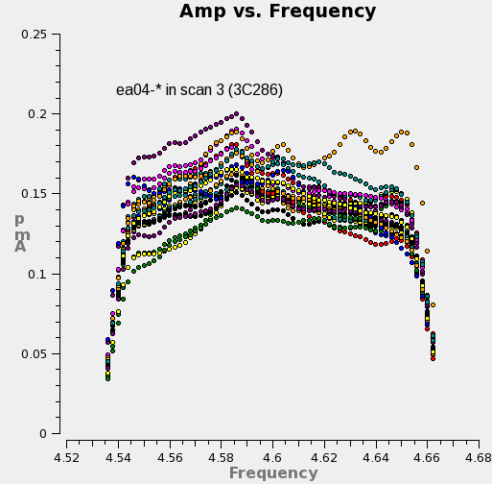
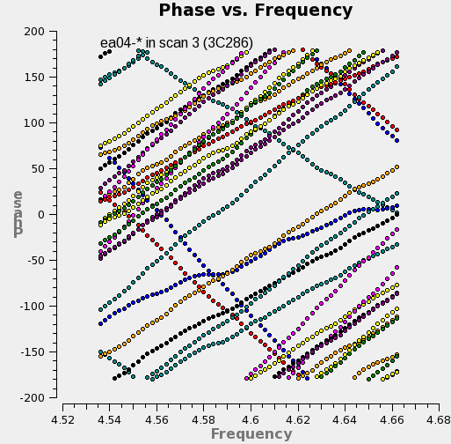
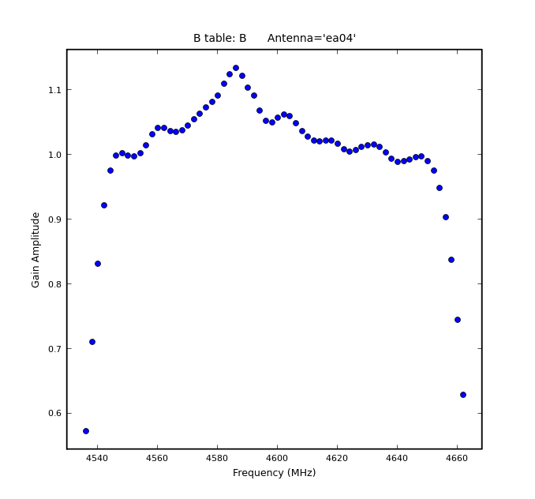
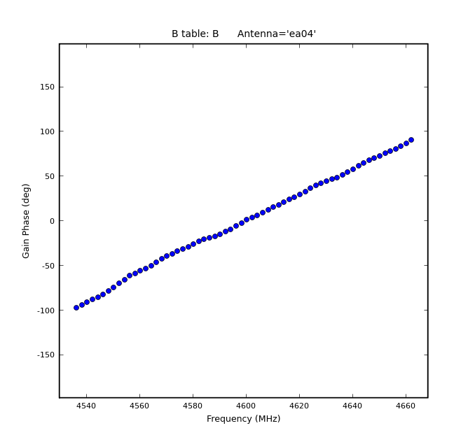
Rationale for Antenna-based Calibration
Amp
Phase

Slide 30
Antenna-based Cross Calibration
The net time-dependent E-field signal sampled by antenna i, x_{i}(t), is a combination of the desired signal, s_{i}(t,l,m), corrupted by a factor J_{i}(t,l,m) and integrated over the sky (l,m), and diluted by noise, n_{i}(t):
x_{i}(t) is sampled (complex) voltage provided to the correlator input
J_{i}(t,l,m) is the product of a series of effects encountered by the incoming signal
J_{i}(t,l,m) is an antenna-based complex number
Usually, |n_{i}|>> |s_{i}’| (i.e., noise dominates)

Slide 31
Correlation of Realistic Signals - I
The correlation of two realistic (aligned for a specific direction) signals from different antennas:
Noise correlations have zero mean—even if |n_{i}|>> |s_{i}|, the correlation process isolates desired signals:
In integral, only s_{i}(t,l,m) from the same directions potentially correlate (i.e., when l_{i}=l_{j}, m_{i}=m_{j}), so order of integration and signal product can be reversed:

Slide 32
Correlation of Realistic Signals - II
The s_{i} & s_{j} are the common radio source signals, and differ only by the relative arrival phase at each antenna, which varies with direction. This difference is the Fourier phase term (to a good approximation), which we factor out:
On the timescale of the averaging, the only meaningful average is of the squared source signal itself (in each direction), which is just the brightness distribution of the source I(l,m):
If all J=1.0, we of course recover the ideal expression:

Slide 33
Aside: Auto-correlations and Single Dishes
The auto-correlation of a signal from a single antenna:
This is an integrated (sky) power measurement plus non-zero-mean noise
Desired signal not simply isolated from noise
Noise usually dominates
Single dish radio astronomy calibration strategies rely on switching (differencing) schemes to isolate desired signal from the noise

Slide 34
The Scalar Measurement Equation
First, isolate non-direction-dependent effects, and factor them from the integral:
Next, we recognize that over small fields of view, it is possible to assume J^{sky}=1.0, and we have a relationship between ideal and observed Visibilities:
Standard calibration of most existing arrays reduces to solving this last equation for the J_{i}, assuming a visibility model V_{ij}^{mod} for a calibrator
NB: visibilities corrupted by difference of antenna-based phases, and product of antenna-based amplitudes

Slide 35
Solving for the J_{i}
We can write:
…and define chi-squared:
…and minimize chi-squared w.r.t. each J_{i}*, yielding (iteration):
(…which we may be gratified to recognize as a peculiarly weighted average of the implicit J_{i} contribution to V^{obs}:)

Slide 36
Solving for J_{i} (cont)
Formal errors:
For a ~uniform array (~same sensitivity on all baselines, ~same calibration magnitude on all antennas) and point-like calibrator:
Calibration error decreases with increasing calibrator strength and square-root of N_{ant} (c.f. baseline-based calibration).
Other properties of the antenna-based solution:
Minimal degrees of freedom (N_{ant} factors, N_{ant}(N_{ant}-1)/2 measurements)
Net calibration for a baseline involves a phase difference, so absolute directional information is lost
Closure…
Notes:
Are units correct? Yes, J is unitless! (Actually, J = [c/Jy]^0.5, V=[Jy], s=[c])
Factor of 2?

Slide 37
Antenna-based Calibration and Closure
Success of synthesis telescopes relies on antenna-based calibration
Fundamentally, any information that can be factored into antenna-based terms, could be antenna-based effects, and not source visibility
For N_{ant} > 3, source visibility information cannot be entirely obliterated by any antenna-based calibration
Observables independent of antenna-based calibration:
Closure phase (3 baselines):
Closure amplitude (4 baselines):
Baseline-based calibration formally violates closure!

Slide 38
Simple Scalar Calibration Example
Array:
EVLA D-configuration (Apr 2010)
Sources:
Science Target: 3C391 (7 mosaic pointings)
Near-target calibrator: J1822-0938 (~11 deg from target; unknown flux density, assumed 1 Jy)
Flux Density calibrator: 3C286 (7.747 Jy, essentially unresolved)
Signals:
RR correlation only for this illustration (total intensity only)
One spectral window centered at 4600 MHz, 128 MHz bandwidth
64 observed spectral channels averaged with normalized bandpass calibration applied (this illustration considers only the time-dependent ‘gain’ calibration)
(extracted from a continuum polarimetry mosaic observation)

Slide 39
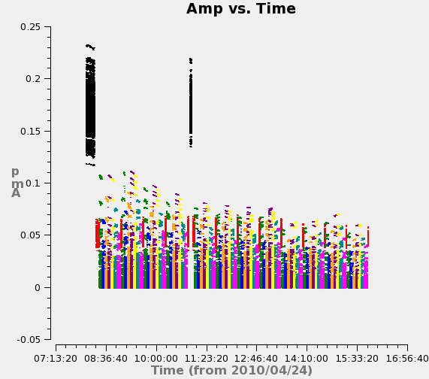
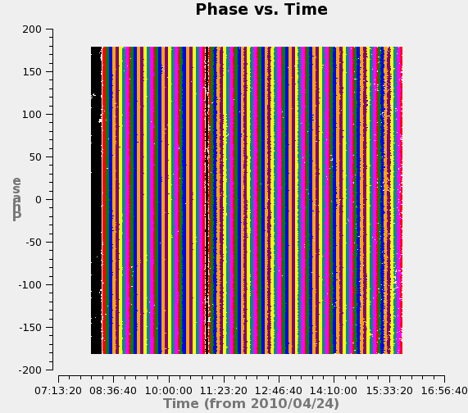
Views of the Uncalibrated Data
Amp
Phase

Slide 40
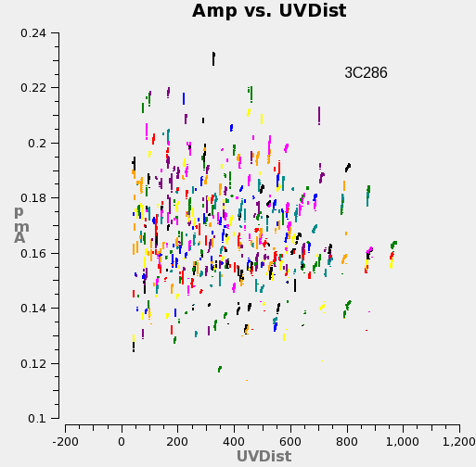
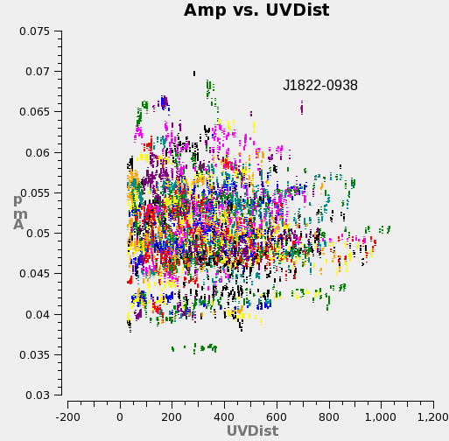
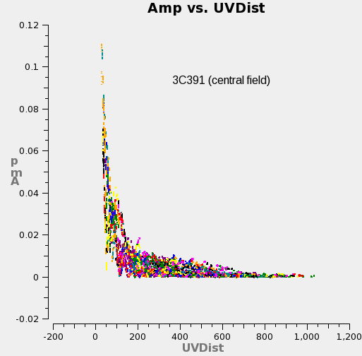
Views of the Uncalibrated Data
Amp
Amp
Amp

Slide 41
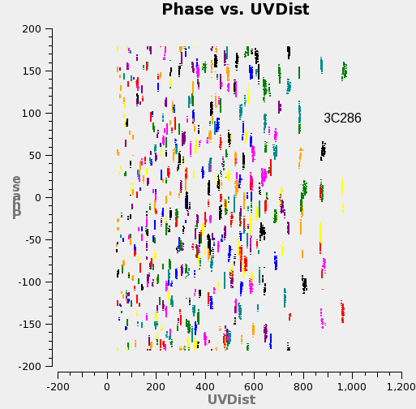
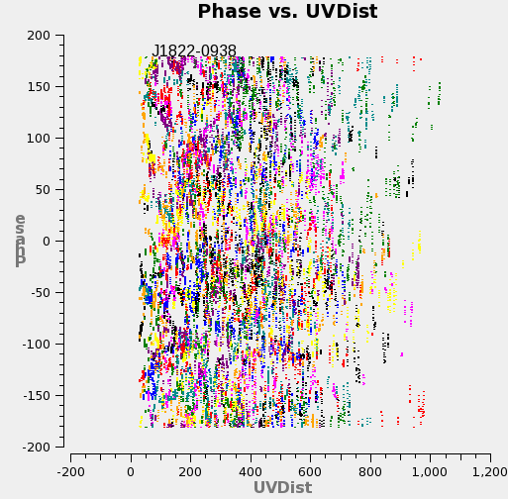
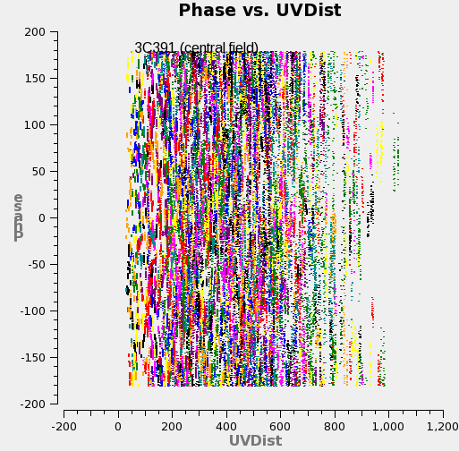
Views of the Uncalibrated Data
Phase
Phase
Phase

Slide 42
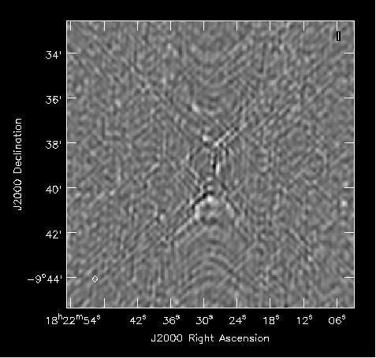
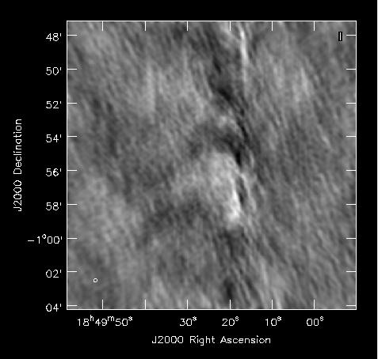
Uncalibrated Images
J1822-0938
(calibrator)
3C391
(science)

Slide 43
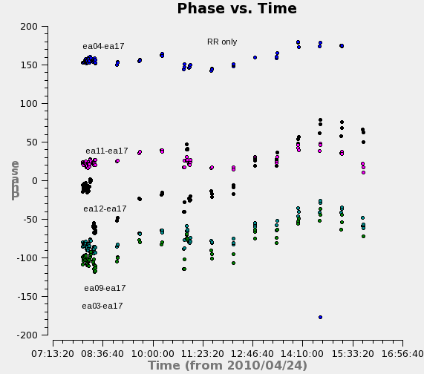
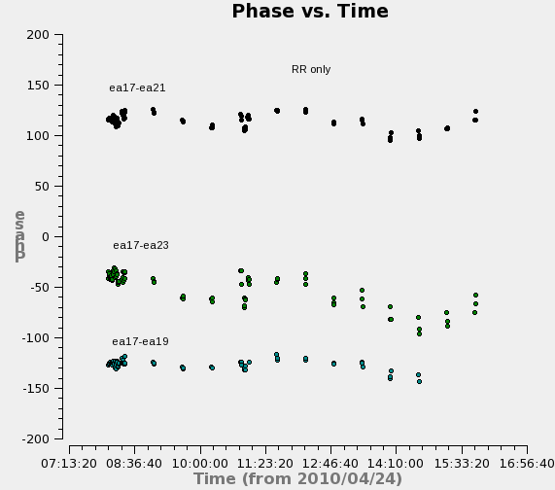
Rationale for Antenna-based Calibration
Phase
Phase

Slide 44
The Calibration Process
Solve for antenna-based gain factors for each scan on all calibrators (V^{mod}=S for f.d. calibrator; V^{mod}=1.0 for others) :
Bootstrap flux density scale by enforcing gain consistency over all calibrators:
Correct data (interpolate, as needed):

Slide 45
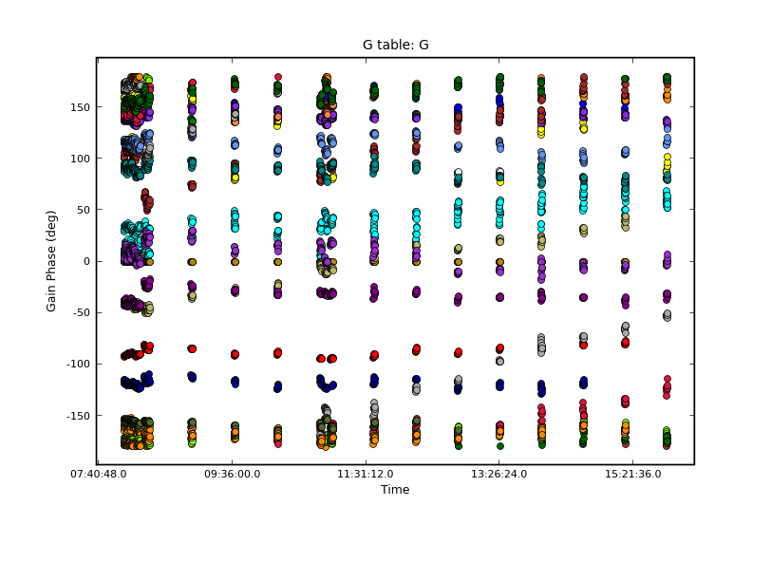
The Antenna-based Calibration Solution
Reference antenna: ea21 (phase = 0)

Slide 46
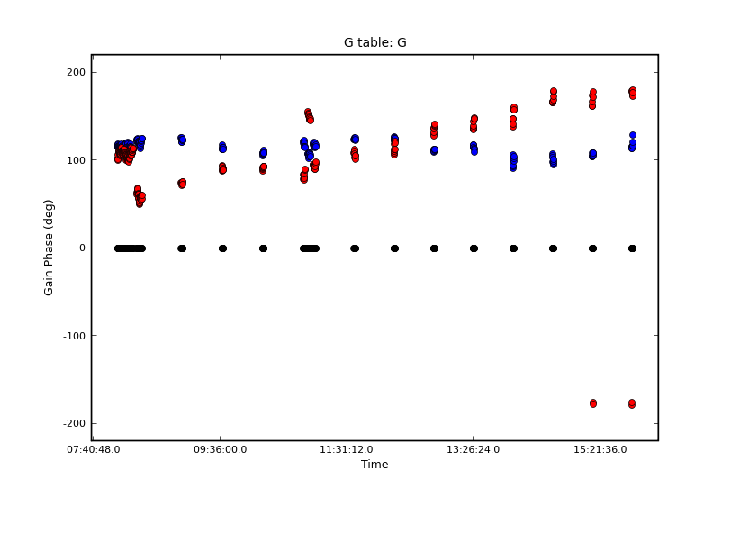
The Antenna-based Calibration Solution
ea17
ea12
ea21 (refant)

Slide 47
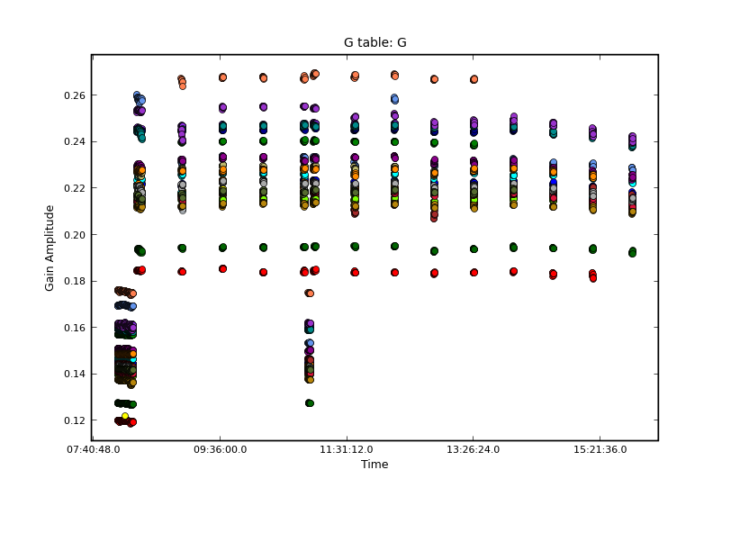
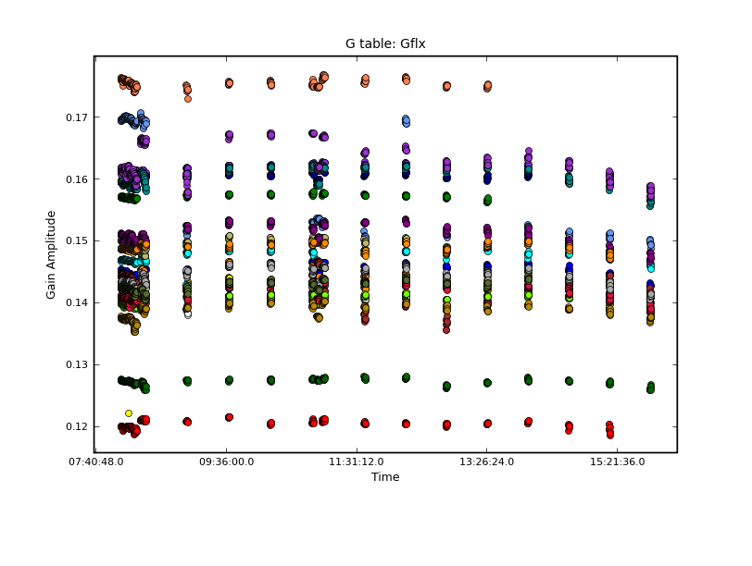
The Antenna-based Calibration Solution
J1822-0938
(assuming 1.0 Jy)
3C286
3C286’s gains have correct scale
Thus, J1822-0938 is 2.32 Jy (not 1.0 Jy, as assumed)

Slide 48
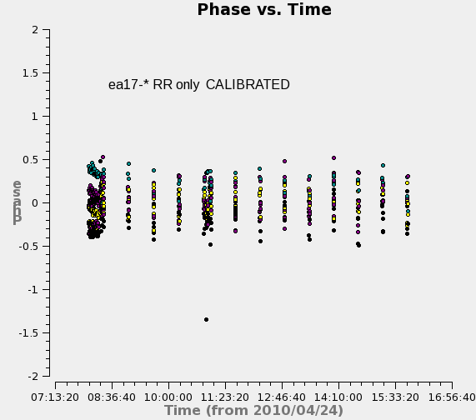
Effect of Antenna-based Calibration
Phase
Phase

Slide 49
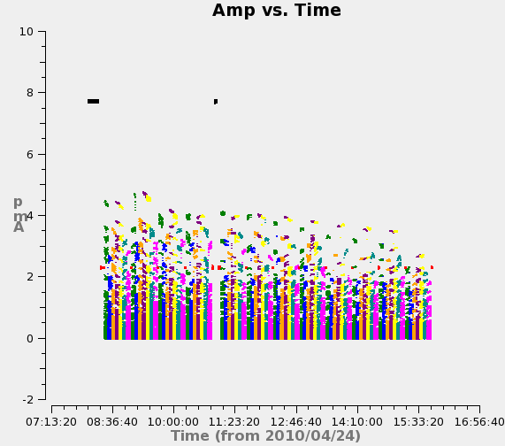
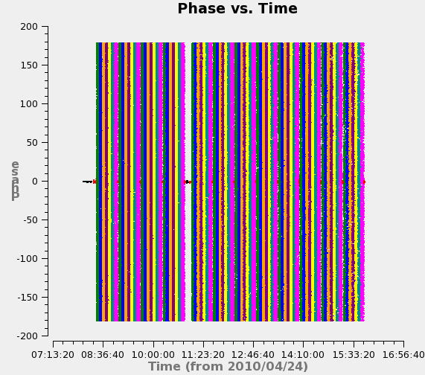
Effect of Antenna-based Calibration
Phase
Amp
Phase
Amp
CALIBRATED

Slide 50
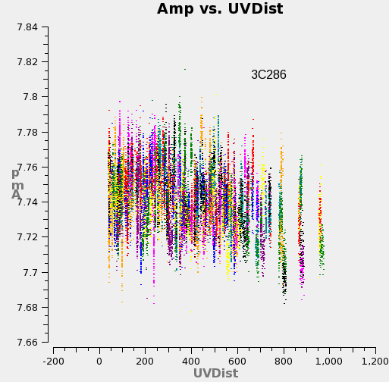
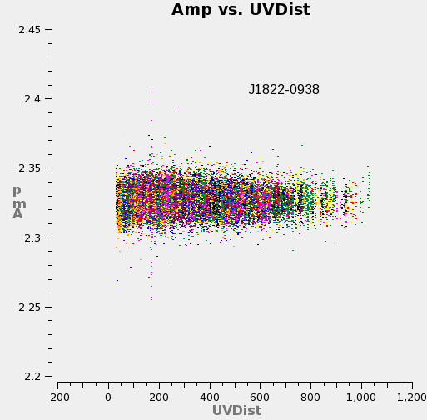
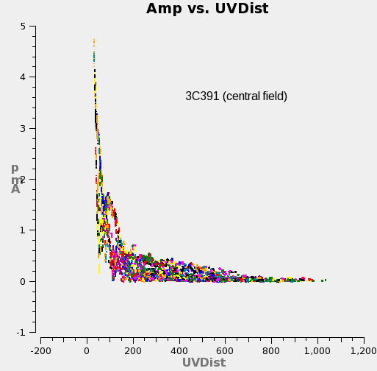
Effect of Antenna-based Calibration
Amp
Amp
Amp
Amp
Amp
Amp
CALIBRATED

Slide 51
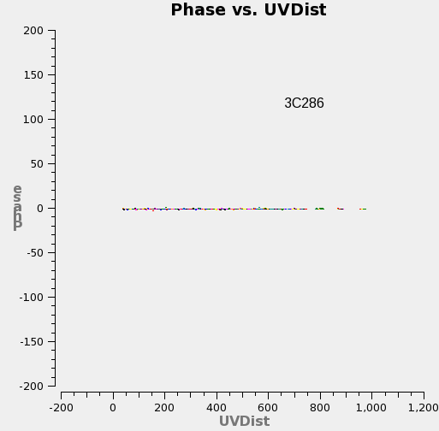
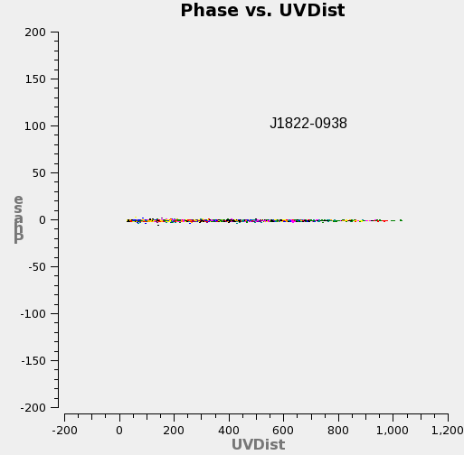
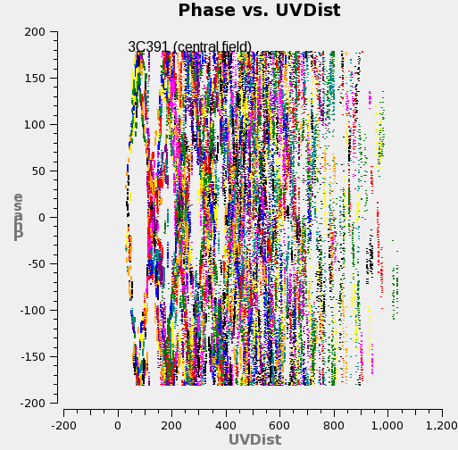
Effect of Antenna-based Calibration
Phase
Phase
Phase
Phase
Phase
Phase
CALIBRATED

Slide 52


Calibration Effect on Imaging
Dave Wilner’s lecture “Imaging and Deconvolution” (Wednesday)
J1822-0938
(calibrator)
3C391
(science)

Slide 53
Evaluating Calibration Performance
Are solutions continuous?
Noise-like solutions are just that—noise (beware calibration of pure noise generates a spurious point source)
Discontinuities indicate instrumental glitches (interpolate with care)
Any additional editing required?
Are calibrator data fully described by antenna-based effects?
Phase and amplitude closure errors are the baseline-based residuals
Are calibrators sufficiently point-like? If not, self-calibrate: model calibrator visibilities (by imaging, deconvolving and transforming) and re-solve for calibration; iterate to isolate source structure from calibration components
Crystal Brogan’s lecture: “Advanced Calibration” (Wednesday)
Any evidence of unsampled variation? Is interpolation of solutions appropriate?
Reduce calibration timescale, if SNR permits
Greg Taylor’s lecture: “Error Recognition” (Wednesday)

Slide 54
Summary of Scalar Example
Dominant calibration effects are antenna-based
Minimizes degrees of freedom
More precise
Preserves closure
Permits higher dynamic range safely!
Point-like calibrators effective
Flux density bootstrapping
Notes:
More to say here?

Slide 55
Generalizations
Full-polarization Matrix Formalism
Calibration Effects Factorization
Calibration Heuristics and ‘Bootstrapping’

Slide 56
Full-Polarization Formalism (Matrices!)
Need dual-polarization basis (p,q) to fully sample the incoming EM wave front, where p,q = R,L (circular basis) or p,q = X,Y (linear basis):
Devices can be built to sample these circular (R,L) or linear (X,Y) basis states in the signal domain (Stokes Vector is defined in “power” domain)
Some components of J_{i} involve mixing of basis states, so dual-polarization matrix description desirable or even required for proper calibration

Slide 57
Full-Polarization Formalism: Signal Domain
Substitute:
The Jones matrix thus corrupts the vector wavefront signal as follows:

Slide 58
Full-Polarization Formalism: Correlation - I
Four correlations are possible from two polarizations. The outer product represents correlation in the matrix formalism:
Observed visibilities (note outer product identity):

Slide 59
Full-Polarization Formalism: Correlation - II
The outer product for the Jones matrix:
J_{ij} is a 4x4 Mueller matrix
This is starting to get ugly…..
Synthesis array design driven by minimizing off-diagonal terms!

Slide 60
Full-Polarization Formalism: Correlation - III
And finally, for fun, expand the correlation of corrupted signals:
UGLY, but we rarely, if ever, need to worry about algebraic detail at this level---just let this occur “inside” the matrix formalism, and work with the matrix short-hand notation

Slide 61
The Matrix Measurement Equation
We can now write down the Measurement Equation in matrix notation:
S maps Stokes parameters onto observed basis
…and consider how the J_{i} are products of many effects.

Slide 62
A Dictionary of Calibration Components
J_{i} contains many components, in principle:
F = ionospheric effects
T = tropospheric effects
P = parallactic angle
X = linear polarization position angle
E = antenna voltage pattern
D = polarization leakage
G = electronic gain
B = bandpass response
K = geometric compensation
M, A = baseline-based corrections
Order of terms follows signal path (right to left)
Each term has matrix form of J_{i} with terms embodying its particular algebra (on- vs. off-diagonal terms, etc.)
Direction-dependent terms must stay inside FT integral
‘Full’ calibration is traditionally a bootstrapping process wherein relevant terms (usually a minority of above list) are considered in decreasing order of dominance, relying on approximate separability

Slide 63
Ionospheric Effects, F
The ionosphere introduces a dispersive path-length offset:
More important at lower frequencies (<5 GHz)
Varies more at solar maximum and at sunrise/sunset, when ionosphere is most active and variable
Direction-dependent within wide field-of-view
The ionosphere is birefringent: Faraday rotation:
as high as 20 rad/m² during periods of high solar activity will rotate linear polarization position angle by ε = 50 degrees at 1.4 GHz
Varies over the array, and with time as line-of-sight magnetic field and electron density vary, violating the usual assumption of stability in position angle calibration
Book: Chapter 5, sect. 4.3,4.4,9.3; Chapter 6, sect. 6; Chapter 29, sect.3
Lincoln Greenhill’s lecture: “Low Frequency Interferometry” (Monday)

Slide 64
Tropospheric Effects, T
The troposphere causes polarization-independent amplitude and phase effects due to emission/opacity and refraction, respectively
Up to 2.3m excess path length at zenith compared to vacuum
Higher noise contribution, less signal transmission: Lower SNR
Most important at ν > 20 GHz where water vapor and oxygen absorb/emit
Zenith-angle-dependent (more troposphere path nearer horizon)
Clouds, weather = variability in phase and opacity; may vary across array
Water vapor radiometry (estimate phase from power measurements)
Phase transfer from low to high frequencies (delay calibration)
Book: Chapter 5: sect. 4.3,4.4; Chapter 28, sect. 3
ALMA!

Slide 65
Parallactic Angle, P
Visibility phase variation due to changing orientation of sky in telescope’s field of view
Constant for equatorial telescopes
Varies for alt-az-mounted telescopes:
Rotates the position angle of linearly polarized radiation
Analytically known, and its variation provides leverage for determining polarization-dependent effects
Book: Chapter 6, sect. 2.1
Michiel Brentjens’ lecture: “Polarization in Interferometry” (today!)

Slide 66
Linear Polarization Position Angle, X
Configuration of optics and electronics causes a linear polarization position angle offset
Can be treated as an offset to the parallactic angle, P
Calibrated by registration with a strongly polarized source with known polarization position angle (e.g., flux density calibrators)
For circular feeds, this is a phase difference between the R and L polarizations, which is frequency-dependent (a R-L phase bandpass)
For linear feeds, this is the orientation of the dipoles in the frame of the telescope
Michiel Brentjens’ lecture: “Polarization in Interferometry” (today!)
Notes:
Am I missing any factors of 2 here? (circ vs. lin)

Slide 67
Antenna Voltage Pattern, E
Antennas of all designs have direction-dependent gain within field-of-view
Important when region of interest on sky comparable to or larger than λ/D
Important at lower frequencies where radio source surface density is greater and wide-field imaging techniques required
Beam squint: E^{p} and E^{q} offset, yielding spurious polarization
Sky rotates within field-of-view for alt-az antennas, so off-axis sources move through the pattern
Direction dependence of polarization leakage (D) may be included in E (off-diagonal terms then non-zero)
Shape and efficiency of the voltage pattern may change with zenith angle: ‘gain curve’
Book: Chapters 19, 20
Sanjay Bhatnagar’s lecture: “Wide Field Imaging I” (Thursday)
Juergen Ott’s lecture: “Wide Field Imaging II” (Thursday)

Slide 68
Polarization Leakage, D
Antenna & polarizer are not ideal, so orthogonal polarizations not perfectly isolated
Well-designed feeds have d ~ a few percent or less
A geometric property of the optics design, so frequency-dependent
For R,L systems, total-intensity imaging affected as ~dQ, dU, so only important at high dynamic range (Q,U,d each ~few %, typically)
For R,L systems, linear polarization imaging affected as ~dI, so almost always important
For small arrays (no differential parallactic angle coverage), only relative D solution is possible from standard linearized solution, so parallel-hands cannot be corrected absolutely (closure errors)
Best calibrator: Strong, point-like, observed over large range of parallactic angle (to separate source polarization from D)
Book: Chapter 6
Michiel Brentjens’ lecture: “Polarization in Interferometry” (today!)

Slide 69
“Electronic” Gain, G
Catch-all for most amplitude and phase effects introduced by antenna electronics and other generic effects
Most commonly treated calibration component
Dominates other effects for most standard observations
Includes scaling from engineering (correlation coefficient) to radio astronomy units (Jy), by scaling solution amplitudes according to observations of a flux density calibrator
Includes any internal system monitoring, like EVLA switched power calibration
Often also includes tropospheric and (on-axis) ionospheric effects which are typically difficult to separate uniquely from the electronic response
Excludes frequency dependent effects (see B)
Best calibrator: strong, point-like, near science target; observed often enough to track expected variations
Also observe a flux density standard
Book: Chapter 5

Slide 70
Bandpass Response, B
G-like component describing frequency-dependence of antenna electronics, etc.
Filters used to select frequency passband not square
Optical and electronic reflections introduce ripples across band
Often assumed time-independent, but not necessarily so
Typically (but not necessarily) normalized
ALMA Tsys is a “bandpass”
Best calibrator: strong, point-like; observed long enough to get sufficient per-channel SNR, and often enough to track variations
Book: Chapter 12, sect. 2
David Meier’s lecture: “Analysis of Data Cubes” (Wednesday)

Slide 71
Geometric Compensation, K
Must get geometry right for Synthesis Fourier Transform relation to work in real time
Antenna positions (geodesy)
Source directions (time-dependent in topocenter!) (astrometry)
Clocks
Electronic path-lengths introduce delays (polarization, spw differences)
Longer baselines generally have larger relative geometry errors, especially if clocks are independent (VLBI)
Importance scales with frequency
K is a clock- & geometry-parameterized version of G (see chapter 5, section 2.1, equation 5-3 & chapters 22, 23)
All-sky observations used to isolate geometry parameters
Book: Chapter 5, sect. 2.1; Chapters 22, 23
Matt Lister’s lecture: “Very Long Baseline Interferometry” (Wednesday)

Slide 72
Non-closing Effects: M, A
Baseline-based errors which do not decompose into antenna-based components
Digital correlators designed to limit such effects to well-understood and uniform (not dependent on baseline) scaling laws (absorbed in f.d. calibration)
Simple noise (additive)
Additional errors can result from averaging in time and frequency over variation in antenna-based effects and visibilities (practical instruments are finite!)
Instrumental polarization effects in parallel hands
Correlated “noise” (e.g., RFI)
Difficult to distinguish from source structure (visibility) effects
Geodesy and astrometry observers consider determination of radio source structure—a baseline-based effect—as a required calibration if antenna positions are to be determined accurately
Diagonal 4x4 matrices, M_{ij} multiplies, A_{ij} adds

Slide 73
Decoupling Calibration Effects
Multiplicative gain (G) term will soak up many different effects; known priors should be compensated for separately, especially when direction-dependent differences (e.g., between calibrator and target) will limit the accuracy of calibration transfer:
Zenith angle-dependent atmospheric opacity, refraction (T,F)
Zenith angle-dependent gain curve (E)
Antenna position errors (K)
Early calibration solves (e.g., G) are always subject to more subtle, uncorrected effects
E.g., instrumental polarization (D), which introduces gain calibration errors and causes apparent closure errors in parallel-hand correlations
When possible, iterate and alternate solves to decouple effects…

Slide 74
The Full Matrix Measurement Equation
The total general Measurement Equation has the form:
S maps the Stokes vector, I, to the polarization basis of the instrument, all calibration terms cast in this basis
Suppressing the direction-dependence (on-axis calibration):
Generally, only a subset of terms are considered, though highest-dynamic range observations may require more
Solve for terms in decreasing order of dominance, iterate to isolate
(Non-trivial direction-dependent solutions involve convolutional treatment of the visibilities, and is coupled to the imaging and deconvolution process)

Slide 75
Solving the Measurement Equation
Formally, solving for any antenna-based visibility calibration component is always the same general non-linear fitting problem:
Observed and Model visibilities are corrected/corrupted by available prior calibration solutions
Resulting solution used as prior in subsequent solves, as necessary
Each solution is relative to priors and assumed source model
Iterate sequences, as needed → generalized self-calibration
Viability and accuracy of the overall calibration depends on isolation of different effects using proper calibration observations, and appropriate solving strategies
Heuristic mnemonics….

Slide 76
Calibration Heuristics – Spectral Line
Total Intensity Spectral Line (B=bandpass, G=gain):
V^{obs} = B G V^{true}
Preliminary Gain solve on B-calibrator:
V^{obs} = G_{B} V^{mod}
Bandpass Solve (using G_{B}) on B-calibrator (then discard G_{B}):
V^{obs} = B (G_{B} V^{mod})
Gain solve (using inverse of B) on calibrators:
(B’ V^{obs}) = G V^{mod}
Flux Density scaling:
G → G_{f} (enforce gain consistency)
Correct with inverted solutions:
V^{cor} = G_{f}’ B’ V^{obs}
Image!
Heuristic notation!
Rigorous math notation
(antenna-basedness,
subscripts, etc.) omitted.

Slide 77
Calibration Heuristics – Polarimetry
Polarimetry (B=bandpass, G=gain, D=instr. poln, X=pos. ang., P=parallactic ang.):
V^{obs} = B G D X P V^{true}
Preliminary Gain solve on B-calibrator:
V^{obs} = G_{B} V^{mod}
Bandpass (B) Solve (using G_{B}) on B-calibrator (then discard G_{B}):
V^{obs} = B (G_{B} V^{mod})
Gain (G) solve (using parallactic angle P, inverse of B) on calibrators:
(B’ V^{obs}) = G (PV^{mod})
Instrumental Polarization (D) solve (using P, inverse of G,B) on instrumental polarization calibrator:
(G’ B’ V^{obs}) = D (P V^{mod})

Slide 78
Calibration Heuristics – Polarimetry
Polarization position angle solve (using P, inverse of D,G,B) on position angle calibrator:
(D’ G’ B’ V^{obs}) = X (P V^{mod})
Flux Density scaling:
G → G_{f} (enforce gain consistency)
Correct with inverted solutions:
V^{cor} = P’ X’ D’ G_{f}’ B’ V^{obs}
Image!
To use external priors, e.g., T (opacity), K (ant. position errors), E (gaincurve), revise step 3 above as:
(B’ K’ V^{obs}) = G (E P T V^{mod})
and carry T, K, and E forward to subsequent steps

Slide 79
New Calibration Challenges (EVLA, ALMA)
Bandpass Calibration
Parameterized solutions (narrow-bandwidth, high resolution regime)
Spectrum of calibrators, incl. structure (wide absolute bandwidth regime)
‘Delay-aware’ gain (self-) calibration
Troposphere and Ionosphere introduce time-variable phase effects which are easily parameterized in frequency and should be (c.f. merely sampling the calibration in frequency)
Frequency-dependent Instrumental Polarization
Contribution of geometric optics is wavelength-dependent (standing waves)
Frequency-dependent voltage pattern
Wide-field voltage pattern accuracy (sidelobes, rotation)
Direction-dependent components
E.g., Instrumental Polarization (polarized voltage pattern)
Couples to the imaging process
Increased sensitivity: Can implied dynamic range be reached by conventional calibration and imaging techniques?
Notes:
Anything to add?

Slide 80
Summary
Determining calibration is as important as determining source structure—can’t have one without the other
Data examination and editing an important part of calibration
Calibration dominated by antenna-based effects, permits efficient, accurate and defensible separation of calibration from astronomical information (satisfies closure)
Full calibration formalism algebra-rich, but is modular
Calibration an iterative process, improving various components in turn, as needed
Point sources are the best calibrators
Observe calibrators according requirements of calibration components

