Slide 1
Time Domain Science
Gregg Hallinan, Caltech

Slide 2
What are Radio Transients?
Anything that flares, pulses, flickers, burps, chirps…
Inevitably signal dynamic and often explosive events, in some cases probing the highest energy particle populations in the observable universe.
Radio observations offer unique diagnostic information on magnetic field, plasma densities, energetics unavailable at other wavebands.
Some classes of transients are unique to radio wavelengths.
The discovery, classification and study of such transients offers enormous potential to uncover a wide range of new physics and astrophysics.

Slide 3
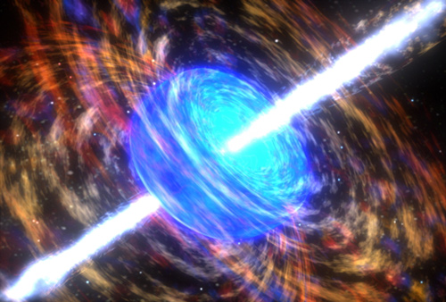
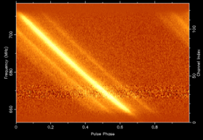
Types of Transients
Incoherent
Coherent
Typically synchrotron emission
Variable on timescales of seconds – years
Brightness temperature limited to <10¹² K
Typically discovered in image data
Various flavors of coherent emission
Variable on timescales of ns - minutes
Brightness temperatures as high as >10³⁸ K
Typically discovered in time-series data
Examples:
AGN and Microquasar jets
Supernovae & GRBs afterglows
Black hole tidal disruption events (TDEs)
Giant flares from magnetars
Examples:
Various classes of neutron stars
Galactic Center Radio Transients
Planets and Exoplanets
Stellar bursts and pulsing brown dwarfs

Slide 4
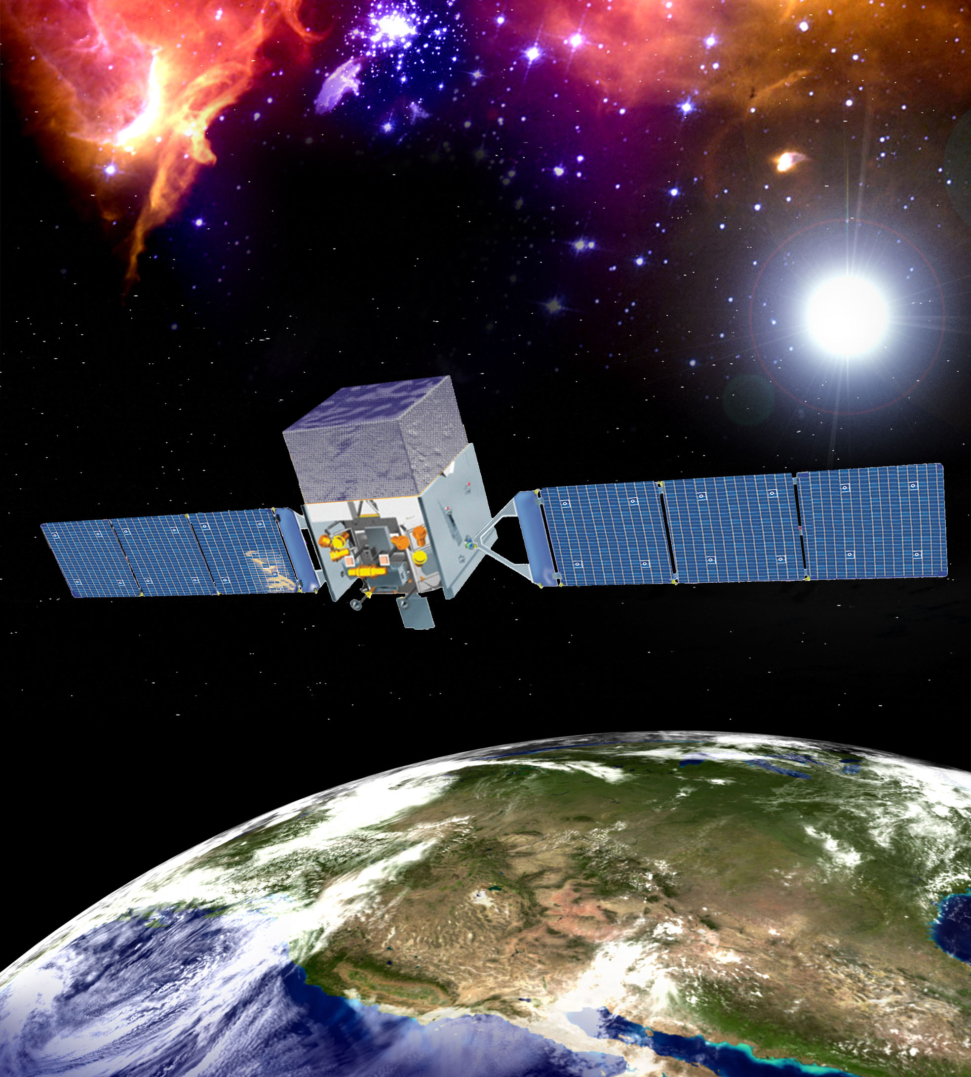
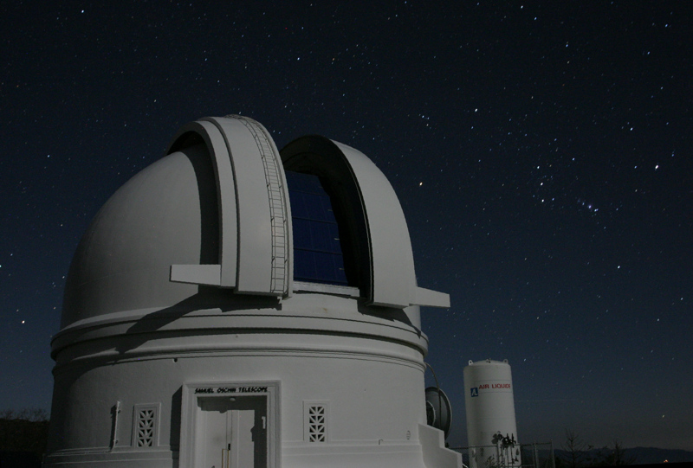
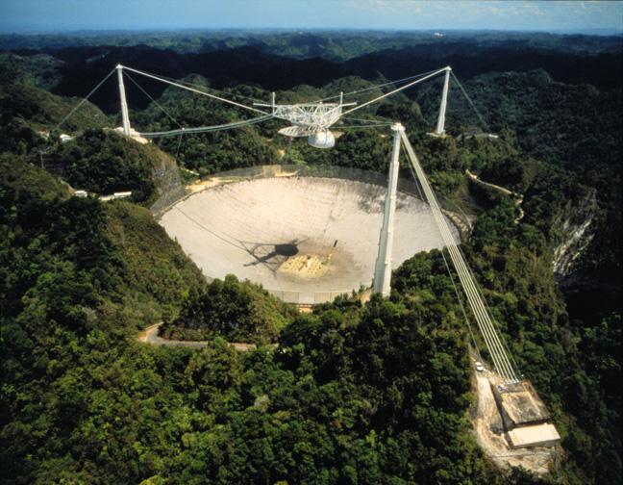
Detection Strategies
Need large A.Ω.T
Collecting area
Instantaneous
sky coverage
Time coverage
and time resolution
Gamma-ray
Optical
Radio
Fermi LAT
FoV ~ 2 steradians
Palomar Transient Factory
FoV ~ 7.8 deg²
Arecibo
FoV ~ 3 arcminutes

Slide 5
New Generations of Radio Telescopes
Radio astronomy is undergoing a revolution driven by progress in receiver technology, digital signal processing, data processing and computational resources
Existing telescopes are being upgraded with wideband receivers and/or phased array feeds (radio cameras) - JVLA, VLBA, GBT, e-MERLIN, ATCA, WSRT, Arecibo
New telescopes are being built or planned. Many employ large numbers of small dishes (or antennas) and/or phased array feeds. Large fields of view AND large collecting area – ASKAP, MEERKAT, LOFAR, LWA, MWA, SKA
Time domain science has been identified as a key science driver for all these new and upgraded facilities
See Lincoln Greenhill’s talk on Monday!

Slide 6
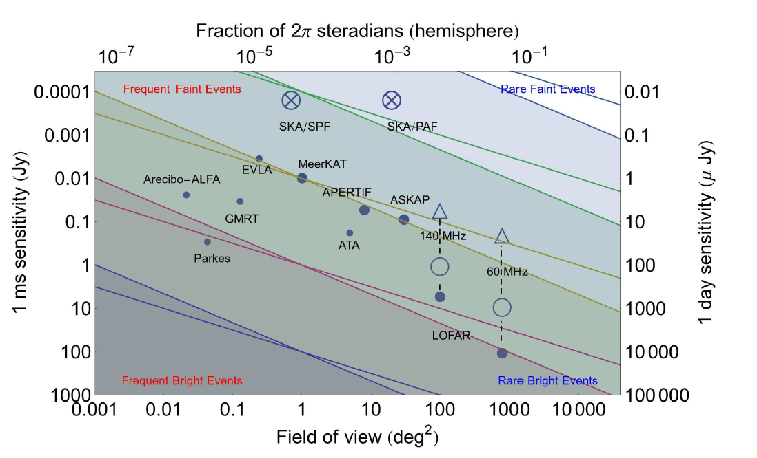
Radio Transients: A New Era
TDEs
Fender & Bell 2011
Lines are shown to compare:
ability to achieve an equivalent FoV to a uniform depth
sensitivity to source populations with uniform space density in a Euclidean universe

Slide 7
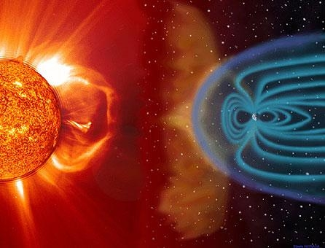
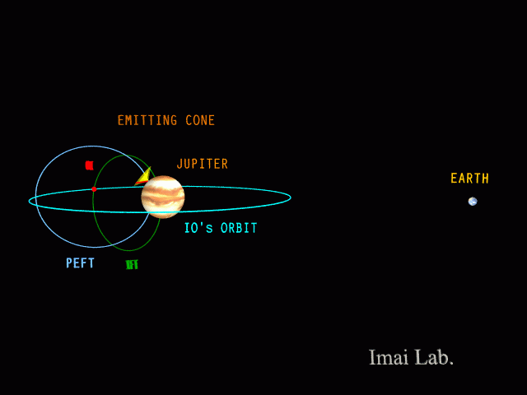
Galactic - Planets
Earth is a transient radio source! 10,000 times more intense than the strongest military radar signal
All the magnetized planets produce intensely bright coherent radio emission (Tb up to 10²⁰ K) at low frequencies (kHz-MHz)
Highly beamed, 100% circularly polarized
Credit: NASA
Electron cyclotron maser emission – produced at the electron cyclotron frequency ν ≈ 2.8 x 10⁶ B Hz
Powered by interaction with the solar wind and satellites (eg. Jupiter-Io)
Enables accurate measurement of magnetic field strength

Slide 8
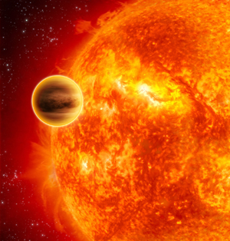
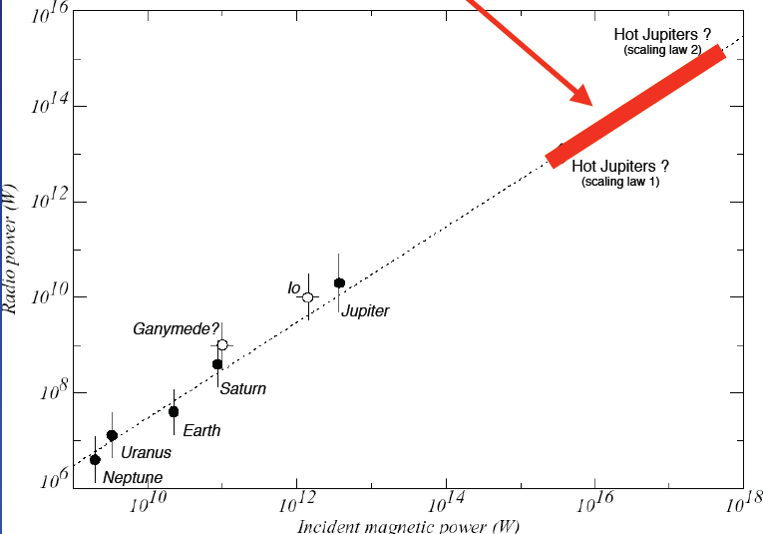
Galactic – Extrasolar Planets
Jupiter would be ~ a few μJy at Proxima Centauri – too faint!
Hot Jupiters should be 10⁵ times brighter
Detectable with new low frequency telescopes such as LOFAR, the LWA and the MWA
Will allow the detection and measurement of magnetic fields on extrasolar planets
New field – Exoplanetary magnetospheric physics
Credit: ESA
Zarka et al. 2001

Slide 9
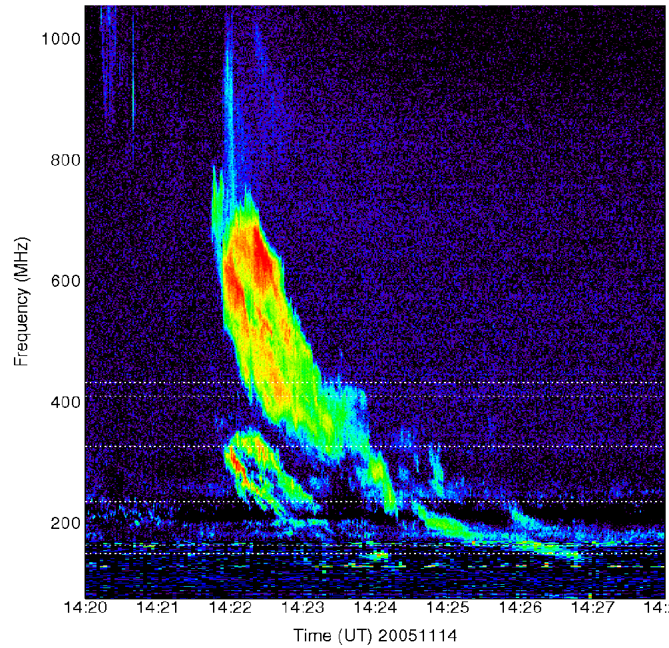
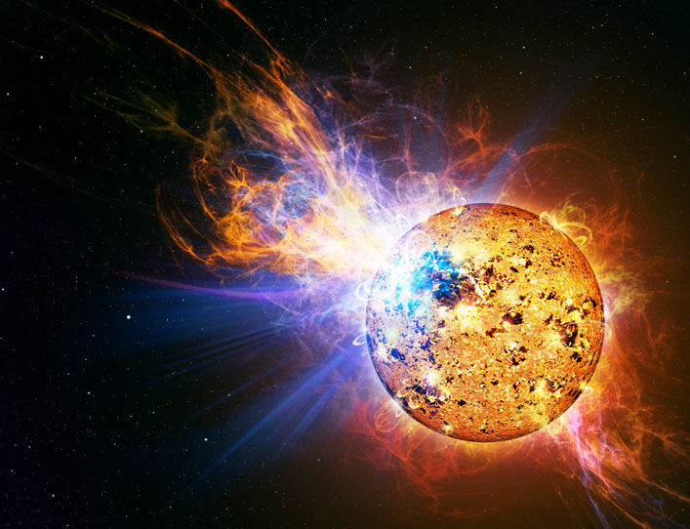
Galactic – The Sun and Stars
The Sun produces bright coherent bursts during solar flares and CMEs (Type II, Type III etc.)
Typically due to coherent plasma radiation emitted at the plasma frequency ν ≈ 9000 n_{e}^{1/2} Hz
Traces plasma density at the source of these explosive events
Solar Type II burst Nov 2005 (Stephen White)
Many classes of star are orders of magnitude more active than the Sun and produce bright coherent bursts up to 1 Jy (M dwarfs, T Tauri stars, RS CVn and Algol binaries…)
The JVLA can produce dynamic spectra of these bursts
Associated flares and CMEs can be imaged with VLBI

Slide 10
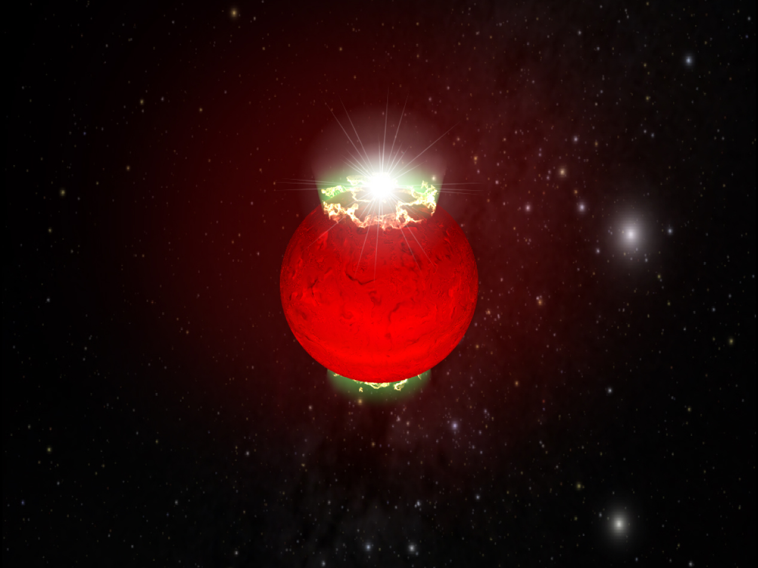
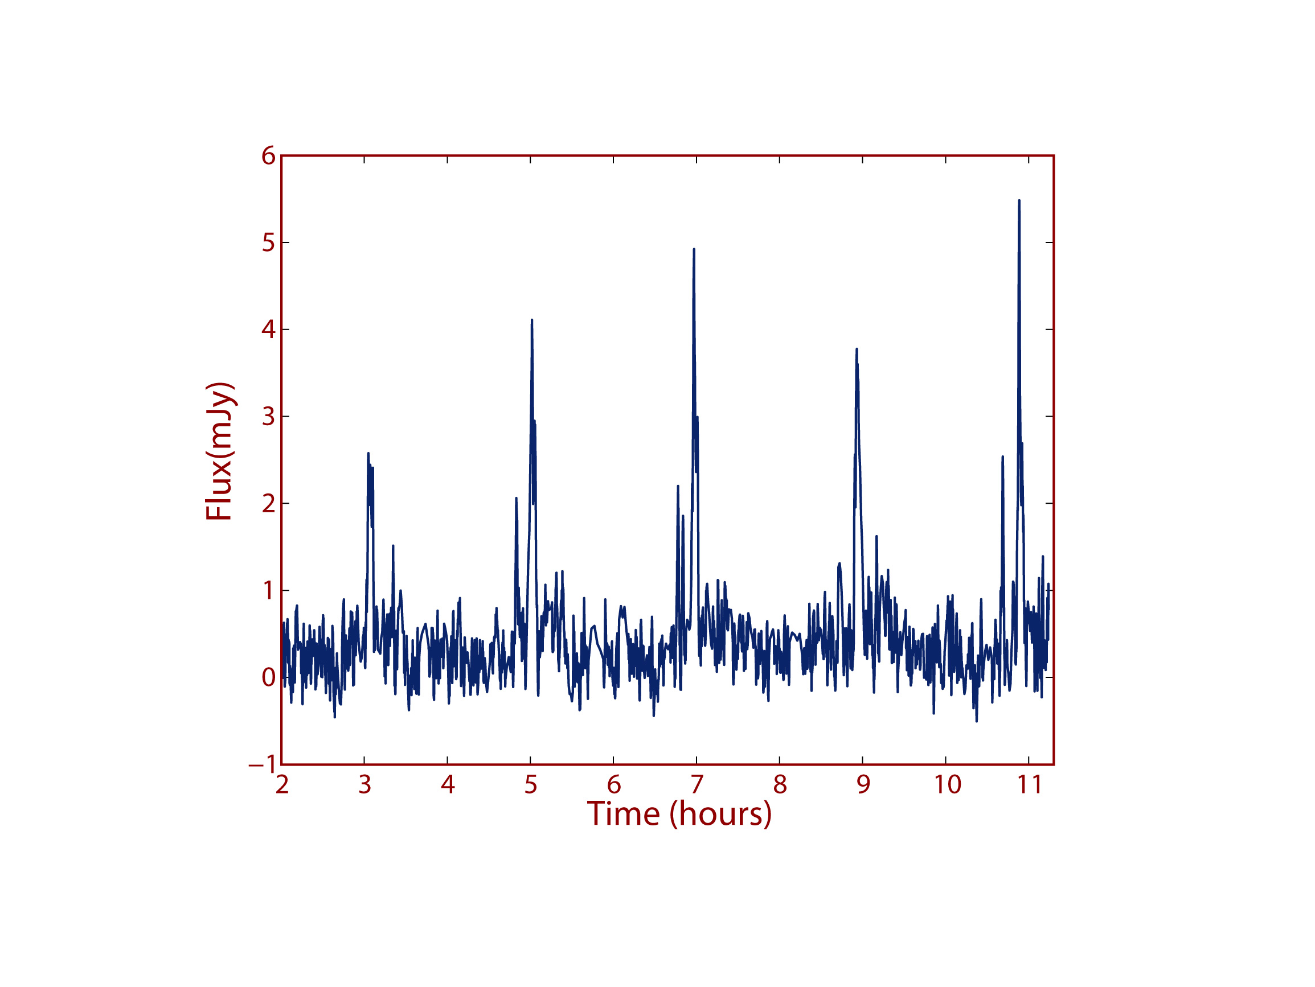
Brown Dwarfs
Brown dwarfs have been discovered to be radio sources (Berger et al. 2001). They also pulse (Hallinan et al. 2007).
The radio emission is 100% circularly polarized with brightness temperature > 10¹⁵ K
The radio emission is the same as that produced by the planets - electron cyclotron maser emission
Only way to measure magnetic fields for brown dwarfs. Confirmed field strengths > 3000 Gauss
Coolest brown dwarf recently detected. T6.5 dwarf – only 900 K with 1700 Gauss magnetic fields - Route & Wolszczan (2012)
Artist’s impression of super-aurorae on a brown dwarf
Hallinan et al. 2007

Slide 11
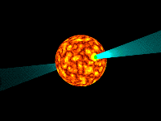
The Exemplar Radio Transient : Pulsars
Serendipitously discovered in 1968
Two Nobel Prizes awarded for pulsar science - demonstrating the existence of neutron stars and providing exquisitely precise tests of general relativity
We still don’t know how they produce their radio emission!
Subclasses include millisecond pulsars, RRATs and magnetars
Surveys carried out with large single dishes or phased antenna arrays - >2000 detected thus far
Detection requires advanced digital processing techniques to account for dispersion and to achieve SNR through period folding
Pulsar science remains an exciting frontier – Global efforts are underway to detect gravitational waves via precision timing of millisecond pulsars

Slide 12
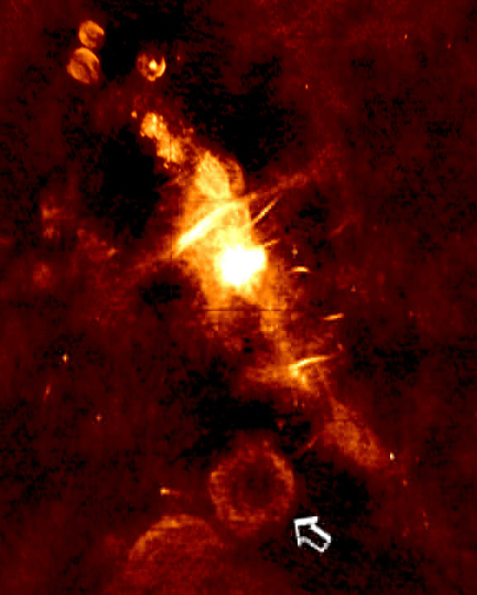
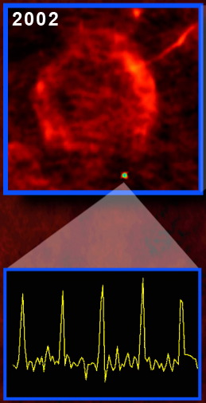
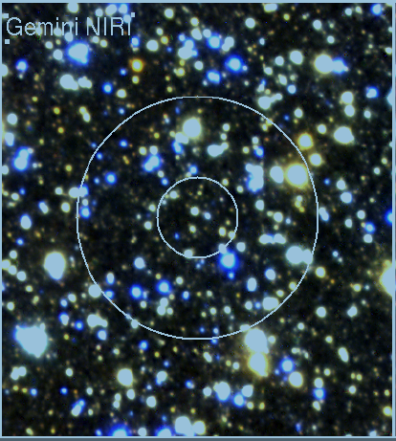
Galactic -The Mysterious GCRT J1745-3009
Pulsing source (period 77 mins) discovered in archival 330 MHz VLA data Hyman et al 2007)
Localization to poor to establish an optical counterpart
Nulling pulsar? White dwarf pulsar? Brown dwarf?

Slide 13
Galactic – Explosive Events
Microquasars – X-ray binaries involving accretion onto a compact object. Explosive injection of energy into the ambient medium result in particle acceleration and jet formation → synchrotron emission
Novae – White dwarf accreting material from a binary companion undergoes violent, self-sustaining nuclear burning. Radio emission typically due to thermal bremmsstrahlung from an expanding shell of ejecta. Recent radio observations with the JVLA are challenging decades old models (Krauss et al. 2011)
Hyperflares on magnetars - A giant gamma-ray flare from the magnetar SGR-1806-20 caused an ionospheric disturbance in the Earth’s upper atmosphere that was recorded around the globe. It was accompanies by a 1 Jy synchrotron flare Cameron et al. 2005
Explosive events all discovered at higher energy wavebands and followed up at radio wavelengths – future synoptic radio sources will detect early time transient radio emission

Slide 14
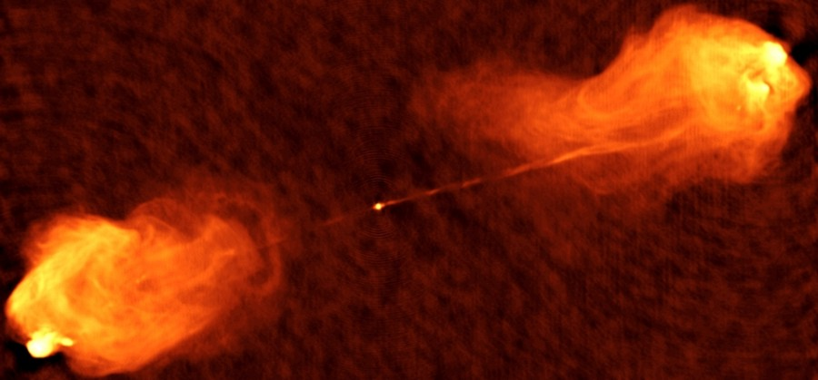
Extragalactic – Galactic Nuclei
Synchrotron emission associated with the interaction of expanding jets with the surrounding ambient medium
Active Galactic Nuclei (AGN) – Powered by long-term accretion of mass onto a supermassive black hole at the center of a galaxy
Tidal Disruption Event (TDE) – Recently discovered phenomenon of a star being tidally disrupted in the vicinity of an otherwise dormant super-massive nuclear black hole (Bloom et al. 2011)
Initially detected as a hard X-ray transient but the resulting relativistic jet was detected at radio frequencies (Zauderer et al 2011)
Radio synoptic surveys are ideal for detecting this class of transient – much lower beaming than higher energy

Slide 15
Extragalactic – Explosive Afterglows
Synchrotron emission associated with the interaction of expanding fireballs with the surrounding ambient medium
Radio Supernovae (RSN) – Follow up observations of optically detected core-collapse (Type II or Type 1b/c) supernovae. Type 1a are not detected.
Radio light curve monitoring and VLBI imaging allow the physics of the surrounding circumstellar and interstellar media to be investigated.
Gamma Ray Bursts (GRBs) – The detection of afterglow radio emission played an important role in determining the progenitors of long GRBs (Frail et al. 1997)
Exciting potential in synoptic radio surveys:
  Possible detection of ‘orphan afterglows’ not detected at higher energies due to relativistic beaming effects
  Possible detection of radio transient associated with neutron-neutron star mergers, believed to be the progenitors of short GRBs (Nakar and Piran 2011). ‘Smoking gun’ for gravitational wave searches.

Slide 16
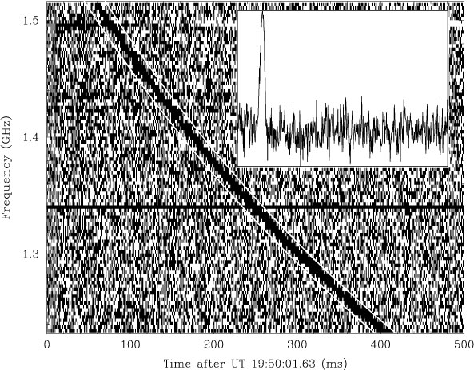
Extragalactic – Coherent Bursts?
It has been postulated that an exploding fireball interacting with an ambient magnetic field may generate coherent electromagnetic radiation at radio frequencies - (Rees 1977)
Possible examples include evaporating black holes, GRBs and coalescing neutron stars
Putative examples include the Lorimer Burst (Lorimer et al. 2007) – a huge (30 Jy) millisecond very high dispersion measure (DM ~ 375 cm⁻³pc)
Atmospheric effects have been touted as a possible source of the burst but another example has recently been found (Keane et al. 2011)

Slide 17
Summary
An exciting new era of time domain radio astronomy is approaching
Upgrades to existing telescopes as well as a new generations of instrument will enable synoptic surveys of the radio sky
Known classes of transients should be detected and perhaps many classes of as yet unknown transients are waiting to be discovered
Start searching!

