Slide 1
Galactic Radio Science
Including recent results from NRAO facilities
Claire Chandler, NRAO (with thanks to Cornelia Lang and
Crystal Brogan)

Slide 2
Outline
What can we learn from radio emission – radio emission mechanisms with examples
  Thermal and non-thermal continuum emission
  Thermal and non-thermal spectral line emission
  Considerations for observing galactic sources
A tour of selected galactic radio sources
  Stellar birth
  Stars
  Stellar death
  The interstellar medium

Slide 3
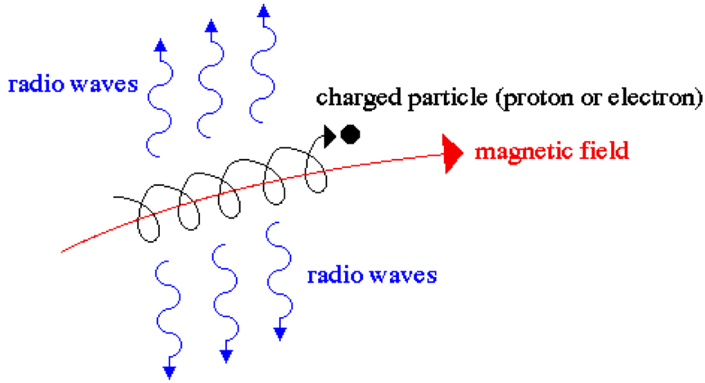
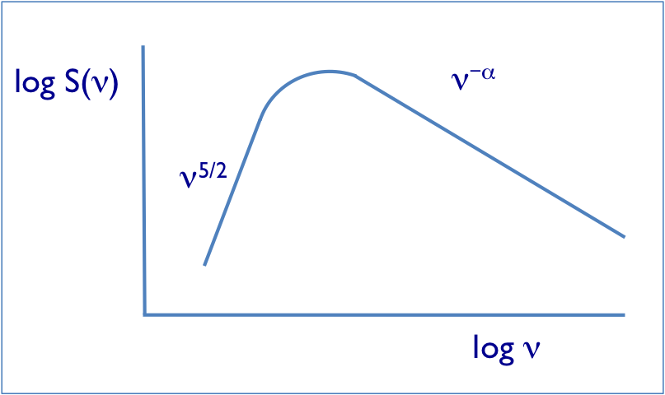
Radio emission mechanisms
Synchrotron radiation
  Non-thermal continuum process, arises from energetic charged particles spiraling (accelerating) along magnetic field lines
  Emission spectral index → energy distribution of electrons
  Equipartition → magnetic field strength
  Polarization → direction of magnetic field

Slide 4
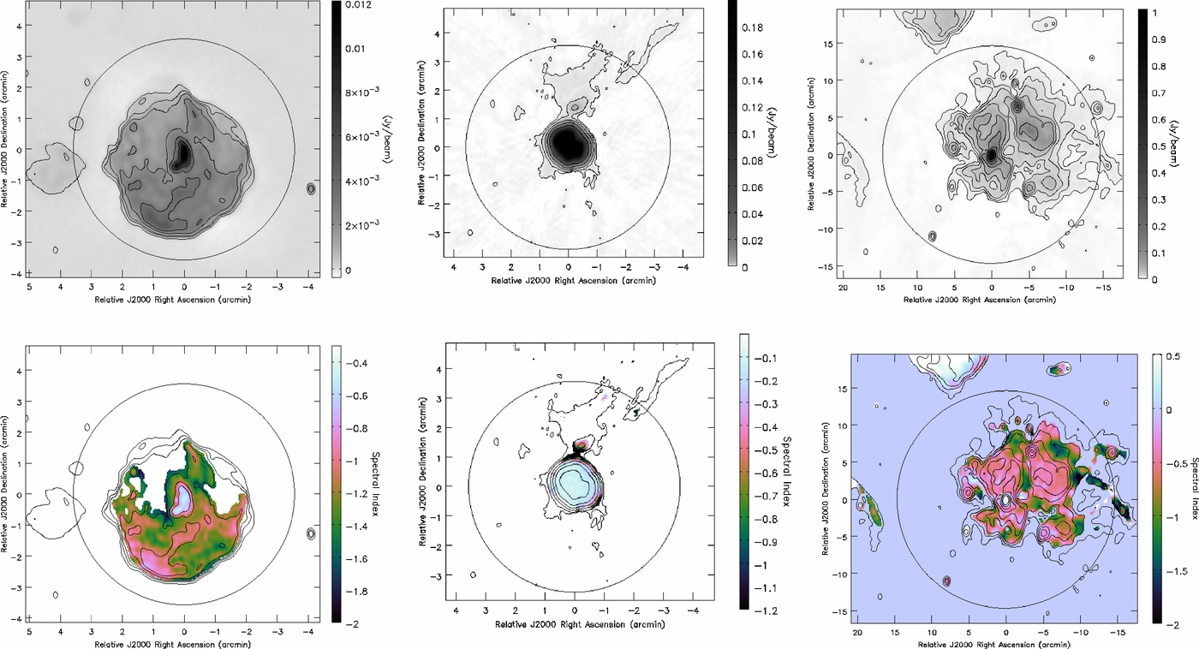
Synchrotron emission: SNRs
EVLA imaging of supernova remnants (Bhatnagar et al. 2011)
Stokes I
Spectral index, α

Slide 5
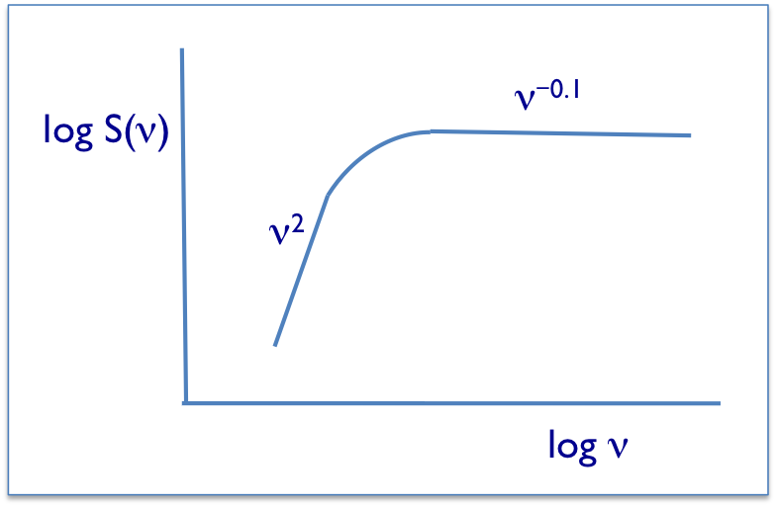
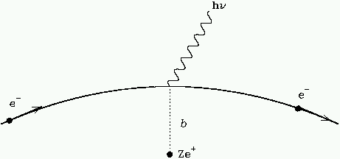
Radio emission mechanisms
Bremsstrahlung (free-free) emission
  Thermal continuum process, arises from electrons being accelerated by ions in a plasma
  Mass of ionized gas
  Optical depth
  Density of electrons in the plasma
  Rate of ionizing photons

Slide 6
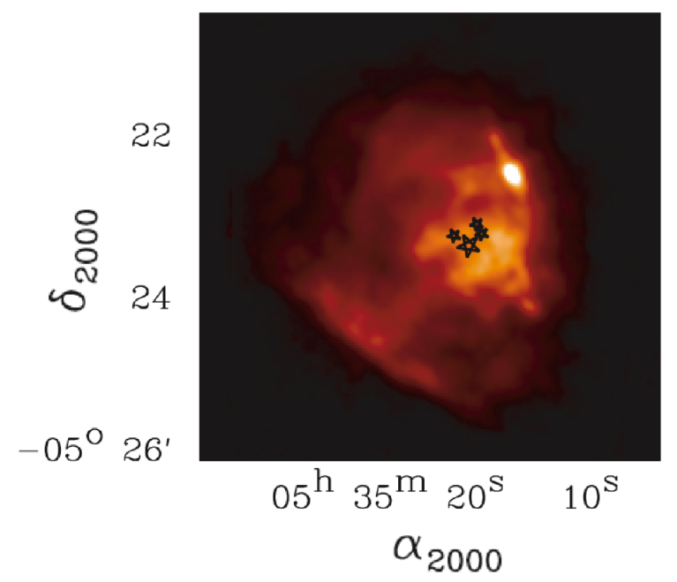
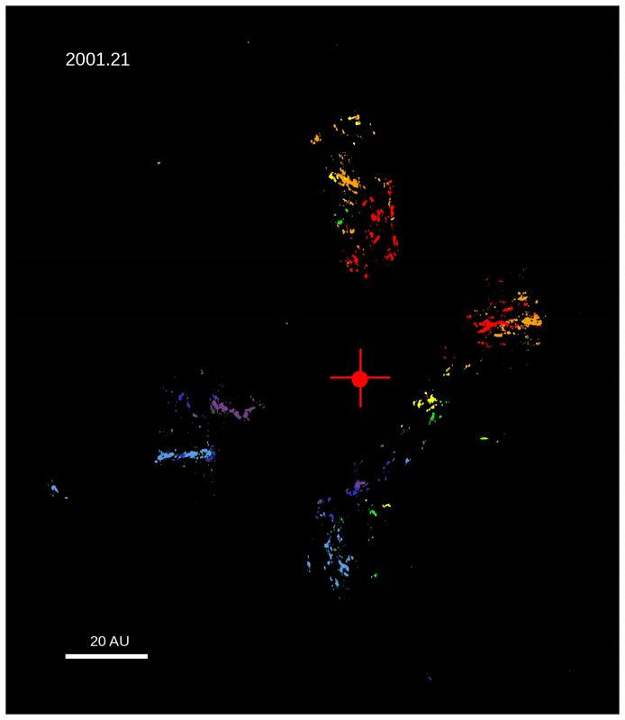
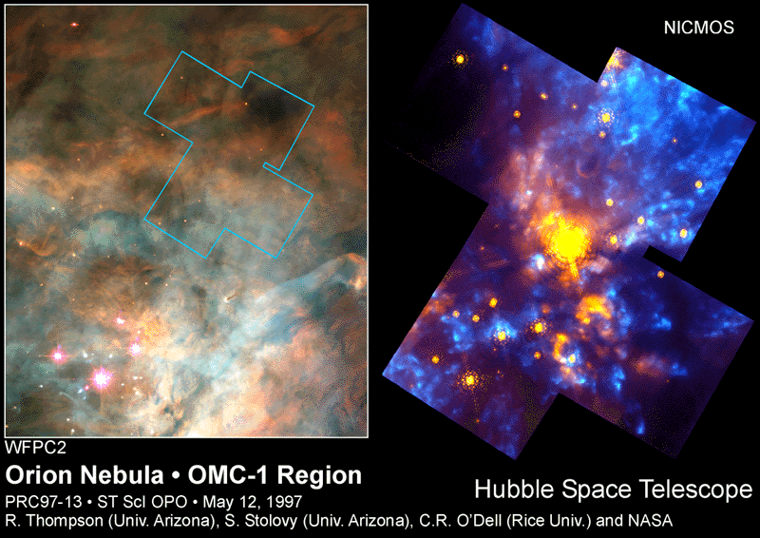
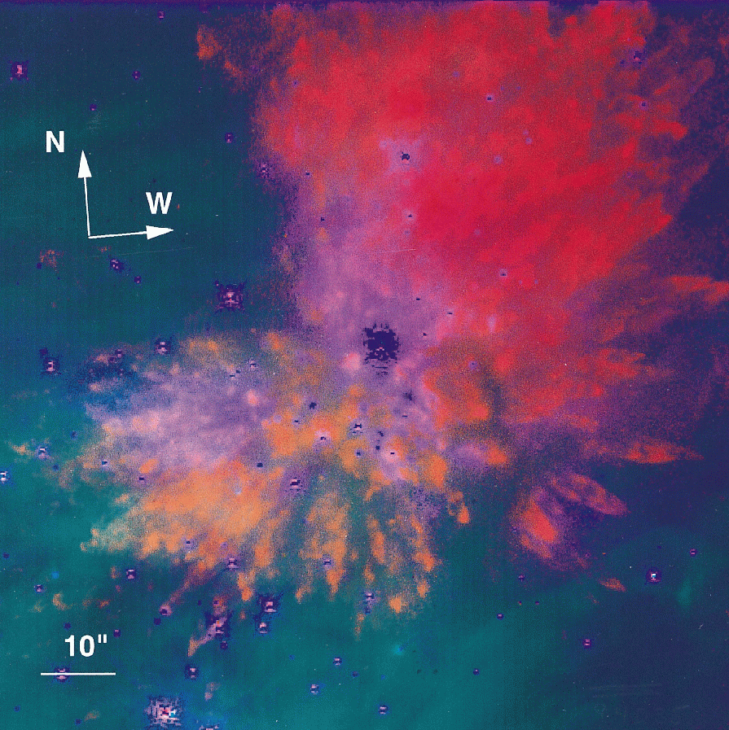
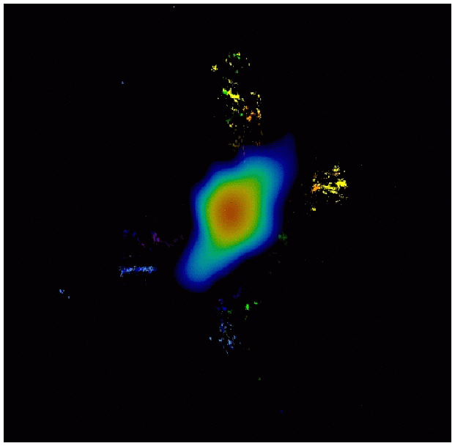

Bremsstrahlung emission: Orion nebula
Dust cloud located behind the HII region
Orion nebula observed with 90 GHz camera on GBT (Dicker et al. 2009)
Source I: Reid et al. (2007), Matthews et al. (2010)

Slide 7
Radio emission mechanisms
Dust emission
  Thermal continuum process, modified black-body emission from dust grains ~10 to ~ few 100 K
  Spectrum of dust emissivity/opacity → dust properties (grain size)
  Dust temperature
  Dust mass (assume a gas-to-dust ratio → total gas mass)
log S(ν)
ν³⁻⁴
log ν

Slide 8
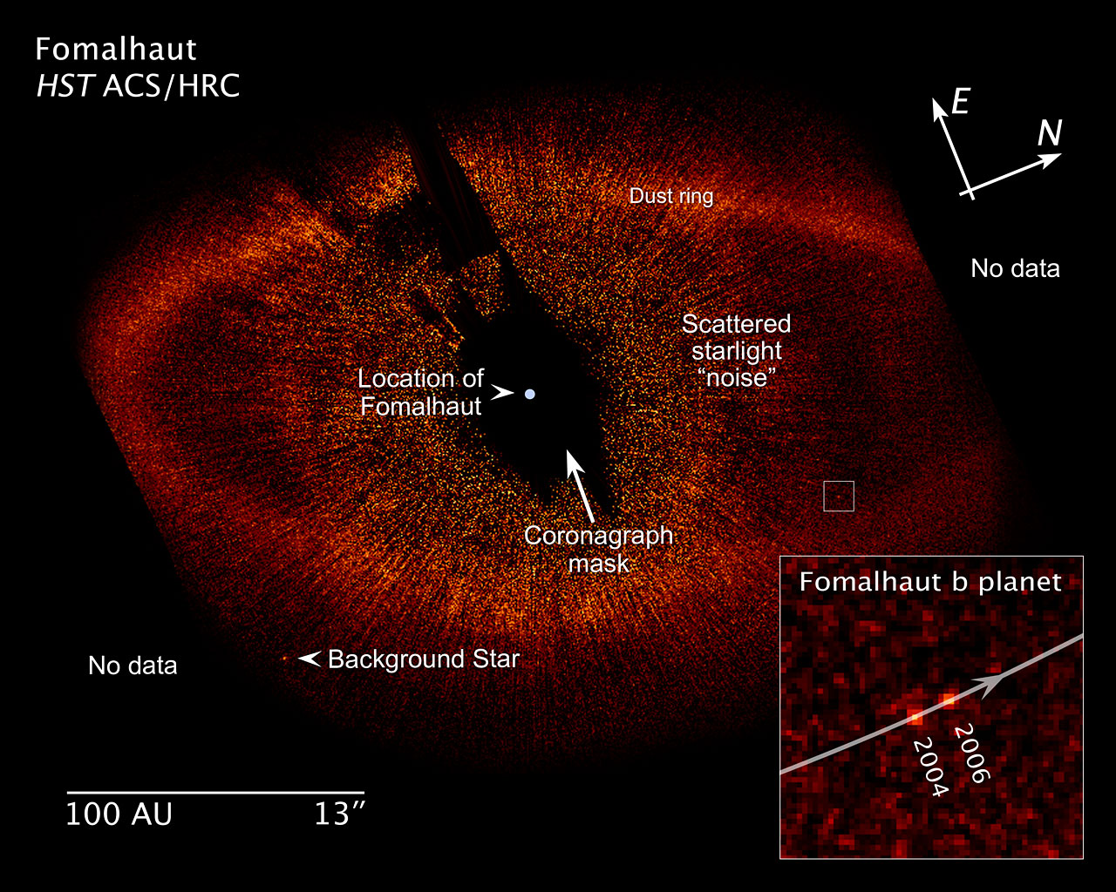
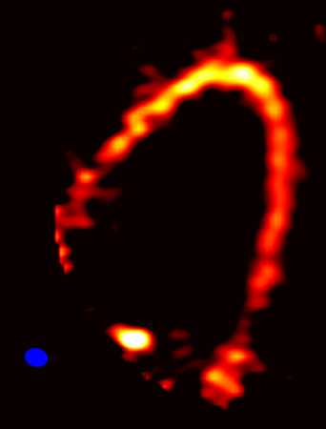
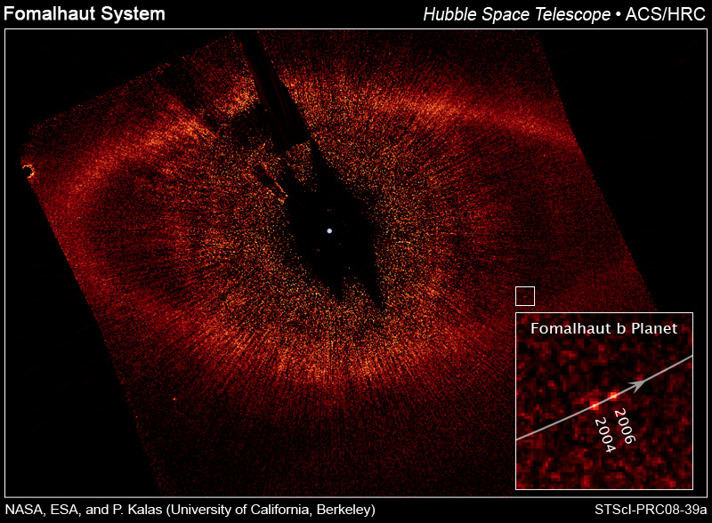
Dust emission: Fomalhaut
ALMA Cycle 0 Reference Image
Band 7 (870 μm)
Dust Continuum
No data
Dust ring
Location of
Fomalhaut
Coronagraph
mask
Scattered
starlight
1.5” x 1.2”
No data
Boley et al. 2012
20 arcseconds ~ 150 AU

Slide 9
Continuum spectral index
S(ν) ∝ ν^{α}
Measurement of spectral index, α, is key to interpreting the origin of the radio emission, and translating S(ν) into physical properties of the source
dust α ∼ 3
log S(ν)
thermal free-free α ∼ −0.1
non-thermal α ∼ −0.7
~40 GHz
log ν

Slide 10


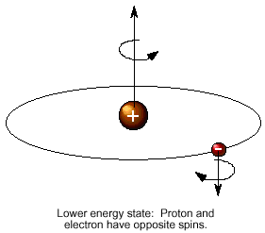
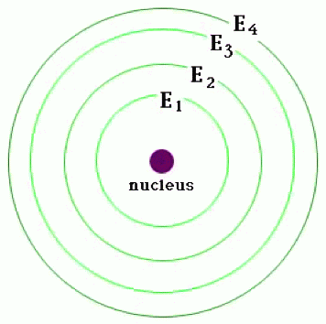
Radio emission mechanisms
Spectral line emission: discrete transitions in atoms and molecules
  Physical and chemical conditions of the gas (density, temperature)
  Kinematics (Doppler effect)
  Zeeman effect → B-field
  Masers
Molecular lines: CO, CS, H₂O, SiO, CH₃OH, NH₃, etc…
Atomic hydrogen: 21cm “spin-flip” transition
Recombination lines: outer electronic transitions of H, He, C

Slide 11
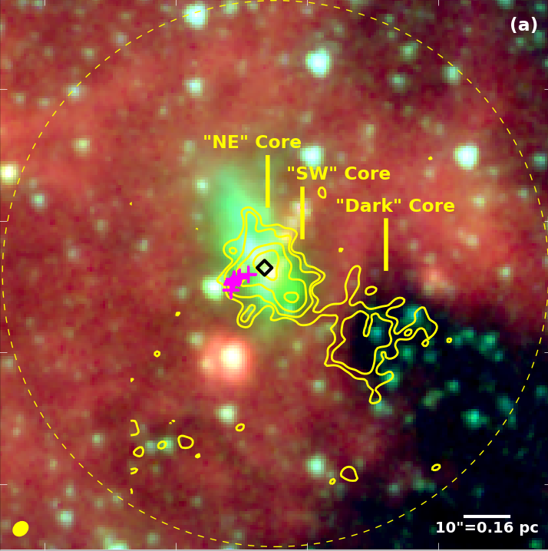
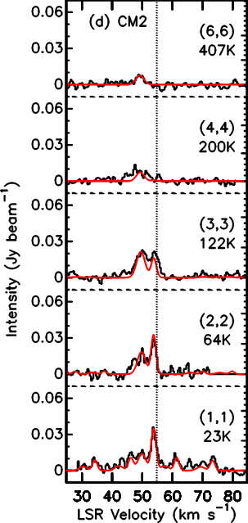
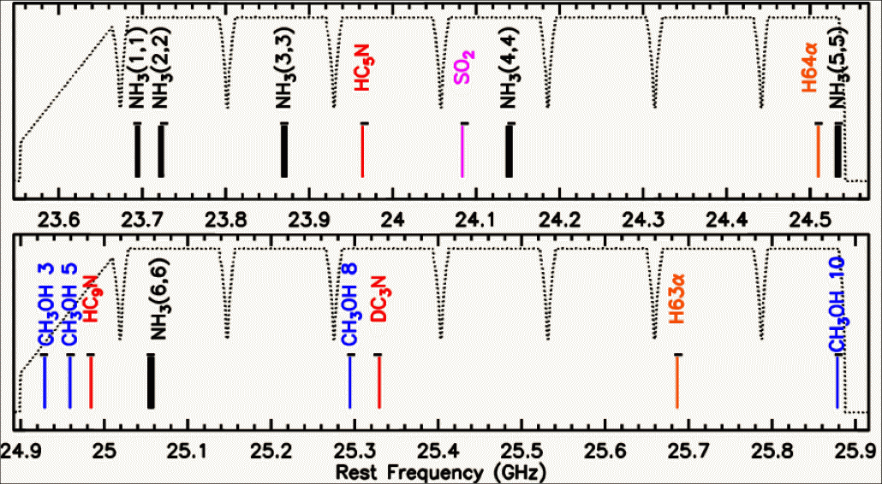
Spectral line emission: G35.03+0.35
WIDAR correlator enables many spectral lines to be observed at once
  16 x 8 MHz sub-bands covering: NH₃ (1,1) – (6,6), four CH₃OH transitions, SO₂, HC₅N DC₃N, two RRLs, continuum
  Cyganowski et al. (2009), Brogan et al. (2011)
T_{k} ~ 30, 35, 220 K
3.6 μm 4.5 μm 8.0 μm
6.7 GHz ✚ 44 GHz
NH₃ (1,1)

Slide 12
Considerations for proposing/observing
Need multi-frequency to determine α
Instrument sensitivity
Source structure!
  Galactic sources range from point-like (stars, masers) to very extended (GMCs, SNRs) – match your science goals to your telescope/configuration
From the D to A configurations the VLA varies its angular resolution by a factor ~35 (depends on largest baseline/telescope separation) at a given frequency, reconfigures every ~4 months
  The shortest baseline sets the largest angular scale measured
  Compact configurations give less spatial resolution but better surface brightness sensitivity
ALMA will be continuously re-configuring its antennas
VLBA/VLBI has the highest spatial resolution of any ground-based observatory but requires very high surface brightness → mostly non-thermal sources

Slide 13
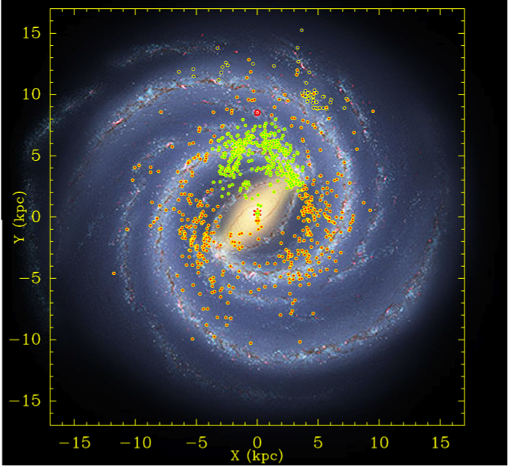
Galactic structure with the VLBA
Bar and Spiral Structure Legacy Survey (BeSSeL) project: use methanol and water masers in star-forming regions, along with exquisite astrometry from the VLBA, to map out the spiral structure of the Milky Way using trigonometric parallax
  Probes obscured regions to far side of Galaxy
Results so far:
  Milky Way 2 times more massive than previously thought
  R_{O} = 8.3 kpc (vs. 8.5 kpc)
  Θ_{O}= 239 km/s (vs. 220 km/s)
  Previous values can yield kinematic distanced in error by a factor of 2
http://www.mpifr-bonn.mpg.de/staff/abrunthaler/BeSSeL

Slide 14
Stellar birth, death, and the ISM
gravitational collapse
ignition of thermonuclear burning
protostars
Main sequence stars
Giant molecular clouds
wind
clumping
…stellar evolution…
ISM
wind
dissipation
Red giants
SNR
dissipation
…more stellar evolution…
PN +
white dwarf
expansion
wind
Horizontal branch, asymptotic giant branch stars
low mass
instability to thermal pulses
Type II SN
Long period variables (e.g., Mira)
high mass progenitor

Slide 15
Star formation
Formation of massive stars, HII regions (Orion)
Formation of protoclusters (G35.03)
Formation of low-mass stars (examples on next slides)
  Radio techniques vital for penetrating the dust that obscures star formation at optical/IR wavelengths, especially for the very young, deeply embedded sources
  First showed that protostars have energetic winds and jets ⇒ mass loss
Formation of planetary systems (Fomalhaut)

Slide 16
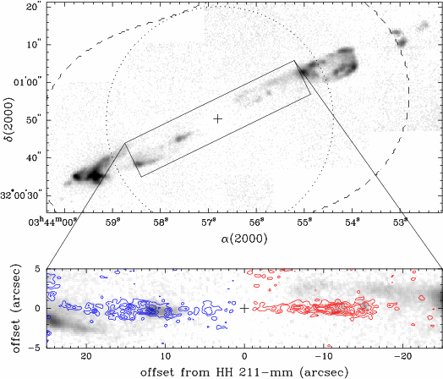
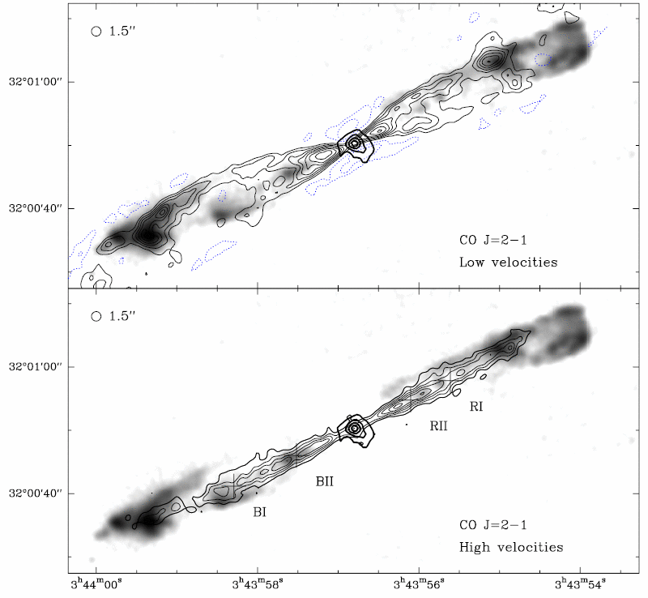
Low-mass star-formation: HH211
Collimated jet shows shocked H₂ emission (2.2μm) but protostar obsured in infrared, SiO(1–0) emission at 43 GHz traces jet closer to source
Swept-up molecular gas is traced by CO(2–1) emission at 230 GHz and dense dust disk is detected in continuum emission
(Chandler & Richer 2001)
(Gueth & Guilloteau 1999)

Slide 17
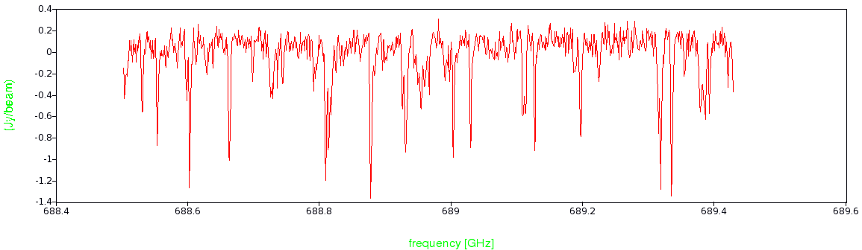
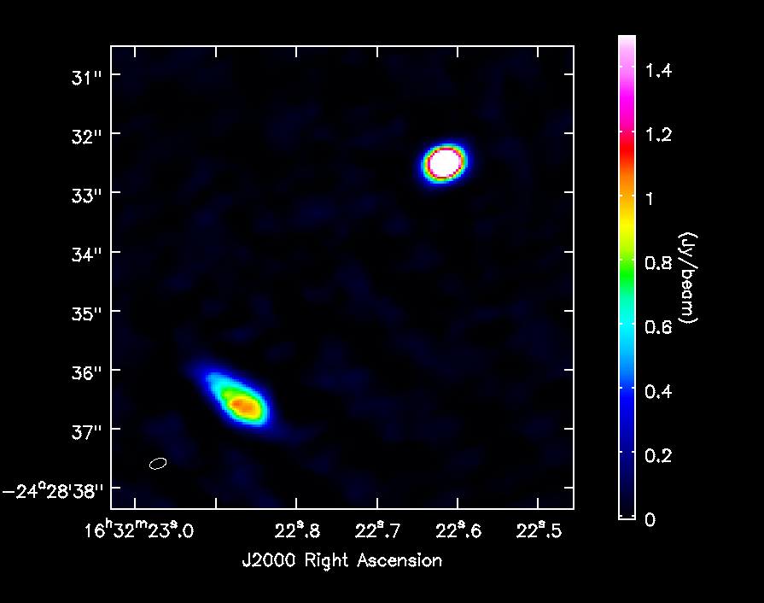
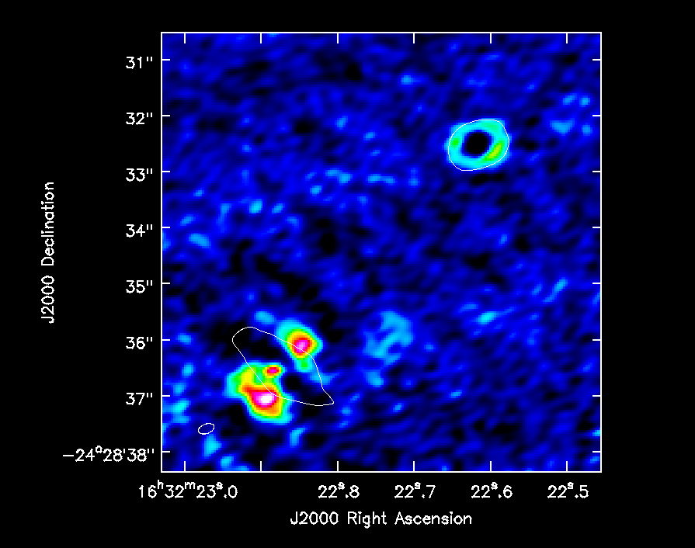
Low-mass star-formation: IRAS16293-2422
Band 9 (690 GHz) SV data from ALMA shows optically-thick dust continuum emission from source B, T_{B}~150 K
B
A

Slide 18
Stellar birth, death, and the ISM
gravitational collapse
ignition of thermonuclear burning
protostars
Main sequence stars
Giant molecular clouds
wind
clumping
…stellar evolution…
ISM
wind
dissipation
Red giants
SNR
dissipation
…more stellar evolution…
PN +
white dwarf
expansion
wind
Horizontal branch, asymptotic giant branch stars
low mass
instability to thermal pulses
Type II SN
Long period variables (e.g., Mira)
high mass progenitor

Slide 19
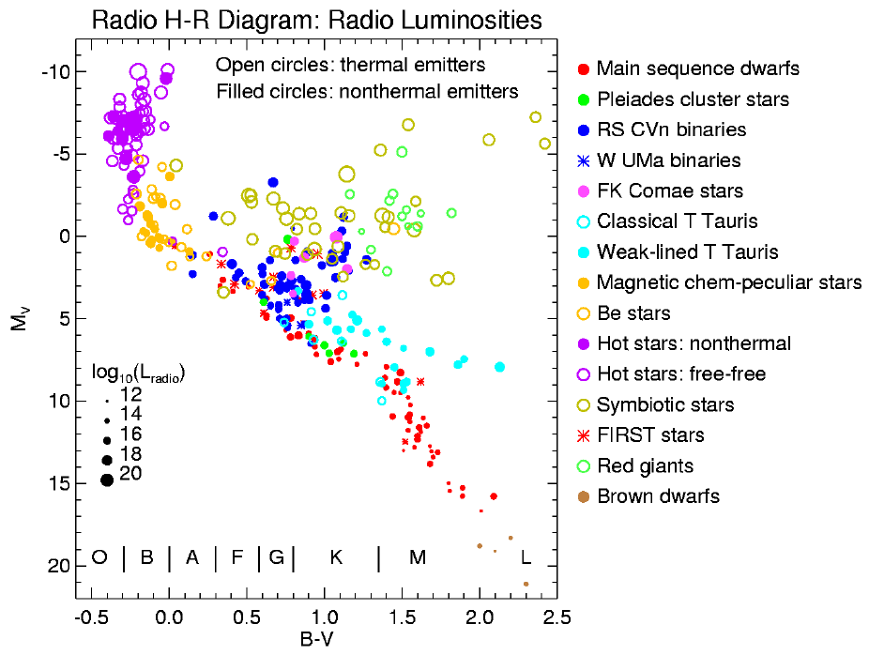
Radio emission from stars
“Radio H-R Diagram” from Stephen White

Slide 20
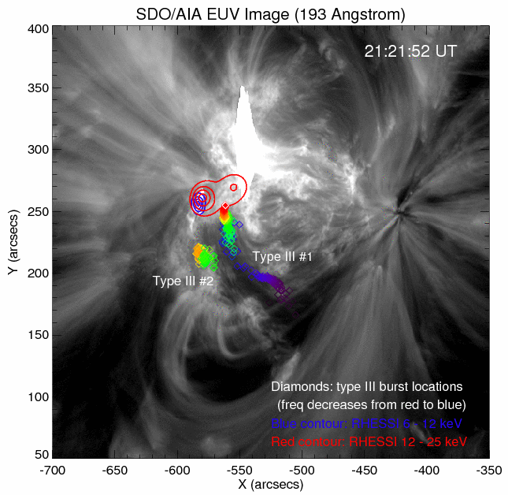
The Sun
Strongest radio source in the sky, at ν > 100 MHz!
5 Nov 2011, Type III burst
  Electrons accelerated via magnetic reconnection, emit at plasma frequency, ν ∝ n_{e}^{½}
  Burst lasts < 100 ms
  Location of peak emission from 1.5 to 1.0 GHz traces density gradient, reveals topology of B-field
Big flares can be associated with 10s-100s of bursts
Chen et al. (in prep)

Slide 21
Stellar birth, death, and the ISM
gravitational collapse
ignition of thermonuclear burning
protostars
Main sequence stars
Giant molecular clouds
wind
clumping
…stellar evolution…
ISM
wind
dissipation
Red giants
SNR
dissipation
…more stellar evolution…
PN +
white dwarf
expansion
wind
Horizontal branch, asymptotic giant branch stars
low mass
instability to thermal pulses
Type II SN
Long period variables (e.g., Mira)
high mass progenitor

Slide 22
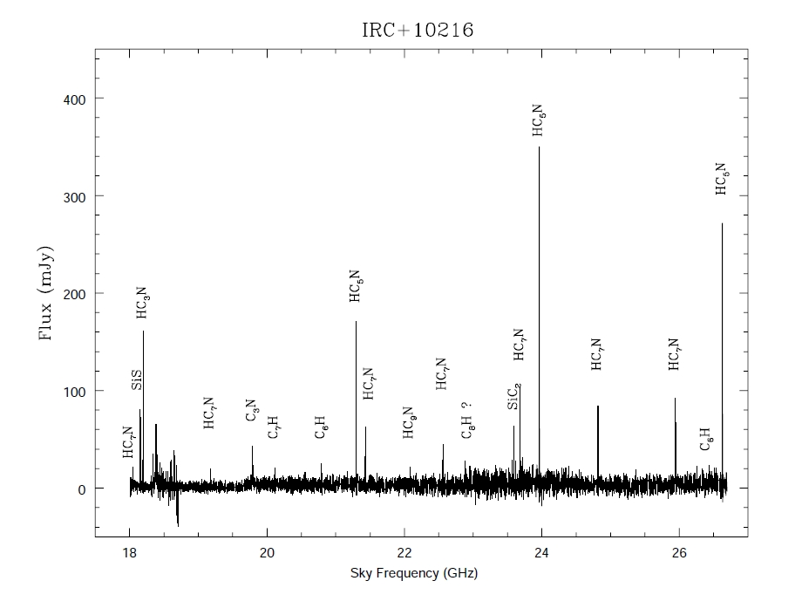
The carbon-rich AGB star IRC+10216
Spectroscopy and imaging at 1.3cm (K-band)
https://science.nrao.edu/facilities/evla/early-science/demoscience

Slide 23
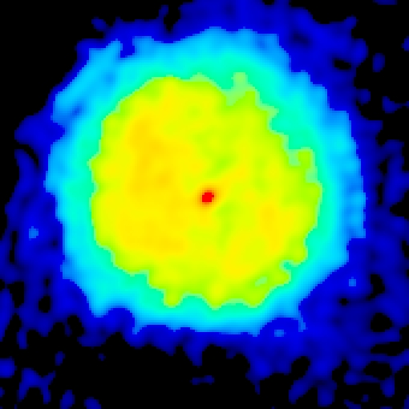
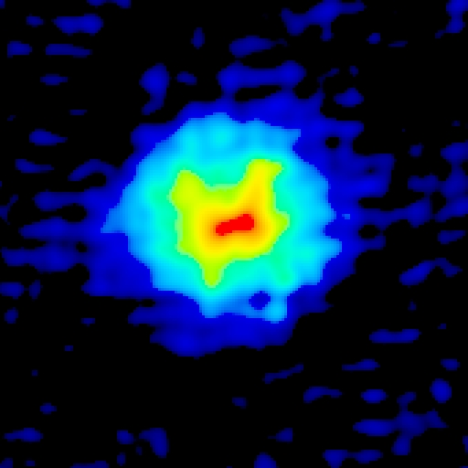
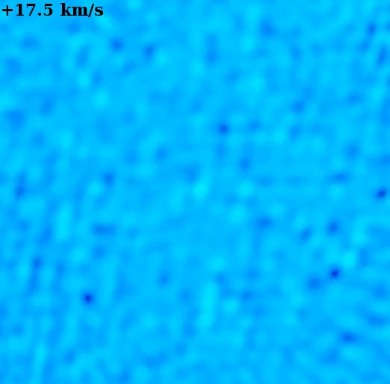
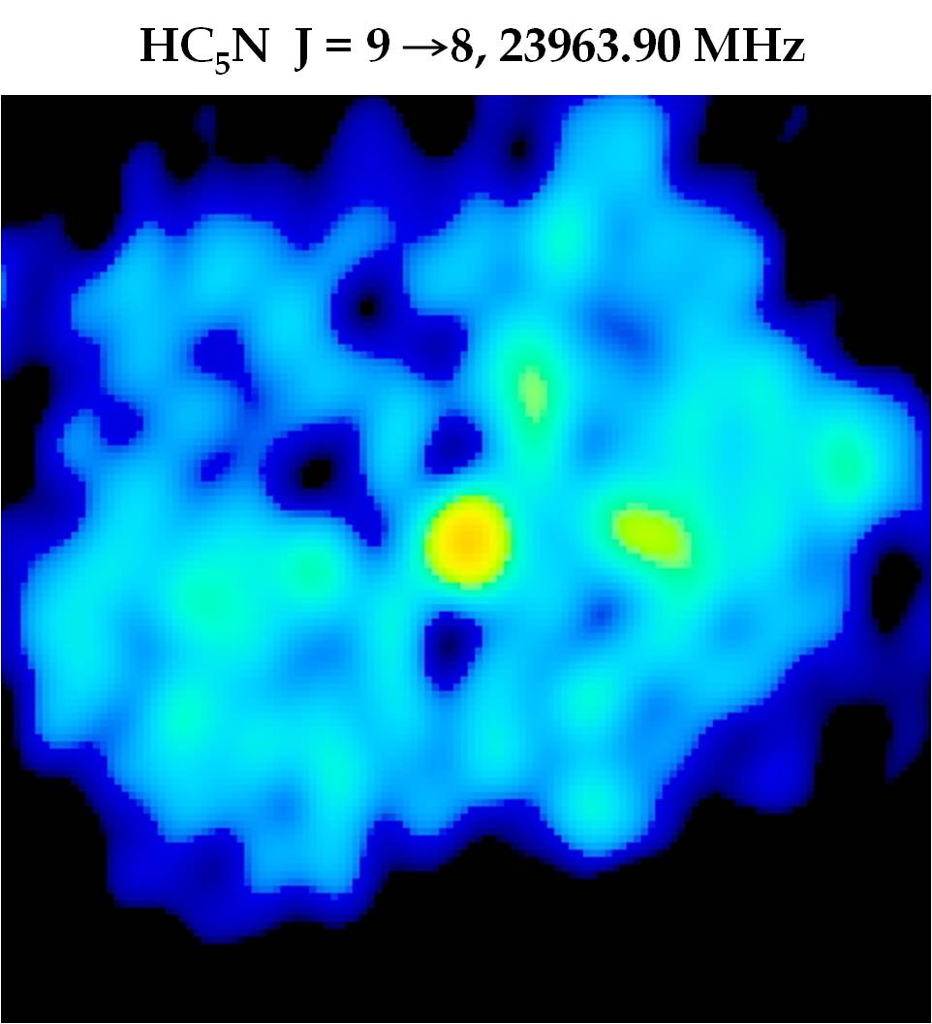
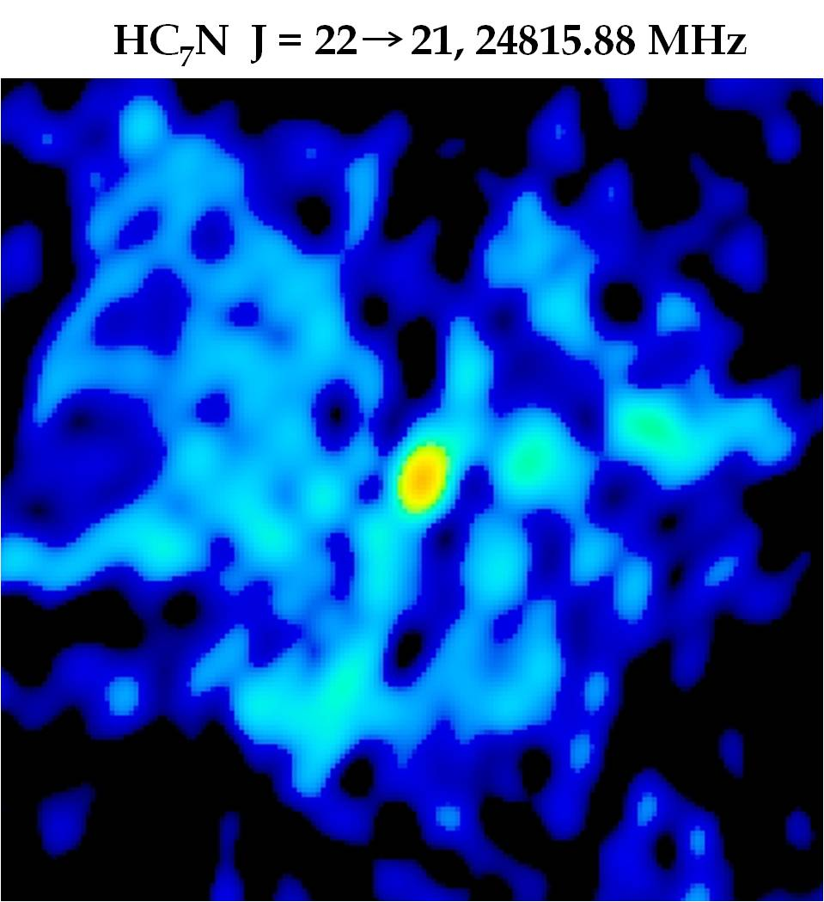
Spectral movie of IRC+10216
HC₃N(4−3) emission at 36.4 GHz traces the expanding shell
Similar movies for HC₅N(9−8), HC₇N(22−21), SiS(2−1), reveal chemical structure of the envelope
HC₃N
SiS
HC₅N
HC₇N

Slide 24
Stellar birth, death, and the ISM
gravitational collapse
ignition of thermonuclear burning
protostars
Main sequence stars
Giant molecular clouds
wind
clumping
…stellar evolution…
ISM
wind
dissipation
Red giants
SNR
dissipation
…more stellar evolution…
PN +
white dwarf
expansion
wind
Horizontal branch, asymptotic giant branch stars
low mass
instability to thermal pulses
Type II SN
Long period variables (e.g., Mira)
high mass progenitor

Slide 25
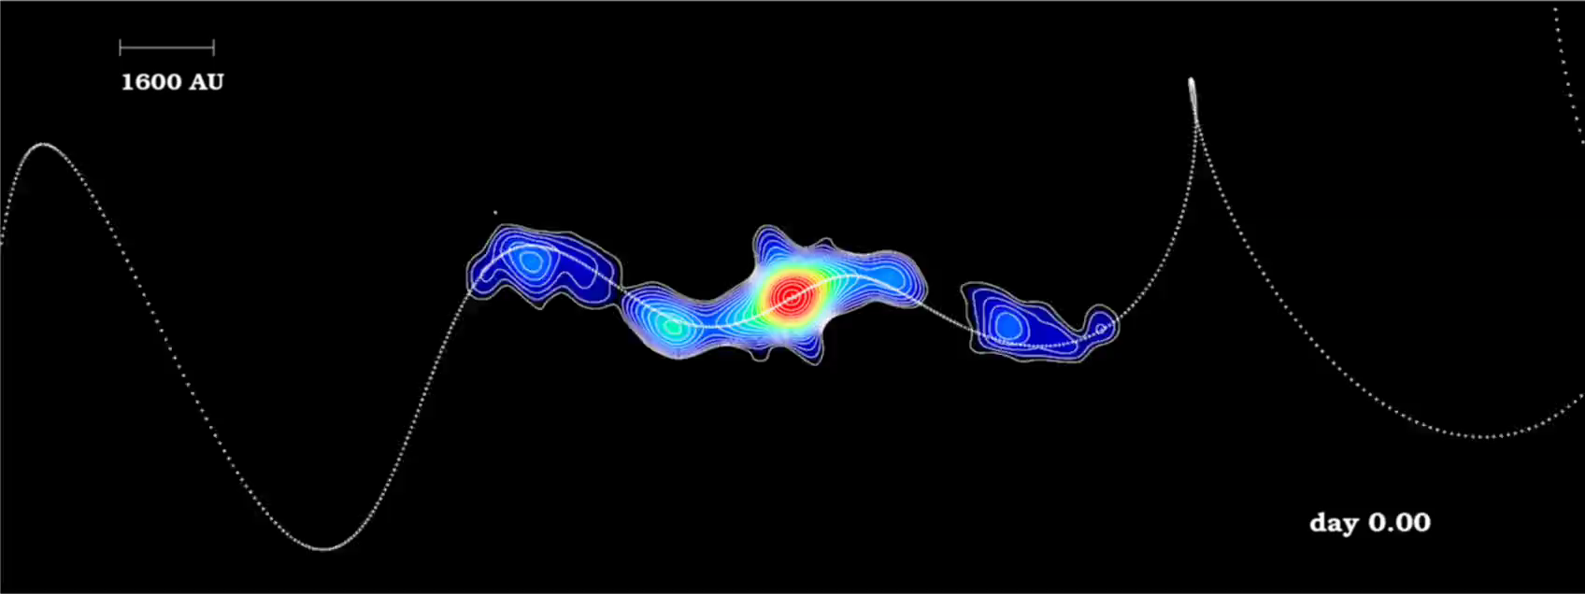
SS433 and the W50 nebula
26 GHz emission from SS433, 0.095” (520 AU) resolution

Slide 26
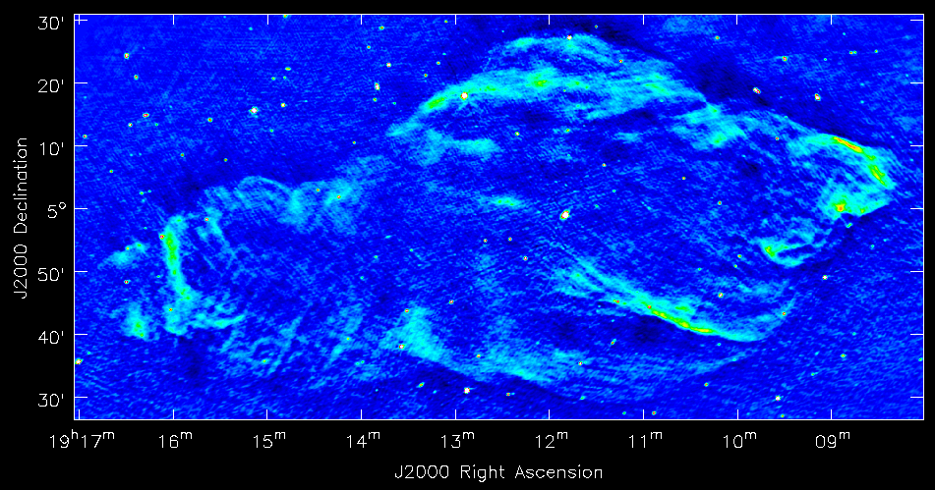
SS433 and the W50 nebula

Slide 27
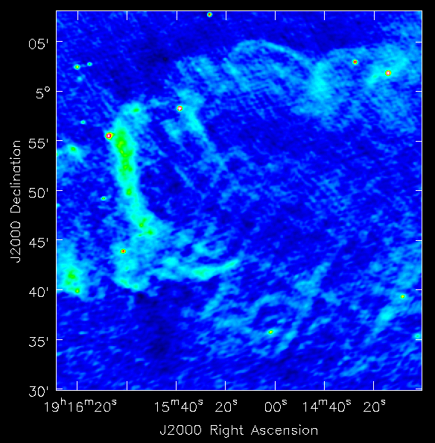
SS433 and the W50 nebula

Slide 28
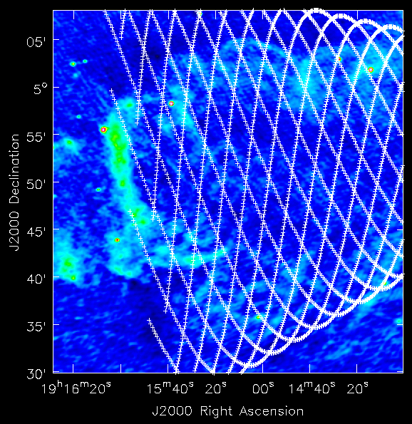
SS433 and the W50 nebula

Slide 29
Stellar birth, death, and the ISM
gravitational collapse
ignition of thermonuclear burning
protostars
Main sequence stars
Giant molecular clouds
wind
clumping
…stellar evolution…
ISM
wind
dissipation
Red giants
SNR
dissipation
…more stellar evolution…
PN +
white dwarf
expansion
wind
Horizontal branch, asymptotic giant branch stars
low mass
instability to thermal pulses
Type II SN
Long period variables (e.g., Mira)
high mass progenitor

Slide 30
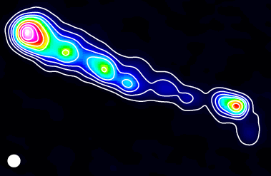
The ISM
Many applications of radio techniques to the interstellar medium
  Molecular clouds, chemistry, physics, structure
  Diffuse clouds (HI)
  Intercloud medium (HI+HII)
  Diffuse nebulae (Bremsstrahlung, RRLs)
Small-scale HI structures detected in absorption against extra-galactic sources:VLBA provides spatial resolution of a few AU!
Local bubble ~100 pc
Cold HI scale height (2z) ~200 pc
(C. Brogan)
3C138

Slide 31
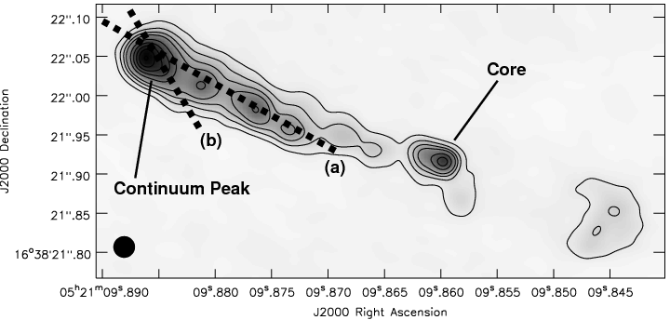
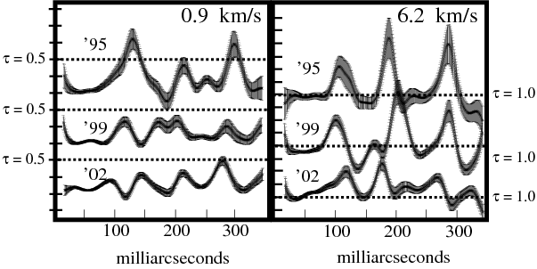
HI absorption toward 3C138
Multi-epoch VLBA observations, 1995, 1999, 2002
Resolution 20 mas = 10 AU at 500pc
Changes in τ indicate changes in density of intervening Galactic atomic gas, size-scale of features ~25AU (Brogan et al. 2005)

Slide 32
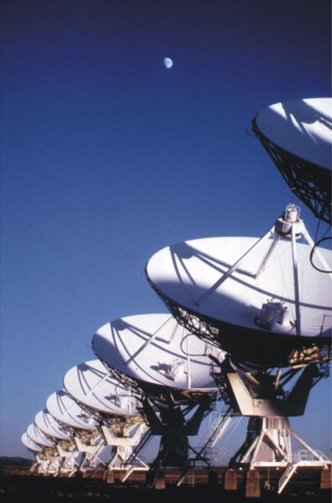
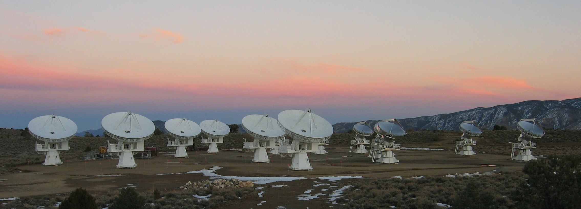
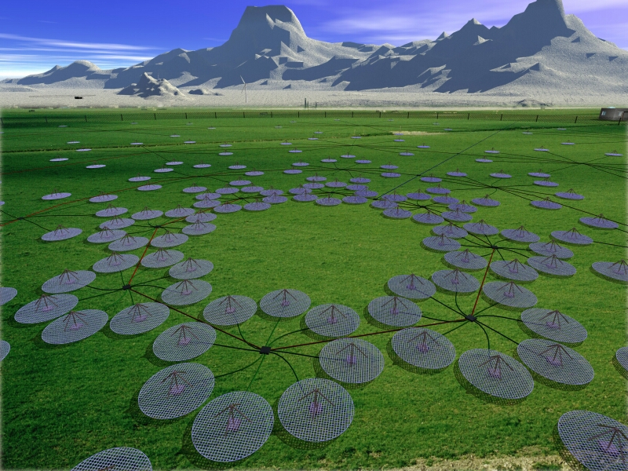
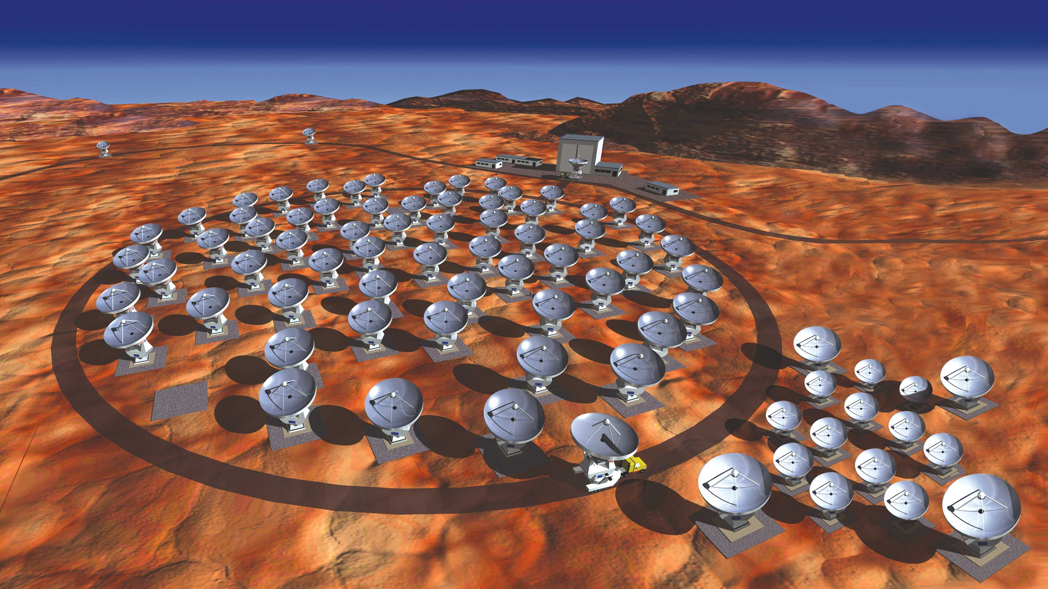
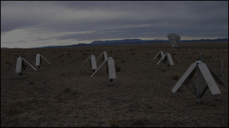
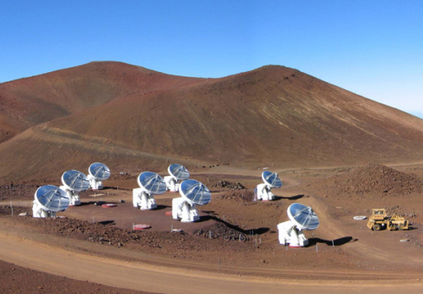
Summary
Radio interferometry is a powerful tool for investigating Galactic sources
  Especially important in the Galactic Plane, where extinction is a problem at other wavelengths
  Provides insight into all phases of stellar evolution and the interstellar medium
  Spatial resolution comparable to (or better than!) other wavelengths → enables multi-wavelength approach to solving science problems on matched spatial scales
New capabilities coming online → opportunity for you!
Expanded
VLA
CARMA
LOFAR
LWA
ALMA
SMA

