Slide 1
Using CASA to Simulate Interferometer Observations
Nuria Marcelino
North American ALMA Science Center

Slide 2
Simulating Interferometer Data
Take a model image and simulate how it would look if observed by ALMA or the EVLA.
Other arrays (e.g., SMA, CARMA, etc.) also included
Explore the effects of:
Number of antennas
Antenna configuration
Length of observation
Thermal noise
Phase noise
Functionality included in CASA via tasks simobserve and simanalyze (nee simdata).
CASAguides includes several walkthroughs: http://casaguides.nrao.edu/index.php?title=Simulating_Observations_in_CASA
Notes:
Vital stats
~ 1.3 billion 2006 dollar project
~ unique high dry site in the Chilean Andes

Slide 3
Basic Simulation Workflow
In CASA…
Model Sky Distribution
(FITS, image, components)
simobserve
Simulated Measurement Set
(calibrated u-v data)
simanalyze
Simulated Image
& Analysis Plots Comparing “Observed”/original image
Notes:
Vital stats
~ 1.3 billion 2006 dollar project
~ unique high dry site in the Chilean Andes

Slide 4
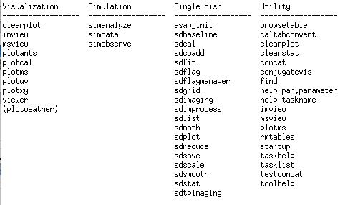
Simulation Tasks
simobserve simulates interferometric (and single dish)observations of a source.
simanalyze images and analyzes these simulations.
“tasklist” output
Notes:
Vital stats
~ 1.3 billion 2006 dollar project
~ unique high dry site in the Chilean Andes

Slide 5
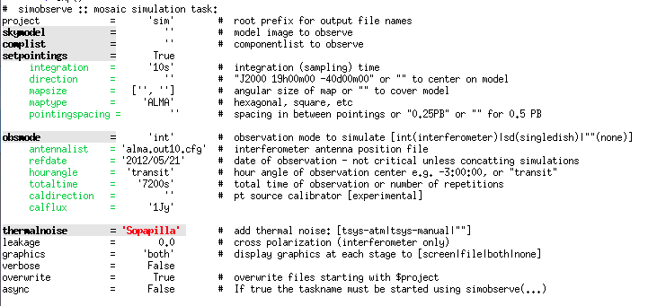
simobserve
simulates interferometer observations of a source.
“inp simobserve” output
Notes:
Vital stats
~ 1.3 billion 2006 dollar project
~ unique high dry site in the Chilean Andes

Slide 6
CASA Refresher
In casapy type default simobserve inp simobserve
Notes:
Vital stats
~ 1.3 billion 2006 dollar project
~ unique high dry site in the Chilean Andes

Slide 7
CASA Refresher
inp shows parameter names
Expandable parameter (currently NOT expanded)
Expandable parameter (currently expanded)
Notes:
Vital stats
~ 1.3 billion 2006 dollar project
~ unique high dry site in the Chilean Andes

Slide 8
CASA Refresher
inp shows current value (change, e.g., by project = “myproj”)
Invalid Value
Notes:
Vital stats
~ 1.3 billion 2006 dollar project
~ unique high dry site in the Chilean Andes

Slide 9
CASA Refresher
inp shows brief description
Notes:
Vital stats
~ 1.3 billion 2006 dollar project
~ unique high dry site in the Chilean Andes

Slide 10
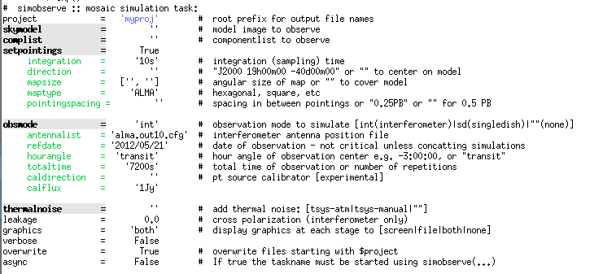
CASA Refresher
Change values by project = “myproj” inp
Notes:
Vital stats
~ 1.3 billion 2006 dollar project
~ unique high dry site in the Chilean Andes

Slide 11
CASA Refresher
When all parameters are set, execute with “go simobserve”
If you get stuck:
Type “tasklist” to see all tasks
Type “help taskname” to get help on taskname
Type “default taskname” to set the default inputs
Type “inp” to review the inputs of the current task
Ask!
Notes:
Vital stats
~ 1.3 billion 2006 dollar project
~ unique high dry site in the Chilean Andes

Slide 12
Basic Simulation Workflow
In CASA…
Model Sky Distribution
(FITS, image, components)
simobserve
Simulated Measurement Set
(calibrated u-v data)
simanalyze
Simulated Image
& Analysis Plots Comparing “Observed”/original image
Notes:
Vital stats
~ 1.3 billion 2006 dollar project
~ unique high dry site in the Chilean Andes

Slide 13
What Defines a Simulation?
Model Sky Distribution (Required)
What does the sky really look like in your field?
Telescope (Required)
Number of Antennas, Configuration, Diameter
Observation (Required)
Integration time, scan length, pointing centers
Corruption
(Optional)
Thermal noise, phase noise, polarization leakage
Notes:
Vital stats
~ 1.3 billion 2006 dollar project
~ unique high dry site in the Chilean Andes

Slide 14
simobserve
Model sky distribution as FITS file or “component list”
Model Sky Distribution (Required)
What does the sky really look like in your field?
Notes:
Vital stats
~ 1.3 billion 2006 dollar project
~ unique high dry site in the Chilean Andes

Slide 15
simobserve
Telescope via configuration file.
Telescope (Required)
Number of Antennas, Configuration, Diameters
Notes:
Vital stats
~ 1.3 billion 2006 dollar project
~ unique high dry site in the Chilean Andes

Slide 16
simobserve
Observations defined via setpointings and obsmode
Observation (Required)
Integration time, scan length, pointing centers
Notes:
Vital stats
~ 1.3 billion 2006 dollar project
~ unique high dry site in the Chilean Andes

Slide 17
simobserve
Corruption with thermalnoise & toolkit
Corruption
(Optional)
Thermal noise, phase noise, polarization leakage
Notes:
Vital stats
~ 1.3 billion 2006 dollar project
~ unique high dry site in the Chilean Andes

Slide 18
simobserve
Model sky distribution as FITS file or “component list”
Model Sky Distribution (Required)
What does the sky really look like in your field?
Notes:
Vital stats
~ 1.3 billion 2006 dollar project
~ unique high dry site in the Chilean Andes

Slide 19
Input Sky Model
Model sky distribution as FITS file. simobserve needs:
Coordinates
Brightness units
Pixel scale (angular and spectral)
Polarization*
These may be specified in your FITS header or supplied/over-written by simobserve.
Notes:
Vital stats
~ 1.3 billion 2006 dollar project
~ unique high dry site in the Chilean Andes

Slide 20
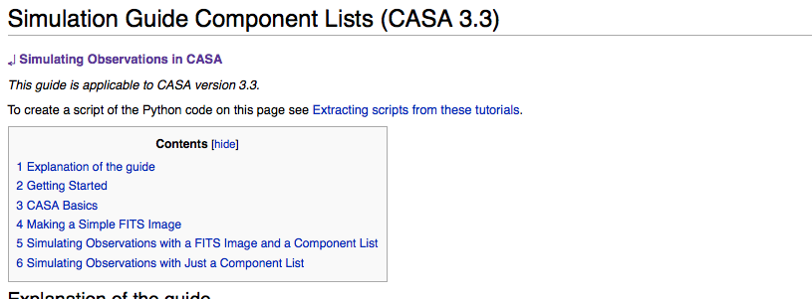
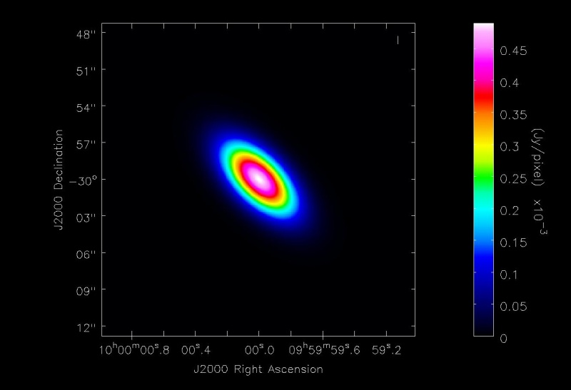
Input Sky Model
Alternatively, supply a Gaussian “component list.” Example at: http://casaguides.nrao.edu/index.php?title=Simulation_Guide_Component_Lists_(CASA_3.3)
Notes:
Vital stats
~ 1.3 billion 2006 dollar project
~ unique high dry site in the Chilean Andes

Slide 21
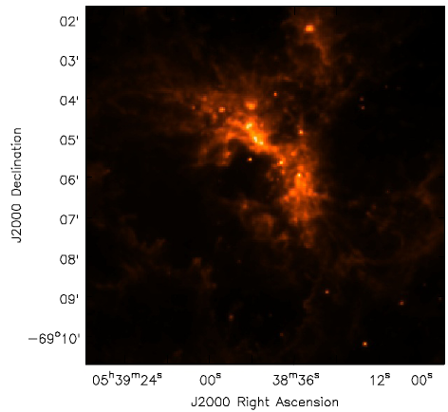
Simple Example
Simulate observing 1mm dust continuum in a 30-Doradus (LMC)-like region at the distance of M31/M33 (800 kpc).
We have a near-IR image of 30 Doradus, will need to:
Scale the brightness and observing frequency
Adjust the pixel scale (move it from 50-800 kpc)
Set a new position
Define the observations integration time, telescope, etc.
Our Model
30 Doradus in the LMC
8 μm (credit: SAGE collaboration)
Notes:
Vital stats
~ 1.3 billion 2006 dollar project
~ unique high dry site in the Chilean Andes

Slide 22
Simple Example
inbright = “0.6mJy/pixel” Requires spectral model/other knowledge to estimate (Science!)
Indirection = “J2000 10h00m00s -40d00m00s”
incell=“0.15arcsec” native cell size = 2.3”, moving from 50 kpc➔800 kpc scale by 50/800
incenter=“230GHz”, inwidth=“2GHz” Need to supply observing frequency & bandwidth (here 1mm dust continuum)
Notes:
Vital stats
~ 1.3 billion 2006 dollar project
~ unique high dry site in the Chilean Andes

Slide 23
Simple Example
inbright = “0.6mJy/pixel” Requires spectral model/other knowledge to estimate (Science!)
Indirection = “J2000 10h00m00s -40d00m00s”
incell=“0.15arcsec” native cell size = 2.3”, moving from 50 kpc➔800 kpc scale by 50/800
incenter=“230GHz”, inwidth=“2GHz” Need to supply observing frequency & bandwidth (here 1mm dust continuum)
Notes:
Vital stats
~ 1.3 billion 2006 dollar project
~ unique high dry site in the Chilean Andes

Slide 24
simobserve
Telescope via configuration file.
Telescope (Required)
Number of Antennas, Configuration, Diameter
Notes:
Vital stats
~ 1.3 billion 2006 dollar project
~ unique high dry site in the Chilean Andes

Slide 25
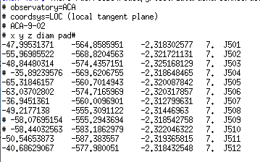
Configuration Files
Define telescope array for simobserve.
Config Files in CASA Already
ALMA, EVLA, CARMA, SMA, etc.
Example Config File: ALMA Cycle 1 ACA
x y z diameter name
Notes:
Vital stats
~ 1.3 billion 2006 dollar project
~ unique high dry site in the Chilean Andes

Slide 26
Configuration Files
Pick an intermediate-extent full-ALMA configuration
Notes:
Vital stats
~ 1.3 billion 2006 dollar project
~ unique high dry site in the Chilean Andes

Slide 27
simobserve
Observations defined via setpointings and obsmode
Observation (Required)
Integration time, scan length, pointing centers
Notes:
Vital stats
~ 1.3 billion 2006 dollar project
~ unique high dry site in the Chilean Andes

Slide 28
setpointings
setpointings dictates field, integration time, mosaic
integration sets data averaging (and field visit) time here averaging 600s (10m) ensures a quick initial execution
direction sets field or map center
mapsize, maptype, pointingspacing define a mosaic By default it will cover the model, here that means a 9-point mosaic
Notes:
Vital stats
~ 1.3 billion 2006 dollar project
~ unique high dry site in the Chilean Andes

Slide 29
obsmode
obsmode sets total time, date, observing sequence
totaltime sets total observation direction Here 7200s is a typical ALMA observation duration
Optionally specify the date, LST, and a calibrator sequence.
go simobserve simobserve creates a measurement set (MS) in projectname/projectname.ms
Notes:
Vital stats
~ 1.3 billion 2006 dollar project
~ unique high dry site in the Chilean Andes

Slide 30
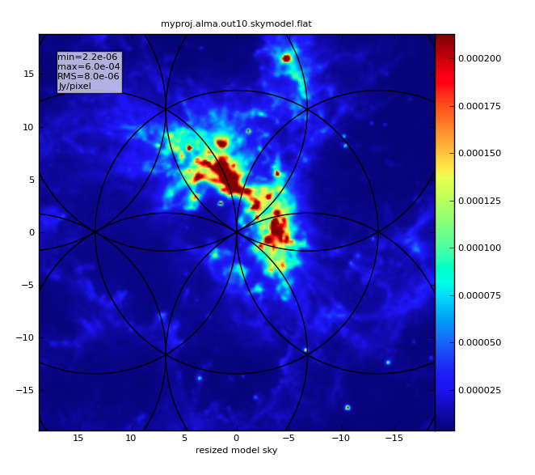
skymodel image
simobserve outputs diagnostic plots to project directory Text files show the location of pointing centers (or listobs)
Notes:
Vital stats
~ 1.3 billion 2006 dollar project
~ unique high dry site in the Chilean Andes

Slide 31
simobserve
Corruption with thermalnoise & toolkit
Corruption
(Optional)
Thermal noise, phase noise, polarization leakage
Notes:
Vital stats
~ 1.3 billion 2006 dollar project
~ unique high dry site in the Chilean Andes

Slide 32
Multiple sets of observations
One can simulate multiple sets of observations with multiple calls to simobserve
Simulate combining data from compact and extended arrays
Simulate combining data from interferometers and single dish telescopes
The CLEAN task can take multiple measurement sets to combine interferometric observations
The FEATHER task can combine single dish and interferometric observations
Notes:
Vital stats
~ 1.3 billion 2006 dollar project
~ unique high dry site in the Chilean Andes

Slide 33
thermalnoise
Set observing conditions to add random noise to image
See CASAguides and toolkit for other ways to corrupt data. e.g., phase noise
We will make a noisy and a not-noisy version to compare.
MAKE SURE TO SHOW THIS, OR NOT SAY IT
go simobserve simobserve creates a measurement set (MS) in projectname/projectname.ms
Notes:
Vital stats
~ 1.3 billion 2006 dollar project
~ unique high dry site in the Chilean Andes

Slide 34
Basic Simulation Workflow
In CASA…
Model Sky Distribution
(FITS, image, components)
simobserve
Simulated Measurement Set
(calibrated u-v data)
simanalyze
Simulated Image
& Analysis Plots Comparing “Observed”/original image
Notes:
Vital stats
~ 1.3 billion 2006 dollar project
~ unique high dry site in the Chilean Andes

Slide 35
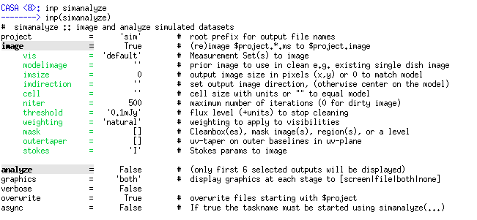
simanalyze
Image and analyze simobserve output
Notes:
Vital stats
~ 1.3 billion 2006 dollar project
~ unique high dry site in the Chilean Andes

Slide 36
image
Grid, invert, and CLEAN the simulated data set.
Similar but reduced options compared to CLEAN. Defaults are “smart”, informed by the model.
You can also image the simulated observations with CLEAN. They are a normal CASA measurement set for all purposes
Notes:
Vital stats
~ 1.3 billion 2006 dollar project
~ unique high dry site in the Chilean Andes

Slide 37
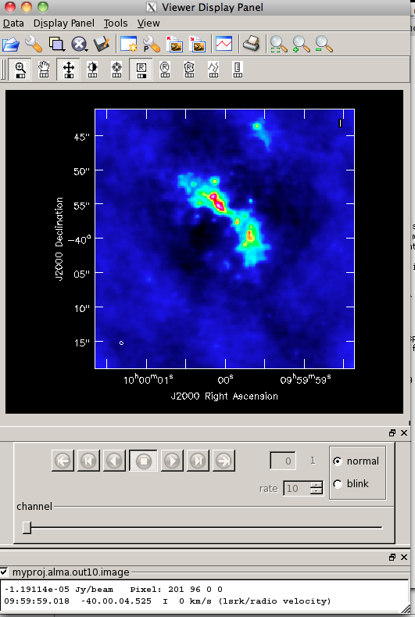
image
Output files can be examined with the CASA viewer. In CASA 3.4 these live in projectname/projectname.image
Notes:
Vital stats
~ 1.3 billion 2006 dollar project
~ unique high dry site in the Chilean Andes

Slide 38
analyze
Create diagnostic plots based on simobserve and image
Pick up to 6 of these.
Notes:
Vital stats
~ 1.3 billion 2006 dollar project
~ unique high dry site in the Chilean Andes

Slide 39
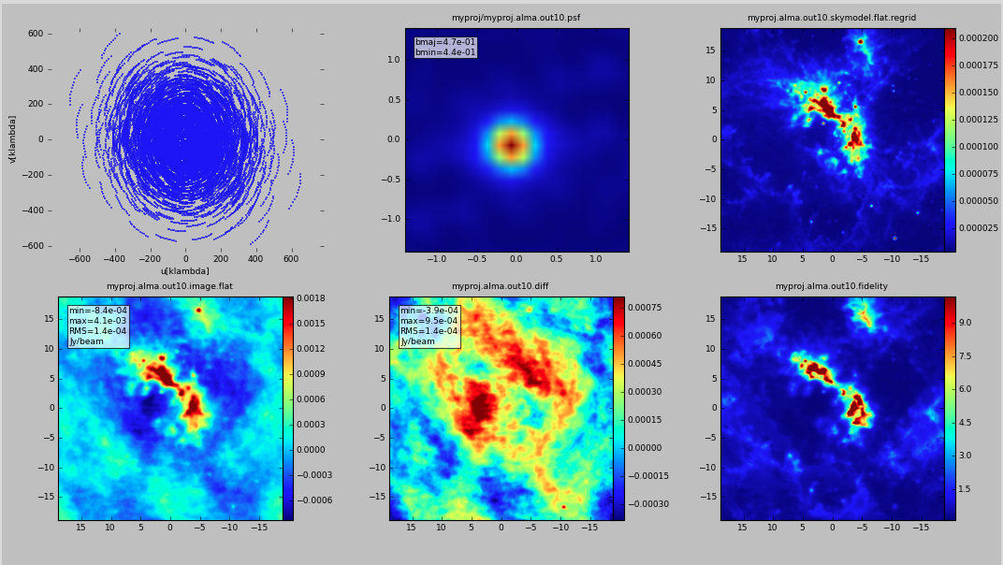
analyze
Create diagnostic plots based on simobserve and image
Notes:
Vital stats
~ 1.3 billion 2006 dollar project
~ unique high dry site in the Chilean Andes

Slide 40
analyze
Create diagnostic plots based on simobserve and image
u-v coverage
Point spread function
Sky Model
Simulated image
Model - Observed
Image Fidelity
Notes:
Vital stats
~ 1.3 billion 2006 dollar project
~ unique high dry site in the Chilean Andes

Slide 41
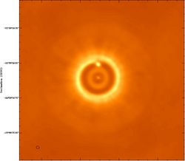
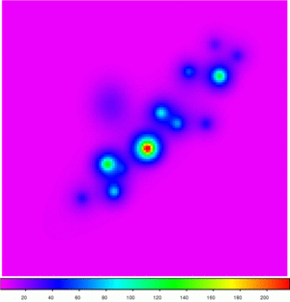
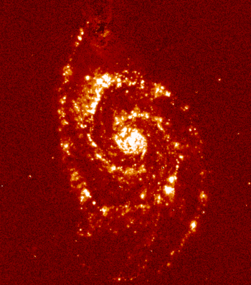
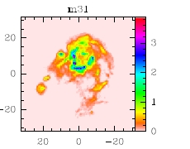
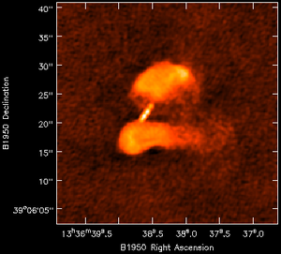
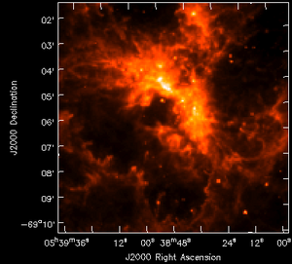
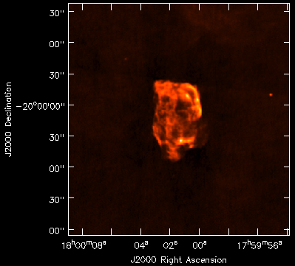
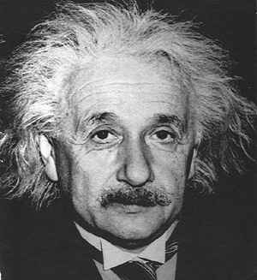
Try It Yourself!
Simulate one of the suite of model images at http://casaguides.nrao.edu/index.php?title=Sim_Inputs
Notes:
Vital stats
~ 1.3 billion 2006 dollar project
~ unique high dry site in the Chilean Andes

