Slide 1
Advanced Calibration Techniques
Crystal Brogan (NRAO / North American ALMA Science Center)

Slide 2
Outline
The Troposphere
  Mean effect
  Correcting for atmospheric noise and attenuation
  Phase Fluctuations / Decorrelation
Phase Correction Techniques
  Techniques
  Self-calibration
  WVRs
Absolute Flux Calibration

Slide 3
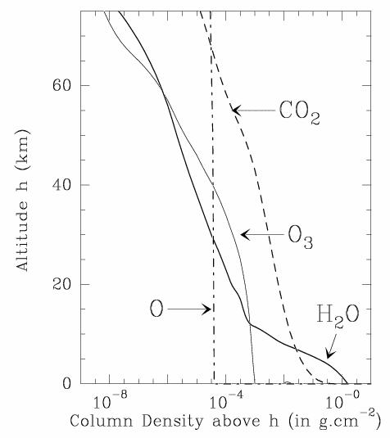
Constituents of Atmospheric Opacity
Due to the troposphere (lowest layer of atmosphere): h < 10 km
Temperature  with  altitude: clouds & convection can be significant
Dry Constituents of the troposphere:, O₂, O₃, CO₂, Ne, He, Ar, Kr, CH₄, N₂, H₂
H₂O: abundance is highly variable but is < 1% in mass, mostly in the form of water vapor
“Hydrosols” (water droplets in clouds and fog) also add a considerable contribution when present
Column Density as a Function of Altitude
Stratosphere
Troposphere

Slide 4
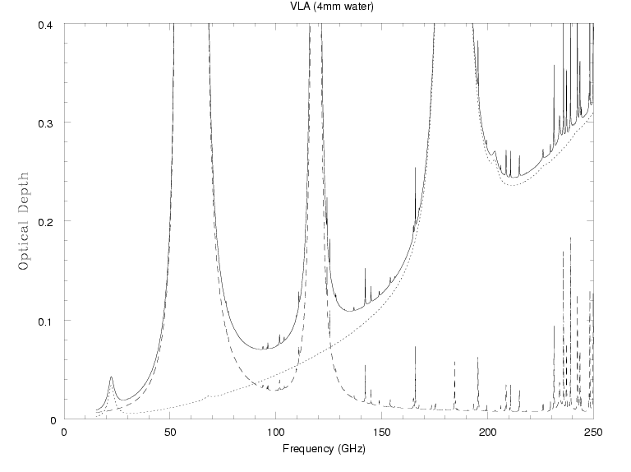
Optical Depth as a Function of Frequency
At 1.3cm most opacity comes from H₂O vapor
At 7mm biggest contribution from dry constituents
At 3mm both components are significant
“hydrosols” i.e. water droplets (not shown) can also add significantly to the opacity
total optical depth
Opacity
optical depth due to H₂O vapor
optical depth due to dry air
22 GHz
1.3cm
K band
43 GHz
7mm
Q band
100 GHz
3mm
MUSTANG
ALMA
Notes:
Dry air = O₂ and other trace gases

Slide 5
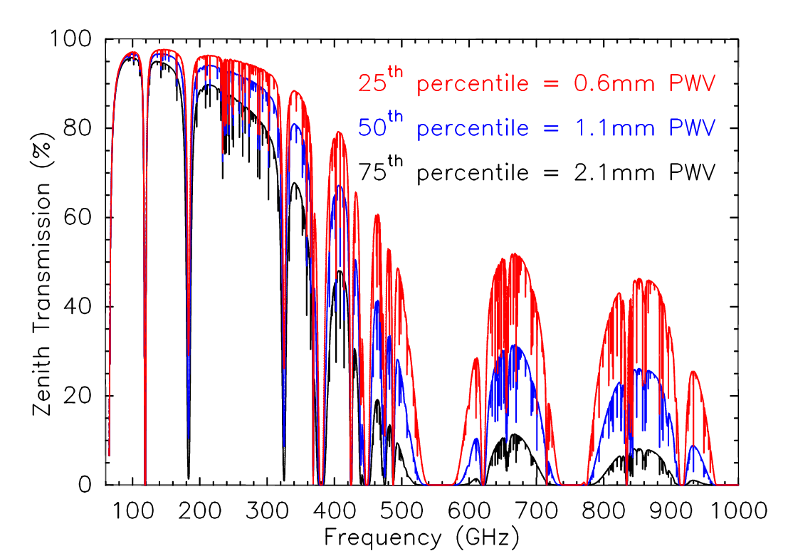
Atmospheric Opacity at ALMA (PWV = Precipitable Water Vapor)
O₃
O₂
H₂O
H₂O
H₂O
H₂O

Slide 6
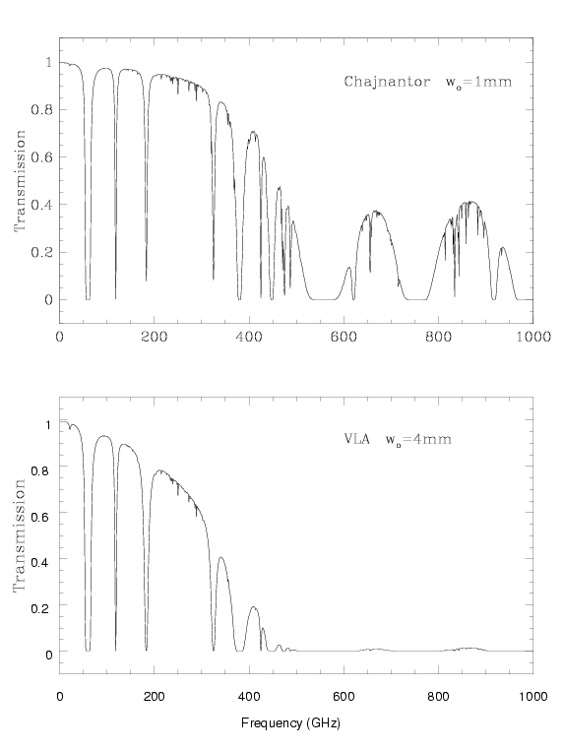
Tropospheric Opacity Depends on Altitude:
Altitude: 5000 m
Models of atmospheric transmission from 0 to 1000 GHz for the ALMA site in Chile, and for the VLA site in New Mexico
The difference is due primarily to the scale height of water vapor, not the “dryness” of the site.
⇒ Atmosphere transmission not a problem for λ > cm (most VLA bands)
ALMA PWV= 1mm
O₂ H₂O
Altitude: 2150 m
EVLA PWV= 4mm
PWV = depth of H₂O if converted to liquid

Slide 7
Mean Effect of Atmosphere on Phase
Since the refractive index of the atmosphere ≠1, an electromagnetic wave propagating through it will experience a phase change (i.e. Snell’s law)
The phase change is related to the refractive index of the air, n, and the distance traveled, D, by
φ_{e} = (2π/λ) × n × D
For water vapor n ∝ w
DT_{atm}
so φ_{e} ≈ 12.6π × w for T_{atm} = 270 K
λ
w=precipitable water vapor (PWV) column
T_{atm} = Temperature of atmosphere
This refraction causes:
- Pointing off-sets, Δθ ≈ 2.5x10⁻⁴ x tan(i) (radians)
@ elevation 45º typical offset~1’
- Delay (time of arrival) off-sets
These “mean” errors are generally removed by the online system

Slide 8
Sensitivity: System noise temperature
In addition to receiver noise, at millimeter wavelengths the atmosphere has a significant brightness temperature (T_{sky}):
T_{noise} ≈ T_{rx} + T_{sky}
where T_{sky} =T_{atm} (1 – e^{−τ}) + T_{bg}e^{−τ}
T_{atm} = temperature of the atmosphere ≈ 300 K
T_{bg} = 3 K cosmic background
For a perfect antenna, ignoring spillover and efficiencies
so T_{noise} ≈ T_{rx} +T_{atm}(1-e^{−τ})
Receiver temperature
Emission from atmosphere
Before entering atmosphere the source signal S= T_{source}
After attenuation by atmosphere the signal becomes S=T_{source} e^{-τ}
  Consider the signal-to-noise ratio:
  S / N = (T_{source} e^{-τ}) / T_{noise} = T_{source} / (T_{noise} e^{τ})
  T_{sys} = T_{noise} e^{τ} ≈ T_{atm}(e^{τ} −1) + T_{rx}e^{τ}
  ⇨The system sensitivity drops rapidly (exponentially) as opacity increases

Slide 9
Impact of Atmospheric Noise
Assuming T_{atm} = 300 K, elevation=40 degrees, ignoring antenna efficiencies
  T_{sys} ≈ T_{atm}(e^{τ} −1) + T_{rx}e^{τ}
JVLA Qband (43 GHz)
typical winter PWV = 5 mm ➔ τ_{zenith}=0.074 ➔ τ₄₀= 0.115
typical Trx=35 K
Tsys = 76 K
ALMA Band 6 (230 GHz)
typical PWV = 1.8 mm ➔ τ_{zenith}=0.096 ➔ τ₄₀= 0.149
typical Trx=50 K
Tsys= 106 K
ALMA Band 9 (690 GHz)
typical PWV = 0.7 mm ➔ τ_{zenith}=0.87 ➔ τ₄₀= 1.35
typical Trx= 150 K
Tsys= 1435 K

Slide 10
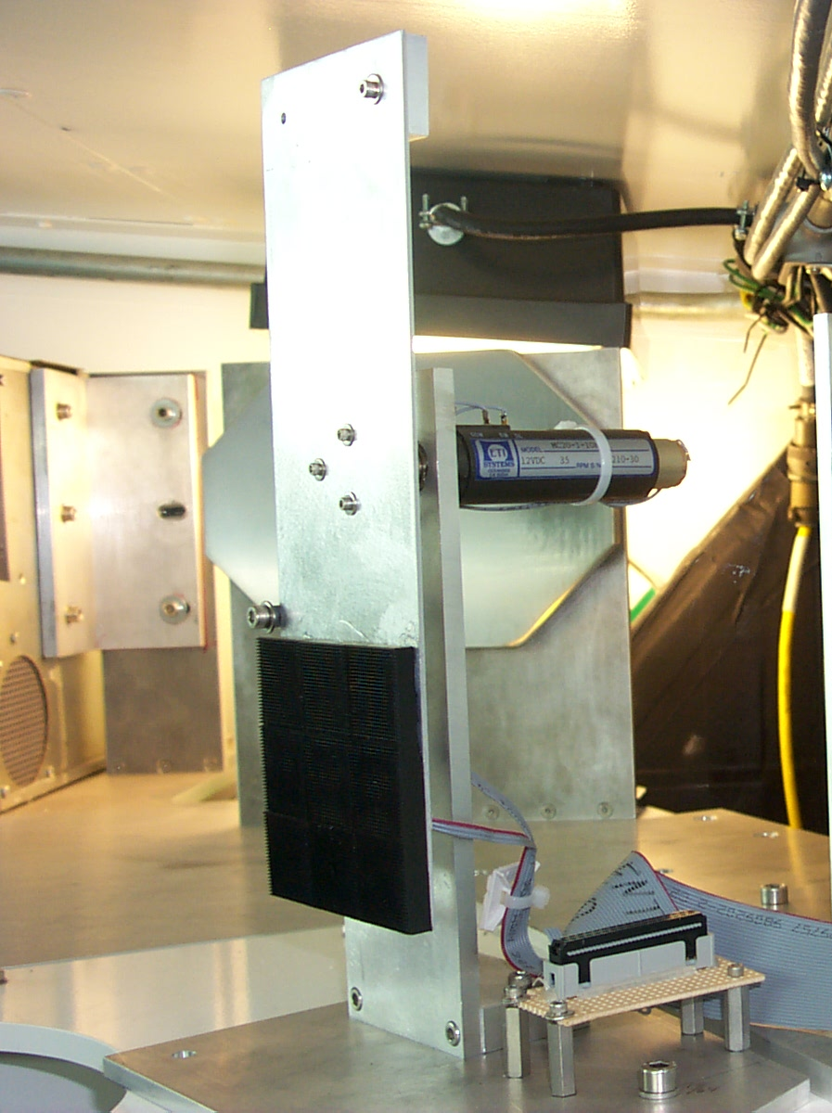
Measurement of T_{sys} in the Sub(millimeter)
How do we measure T_{sys} = T_{atm}(e^{τ} −1) + T_{rx}e^{τ} without constantly measuring T_{rx} and the opacity?
The “chopper wheel” method: putting an ambient temperature load (T_{load}) in front of the receiver and measuring the resulting power compared to power when observing sky T_{atm} (Penzias & Burrus 1973).
V_{in} =G T_{in} = G [T_{rx} + T_{load}]
V_{out} = G T_{out} = G [T_{rx} + T_{atm}(1-e^{−τ}) + T_{bg}e^{−τ} + T_{source}e^{−τ} ]
Load in
Load out
assume T_{atm} ≈ T_{load}
Comparing in and out
V_{in} – V_{out} T_{load}
V_{out} T_{sys}
=
T_{sys} = T_{load} * T_{out} / (T_{in} – T_{out})
Power is really observed but is ∝ T in the R-J limit
SMA calibration load swings in and out of beam
IF T_{atm} ≈ T_{load}, and T_{sys} is measured often, changes in mean atmospheric absorption are corrected. ALMA has a two temperature load system which allows independent measure of T_{rx}

Slide 11
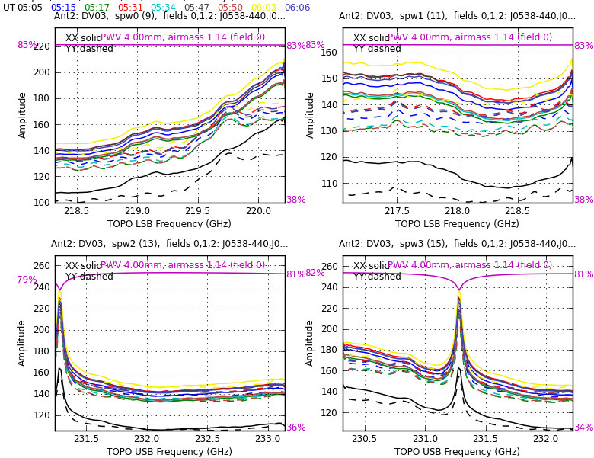
ALMA Spectral Tsys: DV03 Band 6 (230 GHz)

Slide 12
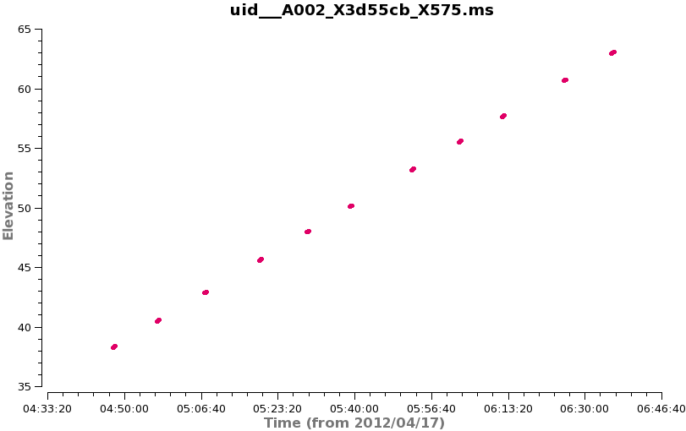
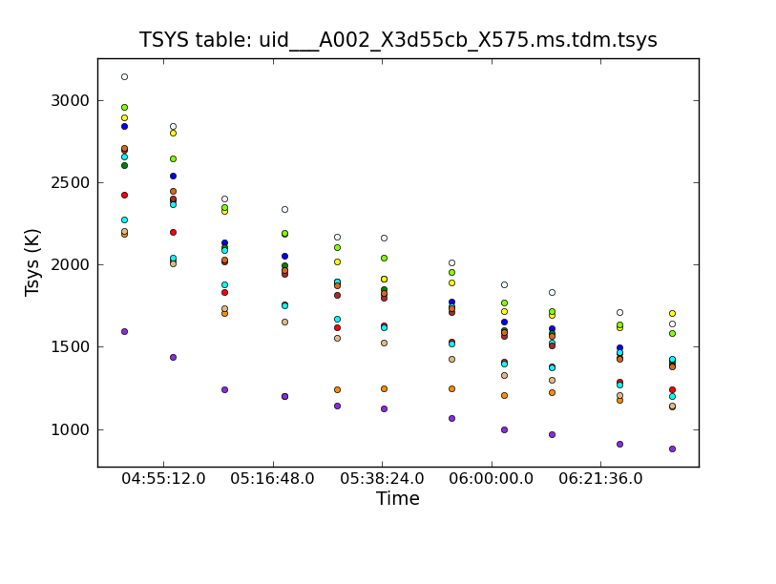
ALMA System Temperature: Example-1
Elevation vs. Time
ALMA Band 9 Test Data on the quasar NRAO530
Notice:
Inverse relationship between elevation and Tsys
Large variation of Tsys among the antennas
Tsys vs. Time (all antennas)

Slide 13
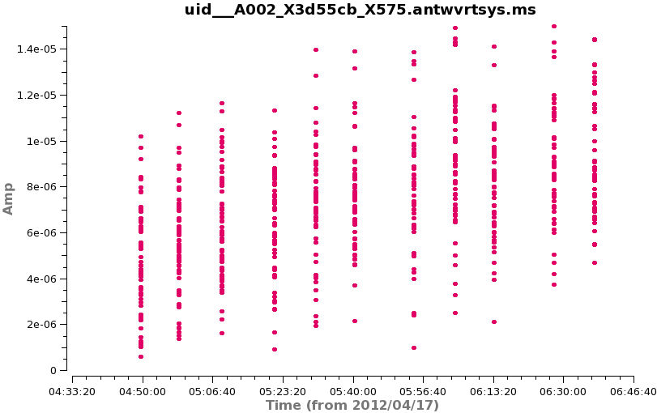
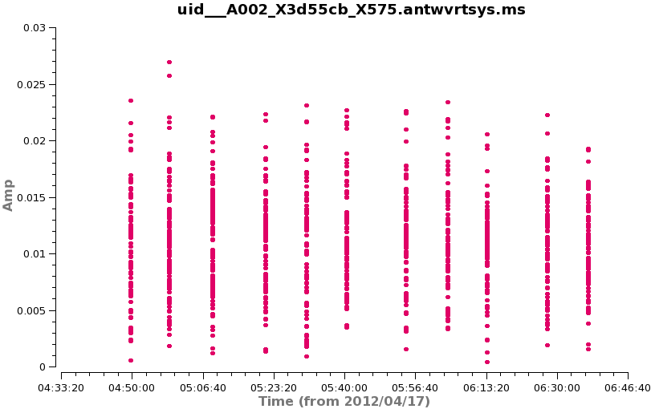
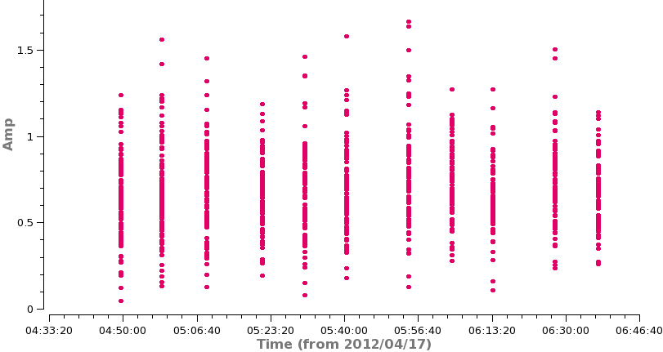
ALMA System Temperature: Example-2
Raw Amplitude vs. Time
Tsys vs. Time (all antennas)
Amplitude Corrected for Tsys
Fully Calibrated using flux reference
S_{final} ~ S_{Tsys} * Antenna Efficiency Factor (about 40 Jy/K for ALMA)

Slide 14
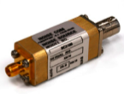
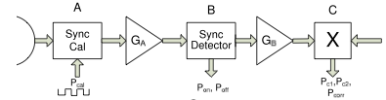
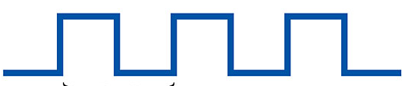
JVLA Switched Power
Alternative to a mechanical load system is a switched “calibration diode”
Broad band, stable noise (Tcal~3K) is injected into receiver at ~20 Hz
Synchronous detector downstream of gives sum & difference powers
Advantages
Removes all gain variations due to the analog electronics between A and B
Puts data on absolute temperature scale
Caveats:
Does not account for opacity effects
Does not account for antenna gain curve

Slide 15
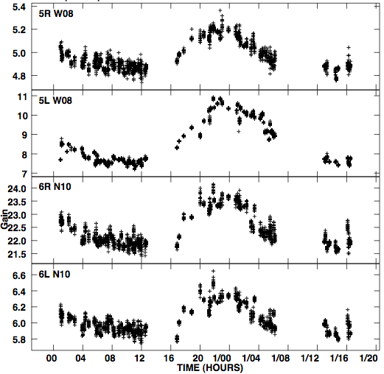
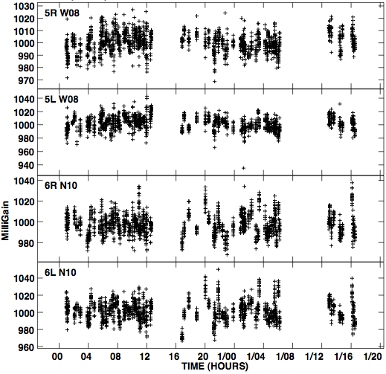
JVLA Switched Power Example
Antenna Gain as a function of time
Gain solutions from calibrator-based calibration; all the sources are strong calibrators
This is what you get if you apply switched power first, large variations with time are removed
A science source will have similar (large) gain variations with time, and only if you switch frequently to a strong calibrator for gain solutions can you TRY to take out these variations.
This calibration takes out electronic but not ionospheric or tropospheric gain variations. The latter would still need to be taken out by calibrator (or other calibration) observations.

Slide 16
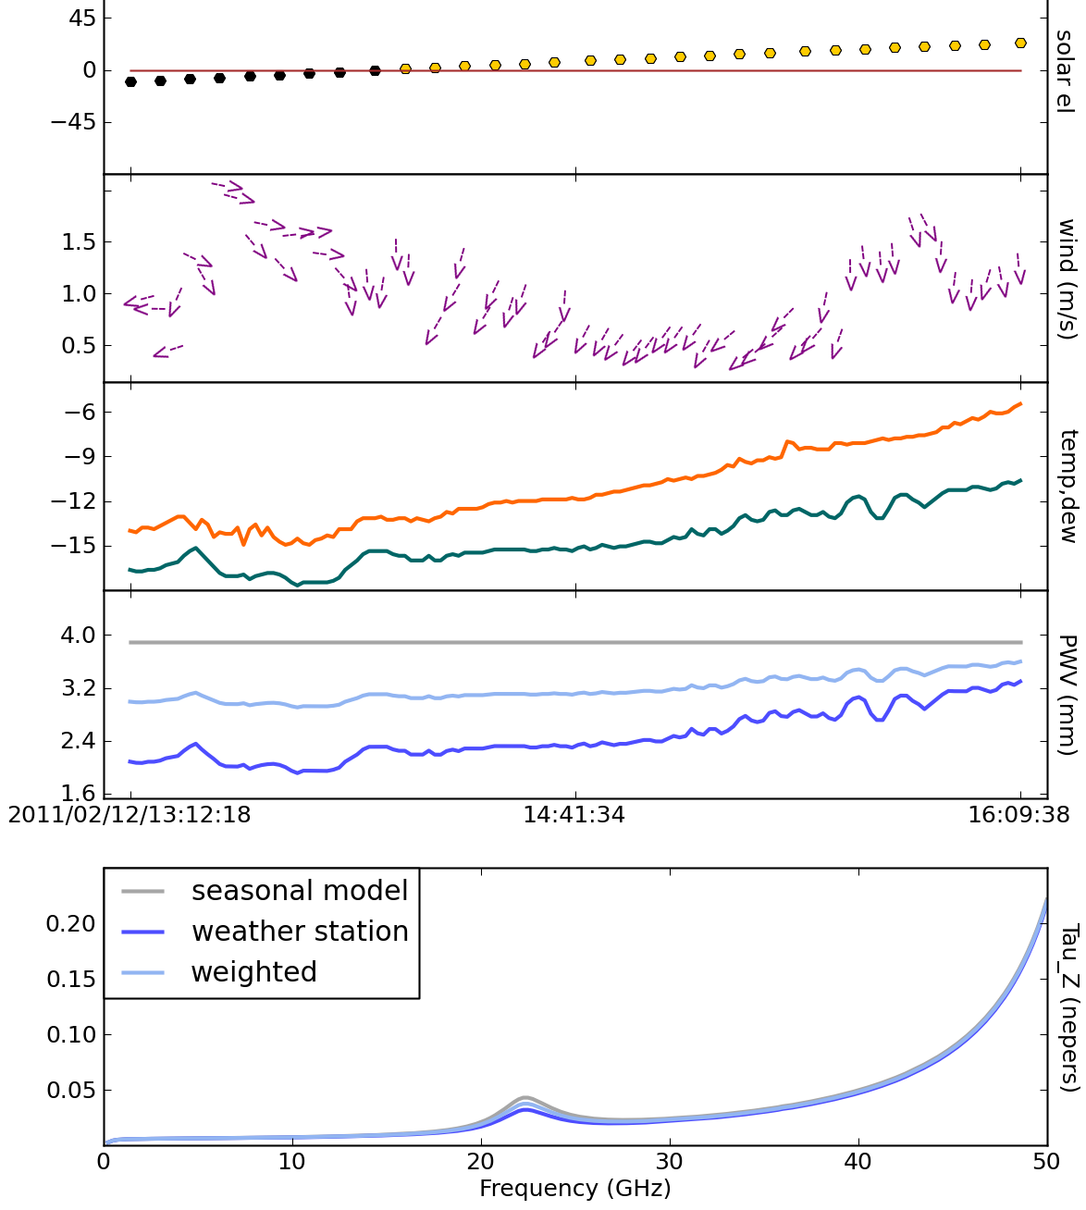
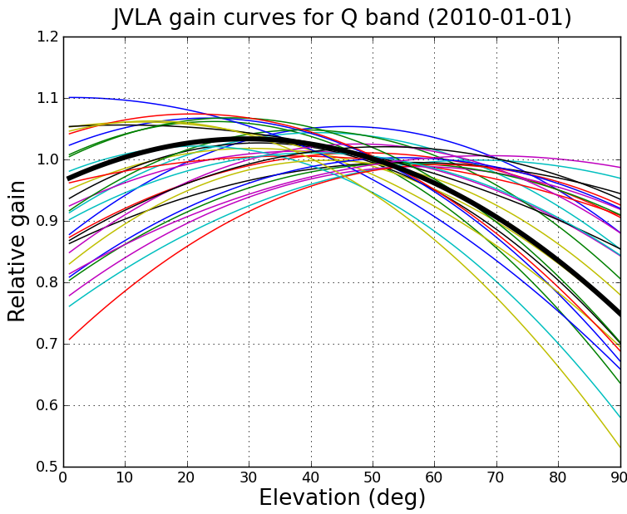
JVLA Atmospheric Correction
At higher frequencies still need to account for atmospheric opacity and antenna gain variations with elevation (i.e. antenna gain curves)
plotweather task available in CASA3.4
Hopefully in the future a “tipper” that directly monitors the atmospheric opacity will provide more accurate estimates
Optical depth at zenith

Slide 17
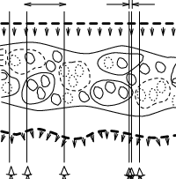
Atmospheric phase fluctuations
Variations in the amount of precipitable water vapor (PWV) cause phase fluctuations, which are worse at shorter wavelengths (higher frequencies), and result in:
  Low coherence (loss of sensitivity)
  Radio “seeing”, typically 0.1-1″ at 1 mm
  Anomalous pointing offsets
  Anomalous delay offsets
You can observe in apparently excellent submm weather (in terms of transparency) and still have terrible “seeing” i.e. phase stability.
Patches of air with different water vapor content (and hence index of refraction) affect the incoming wave front differently.

Slide 18
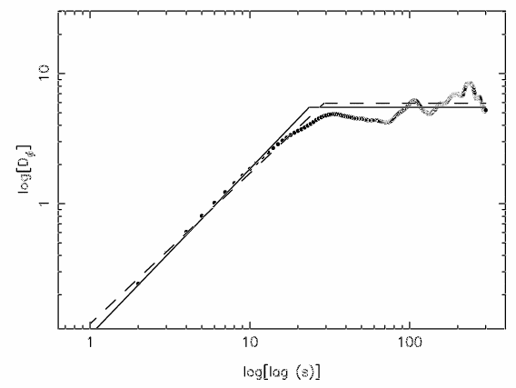
Atmospheric phase fluctuations, continued…
Phase noise as function of baseline length
“Root phase structure function” (Butler & Desai 1999)
RMS phase fluctuations grow as a function of increasing baseline length until break when baseline length ≈ thickness of turbulent layer
The position of the break and the maximum noise are weather and wavelength dependent
log (RMS Phase Variations)
Break
Log (Baseline Length)
RMS phase of fluctuations given by Kolmogorov turbulence theory
φ_{rms} = K b^{α} / λ [deg]
  b = baseline length (km)
    = 1/3 to 5/6 (thin atmosphere vs. thick atmosphere)
    = wavelength (mm)
K = constant (~100 for ALMA, 300 for JVLA)

Slide 19
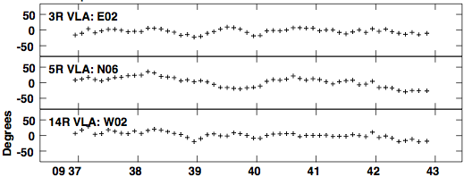
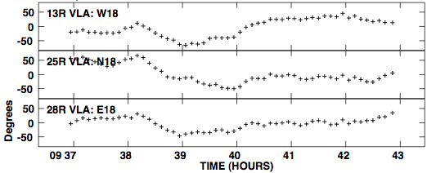
Residual Phase and Decorrelation
Q-band (7mm) VLA C-config. data from “good” day
An average phase has been removed from absolute flux calibrator 3C286
Coherence = (vector average/true visibility amplitude) = ⟨V⟩/ V₀
Where, V = V₀e^{iφ}
The effect of phase noise, φ_{rms}, on the measured visibility amplitude :
⟨V⟩ = V₀ × ⟨e^{iφ}⟩ = V₀ × e^{−φ2rms/2} (Gaussian phase fluctuations)
Example: if φ_{rms} = 1 radian (~60 deg), coherence = ⟨V⟩ = 0.60V₀
Short baseline
Long baseline
For these data, the residual rms phase (5-20 degrees) from applying an average phase solution produces a 7% error in the flux scale
(minutes)
Residual phase on long baselines have larger excursions, than short baselines

Slide 20
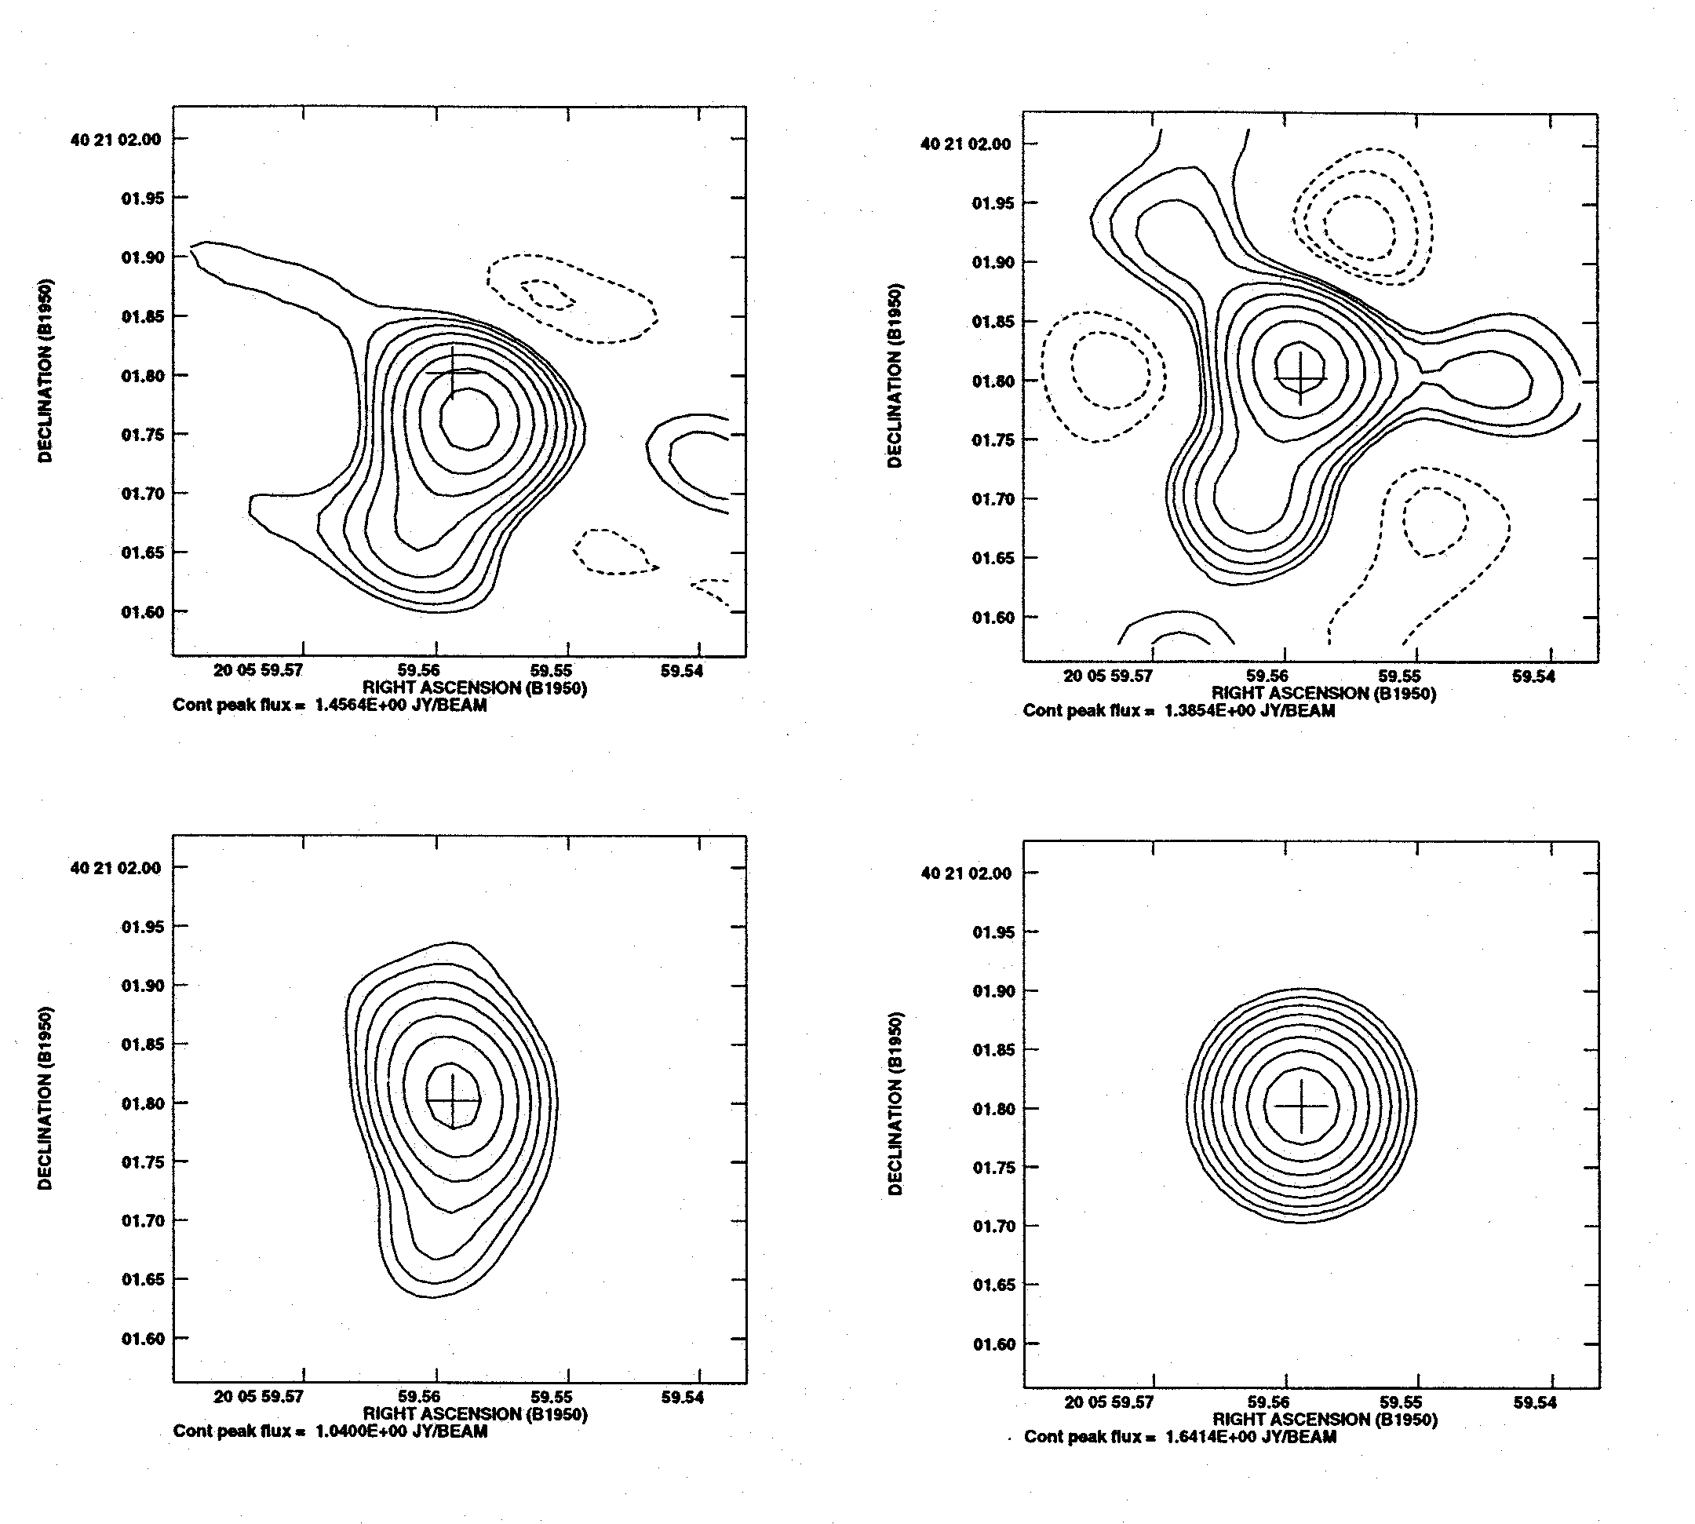
22 GHz VLA observations of the calibrator 2007+404
resolution of 0.1” (Max baseline 30 km)
one-minute snapshots at t = 0 and t = 59 minutes
Sidelobe pattern shows signature of antenna based phase errors ⇨ small scale variations that are uncorrelated
Position offsets due to large scale structures that are correlated ⇨ phase gradient across array
Corrections 30min:
Corrections 30sec:
All data: Reduction in peak flux (decorrelation) and smearing due to phase fluctuations over 60 min
No sign of phase fluctuations with timescale ~ 30 s
Uncorrelated phase variations degrades and decorrelates image ⇨ Correlated phase offsets = position shift

Slide 21
Phase Correction

Slide 22
Phase fluctuation correction methods
Fast switching: An Observing strategy - used at the EVLA for high frequencies and will be used at ALMA. Choose fast switching cycle time, t_{cyc}, short enough to reduce Φ_{rms} to an acceptable level. Calibrate in the normal way.
Self-calibration: Good for bright sources that can be detected in a few seconds.
Radiometer: Monitor phase (via path length) with special dedicated receivers
Phase transfer: simultaneously observe low and high frequencies, and transfer scaled phase solutions from low to high frequency. Can be tricky, requires well characterized system due to differing electronics at the frequencies of interest.
Paired array calibration: divide array into two separate arrays, one for observing the source, and another for observing a nearby calibrator.
  Will not remove fluctuations caused by electronic phase noise
  Can only work for arrays with large numbers of antennas (e.g., CARMA, JVLA, ALMA)

Slide 23
Self-Calibration: Motivation
JVLA and ALMA have impressive sensitivity!
Many objects will have enough Signal-to-Noise (S/N) so they can be used to better calibrate themselves to obtain a more accurate image. This is called self-calibration and it really works, if you are careful! Sometimes, the increase in effective sensitivity may be an order of magnitude.
It is not a circular trick to produce the image that you want. It works because the number of baselines is much larger than the number of antennas so that an approximate source image does not stop you from determining a better temporal gain calibration which leads to a better source image.
Self-cal may not be included in the data pipelines. SO, YOU SHOULD LEARN HOW TO DO IT.

Slide 24
Data Corruption Types
The true visibility is corrupted by many effects:
  Atmospheric attenuation
  Radio “seeing”
  Variable pointing offsets
  Variable delay offsets
  Electronic gain changes
  Electronic delay changes
  Electronic phase changes
  Radiometer noise
  Correlator mal-functions
  Most Interference signals
| Antenna-based | baseline

Slide 25
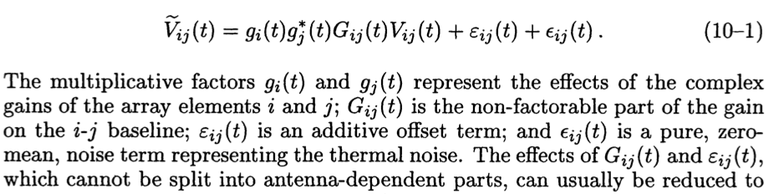

Antenna-based Calibration- I
The most important corruptions are associated with antennas
Basic Calibration Equation
Factorable (antenna-based) complex gains
Non-factorable complex gains (not Antenna based)
True Visibility
Additive offset (not antenna based) and thermal noise, respectively
Can typically be reduced to approximately

Slide 26
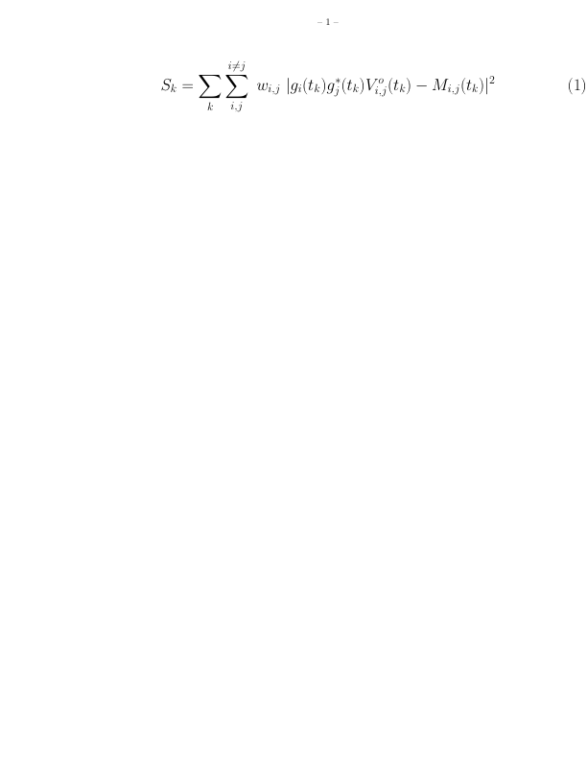
Antenna-based Calibration-II
For N antennas, [(N-1)*N]/2 visibilities are measured, but only N amplitude and (N-1) phase gains fully describe the complete calibration. This redundancy is used for antenna gain calibration
Basic gain (phase and amplitude) calibration involves observing unresolved (point like) “calibrators” of known position with visibility M_{i,j} (t_{k,} ν)
Determine gain corrections, g_{i}, that minimizes S_{k} for each time stamp t_{k} where
The solution interval, t_{k}, is the data averaging time used to obtain the values of g_{i}, typically [solint=‘int’ or ‘inf’] The apriori weight of each data point is w_{i,j}.
This IS a form of Self-calibration, only we assume a Model (Mij) that has constant amplitude and zero phase, i.e. a point source
The transfer of these solutions to another position on the sky at a different time (i.e. your science target) will be imperfect, but the same redundancy can be used with a model image for Self-calibration

Slide 27
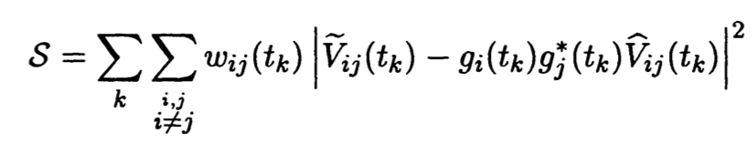
Self-Calibration Equation
The clean model from making an image can be compared to the data, and differential gains can be found that minimize the differences
Data Weights
Complex Visibilities
Fourier transform of model image
Complex Gains
is the corrected visibility data after normal gain calibration
Are the new complex gain corrections you are looking for

Slide 28
Sensitivities for Self-Calibration-I
For phase only self-cal: Need to detect the target in a solution time (solint) < the time for significant phase variations with only the baselines to a single antenna with a S/N_{self} > 3. For 25 antennas, S/N_{Self} > 3 will lead to < 15 deg error.
Make an initial image, cleaning it conservatively
  Measure rms in emission free region
  rms_{Ant} = rms x sqrt(N-3) where N is # of antennas
  rms_{self} = rms_{Ant} x sqrt(total time/solint)
  Measure peak flux density = Signal
  If S/N_{self} = Peak/rms_{Self} >3 try phase only self-cal
Rule of thumb:
If S/N in image >20 you can usually self-cal
CAVEAT: If dominated by extended emission, estimate what the flux will be on the longer baselines (by plotting the uv-data) instead of the image
  If the majority of the baselines in the array cannot "see" the majority of emission in the target field (i.e. emission is resolved out) at a S/N of about 3, the self-cal will fail in extreme cases (though bootstrapping from short to longer baselines is possible it can be tricky).
CAVEAT: If severely dynamic range limited (poor uv-coverage), it can also be helpful to estimate the rms noise from uv-plots

Slide 29
Sensitivities for Self-Calibration-II
For amplitude self-cal: Need to detect the target with only the baselines to a single antenna with a S/N > 10, in a solution time (solint) < the time for significant amplitude variations. For 25 antennas, an antenna based S/N > 10 will lead to a 10% amplitude error.
  If clean model is missing significant flux compared to uv-data, give uvrange for amplitude solution that excludes short baselines
Additional S/N can be obtained by:
Increase solint (solution interval)
gaintype= ‘T’ to average polarizations
  Caveat 1: Only if your source is unpolarized
Combine = ‘spw’ to average spw’s
  Caveat 1: if your observing frequency / bandwidth ratio is < 10 so that changes in source morphology are seen across the band, do not combine spws for any self-cal
  Caveat 2: if your source spectral index changes significantly across the band, do not combine spws for amplitude self-cal
Combine = ‘fields’ to average fields in a mosaic (use with caution)

Slide 30
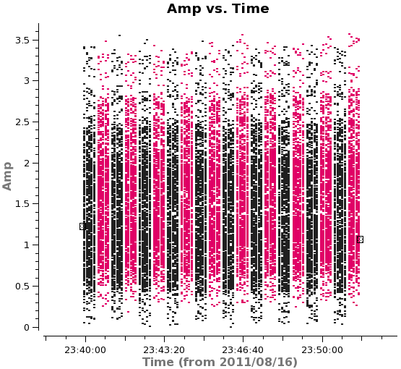
Self-calibration Example:
ALMA SV Data for IRAS16293 Band 6 (Ia)
Step 1 – Determine basic setup of data:
2 pointing mosaic
Integration = 6.048 sec; subscans ~ 30sec
Scan= 11min 30s (split between two fields)
Step 2 – What is the expected rms noise?
Use actual final total time and # of antennas on science target(s) from this stage and sensitivity calculator.
Be sure to include the actual average weather conditions for the observations in question and the bandwidth you plan to make the image from
54 min per field with 16 antennas and average Tsys ~ 80 K, 9.67 MHz BW; rms= 1 mJy/beam
Inner part of mosaic will be about 1.6 x better
ALMA mosaic: alternates fields in “subscan” this picture = 1 scan
EVLA mosaic: alternates fields in scans
Subscans are transparent to CASA (and AIPS)

Slide 31
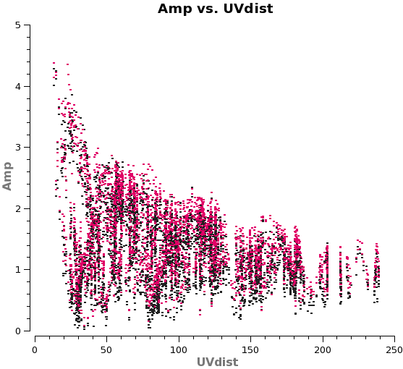
Self-calibration Example:
ALMA SV Data for IRAS16293 Band 6 (Ib)
Step 3 – What does the amplitude vs uv-distance of your source look like?
  Does it have large scale structure? i.e. increasing flux on short baselines.
  What is the flux density on short baselines?
  Keep this 4 Jy peak in mind while cleaning. What is the total cleaned flux you are achieving?

Slide 32
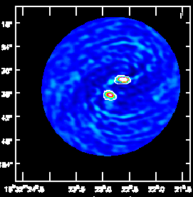
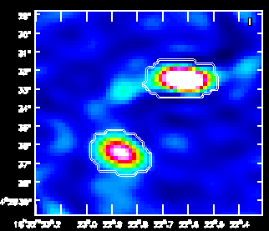
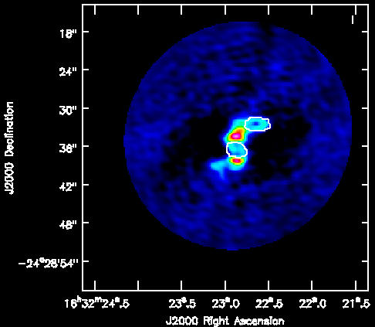
Self-calibration Example:
ALMA SV Data for IRAS16293 Band 6 (II)
Step 3 – What is the S/N in a conservatively cleaned image?
What is this “conservative” of which you speak
Rms~ 15 mJy/beam; Peak ~ 1 Jy/beam ➔ S/N ~ 67
Rms > expected and S/N > 20 ➔ self-cal!
Stop clean, and get rms and peak from image, avoiding negative bowls and emission
Clean boxes only around emission you are SURE are real at this stage
Residual after 200 iterations

Slide 33
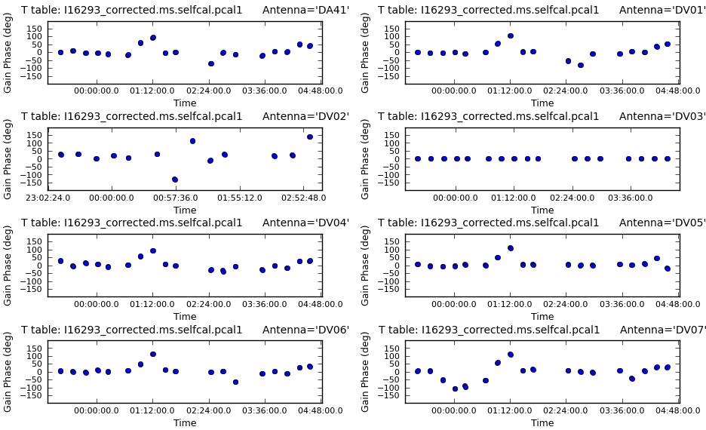
Self-calibration Example:
ALMA SV Data for IRAS16293 Band 6 (III)
Step 4: Decide on an time interval for initial phase-only self-cal
A good choice is often the scan length (in this case about 5 minutes per field)
  Exercise for reader: from page 27 show that S/N_{self} ~ 5.4
In CASA you can just set solint=‘inf’ (i.e. infinity) and as long as combine ≠ ‘scan’ AND ≠ ‘field’ you will get one solution per scan, per field.
Use ‘T’ solution to combine polarizations
What to look for:
Lot of failed solutions on most antennas? if so, go back and try to increase S/N of solution = more averaging of some kind
Do the phases appear smoothly varying with time (as opposed to noise like)

Slide 34
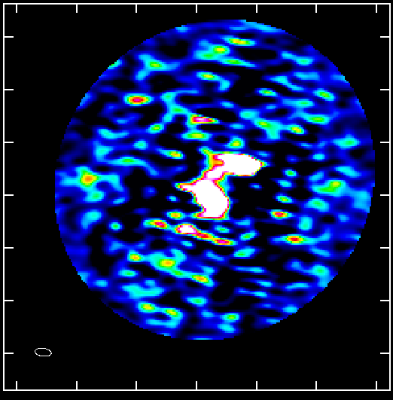
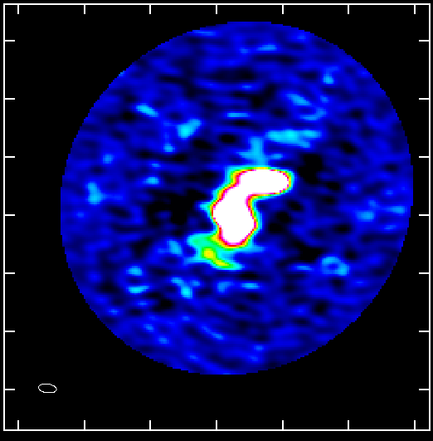
Self-calibration Example:
ALMA SV Data for IRAS16293 Band 6 (IV)
Step 5: Apply solutions and re-clean
Incorporate more emission into clean box if it looks real
Stop when residuals become noise-like but still be a bit conservative, ESPESCIALLY for weak features that you are very interested in
  You cannot get rid of real emission by not boxing it
  You can create features by boxing noise
Original
Step 6: Compare Original clean image with 1st phase-only self-cal image
Original:
Rms~ 15 mJy/beam; Peak ~ 1 Jy/beam ➔ S/N ~ 67
1st phase-only:
Rms~ 6 mJy/beam; Peak ~ 1.25 Jy/beam ➔ S/N ~ 208
Did it improve? If, yes, continue. If no, something has gone wrong or you need a shorter solint to make a difference, go back to Step 4 or stop.
1st phase cal

Slide 35
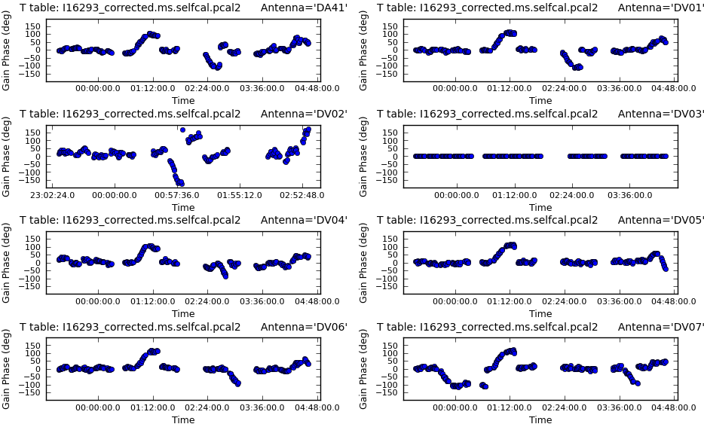
Self-calibration Example:
ALMA SV Data for IRAS16293 Band 6 (V)
Step 5:Try shorter solint for 2nd phase-only self-cal
In this case we’ll try the subscan length of 30sec
It is best NOT to apply the 1st self-cal while solving for the 2nd. i.e. incremental tables can be easier to interpret but you can also “build in” errors in first model by doing this
What to look for:
Still smoothly varying?
If this looks noisy, go back and stick with longer solint solution
IF this improves things a lot, could try going to even shorter solint

Slide 36

Self-calibration Example:
ALMA SV Data for IRAS16293 Band 6 (VI)
Step 6: Apply solutions and re-clean
Incorporate more emission into clean box if it looks real
Stop when residuals become noise-like but still be a bit conservative, ESPECIALLY for weak features that you are very interested in
  You cannot get rid of real emission by not boxing it
  You can create features by boxing noise
1st phase cal
Step 7: Compare 1st and 2nd phase-only self-cal images
1st phase-only:
Rms~ 6 mJy/beam; Peak ~ 1.25 Jy/beam ➔ S/N ~ 208
2nd phase-only:
Rms~ 5.6 mJy/beam; Peak ~ 1.30 Jy/beam ➔ S/N ~ 228
Did it improve? Not much, so going to shorter solint probably won’t either, so we’ll try an amplitude self-cal next
2nd phase cal

Slide 37
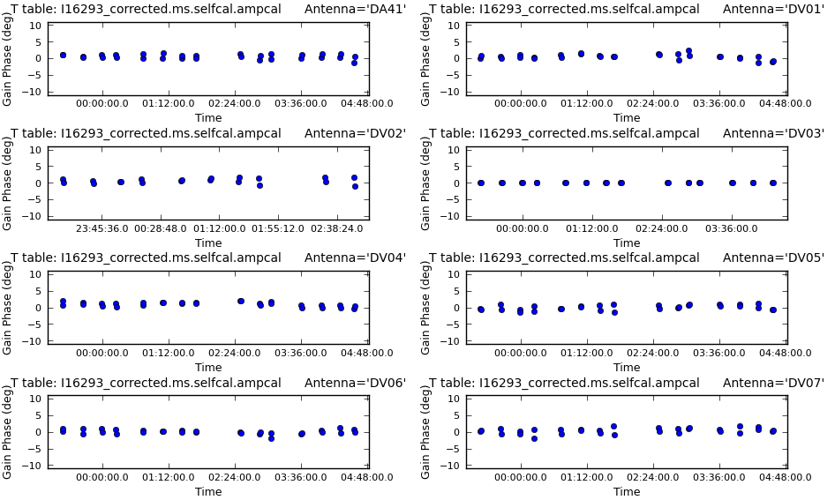
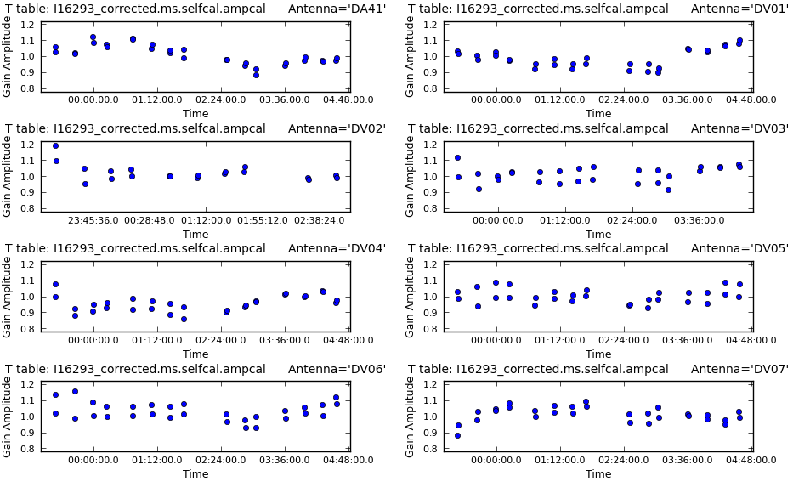
Self-calibration Example:
ALMA SV Data for IRAS16293 Band 6 (VII)
Step 8:Try amplitude self-cal
Amplitude tends to vary more slowly than phase. It’s also less constrained, so solints are typically longer. Lets try two scans worth or 23 minutes
Essential to apply the best phase only self-cal before solving for amplitude. Also a good idea to use mode=‘ap’ rather than just ‘a’ to check that residual phase solutions are close to zero.
Again make sure mostly good solutions, and a smoothly varying pattern.
Residual phase
Scale +/- 10 degrees
Amplitude
Scale 0.8 to 1.0

Slide 38
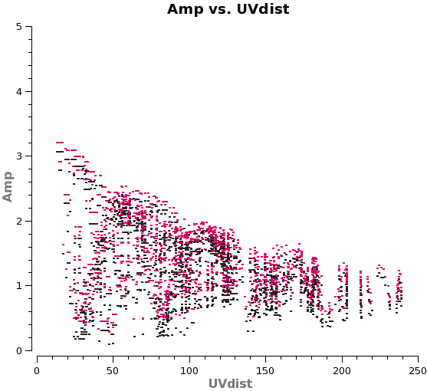
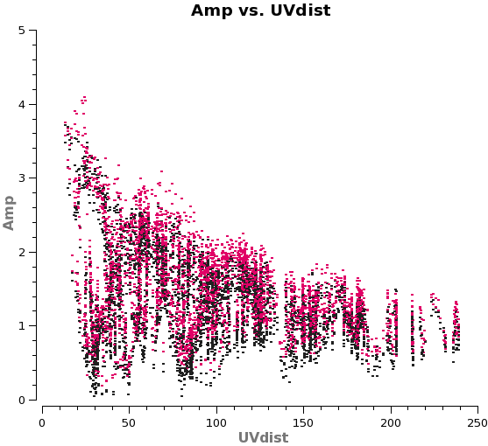
Self-calibration Example:
ALMA SV Data for IRAS16293 Band 6 (VIII)
Step 9: Apply solutions
Apply both 2nd phase and amp cal tables
Inspect uv-plot of corrected data to
  Check for any new outliers, if so flag and go back to Step 9.
  Make sure model is good match to data.
  Confirm that flux hasn’t decreased significantly after applying solutions
Original
Image Model
(total cleaned flux = 3.4 Jy)
Amp & Phase applied

Slide 39

Self-calibration Example:
ALMA SV Data for IRAS16293 Band 6 (IX)
Step 10: Re-clean
Incorporate more emission into clean box
Stop when residuals become noise-like – clean everything you think is real
Step 11: Compare 2nd phase-only and amp+phase self-cal images
2nd phase-only:
Rms~ 5.6 mJy/beam; Peak ~ 1.30 Jy/beam ➔ S/N ~ 228
Amp & Phase:
Rms~4.6 mJy/beam; Peak~1.30 Jy/beam ➔ S/N ~283
Did it improve? ➔ Done!
Original
2nd phase cal
Final: S/N=67 vs 283!
But not as good as theoretical = dynamic range limit
Amp & Phase cal

Slide 40
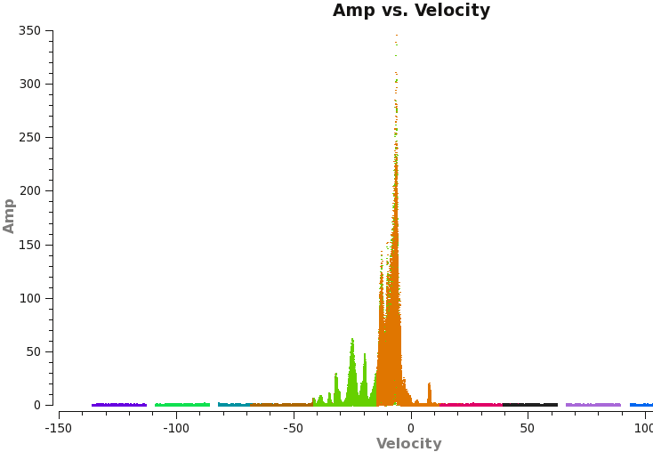
Self-Calibration example 2: JVLA Water Masers (I)
uv-spectrum after standard calibrator-based calibration for bandpass and antenna gains
There are 16 spectral windows, 8 each in two basebands (colors in the plot)
Some colors overlap because the basebands were offset in frequency by ½ the width of an spw in order to get good sensitivity across whole range.
The continuum of this source is weak. How do you self-cal this?
Make an image
  If you want to speed things up, limit the velocity to the region with strong emission in the uv-plot: -20 to 0 km/s in this case.
  Then look at the model data column the same way

Slide 41
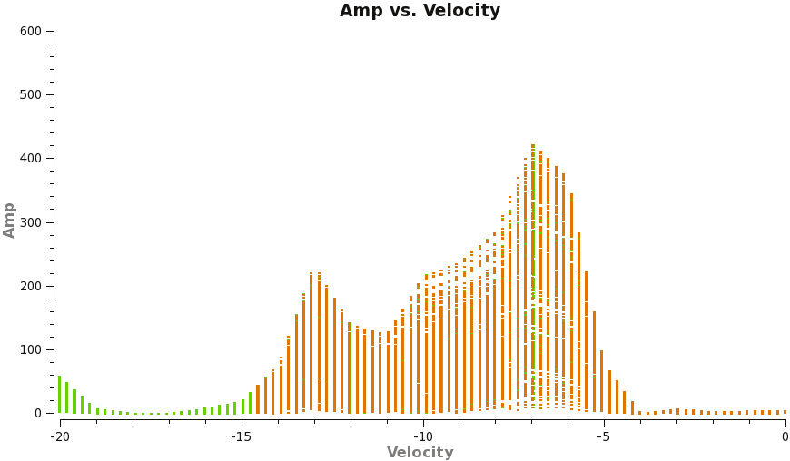
Self-Calibration example 2: JVLA Water Masers (II)
Model from initial clean image, zoomed in to the velocity range imaged: -20 to 0 km/s.
But to calibrate we need to know the SPWs and the CHANNELs with strong emission in the model:
CASA’s plotms with locate can help

Slide 42
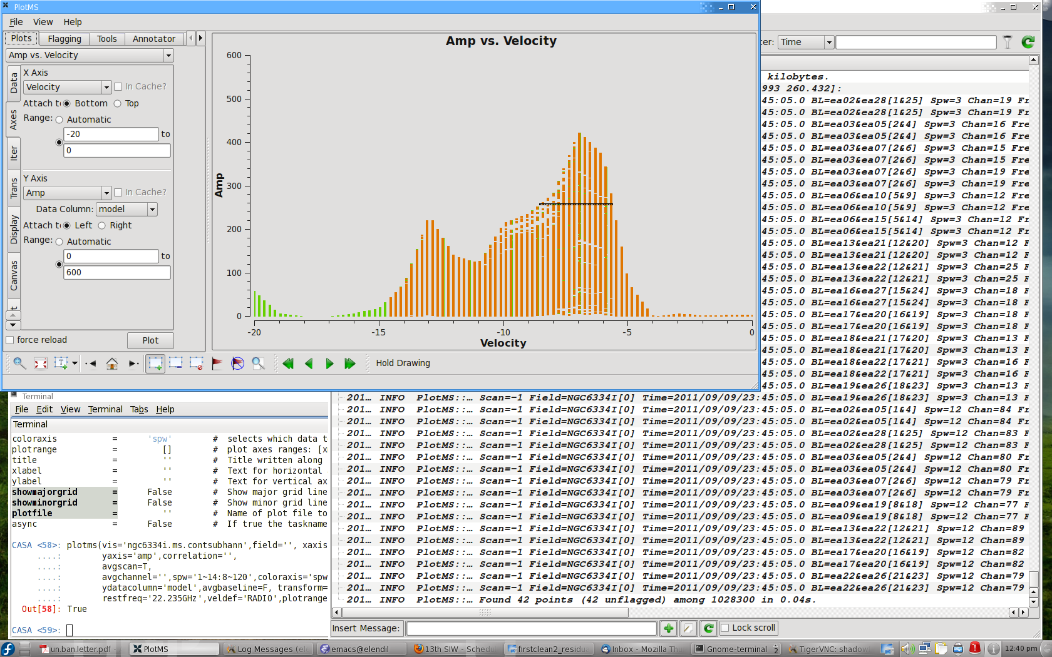
Self-Calibration example 2: JVLA Water Masers (III)

Slide 43
Self-Calibration example 2: JVLA Water Masers (IV)
Model from initial clean image, zoomed in to the velocity range imaged: -20 to 0 km/s.
But to calibrate we need to know the SPWs and the CHANNELs with strong emission in the model:
CASA’s plotms with locate can help
From the locate we find a strong set of channels in
  spw=3 channels 12~22
  spw=12 channels 76~86
We use these channels in the self-calibration.
It is very important not to include channels with no signal in the clean model!

Slide 44
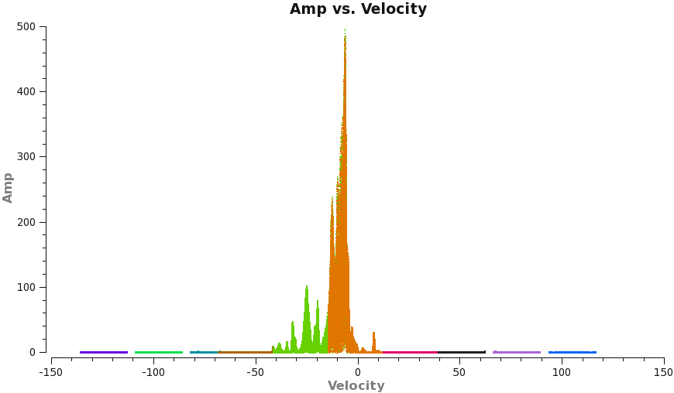
Self-Calibration example 2: JVLA Water Masers (V)
Final self-calibrated spectrum
One remaining trickiness: calibration solutions are only for spw=3 and 12. The spwmap parameter can be used to map calibration from one spectral window to another. There must be an entry for all spws:
  spwmap=[3,3,3,3,3,3,3,3,12,12,12,12,12,12,12,12]
  In other words apply the spw=3 calibration to the 8 spectral windows in the lower baseband and the calibration from spw=12 to the 8 spws in the upper baseband
Beyond this everything is the same as previous example.

Slide 45
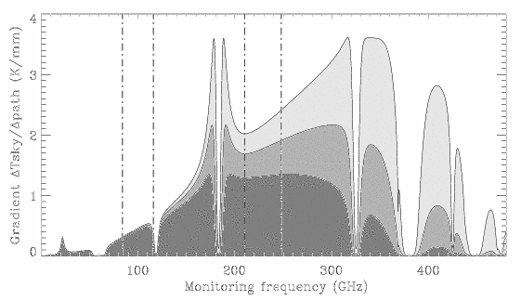
Radiometers:
Radiometry: measure fluctuations in T_{B}^{atm} with a radiometer, use these to derive changes in water vapor column (w) and convert this into a phase correction using
φ_{e} ≈ 12.6π × w
λ
183 GHz
w=precipitable water vapor (PWV) column
22 GHz
(Bremer et al. 1997)
Monitor: 22 GHz H₂O line (CARMA, VLA)
183 GHz H₂O line (CSO-JCMT, SMA, ALMA)
total power (IRAM)

Slide 46
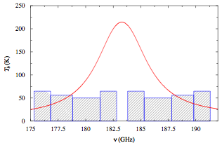
ALMA WVR System
There are 4 “channels” flanking the peak of the 183 GHz water line
Installed on all the 12m antennas
Data taken every second
Matching data from opposite sides are averaged
The four channels allow flexibility for avoiding saturation
Next challenges are to perfect models for relating the WVR data to the correction for the data
  An atmospheric model is used for the dry component
It works pretty well already!

Slide 47
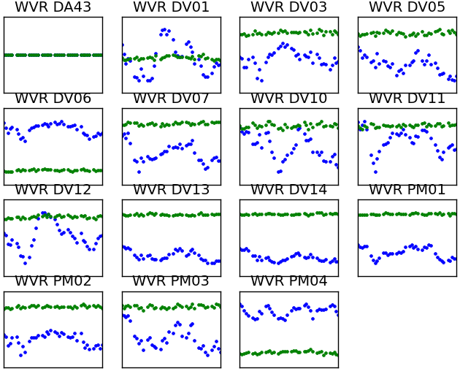
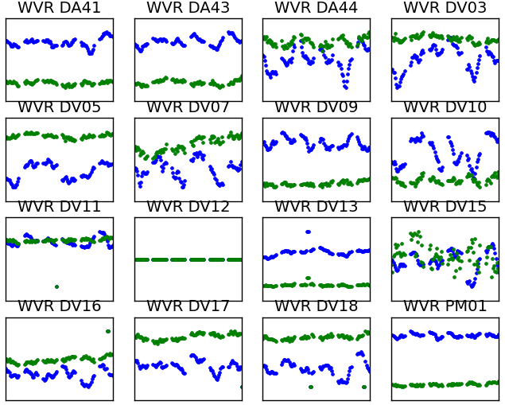
ALMA WVR Correction - Examples
Band 6 (230 GHz) Compact config
Band 7 (340 GHz) Extended config
Raw phase & WVR corrected phase

Slide 48
Absolute Flux Calibrators

Slide 49
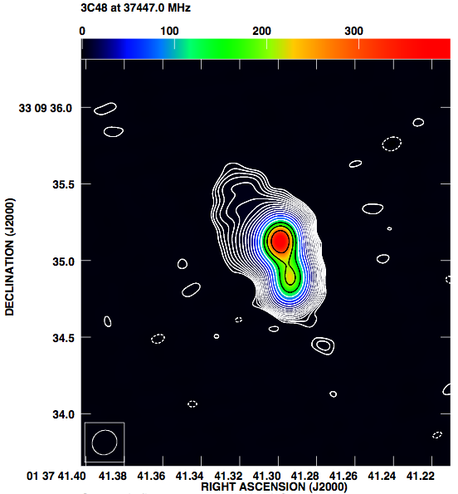
Flux calibrators – JVLA
JVLA Flux Calibrators
3C 48 (0137+331)
3C286 (1331+305)
3C138 (0521+166)
3C147 (0542+498)
Stable brightness and morphology, but are resolved on long baselines
and high frequencies.
An image model must be used

Slide 50
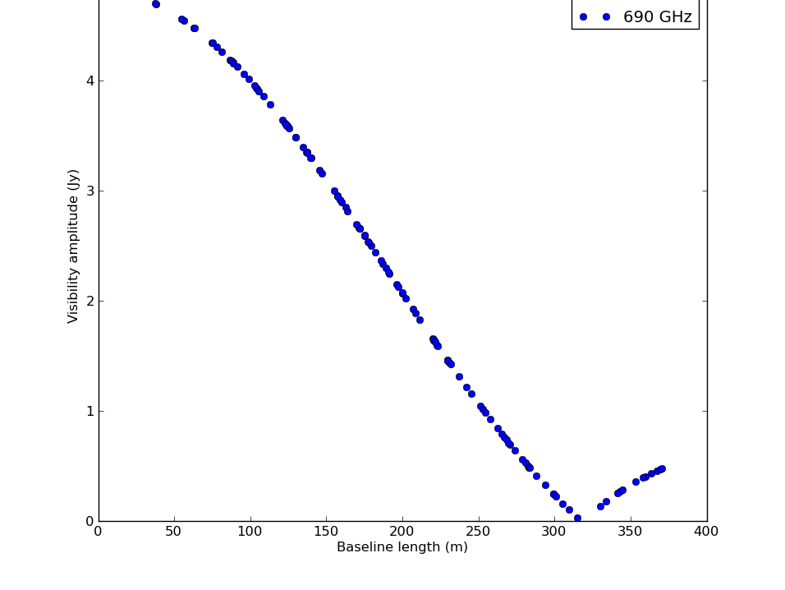
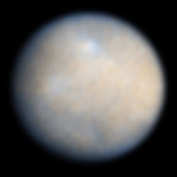


Flux calibrators – ALMA
Quasars are strongly time-variable and good models do not exist at higher frequencies
Solar system bodies are used as primary flux calibrators (Neptune, Jovian moons, Titan, Ceres) but with many challenges:
All are resolved on long ALMA baselines
Brightness varies with distance from Sun and Earth
Line emission (Neptune, Titan)
More asteroids? modeling is needed because they are not round!
Red giant stars may be better
Regular monitoring of a small grid of point-like quasars as secondary flux calibrators.
Ceres
690 GHz
ALMA extended
UV distance
Neptune, 690 GHz
ALMA compact config
UV distance

Slide 51



Next phase - model spectral lines
Example: CO in Titan

Slide 52


Summary
Atmospheric emission can dominate the system temperature
  Calibration through T_{sys} or opacity/gain curves is essential
Tropospheric water vapor causes significant phase fluctuations
  Decorrelation can be severe
  Phase correction techniques are essential: ALMA – WVRs
Self-calibration is not so hard and can make a big difference
  Make sure your model is a good representation of the data
  Make sure the data you put into solver, is a good match to the model
  If you are lacking a little in S/N try one of the “S/N increase techniques”
  If you really don’t have enough S/N don’t keep what you try!
It is essential to use models for most currently available absolute flux density calibrators

Slide 53
Extra Slides

Slide 54
Calibration Sensitivities Effects (N=25)
  d_{Ant} phase error must be smaller than expected instrumental and tropospheric phase error which is often 10-20 deg
  d_{Ant} amp error must be smaller than expected instrumental and
  absorption amplitude errors, usually < 5%
S/N_{Ant} | Amp error | Phase error | S/N _{base} | S/N_{image}
0 | 100% | 180 d | 0 | 0
3 | 33% | 15.0 d | 0.6 | 11.0
5 | 20% | 9.7 d | 1.1 | 18.4
10 | 10% | 5.7 d | 2.1 | 36.9
25 | 4% | 2.3 d | 5.3 | 92.3
100 | 1% | 0.6 d | 21.3 | 370

Slide 55

Fast Switching
The characteristic timescale for the phase variations is the baseline length divided by the wind speed in the turbulent layer of the troposphere. Fast switching phase calibration will stop tropospheric phase fluctuations on baselines longer than an effective baseline length of:
b_{eff}: effective baseline length in km
V_{a}: velocity of the winds aloft in m/s
t_{cyc}: cycle time in seconds
Cycle times shorter than the baseline crossing time of the troposphere (b_{eff}/V_{a}) are needed. For example, substituting into the phase rms Eq on slide 18 with α = 0.7 and Va=10m/s (typical for JVLA site) yields:
K = constant (~100 for ALMA, 300 for VLA)
With this eq. you can dial in the level of acceptable phase rms - note that a 90 degrees phase rms will easily wipe out a source.

Slide 56

Antenna Gain Averaging over Baseline
PLOT: MODEL VISIBILITY AMPLITUDE
VS UV-DIST FOR 2157-694
Small blue dots: The amplitudes for all
105 baselines (N=15).
Big red dots: Visibility amplitudes for an
antenna near the array center
Big yellow dots: visibility amplitudes for
an antenna at the end of the array.
The large-scale and small-scale structure in the source produce the
variations in amplitude with uv-distance. The average of these visibilities
associated with one antenna averages out most of the structure variation
to give a good approximation of that antenna gain.

Slide 57

Determining the T_{rx} and the Temperature Scale
Good receiver systems have a linear response:
V_{out}
Unknown slope
Calibrated ‘load’
Receiver temperature
V_{rx} + V_{hot}
Power detector P ∝ V
Power(ν) ⇨
⇨ Voltage
V_{rx} +V_{cold}
To measure T_{rx}, you need measurements of two calibrated ‘loads’:
T_{cold} = 77 K liquid nitrogen load
T_{hot} = Room temperature load
−T_{rx}
T_{cold}
T_{hot}
T_{input}
Starting from
And letting, the “Y” factor
However, T_{rx} is not a constant, especially for mm/submm receivers which are more difficult to tune to ideal performance ➔ best approach is to measure it often

