Slide 1
A Crash Course in CASA
With a focus on calibration
Amy Kimball
North American ALMA Science Center
Notes:
Some specifics on ALMA data, but largely applicable to CASA use on other telescopes data: JVLA, CARMA, SMA…
Then you’ll do a hands-on tutorial calibrating ALMA data of TW Hydra.

Slide 2
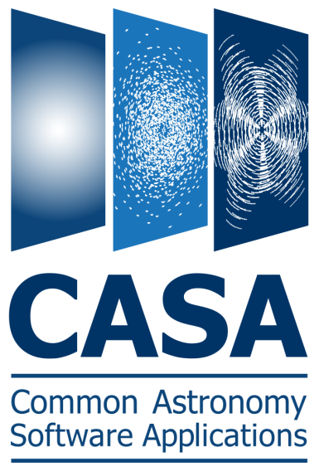
CASA
Common Astronomy Software Applications
The ofﬂine data reduction package for ALMA and EVLA
Handles both interferometric and single-dish ALMA data
Current version: 3.4.0
New releases about every 6 months
  CASA home: http://casa.nrao.edu
  Download, Cookbook, Reference, Example scripts, Mailing lists
Training material on “CASAguides” wiki: http://casaguides.nrao.edu
NRAO helpdesk: http://help.nrao.edu
NRAO user’s forum: https://science.nrao.edu/forums/
Notes:
We’ll be using 3.4. The current official release is 3.3, but 3.4 will be released soon, probably in the next few weeks (packaging issues).
Today we’ll do a shorter version of one of the CASAguides, specially updated for this workshop. There are other guides available.

Slide 3
Outline
CASA interface: Python, tools, and tasks
Structure of CASA data
Basic calibration flow in CASA
Example calibration task: focus on gaincal
ALMA online calibration

Slide 4
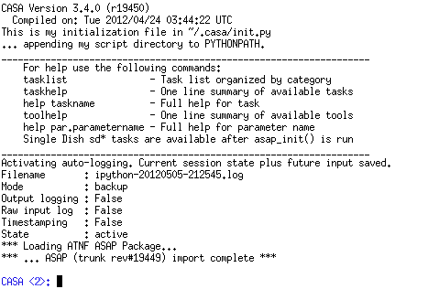
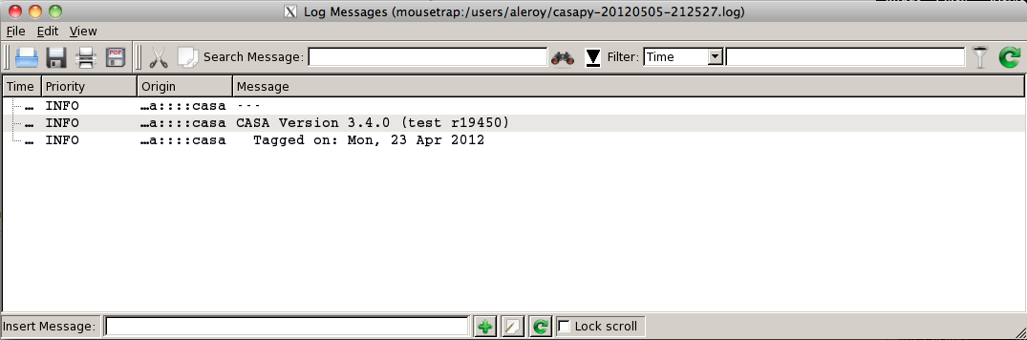
casapy Shell
Start CASA by typing casapy
Version number and logger will appear, you get an ipython prompt
Python tips (tutorials at http://python.org/doc):
  Indentation matters! So careful with cut/paste (a few lines at a time)
  or use cpaste (type cpaste, paste code, end with a line of “--”)
  Run shell commands with leading “!”, e.g., “!du –hc”
  To run a script: execfile(‘scriptname.py’)
Notes:
CASA runs in python! or rather, ipython.
EMPHASIZE writing a script with your calibration/flagging etc. steps
OR a copy/paste version
SCRIPT AS REFERENCE FOR DATA REDUCTION STEPS

Slide 5
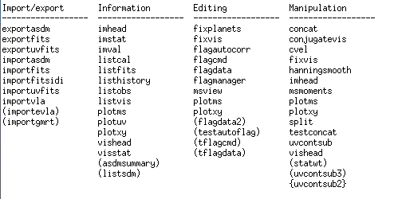
“Tasks”
Tasks – high-level functionality
  Python wrapper around the toolkit and pythoncode
  Accessed via python function call or parameter setting interface
  List CASA tasks with command tasklist or taskhelp
  Most data reduction and tutorials and CASA guides focus on tasks
Notes:
Don’t spend long on this slide: it’s an intro. The tools and tasks get talked about in more detail in the following slides.

Slide 6
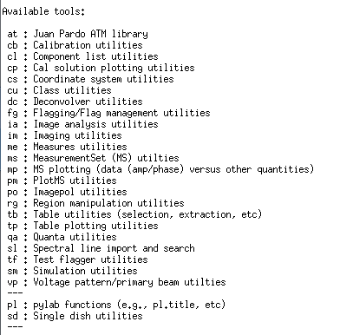
“Tools”
Tools – low level, complete functionality
  Interface to underlying C++ code
  Intended for power users, less user-friendly, less well-documented
  Objects: call with <tool>.<method>
  List available tools with command toolhelp
Notes:
This is the only slide on tools, but it shouldn’t be a big focus. It’s really tasks we care about.

Slide 7
Task Syntax
get detailed help with help(<taskname>)
Two ways to call tasks:
  As a function with arguments:
  Unspecified parameters use default values
gaincal(vis=‘mydata.ms’, caltable=‘caltable.cal’, field=‘2’)
  Standard, interactive task mode:
  set global input variables ahead of time, then <taskname> or go
  Omitting “taskname” operates on current task
  default(<taskname>) sets task’s parameters to default values
    inp(<taskname>) see task’s parameter settings (input values)
    saveinputs(<taskname>) saves parameters to <taskname>.saved
    tget(<taskname>) retrieves parameters (<taskname>.last)
Notes:
Tasks: this is how you’ll be doing most of the calibration.

Slide 8
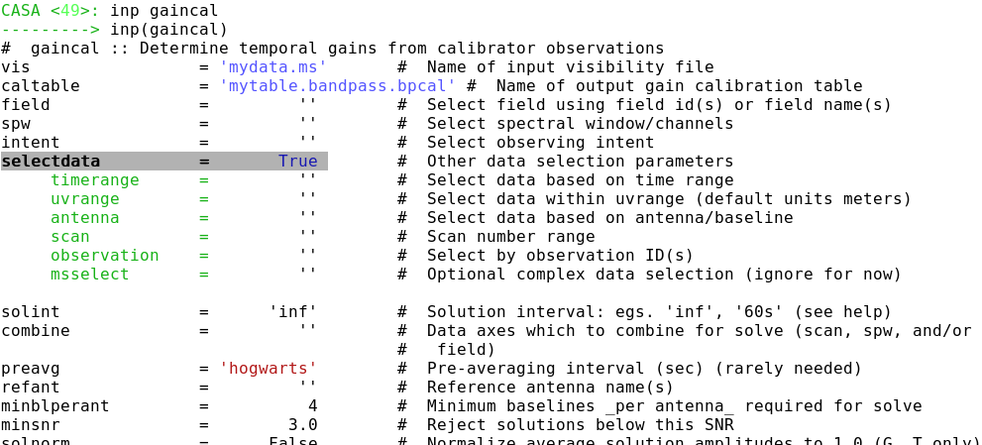
Standard Task Interface
Examine task parameters (inputs) with inp :

Slide 9
Standard Task Interface
Default values in BLACK

Slide 10
Standard Task Interface
Expandable parameters are highlighted
Sub-parameters indented

Slide 11
Standard Task Interface
User set values in BLUE
Erroneous values in RED

Slide 12
Outline
CASA interface: Python, tools, and tasks
Structure of CASA data
Basic calibration flow in CASA
Example calibration task: focus on gaincal
ALMA online calibration

Slide 13
Measurement Set
CASA stores u-v data in directories called “Measurement Sets”
to delete them use os.system(“rm –rf my_data.ms”)
These data sets store two copies of the data (called “columns”):
Additionally a “model” may be stored separately.
This is used to calculate what the telescope SHOULD have observed.
Each data point may also be “flagged,” i.e., marked bad.
In this case it is ignored (treated as missing) by CASA operations.
“Data” Column
Contains the raw, unprocessed measurements.
“Corrected” Column
Usually created by applying one or more calibration terms to the data.

Slide 14
listobs
Measurement sets contain a mix of data:
  One or more spectral windows
  One or more fields (e.g., source, phase calibrator, flux calibrator)
  Data from several antennas
  Data organized into discrete scans
Inspect the contents of your measurement set using listobs.
    Can print output to a file or the logger (use the file option!)
    Verbose (detailed time log) output possible
    Summarizes fields, antennas, sources, spectral windows
  Always run listobs first to get oriented!

Slide 15
Calibration Tables
Calibration yields estimates of phase and amplitude corrections.
e.g., as a function of telescope, time, frequency, polarization.
CASA stores these corrections in directories called “calibration tables.”
to delete them use os.system(“rm –rf my_table.cal”)
These are created by calibration tasks:
e.g., gaincal, bandpass, gencal
Applied via “applycal” to the data column and saved as corrected.
Measurement Set
Measurement Set
applycal
CASA Task
(“Data” Column)
“Data” Column
Still holds original data
Calibration Table(s)
“Corrected” Column
Now holds corrected data.

Slide 16
Outline
CASA interface: Python, tools, and tasks
Structure of CASA data
Basic calibration flow in CASA
Example calibration task: focus on gaincal
ALMA online calibration

Slide 17
Key Tasks for Calibration
Derive Calibration Tables
setjy: set “model” (correct) visibilities using known model for a calibrator
bandpass: calculate bandpass calibration table (amp/phase vs frequency)
gaincal: calculate temporal gain calibration table (amp/phase vs time)
fluxscale: apply absolute flux scaling to calibration table from known source
Manipulate Your Measurement Set
flagdata/flagcmd/flagmanager: flag (remove) bad data
applycal: apply calibration table(s) from previous steps
split: split off calibrated data from your ms (for imaging!)
Inspect Your Data and Results
plotms: inspect your data interactively
plotcal: examine a calibration table

Slide 18
Basic Calibration Flow
Define what the telescope SHOULD have seen.
Measurement Set
Define a model for the data (setjy)
Measurement Set
(with associated model)
Model
(defaults to point source)
Derive the corrections needed to make the data match the model.
Measurement Set
(with associated model)
Calibration Task
(e.g., gaincal, bandpass)
Calibration Table
Apply these corrections to derive the corrected (calibrated) data.
Measurement Set
Apply Calibration
applycal
Measurement Set
Data Column
Corrected column now holds calibrated data.
Calibration Table
Notes:
Corrections are applied… the corrections for the calibrators are applied to the science source, under the basic assumption that the telescope hardware doesn’t “know” if it’s pointing at a science target or a calibrator, and should have the same behavior in those cases. And direction dependent behavior, such as elevation, or difference is atmosphere, gets taken out in the calibration anyway.
Now I will focus a bit more on this inner step: what goes into the “creating the calibration tables” step.

Slide 19
Schematic Calibration
Calibrate the Amplitude and Phase vs. Frequency of Each Antenna
Assume time & frequency response separable, remove time variability
Calibrate the Amplitude and Phase vs. Time of Each Antenna
Assume time & frequency response separable, remove freq. variability
Set the Absolute Amplitude Scale With Reference to a Known Source
Planet (modeled), Monitored Quasar, etc.
Apply all corrections to produce calibrated data

Slide 20
Schematic Calibration
Calibrate the Amplitude and Phase vs. Frequency of Each Antenna
bandpass
Bandpass Calibration Table
Calibrate the Amplitude and Phase vs. Time of Each Antenna
gaincal
Phase Calibration Table
Amplitude Calibration Table
Set the Absolute Amplitude Scale With Reference to a Known Source
fluxscale
Flux Calibration Table
Apply all corrections to produce calibrated data
applycal
Measurement Set
Corrected column now holds calibrated data.

Slide 21
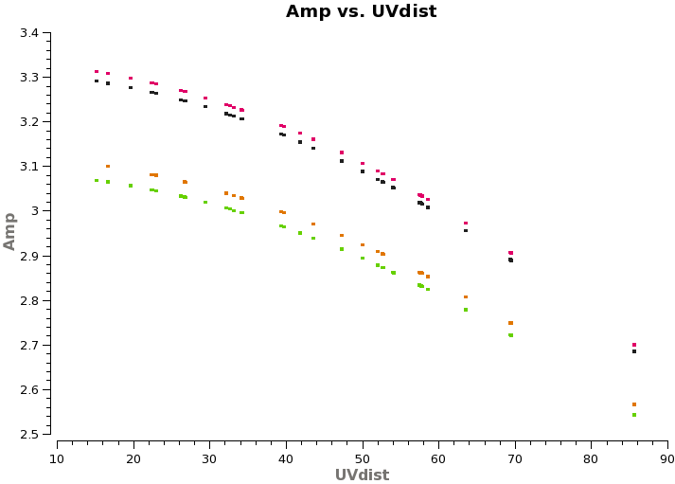
Absolute flux calibration
Define a model for the flux calibrator source
setjy
Titan model (distributed with CASA)
For all other sources, default model is 1 Jy point source
Notes:
Models of other common flux calibrators also come with CASA, including some quasars and other minor planets.

Slide 22
Absolute flux calibration
Define a model for the flux calibrator source
setjy
Find calibration solutions to give best match of data to model
gaincal
Amplitude Calibration Table
Transfer gain scaling from flux calibrator to phase calibrator
fluxscale
New Flux Calibration Table

Slide 23
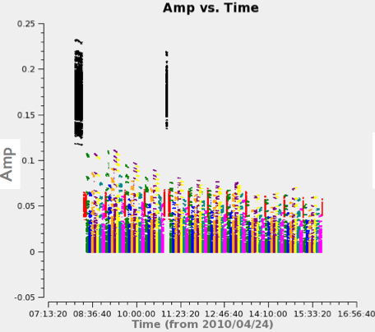
Absolute flux calibration
Define a model for the flux calibrator source
setjy
Find calibration solutions to give best match of data to model
gaincal
Amplitude Calibration Table
Transfer gain scaling from flux calibrator to phase calibrator
fluxscale
New Flux Calibration Table
Fluxscale: applies constraint that field-dependent antenna gains are due solely to unknown flux densities of calibrators.
Notes:
The constraint: applied using the corrections in the amplitude calibration table, averaged over time and all antennas and polarization.
Using time-averaged gain amplitudes, the ratio between each ordinary calibrator and the flux density calibrator(s) is formed for each antenna and polarization (that they have in common). The average of this ratio over antennas and polarizations yields a correction factor that is applied to the ordinary calibrators' gains.

Slide 24
Outline
CASA interface: Python, tools, and tasks
Structure of CASA data
Basic calibration flow in CASA
Example calibration task: focus on gaincal
ALMA online calibration
Notes:
Focus on gaincal as an example of typical input parameters when running calibration tasks, and also because this task gets used multiple times, in different calibration steps, so it’s pretty important.

Slide 25
gaincal
Measurement Set
(Optional)
One or More Calibration Tables
(applied on the fly before solution)
Data column holds observations.
Associate a model (expected sky distribution) with the MS.
(Default: assume point source)
gaincal
Solve for phase and amplitude response of each telescope as a function of time.
(Solutions derived to give best match of data to model once they are applied.)
What time interval to solve over?
Requirements for a good solution.
Reference Antenna
Calibration Table
Later applied with applycal

Slide 26
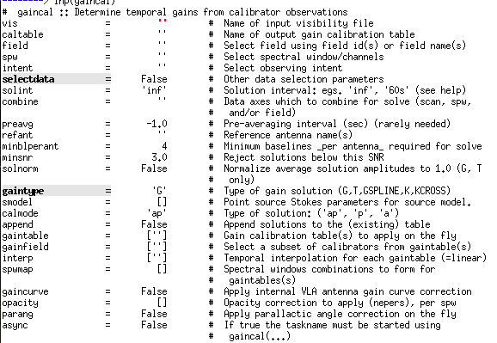
gaincal

Slide 27
gaincal
Input Measurement Set
(with model set, if needed)

Slide 28
gaincal
Output Calibration Table
(apply later with applycal)

Slide 29
gaincal
Options to select which data to consider:
e.g., select calibrator fields

Slide 30
gaincal
Time interval over which to solve.
(Only cross scan or spw boundaries with “combine”)

Slide 31
gaincal
Reference Antenna
(pick a central one with little or no flagging)

Slide 32
gaincal
Requirements for a solution in terms of S/N and # of baselines contributing

Slide 33
gaincal
Normalize solutions?
Notes:
In gaincal, default of False is appropriate. Should only be applied with care by folks who really know what they are doing.

Slide 34
gaincal
What to solve for?
‘a’mplitude
‘p’hase
‘ap’ - both
Notes:
Typically first solve for phase in one run of gaincal, then solve for amplitude and phase in another run of gaincal.

Slide 35
gaincal
Calibration tables to apply before solution:
e.g., apply bandpass calibration before gaincal

Slide 36
Outline
CASA interface: Python, tools, and tasks
Structure of CASA data
Basic calibration flow in CASA
Example calibration task: focus on gaincal
ALMA online calibration

Slide 37
ALMA Online Calibration
System Temperature (Tsys) – atmospheric emission/opacity
  Key to gain transfer across elevation
  Amplitude calibration, variable with frequency (observed in “TDM”)
Water Vapor Radiometer (WVR) – phase delay due to atmosphere
  Key to correct short-timescale phase variations
  Phase calibration, variable with time
These are provided by the observatory (eventually applied online).
  Apply them as first step (or start with provided pre-applied versions)
  In either case, inspect these tables to learn about data quality
Notes:
We heard about both the Tsys and the WVR from Crystal a couple of days ago. For today’s tutorial, we are providing both kinds of data. Recommend that you start with pre-applied versions, then go back and look at how to apply them if there is time. Even if you don’t know how to apply them, it’s important to understand (and always inspect) the tables to understand your data quality.

Slide 38
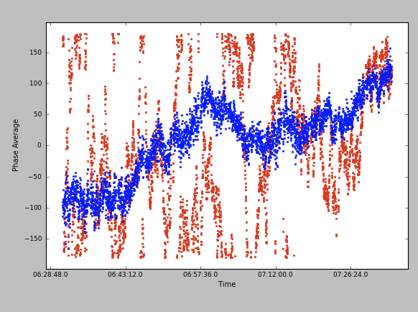
ALMA Online Calibration
Phase vs. Time
One 600m Baseline
~600 GHz
Before WVR, After WVR
Notes:
Example of why the WVR calibration is so important! Phase changes as it goes through different amounts of water vapor. But because we measure the amount of water vapor, we know how the phases were affected, and so can apply this calibration. CRUCIAL!

Slide 39
Your Turn
Point your web browser at the Synthesis Imaging School CASA guide.
http://casaguides.nrao.edu/index.php?title=TWHydraBand7_SS12
Decide whether to start with WVR and Tsys applied.
Work end-to-end through the calibration of a single measurement set.
The full online guides step through calibration for several MSs.
(Optional) Try writing a python script as you go.
This is very good practice for actual reduction.
After lunch, we will image the results.
Don’t worry, we have provided calibrated data for the afternoon!
Ask if you need help!

