Slide 1
Widefield Imaging II: Mosaicing
Juergen Ott (NRAO)

Slide 2
What is it all about?
Imaging regions on the sky that are larger than the primary beam
The primary beam depends on the individual size of the dish,
not your array configuration
Re-gain some of the short spacing information
Is this important? Yes!
Sky has about 41,253 deg²
1 primary beam is:
EVLA (25m dishes): 20cm: 0.25 deg², 7mm: 0.0003 deg²
ALMA (12m dishes): band 3, 3mm: 0.02 deg², band 9 (650GHz): 0.000005 deg²
Solution 1: go to smaller dishes (e.g. ATA, 6m dishes @20cm: 6.3 deg²) but you will need a lot of dishes to gain sensitivity (ATA plans hundreds)
Solution 2: Mosaicing

Slide 3
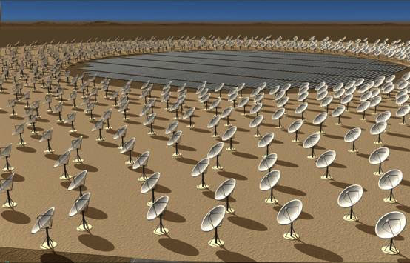
Small Dishes: SKA

Slide 4
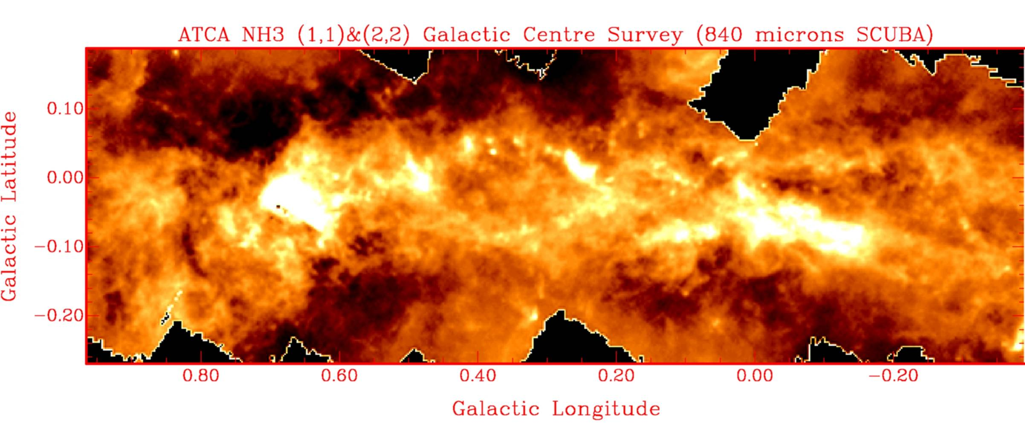
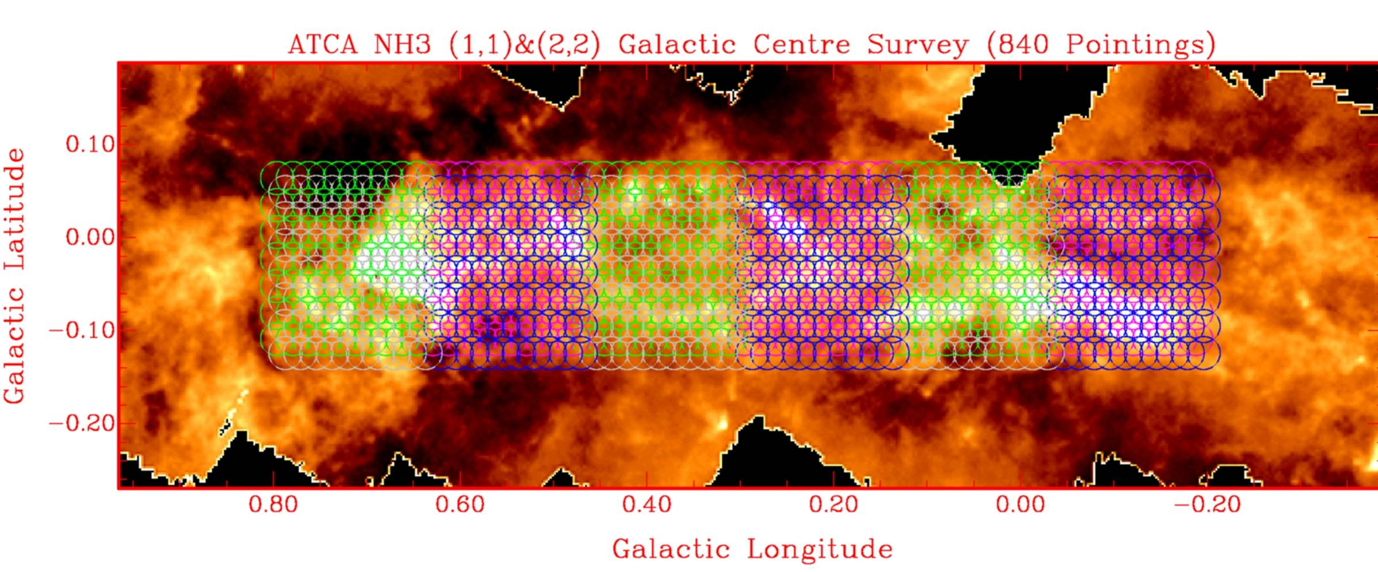
What is it all about?
Galactic Center: image: 1deg x 0.2 deg, primary beam @ 1cm: 2.4’
Ammonia in the Galactic Center
Sgr B2
Sgr A*
(Scuba 850 microns)
150 pc
30 pc

Slide 5
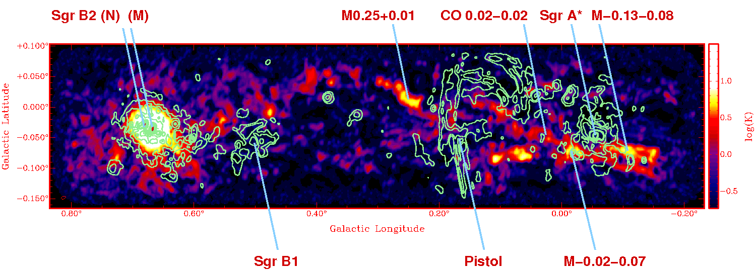
Galactic Center
Ammonia in the Galactic Center
Sgr B2
Sgr A*
(Scuba 850 microns)
150 pc
30 pc

Slide 6
Galactic Center
Yusef-Zadeh et al.

Slide 7
Problems to solve
Each primary beam has attenuation which needs to be accounted for
Non-linearity in deconvolution process
Obtain adequate sky coverage, try to keep Nyquist sampling when needed
At high frequencies: atmospheric variation on small time scales
Minimize drive time but maximize well spaced uv-coverage across map
Gain some of the shorter spacings, maybe add single dish data for zero spacings

Slide 8
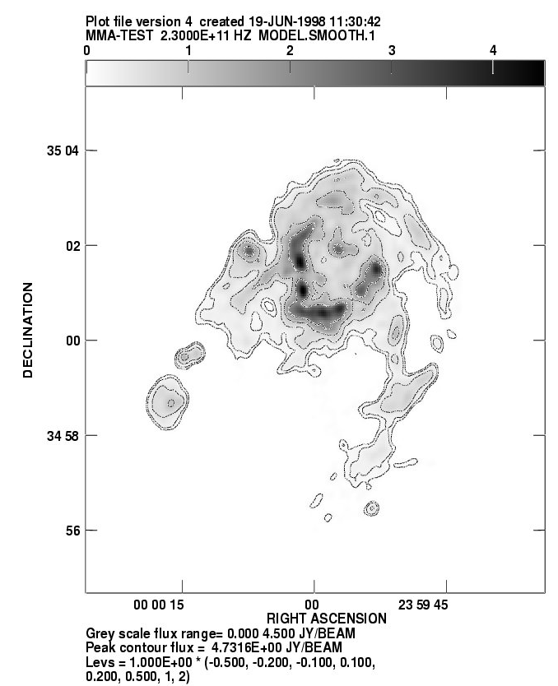
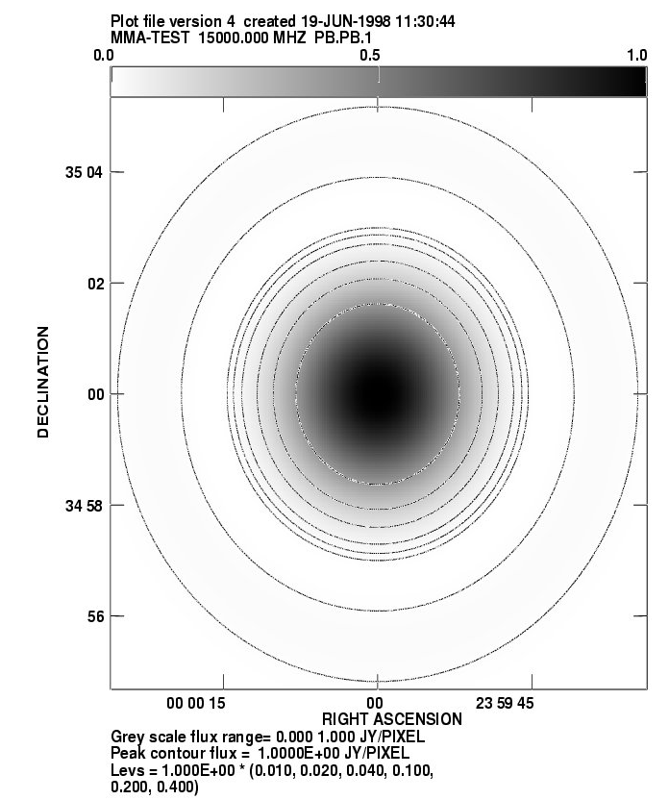
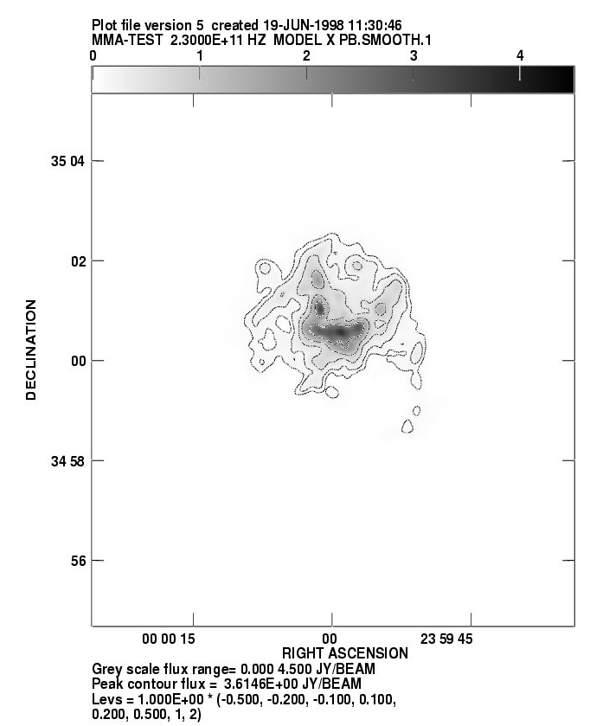
The effect of the Primary Beam
PB defined by single antenna (SD). Not by the array.
Primary beam used for simulations
Image larger than PB
Primary beam used for simulations
PB provides sensitivity pattern on sky
Primary beam used for simulations
PB applied: sensitive to center only
Primary beam used for simulations

Slide 9
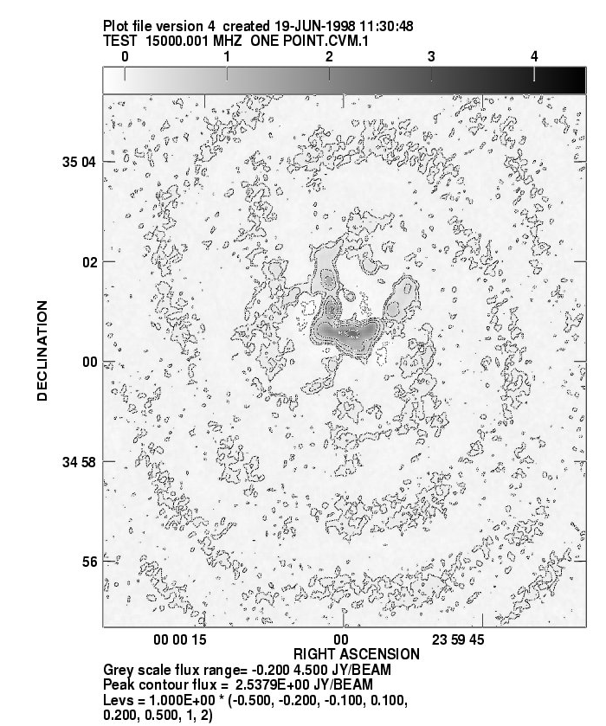
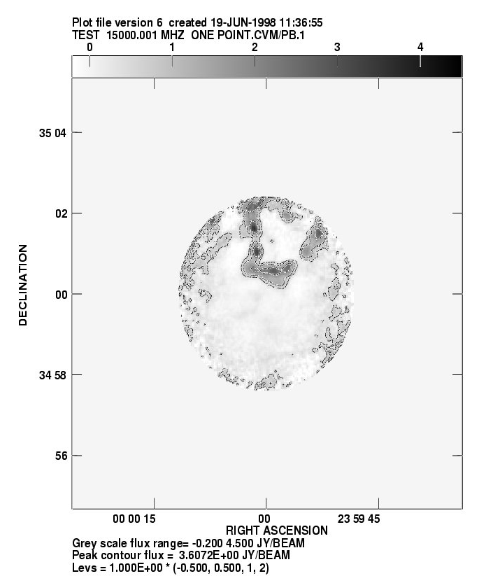
The effect of the Primary Beam
Noise before PB correction
PB correction changes noise characteristics
Primary beam-corrected image. Blanked

Slide 10
Stitching the maps together
3 main methods for mosaicing:
Linear combination of deconvolved maps
Joint deconvolution
Regridding of all visibilities before FFT

Slide 11
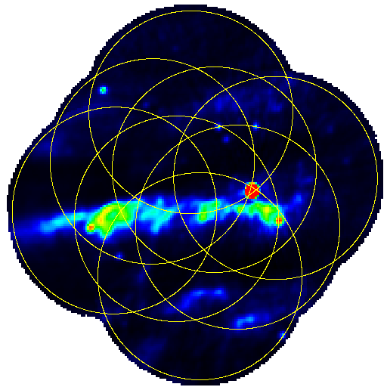
Mosaicing: Linear Combination of Images

Slide 12
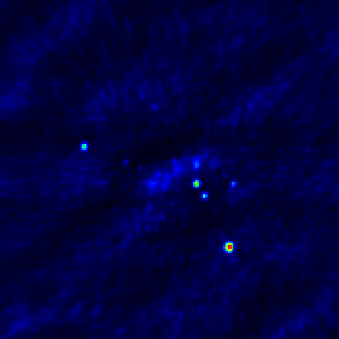
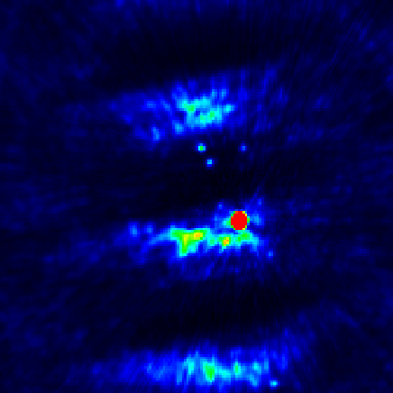
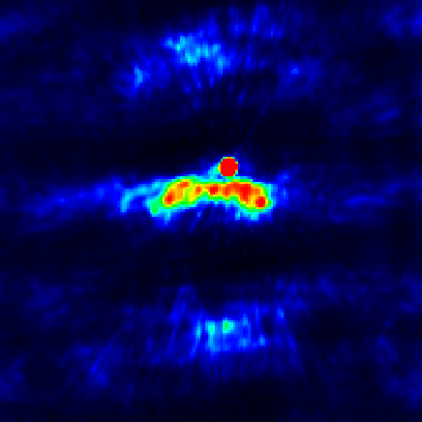
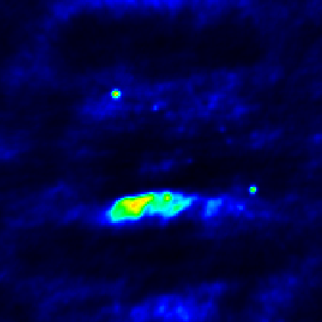
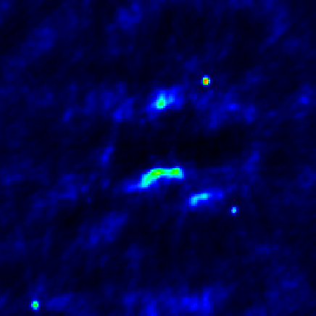
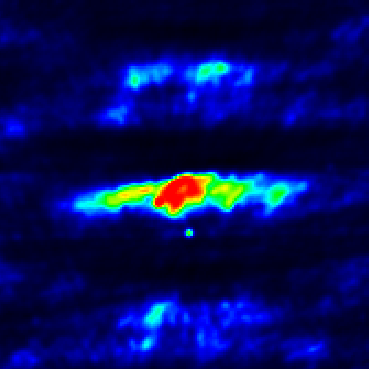
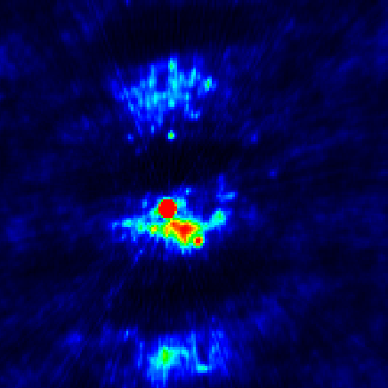
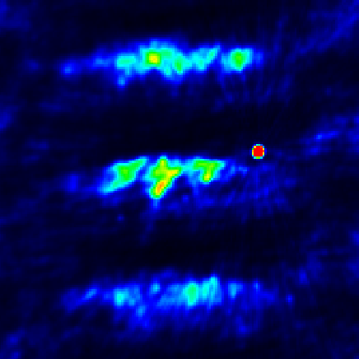
The Individual Approach
Treat each pointing separately
Image each pointing
Deconvolve each pointing
Stitch together linearly with weights
for primary beam

Slide 13
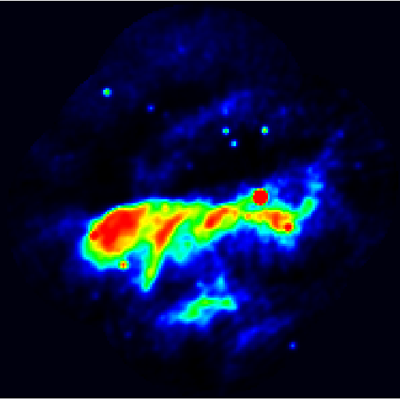
Mosaicing: Linear Combination of Images

Slide 14
Mosaicing: Linear Combination of Images
Most straightforward method to create map
But deconvolution is non-linear
Artifacts, in particular at edges may creep in
But still a very good method for high-dynamic range imaging
One can manipulate every pointing extensively (e.g. solve for off-axis gains, like ‘peeling’)
Depends less on exact knowledge of primary beam shape, as it is used typically only to the half power point

Slide 15
Ekers & Rots Theorem
Extended this formalism to interferometers to show that an interferometer doesn’t just measure angular scales θ =λ / b it actually measures λ / (b – D) < θ < λ / (b + D)
b + D
“Fourier coverage”
b - D
D
D
b
b - D
b
b + D

Slide 16
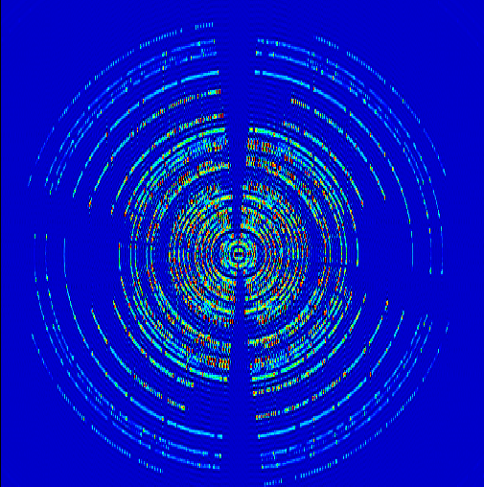
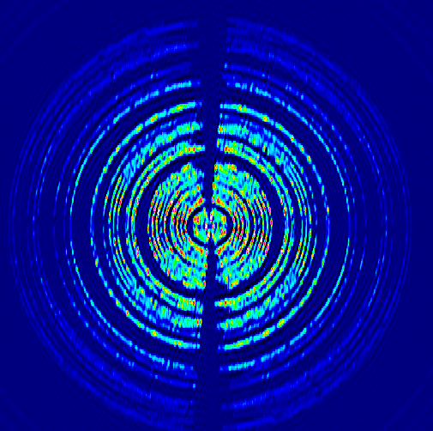
Comparison of u-v coverage
Notes:
Replace each delta function in the u-v sampling with the autocorrelation of the dish illumination pattern

Slide 17
Ekers & Rots Theorem
But you can’t get all that extra info from a single visibility
Interferometer measures a number per baseline not a range.
  Same as with a single dish, you have to scan to get the extra “spacings”
Ekers & Rots showed that you can recover this extra information by scanning the interferometer
The sampling theorem states that we can gather as much information by sampling the sky with a regular, Nyquist spaced grid
Convolution of the FT of the primary beam with your uv plane

Slide 18
The Joint Approach
Form a linear combination of the individual pointings, p on
DIRTY IMAGE:
Here σ_{p} is the noise variance of an individual pointing and A(x) is the primary response function of an antenna (primary beam)
W(x) is a weighting function that suppresses noise amplification at the edge of mosaic
Sault, Staveley-Smith, Brouw (1996)

Slide 20
Mosaicing: Joint Approach
Joint dirty beam depends on antenna primary beam, ie weight the dirty beam according to the position within the mosaiced primary beams:
Use all u-v data from all points simultaneously
  Extra info gives a better deconvolution
  Provides Ekers & Rots spacings and therefore better beam
  Better for extended emission
  But: overlapping pointings require knowledge of shape of PB further out than the half power point

Slide 21
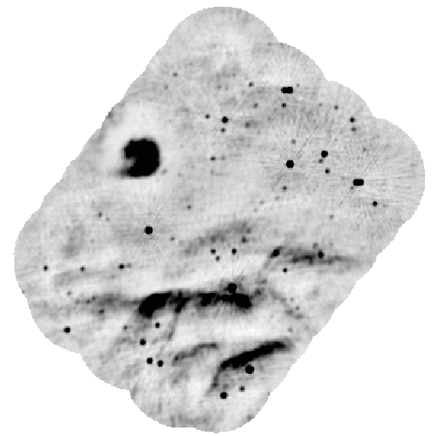
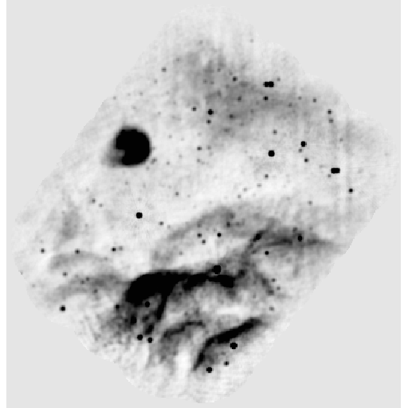
Mosaicing Example
Joint Linear Mosaic of individual pointings
int Imaging and Deconvolution

Slide 22
Mosaicing: Comparison
Individual approach:
  Disadvantages:
    Deconvolution non-linear (cleaning bowl)
    Overlap regions noisy (primary beam shape)
  Advantage:
    Not susceptible to deconvolution errors due to poor primary model, so good for high-resolution, high-dynamic range images
Joint Approach:
  Advantages:
    Uses all u-v info -> better beam
    More large-scale structure
  Disadvantage:
    Requires a good model for the primary beam

Slide 23
Widefield Imaging
What if you have many many points? (e.g. OTFI)
Take each uv data for each pointing and regrid to a common phase reference center
Then:
Regrid in Fourier domain

Slide 24
Widefield Imaging
Next Step: Perform weighting for primary beam(s)
Multiplication in image domain = convolution in FT domain
The PBs for each pointing are identical but shifted
FT of a shift is a phase gradient
Sum of Phase gradient for each offset pointing * single FT{A} is the weighting for each visibility to correct for primary beams
Deconvolution with synthesized beam of one of the pointings
(+ weighting terms)

Slide 25
Deconvolution
Mosaics can be lots of point like sources but typically are performed for extended emission
3 main deconvolution algorithms
(Preferably Cotton-Schwab, with small gain;
FFT of major cycle will reduce sidelobes):
CLEAN: subtract dirty beam (point sources) from dirty image
Multiscale clean: Use a number of kernel sizes for different scales
Maximum entropy: iterate on minimizing c² between
data and a model

Slide 26
Mosaicing in CASA
Don’t panic!
Most of the tricky techniques are performed under the hood for your convenience
Calibrate as you would do for a single pointing
Use the clean task with your favorite parameters
In imagermode use ‘mosaic’
Use ftmachine=‘ft’ for joint deconvolution, ‘mosaic’ for the widefield imaging
Use psfmode=‘clark’ for Cotton-Schwab Algorithm
Fill in ‘multiscale’ parameters (scales) for MS Clean
Maximum Entropy and linear mosaicing of cleaned images is available from the CASA toolkit at this stage

Slide 27
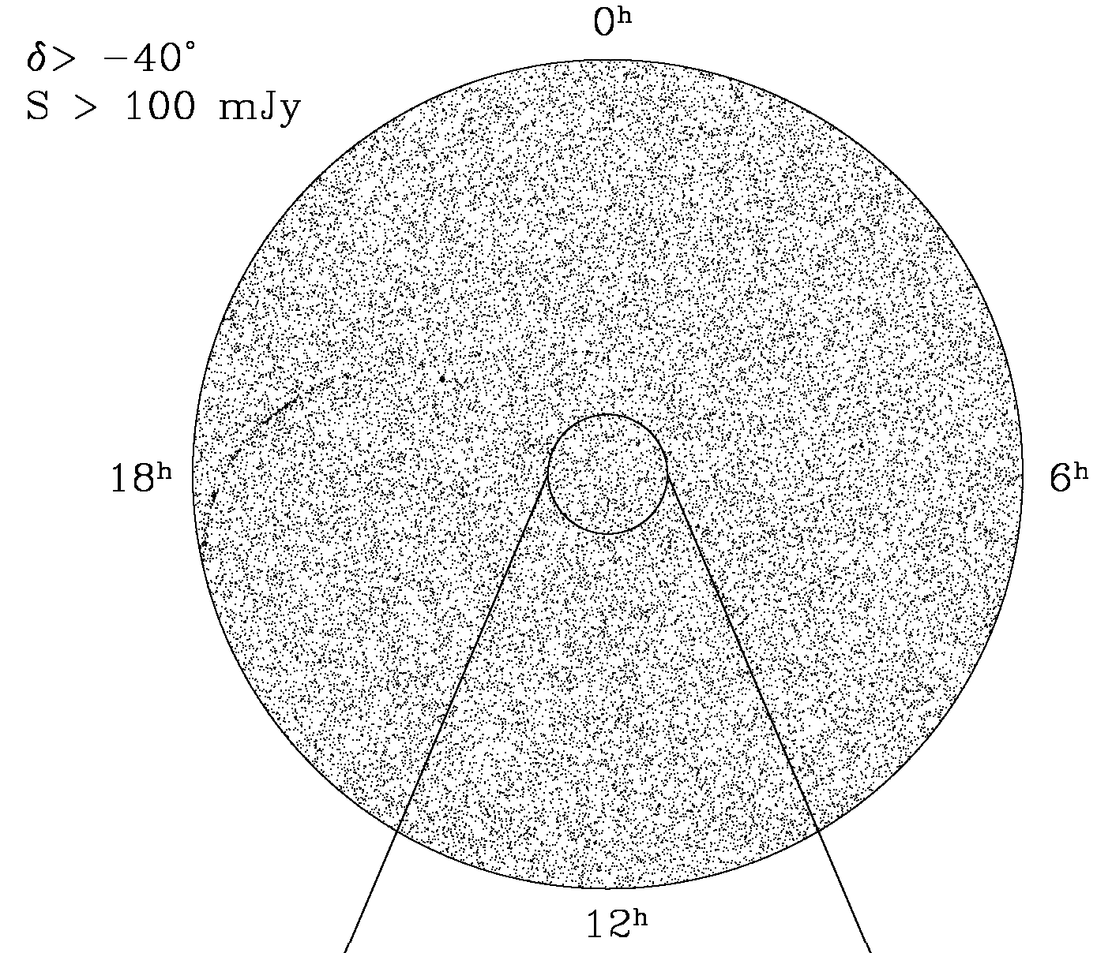
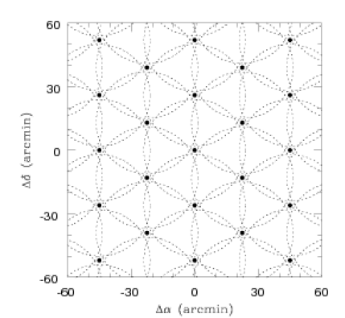
NVSS: 217,446 pointings

Slide 28
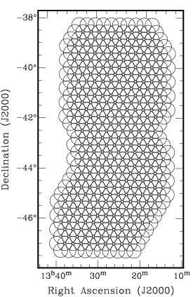
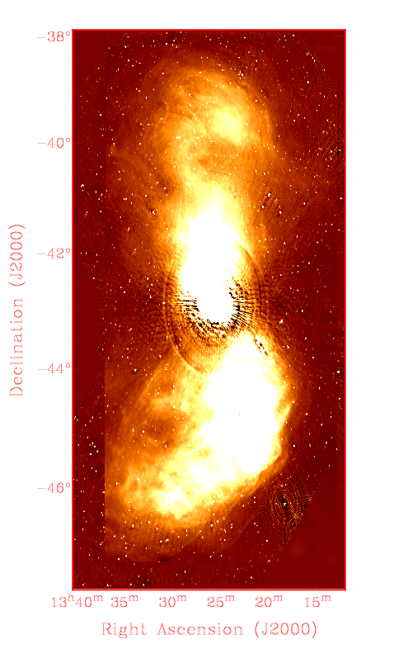
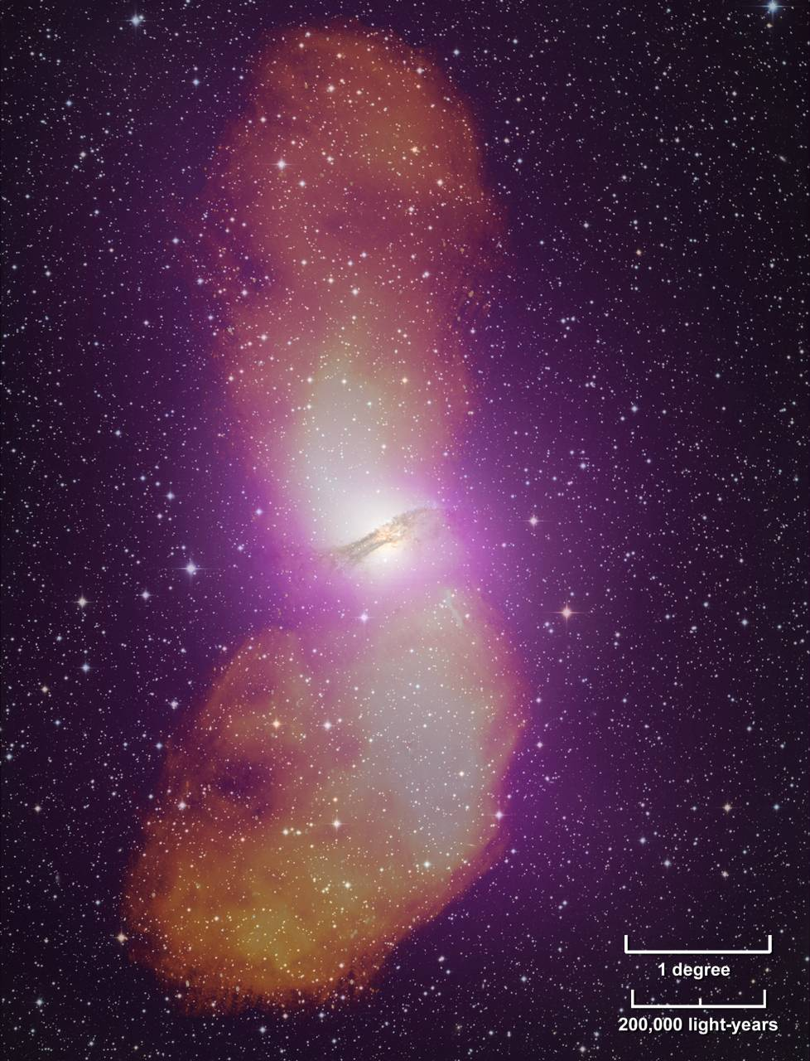
Centaurus A
406 pointings

Slide 29
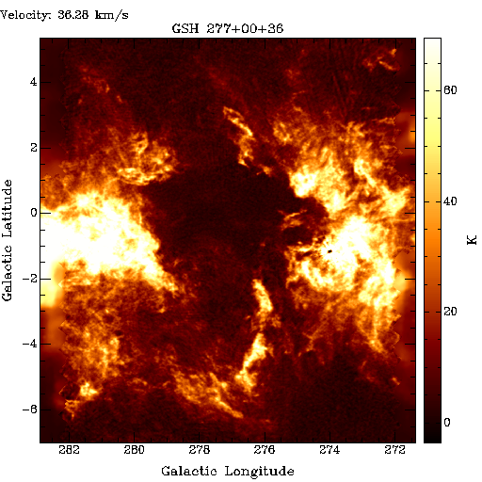
Southern Galactic Plane Survey
primary beam
1025 pointings

Slide 30
Practical Considerations
What grids to use?
How often to come back to a individual pointing
Slew time of Antennas
Change of atmospheric conditions

Slide 31
Practical Consideration: Choice of Grid
Different ways to layout the grid on the sky:
Nyquist sampling:
Rectangular grid
Hexagonal grid
Nyquist for structure
information recovery, but some areas
only covered by single pointing
Oversampled but every position
at least covered twice

Slide 32
Practical Consideration: Choice of Grid
On-The-Fly Interferometry
Non-Nyquist sampling
OTF
Non-Nyquist
Scan does not stop
fast dumping of data
Basic Sky coverage

Slide 33
Complete u-v sampling
One baseline measures region in u-v plane with size 2D
Want adjacent samples to be completely independent
At transit, the time between independent points is τ = (86400 / 2π)(2D / L) sec, where D = antenna diameter, L = longest baseline
Nyquist sampling for N pointings: dwell time is τ /2N sec
v
Earth rotation
u
Nyquist sample

Slide 34
Practical Consideration: Slew Time
slew
accel
decel
Telescope slew times are calculated by:
Acceleration
Constant Slew velocity
Deceleration
Settling time
Some telescopes may have variations in Az and El
EVLA: acceleration: 0.2 deg s⁻², slew rate: 20 deg min⁻¹ in El, 40 in Az
ALMA: acceleration: 24 deg s⁻², slew rate 180 deg min⁻¹ in El, 360 in Az

Slide 35
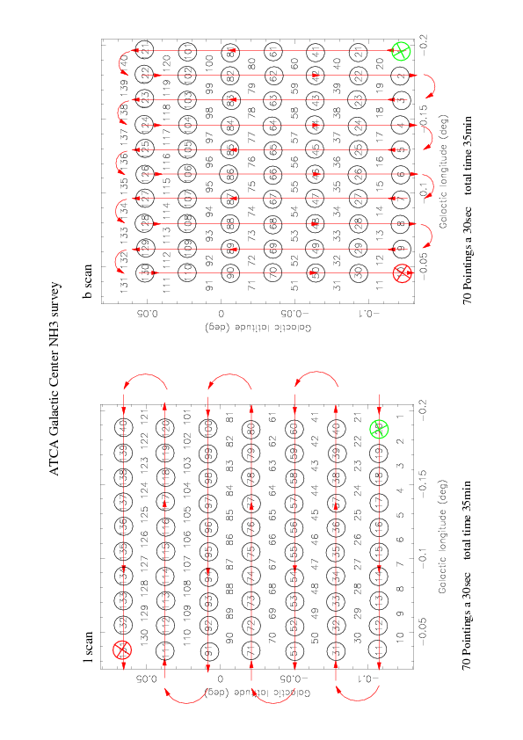
Practical Considerations

Slide 36
Practical Consideration: Changing Atmosphere
The water content of the atmosphere can change on small timescales
In particular variations in individual cells
On long baselines this can lead to:
Variations in opacity
Larger phase noise
It may be advisable to:
Slew fast. Try to cover the full mosaic more frequently
This will make the map more uniform

Slide 37
Mosaicing Practicalities
Sensitivity concerns
  Time per pointing reduced, but adjacent pointings contribute so for a fixed time observation the total noise is
  where n is the number of pointings
Mosaicing requires a good model of the primary beam
Pointing errors can significantly impact your mosaic
  Pointing errors are first order in mosaics (only second order in single pointing obs of sources smaller than primary beam)
  Solution: do reference pointing at higher frequencies

Slide 38
Summary
Mosaicing is a technique to image objects much larger than the primary beam
Unlocks additional uv spacings added by single dish elements
Needs a bit of care to setup
Mosaicing techniques will be used very commonly in the future:
ALMA will work mostly in mosaic mode: primary beam @ band 3 (3mm) about 1 arcminute, band 9 (600GHz) about 10 arcsec! → mosaicing becomes more important at smaller wavelengths
SKA demonstrators cover large areas at once, but aim for frequent full sky coverage (ASKAP, MWA, MEERKAT, …)
Fun to reduce and you will obtain beautiful images!

Slide 39
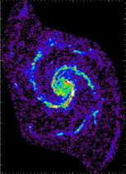
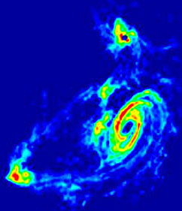
Summary
1025 pointings

Slide 40
Is that all? No – add in zero spacings

Slide 41
Is that all? No – add in zero spacings
Looks unimportant, but the hole is where
the flux of the entire map is defined!!
Zero spacings, can only be recovered
by a single dish telescope
Mosaicing is a technique to image objects much larger than the primary beam
Unlocks additional uv spacings added by single dish elements
Needs a bit of care to setup
Fun to reduce and beautiful images!

Slide 42
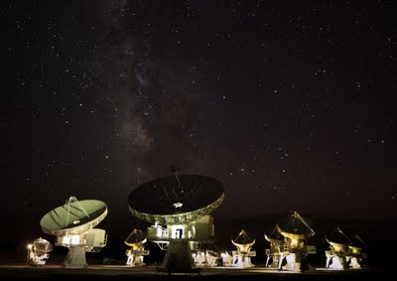
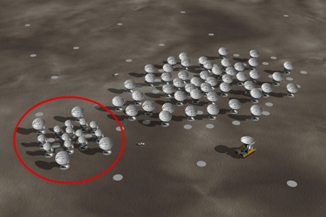
Heterogeneous Arrays
Mix small and large antennas as a compromise between sensitivity and field of view
Regain smaller spacings
CARMA=OVRO(10m)+BIMA(6m) ALMA(12m)+ACA(7m)

Slide 43
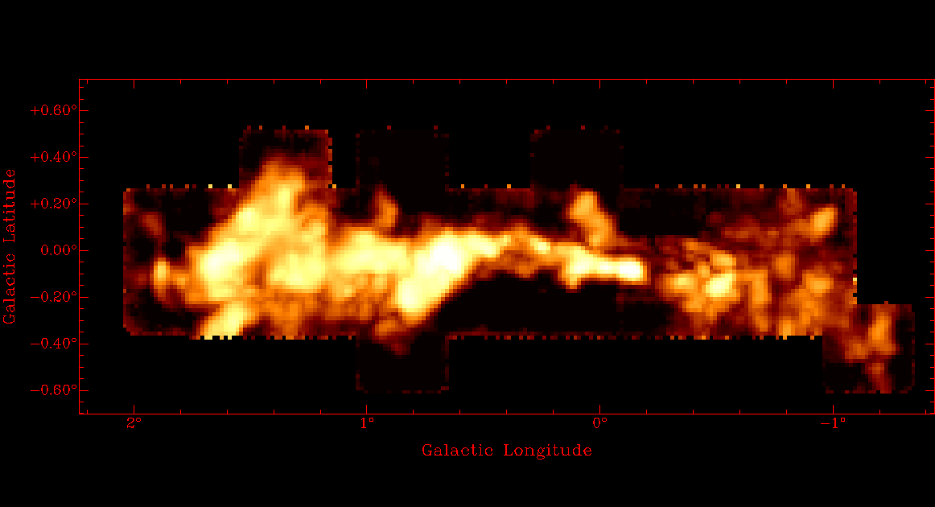
Zero spacing correction

Slide 44
Zero spacing correction
Get an interferometric observation!
Go to a single dish and map the same region, use a SD with a diameter larger than the shortest baseline of your interferometric map
Aim for same surface brightness sensitivity at shortest BL and SD
Calibrate, calibrate, calibrate!
3 basic methods:
FT SD map → combine with UV data of interferometer → FT to image → deconvolve with combined dirty beam
Get your interferometric map → deconvolve, it will extrapolate the center → FT back to FT domain → cut out the central info as clean is only an extrapolation → replace by SD FT and → FT back to image
Use the SD map as a model for deconvolution with maximum entropy/feather

Slide 45
Zero spacing correction
+
=
+ weighting
FT SD map → combine with UV data of interferometer → FT to image → deconvolve with combined dirty beam

Slide 46
Zero spacing correction
Clean in image domain
FFT back
=
Clean you interferometric map → deconvolve, it will extrapolate the center → FT back to FT domain → cut out the central info as clean is only an extrapolation → replace by SD FT and → FT back to image

