Slide 1
Proposal Writing and PST Demo
Joan Wrobel, EVLA Scheduling Officer

Slide 2
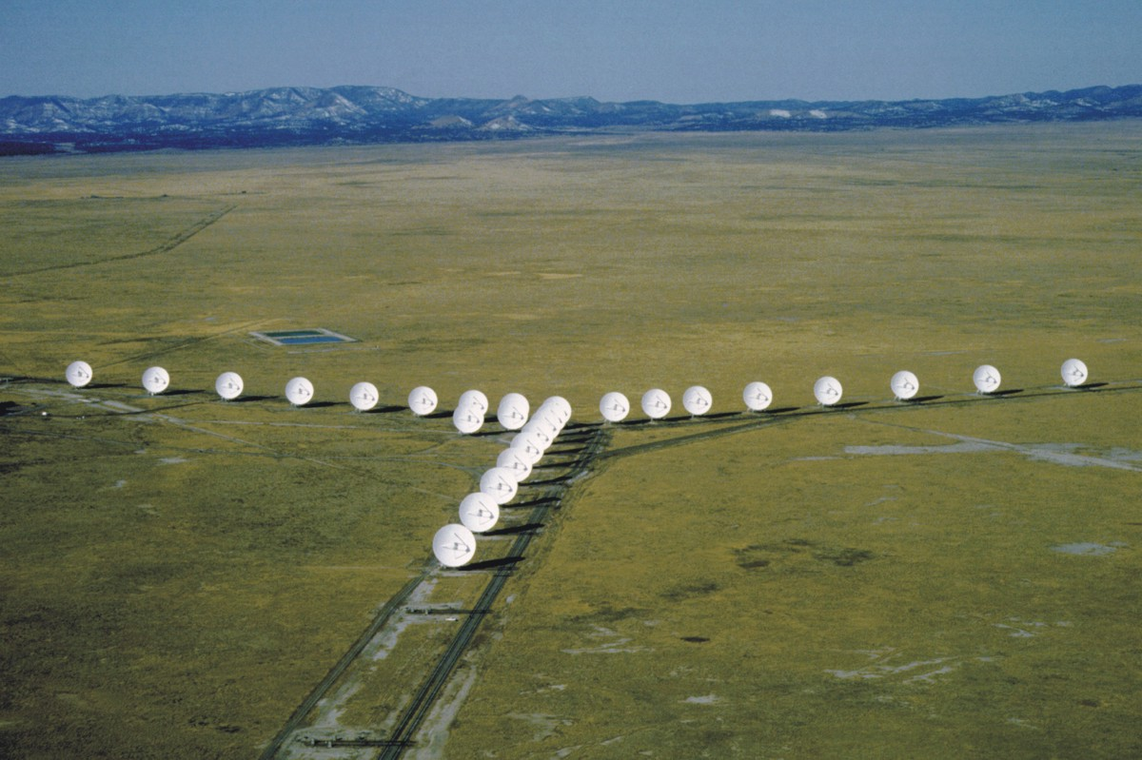
Outline
NRAO EVLA
NRAO VLBA
Proposal writing
Generic
EVLA and VLBA
Demonstration of NRAO Proposal Submission Tool (PST)
Questions

Slide 3
Outline
NRAO EVLA
NRAO VLBA
Proposal writing
Generic
EVLA and VLBA
Demonstration of NRAO Proposal Submission Tool (PST)
Questions

Slide 4
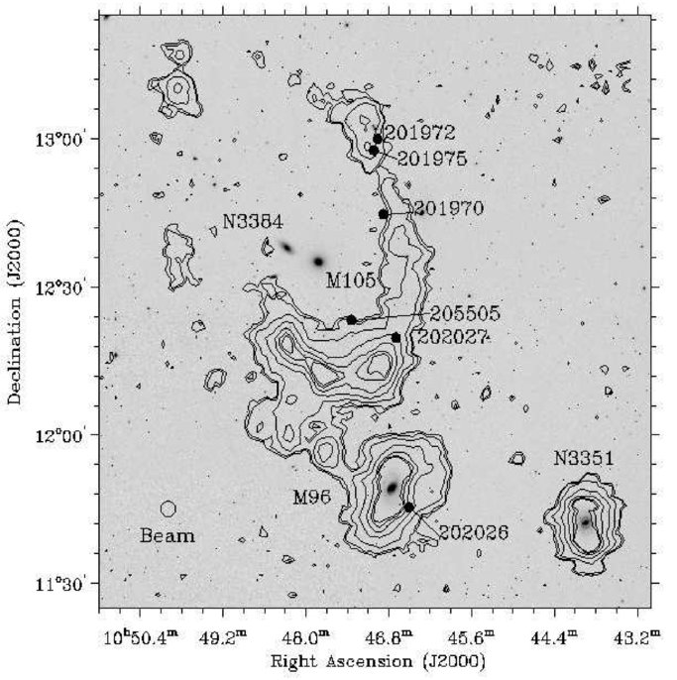
Generic
200 kpc HI Ring in Leo Group
Arecibo 1.4 GHz S. Stierwalt
Primordial versus tidal ring ?
Look for dark halos in dwarfs
Start with a scientific idea and target list
Draft a scientific justification
Write to astrophysically-literate but non-expert reviewers
Give science context and motivation
Pose specific science questions
State specific science goals
Describe target selection criteria
Say how the proposed observations will …
Answer the science questions
Achieve the science goals
Be quantitative !
•

Slide 5
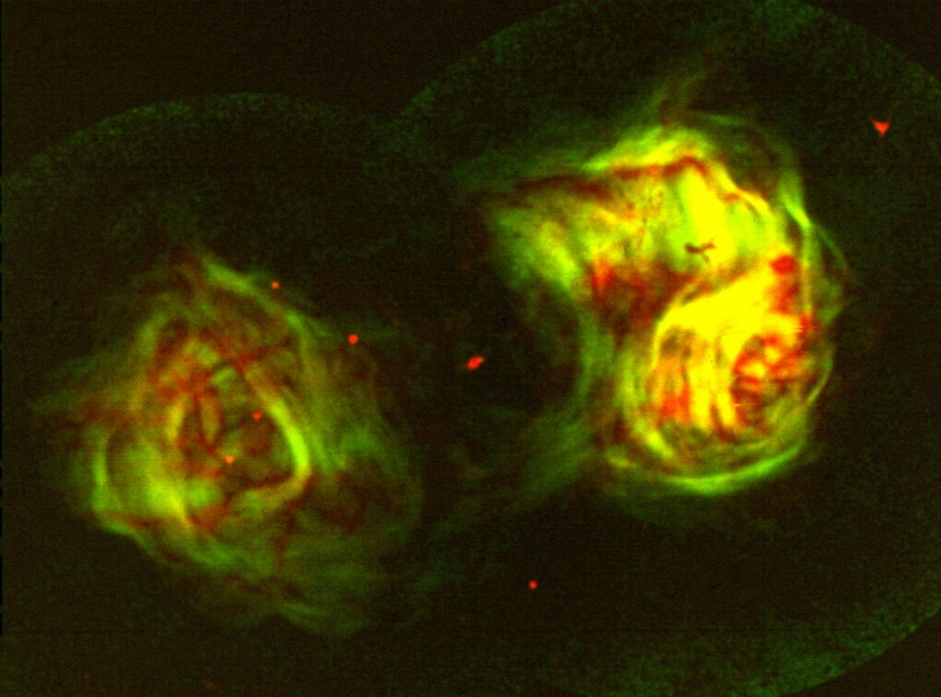
Generic
Specify required …
Angular resolution
Largest angular scale
Observing frequency
Observing bandwidth
Stokes parameters
Select trial array
EVLA, VLBA, ALMA, MERLIN, EVN, GMRT, SMA, RT, PBI, CARMA, ATA, NMA, ATCA, LOFAR, LWA, ASKAP, MEERKAT …
Radio Galaxy Fornax A
VLA 1.4 GHz 1.0d x 0.7d R. Ekers
NRAO Image Gallery

Slide 6
Generic: Evaluate Trial Array
Special needs
Redshifted HI ?
Redshifted CO ?
Geometry
Target above elevation limit ?
Snapshot or full u-v coverage ?
Interferometer sensitivity
Signal-to-noise to self-cal target ?
Image sensitivity
Enough signal-to-noise on target ?
Dynamic-range limited ?
Supernova Remnant Crab Nebula
VLA 5GHz 7’ x 5’ M. Bietenholz

Slide 7
Generic: Evaluate Trial Array
Enough field of view ?
Primary beam attenuation
Bandwidth smearing
Time-average smearing
Non-coplanar baselines
Optimal timeframes ?
Time of day
Season
Year ~ sunspot number
If trial array fails, pick another
If trial array passes, search its archive for suitable data
If no suitable data exist, complete your scientific justification
Add a quantitative technical justification then submit your proposal
Sun TRACE X-rays

Slide 8
EVLA/VLBA Proposals
See NRAO Call for Proposals at http://science.nrao.edu/enews
Add cover information via NRAO Proposal Submission Tool (PST)
Access NRAO PST at http://my.nrao.edu
For EVLA, VLBA, GBT or any joint combination thereof
Add scientific and technical justification as a pdf file
4 pages for a regular proposal
6 pages for an EVLA resident shared risk proposal
10 pages for a large proposal (200 or more NRAO hours)
NRAO staff co-author optional
Submit via NRAO PST

Slide 9
EVLA/VLBA Proposal Handling
Received for deadlines 1 Feb, 1 Jun, 1 Oct for trimesters B, C, A
Classified by scientific categories
Sent to category’s referees
Referees return ratings and comments
Ratings and comments sent to Proposal Selection Committee (PSC)
David Hough, Deidre Hunter, Stan Kurtz, Ylva Pihlstrom, Arnuj Sarma, Russ Taylor, Stephen White, Min Yun
Barry Clark, Mark Claussen, Bob Dickman, Dale Frail, Joan Wrobel
PSC meets Apr, Aug, Dec
PSC results emailed to proposers 1 May, 1 Sep, 1 Jan
Details at http://science.nrao.edu/evla/proposing/timeallocation.shmtl
Changes to this scheme are coming in 2011

Slide 10
EVLA/VLBA Proposals and Students
Consider submitting a deadline early
Use referee feedback to prepare, re-submit improved proposal
Are proposed observations for your thesis ?
If yes, amend your user profile at http://my.nrao.edu
Add Plan of Dissertation ~ timeline + NRAO resources
Update graduation year
Are you eligible for funding ?
US universities and colleges
Regular or Large proposals
Apply via NRAO PST
Donate thesis copies to NRAO
http://www.nrao.edu/library
VLBA 22 GHz A. Brunthaler

Slide 11
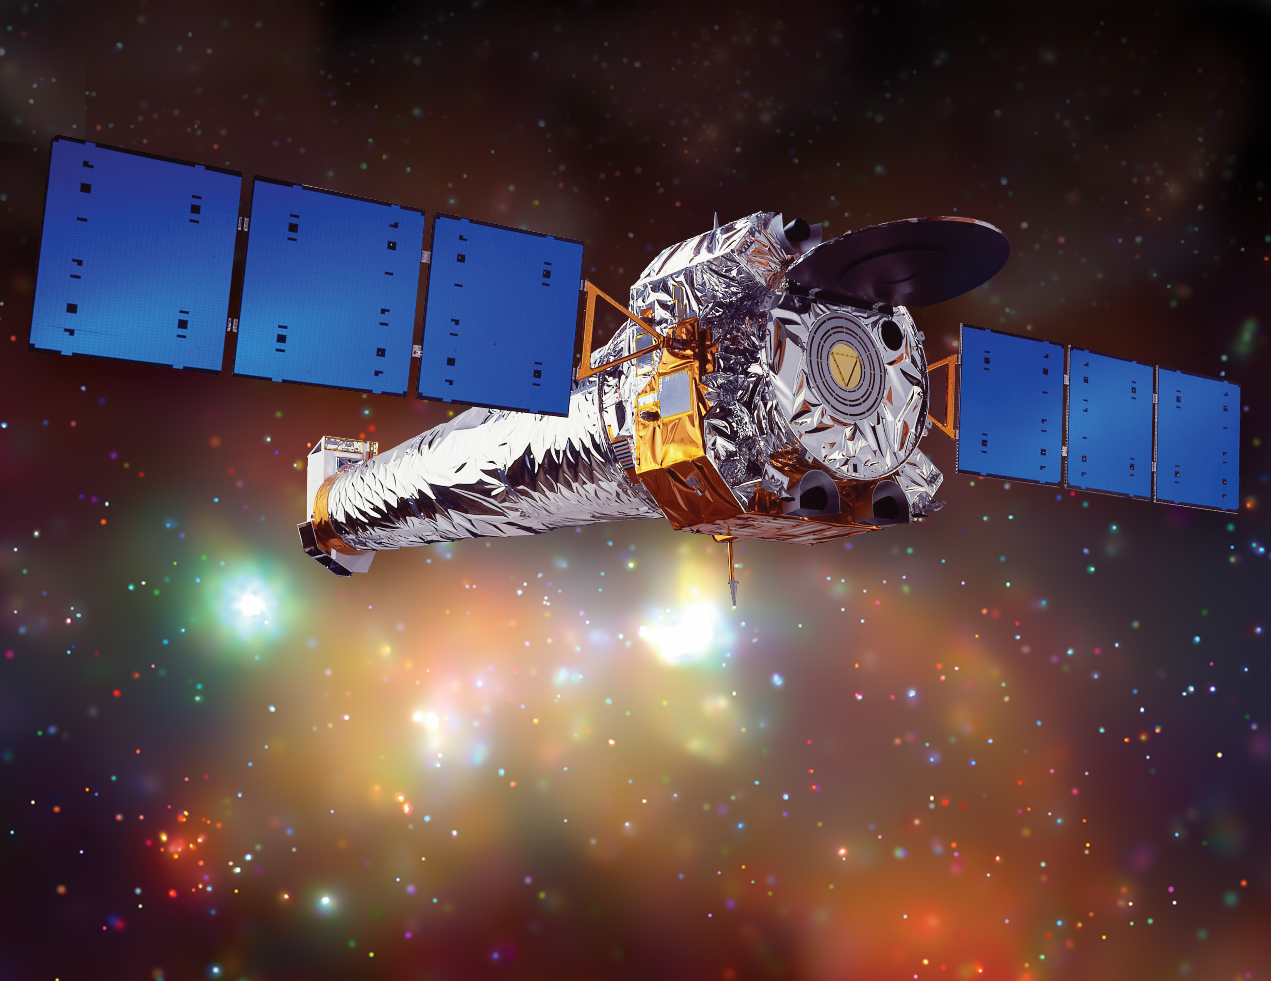
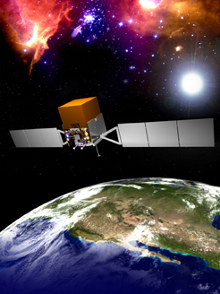
Other Proposal Types and Routes
EVLA/VLBA rapid response science
Exploratory
Eg, quick follow-up of recent discovery
Target of opportunity:
Eg, unpredicted phenomenon
http://science.nrao.edu/evla/proposing/rapid.shtml
Joint proposal routes
Chandra/EVLA/VLBA
http://cxc.harvard.edu/
Fermi/EVLA/VLBA
http://fermi.gsfc.nasa.gov/ssc/
Binary Black
Hole Candidate
VLA 8.5 GHz
J. Wrobel
Chandra
Fermi

Slide 12
Outline
NRAO EVLA
NRAO VLBA
Proposal writing
Generic
EVLA and VLBA
Demonstration of NRAO Proposal Submission Tool (PST)
Questions

