Slide 1
High Fidelity Imaging
Rick Perley, NRAO-Socorro

Slide 2
1 What is High Fidelity Imaging?
Getting the ‘Correct Image’ – limited only by noise.
  The best ‘dynamic ranges’ (brightness contrast) exceed 10⁶ for some images.
  (But is the recovered brightness correct?)
Errors in your image can be caused by many different problems, including (but not limited to):
    Errors in your data – many origins!
    Errors in the imaging/deconvolution algorithms used
    Errors in your methodology
    Insufficient information
  But before discussing these, and what you can do about them, I show the effect of errors of different types on your image.

Slide 3
2 The Effects of Visibility Errors on Image Fidelity
The most common, and simplest source of error is an error in the measures of the visibility (spatial coherence function).
Consider a point source of unit flux density (S = 1) at the phase center, observed by a telescope array of N antennas.
Formally, the sky intensity is:
The correct visibility, for any baseline is:
This are analytic expressions – they presume infinite coverage.
In fact, we have N antennas, from which we get, at any one time
Each of these N_{V} visibilities is a complex number, and is a function of the baseline coordinates (u_{k},v_{k}).

Slide 4
2 The Effects of Visibility Errors on Image Fidelity
The simplest image is made by direction summation over all the visibilities -- (a Direct Transform):
For our unit source at the image center, we get
But let us suppose that for one baseline, at one time, there is an error in the amplitude and the phase, so the measured visibility is:
where ε = the error in the visibility amplitude
φ = the error (in radians) in the visibility phase.

Slide 5
2 The Effects of Visibility Errors on Image Fidelity
The map we get from this becomes
The ‘error map’ associated with this visibility error is the difference between the image and the ‘beam’:
This is a single-(spatial) frequency fringe pattern across the entire map, with a small amplitude and phase offset.
Let us simplify by considering amplitude and phase errors separately.
1) Amplitude error only: φ = 0. Then,

Slide 6
The Effect of an Amplitude Error on Image Fidelity
This is a sinusoidal wave of amplitude ε/N_{V}, with period
tilted at an angle
As an example, if the amplitude error is 10% (ε = 0.1), and N_{V} = 10⁶, the ΔI = 10⁻⁷ – a very small value!
Note: The error pattern is even about the location of the source.
m
θ
1/v
l
1/u

Slide 7
The Effect of a Phase Error on Image Fidelity
In this case:
For small phase error, φ << 1,
This gives the same error pattern, but with the amplitude ε replaced by φ, and the phase shifted by 90 degrees.
From this, we derive an Important Rule:
m
θ
1/v₁
1/u₁
l
A phase error of x radians has the same effect as an amplitude error of 100 x %
For example, a phase error of 1/10 rad ~ 6 degrees has the same effect as an amplitude error of 10%.

Slide 8
Amplitude vs Phase Errors.
This little rule explains why phase errors are deemed to be so much more important than amplitude errors.
Modern interferometers, and cm-wave atmospheric transmission, are so good that fluctuations in the amplitudes of more than a few percent are very rare.
But phase errors – primarily due to the atmosphere, but also from the electronics, are always worse than 10 degrees – often worse than 1 radian!
Phase errors – because they are large – are nearly always the initial limiting cause of poor imaging.

Slide 9
Errors and Dynamic Range (or Fidelity):
I now define the dynamic range as the ratio: F = Peak/RMS.
For our examples, the peak is always 1.0, so the fidelity F is:
For amplitude error of 100ε %
For phase error of φ radians
So, taking our canonical example of 0.1 rad error on one baseline for one single visibility, (or 10% amplitude error):
F = 3 x 10⁶ for N_{V} = 250,000 (typical for an entire day)
F = 5000 for N_{V} = 351 (a single snapshot).
Errors rarely come on single baselines for a single time. We move on to more practical examples now.

Slide 10
Other Examples of Fidelity Loss
Example A: All baselines have an error of ~ φ rad at one time.
Since each baseline’s visibility is gridded in a different place, the errors from each can be considered random in the image plane. Hence, the rms adds in quadrature. The fidelity declines by a factor
Thus: (N = # of antennas)
So, in a ‘snapshot’, F ~ 270.
Example B: One antenna has phase error ε, at one time.
Here, (N-1) baselines have a phase error – but since each is gridded in a separate place, the errors again add in quadrature. The fidelity is lowered from the single-baseline error by a factor , giving
So, for our canonical ‘snapshot’ example, F ~ 1000

Slide 11
The Effect of Steady Errors
Example C: One baseline has an error of ~ φ rad at all times.
This case is importantly different, in that the error is not randomly distributed in the (u,v) plane, but rather follows an elliptical locus.
  To simplify, imagine the observation is at the north pole. Then the locus of the bad baseline is a circle, of radius
One can show (see EVLA Memo 49 for details) that the error pattern is:
The error pattern consists of rings centered on the source (‘bull’s eye’).
For large qθ (this is the number of rings away from the center), the fidelity can be shown to be
So, again taking ε = 0.1, and qθ = 100, F ∼ 1.6 x 10⁵.

Slide 12
One More Example of Fidelity Loss
Example D: All baselines have a steady error of ~ ε at all times.
Following the same methods as before, the fidelity will be lowered by the square root of the number of baselines.
Hence,
So, again taking ε = 0.1, and qθ = 100, F ∼ 8000.

Slide 13
Time-Variable Errors
In real life, the atmosphere and/or electronics introduces phase or amplitude variations. What is the effect of these?
Suppose the phase on each antenna changes by φ radians on a typical timescale of Δt hours.
Over an observation of T hours, we can imagine the image comprising N_{S} = Δt/T individual ‘snapshots’, each with an independent set of errors.
The dynamic range on each snapshot is given by
So, for the entire observation, we get
The value of N_{S} can vary from ~100 to many thousands.

Slide 14
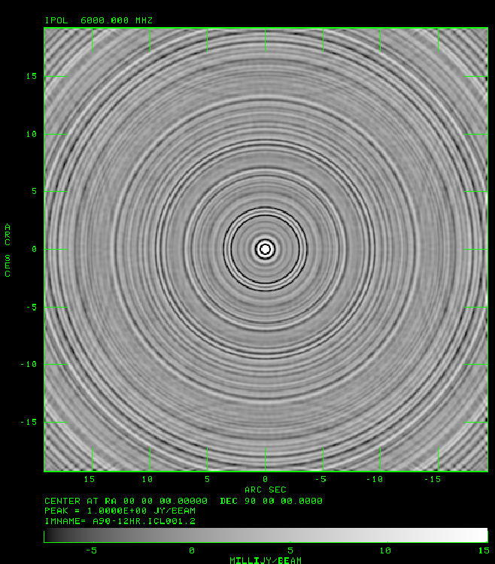
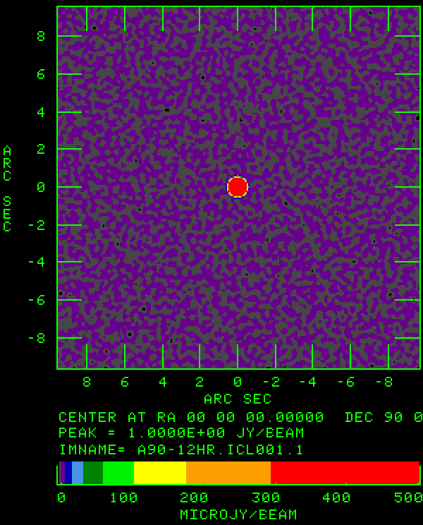
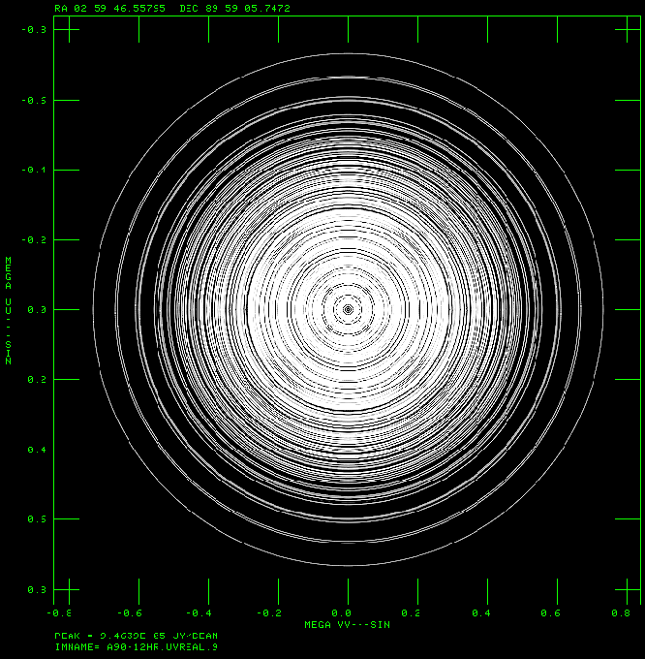
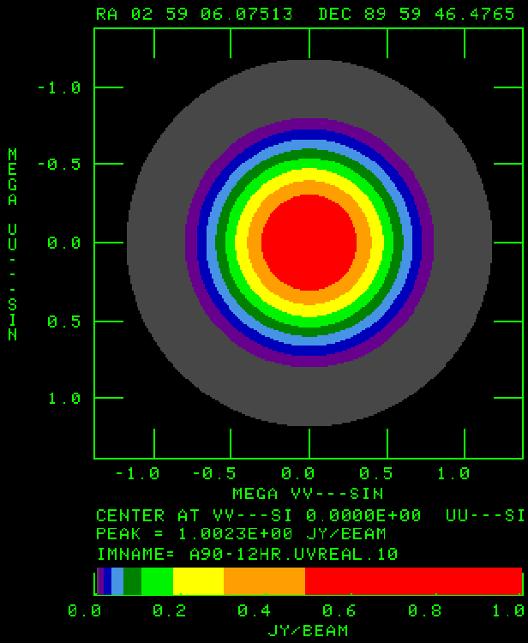
Some Examples: Ideal Data
I illustrate these ideas with some simple simulations.
EVLA , ν₀ = 6 GHz, BW = 4 GHz, δ = 90, ‘A’-configuration
Used the AIPS program ‘UVCON’ to generate visibilities, with S = 1 Jy.
The ‘Dirty’ Map after a 12 hour observation.
Note the ‘reflected’ grating rings.
The ‘Clean’ Map
1σ = 1.3 μJy
Pk = 1 Jy
No artifacts!
The U-V Coverage after a 12 hour observation.
Variations are due to gridding.
The FT of the ‘Clean’ map
Note that the amplitudes do *not* match the data!
The taper comes from the Clean Beam.

Slide 15

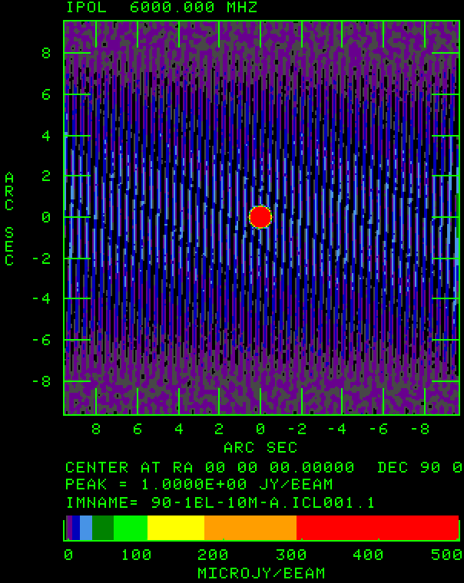
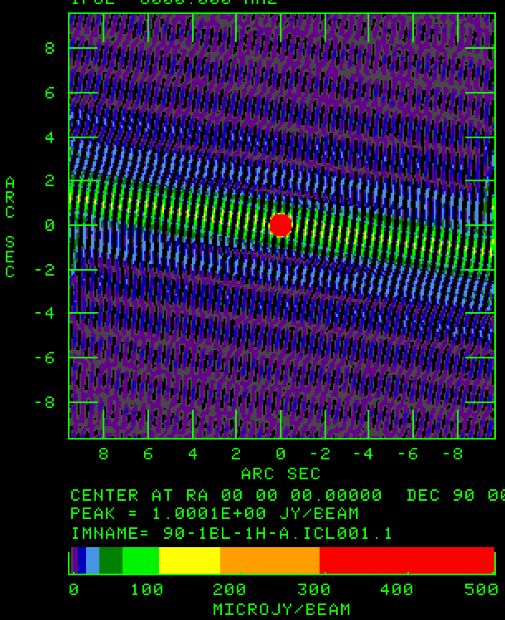
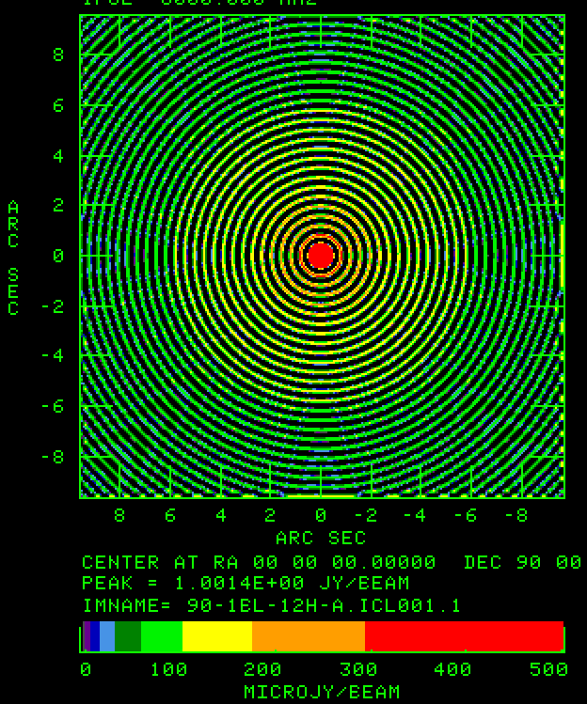
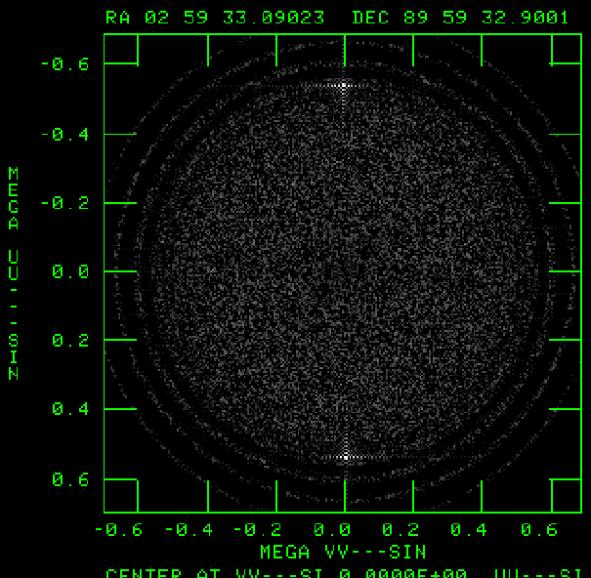
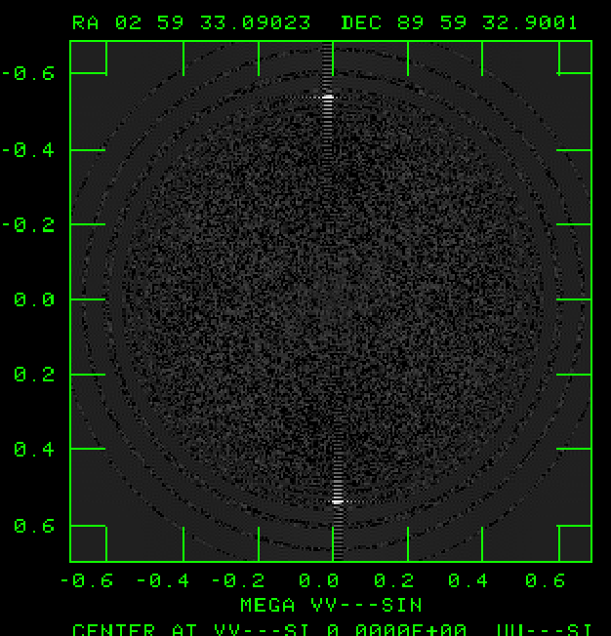
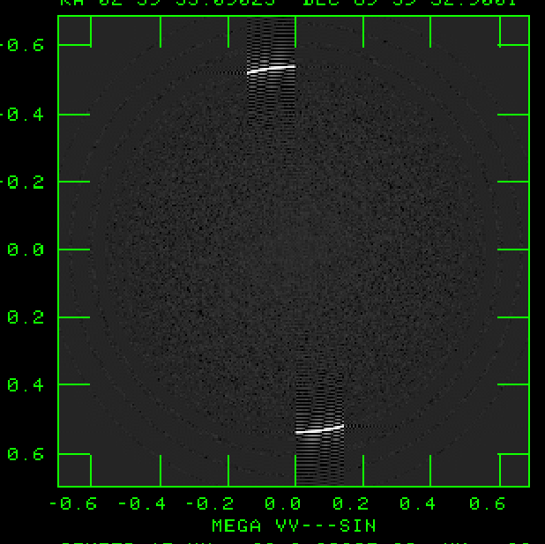
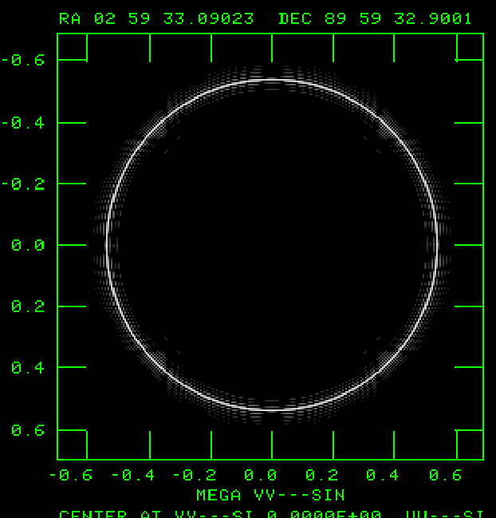
One-Baseline Errors – Amplitude Error of 10%
Examples with a single errant baseline for 1m, 10 m, 1 h, and 12 hours
N_{v} ~250,000
1 minute 10 minutes 1 hour 12 hours
The four ‘cleaned’ images, each with peak = 1 Jy.
All images use the same transfer function.
1 σ = 1.9 μJy 1 σ = 9.4 μJy 1 σ = 25 μJy 1 σ = 79 μJy
The four U-V plane amplitudes.
Note the easy identification of the errors.

Slide 16
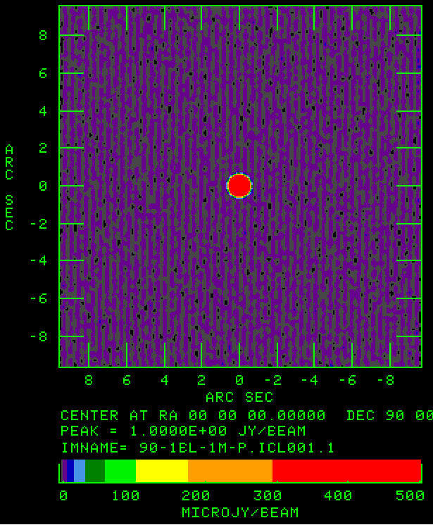
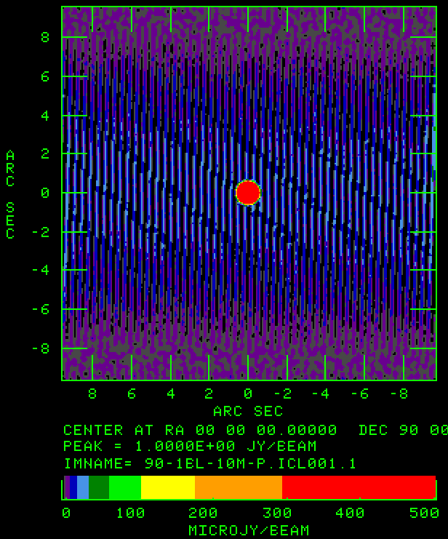
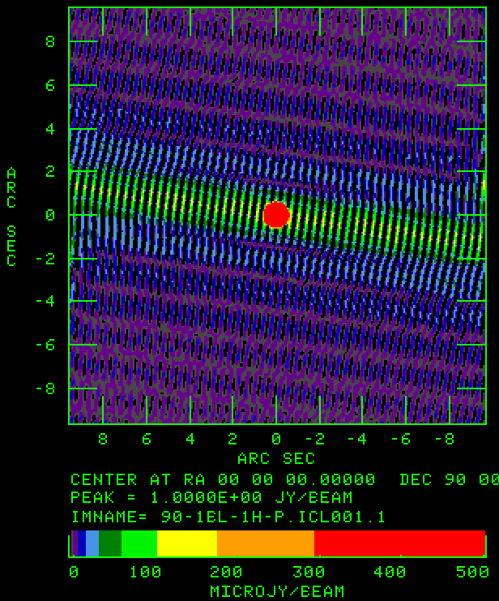
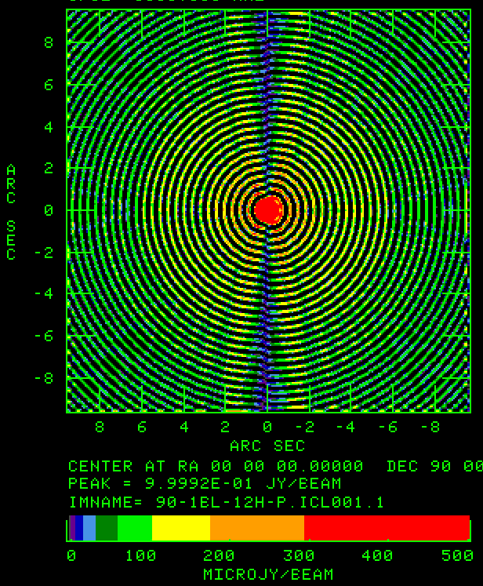
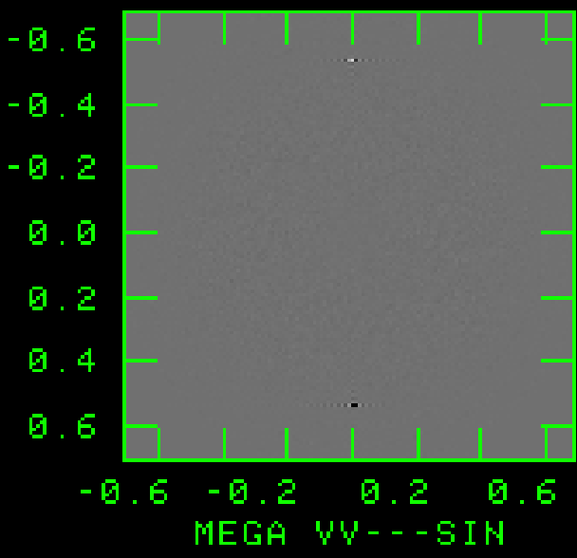
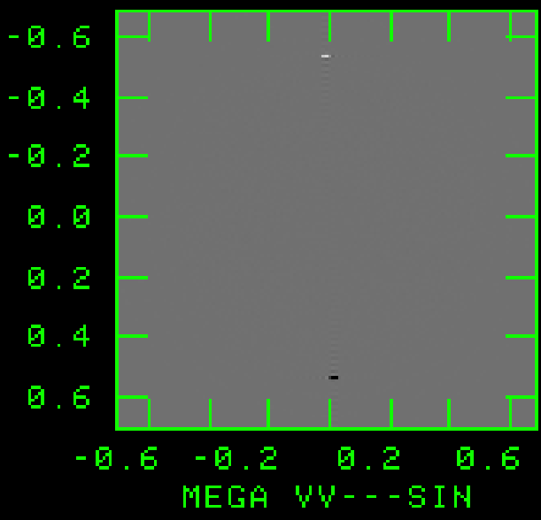
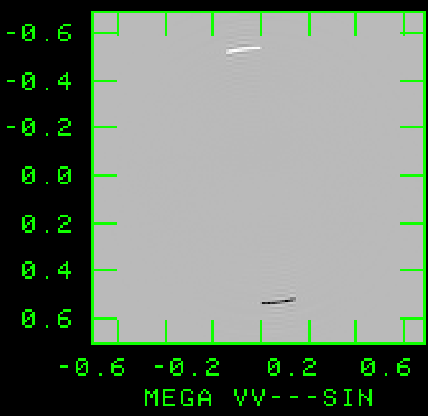
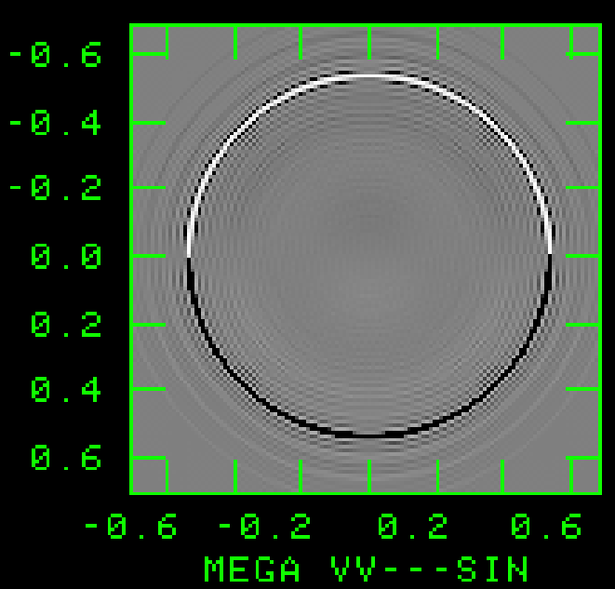
One-Baseline Errors – Phase Error of 0.1 rad = 6 deg.
Examples with a single errant baseline for 1m, 10 m, 1 h, and 12 hours
N_{v} ~250,000
1 minute 10 minutes 1 hour 12 hours
The four ‘cleaned’ images, each with peak = 1 Jy.
All images use the same transfer function.
1 σ = 2.0 μJy 1 σ = 9.8 μJy 1 σ = 26 μJy 1 σ = 82 μJy
The four U-V plane phases.
Note the easy identification of the errors.

Slide 17
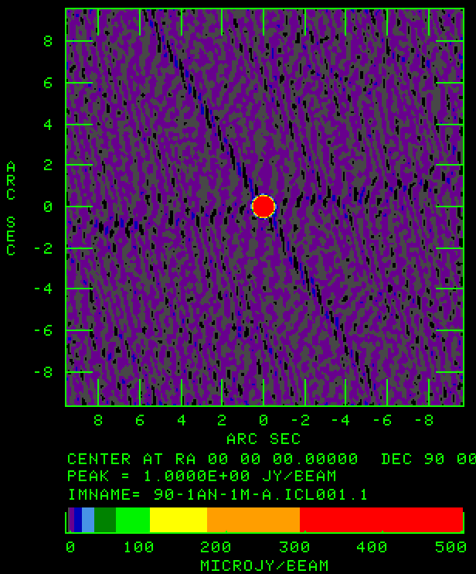
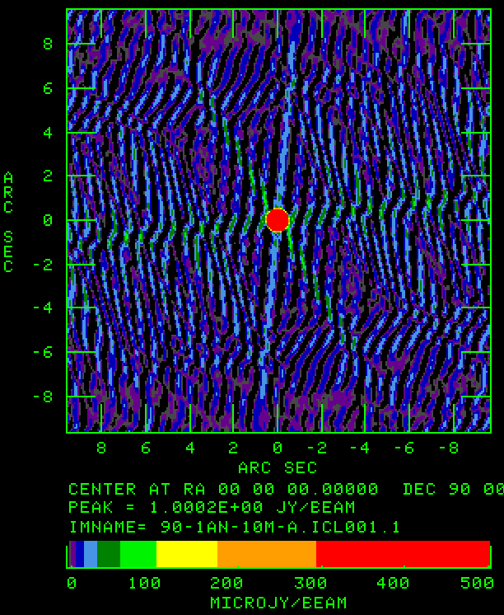
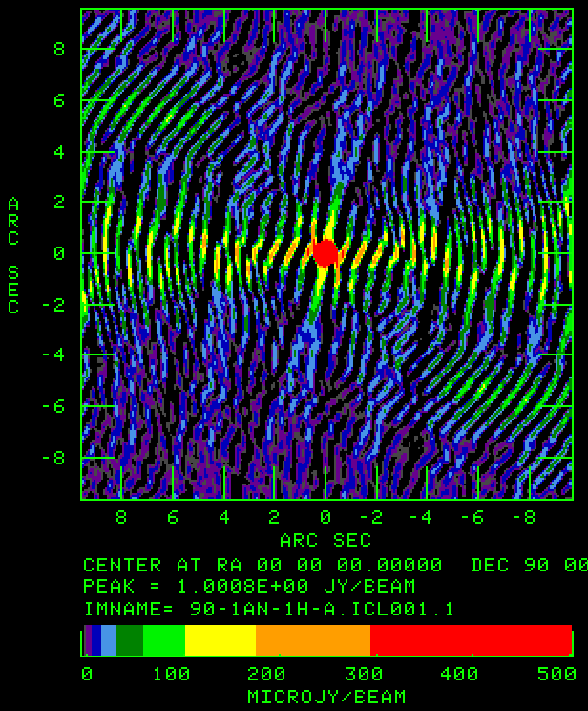
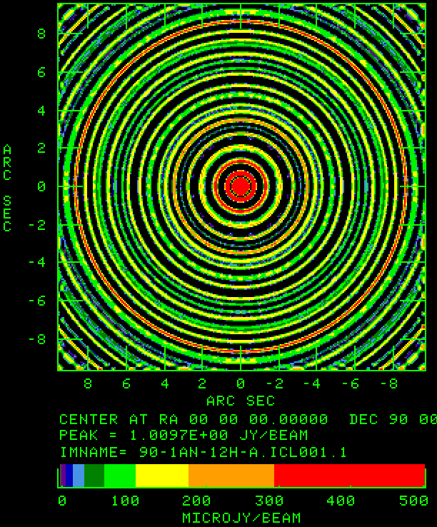
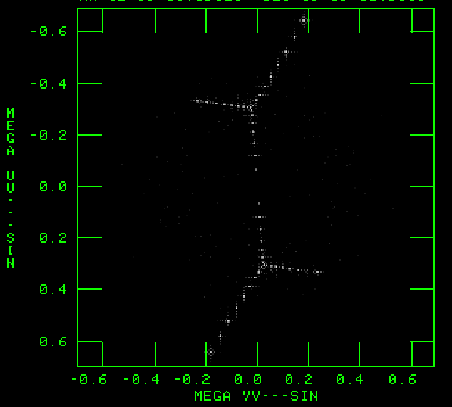
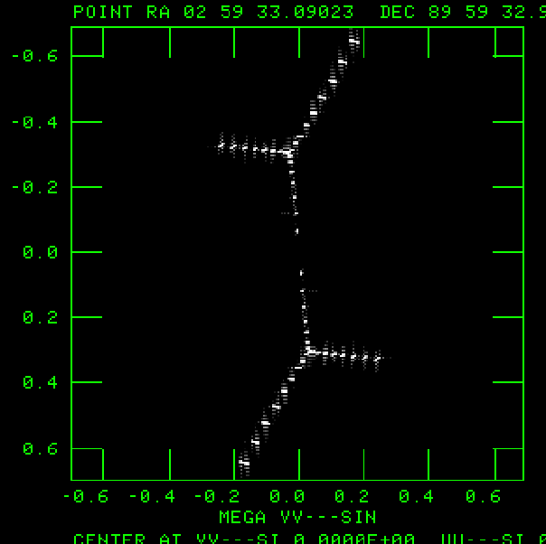
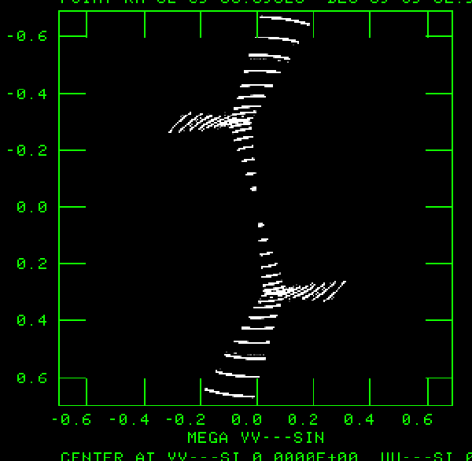
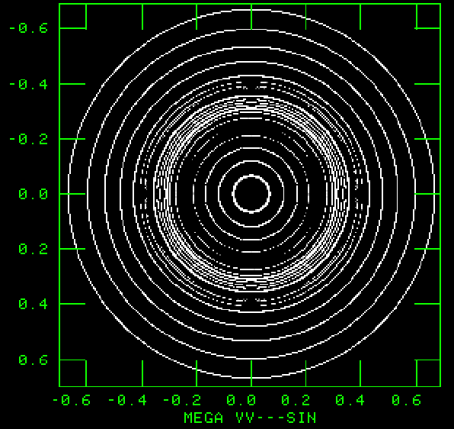
One-Antenna Errors – Amplitude Error of 10%
Examples with a single errant antenna for 1m, 10 m, 1 h, and 12 hours
N_{v} ~250,000
1 minute 10 minutes 1 hour 12 hours
The four ‘cleaned’ images, each with peak = 1 Jy.
All images use the same transfer function.
1 σ = 2.3 μJy 1 σ = 16 μJy 1 σ = 42 μJy 1 σ = 142 μJy
The four U-V plane amplitudes.
Note the easy identification of the errors.

Slide 18
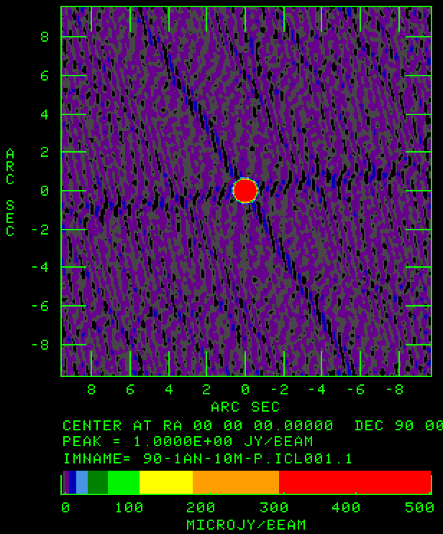
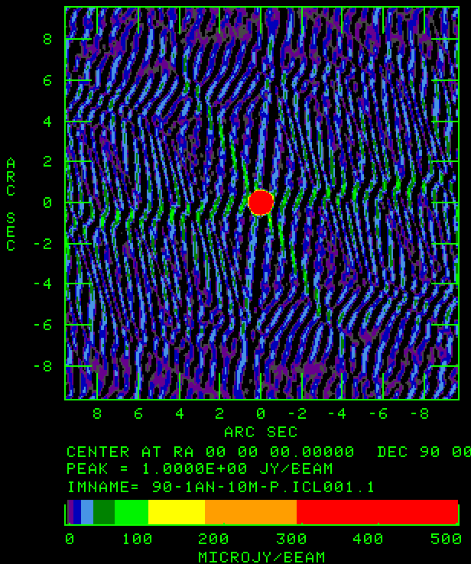

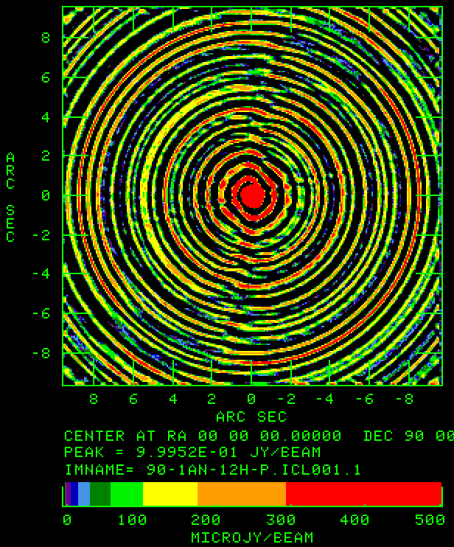
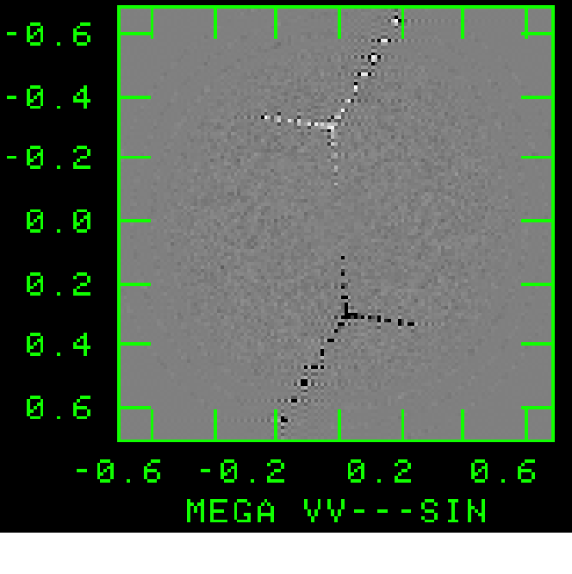
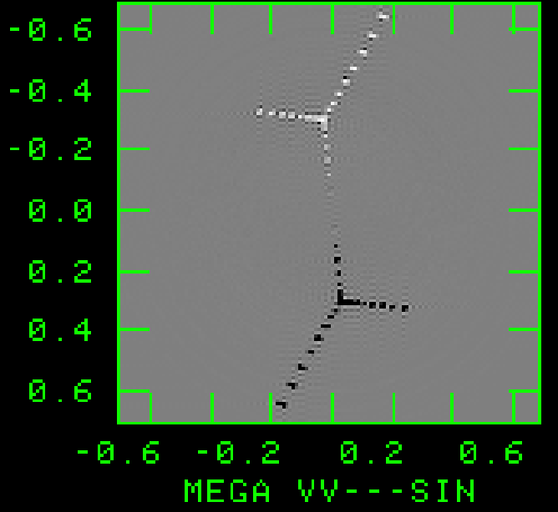
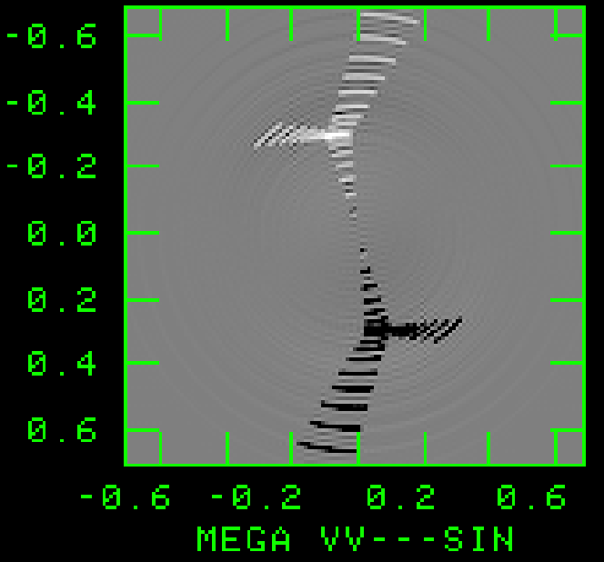
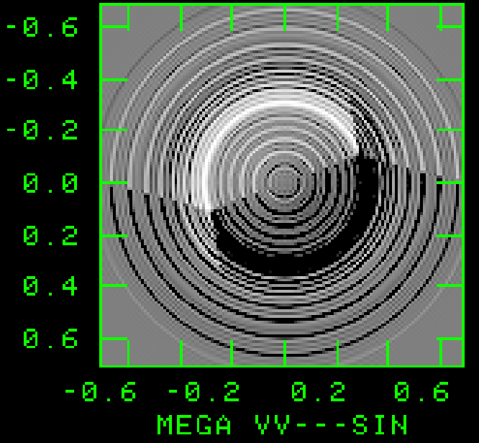
One-Antenna Errors – Phase Error of 0.1 rad = 6 deg.
Examples with a single errant antenna for 1m, 10 m, 1 h, and 12 hours
N_{v} ~250,000
1 minute 10 minutes 1 hour 12 hours
The four ‘cleaned’ images, each with peak = 1 Jy.
All images use the same transfer function.
1 σ = 2.9 μJy 1 σ = 20 μJy 1 σ = 52 μJy 1 σ = 147 μJy
The four U-V plane phases.
Note the easy identification of the errors.

Slide 19
Finding and Correcting, or Removing Bad Data
How to find and fix bad data?
We first must consider the types, and origins, of errors.
We can write, in general:
Here, is the calibrated visibility, and is the observed visibility.
g_{i}(t) is an antenna based gain
g_{ij}(t) is a multiplicative baseline-based gain.
C_{ij}(t) is an additive baseline-based gain, and
ε_{ij}(t) is a random additive term, due to noise.
In principle, the methods of self-calibration are extremely effective at finding and removing all the antenna-based (‘closing’) errors.
The method’s effectiveness is usually limited by the accuracy of the model.
In the end, it is usually the ‘non-closing’ errors which limit fidelity for strong sources.

Slide 20
Finding and Correcting, or Removing Bad Data
Self-calibration works well for a number of reasons:
    The most important errors really are antenna-based (notably atmospheric/instrumental phase.
    The error is ‘seen’ identically on N - 1 baselines at the same time – improving the SNR by a factor ~ .
    The N – 1 baselines are of very different lengths and orientations, so the effects of errors in the model are randomized amongst the baselines, improving robustness.
Non-closing errors can also be calibrated out – but here the process is much less robust! The error is on a single baseline, so not only is the SNR poorer, but there is no tolerance to model errors. The data will be adjusted to precisely match the model you put in!
  Some (small) safety will be obtained if the non-closing error is constant in time – the solution will then average over the model error, with improved SNR.

Slide 21
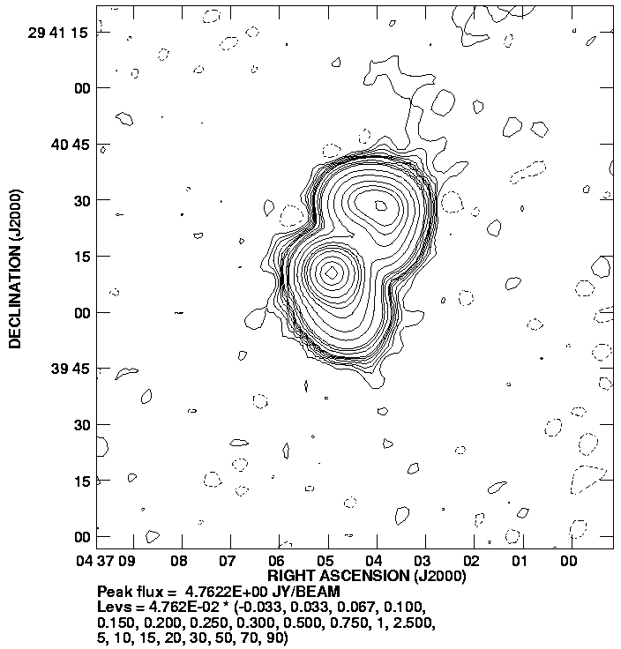
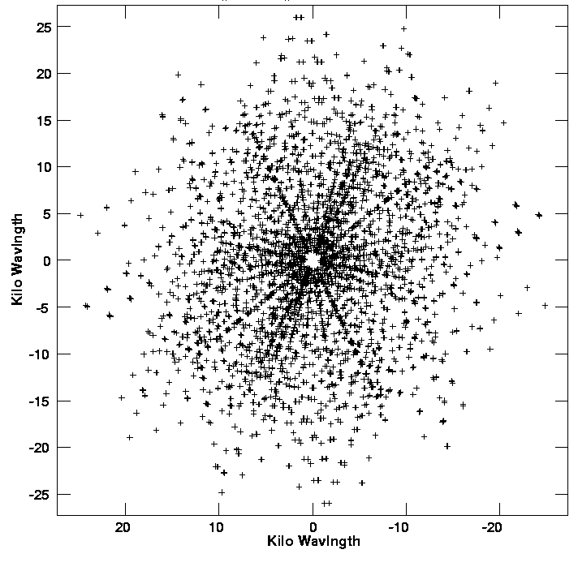
Finding and Correcting, or Removing Bad Data –
a simple example.
I show some ‘multiple snapshot’ data on 3C123, a fluxy compact radio source, observed in D-configuration in 2007, at 8.4 GHz.
There are 7 observations, each of about 30 seconds duration.
For reference, the ‘best image’, and UV-coverage are shown below.
Resolution = 8.5 arcseconds. Maximum baseline ~ 25 kλ

Slide 22
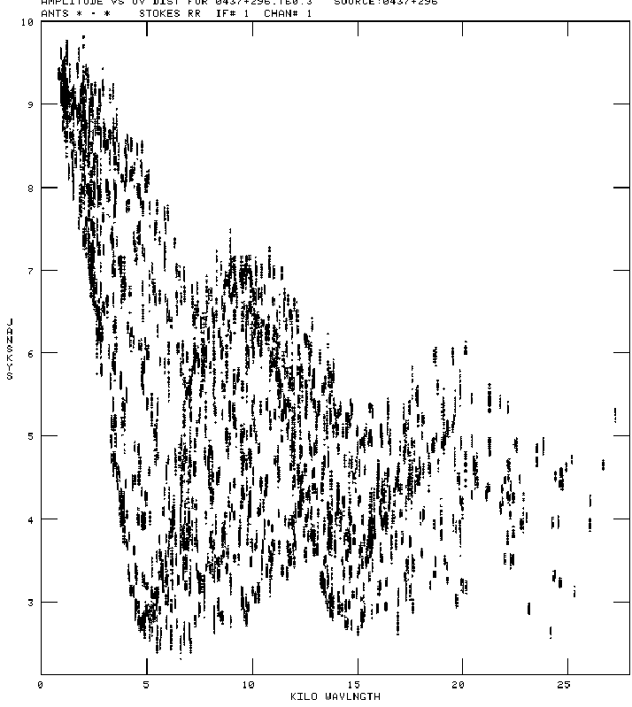
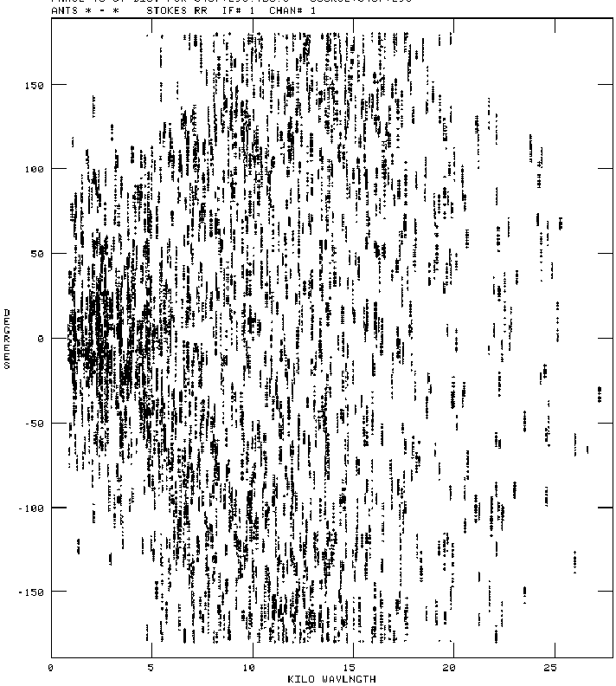
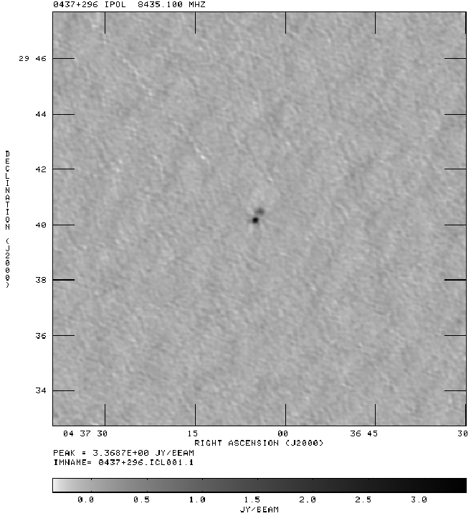
Following standard calibration against unresolved point sources, and editing the really obviously bad data, the 1-d visibility plots look like this, in amplitude and phase:
Ugh!
Note that the amplitudes look quite good, but the phases do not.
We don’t expect a great image.
Image peak: 3.37 Jy/beam; Image rms = 63 mJy.
DR = 59 – that’s not good!

Slide 23
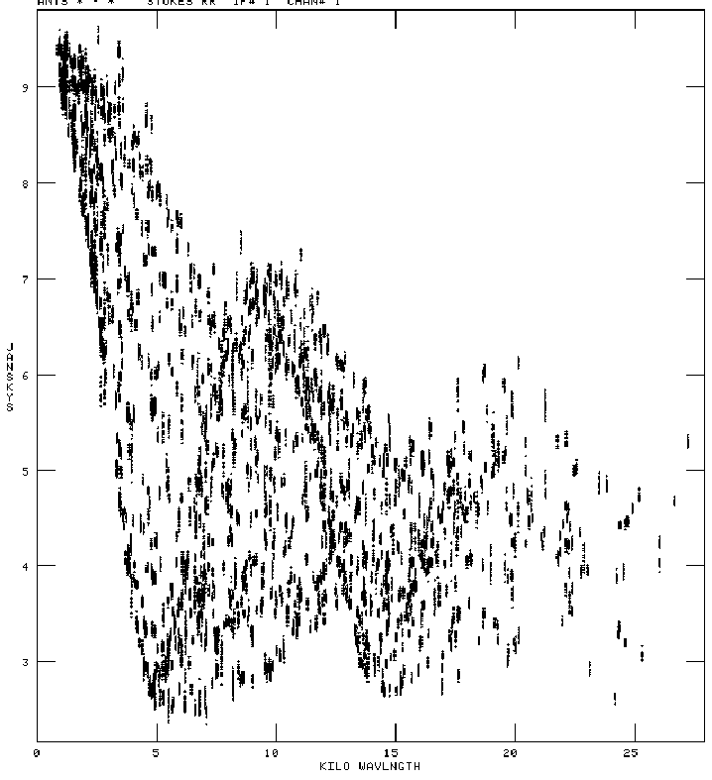
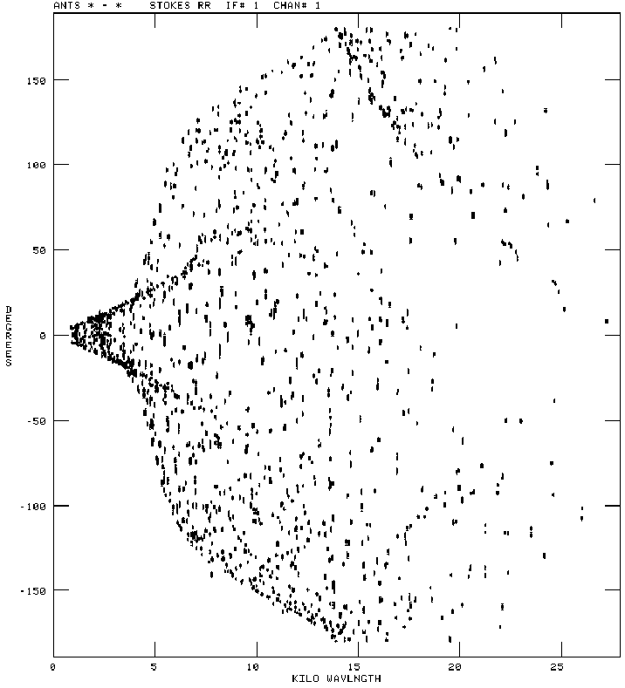
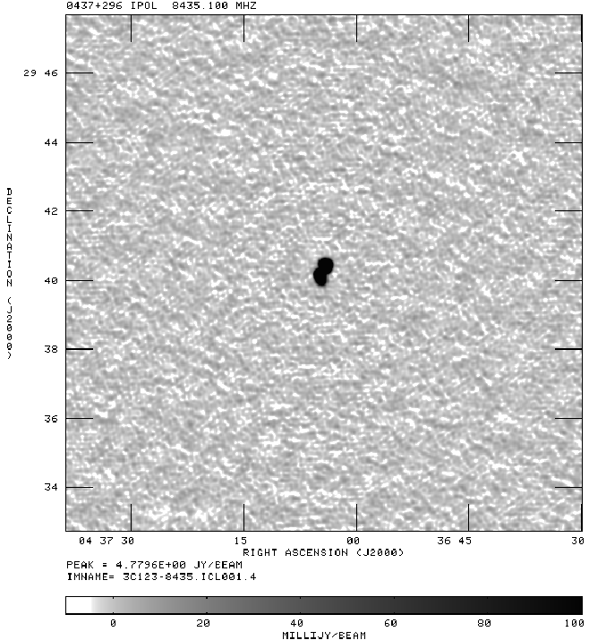
Using our good reference image, we do an ‘amplitude and phase’ self-cal.
The resulting distributions and image are shown below.
Nice!
What’s this?
Note that the amplitudes look much the same, but the phase are much better organized..
Image peak: 4.77 Jy/beam; Image rms = 3.3 mJy.
DR = 1450 – better, but far from what it should be…

Slide 24
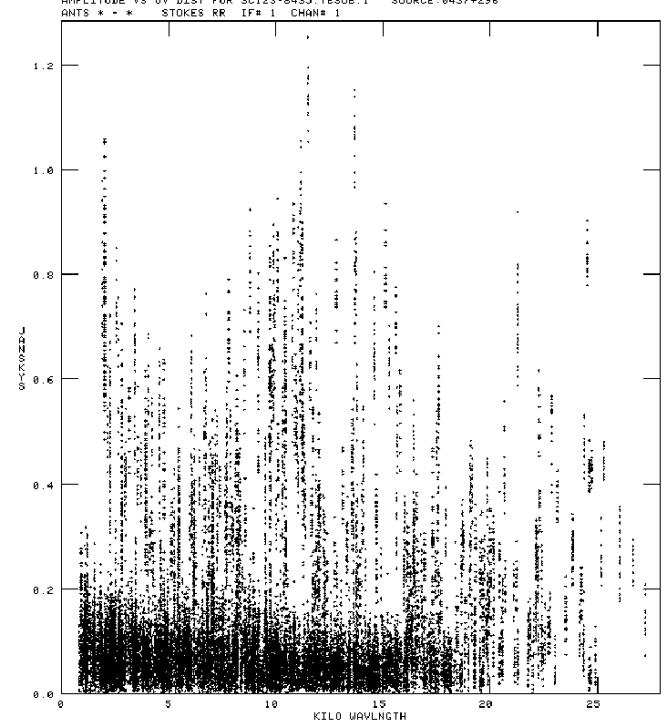
When self-calibration no longer improves the image, we must look for more exotic errors.
The next level are ‘closure’, or baseline-based errors.
The usual step is to subtract the (FT) of your model from the data.
In AIPS, the program used is ‘UVSUB’.
Plot the residuals, and decide what to do …
If the model matches the data, the residuals should be in the noise – a known value.
For these data, we expect ~50 mJy.
Most are close to this, but many are not.
These are far too large
These are about right.

Slide 25
Removing or Correcting Baseline-based Errors
Once it is determined there are baseline-based errors, the next questions is: What to do about them?
Solution A: Flag all discrepant visibilities;
Solution B: Repair them.
Solution A:
  For our example, I clipped (‘CLIP’) all residual visibilities above 200 mJy, then restored the model visibilities.
  Be aware that by using such a crude tool, you will usually be losing some good visibilities, and you will let through some bad ones …
Solution B:
  Use the model to determine individual baseline corrections.
  In AIPS, the program is ‘BLCAL’. This produces a set of baseline gains that are applied to the data.
  This is a powerful – but *dangerous* tool …
  Since ‘closure’ errors are usually time invariant, use that condition.

Slide 26
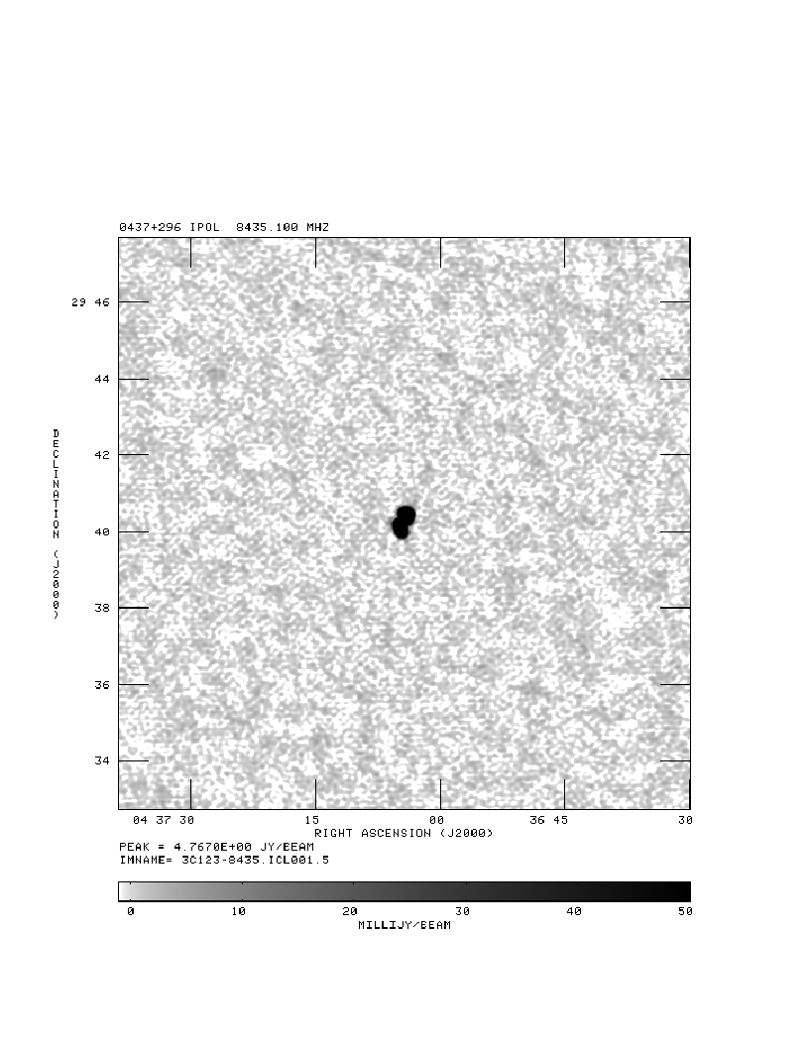
On Left – Image after clipping high residual visibilities. 20.9 kVis used.
On Right – Image after correcting for baseline-based errors.
Peak = 4.77 Jy s = 1.2 mJy Peak = 4.76 Jy s = 0.83 mJy
DR = 3980 DR = 5740

Slide 27
Law of Diminishing Returns
or
Knowing When to Quit
I did not proceed further for this example.
One can (and many do) continue the process of:
  Self-calibration (removing antenna-based gains)
  Imaging/Deconvolution (making your latest model)
  Visibility subtraction
  Clipping residuals, or a better baseline calibration.
  Imaging/Deconvolution
The process always asymptotes, and you have to give it up, or find a better methodology.
Note that not all sources of error can be removed by this process.

Slide 28
Sources of Error
I conclude with a short summary of sources of error.
This list is necessarily incomplete.
Antenna-Based Errors
  Electronics gain variations – amplitude and phase – both in time and frequency.
    Modern systems are very stable – typically 1% in amplitude, a few degrees in phase
  Atmospheric (Tropospheric/Ionospheric) errors.
    Attenuation very small at wavelengths longer than ~2 cm – except through heavy clouds (like thunderstorms) for 2 – 6 cm.
    Phase corruptions can be very large – tens to hundreds of degrees.
    Ionosphere phase errors dominate for λ > 20cm.
  Antenna pointing errors: primarily amplitude, but also phase.
  Non-isoplanatic phase screens

Slide 29
Baseline-Based Errors – this list is much longer
  System Electronics.
    Offsets in a particular correlator (additive)
    Gain (normalization?) errors in correlator (multiplicative)
    Other correlator-based issues (WIDAR has ‘wobbles’ …)
    Phase offsets between COS and SIN correlators
    Non-identical bandpasses, on frequency scales smaller than channel resolution.
    Delay errors, not compensated by proper delay calibration.
    Temporal phase winds, not resolved in time (averaging time too long).

Slide 30
  Impure System Polarization
    Even after the best regular calibration, the visibilities contain contaminants from the other polarizations
    For example, for Stokes ‘I’, we can write:
    The ‘I’ visibility has been contaminated by contributions from Q, U, and V, coupled through by complex ‘D’ factors which describe the leakage of one polarization into the other.
    This term can be significant – polarization can be 30% or higher, and the ‘D’ terms can be 5%
    The additional terms can easily exceed 1% of the Stokes ‘I’.
    Polarization calibration necessary – but note that the antenna beam is variably polarized as a function of angle.

Slide 31
Other, far-out effects (to keep you awake at night …)
Correlator quantization correction
  Digital correlators are non-linear – they err in the calculation of the correlation of very strong sources.
  This error is completely eliminated with WIDAR.
Non-coplanar baselines.
  Important when
  Software exists to correct this.
Baseline errors: incorrect baselines leads to incorrect images.
  Apply baseline corrections to visibility data, perhaps determined after observations are completed.
Deconvolution Algorithm errors
  CLEAN, VTESS, etc. do not *guarantee* a correct result!
  Errors in data, holes in the coverage, absence of long or short spacings will result in incorrect images.
  Best solution – more data!

Slide 32
Wide-band data
  New instruments (like EVLA) have huge fractional bandwidths
  Image structure changes dramatically
  Antenna primary beams change dramatically
  New algorithms are being developed to manage this.
Distant structure
  In general, antennas ‘sense’ the entire sky – even if the distant structure is highly attenuated. (This problem is especially bad at low frequencies …)
  You are likely interested in only a part of the sky.
  You probably can’t afford to image the entire hemisphere …
  Some form of full-sky imaging will be needed to remove distant, unrelated visibilities.
  Algorithms under development for this.

Slide 33
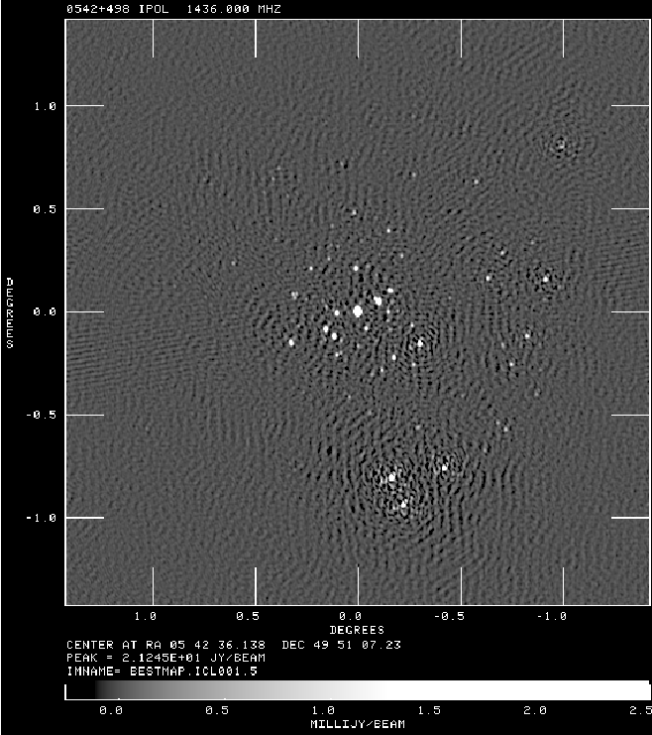
How Good Can It Get?
Shown is our best image (so far) from the EVLA.
3C147, with ‘WIDAR0’ – 12 antennas and two spectral windows at L-band (20cm).
Time averaging 1 sec.
BW averaging 1 MHz
BW 2 x 100 MHz
Peak = 21200 mJy
2nd brightest source 32 mJy
Rms in corner: 32 μJy
Peak in sidelobe: 13 mJy – largest sidelobes are around this!
DR ~ 850,000!
Fidelity quite a bit less.

