Slide 1
Observation Preparation Tool (OPT)
Loránt Sjouwerman (NRAO/Socorro)

Slide 2
Introduction
General intro
Reminder about calibration
Designing a schedule
The schedules for the Synthesis Imaging Workshop data sets
    3C391 C-band continuum polarization mozaic
    IRC10216 Ka-band dual spectral line image cube
    Screen shots of using the Observation Preparation web application
    Source catalog tool: SCT (telescope pointing directions)
    Resource catalog tool: RCT (hardware selection and setup)
    Observation preparation tool: OPT
      Build a sequence of “scans”:
        Source + resource + obs. mode + time interval + intent

Slide 3
OPT demo?
Live “demo” usually results in chaos..
If needed, a live demonstration is possible in the discussion groups
Purpose of this talk is to show the “working” of the OPT
  not why certain choices were made
  not whether this is the most optimum way
  all these depend on goal and details of observation
  maybe there is time for this during discussion groups

Slide 4
New software for a new instrument
VLA era: Observe and Jobserve scheduling tool
New correlator is much more flexible – need for new tool
Web based with central data base, code, but also disadvantages!
Learning curve for everyone and not everything included yet
Goal: computer readable observing schedule (SB) with constraints
  Some can be chosen (e.g. wind conditions, LST start range)
  Some cannot (e.g. scientific priority, allocated observing time)
  Some transferred from proposal (check!)

Slide 5
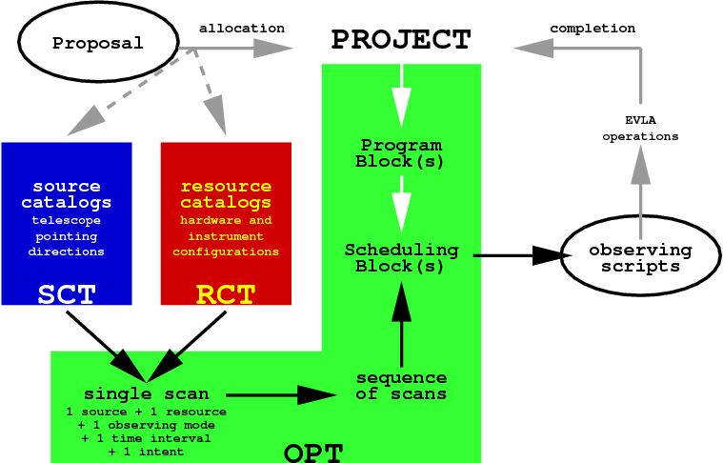
Flow diagram

Slide 6
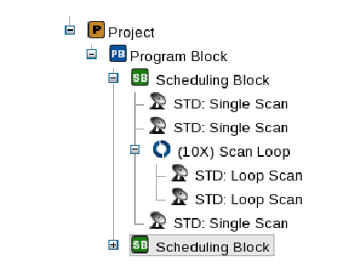
Example project “tree”
Project has Program Blocks (PB)
PB has Scheduling Blocks (SB)
  Is “observing run” script
  Sequence of scans and/or (loops of) loops of scans
  Includes calibration !

Slide 7
Reminder about calibration
Instrument is not prefect (instrumental response, variation with time, etc.)
Atmosphere is not constant (includes troposphere, ionosphere)
Want to do the science, meaning obtain correct measurements
  Such as: flux density/variability, position/astrometry/motion, structure/morphology, frequency/spectrum, polarization, other…
Observe calibrators: answers are known
  Prefer bright, nearby, point source in phase center….
  Determine and apply corrections for the right answer on the target!

Slide 8
Reminder about calibration
Observe calibrators: answers are known
    Bright: determined solution not noisy for calibration goal
    Nearby: target and calibrator are seen through same atmosphere, solutions for about the same time and for similar effects (pointing)
    Point source: amplitude is constant and independent of baseline
    at Phase center: phase is constant and zero
Apart from the target sources, the observing schedule should contain all calibrations needed to achieve the scientific goals
Note: proper calibration may take more time than observing the target
  Good to know amount of overhead before submitting proposal

Slide 9
Designing a schedule
Designing a schedule: determine which/what
  Sources to observe, and for how long (with each setup)
  Setups (“resources”) to use
    Receivers, (baseband/subband) signals, correlator
  Calibrations to perform
    Extra sources/resources? (e.g. pointing)
  Strategies and tactics to apply (short, long, less quality acceptable?)
  Optimization and constraints to choose (slew, wrap, weather..)
Everything is part of a trade-off and depends on the science goals
Demonstration of how to make a scheduling block (SB) with the OPT

Slide 10
The schedules for the 12th SIW data sets: include necessary calibration
3C391 C-band polarization
  Gain (ampl./phase) calibration
    Variations in instrument as well as in atmosphere
  Absolute flux calibration
  Bandpass and delay calibration
  Antenna pointing calibration
  Polarization angle calibration
  Polarization leakage (D-term) calibration
  Ignore other calibrations (?)
IRC10216 Ka-band line
  Gain (ampl./phase) calibration
    Variations in instrument as well as in atmosphere
  Absolute flux calibration
  Bandpass and delay calibration
  Antenna pointing calibration
  Polarization angle calibration
  Polarization leakage (D-term) calibration
  Ignore other calibrations (?)

Slide 11
Designing the 3C391 observing run
7 field mozaic, 7 sources with roughly equal time on source
  Enough signal to be able to use self-calibration
Could use default C band continuum (OSRO1) setup (but didn’t)
Flux: 3C286, can also be used for EVPA calibration (answer: –66˚)
Bandpass: 3C84
Unpolarized nearby point source: J1822–0938 (gain, pol.z leakage)
  C band (i.e. about 5 GHz) thus cycle every ~30 minutes
Do not break into small observing runs (polarization angle)
Spread sources over hour angle for best (u,v)-coverage
  Set up sequence and loop several times
Spread polarization leakage calibrator: include in loop

Slide 12
Designing the IRC10216 observing run
Single target line source, use Doppler setting for frequency (dynamic time)
Setup tuned to (2) Ka band frequencies with 125 kHz spectral resolution
Flux: 3C286 and bandpass: 3C273
Unpolarized nearby point source: J0954+1743 (gain, pol.z leakage)
  Ka band (i.e. about 35 GHz) thus cycle every ~5 minutes
  NOT strong enough for pointing scans: use a different pointing source
Strong (in C or X band) nearby source J1008+0730 (pointing!)
  Pointing every time Az/El changes over ~15˚
Do not break into small observing runs (short already)
Calibrator-target sequence with short cycle time: fast-switching
  Set up sequence and loop several times to accumulate on source time

Slide 13
How to start the OPT
Register at
https://my.nrao.edu
Registration/login/webaddress also good for
  Proposal submission for EVLA, GBT, VLBA (HSA)
  (preparing EVLA observations)
  Proprietary data retrieval (archive.nrao.edu)
  Obtaining user help (help.nrao.edu)
  …

Slide 14
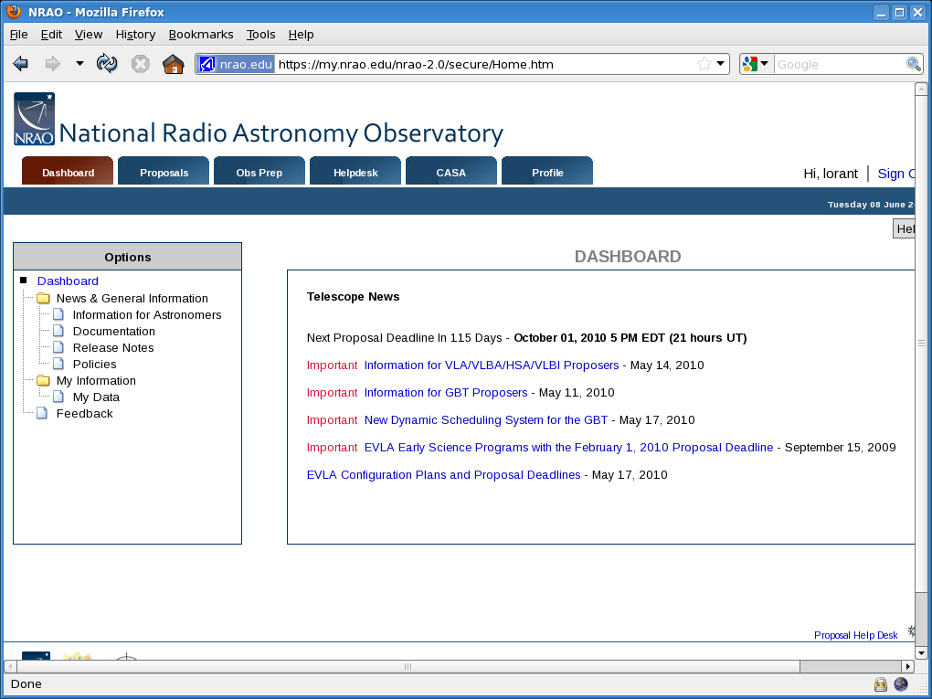

Slide 15
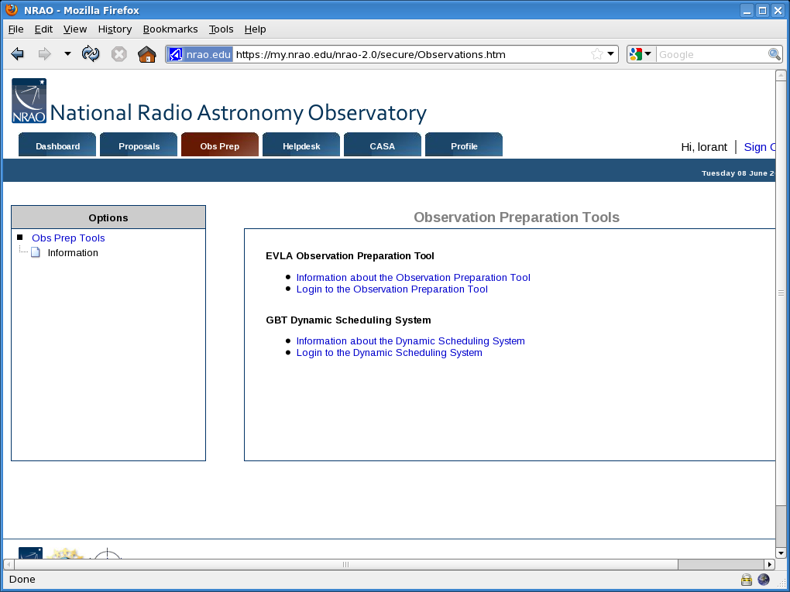

Slide 16
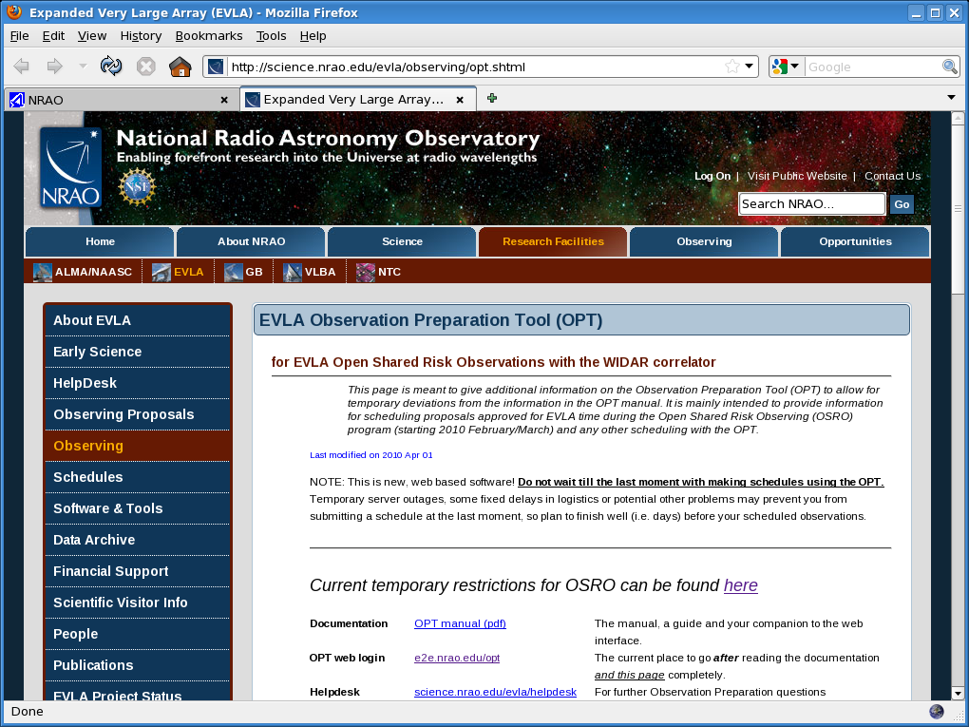

Slide 17
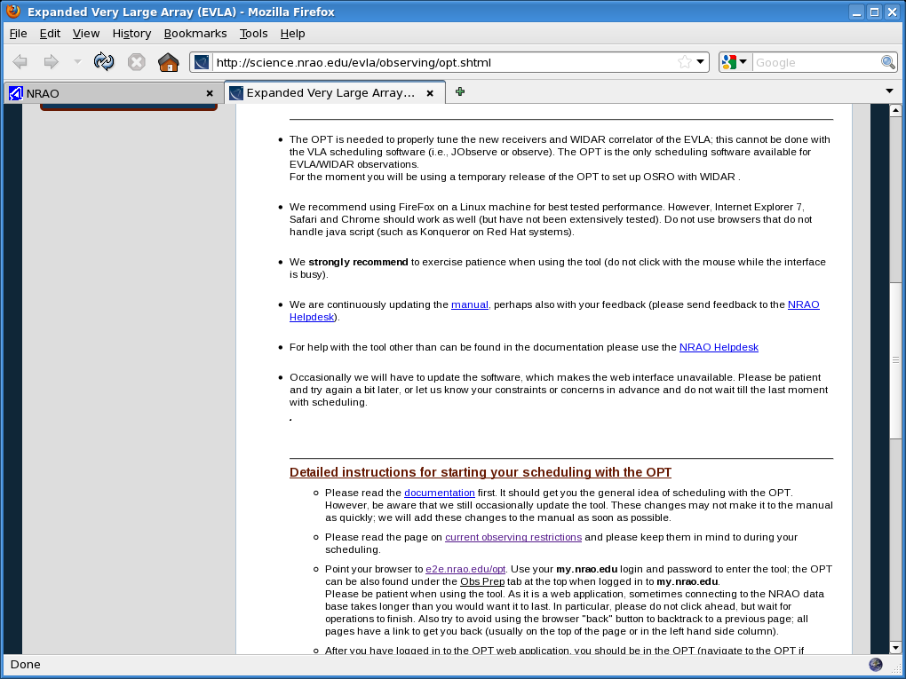

Slide 18
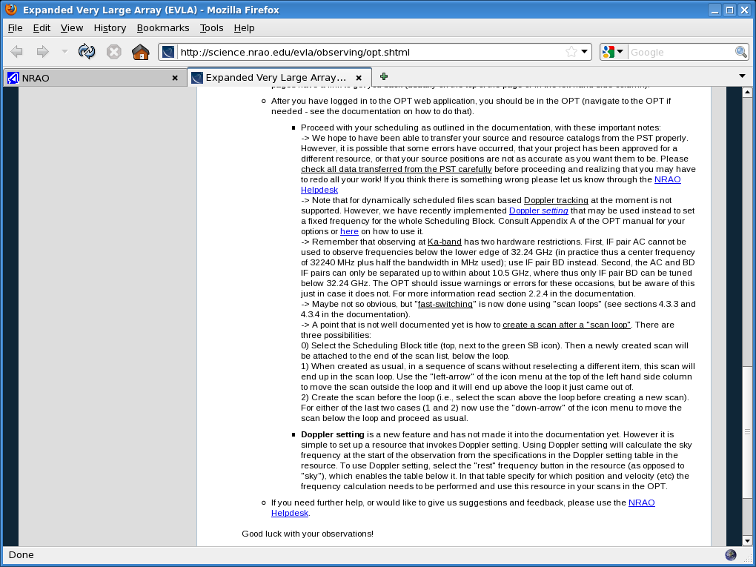

Slide 19
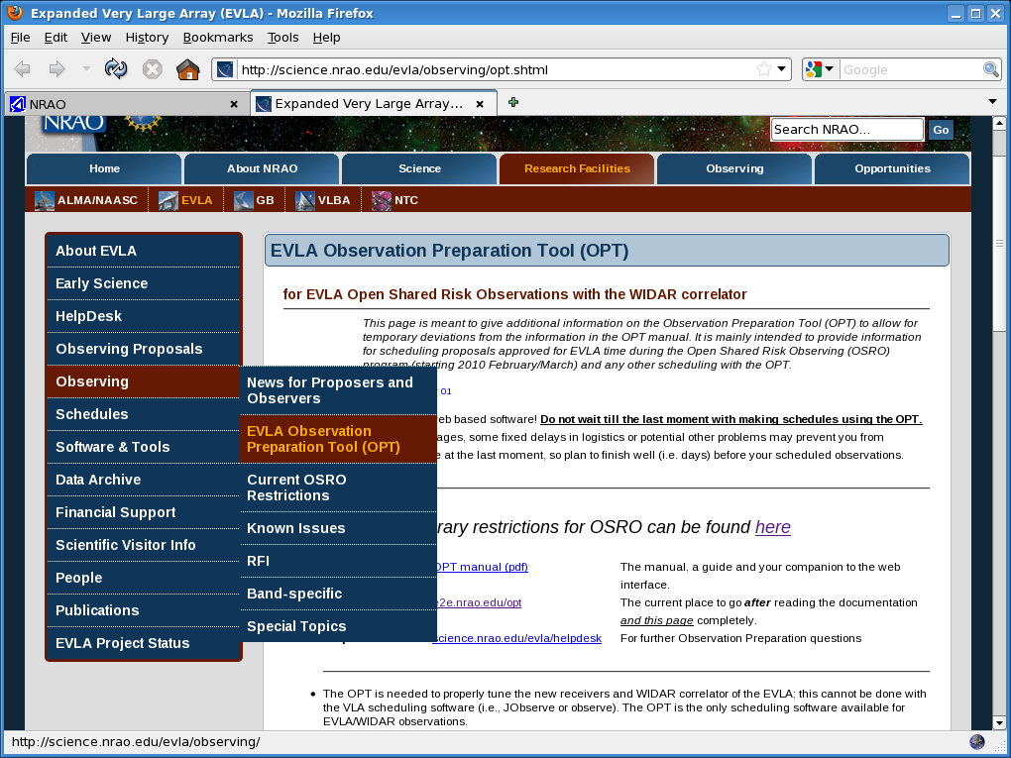

Slide 20
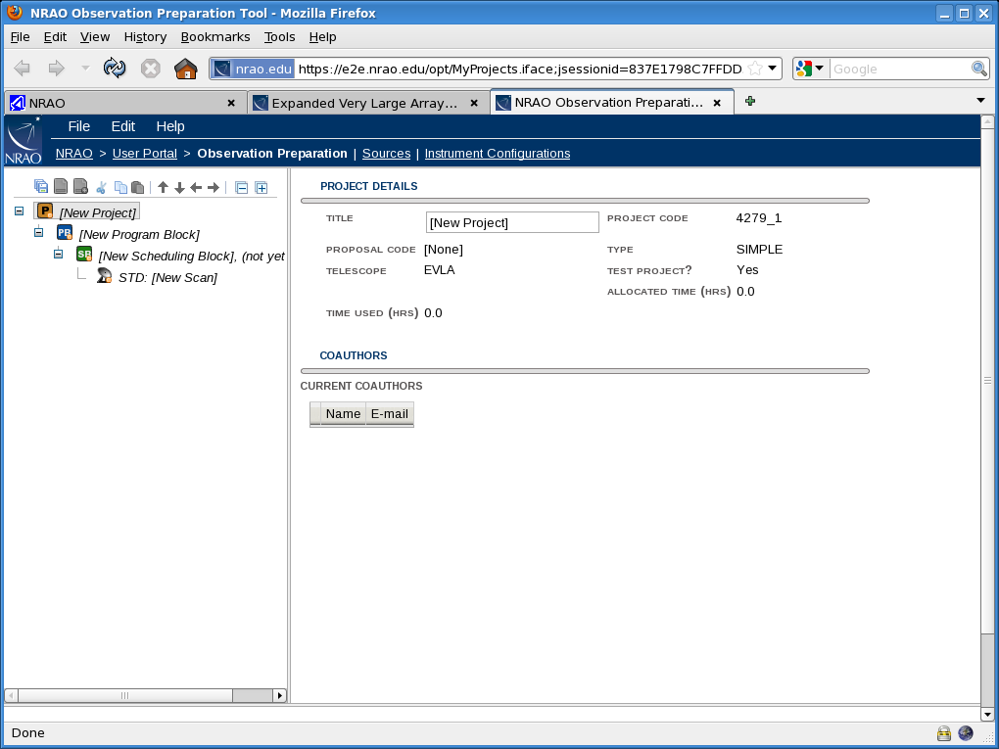

Slide 21
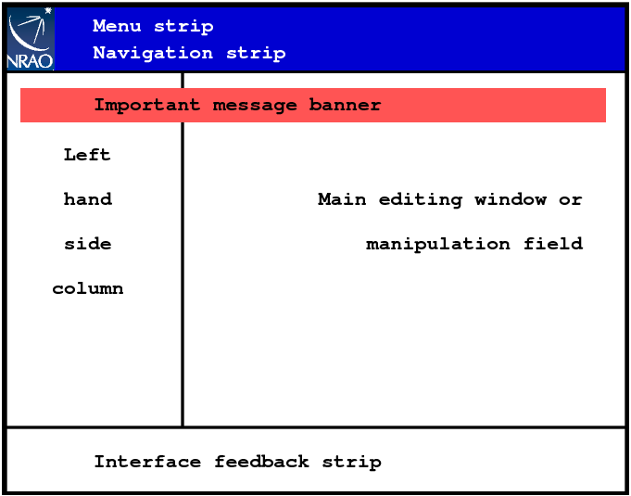
Layout of the OPT

Slide 22
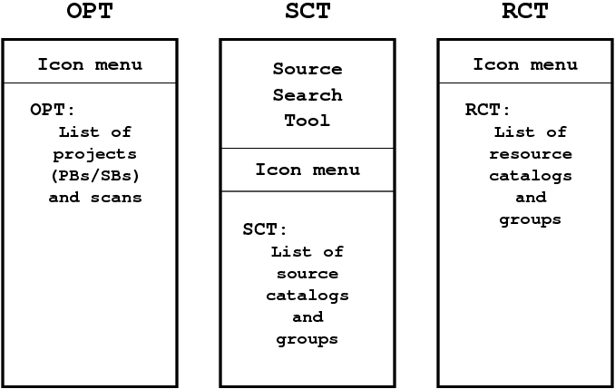
Layout of the OPT

Slide 23
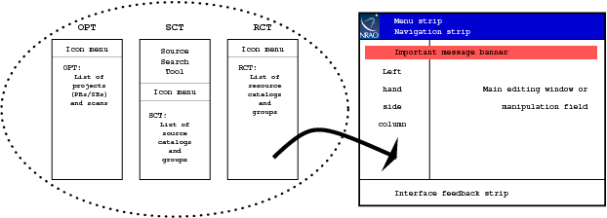
Layout of the OPT

Slide 25
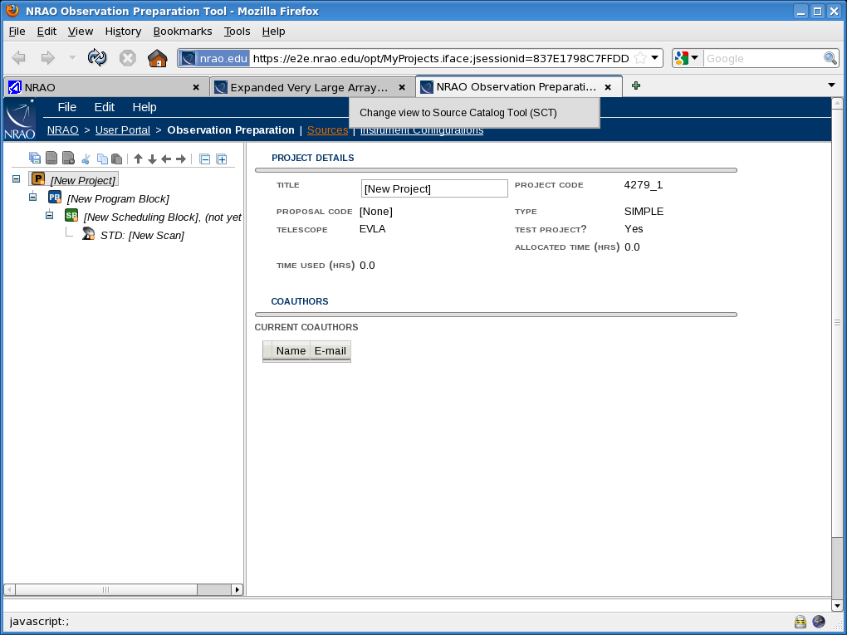

Slide 26
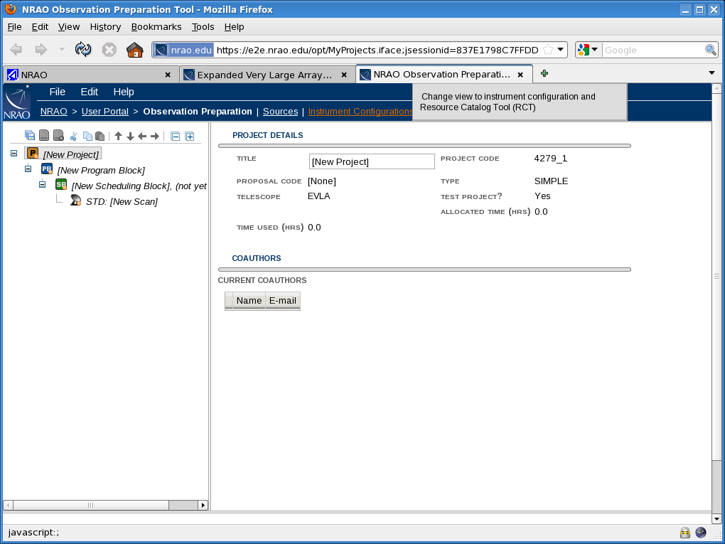

Slide 27
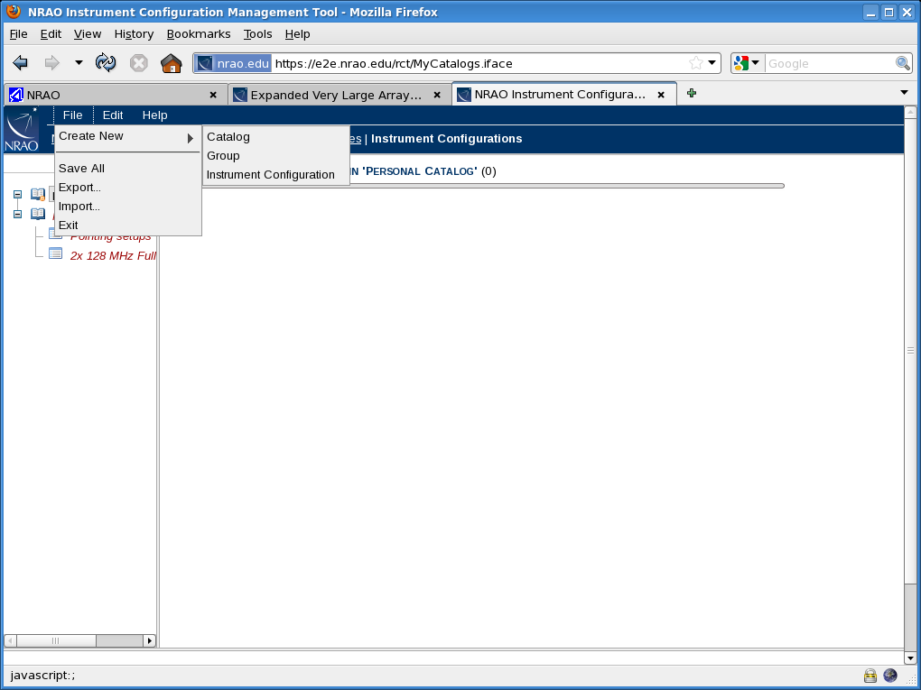

Slide 28
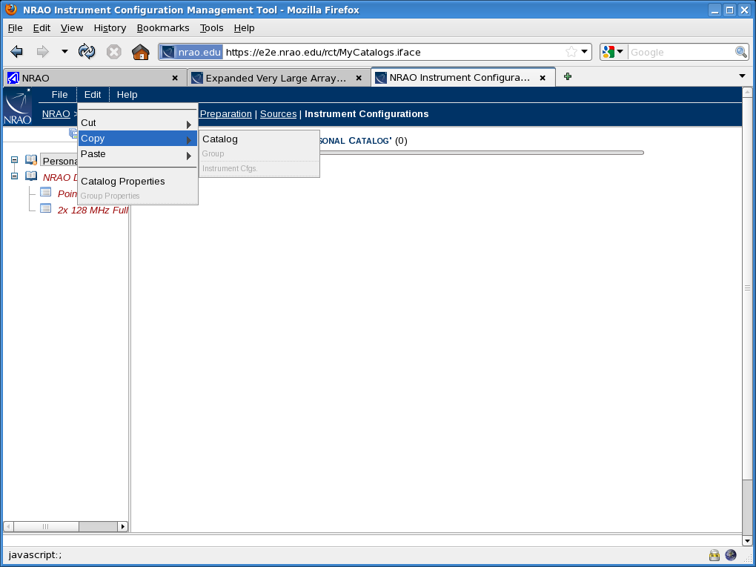

Slide 29
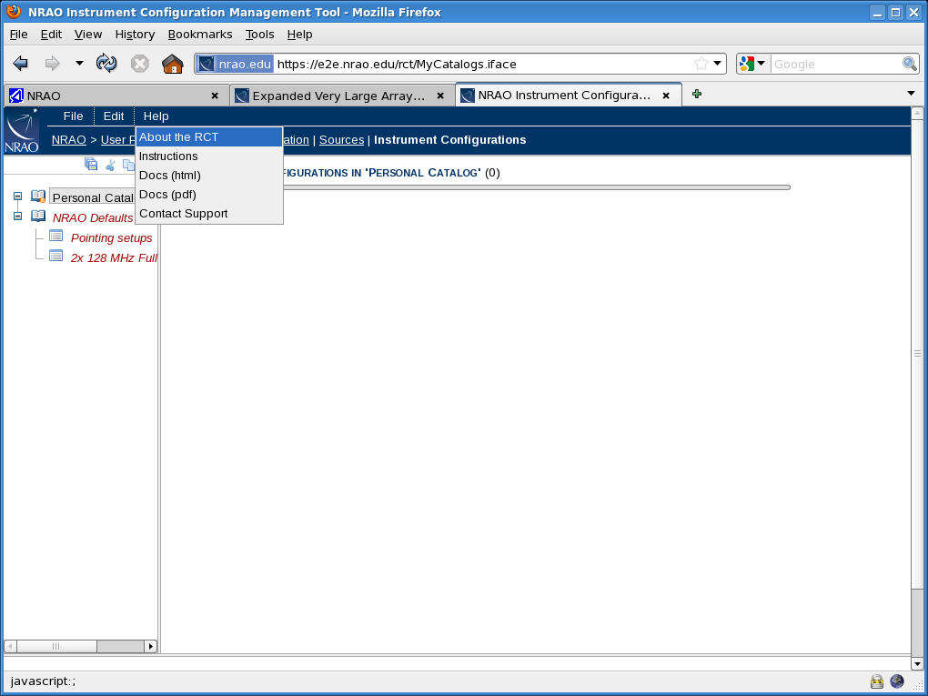

Slide 30
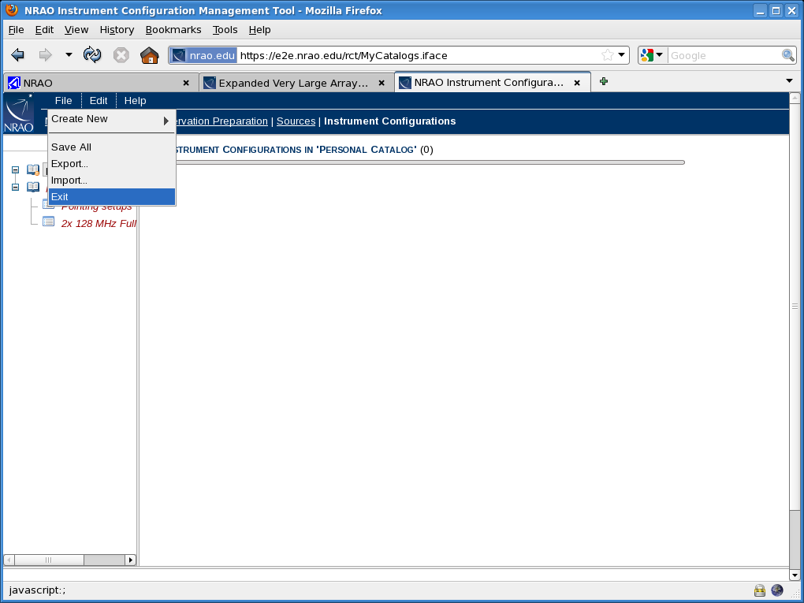

Slide 31
Creating source catalogs using the SCT
Sources may have been transferred from the proposal information
  If so, check the source positions, velocity definitions, ..
Can define your own sources (telescope pointing directions)
Can use sources predefined in (VLA) “calibrator” source list
  Not every (calibrator) source in this list is useful for calibration in every observation; check its properties before using for calibration!
  Some (calibrator) sources make great target sources…
Useful to combine all sources to be used in an SB(/PB) in its own “group”
Make sure all sources are defined before creating the scan list

Slide 33
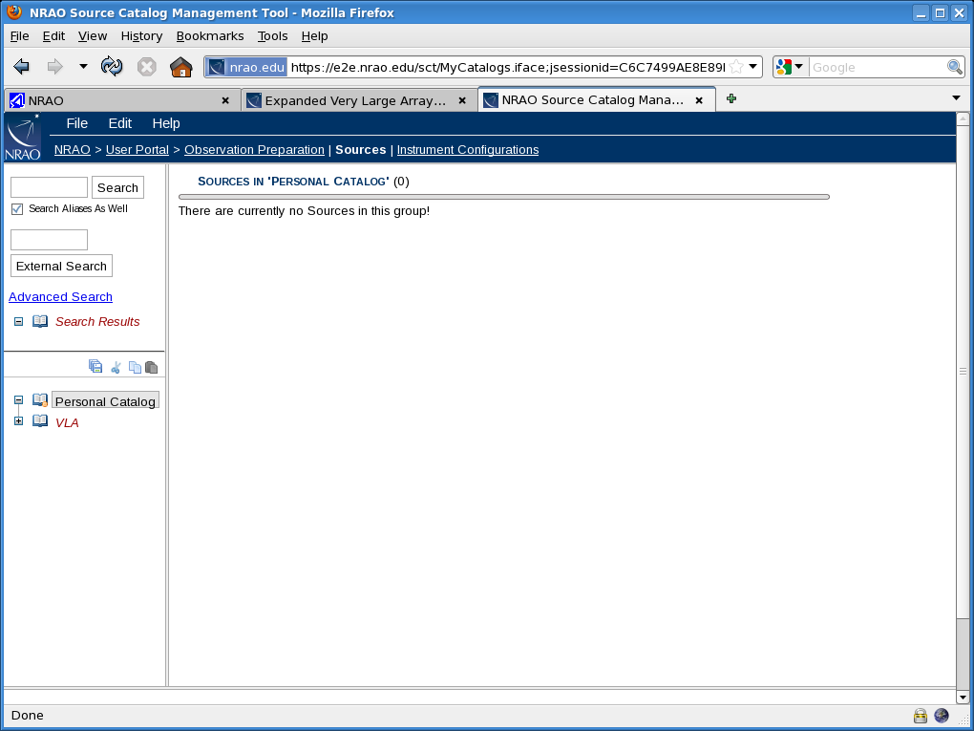

Slide 34
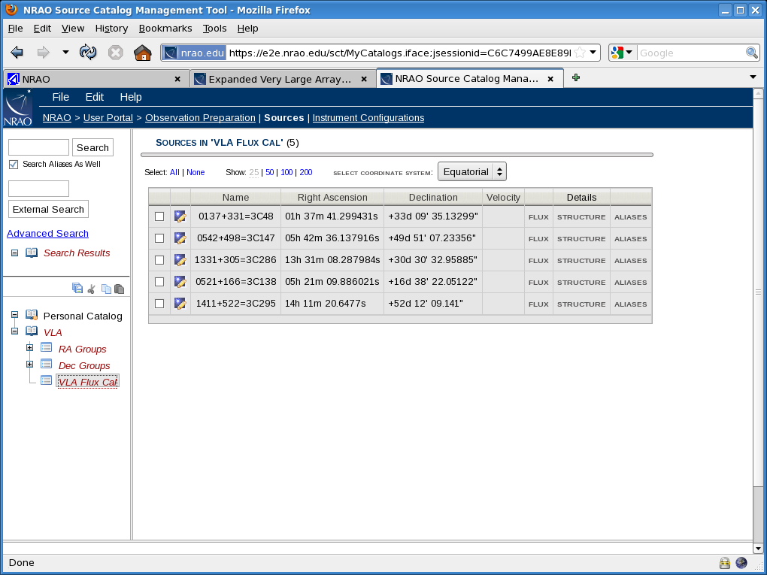

Slide 35
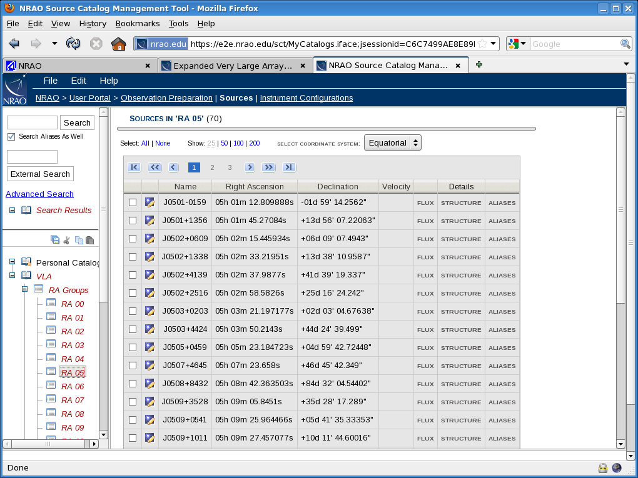

Slide 36
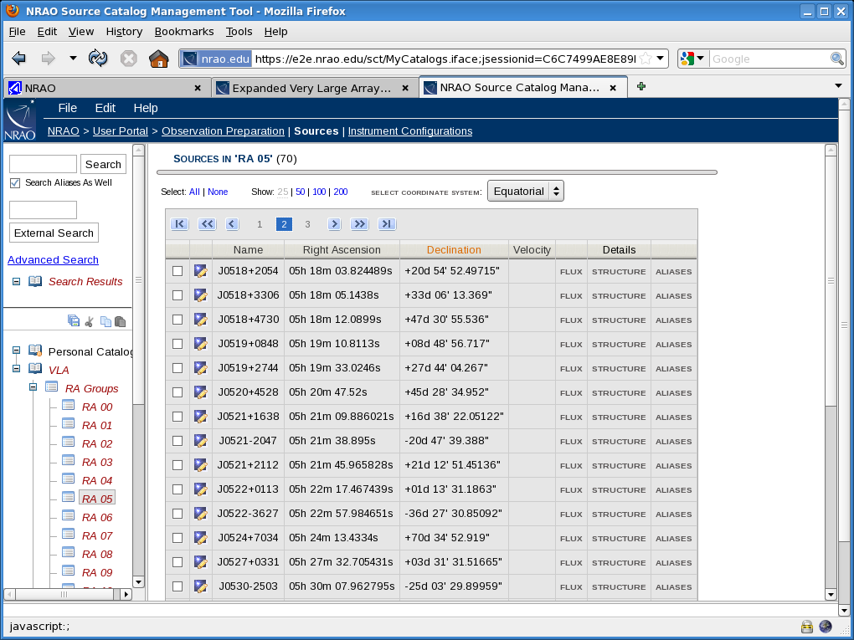

Slide 37


Slide 38
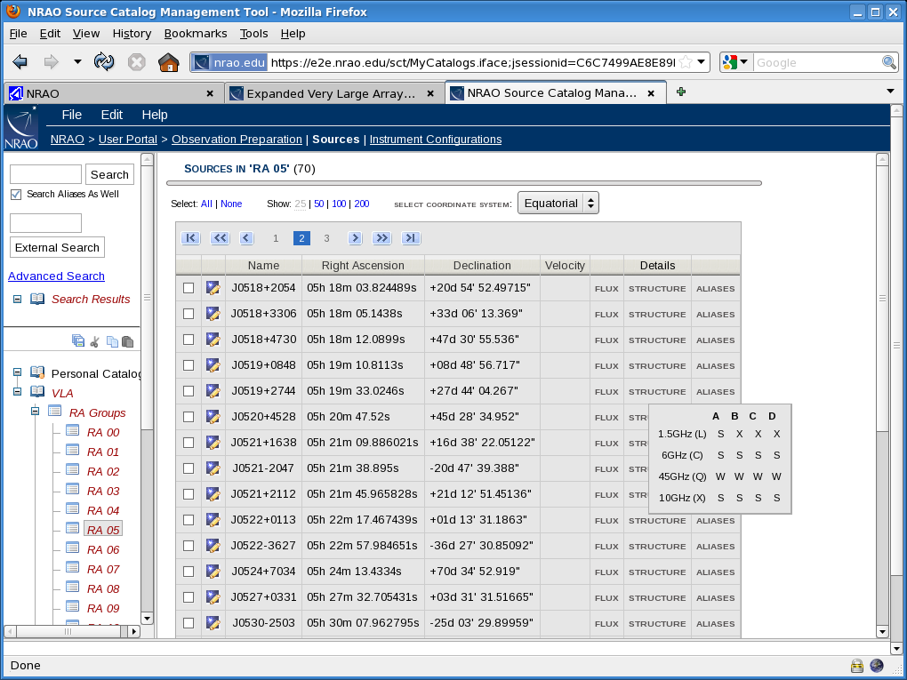

Slide 39
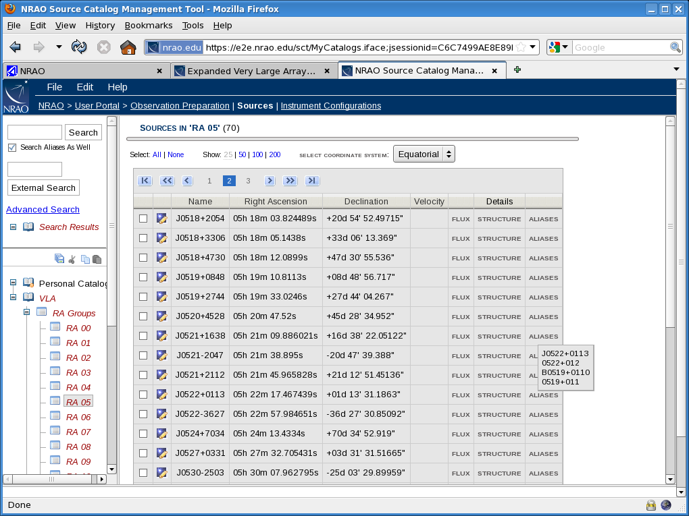

Slide 40
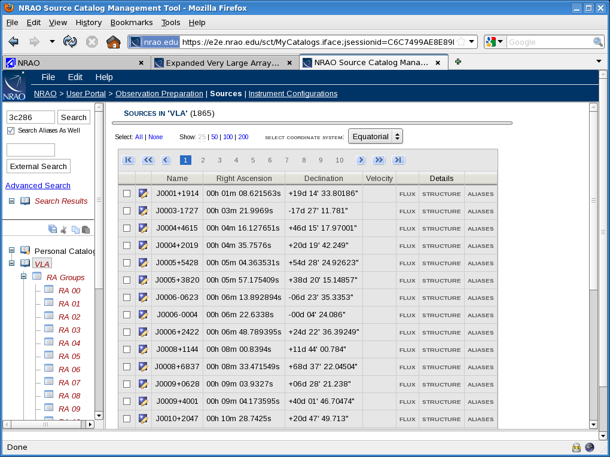

Slide 41
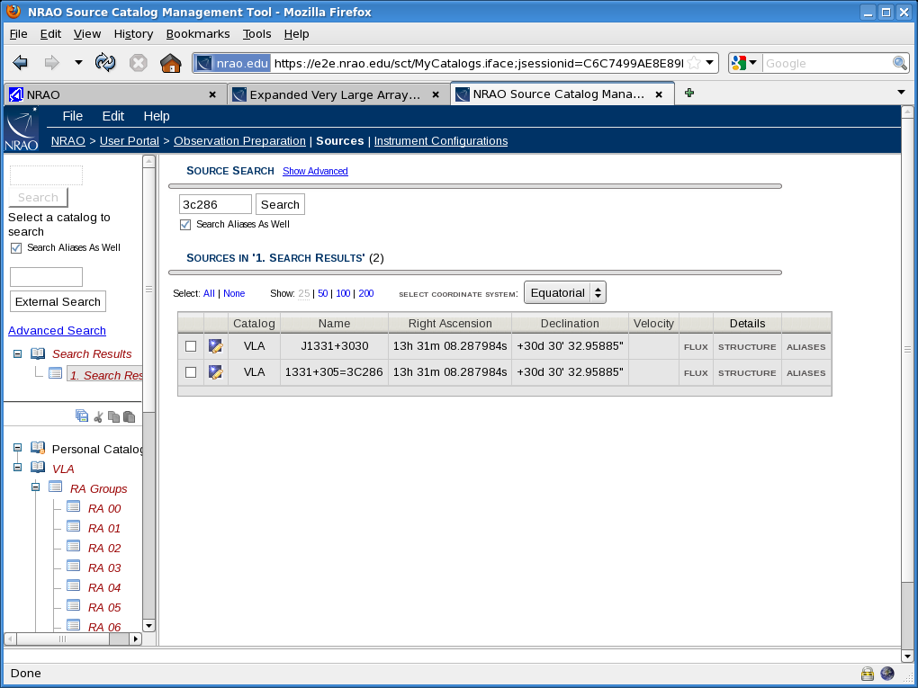

Slide 42
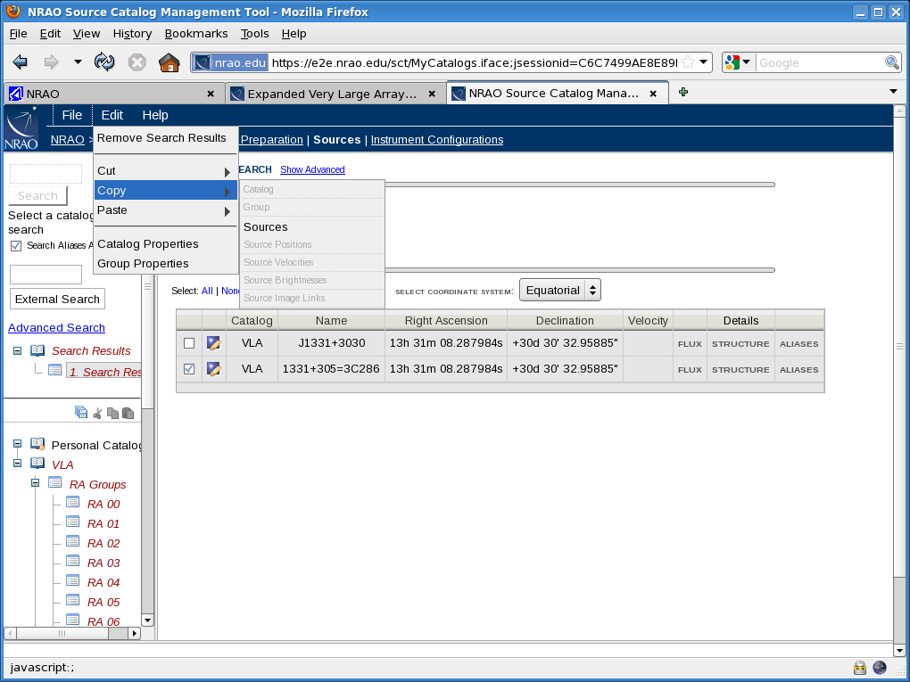

Slide 43
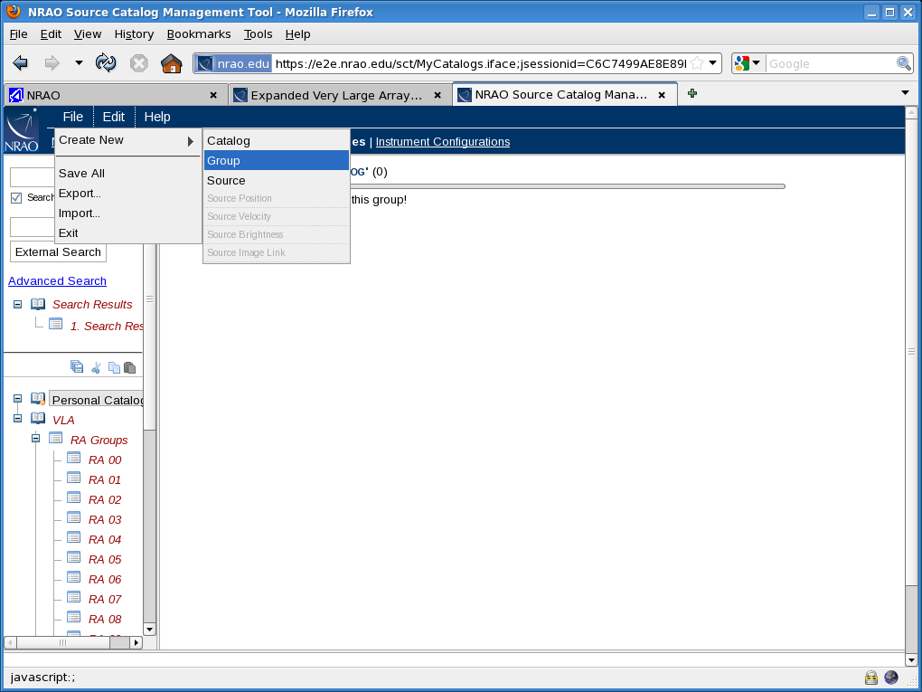

Slide 44
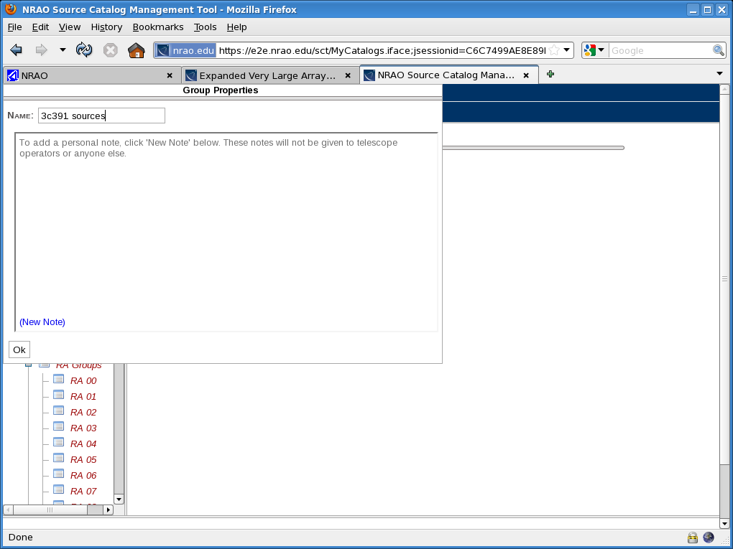

Slide 45
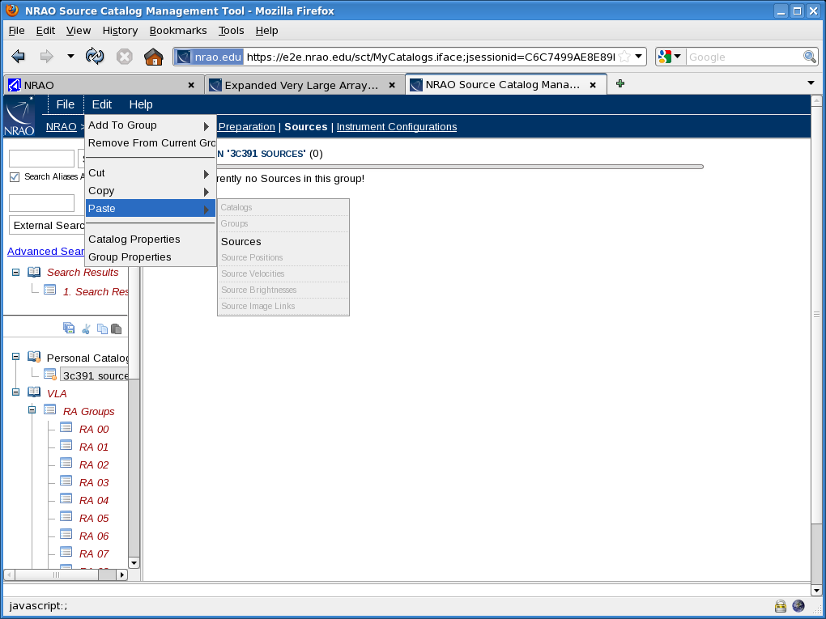

Slide 46


Slide 47
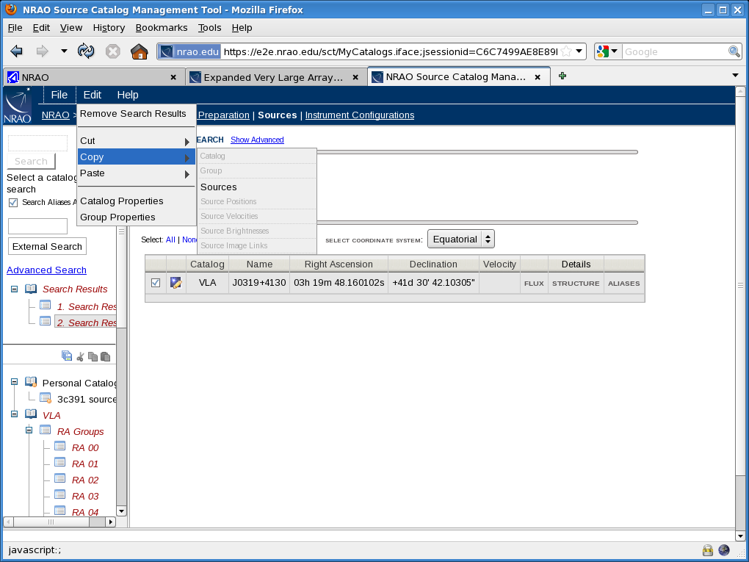

Slide 48
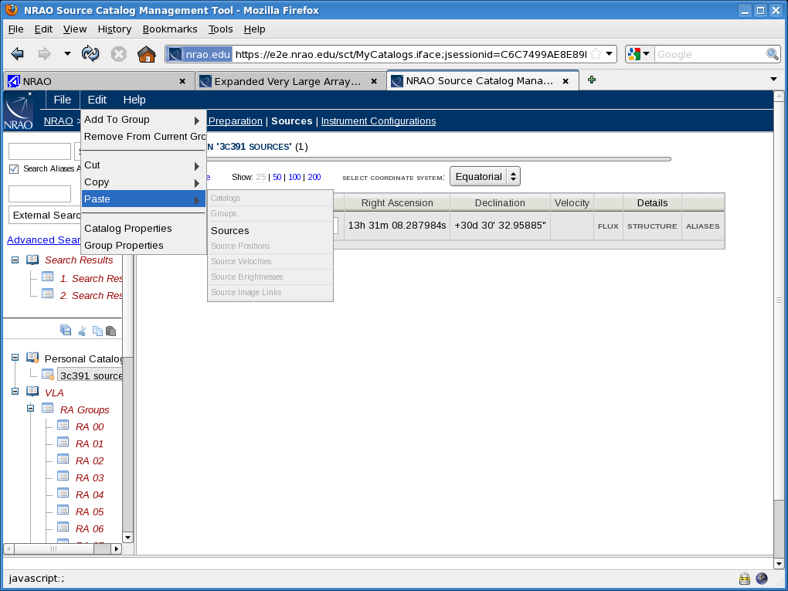

Slide 49
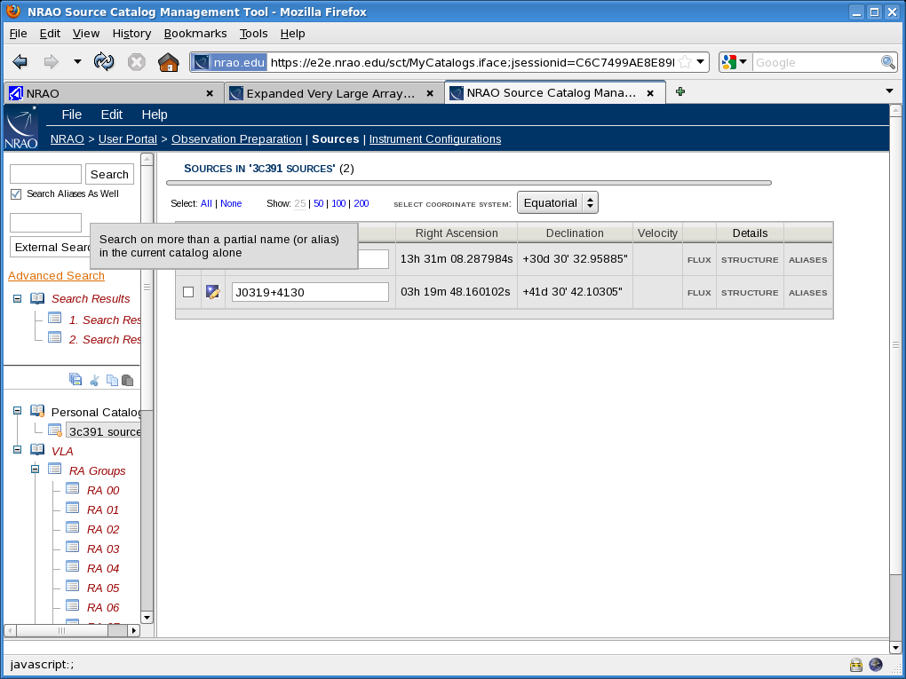

Slide 50
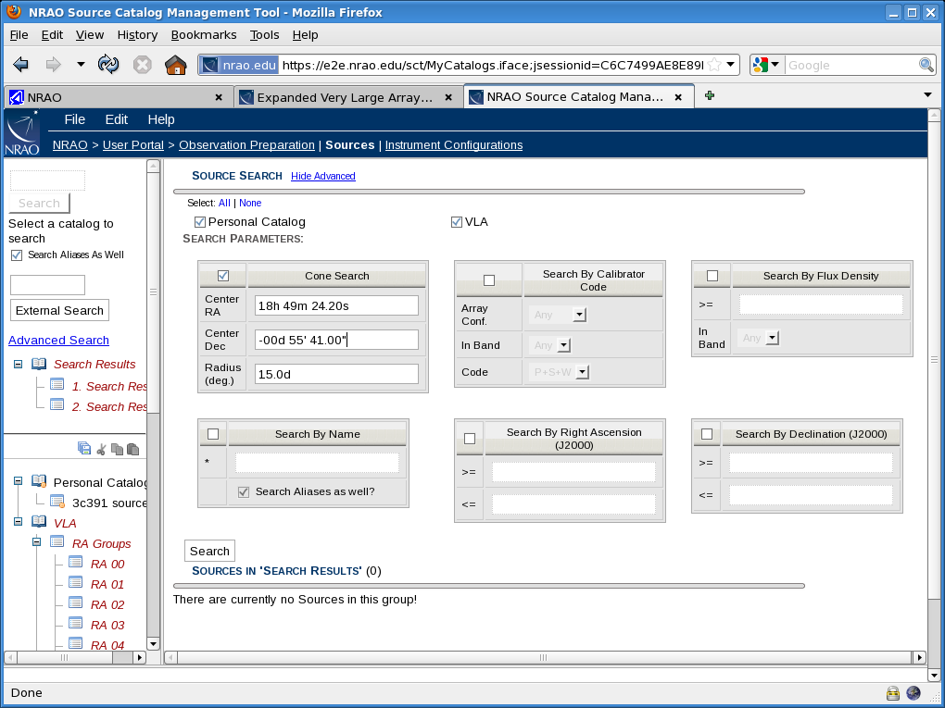

Slide 51
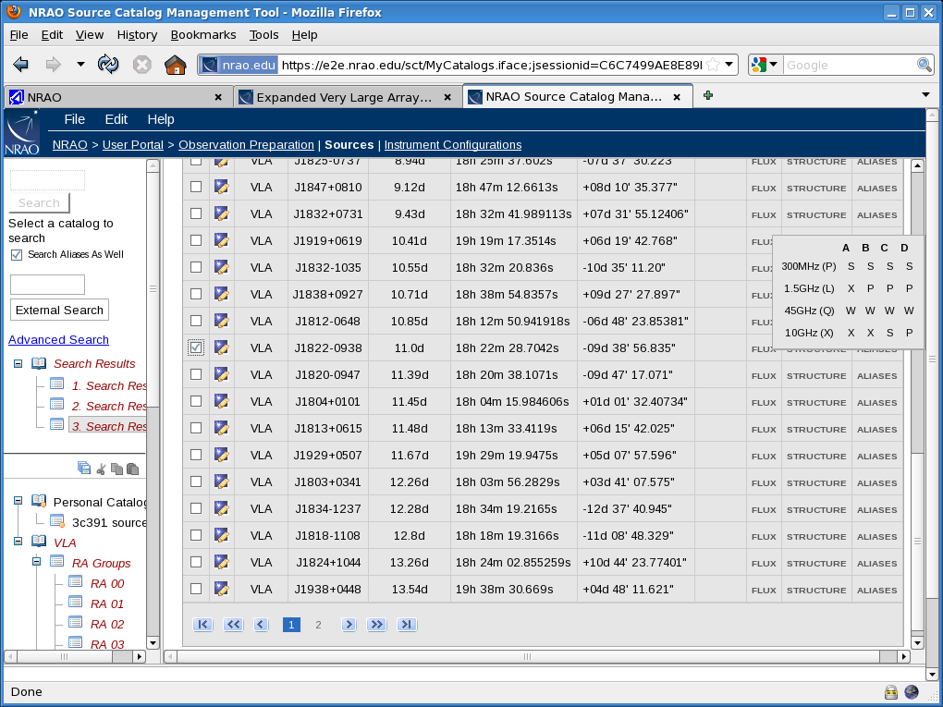

Slide 52
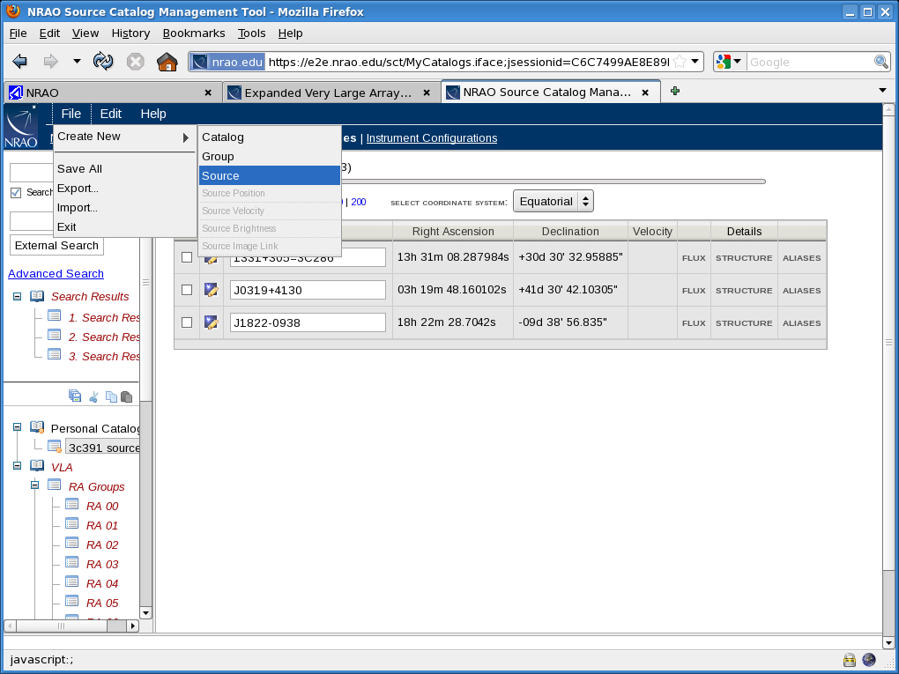

Slide 53
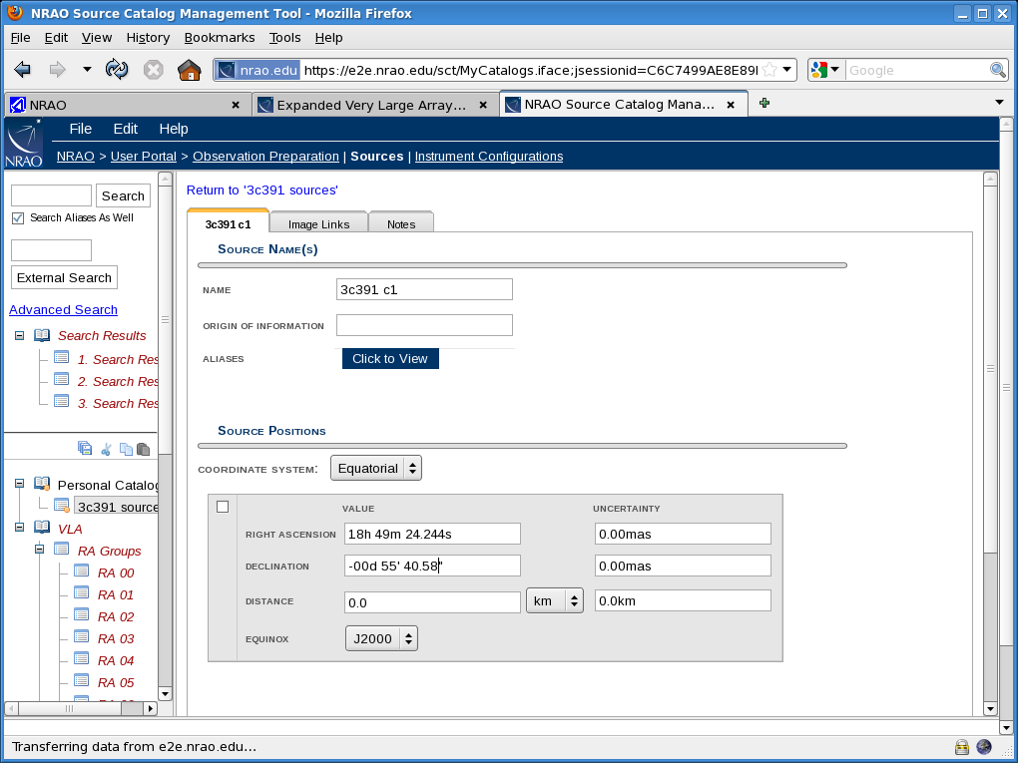

Slide 54
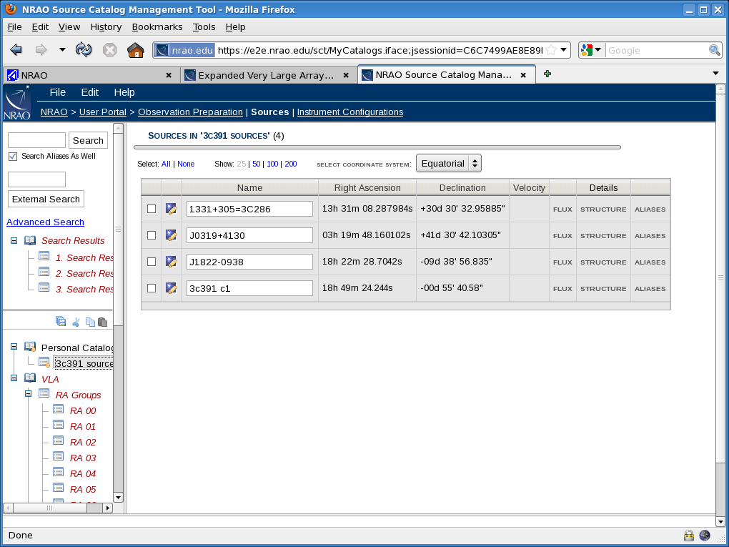

Slide 55
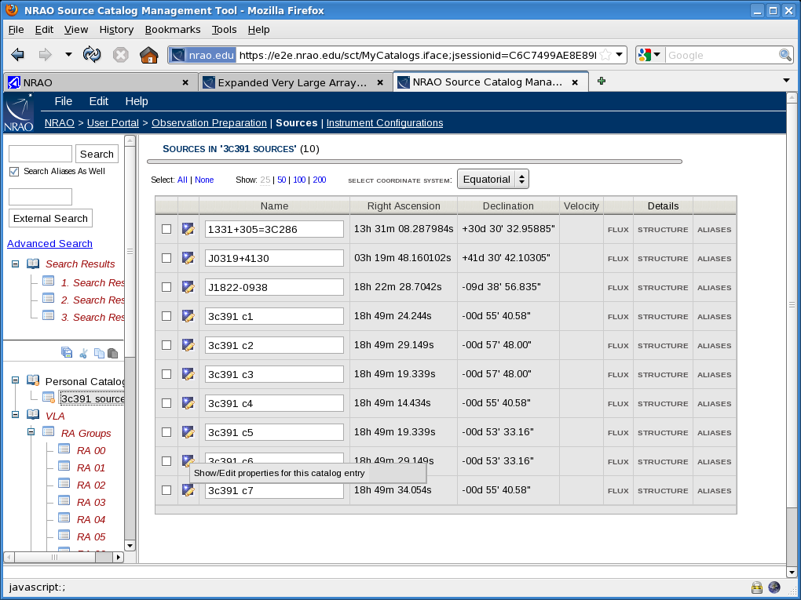

Slide 56
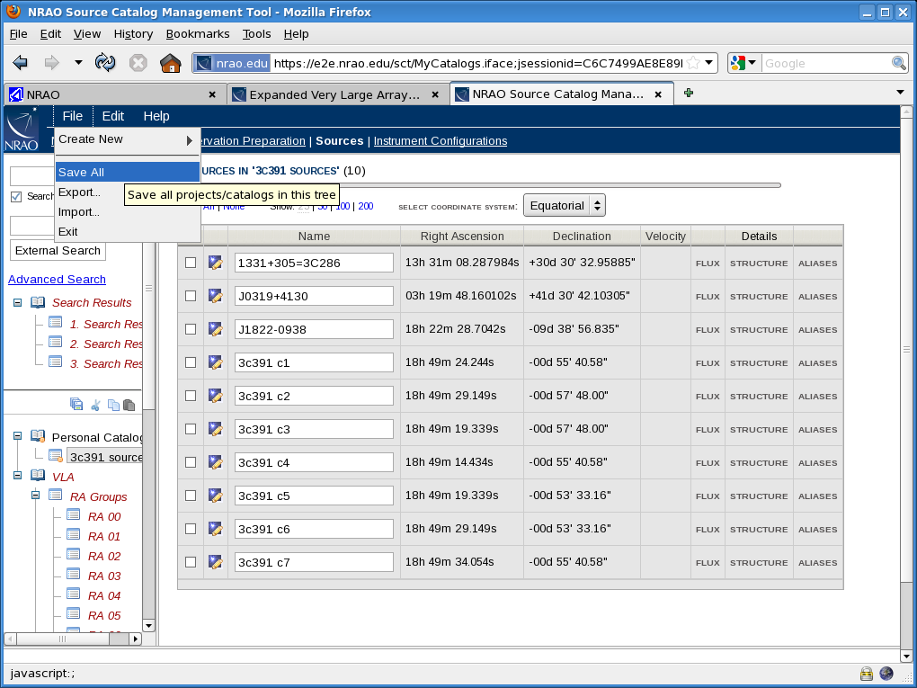
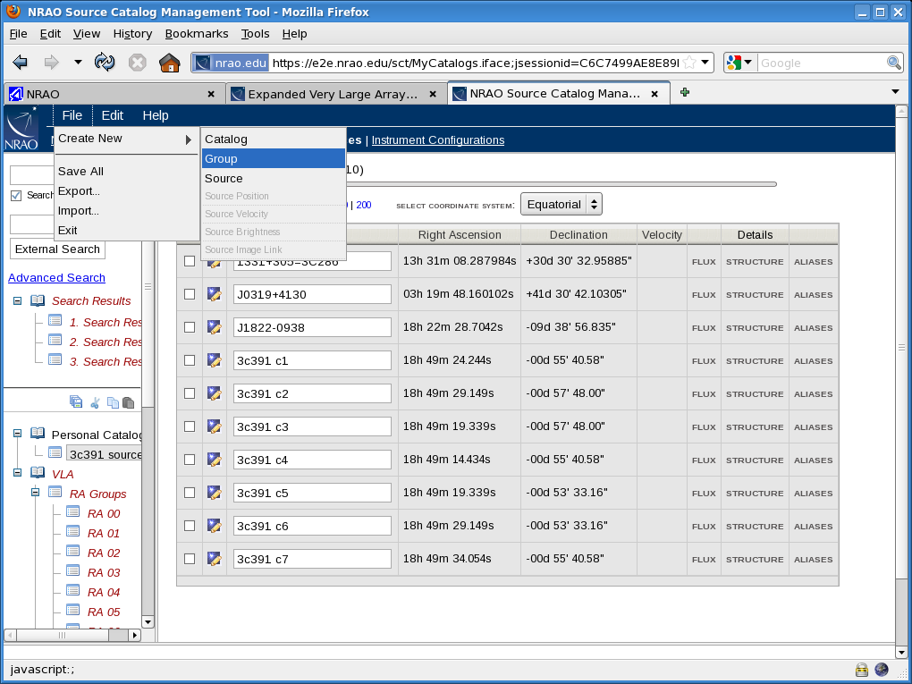
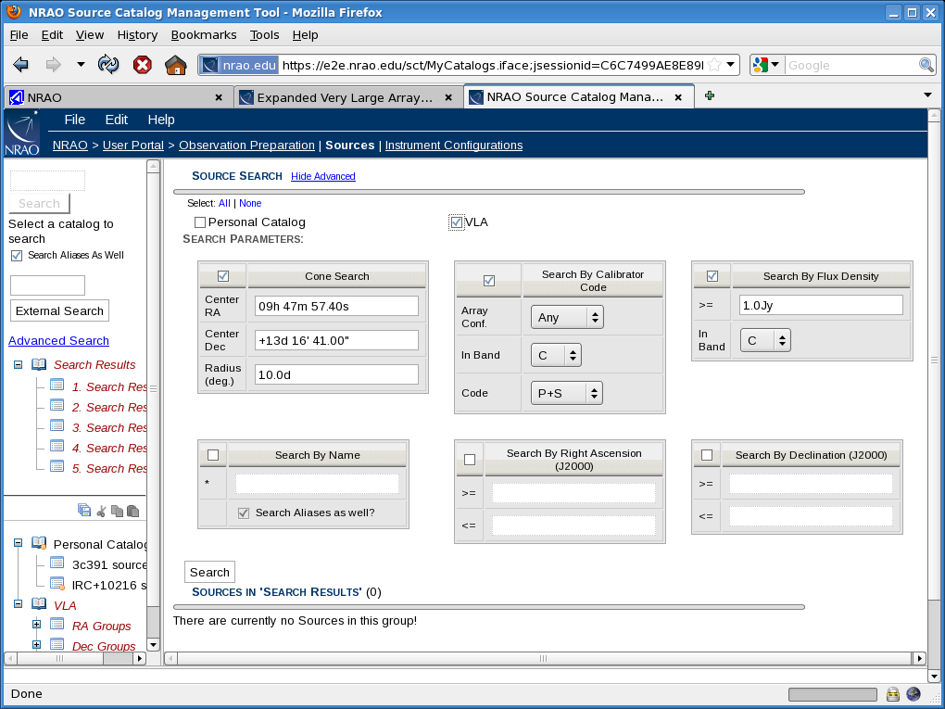
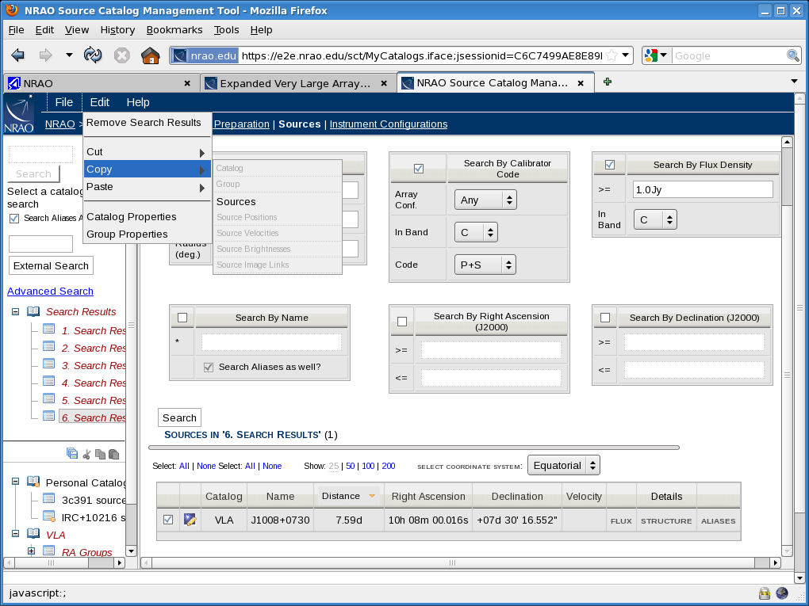

Slide 60
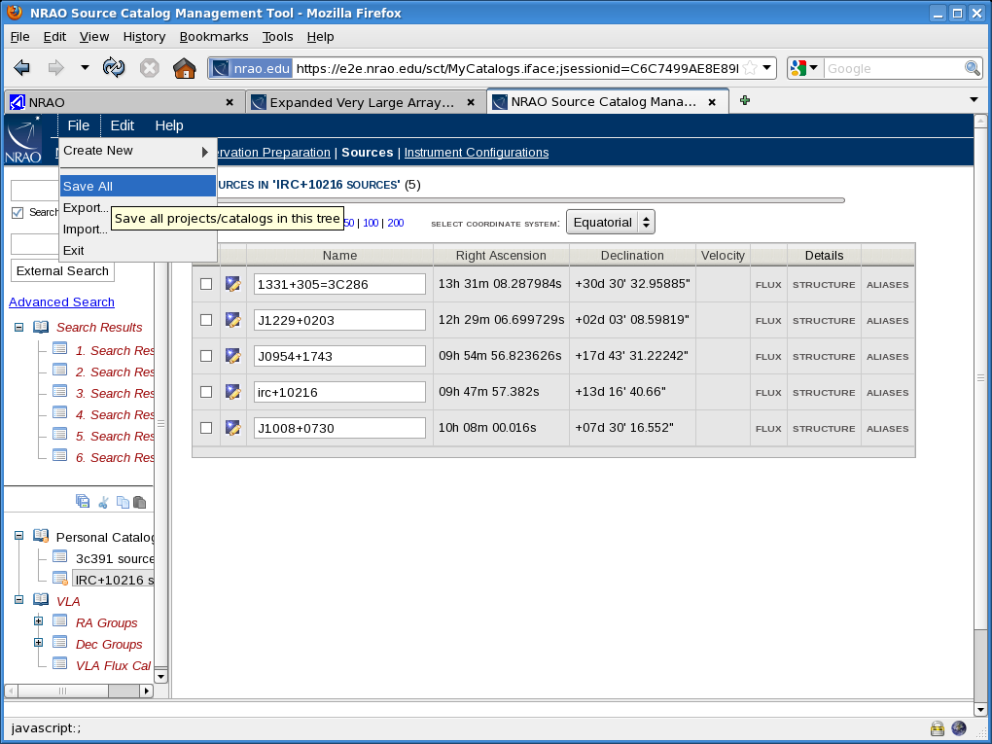

Slide 61
Creating resource catalogs in the RCT
Resources may have been transferred from the proposal information
  If so, check the frequency setup, bandwidths, integration time, ..
Can define your own resources (hardware/instrument configurations)
Can use resources predefined in default continuum “OSRO1” resource list
  Not every (continuum) resource in this list is useful for every continuum observation; check its properties before using !
  More (default) resources will appear with advances in commissioning
Useful to combine resources to be used in an SB(/PB) in its own “group”
Make sure all resources are defined before creating the scan list

Slide 63
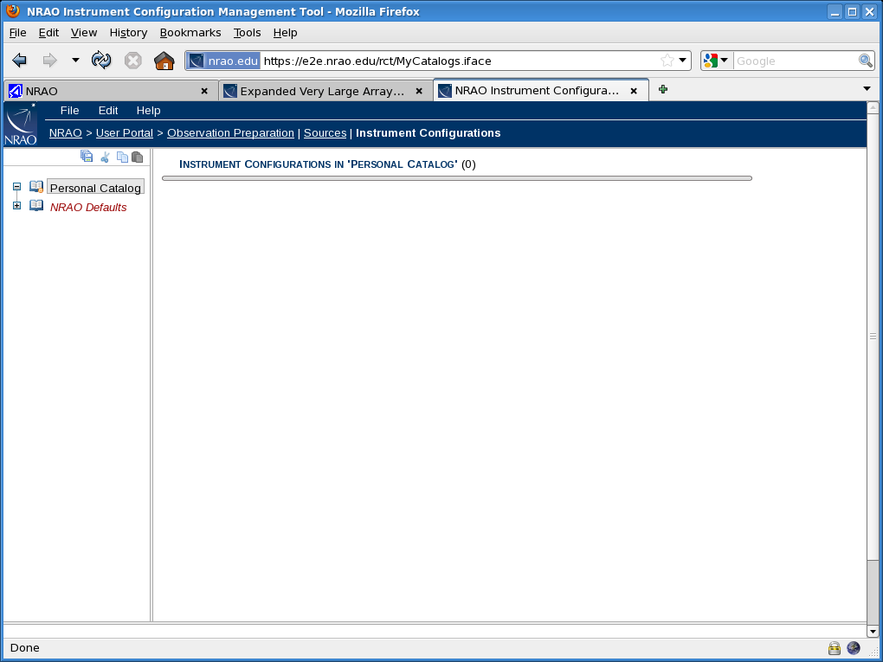

Slide 64
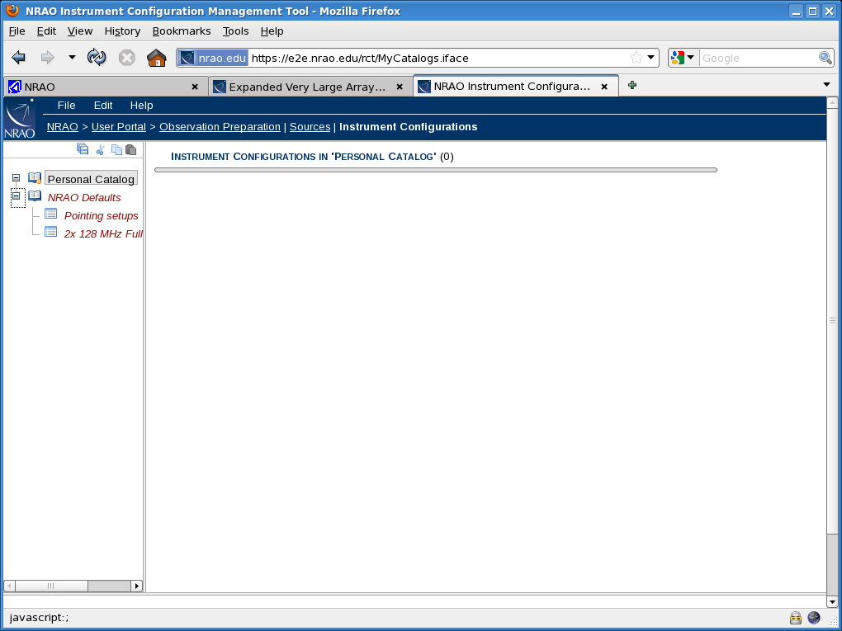

Slide 65
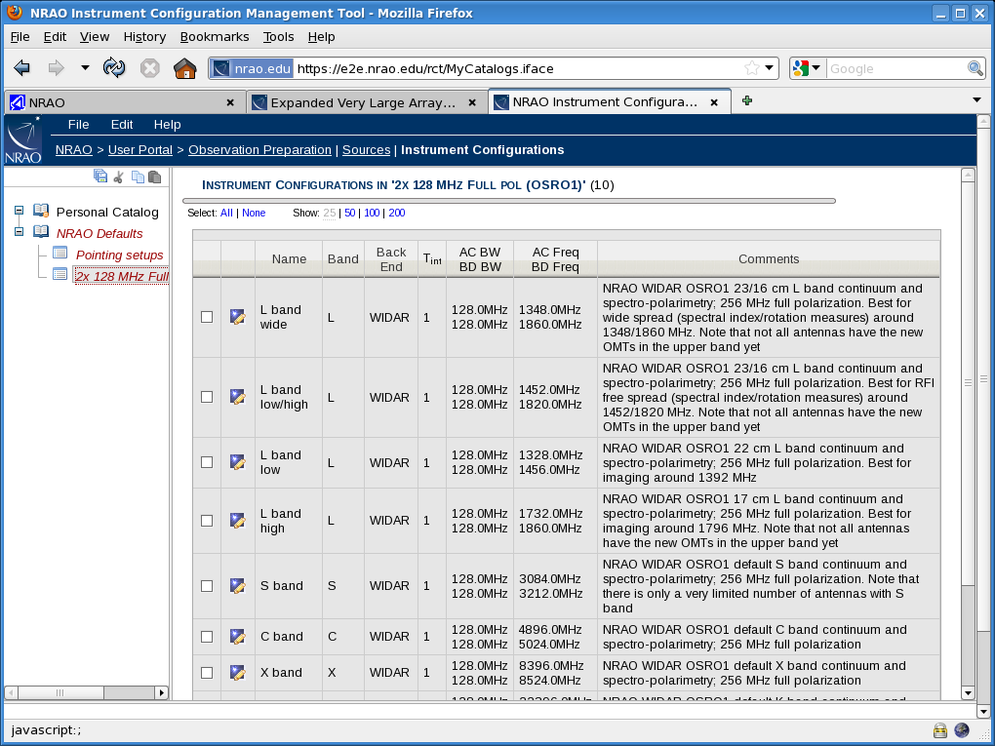

Slide 66
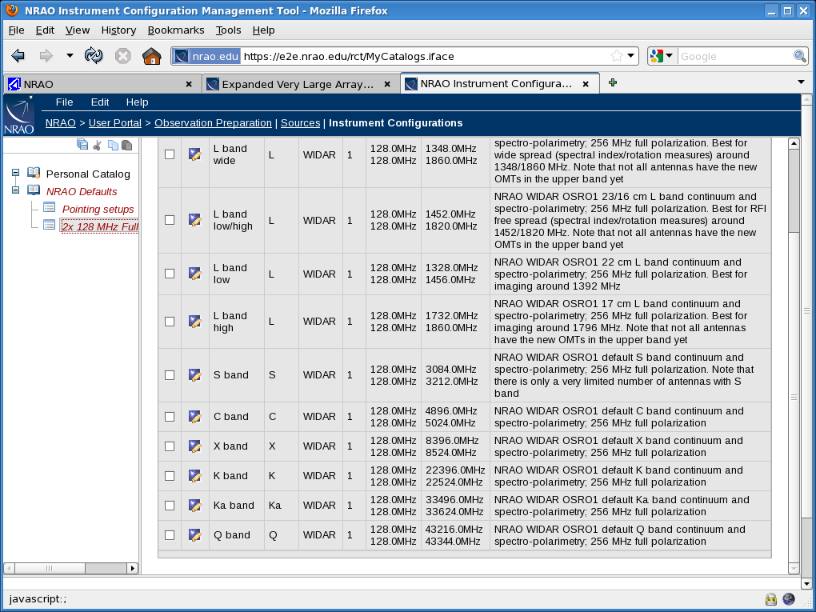

Slide 67
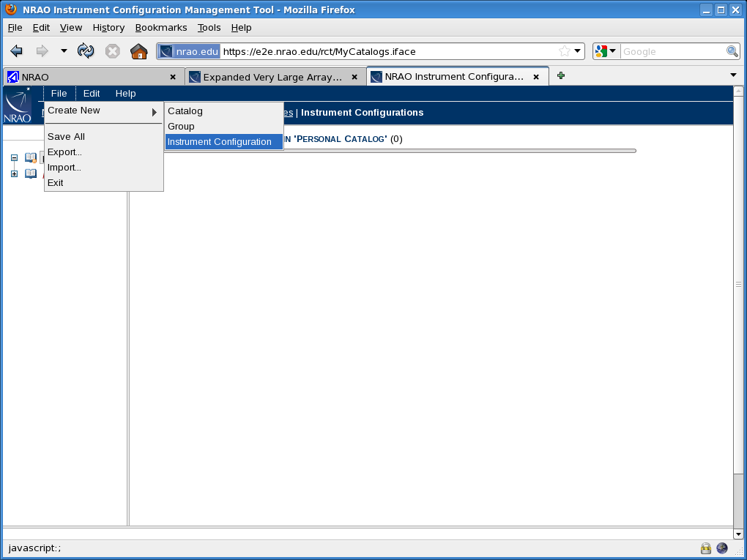

Slide 68
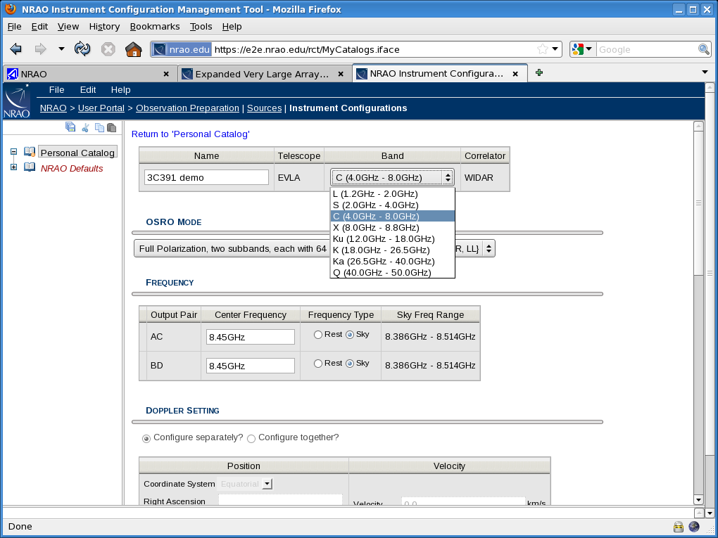

Slide 69


Slide 70


Slide 71


Slide 72


Slide 73


Slide 74


Slide 75


Slide 76


Slide 77


Slide 78


Slide 79
Building Scheduling Blocks (SBs)
All sources to be used are defined
  Transferred from the proposal semi-automatically (i.e. check!)
  Found in existing catalogs
  Created new
All sources to be used are conveniently grouped
  More user friendly if there are many, or from different catalogs
All resources to be used are defined – see above
All resources to be used are conveniently grouped – see above
The project Program Blocks are present
  Proposal information and read-only details already entered
    PI and Co-Is, type, array config., time allocated, (priority,) …, (…)

Slide 80


Slide 81
Designing the 3C391 observing run
7 field mozaic, 7 sources with roughly equal time on source
  Enough signal to be able to use self-calibration
Could use default C band continuum (OSRO1) setup (but didn’t)
Flux: 3C286, can also be used for EVPA calibration (answer: –66˚)
Bandpass: 3C84
Unpolarized nearby point source: J1822–0938 (gain, pol.z leakage)
  C band (i.e. about 5 GHz) thus cycle every ~30 minutes
Do not break into small observing runs (polarization angle)
Spread sources over hour angle for best (u,v)-coverage
  Set up sequence and loop several times
Spread polarization leakage calibrator: include in loop

Slide 82


Slide 83


Slide 84


Slide 85


Slide 86


Slide 87


Slide 88


Slide 89


Slide 90


Slide 91


Slide 92


Slide 93


Slide 94


Slide 95


Slide 96


Slide 97


Slide 98


Slide 99


Slide 100


Slide 101


Slide 102


Slide 103


Slide 104


Slide 105


Slide 106


Slide 107


Slide 108


Slide 109


Slide 110


Slide 111


Slide 112


Slide 113


Slide 114


Slide 115


Slide 116


Slide 117


Slide 118


Slide 119


Slide 120


Slide 121


Slide 122


Slide 123
Designing the IRC10216 observing run
Single target line source, use Doppler setting for frequency (dynamic time)
Setup tuned to (2) Ka band frequencies with 125 kHz spectral resolution
Flux: 3C286 and bandpass: 3C273
Unpolarized nearby point source: J0954+1743 (gain, pol.z leakage)
  Ka band (i.e. about 35 GHz) thus cycle every ~5 minutes
  NOT strong enough for pointing scans
Strong (in C or X band) nearby source J1008+0730 (pointing!)
  Pointing every time Az/El changes over ~15˚
Do not break into small observing runs (short already)
Calibrator-target sequence with short cycle time: fast-switching
  Set up sequence and loop several times to accumulate on source time

Slide 124


Slide 125


Slide 126


Slide 127


Slide 128


Slide 129


Slide 130


Slide 131


Slide 132


Slide 133


Slide 134

Antenna wrap diagram

Slide 135
Some other things to mention
DO NOT FORGET TO EXIT THE WEB APPLICATION
Many ways to optimize schedules – use LST start update feature
Bulk edit
Import line-item scheduling block
Exchange XML catalogs with others (or backup)
Submit/cancel and also approve, etc
Web connection can be slow/interrupted/time-out
RCT will change when full WIDAR is available (much more complex!!)
SCT: working on additions and improvements
Documentation still very useful but getting more and more outdated

