Slide 1
Calibration and Editing
George Moellenbrock

Slide 2
Synopsis
Why calibration and editing?
Idealistic formalism → Realistic practice
Editing and RFI
Practical Calibration Considerations
Baseline-based vs. Antenna-based Calibration
Scalar Calibration Example
Full Polarization Generalization
A Dictionary of Calibration Effects
Calibration Heuristics
New Calibration Challenges
Summary
Notes:
Revise this page last, as needed

Slide 3
Why Calibration and Editing?
Synthesis radio telescopes, though well-designed, are not perfect (e.g., surface accuracy, receiver noise, polarization purity, gain stability, geometric model errors, etc.)
Need to accommodate deliberate engineering (e.g., frequency conversion, digital electronics, filter bandpass, etc.)
Hardware or control software occasionally fails or behaves unpredictably
Scheduling/observation errors sometimes occur (e.g., wrong source positions)
Atmospheric conditions not ideal
RFI
Determining instrumental properties (calibration)
is a prerequisite to
determining radio source properties

Slide 4
From Idealistic to Realistic
Formally, we wish to use our interferometer to obtain the visibility function:
….which we intend to invert to obtain an image of the sky:
  V(u,v) set the amplitude and phase of 2D sinusoids that add up to an image of the sky
How do we measure V(u,v)?

Slide 5
From Idealistic to Realistic
In practice, we correlate (multiply & average) the electric field (voltage) samples, x_{i} & x_{j}, received at pairs of telescopes (i,j) and processed through the observing system:
  x_{i} & x_{j} are delay-compensated for a specific point on the sky
  Averaging duration is set by the expected timescales for variation of the correlation result (~seconds)
J_{ij} is an operator characterizing the net effect of the observing process for baseline (i,j), which we must calibrate
Sometimes J_{ij} corrupts the measurement irrevocably, resulting in data that must be edited or “flagged”

Slide 6
What Is Delivered by a Synthesis Array?
An enormous list of complex numbers! (Enormous!)
E.g., the EVLA:
  At each timestamp (~1s intervals): 351 baselines (+ 27 auto-correlations)
  For each baseline: 1-64 Spectral Windows (“subbands” or “IFs”)
  For each spectral window: tens to thousands of channels
  For each channel: 1, 2, or 4 complex correlations
    RR or LL or (RR,LL), or (RR,RL,LR,LL)
  With each correlation, a weight value
  Meta-info: Coordinates, antenna, field, frequency label info
N_{total} = N_{t} x N_{bl} x N_{spw} x N_{chan} x N_{corr} visibilities
  EVLA: ~1300000 x N_{spw} x N_{chan} x N_{corr} vis/hour (10s to 100s of GB per observation)
ALMA: ~3-5X more baselines than EVLA…

Slide 7
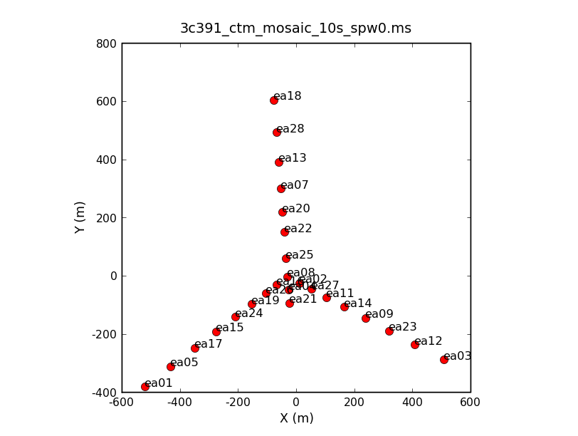
The Array

Slide 8
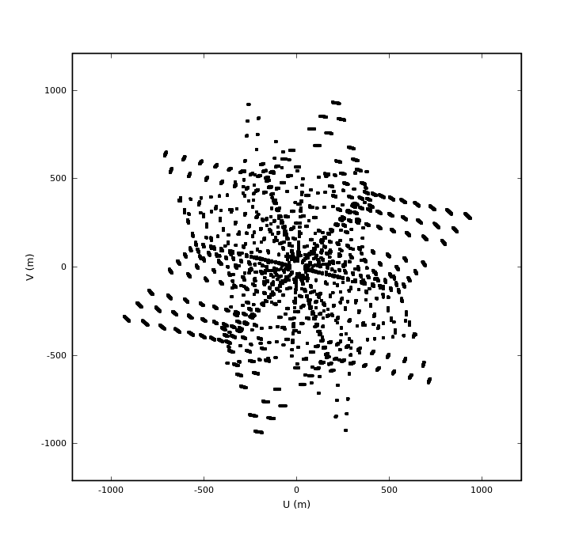
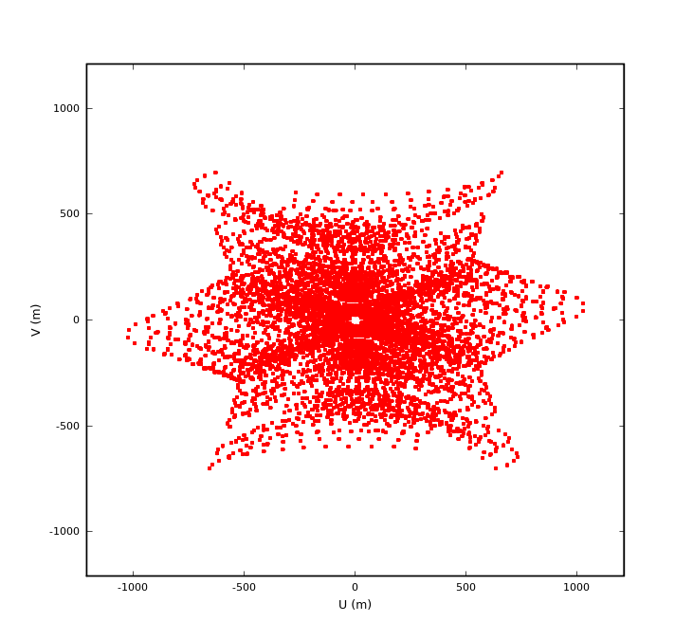
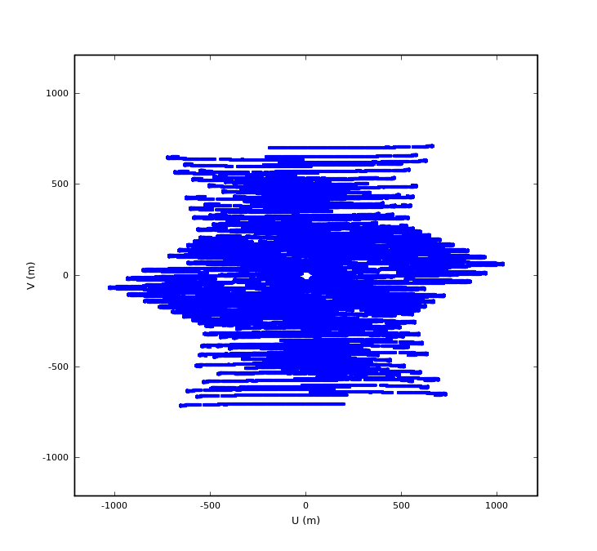
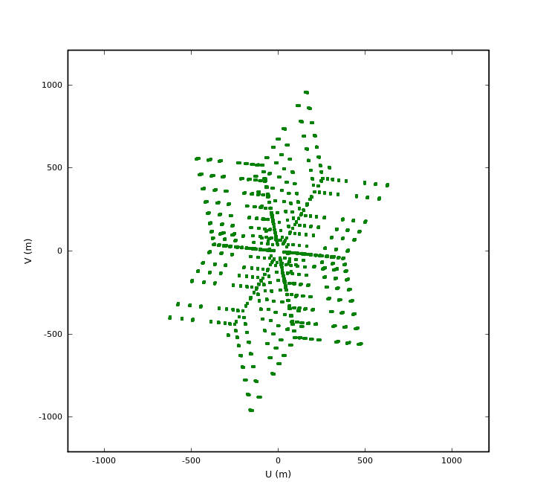
UV-coverages
3C286
Flux Density
J1822-0938
Gain Calibrator
3C391
Science Target
3C84
Instr. Poln Calibrator

Slide 9
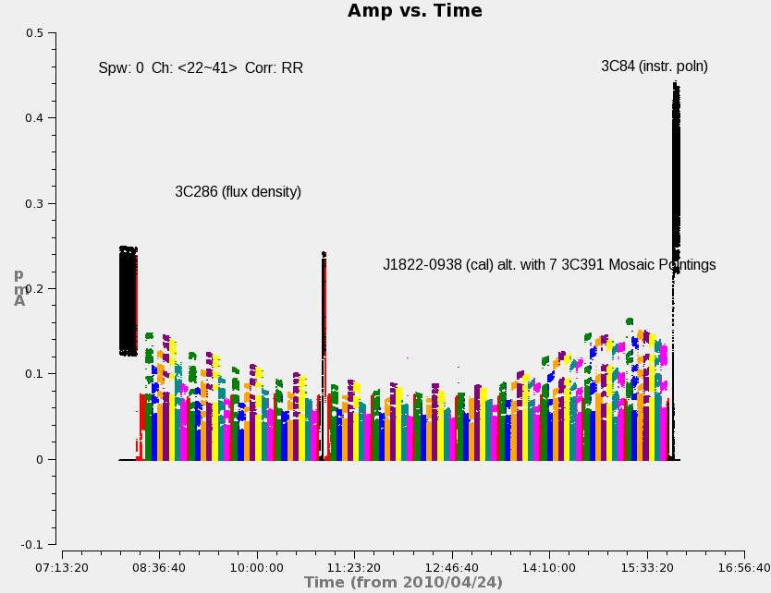
The Visibility Data (source colors)

Slide 10
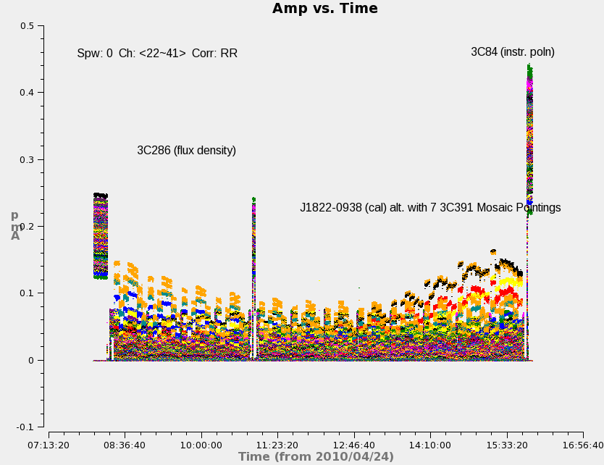
The Visibility Data (baseline colors)

Slide 11
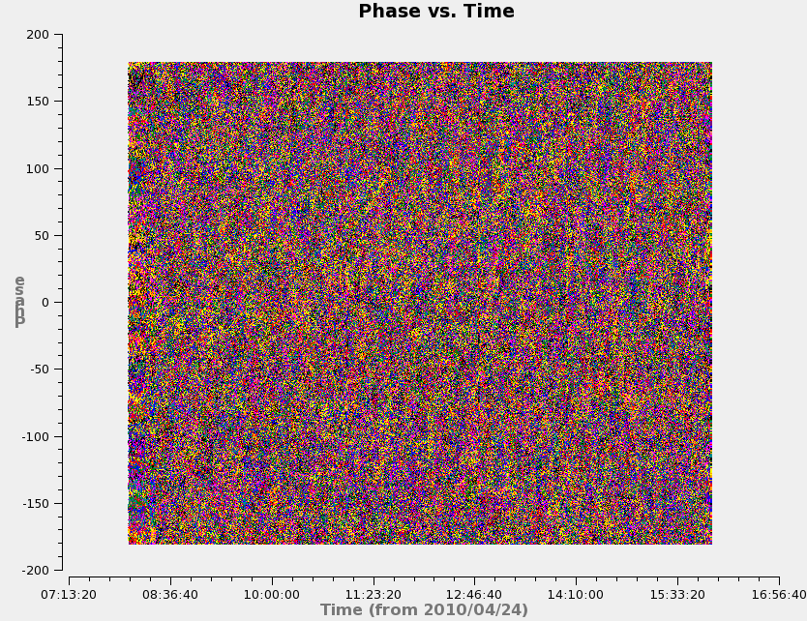
The Visibility Data (baseline colors)

Slide 12
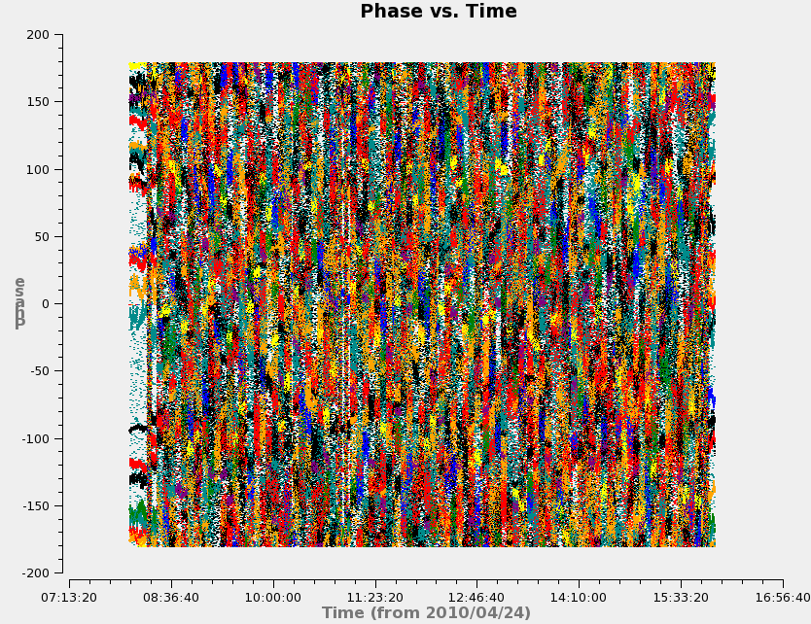
The Visibility Data (baseline colors)
Baselines to
antenna ea21

Slide 13
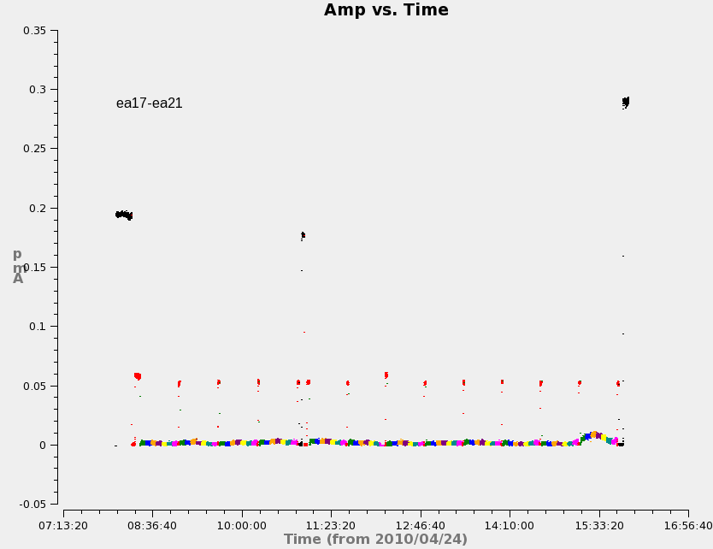
A Single Baseline - Amp

Slide 14
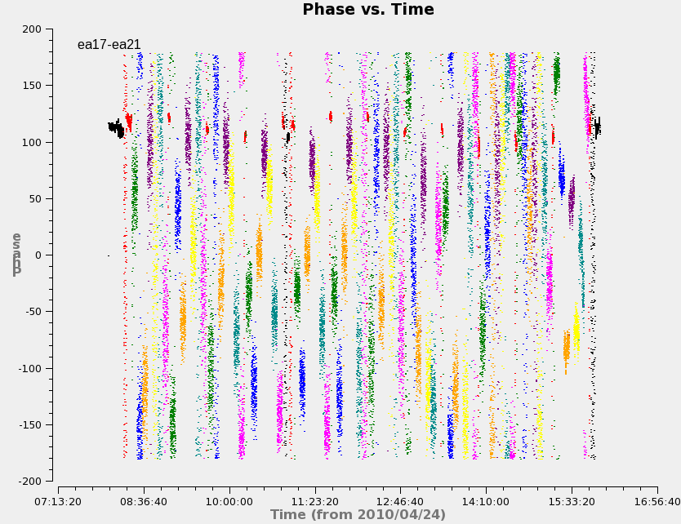
A Single Baseline - Phase

Slide 15
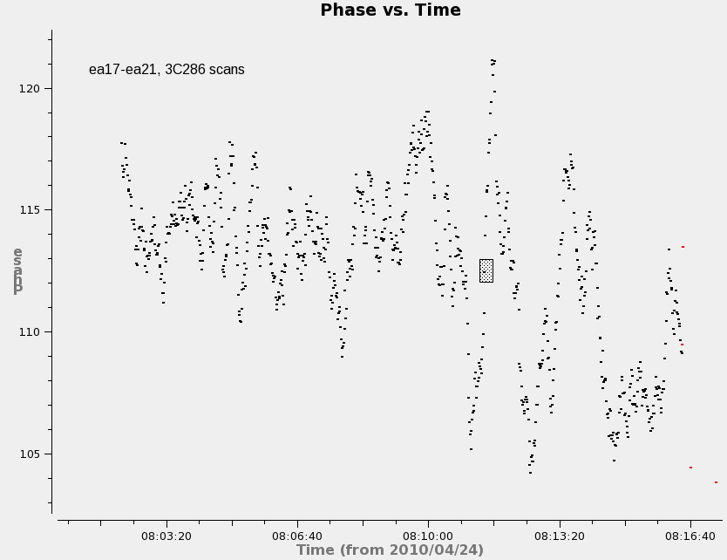
A Single Baseline – 2 scans on 3C286

Slide 16
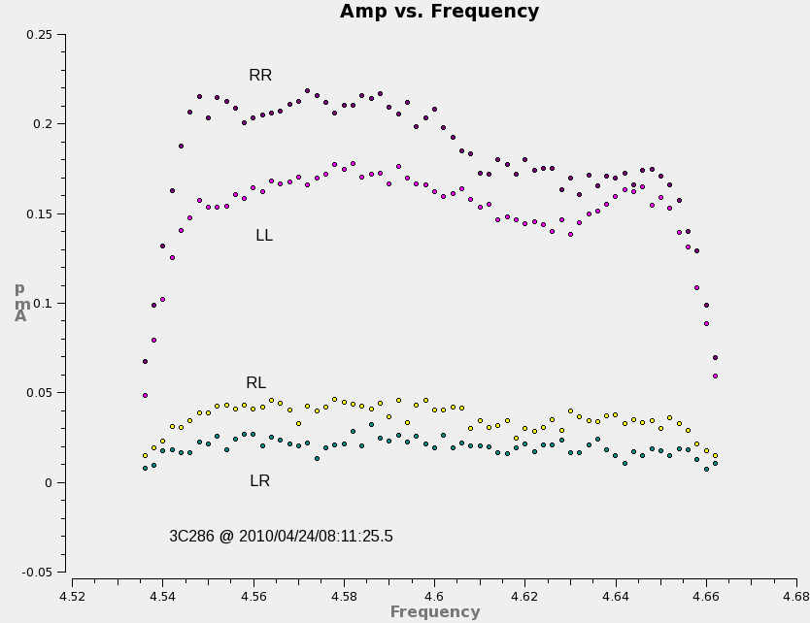
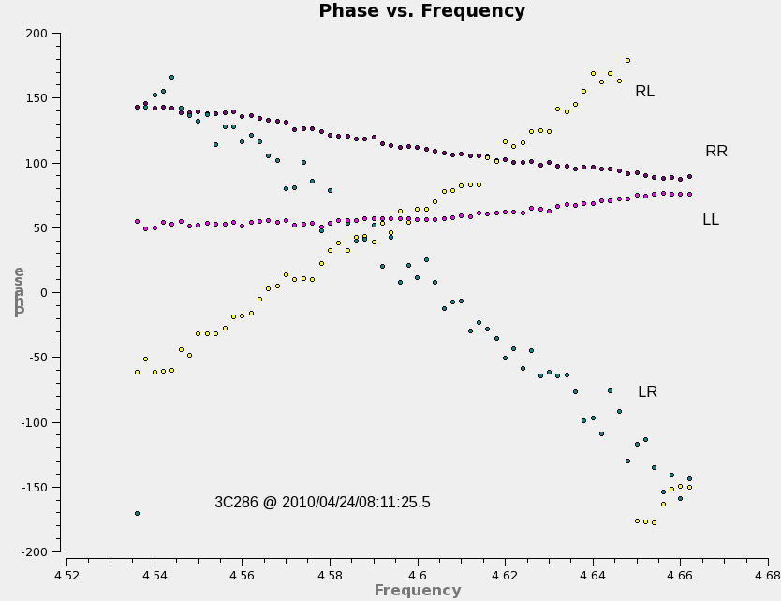
Single Baseline, Single Integration Visibility Spectra (4 correlations)
baseline ea17-ea21

Slide 17
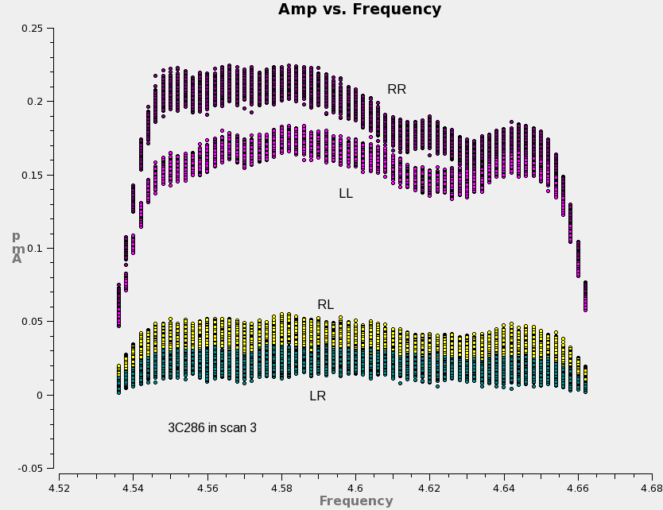
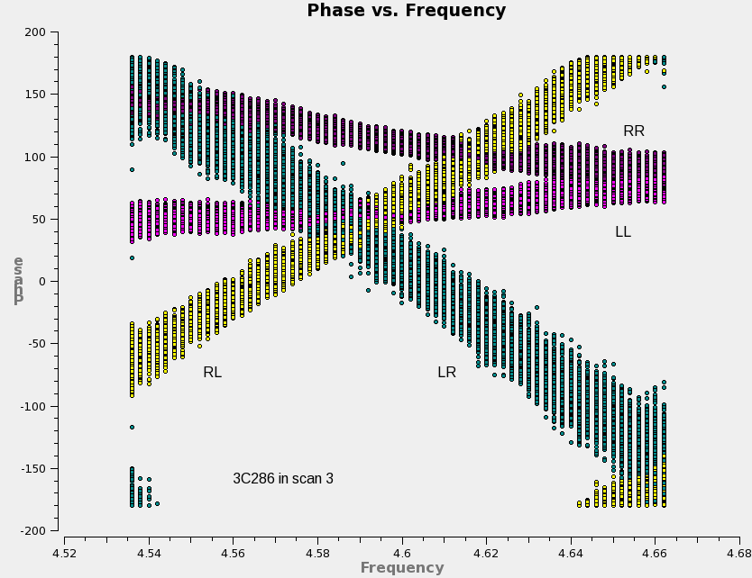
Single Baseline, Single Scan
Visibility Spectra (4 correlations)
baseline ea17-ea21

Slide 18
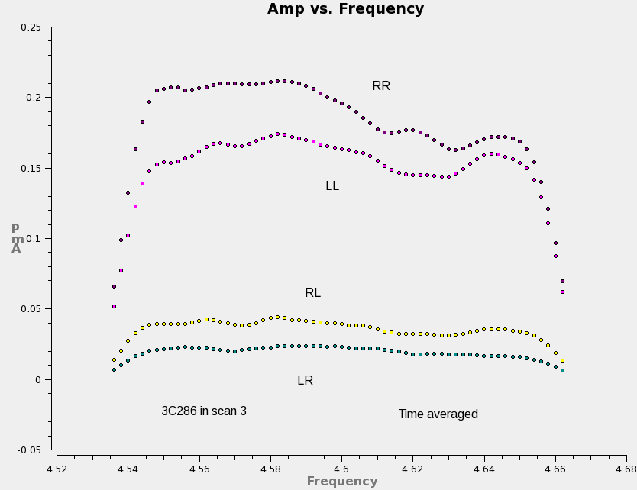
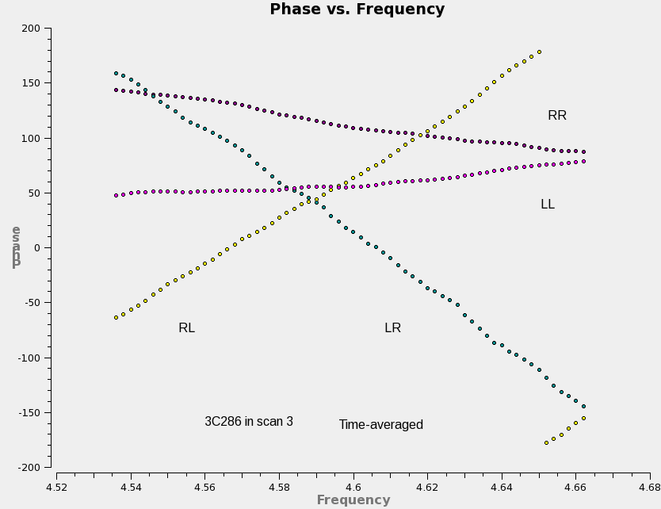
Single Baseline, Single Scan (time-averaged)
Visibility Spectra (4 correlations)
baseline ea17-ea21

Slide 19
Data Examination and Editing
After observation, initial data examination and editing very important
  Will observations meet goals for calibration and science requirements?
What to edit:
  Some real-time flagging occurred during observation (antennas off-source, LO out-of-lock, etc.). Any such bad data left over? (check operator’s logs)
  Any persistently ‘dead’ antennas (check operator’s logs)
  Periods of especially poor weather? (check operator’s log)
  Any antennas shadowing others? Edit such data.
  Amplitude and phase should be continuously varying—edit outliers
  Radio Frequency Interference (RFI)?
Caution:
  Be careful editing noise-dominated data (noise bias).
  Be conservative: those antennas/timeranges which are bad on calibrators are probably bad on weak target sources—edit them
  Distinguish between bad (hopeless) data and poorly-calibrated data. E.g., some antennas may have significantly different amplitude response which may not be fatal—it may only need to be calibrated
  Choose reference antenna wisely (ever-present, stable response)
Increasing data volumes increasingly demand automated editing algorithms…

Slide 20
Radio Frequency Interference (RFI)
RFI originates from man-made signals generated in the antenna electronics or by external sources (e.g., satellites, air traffic, cell-phones, radio and TV stations, automobile ignitions, microwave ovens, computers and other electronic devices, etc.)
  Adds to total noise power in all observations, thus decreasing the fraction of desired natural signal passed to the correlator, thereby reducing sensitivity and possibly driving electronics into non-linear regimes
  Can correlate between antennas if of common origin and baseline short enough (insufficient decorrelation via geometry compensation), thereby obscuring natural emission in spectral line observations
Least predictable, least controllable threat to a radio astronomy observation

Slide 21
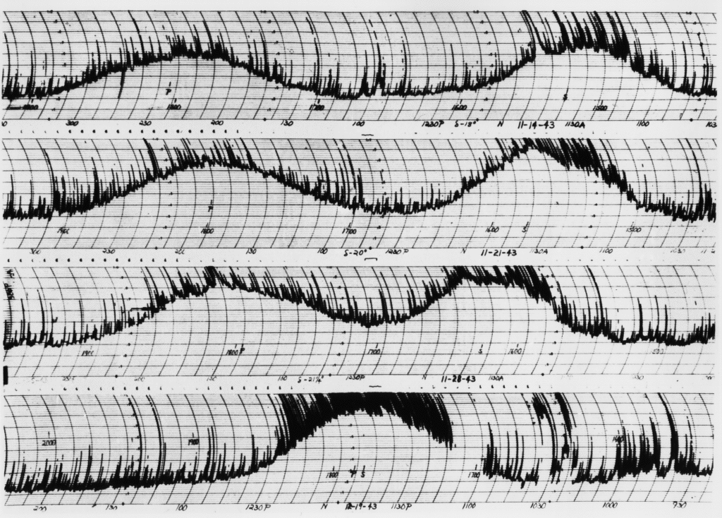
Radio Frequency Interference
Has always been a problem (Reber, 1944, in total power)!

Slide 22
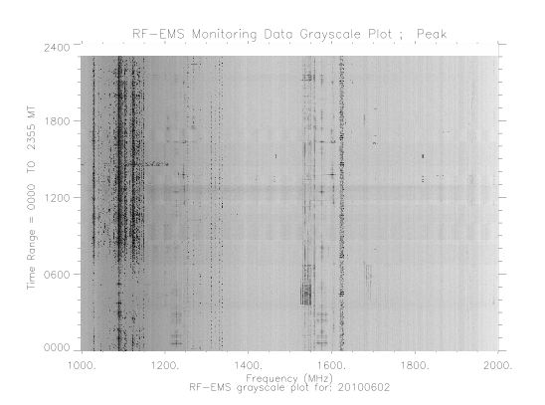
Radio Frequency Interference (cont)
Growth of telecom industry threatening radioastronomy!

Slide 23
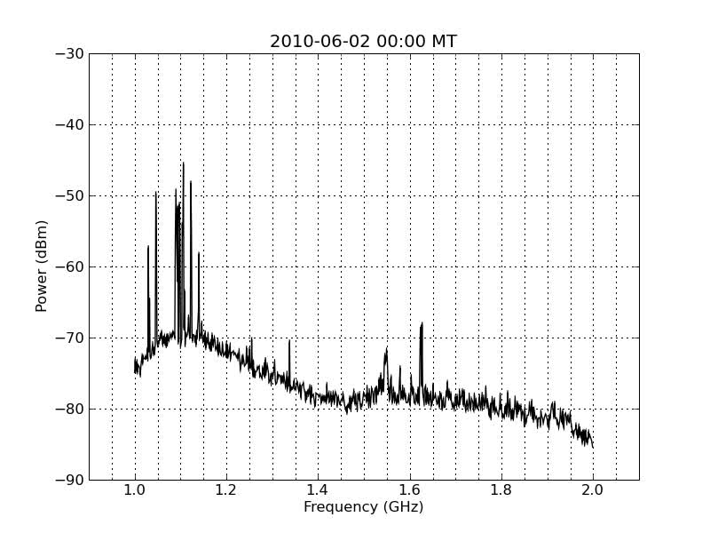
Radio Frequency Interference (cont)
Movie courtesy of T. Hunter.

Slide 24
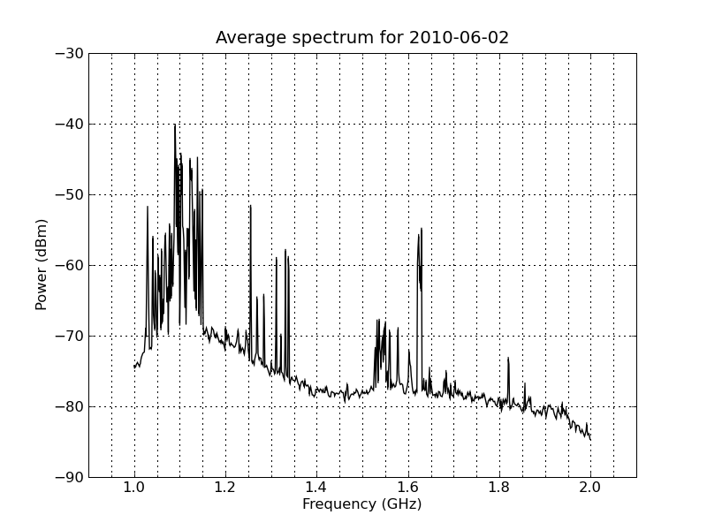
Radio Frequency Interference (cont)
Aircraft
ABQ Radar
Satellites (GPS, Iridium)
Plot courtesy of T. Hunter.

Slide 25
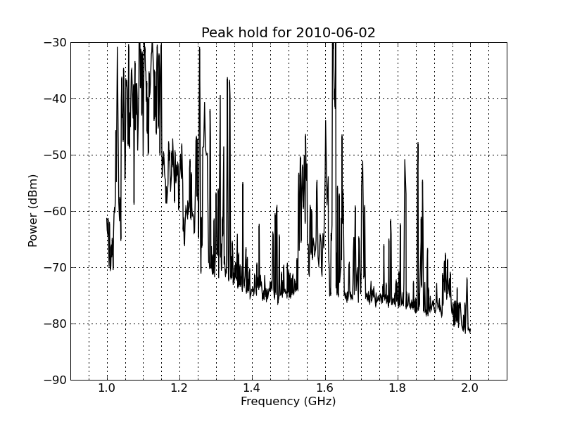
Radio Frequency Interference (cont)
Plot courtesy of T. Hunter.

Slide 26
Radio Frequency Interference (cont)
RFI Mitigation
  Careful electronics design in antennas, including filters, shielding, blanking in the correlator
  High-dynamic range digital sampling
  Observatories world-wide lobbying for spectrum management
  Choose interference-free frequencies (very difficult in EVLA 1-2 GHz band, for continuum bandwidths)
  Observe continuum experiments in spectral-line modes so affected channels can be edited
Various off-line mitigation techniques under study
  E.g., correlated RFI power that originates in the frame of the array appears at celestial pole (also stationary in array frame) in image domain…
  Ue-Li Pen’s lecture “Radio Frequency Interference Excision” (Thursday)

Slide 27
Editing Example

Slide 28
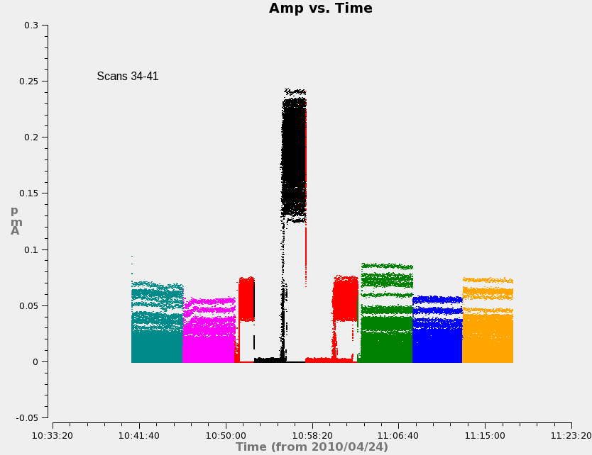
Editing Example
Scan transitions/setup
Dead antenna Slew

Slide 29
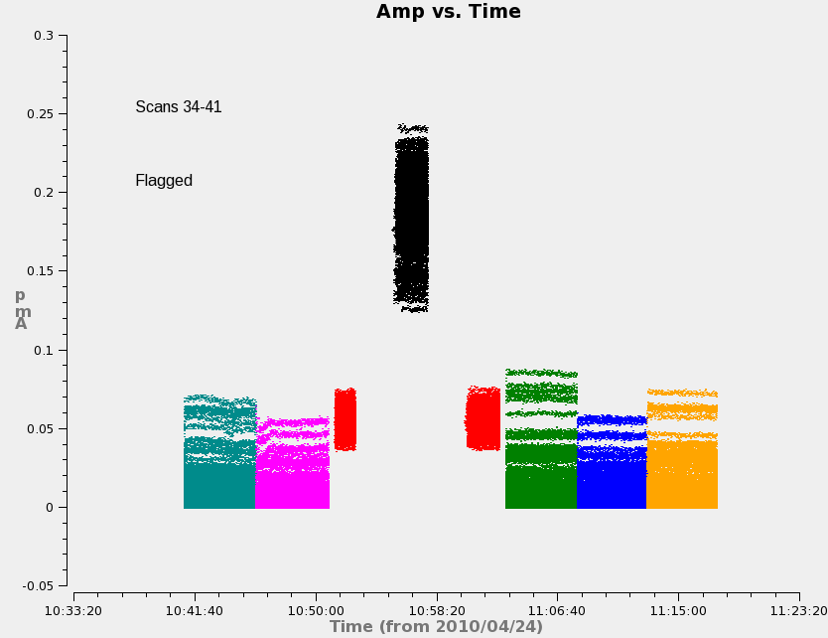
Editing Example

Slide 30
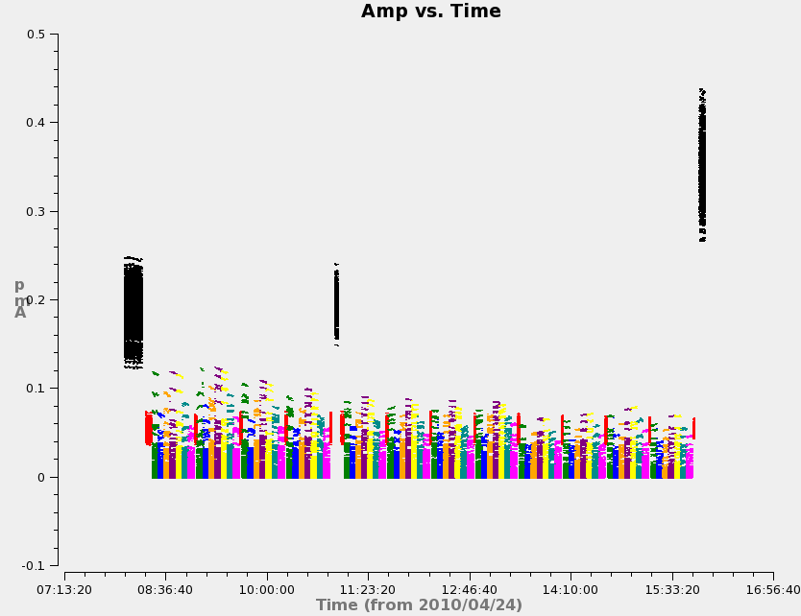
Editing Example

Slide 31
Practical Calibration Considerations
A priori “calibrations” (provided by the observatory)
  Antenna positions, earth orientation and rate
  Clocks
  Antenna pointing, gain curve, voltage pattern
  Calibrator coordinates, flux densities, polarization properties
  Tsys, system gain (EVLA)
Absolute engineering calibration?
  Very difficult, would require heroic efforts by observatory scientific and engineering staff (hot/cold loads, climbing ladders, etc.)
  Concentrate instead on ensuring instrumental stability on adequate timescales
Cross-calibration a better choice
  Observe nearby point sources against which calibration (J_{ij}) can be solved, and transfer solutions to target observations
  Choose appropriate calibrators; usually strong point sources because we can easily predict their visibilities
  Choose appropriate timescales for calibration

Slide 32
“Absolute” Astronomical Calibrations
Flux Density Calibration
  Radio astronomy flux density scale set according to several “constant” radio sources
  Use resolved models where appropriate
Astrometry
  Most calibrators come from astrometric catalogs; directional accuracy of target images tied to that of the calibrators
  Beware of resolved and evolving structures, and phase transfer biases due to troposphere (especially for VLBI)
Linear Polarization Position Angle
  Usual flux density calibrators also have significant stable linear polarization position angle for registration
Relative calibration solutions (and dynamic range) insensitive to errors in these “scaling” parameters

Slide 33
Baseline-based Cross-Calibration
Simplest, most-obvious calibration approach: measure complex response of each baseline on a standard source, and scale science target visibilities accordingly
  “Baseline-based” Calibration
Only option for single baseline “arrays” (3-antenna arrays are effectively baseline-based for per-integration amplitude calibration)
Calibration precision same as calibrator visibility sensitivity (on timescale of calibration solution).
Calibration accuracy sensitive to departures of calibrator from known structure
  Un-modeled calibrator structure transferred (in inverse) to science target!

Slide 34
Antenna-based Cross Calibration
Measured visibilities are formed from a product of antenna-based signals. Can we take advantage of this fact?
  e.g., bandpass…

Slide 35
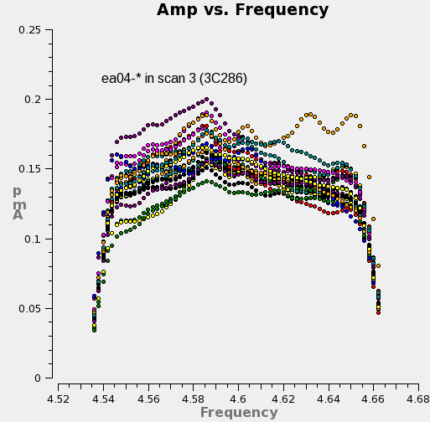
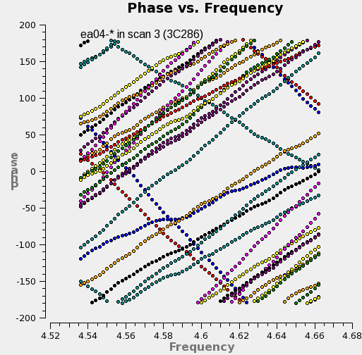
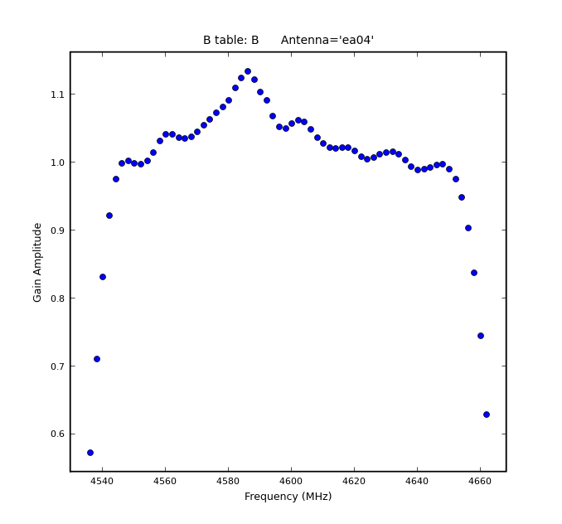
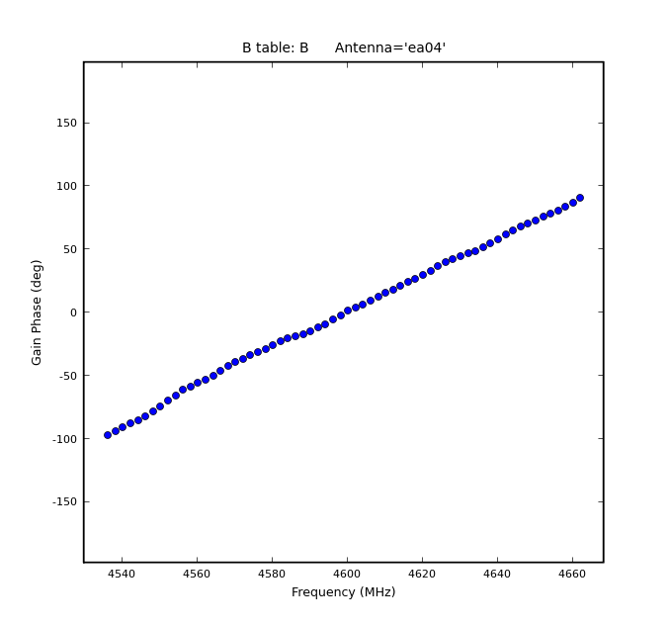
Rationale for Antenna-based Calibration

Slide 36
Antenna-based Cross Calibration
The net time-dependent (t) signal delivered by antenna i, x_{i}(t), is a combination of the desired signal, s_{i}(t,l,m), corrupted by a factor J_{i}(t,l,m) and integrated over the sky (l,m), and diluted by noise, n_{i}(t):
x_{i}(t) is sampled voltage at the correlator input
J_{i}(t,l,m) is the product of a series of effects encountered by the incoming signal
J_{i}(t,l,m) is an antenna-based complex number
Usually, |n_{i} |>> |s_{i}|

Slide 37
Correlation of Realistic Signals - I
The correlation of two realistic (aligned for a specific direction) signals from different antennas:
    Noise correlations have zero mean—even if |n_{i}|>> |s_{i}|, the correlation process isolates desired signals:
    In integral, only s_{i}(t,l,m) from the same directions correlate (i.e., when l_{i}=l_{j}, m_{i}=m_{j}), so order of integration and signal product can be reversed:

Slide 38
Correlation of Realistic Signals - II
The s_{i} & s_{j} are the common radio source signals, and differ only by the relative arrival phase at each antenna, which varies with direction. This is the Fourier phase term (to a good approximation), which we factor out:
On the timescale of the averaging, the only meaningful average is of the squared source signal itself (in each direction), which is just the image of the source:
If all J=1, we of course recover the ideal expression:

Slide 39
Aside: Auto-correlations and Single Dishes
The auto-correlation of a signal from a single antenna:
    This is an integrated (sky) power measurement plus non-zero noise
    Desired signal not isolated from noise
    Noise usually dominates
Single dish radio astronomy calibration strategies rely on switching schemes to isolate desired signal from the noise

Slide 40
The Scalar Measurement Equation
First, isolate non-direction-dependent effects, and factor them from the integral:
Next, we recognize that over small fields of view, it is possible to assume J^{sky}=1, and we have a relationship between ideal and observed Visibilities:
Standard calibration of most existing arrays reduces to solving this last equation for the J_{i}, assuming a visibility model V_{ij}^{mod} for a calibrator

Slide 41
Solving for the J_{i}
We can write:
…and define chi-squared:
…and minimize chi-squared w.r.t. each J_{i}*, yielding (iteration):
    (…which we may recognize as a weighted average of the J_{i} contribution to the chi-squared equation)

Slide 42
Solving for J_{i} (cont)
For a uniform array (~same sensitivity on all baselines, ~same calibration magnitude on all antennas), it can be shown that the error in the calibration solution is:
Calibration error decreases with increasing calibrator strength and square-root of N_{ant} (c.f. baseline-based calibration).
Other properties of the antenna-based solution:
  Minimal degrees of freedom (N_{ant} factors, N_{ant}(N_{ant}-1)/2 measurements)
  Net calibration for a baseline involves a phase difference, so absolute directional information is lost
  Closure…
Notes:
Are units correct? Yes, J is unitless!

Slide 43
Antenna-based Calibration and Closure
Success of synthesis telescopes relies on antenna-based calibration
  Fundamentally, any information that can be factored into antenna-based terms, could be antenna-based effects, and not source visibility
  For N_{ant} > 3, source visibility information cannot be entirely obliterated by any antenna-based calibration
Observables independent of antenna-based calibration:
  Closure phase (3 baselines):
  Closure amplitude (4 baselines):
Baseline-based calibration formally violates closure!

Slide 44
Simple Scalar Calibration Example
Sources:
  Science Target: 3C391 (7 mosaic pointings)
  Near-target calibrator: J1822-0938 (~11 deg from target; unknown flux density, assumed 1 Jy)
  Flux Density calibrators: 3C286 (7.747 Jy, essentially unresolved)
Signals:
  RR correlation only for this illustration (total intensity only)
  One spectral window centered at 4600 MHz, 128 MHz bandwidth
  64 observed spectral channels averaged with normalized bandpass calibration applied (this illustration considers only the time-dependent ‘gain’ calibration)
  (extracted from a continuum polarimetry mosaic observation)
Array:
  EVLA D-configuration (Apr 2010)

Slide 45
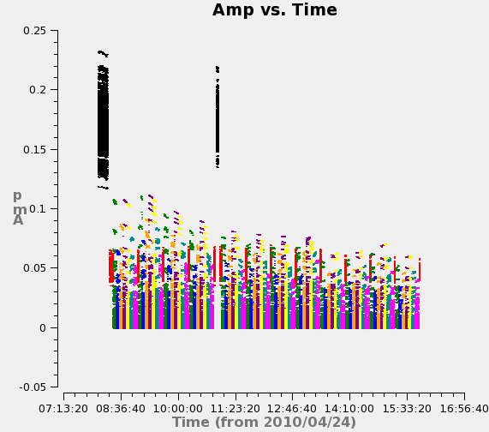
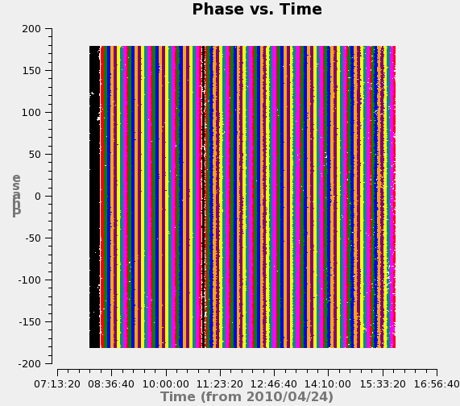
Views of the Uncalibrated Data

Slide 46
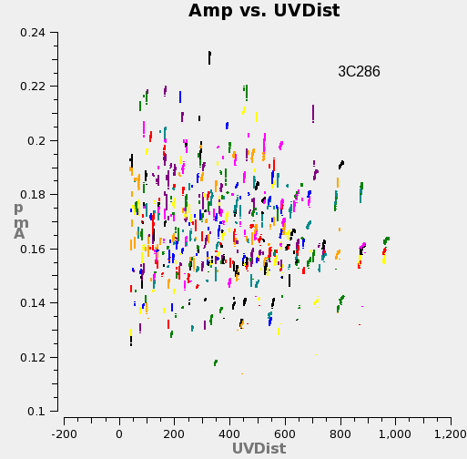
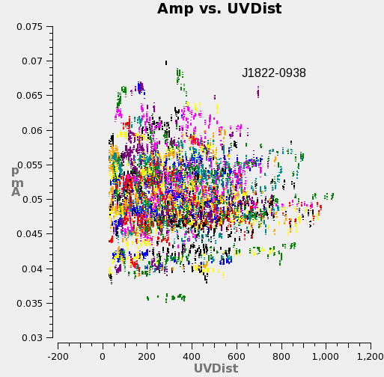
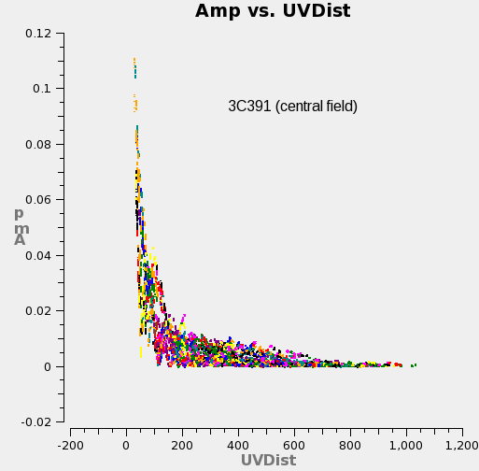
Views of the Uncalibrated Data

Slide 47
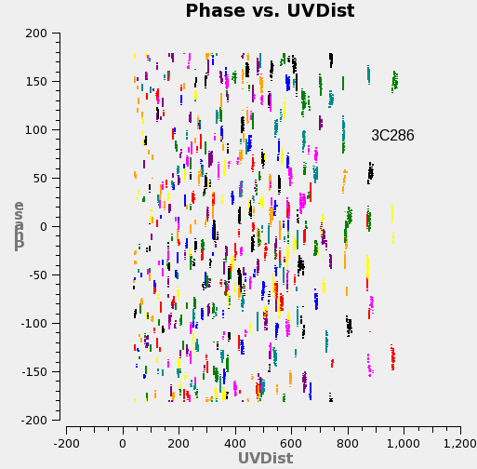
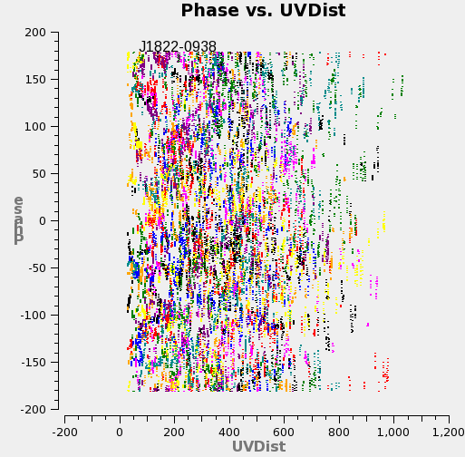
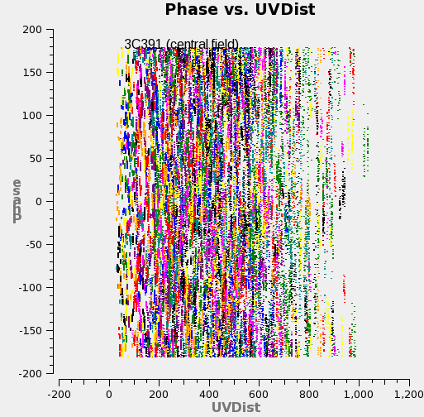
Views of the Uncalibrated Data

Slide 48
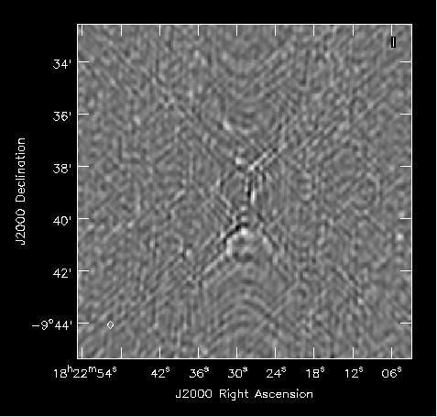
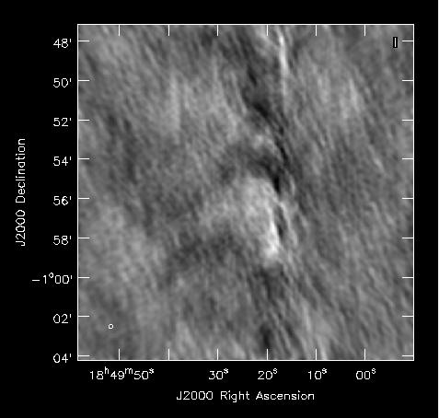
Uncalibrated Images
J1822-0938
(calibrator)
3C391
(science)

Slide 49
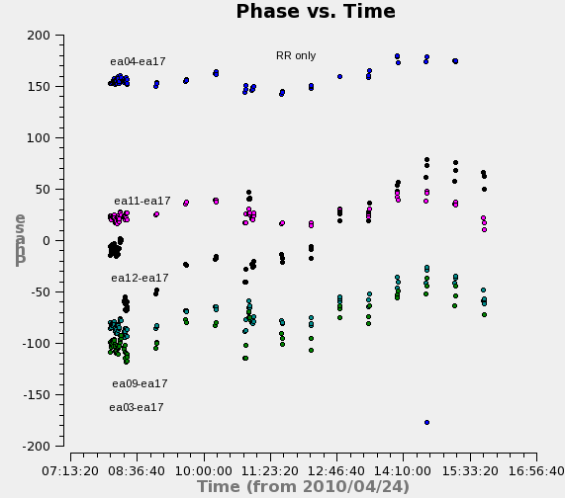
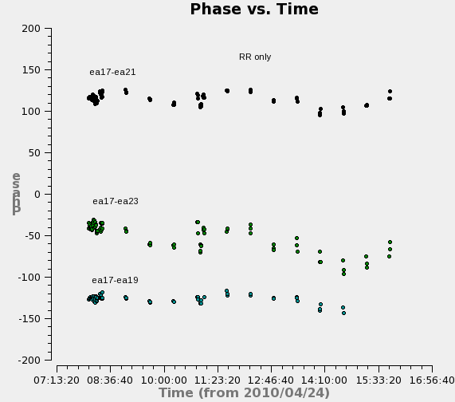
Rationale for Antenna-based Calibration

Slide 50
The Calibration Process
Solve for antenna-based gain factors for each scan on all calibrators:
Bootstrap flux density scale by enforcing gain consistency over all calibrators:
Correct data (interpolate, as needed):

Slide 51
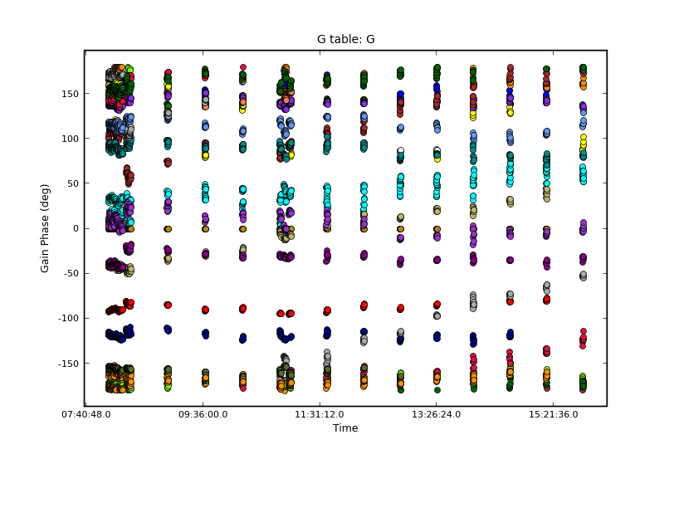
The Antenna-based Calibration Solution
Reference antenna: ea21 (phase = 0)

Slide 52
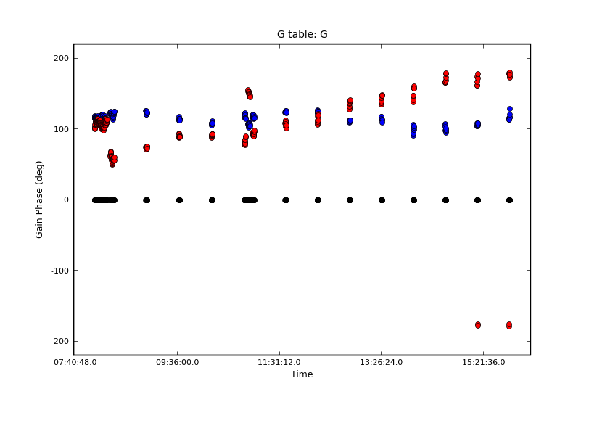
The Antenna-based Calibration Solution
ea17
ea12
ea21 (refant)

Slide 53
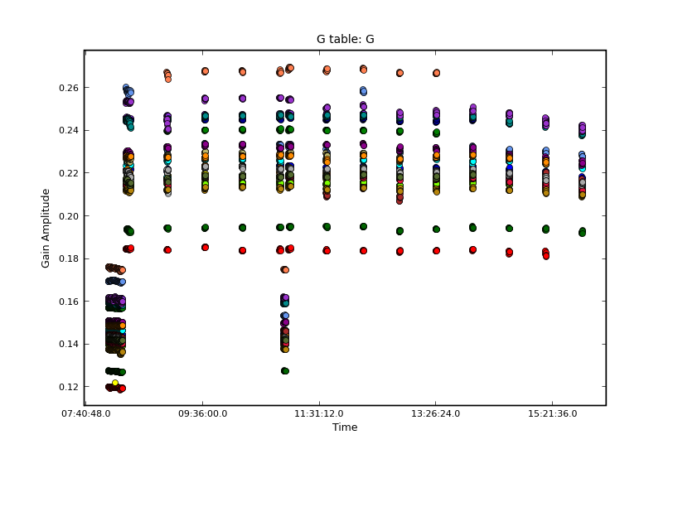
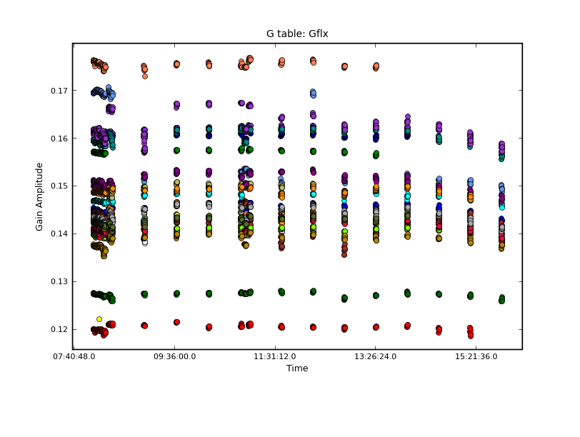
The Antenna-based Calibration Solution
J1822-0938
(assuming 1Jy)
3C286
3C286’s gains have correct scale
Thus, J1822-0938 is 2.32 Jy (not 1 Jy, as assumed)
Notes:
Add some labels

Slide 54
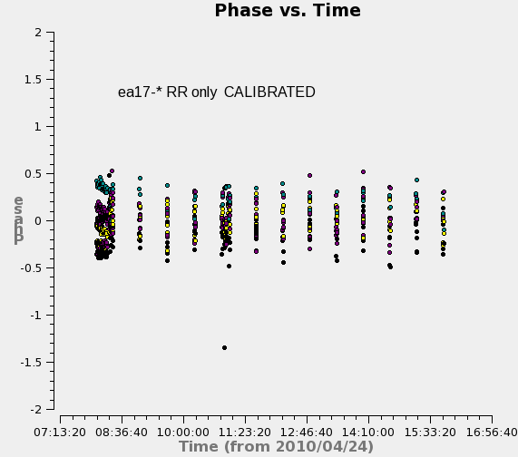
Effect of Antenna-based Calibration

Slide 55
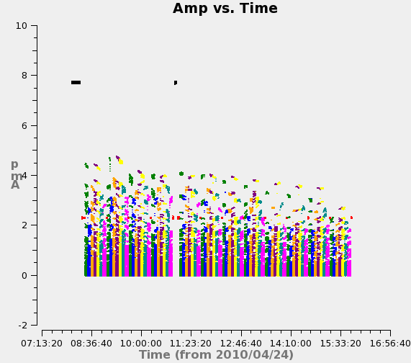
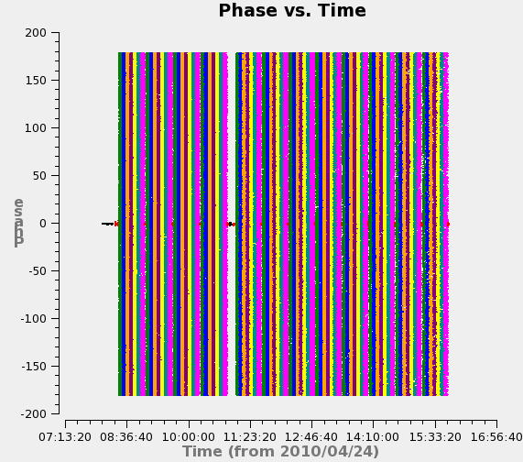
Effect of Antenna-based Calibration
CALIBRATED

Slide 56
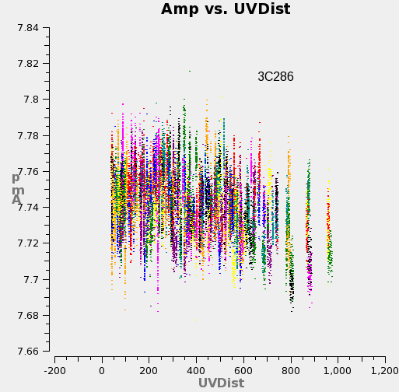


Effect of Antenna-based Calibration
CALIBRATED

Slide 57



Effect of Antenna-based Calibration
CALIBRATED

Slide 58


Calibration Effect on Imaging
Dave Wilner’s lecture “Imaging and Deconvolution” (Wednesday)
J1822-0938
(calibrator)
3C391
(science)

Slide 59
Evaluating Calibration Performance
Are solutions continuous?
  Noise-like solutions are just that—noise (beware calibration of pure noise generates a spurious point source)
  Discontinuities indicate instrumental glitches
  Any additional editing required?
Are calibrator data fully described by antenna-based effects?
  Phase and amplitude closure errors are the baseline-based residuals
  Are calibrators sufficiently point-like? If not, self-calibrate: model calibrator visibilities (by imaging, deconvolving and transforming) and re-solve for calibration; iterate to isolate source structure from calibration components
    Mark Claussen’s lecture: “Advanced Calibration” (Wednesday)
Any evidence of unsampled variation? Is interpolation of solutions appropriate?
  Reduce calibration timescale, if SNR permits
Gustaaf van Moorsel’s lecture: “Error Recognition” (Wednesday)

Slide 60
Summary of Scalar Example
Dominant calibration effects are antenna-based
    Minimizes degrees of freedom
    More precise
    Preserves closure
    Permits higher dynamic range safely!
Point-like calibrators effective
Flux density bootstrapping
Notes:
More to say here?

Slide 61
Full-Polarization Formalism (Matrices!)
Need dual-polarization basis (p,q) to fully sample the incoming EM wave front, where p,q = R,L (circular basis) or p,q = X,Y (linear basis):
Devices can be built to sample these circular (R,L) or linear (X,Y) basis states in the signal domain (Stokes Vector is defined in “power” domain)
Some components of J_{i} involve mixing of basis states, so dual-polarization matrix description desirable or even required for proper calibration

Slide 62
Full-Polarization Formalism: Signal Domain
Substitute:
The Jones matrix thus corrupts the vector wavefront signal as follows:

Slide 63
Full-Polarization Formalism: Correlation - I
Four correlations are possible from two polarizations. The outer product (a ‘bookkeeping’ product) represents correlation in the matrix formalism:
A very useful property of outer products:

Slide 64
Full-Polarization Formalism: Correlation - II
The outer product for the Jones matrix:
  J_{ij} is a 4x4 Mueller matrix
  This is starting to get ugly…..
  Antenna and array design driven by minimizing off-diagonal terms!

Slide 65
Full-Polarization Formalism: Correlation - III
And finally, for fun, the correlation of corrupted signals:
UGLY, but we rarely, if ever, need to worry about detail at this level---just let this occur “inside” the matrix formalism, and work with the matrix short-hand notation

Slide 66
The Matrix Measurement Equation
We can now write down the Measurement Equation in matrix notation:
  S maps Stokes parameters onto observed basis
…and consider how the J_{i} are products of many effects.

Slide 67
A Dictionary of Calibration Components
J_{i} contains many components, in principle:
    F = ionospheric effects
    T = tropospheric effects
    P = parallactic angle
    X = linear polarization position angle
    E = antenna voltage pattern
    D = polarization leakage
    G = electronic gain
    B = bandpass response
    K = geometric compensation
    M, A = baseline-based corrections
Order of terms follows signal path (right to left)
Each term has matrix form of J_{i} with terms embodying its particular algebra (on- vs. off-diagonal terms, etc.)
Direction-dependent terms must stay inside FT integral
‘Full’ calibration is traditionally a bootstrapping process wherein relevant terms (usually a minority of above list) are considered in decreasing order of dominance, relying on approximate separability

Slide 68
Ionospheric Effects, F
The ionosphere introduces a dispersive path-length offset:
    More important at lower frequencies (<5 GHz)
    Varies more at solar maximum and at sunrise/sunset, when ionosphere is most active and variable
    Direction-dependent within wide field-of-view
The ionosphere is birefringent: Faraday rotation:
    as high as 20 rad/m² during periods of high solar activity will rotate linear polarization position angle by ε = 50 degrees at 1.4 GHz
    Varies over the array, and with time as line-of-sight magnetic field and electron density vary, violating the usual assumption of stability in position angle calibration
Tracy Clark’s lecture: “Low Frequency Interferometry” (Monday)
Notes:
Make sure this is right!!!

Slide 69
Tropospheric Effects, T
The troposphere causes polarization-independent amplitude and phase effects due to emission/opacity and refraction, respectively
    Up to 2.3m excess path length at zenith compared to vacuum
    Higher noise contribution, less signal transmission: Lower SNR
    Most important at ν > 20 GHz where water vapor and oxygen absorb/emit
    Zenith-angle-dependent (more troposphere path nearer horizon)
    Clouds, weather = variability in phase and opacity; may vary across array
    Water vapor radiometry (estimate phase from power measurements)
    Phase transfer from low to high frequencies (delay calibration)
Crystal Brogan’s lecture: “Millimeter Interferometry and ALMA” (Thursday)

Slide 70
Parallactic Angle, P
Visibility phase variation due to changing orientation of sky in telescope’s field of view
    Constant for equatorial telescopes
    Varies for alt-az-mounted telescopes:
    Rotates the position angle of linearly polarized radiation
    Analytically known, and its variation provides leverage for determining polarization-dependent effects
Steve Myers’ lecture: “Polarization in Interferometry” (today!)

Slide 71
Linear Polarization Position Angle, X
Configuration of optics and electronics causes a linear polarization position angle offset
Can be treated as an offset to the parallactic angle, P
Calibrated by registration with a strongly polarized source with known polarization position angle (e.g., flux density calibrators)
For circular feeds, this is a phase difference between the R and L polarizations, which is frequency-dependent (a R-L phase bandpass)
For linear feeds, this is the orientation of the dipoles in the frame of the telescope
Steve Myers’ lecture: “Polarization in Interferometry” (today!)
Notes:
Am I missing any factors of 2 here? (circ vs. lin)

Slide 72
Antenna Voltage Pattern, E
Antennas of all designs have direction-dependent gain within field-of-view
    Important when region of interest on sky comparable to or larger than λ/D
    Important at lower frequencies where radio source surface density is greater and wide-field imaging techniques required
    Beam squint: E^{p} and E^{q} offset, yielding spurious polarization
    Sky rotates within field-of-view for alt-az antennas, so off-axis sources move through the pattern
    Direction dependence of polarization leakage (D) may be included in E (off-diagonal terms then non-zero)
Shape and efficiency of the voltage pattern may change with zenith angle: ‘gain curve’
Sanjay Bhatnagar’s lecture: “Wide Field Imaging I” (Thursday)
Juergen Ott’s lecture: “Wide Field Imaging II” (Thursday)

Slide 73
Polarization Leakage, D
Antenna & polarizer are not ideal, so orthogonal polarizations not perfectly isolated
    Well-designed feeds have d ~ a few percent or less
    A geometric property of the optical design, so frequency-dependent
    For R,L systems, total-intensity imaging affected as ~dQ, dU, so only important at high dynamic range (Q,U,d each ~few %, typically)
    For R,L systems, linear polarization imaging affected as ~dI, so almost always important
    For small arrays (no differential parallactic angle coverage), only relative D solution is possible from standard linearized solution, so parallel-hands cannot be corrected (closure errors)
Best calibrator: Strong, point-like, observed over large range of parallactic angle (to separate source polarization from D)
Steve Myers’ lecture: “Polarization in Interferometry” (today!)

Slide 74
“Electronic” Gain, G
Catch-all for most amplitude and phase effects introduced by antenna electronics and other generic effects
    Most commonly treated calibration component
    Dominates other effects for standard EVLA observations
    Includes scaling from engineering (correlation coefficient) to radio astronomy units (Jy), by scaling solution amplitudes according to observations of a flux density calibrator
    Often also includes tropospheric and (on-axis) ionospheric effects which are typically difficult to separate uniquely from the electronic response
    Excludes frequency dependent effects (see B)
Best calibrator: strong, point-like, near science target; observed often enough to track expected variations
  Also observe a flux density standard

Slide 75
Bandpass Response, B
G-like component describing frequency-dependence of antenna electronics, etc.
    Filters used to select frequency passband not square
    Optical and electronic reflections introduce ripples across band
    Often assumed time-independent, but not necessarily so
    Typically (but not necessarily) normalized
Best calibrator: strong, point-like; observed long enough to get sufficient per-channel SNR, and often enough to track variations
Ylva Pihlstrom’s lecture: “Calibration, Imaging, and Analysis of Data Cubes” (Wednesday)

Slide 76
Geometric Compensation, K
Must get geometry right for Synthesis Fourier Transform relation to work in real time; residual errors here require “Fringe-fitting”
    Antenna positions (geodesy)
    Source directions (time-dependent in topocenter!) (astrometry)
    Clocks
    Electronic pathlengths (polarization, spw differences)
    Longer baselines generally have larger relative geometry errors, especially if clocks are independent (VLBI)
    Importance scales with frequency
K is a clock- & geometry-parameterized version of G (see chapter 5, section 2.1, equation 5-3 & chapters 22, 23)
    All-sky observations used to isolate geometry parameters
Adam Deller’s lecture: “Very Long Baseline Interferometry” (Thursday)
Mark Reid’s lecture “Astrometry” (Thursday)

Slide 77
Non-closing Effects: M, A
Baseline-based errors which do not decompose into antenna-based components
  Digital correlators designed to limit such effects to well-understood and uniform (not dependent on baseline) scaling laws (absorbed in G)
  Simple noise (additive)
  Additional errors can result from averaging in time and frequency over variation in antenna-based effects and visibilities (practical instruments are finite!)
  Instrumental polarization effects in parallel hands
  Correlated “noise” (e.g., RFI)
  Difficult to distinguish from source structure (visibility) effects
  Geodetic observers consider determination of radio source structure—a baseline-based effect—as a required calibration if antenna positions are to be determined accurately
  Diagonal 4x4 matrices, M_{ij} multiplies, A_{ij} adds
Rick Perley’s lecture “High Dynamic Range Imaging” (Monday)

Slide 78
Decoupling Calibration Effects
Multiplicative gain (G) term will soak up many different effects; known priors should be compensated for separately, especially when direction-dependent differences (e.g., between calibrator and target) will limit the accuracy of calibration transfer:
  Zenith angle-dependent atmospheric opacity, refraction (T,F)
  Zenith angle-dependent gain curve (E)
  Antenna position errors (K)
Early calibration solves (e.g., G) are always subject to more subtle, uncorrected effects
  E.g., instrumental polarization (D), which introduces gain calibration errors and causes apparent closure errors in parallel-hand correlations
  When possible, iterate and alternate solves to decouple effects…

Slide 79
The Full Matrix Measurement Equation
The total general Measurement Equation has the form:
    S maps the Stokes vector, I, to the polarization basis of the instrument, all calibration terms cast in this basis
Suppressing the direction-dependence (on-axis calibration):
Generally, only a subset of terms (up to 3 or 4) are considered, though highest-dynamic range observations may require more
Solve for terms in decreasing order of dominance
(Non-trivial direction-dependent solutions involve convolutional treatment of the visibilities, and is coupled to the imaging and deconvolution process)

Slide 80
Solving the Measurement Equation
Formally, solving for any antenna-based visibility calibration component is always the same general non-linear fitting problem:
  Observed and Model visibilities are corrected/corrupted by available prior calibration solutions
  Resulting solution used as prior in subsequent solves, as necessary
  Each solution is relative to priors and assumed source model
  Iterate sequences, as needed → generalized self-calibration
Viability of the overall calibration depends on isolation of different effects using proper calibration observations, and appropriate solving strategies
Heuristic mnemonics….

Slide 81
Calibration Heuristics – Spectral Line
Total Intensity Spectral Line (B,G):
      V^{obs} = B G V^{true}
  Preliminary Gain solve on B-calibrator:
      V^{obs} = G_{B} V^{mod}
  Bandpass Solve (using G_{B}) on B-calibrator (then discard G_{B}):
      V^{obs} = B (G_{B} V^{mod})
  Gain solve (using inverted B) on calibrators:
      (B’ V^{obs}) = G V^{mod}
  Flux Density scaling:
      G → G_{f} (enforce gain consistency)
  Correct with inverted solutions:
      V^{cor} = G_{f}’ B’ V^{obs}
  Image!
Heuristic notation!
Rigorous math notation
(antenna-basedness,
subscripts, etc.) omitted.

Slide 82
Calibration Heuristics – Polarimetry
Polarimetry (B,G,D,X,P):
      V^{obs} = B G D X P V^{true}
  Preliminary Gain solve on B-calibrator:
      V^{obs} = G_{B} V^{mod}
  Bandpass (B) Solve (using G_{B}) on B-calibrator (then discard G_{B}):
      V^{obs} = B (G_{B} V^{mod})
  Gain (G) solve (using P, inv B) on calibrators:
      (B’ V^{obs}) = G (PV^{mod})
  Instrumental Polarization (D) solve (using P, inverse of G,B) on instrumental polarization calibrator:
    (G’ B’ V^{obs}) = D (P V^{mod})

Slide 83
Calibration Heuristics – Polarimetry
  Polarization position angle solve (using D,P, inverted G,B) on position angle calibrator:
      (G’ B’ V^{obs}) = X (D P V^{mod})
  Flux Density scaling:
      G → G_{f} (enforce gain consistency)
  Correct with inverted solutions:
      V^{cor} = P’ X’ D’ G_{f}’ B’ V^{obs}
  Image!

Slide 84
New Calibration Challenges
Bandpass Calibration
    Parameterized solutions (narrow-bandwidth, high resolution regime)
    Spectrum of calibrators (wide absolute bandwidth regime)
‘Delay-aware’ gain (self-) calibration
    Troposphere and Ionosphere introduce time-variable phase effects which are easily parameterized in frequency and should be (c.f. sampling the calibration in frequency)
Frequency-dependent Instrumental Polarization
    Contribution of geometric optics is wavelength-dependent (standing waves)
Frequency-dependent voltage pattern
Wide-field voltage pattern accuracy (sidelobes)
Direction-dependent components
    E.g., Instrumental Polarization (polarized beam)
    Couples to the imaging process
Increased sensitivity: Can implied dynamic range be reached by conventional calibration and imaging techniques?
Notes:
Anything to add?

Slide 85
Summary
Determining calibration is as important as determining source structure—can’t have one without the other
Data examination and editing an important part of calibration
Beware of RFI! (Please, no cell phones at the VLA site tour!)
Calibration dominated by antenna-based effects, permits efficient separation of calibration from astronomical information (satisfies closure)
Full calibration formalism algebra-rich, but is modular
Calibration determination is a single standard fitting problem
Calibration an iterative process, improving various components in turn, as needed
Point sources are the best calibrators
Observe calibrators according requirements of calibration components
Notes:
Revisions?

